Slide 1



Προσυμπτωματικός έλεγχος συμπαγών νεοπλασιών
Ηλίας Α. Κοττέας, MD, PhD
Παθολόγος-Ογκολόγος
Ογκολογική Μονάδα, Γ’ Πανεπιστημιακή Παθολογική Κλινική
Νοσοκομείο «Η Σωτηρία»

Slide 2
Principles of Screening
Timeline of Disease
PRECLINICAL
CLINICAL
screening
Onset of
Disease
Detectable
by Test
Signs or
Symptoms
Death from
Disease or
Other causes
Notes:
RSNA 2005
11/30/05
Page
2

Slide 3
Cancer statistics 2019
Siegel R, et al. CA Cancer J Clin, 2019

Slide 4
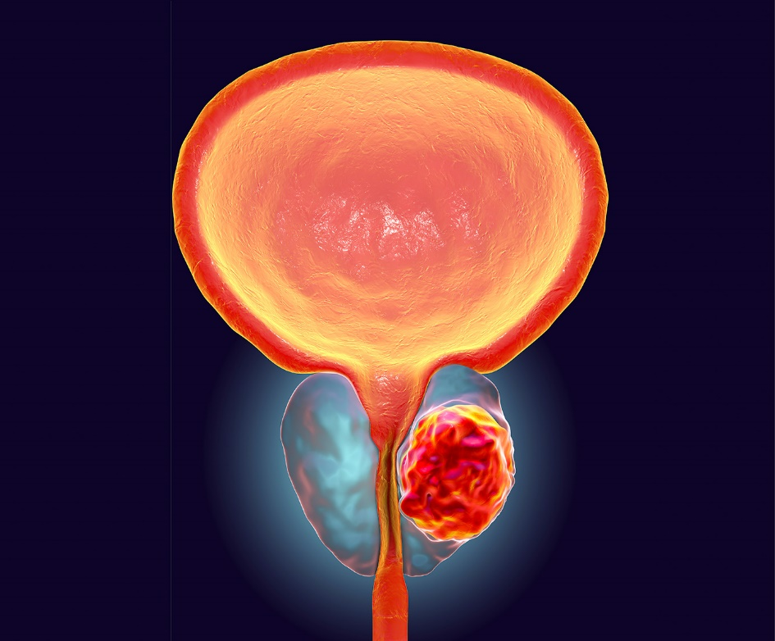
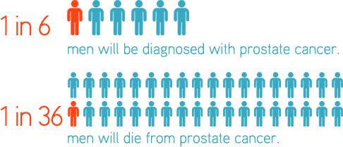
Prostate cancer

Slide 5



Prostate cancer risk factors

Slide 6
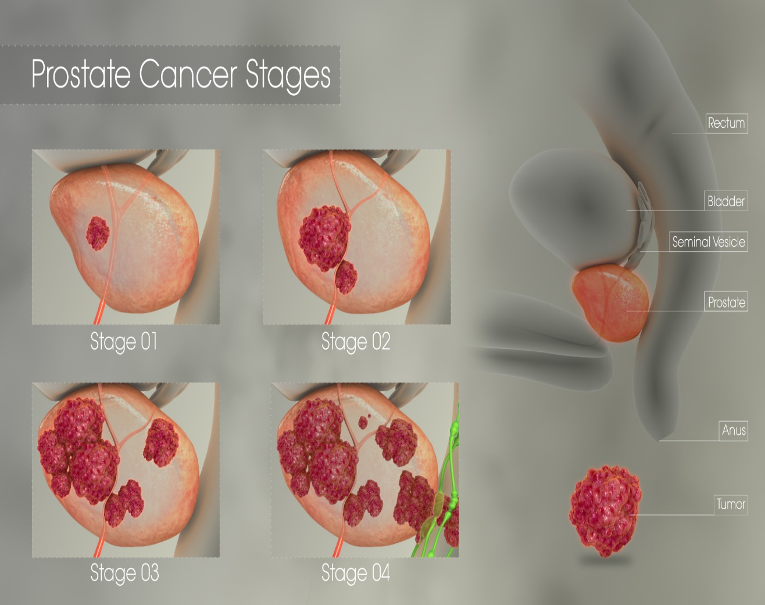
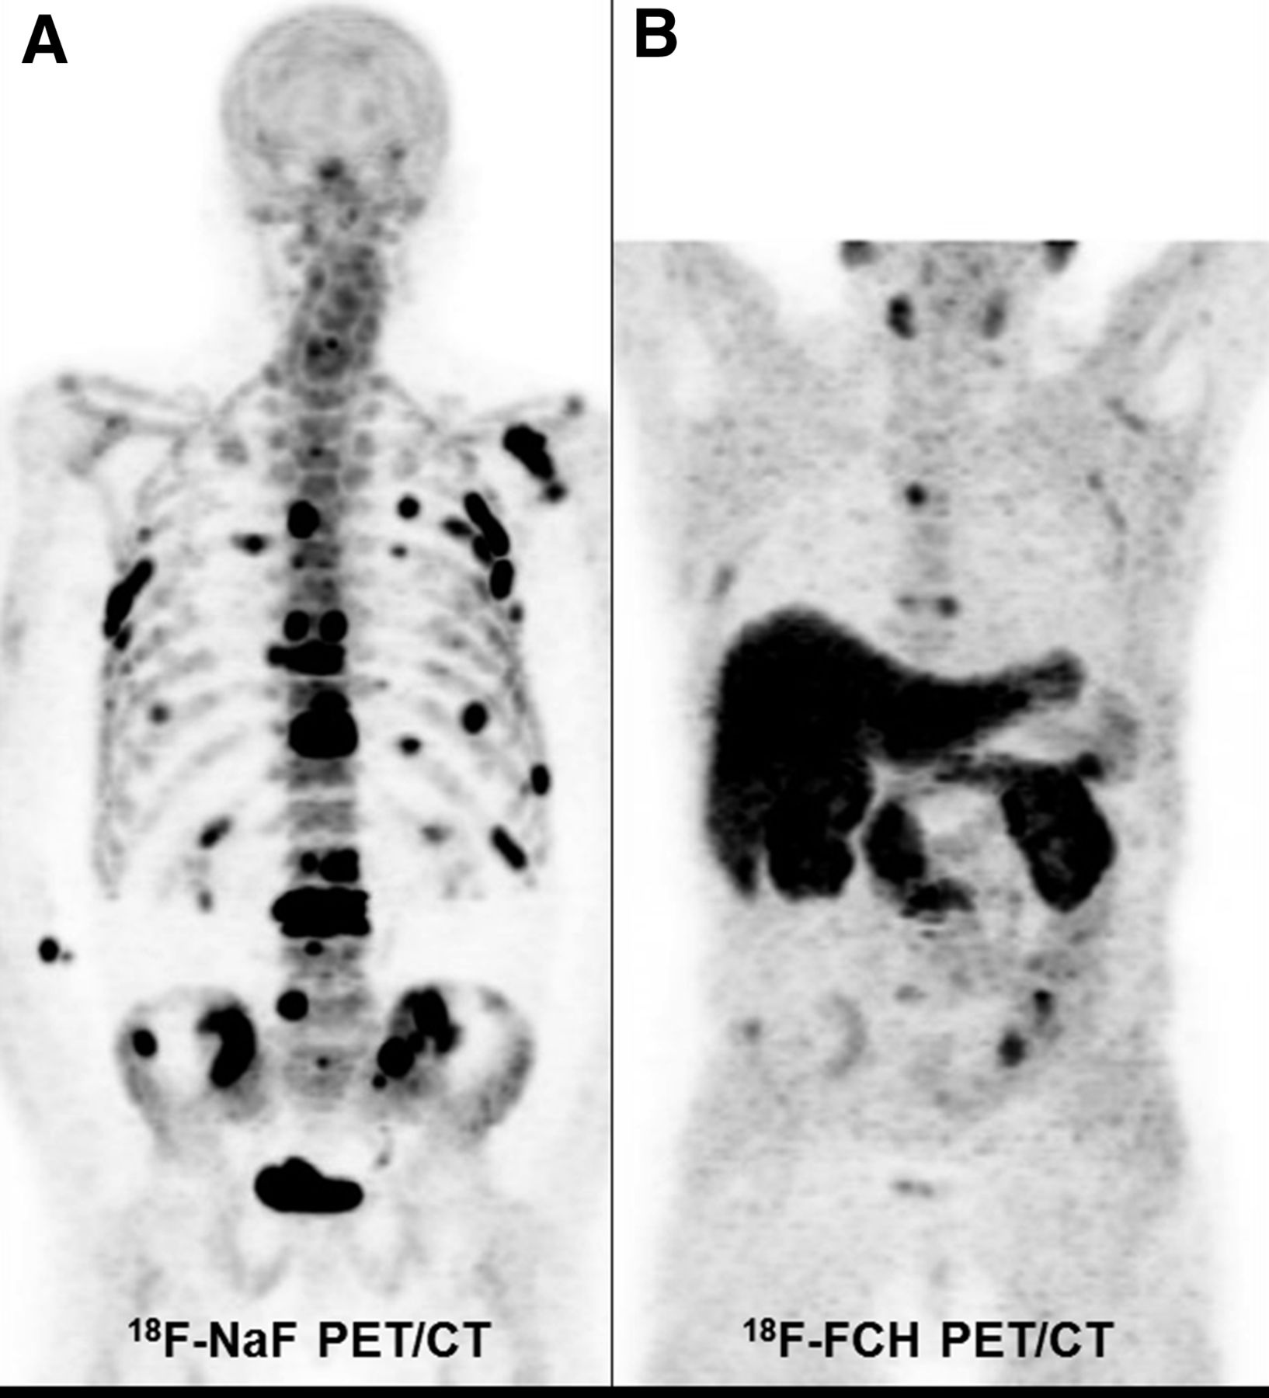
Prostate cancer

Slide 7
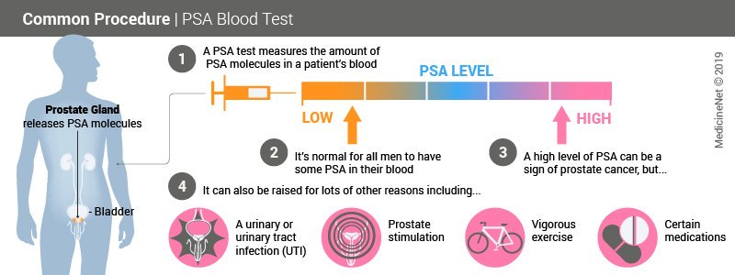

Slide 8
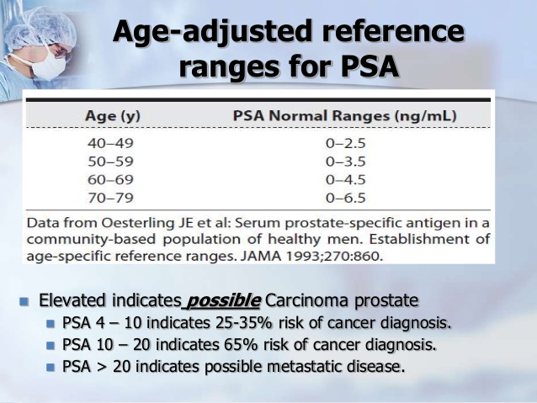

Slide 10

American Urological Association (AUA) recommend against routine screening for the following groups:
Any man with a life expectancy less than 10-15 years
Men under 40 years
Men between ages 40 to 54 years at average risk
Men over age 70
For men 55 to 69 years of age, the AUA advises that the decision to undergo PSA screening involves weighing the benefits and risks. The guidelines strongly recommend the following:
A routine screening interval of 2 years or more in those men who have participated in shared decision-making and decided on screening.

Slide 11
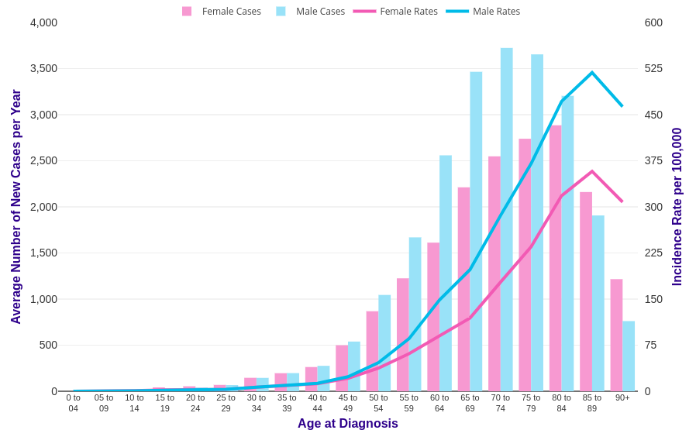
Colon Cancer-incidence

Slide 12
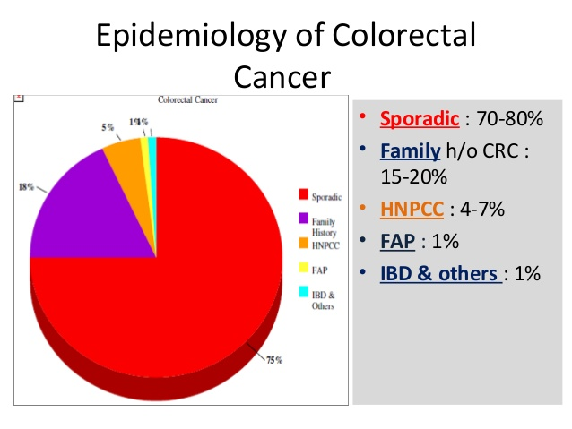

Slide 13
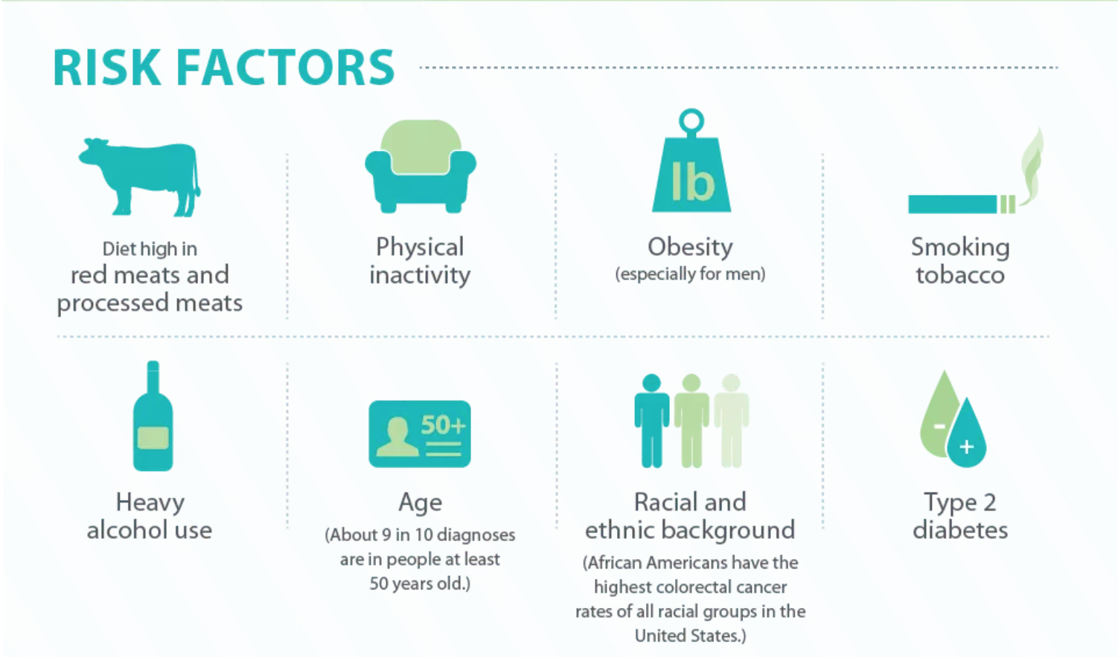
Colon cancer-risk factors

Slide 14
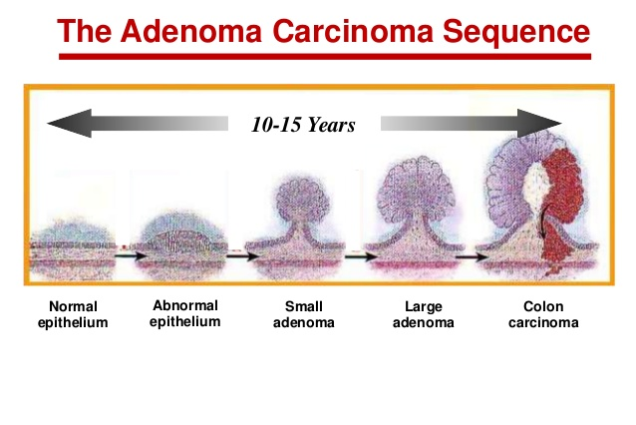
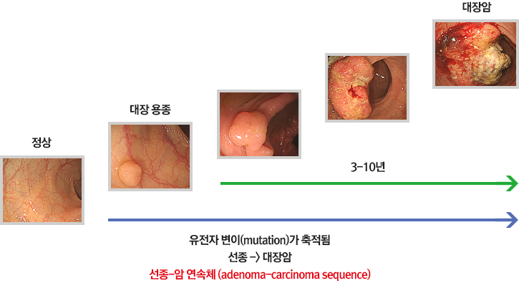

Slide 15
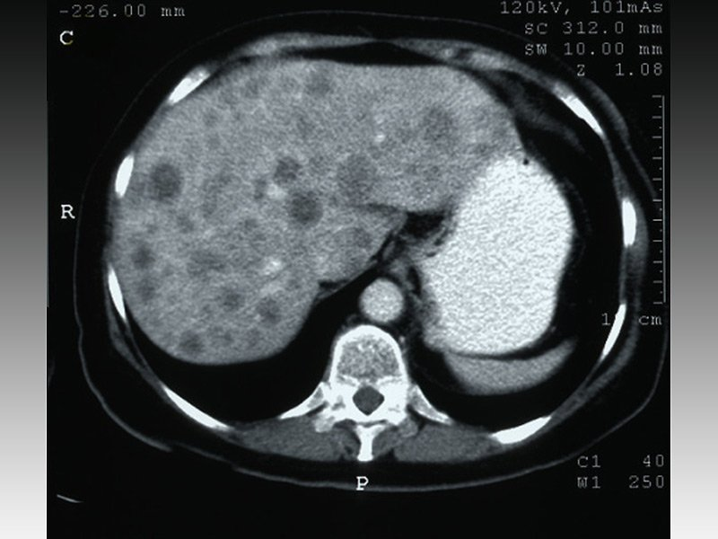
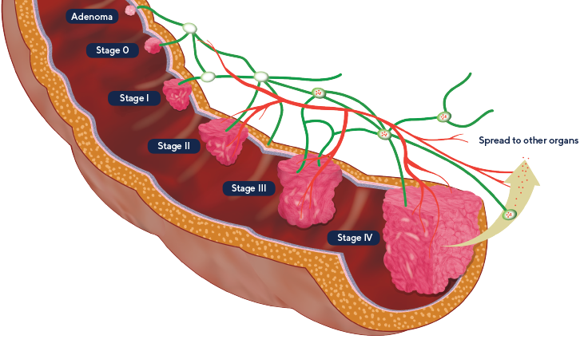
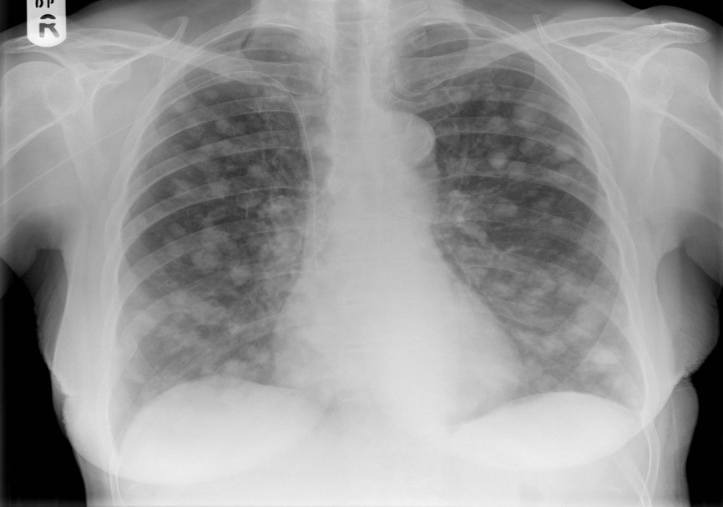
Colon cancer progression

Slide 16


Slide 17
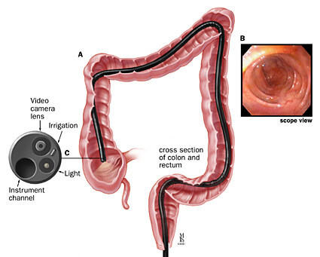
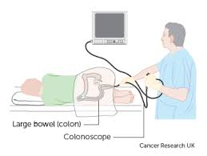

Slide 18
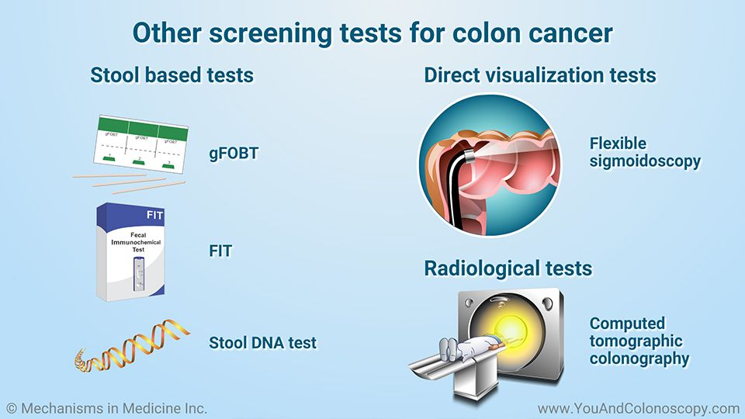

Slide 19
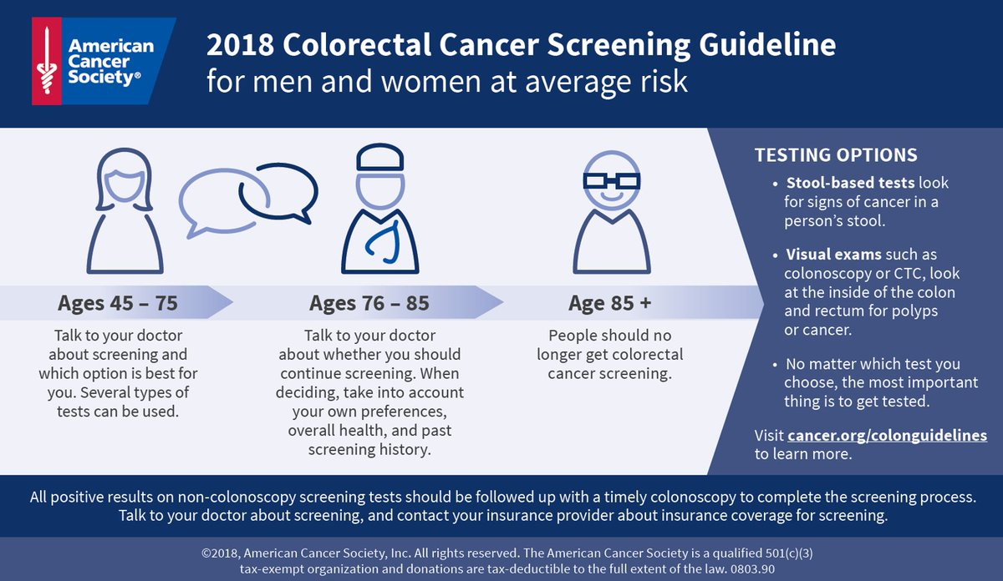

Slide 20
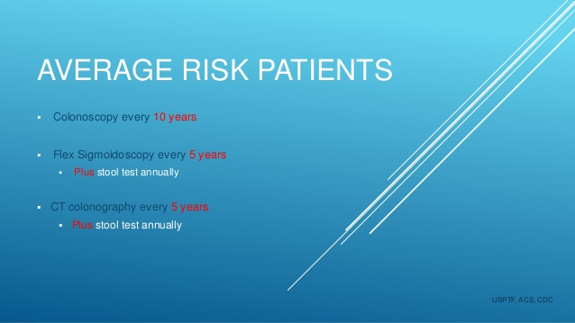
Notes:
Κολονοσκο

Slide 22
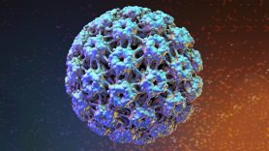
HPV virus

Slide 24
Notes:
Θα πρεπει να γνωριζουμε οτι η συντριπτικη πλειοψηφια των γυναικων θα ερθει σε επαφη με τον HPV. Ομως τις περισσοτερες ο ιος φευγει μετα απο 1-2 ετη,

Slide 26
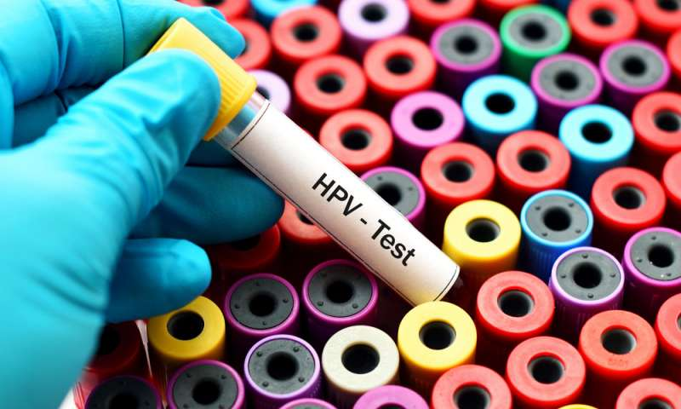

Slide 28
Notes:
.

Slide 29
Vaccine Recommendations
HPV vaccine is recommended for routine vaccination at age 11 or 12 years. (Vaccination can be started at age 9).
People who have already been infected with one or more HPV types can still get protection from other HPV types in the vaccine.

Slide 30


Slide 31
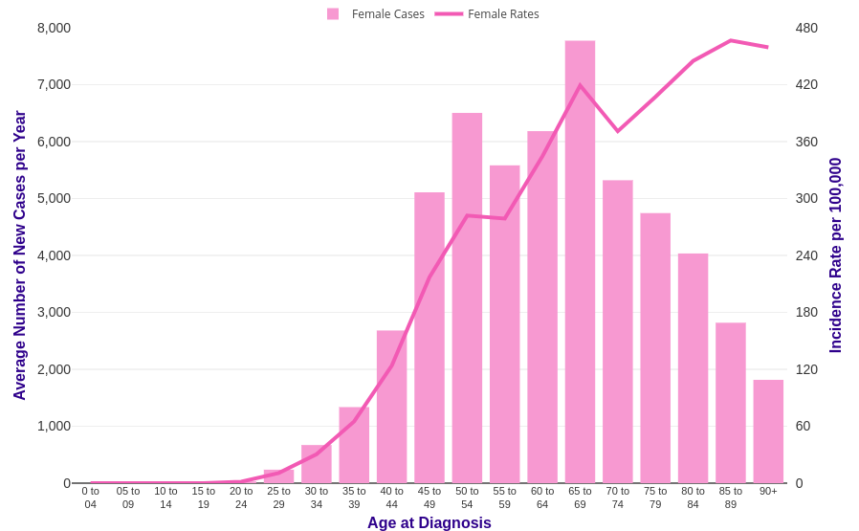
Breast cancer-incidence

Slide 32

7,500/year
Hereditary breast cancer:
10%

Slide 33
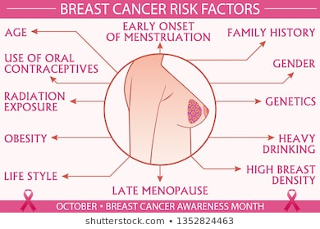

Slide 34
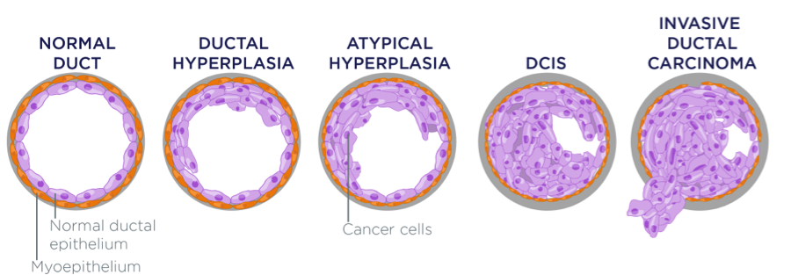

Slide 35
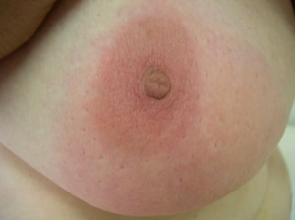
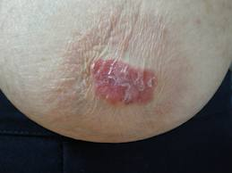
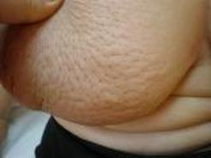
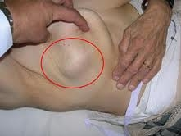
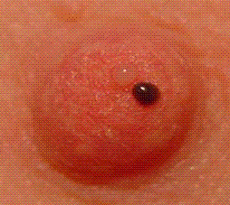
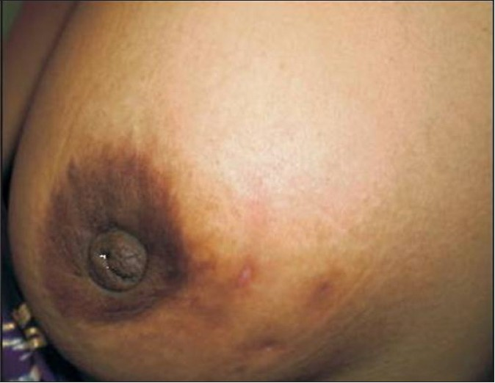
Notes:
Λες για τα 2 ετη που δεν ειναι ψηλαφητο

Slide 36
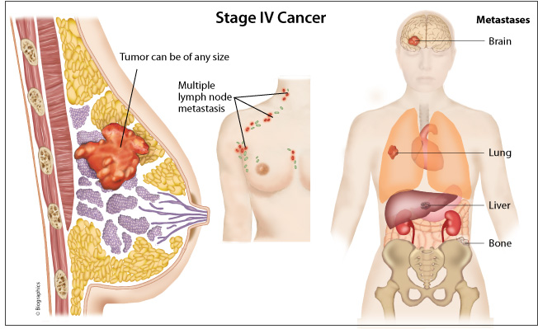

Slide 37
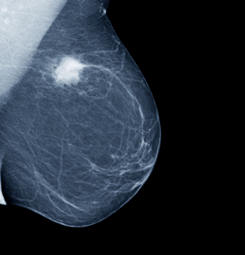
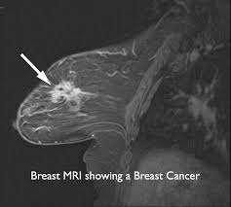
Mammography
MRI Mammography

Slide 38

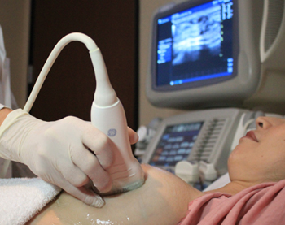
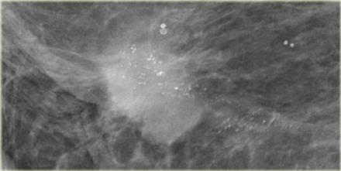

Calcifications
Ultrasound

Slide 39
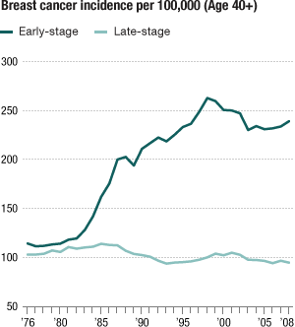
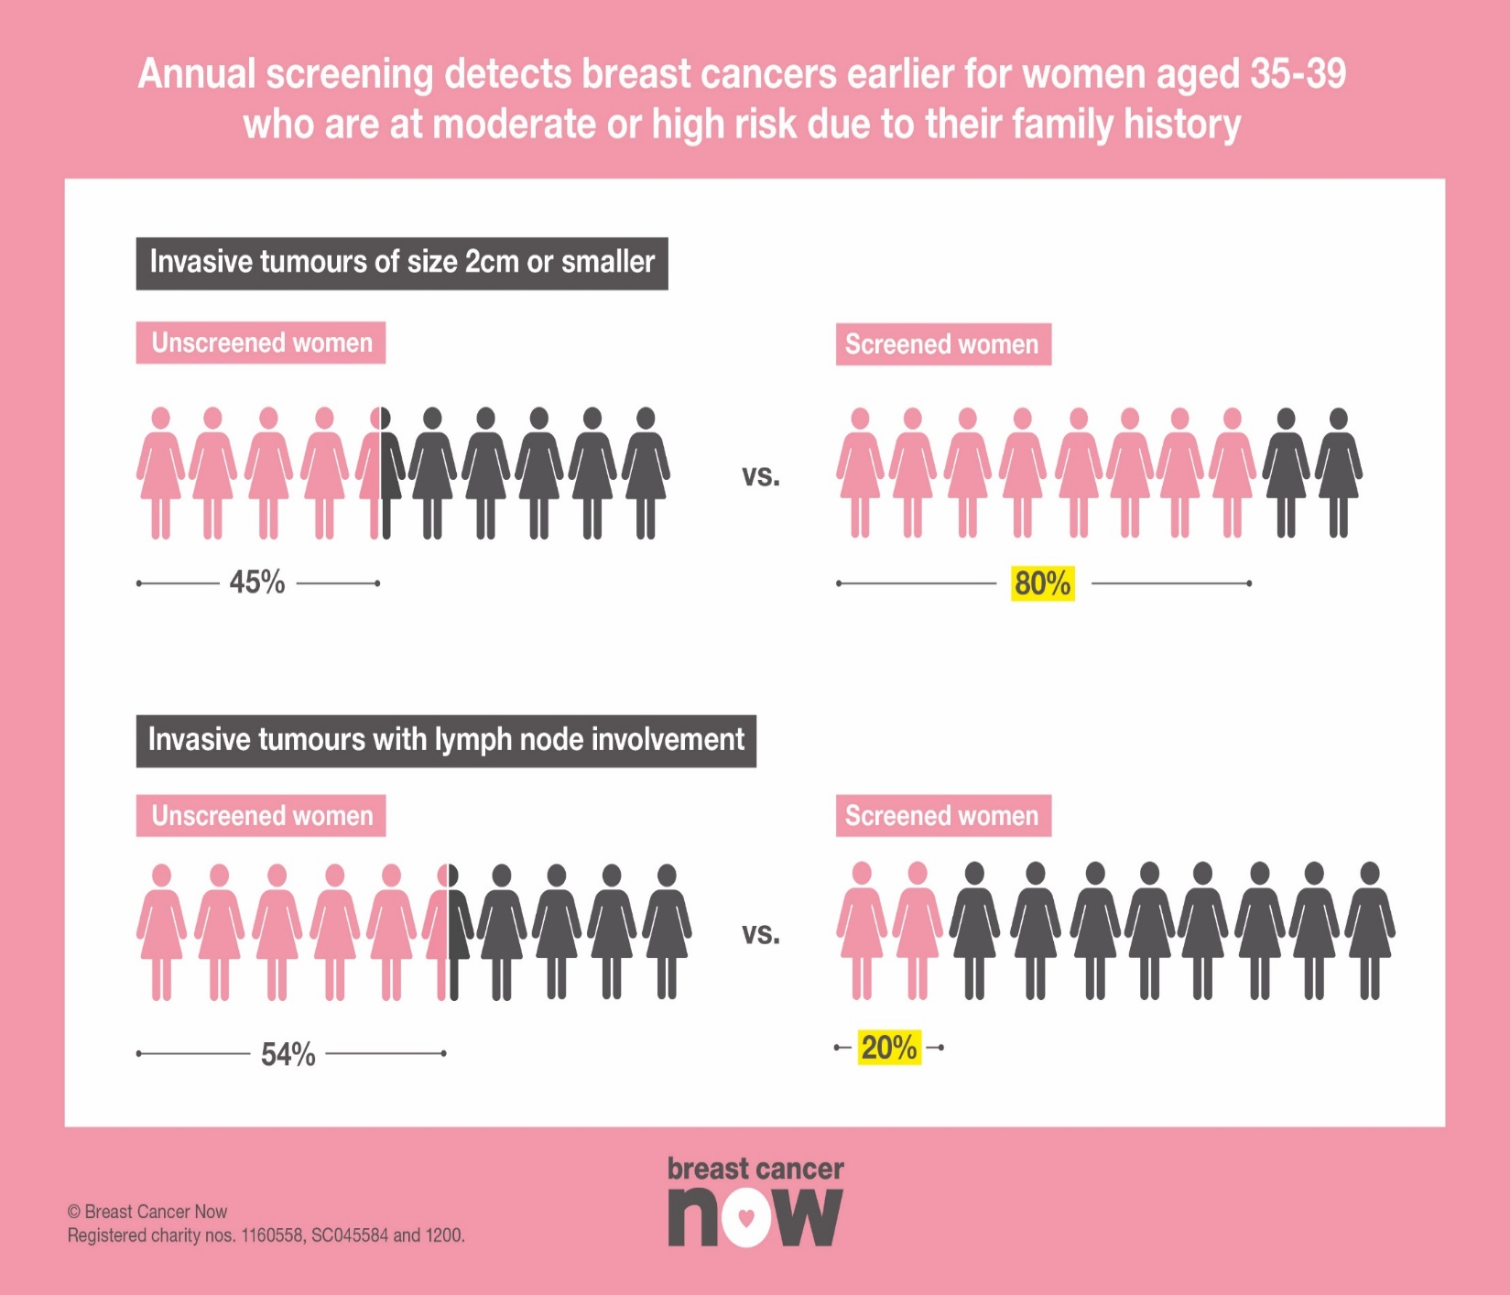

Slide 40
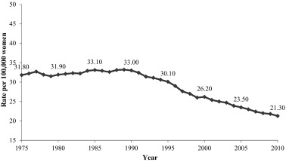
Breast cancer mortality

Slide 41
Screening
Annual mammogram
Age>40

Slide 42
Πηγές
www.esmo.org
www.nccn.org

