Slide 1


Επιλογή θεραπείας στον καρκίνο του μαστού
Ηλίας Α. Κοττέας, M.D, Ph.D
Αναπληρωτής Καθηγητής ΕΚΠΑ
Γ’ Πανεπιστημιακή Παθολογική Κλινική

Slide 2

Επιδημιολογικά δεδομένα
1^{ος} σε συχνότητα στις γυναίκες
2^{η} αιτία θανάτου από καρκίνο

Slide 3
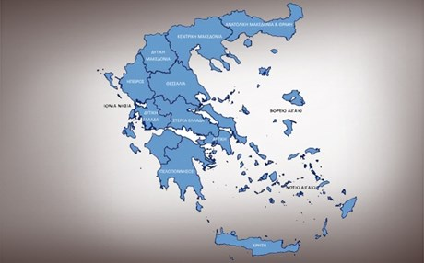
7500/έτος
Κληρονομικότητα
10%

Slide 5
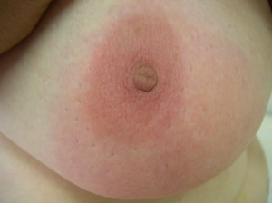
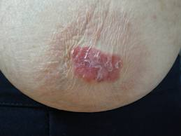
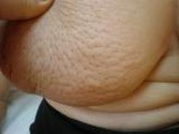
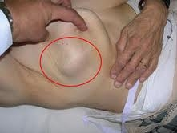
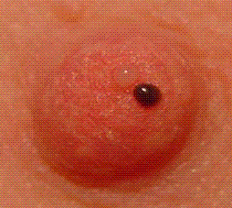
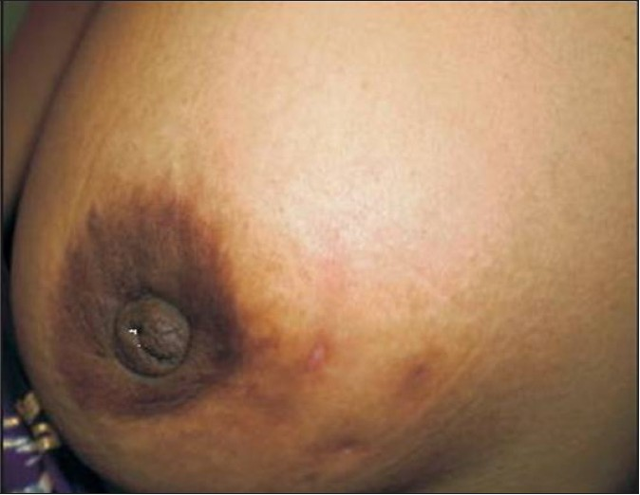

Slide 6
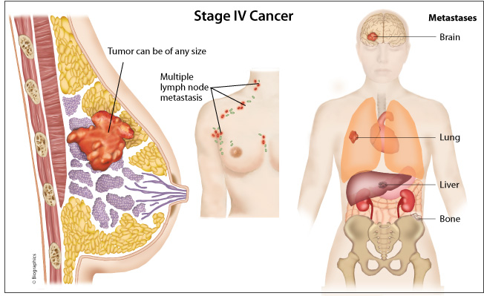

Slide 7
Stages

Slide 9
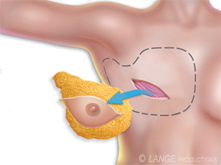
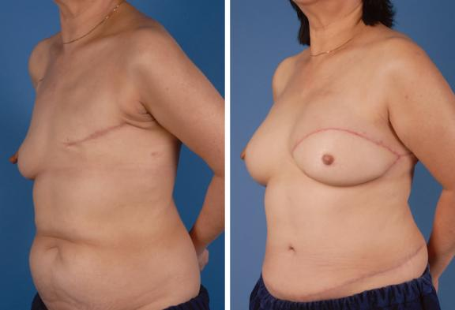
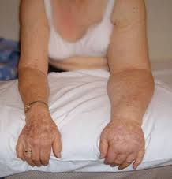
Mastectomy

Slide 10
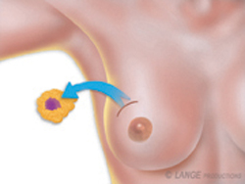
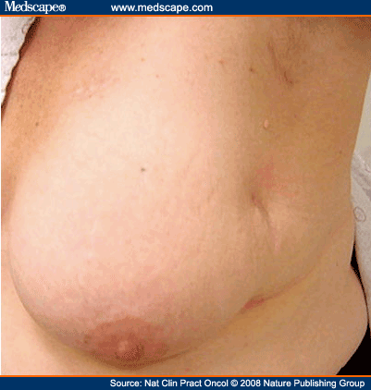
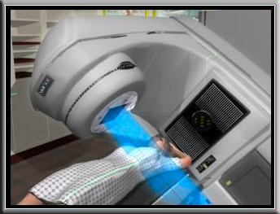
Lumpectomy

Slide 11
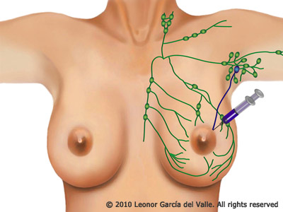
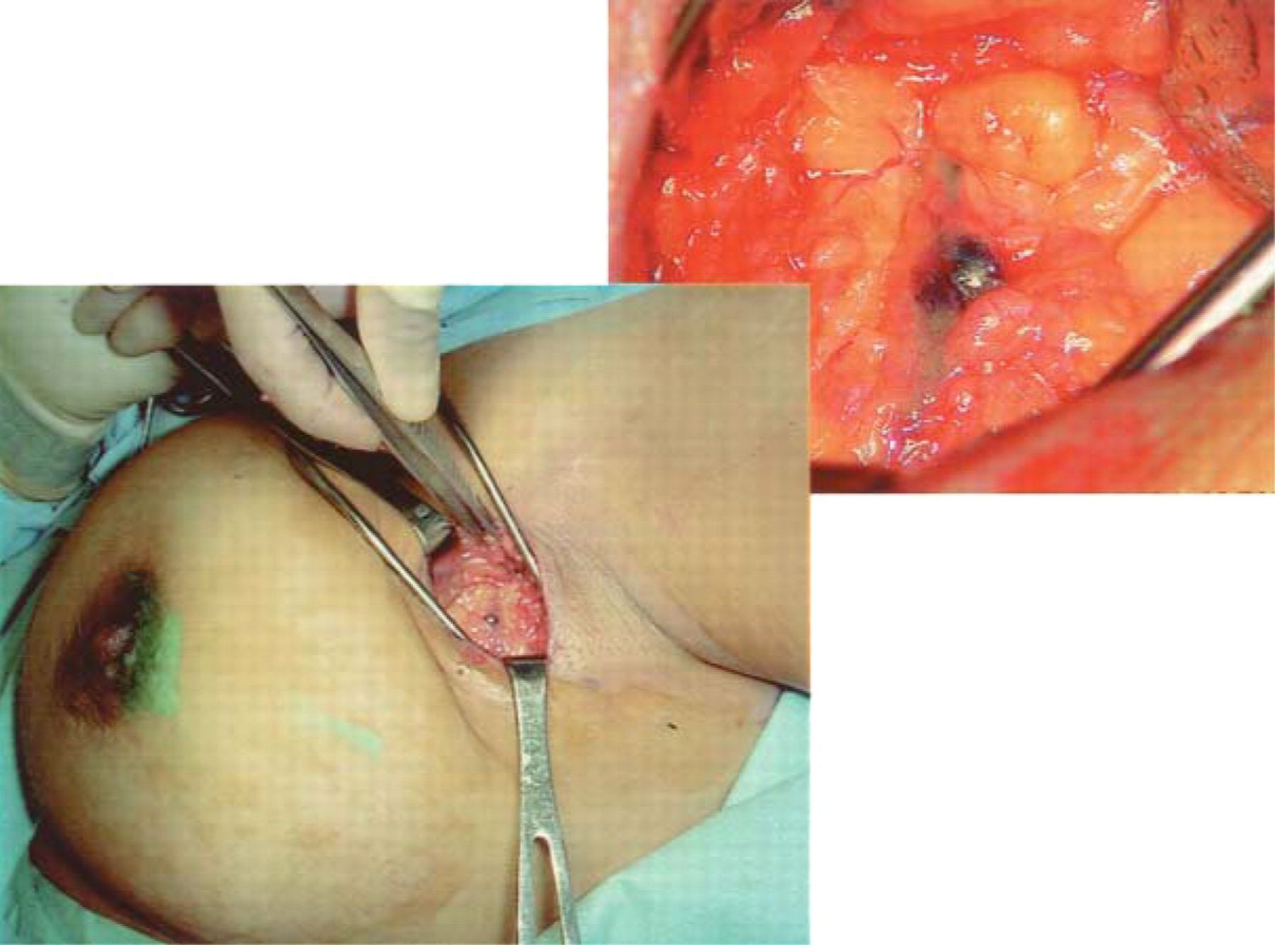
Sentinel Lymph Node Biopsy

Slide 12
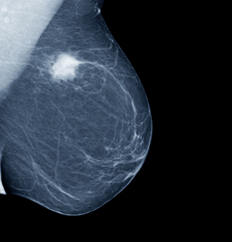
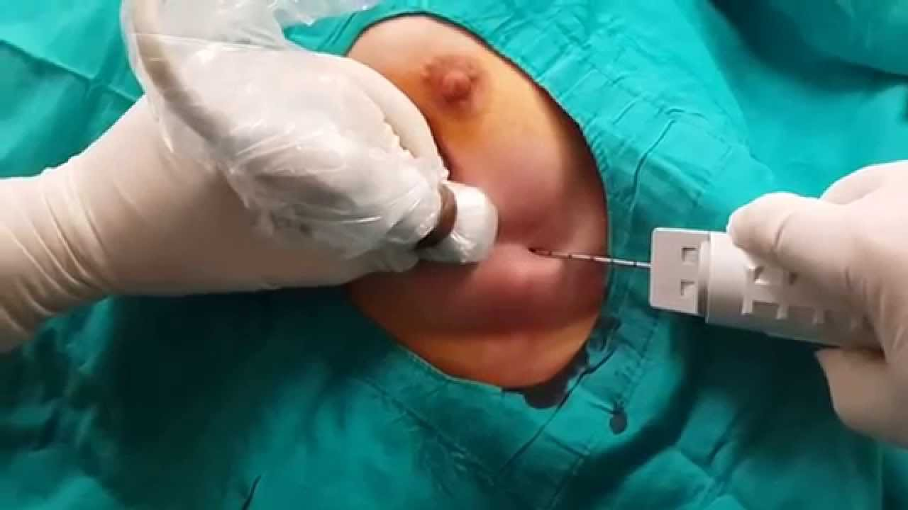
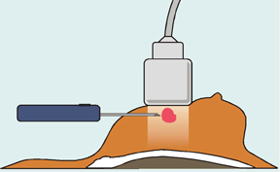

Slide 13
Προγνωστικοί Παράγοντες
Στάδιο
Έκφραση γονιδίου HER2
Διήθηση λεμφαδένων
Grade
ΕR/PR status

Slide 14
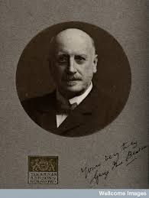
Beatson G. Lancet, 1896

Slide 15
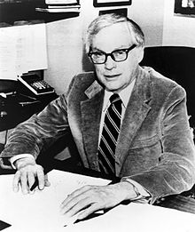
Elwood Jensen
“A lady with growth neoplastic
thought castration was just a bit drastic
She preferred that her ill could be cured with a pill
Today it’s no longer fantastic”

Slide 16
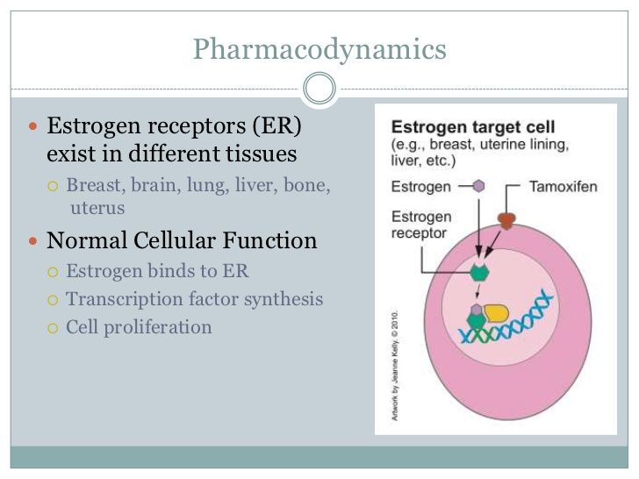

Slide 17
Tamoxifen: 5 years
Davies, et al. Lancet, 2011

Slide 18
Tamoxifen: 10 years
Davies, et al. Lancet, 2013

Slide 19
Toxicities
Davies, et al. Lancet, 2013

Slide 20
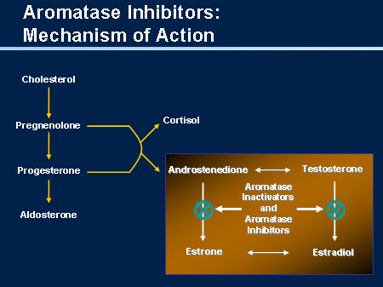
Aromatase inhibitors (Post-menopausal)
Letrozole
Anastrozole
Exemestane

Slide 21
Aromatase inhibitors vs Tamoxifen (Post-menopausal)
Reccurence
Recurrence
Contralateral BC
Cuzick, et al .Lancet 2010

Slide 22
Toxicities
Regan M, et al. Breast cancer Res, 2011

Slide 23
Aromatase inhibitors: 10 years
Letrozole
for 5 yrs
(n = 959)
Postmenopausal pts with ER+ breast cancer who completed 5 yrs of letrozole/Tamoxifen
(N = 1918)
Placebo
for 5 yrs
(n = 959)
Goss PE, et al. ASCO 2016. Abstract LBA1
Notes:
AI, aromatase inhibitor; CBC, contralateral breast cancer; DFS, disease-free survival; ER, estrogen receptor; PgR, progesterone receptor; QoL, quality of life.

Slide 24
DFS and OS After Median Follow-up of 6.3 Yrs
DFS benefit of extended letrozole in all prespecified subgroups
5-yr OS: 93% vs 94% (HR: 0.97; P = NS)
DFS Outcomes | Letrozole | Placebo | HR (95% CI) | P Value
Overall 5-yr DFS, % | 95 | 91 | 0.66 (0.48-0.91) | .01
Events, n (%) | 67 (7.0) | 98 (10.2)
New contralateral breast cancers, n (%) | 13 (1.4) | 31 (3.2) |  | .007
Locoregional recurrences, n | 19 | 30
Distant recurrences, n | 42 | 53
Bone recurrences, n | 28 | 37
LN+
Young age at diagnosis
Goss PE, et al. ASCO 2016. Abstract LBA1
Notes:
AI, aromatase inhibitor; DFS, disease-free survival; NS, not significant.

Slide 25
Fractures During Treatment
Bone Events, % | Letrozole (n = 959) | Placebo (n = 959) | P Value
Bone fracture | 14 | 9 | .001
Location of bone fracture Spine Wrist Pelvis Hip Femur Tibia Ankle Other | 1.8 2.8 0.1 0.7 0.9 0.5 2.0 7.1 | 0.9 1.7 0.7 0.6 0.4 0.4 1.2 5.0 | .12 .09 .08 .79 .17 .74 .14 .06
New-onset osteoporosis | 11 | 6 | < .0001
Goss PE, et al. ASCO 2016. Abstract LBA1

Slide 26
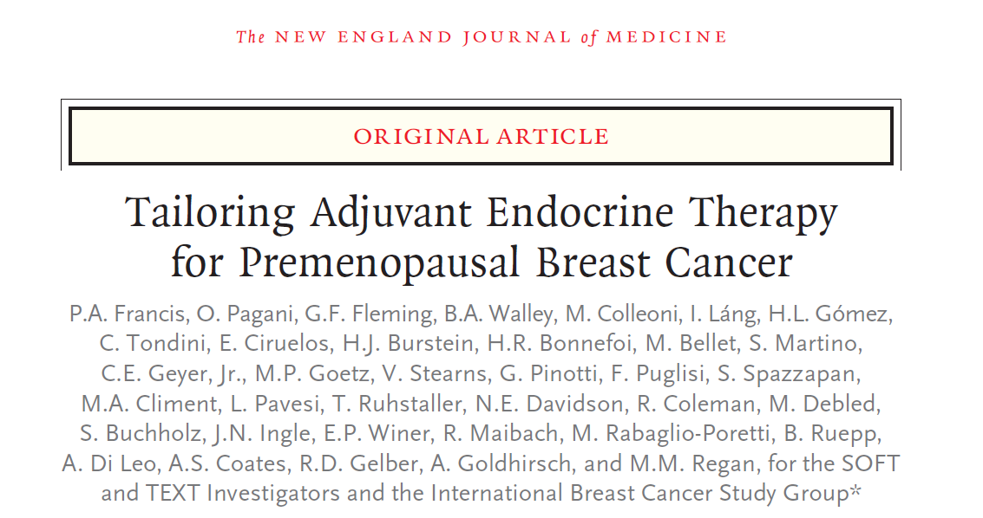

Slide 27
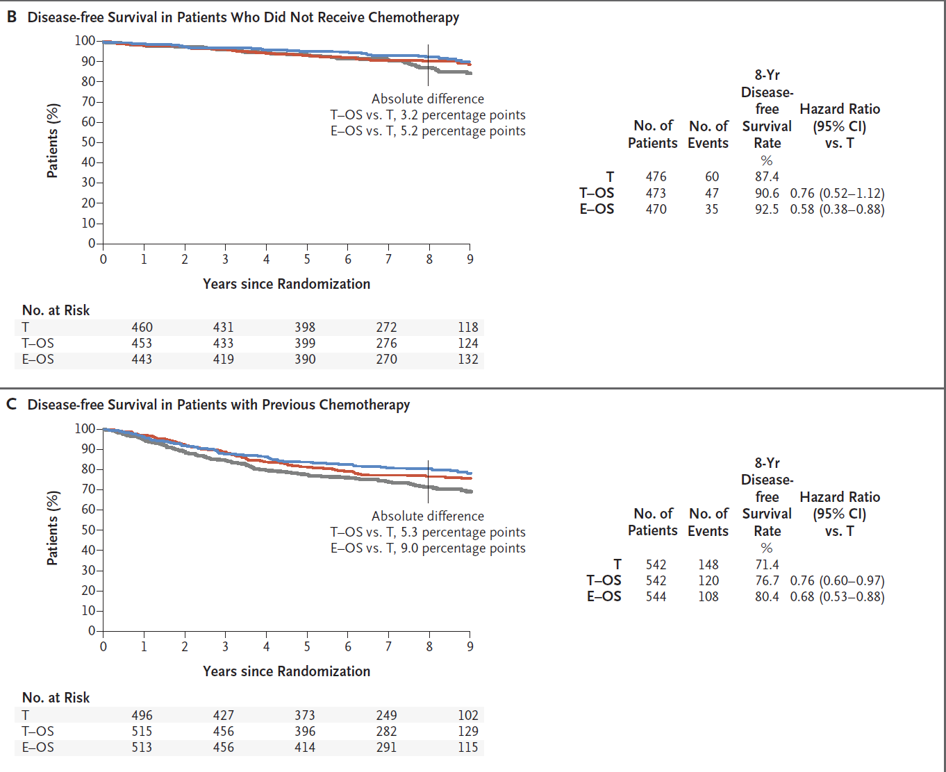
Francis P, et al. NEJM 2018

Slide 28
Subgroup analysis
Exemestane + LHRH
Pre-menopausal after chemo
Age<35
LN+
Regan M, et al. JCO 2016

Slide 29
Guidelines
Tam +- LHRH (5 years)
Tam (10 years)
Pre-menopausal
AI (5 years)
AI+ LHRH (5 years)
AI (5 years)
AI (10 years)
Post-menopausal
AI (5 years)
Tam (5 years)
Tam (10 years)

Slide 30
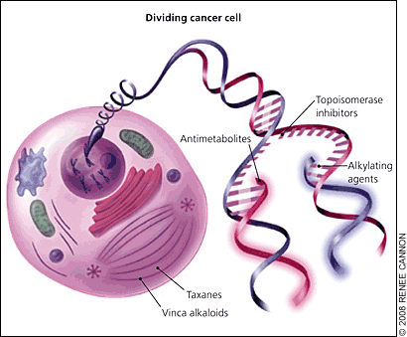
Chemotherapy
Adjuvant /Neo-adjuvant
Anthracyclines
Cyclophosphamide
Taxanes

Slide 31
Chemotherapy indications
LN+
Grade III
Highly proliferative tumors
ER-
HER2+

Slide 32
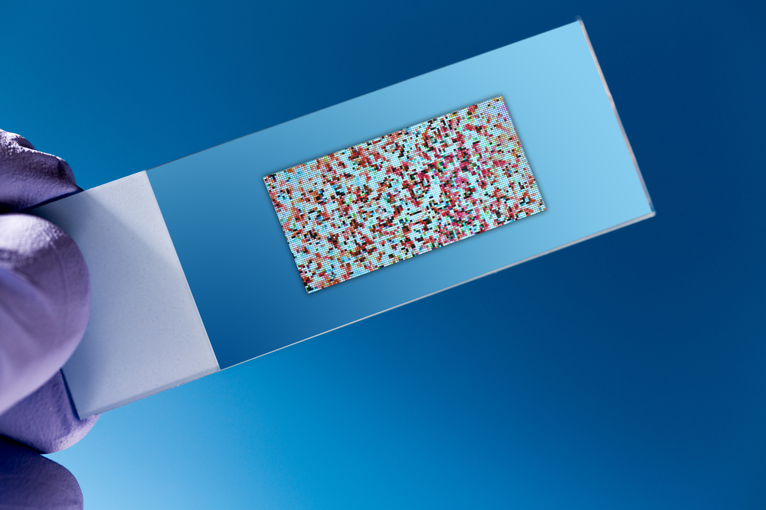
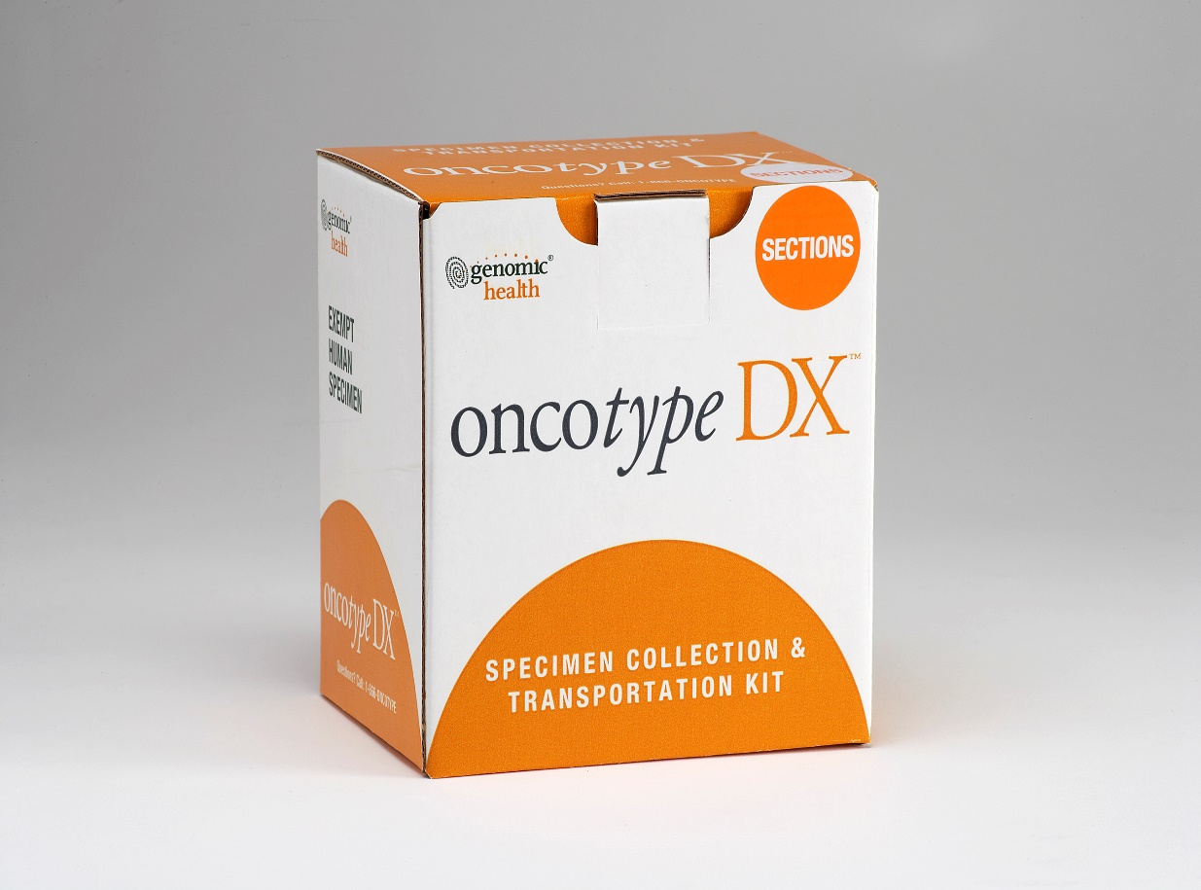
Oncotype
T1-2, Ν0, ER+

Slide 33
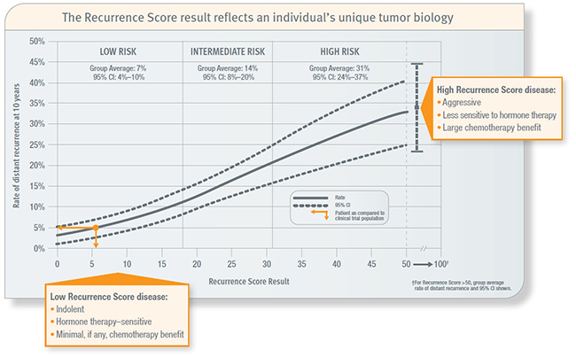
Chemotherapy
Age<50

Slide 34
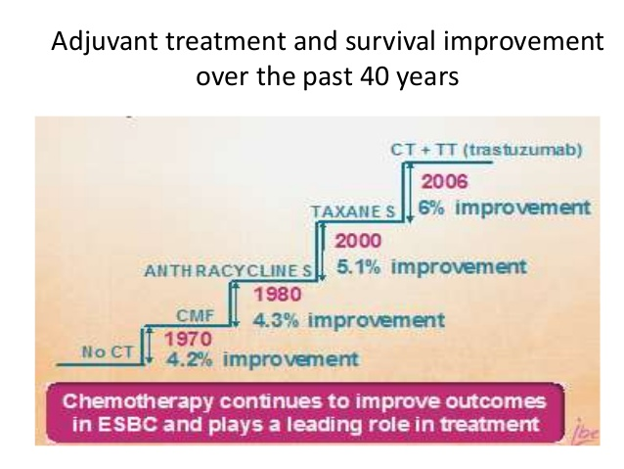
Toxicity
Benefit
Alopecia
Nausea
Diarrhea
Anemia
Neutropenia
Neuropathy
Heart failure
Leukemia

Slide 35
Outcomes
Chemotherapy
Radiotherapy
Hormone therapy
Cure
Relapse (30%-40%)

Slide 36
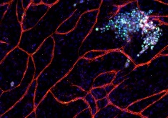
Tumor dormancy – Late relapses

Slide 37
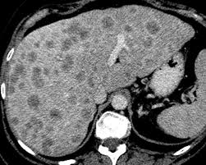
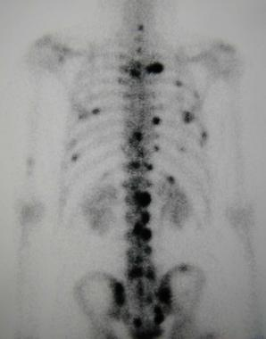
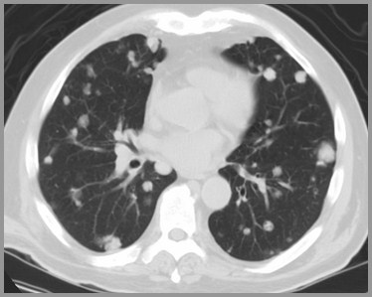
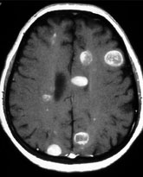
Metastatic breast cancer
Incurable
Survival: 2-3 years

Slide 38
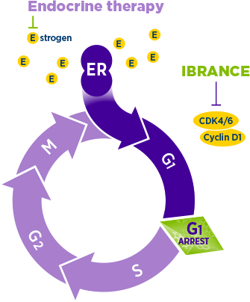
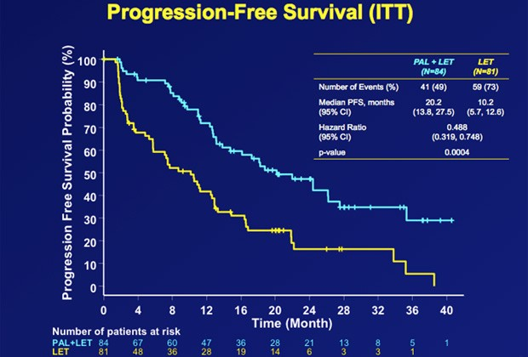
Letrozole + CDK inhibitor
Finn, et al. Presented at ASCO 2016

Slide 39
Endocrine resistance: Mutations & Alternative pathways
ESR mutations

Slide 40
Metastatic breast cancer
Hormone therapy
Hormone therapy
Chemotherapy
Notes:
DES αποNCCN τις κατηγοριες 1 σε 1^{η} γραμμη

Slide 41
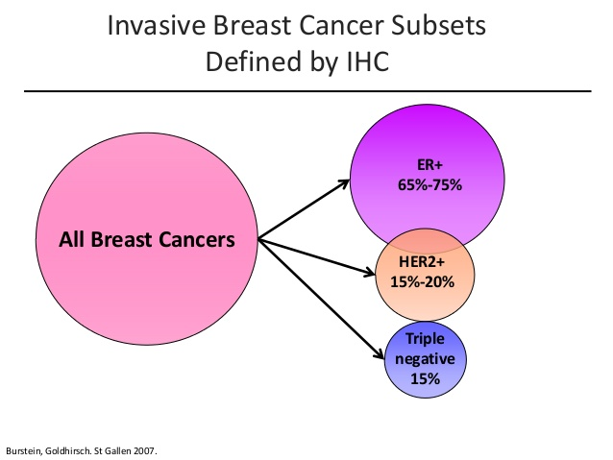

Slide 42
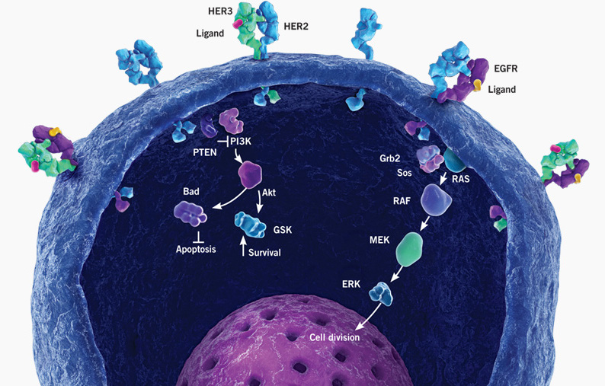
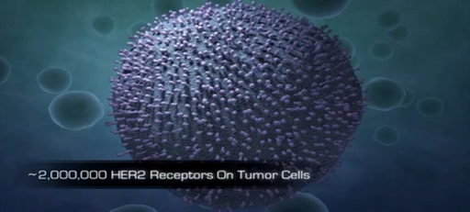
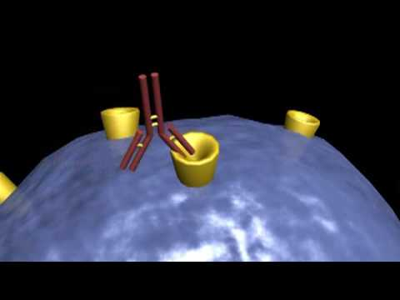
HERCEPTIN

Slide 43
Adjuvant Herceptin (HER2+ breast cancer)
Perez, et al. J Clin Oncol, 2011

Slide 44
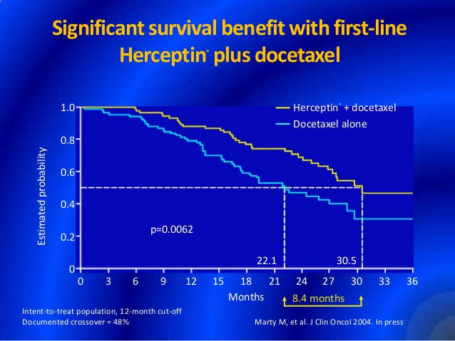
Herceptin: HER2+ metastatic breast cancer

Slide 45
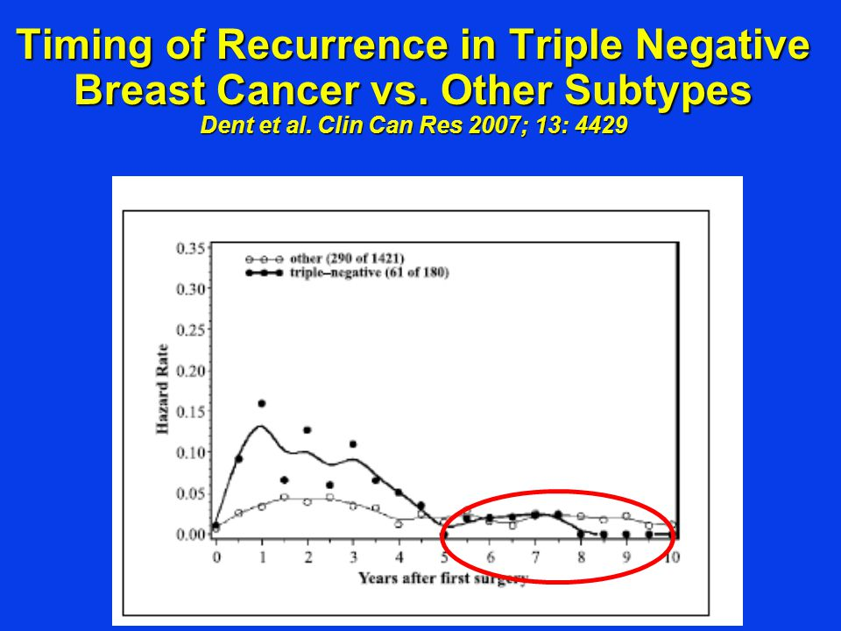
Triple negative breast cancer
Young women
Very aggressive
Early relapses
Poor prognosis
Limited treatment options

Slide 47
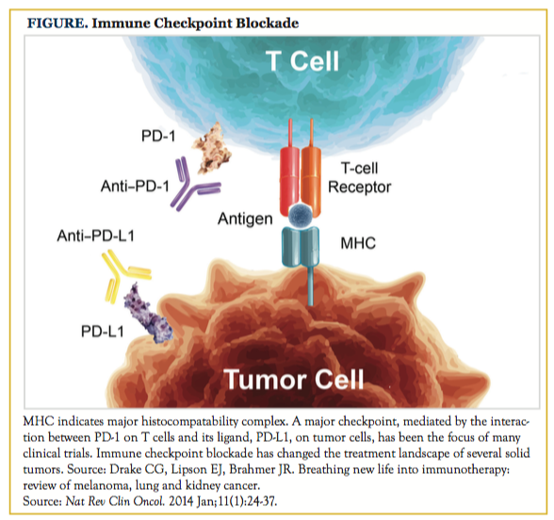

Slide 48
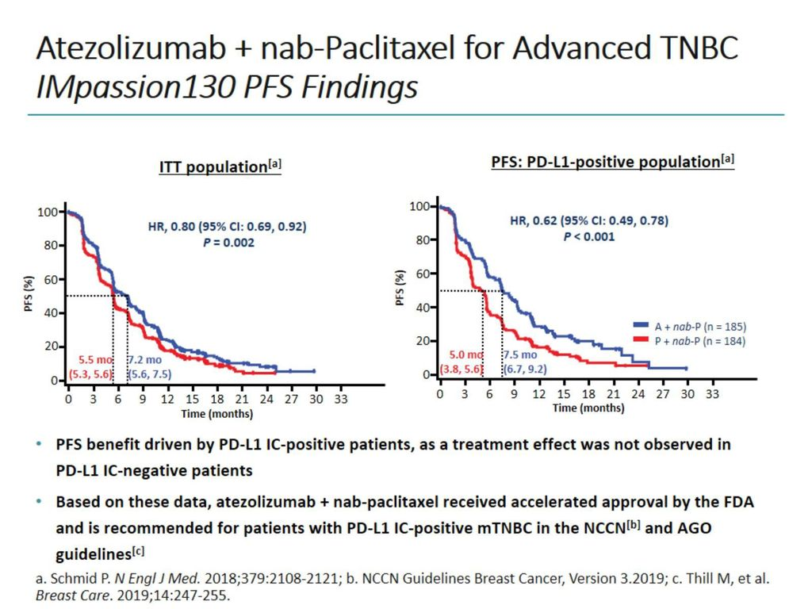

Slide 49
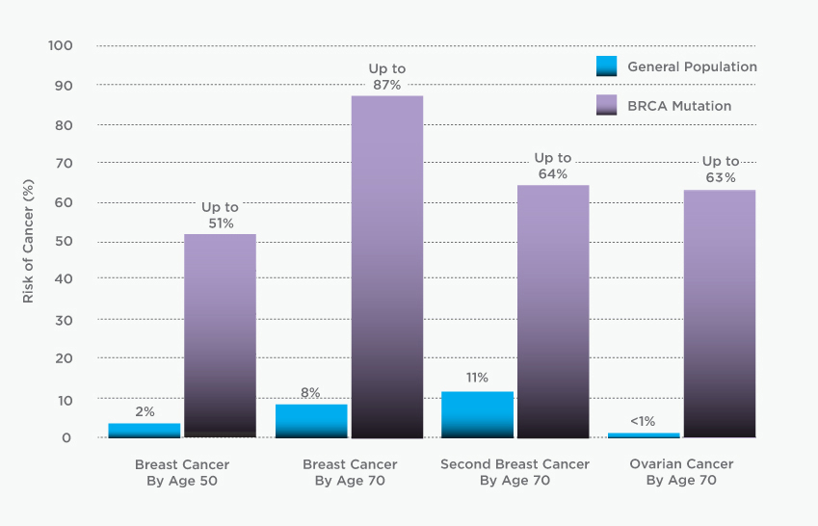
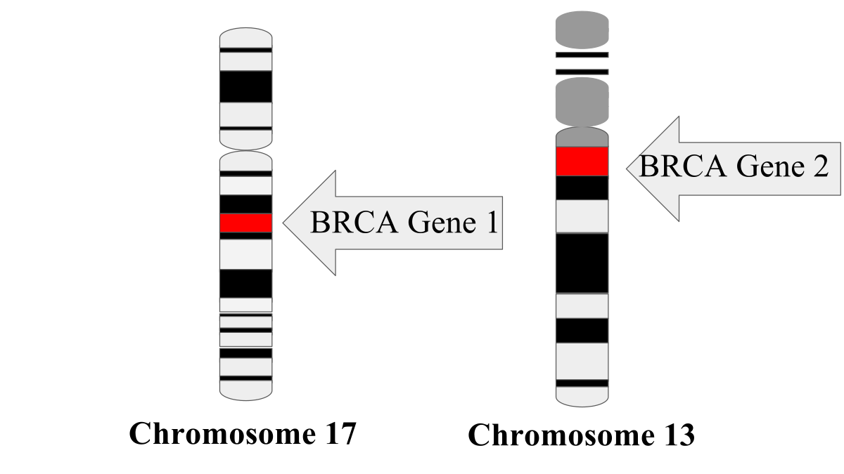
BRCA Mutations

Slide 50
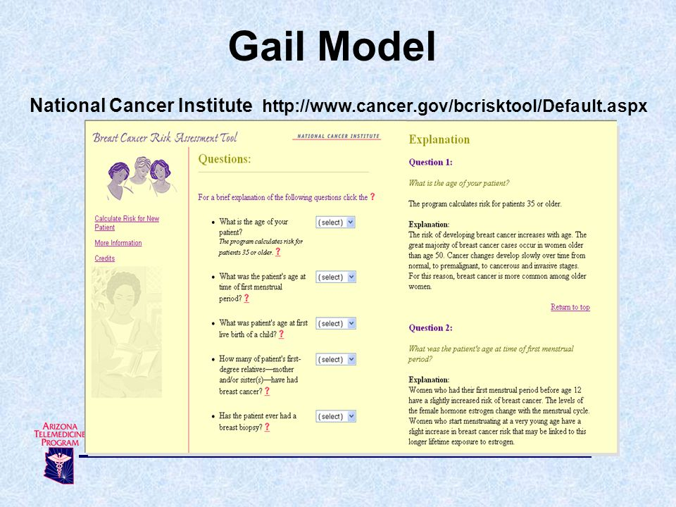

Slide 51


Slide 52


