Slide 1
Περιβαλλοντικά και Επαγγελματικά
Aίτια Καρκινογένεσης
Καραδήμου Αλεξάνδρα MD, PhD
Παθολόγος-Ογκολόγος
Επιμελήτρια Ογκολογικής Μονάδας Ιατρικού Κέντρου Αθηνών
Επιστημονική συνεργάτης Γ' Παν/κής Παθολογικής Κλινικής
και Ομώνυμου Εργαστηρίου Ιατρικής Σχολής ΕΚΠΑ

Slide 2
Carcinogenesis
Cancer is caused by changes to certain genes that alter the way our cells function
Some of these genetic changes occur naturally when DNA is replicated during the process of cell division
Others are the result of environmental exposures that damage DNA

Slide 3
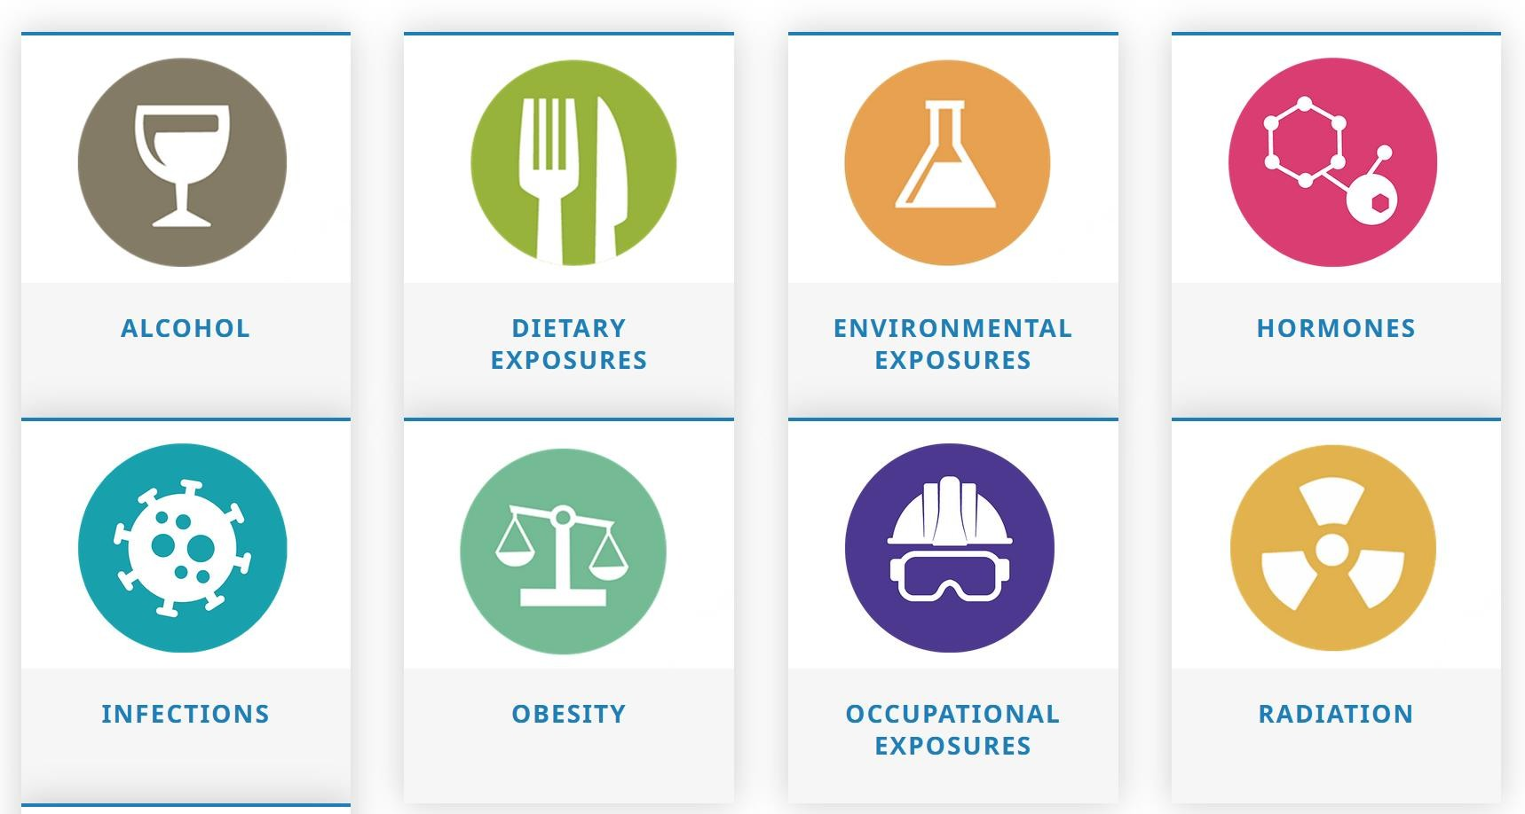
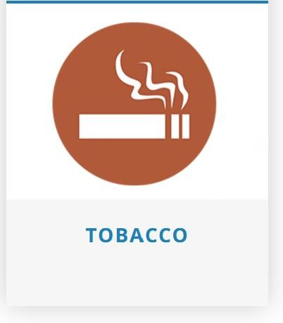
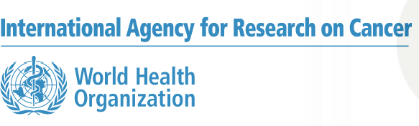
Risk Factors
What is a carcinogen?
A carcinogen is a substance, mixture or agent that can cause cancer or it increases the risk of developing cancer. Known carcinogens include viruses (Hepatitis B), hormones (estrogens), chemicals (benzene, tabacco), naturally occurring minerals (asbestos), alcohol, and solar radiation (ultraviolet radiation)
Αυτή είναι η λίστα με τις πλέον καρκινογόνες ουσίες και συνήθειες | Alfavita

Slide 4

Αυτή είναι η λίστα με τις πλέον καρκινογόνες ουσίες και συνήθειες | Alfavita
Clean air, stable climate, adequate water, sanitation and hygiene, safe use of chemicals, protection fromradiation, healthy and safe workplaces, sound
agricultural practices, health supportive cities and
built environments, and a preserved nature are all
prerequisites for good health.
Environmentalhealth

Slide 5
Epidemiology
13.7 million of deaths per year in 2016, amounting to 24% of the global deaths, are due to modifiable environmental risks
One in five people worldwide develop cancer during their
lifetime. Prevention of cancer has become one of the most significant public health challenges of the 21st century
Based on current scientific evidence, at least 40% of all cancer cases could be prevented with effective primary prevention measures, and further mortality can be reduced through early detection of tumors

Slide 6

Air pollution
A complex mixture of solid particles, liquid droplets, as well as gases. It can come from many sources for example: household fuel burning, industrial chimneys, traffic exhausts, power generation, open burning of waste, agricultural practices, desert dust and many other sources
In 2019, 99% of the world’s population was living in places where the WHO
air quality guidelines levels were not met
The combined effects of ambient air pollution and household air pollution are associated with 6.7 million premature deaths annually
WHO estimates that in 2019, some 11% of outdoor air pollution-related premature deaths were due to cancer within the respiratory tract

Slide 7
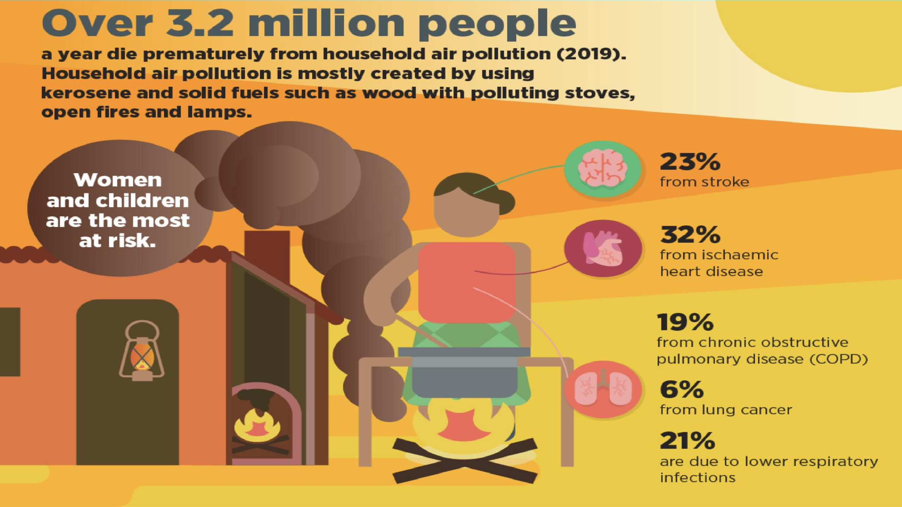

Slide 8

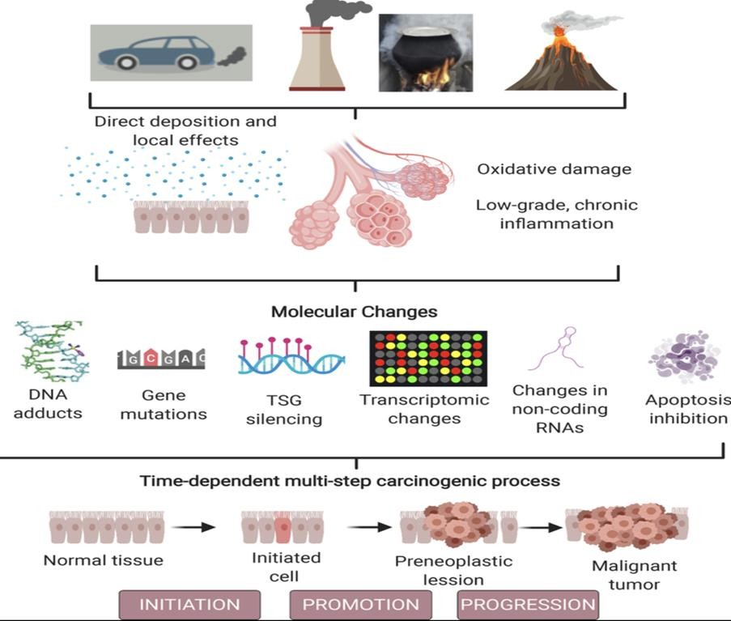
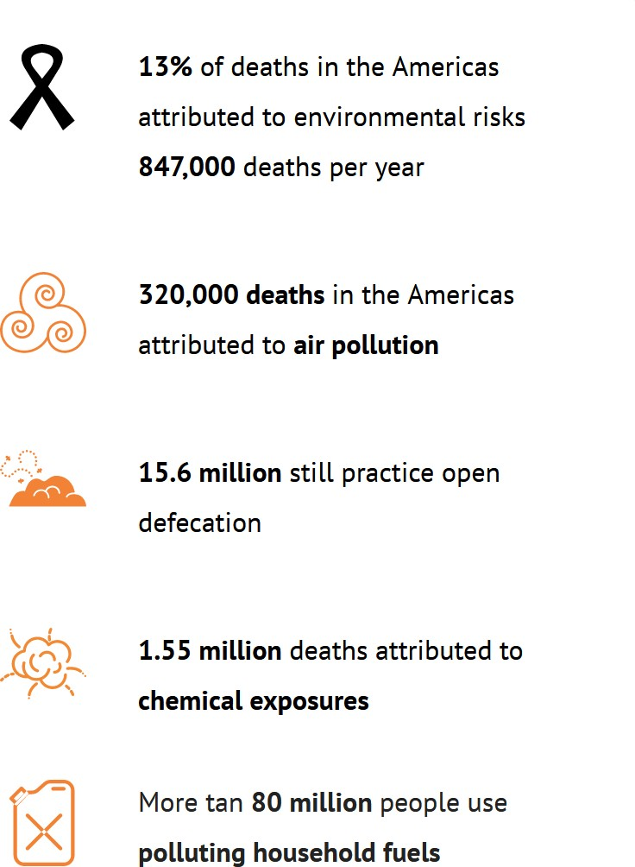
A healthy environment is vital to “ensure healthy lives and promote well-being for all at all ages.”

Slide 9
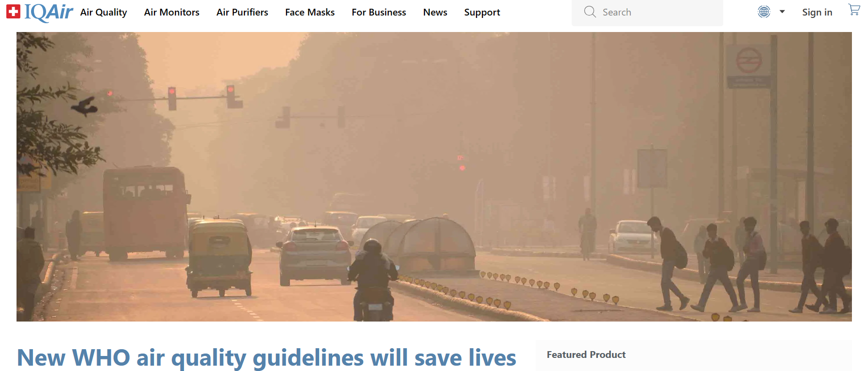
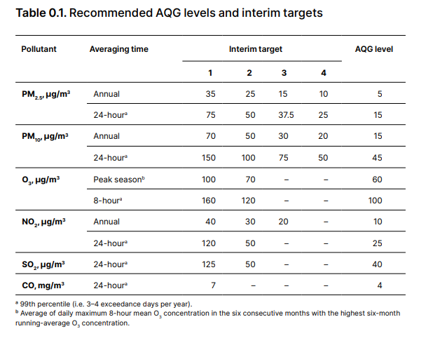
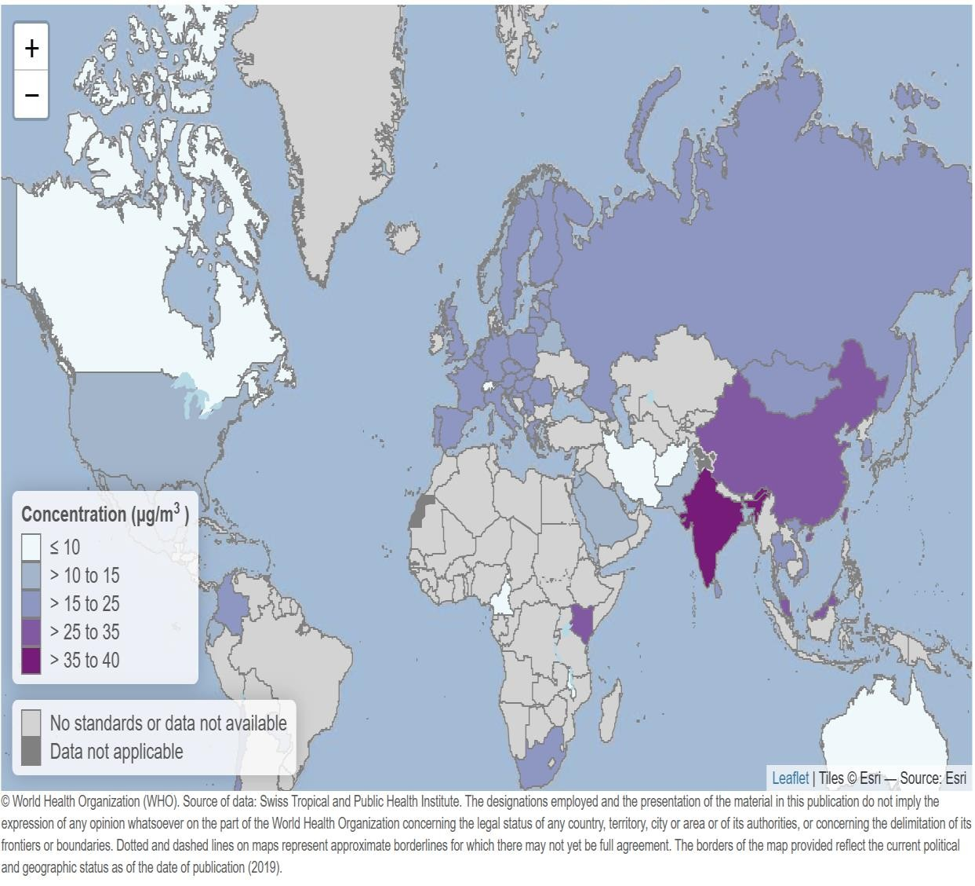
Recommended 2021 AQG levels compared to 2005 air quality guidelines
9789240034228-eng.pdf (who.int)

Slide 10
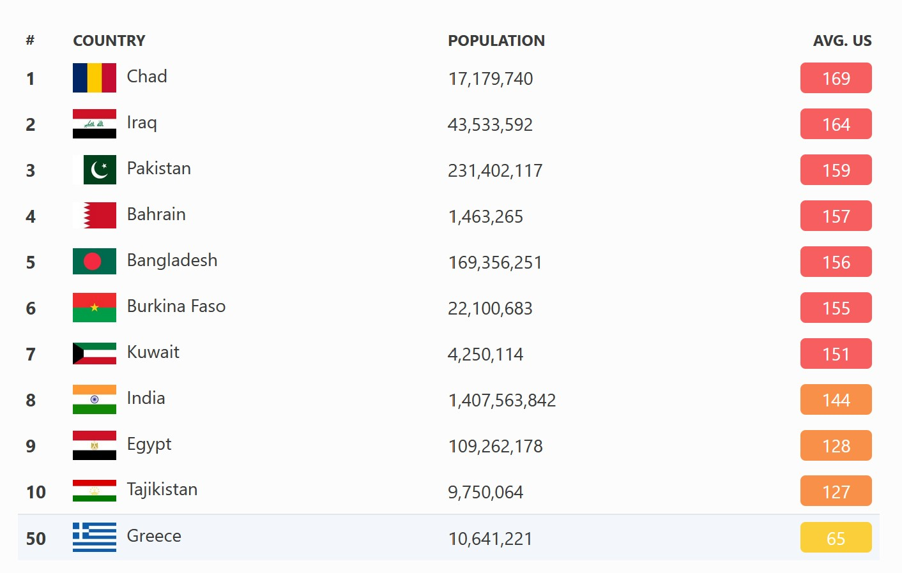

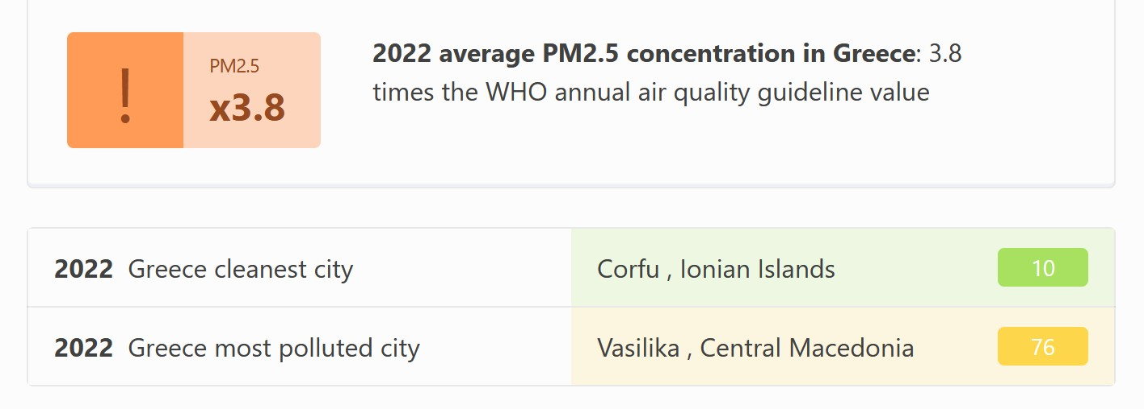
Which country had the worst air quality in 2022?
PM2.5 stands for particulate matter that is 2.5 micrometers or less in diameter, going down to sizes as small as 0.001 microns across. Due to its incredibly small size as well as chemical composition depending on the material, it has the ability to cause considerable harm when respired, and as such is used as a major component for calculating the overall AQI, or air quality index

Slide 11
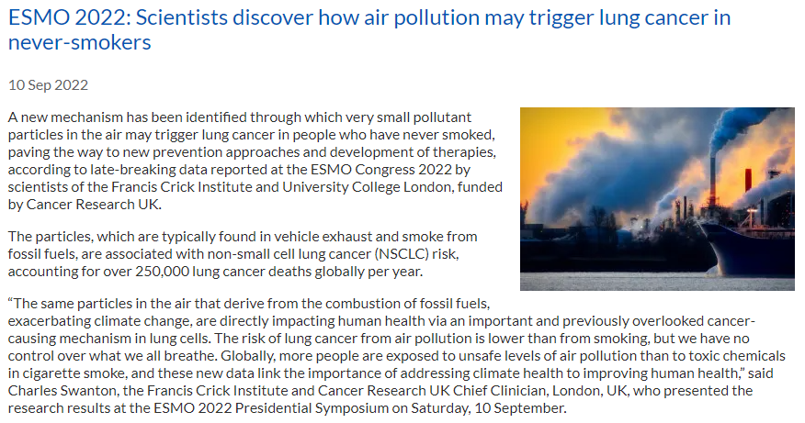

Slide 12
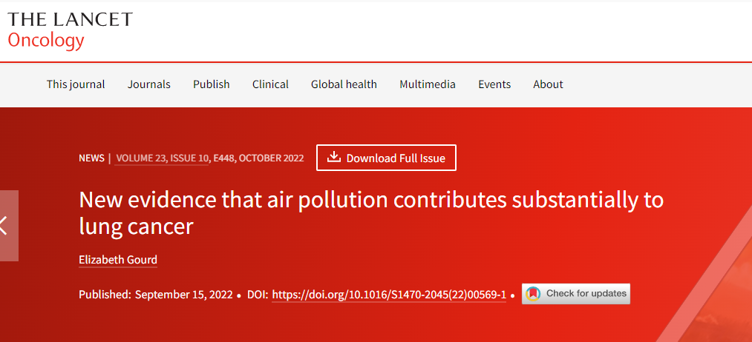

Slide 13
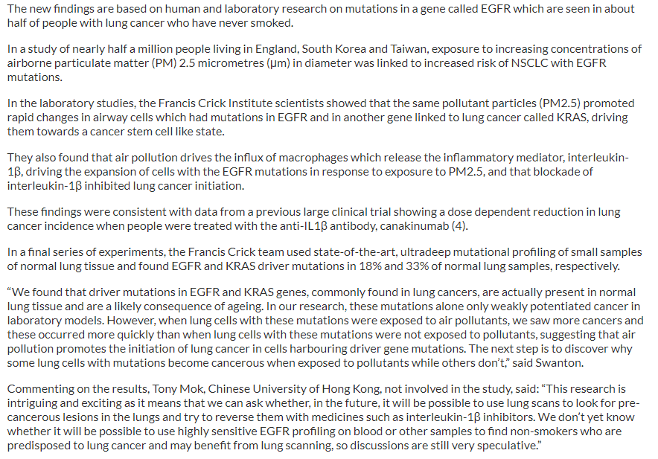

Slide 14
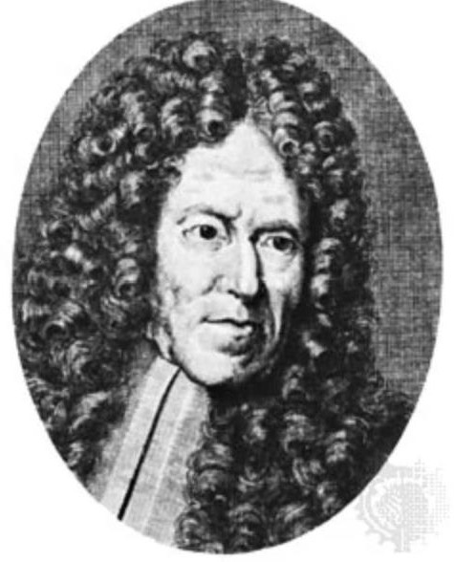
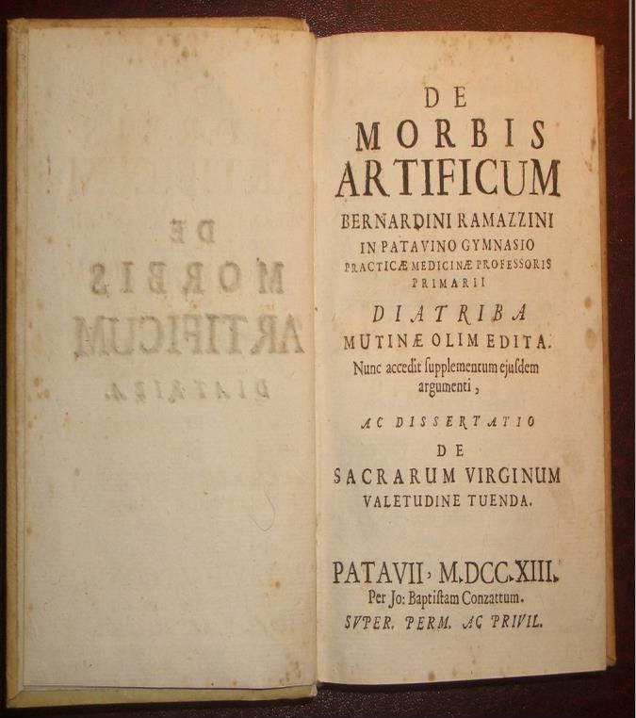


The Father of Occupational Medicine
Bernardino Ramazzini
Βorn in Carpi, Italy, in 1633
Ramazzini focused on workers' health problems in a systematic and scholarly way
De Morbis Artificum Diatriba [Dissertation on Workers' Diseases]; the first edition was printed in Modena in 1700
ΕΛΙΝΥΑΕ (elinyae.gr)

Slide 15

With cancer accounting for an estimated 53 % of all work-related deaths in the EU and other developed countries, reliable data on workplace exposures to cancer risk factors are essential for both the safety and health of workers and a productive and sustainable economy

Slide 16
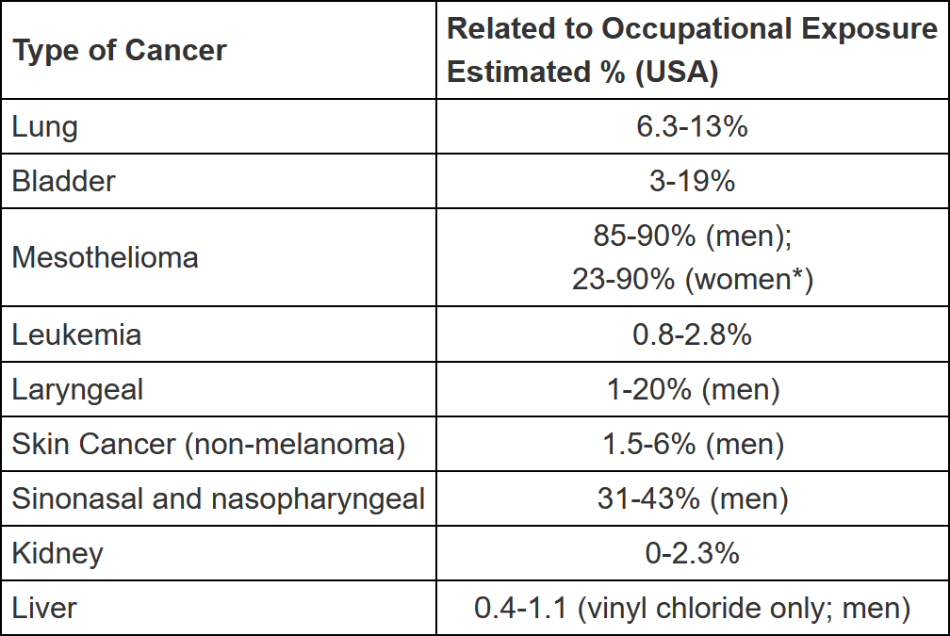
What is occupational cancer?
Occupational cancer is cancer that is caused wholly or partly by exposure to a carcinogen at work
The most common types of occupational cancer are lung cancer, bladder cancer and mesothelioma
Dying for work: the magnitude of US mortality from selected causes of death associated with occupation. K. Steenland, et al. American Journal of Occupational Medicine. Vol. 43 (2003). p. 461-482

Slide 17

Definitions
The agent is a defined substance, a mixture, or a type or source of radiation
The agent is classified in International Agency for Research on Cancer (IARC) as Group 1. This category is used when there is sufficient evidence of carcinogenicity in humans (to ensure that observed exposure-disease associations are causal).
‘Sufficient evidence of carcinogenicity’ in humans is obtained entirely or in part from epidemiologic studies of exposed workers (to ensure that the carcinogen has documented occupational exposure).

Slide 18

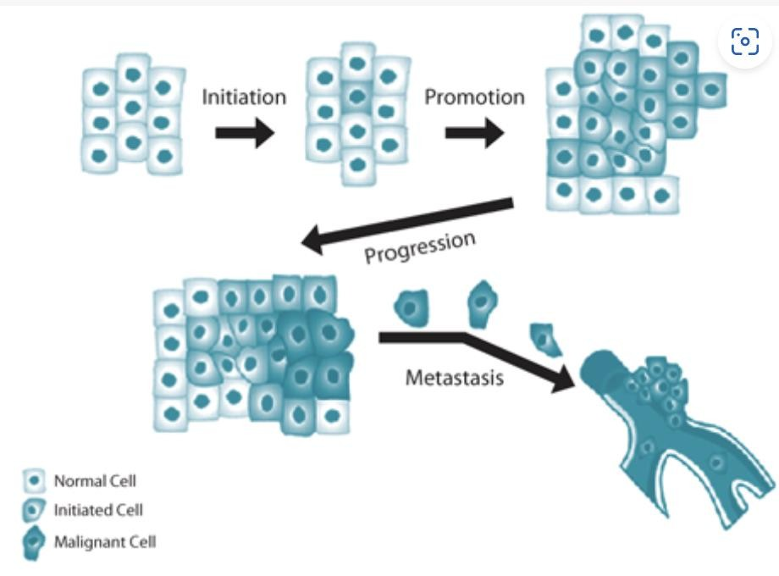
Carcinogenic chemicals are divided into 3 categories:
known to cause cancer to humans (category 1A);
presumed to cause cancer to humans (category 1B);
suspected of causing cancer to humans (category 2)

Slide 19
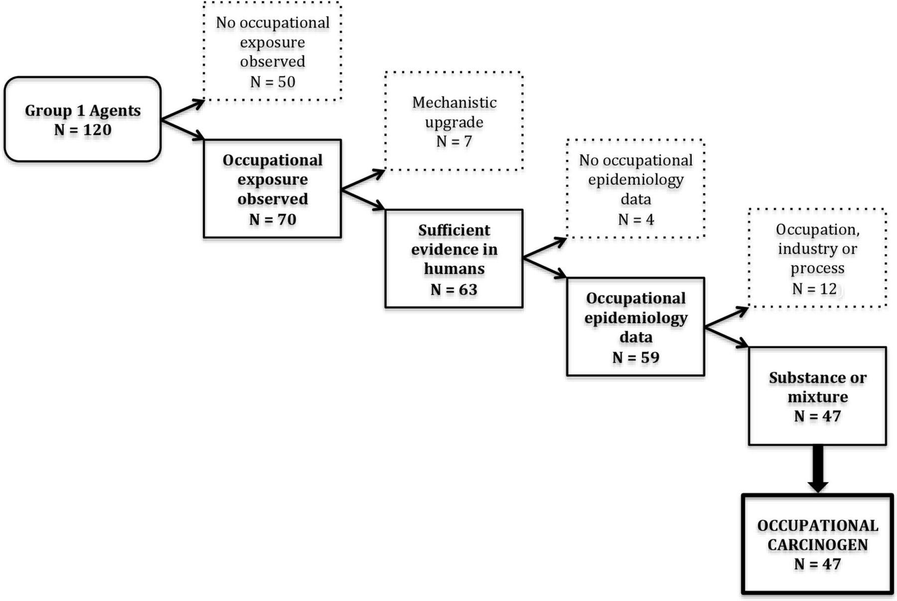

Defining occupational carcinogens from the International Agency for Research on Cancer (IARC) Monographs (1971–2017).
Dana Loomis et al. Occup Environ Med 2018;75:593-603
©2018 by BMJ Publishing Group Ltd

Slide 20
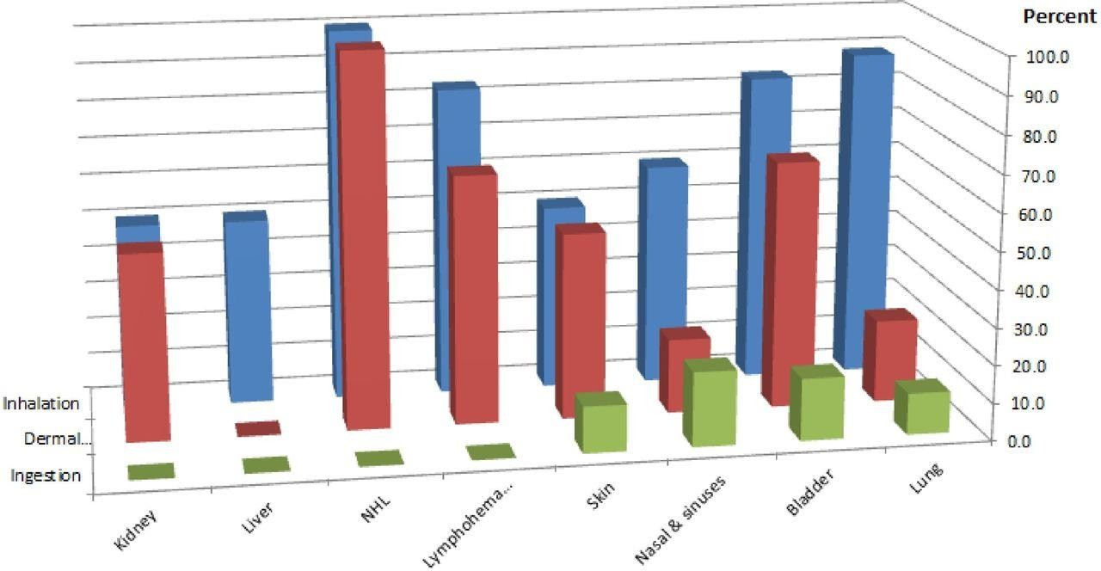
Route of exposure to occupational carcinogens and the cancers they cause (ionising radiation not included due to the diversity of exposure routes and cancer types). NHL, non-Hodgkin lymphoma.
Dana Loomis et al. Occup Environ Med 2018;75:593-603
©2018 by BMJ Publishing Group Ltd

Slide 21
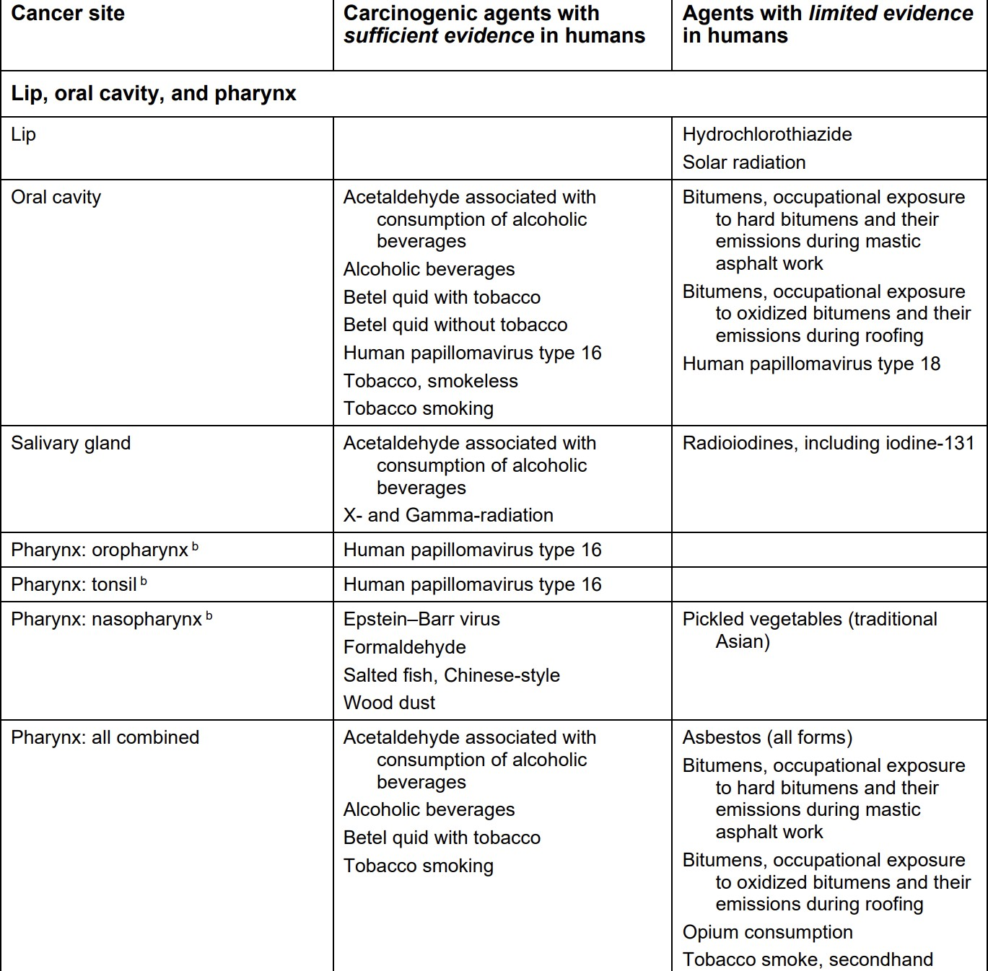
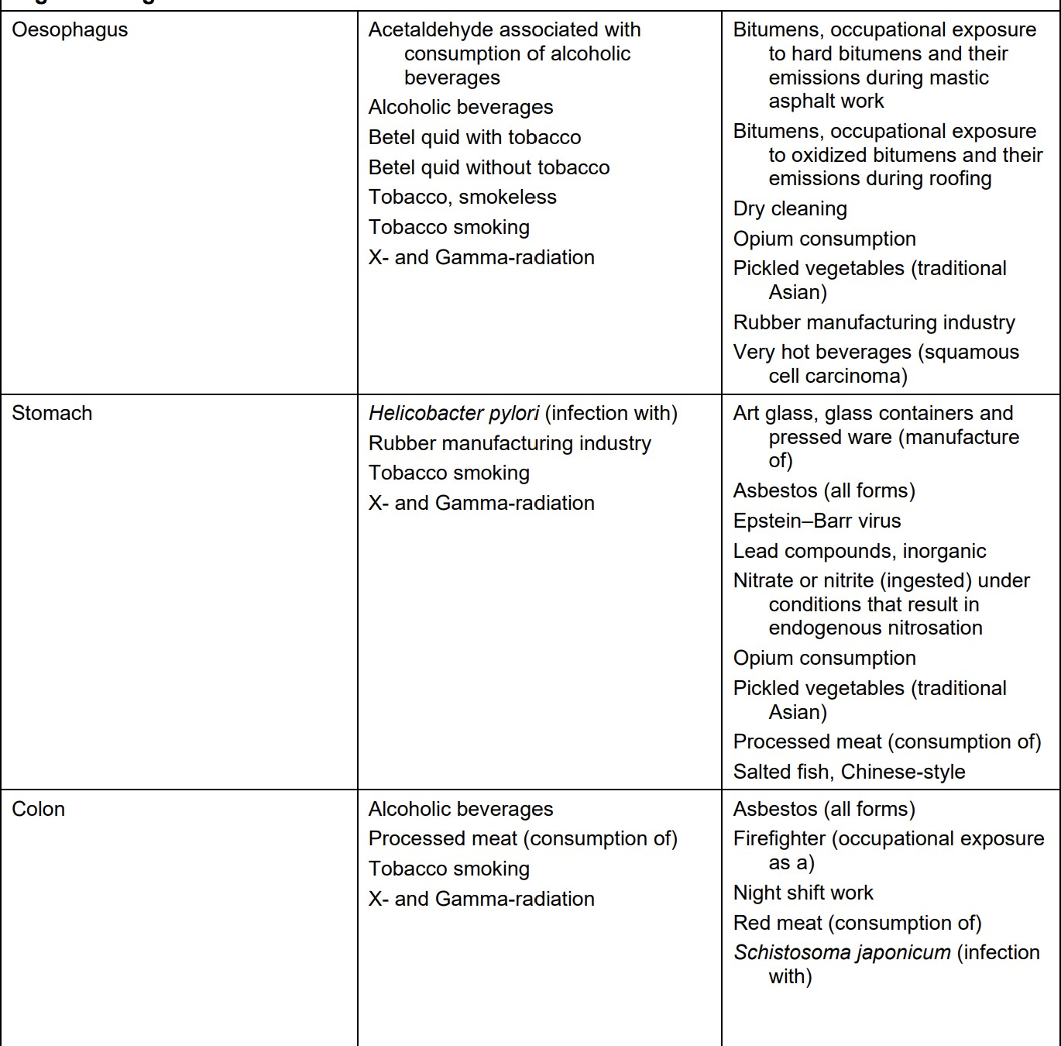
List of classifications by cancer sites with sufficient or limited evidence in humans, IARC Monographs

Slide 22
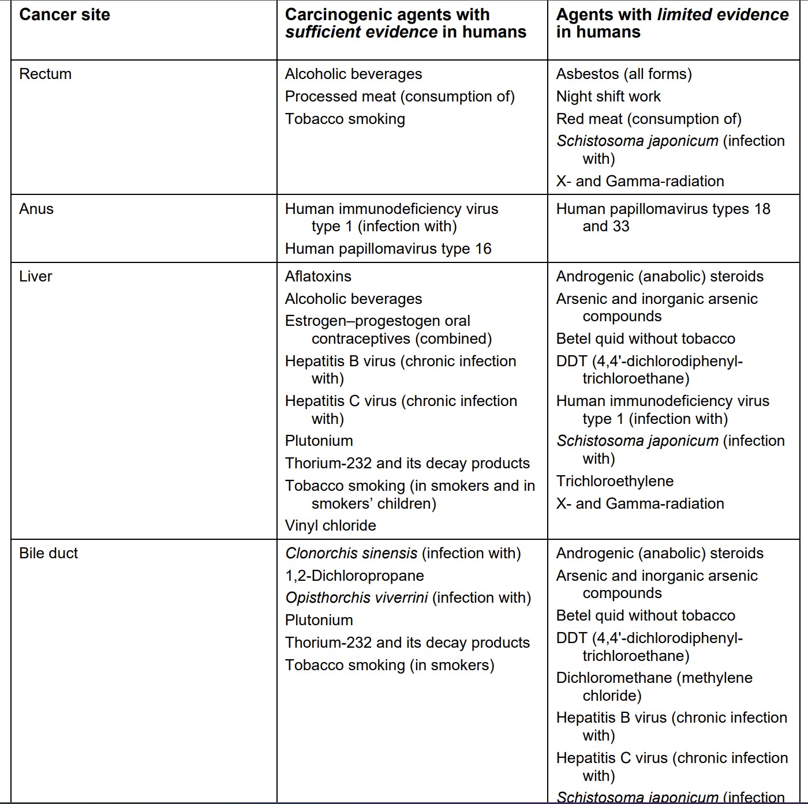
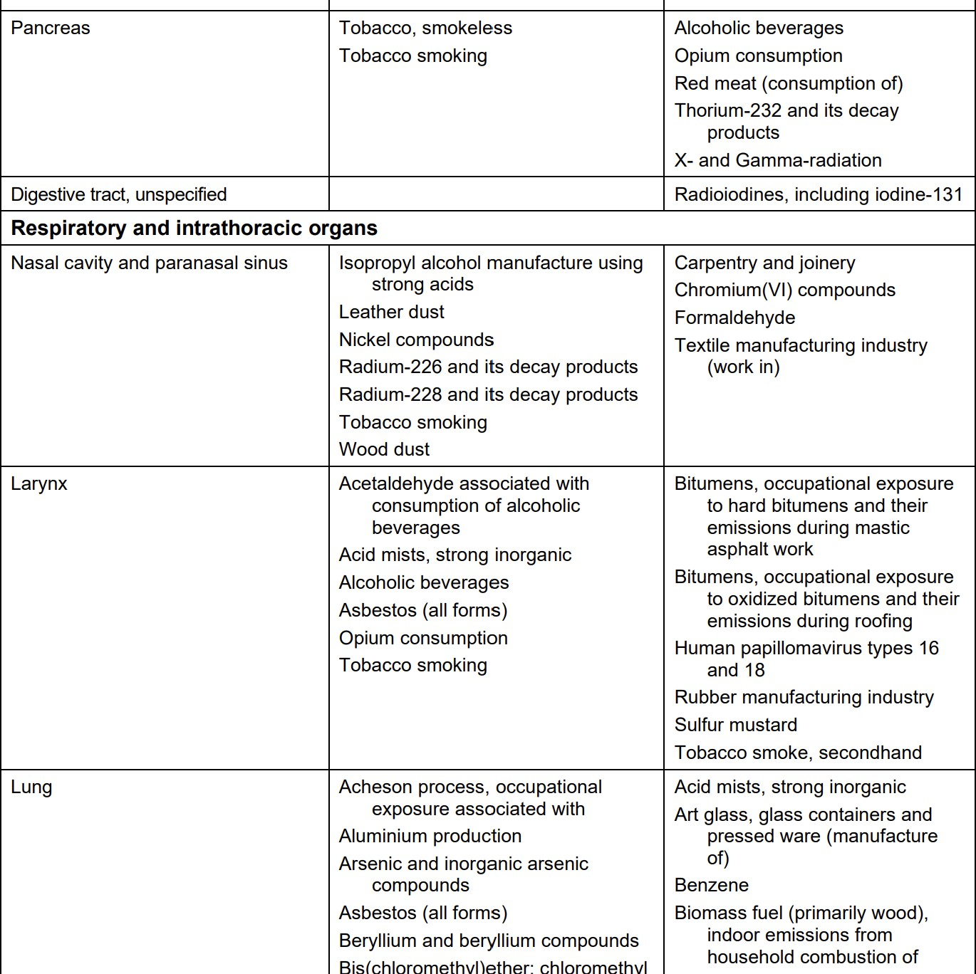
List of classifications by cancer sites with sufficient or limited evidence in humans, IARC Monographs

Slide 23
Data compiled from the IARC Monographs from its initiation in 1971 through 2017 indicate that the number of recognized occupational carcinogens has increased progressively in recent decades
Despite notable progress, there continues to be a need for research on the causes of work-related cancer. Epidemiologic evidence is inadequate or entirely lacking for the majority of the over 1000 agents evaluated by IARC; many more agents present in workplaces have never been evaluated for carcinogenicity

Slide 24
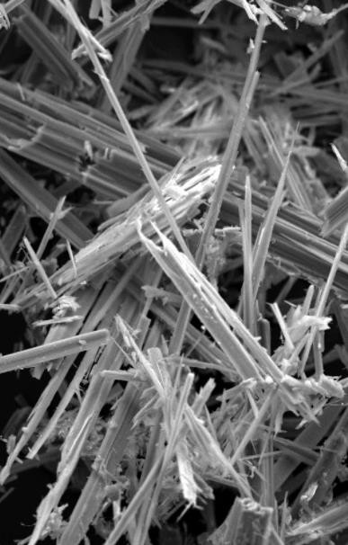
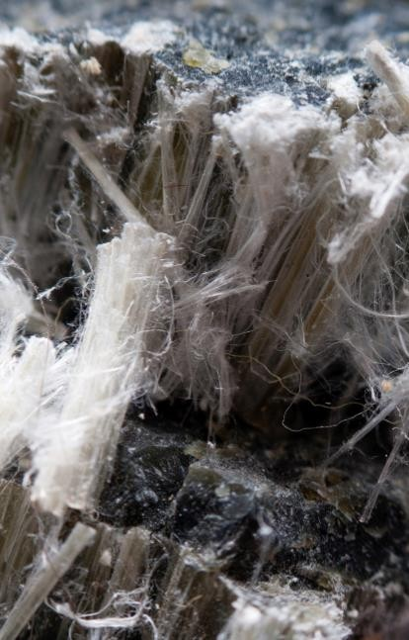
Ίνες αμιάντου
Chrysotile
Amphibole asbestos
Crocidolite (blue)
asbestos
Amosite (brown) asbestos
Anthophyllite
Actinolite
Tremolite

Slide 25
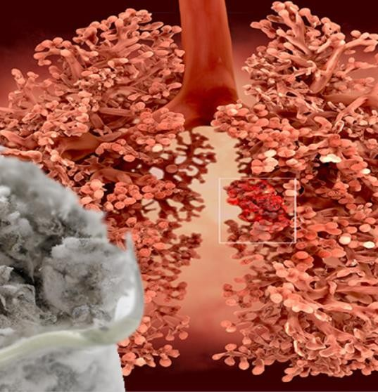
Mesothelioma
Mesothelioma is a rare but fatal form of thoracic cancer that is diagnosed in more than 30,000 people per year and kills over 25,000
Over 80% of cases arise from exposure to asbestos fibres which cause long term inflammation in the mesothelial cells of the lung, slowly leading to cancerous changes 20-50 years later
The incidence of mesothelioma has fallen in Australia, the USA and Western Europe, where asbestos or strict regulations were introduced in the 1970s and 1980s
Approximately 3000 incident cases of mesothelioma are registered each year in the United States

Slide 26
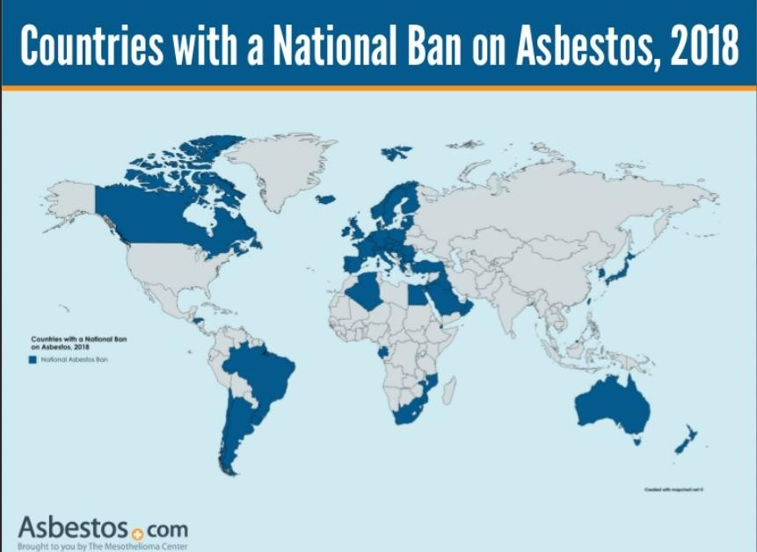

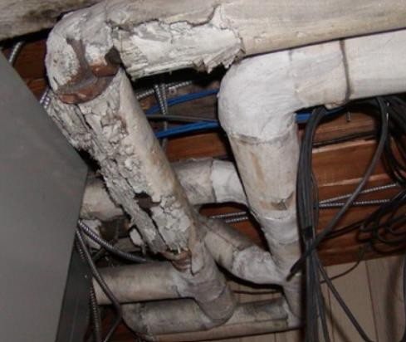
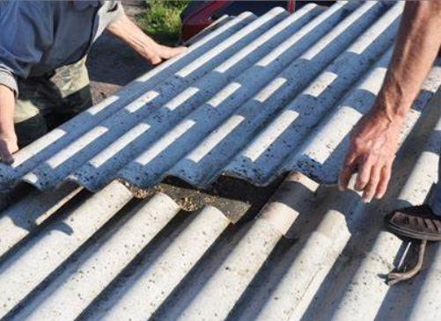
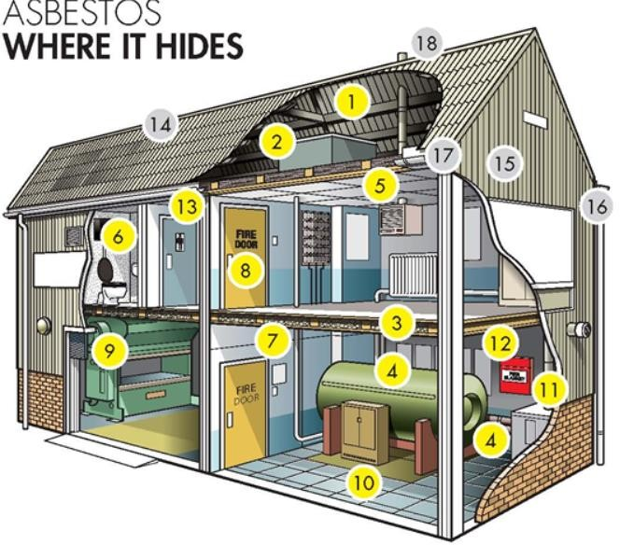

Slide 27
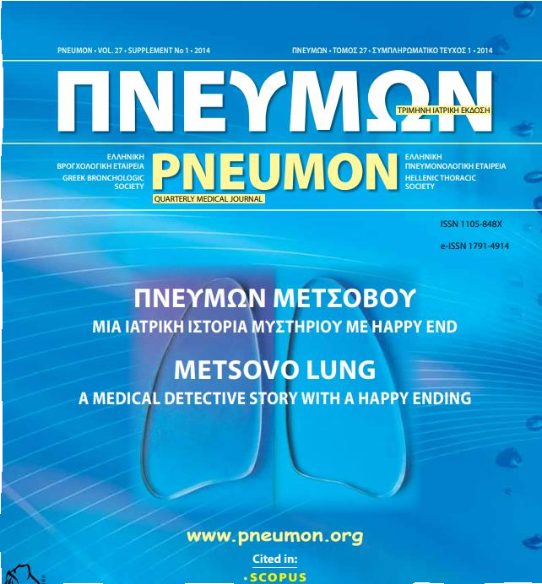
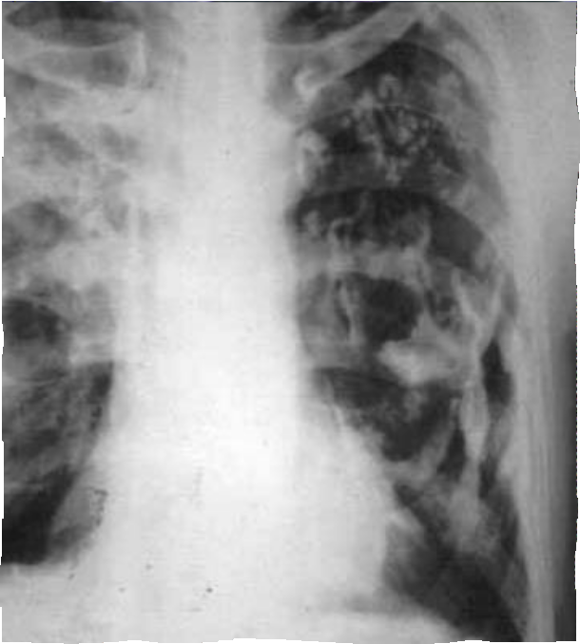
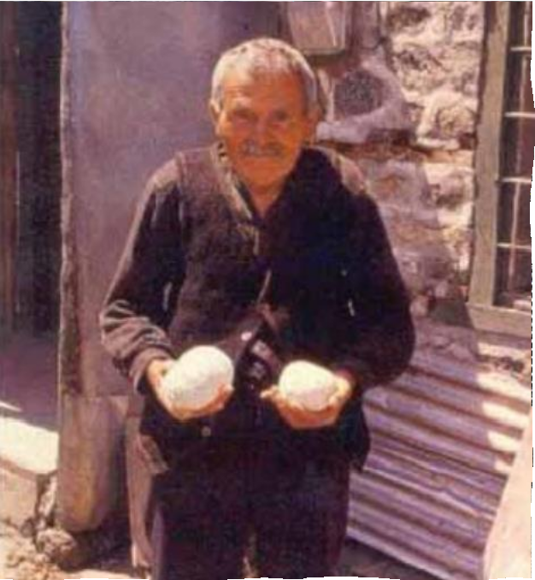
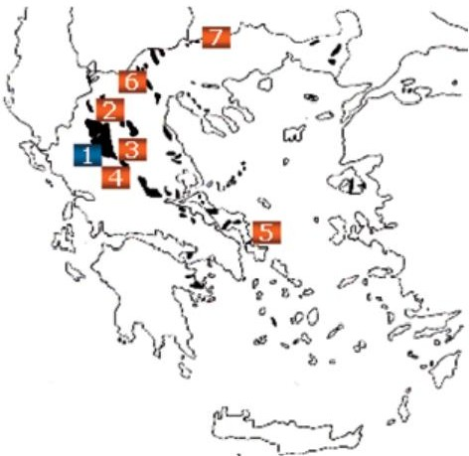
Metsovo Lung

Slide 28
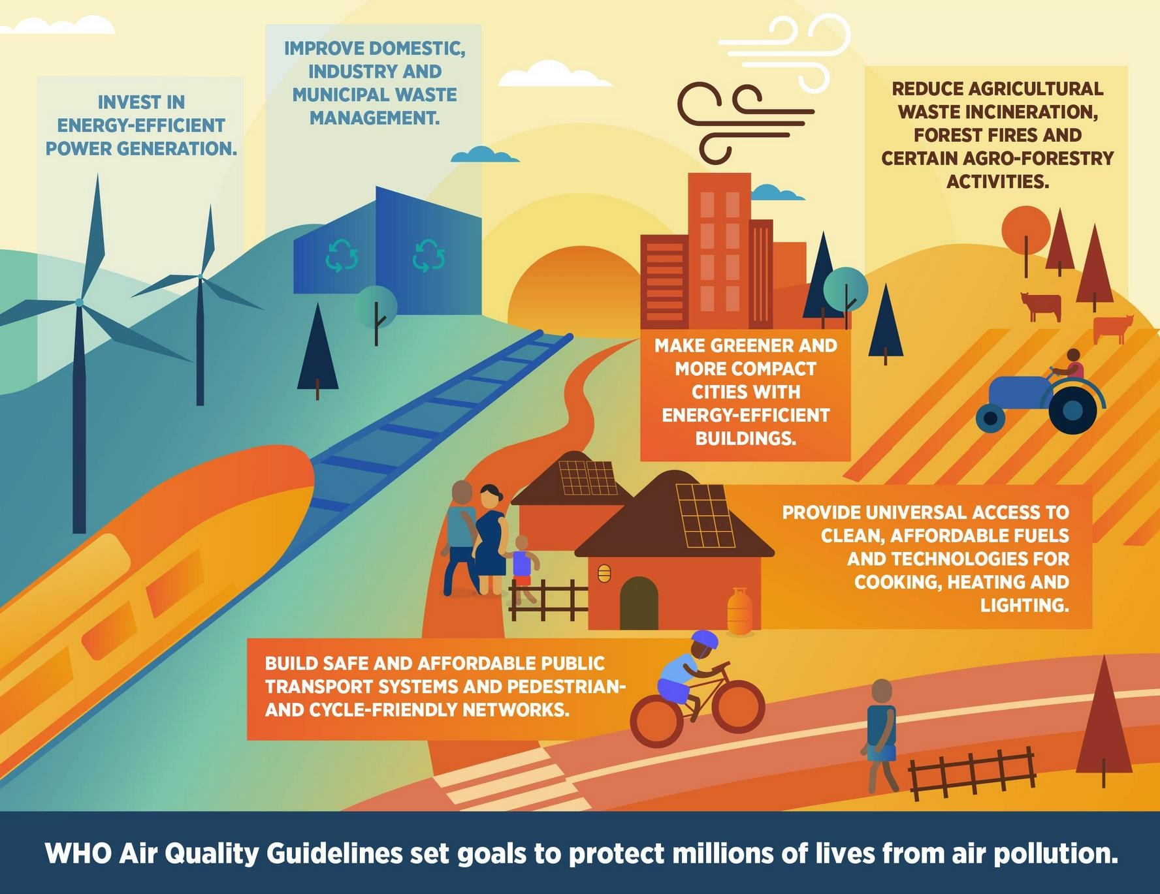
Solutions

Slide 29
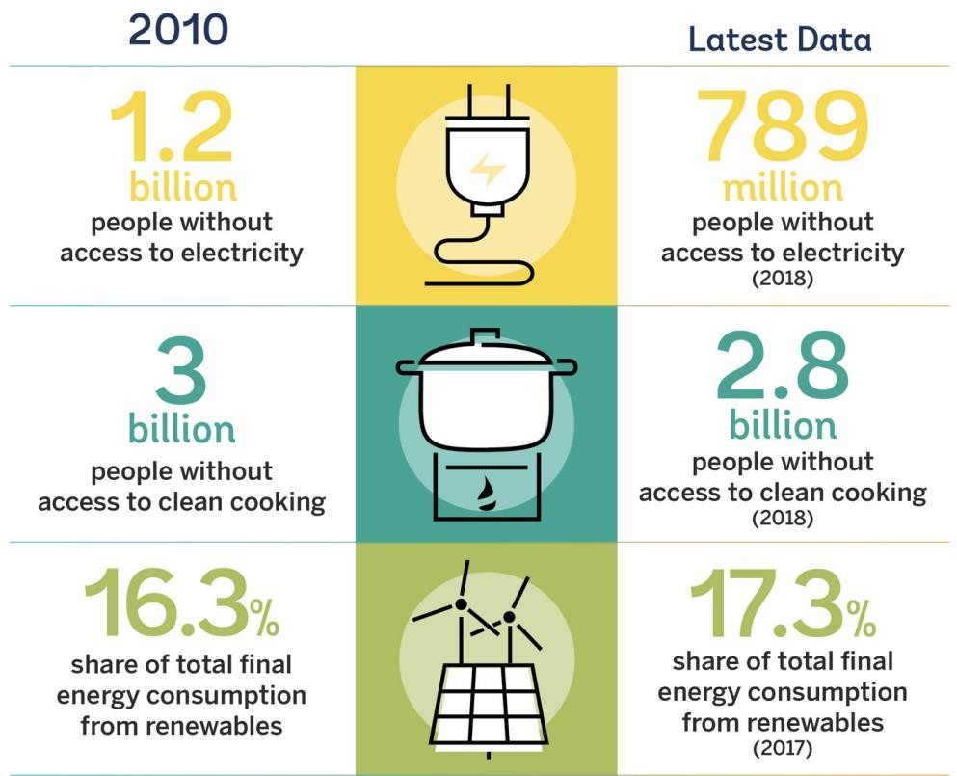
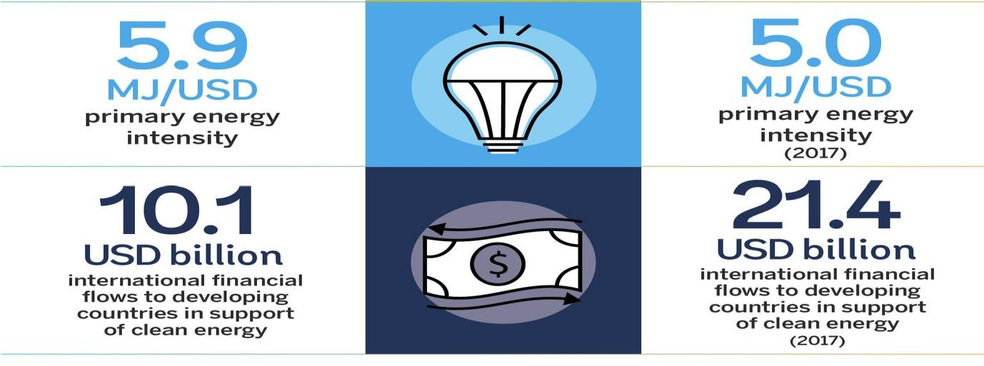
Energy Progress Report for 2020

Slide 30
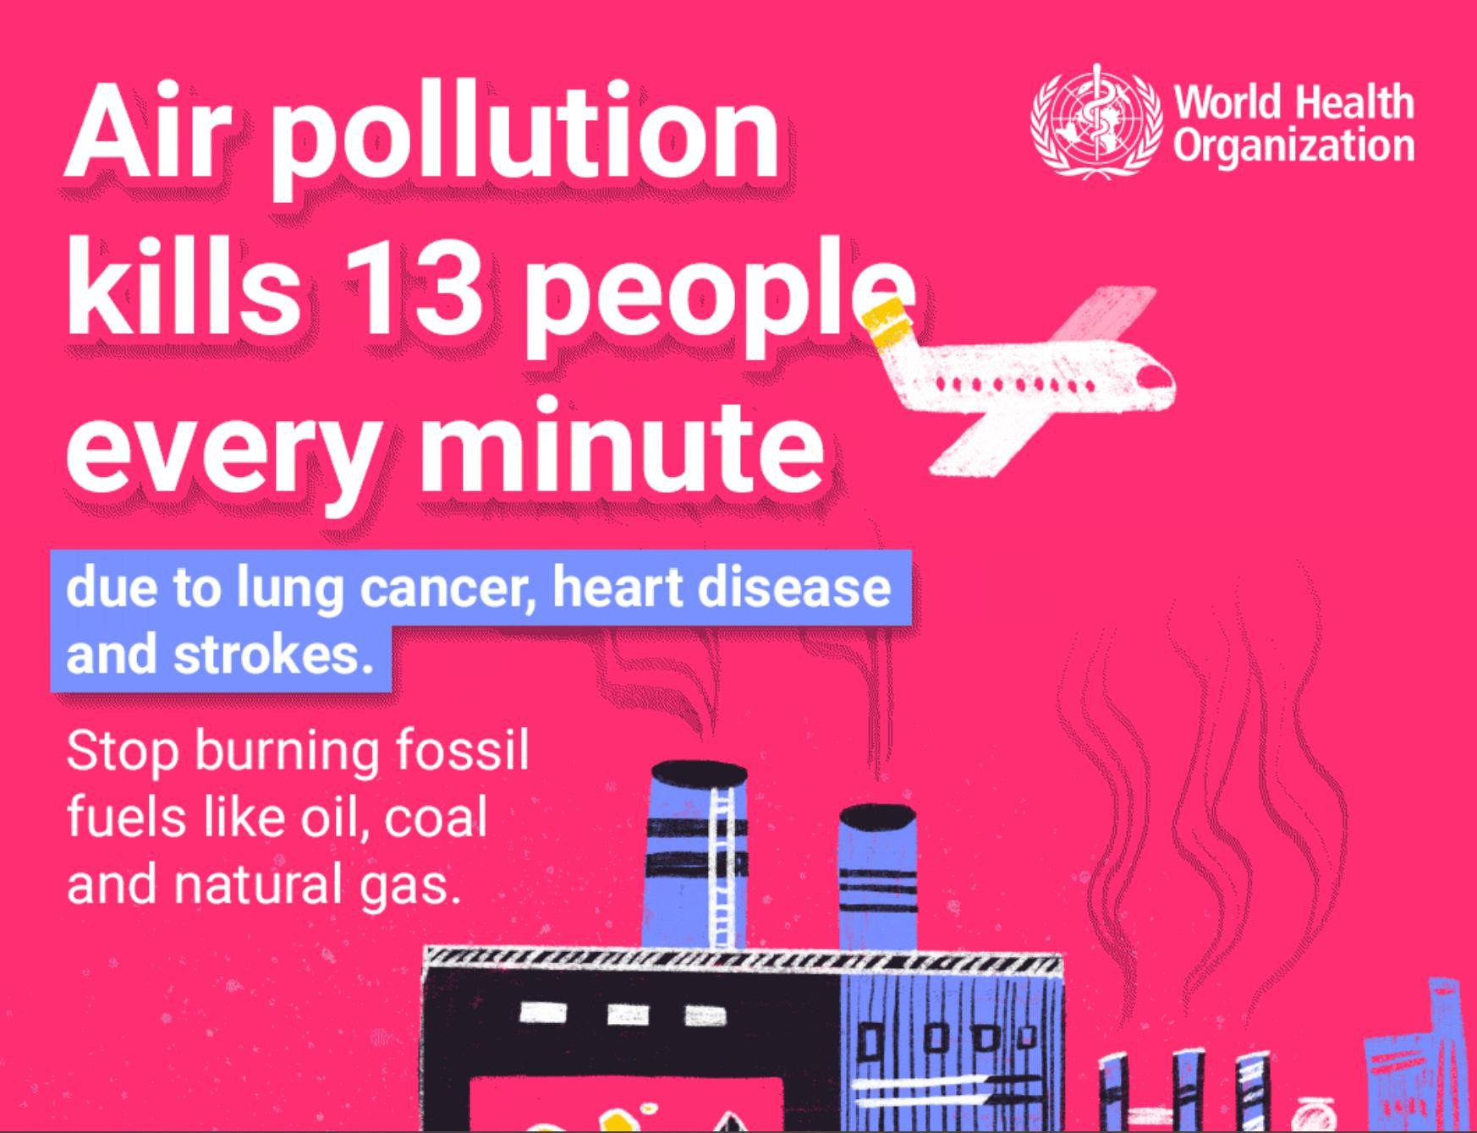
THANK YOU

