Slide 1

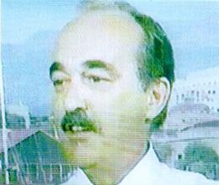



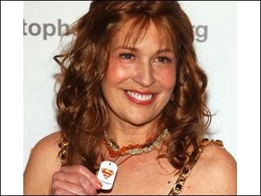



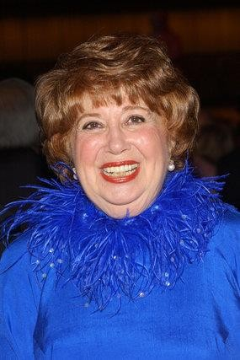


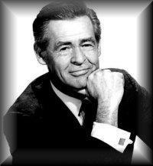

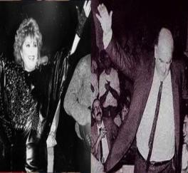

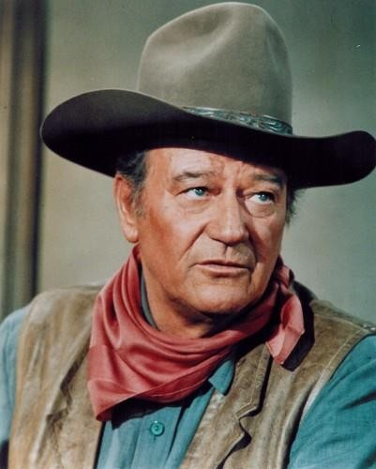






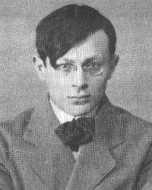




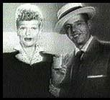

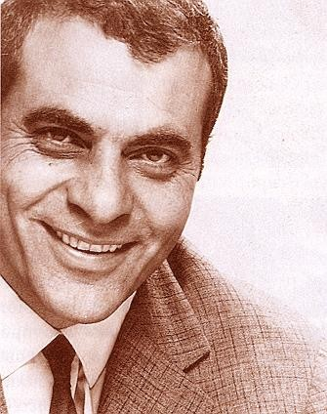
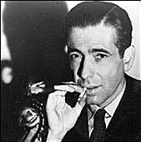






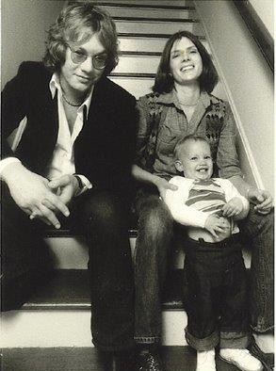

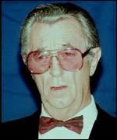

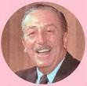









Slide 2

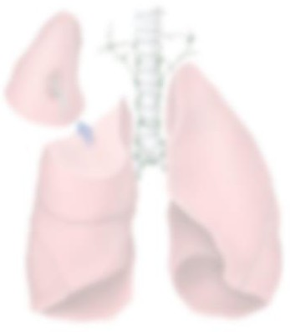



Bασικές Αρχές Ανοσοθεραπείας
Ιωάννης Χ. Γκιόζος MD, PhD, FCCP
Πνευμονολόγος
Ακαδημαικός Υπότροφος Πανεπιστημίου Αθηνών
Ογκολογική Μονάδα Γ’ Πανεπιστημιακή Παθολογική Κλινική
Γεν. Νοσ. Νοσημάτων Θώρακα Αθηνών “Η Σωτηρία”

Slide 3
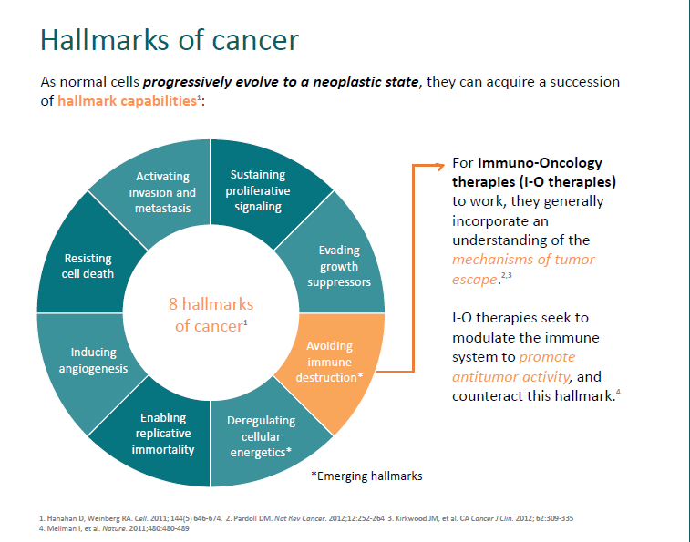

Slide 4


Slide 7
Cancer immunotherapy
The goal of IO is to harness the patient’s immune system to enhance
the adaptive immune response against the tumour rather than kill
tumour cells directly, potentially avoiding the AEs associated with traditional chemotherapy
CANCER IMMUNO-THERAPY

Slide 9
CTL-4 and PD-L1/PD-1: how they compare
PD-1
PD-L1
CTLA-4
Function
Inhibitory receptor/ immune checkpoint
Molecule that binds to immune checkpoint
Inhibitory receptor/ immune checkpoint
IMMUNE
CHECKPOINT INHIBITORS
CTLA-4 and
PD-L1/PD-1
Agents
Nivolumab
Pembrolizumab
Durvalumab
Atezolizumab
Avelumab
Ipilimumab
Tremelimumab
Cellular expression
Activated T cells
Tumour cells
Infiltrating T cells
Activated T cells
Tumour cells
T cells at the time of initial antigen response
Regulatory T cells
Binding partners
PD-L1
PD-L2
PD-1
CD80
CD80
CD86
Effects
Limits T-cell effects in the tumour microenvironment
Limits T-cell effects in the tumour microenvironment
Regulates the early stage of T-cell activation centrally in the lymph nodes
CD, cluster of differentiation; CTLA-4, cytotoxic T-lymphocyte associated protein 4; PD-1, programmed death 1 (receptor); PD-L1, programmed death ligand 1; PD-L2, programmed death ligand 2.

Slide 10
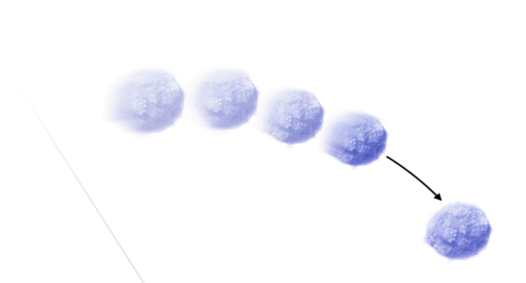
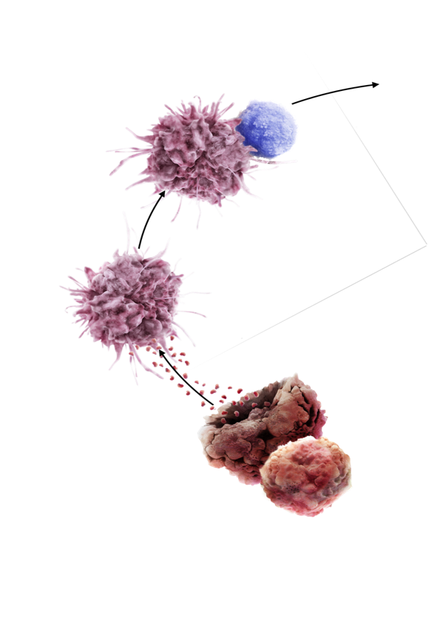
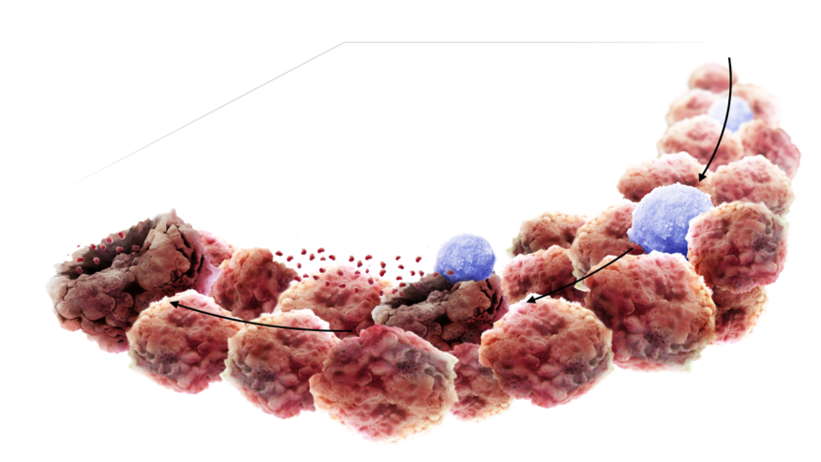
For an effective antitumor immune response, 3 key T-cell activities are required
T-cell infiltration
Accessing the tumour
Active
T cell
Active
T cell
BLOOD VESSELS
T-cell generation
Initiating and propagating
anti-tumour immunity
Dendritic cell
TUMOR
MICROENVIRONMENT
LYMPH NODE
Antigens
Apoptotic
cancer cell
T-cell killing
Cancer cell recognition and initiation of cytotoxicity
Cancer cell
Chen DS & Mellman I, 2013.
Notes:
For an anticancer immune response to lead to effective killing of cancer cells, the cancer-immunity cycle must be initiated and allowed to proceed.
There are 3 key T-cell activities required:
T-cell generation
T-cell infiltration
T-cell killing of tumor
References:
Chen DS & Mellman I. Oncology Meets Immunology: The Cancer-Immunity Cycle. Immunity 2013; 39: 1–10.

Slide 11
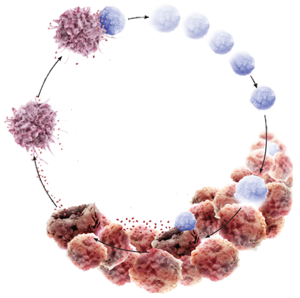
Defects in the cancer-immunity cycle lead to tumours escaping immune control
NP/PIPE/1705/0014(1)
Tumor immune escape can occur as a result of disruption of one or several steps of the cancer-immunity cycle, thus blocking essential T-cell activity
  T-cell KILLING blocked^{1,2}
  T-cell INFILTRATION and
  KILLING blocked^{1,2}
  T-cell GENERATION, INFILTRATION and KILLING blocked^{1,2}
Adapted from Chen & Mellman, 2013; 1. Chen & Mellman, 2013; 2. Kim & Chen, 2016
Notes:
Cancer can grow when the immune system is unable to generate an effective anti-cancer immune response
Tumor immune escape can occur as a result of disruption of any -or several- steps of the cancer-immunity cycle, thus blocking essential T-cell activity
References:
Chen DS & Mellman I. Oncology meets immunology: the cancer-immunity cycle. Immunity 2013; 39: 1–10.
Kim JM & Chen DS. Immune escape to PD-L1/PD-1 blockade: seven steps to success (or failure). Annals of Oncol 2016; 27:1492–1504.

Slide 14

Personalized combinations guided by biomarkers
Conventional agents inducing immunogenic cell death:
Chemotherapy
Radiotherapy
Anti-angiogenics
Targeted therapies
Other checkpoint inhibitory molecules:
CTLA-4
LAG3
TIM3
BTLA
TIGIT
Costimulatory mAbs targeting:
CD137
OX40
CD40
GITR
Functional modification of immunosuppressive enzymes such as:
IDO1
iNOS
Cancer vaccines considering individual neoantigens
T_{reg} cell targeting or inhibition
Adoptive cell therapy
Myeloid cell modulation

Slide 21
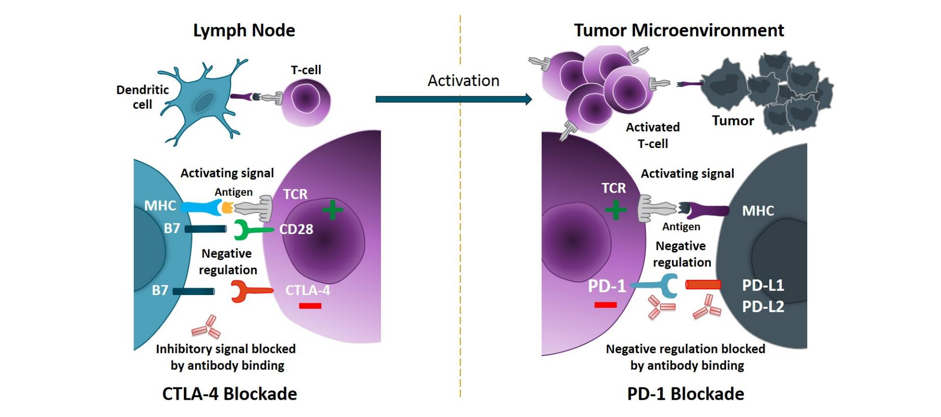
CTLA-4 and PD-1/PD-L1 Checkpoint Blockade for Cancer Treatment
Priming Phase (Lymph Node)
Effector Phase (Peripheral Tissue)
T-Cell Migration
Anti–PD-1:
Cemiplimab-rwlc
Nivolumab
Pembrolizumab
Anti–CTLA-4:
Ipilimumab
Anti–PD-L1:
Atezolizumab
Avelumab
Durvalumab
Ribas. NEJM. 2012;366:2517.
Notes:
MHC, major histocompatibility complex; TCR, T-cell receptor.

Slide 22

Signal 1 provides specificity
Signal 2 provides co-stimulation
Signal 3 further strengthens recognition
T cells require three signals for their activation and differentiation into effector T cells:
  MHC−antigen peptide/TCR recognition
  CD80 or CD86-CD28 co-stimulation
  Inflammatory cytokines provided by APCs
Cytokines
HOW DOES
T-CELL ACTIVATION WORK?
MHC
TCR
Naïve
T cell
APC
CD4+ or CD8+
CD80/CD86
CD28
APC or abnormal cell
Tumour-specific antigen
Roitt’s Essential Immunology, 12th Edition, 2011; pages 30, 239
Chen and Flies. Nat Rev Immunol. 2013;13:227-242.
APC, antigen-presenting cell; CD, cluster of differentiation; MHC, major histocompatibility complex; TCR, T-cell receptor.

Slide 23


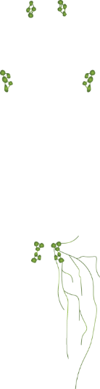
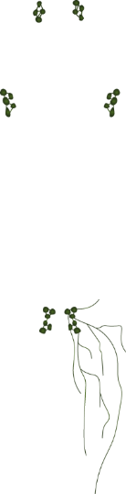
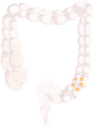

Feedback inhibition helps to control T-cell activation to prevent attacks on healthy tissue and maintain self-tolerance
The adaptive immune response is regulated by inhibitory signalling pathways, known as immune checkpoints
Two key immune checkpoint pathways are:
The CTLA-4 pathway
The PD-L1/PD-1 pathway
Lymph nodes – site of initial activation
Cytokines
HOW DOES
T-CELL ACTIVATION WORK?
Immune checkpoint pathways
TCR
MHC
Naïve
T cell
APC
MHC
CD80
CD28
CTLA-4 immune checkpoint
& PD-1/PD-L1 immune checkpoint
Tumour-specific antigen
PD-1 / PD-L1
immune checkpoint
TCR
Epithelial
cell
CD8+
T cell
MHC
APC, antigen-presenting cell; CD, cluster of differentiation;
CTLA-4, cytotoxic T-lymphocyte associated protein 4;
MHC, major histocompatibility complex; PD-1, programmed death 1 (receptor); PD-L1, programmed death ligand 1;
TCR, T-cell receptor.
Tumour-specific antigen
Peripheral tissues

Slide 24
CTLA-4 mainly works to limit early T-cell activation
T-cell activation
Signal 1
T cell
Signal 2
T-cell downregulation
_
+
+
IMMUNE
CHECKPOINT
PATHWAYS
CTLA-4
TCR
CD28
CTLA-4
CD80/CD86
CTLA-4 protein is up-regulated on activated T cells and expressed constitutively on regulatory T cells
CTLA-4 enhances regulatory T cell’s immunosuppressive activity and induces dormancy of memory T cells
MHC
APC
Tumour-specific antigen
Bertrand A, et al. BMC Med. 2015;13:211. Based on Figure 1.
APC, antigen-presenting cell; CD, cluster of differentiation; CTLA-4, cytotoxic T-lymphocyte associated protein 4; MHC, major histocompatibility complex; ; TCR, T-cell receptor.

Slide 25
PD-L1 mainly works in the tissue microenvironment to limit the function of effector T cells
T-cell activation
T cell
T-cell downregulation
+
_
IMMUNE
CHECKPOINT
PATHWAYS
PD-L1/PD-1
PD-1
TCR
PD-L1
PD-L1 protein is frequently over-expressed in tumour cells and immune cells within the tumour microenvironment, including APCs and activated T cells
When PD-1 expressed on an effector T cell binds PD-L1 it delivers an inhibitory signal to the T cell
MHC
Tumour cell
Tumour-specific antigen
Chen D, et al. Clin Cancer Res. 2012;18(24):6580-6587.
MHC, major histocompatibility complex; PD-1, programmed death 1 (receptor); PD-L1, programmed death ligand 1; TCR, T-cell receptor.

Slide 26
PD-L1 mainly works in the tissue microenvironment to limit the function of effector T cells
T-cell activation
T cell
T-cell downregulation
+
_
IMMUNE
CHECKPOINT
PATHWAYS
PD-L1/PD-1
PD-1
TCR
PD-L1
PD-L1 protein is frequently over-expressed in tumour cells and immune cells within the tumour microenvironment, including APCs and activated T cells
When PD-1 expressed on an effector T cell binds PD-L1 it delivers an inhibitory signal to the T cell
MHC
Tumour cell
Tumour-specific antigen
Chen D, et al. Clin Cancer Res. 2012;18(24):6580-6587.
MHC, major histocompatibility complex; PD-1, programmed death 1 (receptor); PD-L1, programmed death ligand 1; TCR, T-cell receptor.

Slide 27
Feedback inhibition helps to control T-cell activation
Immune checkpoints contribute to a reduction in antitumour immunity, allowing tumours to escape from adaptive immunity and grow.
This makes immune checkpoints attractive targets for cancer therapy
IMMUNE
CHECKPOINT
PATHWAYS

Slide 28

Blocking immune checkpoints has the potential for increased T-cell mediated antitumor immunity
Tremelimumab (anti-CTLA-4)
Blocking CTLA-4 enhances T-cell activation resulting in the potential for increased antitumor immunity
T cell
T cell
TCR
CD28
TCR
CD28
T cell
CTLA-4
CTLA-4
T cell
IMMUNE
CHECKPOINT INHIBITORS
How do they work?
CD80/CD86
T cell
MHC
CD80/CD86
MHC
T cell
CTLA-4 mainly works early
to limit T-cell activation
Blockade of CTLA-4
enhances T-cell activation
Leading to increased numbers
of activated T cells
APC
APC
Durvalumab (anti-PD-L1)
Blocking PD-1/PD-L1 enhances effector T-cell function in the tumour microenvironment
T cell
T cell
PD-L1 mainly works in TME to limit function of effector T cells
PD-1
PD-1
Blockade of
PD-L1 enhances
T-cell activity and tumour cell killing
PD-L1
PD-L1
Hodi et al. NEJM. 2010;363:711-723
CD, cluster of differentiation; CTLA-4, cytotoxic T-lymphocyte associated protein 4;
PD-1, programmed death 1 (receptor); PD-L1, programmed death ligand 1.
Notes:
.differences in toxicity???? mechanism

