Slide 1


Μοριακή Ταυτοποίηση του Καρκίνου
Μάριος Μπακογεώργος, MD, MSc

Slide 2
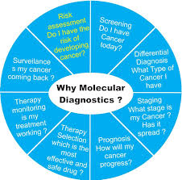
Διάγνωση vs Ταυτοποίηση

Slide 3







Precision Medicine in Oncology is a subset of the overall Personalized Healthcare (PHC) approach
Deeper insights into disease
Technologies
Early & accurate diagnosis
Tailored care
plan
Insights
Patient
Faster, more efficient clinical studies
Faster, more efficient R&D
Improved patient outcomes
Insights
Continuous & remote patient management
Full access to optimal care intervention
Better, earlier go/no-go
decisions
Advanced
Analytics
PHC-enabled patient journey
Precision Medicine in Oncology
Identifying genomic alterations driving patient’s cancer
and treating patient accordingly
Notes:
PHC: The unique combination of meaningful data at scale, advanced analytics, and digital technologies to improve R&D and enhance our ability to deliver personalized diagnosis and care, faster access to treatment, and digital disease monitoring to improve patient outcomes

Slide 4



Transforming oncology care to precision oncology
Identification of genomic alterations through Comprehensive Genomic Profiling (CGP) as starting point
Historically
More Recently
Now
Organ-based
Biomarker Stratified
Genomic Profiling
Therapy selected based on organ, stage and histology
Therapy selected based on single or multiple biomarkers
Personalized Therapy
1. Falzone L, et al. Front Pharmacol 2018; 9:1300; 2. Schwaederle M and Kurzrock R. Oncoscience 2015; 2:779–780; 3. Agyeman AA and Ofori-Asenso R. J Pharm Bioallied 2015; Sci 7:239–244.

Slide 5
Integrating and understanding molecular information is key to precision medicine
In Lung Cancer a CGP approach is required due to high frequency of actionable targets, available treatment options and limited tissue
EGFR sensitising
ALK
MET
Common biomarkers in lung cancer¹
Afatinib
Erlotinib
Erlotinib + bevacizumab▼
Gefitinib
Necitumumab▼
Osimertinib▼
JNJ-372
U3-1402
Alectinib▼
Brigatinib▼
Ceritinib▼
Crizotinib
Ensartinib
Lorlatinib▼
Repotrectinib
Cabozantinib▼
Crizotinib
Capmatinib
Savolitinib
Tepotinib
EGFR other 4%
>1 mutation
3%
MET
3%
ALK
~5%
HER2
2%
ROS1
2%
AT
EGFR sensitising 17%
CG
HER2
TA
RET
Afatinib
Dacomitinib▼
Pertuzumab
TAK-778
Poziotinib
Trastuzumab emtansine
BRAF
2%
Identifying actionable mutations with broad molecular profiling²
BRAF
Apatinib
Cabozantinib▼
Lenvatinib▼
LOXO-292
Ponatinib▼
Pralsetinib
Vandetanib▼
PD-L1
expression
RET
2%
Dabrafenib
Dabrafenib / trametinib
Vemurafenib
KRAS
25%
NTRK
1%
Unknown oncogenic
driver detected 31%
PIK3CA
PIK3CA
1%
NTRK
ROS1
LY3023414
MEK1
<1%
Cabozantinib▼
DS-6051b
Entrectinib▼
Larotrectinib▼
Repotrectinib
Selitrectinib
Ceritinib▼
Crizotinib
DS-6051b
Entrectinib▼
Lorlatinib▼
Repotrectinib
MEK1
Cobimetinib▼
Selumetinib
Trametinib
Slide includes investigational drugs that are not approved in any indication. Some drugs are not approved for use in specific indications in Europe and / or USA. Therapies marked with ▼ are subject to additional monitoring. Reporting suspected adverse reactions after authorisation of the medicinal product is important. Adverse events should be reported to your respective local office Amgen Europe B.V.: Bevazizumab; AstraZeneca AB: Osimertinib; Bayer AG: Larotrectinib; Celltrion Healthcare Hungary Kft.: Trastuzumab; Eli Lilly Nederland B.V.: Necitumumab; Eisai Europe Limited: Lenvatinib; Genzyme Europe B.V.: Vandetanib; Incyte Biosciences Distribution B.V.: Ponatinib; Ipsen Pharma: Cabozantinib; Novartis Europharm Limited: Ceritinib; Pfizer Europe MA EEIG: Lorlatinib, Dacomitinib; Roche Registration GmbH: Alectinib, Cobimetinib; Takeda Pharma A/S: Brigatinib. 1. Adapted from Tsao, A.S., et al. (2016) J Thorac Oncol 11(5):613-38; 2. NSCLC NCCN Guidelines Version 5.2019; NCT03037385; NCT03693339; NCT02967692; NCT02767804 NCT02568267; NCT02609776; NCT03834961; NCT03899792; NCT02132949; NCT03318939 NCT03091192; NCT02716116; NCT02864992; NCT00444587; NCT03260491.

Slide 6
A steadily growing number of biomarkers could have approved targeted therapies for NSCLC by 2024*
Biomarkers likely to have approved targeted therapies in NSCLC †
= established biomarker suitable for CGP
# of biomarkers relevant to CGP
= new biomarker
suitable for CGP
N = 7
N = 10
N = 12
N = 13
N = 18
N = 21
= number of regimens targeting alterations suitable for CGP
(#)
Prior to 2020
2020
2021
2022
2023
2024
ALK (5)
EGFR (5)
NTRK (2)
ROS1 (2)
BRAF (1)
MSI-H (1)
MMR (1)
ALK (5) | BRAF (1)
EGFR (5) | MET (1)
NTRK (2) | MSI-H (1)
ROS1 (2) | MMR (1)
RET (2) | TMB (1)
ALK (6) | FGFR (1)
EGFR (5) | KRAS (1)
NTRK (3) | MET (1)
ROS1 (3) | MSI-H (1)
RET (2) | MMR (1)
BRAF (1) | TMB (1)
ALK (6) | KRAS (2)
EGFR (6) | TMB (2)
MET (3) | FGFR (1)
NTRK (3) | HRD (1)
RET (3) | MSI-H (1)
ROS1 (3) | MMR (1)
BRAF (2)
EGFR (10) | HRD (2)
ALK (6) | KRAS (2)
NTRK (4) | ATM (1)
HER2 (3) | BRCA (1)
MET (3) | FGFR (1)
RET (3) | HER4 (1)
ROS1 (3) | MMR (1)
TMB (3) | MSI-H (1)
BRAF (2) | NRG1 (1)
EGFR (10) | KRAS (2)
ALK (6) | ATM (1)
FGFR (4) | BRCA (1)
MET (4) | EZH2 (1)
NTRK (4) | HER4 (1)
HER2 (3) | KEAP1 (1)
RET (3) | MMR (1)
ROS1 (3) | MSI-H (1)
TMB (3) | NRF2 (1)
BRAF (2) | NRG1 (1)
HRD (2)

Slide 7
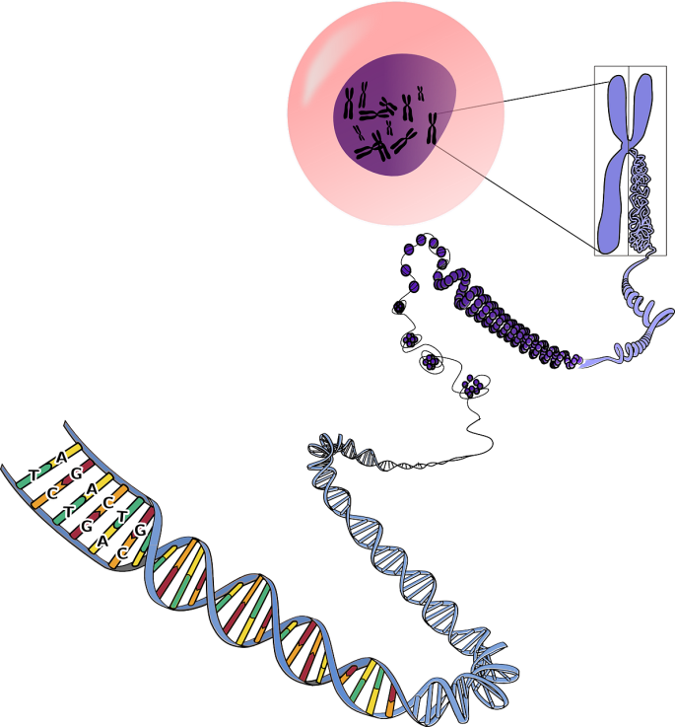







Our understanding of cancer is evolving
Cancer is a disease of the genome
Aetiology¹
Genomic alterations not correctly repaired^{1,2}
Cancer^{1,2}
Environment
Lifestyle
Chromosome
Cell
Malignant tumour
Radiation
Viruses and infection
Carcinogens
DNA
A mass of abnormal cells that divides uncontrollably and can spread to other tissues
A
G
T
A
C
C
T
T
G
Gene
G
A
Genetics and Family History
Exposure to Carcinogens
C
Nucleotides (base pairs)
1. Blackadar, C.B. (2016) World J Clin Oncol. 10(71):54-86;
2. Hanahan, D. and Weinber, R.A. (2011) Cell 144(5):646-74.
Notes:
Excessive exposure to these factors increases the number of genomic alterations
Although a vast majority of these damages are either repaired or do not cause cancer, in rare instances these alterations lead to carcinogenesis

Slide 8
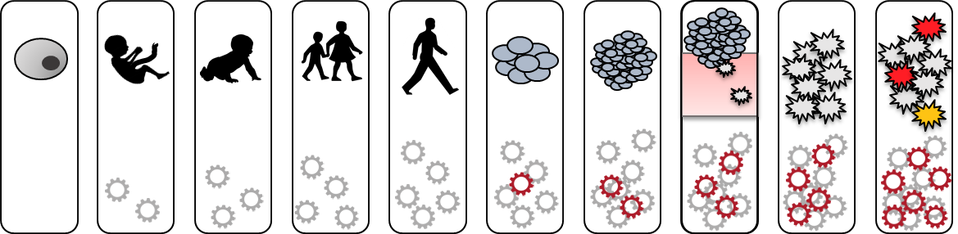

Cancer is caused by an accumulation of genomic alterations
Early clonal expansion
Early invasive cancer
Chemotherapy resistant recurrence
Fertilised egg
Benign tumour
Late cancer
Gestation
Infancy
Childhood
Adulthood
Intrinsic mutation process
Environmental and lifestyle exposure
Mutator phenotype
Passenger mutation
Driver mutation
Chemotherapy
Genomic instability
Adapted from Stratton, M.R. (2013) EMBO Mol Med. 5(2):169-72.

Slide 9




The genomic alterations driving tumour growth
Four classes of genomic alteration can drive tumour growth^{1,2}
Unaltered chromosome
Base
substitutions
Insertions and deletions
Copy number
alterations
Rearrangements
(gene fusions)
Gene of interest
All classes may be clinically relevant because they inform the physician about the molecular changes underlying the patient’s disease²
1. Stratton, M.R., et al. (2009) Nature 458:719-24;
2. Chin, L. and Gray, J.W. Nature 2008; 452:533-63.

Slide 10
Understanding the different types of genomic alterations
All cancers arise as a result of changes in the DNA of cancer cells, though not all of these changes present in a cancer would have been involved in it’s development. These are so-called ‘passenger mutations’¹
A ‘driver mutation’ is causally implicated in cancer; it has conferred a growth advantage on the cancer cell and as such is implicated in oncogenesis¹
The tumour cell genome typically consists of:
  10,000s of passenger alterations²
  5-10 biologically relevant alterations²
  1-2 ‘actionable’ alterations²
An actionable alteration is the term given to a driver mutation with significant diagnostic, prognostic, or therapeutic implications in subsets of cancer patients and for specific therapies³
1. Stratton, M.R., et al. (2009) Nature 458:719-24;
2. Stratton, M.R. (2013) EMBO Mol Med. 5(2):169-72;
3. Dancey, J.E., et al. (2012) Cell 148:409-20.

Slide 11

The number of driver mutations reflects the number of biological processes that need to be subverted to convert a normal cell into a cancer cell. The genes in which driver mutations occur (cancer genes) can present tractable targets for new drug development.
The number of passenger mutations reflects the number of mitoses between the fertilized egg and the cancer cell and the mutation rate at each mitosis. Passenger mutations provide insights into the underlying mutational processes operative in each case.

Slide 12
The evolution of molecular testing towards NGS adoption
Traditional molecular testing approaches
First-generation sequencing
Next-generation sequencing
Hybrid capture
Impact on clinical management
NGS-based hotspot testing
Sanger
WES / WGS
FISH
PCR
Impact will increase as methods become more rapid and less costly, utlimately being used to generate comprehensive genomic profiles
IHC
Evolution of molecular profiling methodology

Slide 13



CGP with FoundationOne starts with the assessment of genomic alterations
FoundationOne comprehensively analyses* the tumour genome to identify all clinically relevant genomic alterations in a broad range of cancers.¹⁻⁴ In a single test, FoundationOne analyses >300 cancer-related genes and also reports TMB and MSI³
✔
✔
✔
✔
✔
Base substitutions
Insertions and deletions
Copy number alterations
Rearrangements
TMB & MSI
Provides additional relevant genomic clues as to which patients may benefit from certain immunotherapies
BRAF V600E
EGFR Exon 19
deletion
HER2
amplification
ALK Fusion
*Using the Illumina® HiSeq 2000 platform, hybrid capture–selected libraries are sequenced to high uniform depth (targeting >500X median coverage with >99% of exons at coverage >100X). CGP: comprehensive genomic profiling;
MSI: microsatellite instability; TMB: tumour mutational burden.
1. Suh JH, et al. (2016) Oncologist 21:684-91; 2. Frampton, GM., et al. (2013) Nat Biotechnol 31:1023-31;
3. FoundationOne® Technical Specifications (2017)
Available at: www.foundationmedicine.com/genomic-testing/foundation-one (Accessed June 2018);
4. Schwaederle, M., et al. (2015) Mol Cancer Ther 14:1488-94.

Slide 14
Identifying genomic alterations is associated with limitations
Invasiveness^{1,2}
Limited / exhausted tissue^{6,7}
To identify genomic alterations, tissue from a primary or metastatic tumour is generally obtained via a tissue-based biopsy, which is limited by challenges
Variable / limited accessibility of tumour sites¹
Potential sampling bias due to
intra-tumour heterogeneity¹⁻⁴
Inability to sample all metastatic sites⁸
Cost⁵

Slide 15

Tissue biopsy may not capture the genomic landscape of a patient’s entire tumour burden
Intratumour heterogeneity
Intrapatient heterogeneity
The genomic landscape within a single tumour manifestation may not be uniform
The genomic landscape may differ between tumour sites within a patient
Tissue biopsy may not capture subclonal
populations of tumour cells with distinct alterations
Tissue biopsy from a single lesion
will miss alterations unique to other lesions
As well as spatial heterogeneity –
as the genomic landscape of a cancer evolves over time
– temporal heterogeneity should also be considered
Therefore archival tissue may not fully represent the tumour genotype at progression
Scherer, F. (2020) in Recent Results in Cancer Research: Tumor Liquid Biopsies. Springer.

Slide 16





Blood provides a rich source of tumour-derived material
Blood vessel
CTC
RBC
Circulating tumours cells (CTCs)
are shed into circulation from primary tumour and metastases^{2,3}
Healthy tissue
Apoptosis
or necrosis
EV
cfDNA
Healthy and tumour tissue release
cell-free DNA and RNA into circulation through apoptosis, necrosis and lysis of circulating cells. ctDNA comprises the fraction of cfDNA originating from cancer cells^{2,4,5}
ctRNA
Apoptosis
ctDNA
EV
Membrane-encapsulated extracellular vesicles (EVs) are released from healthy and tumour cells²
Healthy tissue
Tumour tissue
TEP
Tumour-educated platelets (TEPs)
may contain tumour-derived RNA
and alternatively spliced transcripts²
cfDNA: cell-free DNA; ctDNA: circulating tumour DNA; ctRNA: circulating tumour RNA; CTC: circulating tumour cell; EV: extracellular vesicle; TEP: tumour-educated platelet; RBC: red blood cell.
Figure adapted from references 1-2. 1. Crowley, E., et al. (2013) Nat Rev Clin Oncol 10:472-84; 2. De Rubis, G., et al. (2019)Trends Pharmacol Sci 40:172-86; 3. Yu, M., et al. (2011) J Cell Biol 192:373-82;
4. Francis, G. & Stein, S. (2015) Int J Mol Sci 16:14122-42; 5. Bettegowda, C., et al. (2014) Sci Transl Med 6:224ra24.

Slide 17
Liquid biopsy can assess tumour DNA circulating in the blood
Cell-free DNA (cf)DNA is shed into the circulatory system by all cells, but is higher in cancer patients^{1,2}
cfDNA that is shed by tumour cells into the bloodstream is known as circulating tumour DNA (ct)DNA²
ctDNA can be released into the bloodstream from 1) primary tumours, 2) circulating tumour cells and 3) metastases and is usually highly fragmented^{3,4}
ctDNA may reflect the genetic profile of the tumour
and the ability to detect and characterise it may therefore be of
prognostic and therapeutic value^{5,6}
cfDNA: cell-free DNA; ctDNA: circulating tumour DNA.
1. Hinrichsen, T., et al. (2016) J Lab Med 40:313-22; 2. Francis, G. & Stein, S. (2015) Int J Mol Sci 16:14122-42;
3. Bidard, F., et al. (2013) Sci Transl Med 5:207ps14; 4. Bettegowda, C., et al. (2014) Sci Transl Med 6:224ra24;
5. Krishnamurthy, N., et al. (2017) J Clin Med 6:3; 6. Cheng, F., et al. (2016) Oncotarget 7:48832-41.

Slide 18
Blood-based (liquid) biopsy may overcome some limitations of solid tissue biopsy
the patient has insufficient, inadequate or exhausted solid tissue^{1,2}
direct biopsy is difficult or poses a high risk^{1,3,4}
Liquid biopsy may be useful when…
complementary information to prior or future tissue testing is needed³
disease progression or resistance mutations are suspected³

Slide 19
The potential clinical applications of liquid biopsy are wide-ranging
Screening
Diagnosis
& prognosis
& prediction
Residual disease
Recurrence
Therapy selection
Therapy response
& resistance monitoring
Liquid based assay
(+ )
(+ )
Tissue based assay
Neo Adj.
Early Detection
Adjuvant
Surveillance
Metastatic Treatment
Surgery
Relapse
Mutations
that arise
early during
tumour
evolution
Response to neo-
adjuvant therapy
1st line
2nd line
Minimal
residual
disease
(MRD)
Levels of ctDNA
Resistance
mutations
Time
Early stage monitoring
Late stage monitoring

Slide 20
Liquid biopsy in identifying therapeutic targets
ctDNA can potentially be used to identify actionable genomic alterations (GAs) in diverse cancers and specifically in:
  Lung cancer:
    GAs detected in 84% of non-small cell lung cancer (NSCLC) patients with the most common actionable mutations (EGFR) exhibiting 79% concordance with solid tissue biopsy¹
    GAs detected in 82% of advanced lung carcinoma patients with 81% concordance²
  Breast cancer: Concordance of 75% with tissue biopsy in triple negative breast cancer³ and 76% in metastatic breast cancer⁴
  Carcinoma of unknown primary: GAs detected in 80% of patients, 99.7% with potentially targetable alterations⁵
ctDNA: circulating tumour DNA; GA: genomic alteration; NSCLC: non-small cell lung cancer.
1. Thompson, J.C., et al. (2016) Clin Cancer Res 22:5772-82; 2. Schwaederle, M., et al. (2017) Clin Cancer Res 23:5101-11; 3. Wongchenko, M., et al. (2017) Ann Oncol 28 (suppl. 5): v22-42; 4. Rothé, F., et al. (2014) Ann Oncol 5:1959-65;
5. Kato, S., et al. (2017) Canc Res 77:4238-46.

Slide 21
Novel trial designs generate clinical evidence for molecularly-guided treatment
TARGET⁶
TRACK⁹
WINTHER¹
Matching patients to clinical trials based on liquid biopsy genomic profiling
Matching rare cancer patients to targeted therapies based on tissue and liquid biopsy genomic profiling
Combines RNA and DNA sequencing to guide therapy
TAPUR⁴
CAPTUR⁷
Real world practice of prescribing targeted therapies outside of their approved indication
Matching patients to commercially available targeted therapies based on genomic profile or protein expression
2013
2015
2016
2017
2018
2019
2020
Date of trial initiation
MASTER²
I-PREDICT³
DRUP⁵
CUPISCO⁸
Cancer genome analysis with WES, WGS and RNA sequencing and evaluation aimed to create therapeutic opportunities
Assessment of
combination therapies
guided by molecular profiling
Trial design allows for an unlimited number of parallel cohorts (defined by tumour type, molecular variant and study treatment)
Comparing molecularly-guided therapy vs SoC
in patients with newly diagnosed CUP

Slide 22


I-PREDICT
Prospective Investigation of Profile-Related Evidence
Determining Individualized Cancer Therapy
Customised combination therapies based on:
Allows newly diagnosed patients with lethal solid tumours
“High matching” > 50% of markers targeted
Molecular profiling:
FoundationOne* / FoundationOne Heme / Foundation ACT† (ctDNA)
PD-1 / PD-L1 IHC, TMB, MSI
Discussion at
the Molecular Tumour Board
Treating physician determines customised treatment plan
“Low matching” ≤ 50% of markers targeted
501
243/302
patients treated with matched therapy
(48.5% of total; 80.5% of treated)‡
patients enrolled‡
PI: Jason Sicklick, MD, FACS
Associate Professor of Surgery Division of Surgical Oncology
Co-PI: Razelle Kurzrock, MD
Director, Center for Personalized Cancer Therapy
Avera PI: Brian Leyland-Jones

Slide 23
I-PREDICT (treatment refractory cohort):
Higher matching scores resulted in better outcomes
p = 0.028
1.0
PR / CR
Matching score > 50% (n = 28):
median 6.5 months (95% CI 3.2 - 9.9)
0.8
SD ≥ 6 months
Probability
Matching score ≤ 50% (n = 55):
median 3.1 months (95% CI 2.5 - 3.8)
0.6
SD < 6 months
p = 0.001
HR = 0.40 (95% CI 0.23 - 0.71)
% of patients
PD
0.4
0.2
0.0
0
5
10
15
20
25
Matching score
PFS (months)
Higher matching score (> 50%) translated into significantly better response, progression-free survival and overall survival

Slide 24
Novel trial designs generate clinical evidence for molecularly-guided treatment
TARGET⁶
TRACK⁹
WINTHER¹
Matching patients to clinical trials based on liquid biopsy genomic profiling
Matching rare cancer patients to targeted therapies based on tissue and liquid biopsy genomic profiling
Combines RNA and DNA sequencing to guide therapy
TAPUR⁴
CAPTUR⁷
Real world practice of prescribing targeted therapies outside of their approved indication
Matching patients to commercially available targeted therapies based on genomic profile or protein expression
2013
2015
2016
2017
2018
2019
2020
Date of trial initiation
MASTER²
I-PREDICT³
DRUP⁵
CUPISCO⁸
Cancer genome analysis with WES, WGS and RNA sequencing and evaluation aimed to create therapeutic opportunities
Assessment of
combination therapies
guided by molecular profiling
Trial design allows for an unlimited number of parallel cohorts (defined by tumour type, molecular variant and study treatment)
Comparing molecularly-guided therapy vs SoC
in patients with newly diagnosed CUP

Slide 25
MTBs help to interpret complex data and provide the best possible clinical decision
Clinical
geneticist
Facilitate interpretation
of complex molecular data^{1,2}
Assign precise treatments
to patients by including molecular findings in the treatment decision^{1,2,4}
Provide education
on molecular assays, their findings
and how these relate to treatment strategies^{1,4}
Keep track
of clinical trials and molecularly-guided therapies,
often with the help of a CGP report^{1,3,5}
Clinical
oncologist
Molecular
biologist
Bioinformatician
Pathologist /
molecular pathologist
Virtual MTBs may overcome challenges
of insufficient local infrastructure, expertise or ability to attend (e.g. COVID-19)

Slide 26


Guidelines are advancing broad molecular profiling in lung cancer
The majority of lung cancer patients are diagnosed at advanced or metastatic disease stage
Use of broad molecular profiling in lung cancer is recommended by NCCN and ESMO guidelines and supported by clinical evidence¹⁻⁷
Advanced
with distant metastasis
The Guidelines Panel strongly advises broader molecular profiling, such as NGS, aimed at identifying rare driver mutations for which effective drugs are available or to council patients regarding clinical trials.¹
Broad molecular profiling is a key component of the improvement of care of patients with NSCLC.¹
Locally advanced
Disease stage
Early disease
Diagnosis
1st-line therapy
Subsequent
therapy
Without evidence-based options
ESMO recommends routine use of NGS on tumour samples in advanced non-squamous NSCLC.⁷
Patient journey
NSCLC NCCN Guidelines version 2.2021;
Suh, J. H., et al. (2016) The Oncologist 21:684-691;
Drilon, A., et al. (2015) Clin Cancer Res 21(16):3631-9;
Ali, S.M., et al. (2016) The Oncologist 21:762-70;
Schrock, A.B., et al. (2016) Clin Cancer Res 22(13):3281-5;
Rozenblum, A.B., et al. (2017) J Thorac Oncol 12(2):258-68;
Mosele F, et al. (2020) Ann Oncol. (11):1491-1505.
ESMO: European Society for Medical Oncology
NCCN: National Comprehensive Cancer Network;
NGS: Next-generation sequencing;
NSCLC: Non-small cell lung cancer.
Notes:
Lung Driver Mutation testing should be performed prior to the initiation of 1L therapy for NSCLC

Slide 27
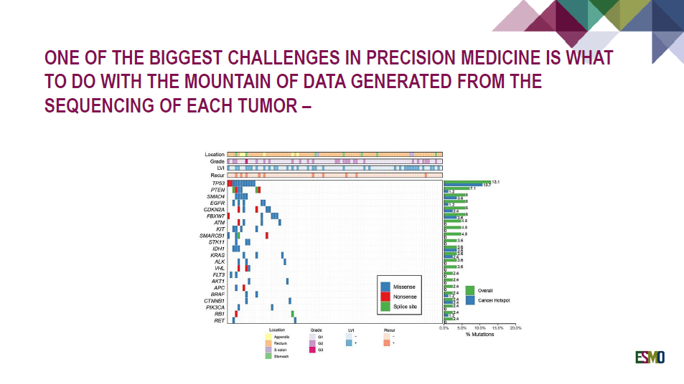

Slide 28
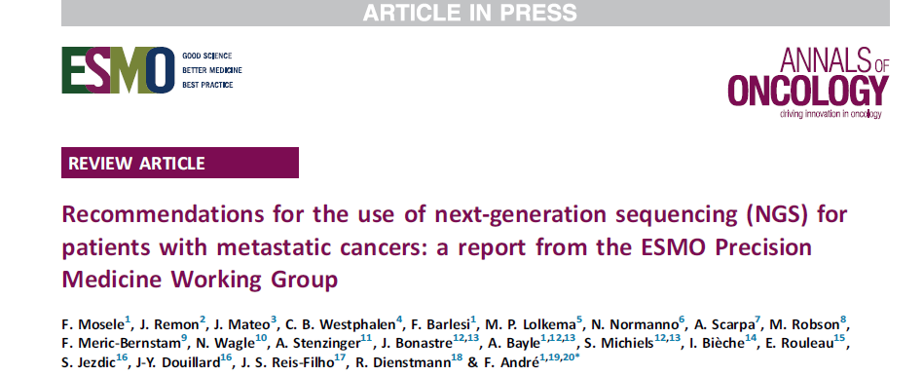
Should NGS be used in daily practice?
If so, should large panels of genes be used?
These questions should be addressed from the perspective of public health, academic clinical research centers and from the perspective of the individual patients.

Slide 29
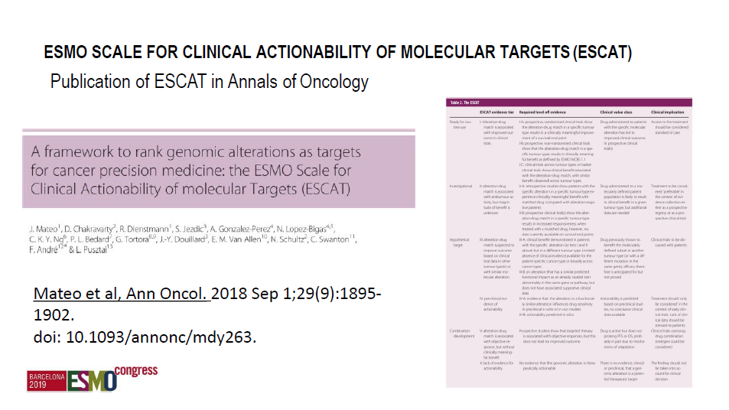

Slide 30
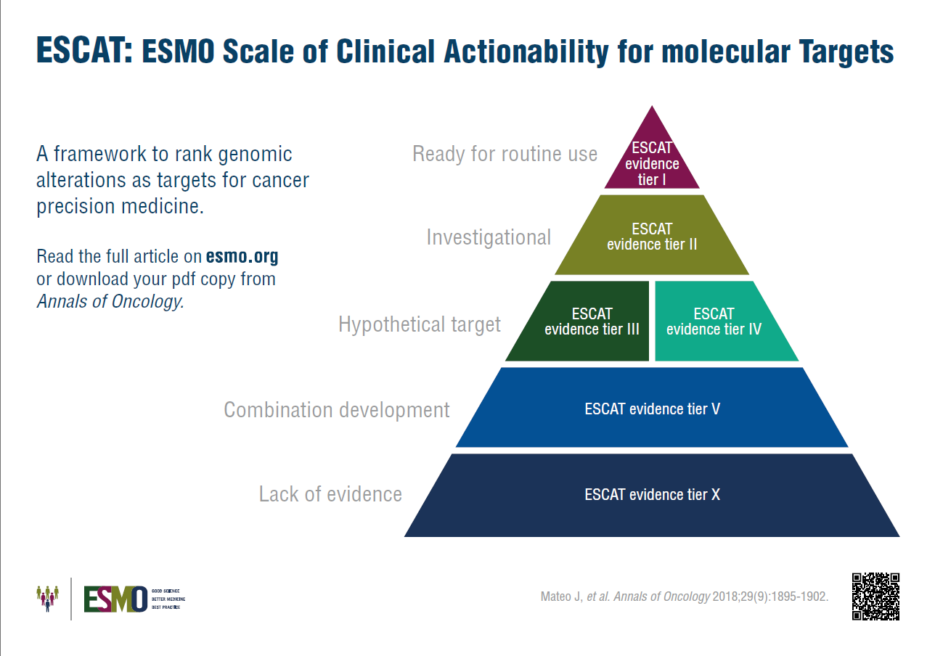
ESCAT levels
ESMO Scale for Clinical Actionability of molecular Targets
ESCAT level I
the match of an alteration and a drug has been validated in clinical trials, and should drive treatment decision in daily practice
ESCAT level II
a drug that matches the alteration has been associated with responses in phase I/II or in retrospective analyses of randomized trials
ESCAT level III
alterations that are validated in another cancer, but not in the disease-to-treat
ESCAT level IV
hypothetically targetable alterations based on preclinical data
ESCAT level V
Alteration-drug match is associated with objective response, but without clinically meaningful benefit
ESCAT level X
Lack of evidence for actionability

Slide 31
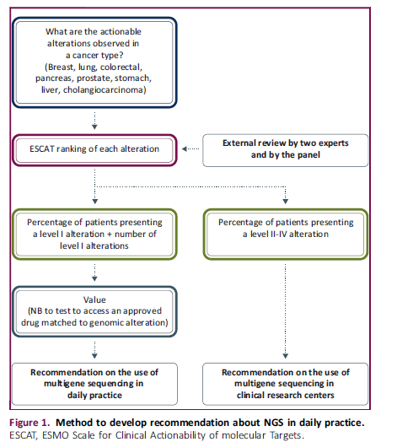
From the ESCAT ranking and prevalence of alterations for each tumor type, we calculated the number of patients to test with NGS, to identify one patient that can be matched to an effective drug in daily practice (ESCAT level I)
We assume that there is no proven impact in terms of public health of detecting level II-IV actionable alterations

Slide 32
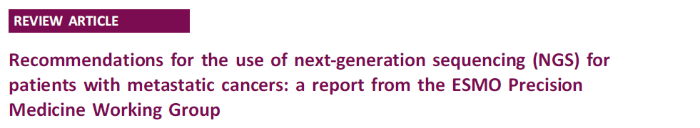
Recommendations
While NGS has been widely implemented, there are no recommendations from scientific societies about its use in oncology practice.
The European Society for Medical Oncology (ESMO) is proposing three levels of recommendations for the use of NGS.
  Recommendations for daily practice (ESCAT level I)
    There is a need to regulate the volumes of NGS procedures at the national level.
  Recommendations for clinical research centers
    To increase access to innovation, accelerate drug development
  Patient-centric recommendations
    If the patient is informed about the low likelihood of benefit.

Slide 33
Recommendations
Non-Squamous NSCLC
  ESCAT level 1 targets: EGFR, ALK, MET, BRAF, ROS1, NTRK, RET
Prostate Cancer
  ESCAT level 1 targets: BRCA 1/2, MSI-H, PTEN*
Cholangiocarcinoma
  ESCAT level 1 targets: IDH1, FGFR2, NTRK
Ovarian Cancer
  ESCAT level 1 targets: BRCA ½, HRD*
CUP
In these tumors, large multigene panels could be used
if they add acceptable extra cost compared with small panels.

Slide 34
Recommendations
Colon cancer
  ESCAT level 1 targets: KRAS*, NRAS*, BRAF, MSI-H, NTRK
Since most level I alterations are hotspot mutations in KRAS, NRAS and BRAF,
and considering that MSI status is determined by IHC or PCR, there is no need to test samples using multigene NGS in the context of daily practice.
Nevertheless, multigene NGS can be an alternative to PCR tests only if it does not generate extra cost compared with standard techniques already implemented in routine.
This would allow detection of ERBB2 amplifications,
and, in some panels, detect MSI status with high accuracy.

Slide 35
Recommendations
TMB ^{[1]}
Cervical cancer
Well and moderately differentiated neuroendocrine tumors
Salivary cancer
Thyroid cancer
Vulvar cancer
Endometrial cancer*
SCLC*
[1]: (KN158) FDA approves pembrolizumab for adults and children with TMB-H solid tumors - the ASCO Post. Available at: https://www.ascopost. com/news/june-2020/fda-approves-pembrolizumab-for-adults-andchildren- with-tmb-h-solid-tumors/. Accessed July 7, 2020.

Slide 36
Squamous NSCLC
Breast cancer
Gastric cancer
Pancreatic cancer
HCC
No Current Recommendation for NGS in daily practice

Slide 37
Precision Medicine in Oncology is a subset of the overall Personalized Healthcare (PHC) approach
Deeper insights into disease
Technologies
Early & accurate diagnosis
Tailored care
plan
Insights
Patient
Faster, more efficient clinical studies
Faster, more efficient R&D
Improved patient outcomes
Insights
Continuous & remote patient management
Full access to optimal care intervention
Better, earlier go/no-go
decisions
Advanced
Analytics
PHC-enabled patient journey
Precision Medicine in Oncology
Identifying genomic alterations driving patient’s cancer
and treating patient accordingly
Notes:
PHC: The unique combination of meaningful data at scale, advanced analytics, and digital technologies to improve R&D and enhance our ability to deliver personalized diagnosis and care, faster access to treatment, and digital disease monitoring to improve patient outcomes

Slide 38


To transform the healthcare system we need strong collaborations between the different stakeholders
EHRs and
clinical data
Digital
monitoring
Physician
Imaging
data
Wearables
and sensors
Genomic and
molecular data
Treatment
options
Patient
Payers
Healthcare
tool options
Clinical decision
support systems
Policy makers
Researchers

Slide 39

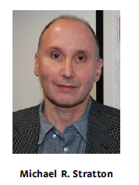
Cancer genomics is already established in the clinical management of patients, as tests for mutations in certain genes, for example EGFR, BRAF and HER2, are required before drugs targeting the encoded protein can be prescribed. It is likely that this position will consolidate further and it is not unreasonable to speculate that in a decade whole cancer genome sequences may be routine for patients requiring cancer treatment. Over the next few years, the complete repertoire of mutated cancer genes across the spectrum of cancer types will be identified. Some are promising direct targets for new therapeutics and novel drugs are likely to emerge quickly. Others are not as tractable. However, they remain potential Achilles’ heels of cancer cells and researchers will be exploring ways to somehow exploit them to develop new therapies. At the same time, deeper understanding of the mechanisms underlying the processes generating somatic mutations will lead to new insights into cancer causation and, potentially, new preventive strategies.

Slide 40






Slide 41
Μοριακή Ταυτοποίηση του Καρκίνου
Μάριος Μπακογεώργος, MD, MSc

