Slide 1



Προεγχειρητικός Έλεγχος
Στεφανιαίας Νόσου
Τσεκούρα Δωροθέα
Καρδιολόγος
Αρεταίειο Νοσοκομείο
Ειδικό Διδακτικό Προσωπικό ΕΚΠΑ

Slide 3
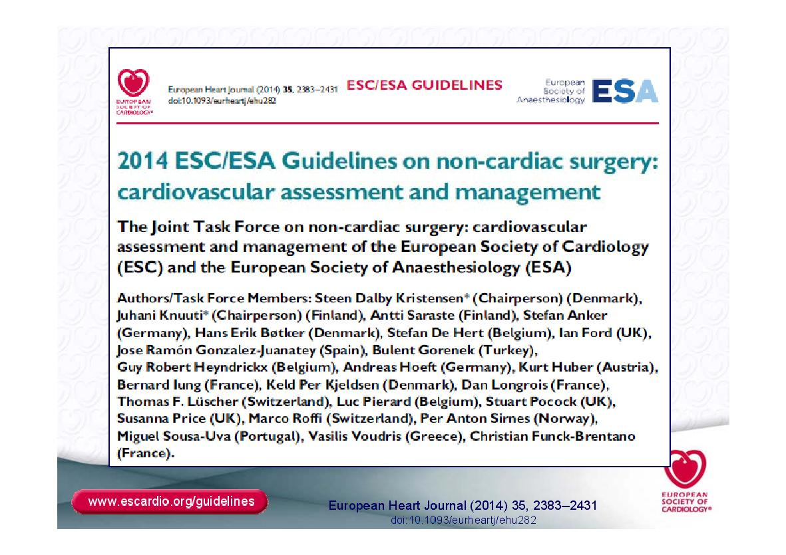

Slide 5
Preoperative evaluation
  Urgency
  Type of surgery
  Duration of procedure
  Change in body core temperature
  Blood loss
  Fluids shift
Surgical risk for cardiac events
European Heart Journal (2014) 35, 2383–2431

Slide 7
Preoperative evaluation
Functional capacity

Slide 8
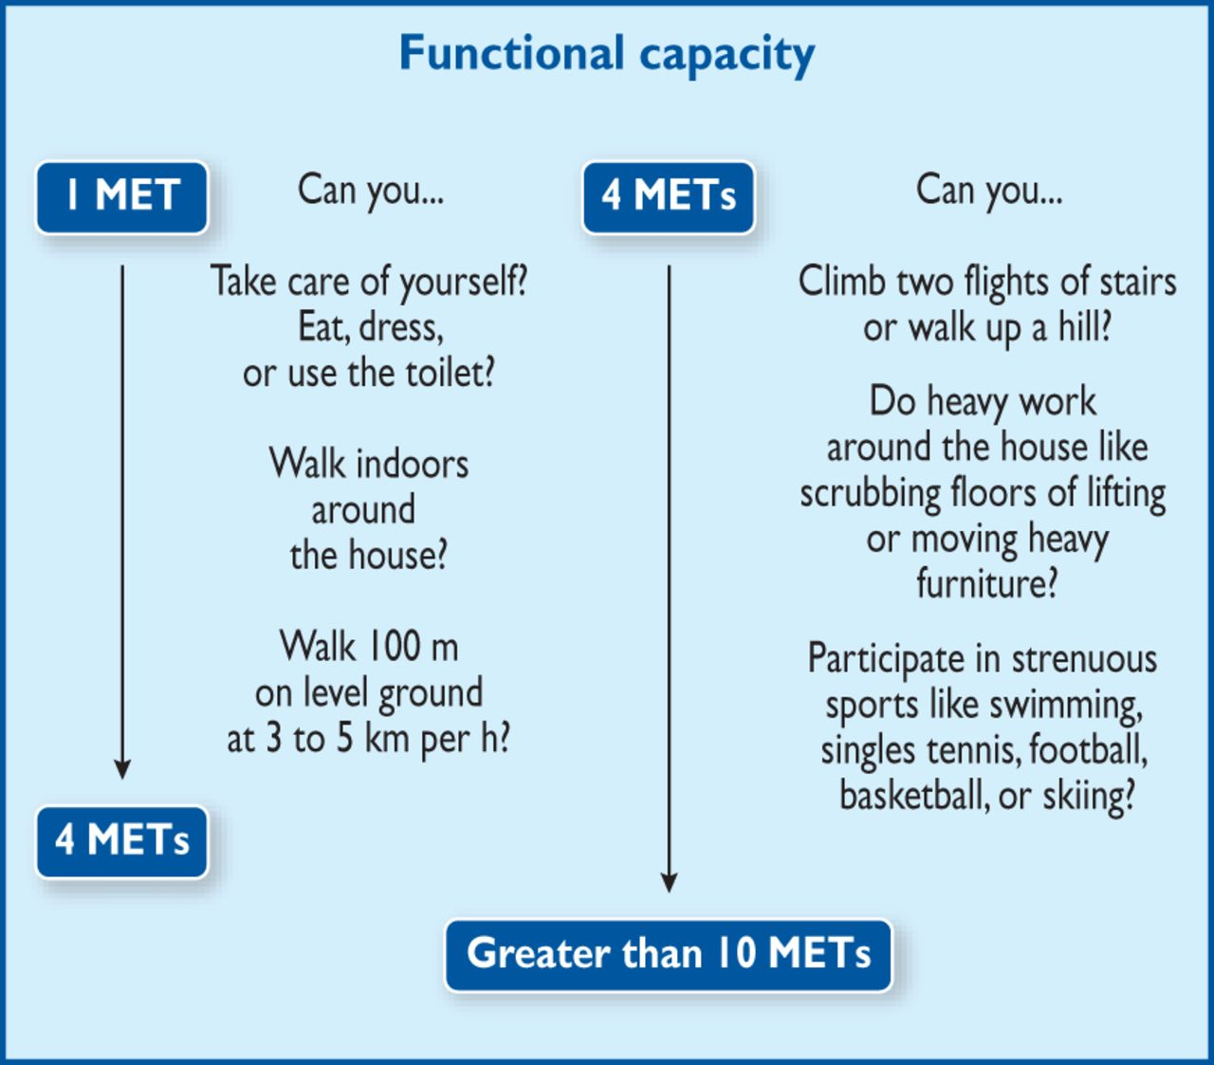
European Heart Journal (2014) 35, 2383–2431

Slide 9
CV risk factors: hypertension, smoking, dyslipidaemia, diabetes, family history of CVD.
Biomarkers: hs-cTn T/I (Class I) and/
or BNP/NT-proBNP (Class IIa). If pathological, consult a cardiologist.
c) Functional capacity based on Duke Activity Status Index (DASI) or the ability to
climb two flights of stairs.
d) For diagnostic and therapeutic efforts to be considered, see Section 6.
e) Close follow-up after intervention and subsequent
management of heart disease are advised.

Slide 19
ªAvailability of 24 h cath-lab service is suggested in case of major surgery within 6 months in non-ACS/non-high-risk patients and within 12 months in ACS/high-risk patients.
^{b}High risk of peri-operative stent thrombosis defined by at least one of the following:
history of recurrent MI,
history of stent thrombosis under antiplatelet therapy,
reduced left ventricular ejection fraction (<40%),
poorly controlled diabetes,
severely impaired renal function/haemodialysis,
recent complex PCI (i.e. severely calcified lesion, left main PCI, chronic total occlusion, bifurcational/crush technique, bypass graft PCI),
stent malapposition/residual dissection

Slide 20
ªAvailability of 24 h cath-lab service is suggested in case of major surgery within 6 months in non-ACS/non-high-risk patients and within 12 months in ACS/high-risk patients.
^{b}High risk of peri-operative stent thrombosis defined by at least one of the following:
history of recurrent MI,
history of stent thrombosis under antiplatelet therapy,
reduced left ventricular ejection fraction (<40%),
poorly controlled diabetes,
severely impaired renal function/haemodialysis,
recent complex PCI (i.e. severely calcified lesion, left main PCI, chronic total occlusion, bifurcational/crush technique, bypass graft PCI),
stent malapposition/residual dissection

Slide 25
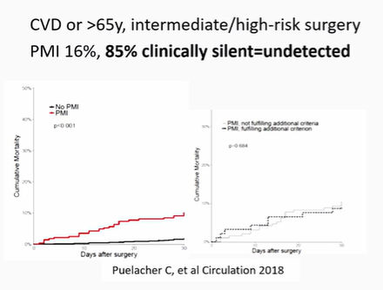

Slide 35


Slide 36
Antithrombotic therapy
Antiplatelets
Anticoagulants

Slide 37
Antiplatelet medication
Aspirin
Ticlopidin
Clopidogrel
Prasugrel
Ticagrelor
Cangrelor
Triflusal
Dipyridamole
ESC guidelines European Heart Journaldoi:10.1093/eurheartj/ehp337

Slide 38
Antiplatelet medication
Management of patients on DAPT who are referred for surgical procedures involves consideration of:
the risk of stent thrombosis (particularly if DAPT needs to be interrupted);
the consequences of delaying the surgical procedure; and
the increased intra- and periprocedural bleeding risk and possible consequences of such bleeding if DAPT is continued
European Hear Journal 2017, https://doi.org/10.1093/eurheartj/ehx419

Slide 39
Antiplatelet medication
In summary, it is recommended that DAPT be administered for at least
1 month after BMS implantation in stable CAD,
for 6 months after new-generation DES implantation and
for up to 1 year in patients after ACS, irrespective of revascularization strategy. Importantly, a minimum of 1 (BMS) to 3 (new-generation DES) months of DAPT might be acceptable, independently of the acuteness of coronary disease, in cases when surgery cannot be delayed for a longer period; however, such surgical procedures should be performed in hospitals where 24/7 catheterization laboratories are available, so as to treat patients immediately in case of peri-operative atherothrombotic events.
Independently of the timeframe between DES implantation and surgery, single anti-platelet therapy (preferably with aspirin) should be continued.
European Heart Journal (2014) 35, 2383–2431

Slide 40
Antiplatelet medication
In patients needing surgery within a few days, current ESC Guidelines recommend withholding
clopidogrel and ticagrelor for five days and prasugrel for seven days
prior to surgery unless there is a high risk of thrombosis.
In contrast, other guidelines recommend using platelet function tests for optimal timing of surgery, as discussed in a recent publication.
However, the guidelines do not provide the ‘ideal’ platelet function assay or a ‘bleeding cut-off’, and more research in this area is needed.
European Heart Journal (2014) 35, 2383–2431

Slide 41
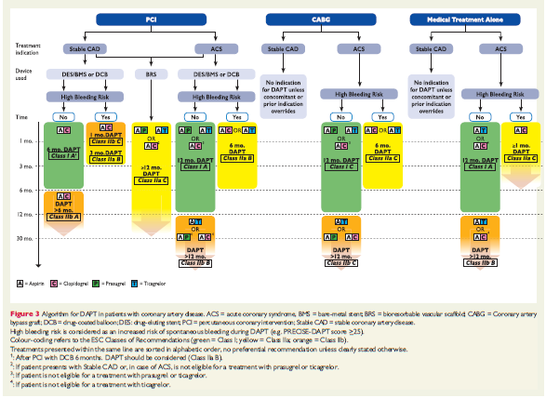

Slide 42
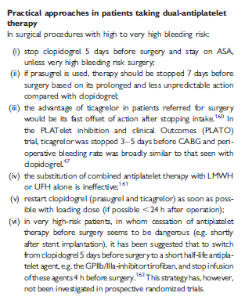
Europace (2011) 13 (5): 723-746.
doi: 10.1093/europace/eur126

Slide 43
Risk reduction strategies
Pharmacological
  b Blockers
  Statins
  Nitrates
  Angiotensin- converting enzyme inhibitor
  Calcium channel blockers
  Ivabradine
  a2 Receptor agonists
  Diuretics
  Antiplatelet medication
  Anticoangulant therapy
Revascularization
European Heart Journal (2014) 35, 2383–2431

Slide 44
b Blockers
Reduce heart rate
    lengthening of the diastolic filling period
    decreased myocardial contractility
    decrease myocardial oxygen consumption
Redistribution of coronary blood flow to the subendocardium
Plaque stabilization
Increase in the threshold for ventricular
fibrillation
European Heart Journal (2014) 35, 2383–2431

Slide 45
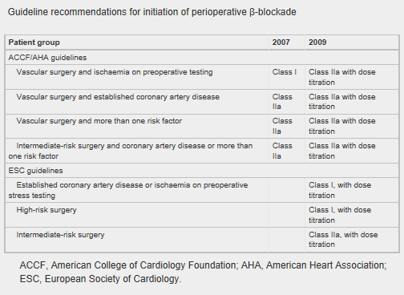
Heart doi:10.1136/heartjnl-2013-304262

Slide 46
Meta-analysis of secure randomised controlled trials of β-blockade to prevent perioperative death in non-cardiac surgery
Background Current European and American guidelines recommend the perioperative initiation of a course of β-blockers in those at risk of cardiac events undergoing high- or intermediate-risk surgery or vascular surgery. The Dutch Echocardiographic Cardiac Risk Evaluation Applying Stress Echocardiography (DECREASE) family of trials, the bedrock of evidence for this, are no longer secure. We therefore conducted a meta-analysis of randomised controlled trials of β-blockade on perioperative mortality, non-fatal myocardial infarction, stroke and hypotension in non-cardiac surgery using the secure data.
Methods The randomised controlled trials of initiation of β-blockers before non-cardiac surgery were examined. Primary outcome was all-cause mortality at 30 days or at discharge. The DECREASE trials were separately analysed.
Results Nine secure trials totalling 10 529 patients, 291 of whom died, met the criteria. Initiation of a course of β-blockers before surgery caused a 27% risk increase in 30-day all-cause mortality (p=0.04). The DECREASE family of studies substantially contradict the meta-analysis of the secure trials on the effect of mortality (p=0.05 for divergence). In the secure trials, β-blockade reduced non-fatal myocardial infarction (RR 0.73, p=0.001) but increased stroke (RR 1.73, p=0.05) and hypotension (RR 1.51, p<0.00001). These results were dominated by one large trial.
Conclusions Guideline bodies should retract their recommendations based on fictitious data without further delay. This should not be blocked by dispute over allocation of blame. The well-conducted trials indicate a statistically significant 27% increase in mortality from the initiation of perioperative β-blockade that guidelines currently recommend. Any remaining enthusiasts might best channel their energy into a further randomised trial which should be designed carefully and conducted honestly.
Heart doi:10.1136/heartjnl-2013-304262

Slide 47
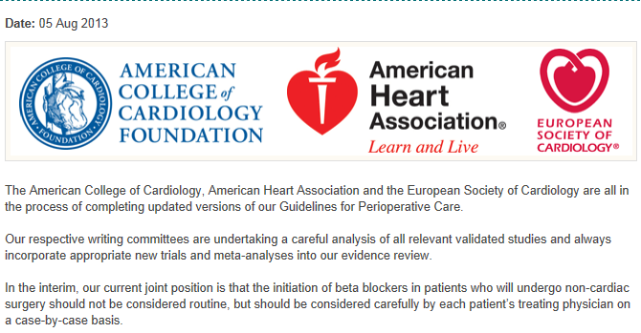

Slide 48
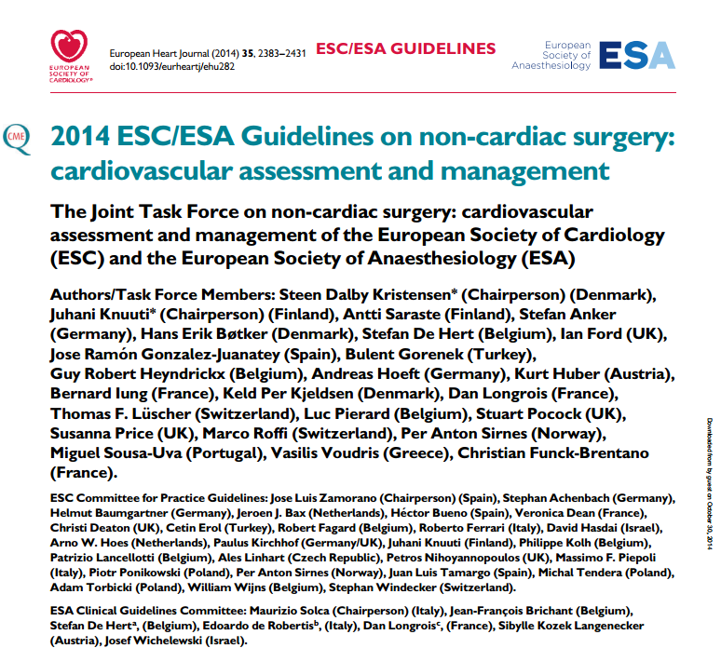

Slide 49
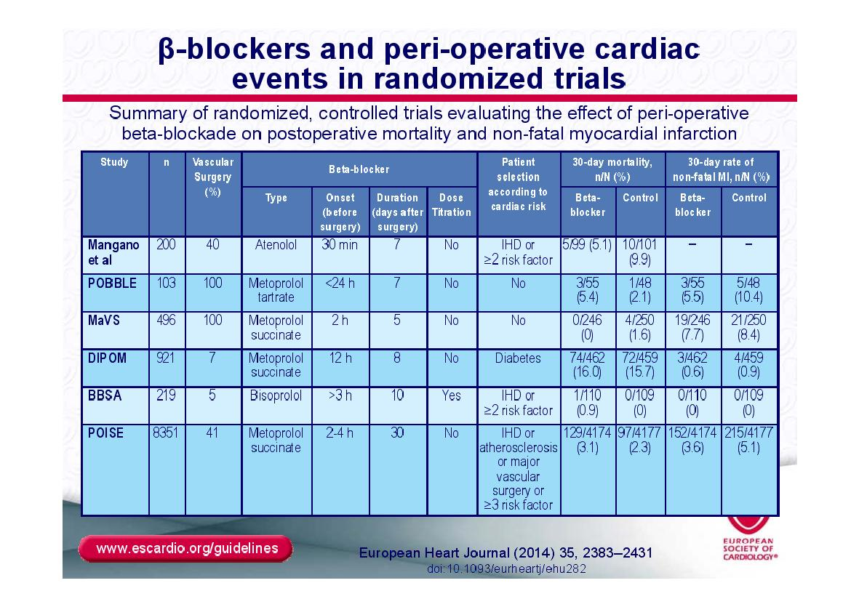

Slide 50
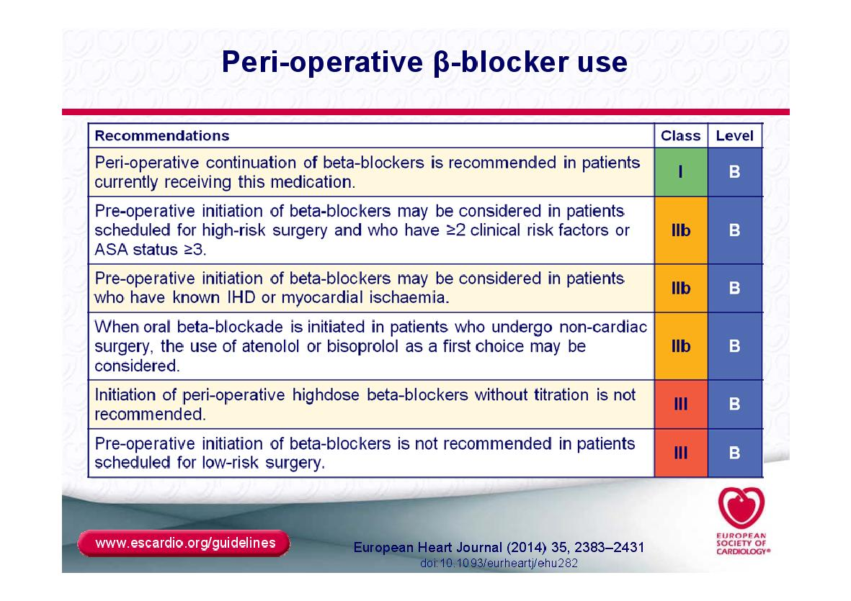


Slide 51
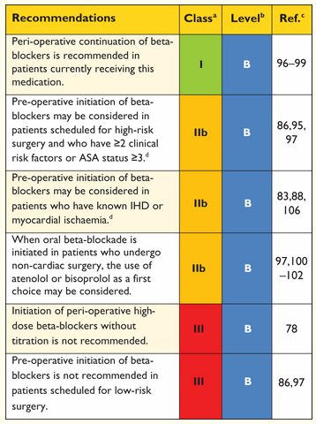
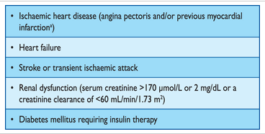
European Heart Journal (2014) 35, 2383–2431

Slide 52
β blockers
Treatment should ideally be initiated between 30 days and (at least) 2 days before surgery, starting at a low dose, and should be continued post-operatively.
The target is a resting heart rate 60–70 bpm and systolic blood pressure >100 mm Hg.
The heart rate goal applies to the whole perioperative period, using intravenous administration when oral administration is not possible
High doses should be avoided, particularly immediately before surgery
Post-operative tachycardia should firstly lead to treatment of the underlying cause - for example, hypovolaemia, pain, blood loss, or infection - ather than simply increasing the beta-blocker dose.
European Heart Journal (2014) 35, 2383–2431

Slide 53
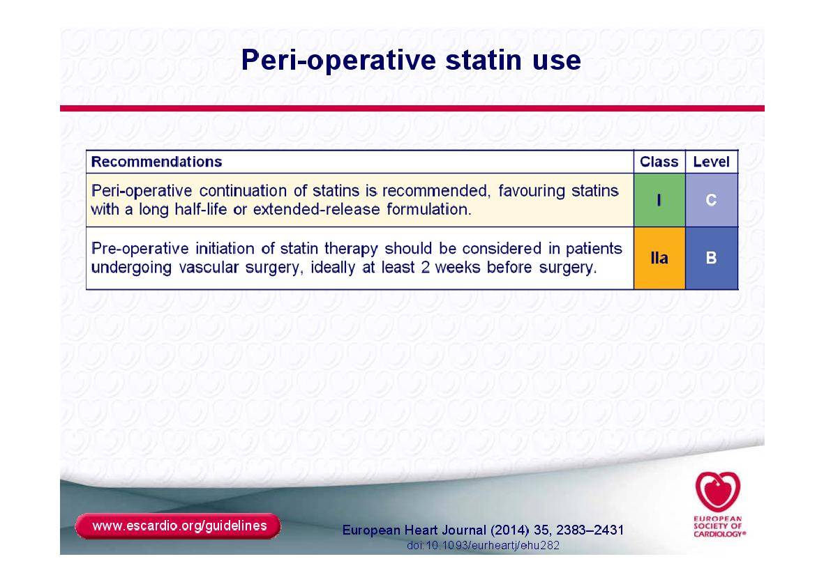

Slide 54
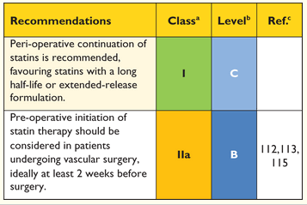
Statins
European Heart Journal (2014) 35, 2383–2431

Slide 55
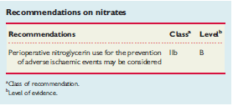
Nitrates
Studies showed no effect on either myocardial ischaemia, MI, or cardiac death.
Perioperative use of nitroglycerin may pose a significant haemodynamic risk to the patients.
Decreased preload may lead to tachycardia, and hypotension.
ESC guidelines European Heart Journaldoi:10.1093/eurheartj/ehp337

Slide 56
Angiotensin-Converting Enzyme Inhibitor
ACEIs have been associated with a 50% increased risk of hypotension requiring vasopressors during induction of anesthesia.
A large retrospective cohort of cardiothoracic surgical patients found a 28% increased risk of post-operative acute renal failure (ARF) with both drug classes
A cardiothoracic report published the same year demonstrated a 50% reduction in risk with ACEIs.
Although the evidence of harm is not unequivocal, perioperative blood-pressure control can be achieved with other drugs without hemodynamic or renal risk, such as CCBs, and in most cases ACEIs/ARBs should be stopped one day before surgery.
ESC guidelines European Heart Journaldoi:10.1093/eurheartj/ehp337

Slide 57
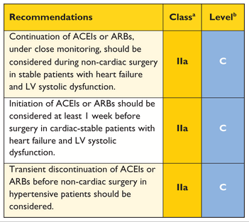
Angiotensin-Converting Enzyme Inhibitor
European Heart Journal (2014) 35, 2383–2431

Slide 58
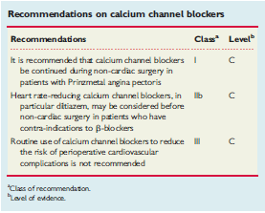
Calcium channel blockers
ESC guidelines European Heart Journaldoi:10.1093/eurheartj/ehp337

Slide 59
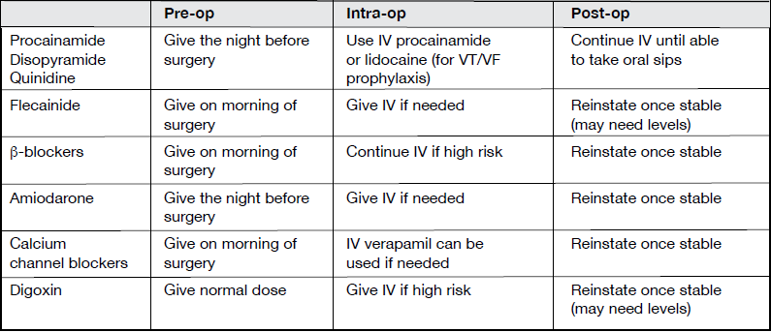
Anti-arrythmics drugs

Slide 60
Ivabradine
Ivabradine might be considered for patients with strict contra-indications to b-blockers and should be adjusted before surgery to achieve a resting heart rate of between 60 and 70 beats/min
ESC guidelines European Heart Journaldoi:10.1093/eurheartj/ehp337

Slide 61
a2 Receptor agonist
Clonidine withdrawal can result in severe rebound hypertension with reports of encephalopathy, stroke, and death. These effects are exacerbated by concomitant beta-blocker therapy. For this reason, if a patient is expected to be NPO for more than 12 hours, they should be converted to a clonidine patch 48-72 hours before surgery with concurrent tapering of the oral dose
ESC guidelines European Heart Journaldoi:10.1093/eurheartj/ehp337

Slide 62
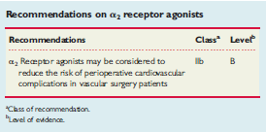
a2 Receptor agonist
ESC guidelines European Heart Journaldoi:10.1093/eurheartj/ehp337

Slide 63
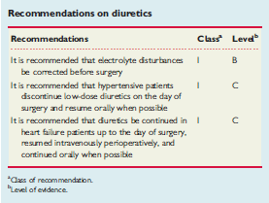
Diuretics
ESC guidelines European Heart Journaldoi:10.1093/eurheartj/ehp337

Slide 64
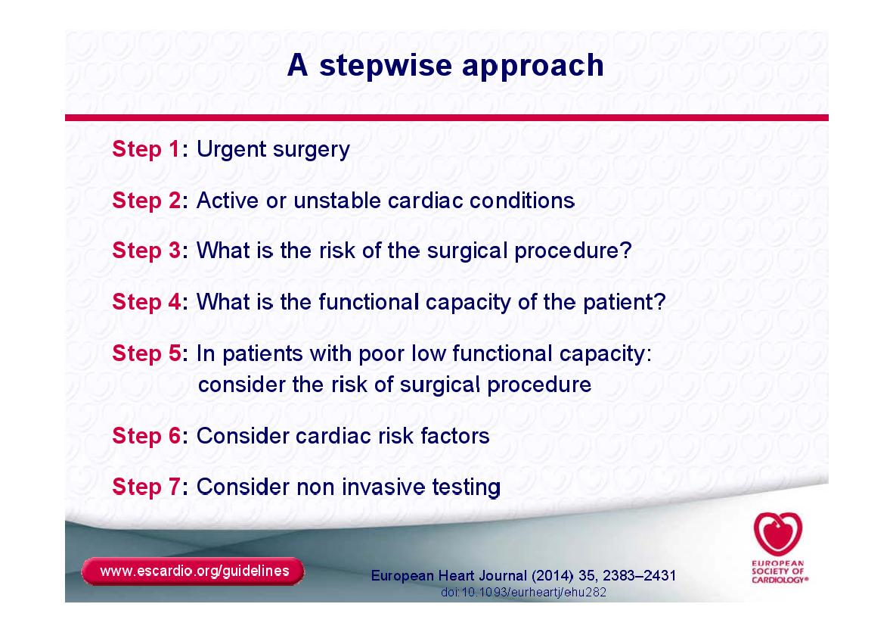

Slide 65
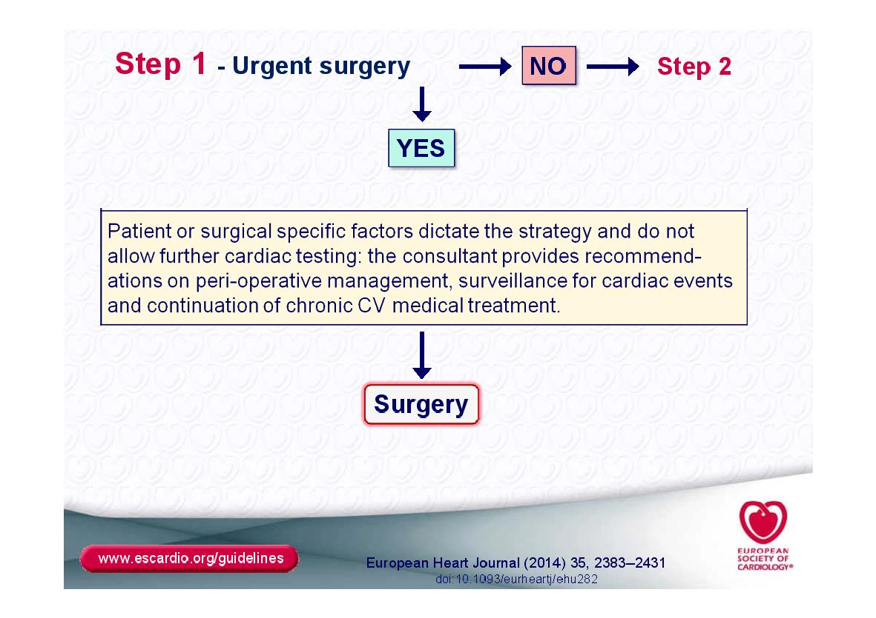

Slide 66
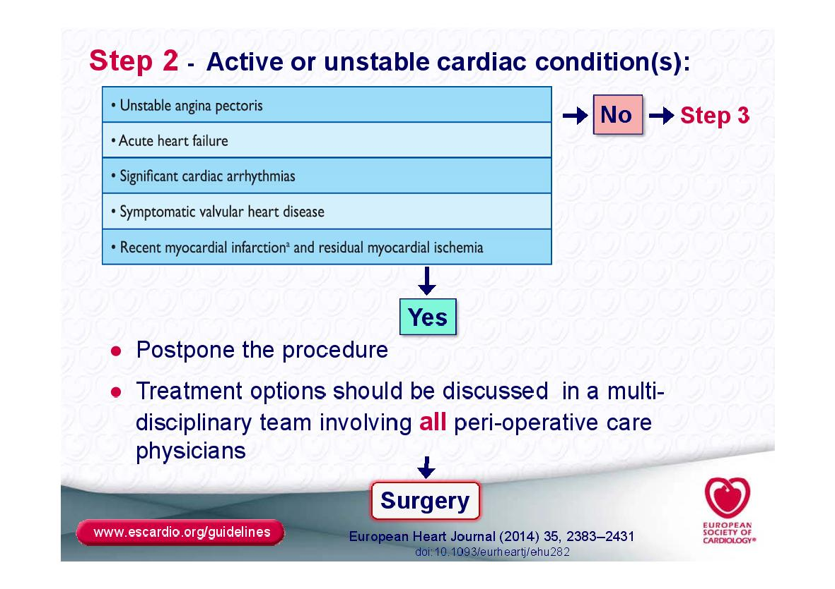

Slide 67
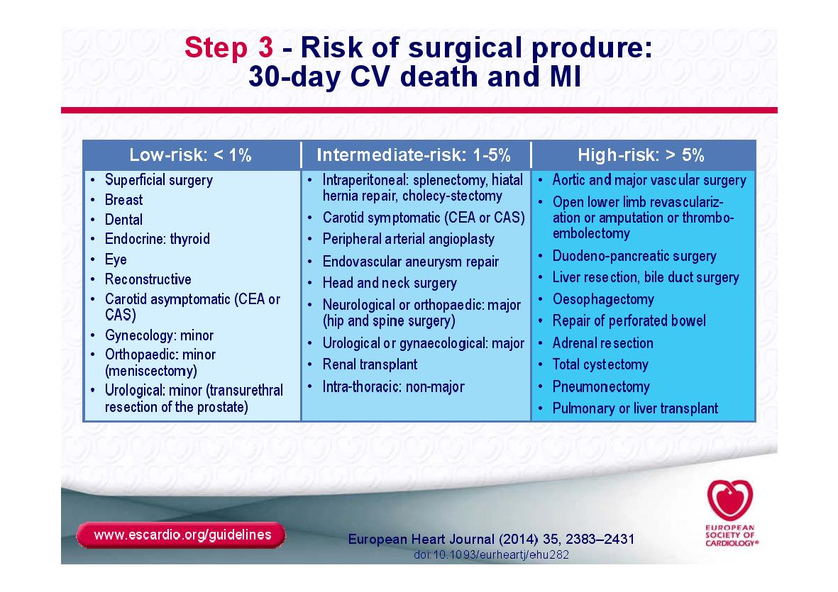

Slide 68
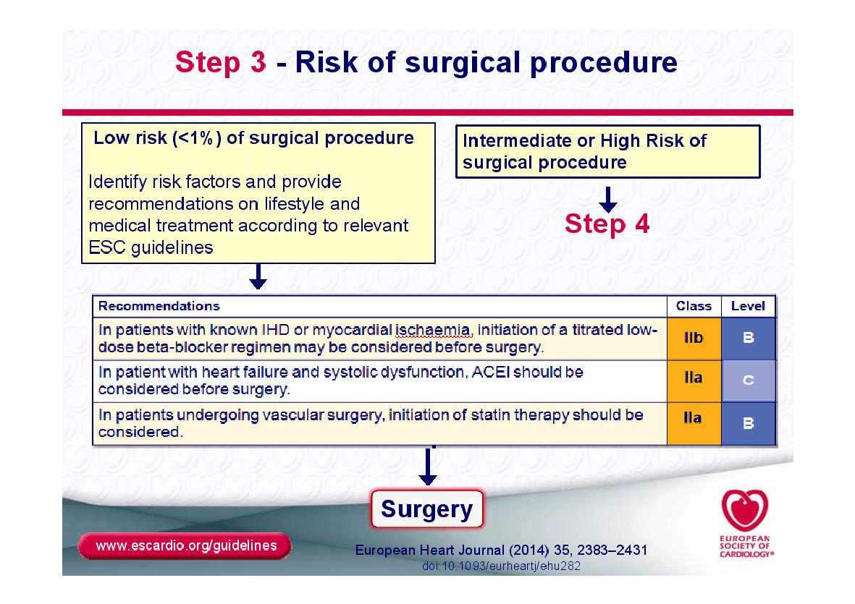

Slide 69
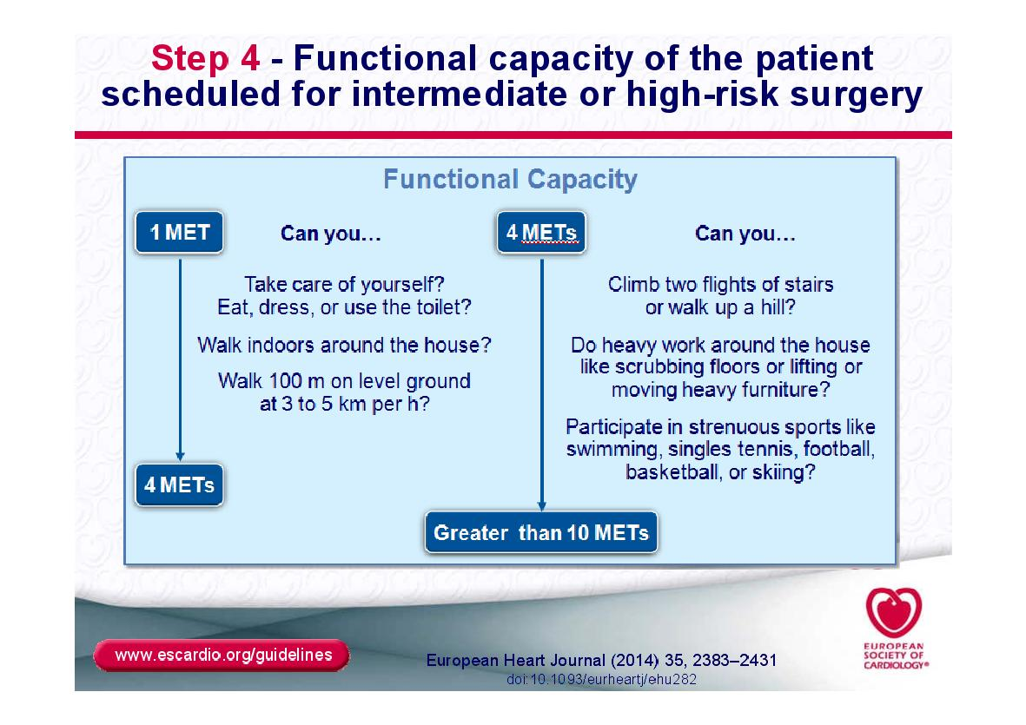

Slide 70
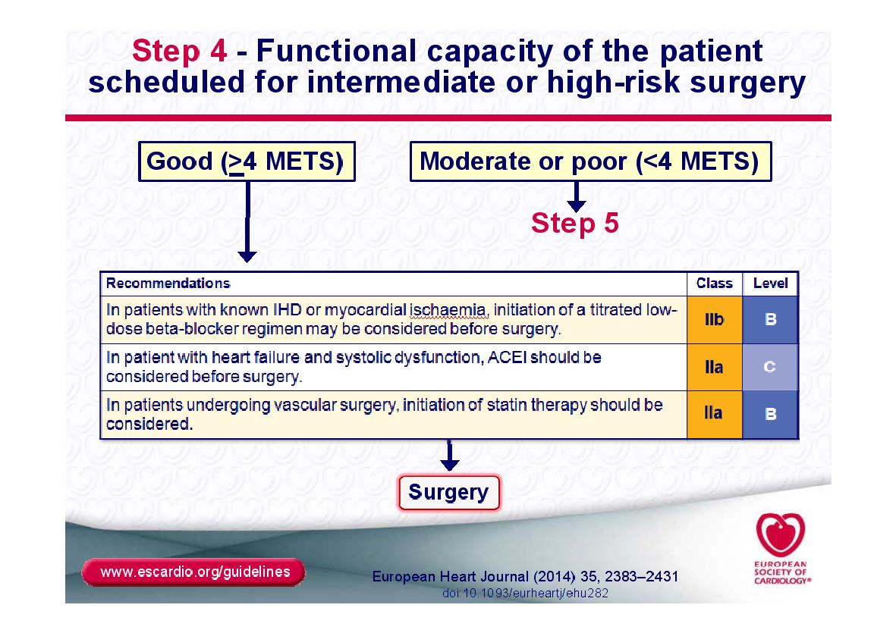

Slide 71
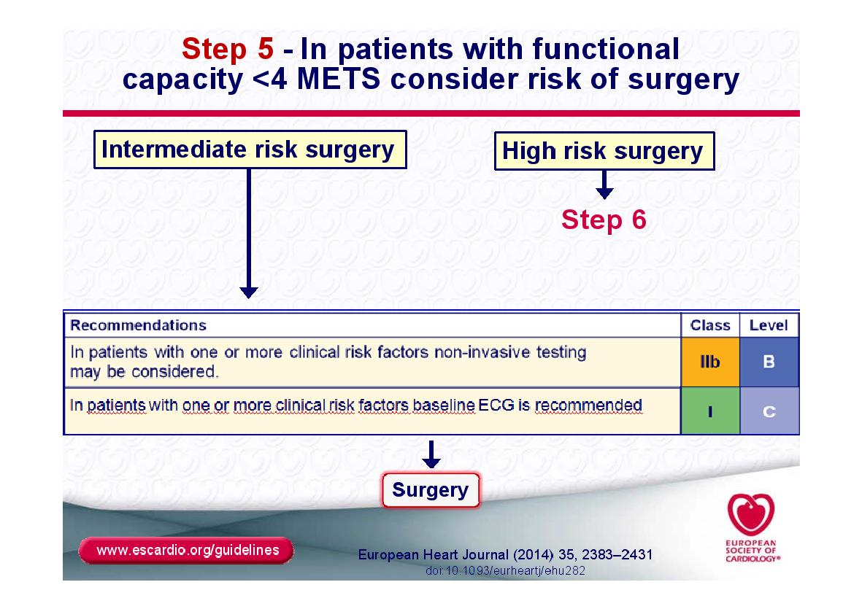

Slide 72
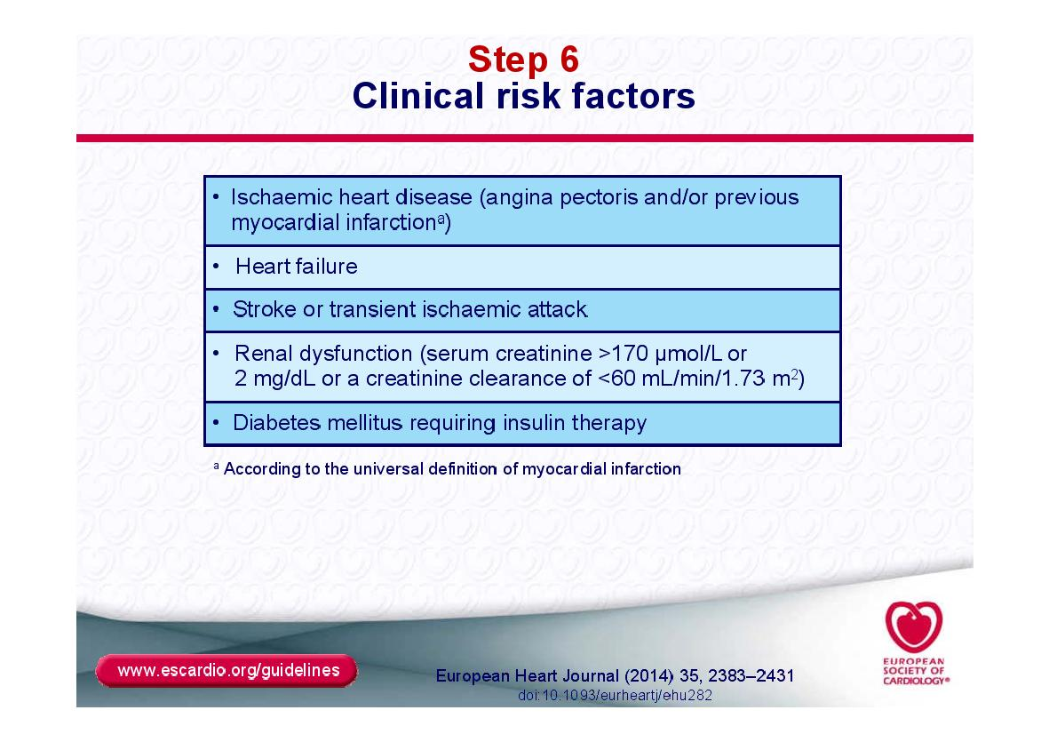

Slide 73
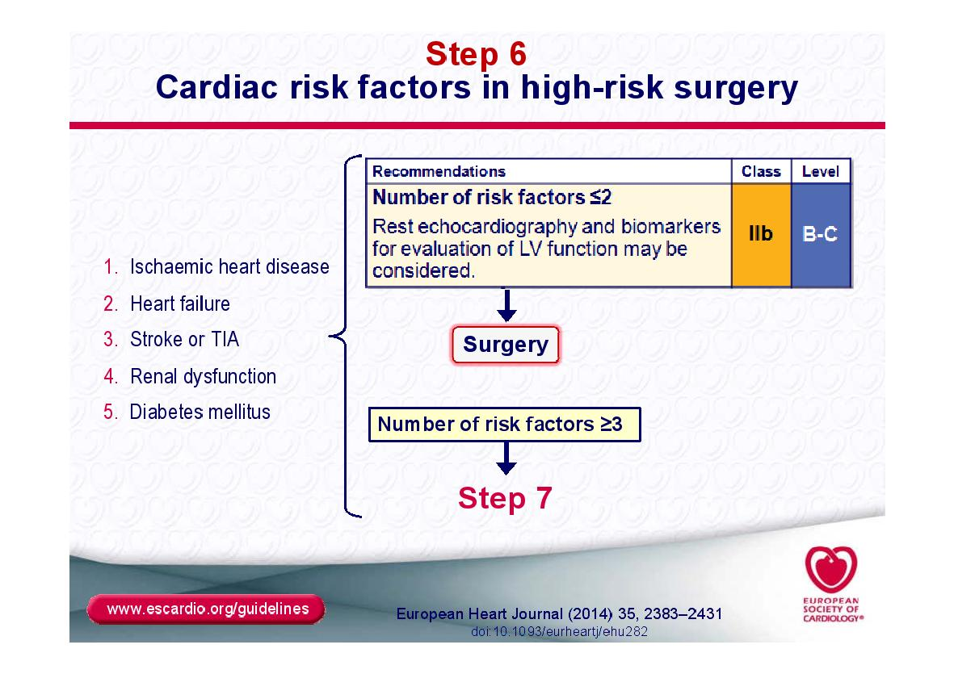

Slide 74
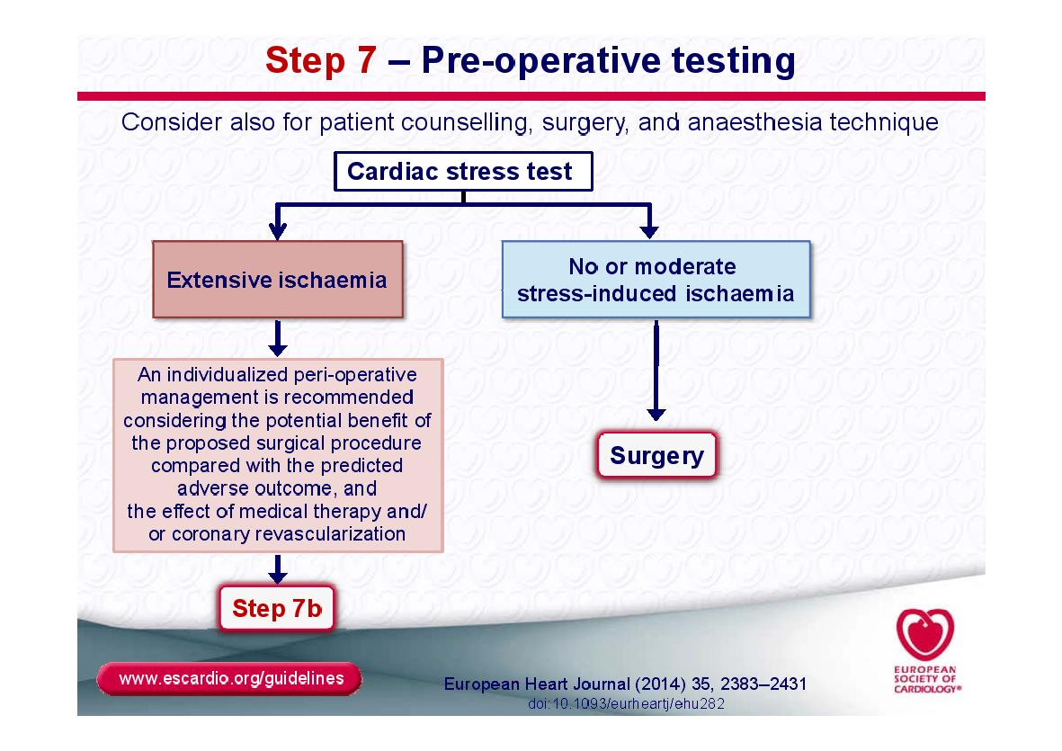

Slide 75
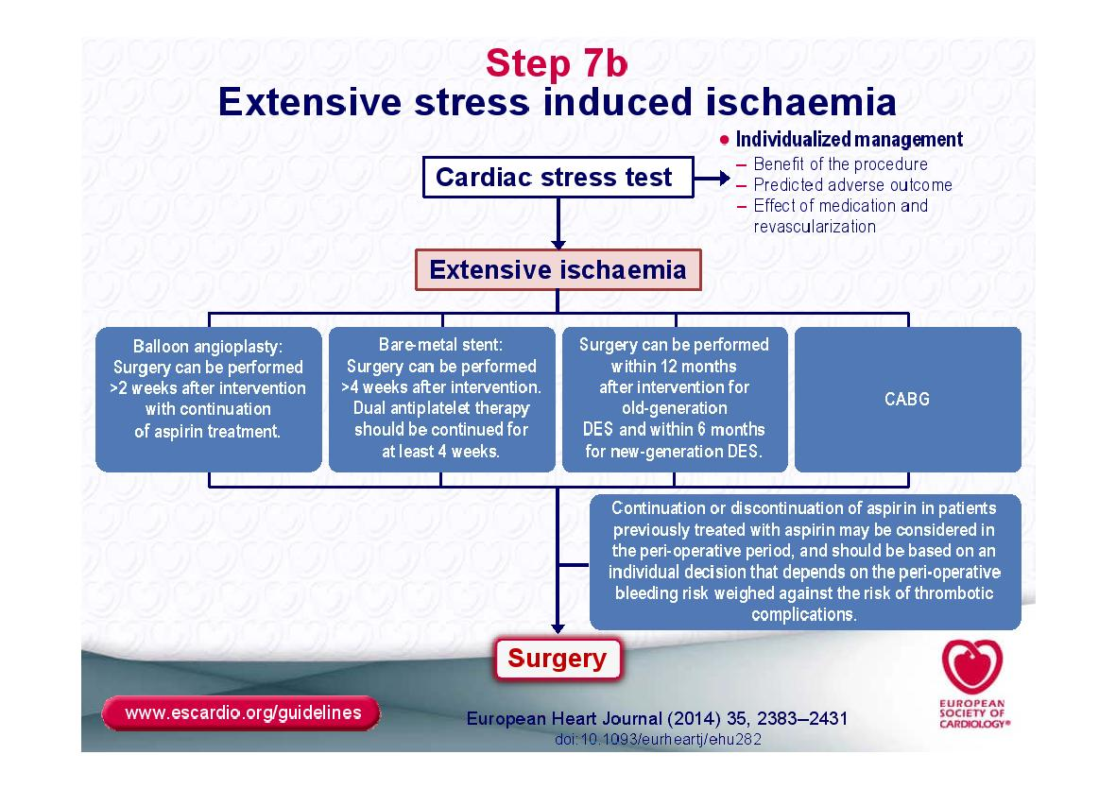

Slide 91
