Slide 1
ANEURYSMS
(Endovascular Treatment of Aortic Aneurysms)
Thanos Katsargyris, MD PhD
Department of Vascular and Endovascular Surgery
Paracelsus Medical University
Klinikum Nuremberg, Germany

Slide 2
Introduction
Vascular Surgery little brother of cardiology
Revolutionary changes in treatment of aneurysms
Practical presentation

Slide 3
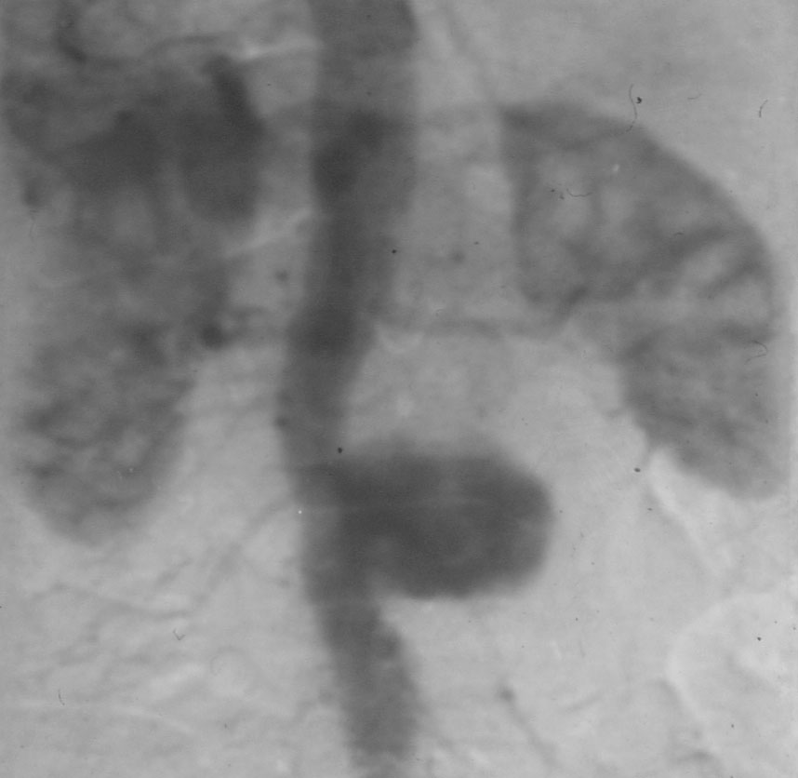
Definition: abnormal dilatation…

Slide 4
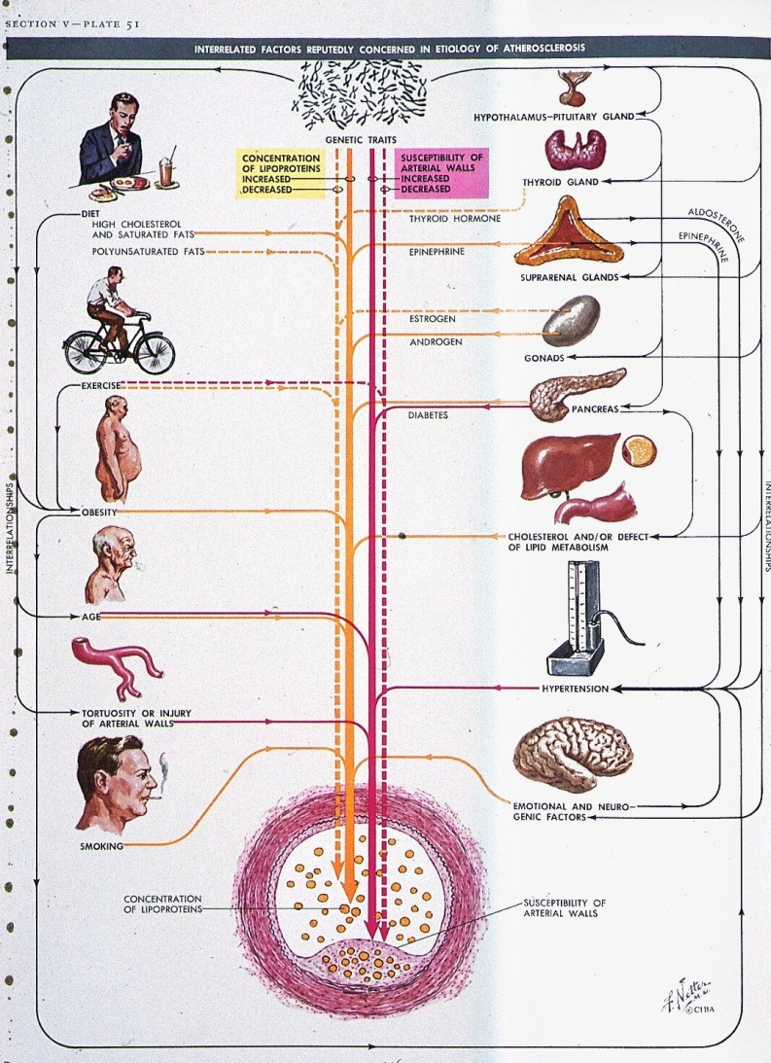
Pathophysiology
Genetic factors
◆
Dilatation of the Aorta
◆
Aneurysm (AAA)
◆
Arteriosclerotic AAA

Slide 5
Aneurysms: increase of incidence
We all get older
More aneurysms detected
Germany:
  20000 AAA’s per year
  (1/4 acute)

Slide 6
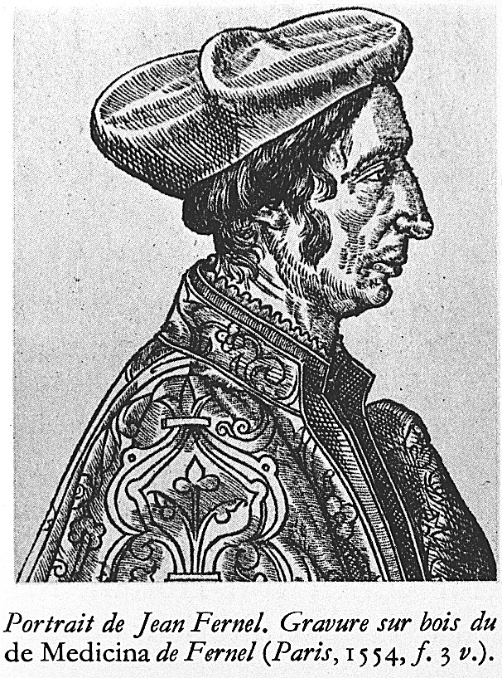
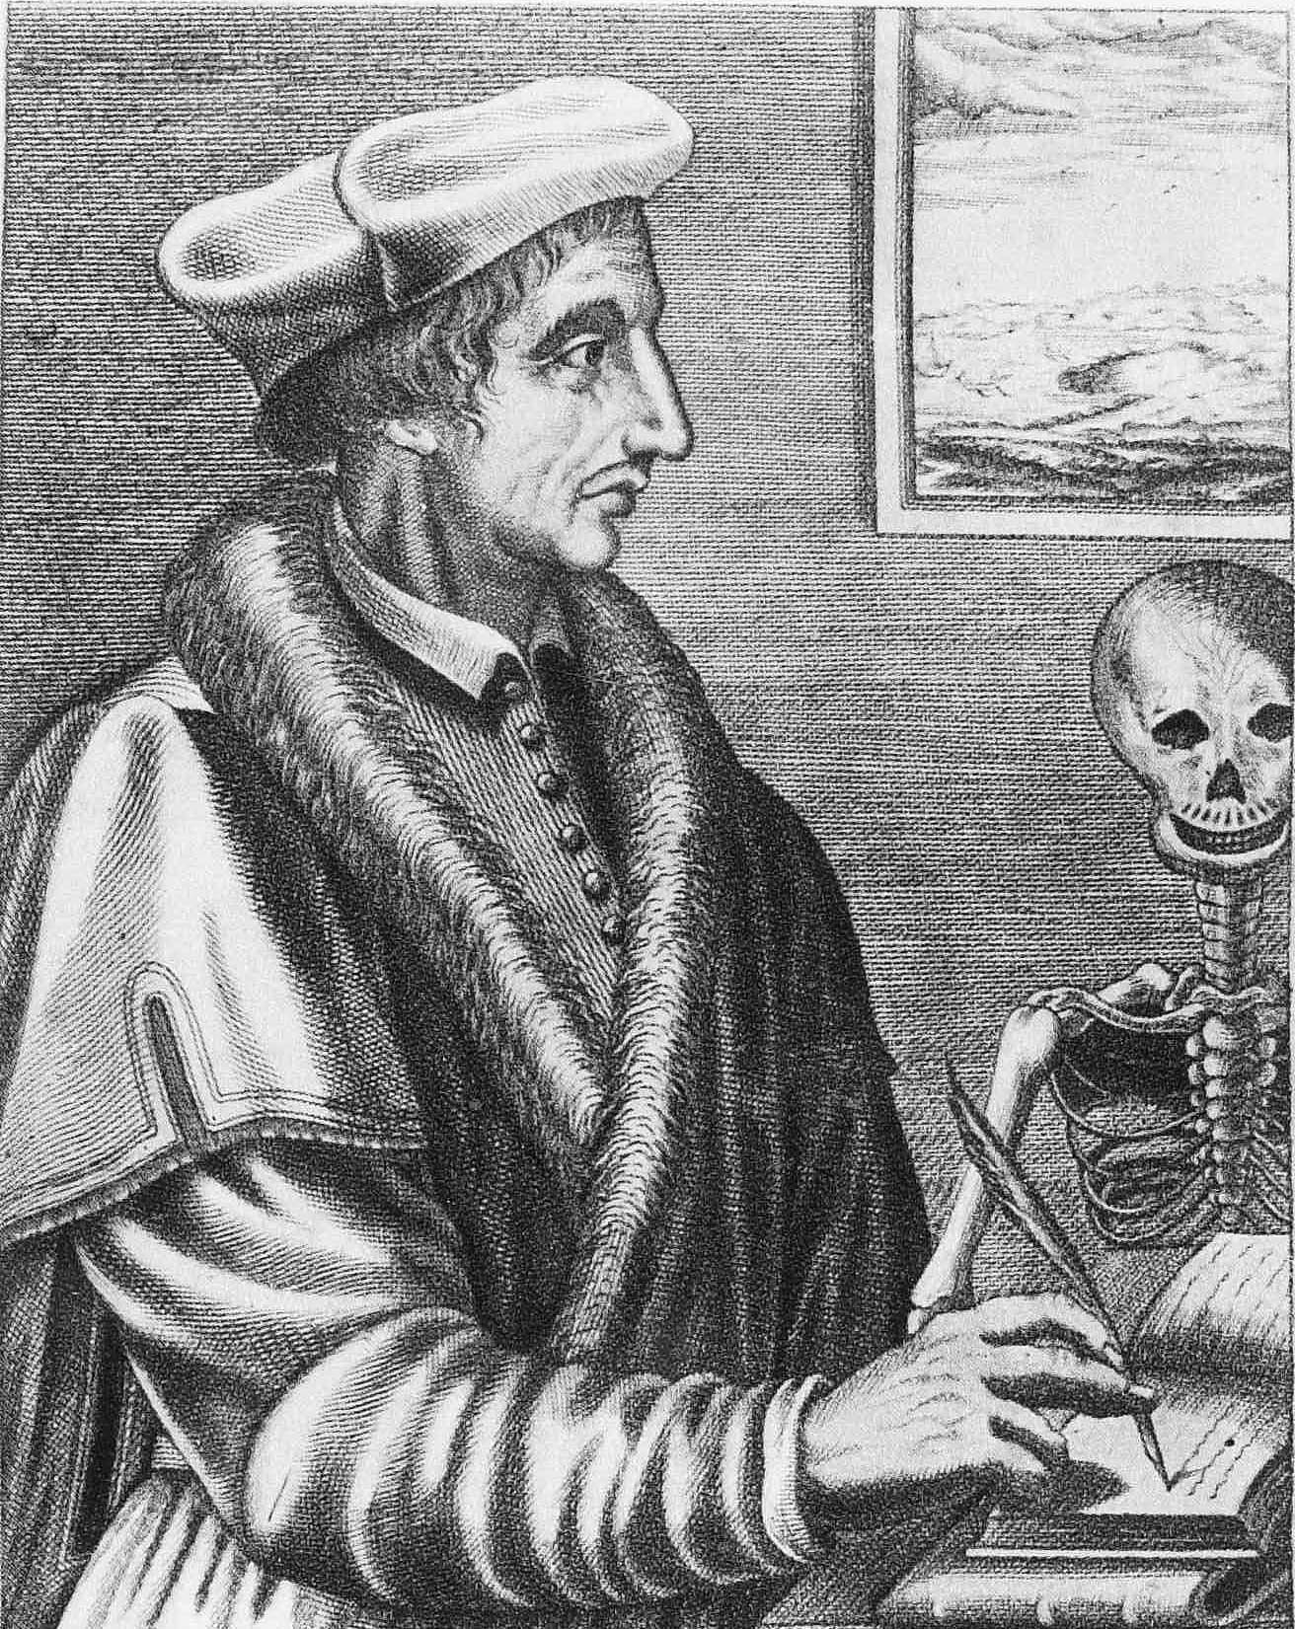
“An aneurysm sometimes occurs in the INTERNAL ARTERIES,
especially in the Chest.” Jean Fernel (1554)

Slide 7
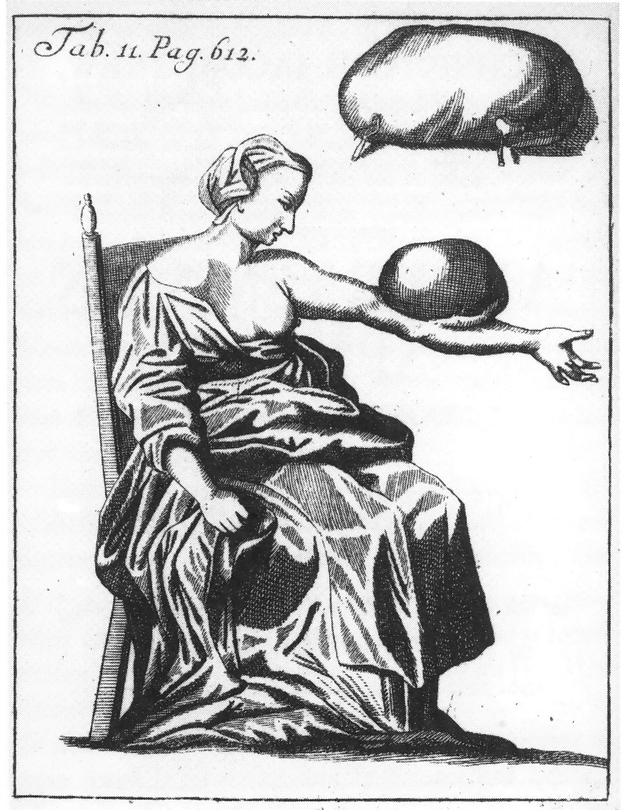
First illustration of
External Aneurysm
Purmann 1699

Slide 8
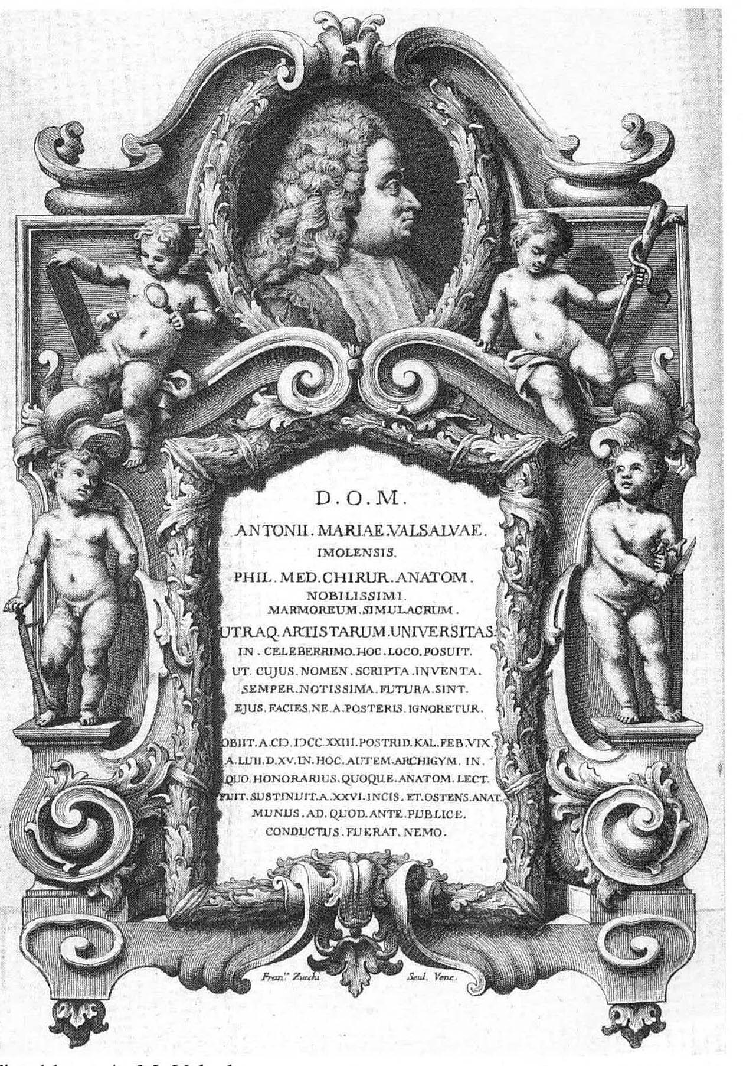
Conservative treatment
Valsalva (1666-1723)
-Ruhe in der Dunkelheit
-Fasten
-Aderlass
A happy few survived this regimen with a thrombosed aneurysm

Slide 9
First Ligation of the Aorta (1817)
The boldest attempt to preserve life by aid
of the science of Surgery (Cooper)

Slide 10
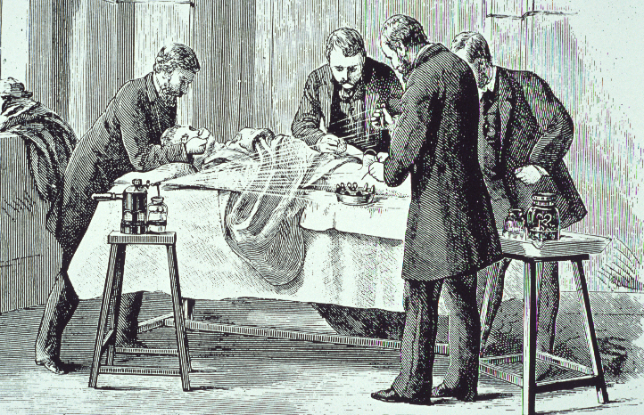
1850 - 1870
Era of Introduction of Antisepsis and Anesthesia.

Slide 11
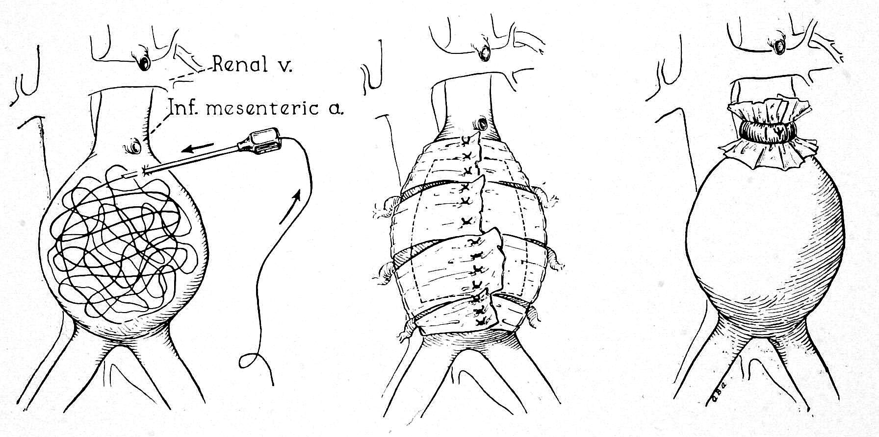
Wiring Wrapping Ligation
Surgical techniques 1900-1950

Slide 12
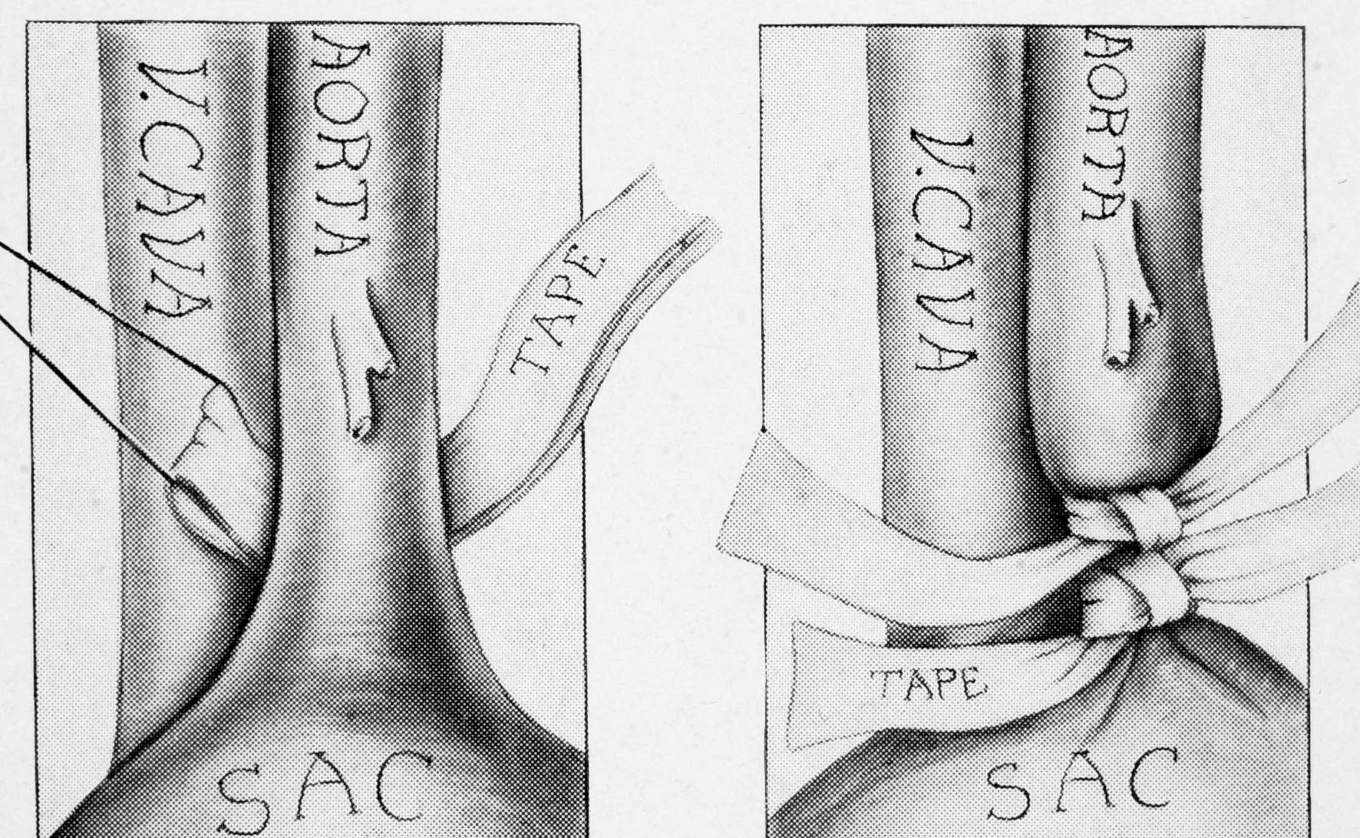
Matas 1923 : First Successful Ligation of Aorta
(Partial occlusion by banding )

Slide 13
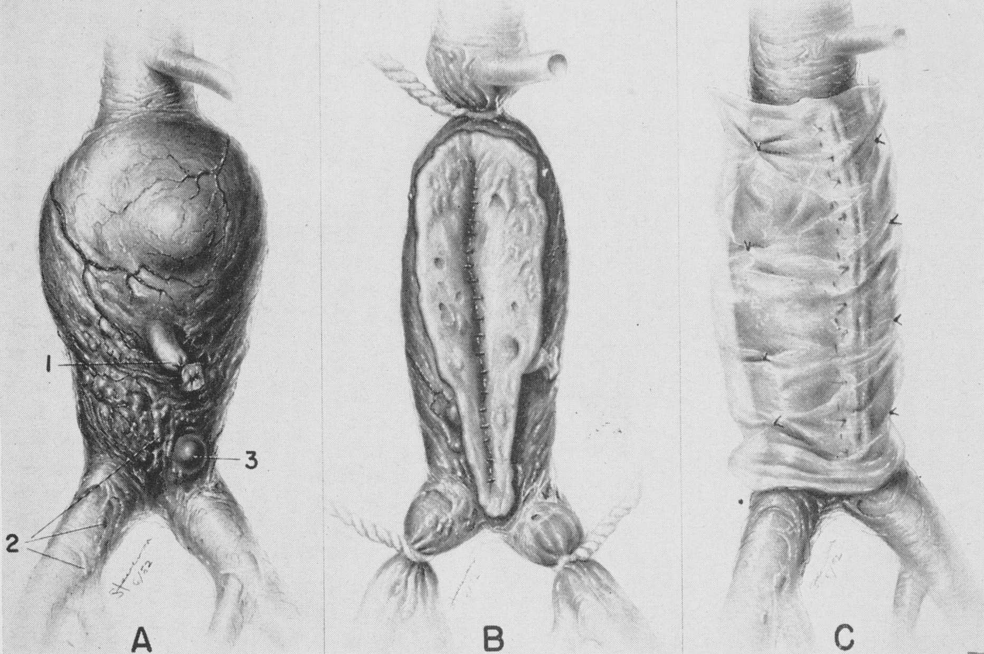
Endoaneuysmorraphy and wrapping of AAA
Cowley and Yeager. Surgery 1953

Slide 14
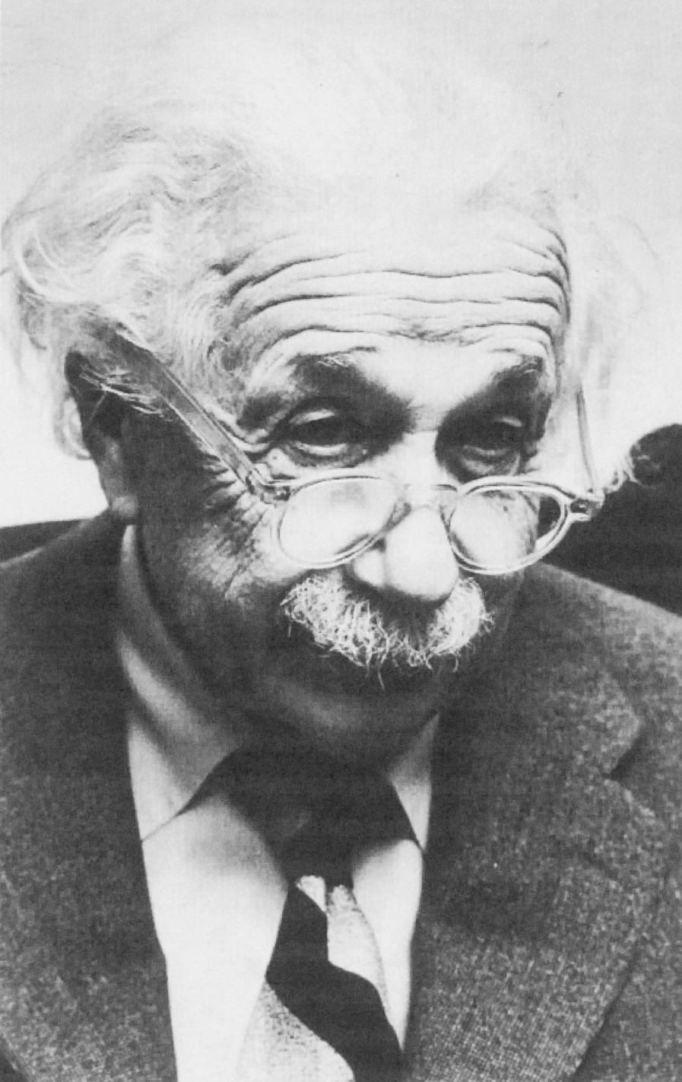
Albert EINSTEIN
(1879 - 1955 )
AAA
wrapping 1948
rupture 1955
(refused aortic surgery)

Slide 15
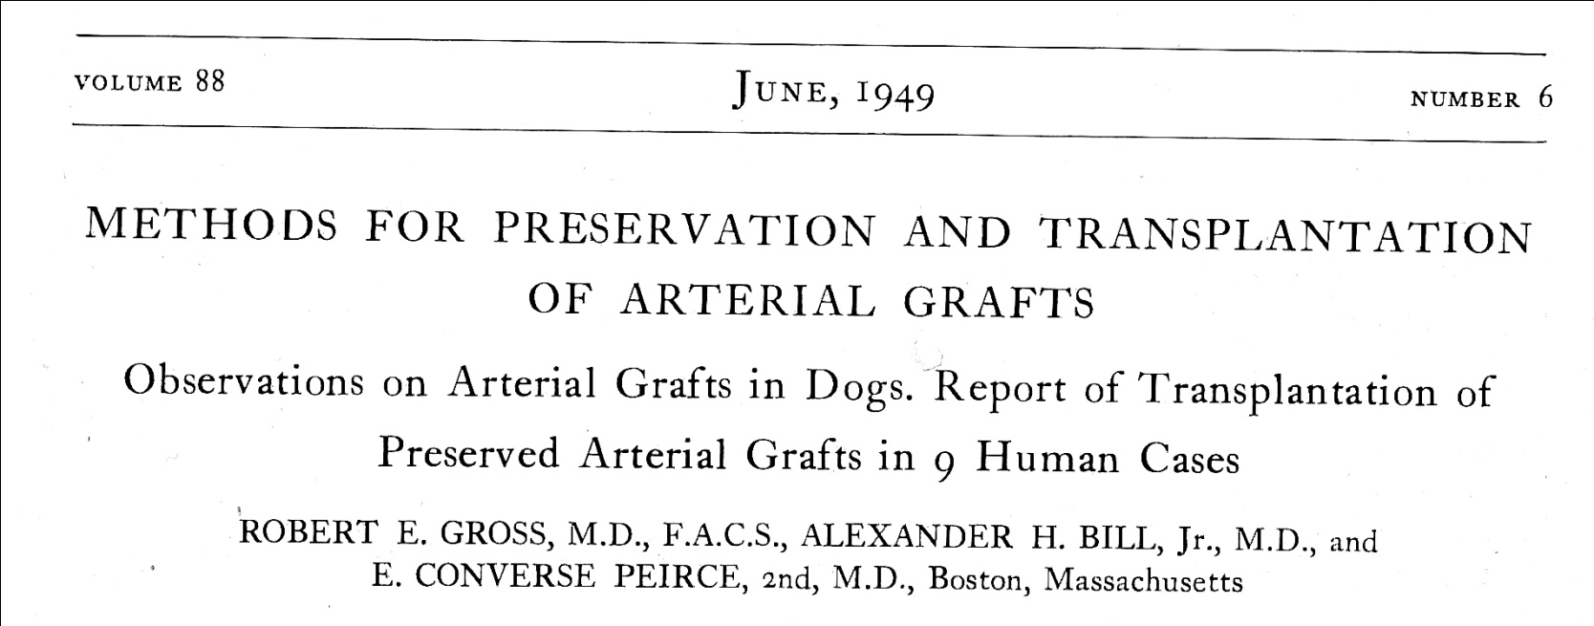
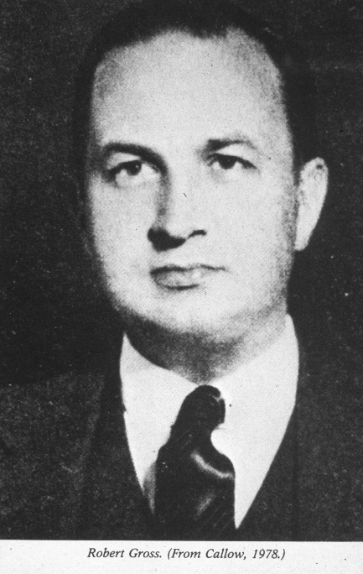
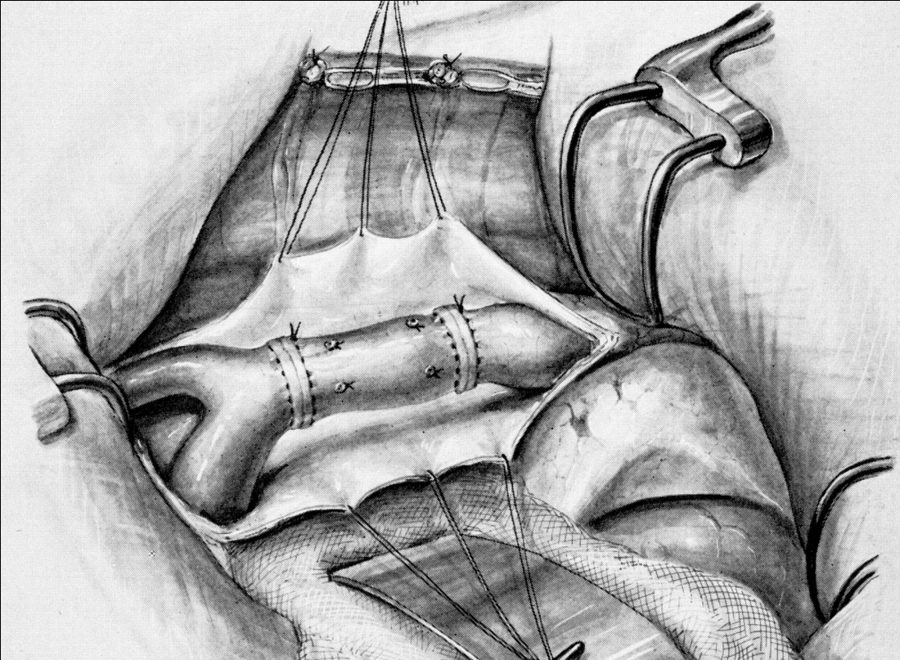
Surg Gyn Obst

Slide 16
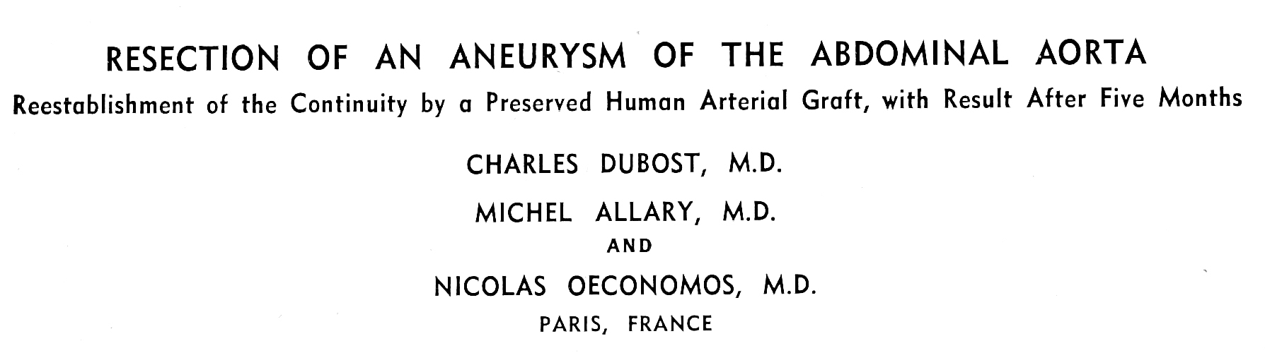
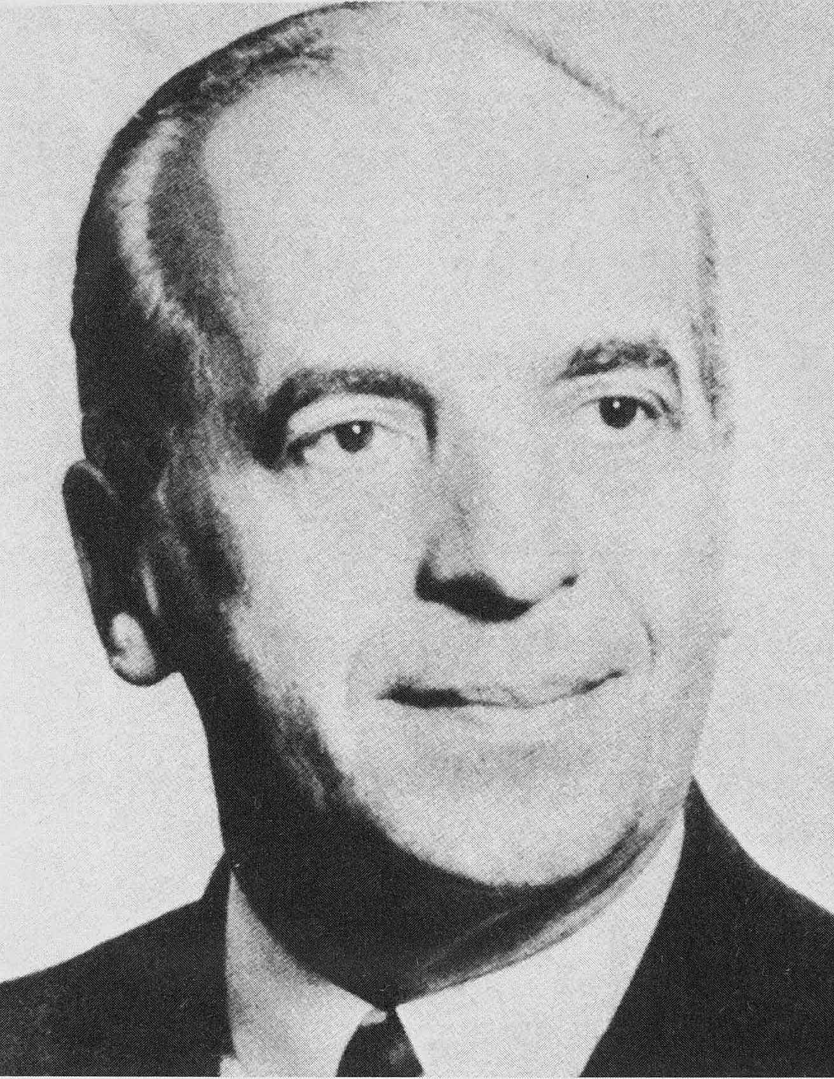
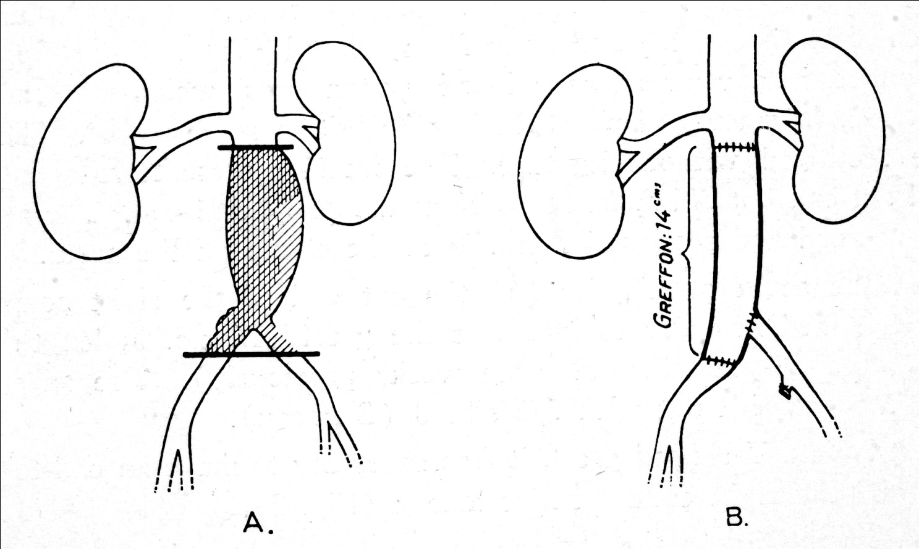
Mem. acad. chir., 1951.
Arch. Surg., 1952.

Slide 17
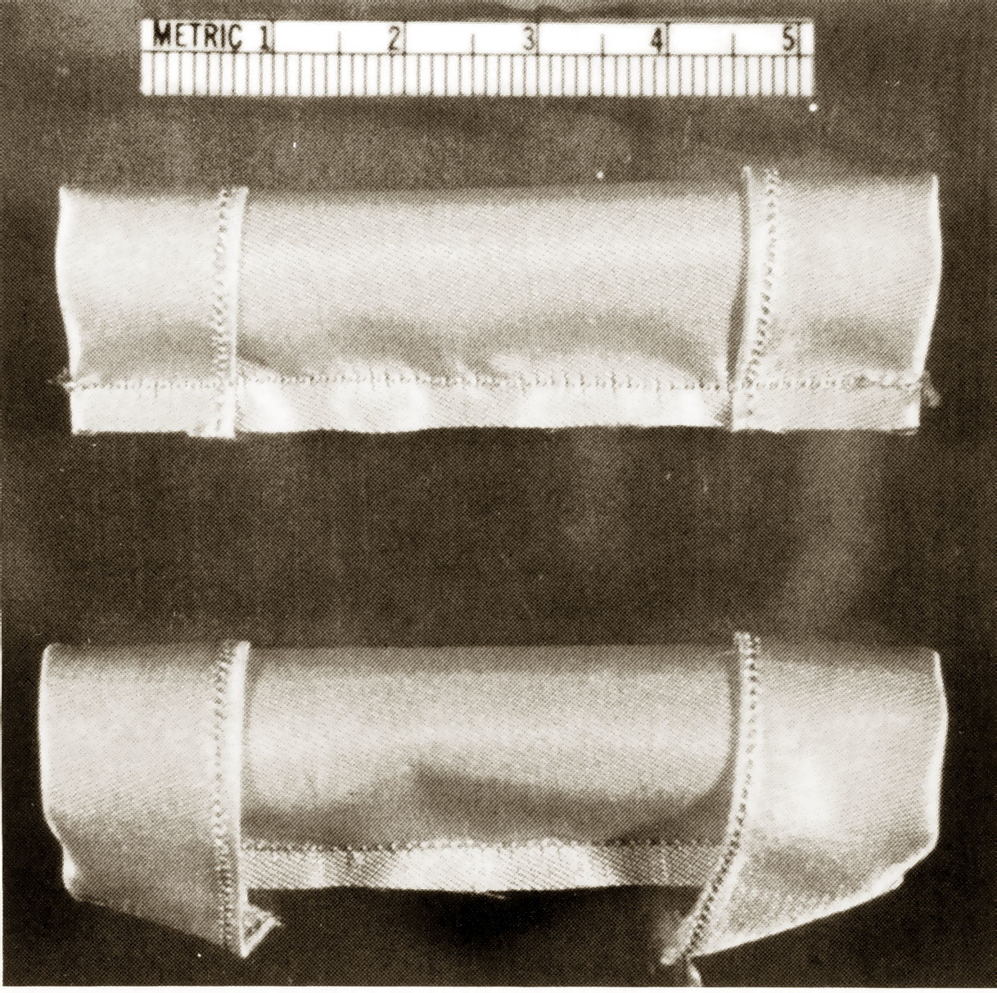
The first
Synthetic
Nylon-graft
Voorhees
New york
1951
Smith R.B. J. Vasc. Surg., 1993

Slide 18
Localisation
AAA
Thoracoabdominal aneurysm
Femoral
Popliteal
Cerebral
Internal Iliac artery
Branches aorta

Slide 19
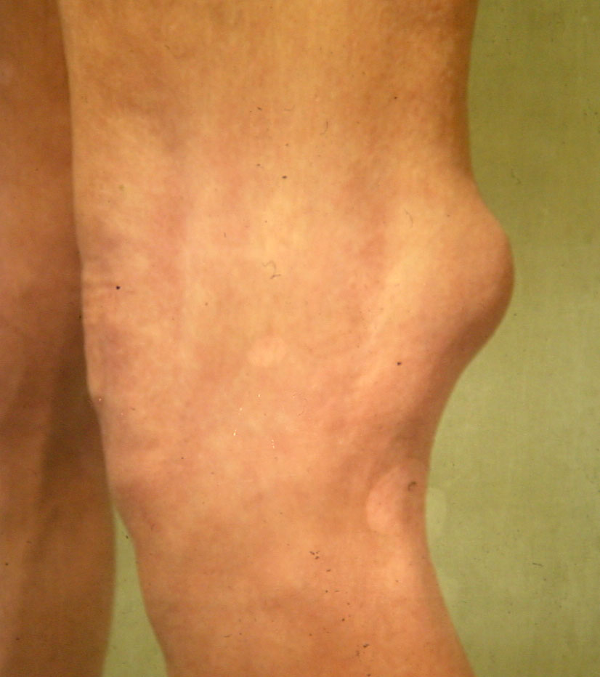

Slide 20
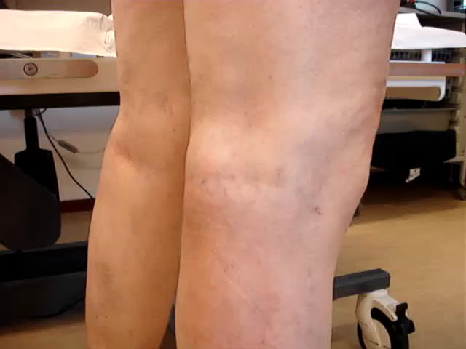

Slide 21
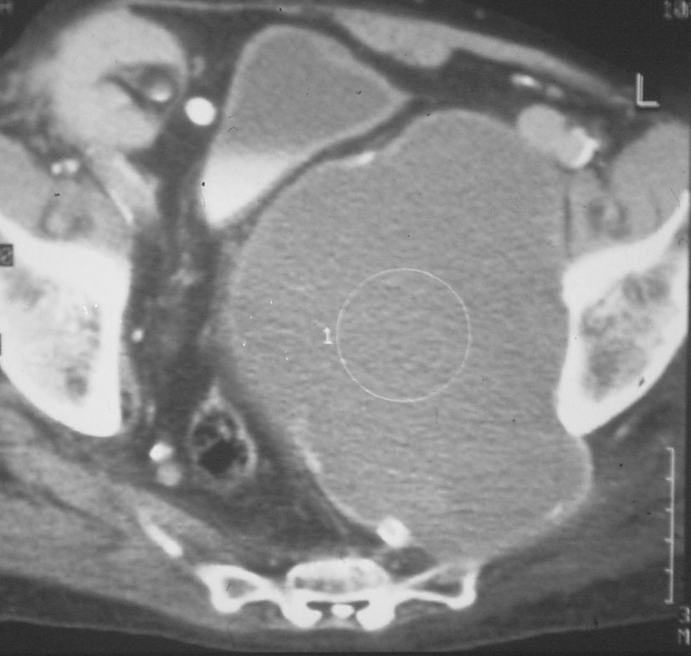
Symptomatology
None!!!!!
Expansion > Pain > Rupture
Local problem
  Knee
  Internal iliac artery: Hydronephrosis

Slide 22
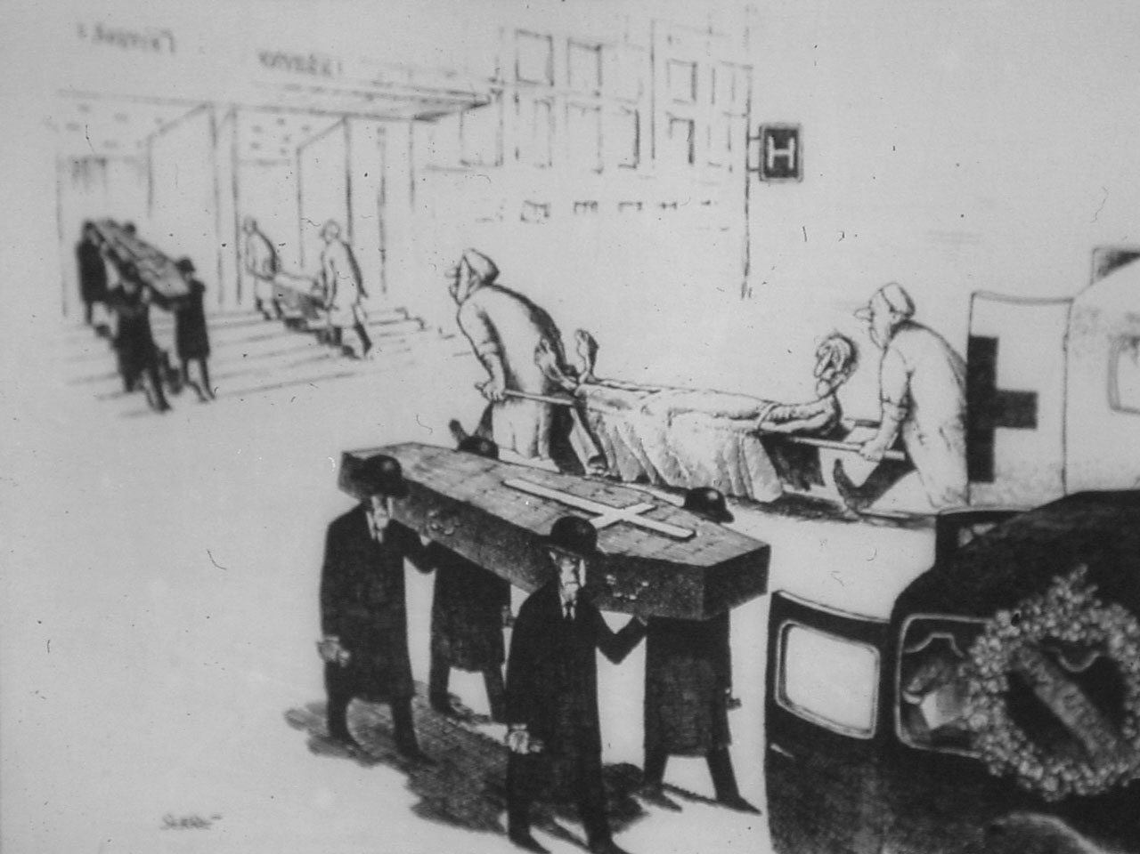
Dangers!!
Rupture
Thrombo-embolisation

Slide 23
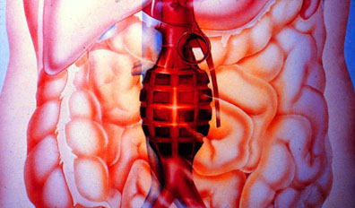
Mortality of RAAA 40-90%
Notes:
And with a mortality of 48% it is not surprising that we are looking for a different treatment modality

Slide 24
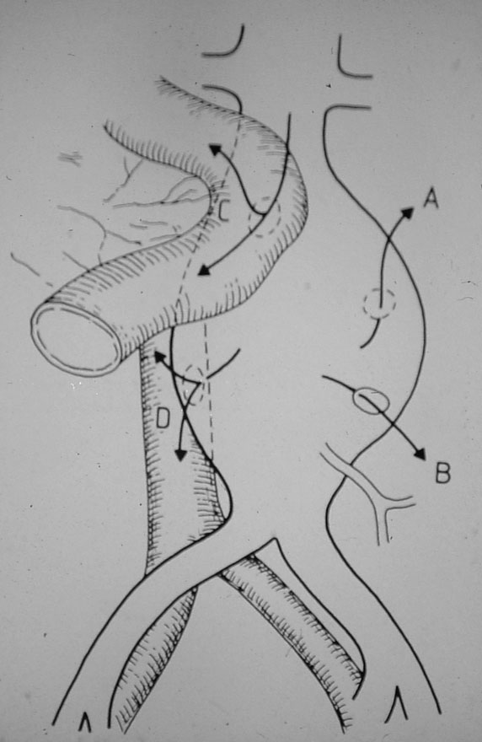
Rupture to…
A. Retroperitoneal
B. Transperitoneal
C. Aortoduodenal fistula
D. Aortocaval fistula

Slide 25
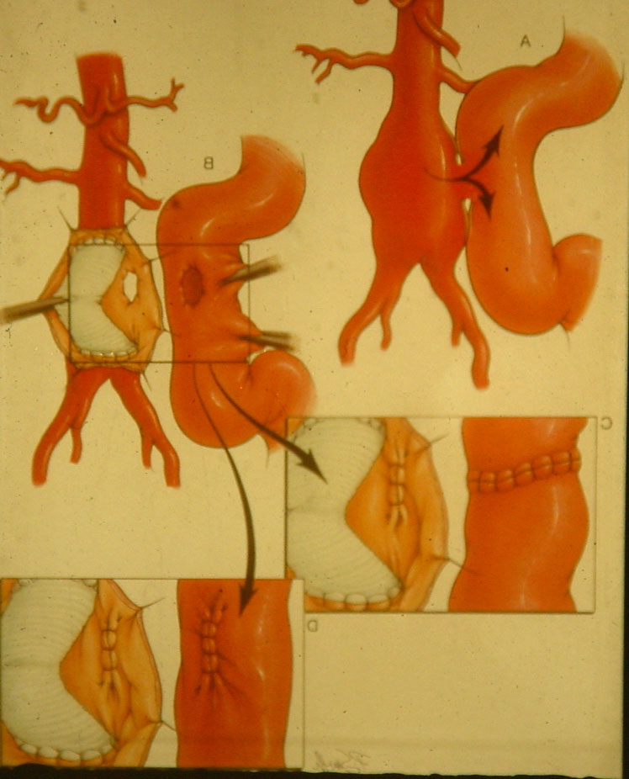
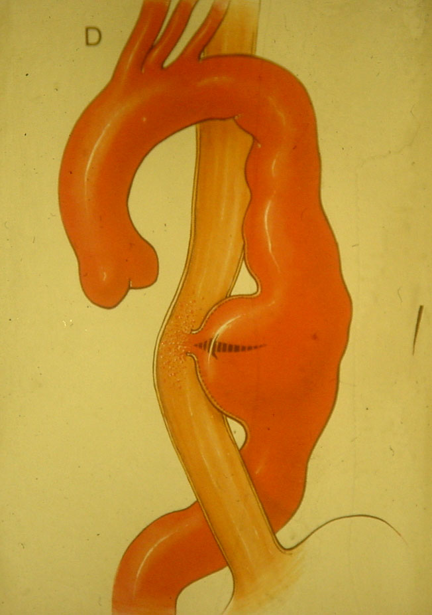
Aorto-enteric fistula

Slide 26
Symptoms acute/ruptured AAA
Acute onset of back pain
Abdominal pain
Shock
(Hemoptoe)
(Right sided heart failure)
Suspicion:
  Palpabele pulsating mass in abdomen
  Elderly man

Slide 27
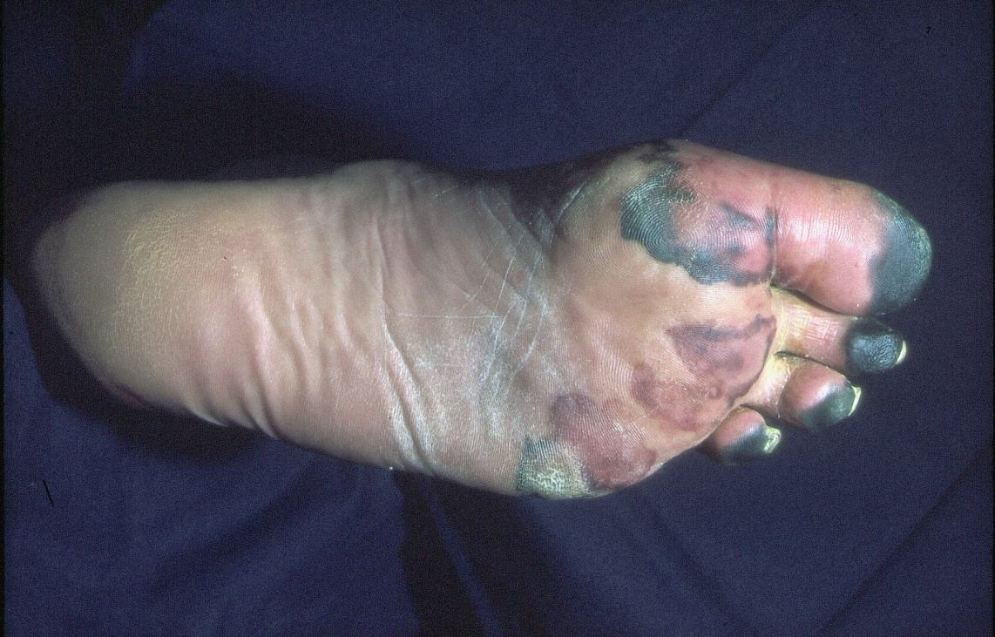
Dangers!!
Rupture
Thrombo-embolisation

Slide 28
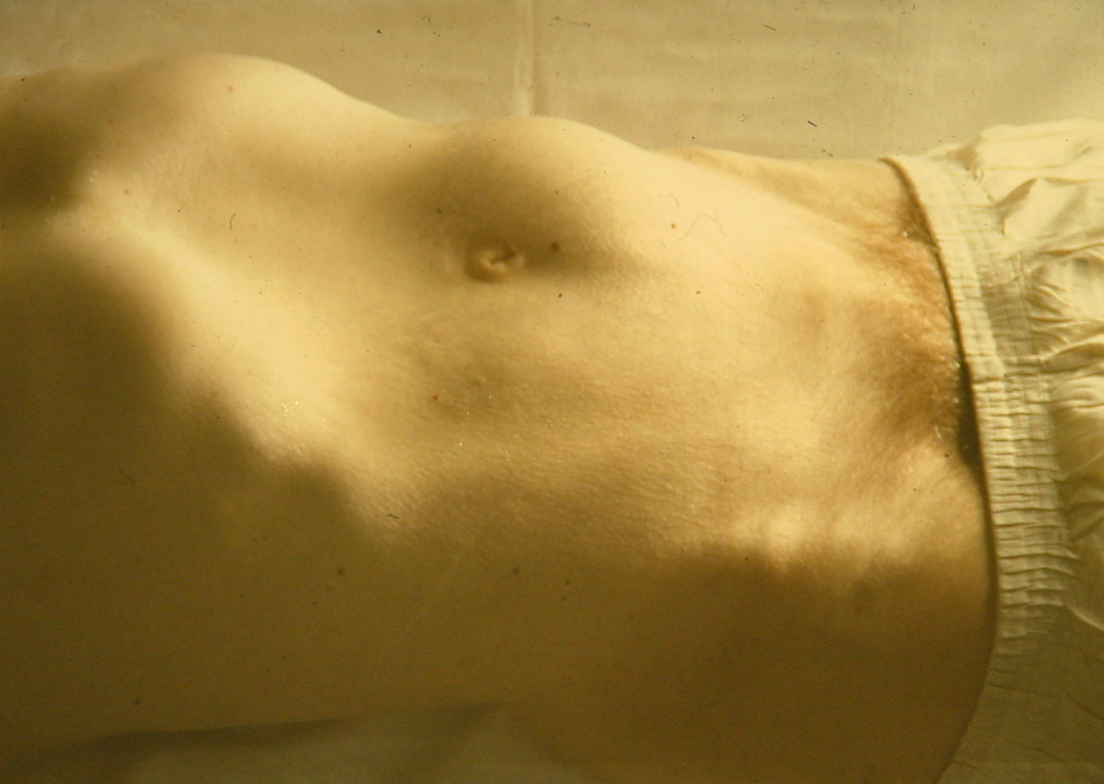
Diagnosis
Clinical examination
Co-incidental:
  Urology
  Internal Medicine

Slide 29
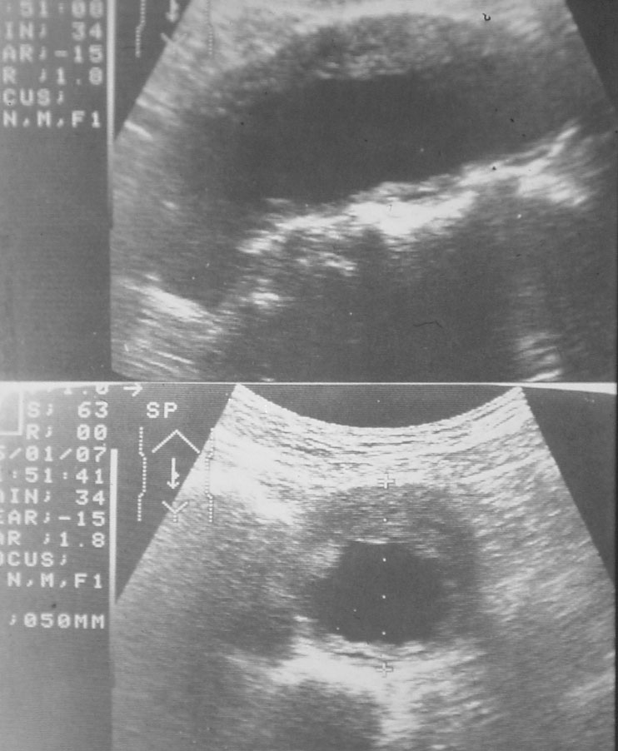
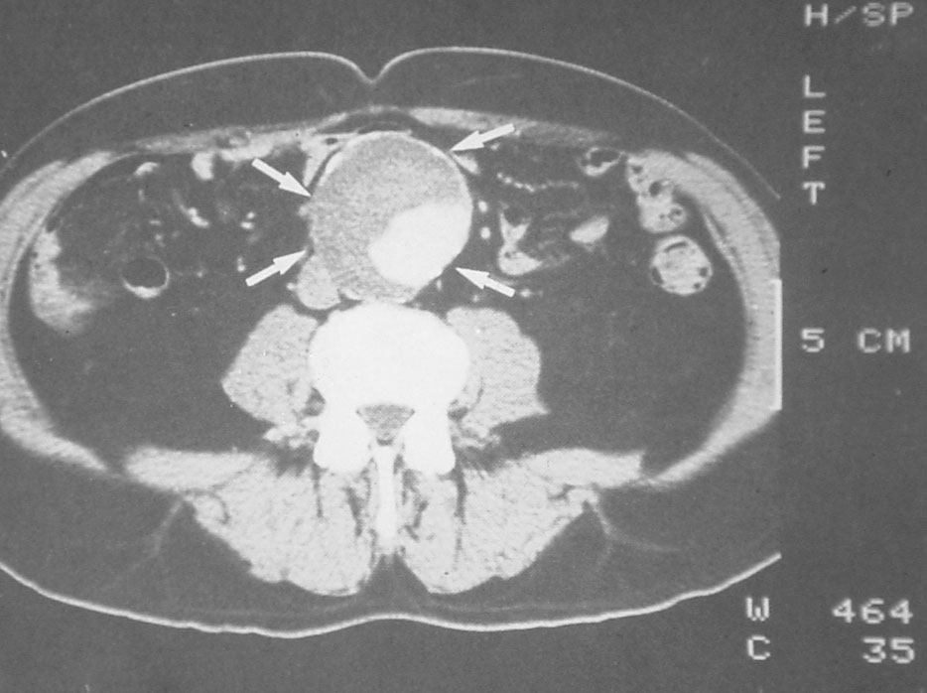
Utrasound/CTscan

Slide 30
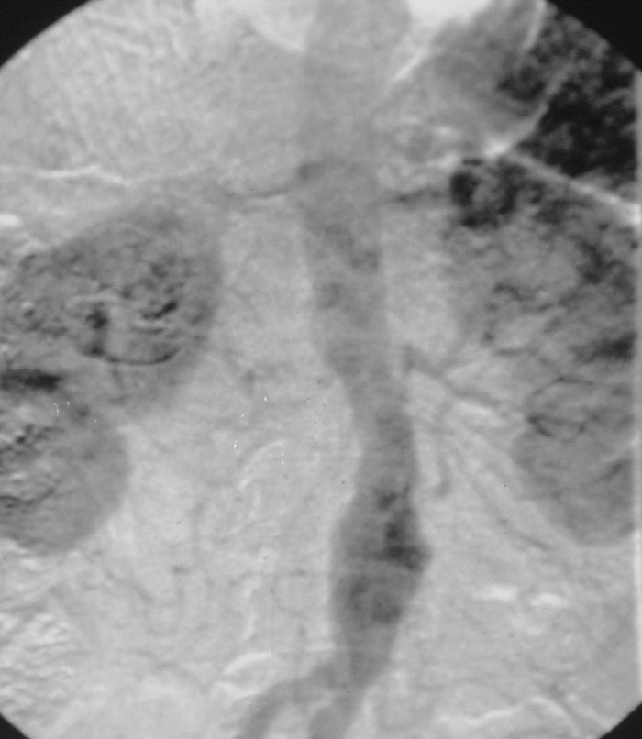
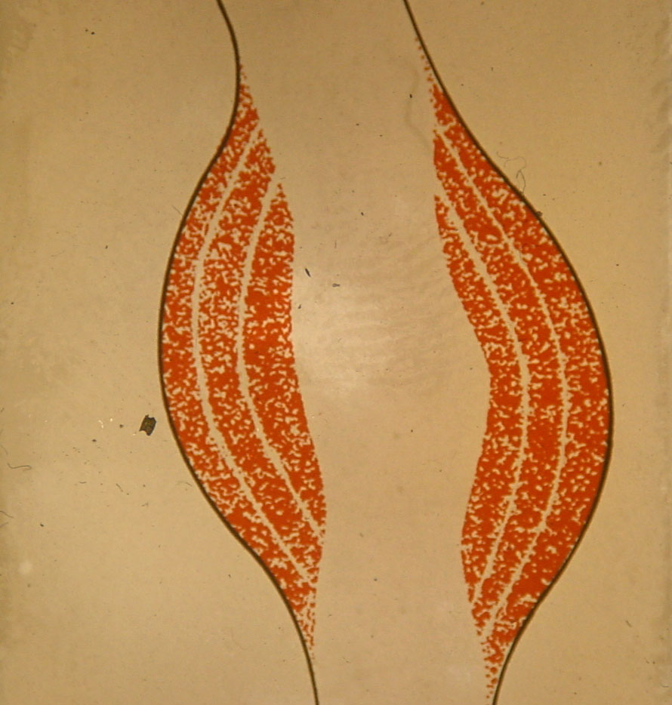
Angiography: NO!

Slide 31
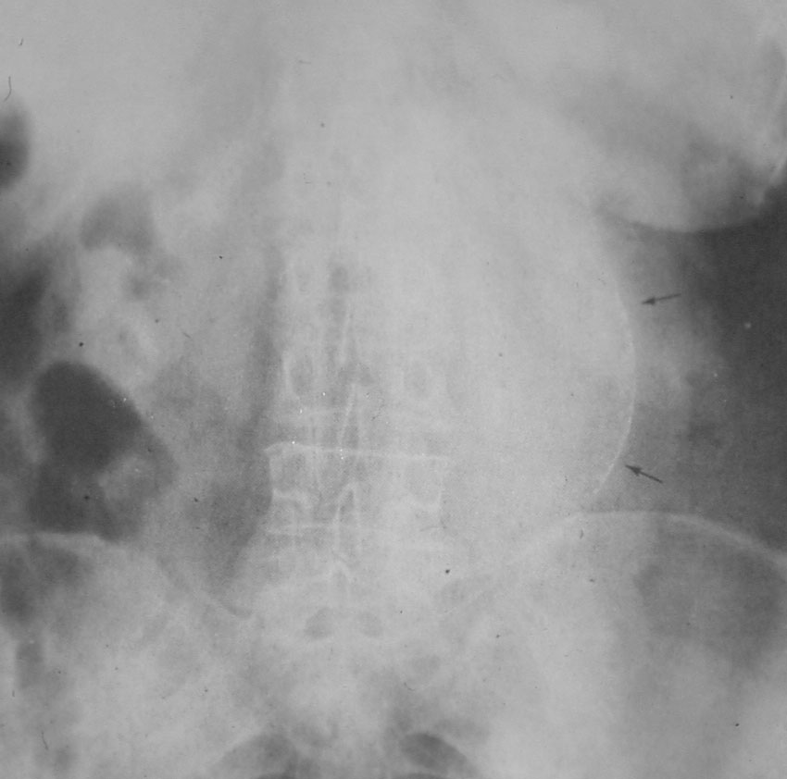
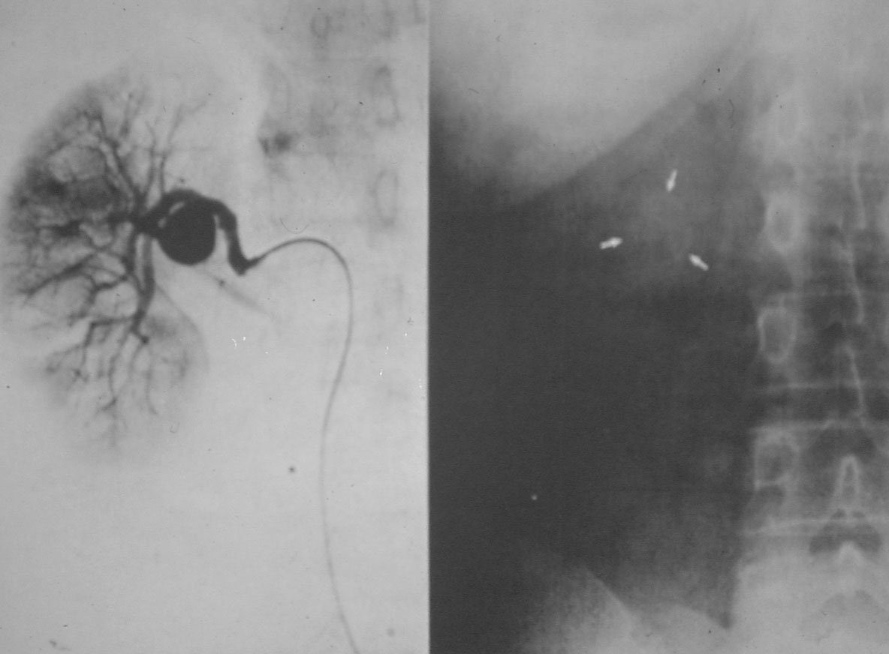
X-Ray

Slide 32
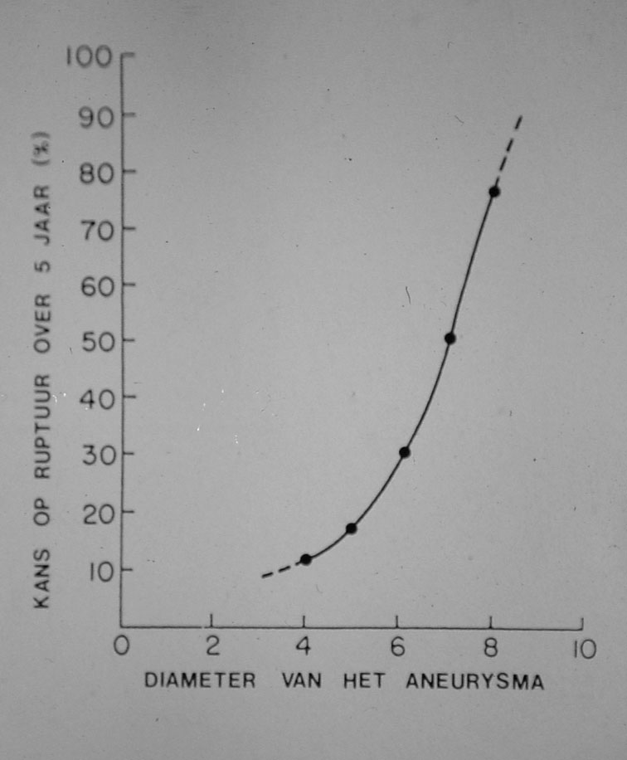
Treatment
Preventive
Exclusion of the aneurysm
Balance: risk of the procedure vs. risk of rupture

Slide 33
Treatment
General rule of thumb:
  Man: > 5,5 cm
  Female: > 5 cm
Based (amongst other literature) on English “Small Aneurysm Trial”

Slide 34
Open Treatment
Big procedure
Mortality: 5-7 %
Morbidity
  Cardiac
  Pulmonal
  Renal
  Sexual

Slide 35
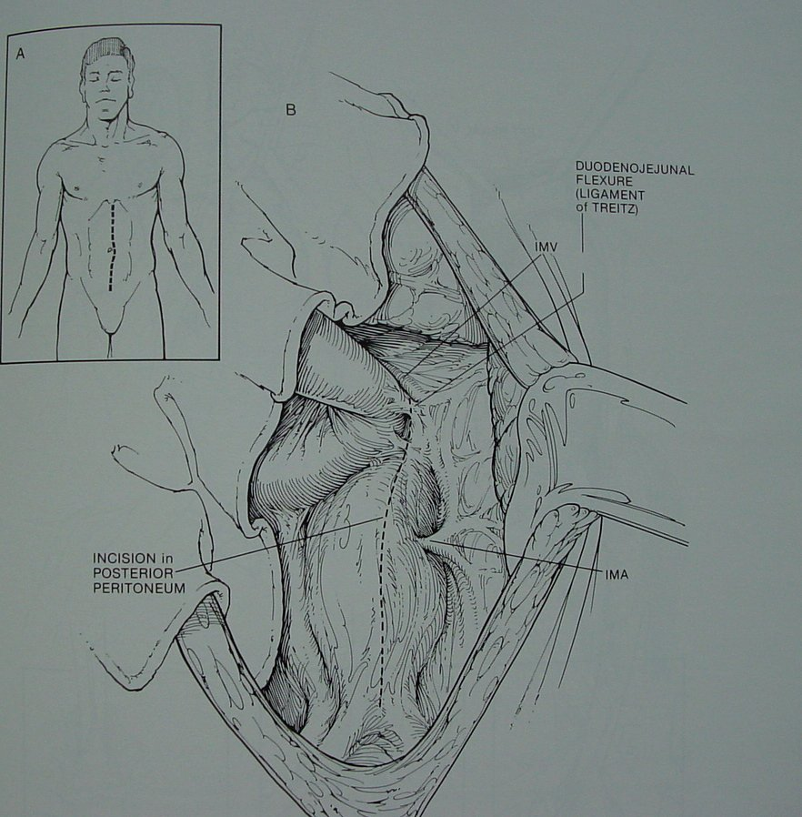
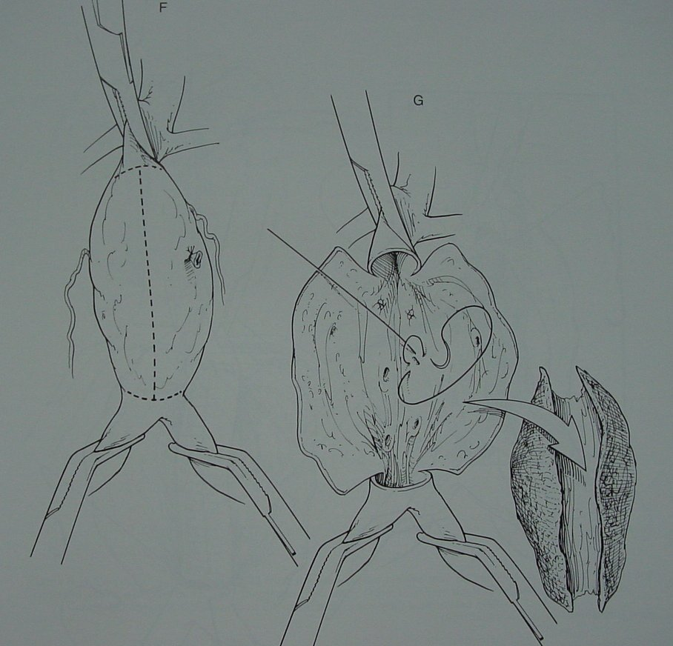
Open Surgery

Slide 36
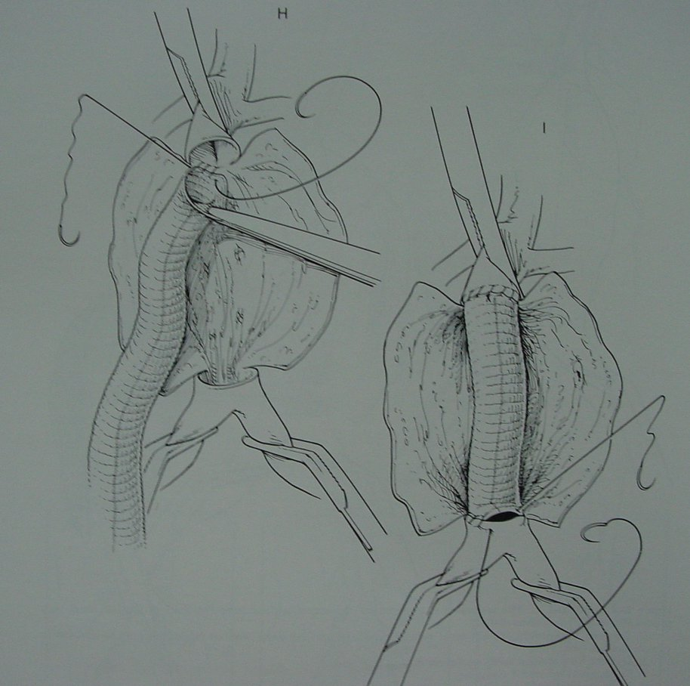
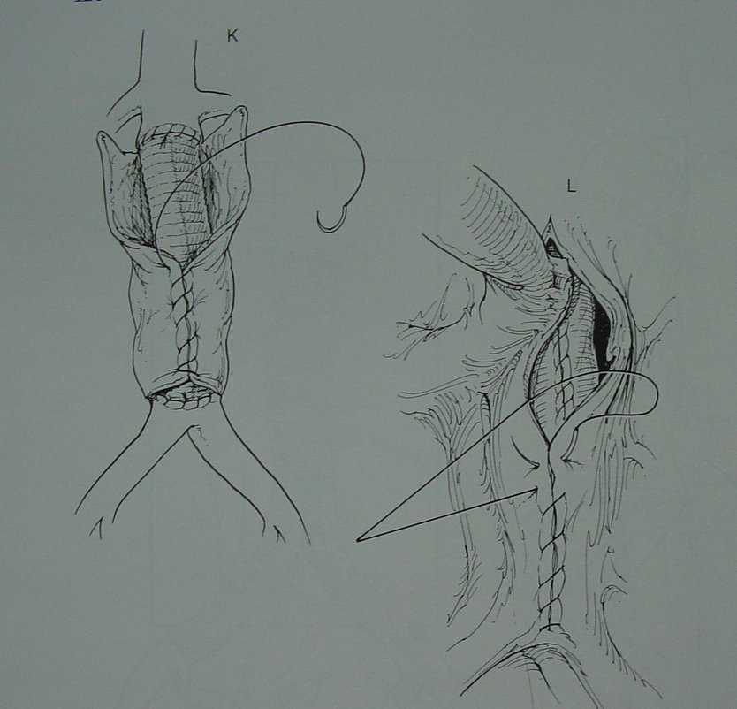
Open Surgery

Slide 37
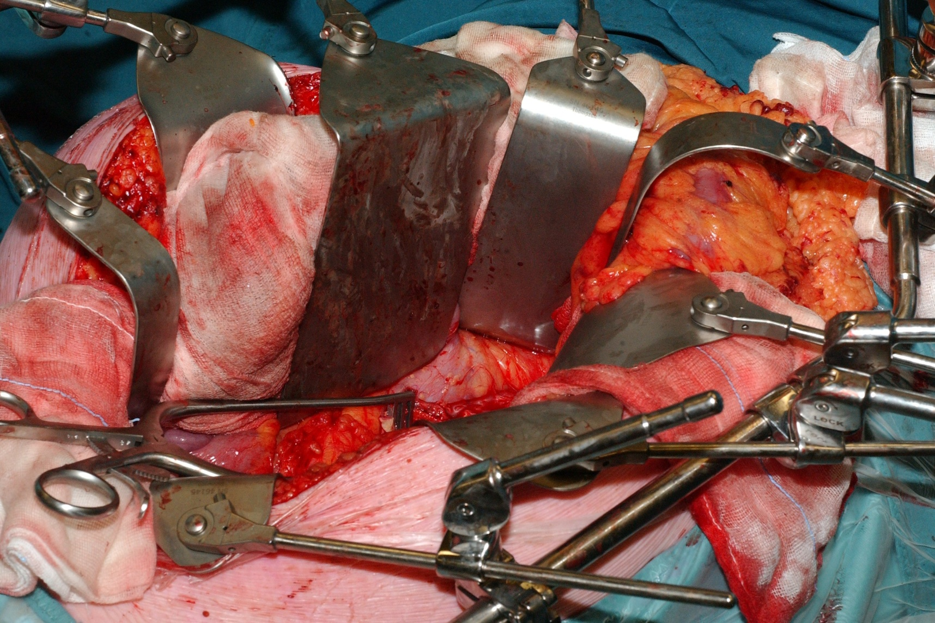
Open Surgery

Slide 38
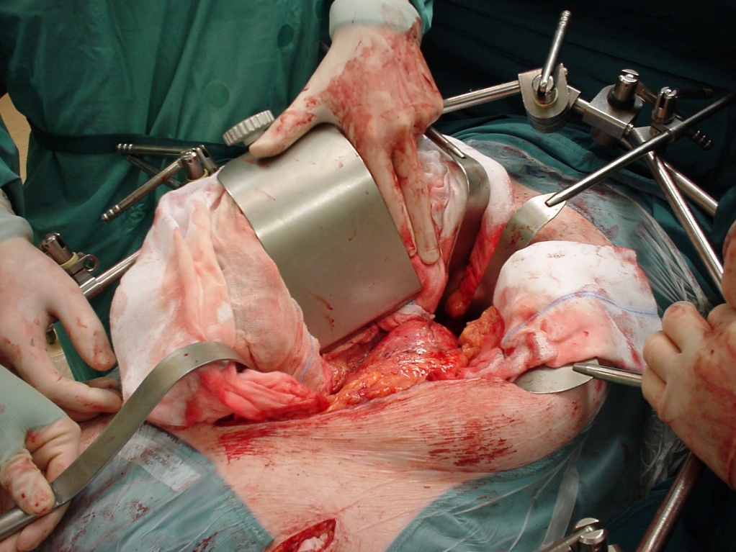
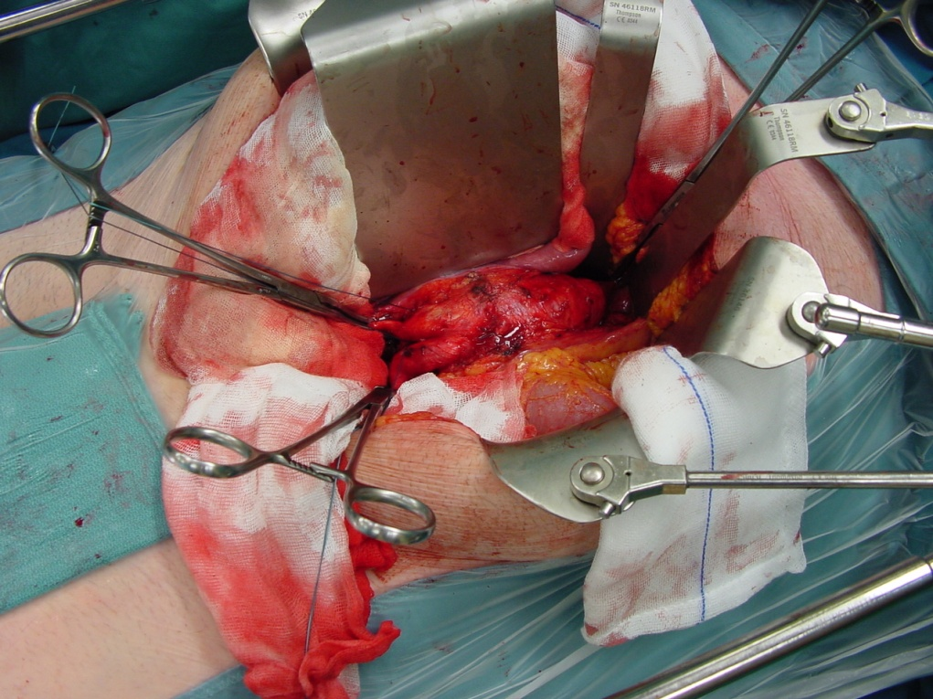
Open Surgery

Slide 39
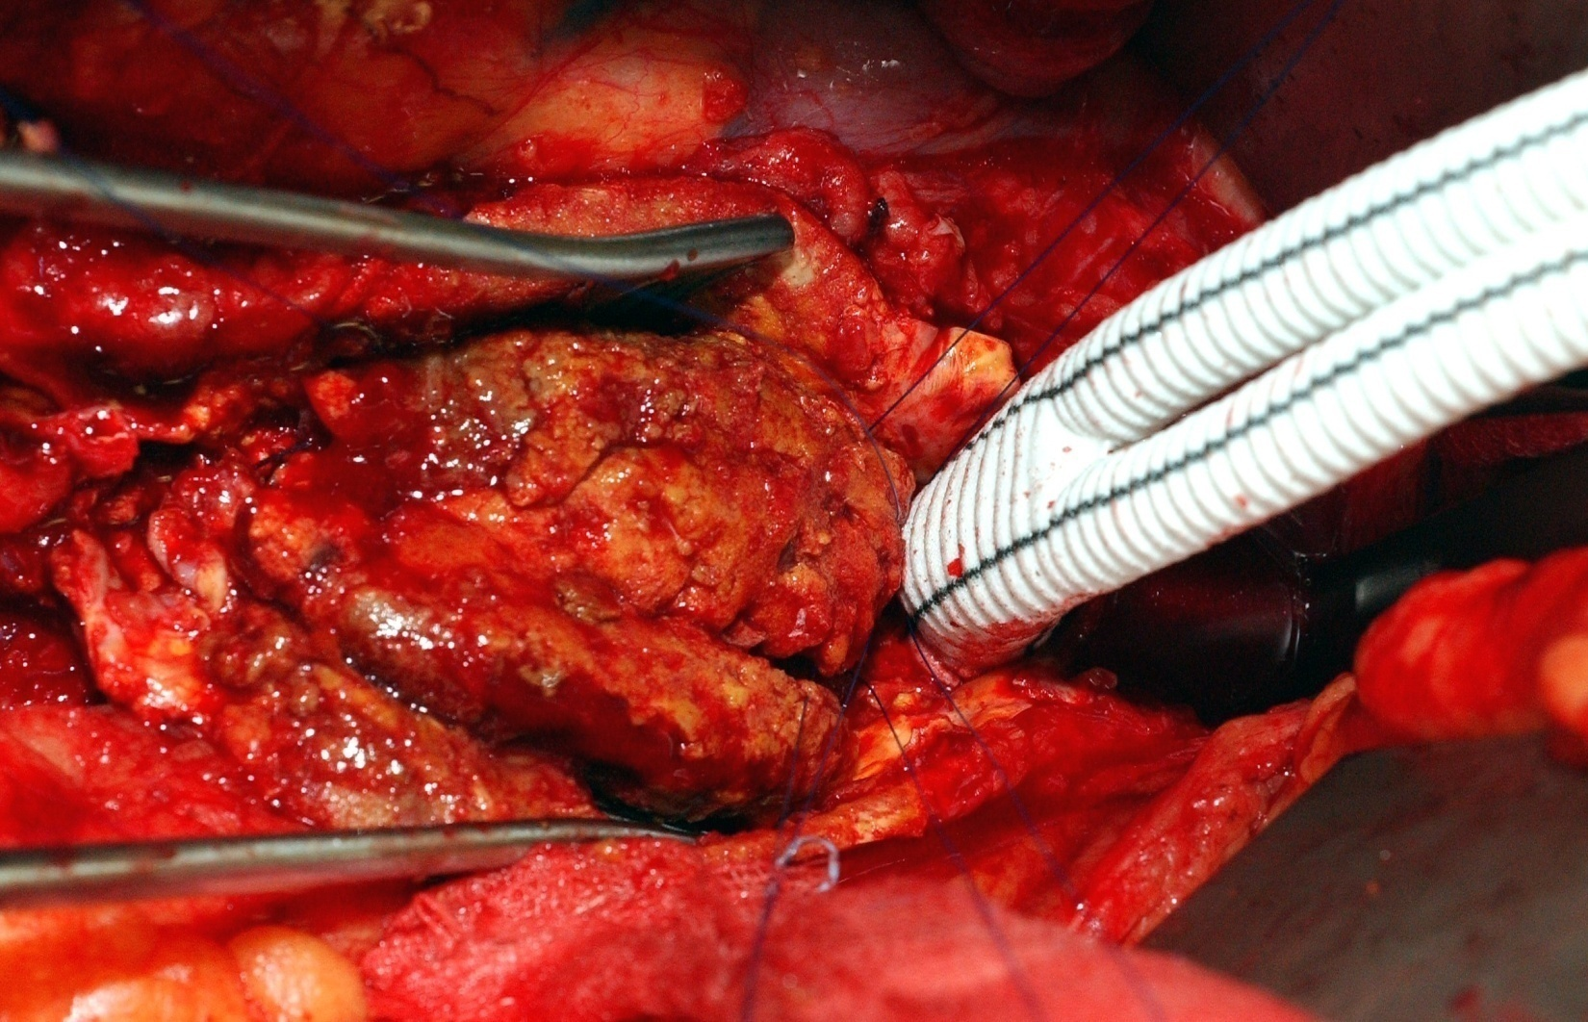
Open Surgery

Slide 40
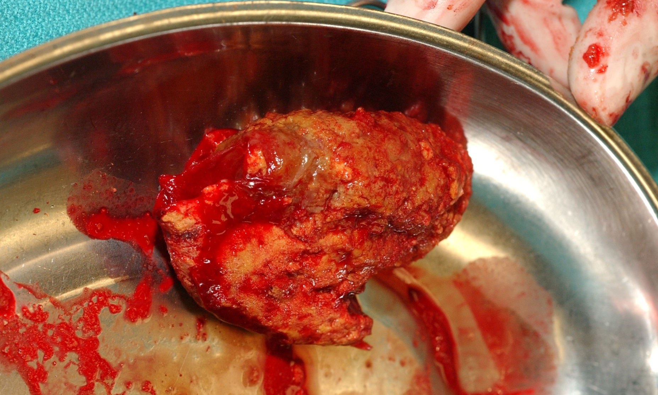
Open Surgery

Slide 41
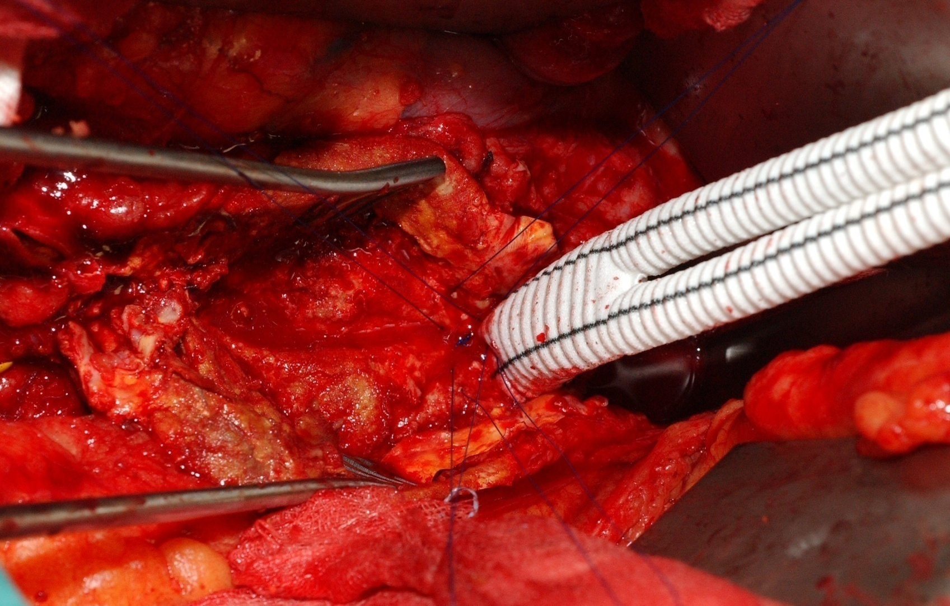
Open Surgery

Slide 42
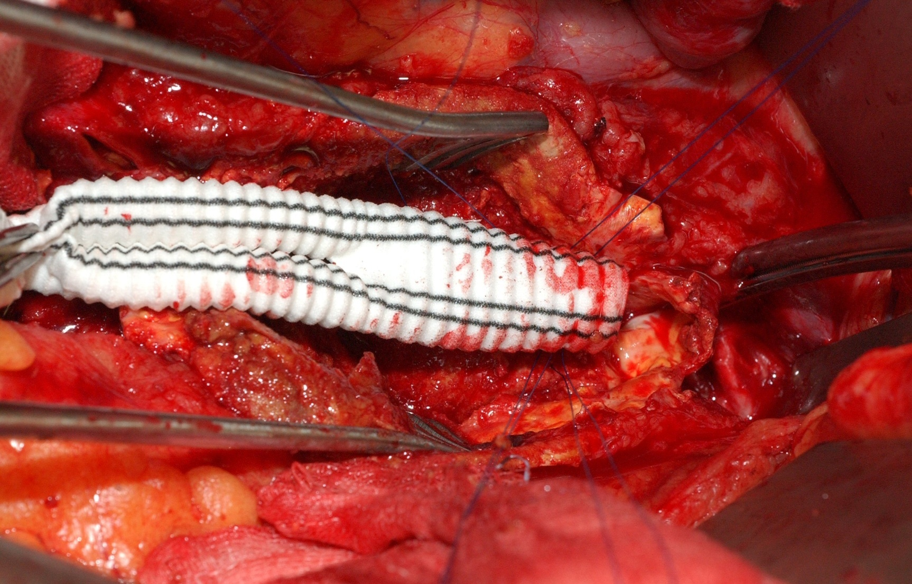
Open Surgery

Slide 43
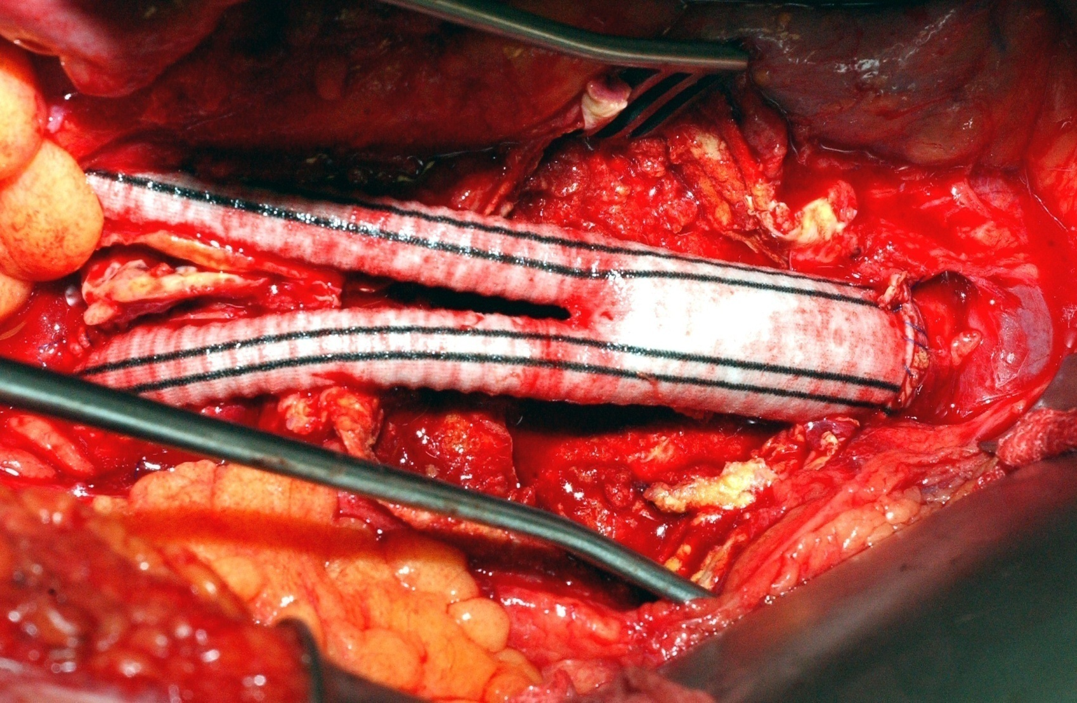
Open Surgery

Slide 44
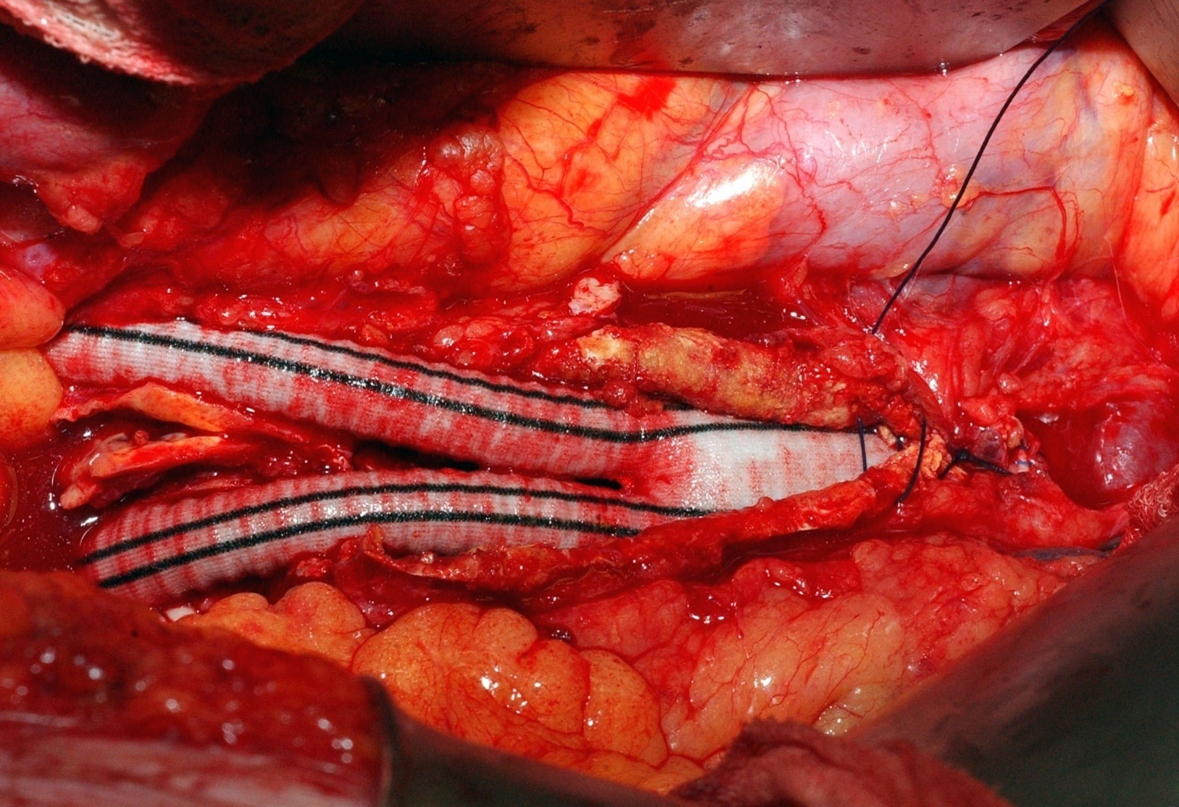
Open Surgery

Slide 45
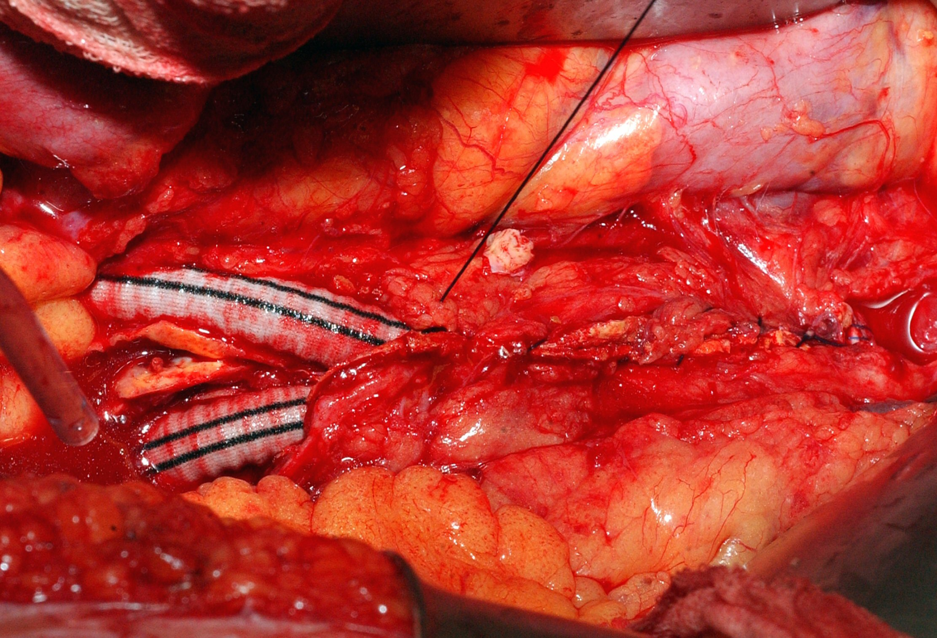
Open Surgery

Slide 46
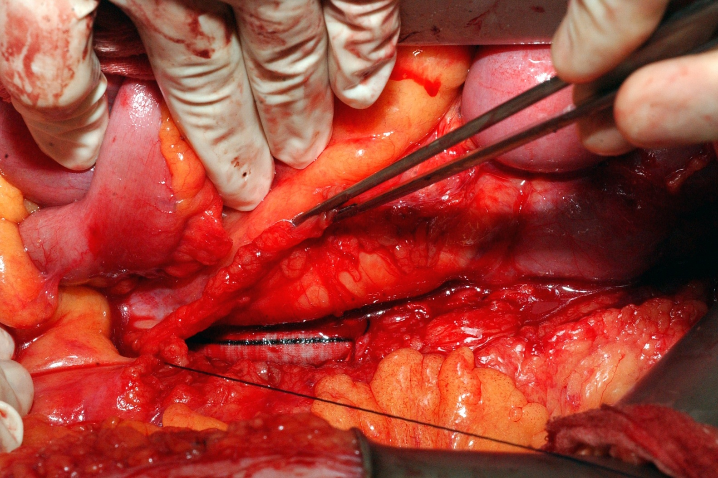
Open Surgery

Slide 47

Open Surgery

Slide 48

Open Surgery

Slide 49

Open Surgery

Slide 50

Open Surgery

Slide 51



Endovascular Treatment

Slide 52

Endovascular Treatment

Slide 53


Slide 54

Indication
Same as open surgery:
  Based on diameter
Landing zone
  proximal
  distal
Access

Slide 55

Advantages
Smaller procedure
No blood transfusion
No I.C.U
Quicker recovery
Lower mortality
Lower morbidity

Slide 56
Complications?
Occlusions
Endoleaks
Migrations
Material failure

Slide 57



Occlusion

Slide 58


Endoleaks

Slide 59



Migration

Slide 60
Material failure
Metal
  Stent fractures
  Desintegration
Prosthesis
  Tearing

Slide 61

Stent fracture

Slide 62

Tear in graft material

Slide 63
Endovascular treatment
Much smaller procedure
Mortality: < 1 %?
Option for about 50%
Strict follow-up needed
Longer term results?

Slide 64
EVAR: Risk Benefit Analysis
Reduced magnitude
Reduced morbidity / mortality
Patient preference
Reduced hospital stay
_
+
Reduced technical success
Reduced durability
Increased procedure cost

Slide 65
EVAR versus Open Repair
Indication for treatment
Information to the patient
Logistics
  Measuring & Ordering
  Bail-out (plan B/reserve material)
  Surgery-Radiology-Industry

Slide 66

Most problems …..
……. Bad planning!

Slide 67
Fenestrated and branched stent-grafting

Slide 68


Slide 69

1. Partial deployment
“Diameter reducing ties”
Purpose
  Catheterisation of fenestrations
  Allows for repositioning

Slide 70

2. Catheterisation of target vessel

Slide 71

Introducer guides

Slide 72

F49

Slide 73

3. Complete deployment
Opening “diameter reducing ties”
Deployment “top cap”

Slide 74


Slide 75

4. Stenting of fenestrations

Slide 76

Deployment of stent

Slide 77

“Flairing” of stent

Slide 78

“Flairing” of stent

Slide 79


Slide 80


Slide 81


Slide 82



Slide 83

Thoraco-abdominal Aneurysms (TAAA)

Slide 84



Slide 85


Slide 86


Slide 87
Treatment options
AAA patients
Conservative...
Open
Endovascular treatment
Fenestrated/Branched
~ age
~ co-morbidity
~ diameter
~ anatomy
~ choice patient

Slide 88
Bullit Points Aneurysm
Abnormal enlargement of a blood vessel
AAA most prevalent (Men above 65…)
Diagnosis: Clinical Examination, US, CT
Risk: Rupture
  Shock & acute back pain in elderly men
Preventive operation
  Balance Risk and Benefit
  Indication: > 5cm

