Slide 1
“Επιπλοκές Χοληφόρων”
ΕΣ Φελέκουρας

Slide 2
Complications
Complication (επιπλοκή): any deviation from the normal (ideal) postoperative course
Sequelae (επακόλουθο): cover conditions that are inherent in the procedure, and that thus will inevitably occur
  Example, scar formation or the inability to walk after an amputation.
Failure to cure (αποτυχία της θεραπείας): diseases or conditions that remain unchanged after surgery are not complications, but rather failure to cure
  example,
    early recurrence of inguinal hernia or
    incompletely resected malignant tumors,
    while clearly reflecting a negative outcome, are better covered under the term ‘‘failure to cure.’’
Dindo D, Clavien PA. What is a surgical complication? World J Surg 2008; 32(6):939-41.

Slide 3
Surgical Complication
Dictionaries: Is an unfavorable evolution or consequence of a disease, a health condition or a therapy (surgery here)
Latest definitions: ‘‘any deviation from the ideal postoperative course that is not inherent in the procedure and does not comprise a failure to cure’’
“οποιαδήποτε απόκλιση από την ιδανική μετεγχειρητική πορεία που δεν είναι εγγενής της επέμβασης και δεν ανήκει στην αποτυχία της θεραπείας”
Dindo D, Clavien PA. What is a surgical complication? World J Surg 2008; 32(6):939-41.

Slide 4
Systemic
Complication
  Any deviation from the normal (ideal) postoperative course
Medical mistake (error)
  A medical error is a preventable adverse effect of care, whether or not it is evident or harmful to the patient.
    This might include an inaccurate or incomplete diagnosis or treatment of a disease, injury, syndrome, behavior, infection, or other ailment.
By the State
By the Health care system
By the Physician

Slide 5
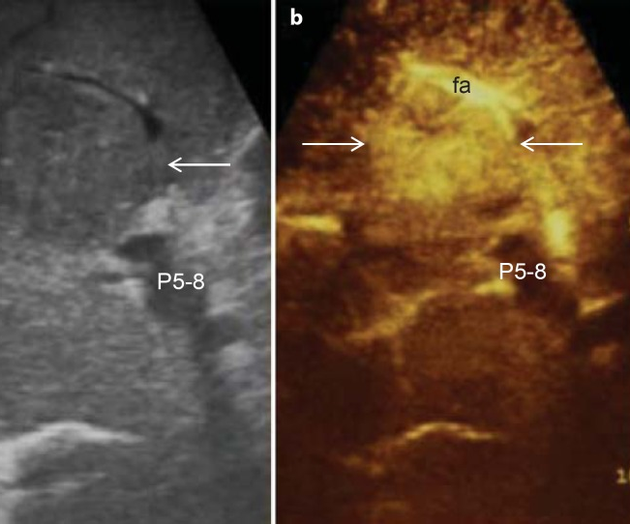

HCC-diagnosis (US)
Current surveillance for HCC
  ultrasound (US)
  with or without alfa-fetoprotein (AFP)
US is operator dependent, and
  all focal lesions on US should be verified using a 4-phase contrast enhanced study (unenhanced, arterial, portal venous, delayed)—multidetector contrast enhanced CT (CECT) or a
  dynamic contrast enhanced MRI (DCE-MRI) with nonspecific or liver-specific contrast agents (Eovist)
Dhir M, Melin AA, Douaiher J, et al. A Review and Update of Treatment Options and Controversies in the Management of Hepatocellular Carcinoma. Ann Surg 2016; 263(6):1112-25.
www.surgery.gr

Slide 6
Medical mistake (error)
Causes
  Healthcare complexity
  System and process design
  Competency, education, and training
  Human factors and ergonomics
Examples
  Errors in diagnosis
  Misdiagnosis of psychological disorders
  Most common misdiagnoses
  Outpatient vs. inpatient
After an error has occurred
  Recognizing that mistakes are not isolated events
  Placing the practice of medicine in perspective
  Disclosing mistakes
    To oneself
    To patients
    To non-physicians
    To other physicians
    To the physician's institution
    Use of rationalization to cover up medical errors
    By presence of to the patient
  Cause-specific preventive measures
  In specific specialties
  Legal procedure
Prevention
  Reporting requirements
Misconceptions

Slide 7
Medical mistake (error)
Όταν ο γιατρός δεν έχει τηρήσει τους κανόνες της ιατρικής επιστήμης είτε από άγνοια είτε από απειρία είτε από απερισκεψία ή ανεπιτηδειότητα.
Όταν έχει υπάρξει μια επιπλοκή είναι πολύ δύσκολο να διακρίνουμε εκ του αποτελέσματος αν ο γιατρός ενήργησε lege artis,
  σύμφωνα δηλαδή με τους κανόνες της ιατρικής επιστήμης και τέχνης ή υπέπεσε σε σφάλμα

Slide 8
The real controversy
Medical mistake vs. Complication
(key points: Documentation and Witness)

Slide 9
Complications
Όλες οι επεμβάσεις έχουν τον κίνδυνο επιπλοκών.
Μπορεί να είναι 0,1%, μπορεί να είναι και πολύ μεγαλύτερος.
Ο γιατρός γνωρίζει ότι η συγκεκριμένη επέμβαση μπορεί να έχει επιπλοκές,
  αλλά δεν γνωρίζει αν θα συμβούν στο συγκεκριμένο ασθενή,
  ακόμη και αν ενεργήσει την επέμβαση lege artis

Slide 10
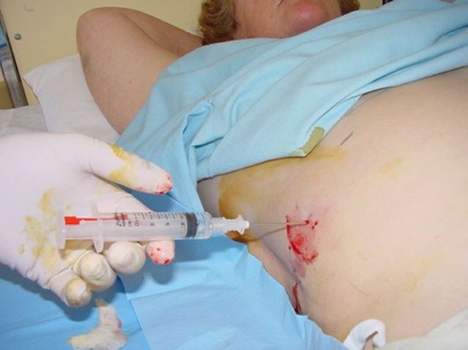
Liver biopsy
Recommendations
Liver biopsy should be considered in patients in whom diagnosis is in question, (Class I, Level B)
When knowledge of a speciﬁc diagnosis is likely to alter the management plan (Class I, Level B).
Liver histology is an important adjunct in the management of patients with known liver disease, particularly in situations where (prognostic) information about ﬁbrosis stage may guide subsequent treatment; the decision to perform liver biopsy in these situations should be closely tied to consideration of the risks and beneﬁts of the procedure (Class I, Level B)
Rockey DC, Caldwell SH, Goodman ZD, et al. Liver biopsy. Hepatology 2009; 49(3):1017-44.
AASLD POSITION PAPER

Slide 12
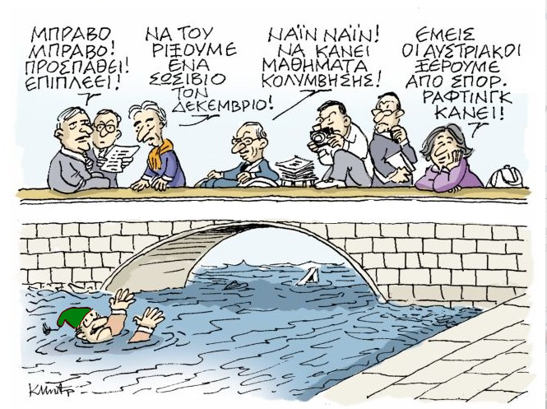
ΧΕΙΡΟΥΡΓΟΣ ΜΕΤΑ ΑΠO ΤΡΑΥΜΑ ΧΟΛΗΦΟΡΩΝ

Slide 13
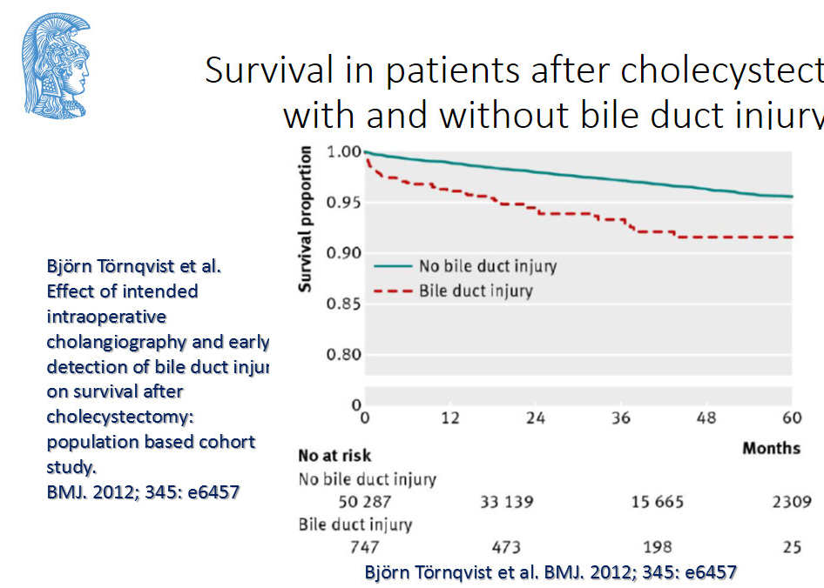
BDI
complication vs. mistake

Slide 14
Attributed to
General health of the patient
Preoperative care
Magnitude of the operation
Quality of postoperative care

Slide 15
Complications of major surgery can be broadly classified as those:
  Due to anesthesia
  Due to surgery

Slide 16
Due to surgery
Perioperative complications
Postoperative complications
  Immediate/early complications
  Late complications

Slide 17

By failing to prepare, you are preparing to fail
Benjamin Franklin

Slide 18
Summary of Preoperative Evaluation
  Cardiovascular
  Pulmonary
  Renal
  Hematologic
  GI
    History of GI bleeding
    Previous operation for ulcers or carcinoma,
    GER disease
  Endocrine
  Infection
  Medication
Biliary

Slide 19
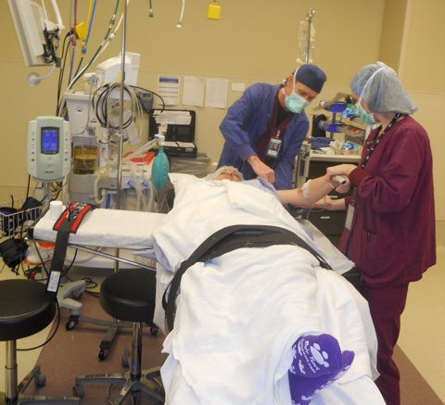
Surgical Basics
Preventing injury and error
Jan Moss, RN

Slide 20
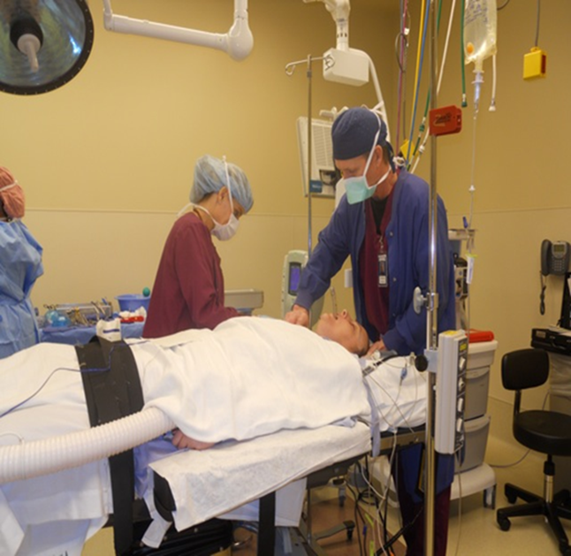
Anesthesia Choices
  Goals of anesthesia
    Exposure, Relaxation
    Keep patient alive
    Pain free, unaware, stable
  Local Anesthesia
  Regional Anesthesia
  Conscious Sedation
  General Anesthesia
    LMA vs. Intubation
Many photos courtesy of John DiPaola, MD

Slide 21
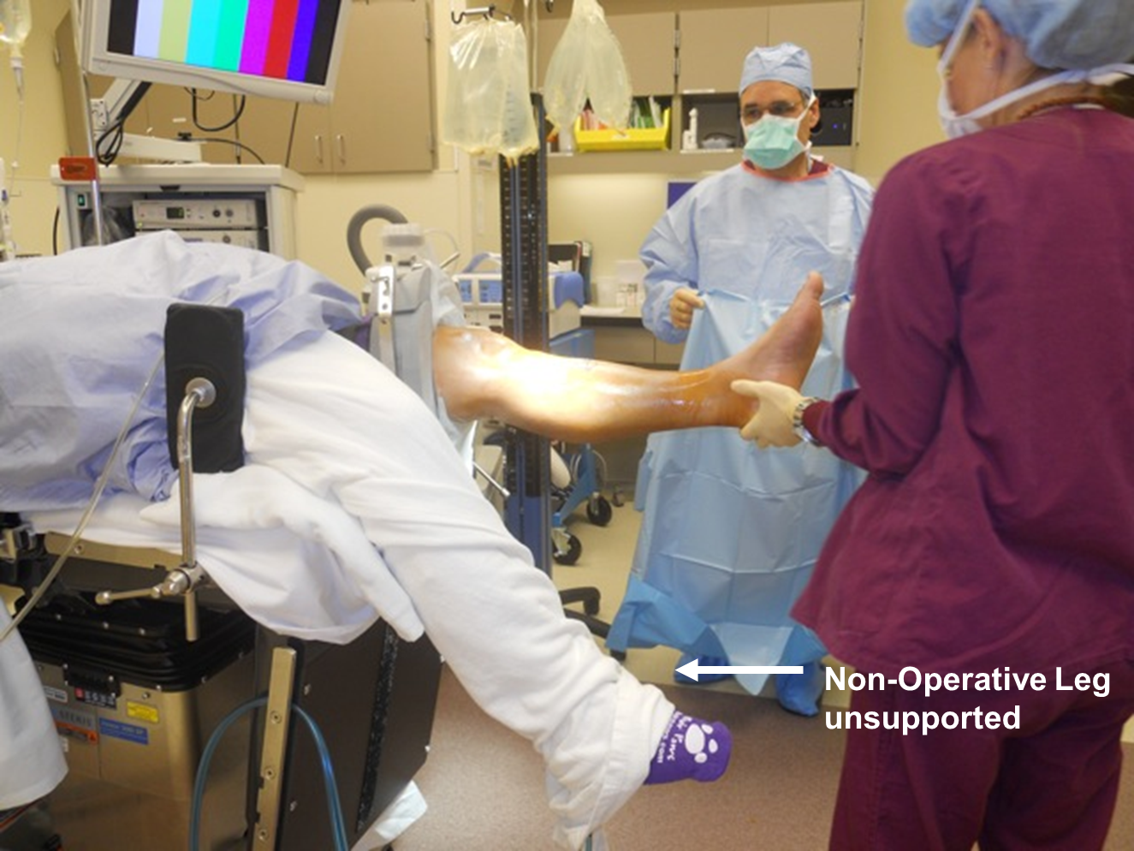
Surgical Positioning
Goals
  Exposure for surgeon
  Immobilize patient
  Injury prevention
    Maintain circulation
    Maintain anatomic alignment
    Prevent pressure points

Slide 22
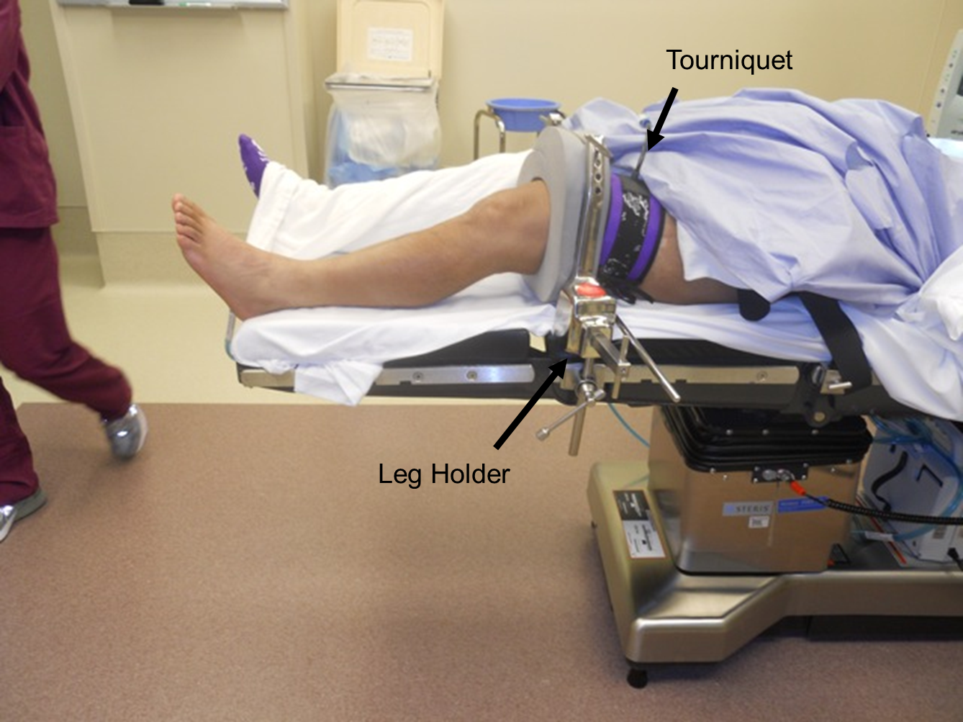
Surgical Positioning
Considerations
  No movement for minutes to hours
  No ability to identify pain
  Sometimes exposure wins out over comfort
  Even supine can be injurious

Slide 23
Documentation
“The table was placed in beach chair configuration. Head, neck, trunk and limbs were padded and protected in appropriate fashion.”
“The right lower extremity was prepped and draped in the usual sterile fashion.”
“Bilateral upper extremities were prepped and draped in standard sterile fashion.”

Slide 24
GI bleeding- necrosis
Hemorrhage:
  Occurs gastrointestinal anastomosis
  Manifest – hematemesis, melena, hematochezia
  Bleeding arise from the suture line (usually after gastric resection
  Treatment:
    1st conservative: irrigation w/ cold lavage / endoscopy
    Reoperation – direct control
Gangrene:
  Due to poor tissue perfusion
  Stomach:
    Following subtotal gastrectomy w/ ligation of left gastric and splenic arteries; thrombosis
  Small bowel and colon:
    Thrombosis; mechanical strangulation (internal herniation) – volvulus, adhesions
  Treatment:
    Resection of gangrenous segment, re-established continuity

Slide 25
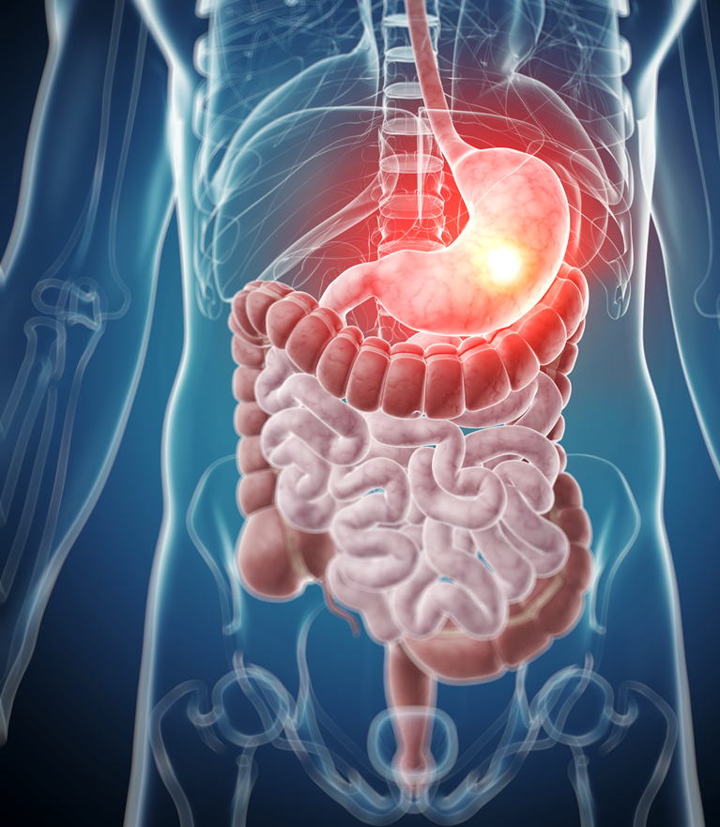
GI system

Slide 26
Complications: Who Knows better ??
What operation did the patient have?
What are the most common complications of this operation?
What is most life-threatening?
What comorbidities does that particular patient have?

Slide 27
Complications: Who Knows better ??
Each surgical procedure has its own set of inherent complications
Surgeon treating the patient usually has the best idea as to what is happening

Slide 28
Common Post Operative Complication
post
Major Surgery
Post Operative Pain
Bleeding : Hypovolemia
Hypoxia : Hypoventilation
Hemodynamic Unstable
Fluid & Electrolyte imbalance
Wound Complication
  Hematoma, infection
  Dehiscent, Keloid
Post Operative infection : wound (Site of Operation)
Post Operative Renal Failure
Liver Failure
Hematological disorder: Coagulopathy
Post Operation Sepsis : ARDS
Post Operative Respiratory Failure :
  Atelectasis,
  Pneumonia,
MOF
Hematoma, Seroma, Intraabdominal
CVS, arrhythmia, Hypovolemia
Contractility (MI)
Post Op Pulmonary edema, CHF

Slide 29

Surgical safety
The holistic idea of Hippocratic medicine
Only with careful attention to both the individuality of illness and the universality of disease etiology can physicians most effectively care for their patients
Mantri S. Holistic medicine and the Western medical tradition. Virtual Mentor 2008; 10(3):177-80.

Slide 30
Three central problems in Surgical safety
Unrecognized as a public health issue
Lack of data on surgery and outcomes
Failure to use existing safety know-how

Slide 31
Unrecognized as a public health issue
234 million operations are done globally each year Source: Weiser, Lancet 2008.

Slide 32
Unrecognized as a public health issue
Known surgical complications of 3-16%
Known death rates of 0,4-0,8%
At least 7 million disabling complications – including 1 million deaths – worldwide each year

Slide 33
Unrecognized as a public health issue (cont.)
Burden of surgical disease is increasing worldwide due to
    Cardiovascular disease
    Traumatic injuries
    Cancer
    Longer life expectancies

Slide 34
Lack of data on surgery and outcomes

Slide 35
Failure to use existing safety know-how
High rates of preventable surgical site infection result from inconsistent timing of antibiotic prophylaxis
Anesthetic complications are 100-1000x higher in countries that do not adhere to monitoring standards
Wrong-patient, wrong-site operations persist despite high publicity of such events

Slide 36
The Safe Surgery Saves Lives: Strategy
Promotion of surgical safety as a public health issue
Creation of a checklist to improve the standards of surgical safety
Collection of “Surgical Vital Statistics”

Slide 37
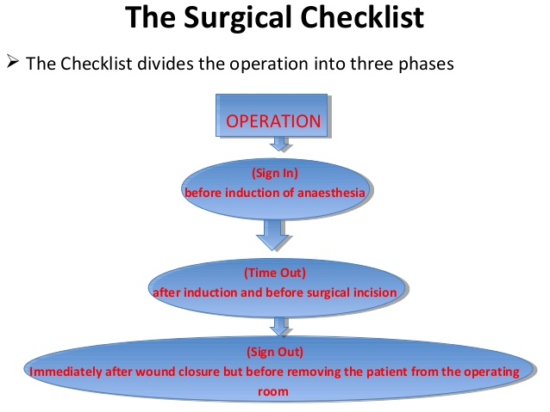
Surgical safety

Slide 38
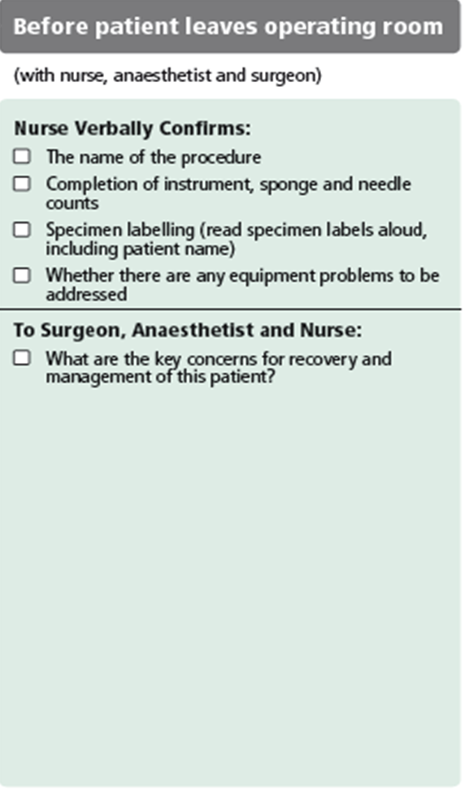
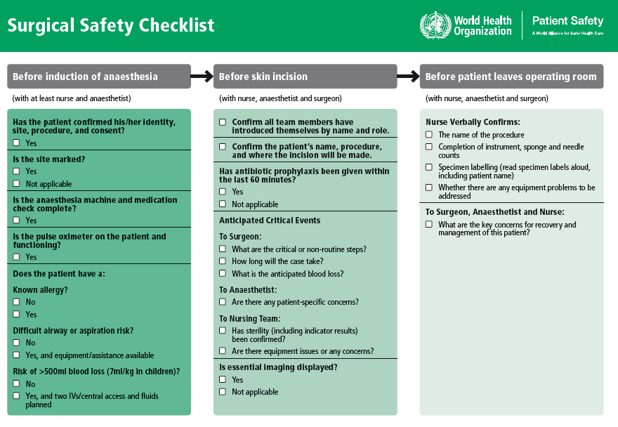
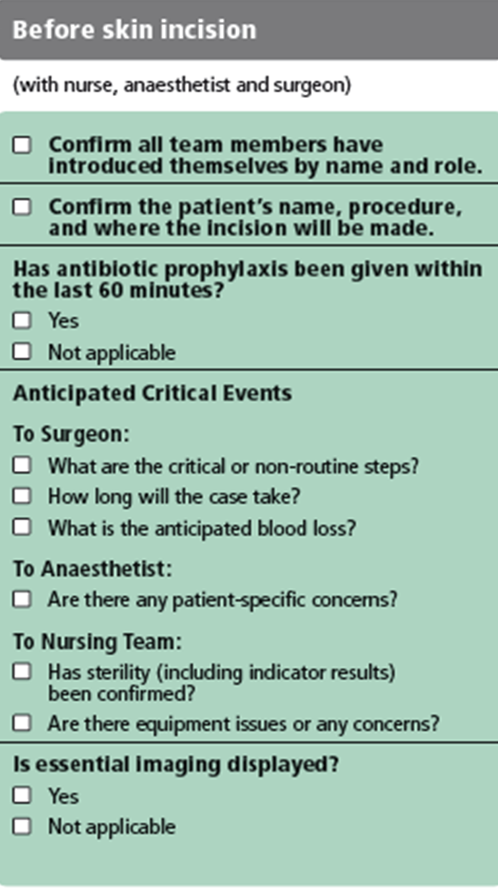
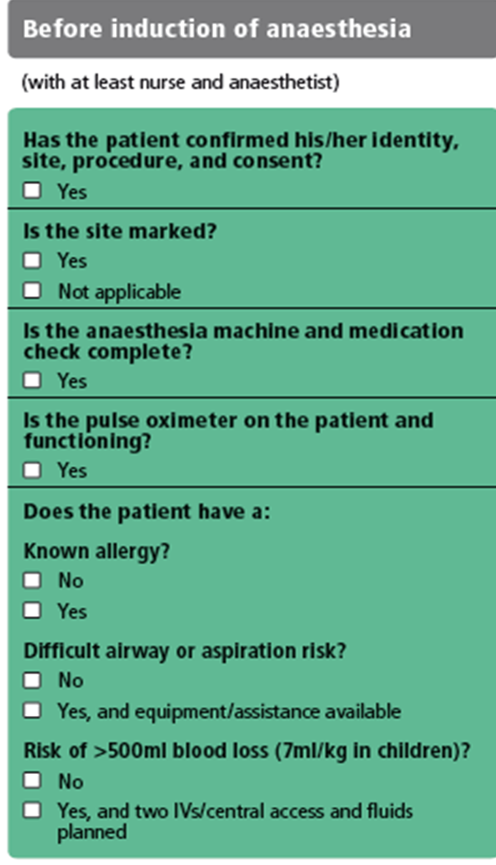
What is this tool that addresses the 10 objectives?
The team will operate on the correct patient at the correct site.
The team will use methods known to prevent harm from administration of anesthetics, while protecting the patient from pain.
The team will recognize and effectively prepare for life-threatening loss of airway or respiratory function.
The team will recognize and effectively prepare for risk of high blood loss.
The team will avoid inducing an allergic or adverse drug reaction for which the patient is known to be at significant risk.
The team will consistently use methods known to minimize the risk for surgical site infection.
The team will prevent inadvertent retention of instruments or sponges in surgical wounds.
The team will secure and accurately identify all surgical specimens.
The team will effectively communicate and exchange critical information for the safe conduct of the operation.
Hospitals and public health systems will establish routine surveillance of surgical capacity, volume and results.

Slide 39
Reality Check
Currently, hospitals
  do MOST of the right things,
  on MOST patients,
  MOST of the time.
The Checklist helps us
  do ALL the right things,
  on ALL patients,
  ALL the time

Slide 40
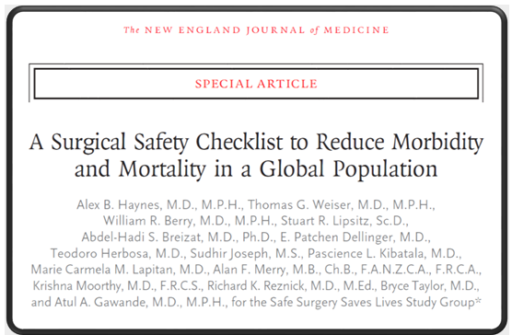
Results
The rate of death was 1.5% before the checklist was introduced and declined to 0.8% afterward (P = 0.003).
Inpatient complications occurred in 11.0% of patients at baseline and in 7.0% after introduction of the checklist (P<0.001).
ΥΠΕΡΑΞΙΑ
N Engl J Med 2009;360:491-9.

Slide 41
Τέτοια υπεραξία δίνουν
Οι υπο-ειδικότητες στην Χειρουργική και ειδικά
Η Χειρουργική ήπατος-παγκρέατος-χοληφόρων

Slide 42
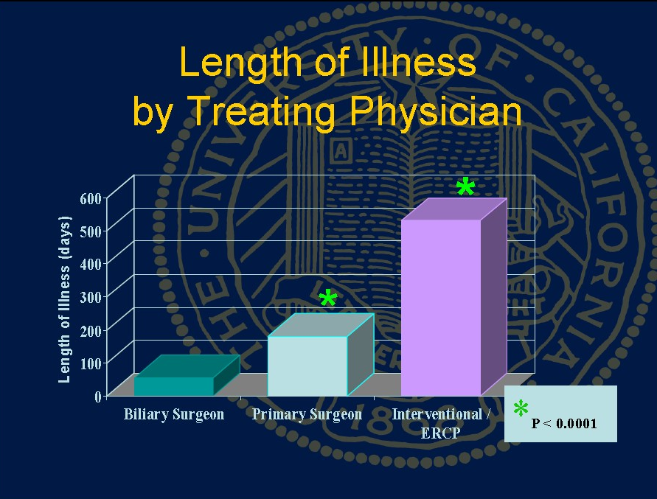

Slide 43
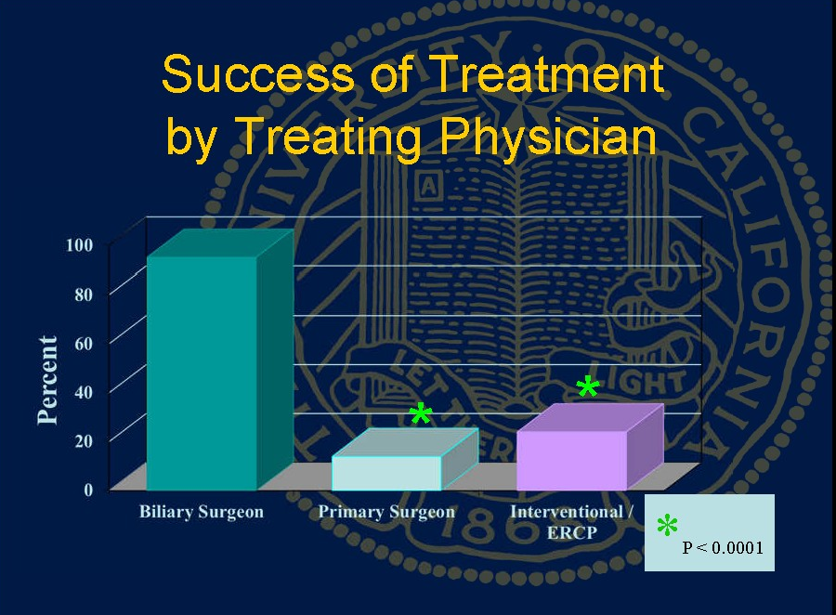

Slide 44
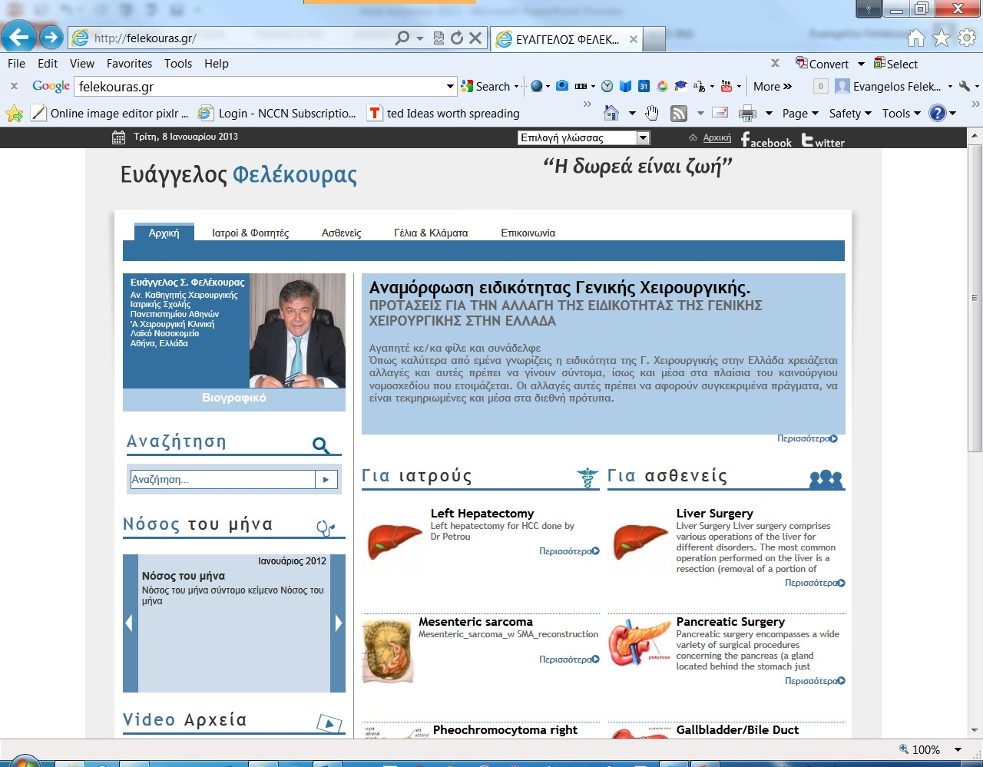

Slide 45
The effect of surgical volume and the provision of residency and fellowship training on complications of major hepatic resection.
Hospitals supporting a surgical residency program had lower overall morbidity and mortality.
The mortality rate increased once greater than approximately 70 cases were performed per annum.
A fellowship program however was not associated with overall lower morbidity and mortality and appeared to result in a higher rate of certain complications.
Predicted mortality rate following major hepatectomy according to annual hospital volume, adjusted for Charlson comorbidity score.
Kohn GP, Nikfarjam M. J Gastrointest Surg. 2010 Dec;14(12):1981-9.

Slide 46
The volume-outcomes effect in hepato-pancreato-biliary surgery: hospital versus surgeon contributions and specificity of the relationship.
Nathan H, Cameron JL, Choti MA, Schulick RD, Pawlik TM. J Am Coll Surg. 2009 Apr;208(4):528-38

Slide 47
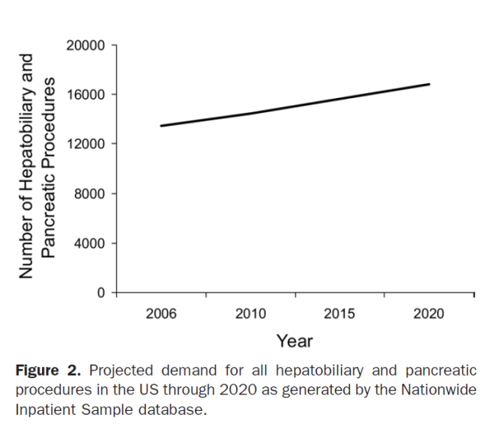
Scarborough JE et al. J Am Coll Surg. 2008 Apr;206(4):678-84
Workforce projections for hepato-pancreato-biliary surgery.
An estimated 16,800 HPB procedures will be performed in 2020, representing a 25% increase during the next 15 years.
28 fellowship-trained HPB subspecialists will enter the workforce each year.
If half of all HPB procedures are performed by HPB subspecialists in 2020, then the average subspecialist will perform only 14 such procedures that year.
If high volume HPB surgery is defined as 40 procedures per year, and 50% of HPB procedures are performed by high-volume surgeons in 2020,
then only 15 fellows need to be trained in HPB surgery each year to meet demand in 2020.

Slide 48
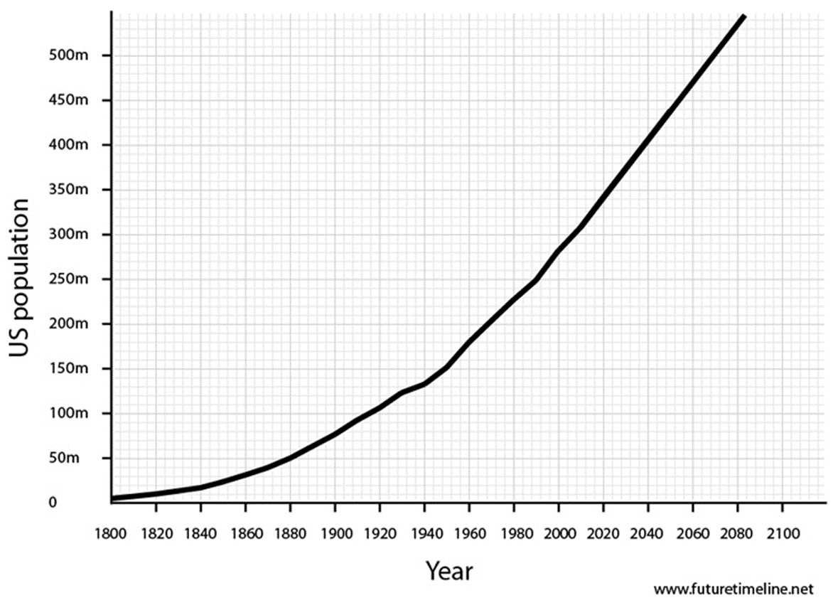
Workforce projections for hepato-pancreato-biliary surgery
Accordingly
15 x 30 (working life span of a HBP)=
450 HBP surgeons by 2020 year in USA
(350 millions)
means
1 HBP surgeon /777.777 USA citizens
For 12.000.000 Greek citizens by year 2020 we need ~ 16 HBP surgeons
in Greece
So we need to train 16/30= 0,5 HBP surgeon every year or
1 HBP surgeon /2 years

Slide 49
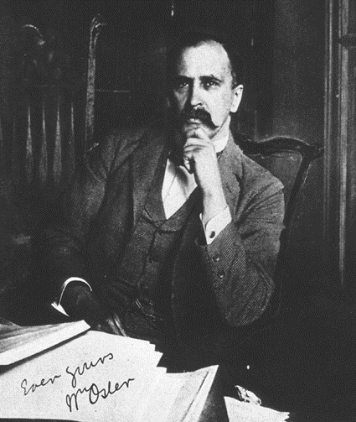
Sir William Osler
“The good physician treats the disease;
The great physician treats the patient who has the disease.”
If there was not bleeding everybody wound do surgery
Sir William Osler
The father of Modern (Academic) Medicine

Slide 50
…What ever we do…
…is still the Surgeon that
makes the decisions
and takes the blame
for death and complications.

Slide 51


Καρκίνος ΗΠΧ
Θεραπευτική προσέγγιση νεοπλασμάτων
χοληφόρων και παγκρέατος στην
εποχή των μοριακών δεικτών
ΕΣ Φελέκουρας

Slide 52
Σύγκρουση συμφερόντων εγκύκλιος ΕΟΦ (Αρ. Πρωτ. 47558/04-07-2012)
Ουδεμία

Slide 53
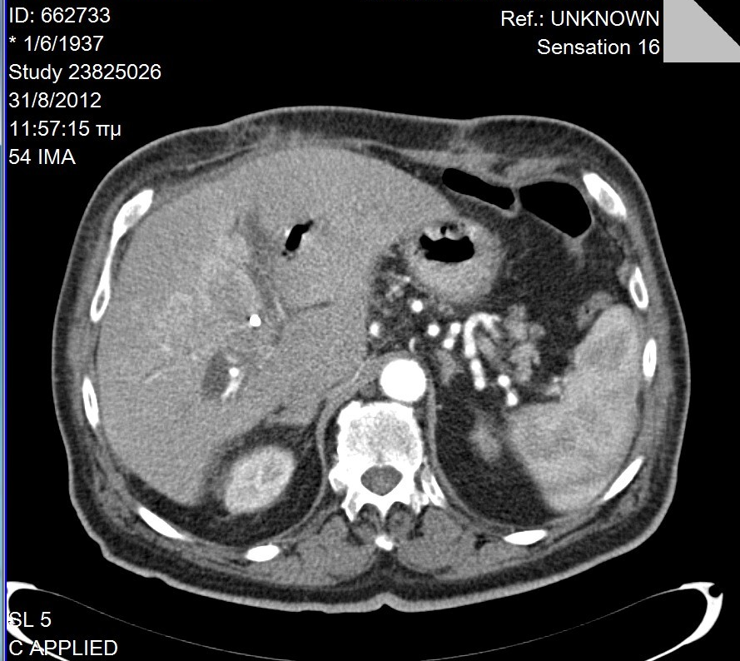
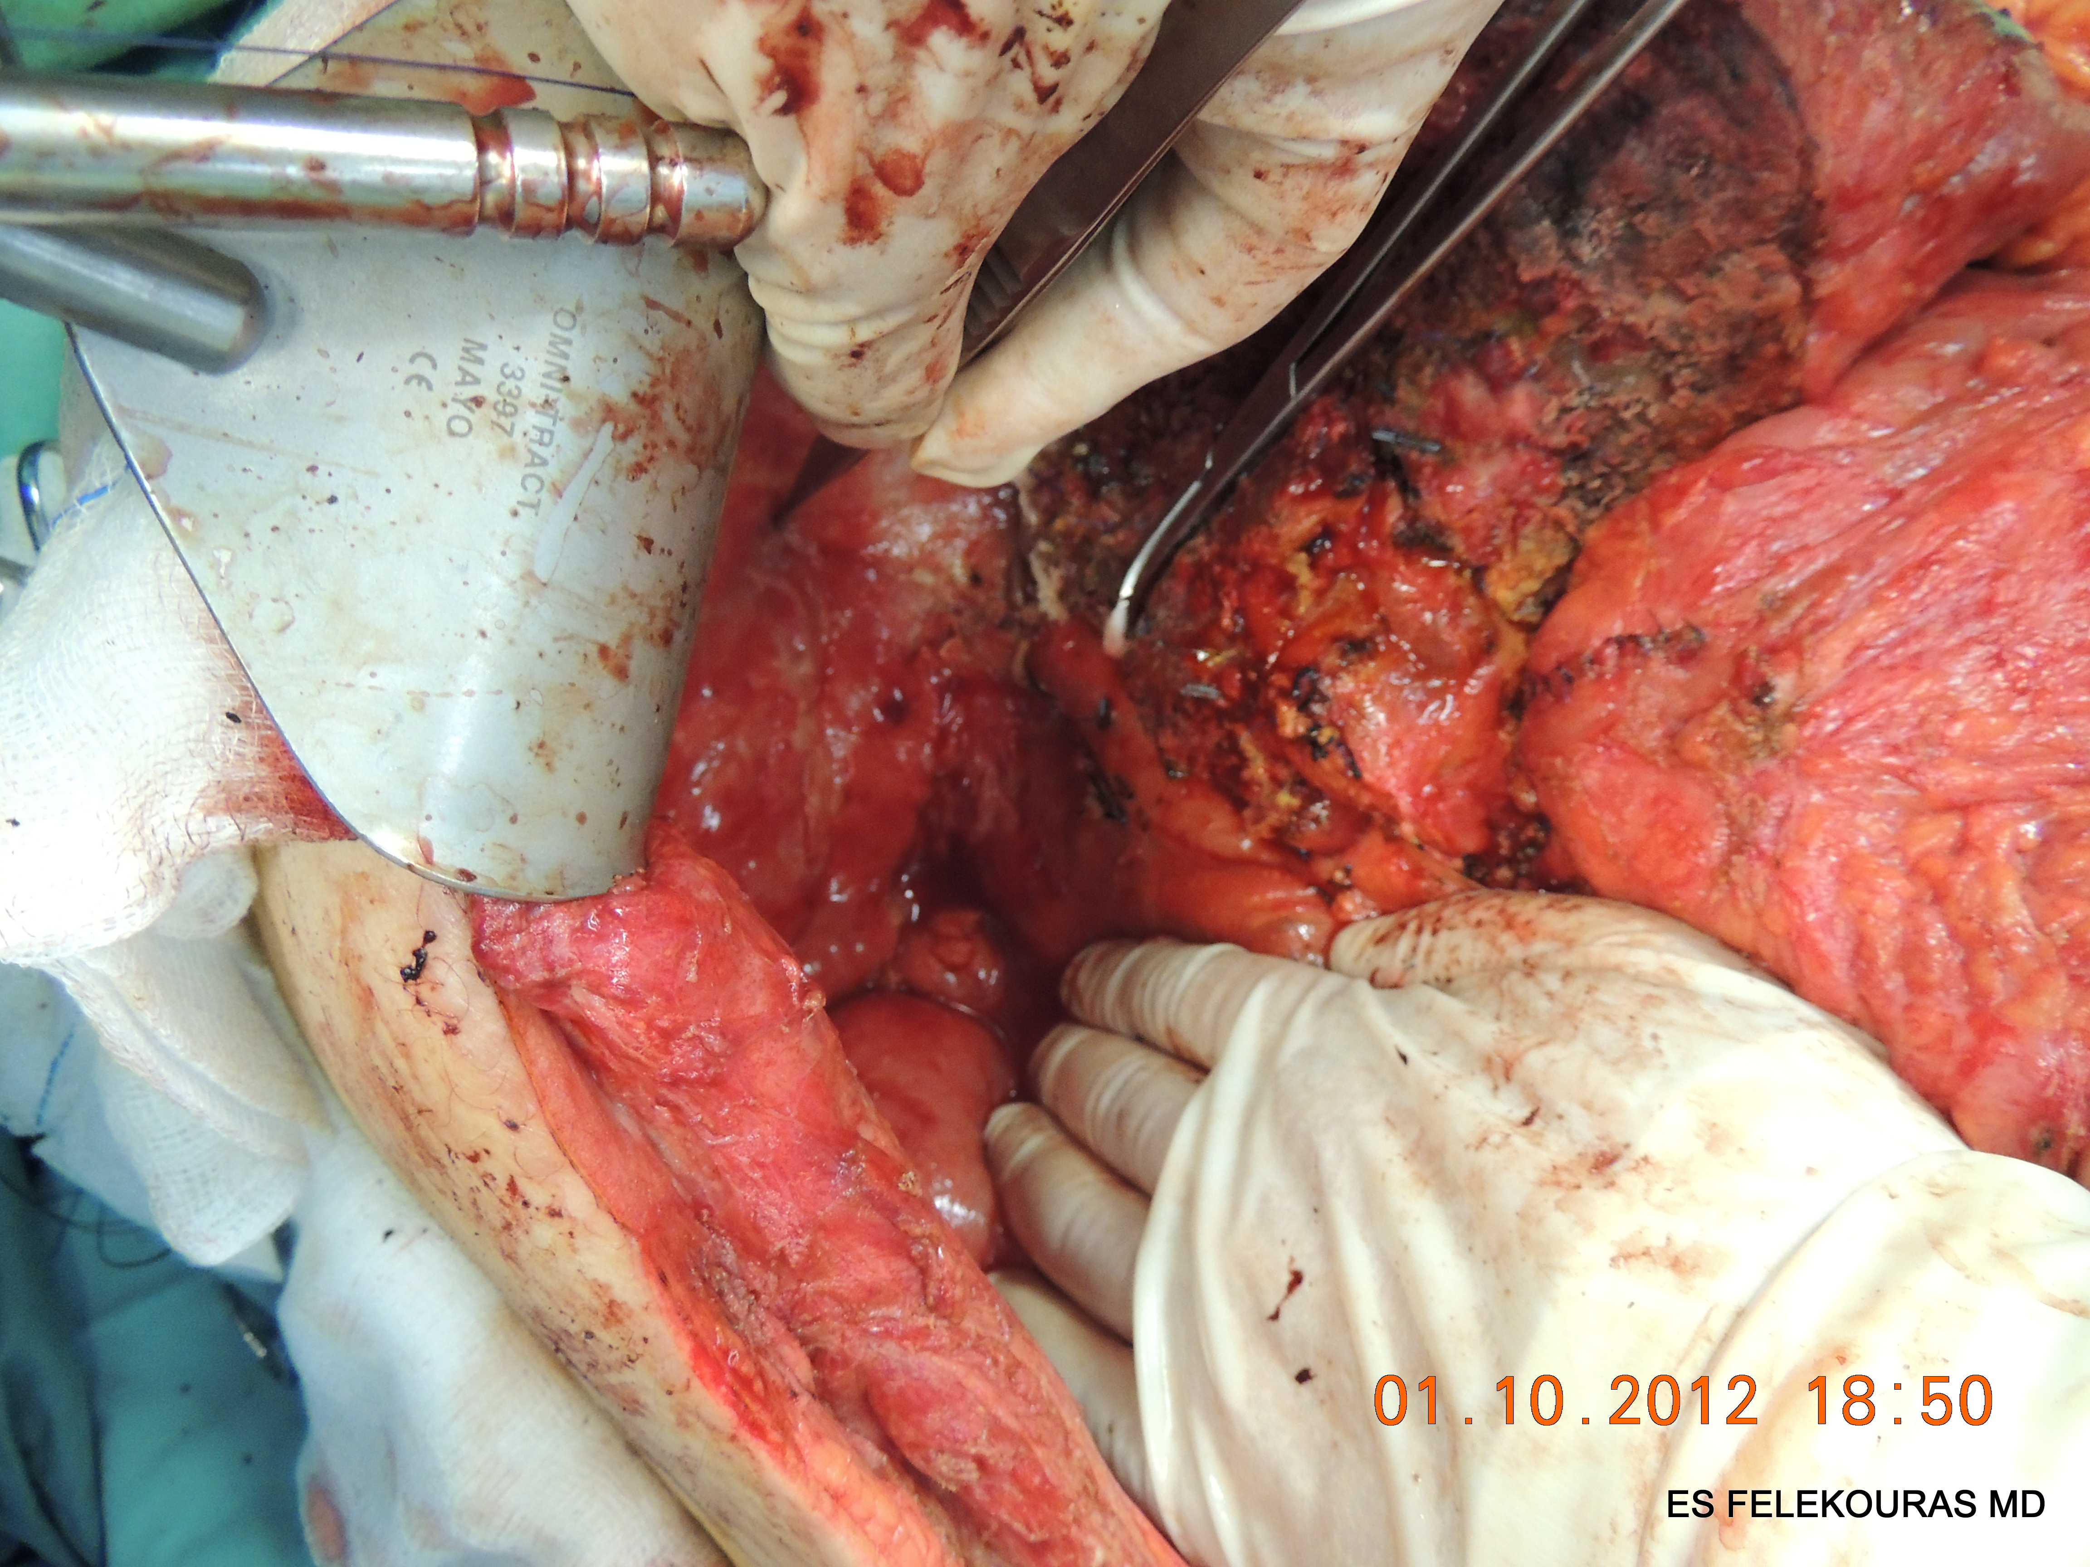
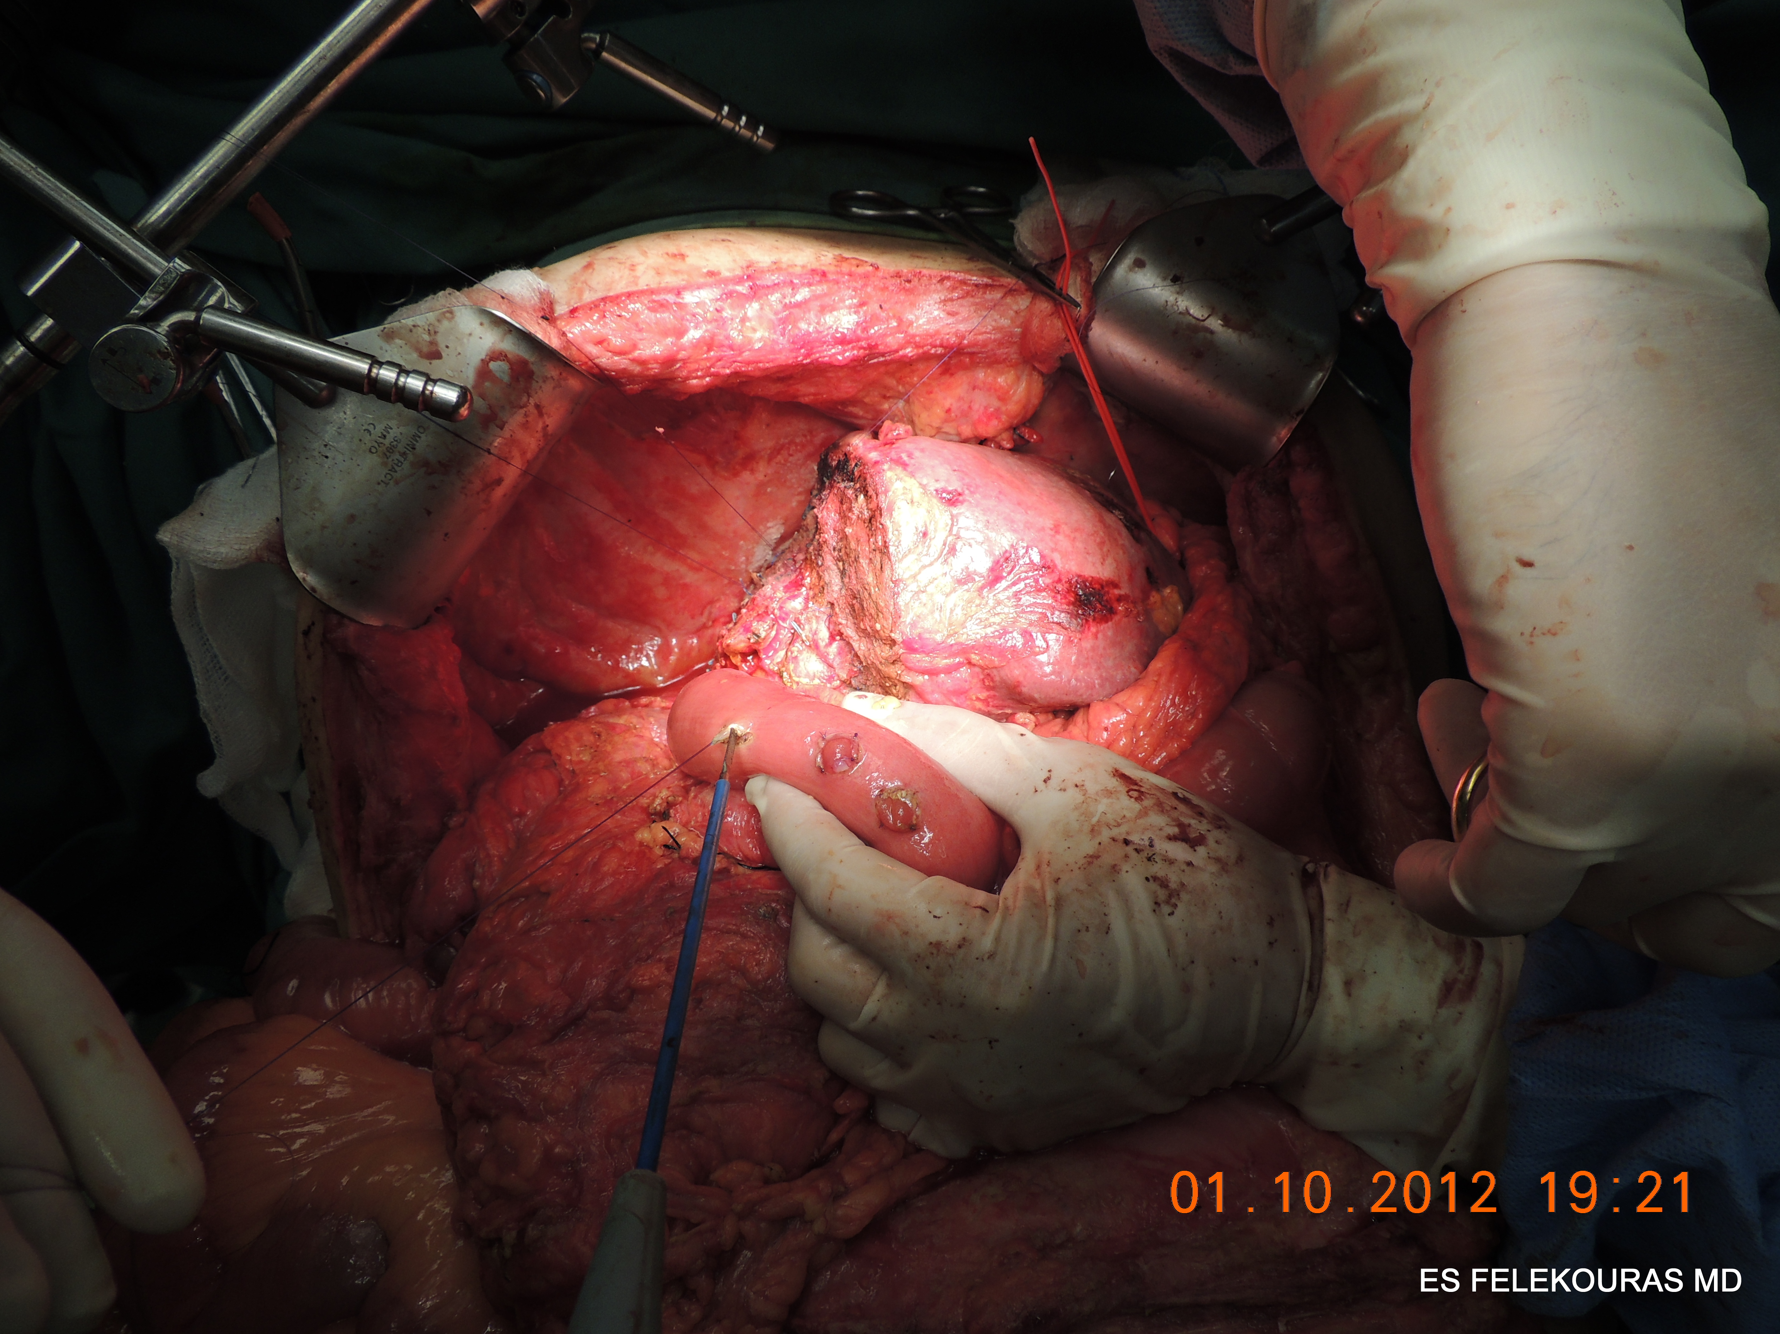
RTS LRx post PVE for iCCA

Slide 54
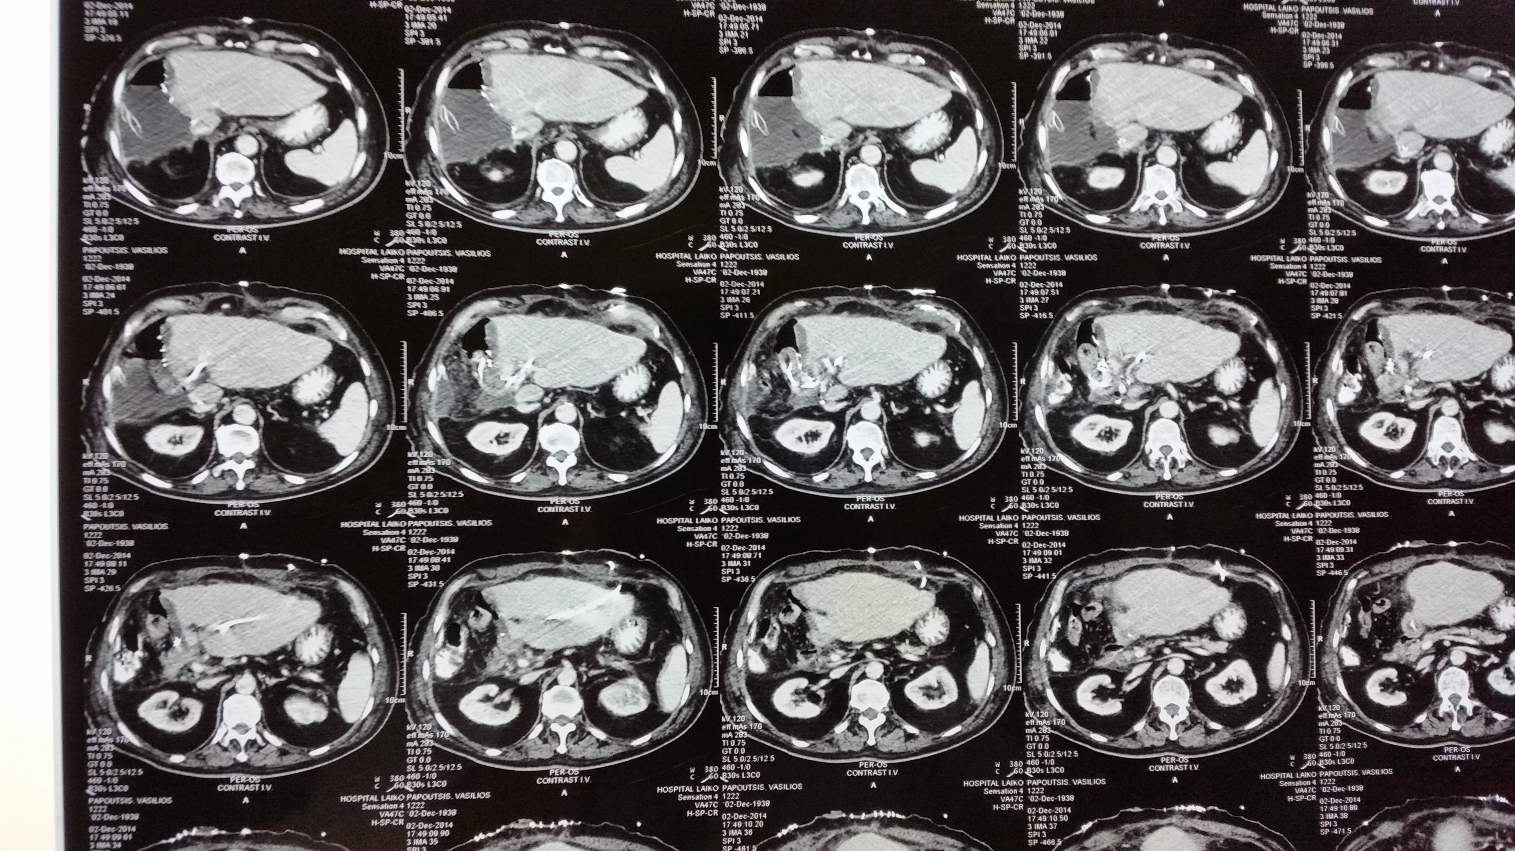
Morbidity increases

Slide 55


1^{ο} Πανελλήνιο Συνέδριο ΕΕΗΠΧ
Σας περιμένουμε στο πάρτι, είστε όλοι καλεσμένοι

