Slide 1
“Επιπλοκές στην Γενική Χειρουργική”
ΕΣ Φελέκουρας

Slide 2
Complications
Complication (επιπλοκή): any deviation from the normal (ideal) postoperative course
Sequelae (επακόλουθο): cover conditions that are inherent in the procedure, and that thus will inevitably occur
  Example, scar formation or the inability to walk after an amputation.
Failure to cure (αποτυχία της θεραπείας): diseases or conditions that remain unchanged after surgery are not complications, but rather failure to cure
  example,
    early recurrence of inguinal hernia or
    incompletely resected malignant tumors,
    while clearly reflecting a negative outcome, are better covered under the term ‘‘failure to cure.’’
Dindo D, Clavien PA. What is a surgical complication? World J Surg 2008; 32(6):939-41.

Slide 3
Surgical Complication
Dictionaries: Is an unfavorable evolution or consequence of a disease, a health condition or a therapy (surgery here)
Latest definitions: ‘‘any deviation from the ideal postoperative course that is not inherent in the procedure and does not comprise a failure to cure’’
“οποιαδήποτε απόκλιση από την ιδανική μετεγχειρητική πορεία που δεν είναι εγγενής της επέμβασης και δεν ανήκει στην αποτυχία της θεραπείας”
Dindo D, Clavien PA. What is a surgical complication? World J Surg 2008; 32(6):939-41.

Slide 4
Systemic
Complication
  Any deviation from the normal (ideal) postoperative course
Medical mistake (error)
  A medical error is a preventable adverse effect of care, whether or not it is evident or harmful to the patient.
    This might include an inaccurate or incomplete diagnosis or treatment of a disease, injury, syndrome, behavior, infection, or other ailment.
By the State
By the Health care system
By the Physician

Slide 5
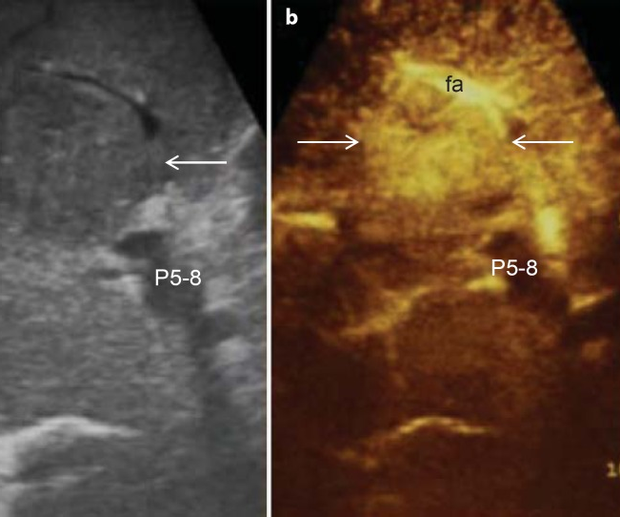

HCC-diagnosis (US)
Current surveillance for HCC
  ultrasound (US)
  with or without alfa-fetoprotein (AFP)
US is operator dependent, and
  all focal lesions on US should be verified using a 4-phase contrast enhanced study (unenhanced, arterial, portal venous, delayed)—multidetector contrast enhanced CT (CECT) or a
  dynamic contrast enhanced MRI (DCE-MRI) with nonspecific or liver-specific contrast agents (Eovist)
Dhir M, Melin AA, Douaiher J, et al. A Review and Update of Treatment Options and Controversies in the Management of Hepatocellular Carcinoma. Ann Surg 2016; 263(6):1112-25.
www.surgery.gr

Slide 6
Medical mistake (error)
Causes
  Healthcare complexity
  System and process design
  Competency, education, and training
  Human factors and ergonomics
Examples
  Errors in diagnosis
  Misdiagnosis of psychological disorders
  Most common misdiagnoses
  Outpatient vs. inpatient
After an error has occurred
  Recognizing that mistakes are not isolated events
  Placing the practice of medicine in perspective
  Disclosing mistakes
    To oneself
    To patients
    To non-physicians
    To other physicians
    To the physician's institution
    Use of rationalization to cover up medical errors
    By presence of to the patient
  Cause-specific preventive measures
  In specific specialties
  Legal procedure
Prevention
  Reporting requirements
Misconceptions

Slide 7
Medical mistake (error)
Όταν ο γιατρός δεν έχει τηρήσει τους κανόνες της ιατρικής επιστήμης είτε από άγνοια είτε από απειρία είτε από απερισκεψία ή ανεπιτηδειότητα.
Όταν έχει υπάρξει μια επιπλοκή είναι πολύ δύσκολο να διακρίνουμε εκ του αποτελέσματος αν ο γιατρός ενήργησε lege artis,
  σύμφωνα δηλαδή με τους κανόνες της ιατρικής επιστήμης και τέχνης ή υπέπεσε σε σφάλμα

Slide 8
The real controversy
Medical mistake vs. Complication
(key points: Documentation and Witness)

Slide 9
Complications
Όλες οι επεμβάσεις έχουν τον κίνδυνο επιπλοκών.
Μπορεί να είναι 0,1%, μπορεί να είναι και πολύ μεγαλύτερος.
Ο γιατρός γνωρίζει ότι η συγκεκριμένη επέμβαση μπορεί να έχει επιπλοκές,
  αλλά δεν γνωρίζει αν θα συμβούν στο συγκεκριμένο ασθενή,
  ακόμη και αν ενεργήσει την επέμβαση lege artis

Slide 10
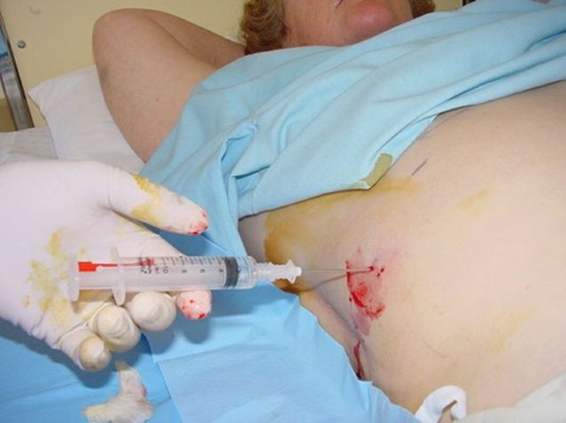
Liver biopsy
Recommendations
Liver biopsy should be considered in patients in whom diagnosis is in question, (Class I, Level B)
When knowledge of a speciﬁc diagnosis is likely to alter the management plan (Class I, Level B).
Liver histology is an important adjunct in the management of patients with known liver disease, particularly in situations where (prognostic) information about ﬁbrosis stage may guide subsequent treatment; the decision to perform liver biopsy in these situations should be closely tied to consideration of the risks and beneﬁts of the procedure (Class I, Level B)
Rockey DC, Caldwell SH, Goodman ZD, et al. Liver biopsy. Hepatology 2009; 49(3):1017-44.
AASLD POSITION PAPER

Slide 12
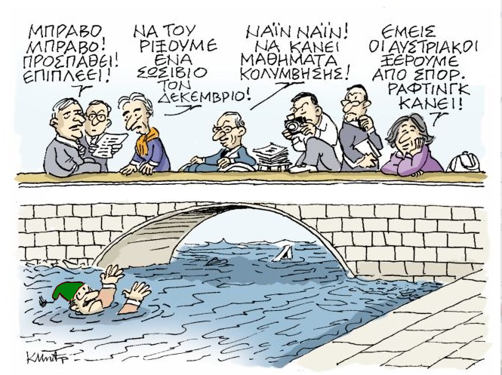
ΧΕΙΡΟΥΡΓΟΣ ΜΕΤΑ ΑΠO ΤΡΑΥΜΑ ΧΟΛΗΦΟΡΩΝ

Slide 13
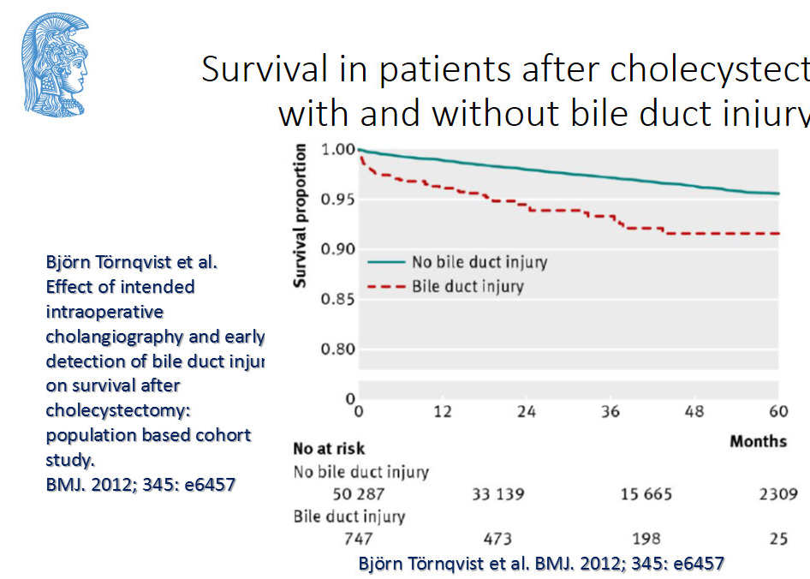
BDI
complication vs. mistake

Slide 14
Attributed to
General health of the patient
Preoperative care
Magnitude of the operation
Quality of postoperative care

Slide 15
Complications of major surgery can be broadly classified as those:
  Due to anesthesia
  Due to surgery

Slide 16
Due to surgery
Perioperative complications
Postoperative complications
  Immediate/early complications
  Late complications

Slide 17

By failing to prepare, you are preparing to fail
Benjamin Franklin

Slide 18
Summary of Preoperative Evaluation
  Cardiovascular
    History of stable/unstable angina,
    arrhythmias,
    MI,
    CHF,
    cardiac surgery,
    rheumatic fever,
    valvular disease,
    endocarditis,
    stroke,
    claudication

Slide 19
Summary of Preoperative Evaluation
Pulmonary
  Recent pneumonia,
  exposure to pulmonary irritants,
  dyspnea,
  productive/non-productive cough,
  wheezing, hemoptysis,
  history of pulmonary tuberculosis,
  asthma,
  bronchitis,
  fungal exposure,
  smoking history, cyanosis or aspiration, availability of previous chest film or CT scans.

Slide 20
Summary of Preoperative Evaluation
Renal
  Renal insufficiency( recent or in the past),
  renal stone
  Prostate diseases

Slide 21
Summary of Preoperative Evaluation
Hematologic
  History of blood transfusion,
  bleeding disorders,
  easy bruising,
  use of NSAID, aspirin or antiplatelet medications ,
  previous history of DVT or PE,
  information regarding blood donation and autologous blood program

Slide 22
Summary of Preoperative Evaluation
Gastrointestinal
  History of GI bleeding or
  previous operation for ulcers or carcinoma,
  GER disease

Slide 23
Summary of Preoperative Evaluation
Endocrine
  history of DM,
  thyroid disease,
  long- term steroid use,
  pituitary or adrenal insufficiency

Slide 24
Summary of Preoperative Evaluation
Infection
  History of bacterial or viral pneumonia,
  chronic bronchitis,
  pulmonary TB,
  fungal infection,
  hepatitis,
  CMV or
  HIV

Slide 25
Summary of Preoperative Evaluation
Medication
  Use of prescription and nonprescription drugs,
  previous radiation or chemotherapy.
Previous operation
  Especially thoracic and abdominal operations
Nutrition
  Note overall appearance of nutritional status, weight loss or gain, obesity and overall eating habit
Patient directives & Health Care
  Organ donation, living will, next of kin, privacy request, points of contact perioperatively,
  logistical and social issues regarding costs, home care, rehabilitation, case cancellation protocols, preoperative counseling.

Slide 26
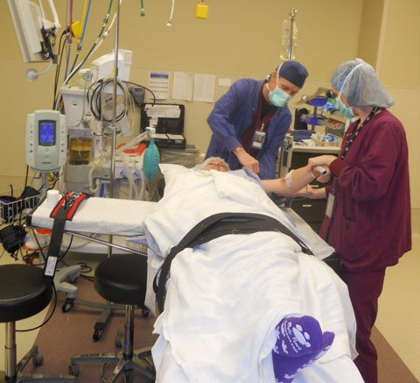
Surgical Basics
Preventing injury and error
Jan Moss, RN

Slide 27
Blah, Blah, Blah…
“The table was placed in beach chair configuration. Head, neck, trunk and limbs were padded and protected in appropriate fashion.”
“The right lower extremity was prepped and draped in the usual sterile fashion.”
“Bilateral upper extremities were prepped and draped in standard sterile fashion.”

Slide 28
Types of Injuries
Wrong site, wrong procedure
Wrong medication
Skin breakdown/decubiti
Burns
Nerve damage
Ischemia
Eyesight

Slide 29
Pre-operative Preparation
Testing
  Determines ability to sustain surgical insult
  Determines type of anesthesia delivery
  Blood Pressure, Diabetes, EKG, Liver function, CBC, Chest X-ray, UA
Medications
  Day before surgery, anti-inflammatory
  Day of surgery, antibiotics
  Post op pain meds
  Smoking cessation?

Slide 30
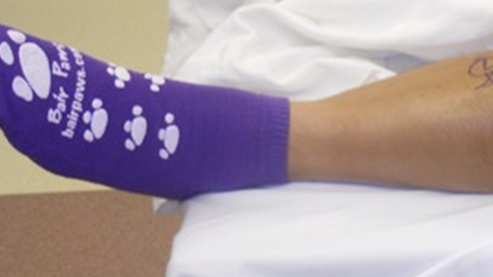
Patient/Procedure Confirmation
Surgical Consent
Pre-operative marking
“Time Out” in the operating room

Slide 31
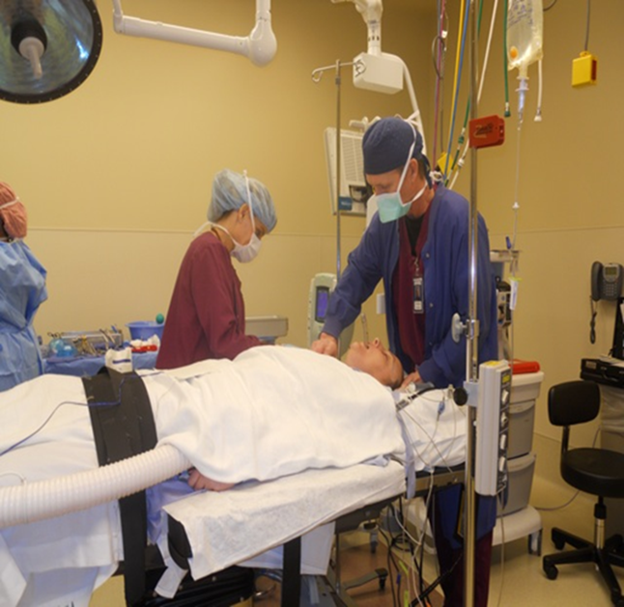
Anesthesia Choices
  Goals of anesthesia
    Exposure, Relaxation
    Keep patient alive
    Pain free, unaware, stable
  Local Anesthesia
  Regional Anesthesia
  Conscious Sedation
  General Anesthesia
    LMA vs. Intubation
Many photos courtesy of John DiPaola, MD

Slide 32
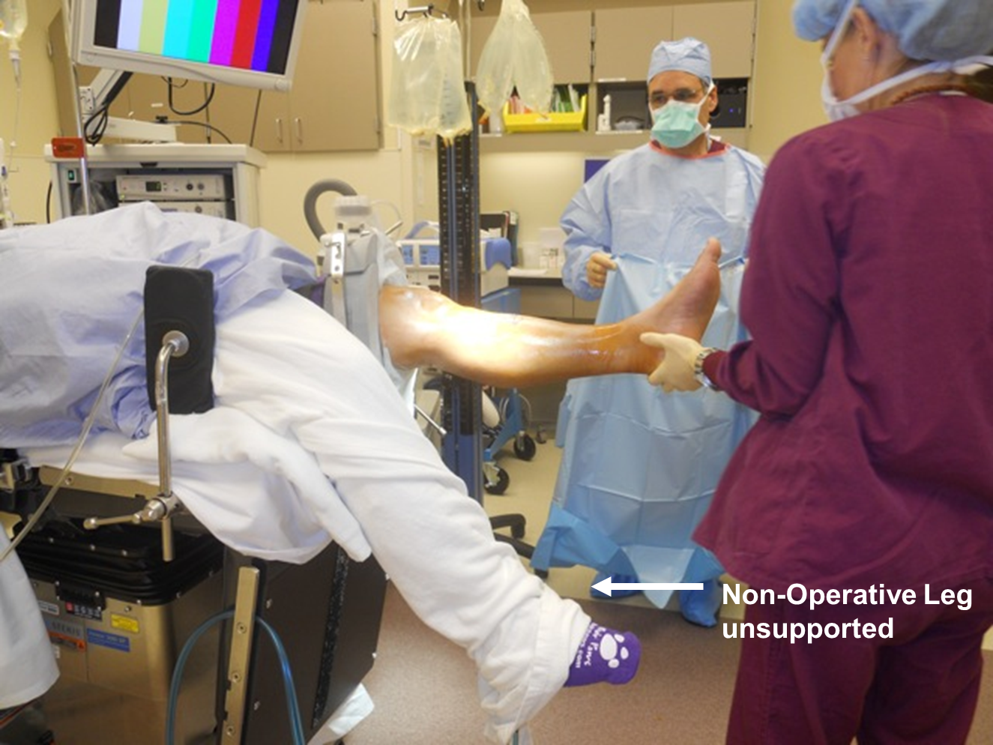
Surgical Positioning
Goals
  Exposure for surgeon
  Immobilize patient
  Injury prevention
    Maintain circulation
    Maintain anatomic alignment
    Prevent pressure points

Slide 33
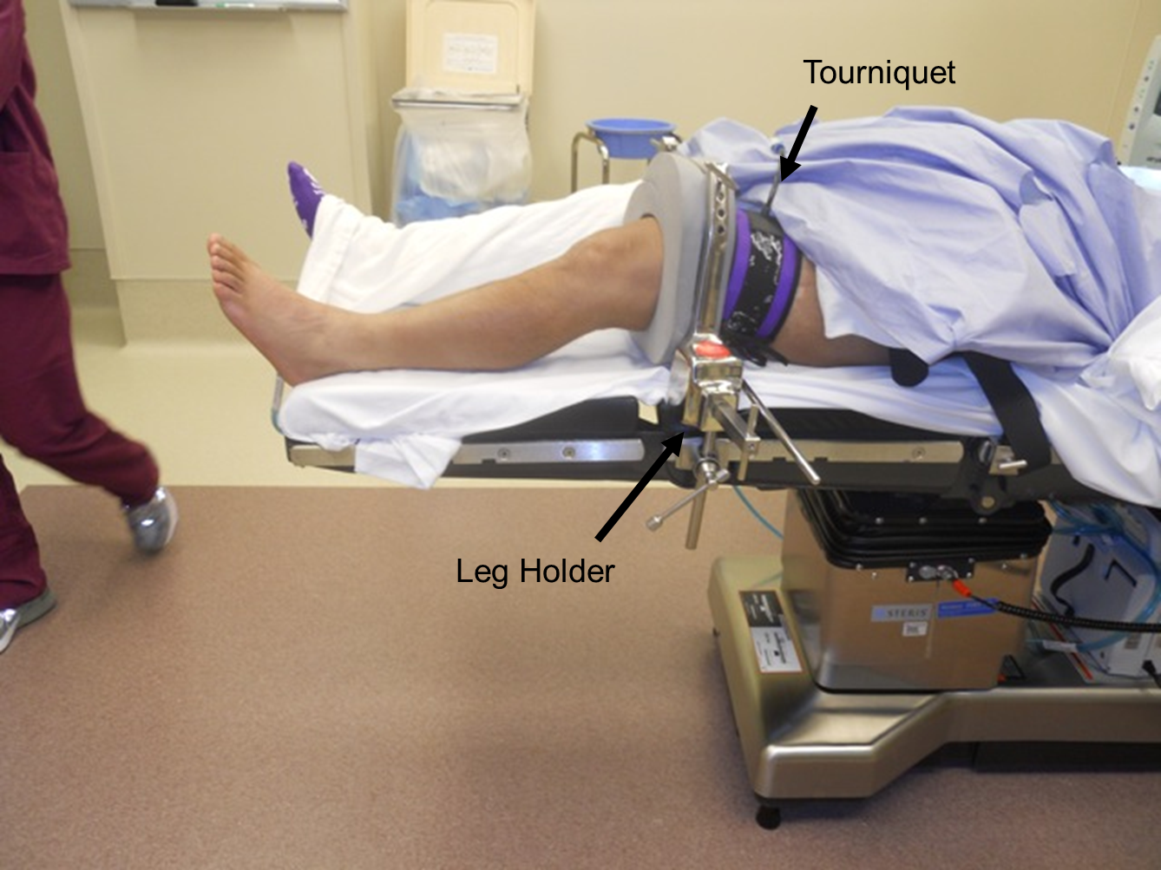
Surgical Positioning
Considerations
  No movement for minutes to hours
  No ability to identify pain
  Sometimes exposure wins out over comfort
  Even supine can be injurious

Slide 34
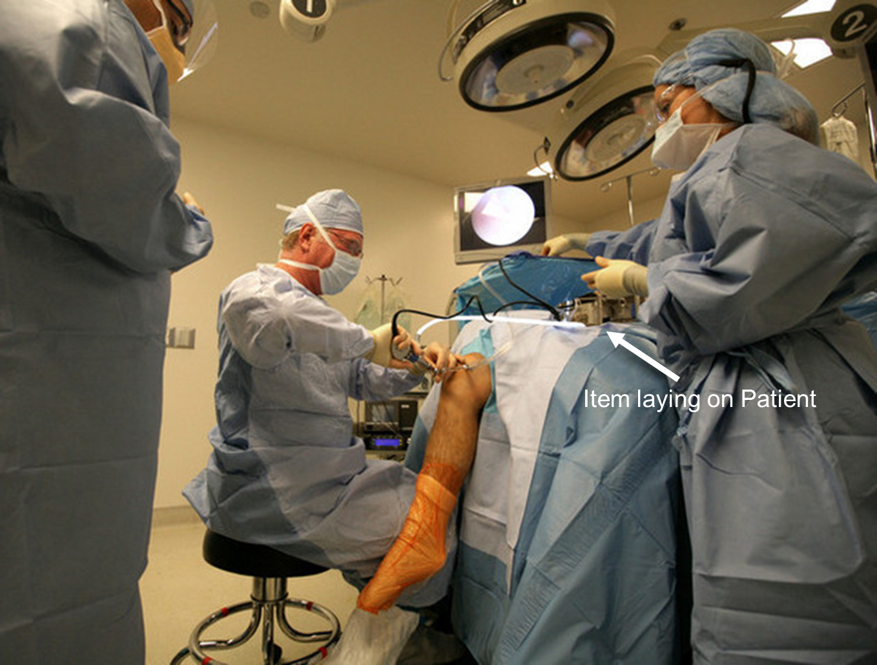
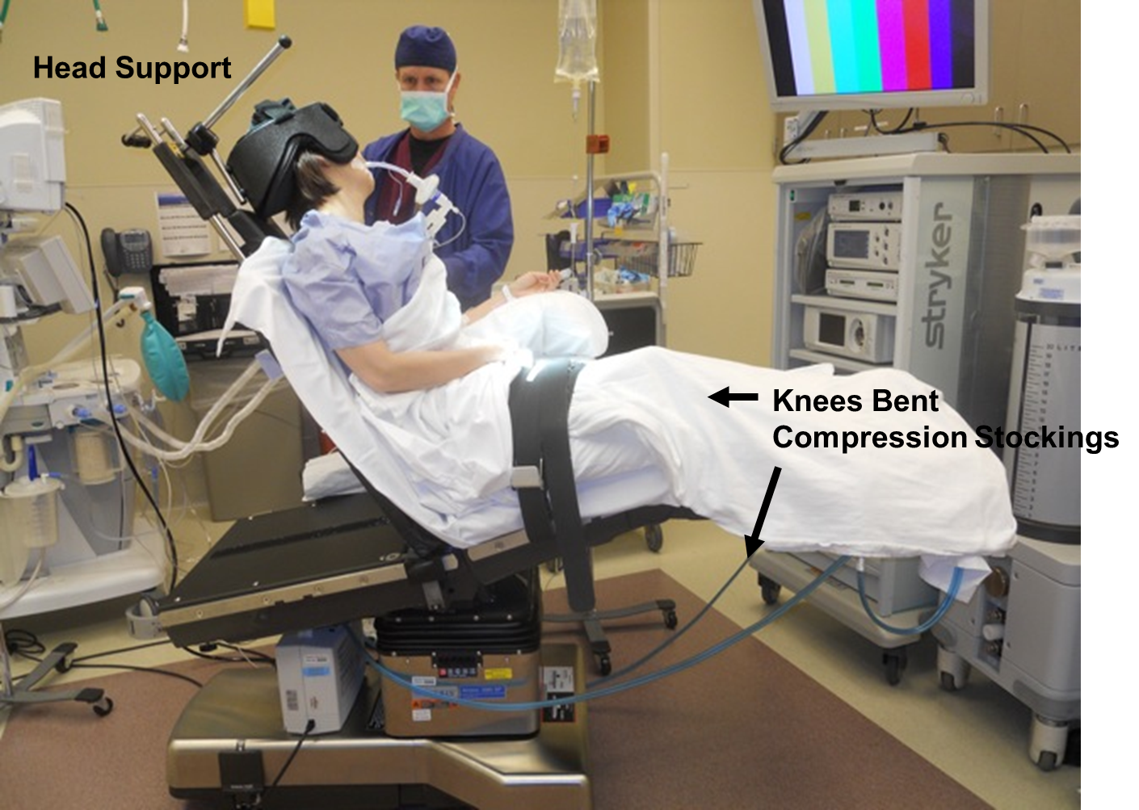

Slide 35
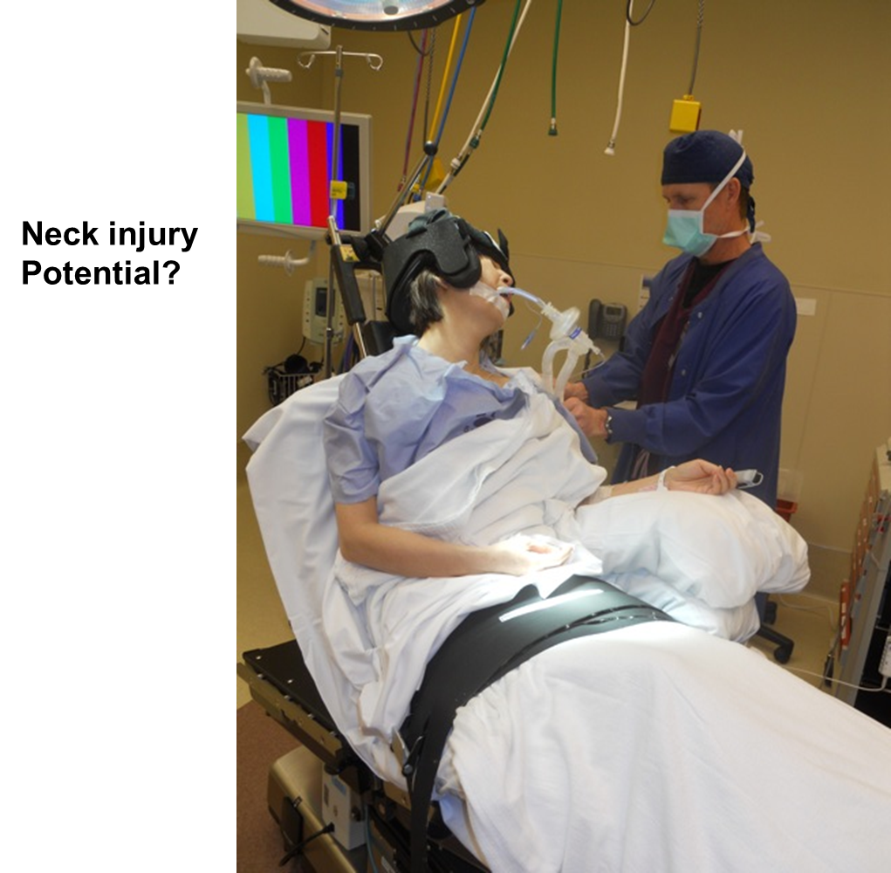
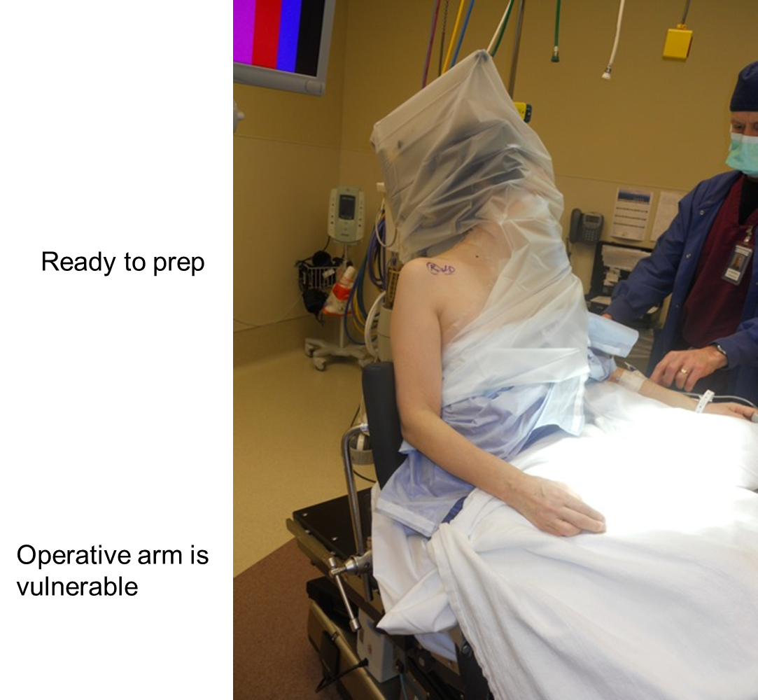

Slide 36
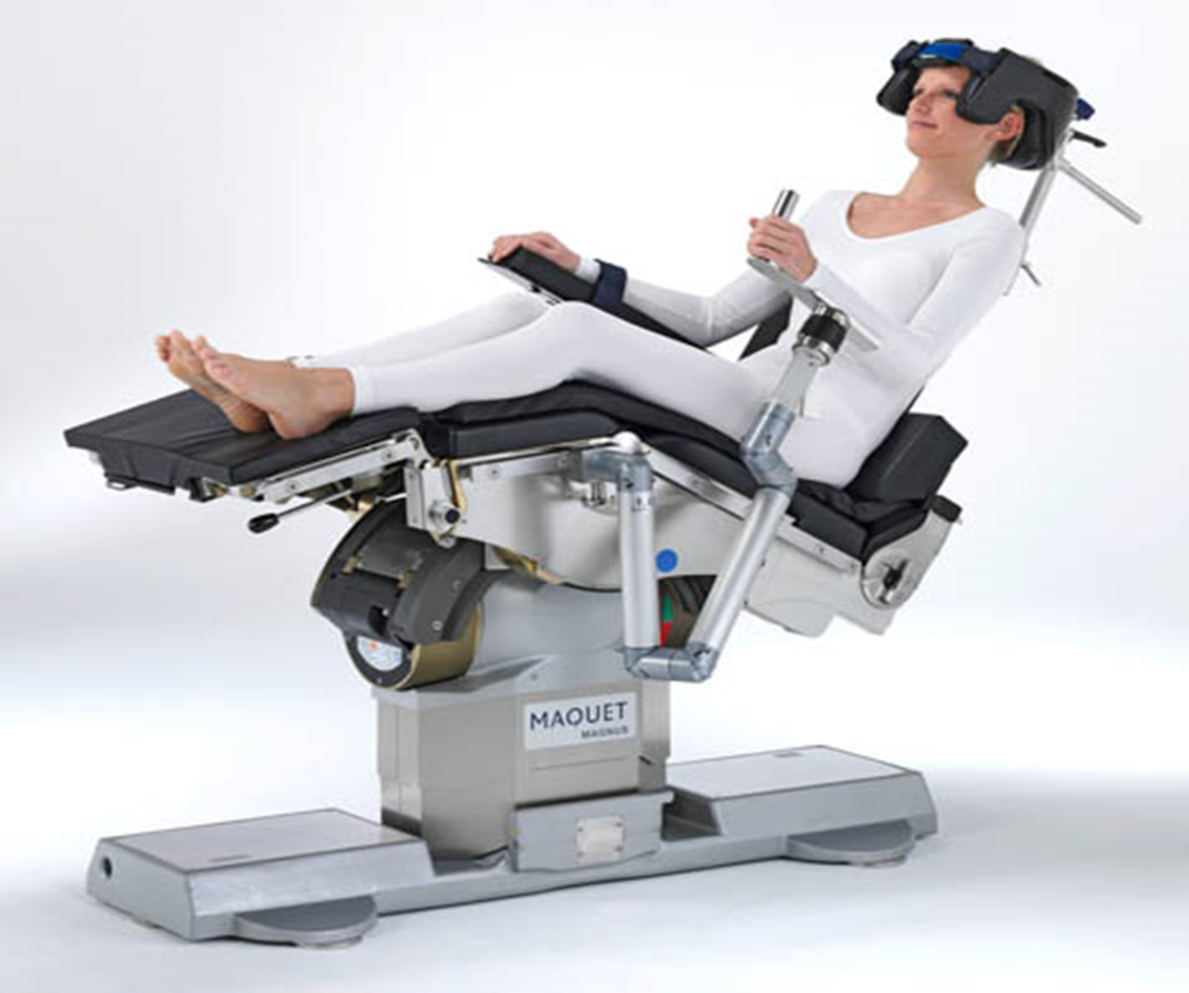
Add 150 lbs
& imagine the injury
potential
Skinny Model

Slide 37
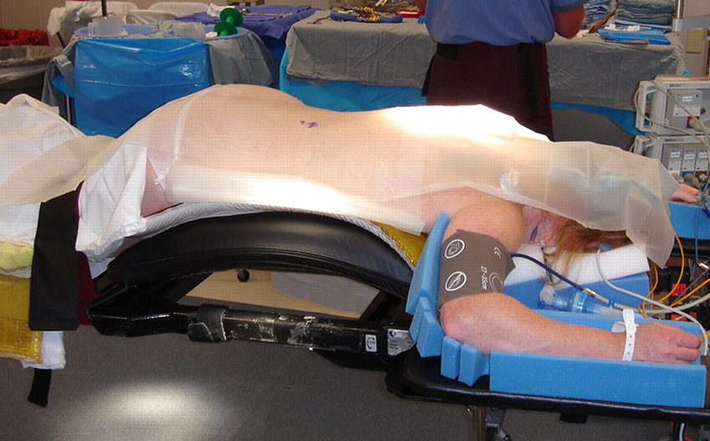
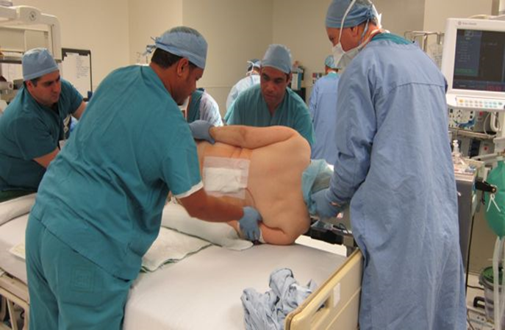
Patient induced on back and then turned. Process reversed at the end of procedure
Arms supported
Face in cradle
Gel pad under
knees
Elevated frame

Slide 38
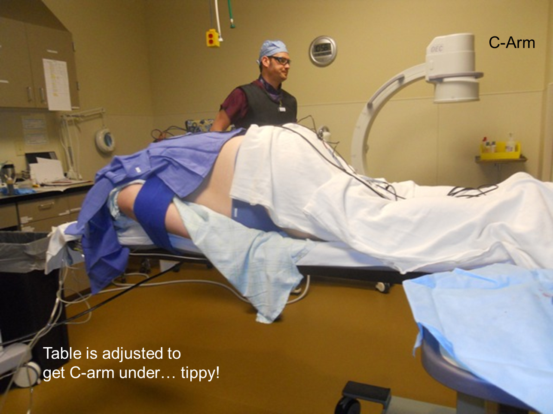
Challenges to positioning
Obesity
Trauma
Pre-existing conditions
Arthritis, amputation, injury
Diabetes
Cardiac/Vascular disease
Smoking

Slide 39
Documentation
“The table was placed in beach chair configuration. Head, neck, trunk and limbs were padded and protected in appropriate fashion.”
“The right lower extremity was prepped and draped in the usual sterile fashion.”
“Bilateral upper extremities were prepped and draped in standard sterile fashion.”

Slide 40
Perioperative complications
Refers to problems arising during surgery, which include:
Hypotension
  Blood loss
  Mismatched blood transfusion
  Vasodilatation from a combination of premedication and anesthetic agents.
Raised blood pressure
  Use of ketamine
  Phaechromocytoma
  Uncontrolled hypertension
Cardiac arrest
  Air embolism
  Tissue hypoxia
    Blood loss
    Air embolism
  Increase in circulating catecholamine
    Use of exogenous adrenaline in the presence of hydrogenated hydrocarbons e.g. Halothane
Hypoxia
  Reduced o₂ in inspired air
  Inadequate blood flow in myocardial failure
  Inadequate alveolar ventilation due to respiratory depression
  Insufficient functioning hemoglobin

Slide 41
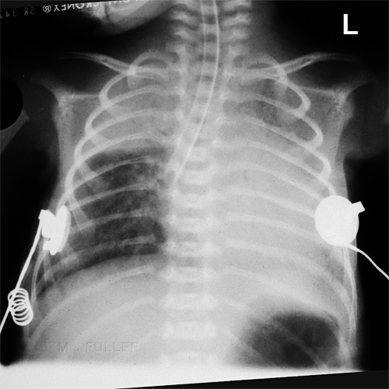
Perioperative complications
Asphyxia
  Combination of hypoxia & hypercapnia, caused by respiratory obstruction
  SIGNS:-
    Noisy breathing during partial obstruction
    In the presence of endotracheal tube, difficulty in inflating & deflating the lungs
    Cyanosis
  CAUSES:- physical & mechanical.
    Flexed head in anesthetized px with/without endotracheal tube.
    Endotracheal tube blocked by pus, blood, foreign bodies.
    Pressure on trachea from without, during operations on large tumors of the neck e.g. thyroidectomy
    Chemical causes
      Inhalation of intestinal contents {can be due to stimulation of the back of the tongue by foreign bodies e.g. laryngoscope

Slide 42
Postoperative Complications
Pre-op:
  Optimize the patients condition
  Give prophylaxis
  Select from of anesthesia
Intra-op :
  Attention to detail
Post-op :
  Monitor to detect

Slide 43
Post operative complications
Refers to complications arising after surgical operations
  Immediate/Early complications
    Respiratory,
    Cardiovascular,
    CNS,
    Genito-urinary,
    GI and
    Wound complications

Slide 44
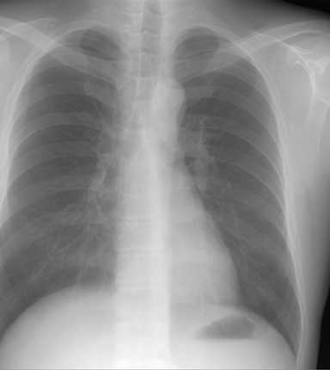
Respiratory

Slide 45
Respiratory Complications
Respiratory insufficiency
  Airway obstruction
    Often caused by the tongue which falls back to block the oro- and nasopharynx
    Presence of foreign bodies e.g. gastric contents, blood, pus, forgotten throat packs.
  Aspiration
    Aspiration of gastric contents in px that have recently eaten
Hiccough
    Clonic spasm of the diaphragm with reflex closure of the glottis. It may occur soon after operation due to irritation of the mucosa of the esophagus and stomach by anesthetic gases

Slide 46
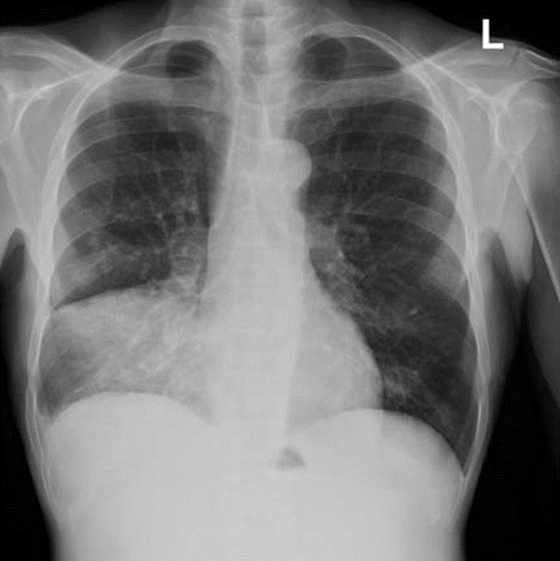
Atelectasis
Atelectasis(pulmonary collapse)
  Increased quantity/viscosity of bronchial secretion
  Deficiency in mechanism for expelling bronchial secretion
  Intubation of respiratory tract
Bronchopneumonia
  Infection of Atelectasis

Slide 47
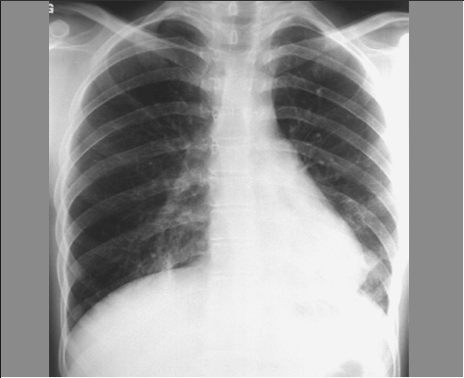
Postoperative Pulmonary Complications
Atelectasis:
90% postoperative pulmonary complications
Etiology:
  Obstruction of the tracheobronchial airway
      Changes in bronchial secretions
      Defects in expulsion mechanism
      Reduction in bronchial caliber
      Pulmonary insufficiency (hypoventilation)
      Decrease surfactant

Slide 48
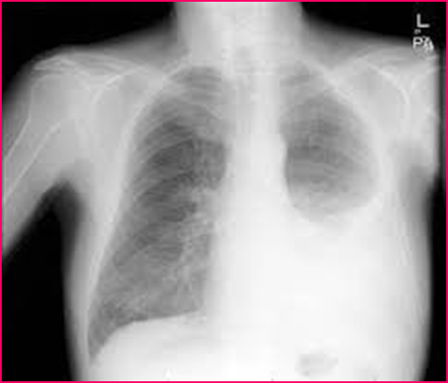
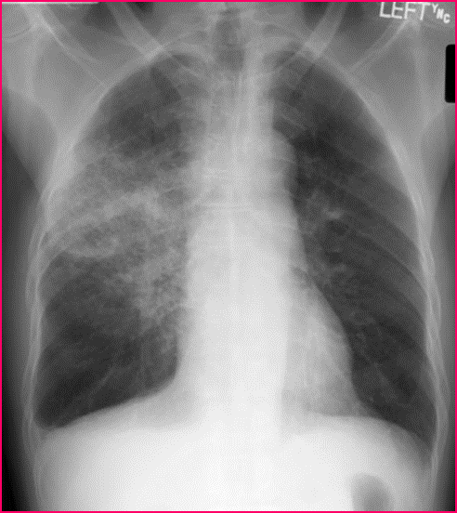
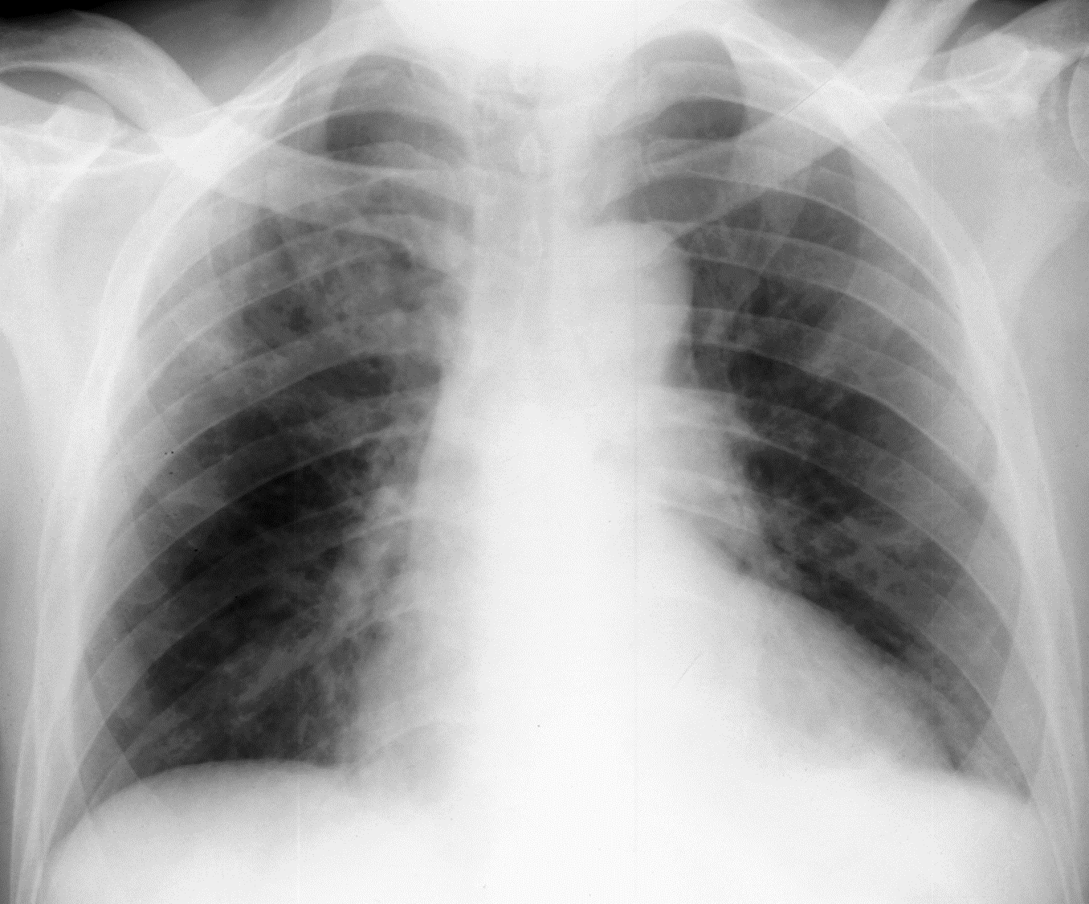
Chest X-ray
Pneumonia
Pulmonary Edema
Pleural Effusion

Slide 49
Risk Factors for Postoperative Pulmonary Complications
Risk Factor
Relative Risk
Age > 70
Age 50-69
Major abdominal surgery
Emergency surgery
Chronic obstructive pulmonary disease
Age 30-49
General anesthesia > 180 minutes
7,46
4,14
3,90
3,49
3,13
2,29
1,52

Slide 50
Common Causes of Postoperative Hypoxemia
Atelectasis Alveolar infiltrates Aspiration
Cardiac-associated pulmonary edema Noncardiac-associated pulmonary edema
(e.g., capillary leak, neurogenic, negative pressure) Pulmonary embolus
Pneumothorax Bronchospasm Mucus plugging
Pulmonary contusion/hemorrhage
Pulmonary embolus
Pneumothorax
Bronchospasm
Mucus plugging
Pulmonary contusion/hemorrhage

Slide 51
Common Causes of Postoperative Hypercapnia
Atelectasis
Alveolar infiltrates
Aspiration
Residual volatile anesthetics
Residual neuromuscular blockade
Narcotic overdose
Sedative overdose
High regional block
Cerebrovascular event
Neuromuscular disorders
Hypothyroidism
Insufflated carbon dioxide (laparoscopic procedures)
Metabolic alkalosis
Malnutrition
Hypermetabolism
Sepsis
Increased physiologic dead space pulmonary edema
Noncardiac-associated pulmonary edema
(e.g., capillary leak, neurogenic, negative pressure)

Slide 52
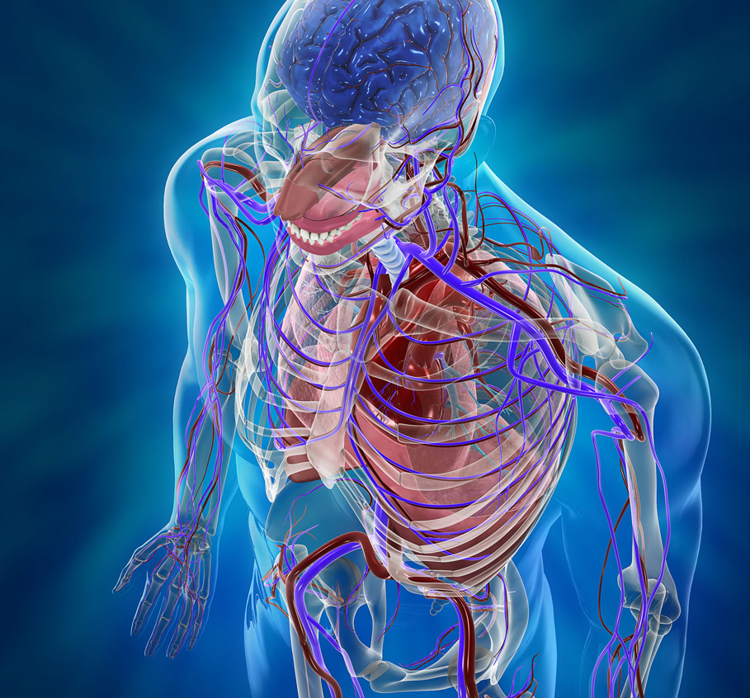
CVS

Slide 53
CVS
Hemorrhage
  Reactionary (occurring within 24hrs)
    Dislodgement of a blood clot/loose ligature at the cut end of a blood vessel
    Oozing of blood from an extensive raw area
    Platelet deficiency resulting in impaired clotting
    Prothrombin deficiency, e.g. in liver dx
  Secondary hemorrhage (after 7days)
    Bleeding follows necrosis of blood vessels from infection and may be accompanied or preceded by fever
    Signs
      Pallor, sweating and cool skin
    Bleeding from wound
Cardiac arrest
  Commonest cause is tissue hypoxia which may result from:
    Resp. obstruction
    Severe hemorrhage
    shock
Deep venous thrombosis
  Venous stasis
  Age
  Roughening of the endothelium resulting from trauma
Myocardial infarction

Slide 54
GI bleeding- necrosis
Hemorrhage:
  Occurs gastrointestinal anastomosis
  Manifest – hematemesis, melena, hematochezia
  Bleeding arise from the suture line (usually after gastric resection
  Treatment:
    1st conservative: irrigation w/ cold lavage / endoscopy
    Reoperation – direct control
Gangrene:
  Due to poor tissue perfusion
  Stomach:
    Following subtotal gastrectomy w/ ligation of left gastric and splenic arteries; thrombosis
  Small bowel and colon:
    Thrombosis; mechanical strangulation (internal herniation) – volvulus, adhesions
  Treatment:
    Resection of gangrenous segment, re-established continuity

Slide 55
Shock
Acute circulatory failure - inability of the cardiovascular system to maintain adequate tissue perfusion
There are three types
  hypovolemic
  cardiogenic
  septic

Slide 56
Deep venous thrombosis (DVT)
Is important cause of morbidity in the surgical patient
Can lead to pulmonary embolism
Its prevalence is up to 40 percent
It can occur in the calf, femoral and iliac veins
Assessing risk
Prevention
Mechanical
Pharmacological

Slide 57
Predisposing factors for DVT
Smoking
Type of surgery
Obesity
Venous stasis
Cancer
Hypercoagulable states
Inactivity after surgery
Oral contraceptive use

Slide 58
Diagnosis and Tx of DVT
History and physical examination
  Calf tenderness and swelling
  Positive Homan’s sign
  Fever
D-dimers
Ultrasound
Anticoagulation
Bed rest early

Slide 59
Pulmonary embolism (PE)
A very serious complication of DVT
10% die within the first hour
90% live longer than one hour-of these patients 70 percent go undiagnosed and of these 30 % die

Slide 60
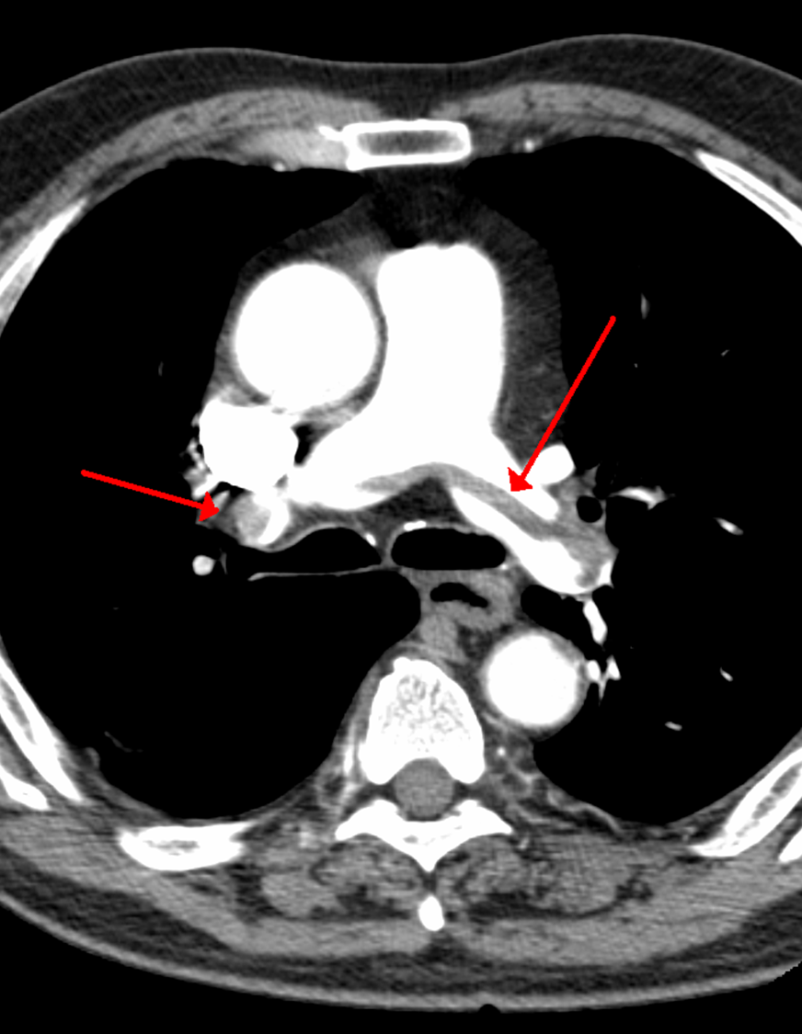
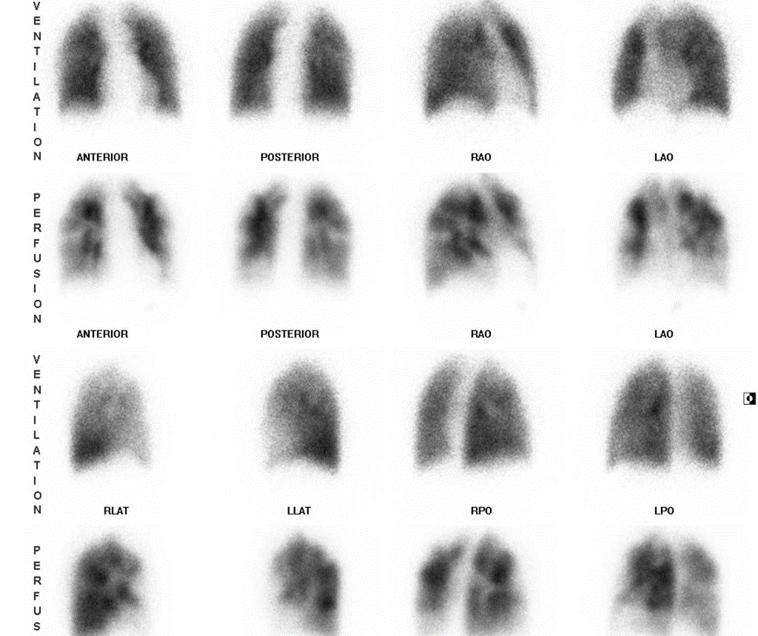
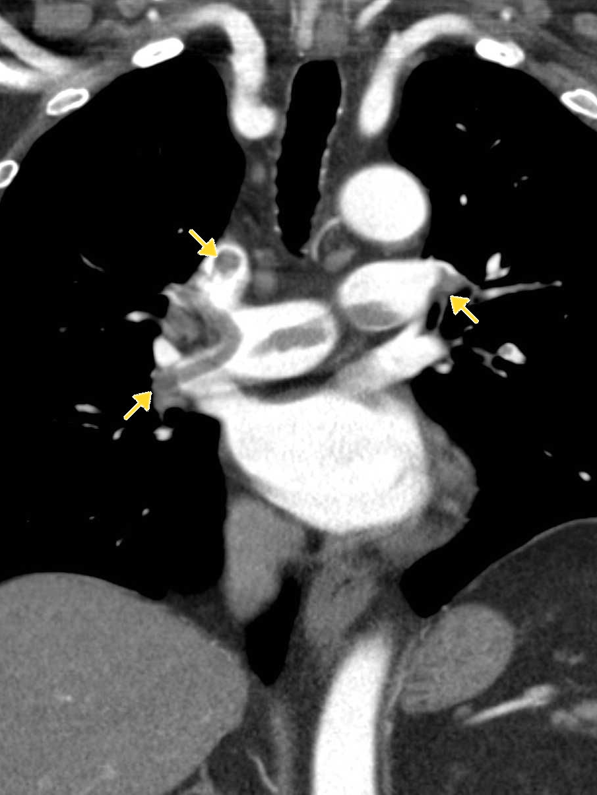
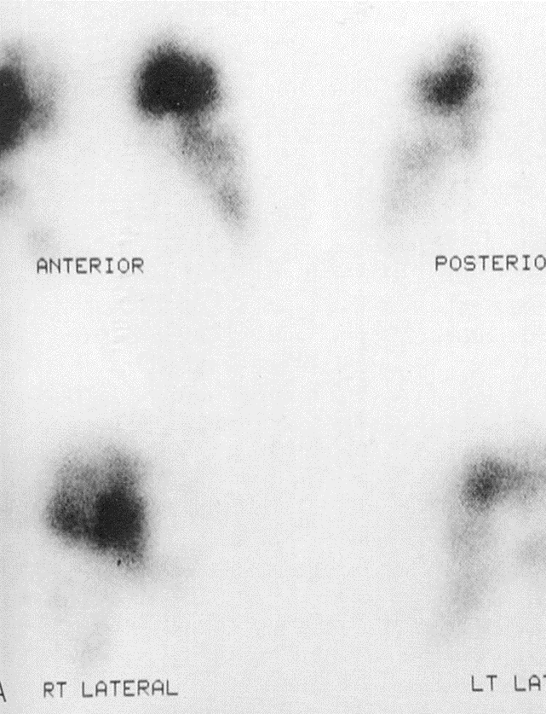
Diagnosis of PE and Tx
Diagnosis
  Clinical
    dyspnea
    chest pain
    Hypotension
  D-dimers
  Imaging
    CT
    Ventilation perfusion scan
Tx
  Medical management
    supportive care
    anticoagulation
    Thrombolysis
  Surgical management

Slide 61
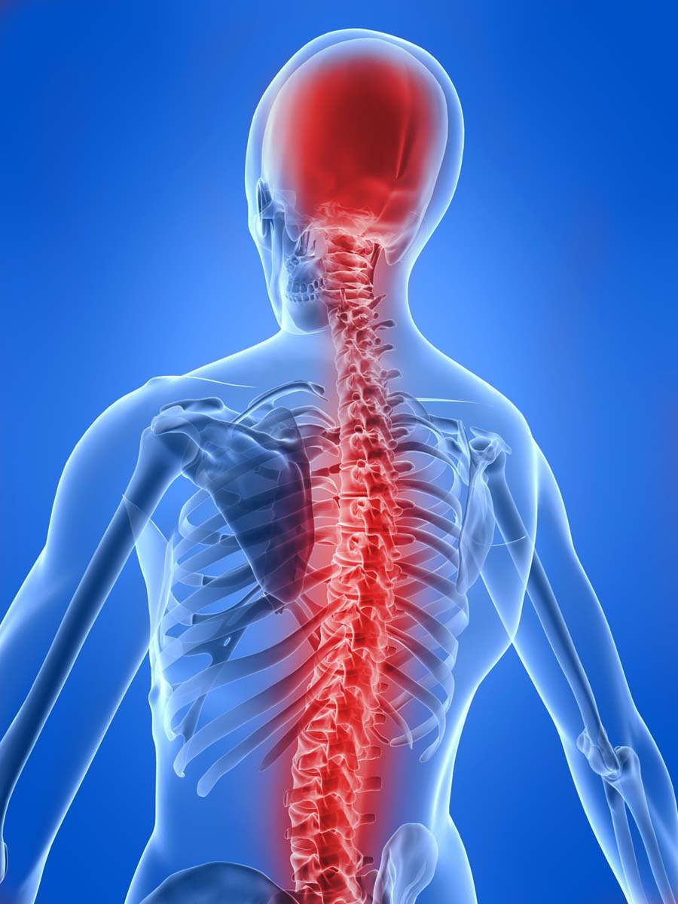
CNS

Slide 62
CNS
Failure to recover consciousness
  May be due to cerebral hypoxia as a result of e.g. hypoglycemia
Convulsion
  Attacks of involuntary tonic or clonic movements of the trunk, limbs and face with or without loss of consciousness.
    Predisposing fx in the post-op period are:
      Pyrexia
      Epilepsy
      hypocalcaemia

Slide 63
Mental status
Mental changes can include somnolence, coma, confusion, disorientation, agitation and convulsions
Elderly
This could be due to hypoxia, low blood sugar, uremia, ammonia or anesthetic agents
Failure to awaken issue usually due to anesthesia
Consider postoperative stroke in patients with carotid bruits
If the patient is a heavy drinker considered delirium tremens
Disorientation at night

Slide 64
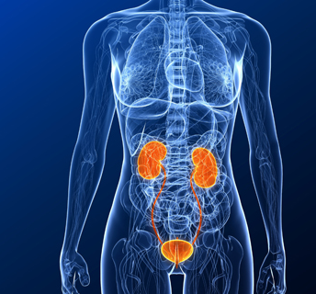
Genito-Urinary

Slide 65
Genito-urinary
Postoperative reduction of urine output to < 0.5 ml / kg / hr.
  Early postoperative fluid and sodium retention
Retention of urine
  failure to pass urine within 12-24hrs of surgery when bladder is distended.
  more common after pelvic and perineal operations.
  Due to action of atropine & other cholinergic anesthetic agents (decrease muscle contractility)
  Pain in operation site
Urinary tract infections

Slide 66
Prerenal
Implies decreased renal blood flow which is usually due to:
  decreased blood volume
  decreased cardiac output
  medications

Slide 67
Renal
Usually occurs with prolonged or uncorrected pre-renal failure (acute tubular necrosis)
Can also be caused by:
  aminoglycosides
  intravenous contrast dye
  blood transfusions
  NSAI’s

Slide 68
Post renal
Usually occurs after the urinary tract has been obstructed
Can be caused by:
  enlarged prostate
  ligation of the ureter during surgery
  Foley catheter blockage

Slide 69
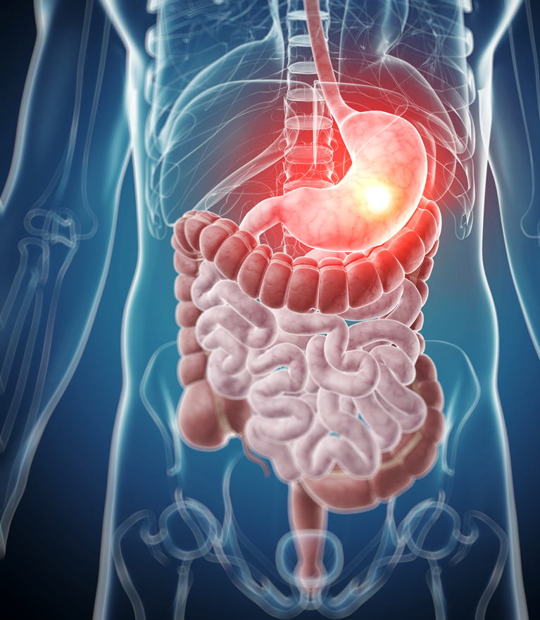
GI system

Slide 70
GI
Anorexia
Nausea & vomiting
  May be caused by anesthetic agents
Peritonitis &intra-abdominal abscesses
  Following operation in septic conditions
Diarrhea
  Drugs: oral antibiotics, laxatives, magnesium containing antacids.
  Operations: vagotomy & drainage, gut resection.
Upper and lower GI bleeding
Postoperative bowel obstruction
Acute gastric dilatation
Gastroduodenal mucosal
Intestinal obstruction (Ileus)
Postoperative fecal impaction
Colitis
Anastomotic leak
  Fistula
  Peritoneal abscess ----> Peritonitis
Hepatobiliary complications and jaundice

Slide 71
Postoperative bowel obstruction
Early obstruction
  Paralytic ileus
  mechanical obstruction
Bowel obstruction should be considered in patients if
  the bowel function does not return to normal after about four days

Slide 72
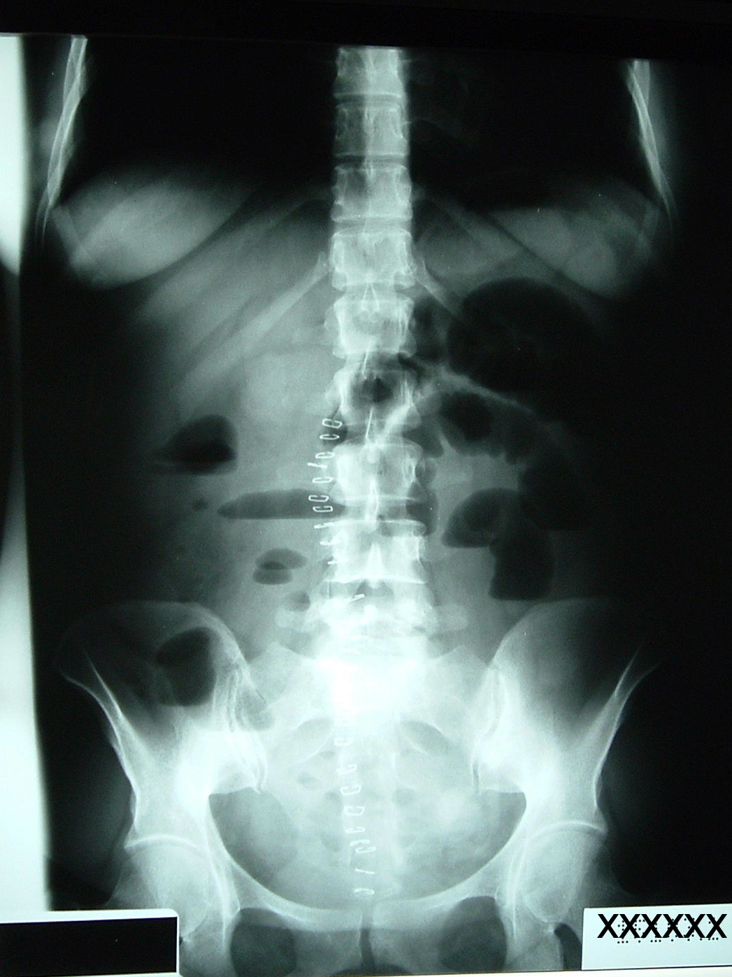
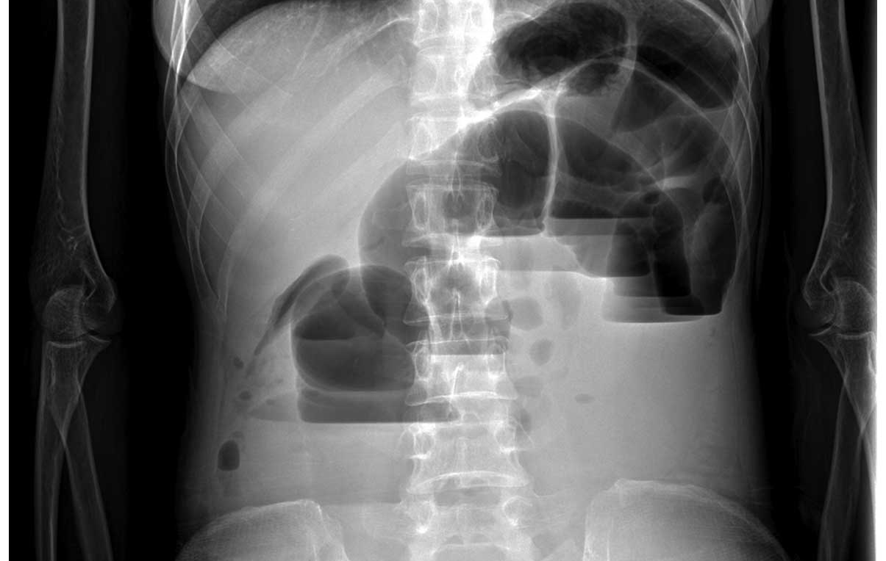
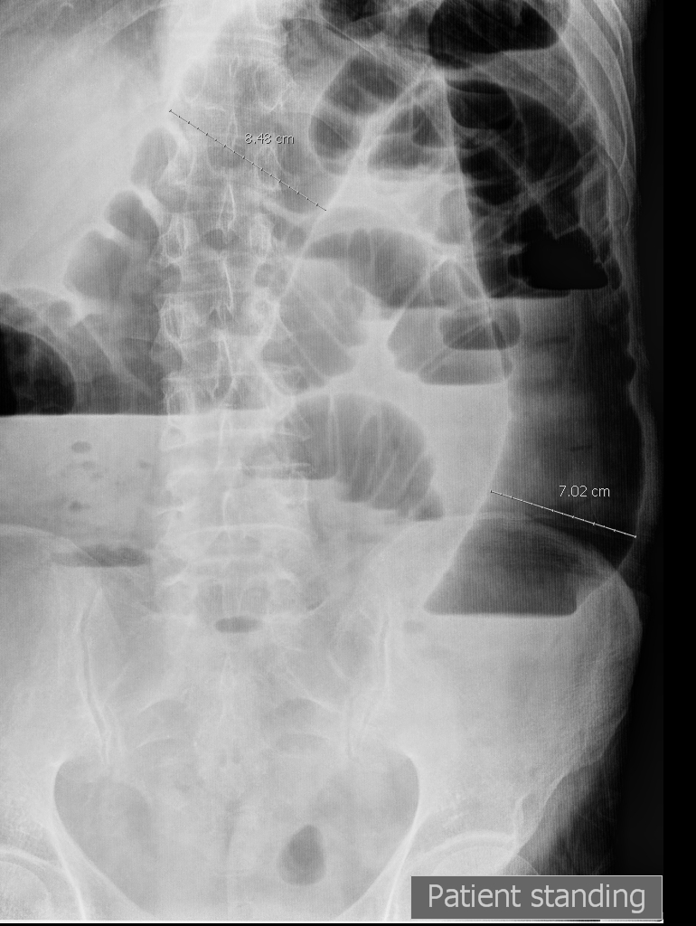
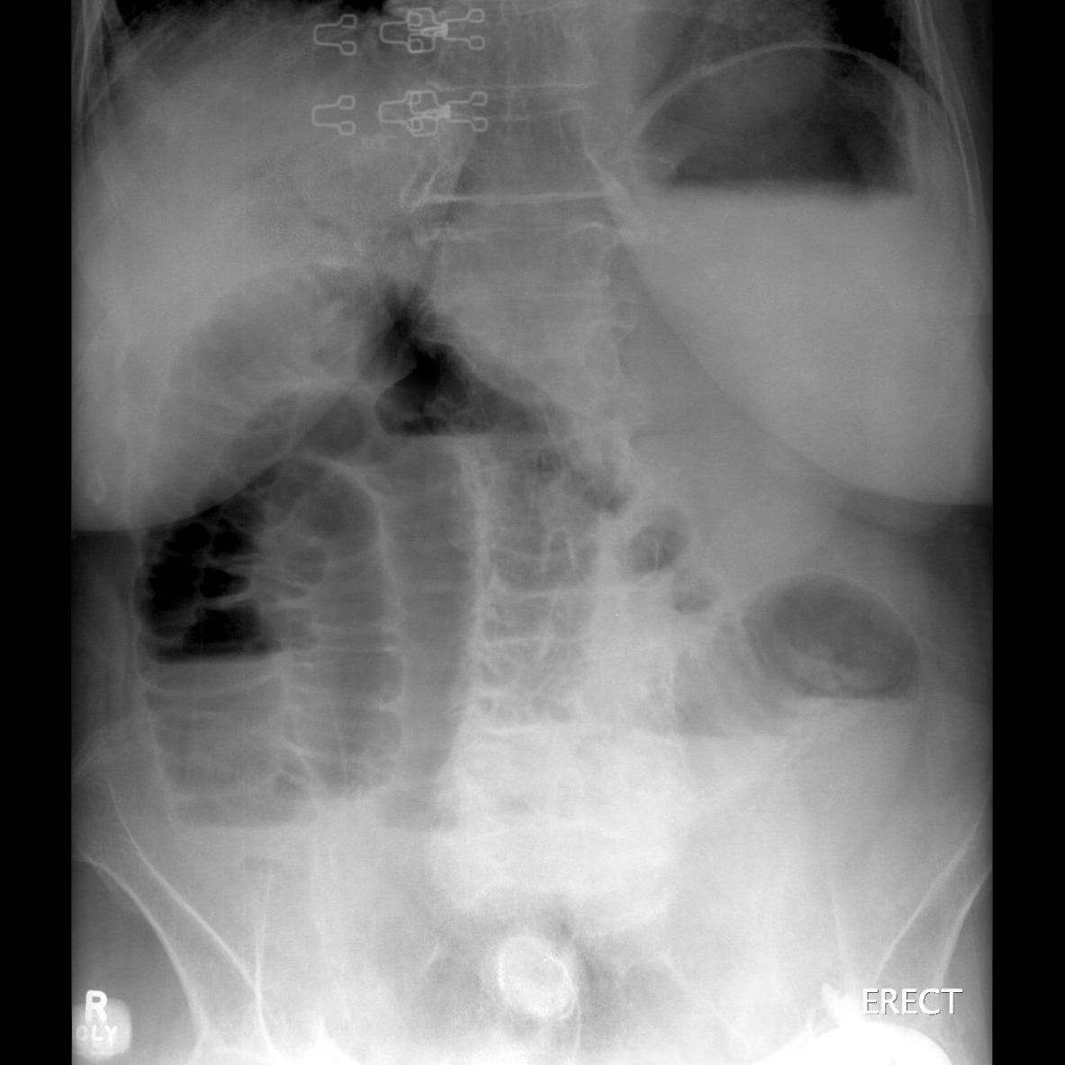
Postoperative bowel obstruction
Commonly caused by
  postoperative adhesions
  Post-operative adhesion
  Intussusception
  Volvulus
  Herniation
Patients usually exhibit normal bowel function for a short while then shows signs of obstruction
S/Sx:
  3rd – 4th postop day
  Abdominal distention, colicky pain, increase NGT drainage, bilious material
Diagnosis
  abdominal x-rays
  CT scanning

Slide 73
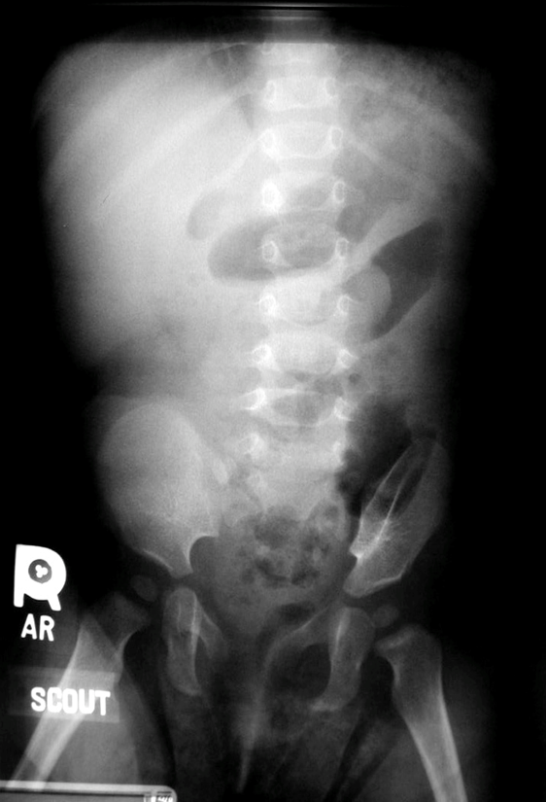
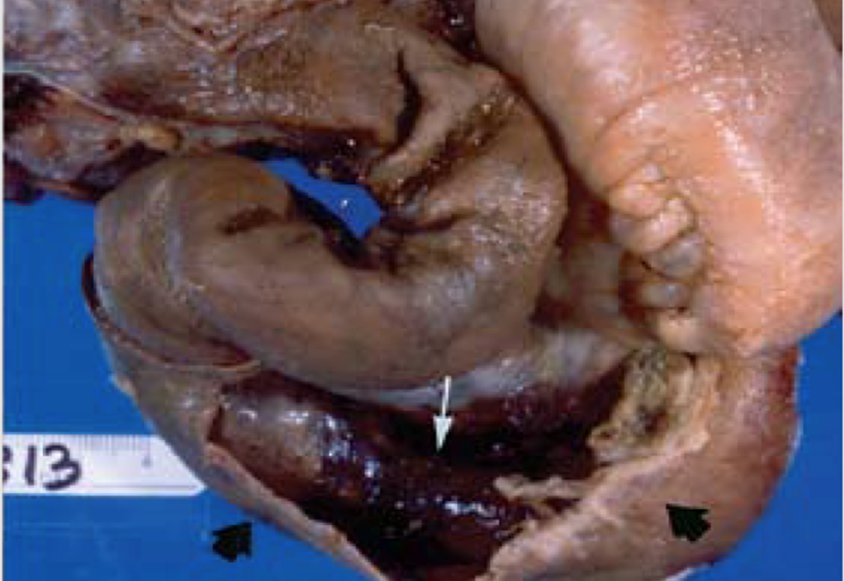
Intussusception

Slide 74
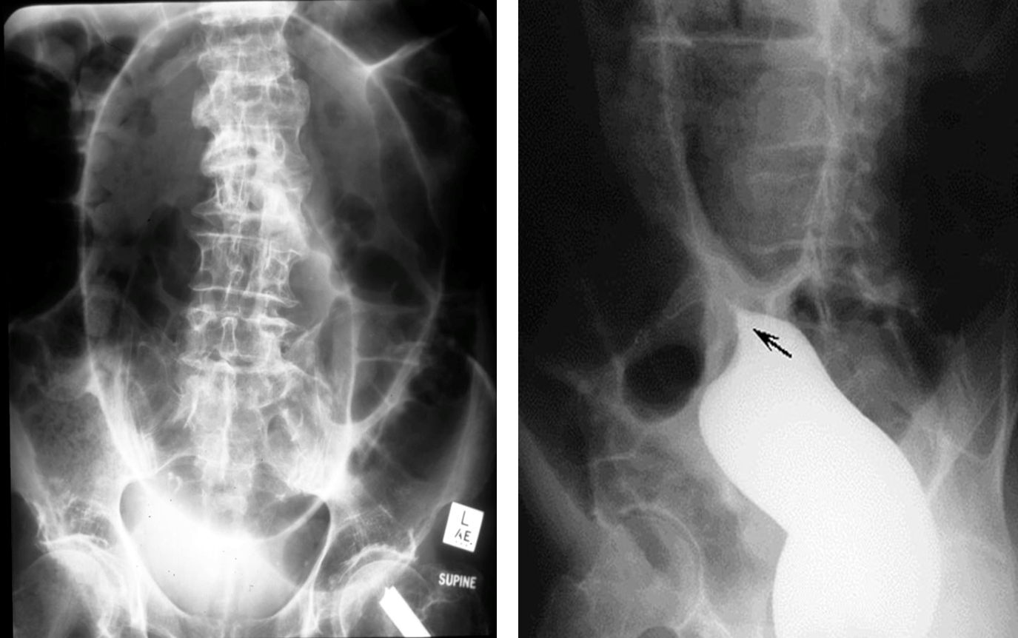
Volvulus

Slide 75
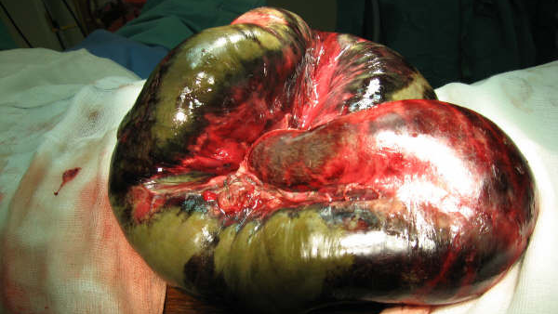
Small bowel volvulus

Slide 76
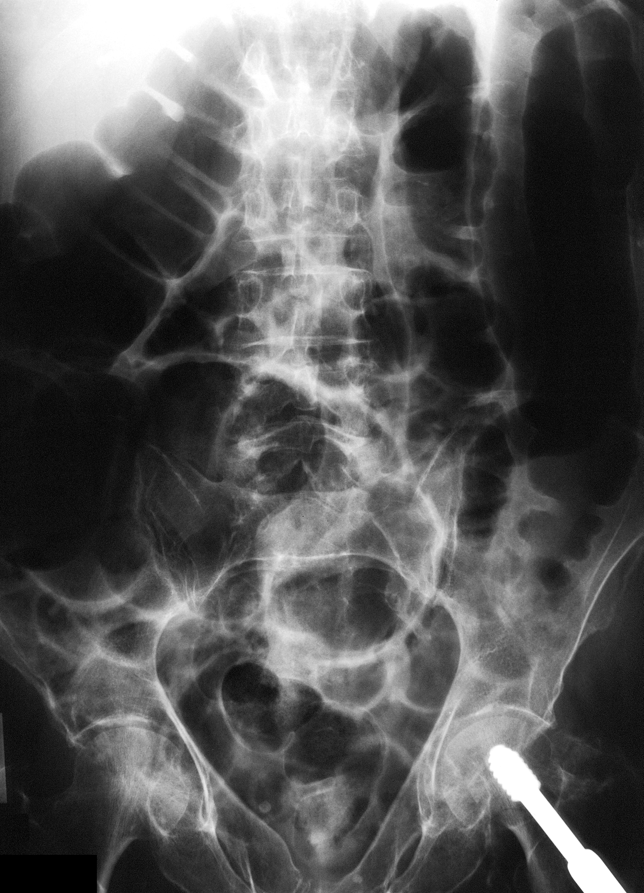
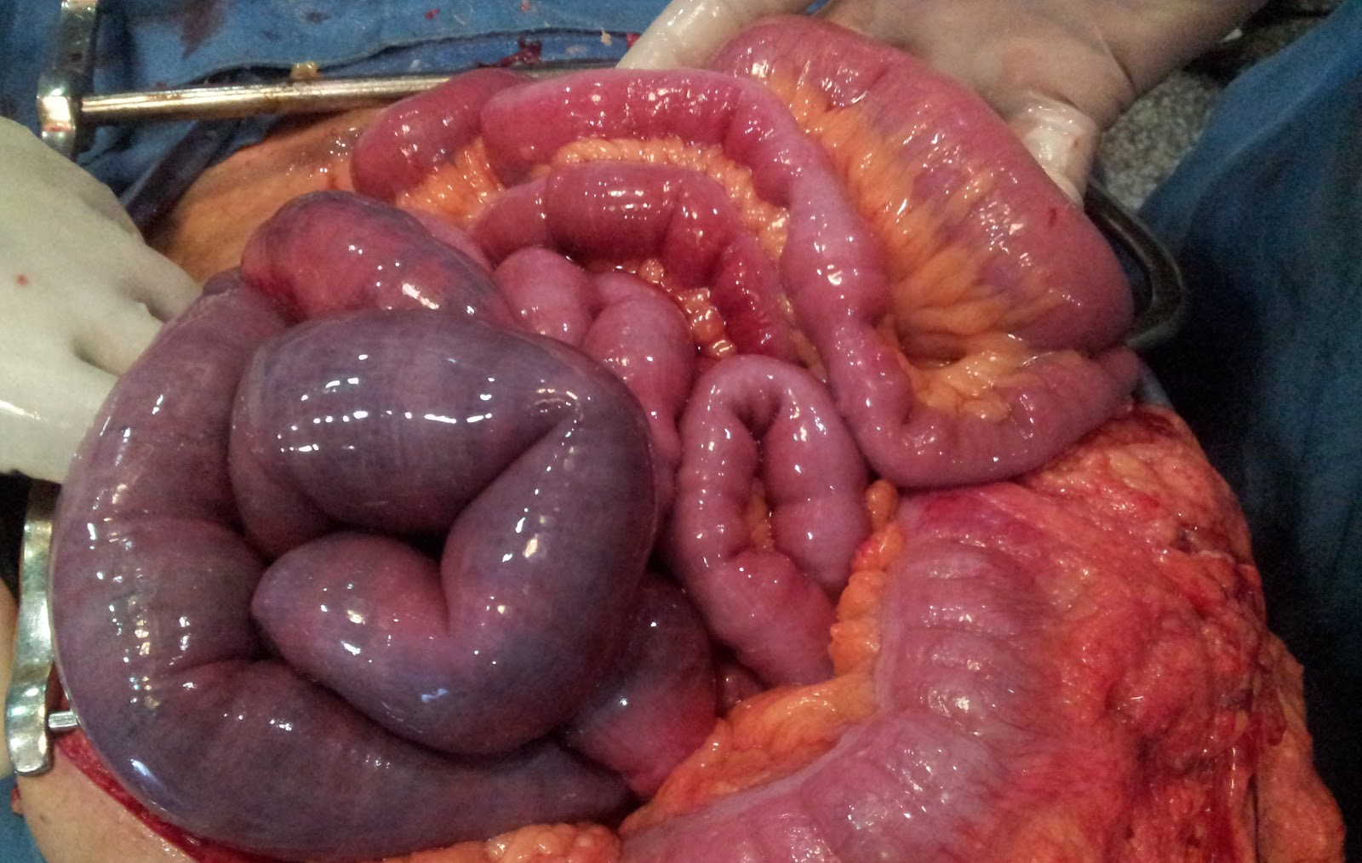
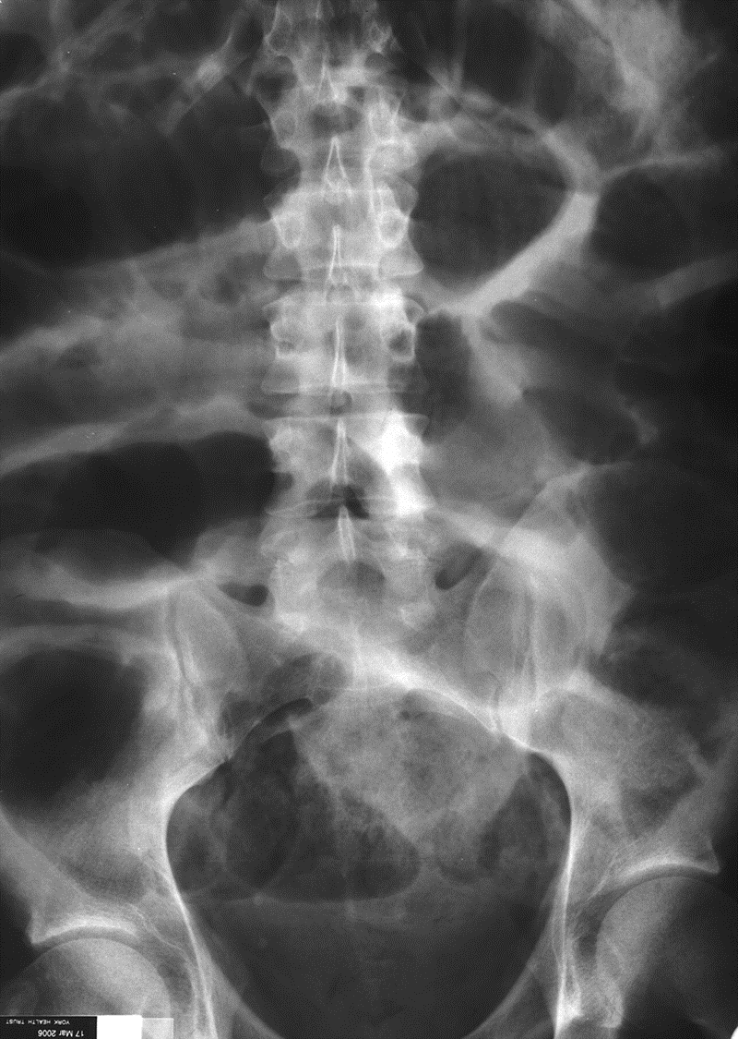
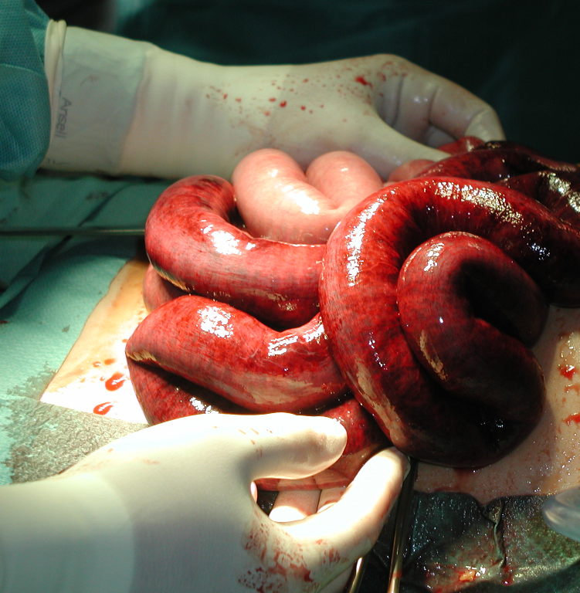
Paralytic ileus
Intra-abdominal inflammation
Drugs

Slide 77
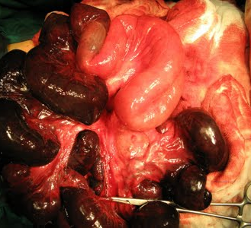
Small bowel internal herniation

Slide 78
Stomal obstruction
Stomal obstruction (due to local edema)
Causes of edema:
  Electrolyte imbalance
  Incomplete hemostasis
  Hypoproteinemia
  Leakage from anastomosis
  Inadequate proximal decompression
  Incorporation of too much tissue w/in the suture

Slide 79
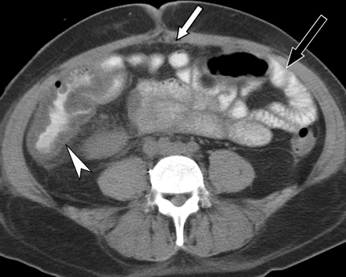
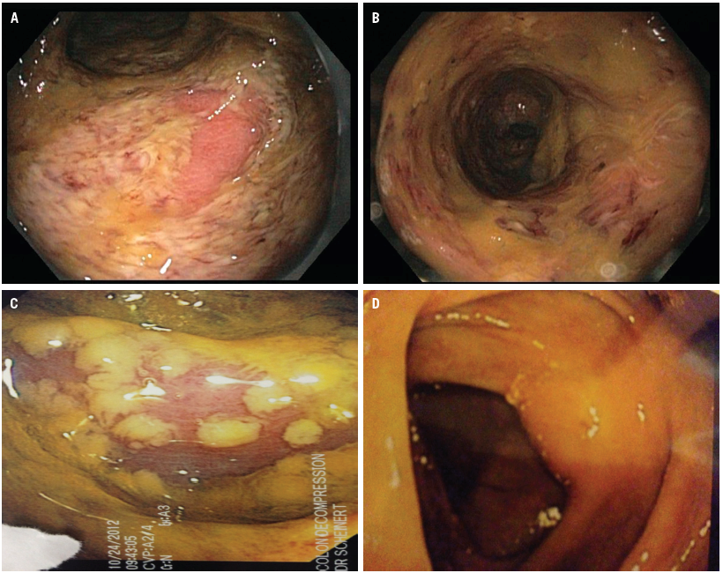
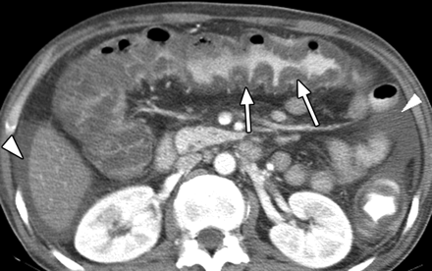
Clostridium Difficile Colitis

Slide 80
Anastomotic Leak
Fistula
  Gastric and duodenal fistula:
    Subtotal gastrectomy gastrojejunal and duodenal stump
    Due to suture line failure
  Bowel
Peritoneal abscess
Peritonitis
Sepsis
Etiologic factor:
  Poor surgical technique
  Distal obstruction
  Inadequate proximal decompression
Can manifest as localized or generalized peritonitis

Slide 81
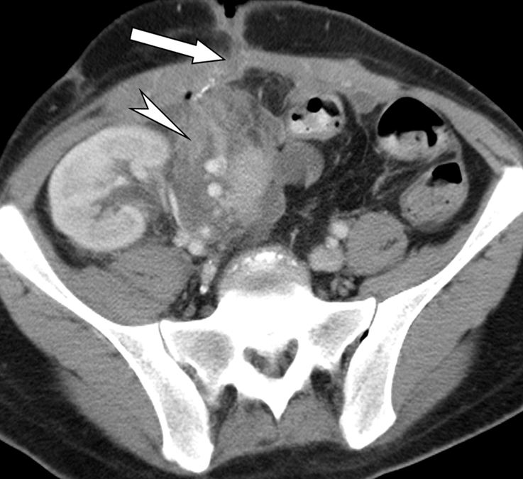
Fistula
Abnormal communication between two lining epithelium
Etiology:
  Anastomotic leak
  Poor blood supply
  Trauma
  Infection
  Inadvertent suturing of bowel wall while closing the fascia
  Carcinoma
Treatment:
  Small leaks:
    Conservative w/ NPO
    Proximal decompression
    Antibiotic
  Large leaks:
    Surgical intervention

Slide 82
Fistula
Gastric and duodenal fistula:
  Treatment:
    NPO / TPN
    Place NGT past the leak and give elemental diet
    Antibiotic
    Majority close spontaneously w/in 6 wks.
    Failure to close
        distal obstruction
        large leak
        Infection
        Cancer
    Surgery – resect the fistula and the bowel segment then re-anastomosis
Small bowel fistula:
  Drainage is less compared to duodenal fistula, but jejunal fistula have a poorer prognosis than ileal fistula

Slide 83
Fistula
Small bowel fistula:
  Treatment:
  Supportive:
    correct fluid & electrolyte imbalance
    Give proper nutrition
  Proximal jejunal fistula: - Distal feeding jejunostomy
  Distal ileal fistula: - low residue diet
  Control diarrhea ----> lomotil / protect the skin
Colonic fistula:
  Fluid & electrolyte imbalance less common but has higher infection can lead to peritonitis, peritoneal abscess and wound infection.
  Skin digestion and irrigation are rare

Slide 84
Fistula
Colonic fistula:
  Treatment:
  Nutrition (low residue or elemental diet)
  Antibiotics
    Spontaneous healing of fistula is the rule rather than the exception
    Medical management is generally indicated for 6 wks. to permit active inflammation to subside ---> fails ----> surgery
  Defunctionalizing colostomies for descending colon
  Ileal transverse colostomies for ascending and distal ileal fistulas
    If w/ generalized peritonitis do emergency resection

Slide 85
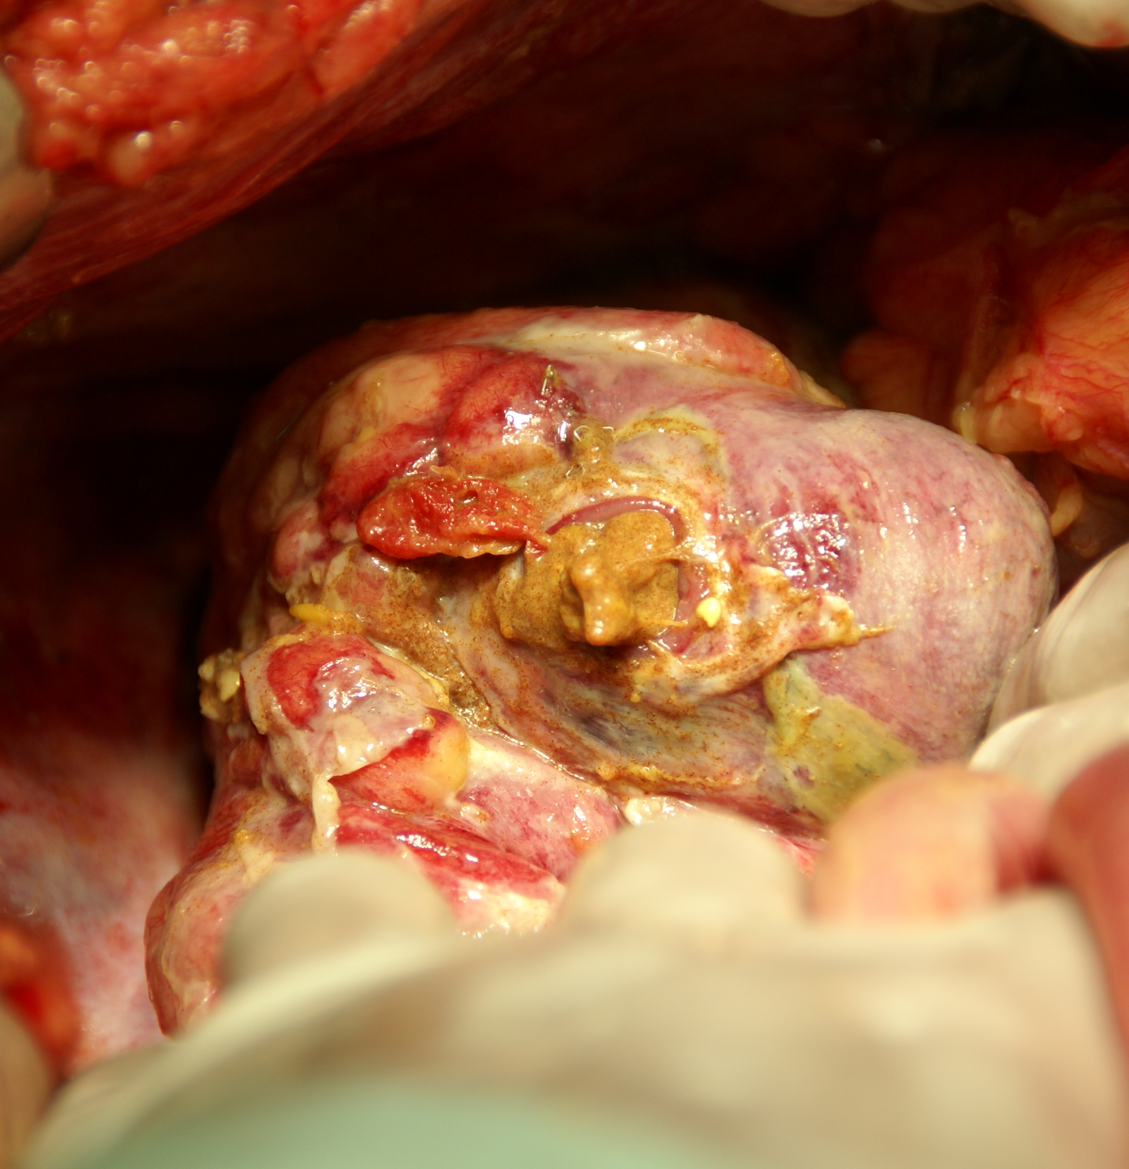


Peritoneal abscess and peritonitis

Slide 86
Late complications
Wound
  Hypertrophic scar, keloid, wound sinus.
Adhesions
  Strangulation, intestinal obstruction

Slide 87

Wound

Slide 88
Wound complications
Types
Attributed to
Type of operation
  Clean
  Clean contaminated
  Contaminated
  Infected
Emergent versus elective
Patients general health
Surgical technique
Wound infection
Postoperative distension
Site of the incision

Slide 89
Wound complications
Hematoma and seromas
  Predisposes to infection and delays wound healing
  Attribute to
    Inadequate hemostasis
    Anticoagulants
    Intraoperative anticoagulation
    Lack of obliteration of dead space
Infection
  Usually occurs 5-7days after surgery
  Contributing factors:
    Longer duration of operation
    Age
    Poor surgical technique
  Measure of ‘good house keeping’ in clean wound
  Erythema to pus collection
  Primary or secondary
Wound dehiscence
  Raised intra-abdominal pressure
  Weakness of wound
  Partial or complete

Slide 90

Wound dehiscence
Type
  Partial
  Complete
Timing
  Early
  Late
Contributing fx
  Malnutrition
  Sepsis
  Anemia
  Steroid therapy
  Uremia
  Diabetes
  Liver failure
Leads to
  Incisional hernia

Slide 91



Necrotizing Fasciitis

Slide 92
Postoperative fever
Common problem
Physical exam is important in evaluating postoperative fever
Timing of fever

Slide 93
Postoperative fever
Pyrexia (fever) after operation may be caused by:
Metabolic response to trauma in the first 24hrs
Atelectasis
Alveolar infiltrates
Aspiration
Infection or hematoma of the wound
Laryngo-tracheitis from endotracheal intubation
Peritonitis or intra-abdominal abscess
Complications of blood transfusion: mismatched blood
Drug sensitivity
Injection abscess
Deep venous thrombosis and Pulmonary embolus
Thyroid storm
Malignant hyperthermia

Slide 94
Early postoperative fever
Respiratory
  atelectasis
Systemic response to trauma of surgery

Slide 95
Postoperative fever (1-3 days)
Urinary tract infection
IV sites
  Phlebitis
  Infection

Slide 96
Postoperative fever (after 5 days)
Wound infection
Respiratory tract infection
Abscess
  Wound
  Intra-abdominal
Urinary tract infection

Slide 97
Common Causes of Elevated Temperature in Surgical Patients
Hyperthermia: temperature greater than 37.5–38.3 °C. as methods for thermoregulation are not as effective. therefore, the body is absorbing more heat than it is dissipating, also known as overheating of the body
Hyperpyrexia: a fever with an extreme elevation of body temperature greater than or equal to 41.5 °C. Fever/pyrexia is body temperature that is high as a result of bacterial or viral infections
Environmental
Malignant hyperthermia
Neuroleptic malignant syndrome
Thyrotoxicosis
Pheochromocytomatous
Carcinoid syndrome
Iatrogenic
Central/hypothalamic responses
Pulmonary embolism
Adrenal insufficiency
Sepsis
Infection
Drug reaction
Transfusion reaction
Collagen disorders
Factitious syndrome
Neoplastic disorders

Slide 98
Postoperative Care
Pain Control
  Pain affects blood pressure, vital signs
  Narcotics affect respiration
  Pain control is a chemical balance
  Challenges in pain control
    Surgical procedure, duration
    History of prior medication use
    Age, co-morbidities
    Experience with pain

Slide 99
Complications: Who Knows better ??
What operation did the patient have?
What are the most common complications of this operation?
What is most life-threatening?
What comorbidities does that particular patient have?

Slide 100
Complications: Who Knows better ??
Each surgical procedure has its own set of inherent complications
Surgeon treating the patient usually has the best idea as to what is happening

Slide 101
Common Post Operative Complication
post
Major Surgery
Post Operative Pain
Bleeding : Hypovolemia
Hypoxia : Hypoventilation
Hemodynamic Unstable
Fluid & Electrolyte imbalance
Wound Complication
  Hematoma, infection
  Dehiscent, Keloid
Post Operative infection : wound (Site of Operation)
Post Operative Renal Failure
Liver Failure
Hematological disorder: Coagulopathy
Post Operation Sepsis : ARDS
Post Operative Respiratory Failure :
  Atelectasis,
  Pneumonia,
MOF
Hematoma, Seroma, Intraabdominal
CVS, arrhythmia, Hypovolemia
Contractility (MI)
Post Op Pulmonary edema, CHF

Slide 102

Surgical safety
The holistic idea of Hippocratic medicine
Only with careful attention to both the individuality of illness and the universality of disease etiology can physicians most effectively care for their patients
Mantri S. Holistic medicine and the Western medical tradition. Virtual Mentor 2008; 10(3):177-80.

Slide 103
Three central problems in Surgical safety
Unrecognized as a public health issue
Lack of data on surgery and outcomes
Failure to use existing safety know-how

Slide 104
Unrecognized as a public health issue
234 million operations are done globally each year Source: Weiser, Lancet 2008.

Slide 105
Unrecognized as a public health issue
Known surgical complications of 3-16%
Known death rates of 0,4-0,8%
At least 7 million disabling complications – including 1 million deaths – worldwide each year

Slide 106
Unrecognized as a public health issue (cont.)
Burden of surgical disease is increasing worldwide due to
    Cardiovascular disease
    Traumatic injuries
    Cancer
    Longer life expectancies

Slide 107
Lack of data on surgery and outcomes

Slide 108
Failure to use existing safety know-how
High rates of preventable surgical site infection result from inconsistent timing of antibiotic prophylaxis
Anesthetic complications are 100-1000x higher in countries that do not adhere to monitoring standards
Wrong-patient, wrong-site operations persist despite high publicity of such events

Slide 109
The Safe Surgery Saves Lives: Strategy
Promotion of surgical safety as a public health issue
Creation of a checklist to improve the standards of surgical safety
Collection of “Surgical Vital Statistics”

Slide 110

Surgical safety

Slide 111




What is this tool that addresses the 10 objectives?
The team will operate on the correct patient at the correct site.
The team will use methods known to prevent harm from administration of anesthetics, while protecting the patient from pain.
The team will recognize and effectively prepare for life-threatening loss of airway or respiratory function.
The team will recognize and effectively prepare for risk of high blood loss.
The team will avoid inducing an allergic or adverse drug reaction for which the patient is known to be at significant risk.
The team will consistently use methods known to minimize the risk for surgical site infection.
The team will prevent inadvertent retention of instruments or sponges in surgical wounds.
The team will secure and accurately identify all surgical specimens.
The team will effectively communicate and exchange critical information for the safe conduct of the operation.
Hospitals and public health systems will establish routine surveillance of surgical capacity, volume and results.

Slide 112
Reality Check
Currently, hospitals
  do MOST of the right things,
  on MOST patients,
  MOST of the time.
The Checklist helps us
  do ALL the right things,
  on ALL patients,
  ALL the time

Slide 113
Advantages of using a Checklist
Customizable to local setting and needs
Supported by evidence
Evaluated in diverse settings around the world
Promotes adherence to established safety practices
Minimal resources required to implement a far-reaching safety intervention

Slide 114
The Checklist was piloted in 8 cities…
PAHO I
EURO
EMRO
London, UK
Amman, Jordan
Toronto, Canada
WPRO I
Manila, Philippines
PAHO II
Seattle, USA
WPRO II
Auckland, NZ
AFRO
Ifakara, Tanzania
SEARO
New Delhi, India

Slide 115
...and was found to reduce the rate of postoperative complications and death by more than one third!
Haynes et al. Surgical Safety Checklist to Reduce Morbidity and Mortality in a Global Population. New England Journal of Medicine 360:491-9. (2009)

Slide 116
Change in Death and Complications by Income Classification
 | Change in Complications | Change in Death
High Income | 10.3% -> 7.1%* | .9% -> 0.6%
Low and Middle Income | 11.7% -> 6.8%* | 2.1% -> 1.0%*
Haynes et al.
A Surgical Safety Checklist to Reduce Morbidity and Mortality in a Global Population.
New England Journal of Medicine 360:491-9. (2009)
* p<0.05

Slide 117
Easy Math
234 million people are operated on each year, and >1 million of these individuals die from complications
At least ½ are avoidable with the Checklist
500,000 save lives on the line each year
+

Slide 118

Results
The rate of death was 1.5% before the checklist was introduced and declined to 0.8% afterward (P = 0.003).
Inpatient complications occurred in 11.0% of patients at baseline and in 7.0% after introduction of the checklist (P<0.001).
ΥΠΕΡΑΞΙΑ
N Engl J Med 2009;360:491-9.

Slide 119
Τέτοια υπεραξία δίνουν
Οι υπο-ειδικότητες στην Χειρουργική και ειδικά
Η Χειρουργική ήπατος-παγκρέατος-χοληφόρων

Slide 120


Slide 121


Slide 122


Slide 123
The effect of surgical volume and the provision of residency and fellowship training on complications of major hepatic resection.
Hospitals supporting a surgical residency program had lower overall morbidity and mortality.
The mortality rate increased once greater than approximately 70 cases were performed per annum.
A fellowship program however was not associated with overall lower morbidity and mortality and appeared to result in a higher rate of certain complications.
Predicted mortality rate following major hepatectomy according to annual hospital volume, adjusted for Charlson comorbidity score.
Kohn GP, Nikfarjam M. J Gastrointest Surg. 2010 Dec;14(12):1981-9.

Slide 124
The volume-outcomes effect in hepato-pancreato-biliary surgery: hospital versus surgeon contributions and specificity of the relationship.
Nathan H, Cameron JL, Choti MA, Schulick RD, Pawlik TM. J Am Coll Surg. 2009 Apr;208(4):528-38

Slide 125

Scarborough JE et al. J Am Coll Surg. 2008 Apr;206(4):678-84
Workforce projections for hepato-pancreato-biliary surgery.
An estimated 16,800 HPB procedures will be performed in 2020, representing a 25% increase during the next 15 years.
28 fellowship-trained HPB subspecialists will enter the workforce each year.
If half of all HPB procedures are performed by HPB subspecialists in 2020, then the average subspecialist will perform only 14 such procedures that year.
If high volume HPB surgery is defined as 40 procedures per year, and 50% of HPB procedures are performed by high-volume surgeons in 2020,
then only 15 fellows need to be trained in HPB surgery each year to meet demand in 2020.

Slide 126

Workforce projections for hepato-pancreato-biliary surgery
Accordingly
15 x 30 (working life span of a HBP)=
450 HBP surgeons by 2020 year in USA
(350 millions)
means
1 HBP surgeon /777.777 USA citizens
For 12.000.000 Greek citizens by year 2020 we need ~ 16 HBP surgeons
in Greece
So we need to train 16/30= 0,5 HBP surgeon every year or
1 HBP surgeon /2 years

Slide 127

Sir William Osler
“The good physician treats the disease;
The great physician treats the patient who has the disease.”
If there was not bleeding everybody would do surgery
Sir William Osler
The father of Modern (Academic) Medicine

Slide 128
…What ever we do…
…is still the Surgeon that
makes the decisions
and takes the blame
for death and complications.

