Slide 1
Αρχές Χειρουργικής Ογκολογίας
Νικολέττα Δημητρίου
Επιμελήτρια Α΄
Α’ Χειρ Κλινική ΛΑΙΚΟ Νοσοκομείο

Slide 2
Ορισμός
Ο ρόλος της Χειρουργικής στη “διαχείριση” της νεοπλασματικής νόσου

Slide 3
Τι περιλαμβάνει
Κατανόηση των μηχανισμών της καρκινογένεσης
Πρόληψη & προληπτικός έλεγχος
Έγκαιρη διάγνωση ή/και Συμβολή στην ακριβή διάγνωση
Σταδιοποίηση της νόσου και Μέθοδοι σταδιοποίησης
Δια-επιστημονική αξιολόγηση του ογκολογικού ασθενούς
Σχεδιασμός θεραπευτικών επιλογών
Προληπτικές
Θεραπευτικές
Παρηγορικές
Αποκατάσταση
Μακροχρόνια παρακολούθηση (Follow-up)

Slide 4
Γιατί την χρειαζόμαστε?
Η επίπτωση του καρκίνου αυξάνεται σταθερά τα τελευταία 50 χρόνια
Πλήθος θεραπευτικών επιλογών είναι διαθέσιμες στην εποχή μας
Πλήθος χειρουργικών τεχνικών, υλικοτεχνικού εξοπλισμού και τεχνολογικών εξελίξεων χαρακτηρίζουν την τελευταία 30ετία
Πολυ-αιτιολογική, Πολυ-παραγοντική αιτιολογία της καρκινογένεσης
Δια-επιστημονική προσέγγιση για την επιλογή της καταλληλότερης θεραπείας.

Slide 5
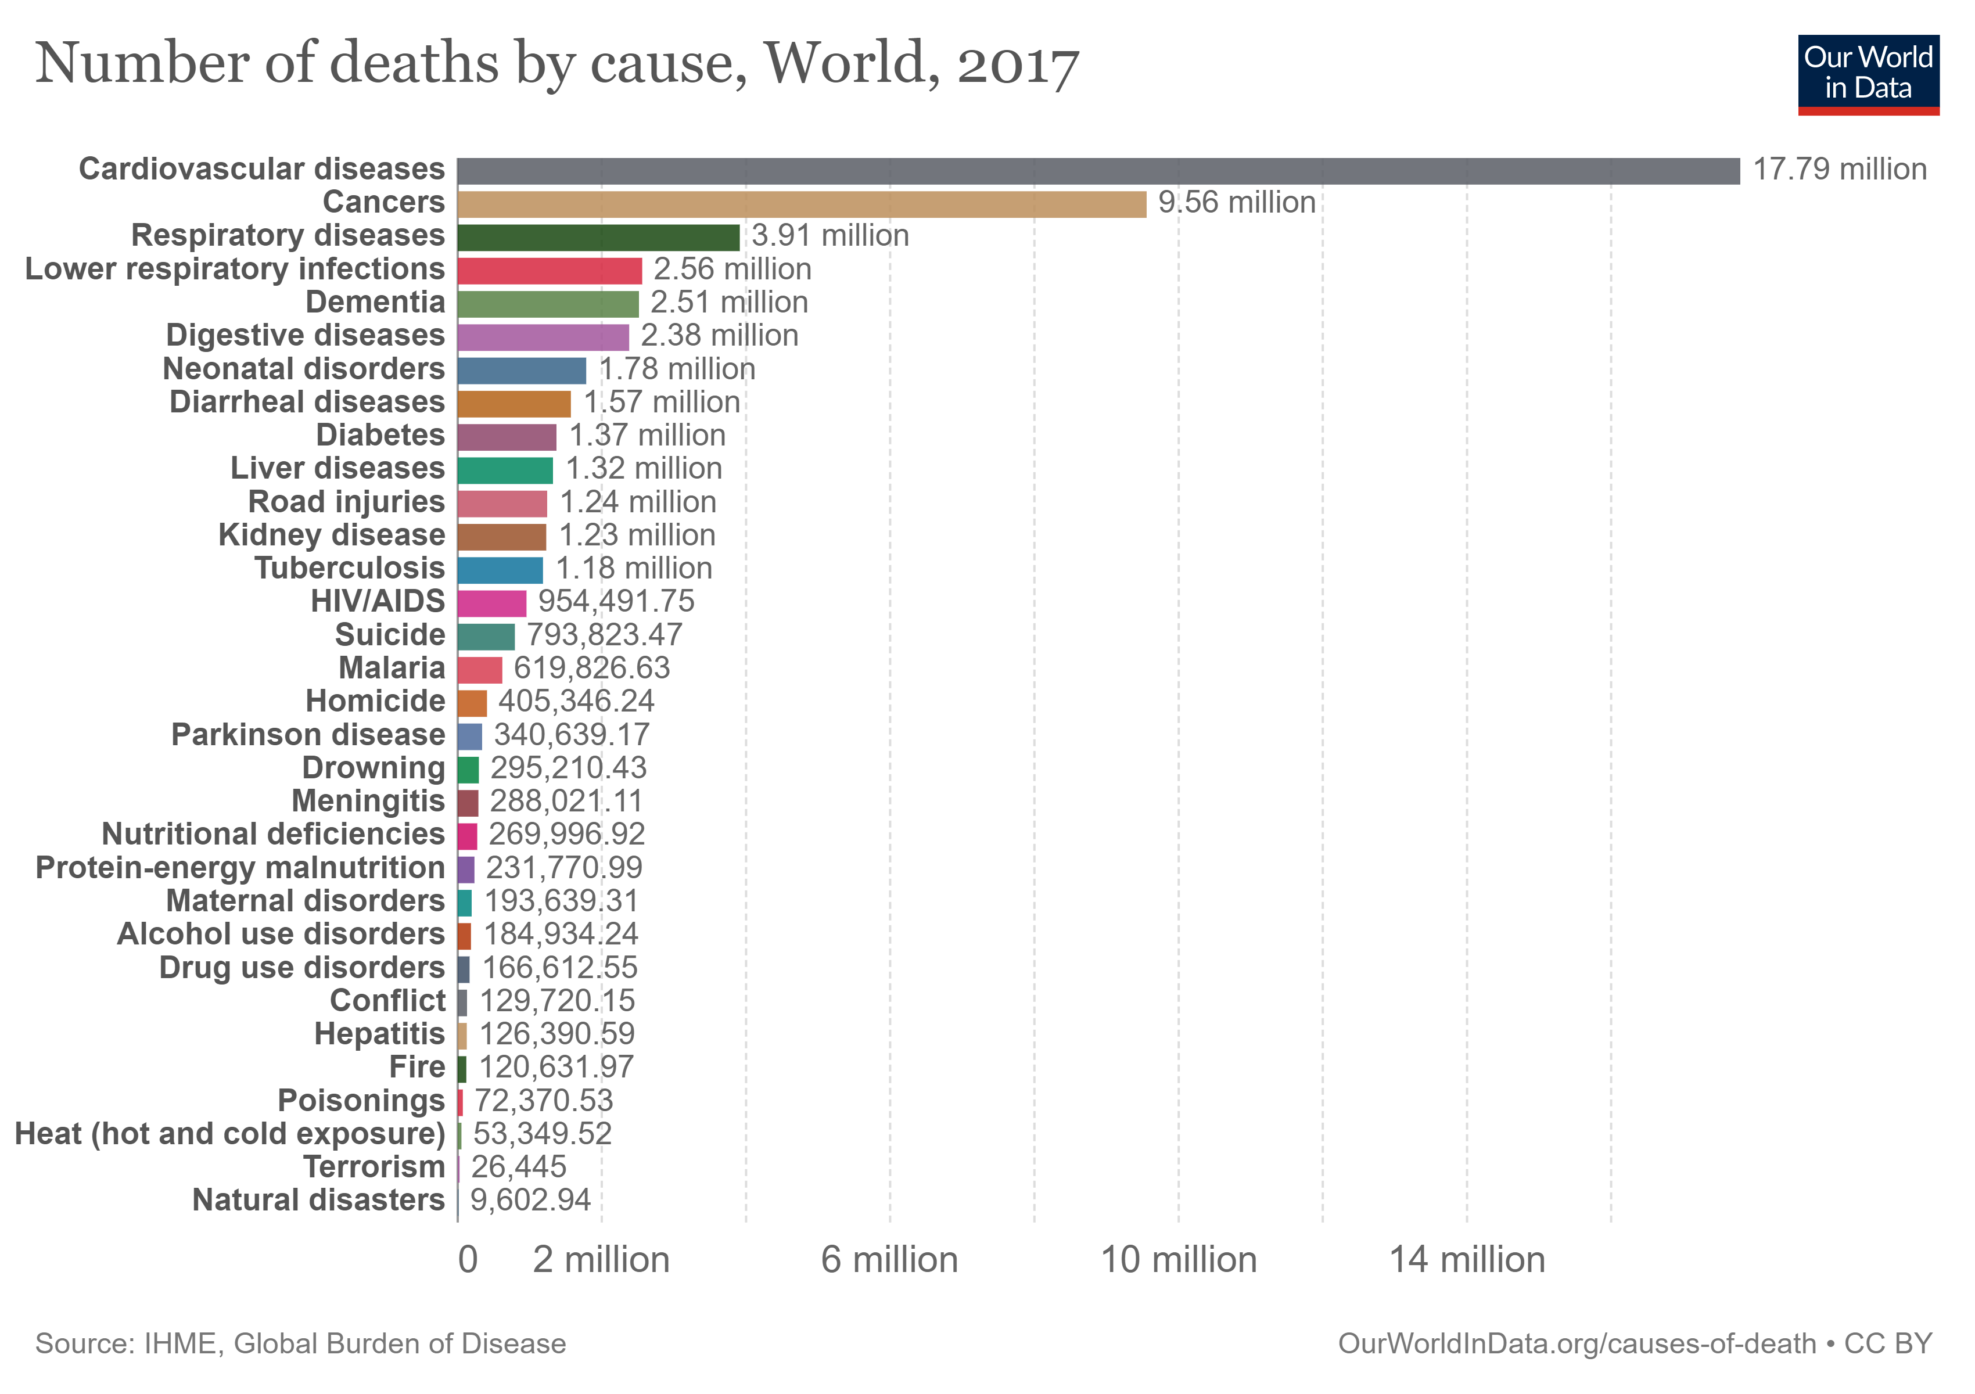

Slide 6
Cancer Epidemiology

Slide 7
Cancer Epidemiology

Slide 8
Cancer Epidemiology

Slide 9
Cancer Epidemiology

Slide 10
Cancer Epidemiology

Slide 11
Cancer Epidemiology

Slide 12
Cancer Epidemiology

Slide 13
Cancer Epidemiology

Slide 14
Cancer Epidemiology

Slide 15
Notes:
Mass of transformed cells that does not respond in normal way regulatory system
No useful function
Atypical uncontrolled growth
Genomic abdormality (increased cell rep;ication, inhibit cell death)

Slide 16
Growth signal autonomy
Evasion of growth inhibitory signals
Avoiding immune destruction
Unlimited replicative potential
Tumor promoting inflammation
Invasion and metastasis
Angiogenesis
Evasion of cell death
Reprogramming energy metabolism
Genome instability and mutation

Slide 17
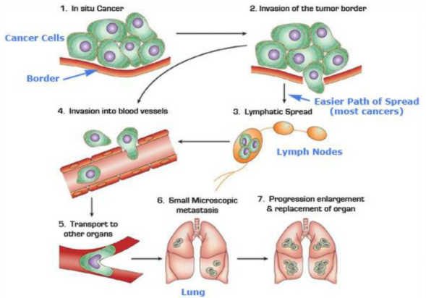
Notes:
Μεταστασεις πολύπλοκο και μη σαφές
Τοπική πιεση από ογκούς που μεγαλώνουν
Απώλεια της συνεκτικής ικανότητας
Αυξημενη κινητικοτητα
Παραγώγη διαφοπων ουστων
Εμβολη καρκινικων κυτταρων
Δυνατότητα αγγειογένεσης

Slide 18
Notes:
Κακοήθης εξαλλάγη είναι η διαδίκασία κατά την οποία ένας κυτταρικός πληθυσμός απόκτα μετάλλαξεις, που του δίνουν πλεονέκτημα ως προς την αναπτυξη συγκριτικά με τα φυσιολογικά κύτταρα. Πόλλες από αυτές τις αλλάγες γίνονται σε γενετικό επίπεδο , επηρεάζοντας την ισορροπά μεταξύ των ογκογονιδίων και των ογκοκατασταλτικων γονίδιων

Slide 19

Κατανόηση καρκινογένεσης
Ογκοκατασταλτικά γονίδια
Tumor suppressor genes
Ογκογονίδια
Oncogenes

Slide 20
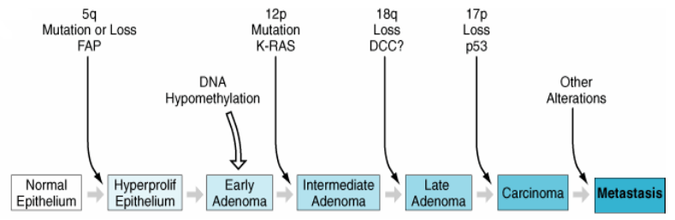
Καρκινογένεση = Έναρξη, Ανάπτυξη, Προώθηση
Initiation Promotion Progression

Slide 21
Notes:
The majority of the growth of a tumour occurs before it is clinically detectable.
By the time they are detected, tumours have passed the period of most rapid growth, that period when they might be most sensitive to anti-proliferative drugs.
There has been plenty of time, before diagnosis, for individual cells to detach, invade, implant and form distant
metastases.
.Cancer cells usually follows “Gompertzian growth” pattern.

Slide 23
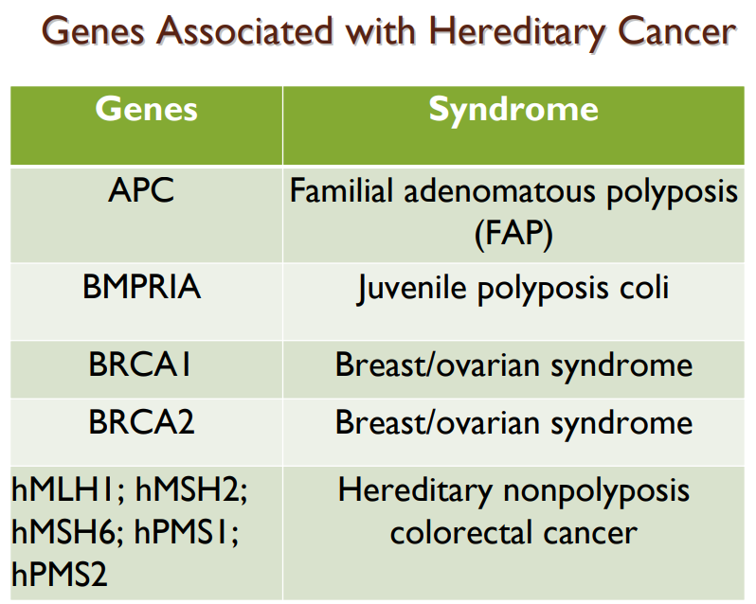
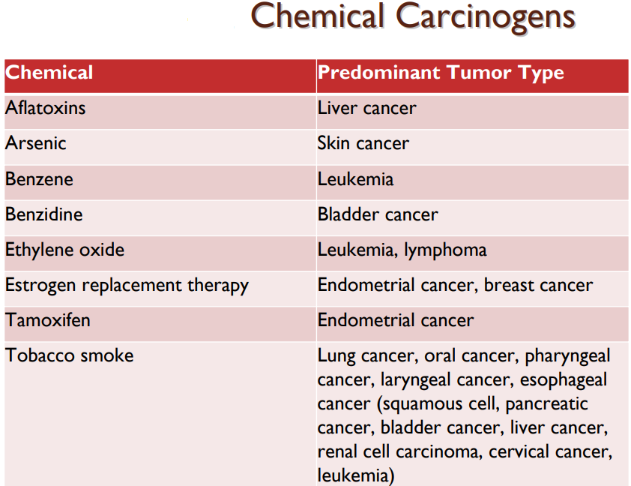
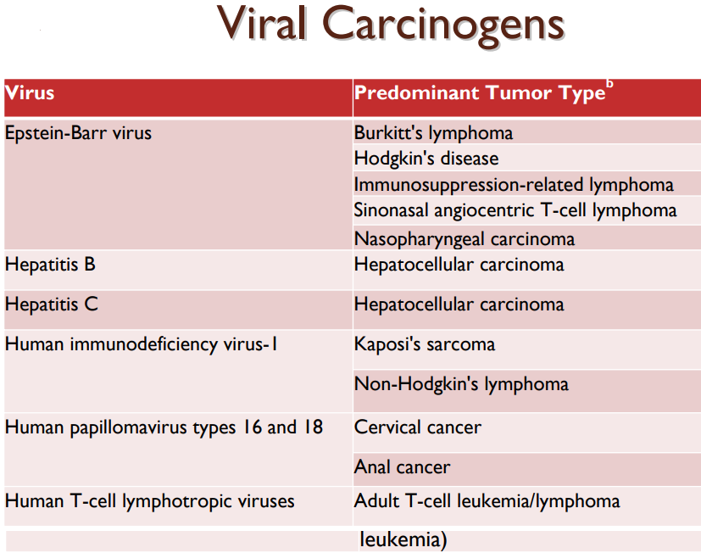
Notes:
Any agent that can contribute to tumor formation is referred to as a carcinogen and can be a chemical, physical, or viral agent
• Currently, approximately 60% to 90% of cancers are thought to be due to environmental factors
• Chemicals are classified into three groups based on how they contribute to tumor formation.
1. Genotoxins - can initiate carcinogenesis by causing a mutation.
2. Cocarcinogens - by themselves cannot cause cancer but potentiate carcinogenesis by enhancing the potency of genotoxins.
3. Tumor promoters - enhances tumor formation when given after exposure to genotoxins.
Physical carcinogenesis can occur through induction of inflammation and cell proliferation over a period of time or through exposure to physical
agents that induce DNA damage.
• In animal models, for example, subcutaneous implantation of a foreign body can lead to the development of tumors that have been attributed to
chronic irritation from the foreign objects.
• In humans, clinical scenarios associated with chronic irritation and inflammation such as chronic nonhealing wounds, burns, and inflammatory
bowel syndrome have all been associated with an increased risk of cancer.
• H. pylori infection is associated with gastritis and gastric cancer
Viral carcinogen
• It is estimated that 15% of all human tumors worldwide are caused by viruses.
• Viruses may cause or increase the risk of malignancy through several mechanisms, including
• Direct transformation
• Expression of cytokines or other growth factors, and
• Alteration of the immune system

Slide 24
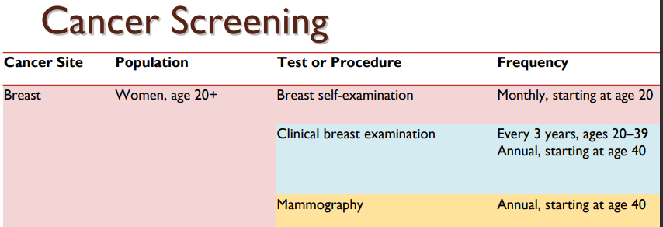

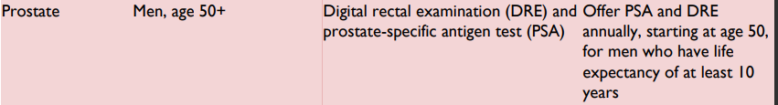
Προσυμπτωματικός έλεγχος – Έγκαιρη διάγνωση
Notes:
• Early detection is the key to success in cancer therapy.
• Screening for common cancers using relatively noninvasive tests is
expected to lead to early diagnosis
• Screening guidelines are developed for the general baseline risk
population.

Slide 25
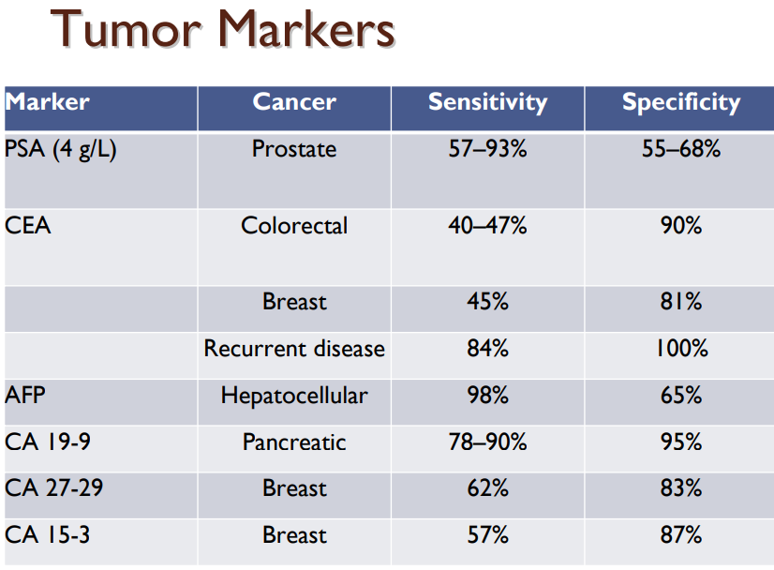
Notes:
Tumor markers are substances that can be detected in higher than normal amounts in the serum, urine, or tissues of patients with
certain types of cancer
• Tumor markers are produced either by the cancer cells themselves or by the body in a response to the cancer
Specific/easycollection/reductiple-cheap-rapid

Slide 26
Συμβολή στη
διάγνωση
Βιοψία

Slide 27
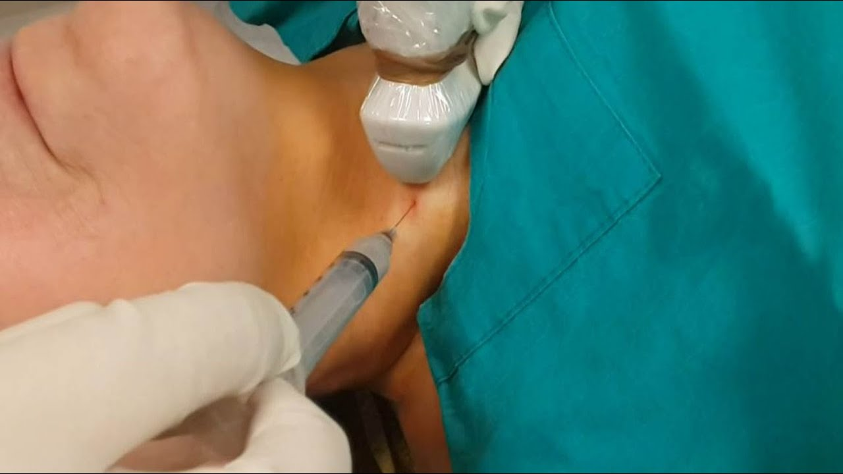
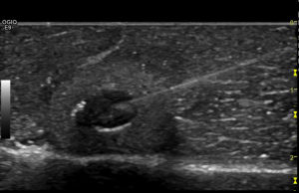
Βιοψία δια λεπτής βελόνας
Fine needle aspiration biopsy (FNAB)
Fine needle aspiration cytology (FNAC)

Slide 28

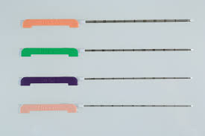
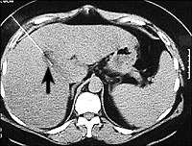
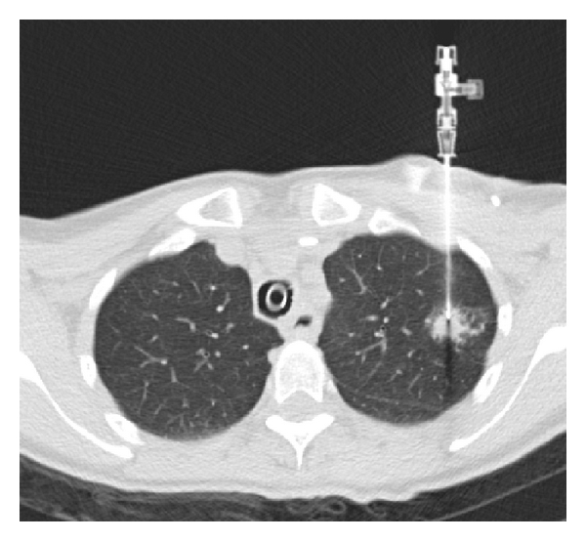
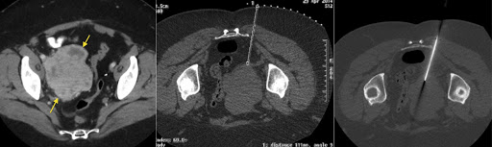
Βιοψία δια βελόνης
Tru-cut biopsy

Slide 29
Βιοψία δια βελόνης
Tru-cut biopsy

Slide 30
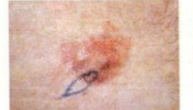
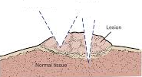
Βιοψία διατομής
Incisional biopsy

Slide 31
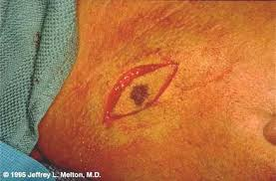
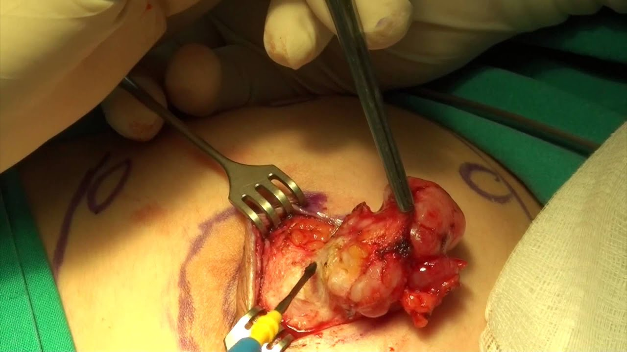

Βιοψία εκτομής
Excisional biopsy

Slide 32
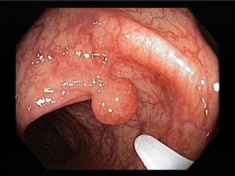
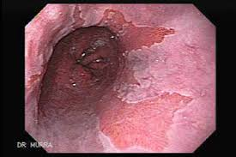
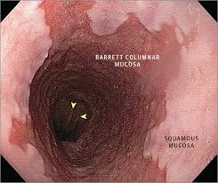
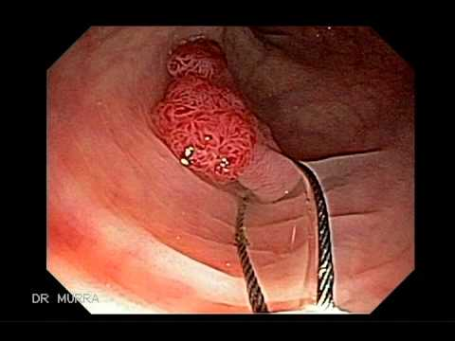
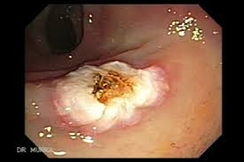
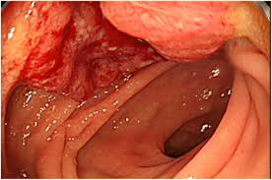
Ενδοσκοπική βιοψία
Endoscopic biopsy

Slide 33
Σταδιοποίηση
Notes:
WHY DO WE STAGE?
DECIDE TREATMENT
PLAN TREATMNET
ASSESS PROGNOSIS

Slide 34
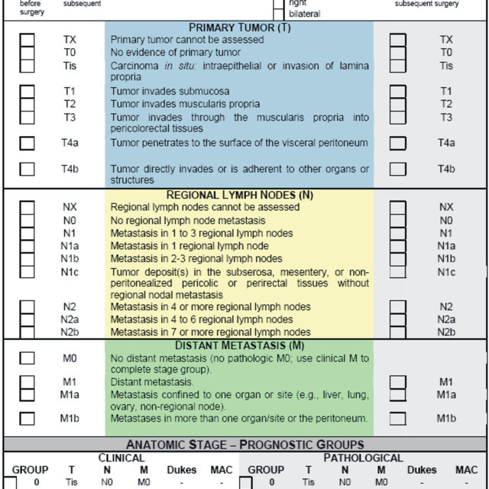
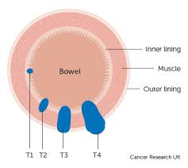
Σταδιοποίηση

Slide 35
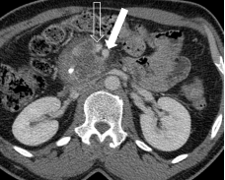
Σταδιοποίηση: α)τοπικο-περιοχική νόσος
Διαταραχή του περιγράμματος
(διήθηση?) της SMV
Χωρίς διήθηση της SMΑ
Borderline resectable PC

Slide 36
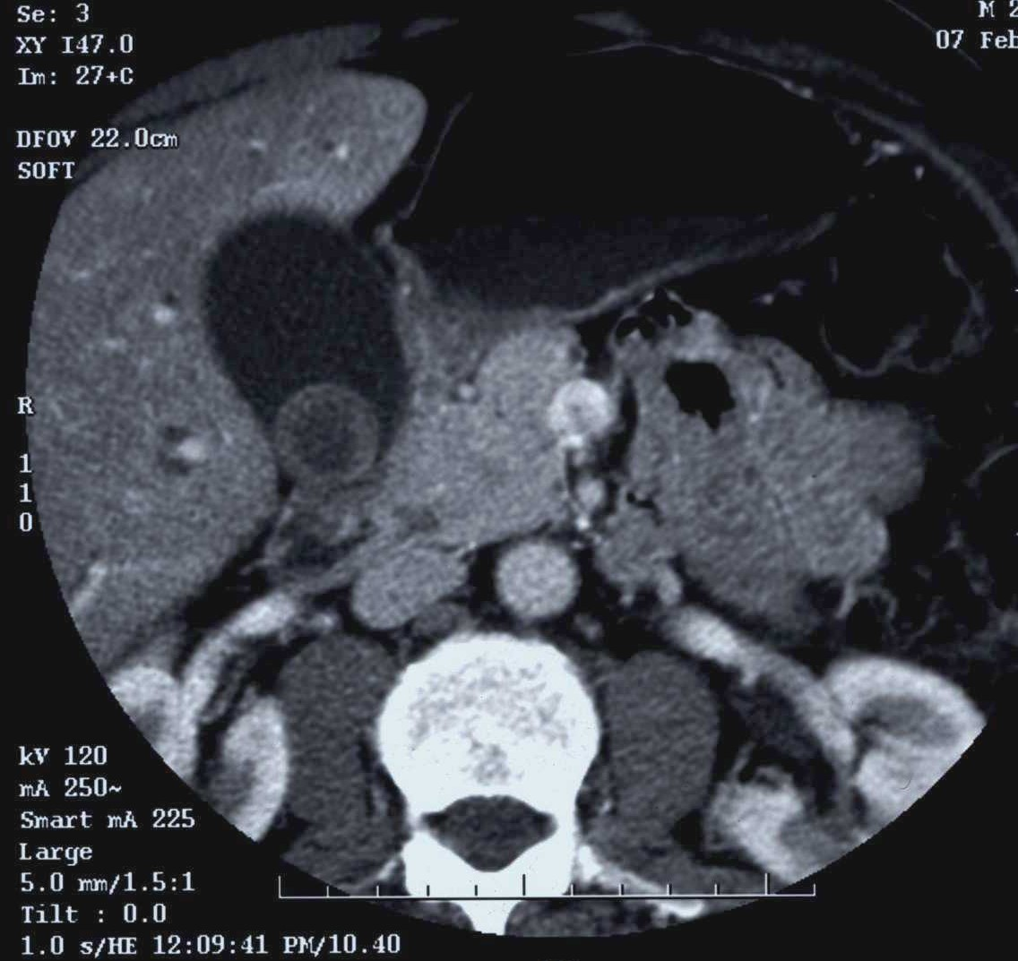
Σαφής διήθηση της SMV
<180^{ο} διήθηση της SMA
Borderline resectable PC

Slide 37
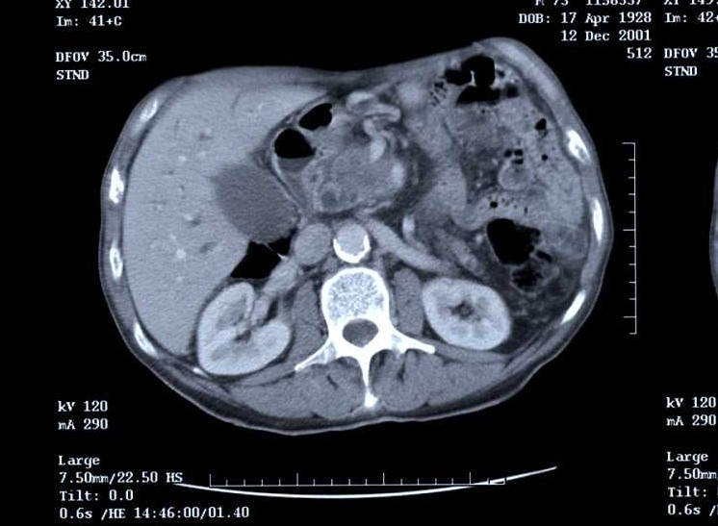
360º επαφή με SMV
>180º επαφή με την SMA
Locally advanced PC

Slide 38
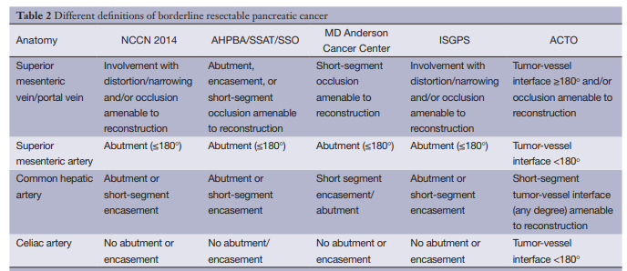
Οριακά εξαιρέσιμος- Borderline resectable

Slide 39
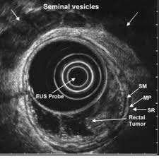
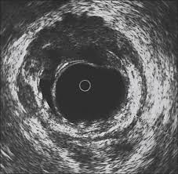
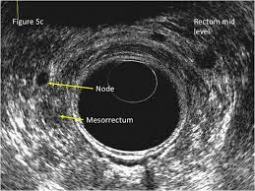

Slide 40
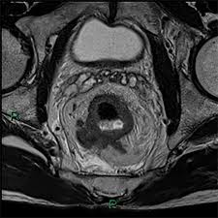
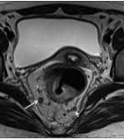

Slide 41
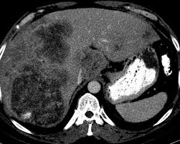
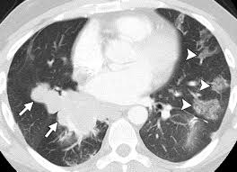
Σταδιοποίηση: β)μεταστατική νόσος

Slide 42
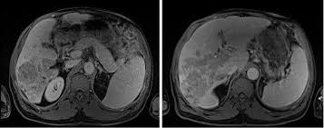

Slide 43
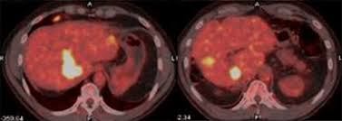
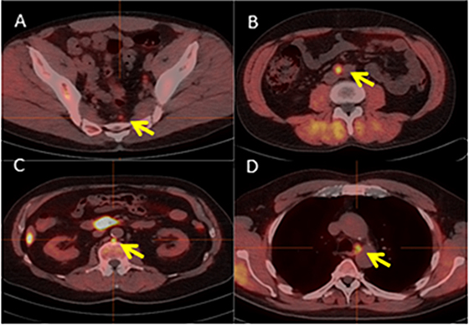

Slide 44
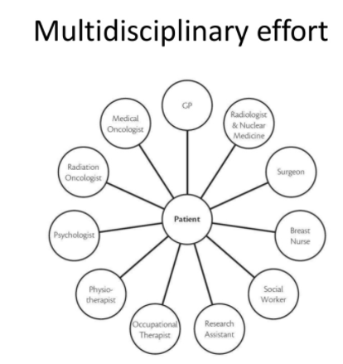

Slide 46
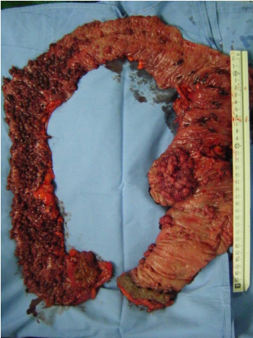
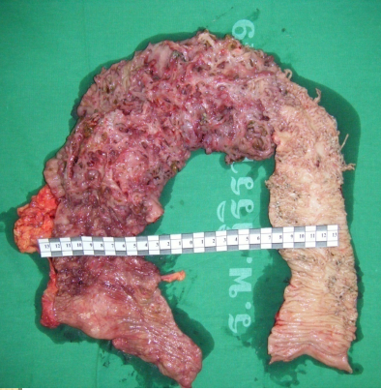
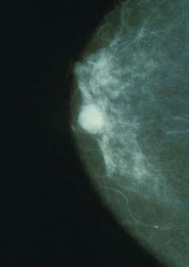
Θεραπεία: α) προφυλακτική
FAP
Ελκώδης κολίτιδα
Ca μαστού (BRCA1 & 2)
Notes:
50%cancer by age of 40./develop colon cancer by 70/proctocolectomy before age 20 to prevent CRC is advised for who Carry APC gene
40% of UC (Pancolitis) die of colon cancer 􀁹3% of children with UC develop colon cancer by the age of 10, and 20% develop cancer during each ensuing decade􀁹Colectomy is indicated for patients with ulcerative colitis if the chronicity of this disease is well established.
risk of cancer in some women is increased substantially over the normal risk (but does not approach 100%),􀁹counseling that explains the benefits and risks of prophylactic mastectomy?􀁹Genetic tests for BRCA1 and BRCA2 mutations provide valuable information

Slide 47
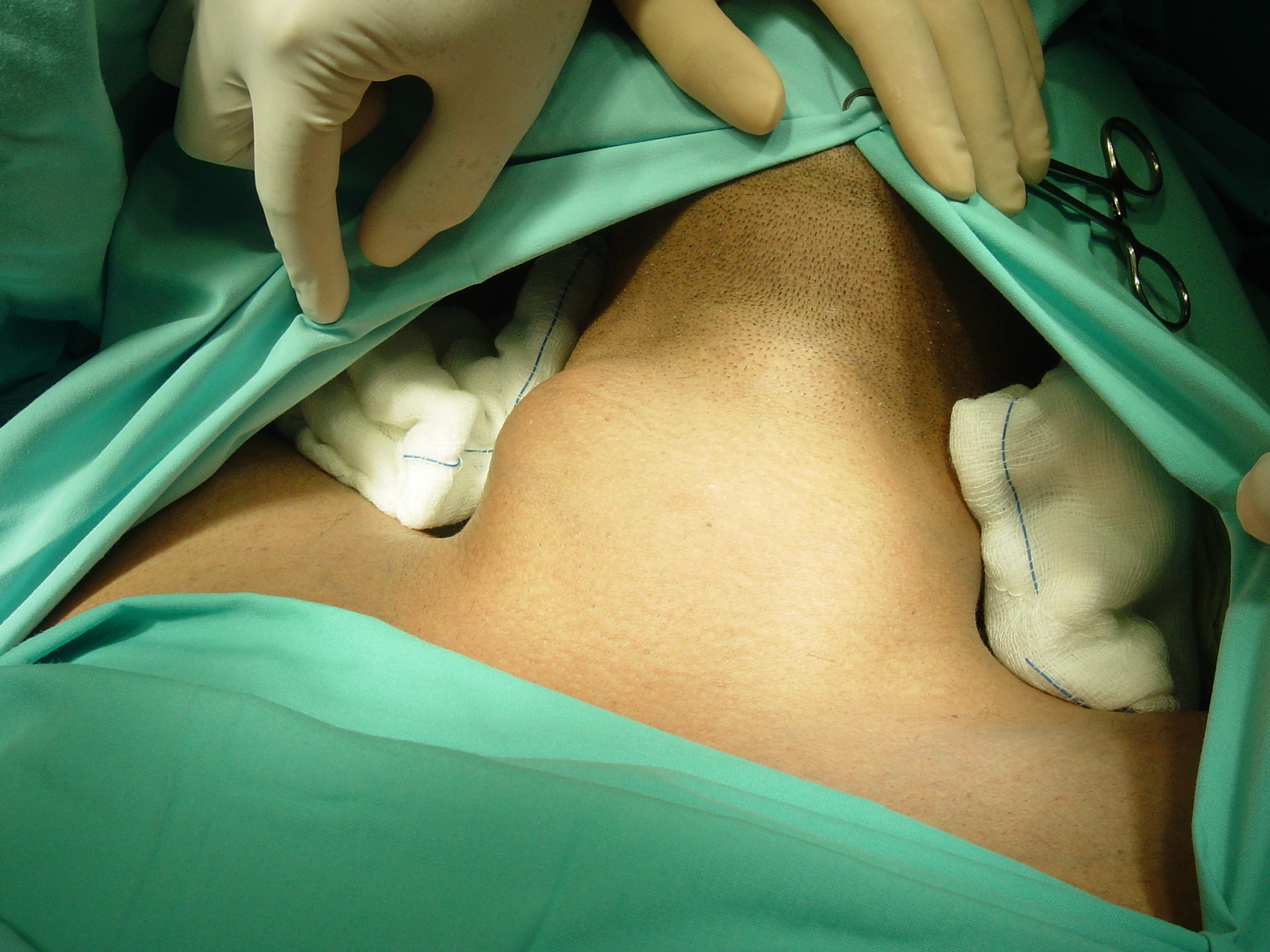
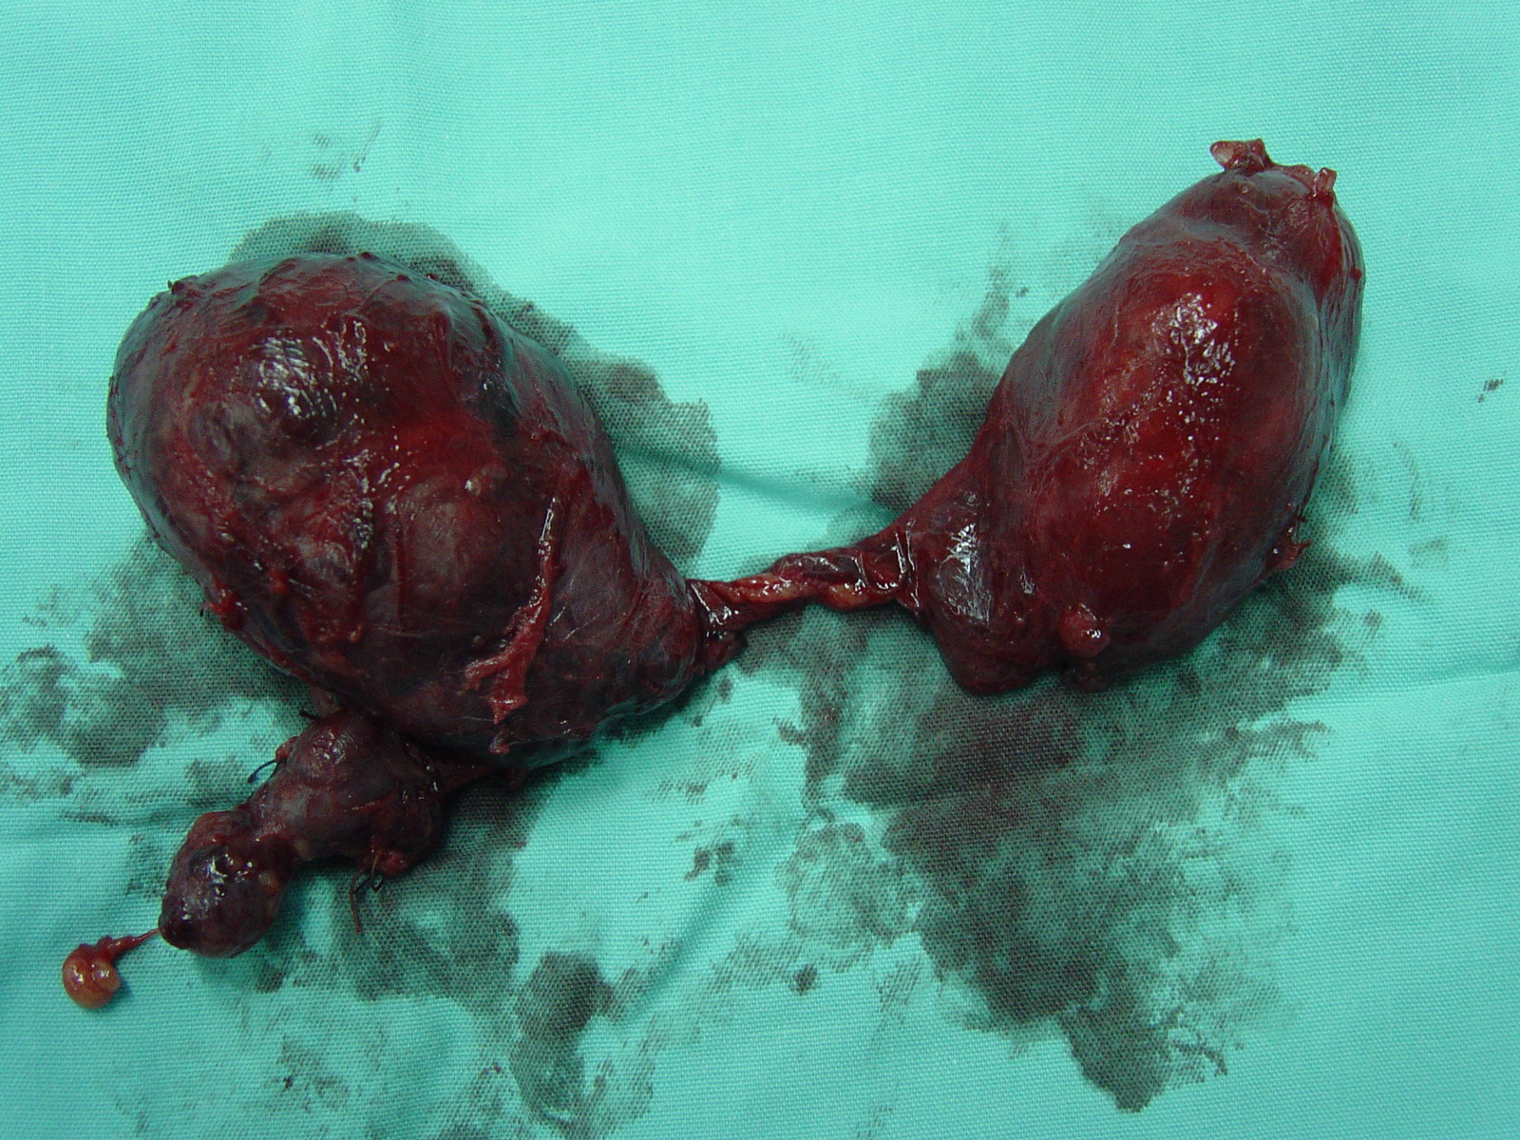
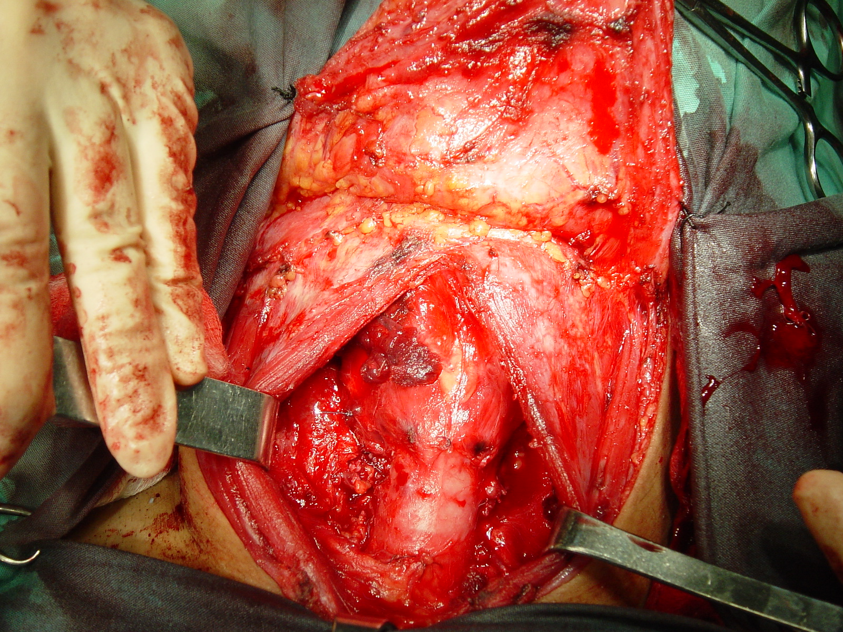
Θεραπεία: β) θεραπευτική
Notes:
Curative Resection of Primary Cancer
Cytoreductive Surgery
Metastatic Disease
Palliation
Reconstruction and Rehabilitation
ROLE OF SURGERY IN CANCER
• surgery has several roles in cancer treatment including diagnosis, removal of primary disease, removal of metastatic disease, palliation, prevention
and reconstruction.
• Removal of primary disease:- Radical surgery for cancer involves removal of the primary tumour and as much of the surrounding tissue and lymph node
drainage as possible in order not only to ensure local control but also to prevent spread of tumour through the lymphatics.
• Removal of metastatic disease:- Under certain circumstances surgery for metastatic disease may be appropriate. This is particularly true for liver metastases arising from colorectal cancer where successful resection of all detectable disease can lead to long-term survival in about onethird of patients. Metastatic Pulmonary resection in renal cell carcinoma
Identification of patients who cured by local treatment alone;
Best balance between local cure vs. morbidity and the QoLof treatment
Apply adjuvant treatments which improve the local control and distant metastasis.
wide excision of primary melanomas of skin can be cured locally by surgery alone in 90% of cases.

Slide 48
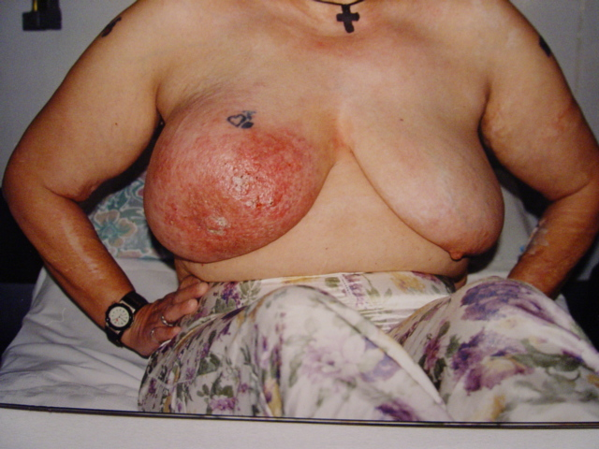
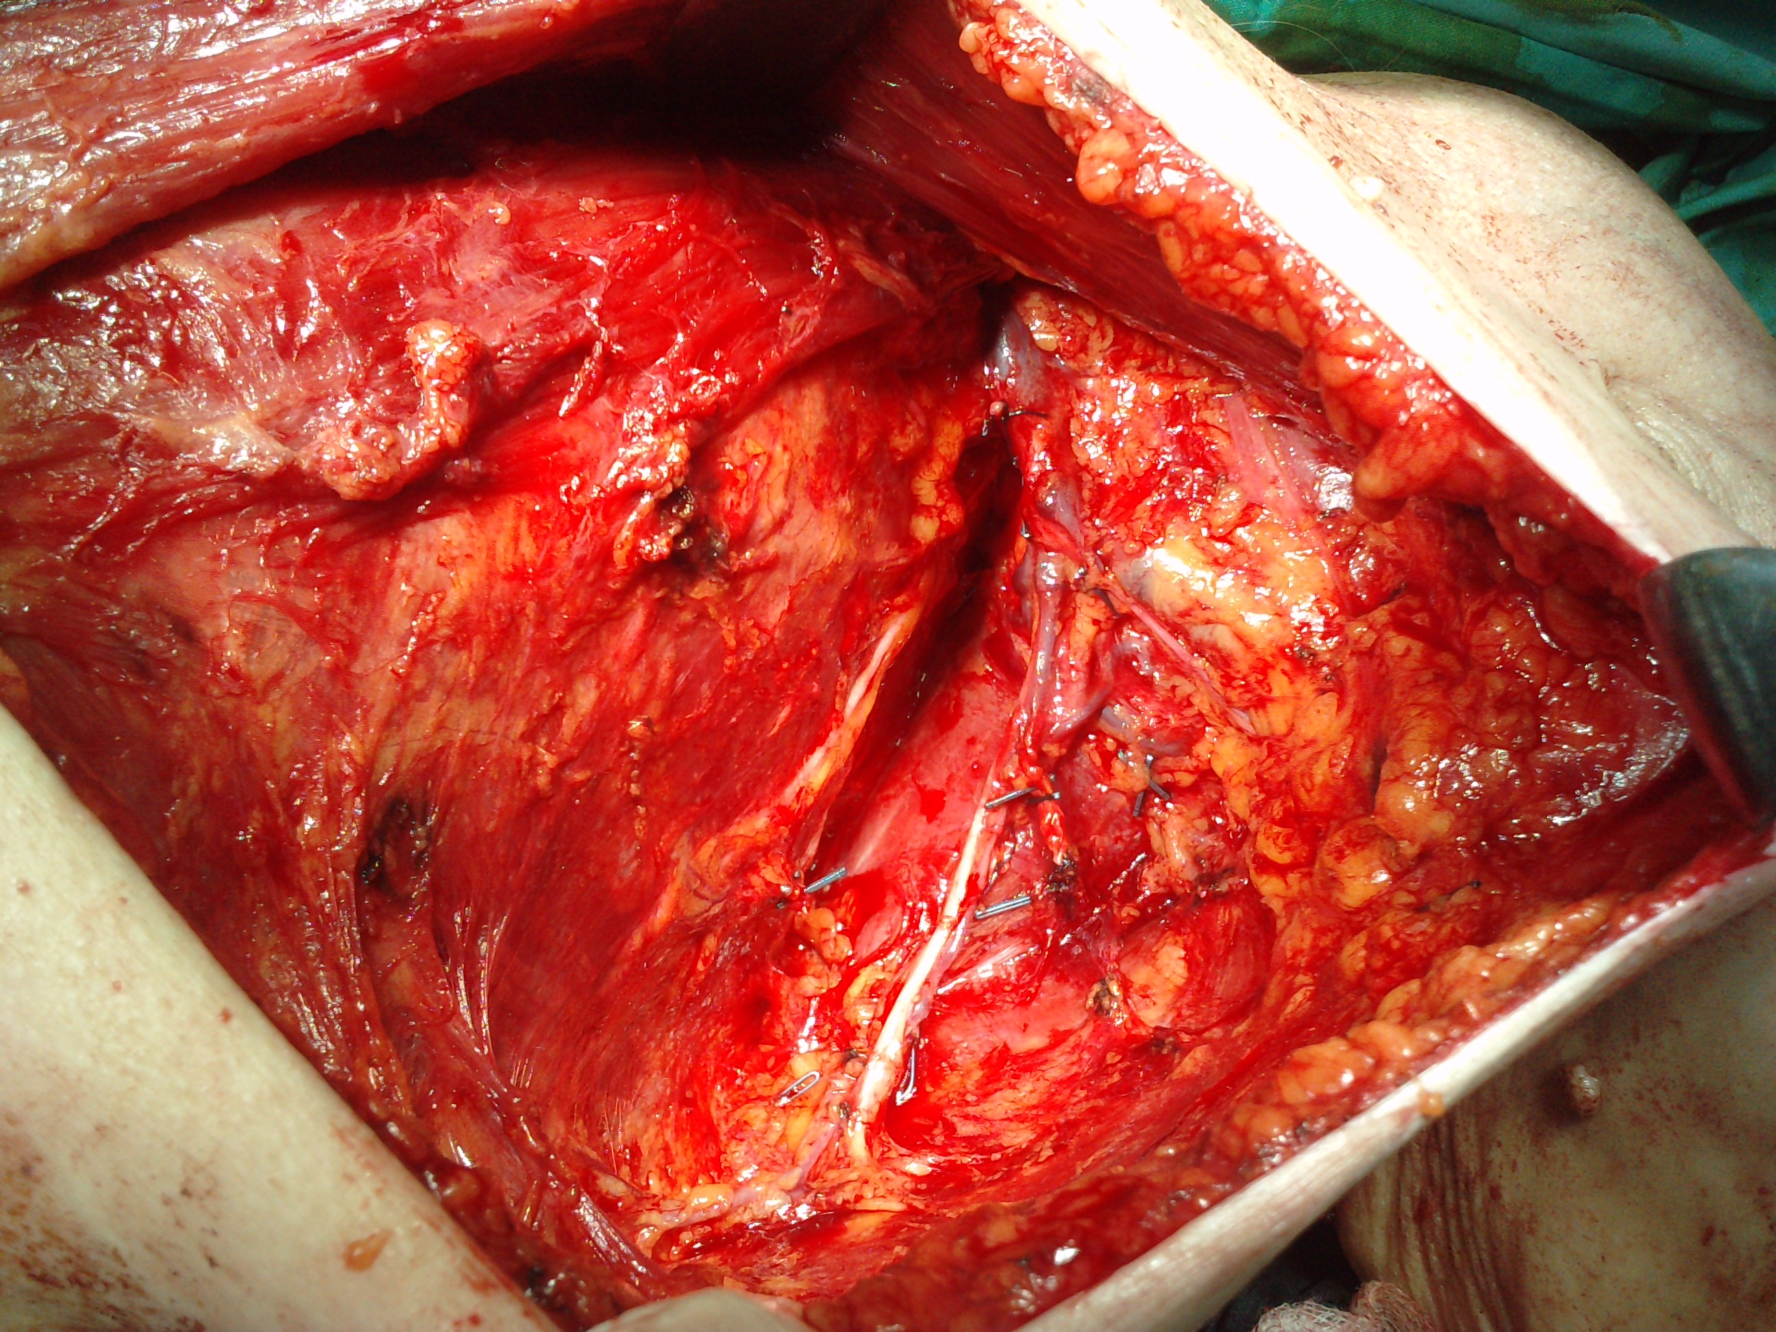

Slide 49




Slide 50




Slide 51



Slide 52
Παρηγορική θεραπεία
Notes:
• Palliation:- In many cases surgery is not appropriate for cure but may be extremely valuable for palliation. Symptomatic primary tumour
who also has distant metastases-bypass procedures. Increase the patient’s quality of life

Slide 53
Αποκατάσταση

Slide 54
Follow-up

Slide 55
THANK YOU

