Slide 1
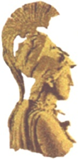

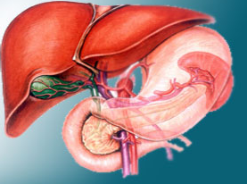
ΝΕΥΡΟΕΝΔΟΚΡΙΝΗ ΝΕΟΠΛΑΣΜΑΤΑ
ΕΘΝΙΚΟ ΚΑΙ ΚΑΠΟΔΙΣΤΡΙΑΚΟ ΠΑΝΕΠΙΣΤΗΜΙΟ ΑΘΗΝΩΝ
ΙΑΤΡΙΚΗ ΣΧΟΛΗ
A΄XEIΡΟΥΡΓΙΚΗ ΚΛΙΝΙΚΗ Γ.Ν.Α «ΛΑΙΚΟ»
Alexandros Papalampros
EKPA-LAIKO ENETS CENTER OF EXCELLENCE

Slide 2
NET: Μια ετερογενής ομάδα νεοπλασμάτων
Πολλαπλά διαφορετικά σημεία ανατομικής εντόπισης
Λειτουργικά (10-30%)
  Γαστρίνωμα
  Ινσουλίνωμα
  Γλυκαγόνωμα
  VIΡoma
  Σωματοστατίνωμα
  Καρκινοειδές σύνδρομο
Μη λειτουργικά (70-90%)
Σποραδικά (90%)
MEN1-VHL-TSC (5-17%)
ΜΕΤΑΣΤΑΣΕΙΣ
Λεμφαδένες
Ήπαρ
Πνεύμονες
Οστά
Εγκέφαλος

Slide 3
Incidence of NETs Increasing
6.00
600
All malignant neoplasms
5.00
500
4.00
400
Incidence per 100,000 - NETs
Incidence per 100,000 – All malignant neoplasms
3.00
300
2.00
200
1.00
Neuroendocrine tumors
100
0.00
0
1973
1974
1975
1976
1977
1978
1979
1980
1981
1982
1983
1984
1985
1986
1987
1988
1989
1990
1991
1992
1993
1994
1995
1996
1997
1998
1999
2000
2001
2002
2003
2004
Yao JC et al. J Clin Oncol. 2008;26:3063-3072.
Notes:
3
3
TO PURCHASE – USE AS IS

Slide 4
Functioning NETs
Insulinoma
Hypoglycemia
Gastrinoma (ZES)
Dyspepsia
Peptic ulcers
Diarrhea
Glucagonoma
Skin lesions (migrating necrolytic erythema)
Diabetes
Carcinoid syndrome
Diarrhea
Flushing
Dyspnea
Carcinoid heart disease
Somatostatinoma
Gall stones
Diabetes
Steatorrhea
VIPoma
Diarrhea
Hypokalemia
Rare syndromes
Cushing (ACTH)
Acromegaly/GHRH

Slide 5
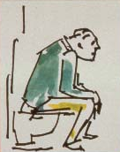
Οι ασθενείς με ΝΕΤ μπορεί να εμφανίζουν…
Flushing
Εφίδρωση
Υπόταση
Καρδιοαναπνευστική ανεπάρκεια
Διάρροια
Αφυδάτωση
Υποκαλιαιμία
Υποχλωρυδρία
Πεπτικά έλκη
Εξάνθημα
Σακχαρώδη Διαβήτη
Απώλεια βάρους
Μυική απώλεια
Υπογλυκαιμία

Slide 6
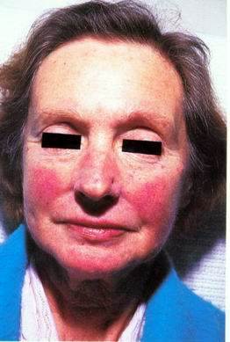
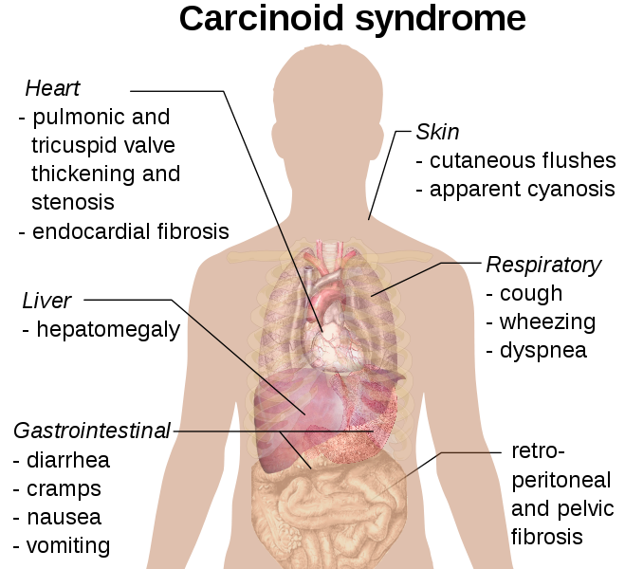
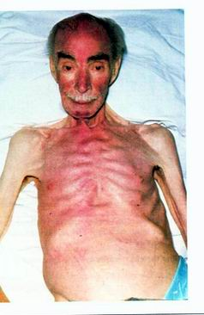
Carcinoid Syndrome

Slide 7
Non functioning tumours, atypical symptoms
delayed diagnosis
Abdominal mass 7-40 %
Pain 35-80 %
Weight loss 20-35 %
Anorexia and nausea 45 %
Jaundice 17-50 %
Notes:
Keep as is
50% + 24% + 27% = 101% OK? [copyeditor note]
Yes—these numbers are rounded from the original publication; keep as is.[SD note]

Slide 8
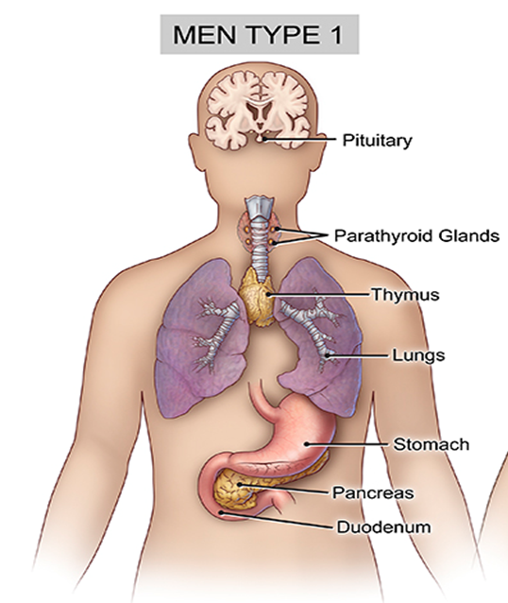
Κλινικές εκδηλώσεις ΜΕΝ1
ENDOCRINE | NON-ENDOCRINE
1. Parathryroid hyperplasia - adenomas (95%) | Face angiofibromas (85%)
2. Enteropancreatic Tumors (multiple) (40-70%) | Collagenomas (70%)
- Gastrinomas (40-50%) | Lipomas (30%)
- Insulinomas (10%) | Leiomyomas (5%)
- Non Functioning tumors and PPomas (20-55%) | Meningiomas (8%)
- VIPomas, Glucagonomas, Somatistatinomas (each <2%) | Ependymomas (<1%)
3. Anterior Pituitary Tumors (30-40%)
- Prolactinomas (20-30%)
- GH-secreting adenomas (10-20%) - mixed PRL/GH (5%)
- Non functioning adenomas (<5%), ACTH-secreting adenomas (<5%), TSH-secreting adenomas (rare)
4. Adrenal Neoplasms (30-40%)
- Cortex: Non functioning adenomas (30%) Functioning adenomas or Carcinomas (2%)
- Medulla: Pheochromocytomas (<1%)
5. Foregut Carcinoids
- Thymic (2%)
- Bronchial (4%)
- Gastric Type II (ECLomas) (10%)

Slide 9
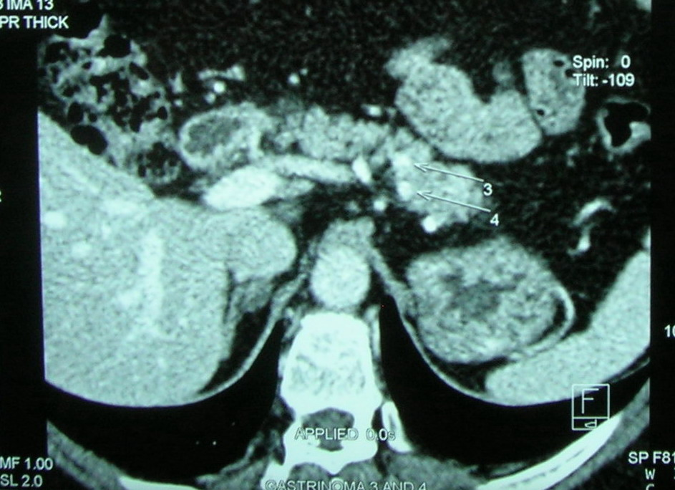
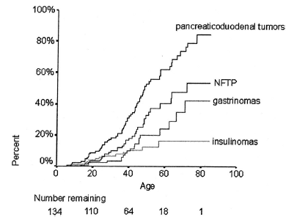
ΝΕΤs in MEN1
Προσβολή πολλαπλών οργάνων
Υποκείμενη υπερπλασία
Διαφορετικός χρόνος εμφάνισης
Νεαρή ηλικία εμφάνισης
Κληρονομικότητα
Ηλικία (έτος) | pNET | NF pNET
20 | 9% | 3%
50 | 53% | 34%
80 | 84% | 54%

Slide 10
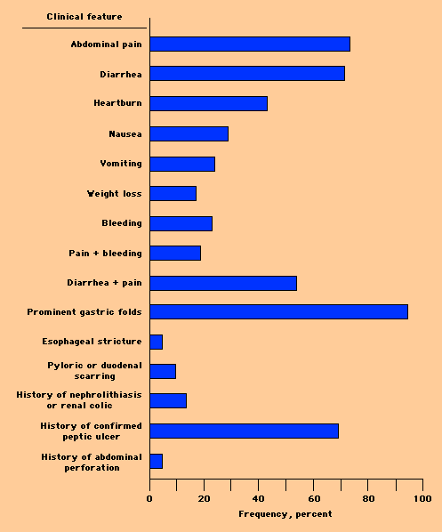
Γαστρίνωμα-ZES
ZES συνήθως σε ασθενείς με εγκατεστημένο PHP (↑ Ca)
> 50% δωδεκαδακτυλική εντόπιση MEN1 (έως 85%)
- Πολλαπλά < 5mm
  Οζώδεις σχηματισμοί εν τω βάθει βλενογόνου
  Συχνή μετάσταση LN, σπανιότερα στο ήπαρ
Παγκρεατικά
  Πιo σπάνια ≠ μη λειτουργικούς ΝΕΤ (SASI test)
16-38% ασθενών με γαστρινώματα έχουν MEN 1

Slide 11
Διάγνωση-Σταδιοποίηση
Ιστοπαθολογική επιβεβαίωση
Εκτίμηση έκτασης νόσου
Εκτίμηση λειτουργικότητας

Slide 12
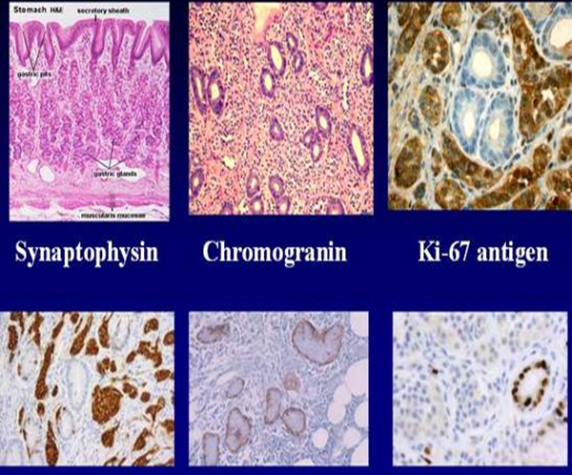
Ιστοπαθολογία
Μορφολογία
Δείκτης κυτταρικού πολλαπλασιασμού Ki-67
Ανοσοϊστοχημεία
- Χρωμογρανίνη Α
- Συναπτοφυσίνη
- Ορμόνες (ινσουλίνη, προϊνσουλίνη,
γλυκαγόνη, γαστρίνη, VIP κ.α.)

Slide 13
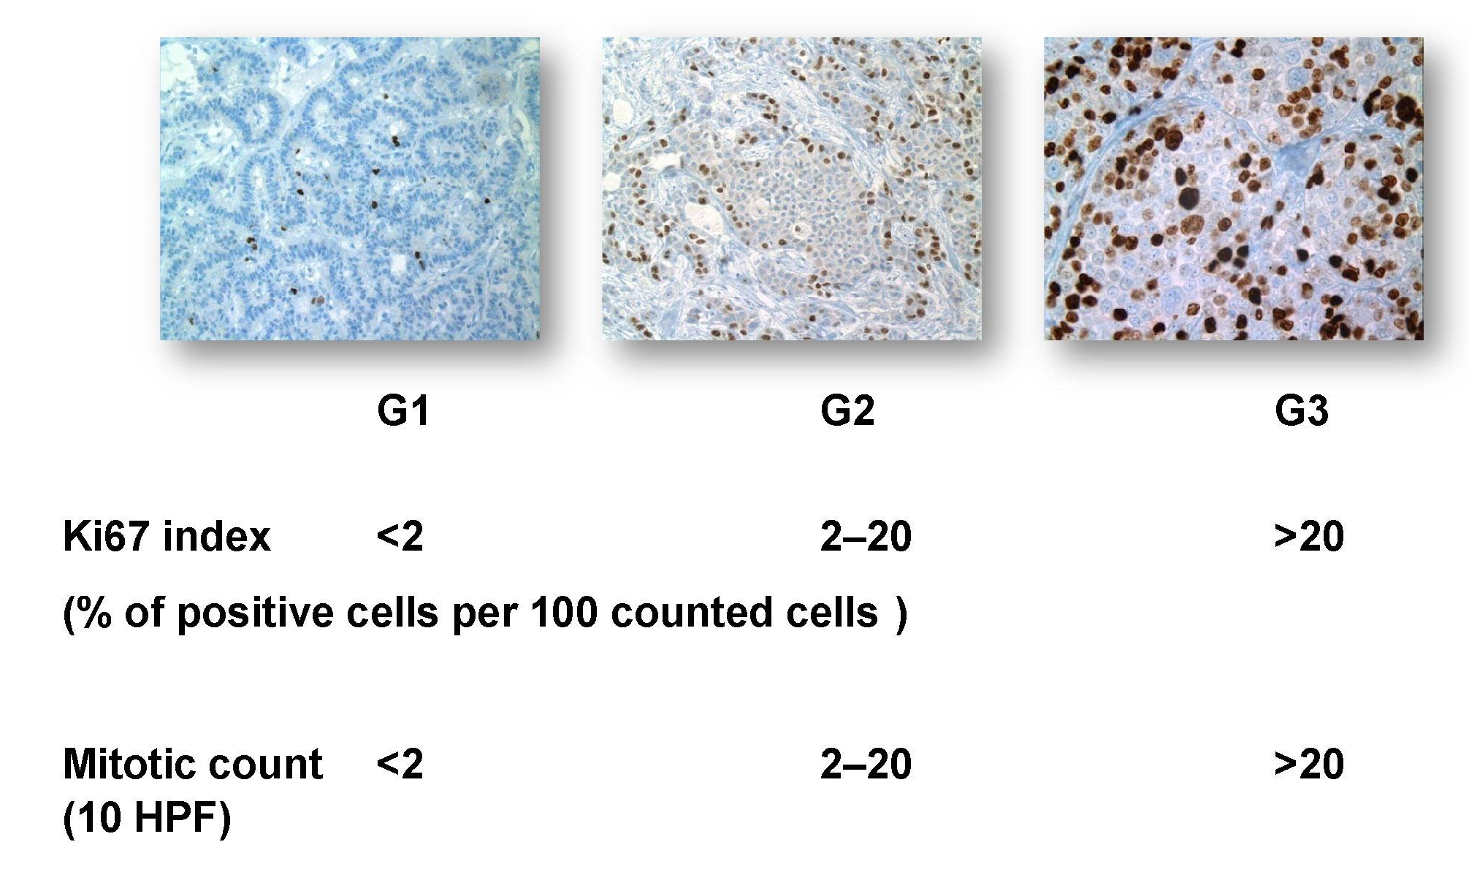
Ταξινόμηση των GEP-NET

Slide 14


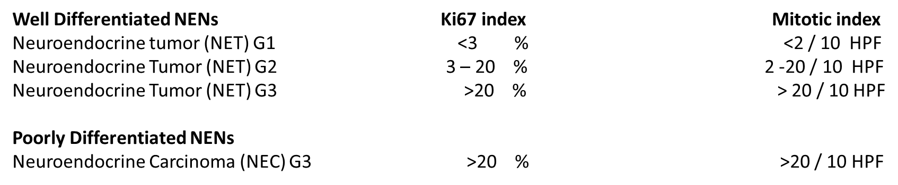
Διαχωρισμός των Νευροενδοκρινικών Νεοπλασμάτων Παγκρέατος με Ki-67 >20%
Well Differentiated NENs Ki67 index Mitotic index
Neuroendocrine tumor (NET) G1 <2 % <2/10 HPF
Neuroendocrine Tumor (NET) G2 3 – 20 % 2 -20/10 HPF
Poorly Differentiated NENs
Neuroendocrine Carcinoma (NEC) G3 >20 % >20/10 HPF

Slide 15
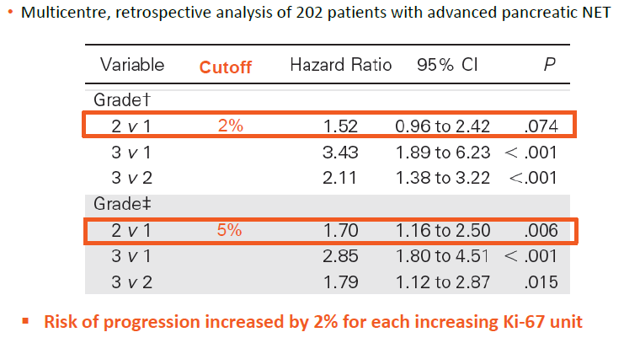
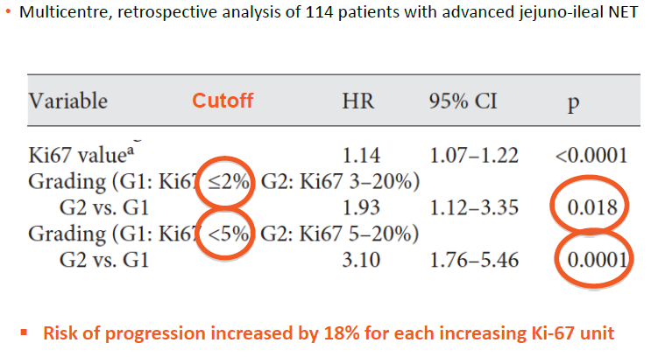
Ποσοστό επιβίωσης ανάλογα με το βαθμό διαφοροποίησης
JCO 29:2372-2377, 2011
Neuroendocrinology, 96:32-40, 2012

Slide 16
Η προγνωστική αξία του Ki-67 στον καθορισμό του σταδίου της νόσου
Grade | G1 | G2 | G3
No of patients | 115 | 36 | 10
Metastatic disease (%) | 53 (46,1%) | 28 (77,8%) | 10 (100%)
Stage IV (%) | 32 (27,8%) | 26 (72,2%) | 9 (90%)
Miller HC, et al. World J Surg. 2014;38(6):1353-61
Pape UF et al. Cancer. 2008;113:256-265

Slide 17
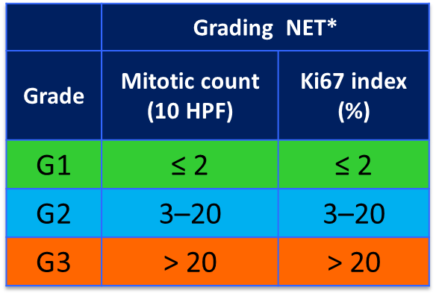
Ποσοστό επιβίωσης ανάλογα με το βαθμό διαφοροποίησης
Rindi G, et al. Virchows Arch. 2006;449:395-401.
Rindi G, et al. Virchows Arch. 2007;451:757-762.
Pape UF, et al. Cancer. 2008;113:256-265.

Slide 18
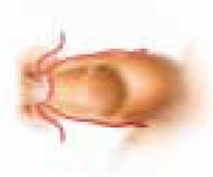
TNM classification for GEP-NETs
Stage 0* | Τis | N0 | M0
Stage I | T1** | N0 | M0
Stage IIa | T2 | N0 | M0
IIb | T3 | N0 | M0
Stage IIIa | T4 | N0 | M0
IIIb | Any Τ | Ν1 | Μ0
Stage IV | Any Τ | Any Ν | Μ1
Classification according to the anatomic origin
ENETS 2009

Slide 19
Ποσοστό επιβίωσης ανάλογα με το στάδιο ΤΝΜ
Miller HC, et al. World J Surg. 2014;38(6):1353-61
Pape UF et al. Cancer. 2008;113:256-265

Slide 20
Primary GEP-NETs and metastases

Slide 21
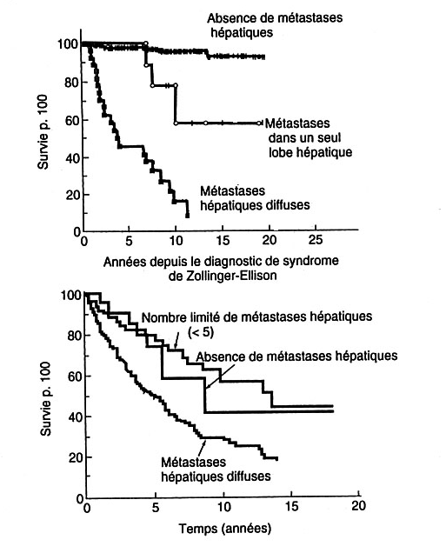
Liver metastases secondary to GEP-NETs
Evolution of the disease
HM unilobar resectable
  5 year survival > 80-90%
HM multiple resectable:
  5 year survival 60-70%
HM multiple non resectable:
  5 year survival 30-40%
Zollinger-Ellison
GEP non-functioning
Mignon 1986, Moertel 1987,Thompson 1988, Delcore 1994, Weber 1995, Norton 1999, 2003, Zogakis 2003, Jensen 2001, Que 2002; Solorzano 2001, Sarmiento 2003, Elias 2003

Slide 22
Απεικονιστικές μέθοδοι
U/S
Chest-Abdominal CT-CT εντερογραφία
Abdominal MRI (↓ σήμα στην Τ1- ↑ σήμα στην Τ2)
EUS
Somatostatin Receptor Imaging (Octreoscan - ⁶⁸Ga-DOTATOC-PET/CT)
FDG-PET/CT
Bone scan
Brain MRI

Slide 23
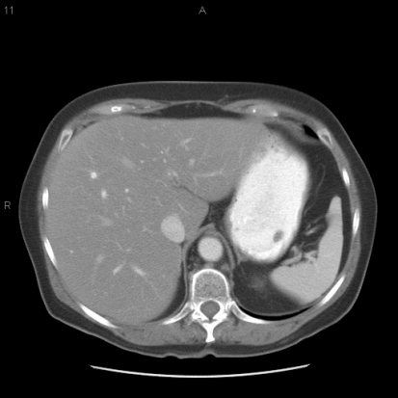
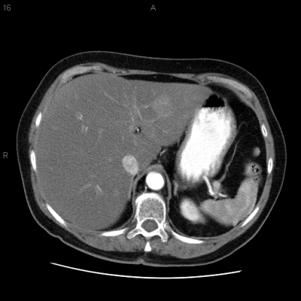
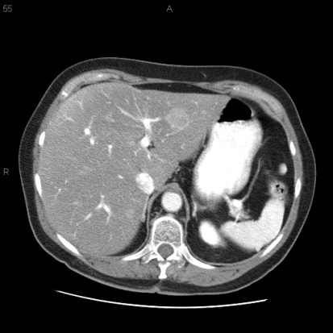
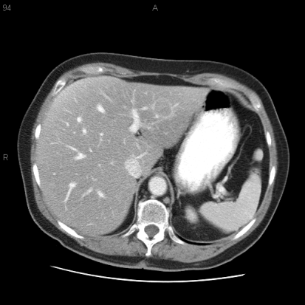
Anatomic Imaging: CT
Std
Arterial
Venous
Delayed
CT: computed tomography.

Slide 24
Anatomic Imaging: MRI
Neuroendocrinology. 2017;105:212-244

Slide 25
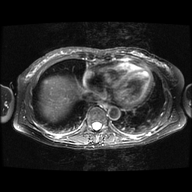
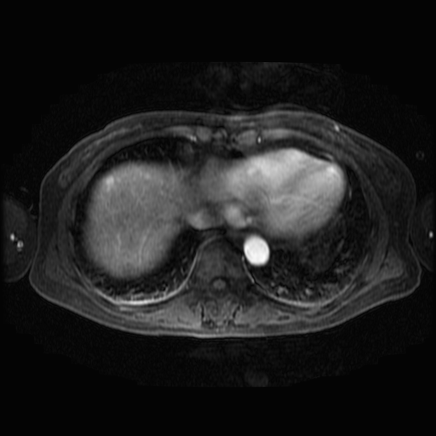
Anatomic Imaging: MRI

Slide 26
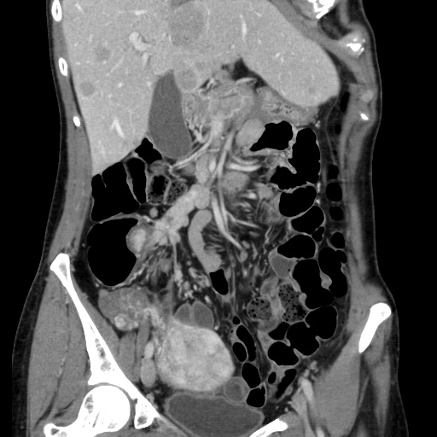
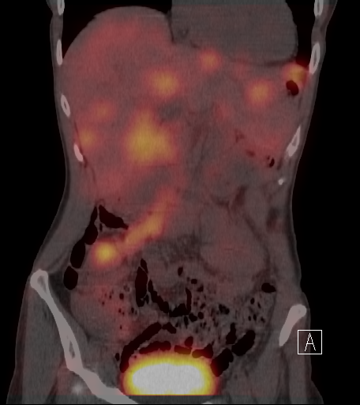
Anatomic CT and 68 Gallium DOTATATE

Slide 27
Octreoscan- ⁶⁸Gallium DOTATATE
Το ⁶⁸Ga Dotatate PET/CT υπερτερεί των Octreoscan, CT και MRI στη διάγνωση και σταδιοποίηση
Οδηγεί υψηλό ποσοστό ασθενών σε αλλαγή θεραπευτικού πλάνου
J Clin Oncol. 2016;34:588-96.

Slide 28
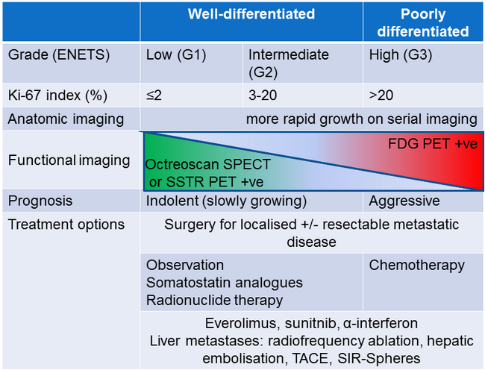
Relation of functional imaging with prognostic markers
Hofman et al., (2012). Discovery Medicine, 16 (74), 1-9

Slide 29
Tumor Markers
CgA is the best available biomarker for diagnosis of NET
Elevated in >70-80% of cases
Elevated CgA may correlate
with tumor progression
NSE is also expressed in NET: Often elevated in poorly differentiated tumors

Slide 30
Causes of CgA elevation

Slide 31
Markers in Functional Tumors
Fasting measurements when possible
Gastrinoma
Gastrin
Glucagonoma
Insulinoma
Insulin
Pro-insulin
VIPoma
Vasoactive intestinal peptide
Glucagon
C-peptide
Carcinoid syndrome
Urine 5-HIAA

Slide 32

Τα ΝΕΤ εμφανίζουν ευρύ φάσμα βιολογικών συμπεριφορών
Παθολογοανατομικά και κλινικά κριτήρια καθορίζουν το είδος της χορηγούμενης θεραπείας
Η πλειοψηφία των ΝΕΤ παρουσιάζει χαμηλό αριθμό μεταλλάξεων
Περιορισμένος αριθμός τυχαιοποιημένων μελετών
Η αντιμετώπιση βασίζεται σε κατευθυντήριες οδηγίες (ENETS, NCCN, NANETS, NORDIC Guidelines) και είναι εξατομικευμένη
Η αντιμετώπιση των ΝΕΤ αποτελεί μια πρόκληση…

Slide 33
Treatment Goals in GEP-NETs
Total eradication by surgery
Control of tumor growth
Alleviation of clinical symptoms
Improving and preserving quality of life
Notes:
33

Slide 34
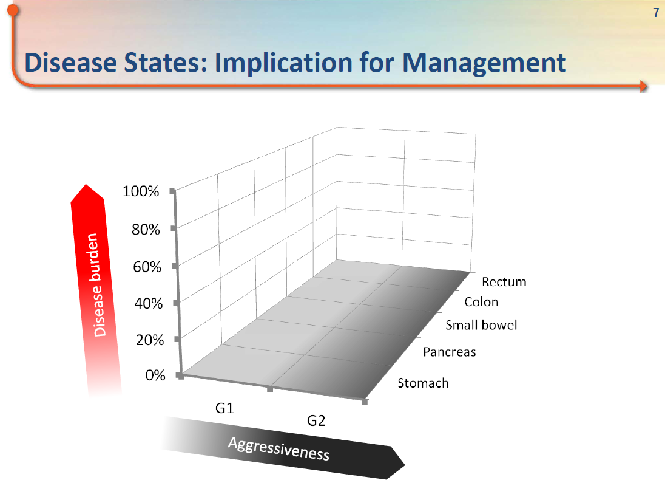
Factors in Treatment Decisions in GEP-NETs
Treatment decisions require discussion by a multidisciplinary team
Options may depend on:
  Type of GEP-NET
  TNM stage (I-IV), degree hepatic involvement
  Tumor grade (G1-3)
  Functional status of tumour
  Growth rate
  Presence familial syndrome (MEN1)
  Patient: organ function, ECOG PS, comorbidity
  Access to various options
ECOG: Eastern Cooperative Oncology Group; PS: performance status
Notes:
34

Slide 35
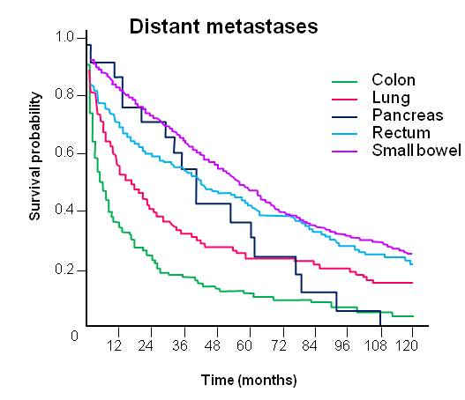
H πρωτοπαθής εντόπιση χαρακτηρίζει GEP-NETs με διαφορετική βιολογική συμπεριφορά και καθορίζει θεραπευτική αντιμετώπιση
65% of patients with advanced NET will not be alive in 5 years
Stomach, appendix
Scarpa A et al. Mod Pathol.2010. Yao JC et al. J Clin Oncol. 2008

Slide 36

ΧΕΙΡΟΥΡΓΙΚΗ ΑΝΤΙΜΕΤΩΠΙΣΗ

Slide 37


Slide 39
Surgical resection

Slide 40
Surgical Options in GEP-NETs
Radical surgery
Complete resection of entire tumour even in presence of liver metastases (R0/1)
Debulking surgery
Always employed in functional neoplasms, when medical therapies do not control symptoms
Resection of at least the primary tumour and liver metastases (suitable procedure when at least 90% of the tumour is resectable)
Palliative surgery
No resection
Biliary, gastric, or digestive bypasses in case of obstruction when tumour is unresectable

Slide 41

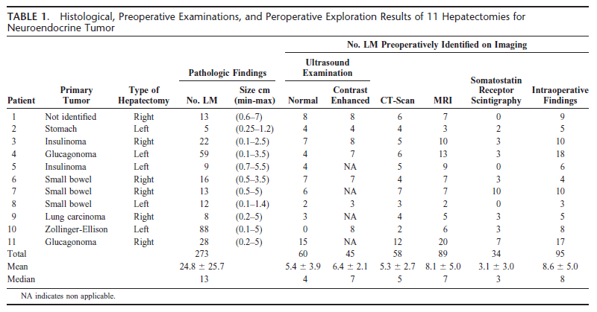
Elias D et al. Ann Surg 2010;251:307-310

Slide 42
They are 3 times more than preop counted
Elias D et al. Ann Surg 2010;251:307-310

Slide 43
Surgical resection with curative intent remains the gold standard
in the treatment of liver metastases
Median R0 resection: 63%
5- and 10-year OS: 70,5% and 42% respectively
Median rate of symptomatic relief: 95%
However, recurrence is the rule…
78% after a median of 19 months
Notes:
78% μετά από 19 μήνες…recurrence free survival rate στα 5 ή 10 χρόνια: 31 ή 1%.

Slide 45
Who should not get surgery for NET??

Slide 46
Who should not get surgery for NET??
Patients not fit for surgery

Slide 47
Who should not get surgery for NET??
Patients not fit for surgery
Patients at risk for over-treatment
NF-pNET in MEN1
Asymptomatic NF-pNET<2 cm
Unresectable liver metastases in the presence of asymptomatic resectable primary

Slide 50
Παρακολούθηση ασθενών με ΜΕΝ1
EUS vs. MRI (n=90)
EUS 268 pNETs σε 75 MEN1 vs. MRI 158 pNETs σε 67 ασθενείς
pNETs> 10mm: EUS 86 βλάβες σε 48 ασθενείς vs. MRI 67 βλάβες σε 20 ασθενείς
pNETs >20mm: EUS 13 βλάβες σε13 ασθενείς vs. MRI 42 βλάβες σε 17ασθενείς
Βλάβες > 10 mm kappa coefficient of 0.55
Συμπληρωματικός ρόλος
Μια και οι δύο μέθοδοι μπορεί να μην αναγνωρίσουν βλαβες ? Χρήση και των δύο έως ότου προκύψουν νέα στοιχεία
No clear recommendations
Alternate MRI and EUS
1yr…(2-3yrs according to size??)
Dig Liver Dis. 2012;44(3):228-234

Slide 51
Guidelines for asymptomatic NF-pNET<2cm

Slide 53
Surgery in G3 NET

Slide 54
Gastric Neuroendocrine Neoplasms
 | GNEN type 1 | GNEN type 2 | GNEN type 3
% GNET | 70-80 | 5-6 | 14-25
Characteristics neoplasms | Single or multiple, polypoid small sized lesions (1-2 cm) | Multiple, polypoid small sized lesions (1-2 cm) | Mostly single polypoid, ulcerated lesions, size >2cm,
Concomitant pathologies | Chronic atrophic gastritis | Gastrinoma/MEN1 | -
Histopathological features | Well differentiated neoplasms | Well differentiated neoplasms | Well/moderate differentiated neoplasms
Serum gastric | ↑ | ↑ | Ν
Gastric PH | ↑ ↑ | ↓↓ | Ν
Metastases % | 2-5 | 10-30 | 50-100
Deaths | 0 | <10 | 25-30

Slide 55
Gastric Neuroendocrine Neoplasms
EUS

Slide 56
Gastric Neuroendocrine Neoplasms

Slide 57
Gastric Neuroendocrine Neoplasms
Surgery

Slide 59
Debulking Procedures
Aims
Means
  Reduce mechanical symptoms
  Improve functional symptoms
  Preserve one target organ (the liver) for further therapies
  Improve survival
  Surgery
  TACE
  RFA
  Radioembolization
  Combination of these procedures

Slide 60
Debulking Procedures
Aims
Means
No randomized trials of locoregional therapies that show superiority of any technique
  Reduce mechanical symptoms
  Improve functional symptoms
  Preserve one target organ (the liver) for further therapies
  Improve survival
  Surgery
  TACE
  RFA
  Radioembolization
  Combination of these procedures

Slide 61
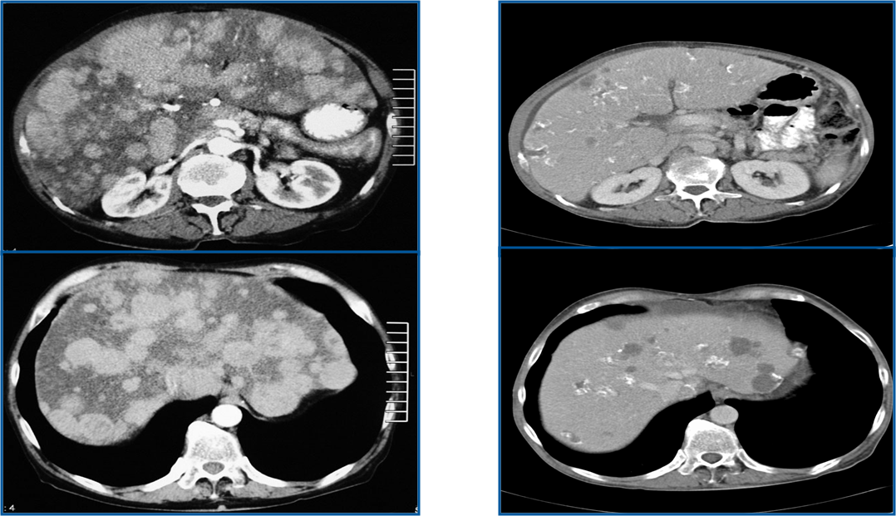
Response after liver embolization
Before
After

Slide 62
ΦΑΡΜΑΚΕΥΤΙΚΗ ΘΕΡΑΠΕΙΑ

Slide 63
Η διαδρομή προς τη μοριακή εξατομικευμένη θεραπεία…

Slide 64
MEDICAL TREATMENT
Treatment of secretory syndromes (functioning tumours)
Control of tumour growth
Improvement of disease free survival (PFS)

Slide 65
Evidence-based antiproliferative therapies
Στοχευμένες θεραπείες για την αντιμετώπιση των ΝΕΤ
SSA: Octreotide LAR και Lanreotide LAR διαθέτουν αντινεοπλασματική και αντι-εκκριτική δράση
Sunitinib: θεραπεία των μη εξαιρέσιμων ή μεταστατικών pΝΕΤ που παρουσιάζουν πρόοδο νόσου
Everolimus: θεραπεία των μη εξαιρέσιμων ή μεταστατικών ΝΕΤ που παρουσιάζουν πρόοδο νόσου
Lee A et al. Neuroendocrinology 2017;104:209-222

Slide 66
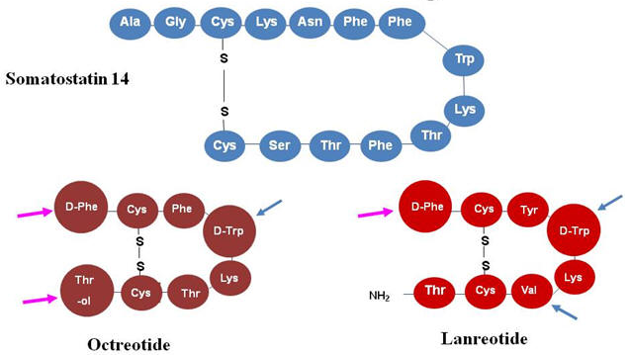


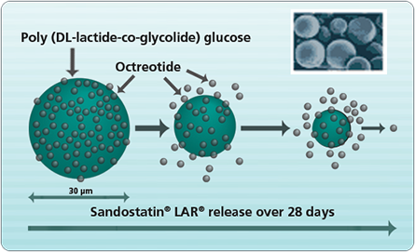

Somatostatin analogues (SSAs)
Notes:
Current clinical practice CS is treated with SSAs that act through sstr2/5. The initial demonstration was 1986 by L Kvols when 150mcg x 3 improved symptoms of CS in 88% of patients
Now 2 long acting available

Slide 67
Treatment with Somatostatin analogues : Sandostatin LAR® Controls Symptoms of Carcinoid Syndrome
Median Stools per Day
Median Flushing Episodes per Day
SCN = screening; BASE = baseline.
Rubin J, et al. J Clin Oncol. 1999;17:600-606.

Slide 68
SSA treatment in a patient with glucagonoma
Before treatment
After treatment

Slide 69
SSA-Anti-proliferative effects
Susini C, Buscail L, Ann Oncol. 2006;17:1733-1742.
Grozinsky-Glasberg S et al, ERC, 2008;15:701

Slide 70
Anti-proliferative effect of SSA

Slide 71
Anti-proliferative effect of SSA
CLARINET STUDY

Slide 72
Everolimus in pNET
Patients with advanced low or intermediate grade pNET
RADIANT 3
Notes:
Radiant 4

Slide 73
Everolimus in intestinal and lung NET
RADIANT 4
2nd or 3rd line in GI NET
1st or 2nd line in lung NET
Lao et al. Lancet 2016
Notes:
Radiant 4

Slide 74
Sunitinib vs Placebo in Advanced pNET
1.0
Kaplan-Meier median PFS
Sunitinib: 11.4 mo
Placebo: 5.5 mo
HR = 0.42 (95% CI, 0.26–0.66) P<0.001
0.8
0.6
Proportion of Patients
0.4
0.2
Sunitinib
Placebo
0
0
5
10
15
20
25
Time (mo)
Number at risk
Sunitinib
86
39
19
4
0
0
Placebo
85
28
7
2
1
0
Raymond E, et al. N Engl J Med. 2011

Slide 75
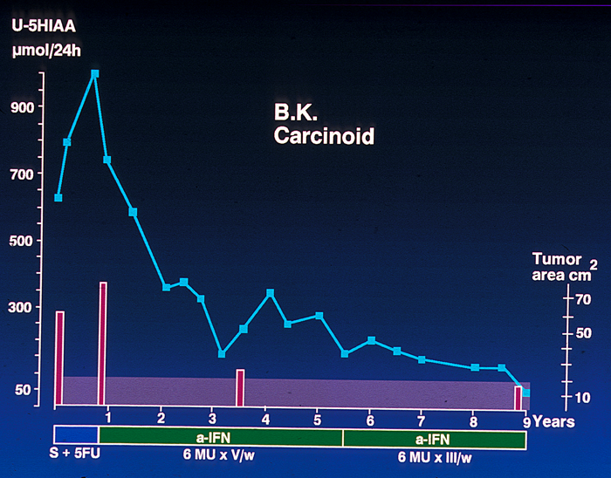
Interferon-α (ΙΝF-α)
40-70% symptomatic improvement
44% biochemical improvement
11% reduction of tumour size
35% stable disease
No synergistic effect of combination of SSAs & INF-α

Slide 76
STZ based chemotherapy in advanced pNET
Moertel et al, NEJM 1992

Slide 77
STZ based chemotherapy in advanced pNET
Progressive or bulky disease

Slide 78
STZ based chemotherapy in advanced pNET
96 pNET patients (79,2% G2) treated with STZ/5-FU were analysed retrospectively
Objective response rate: 42,7%
Stable disease: 40,6%
Progressive disease: 16,7%
Median TTP: 19,4 m
Median OS: 54,8 m
Dilz et al. Eur J Canc, 2015

Slide 79
Multicenter retrospective study in 78 patients with NET (mostly G2)
In the PR group 65% were G2

Slide 80
First-Line Tem-Cap in metastatic pNET
Retrospective study: 30 patients (9 moderately differentiated)
Capecitabine: 750 mg/m² (twice daily, days 1-14) – Temozolomide: 200 mg/m² (once daily, days 10-14)
Median PFS: 18 months
OS (2 years): 92%
Strosberg et al, Cancer 2011;117:268-275

Slide 81
Temοzolomide-Capecitabine in pNET
Retrospective study in 143 patients (37 G2)
ORR: 54%
OS (G2): 73 m
No predictive markers, such as MGMT expression or proliferative activity
Gives et al, Endocrine-Related Cancer, 2016

Slide 82
65 patients with GEP NETs (59 G2)
ORR: 47,7%
PFS: Ki-67 <5%: 22m
Ki-67 6-20%: 15,3 m
PFS
OS
No difference in PFS and OS in pNET and non-pNET
Notes:
Green;pnet blue:non-pnet

Slide 83
Median PFS: 16,9 m Median OS: 32,2 m
Higher response rate in pNETs (26%) vs non-pancreatic NETs (10%)
Lamarca et al. Cancer Treatment Reviews 2016

Slide 84
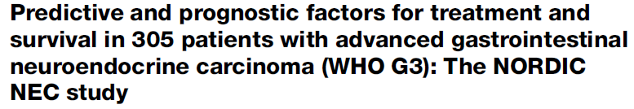
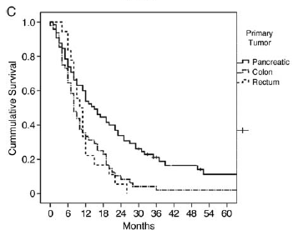
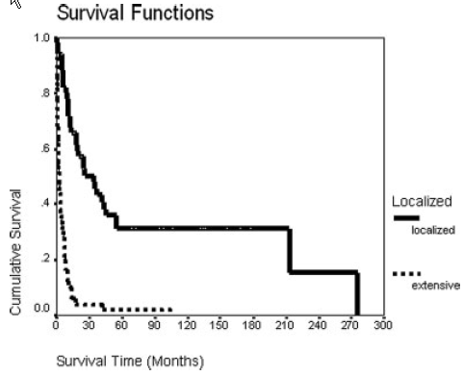
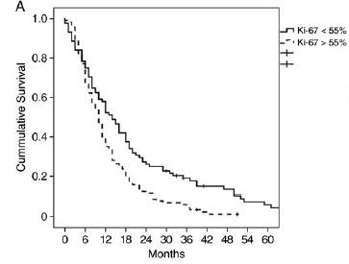

Slide 85
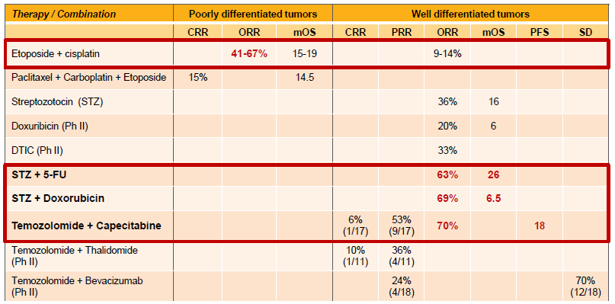
Stage IV GEP-NETs
Results on chemotherapy
Clinical Evidence based on Ph II studies

Slide 86
Chemotherapy in GI NET
ENETS Guidelines do not recommend chemotherapy in GI NET unless in higher grade G2 (>15%) or in NET with aggressive biological behavior.

Slide 87
Chemotherapy vs Targeted Agents
When would we favour chemotherapy ?
High Ki-67 (cut-off ?)
Higher tumor burden
Control symptoms related to tumor load
Neo-adjuvant setting ?
Rapid tumor progression (< 6-12 months)
Pancreatic primary tumor site

Slide 88
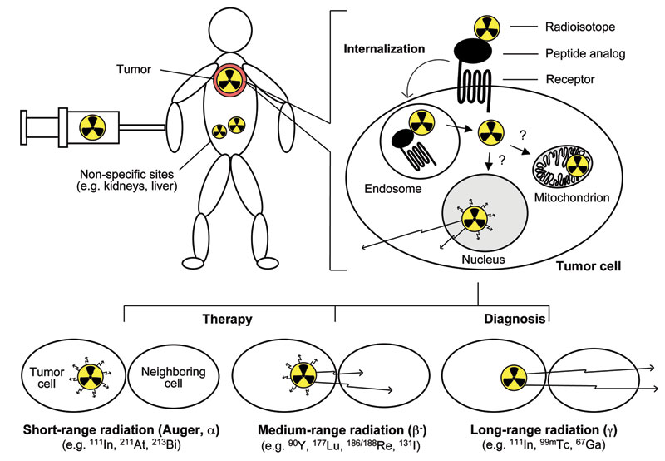
Radiopharmaceuticals for GEP-NETs

Slide 89
NETTER -1 Study Objectives and Design
Aim
Evaluate the efficacy and safety of ¹⁷⁷Lu-Dotatate + SSAs (symptoms control) compared to Octreotide LAR 60mg (off-label use)¹ in patients with inoperable, somatostatin receptor positive, midgut NET, progressive under Octreotide LAR 30mg (label use)
Design
International, multicenter, randomized, comparator-controlled, parallel-group
Treatment and Assessments
Progression free survival (Recist criteria) every 12 weeks
Dose 1
Dose 2
Dose 3
Dose 4
5 Years follow up
Baseline
and
Randomization
n = 115
4 administrations of 7.4 GBq of ¹⁷⁷Lu-Dotatate every 8 weeks + SSAs (symptoms control)
n = 115
Octreotide LAR (high dose - 60mg every 4 weeks¹)
^{1. FDA and EMA recommendation}
Presentation Presidential Session II of the 18th ECCO – 40th ESMO – European Cancer Congress 2015, 27 September 2015, abstract 6LBA, Vienna
89
Notes:
Primary objective
Compare Progression Free Survival (PFS) after treatment with ¹⁷⁷Lu-Dotatate plus 30 mg octreotide LAR (symptoms control) vs treatment with high dose (60 mg) octreotide LAR
Secondary objectives
Compare the Objective Response Rate between study arms
Compare the Overall Survival between study arms
Compare the Time to Progression between study arms
Evaluate the safety and tolerability of ¹⁷⁷Lu-Dotatate
Evaluate the health related quality of life (QoL) as measured by the EORTC QLQ-G.I.NET21 questionnaire

Slide 90
PRRT in intestinal NET (NETTER-1 trial)
Final median PFS
PRRT vs. Octreotide LAR 60mg
28,5 m vs. 8,4m

Slide 91
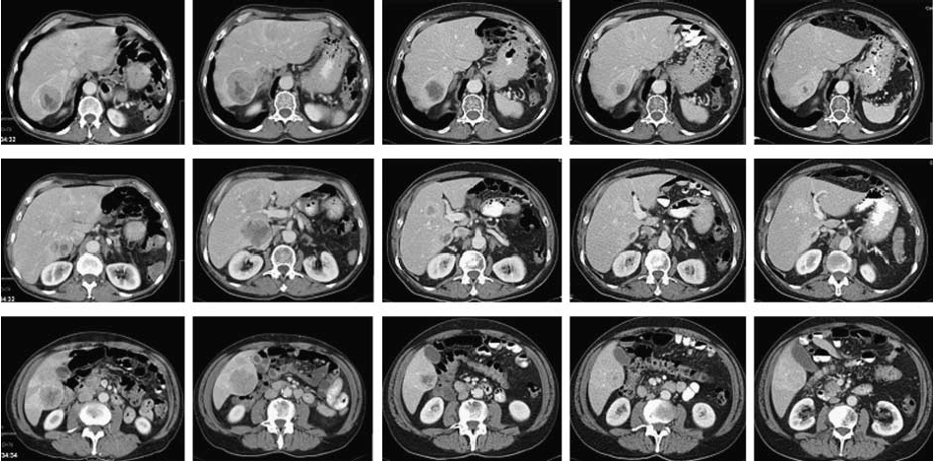
Sequential CT scans in a patient with metastatic pNΕΤ after treatment with 177Lu-DOTATATE
Before
6 weeks
3 months
6 months

Slide 92
FDG-PET/CT predicts survival
Prospective study of 98 patients
( + ) FDG-PET/CT: Ki67: 2-15: 70% Ki-67: >15: 93%
Binderup et al. Clin Cancer Res 2010

Slide 93
Role of FDG-PET/CT in patients treated with PRRT
60 patients with advanced pNET
Median PFS: 53,4 m
PFS: FDG ( + ): 21,2 m
FDG ( - ): 68,7 m
P < 0,0002
Sansovini et al. 2017

Slide 94
Chemoradionuclide in FDG avid NET
Favourable outcomes of (177)Lu-octreotate peptide receptor chemoradionuclide therapy in patients with FDG-avid neuroendocrine tumours.
Kashyap R, et al. Eur J Nucl Med Mol Imaging. 2015
Phase II study of radiopeptide 177Lu-octreotate and capecitabine therapy of progressive disseminated neuroendocrine tumours.
Claringbold et al. Eur J Nucl Med Mol Imaging. 2011

Slide 95
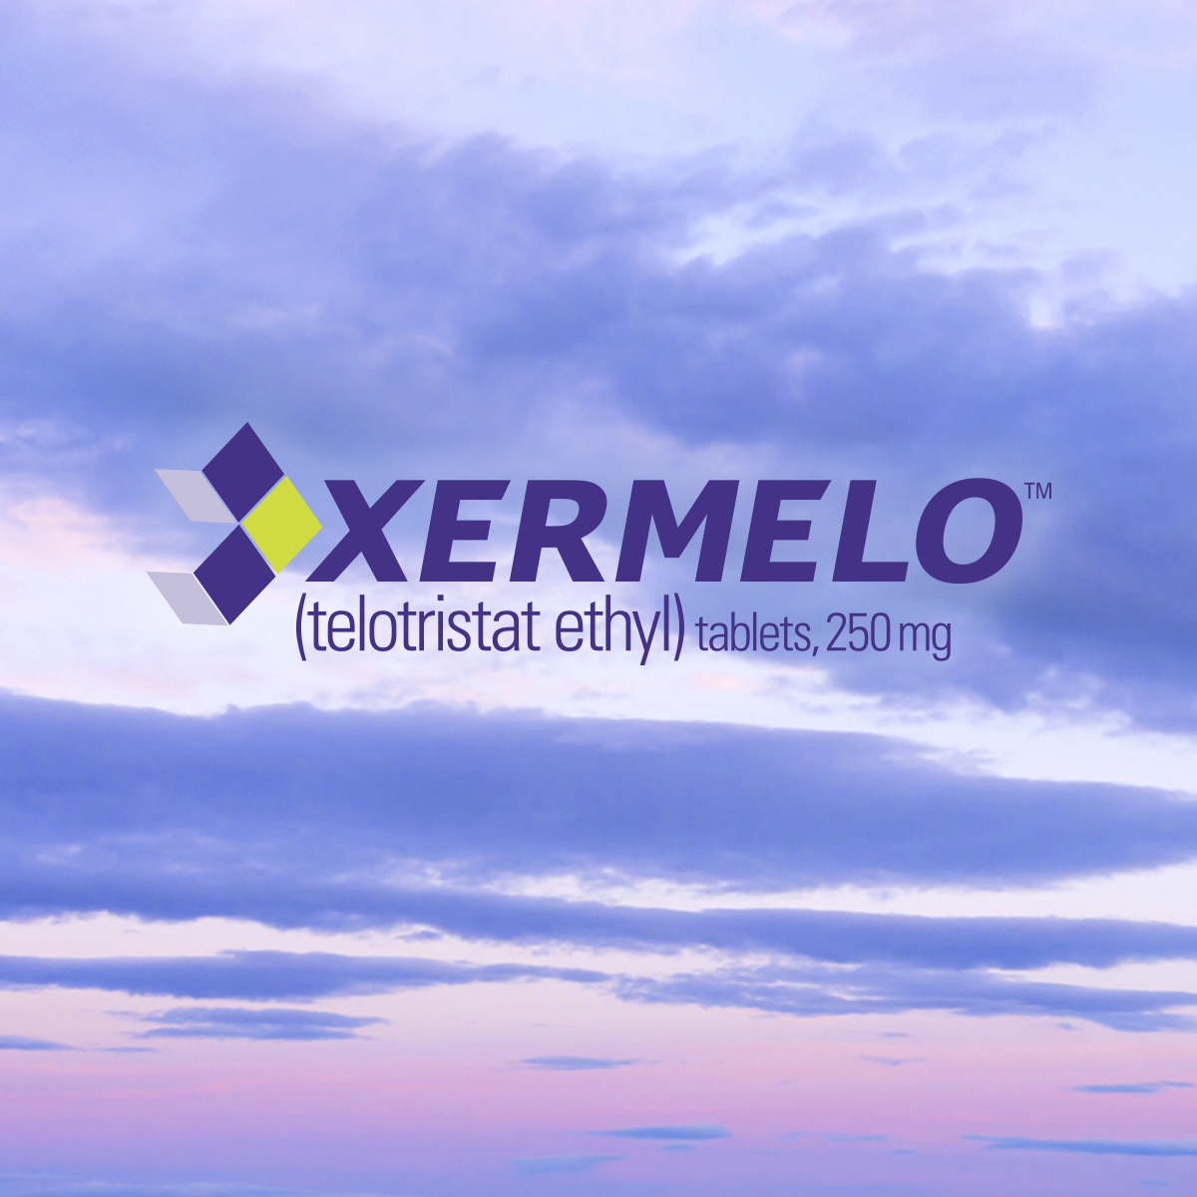
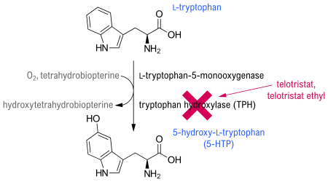

Slide 96
ENETS Guidelines in advanced intestinal NET
First line
Second line
Pavel et al, Neuroendocrinology 2016

Slide 97
ENETS Guidelines in advanced pNET
First line
Second/Third line
Pavel et al, Neuroendocrinology 2016

Slide 98
Interdisciplinary management of NET
ENETS Consensus Guidelines 2016

Slide 99
Διαδραστική διεπιστημονική ομάδα
Multidisciplinary team (MDT)

Slide 100

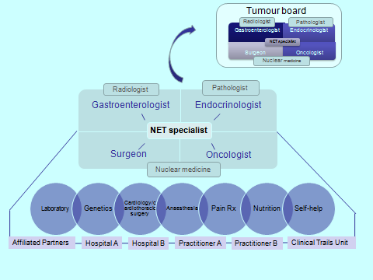
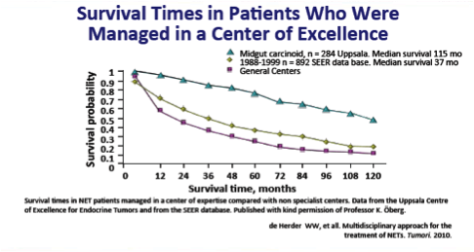
Ευρωπαϊκή πρωτοβουλία δημιουργίας Κέντρων Αριστείας ΝΕΤ (Center of excellence initiative)

Slide 101
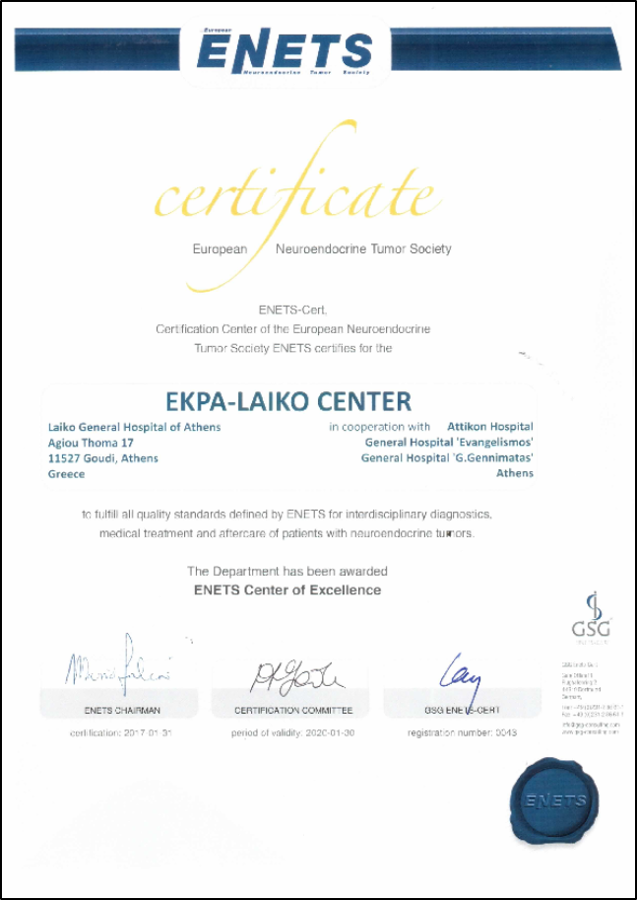
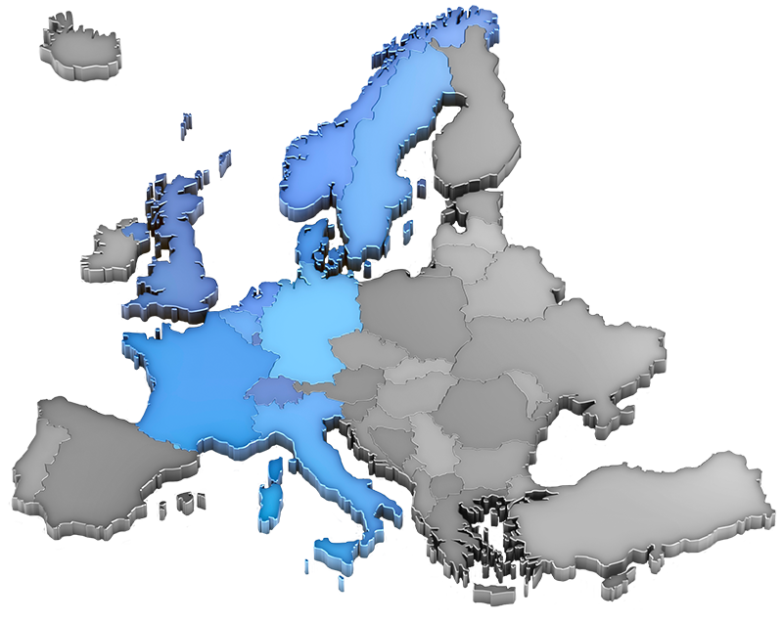
Κέντρα Αριστείας ΕΝΕΤS

Slide 102
ΕΥΧΑΡΙΣΤΩ ΠΟΛΥ

Slide 103
Πρόγνωση pNET: Επίδραση παρουσίας κλινικού συνδρόμου
100
90
P < 0.001
80
70
Median OS, months
Functional 54
Nonfunctional 26
60
Survival, %
50
40
30
20
10
0
0
5
10
15
20
25
30
Survival, years
Halfdanarson TR et al. Ann Oncol. 2008;19:1727-1733. Adapted with permission from
Oxford University Press on behalf of the European Society for Medical Oncology.

Slide 104
Systemic treatment of intestinal (+ lung) NET
G1, G2 -10%
Intestinal >Lung
(G1)G2
G1/G2
G1/G2
Lung>intestinal
G2
G2>15-20%

Slide 105
Systemic treatment of pNET

