Slide 1

Neuroendocrine tumors
Μιχαήλ Βάιλας MD, MSc (HPB), Pharm.D, PhDc
Ακαδημαϊκός Υπότροφος
Α΄ Χειρουργική Κλινική ΕΚΠΑ

Slide 2
Σύγκρουση συμφερόντων εγκύκλιος ΕΟΦ (Αρ. Πρωτ. 47558/04-07-2012)
Ουδεμία

Slide 3
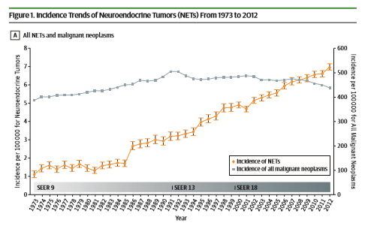
Neuroendocrine tumors
Epithelial neoplasms with predominant neuroendocrine differentiation
• Considered rare traditionally, comprising 0.5 % of all malignancies
• Increasing incidence and prevalence, 2.5 - 5/100,000 people per year
Increasing awareness
oImprovement in diagnostic modalities

Slide 4
Distribution
Gastrointestinal tract: 65%
Bronchopulmonary system: 25%
Other locations 1 0%
Thymus
gonads
heart
kidneys
prostate

Slide 5
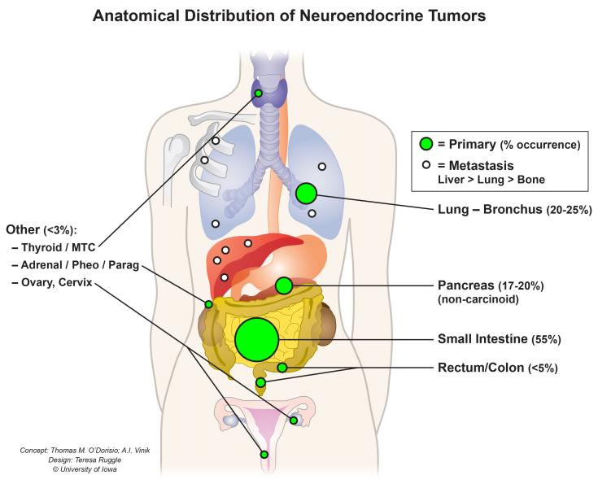

Slide 6
Classifications
WHO classification:
tumour site
degree of differentiation and grading
functionality
TNM classification

Slide 7
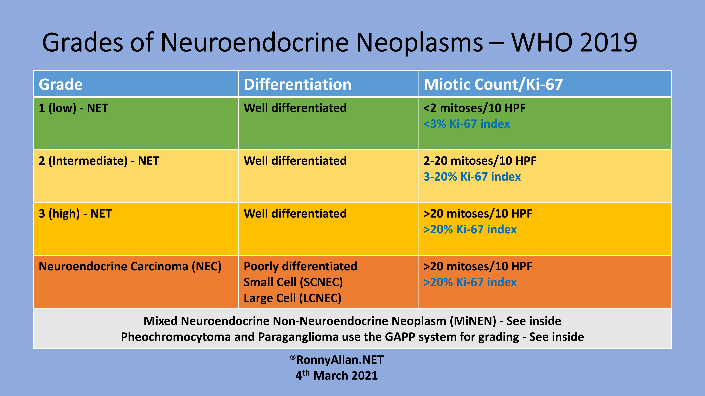

Slide 8
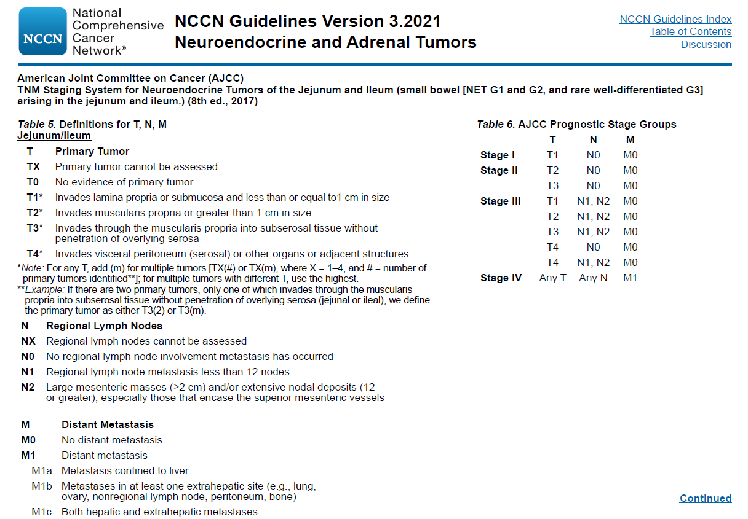

Slide 9
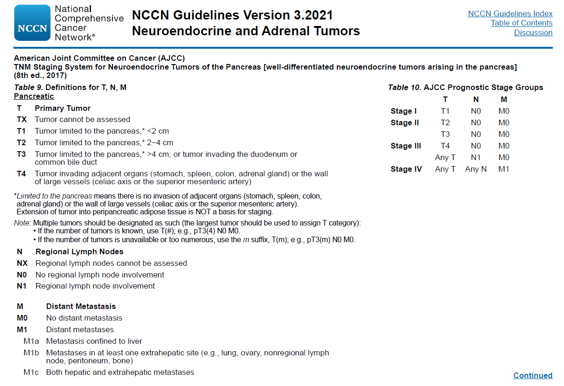

Slide 10
For appropriate pathological diagnosis, morphology, grading and immunohistochemical staining for CgA and synaptophysin should be reported.

Slide 11
Presentation
Asymptomatic
Non-functional: non-specific symptoms
abdominal pain, small bowel obstruction, gastrointestinal bleeding, anorexia, weight loss
Functional: hormone/ peptides-related
Serotonin: carcinoid syndrome
Insulin: Whipple's triad
Gastrin
Vasoactive intestinal peptide etc.

Slide 13
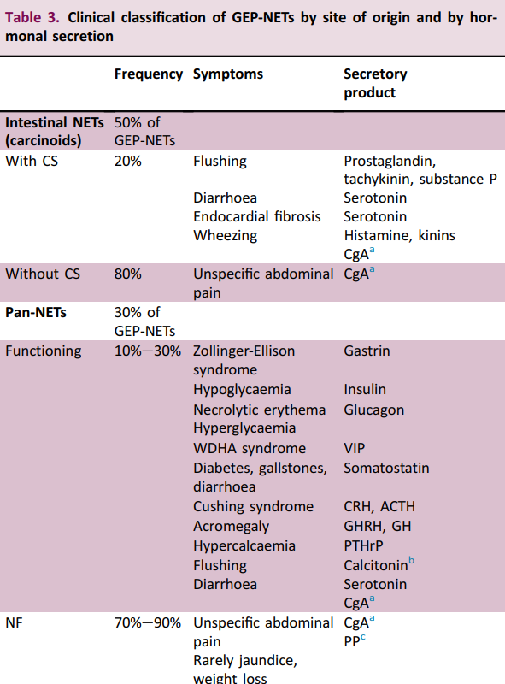

Slide 14
Investigation
Biochemical markers
Radiological imaging

Slide 15
Specific markers depending on origin
Urinary 5-hydroxyindoleacetic acid (5-HIAA): main metabolite of serotonin
Gastrin
lnsulin
Glucagon etc.

Slide 16
Chromogranin A
Co-secreted by different neuroendocrine cell types
Correlates with tumour burden and stage
Established roles in literatures:
Diagnosis
Treatment response monitoring
Relapse detection

Slide 17
Chromogranin A
Relatively high sensitivity 53-85°/o
Ben L. Endocrinol Metab Clin N Am 40 (2011) 111-134
X Non-specific
X Elevated in non-NETs condition:
Non-neoplastic: chronic atrophic gastritis; renal failure;
liver cirrhosis
Neoplastic: HCC; colon cancers
Drugs: proton pump inhibitors

Slide 18
Investigation: radiology
• Computed tomography:
arterial enhancing lesions with washout in venous phase
• Magnetic resonance imaging:
more sensitive for liver and bone marrow metastases

Slide 19
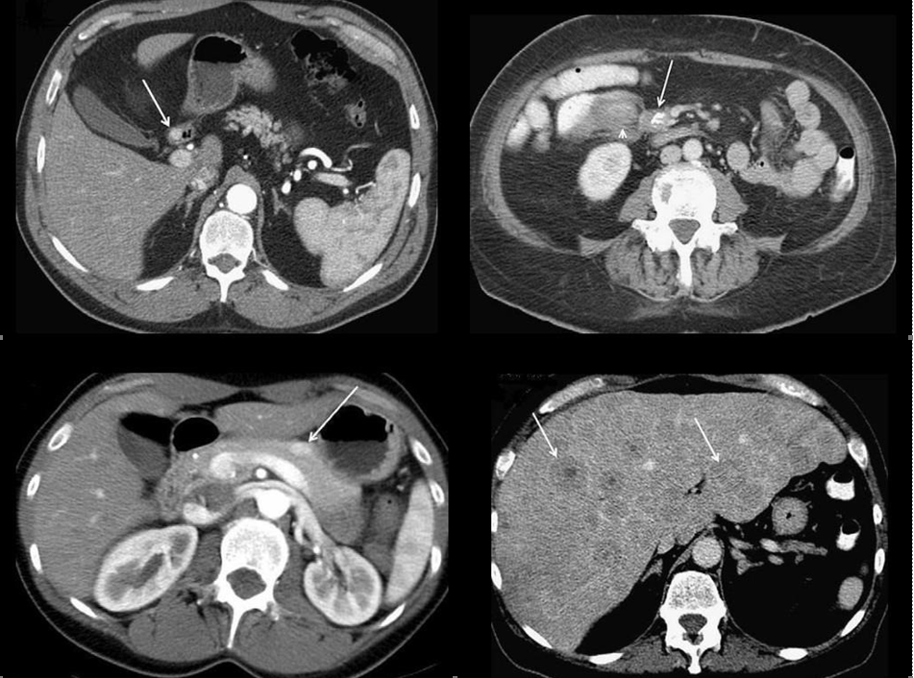

Slide 21
Endoscopic ultrasound
• High sensitivity for tumours at esophagus, stomach, duodenum, and pancreas
•Allows image-guided biopsy

Slide 22
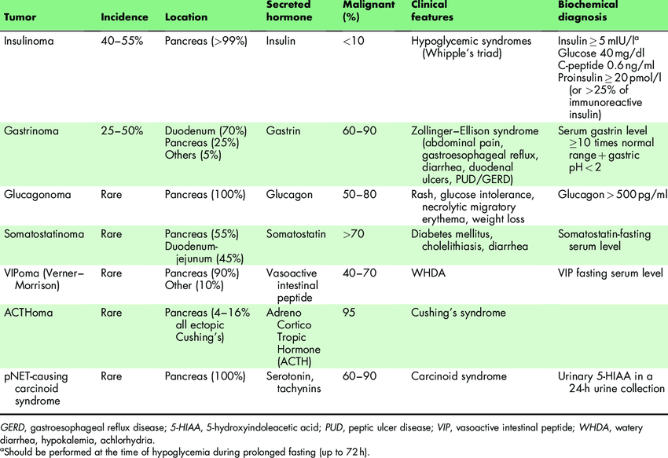

Slide 26
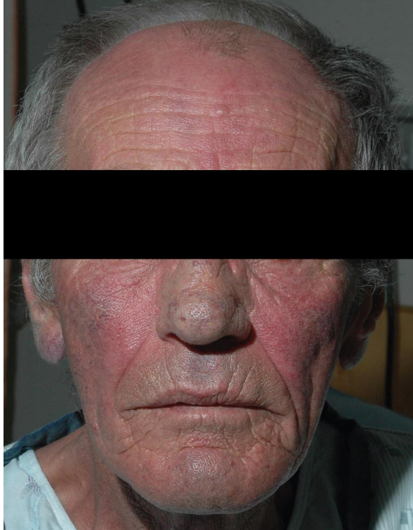

Slide 27
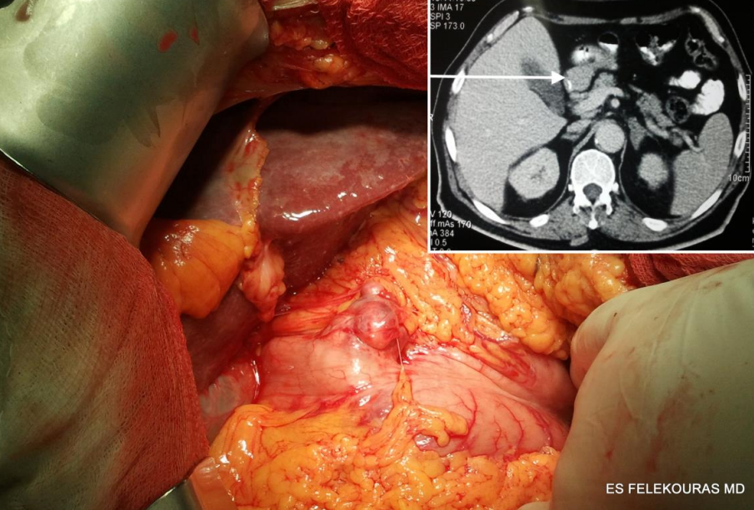

Slide 28
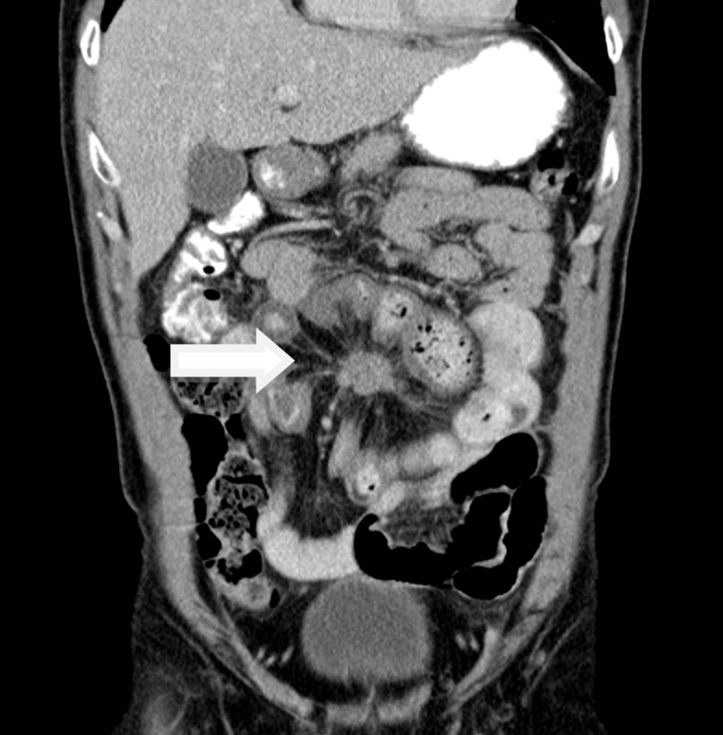

Slide 29
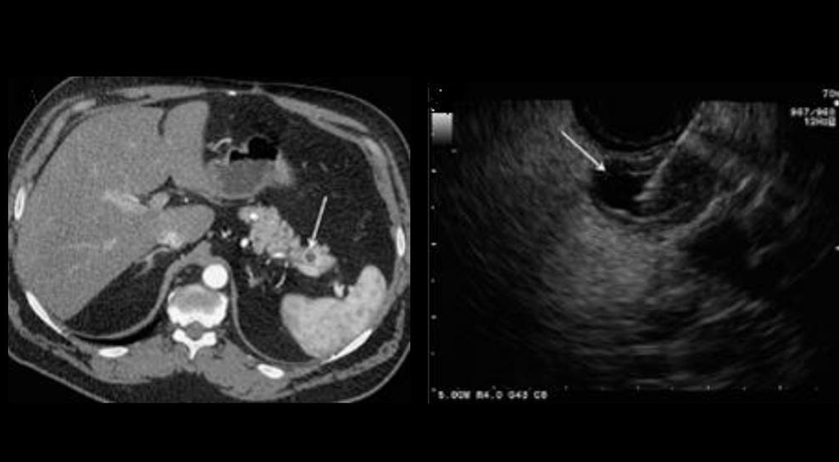

Slide 30
Octreoscan
Somatostatin (SST) receptor scintigraphy
• Principle: 80-90°/o of NETs express SST
receptors
Inflammatory lesions and some non-NET malignancies may give false positive results

Slide 31
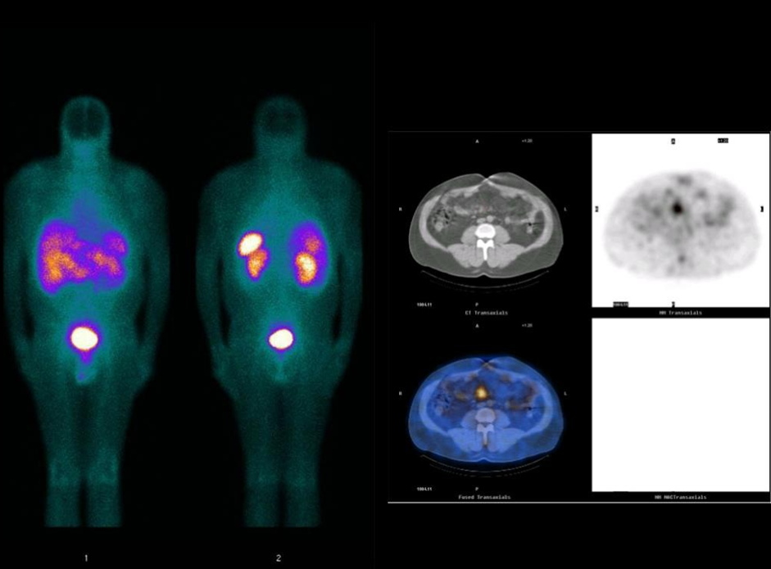

Slide 32
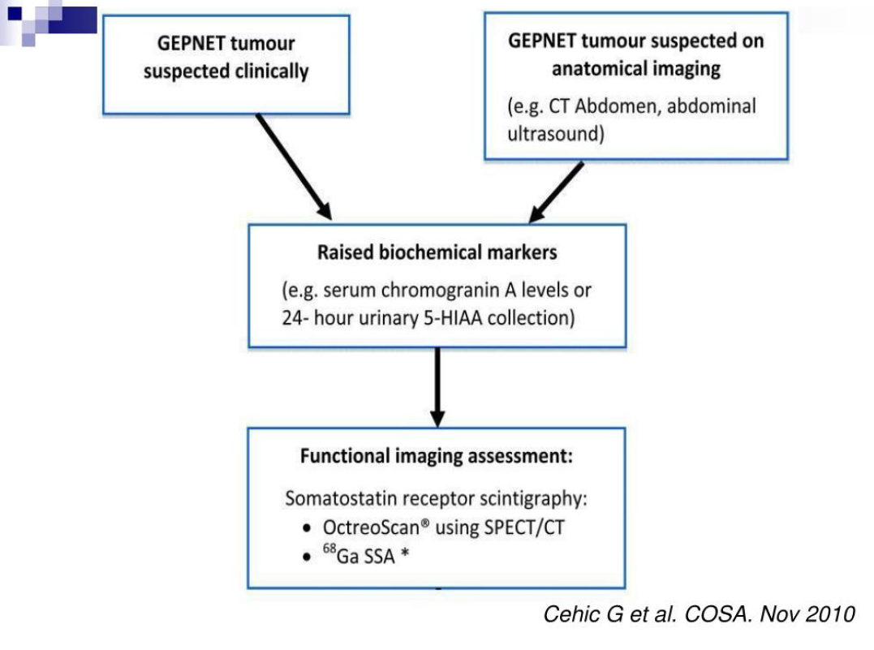

Slide 33
Positron Emission Tomography
• Ga-68 DOTATOC: high binding affinity for SST receptors
• 18-FDG: identifies clinically aggressive
lesions with high metabolism

Slide 34
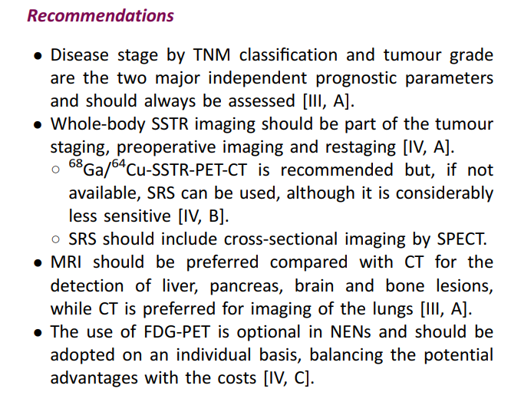
ESMO Guidelines

Slide 35
Management
Surgery remains the only curative treatment
Curative surgery should always be considered if feasible

Slide 36
Palliative surgery in metastatic disease:
o Debulking
o Resection of primary tumour
Proven benefit for local and hormonal symptom control

Slide 37
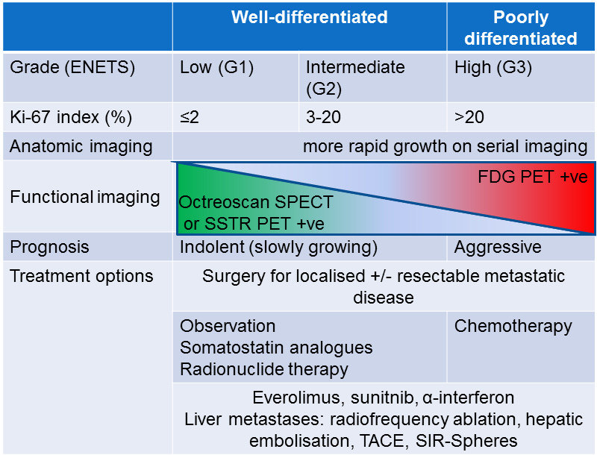

Slide 38
Conclusion
Diagnostic and treatment options for
GEPNETs are expanding
• Controversies exist for choice and sequencing of treatments requiring relevant expertise input
• Multidisciplinary approach warranted for best outcome for patients

