Slide 1

Acute pancreatitis
Μιχαήλ Βάιλας MD, MSc (HPB), Pharm.D, PhDc
Ακαδημαϊκός Υπότροφος
Α΄ Χειρουργική Κλινική ΕΚΠΑ

Slide 2
Epidemiology
300,000 annually in US
10-20% are severe
Total annual cost of 2 billion $$$
(Biliary + alcoholic) 90%
Even in the west, biliary pancreatitis is the most prevalent type.
Incidence among AIDS patients 4-22%

Slide 3
Pathophysiology
Causes
  Biliary tract disease
  Alcohol
    Hyperlipedemia
    Hypercalcemia
    Trauma
    ERCP
    Ischemia
    Pancreatic neoplasia
    Pancreas divisum
    Ampullary lesions
    Duodenal lesions
    Infections
    Venom
    Drugs
    idiopathic

Slide 4
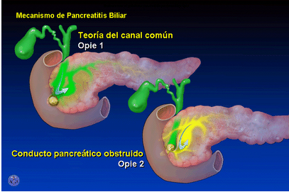
PATHOPHYSIOLOGY
Common channel theory
  “Opie 1901”
  Detergent effect of bile

Slide 5
Pathophysiology
Theories behind mechanism of biliary pancreatitis
  Common channel theory
  Incompetent sphincter theory
  Co-localization theory

Slide 6
Pathophysiology
Critique of common channel theory
  Higher hydrostatic pressure in PD
  Introduction of bile into PD in animal models failed to cause AP

Slide 7
Pathophysiology
Incompetent sphincter theory
  Incompetent sphincter of Oddi due to stone passage → reflux → AP
  Critique
    How come papillotomy doesn’t routinely cause AP??

Slide 8
Pathophysiology
Co-localization theory “Steer & Saluja” 1998
  Most acceptable
  Stones → PD ductal hypertension → ducutle rupture
  Ductal pH = 9 …… parynchemal pH = 7
  trypsinogen + cathepsin B → trypsin → autodigestion cascade

Slide 9
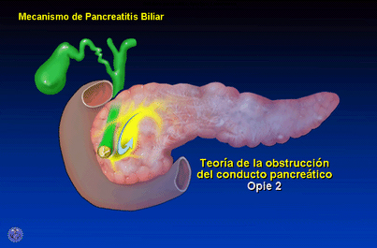
Pathophysiology

Slide 10
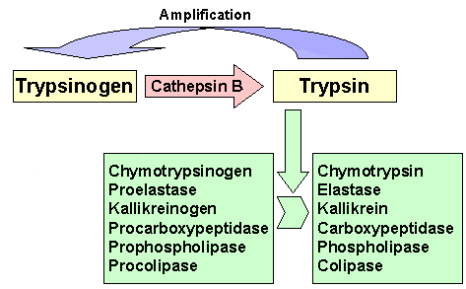
Pathophysiology

Slide 11
Diagnosis
Clinical picture
Investigations
“Acute pancreatitis is a diagnosis of exclusion” Schwartz’s

Slide 12
Diagnosis
Hx:
  Epigastric pain
  Radiating to back
  Nausea, vomitting
  Precipitating factor?

Slide 13
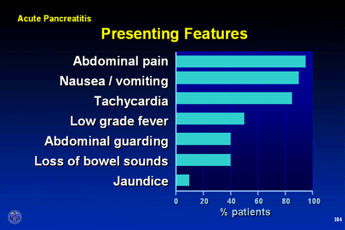
Diagnosis
Physical
  V/S → variable
  Epigastric tenderness
  Cullen’s / Grey Turner’s (1%)
  Findings of complication(s)

Slide 14
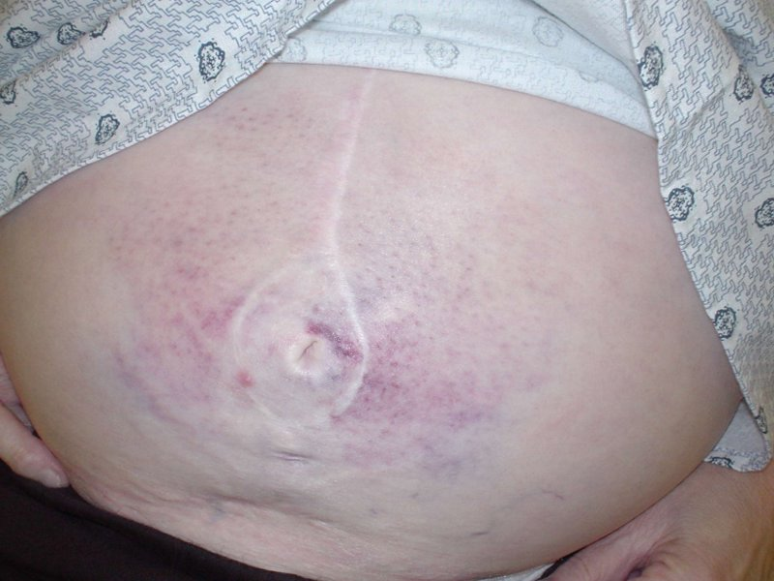
Cullen’s sign

Slide 15
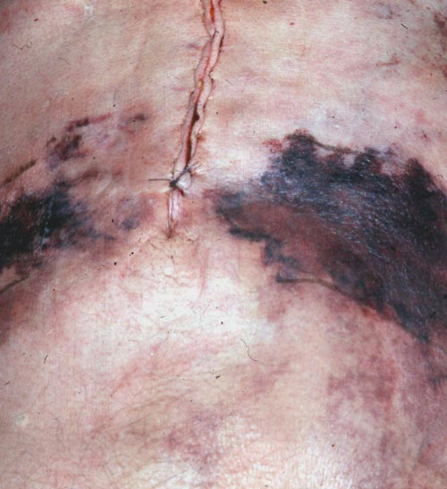
Grey Turner’s sign

Slide 16
Diagnosis
Serum markers
  Amylase
    Easiest to measure and most widely used
    Rises immediately
    Peaks in few hours
    Remains for 3-5 days
    “Three fold rise is diagnostic”
    May be normal in severe attacks
    May be falsely negative in hyperlipedimic patients
    Inverse correlation between severity and serum amylase level
    No need to repeat

Slide 17
Diagnosis
Serum markers
  Urine amylase
    Remains elevated for a few more days
    Increase excretion of amylase with attacks of AP
    Of great value when dealing with severe pancreatitis

Slide 18
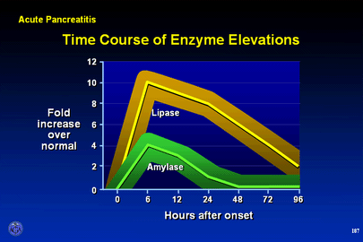
Diagnosis
Serum markers
  P/S – amylase
    P amylase increases specificity to 93%
  Lipase
    “the serum marker of highest probability of disease”
    Specificity of 96%
    Remains elevated for longer time than total amylase

Slide 19
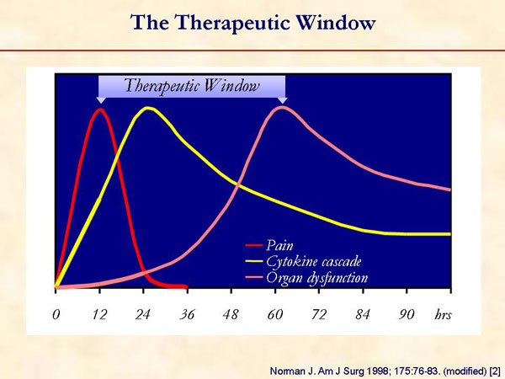
Diagnosis

Slide 20
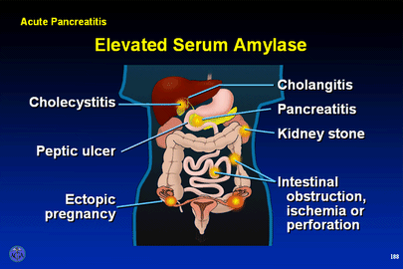
Causes of hyperamylesemia
  Malignancies
    Lung CA
    Ovarian CA pancreatic CA
    Colonic CA
    pheochromocytoma;
    Thymoma
    multiple myeloma
    breast cancer
  Pancreatitis p
  Choledocolethiasis p
  Parotitis s
  Renal failure s/p
  Liver cirrhosis s/p
  perforated bowel p
  mesenteric infarction p
  intestinal obstruction p
  Appendicitis p
  Peritonitis. P
  Gyne disease s

Slide 21
Radiology
Diagnostic role
  X-ray
  U/S
  CE-CT

Slide 22
Radiology
X-ray
  Air in the duodenal C loop
  Sentinel loop sign
  Colon cutoff sign
  All these signs are non specific

Slide 23
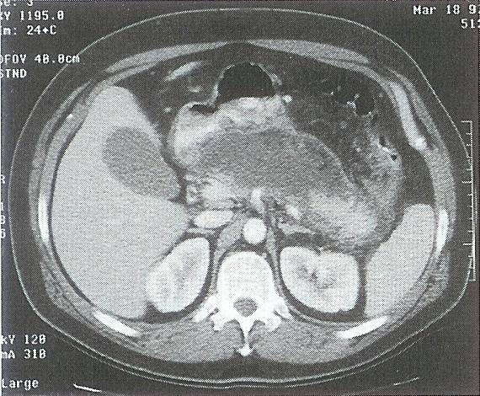
Radiology
CE-CT
  Enlargement of the pancreas
    (focal/diffuse)
  Irregular enhancement
  Shaggy Pancreatic contour
  Thickening of fascial planes
  fluid collections.
    Intraperitoneal / retroperitoneal
  Retroperitoneal air

Slide 24
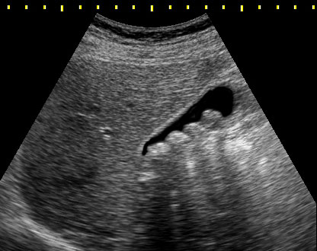
Radiology
U/S
  Diagnosis of gallstones
  F/U of pseudocysts.

Slide 25
Prognosis
Course either mild or severe
  Mild = edematous pancreatitis
  Severe = necrotic pancreatitis

Slide 26
Prognosis
Serum markers
CT
Systemic complications
Prognostic scores
  Ranson
  Apache II
  Modified Glasgow
  Atlanta
Atlanta Consensus
1992

Slide 27
Prognostic scores
Ranson’s
  Predictor of morbidity/mortality
    <2 0% mortality
    3-5 10-20%
    >7 >50% mortality
Critique of Ranson’s
  11 parameters
  48 hours
  No predictor value beyond 48hrs

Slide 28
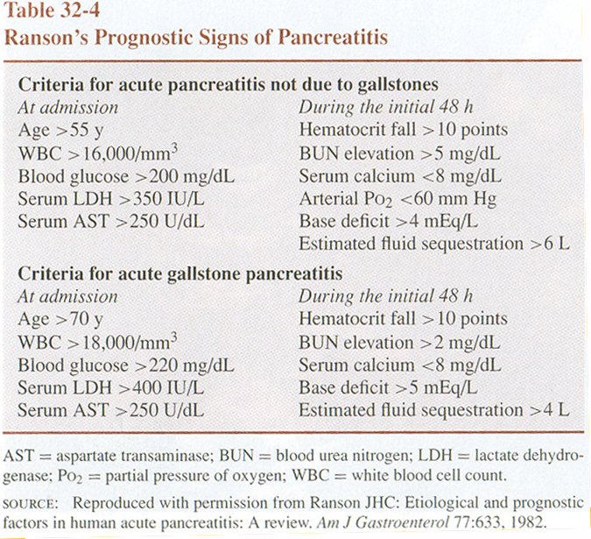

Slide 29
Prognostic scores
APACHE II
  Immediate
  Acute and chronic parameters
  Complicated
  >7 = severe pancreatitis

Slide 30
Prognostic biochemical markers
Biochemical markers of prognosis
  Ideally
    High sensitivity
    High specificity
    Discriminate severe from mild
    Immediate
    Widely available
  Amylase & lipase
    Highly sens./spec.
    Lack prognostic value

Slide 31
Prognostic biochemical markers
Alternatives
    CRP
    α2 macroglobulin
    PMN elastase
    α1 antitrypsin
    Phospholipase A2
  “CRP seems to be the marker of choice in these settings”
  CRP >150 is diagnostic of severe pancreatitis

Slide 32
CT scan (prognostic aspect)
“CT scanning with bolus IV contrast has become the gold standard for detecting and assessing the severity of pancreatitis”
“Currently, IV bolus contrast enhanced CT scanning is routinely performed on patients who are suspected of harboring severe pancreatitis, regardless of their Ranson’s or APACHE scores” Schwartz’s

Slide 33
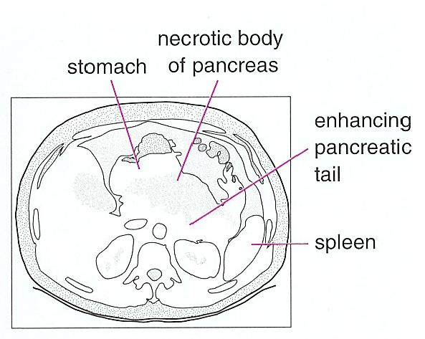
CT scan (prognostic aspect)

Slide 34
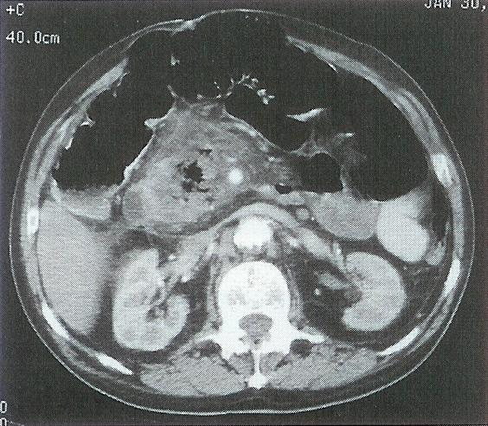
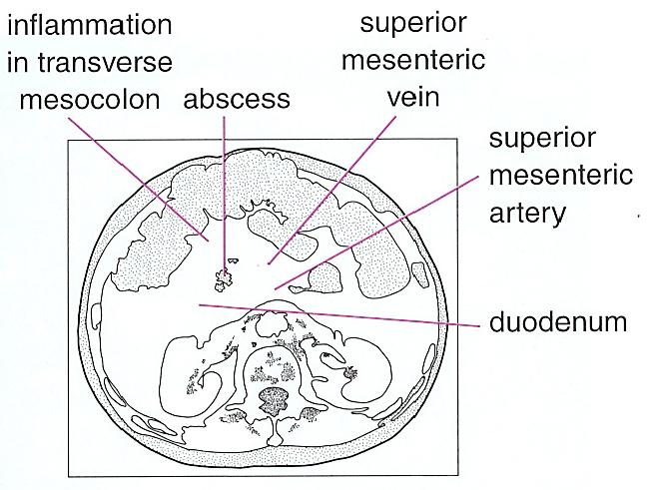
CT scan (prognostic aspect)

Slide 35
CT scan (prognostic role)
Balthazar CT-severity index (CTSI)
  CTSI considers degree of necrosis
  Also considers the CT grade
  A final score is given and correlates with mortality and complication development

Slide 36
CT scan (prognostic role)
Balthazar grading
    Grade A - Normal-appearing pancreas 0
    Grade B - Enlargement of the pancreas 1
    Grade C - Pancreatic gland abnormalities a with peripancreatic fat infiltration 2
    Grade D - A single fluid collection 3
    Grade E - Two or more fluid collections 4

Slide 37
CT scan (prognostic role)
Grade of necrosis and the points assigned per grade are as follows:
  None 0 points
  Grade 0.33 2 points
  Grade 0.5 4 points
  Grade > 0.5 6 points

Slide 38
CT scan (prognostic role)
Overall prognostic outlook:
CTSI | Mortality | Complication
0-3 | 3% | 8%
4-6 | 6% | 35%
7-10 | 17% | 92%

Slide 39
MANAGEMENT
Management depends on severity
We will consider management of edematous pancreatitis separately from necrotizing pancreatitis for purpose of simplification

Slide 40
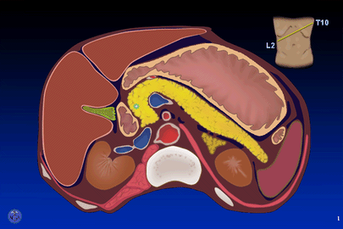
MANAGEMENT OF MILD PANCREATITIS

Slide 41
Management (mild)
Core of treatment based on
  Physiological monitoring
  Metabolic support
  Maintenance of fluids and electrolytes

Slide 42
Management (mild)
Pancreatitis is an autodigestive process
Role of protease inhibitors?
    Aprotinin
    Gabexate mesylate
    Camostate
    Phospholipase A2 inhibitors
    FFP
No benefit

Slide 43
Management (mild)
Vascular injury is mediated by platelet aggregating factor
What’s the role of PAF inhibitors?
    PAF acetylhydrolase
    Lexipafant
  Great results in models
  Great results in small clinical trials
  Failed in larger studies
Verdict: useless

Slide 44
Management (mild)
Question to audience:
When dealing with acute pancreatitis, do u start Abx therapy?
“Antibiotic therapy has not proved to be of value in the absence of signs or documented sources of infection”

Slide 45
Management (mild)
Mainstay of management is supportive
  NPO
  IVF
When to resume oral intake?
  Absence of pain
  Absence of tenderness
  Patient feeling hungry
On average takes about 3-7 days
Sips of water and build up to low protein low fat diet

Slide 46
MANAGEMENT OF SEVERE PANCREATITIS

Slide 47
Management (severe)
Severe pancreatitis:
  > Ranson / APACHE
  CRP >150
  Systemic complications
  Necrosis on CE-CT
  Hemodynamic compromise

Slide 48
Management (severe)
Complications
  Local
    Phlegmon
    Abcess
    Pseudocyst
    Ascitis
    pseudoanurysm
    Adjacent organ envolvment
  Systemic
    pulmonary
    Cardiac
    Hematological
    GI
    Renal
    Metabolic
    CVS
    Fat necrosis

Slide 49
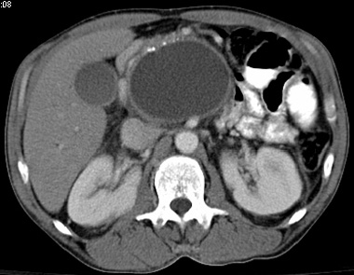
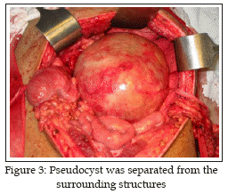
Pseudocyst

Slide 50
Management (severe)
Sterile necrosis
  Absence of retroperitoneal air on CT
  Prognosis
    0% mortality without complications
    38% with single sys. complication

Slide 51
Management (severe)
How to approach sterile necrosis?:
  No sys. Comp., no infec. (i.e. uncomplicated)
    supportive
  Sys. Comp. + infection? ( mild complication)
    CT guided aspiration → gram stain/culture → Abx
  Mult. Sys comp + toxicity/shock (frank complication)
    surgical debridment
S
E
V
E
R
I
T
Y

Slide 52
Management (severe)
Role of prophylactic Abx?
  Previously thought to have no role in sterile necrosis
  Prophylaxis indicated whenever there is necrosis
  Drugs with proven benefit
    Imipenem
    Flagyl
    3rd gen. Cephalosporins
  Abx prophylaxis reduced:*
    Sepsis by 21.1%
    Mortality by 12.3%

Slide 53
Management (severe)
Role of Antifungal medication
  Candida is a common inhabitant of upper GI tract
    Risk of secondary infection
    Empiric fluconazole?
      Clansy TE “current management of necrotizing pancreatitis”*

Slide 54
Management (severe)
Nutritional support
  NPO with resumption of diet when fit
  If NPO > 7 days…
  TPN vs. Jujenal tube feeding?
    TPN: gastric mucosal atrophy → bacterial translocation
    Jujenal tube feeding: induces pancreatic secretion
  Inconclusive studies:
    Jujenal T. feeding is superior*

Slide 55
Management (severe)
Benefit of enteral feeding
  Prospective randomized trial
  n=34
  Severe acute pancreatitis
  “enteral feeding modulates the inflamatory and sepsis response in acute pancreatitis”*

Slide 56
Specific considerations of biliary pancreatitis

Slide 57
Management (severe)
Specific consideration of biliary pancreatitis:
  Majority of stones will pass within hours
  Some might impact
  Patient at risk of subsequent stone obst.

Slide 58
Management (severe)
If hyperbilirubinemia is dropping:
  Lap chole with surgical duct clearance
  <72 hours vs. >72 (within admission)
  If patient critical → ERCP stone clearance
  Routine ERCP NOT ADVOCATED

Slide 59
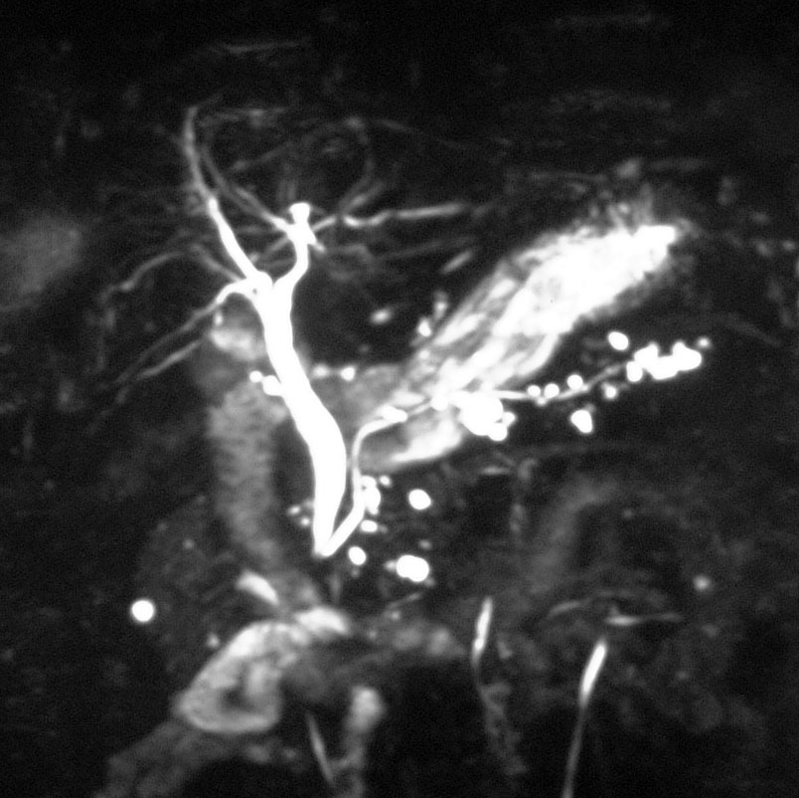
Management (severe)
If hyper bilirubinemia persists:
  confirm presence of stone before ERCP (MRCP, EUS)

Slide 60
Conclusion
Acute pancreatitis is a hot area for research
Advances at the cellular level show promise to “halt”pancreatitis
Most patients need just supportive care
No indication for Antibiotics in mild type
Severe pancreatitis needs antibiotics
Surgical management ►gallstones / complications

