Slide 1
“Επιπλοκές στην Γενική Χειρουργική”
ΕΣ Φελέκουρας

Slide 2
Complications
Complication (επιπλοκή): any deviation from the normal (ideal) postoperative course
Sequelae (επακόλουθο): cover conditions that are inherent in the procedure, and that thus will inevitably occur
Example, scar formation or the inability to walk after an amputation.
Failure to cure (αποτυχία της θεραπείας): diseases or conditions that remain unchanged after surgery are not complications, but rather failure to cure
example,
early recurrence of inguinal hernia or
incompletely resected malignant tumors,
while clearly reflecting a negative outcome, are better covered under the term ‘‘failure to cure.’’
Dindo D, Clavien PA. What is a surgical complication? World J Surg 2008; 32(6):939-41.

Slide 3
Surgical Complication
Dictionaries: Is an unfavorable evolution or consequence of a disease, a health condition or a therapy (surgery here)
Latest definitions: ‘‘any deviation from the ideal postoperative course that is not inherent in the procedure and does not comprise a failure to cure’’
“οποιαδήποτε απόκλιση από την ιδανική μετεγχειρητική πορεία που δεν είναι εγγενής της επέμβασης και δεν ανήκει στην αποτυχία της θεραπείας”
Dindo D, Clavien PA. What is a surgical complication? World J Surg 2008; 32(6):939-41.

Slide 4
Systemic
Complication
Any deviation from the normal (ideal) postoperative course
Medical mistake (error)
A medical error is a preventable adverse effect of care, whether or not it is evident or harmful to the patient.
This might include an inaccurate or incomplete diagnosis or treatment of a disease, injury, syndrome, behavior, infection, or other ailment.
By the State
By the Health care system
By the Physician

Slide 5
HCC-diagnosis (US)
Current surveillance for HCC
ultrasound (US)
with or without alfa-fetoprotein (AFP)
US is operator dependent, and
all focal lesions on US should be verified using a 4-phase contrast enhanced study (unenhanced, arterial, portal venous, delayed)—multidetector contrast enhanced CT (CECT) or a
dynamic contrast enhanced MRI (DCE-MRI) with nonspecific or liver-specific contrast agents (Eovist)
Dhir M, Melin AA, Douaiher J, et al. A Review and Update of Treatment Options and Controversies in the Management of Hepatocellular Carcinoma. Ann Surg 2016; 263(6):1112-25.
www.surgery.gr

Slide 6
Medical mistake (error)
Causes
Healthcare complexity
System and process design
Competency, education, and training
Human factors and ergonomics
Examples
Errors in diagnosis
Misdiagnosis of psychological disorders
Most common misdiagnoses
Outpatient vs. inpatient
After an error has occurred
Recognizing that mistakes are not isolated events
Placing the practice of medicine in perspective
Disclosing mistakes
To oneself
To patients
To non-physicians
To other physicians
To the physician's institution
Use of rationalization to cover up medical errors
By presence of to the patient
Cause-specific preventive measures
In specific specialties
Legal procedure
Prevention
Reporting requirements
Misconceptions

Slide 7
Medical mistake (error)
Όταν ο γιατρός δεν έχει τηρήσει τους κανόνες της ιατρικής επιστήμης είτε από άγνοια είτε από απειρία είτε από απερισκεψία ή ανεπιτηδειότητα.
Όταν έχει υπάρξει μια επιπλοκή είναι πολύ δύσκολο να διακρίνουμε εκ του αποτελέσματος αν ο γιατρός ενήργησε lege artis,
σύμφωνα δηλαδή με τους κανόνες της ιατρικής επιστήμης και τέχνης ή υπέπεσε σε σφάλμα

Slide 8
The real controversy
Medical mistake vs. Complication
(key points: Documentation and Witness)

Slide 9
Complications
Όλες οι επεμβάσεις έχουν τον κίνδυνο επιπλοκών.
Μπορεί να είναι 0,1%, μπορεί να είναι και πολύ μεγαλύτερος.
Ο γιατρός γνωρίζει ότι η συγκεκριμένη επέμβαση μπορεί να έχει επιπλοκές,
αλλά δεν γνωρίζει αν θα συμβούν στο συγκεκριμένο ασθενή,
ακόμη και αν ενεργήσει την επέμβαση lege artis

Slide 10
Liver biopsy
Recommendations
Liver biopsy should be considered in patients in whom diagnosis is in question, (Class I, Level B)
When knowledge of a speciﬁc diagnosis is likely to alter the management plan (Class I, Level B).
Liver histology is an important adjunct in the management of patients with known liver disease, particularly in situations where (prognostic) information about ﬁbrosis stage may guide subsequent treatment; the decision to perform liver biopsy in these situations should be closely tied to consideration of the risks and beneﬁts of the procedure (Class I, Level B)
Rockey DC, Caldwell SH, Goodman ZD, et al. Liver biopsy. Hepatology 2009; 49(3):1017-44.
AASLD POSITION PAPER

Slide 12
ΧΕΙΡΟΥΡΓΟΣ ΜΕΤΑ ΑΠO ΤΡΑΥΜΑ ΧΟΛΗΦΟΡΩΝ

Slide 13
BDI
complication vs. mistake

Slide 14
Attributed to
General health of the patient
Preoperative care
Magnitude of the operation
Quality of postoperative care

Slide 15
Complications of major surgery can be broadly classified as those:
Due to anesthesia
Due to surgery

Slide 16
Due to surgery
Perioperative complications
Postoperative complications
Immediate/early complications
Late complications

Slide 17
By failing to prepare, you are preparing to fail Benjamin Franklin

Slide 18
Summary of Preoperative Evaluation
Cardiovascular
History of stable/unstable angina,
arrhythmias,
MI,
CHF,
cardiac surgery,
rheumatic fever,
valvular disease,
endocarditis,
stroke,
claudication

Slide 19
Summary of Preoperative Evaluation
Pulmonary
Recent pneumonia,
exposure to pulmonary irritants,
dyspnea,
productive/non-productive cough,
wheezing, hemoptysis,
history of pulmonary tuberculosis,
asthma,
bronchitis,
fungal exposure,
smoking history, cyanosis or aspiration, availability of previous chest film or CT scans.

Slide 20
Summary of Preoperative Evaluation
Renal
Renal insufficiency( recent or in the past),
renal stone
Prostate diseases

Slide 21
Summary of Preoperative Evaluation
Hematologic
History of blood transfusion,
bleeding disorders,
easy bruising,
use of NSAID, aspirin or antiplatelet medications ,
previous history of DVT or PE,
information regarding blood donation and autologous blood program

Slide 22
Summary of Preoperative Evaluation
Gastrointestinal
History of GI bleeding or
previous operation for ulcers or carcinoma,
GER disease

Slide 23
Summary of Preoperative Evaluation
Endocrine
history of DM,
thyroid disease,
long- term steroid use,
pituitary or adrenal insufficiency

Slide 24
Summary of Preoperative Evaluation
Infection
History of bacterial or viral pneumonia,
chronic bronchitis,
pulmonary TB,
fungal infection,
hepatitis,
CMV or
HIV

Slide 25
Summary of Preoperative Evaluation
Medication
Use of prescription and nonprescription drugs,
previous radiation or chemotherapy.
Previous operation
Especially thoracic and abdominal operations
Nutrition
Note overall appearance of nutritional status, weight loss or gain, obesity and overall eating habit
Patient directives & Health Care
Organ donation, living will, next of kin, privacy request, points of contact perioperatively,
logistical and social issues regarding costs, home care, rehabilitation, case cancellation protocols, preoperative counseling.

Slide 26
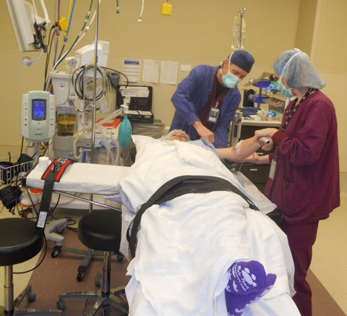
Surgical Basics
Preventing injury and error
Jan Moss, RN

Slide 27
Blah, Blah, Blah…
“The table was placed in beach chair configuration. Head, neck, trunk and limbs were padded and protected in appropriate fashion.”
“The right lower extremity was prepped and draped in the usual sterile fashion.”
“Bilateral upper extremities were prepped and draped in standard sterile fashion.”

Slide 28
Types of Injuries
Wrong site, wrong procedure
Wrong medication
Skin breakdown/decubiti
Burns
Nerve damage
Ischemia
Eyesight

Slide 29
Pre-operative Preparation
Testing
Determines ability to sustain surgical insult
Determines type of anesthesia delivery
Blood Pressure, Diabetes, EKG, Liver function, CBC, Chest X-ray, UA
Medications
Day before surgery, anti-inflammatory
Day of surgery, antibiotics
Post op pain meds
Smoking cessation?

Slide 30
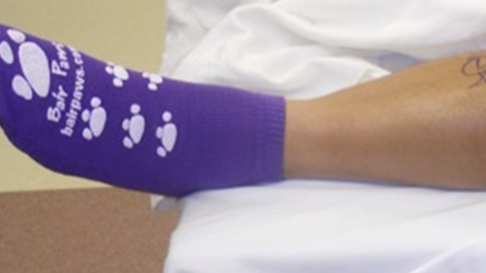
Patient/Procedure Confirmation
Surgical Consent
Pre-operative marking
“Time Out” in the operating room

Slide 31
Anesthesia Choices
Goals of anesthesia
Exposure, Relaxation
Keep patient alive
Pain free, unaware, stable
Local Anesthesia
Regional Anesthesia
Conscious Sedation
General Anesthesia
LMA vs. Intubation
Many photos courtesy of John DiPaola, MD

Slide 32
Surgical Positioning
Goals
Exposure for surgeon
Immobilize patient
Injury prevention
Maintain circulation
Maintain anatomic alignment
Prevent pressure points

Slide 33
Surgical Positioning
Considerations
No movement for minutes to hours
No ability to identify pain
Sometimes exposure wins out over comfort
Even supine can be injurious

Slide 36
Add 150 lbs
& imagine the injury
potential
Skinny Model

Slide 37
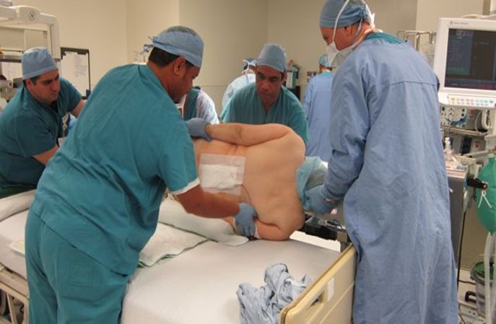
Patient induced on back and then turned. Process reversed at the end of procedure
Arms supported
Face in cradle
Gel pad under
knees
Elevated frame

Slide 38
Challenges to positioning
Obesity
Trauma
Pre-existing conditions
Arthritis, amputation, injury
Diabetes
Cardiac/Vascular disease
Smoking

Slide 39
Documentation
“The table was placed in beach chair configuration. Head, neck, trunk and limbs were padded and protected in appropriate fashion.”
“The right lower extremity was prepped and draped in the usual sterile fashion.”
“Bilateral upper extremities were prepped and draped in standard sterile fashion.”

Slide 40
Perioperative complications
Refers to problems arising during surgery, which include:
Hypotension
Blood loss
Mismatched blood transfusion
Vasodilatation from a combination of premedication and anesthetic agents.
Raised blood pressure
Use of ketamine
Phaechromocytoma
Uncontrolled hypertension
Cardiac arrest
Air embolism
Tissue hypoxia
Blood loss
Air embolism
Increase in circulating catecholamine
Use of exogenous adrenaline in the presence of hydrogenated hydrocarbons e.g. Halothane
Hypoxia
Reduced o₂ in inspired air
Inadequate blood flow in myocardial failure
Inadequate alveolar ventilation due to respiratory depression
Insufficient functioning hemoglobin

Slide 41
Perioperative complications
Asphyxia
Combination of hypoxia & hypercapnia, caused by respiratory obstruction
SIGNS:-
Noisy breathing during partial obstruction
In the presence of endotracheal tube, difficulty in inflating & deflating the lungs
Cyanosis
CAUSES:- physical & mechanical.
Flexed head in anesthetized px with/without endotracheal tube.
Endotracheal tube blocked by pus, blood, foreign bodies.
Pressure on trachea from without, during operations on large tumors of the neck e.g. thyroidectomy
Chemical causes
Inhalation of intestinal contents {can be due to stimulation of the back of the tongue by foreign bodies e.g. laryngoscope

Slide 42
Postoperative Complications
Pre-op:
Optimize the patients condition
Give prophylaxis
Select from of anesthesia
Intra-op :
Attention to detail
Post-op :
Monitor to detect

Slide 43
Post operative complications
Refers to complications arising after surgical operations
Immediate/Early complications
Respiratory,
Cardiovascular,
CNS,
Genito-urinary,
GI and
Wound complications

Slide 44
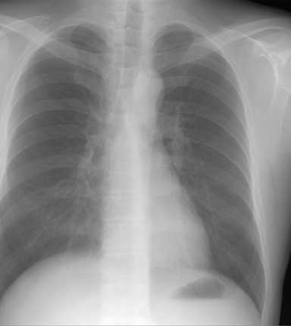
Respiratory

Slide 45
Respiratory Complications
Respiratory insufficiency
Airway obstruction
Often caused by the tongue which falls back to block the oro- and nasopharynx
Presence of foreign bodies e.g. gastric contents, blood, pus, forgotten throat packs.
Aspiration
Aspiration of gastric contents in px that have recently eaten
Hiccough
Clonic spasm of the diaphragm with reflex closure of the glottis. It may occur soon after operation due to irritation of the mucosa of the esophagus and stomach by anesthetic gases

Slide 46
Atelectasis
Atelectasis(pulmonary collapse)
Increased quantity/viscosity of bronchial secretion
Deficiency in mechanism for expelling bronchial secretion
Intubation of respiratory tract
Bronchopneumonia
Infection of Atelectasis

Slide 47
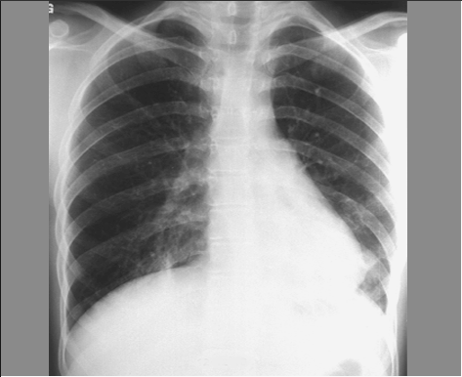
Postoperative Pulmonary Complications
Atelectasis:
90% postoperative pulmonary complications
Etiology:
Obstruction of the tracheobronchial airway
Changes in bronchial secretions
Defects in expulsion mechanism
Reduction in bronchial caliber
Pulmonary insufficiency (hypoventilation)
Decrease surfactant

Slide 48
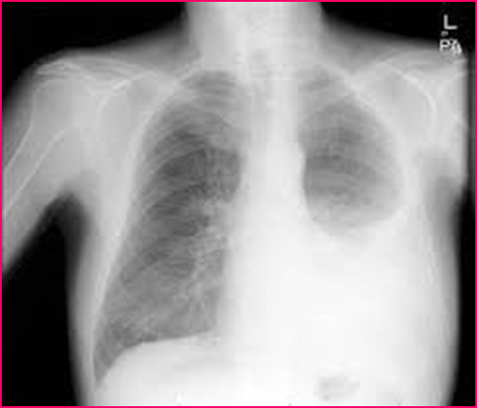
Chest X-ray
Pneumonia
Pulmonary Edema
Pleural Effusion

Slide 49
Risk Factors for Postoperative Pulmonary Complications
Risk Factor
Relative Risk
Age > 70
Age 50-69
Major abdominal surgery
Emergency surgery
Chronic obstructive pulmonary disease
Age 30-49
General anesthesia > 180 minutes
7,46
4,14
3,90
3,49
3,13
2,29
1,52

Slide 50
Common Causes of Postoperative Hypoxemia
Atelectasis Alveolar infiltrates Aspiration
Cardiac-associated pulmonary edema Noncardiac-associated pulmonary edema
(e.g., capillary leak, neurogenic, negative pressure) Pulmonary embolus
Pneumothorax Bronchospasm Mucus plugging
Pulmonary contusion/hemorrhage
Pulmonary embolus
Pneumothorax
Bronchospasm
Mucus plugging
Pulmonary contusion/hemorrhage

Slide 51
Common Causes of Postoperative Hypercapnia
Atelectasis
Alveolar infiltrates
Aspiration
Residual volatile anesthetics
Residual neuromuscular blockade
Narcotic overdose
Sedative overdose
High regional block
Cerebrovascular event
Neuromuscular disorders
Hypothyroidism
Insufflated carbon dioxide (laparoscopic procedures)
Metabolic alkalosis
Malnutrition
Hypermetabolism
Sepsis
Increased physiologic dead space pulmonary edema
Noncardiac-associated pulmonary edema
(e.g., capillary leak, neurogenic, negative pressure)

Slide 52
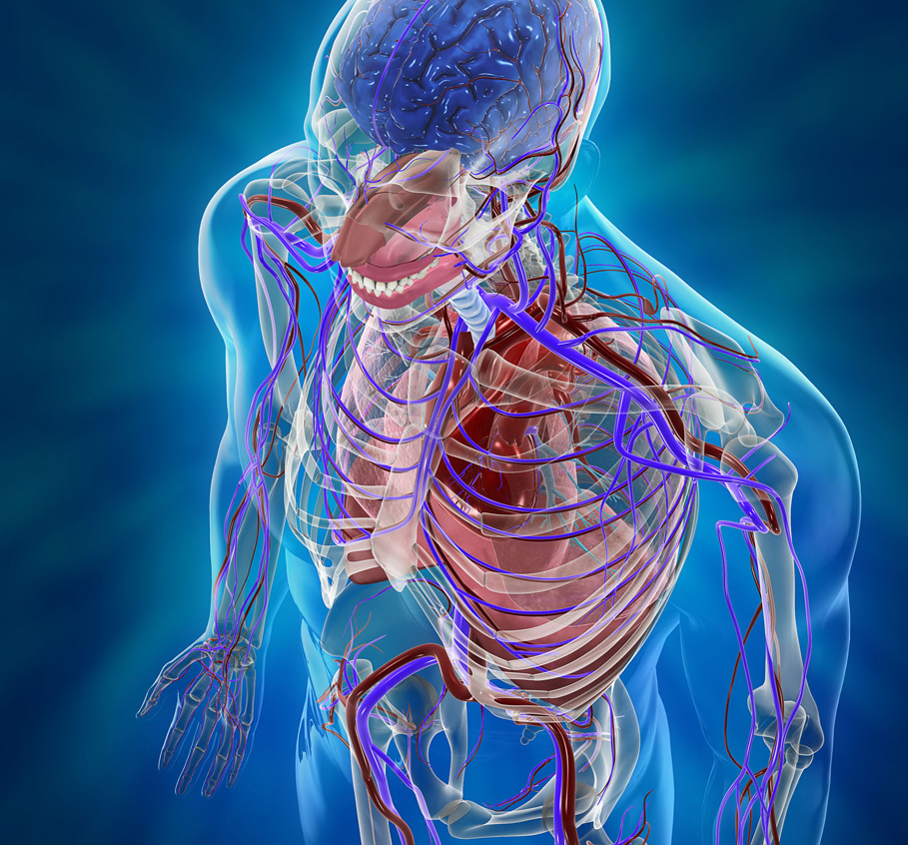
CVS

Slide 53
CVS
Hemorrhage
Reactionary (occurring within 24hrs)
Dislodgement of a blood clot/loose ligature at the cut end of a blood vessel
Oozing of blood from an extensive raw area
Platelet deficiency resulting in impaired clotting
Prothrombin deficiency, e.g. in liver dx
Secondary hemorrhage (after 7days)
Bleeding follows necrosis of blood vessels from infection and may be accompanied or preceded by fever
Signs
Pallor, sweating and cool skin
Bleeding from wound
Cardiac arrest
Commonest cause is tissue hypoxia which may result from:
Resp. obstruction
Severe hemorrhage
shock
Deep venous thrombosis
Venous stasis
Age
Roughening of the endothelium resulting from trauma
Myocardial infarction

Slide 54
GI bleeding- necrosis
Hemorrhage:
Occurs gastrointestinal anastomosis
Manifest – hematemesis, melena, hematochezia
Bleeding arise from the suture line (usually after gastric resection
Treatment:
1st conservative: irrigation w/ cold lavage / endoscopy
Reoperation – direct control
Gangrene:
Due to poor tissue perfusion
Stomach:
Following subtotal gastrectomy w/ ligation of left gastric and splenic arteries; thrombosis
Small bowel and colon:
Thrombosis; mechanical strangulation (internal herniation) – volvulus, adhesions
Treatment:
Resection of gangrenous segment, re-established continuity

Slide 55
Shock
Acute circulatory failure - inability of the cardiovascular system to maintain adequate tissue perfusion
There are three types
hypovolemic
cardiogenic
septic

Slide 56
Deep venous thrombosis (DVT)
Is important cause of morbidity in the surgical patient
Can lead to pulmonary embolism
Its prevalence is up to 40 percent
It can occur in the calf, femoral and iliac veins
Assessing risk
Prevention
Mechanical
Pharmacological

Slide 57
Predisposing factors for DVT
Smoking
Type of surgery
Obesity
Venous stasis
Cancer
Hypercoagulable states
Inactivity after surgery
Oral contraceptive use

Slide 58
Diagnosis and Tx of DVT
History and physical examination
Calf tenderness and swelling
Positive Homan’s sign
Fever
D-dimers
Ultrasound
Anticoagulation
Bed rest early

Slide 59
Pulmonary embolism (PE)
A very serious complication of DVT
10% die within the first hour
90% live longer than one hour-of these patients 70 percent go undiagnosed and of these 30 % die

Slide 60
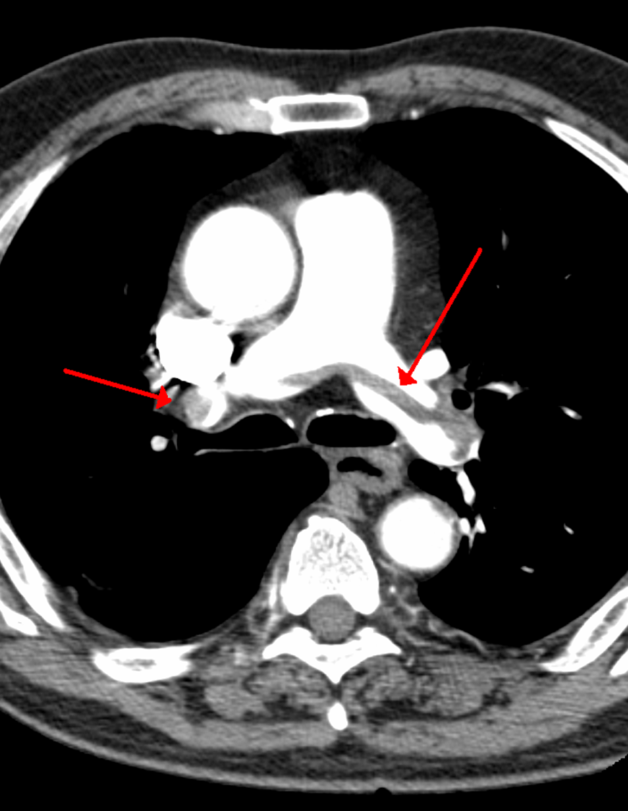
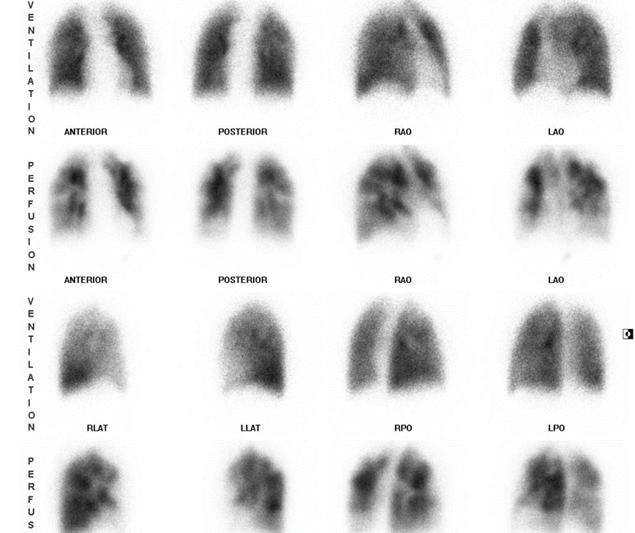
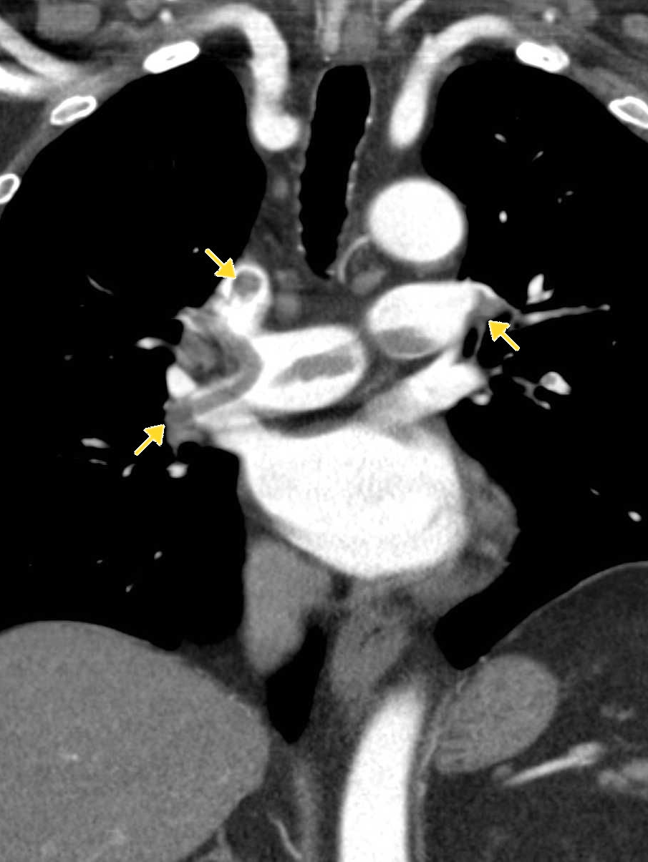
Diagnosis of PE and Tx
Diagnosis
Clinical
dyspnea
chest pain
Hypotension
D-dimers
Imaging
CT
Ventilation perfusion scan
Tx
Medical management
supportive care
anticoagulation
Thrombolysis
Surgical management

Slide 61
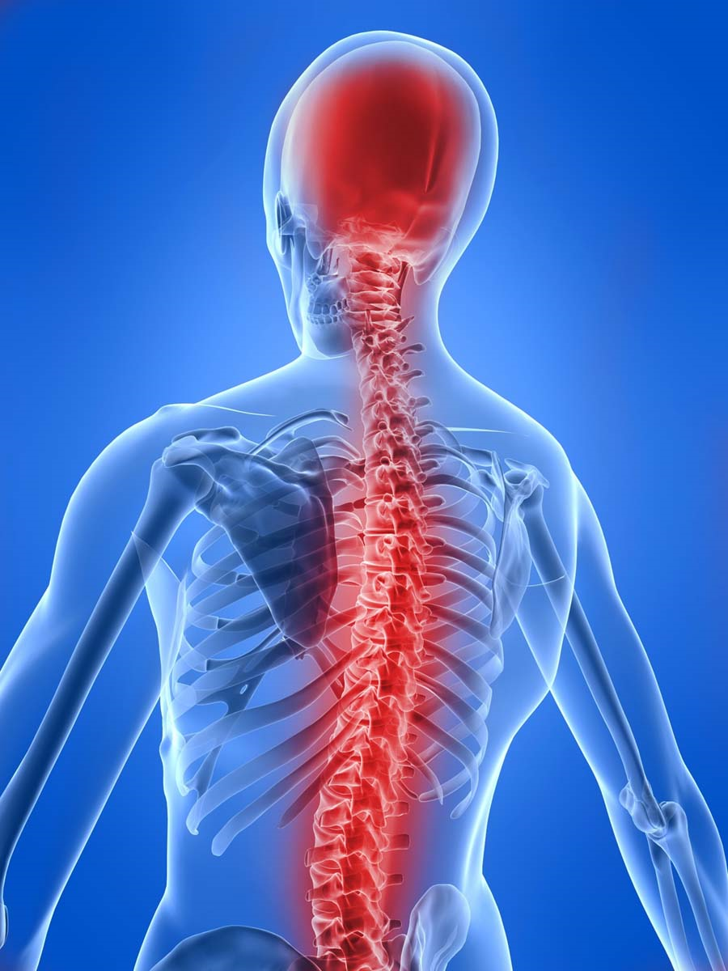
CNS

Slide 62
CNS
Failure to recover consciousness
May be due to cerebral hypoxia as a result of e.g. hypoglycemia
Convulsion
Attacks of involuntary tonic or clonic movements of the trunk, limbs and face with or without loss of consciousness.
Predisposing fx in the post-op period are:
Pyrexia
Epilepsy
hypocalcaemia

Slide 63
Mental status
Mental changes can include somnolence, coma, confusion, disorientation, agitation and convulsions
Elderly
This could be due to hypoxia, low blood sugar, uremia, ammonia or anesthetic agents
Failure to awaken issue usually due to anesthesia
Consider postoperative stroke in patients with carotid bruits
If the patient is a heavy drinker considered delirium tremens
Disorientation at night

Slide 64
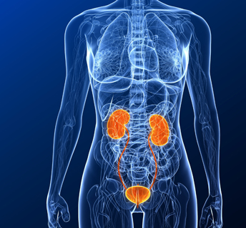
Genito-Urinary

Slide 65
Genito-urinary
Postoperative reduction of urine output to < 0.5 ml / kg / hr.
Early postoperative fluid and sodium retention
Retention of urine
failure to pass urine within 12-24hrs of surgery when bladder is distended.
more common after pelvic and perineal operations.
Due to action of atropine & other cholinergic anesthetic agents (decrease muscle contractility)
Pain in operation site
Urinary tract infections

Slide 66
Prerenal
Implies decreased renal blood flow which is usually due to:
decreased blood volume
decreased cardiac output
medications

Slide 67
Renal
Usually occurs with prolonged or uncorrected pre-renal failure (acute tubular necrosis)
Can also be caused by:
aminoglycosides
intravenous contrast dye
blood transfusions
NSAI’s

Slide 68
Post renal
Usually occurs after the urinary tract has been obstructed
Can be caused by:
enlarged prostate
ligation of the ureter during surgery
Foley catheter blockage

Slide 69
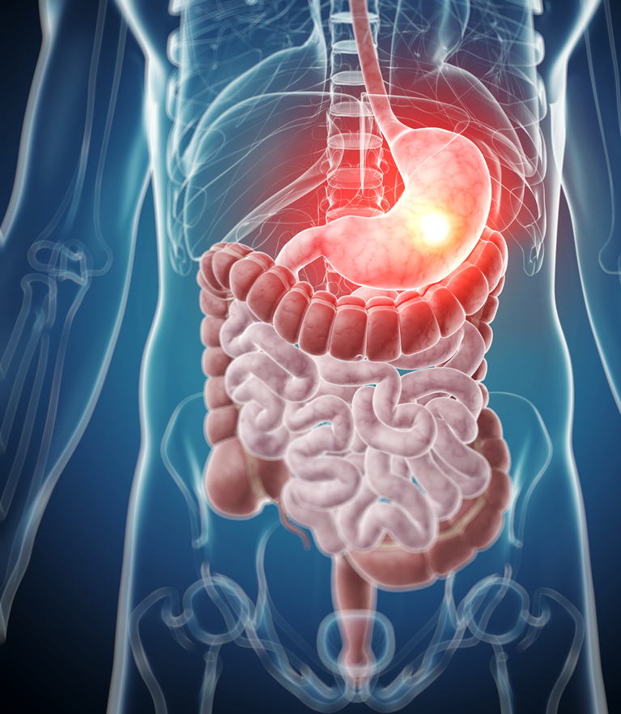
GI system

Slide 70
GI
Anorexia
Nausea & vomiting
May be caused by anesthetic agents
Peritonitis &intra-abdominal abscesses
Following operation in septic conditions
Diarrhea
Drugs: oral antibiotics, laxatives, magnesium containing antacids.
Operations: vagotomy & drainage, gut resection.
Upper and lower GI bleeding
Postoperative bowel obstruction
Acute gastric dilatation
Gastroduodenal mucosal
Intestinal obstruction (Ileus)
Postoperative fecal impaction
Colitis
Anastomotic leak
Fistula
Peritoneal abscess ----> Peritonitis
Hepatobiliary complications and jaundice

Slide 71
Postoperative bowel obstruction
Early obstruction
Paralytic ileus
mechanical obstruction
Bowel obstruction should be considered in patients if
the bowel function does not return to normal after about four days

Slide 72
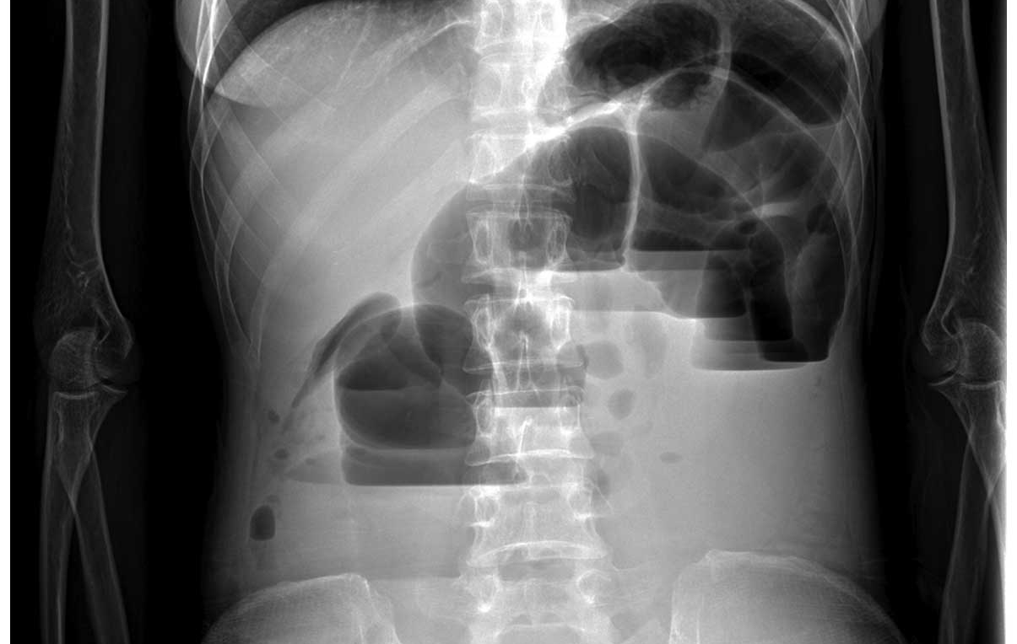
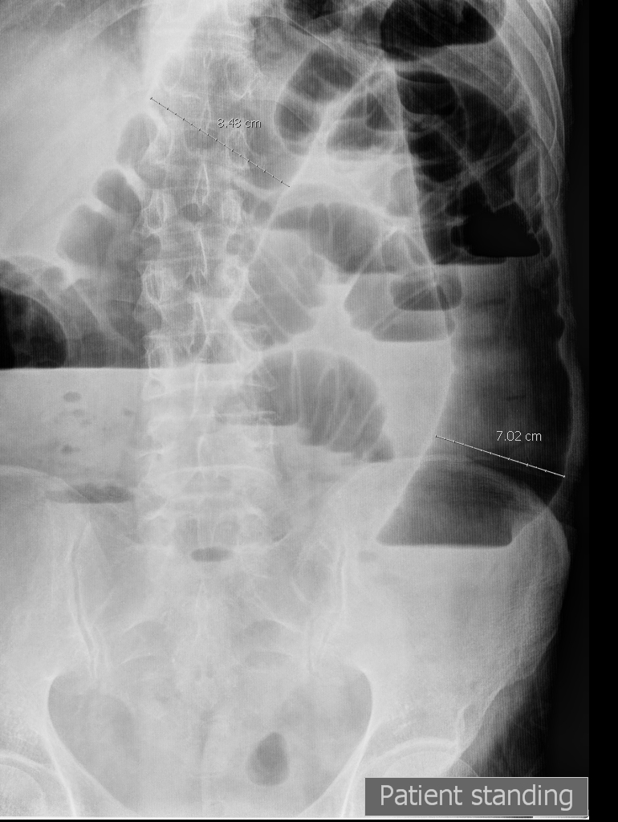
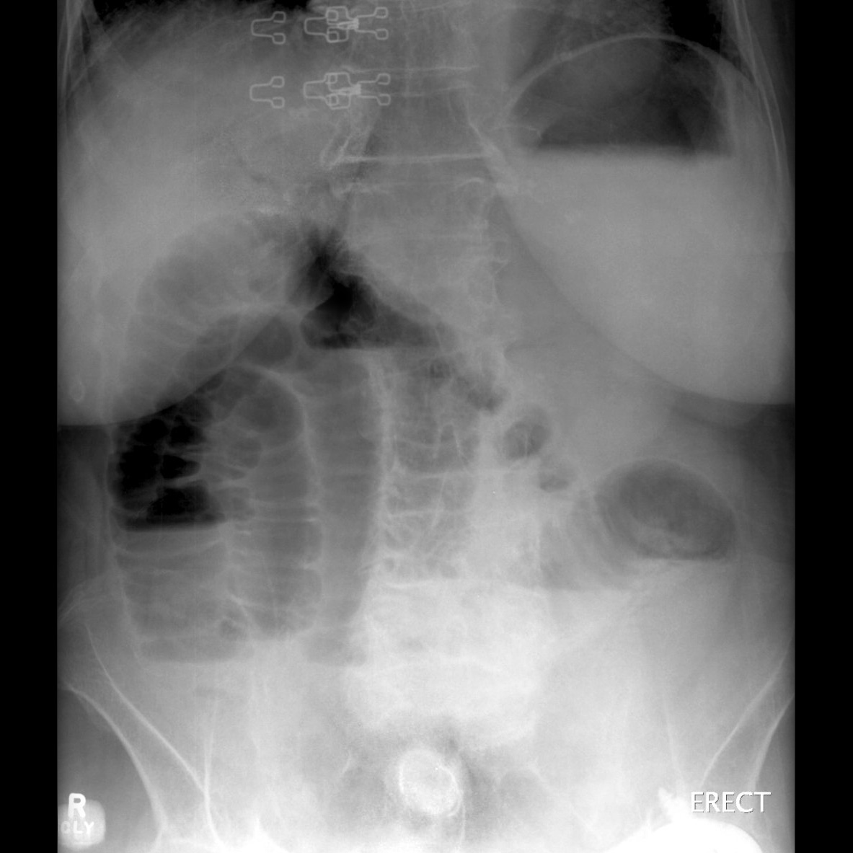
Postoperative bowel obstruction
Commonly caused by
postoperative adhesions
Post-operative adhesion
Intussusception
Volvulus
Herniation
Patients usually exhibit normal bowel function for a short while then shows signs of obstruction
S/Sx:
3rd – 4th postop day
Abdominal distention, colicky pain, increase NGT drainage, bilious material
Diagnosis
abdominal x-rays
CT scanning

Slide 73
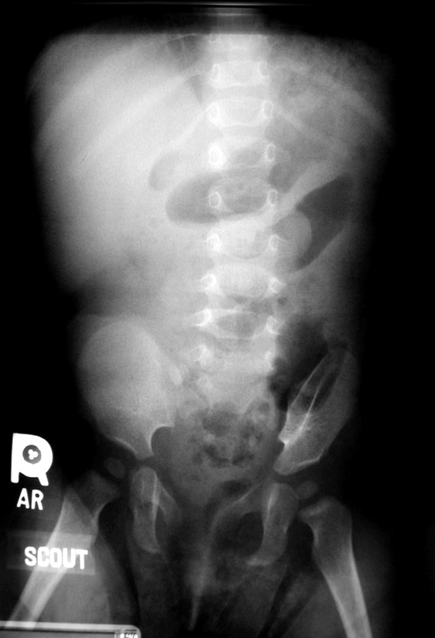
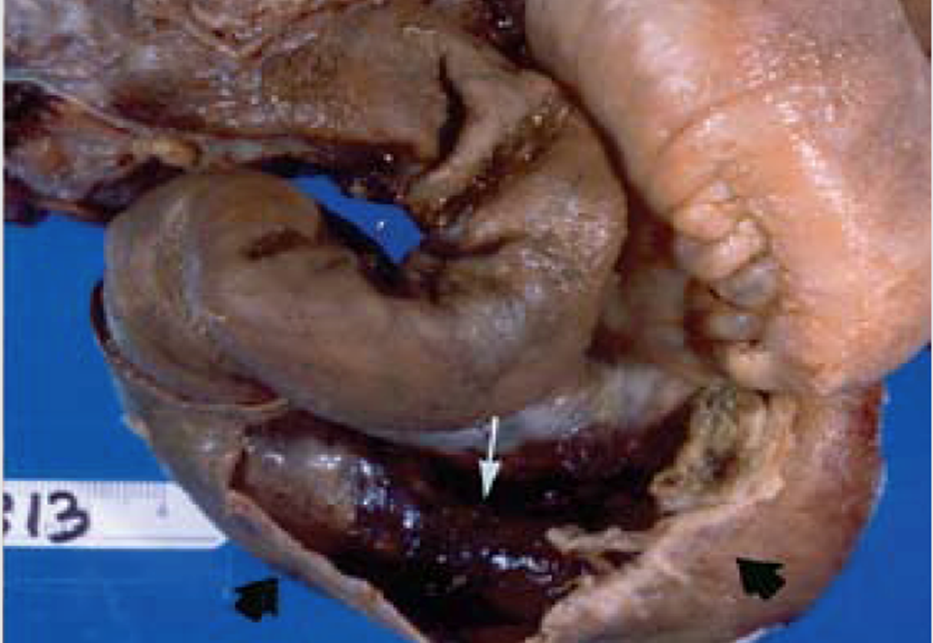
Intussusception

Slide 74
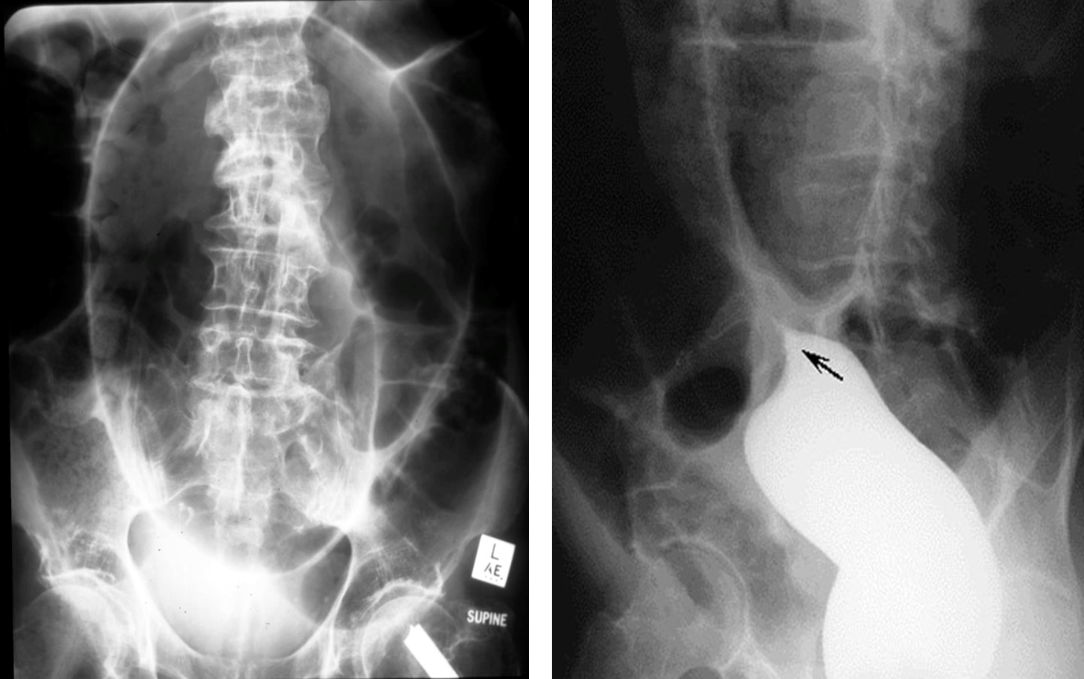
Volvulus

Slide 75
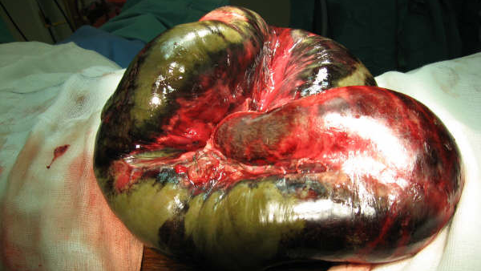
Small bowel volvulus

Slide 76
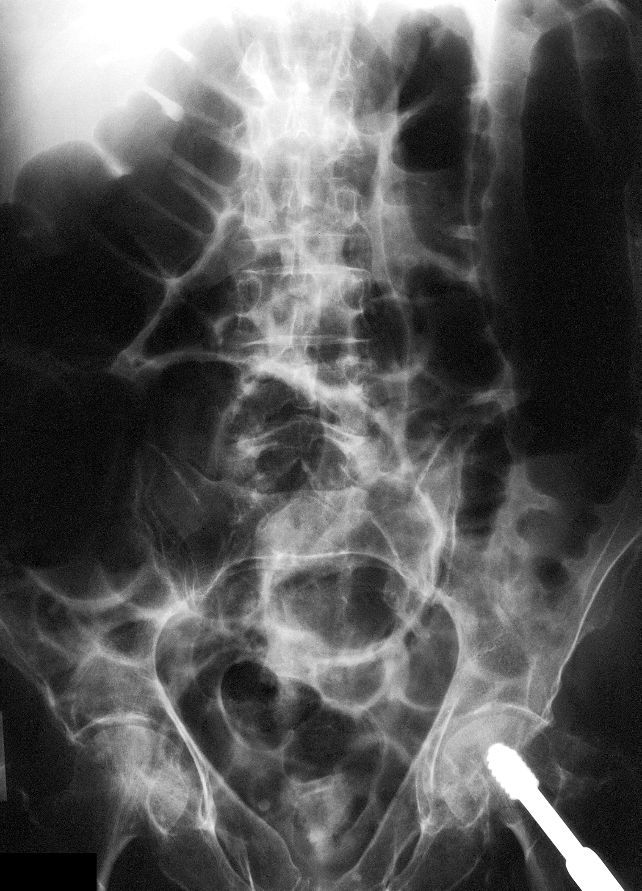
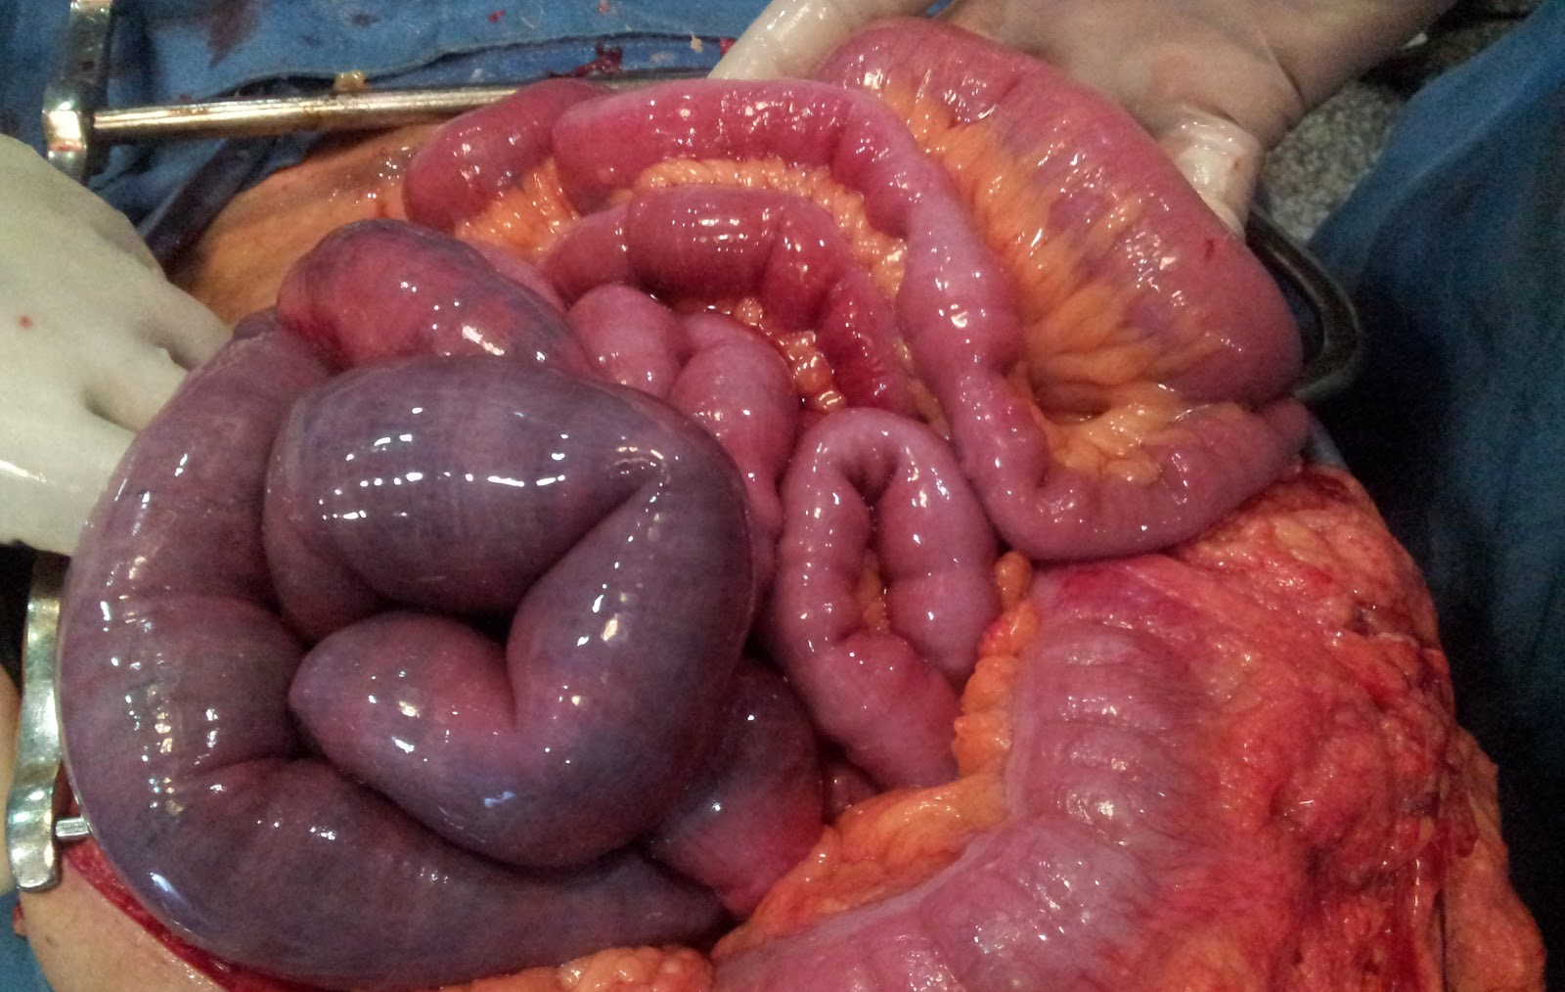
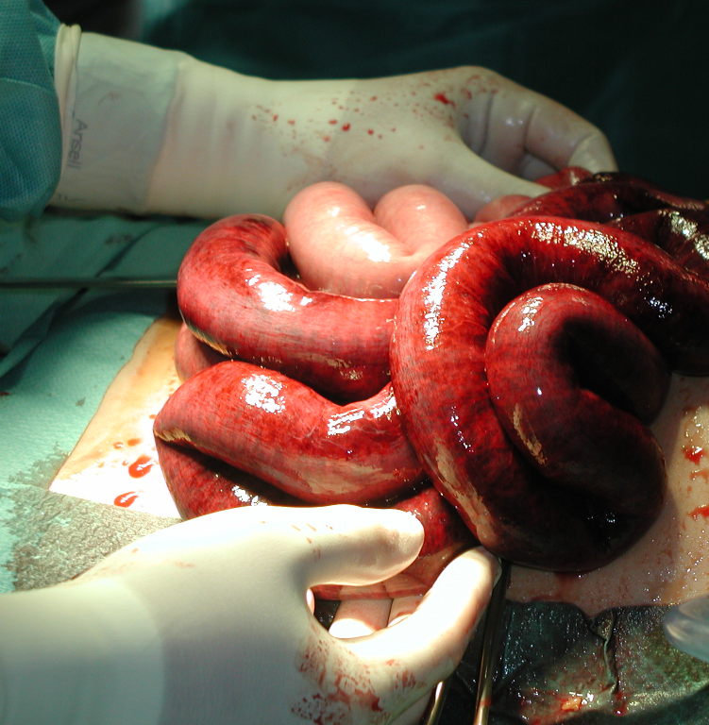
Paralytic ileus
Intra-abdominal inflammation
Drugs

Slide 77
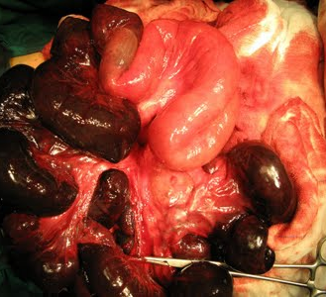
Small bowel internal herniation

Slide 78
Stomal obstruction
Stomal obstruction (due to local edema)
Causes of edema:
Electrolyte imbalance
Incomplete hemostasis
Hypoproteinemia
Leakage from anastomosis
Inadequate proximal decompression
Incorporation of too much tissue w/in the suture

Slide 79
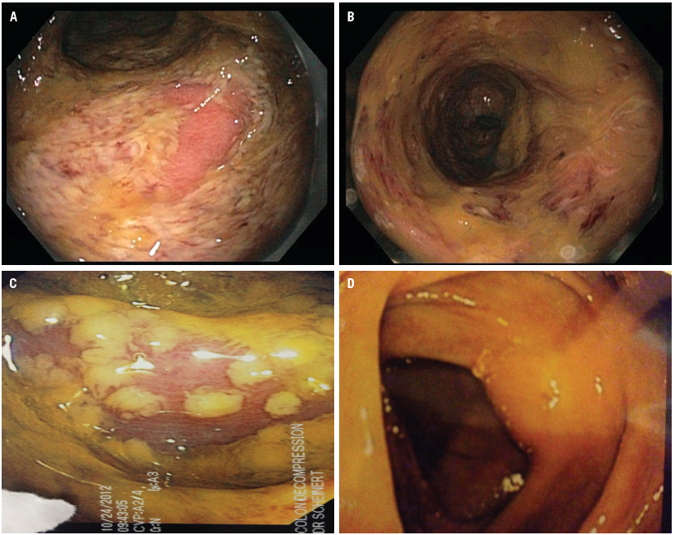
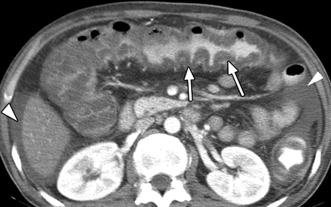
Clostridium Difficile Colitis

Slide 80
Anastomotic Leak
Fistula
Gastric and duodenal fistula:
Subtotal gastrectomy gastrojejunal and duodenal stump
Due to suture line failure
Bowel
Peritoneal abscess
Peritonitis
Sepsis
Etiologic factor:
Poor surgical technique
Distal obstruction
Inadequate proximal decompression
Can manifest as localized or generalized peritonitis

Slide 81
Fistula
Abnormal communication between two lining epithelium
Etiology:
Anastomotic leak
Poor blood supply
Trauma
Infection
Inadvertent suturing of bowel wall while closing the fascia
Carcinoma
Treatment:
Small leaks:
Conservative w/ NPO
Proximal decompression
Antibiotic
Large leaks:
Surgical intervention

Slide 82
Fistula
Gastric and duodenal fistula:
Treatment:
NPO / TPN
Place NGT past the leak and give elemental diet
Antibiotic
Majority close spontaneously w/in 6 wks.
Failure to close
distal obstruction
large leak
Infection
Cancer
Surgery – resect the fistula and the bowel segment then re-anastomosis
Small bowel fistula:
Drainage is less compared to duodenal fistula, but jejunal fistula have a poorer prognosis than ileal fistula

Slide 83
Fistula
Small bowel fistula:
Treatment:
Supportive:
correct fluid & electrolyte imbalance
Give proper nutrition
Proximal jejunal fistula: - Distal feeding jejunostomy
Distal ileal fistula: - low residue diet
Control diarrhea ----> lomotil / protect the skin
Colonic fistula:
Fluid & electrolyte imbalance less common but has higher infection can lead to peritonitis, peritoneal abscess and wound infection.
Skin digestion and irrigation are rare

Slide 84
Fistula
Colonic fistula:
Treatment:
Nutrition (low residue or elemental diet)
Antibiotics
Spontaneous healing of fistula is the rule rather than the exception
Medical management is generally indicated for 6 wks. to permit active inflammation to subside ---> fails ----> surgery
Defunctionalizing colostomies for descending colon
Ileal transverse colostomies for ascending and distal ileal fistulas
If w/ generalized peritonitis do emergency resection

Slide 85
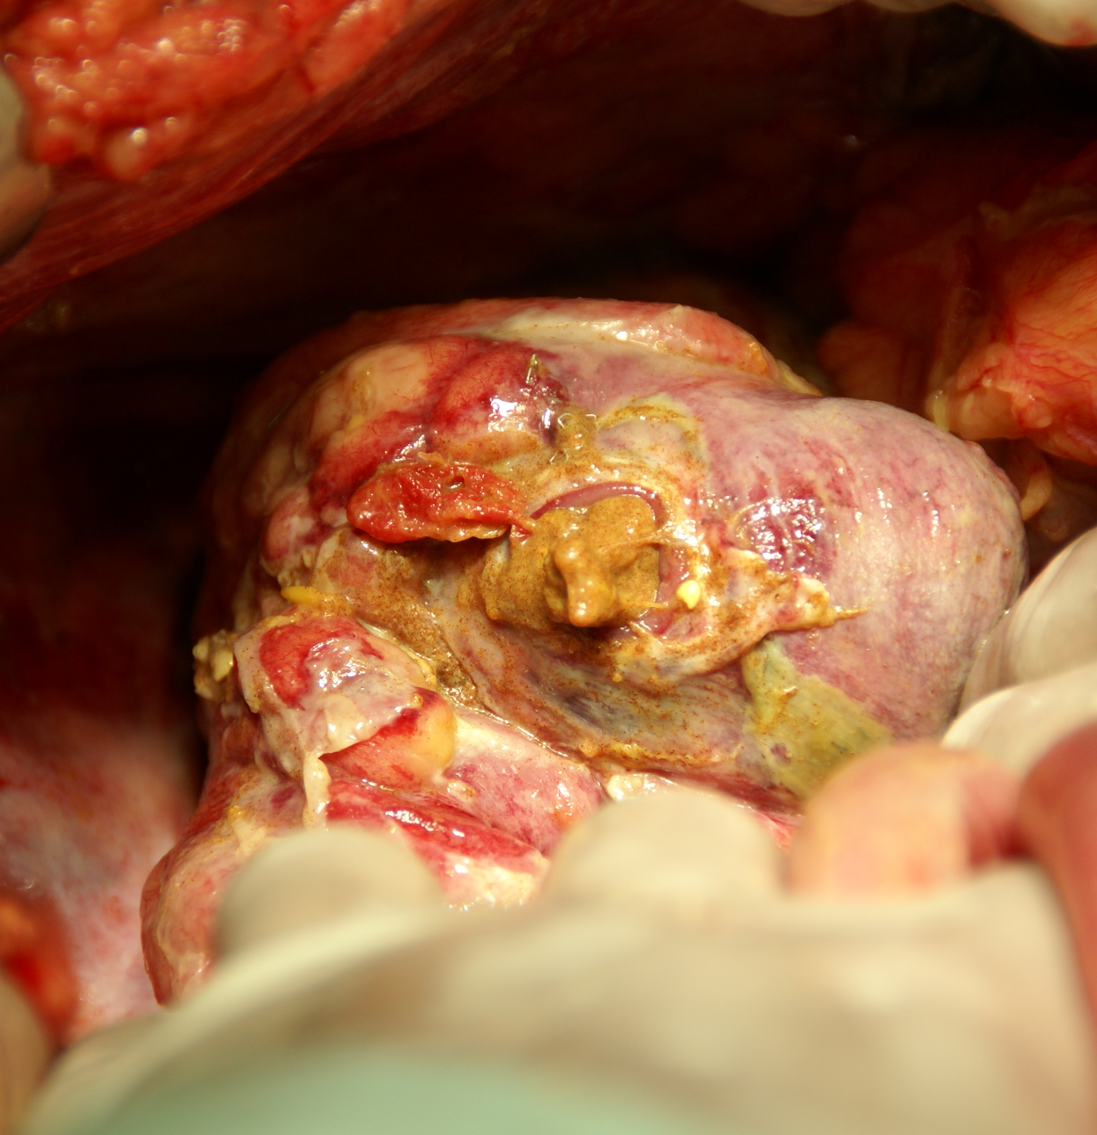
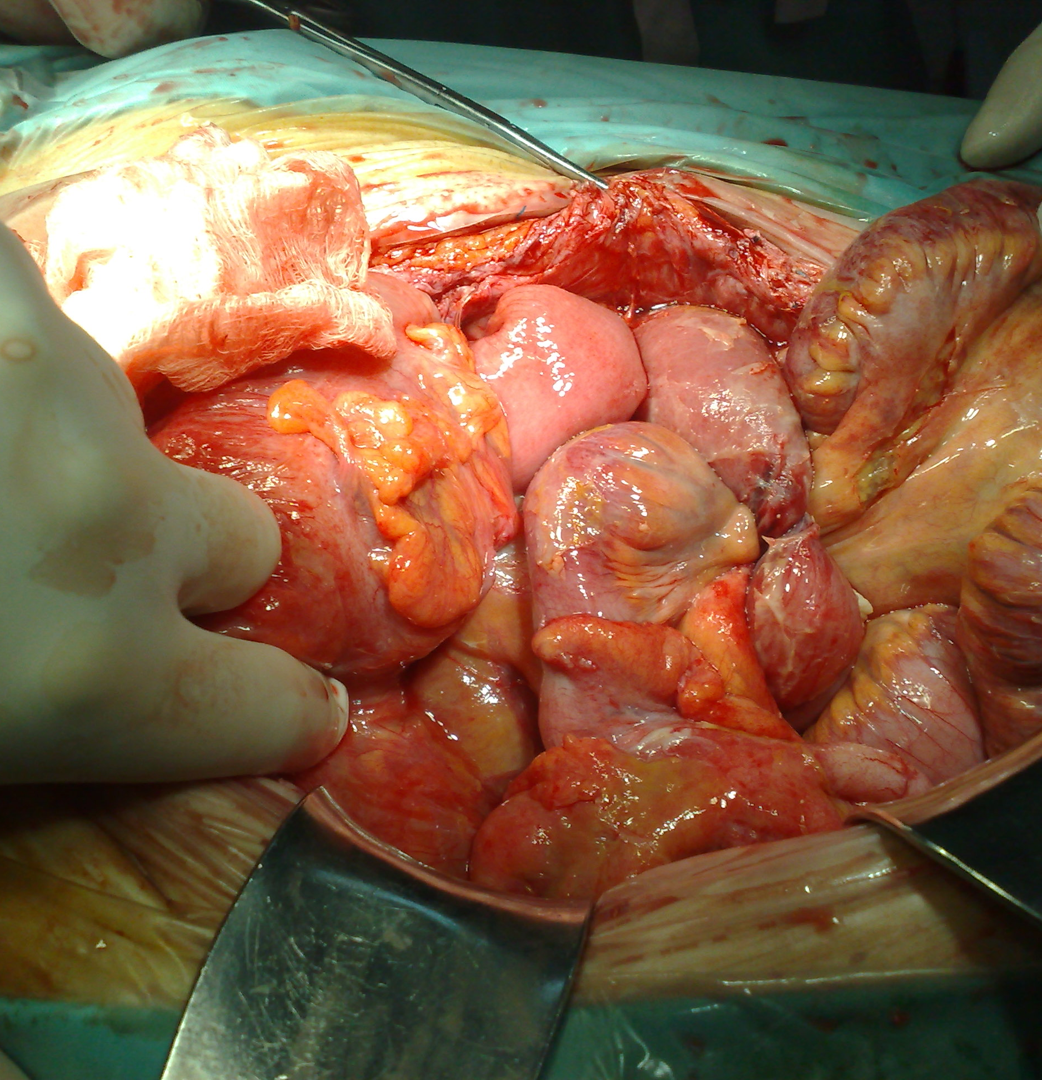
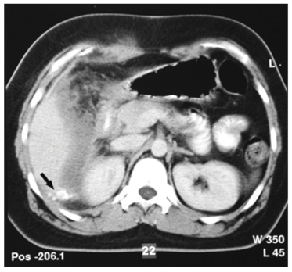
Peritoneal abscess and peritonitis

Slide 86
Late complications
Wound
Hypertrophic scar, keloid, wound sinus.
Adhesions
Strangulation, intestinal obstruction

Slide 87
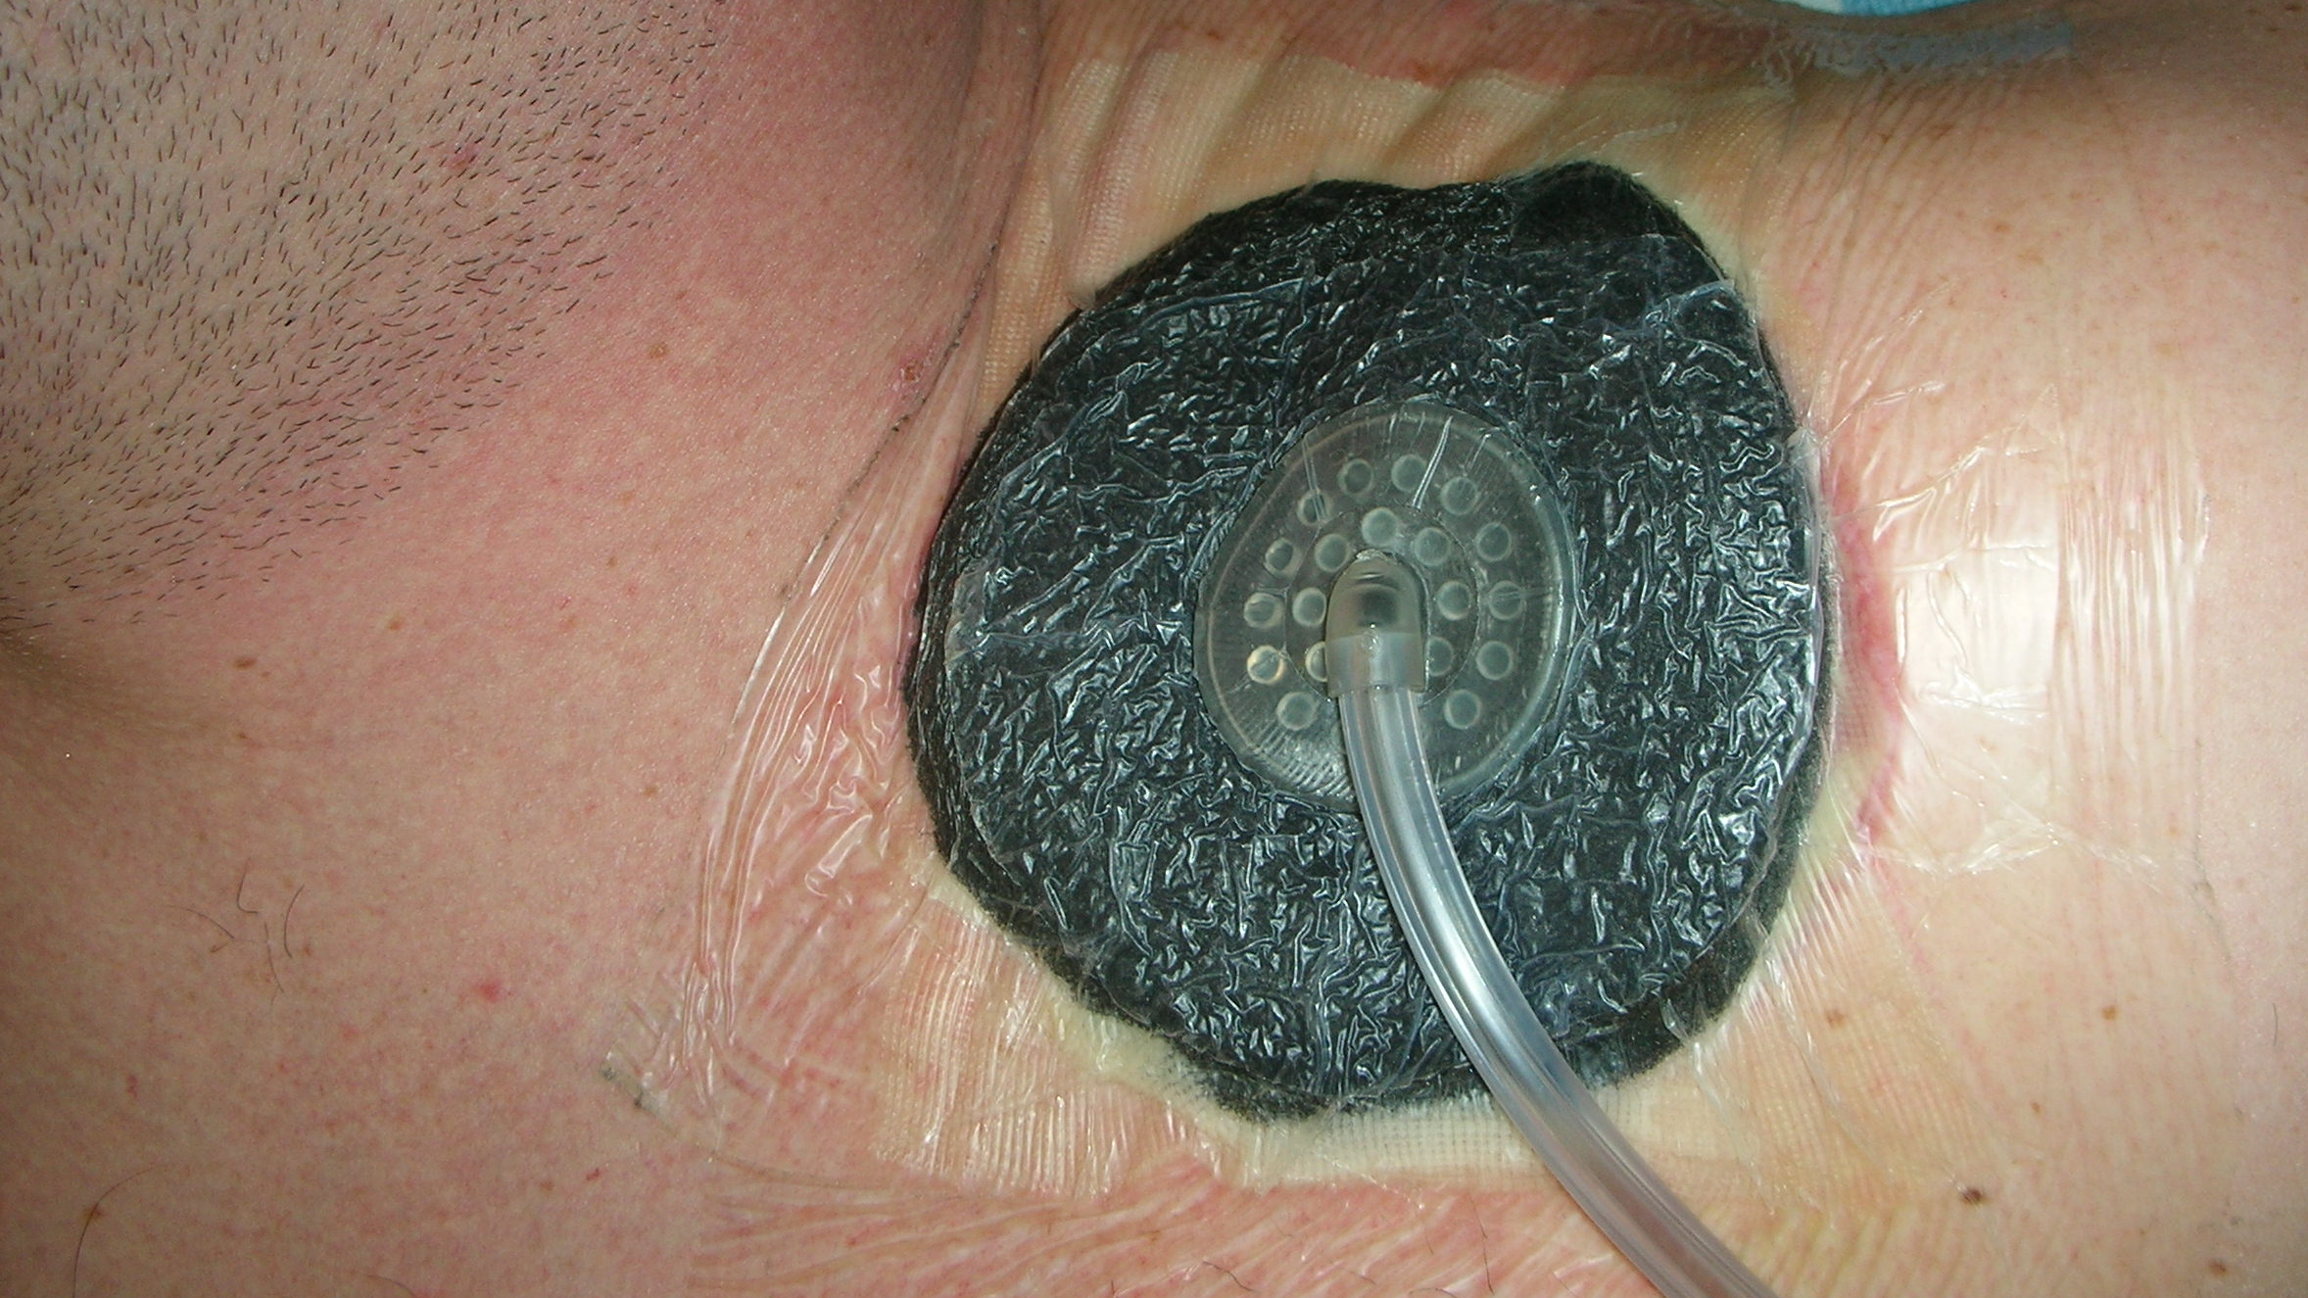
Wound

Slide 88
Wound complications
Types
Attributed to
Type of operation
Clean
Clean contaminated
Contaminated
Infected
Emergent versus elective
Patients general health
Surgical technique
Wound infection
Postoperative distension
Site of the incision

Slide 89
Wound complications
Hematoma and seromas
Predisposes to infection and delays wound healing
Attribute to
Inadequate hemostasis
Anticoagulants
Intraoperative anticoagulation
Lack of obliteration of dead space
Infection
Usually occurs 5-7days after surgery
Contributing factors:
Longer duration of operation
Age
Poor surgical technique
Measure of ‘good house keeping’ in clean wound
Erythema to pus collection
Primary or secondary
Wound dehiscence
Raised intra-abdominal pressure
Weakness of wound
Partial or complete

Slide 90
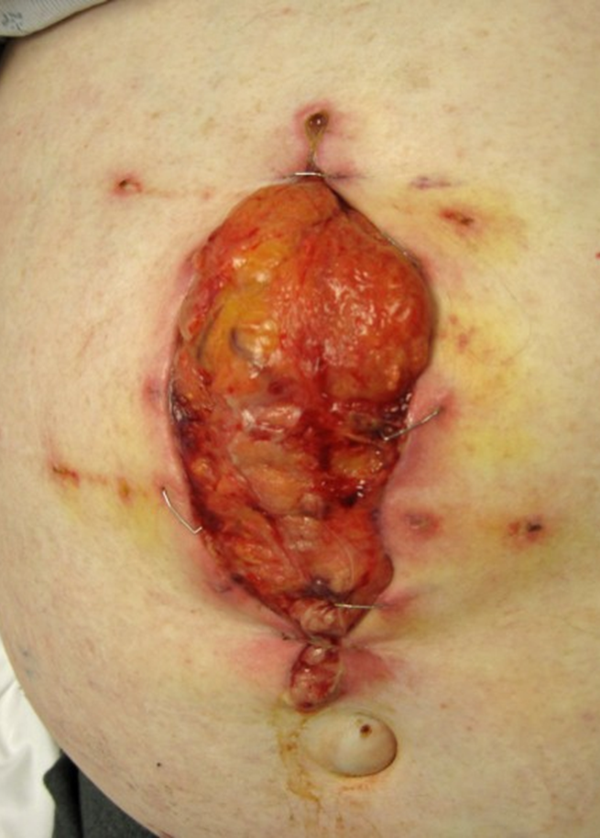
Wound dehiscence
Type
Partial
Complete
Timing
Early
Late
Contributing fx
Malnutrition
Sepsis
Anemia
Steroid therapy
Uremia
Diabetes
Liver failure
Leads to
Incisional hernia

Slide 91
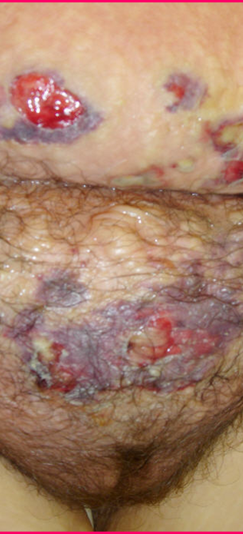
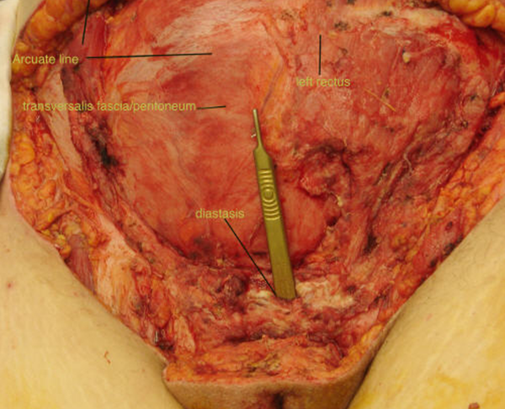
Necrotizing Fasciitis

Slide 92
Postoperative fever
Common problem
Physical exam is important in evaluating postoperative fever
Timing of fever

Slide 93
Postoperative fever
Pyrexia (fever) after operation may be caused by:
Metabolic response to trauma in the first 24hrs
Atelectasis
Alveolar infiltrates
Aspiration
Infection or hematoma of the wound
Laryngo-tracheitis from endotracheal intubation
Peritonitis or intra-abdominal abscess
Complications of blood transfusion: mismatched blood
Drug sensitivity
Injection abscess
Deep venous thrombosis and Pulmonary embolus
Thyroid storm
Malignant hyperthermia

Slide 94
Early postoperative fever
Respiratory
atelectasis
Systemic response to trauma of surgery

Slide 95
Postoperative fever (1-3 days)
Urinary tract infection
IV sites
Phlebitis
Infection

Slide 96
Postoperative fever (after 5 days)
Wound infection
Respiratory tract infection
Abscess
Wound
Intra-abdominal
Urinary tract infection

Slide 97
Common Causes of Elevated Temperature in Surgical Patients
Hyperthermia: temperature greater than 37.5–38.3 °C. as methods for thermoregulation are not as effective. therefore, the body is absorbing more heat than it is dissipating, also known as overheating of the body
Hyperpyrexia: a fever with an extreme elevation of body temperature greater than or equal to 41.5 °C. Fever/pyrexia is body temperature that is high as a result of bacterial or viral infections
Environmental
Malignant hyperthermia
Neuroleptic malignant syndrome
Thyrotoxicosis
Pheochromocytomatous
Carcinoid syndrome
Iatrogenic
Central/hypothalamic responses
Pulmonary embolism
Adrenal insufficiency
Sepsis
Infection
Drug reaction
Transfusion reaction
Collagen disorders
Factitious syndrome
Neoplastic disorders

Slide 98
Postoperative Care
Pain Control
Pain affects blood pressure, vital signs
Narcotics affect respiration
Pain control is a chemical balance
Challenges in pain control
Surgical procedure, duration
History of prior medication use
Age, co-morbidities
Experience with pain

Slide 99
Complications: Who Knows better ??
What operation did the patient have?
What are the most common complications of this operation?
What is most life-threatening?
What comorbidities does that particular patient have?

Slide 100
Complications: Who Knows better ??
Each surgical procedure has its own set of inherent complications
Surgeon treating the patient usually has the best idea as to what is happening

Slide 101
Common Post Operative Complication
post Major Surgery
Post Operative Pain
Bleeding : Hypovolemia
Hypoxia : Hypoventilation
Hemodynamic Unstable
Fluid & Electrolyte imbalance
Wound Complication
Hematoma, infection
Dehiscent, Keloid
Post Operative infection : wound (Site of Operation)
Post Operative Renal Failure
Liver Failure
Hematological disorder: Coagulopathy
Post Operation Sepsis : ARDS
Post Operative Respiratory Failure :
Atelectasis,
Pneumonia,
MOF
Hematoma, Seroma, Intraabdominal
CVS, arrhythmia, Hypovolemia
Contractility (MI)
Post Op Pulmonary edema, CHF

Slide 102
Surgical safety
The holistic idea of Hippocratic medicine
Only with careful attention to both the individuality of illness and the universality of disease etiology can physicians most effectively care for their patients
Mantri S. Holistic medicine and the Western medical tradition. Virtual Mentor 2008; 10(3):177-80.

Slide 103
Three central problems in Surgical safety
Unrecognized as a public health issue
Lack of data on surgery and outcomes
Failure to use existing safety know-how

Slide 104
Unrecognized as a public health issue
234 million operations are done globally each year Source: Weiser, Lancet 2008.

Slide 105
Unrecognized as a public health issue
Known surgical complications of 3-16%
Known death rates of 0,4-0,8%
At least 7 million disabling complications – including 1 million deaths – worldwide each year

Slide 106
Unrecognized as a public health issue (cont.)
Burden of surgical disease is increasing worldwide due to
Cardiovascular disease
Traumatic injuries
Cancer
Longer life expectancies

Slide 107
Lack of data on surgery and outcomes

Slide 108
Failure to use existing safety know-how
High rates of preventable surgical site infection result from inconsistent timing of antibiotic prophylaxis
Anesthetic complications are 100-1000x higher in countries that do not adhere to monitoring standards
Wrong-patient, wrong-site operations persist despite high publicity of such events

Slide 109
The Safe Surgery Saves Lives: Strategy
Promotion of surgical safety as a public health issue
Creation of a checklist to improve the standards of surgical safety
Collection of “Surgical Vital Statistics”

Slide 110
Surgical safety

Slide 111
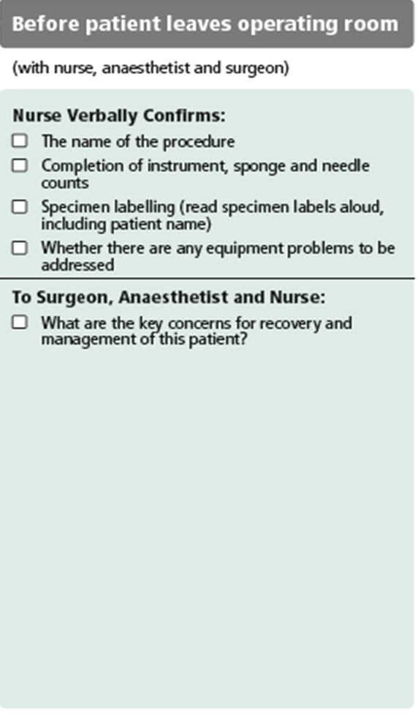
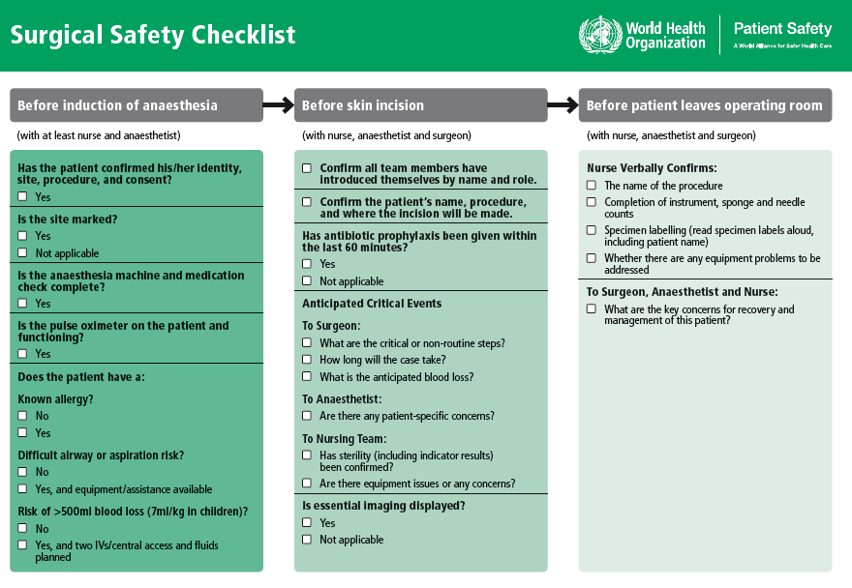
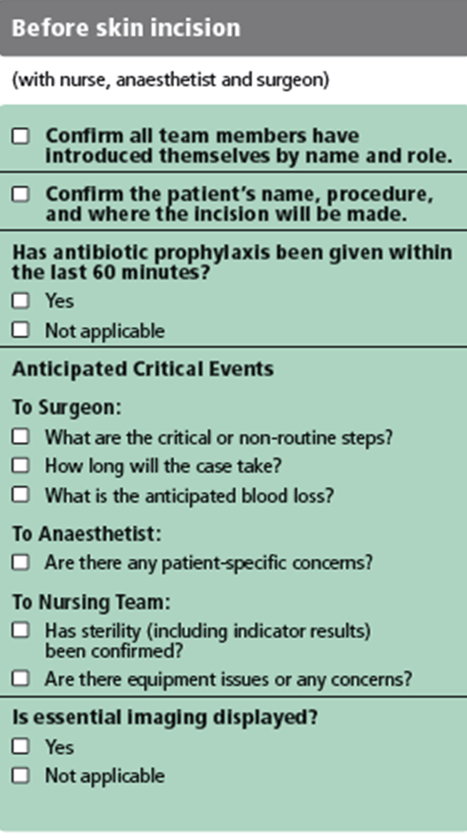
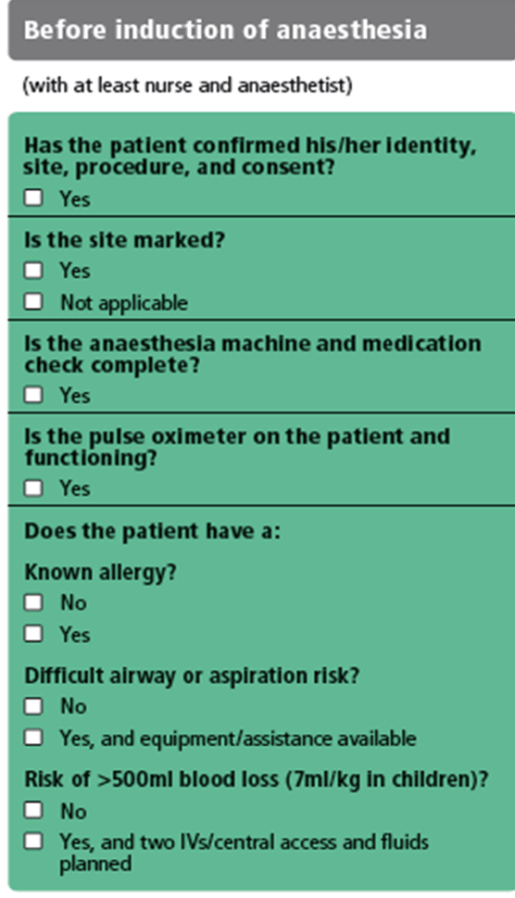
What is this tool that addresses the 10 objectives?
The team will operate on the correct patient at the correct site.
The team will use methods known to prevent harm from administration of anesthetics, while protecting the patient from pain.
The team will recognize and effectively prepare for life-threatening loss of airway or respiratory function.
The team will recognize and effectively prepare for risk of high blood loss.
The team will avoid inducing an allergic or adverse drug reaction for which the patient is known to be at significant risk.
The team will consistently use methods known to minimize the risk for surgical site infection.
The team will prevent inadvertent retention of instruments or sponges in surgical wounds.
The team will secure and accurately identify all surgical specimens.
The team will effectively communicate and exchange critical information for the safe conduct of the operation.
Hospitals and public health systems will establish routine surveillance of surgical capacity, volume and results.

Slide 112
Reality Check
Currently, hospitals
do MOST of the right things,
on MOST patients,
MOST of the time.
The Checklist helps us
do ALL the right things,
on ALL patients,
ALL the time

Slide 113
Advantages of using a Checklist
Customizable to local setting and needs
Supported by evidence
Evaluated in diverse settings around the world
Promotes adherence to established safety practices
Minimal resources required to implement a far-reaching safety intervention

Slide 114
The Checklist was piloted in 8 cities…
PAHO I
EURO
EMRO
London, UK
Amman, Jordan
Toronto, Canada
WPRO I
Manila, Philippines
PAHO II
Seattle, USA
WPRO II
Auckland, NZ
AFRO
Ifakara, Tanzania
SEARO
New Delhi, India

Slide 115
...and was found to reduce the rate of postoperative complications and death by more than one third!
Haynes et al. Surgical Safety Checklist to Reduce Morbidity and Mortality in a Global Population. New England Journal of Medicine 360:491-9. (2009)

Slide 116
Change in Death and Complications by Income Classification
 | Change in Complications | Change in Death
High Income | 10.3% -> 7.1%* | .9% -> 0.6%
Low and Middle Income | 11.7% -> 6.8%* | 2.1% -> 1.0%*
Haynes et al.
A Surgical Safety Checklist to Reduce Morbidity and Mortality in a Global Population.
New England Journal of Medicine 360:491-9. (2009)
* p<0.05

Slide 117
Easy Math
234 million people are operated on each year, and >1 million of these individuals die from complications
At least ½ are avoidable with the Checklist
500,000 save lives on the line each year
+

Slide 118
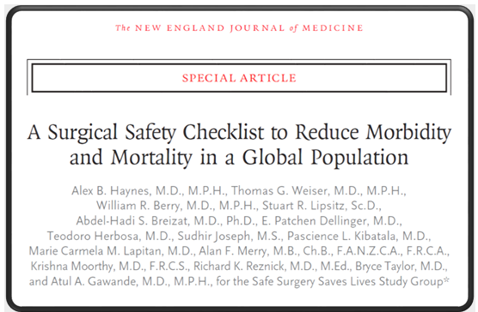
Results The rate of death was 1.5% before the checklist was introduced and declined to 0.8% afterward (P = 0.003). Inpatient complications occurred in 11.0% of patients at baseline and in 7.0% after introduction of the checklist (P<0.001).
ΥΠΕΡΑΞΙΑ
N Engl J Med 2009;360:491-9.

Slide 119
Τέτοια υπεραξία δίνουν
Οι υπο-ειδικότητες στην Χειρουργική και ειδικά
Η Χειρουργική ήπατος-παγκρέατος-χοληφόρων

Slide 123
The effect of surgical volume and the provision of residency and fellowship training on complications of major hepatic resection.
Hospitals supporting a surgical residency program had lower overall morbidity and mortality.
The mortality rate increased once greater than approximately 70 cases were performed per annum.
A fellowship program however was not associated with overall lower morbidity and mortality and appeared to result in a higher rate of certain complications.
Predicted mortality rate following major hepatectomy according to annual hospital volume, adjusted for Charlson comorbidity score.
Kohn GP, Nikfarjam M. J Gastrointest Surg. 2010 Dec;14(12):1981-9.

Slide 124
The volume-outcomes effect in hepato-pancreato-biliary surgery: hospital versus surgeon contributions and specificity of the relationship.
Nathan H, Cameron JL, Choti MA, Schulick RD, Pawlik TM. J Am Coll Surg. 2009 Apr;208(4):528-38

Slide 125
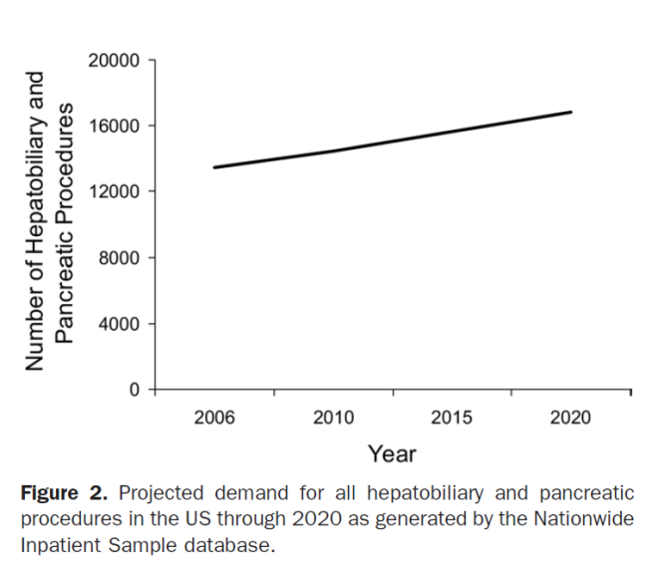
Scarborough JE et al. J Am Coll Surg. 2008 Apr;206(4):678-84
Workforce projections for hepato-pancreato-biliary surgery.
An estimated 16,800 HPB procedures will be performed in 2020, representing a 25% increase during the next 15 years.
28 fellowship-trained HPB subspecialists will enter the workforce each year.
If half of all HPB procedures are performed by HPB subspecialists in 2020, then the average subspecialist will perform only 14 such procedures that year.
If high volume HPB surgery is defined as 40 procedures per year, and 50% of HPB procedures are performed by high-volume surgeons in 2020,
then only 15 fellows need to be trained in HPB surgery each year to meet demand in 2020.

Slide 126
Workforce projections for hepato-pancreato-biliary surgery
Accordingly
15 x 30 (working life span of a HBP)=
450 HBP surgeons by 2020 year in USA
(350 millions)
means
1 HBP surgeon /777.777 USA citizens
For 12.000.000 Greek citizens by year 2020 we need ~ 16 HBP surgeons
in Greece
So we need to train 16/30= 0,5 HBP surgeon every year or
1 HBP surgeon /2 years

Slide 127
Sir William Osler
“The good physician treats the disease;
The great physician treats the patient who has the disease.”
If there was not bleeding everybody would do surgery
Sir William Osler
The father of Modern (Academic) Medicine

Slide 128
…What ever we do…
…is still the Surgeon that
makes the decisions
and takes the blame
for death and complications.

