Slide 1
EXOSOMES and CANCER
Stamatios Theocharis

Slide 2
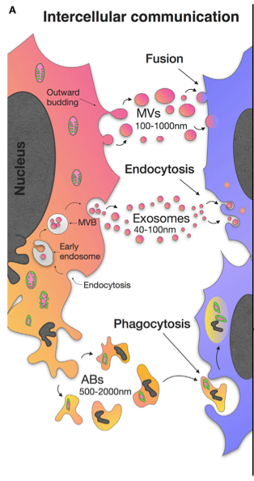
Chulpanova D, et al., Frontiers in Immunology 2018;9:1534

Slide 3
EXTRACELLULAR VESICLES (EV)
Exosomes
Microvesicles
Apoptotic bodies
*differ in terms of biogenesis and largely in terms of composition, but occasionally overlap in size

Slide 4
Microvesicles: 50-1000 nm in diameter (formed through direct outward blebbing of the plasma membrane)
Apoptotic bodies: 500-2000 nm in diameter (formed by the breakdown of recently deceased cells-contain nuclear fragments)
Exosomes: 40-120 nm in diameter (cell-secreted nanovesicles of endocytic origin)

Slide 5
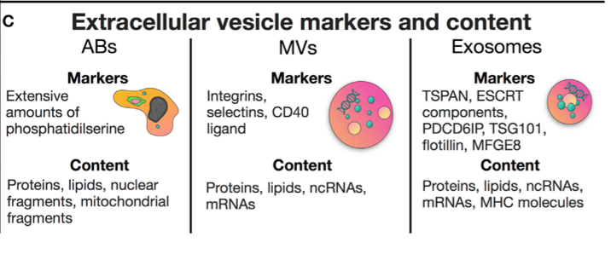
Chulpanova D, et al., Frontiers in Immunology 2018;9:1534

Slide 6
Exosomes benefits:
wide distribution throughout the human body fluids
poor immunogenicity and less toxicity
no mutagenicity as opposed to nanoparticle-based drug delivery systems
ability to transport a variety of substrates across the blood brain barrier and deliver them to cell's lipid bilayer membrane
presence of ligands and peptides on their surface, which enhance their ability to target specific recipient cells

Slide 7
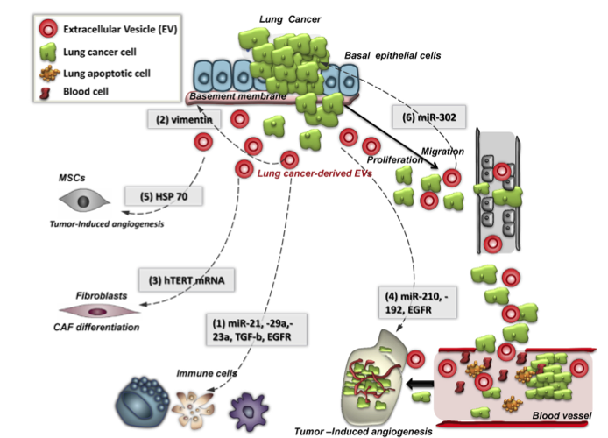
Masaoutis C, et al. Biochimie 151 (2018) 27e36

Slide 8
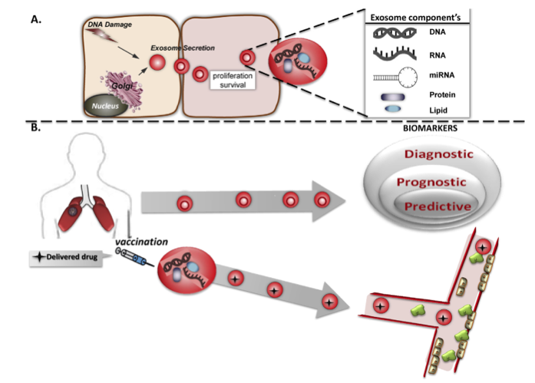
C. Masaoutis et al. / Biochimie 151 (2018) 27e36

Slide 9
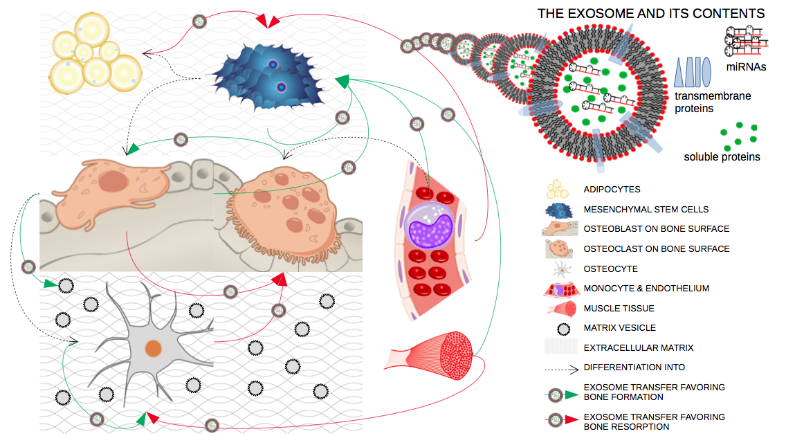
Exosomes in Bone Remodeling
Masaoutis and Theocharis. Dis Markers (2019)

Slide 10
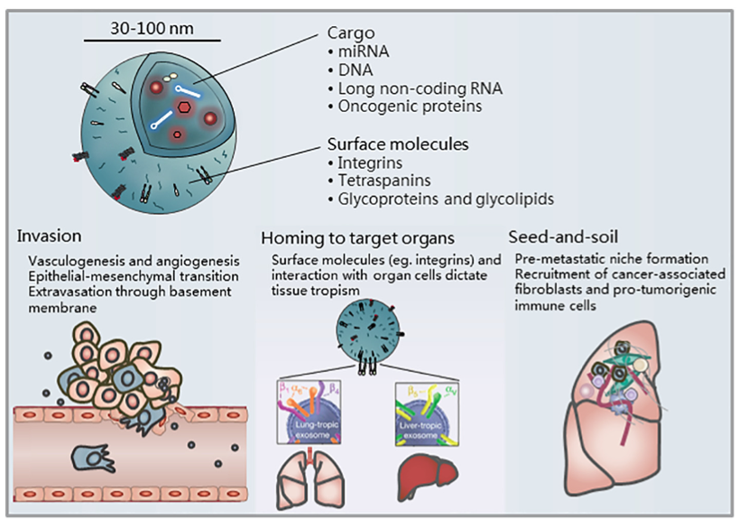
Wee I, et al., BBA - Reviews on Cancer 2019; 1871:12–19

Slide 11
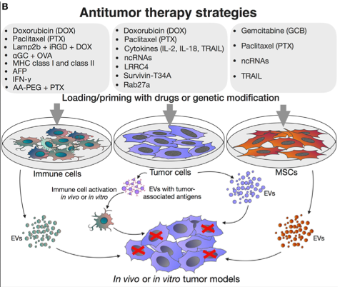
Chulpanova D, et al., Frontiers in Immunology 2018;9:1534

Slide 12
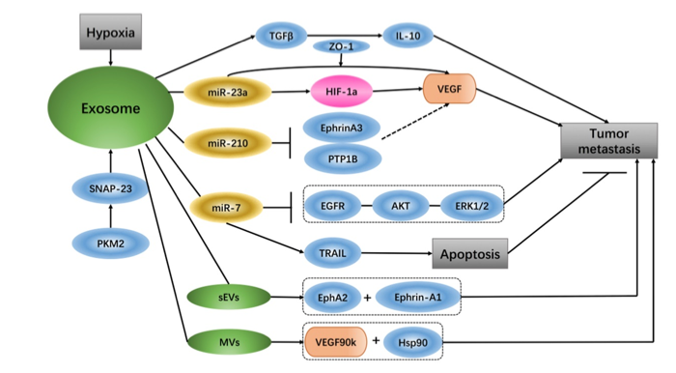
Hu C, et al., Journal of Cancer 2018; 9:3084-3092

Slide 13
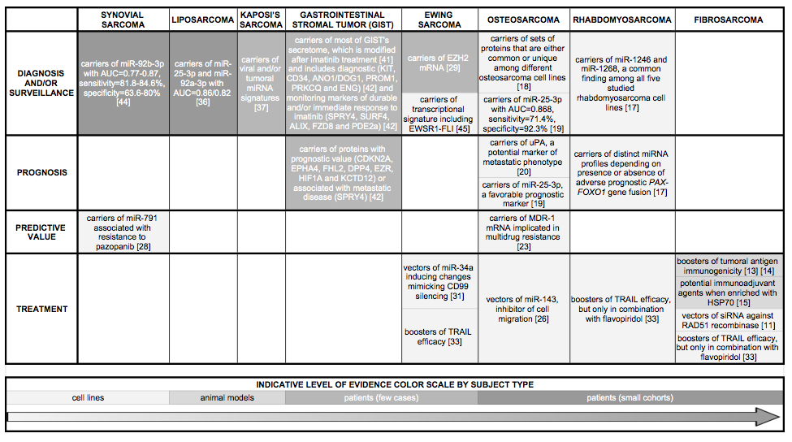
Exosomes and Sarcoma
Masaoutis C, et al. Cancer Letters (2019)

Slide 14
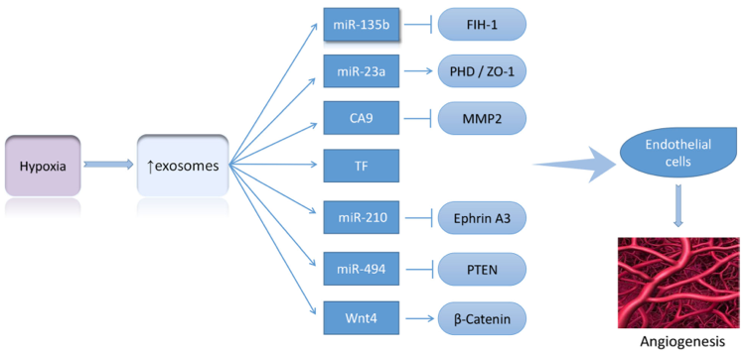
Shao et al. Molecular Cancer (2018) 17:120

Slide 15
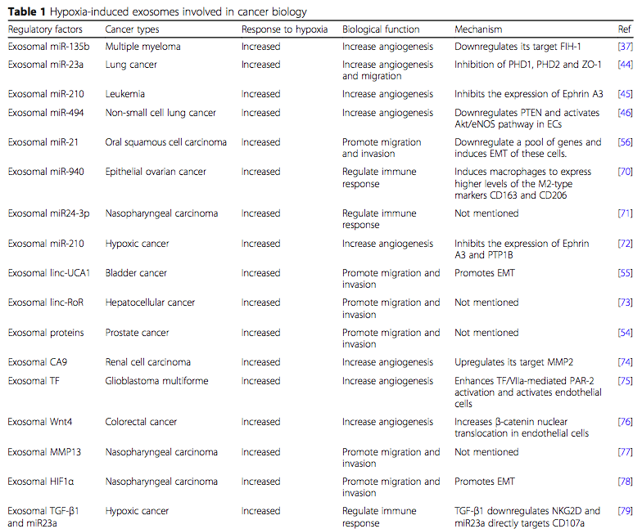
Shao et al. Molecular Cancer (2018) 17:120

Slide 16
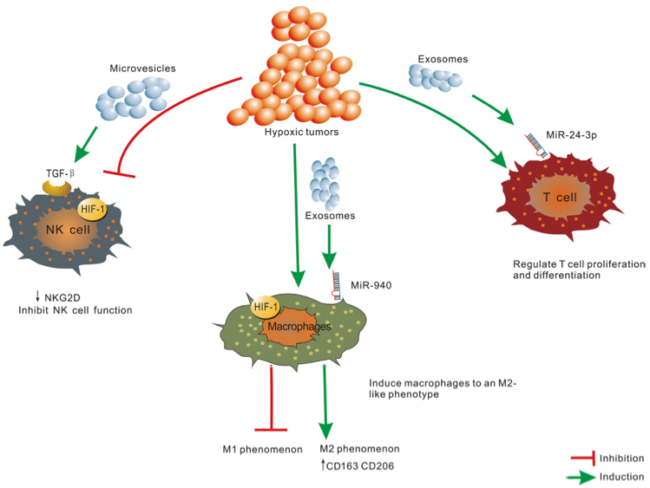
Shao et al. Molecular Cancer (2018) 17:120

Slide 17
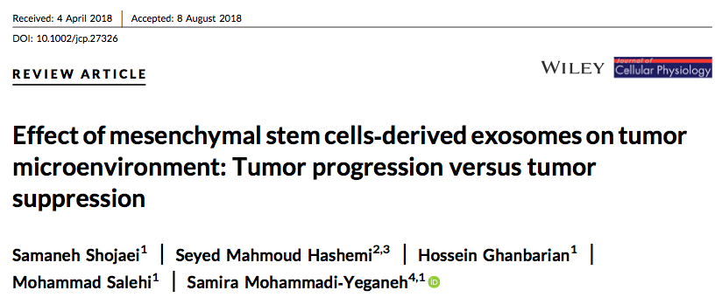

Slide 18
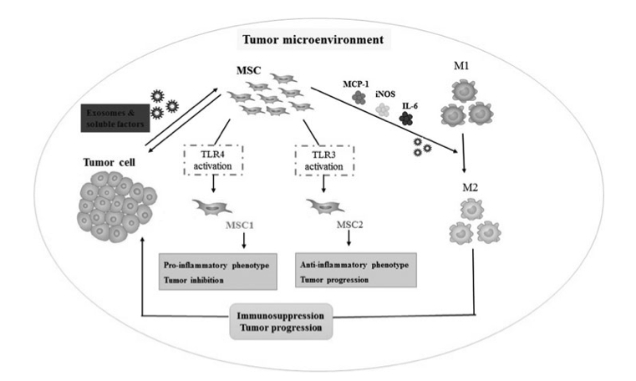
Shojaei S, et al., J Cell Physiol. 2018;1–16.

Slide 19
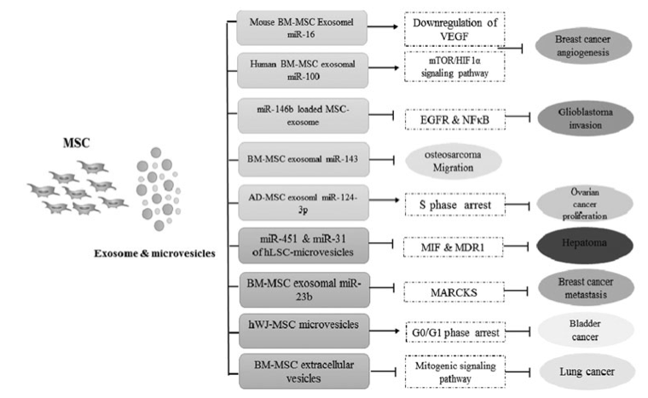
Shojaei S, et al., J Cell Physiol. 2018;1–16.

Slide 20
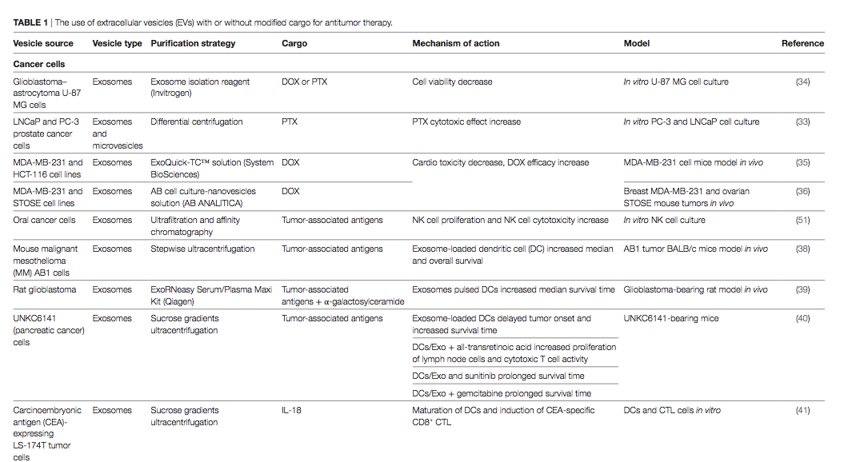
Chulpanova D, et al., Frontiers in Immunology 2018;9:1534

Slide 21
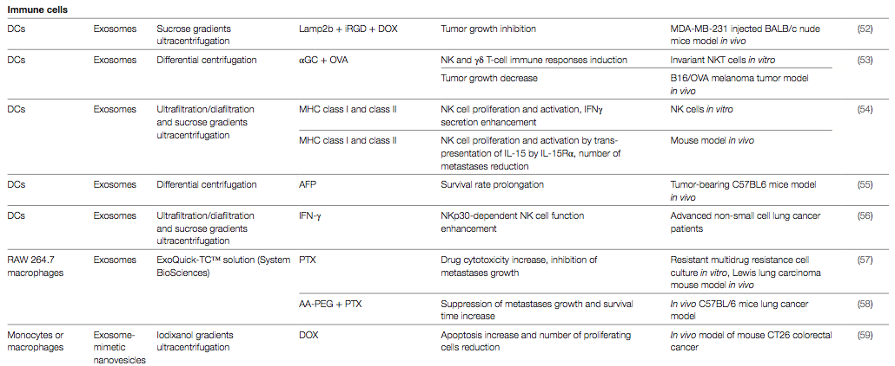
Chulpanova D, et al., Frontiers in Immunology 2018;9:1534

Slide 22
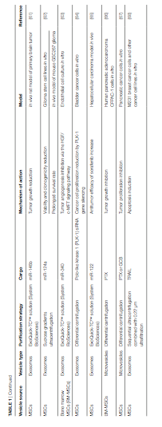
Chulpanova D, et al., Frontiers in Immunology 2018;9:1534

Slide 23
FUTURE RESEARCH
Exosomes and Different Cancer Types
Exosomes is remission
Exosomes and drug resistance
Exosomes originated from different cells of tumor microenvironment

