Slide 1
Synovial Sarcoma
Pathologic diagnosis
P. Korkolopoulou,
First Dept of Pathology, Athens University School of Medicine

Slide 2
Synovial Sarcoma (SS)
Malignant mesenchymal spindle cell neoplasm with variable epithelial differentiation, including gland formation, and characterized by SS18::SSX1/SSX2/SSX4 [t(x;18)(p11;q11)] fusion in most cases. Despite its name, tumor does not arise from or differentiate towards synovium
Definition:
Considered a tumor of uncertain histogenesis in WHO 2020 classification
Histologic subtypes: monophasic, biphasic, poorly differentiated
Chromosome 18
Chromosome X
SSX1
Biphasic (2/3) or monophasic (1/3) histology
SS18
SSX2
Monophasic histology
SS18::SSX fusion extremely useful for the differential diagnosis of SS
WHO Soft Tissue and Bone Tumors 2020
Diagnostic Pathology Soft tissue Tumors 2024

Slide 3
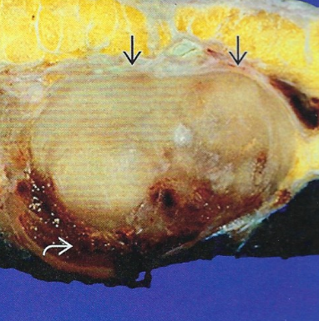
SS - Clinical Issues
Macroscopic Features
Cystic change not uncommon
Calcification and/or ossification may be seen
Usually 3-10 cm, can be minute (<1cm) or large (>15cm)
Epidemiology:
Wide range but most common in young adults
Site:
Most arise in deep soft tissues of extremites, mostly
near joints (particularly knee)
Head and neck (parapharynx, oral cavity, tonsil)
Trunk (rarely in abdominal wall or perineum)
Rare subsets
Viscera (kidney, pleura, lung,prostate CNS, bone, GI, male and female genital tracts, other organs)
Retroperitoneum, mediastinum
Intraneural
Very rare superficial tumors ( Li 2021, Alexia – Landa 2018)
Nodular circumscribed mass located in skeletal muscle beneath the fascia
Diagnostic Pathology Soft tissue Tumors 2024

Slide 4
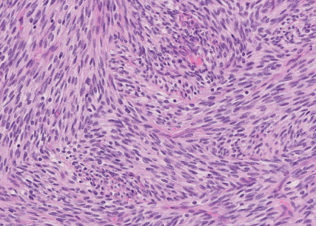
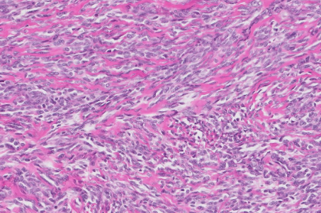
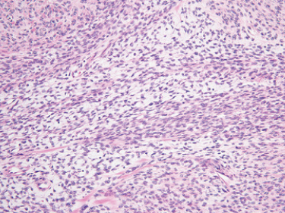
Microscopic features
Monophasic SS (I)
Dense cellular sheets or vague fascicles of uniform spindle cells with scanty cytoplasm
Relatively uniform, ovoid, bland nuclei, often overlapping. Lack significant pleomorphism
Highly variable mitotic rate (from sparse to numerous)
Rare herringbone or focal palisaded growth patterns
Variable collagenous stroma, often inconspicuous
Thickened bundles of “wiry” collagen can be seen
Myxoid stromal changes in some tumors
Extensive stromal fibrosis and associated hypocellularity common in irradiated tumors
Fascicles of spindle cells
Wiry Collagen
Alternating hypercellular and hypocellular areas
Diagnostic Pathology Soft tissue Tumors 2024
WHO, Soft tissue and bone 2020
Practical Soft Tissue Pathology: A Diagnostic Approach 2019

Slide 5
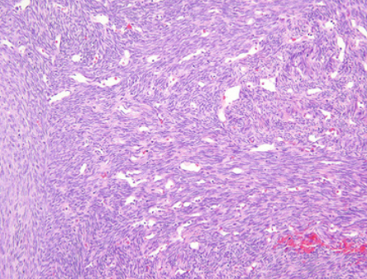
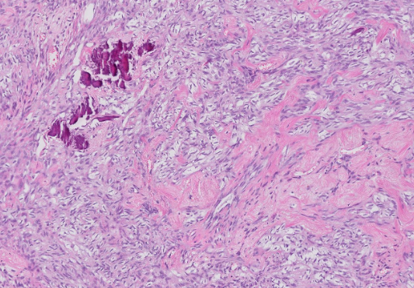
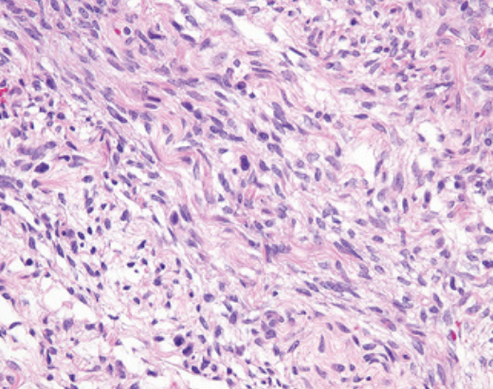
Microscopic features
Monophasic SS (II)
Stromal calcification identified in 30% of cases
Helpful diagnostic clue
May also show metaplastic bone or osteoid formation
Stromal vasculature can be prominent
Focally “staghorn” or hemangiopericytoma-like vessels
Mast cells common (may be prominent in some tumors)
Necrosis uncommon
Tumors arising within peripheral nerve often strikingly multinodular
Hemangiopericytoma-like vessels
*
*
Diagnostic Pathology Soft tissue Tumors 2024
WHO, Soft tissue and bone 2020
Practical Soft Tissue Pathology: A Diagnostic Approach 2019
*
Calcification
Hypocellular area with scattered mast cells (*)

Slide 6
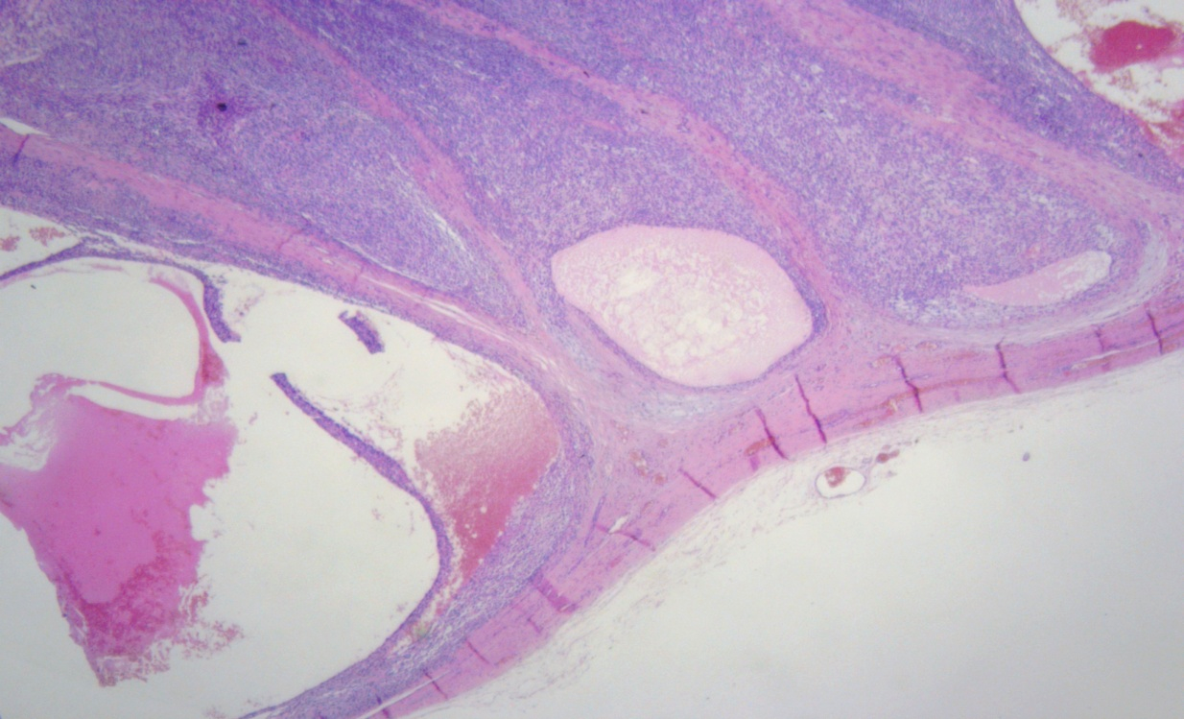
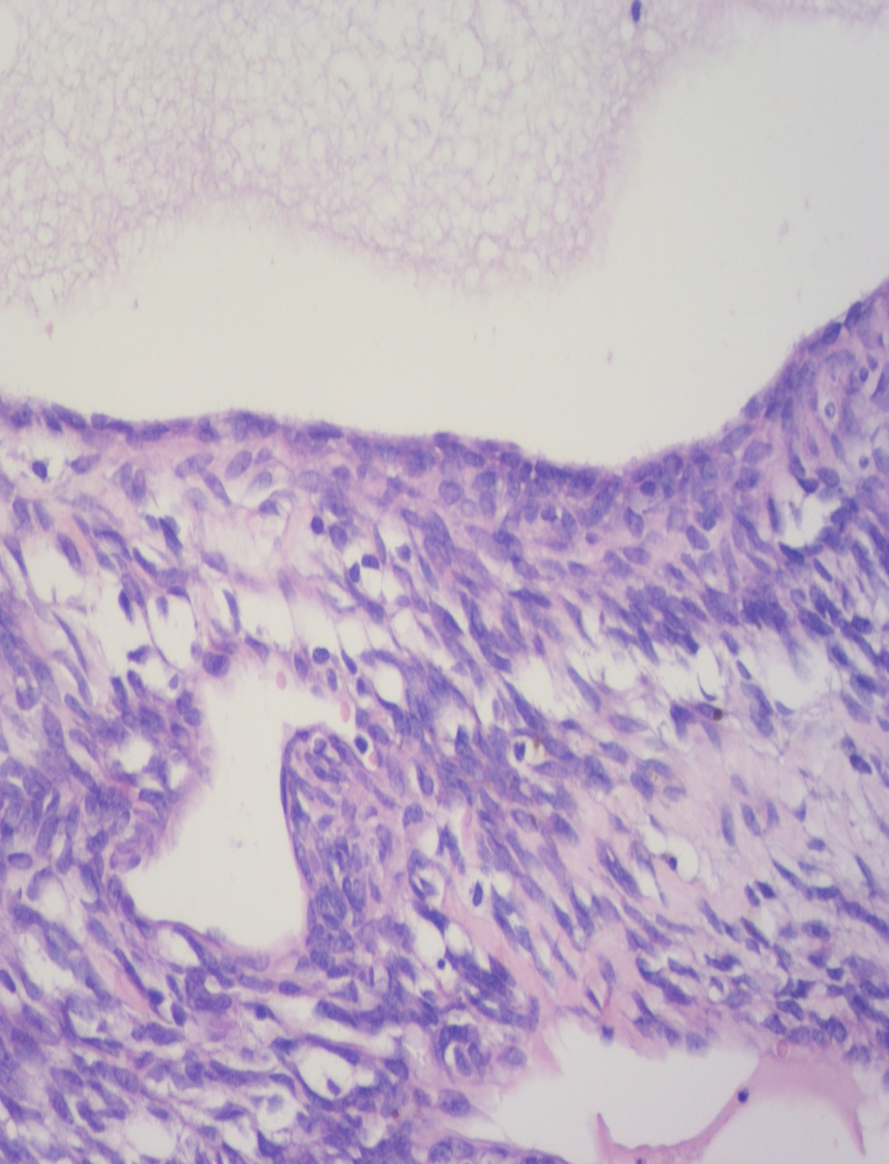
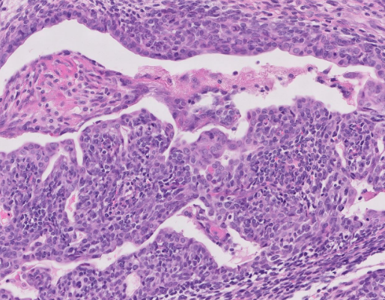
Microscopic features
Biphasic SS
Contains same spindle cell population as monophasic SS (at least focally)
Additionally features epithelial structures
Can be focal/subtle or extensive/prominent
Glands (well or poorly formed), ducts, nests, and cords
Rare: Squamous differentiation, granular cell change
Extensively cystic biphasic SS
P. Korkolopoulou Personal Archives
Spindle cell and epithelial elements
Diagnostic Pathology Soft tissue Tumors 2024
WHO, Soft tissue and bone 2020

Slide 7
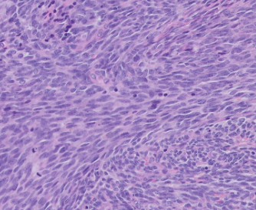
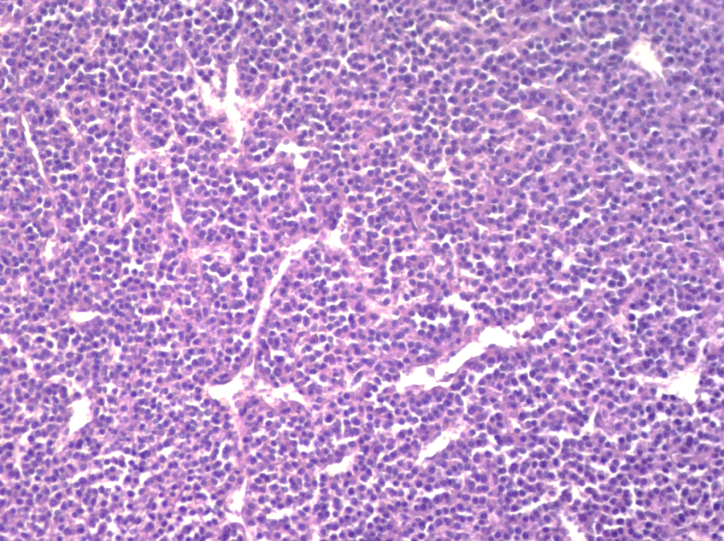
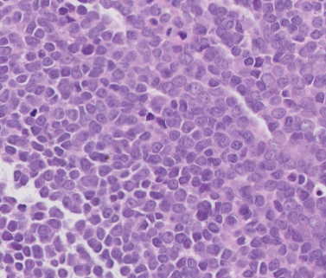
Microscopic features
Poorly differentiated histology
Can be seen within monophasic or biphasic SS
May be focal or extensive
Characterized by hypercellularity, high-grade nuclear features, and increased mitoses
Nuclei often show irregular contours and “chunky” chromatin or prominent nucleoi
Spindle cell pattern can be highly fascicular (fibrosarcoma-like)
Round cell pattern resembles Ewing sarcoma
Necrosis more common
Highly cellular spindle cell tumor (Fibrosarcoma –like)
Stromal vasculature hemangiopericytoma-like
Diagnostic Pathology Soft tissue Tumors 2024
WHO, Soft tissue and bone 2020
Small round cell histology

Slide 8
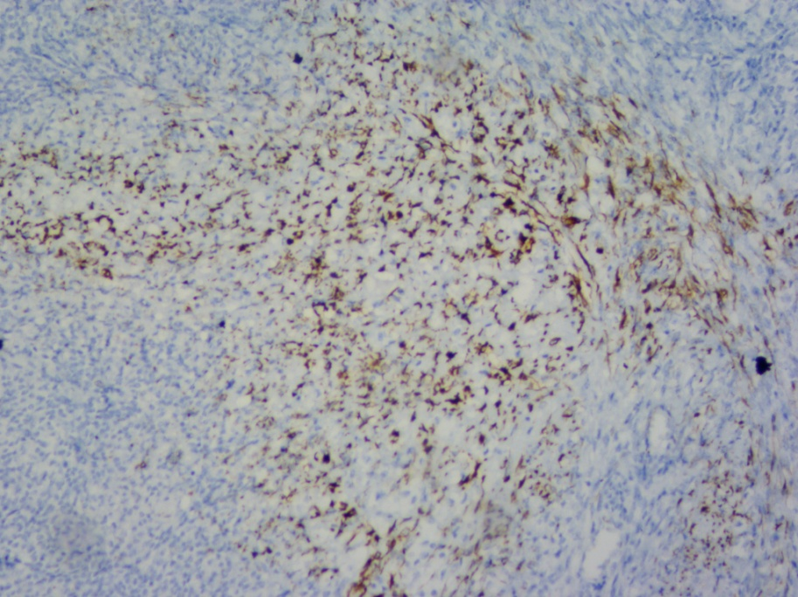
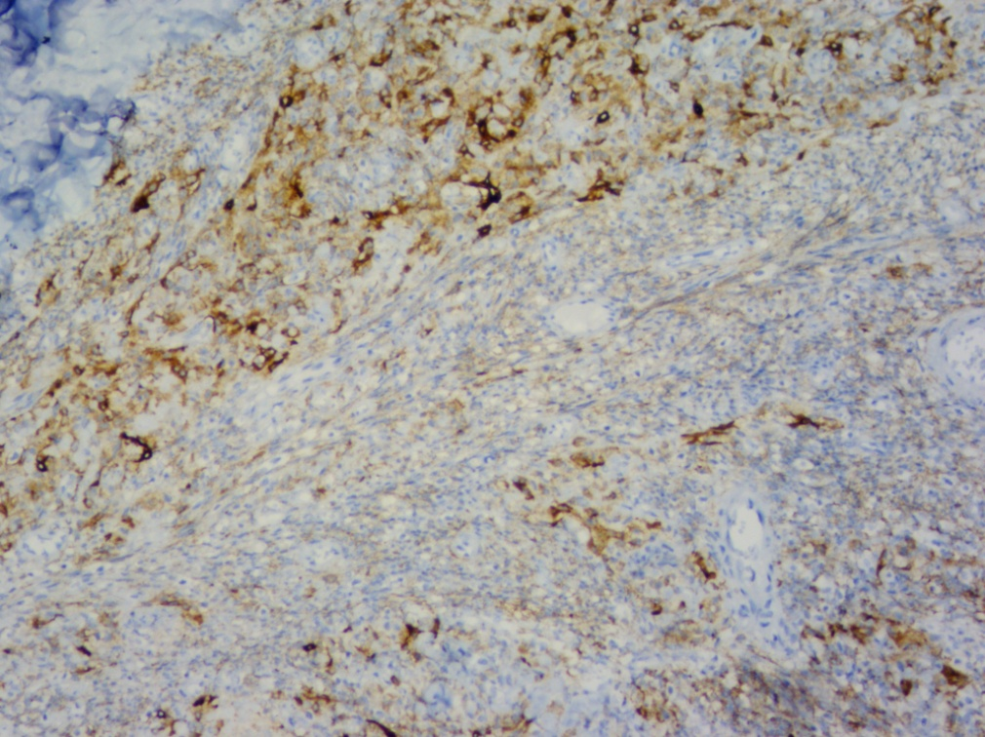
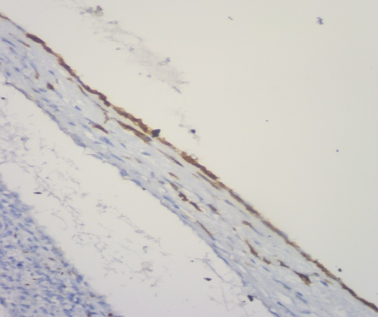
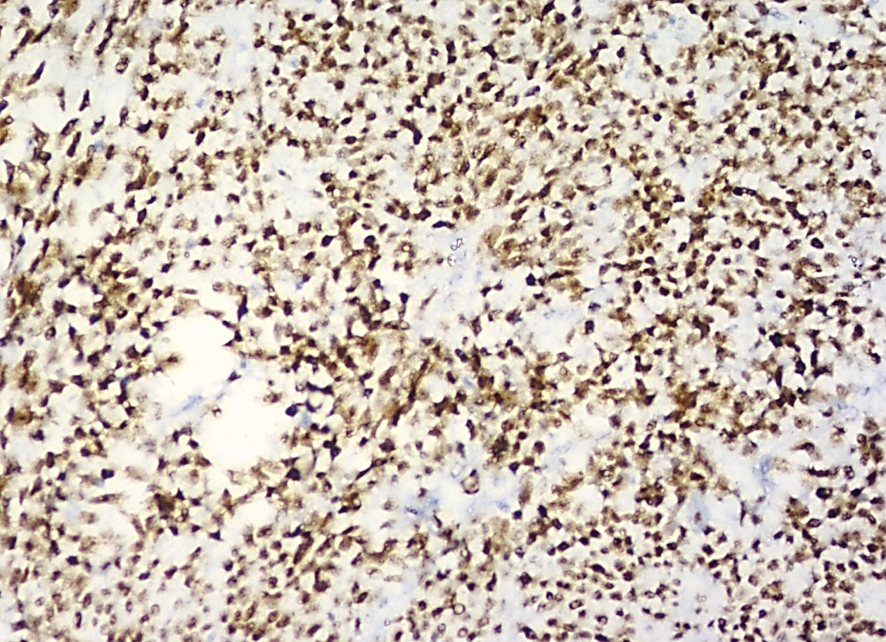
Ancillary Tests
Immunohistochemistry:
Keratin and EMA (+)
Characteristic focal/patchy expression in spindle cells
Strong expression in epithelial components (biphasic SS)
Strong, diffuse TLE1(+) [sensitivity 94%, specificity 81%, negative predictive value 96%]
Focal or weak expression is nonspecific
Caveat: Variable TLE1 expression can also be seen in histologic mimics of SS, such as solitary fibrous tumor, MPNST, and biphenotypic sinonasal sarcoma
TLE-1 also expressed in mesotheliomas nad carcinomas
Newer IHC: Antibodies against SS18-SSX and SSX ( C-terminus)
Together, highly sensitive and specific for SS
Focal S100(+) and/or SOX10(+) in up to 40% of cases
CD56 and CD99 (+); variable calretinin (+)
CD34, SMA, desmin, myogenin, PAX3, synaptophysin, TTF-1, and NKX2.2 (-)
Retention of nuclear H3K27me3 in most cases
EMA
CK7
P. Korkolopoulou Personal Archives
TLE1
Diagnostic Pathology Soft tissue Tumors 2024
Beaino, Sarcoma 2020
WHO, Soft tissue and bone 2020

Slide 9
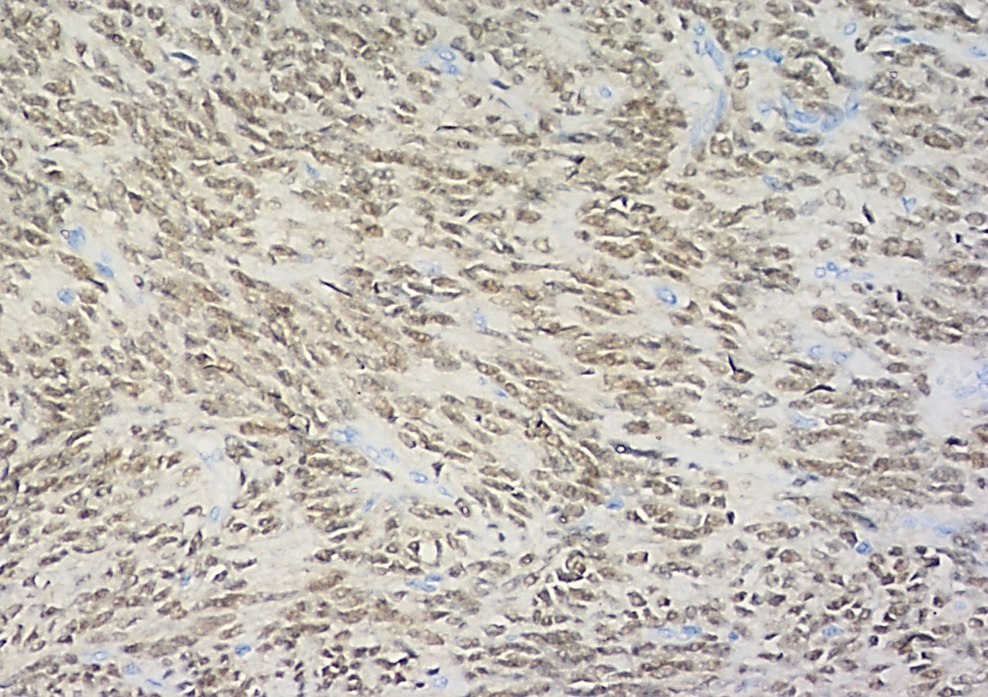
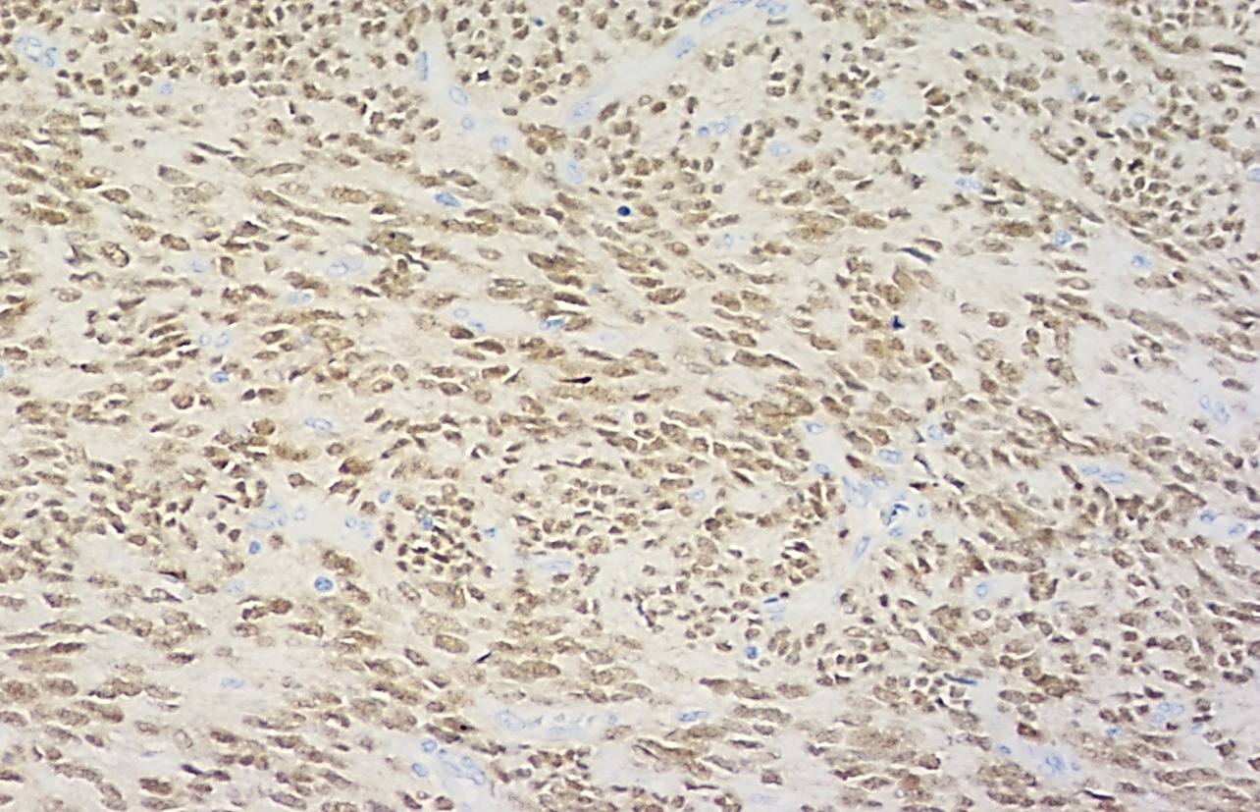
SS18-SSX and SSX C-terminus Abs for the diagnosis of SS
SS18-SSX fusion specific Mab (clone E9X9V) 100% specific and 95% sensitive
SSX C-terminus specific Mab (clone E5A2C) 92% specific and 100% sensitive
SSX C-terminus valuable for alternate SSX fusions
SS18-SSX IHC more specific than SS18 FISH in diagnosing SS with atypical FISH patterns and correlates well with RNA sequencing results
A positive IHC result supports the diagnosis of SS; a negative result combined with atypical FISH pattern should prompt molecular testing
P. Korkolopoulou Personal Archives
SS18-SSX
SSX C-terminus
Tay Virchow Archiv 2021; Zaborowski, Histopathol 2020;Yoshida Mod Pathol 2022;WHO, Soft tissue and bone 2020

Slide 10
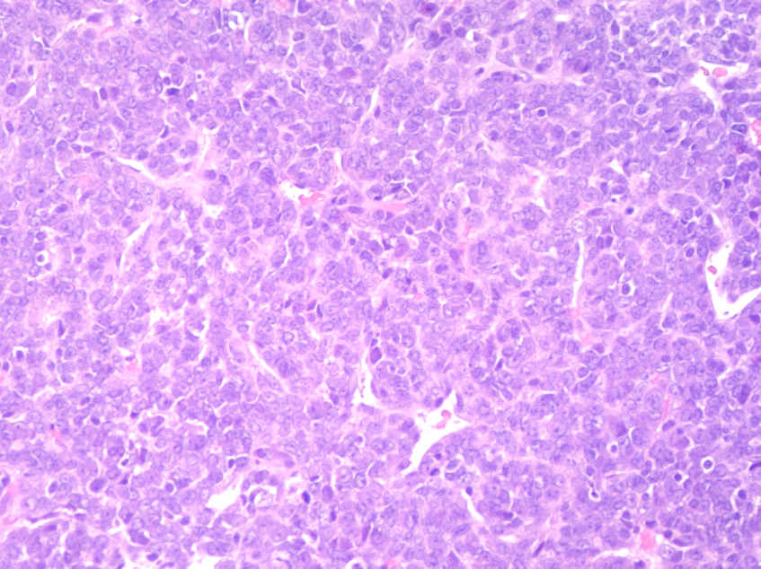
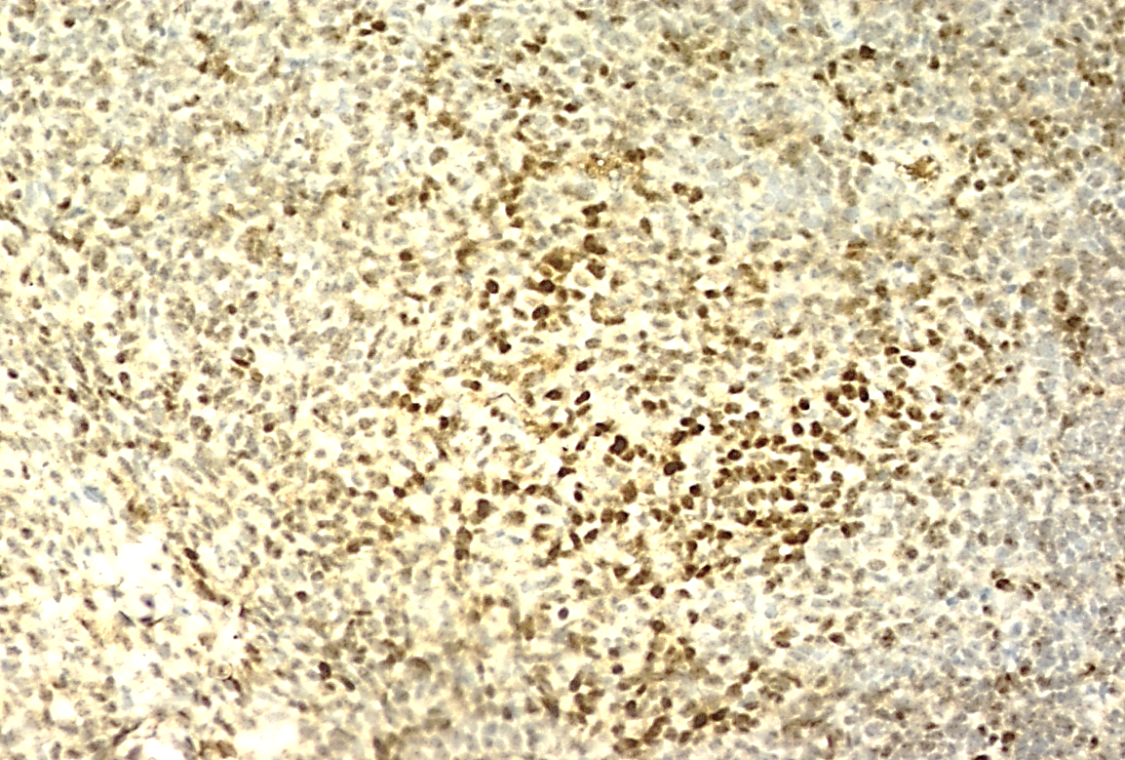
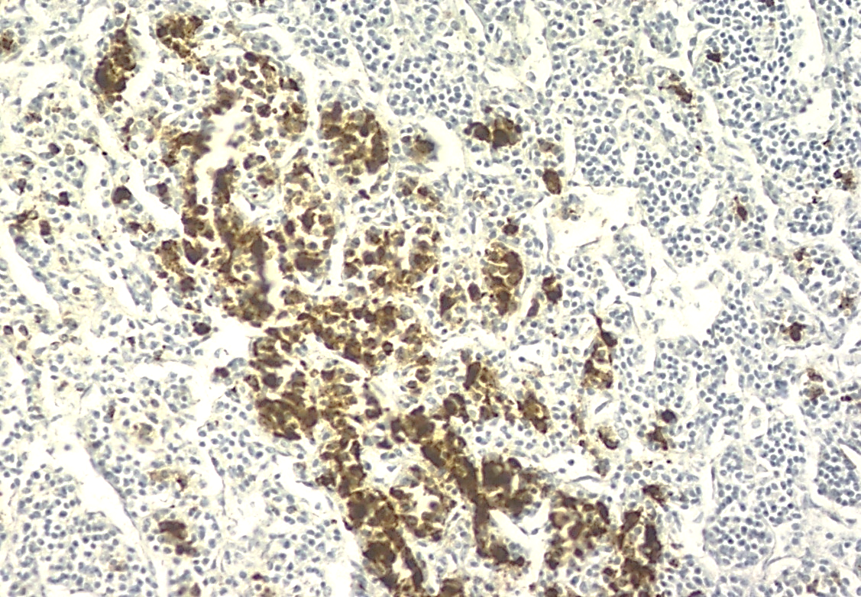
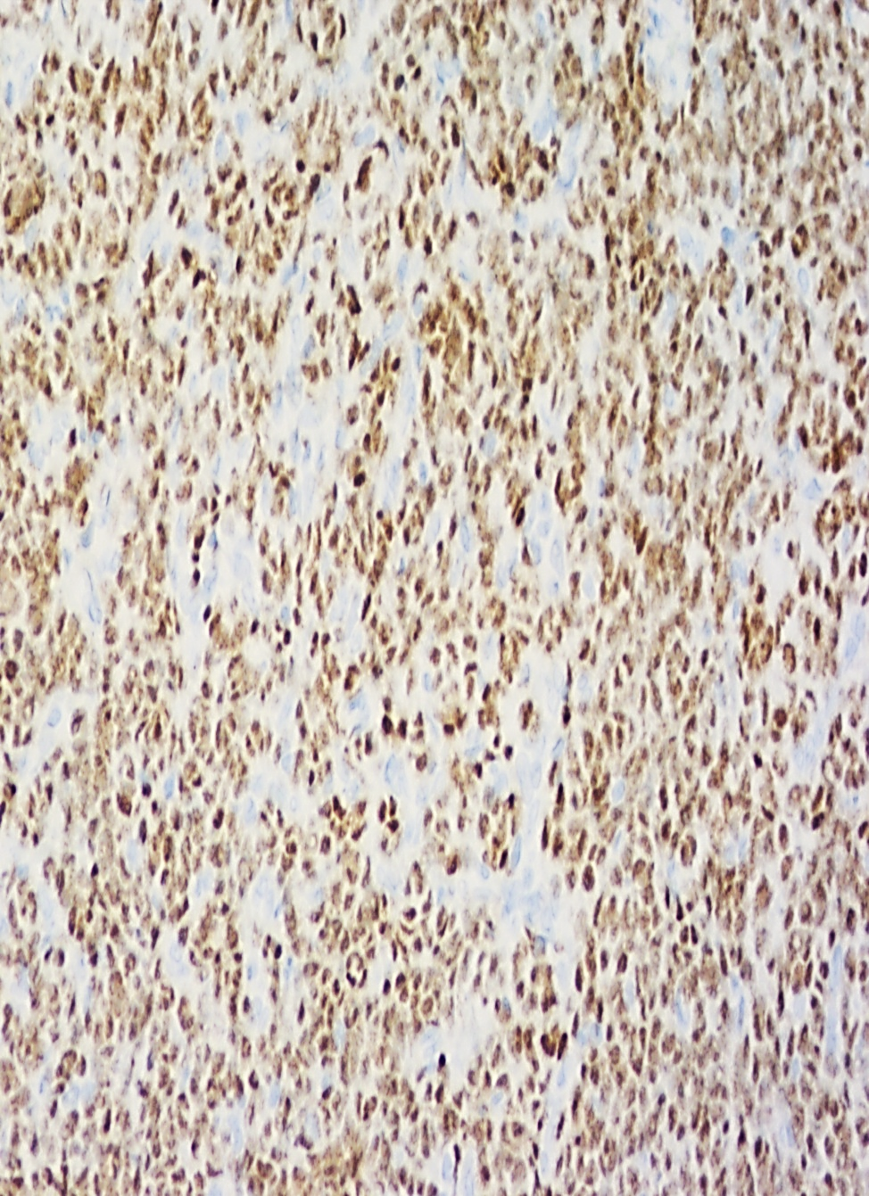
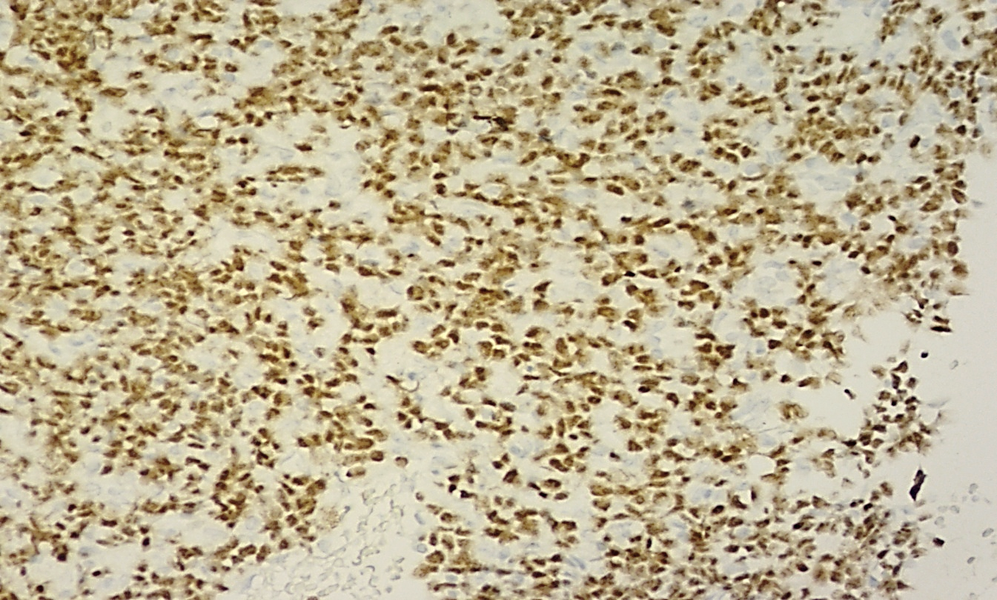
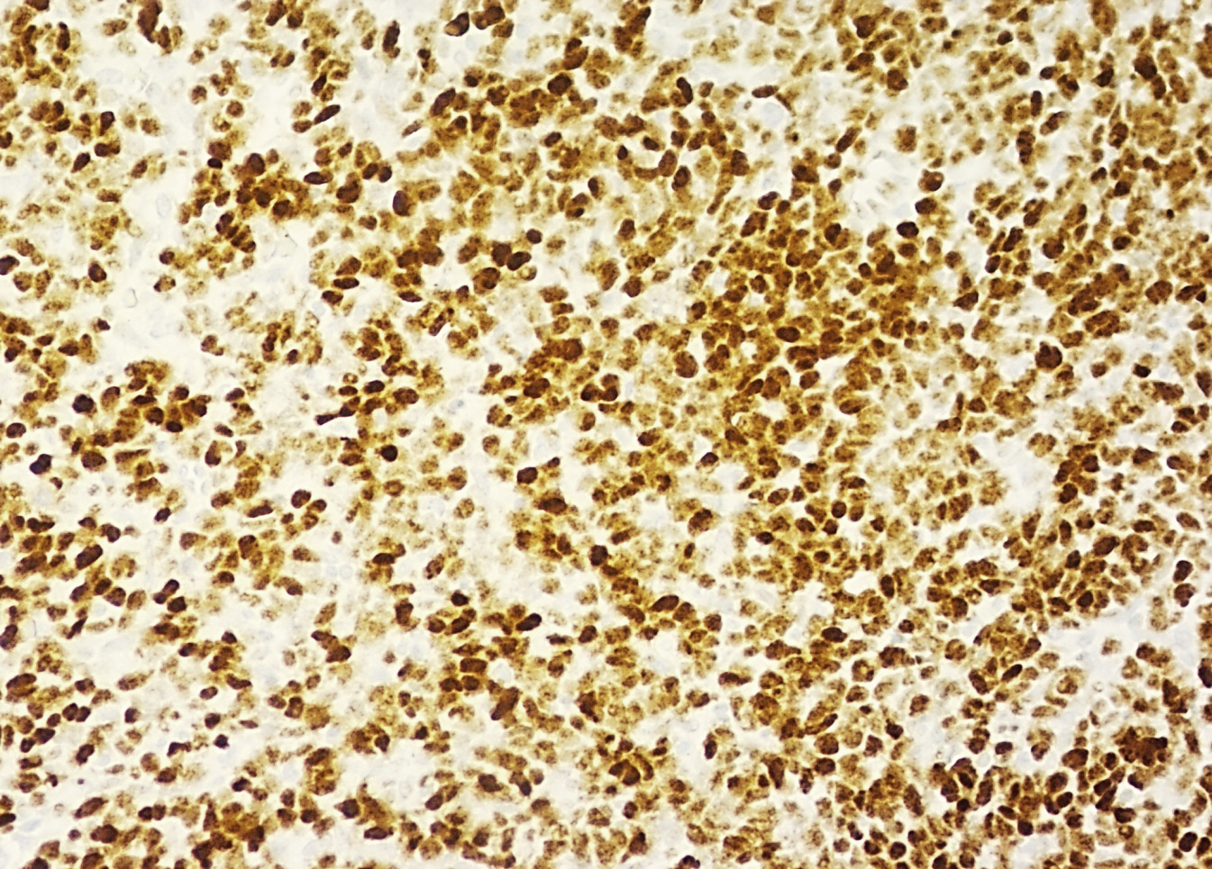
SS18-SSX and SSX C-terminus Abs for the diagnosis of SS
Poorly differentiated SS
BCOR
AE1/AE3
SS18/SSX
SSX C-terminus
TLE1
P. Korkolopoulou Personal Archives

Slide 11
Novel immunophenotypic markers
SOX2 expression in >90% of SS [due to binding of modified BAF complex to SOX2 locus]
Essential role in increased proliferation
Expression of several CTAs, including PRAME → association with response to immunotherapy [SS is a “cold” tumor]
SMARCB1(INI1/BAF47) reduced/absent in the vast majority of SS
PAX7 expression in the epithelial components of biphasic SS
NKX3.1 uniformly negative
Frequent concurrent nuclear accumulation of YAP1/TAZ and β-catenin [due to dysregulation of BAF mediated gene transcription]
Proposed panel of SOX2, PAX7, SMARCB1(INI1/BAF47), NKX3.1 to be combined with classical SS markers
Blay, ESMO Open 2023
Zhong, Sci Rep 2023
Isfort, Mol Cancer Res 2023

Slide 12
Molecular genetics
:
Characteristic t(X;18)(p11;q11) in >90% of tumors
One of SSX genes at Xp11 fuses to SS18 gene (formerly termed SYT) at 18q11
May involve SSX1 (most common), SSX2, or rarely SSX4
Using an SS18 FISH BAP probe, 11% of SS are negative or display atypical patterns
SS18-negative tumors may harbor alternate SSX1 fusions, including SS18L1::SSX1, EWSR1::SSX1(clustering together with SS in methylation analysis), and MN1::SSX1 → all alternate fusions exhibiting, strong expression with SSX- C-terminus antibody
No difference with regard to histology and immunophenotype (apart from being negative for SS18-SSX fusion specific mAb)
Novel fusions identified in <5% of SS (SSX1:: non-SS18)
In the remaining SS cases negative for fusions (classic or alternate) by FISH (7%), SS18::SSX identified by RNA sequencing
EWSR1 gene alterations (translocation, amplification, deletion) may be seen in ~1/3 of SS18::SSX classical SS cases
Diagnostic Pathology Soft tissue Tumors 2024
Yoshida Mod Pathol 2022
Zhong Sci Rep 2023

Slide 13
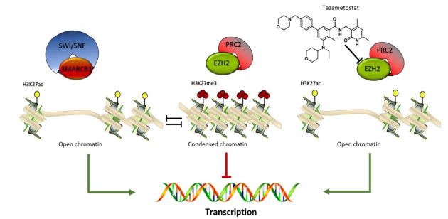
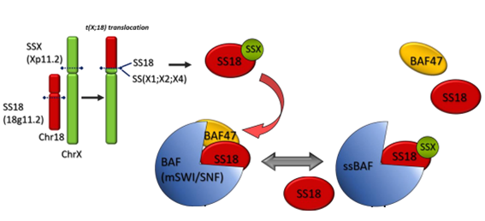
Molecular implications of SS18::SSX fusion in SS
BAF(SWI/SNF) and PRC2 complexes are in dynamic equilibrium to define chromatin remodeling and exert opposite transcriptional effects
SMARCB1(INI1/BAF47) is a strong tumor suppressor binding BAF(SWI/SNF) complex; loss or reduction seen in SS (>70%)
SS18/SSX fusion proteins replace the wild type SS18 in the BAF(SWI/SNF) complex resulting in disruption of BAF-PRC dynamic balance, enhanced activity of EZH2, overproduction of H3K27me3 and increased expression of SOX2
Most SS cases express high EZH2 levels, associated with poorly differentiated histology, poor outcome and increased metastatic potential
Blocking EZH2 activity emerged as a druggable vulnerability
Tazemetostat - an EZH2 inhibitor - has yielded only modest and sporadic responses in SS (compared to ES)
Montella, Cancers 2021
Lanzi, Biochem Pharmacol 2023
Changchien J Transl 2012

Slide 14
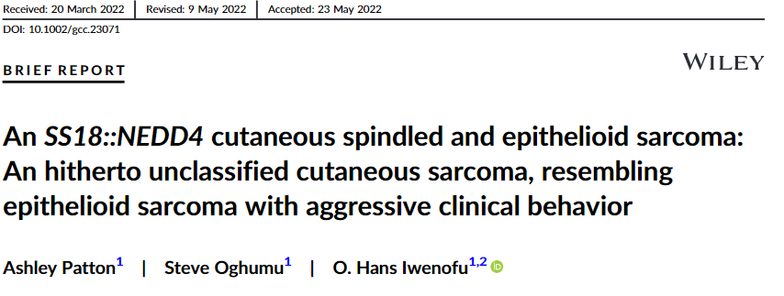
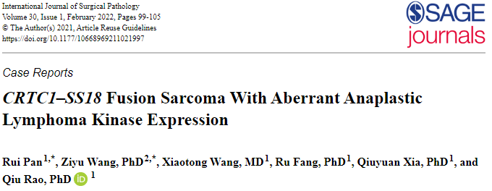
SS18::non-SSX fusions in other sarcoma types
Morphology compatible with epithelioid sarcoma
Immunophenotype: SMARCB1(INI1/BAF47) retained, TLE1 positive
Small round cell morphology
Prolonged survival, low Ki67
Diffuse ALK positivity
SS18::NEDD4 also described in case of renal SS (Argani, Chromosomes Cancer 2020)

Slide 15
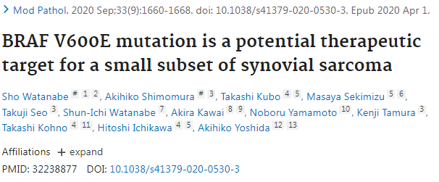
2 patients with intrathoracic SS harboring the BRAF V600E mutation
BRAF V600E mutations were detected by NGS and validated immunohistochemically by diffuse intense positivity to BRAF V600E mutation specific antibodies
ERK (pERK) was also positive
Immunohistochemical screening of 67 archival SS tumor samples failed to identify additional samples with BRAF V600E mutation
Frequency of BRAF V600E mutation ~2.5%
32% of BRAF V600E negative cases was positive for pERK
Patient in continuous PR following Vemurafenib
This study highlights the role of routine NGS to investigate SS for BRAF mutation

Slide 16
Differential Diagnosis
Malignant Peripheral Nerve Sheath Tumor
Diffuse loss of nuclear H3K27me3 by IHC
May show focal or weak TLE (+)
Lacks molecular features of SS
Fibrosarcomatous Dermatofibrosarcoma Protuberans
Predominantly affects superficial soft tissue
May be associated with areas of low-grade dermatofibrosarcoma protuberans
Keratin and TLE1 (-)
Characteristic COL1A1::PDGFB fusion in most cases
Solitary Fibrous Tumor
Characteristic dilated, irregular staghorn vasculature
STAT6 and CD34 (+), Keratin (-)
Rare tumors can show diffuse TLE1 (+)
Characteristic NAB2::STAT6 fusion
Ewing Sarcoma
Can mimic poorly differentiated SS
Diffuse membranous CD99 (+), NKX2.2 (+)
EWSR1 translocations in vast majority of cases
BCOR::CCNB3 (Ewing-Like) Sarcoma
Can mimic poorly differentiated SS
CD99 variable, TLE1 (+)
Lacks molecular features of SS
Leiomyosarcoma
SMA (+), variable desmin and h-caldesmon (+)
Lacks molecular features of SS
Biphasic Sinonasal Sarcoma
Closely resembles monophasic SS
Expression of myogenic markers (SMA, desmin, myogenin)
PAX3 and S100 (+), SOX10 (-)
PAX3 rearrangements (PAX3::MAML3 fusion most common)
Mixed mullerian tumor (carcinosarcoma)
Closely resembles biphasic SS
Usually WT1+
PAX8 and ER expressed in both types of tumors
Lacks molecular features of SS
Mesothelioma
Closely resembles biphasic SS
Usually WT1+/calretinin+/TLE1+/BAP1-
Lacks molecular features of SS
Diagnostic Pathology Soft tissue Tumors 2024

Slide 17
SS - Prognosis
Local recurrence common
Metastasis in up to 50% of cases, most commonly in the lung; even after many years following diagnosis
Small subset (5-10%) can spread to lymph nodes
5-year survival rate 50-85%
Prognostic factors
Favorable factors: small tumor size (<5cm) [tumors <1cm have excellent prognosis], occurrence in childhood
Unfavorable factors: age >40 years, large tumor size, non extremity location (trunk, head/neck), poorly differentiated histology (>20% component) [more common in older patients], high stage at presentation
Fusion type not prognostically significant
Biphasic vs. monophasic not clearly prognostic
FNCLCC grade (with grade 1 tumors [~40%] fare better than grade 2/3
Adverse prognostic parameters:
Increased H3K27me3, Increased EZH2
:
Diagnostic Pathology Soft tissue Tumors 2024
Fice JSO 2022
Bianchi EJSO 2017, Diao Pathol Res Pract 2018
Steinbrcher Clin Oncol 2023
Rerjrichaisuth, Histopathology 2023
Changchien, J Transl Med 2012

Slide 18
SS - Take home messages
The molecular hallmark of SS is SS18::SSX fusion; less common non-SS18::SSX fusions recently documented
Identification of these fusions is important for differential diagnosis
Excellent surrogate marker considered even superior to SS18 FISH BAP is the IHC using the new SS18/SSX fusion specific and SSX C-terminus specific Mabs, the latter remaining positive even in the cases with alternate fusions
Negative IHC using these antibodies, combined with negative/atypical FISH, should prompt molecular testing investigation (RNA sequencing)
Molecular implications of SS18::SSX fusions involve disruption of epigenetic control by BAF/PRC2 complex balance resulting in increased EZH2 levels and low/absent SMARCB1(INI1/BAF47) expression; EZH2 considered a druggable vulnerability and important adverse prognostic factor
Poorly differentiated histology, grade, size, site and age important prognostic parameters

Slide 19
Thank you

