Slide 1
The NTRK rearrangement as a therapeutic biomarker
Αναστάσιος Κυριαζόγλου MD,PhD
Β ΠΠΚ Αττικό

Slide 2
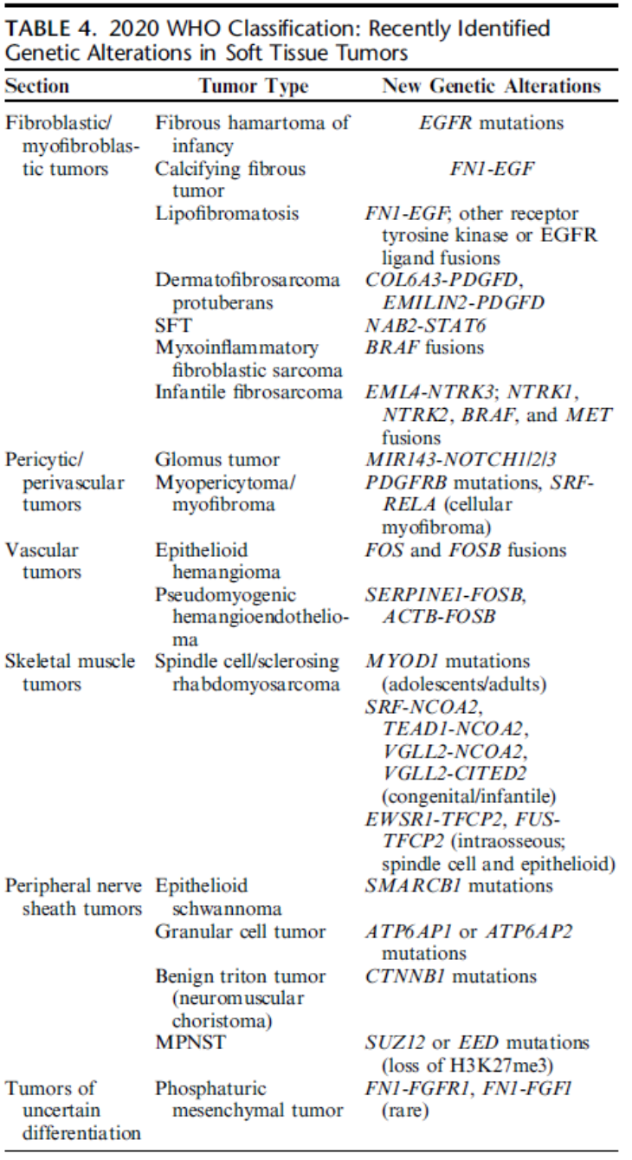
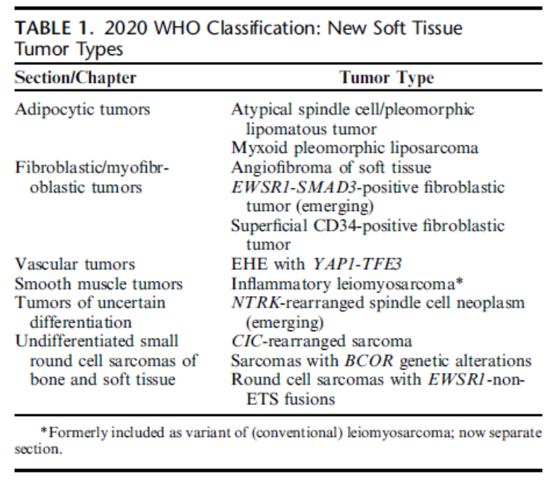
Histopathology
2020 WHO Classification of bone and soft tissue sarcomas identifies 120 tumor entities
New entities based on genetics

Slide 3
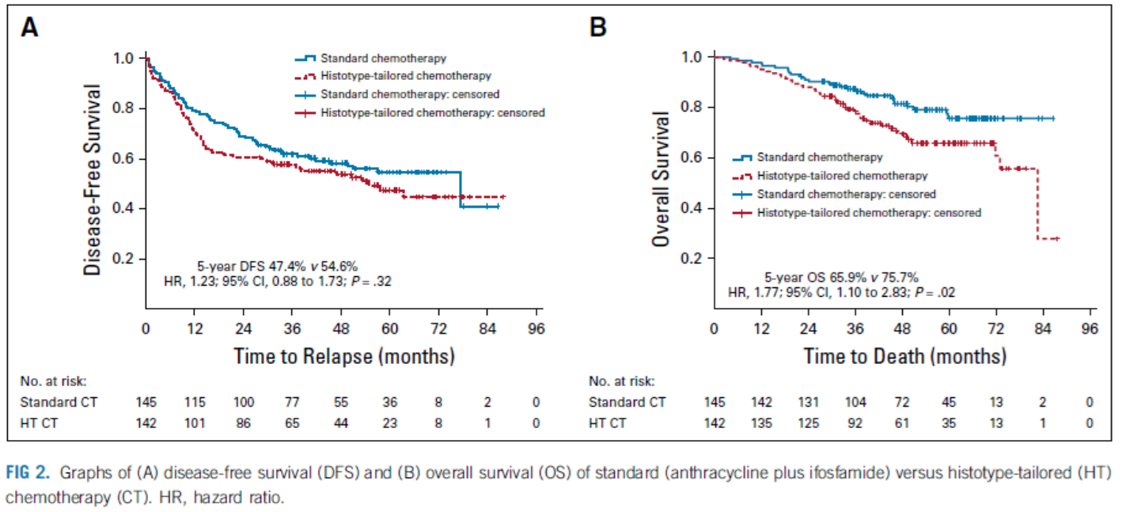
Systemic treatment
Doxorubicin (anthracyclines) is the gold standard!!!
Neoadjuvant Chemotherapy in High-Risk Soft Tissue Sarcomas: Final Results of a Randomized Trial From Italian (ISG), Spanish (GEIS), French (FSG), and Polish (PSG) Sarcoma Groups. Gronchi A, et al. J Clin Oncol. 2020. PMID: 32421444

Slide 4
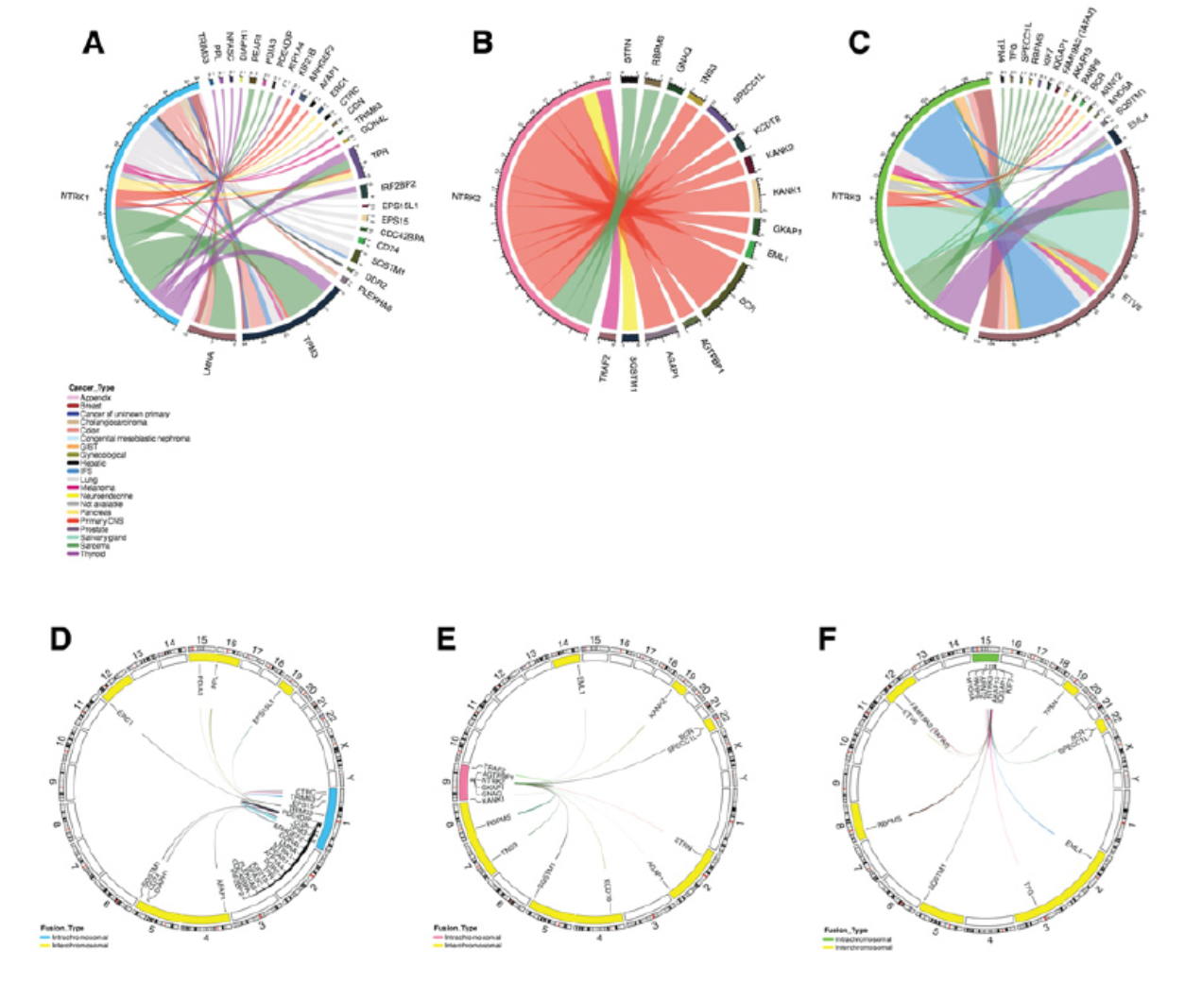
NTRK: neurotrophic tyrosine kinases 1,2,3

Slide 5
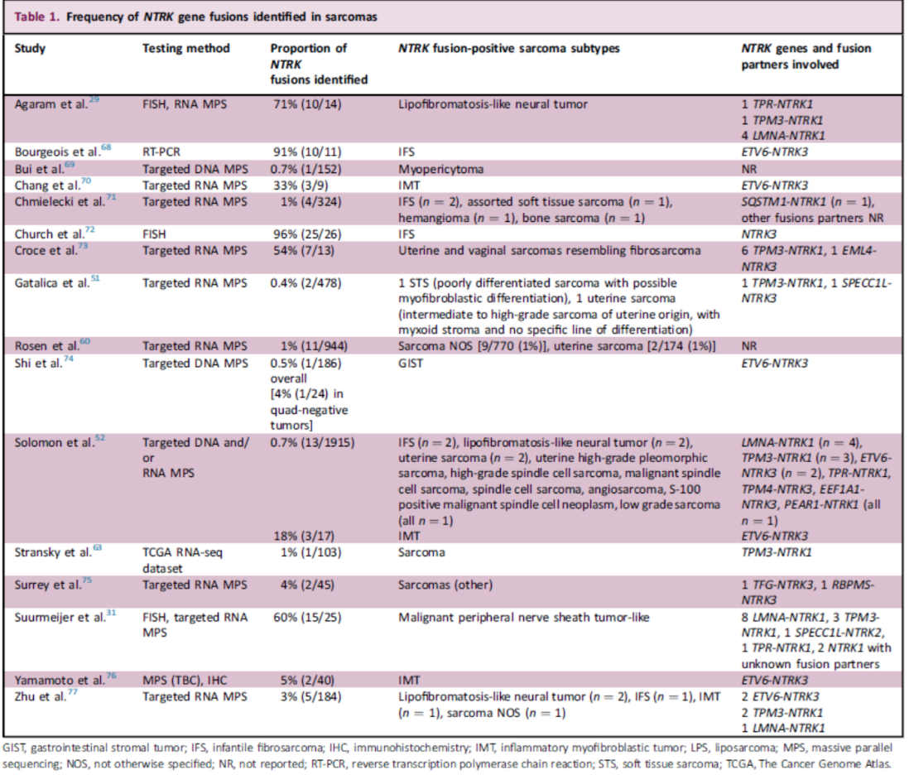
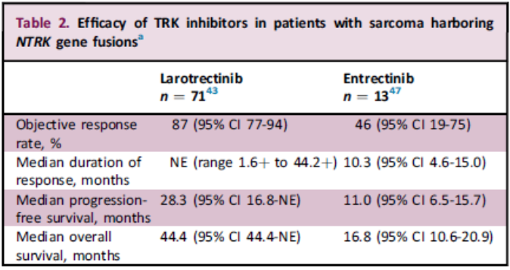
NTRKs (NTRK1,NTRK2,NTRK3)
ETV6/NTRK3 is identified to >90% of infantile fibrosarcomas
S100, CD34 co-expression in NTRK altered sarcomas
FISH, IHC, RT-PCR,MPS
Desmoplastic round cell tumors are characterized by EWSR1-WT1 fusion
EWSR1-WT1 binds upstream to NTRK3 and upregulates its expression
Diagnosis and management of tropomyosin receptor kinase (TRK) fusion sarcomas: expert recommendations from the World Sarcoma Network.Demetri GD, Antonescu CR, Bjerkehagen B, Bovée JVMG, Boye K, Chacón M, Dei Tos AP, Desai J, Fletcher JA, Gelderblom H, George S, Gronchi A, Haas RL, Hindi N, Hohenberger P, Joensuu H, Jones RL, Judson I, Kang YK, Kawai A, Lazar AJ, Le Cesne A, Maestro R, Maki RG, Martín J, Patel S, Penault-Llorca F, Premanand Raut C, Rutkowski P, Safwat A, Sbaraglia M, Schaefer IM, Shen L, Serrano C, Schöffski P, Stacchiotti S, Sundby Hall K, Tap WD, Thomas DM, Trent J, Valverde C, van der Graaf WTA, von Mehren M, Wagner A, Wardelmann E, Naito Y, Zalcberg J, Blay JY.
Therapeutic potential of NTRK3 inhibition in desmoplastic small round cell tumor.Ogura K, Somwar R, Hmeljak J, Magnan H, Benayed R, Momeni-Boroujeni A, Bowman AS, Mattar M, Khodos I, de Stanchina E, Jungbluth AA, Asher M, Odintsov I, Hartono AB, LaQuaglia M, Slotkin EK, Pratilas CA, Lee SB, Spraggon L, Ladanyi M. Clin Cancer Res. 2020 Nov 23:clincanres.2585.2020. doi: 10.1158/1078-0432.CCR-20-2585. Online ahead of print.

Slide 6
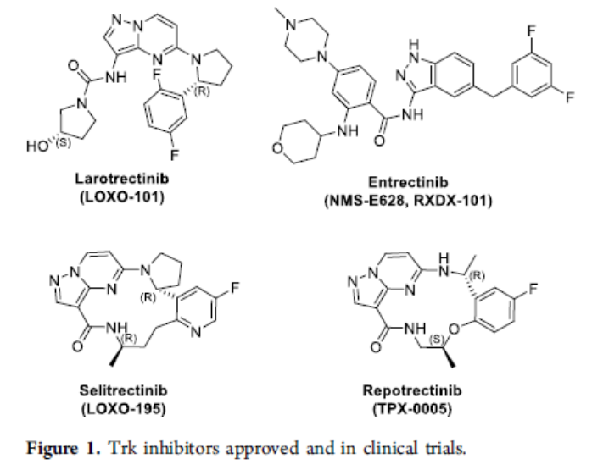
NTRK inhibitors
First generation inhibitors
Larotrectinib (LOXO-101)
Entrectinib (RXDX-101)

Slide 7
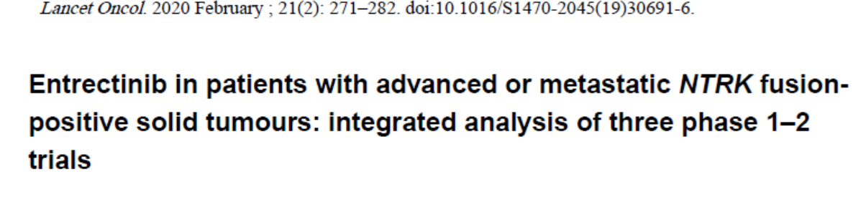
Age>18
ECOG PS: 0-2
Metastatic or locally advanced NTRK fusion positive solid tumor
Primary endpoints: objective response (CR or PR) and duration of response
Secondary endpoints: PFS, clinical benefit rate (CR,PR, SD for >6months), time to CNS progression, safety

Slide 8
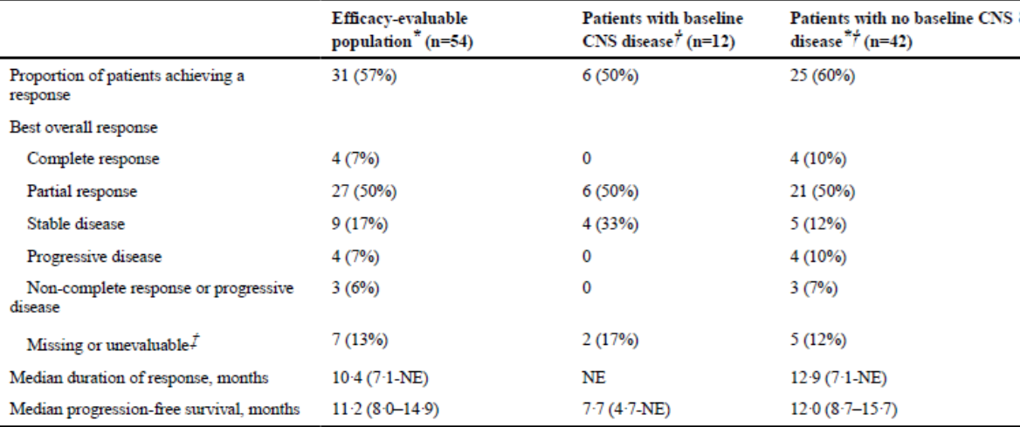
54 adults
Median f/up 12.9months (8.77-18.76)
Median duration of treatment 7.85m (3.68-12.71)

Slide 9
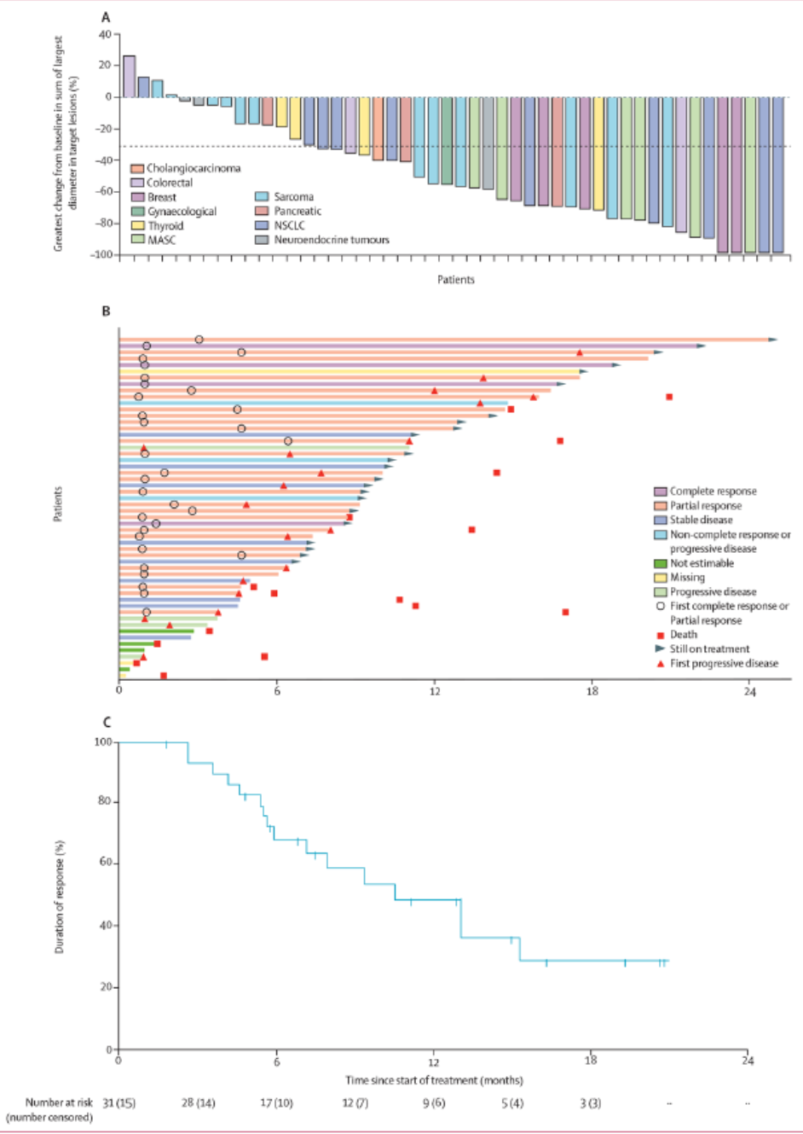

Slide 10
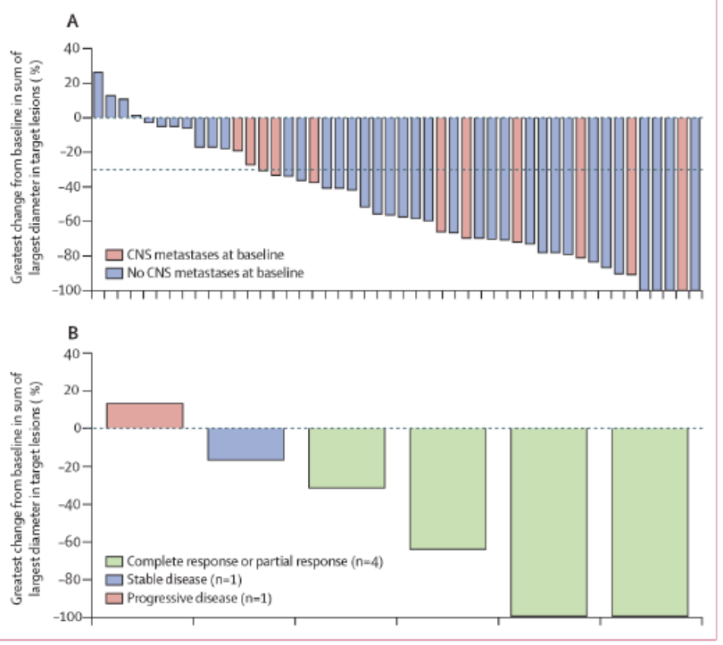
CNS metastases

Slide 11
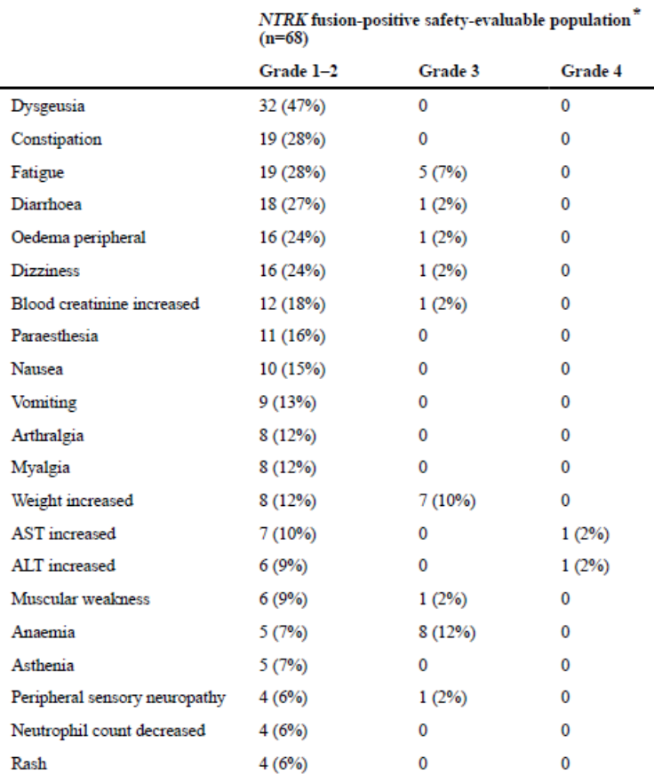
Safety!!!

Slide 12
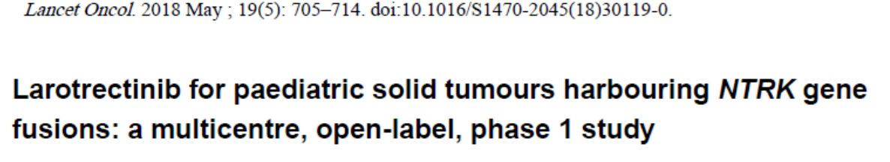
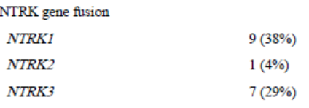
Age 1-21
PS> 50%
Primary endpoint: safety of larotrectinib
Secondary endpoints: maximum tolerated dose, ORR
24 pts (17 NTRK positive)

Slide 13
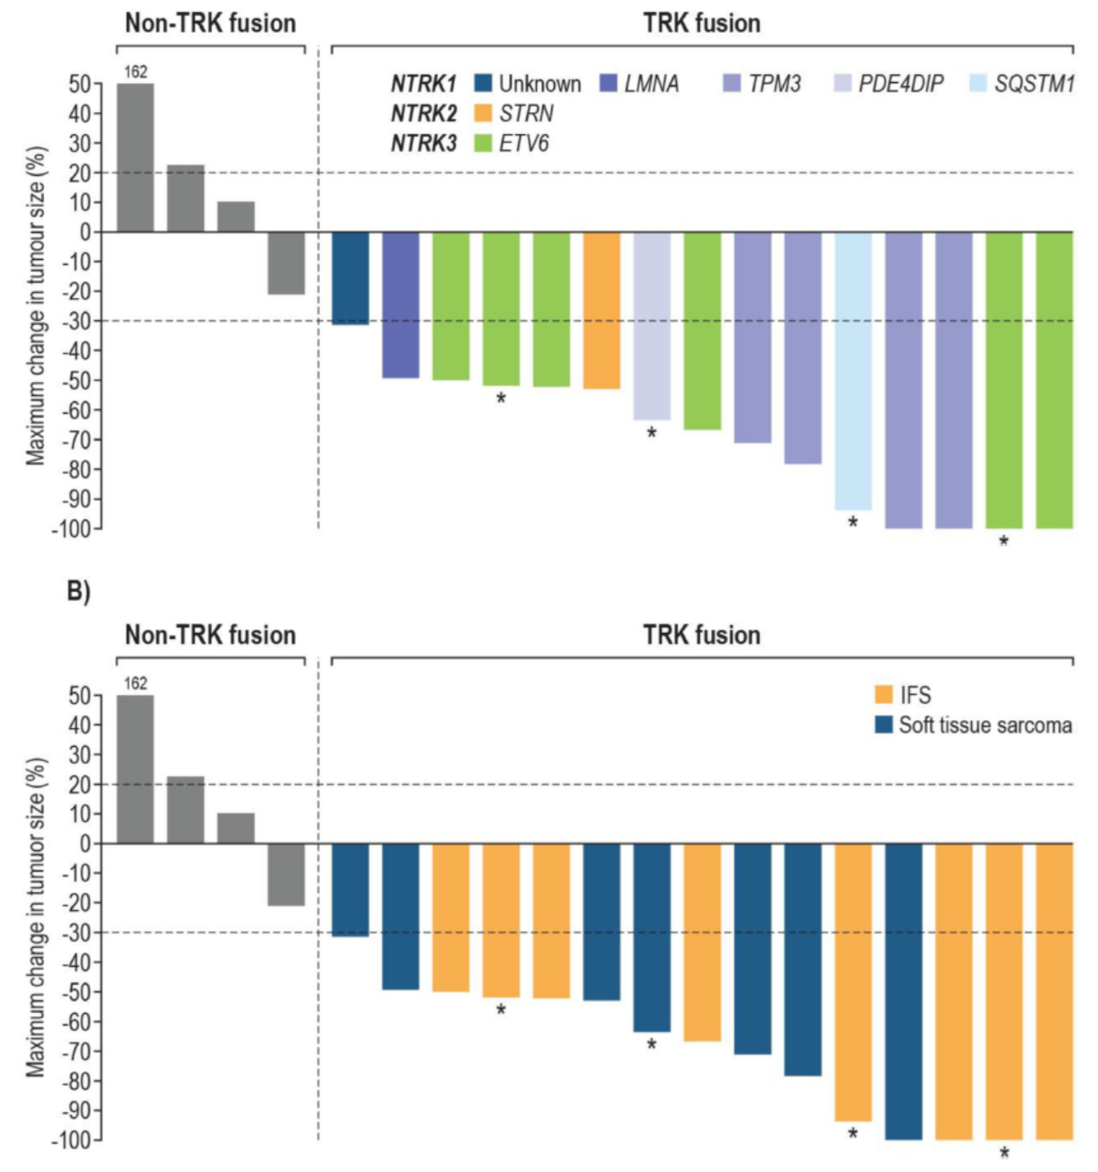

Slide 14
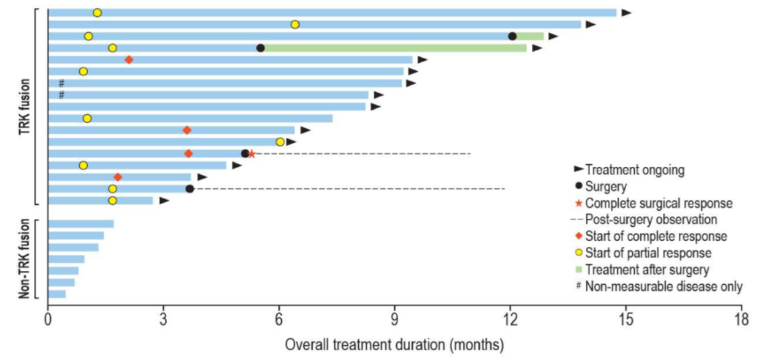
F/up 8.2m (5.2-9.5) all pts except 1 remain on treatment!

Slide 15
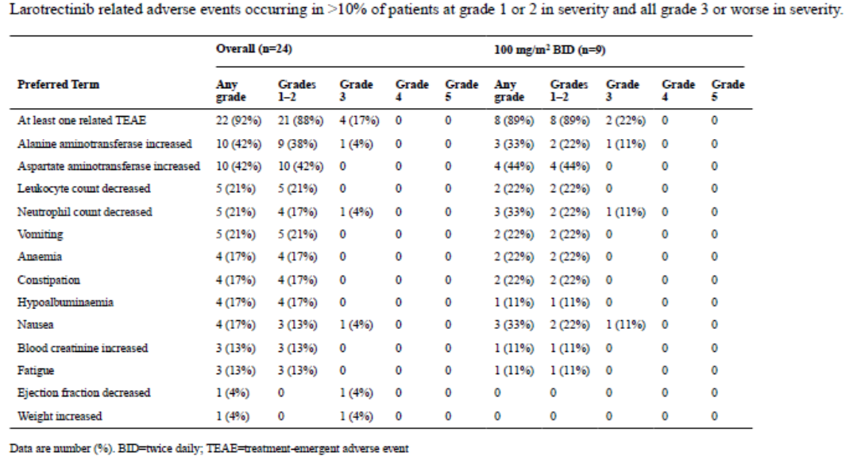
Larotrectinib ORR in NTRK fused pediatric patients was 93% (14/15 pts)

Slide 16
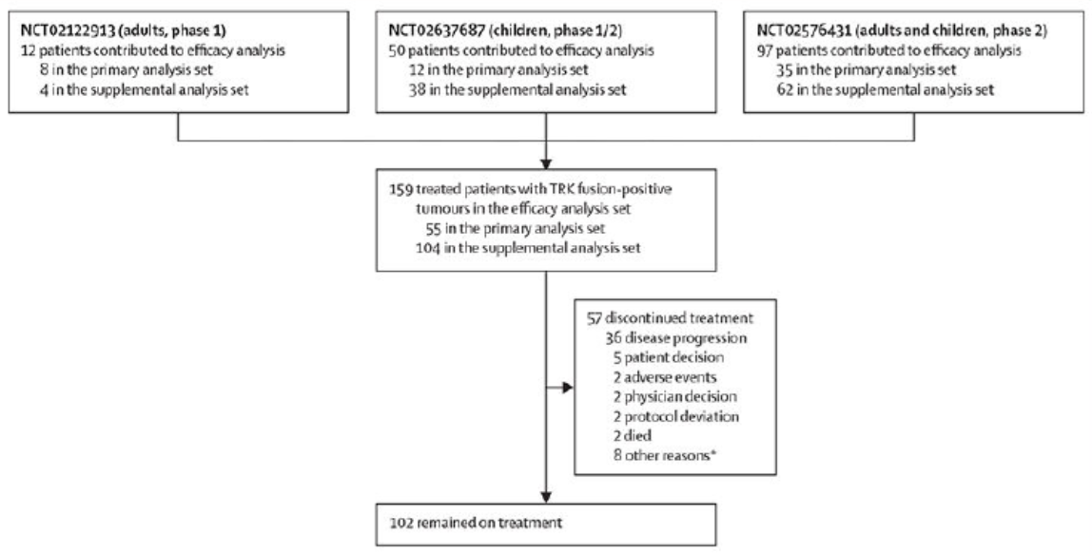
Larotrectinib pooled analysis of 159 pts

Slide 17
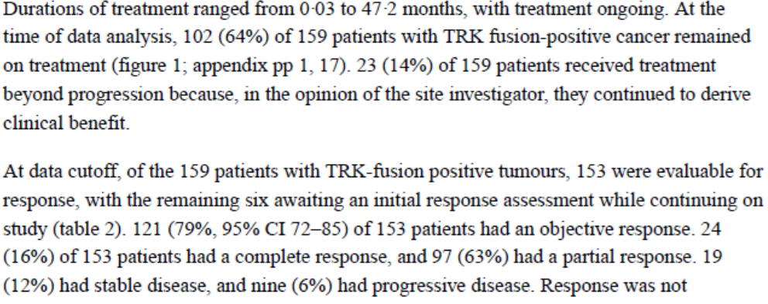
Results
Median duration of response: 35.2months
mPFS: 25.8 months

Slide 18
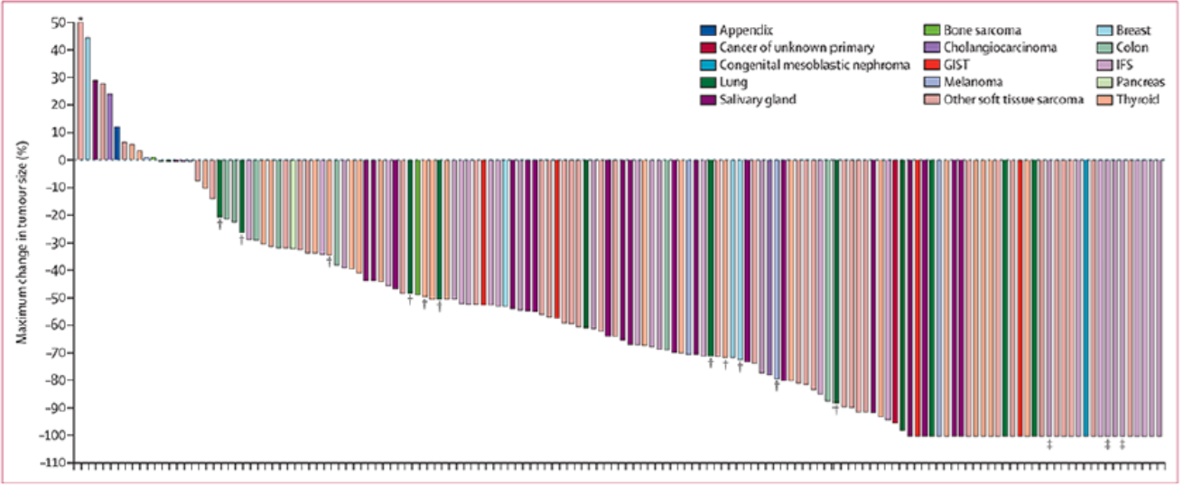
RESPONSE!!!

Slide 19
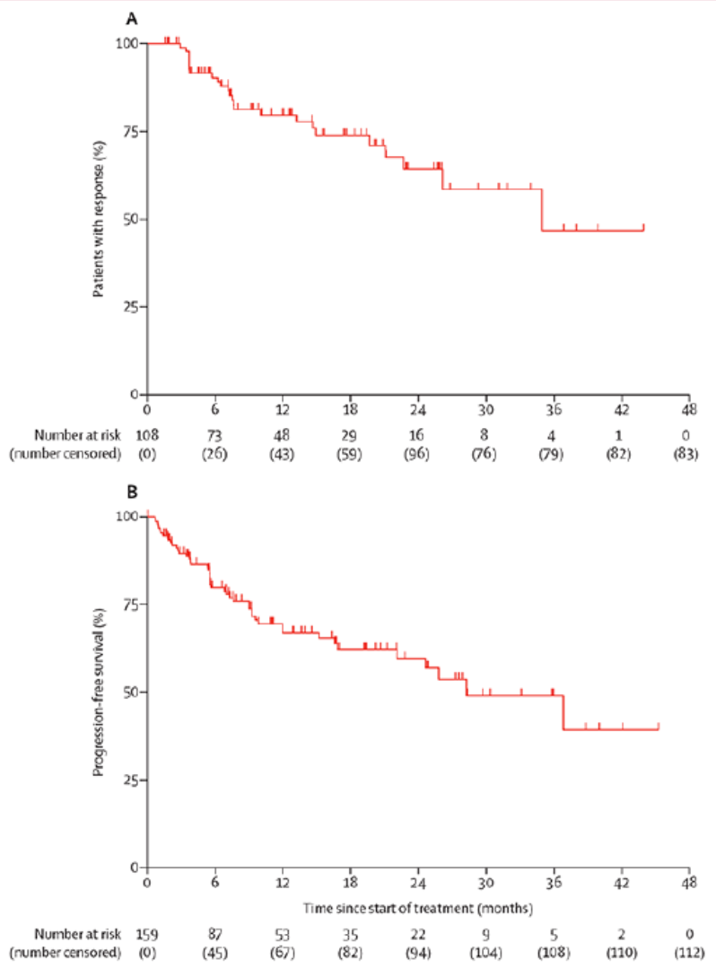

Slide 20
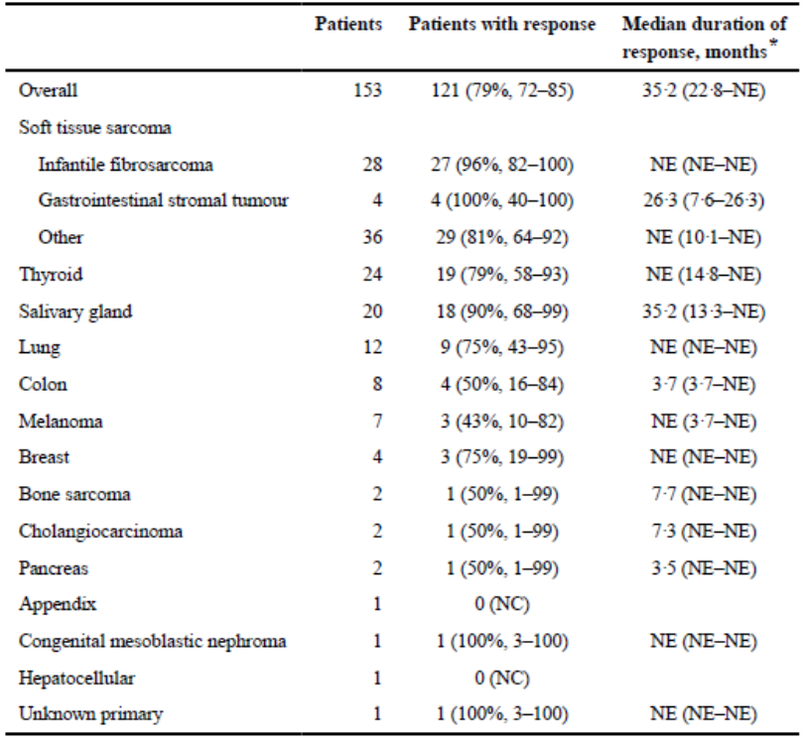
RESPONSE!!!

Slide 21
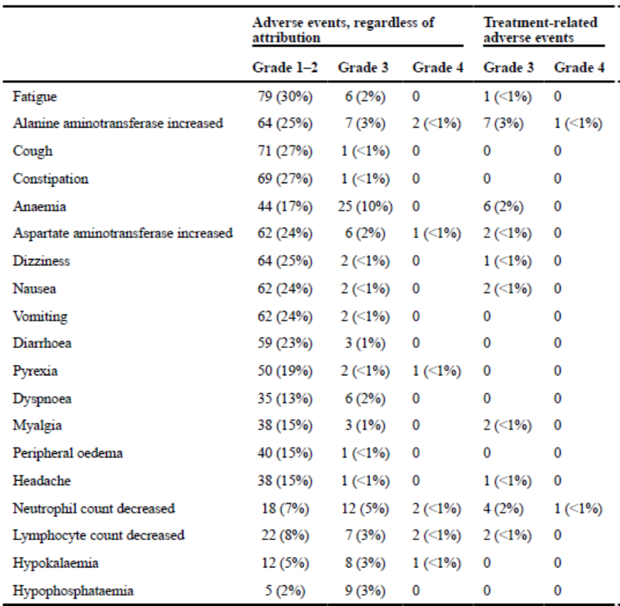
SAFETY!!!

Slide 22
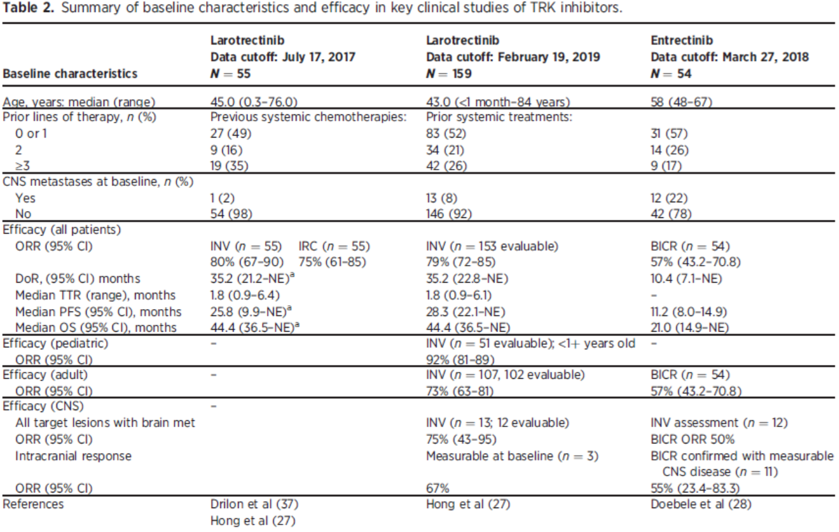
Overall NTRK inhibitors

Slide 23
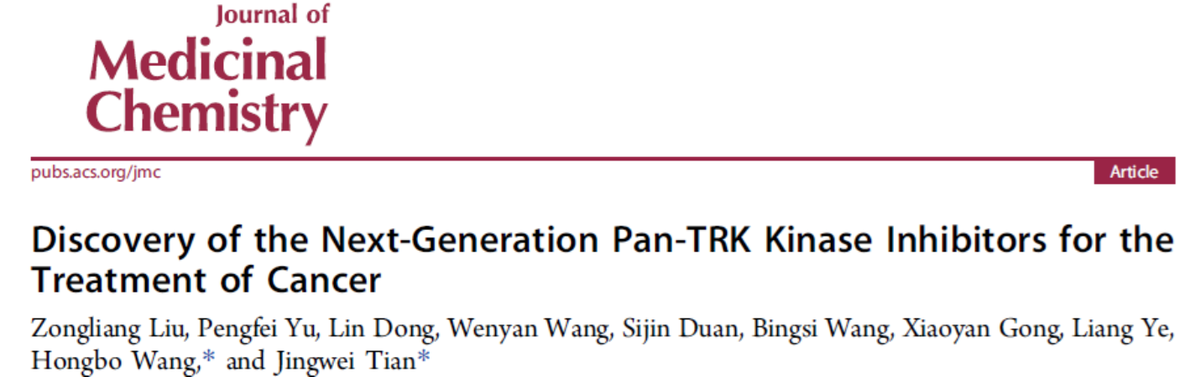
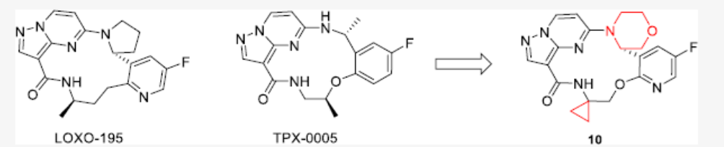
Second generation NTRK inhibitors: overcoming resistance
Selictrectinib (LOXO-195)
Repotrectinib (TPX-0005)

Slide 24
Questions without an answer yet
Are there histopathological markers to predict NTRK fusions?
Which tumors should we test in routine basis for NTRK alterations?
Should we give NTRK inhibitors in first line?

Slide 25
