Slide 1
Aποκατάσταση ελλειμμάτων μαλακών μορίων μετά την αφαίρεση μυοσκελετικών όγκων με μισχωτούς και ελεύθερους κρημνούς
Παρθένα Δεσκουλίδη
Επικουρική Ιατρός Πλαστικής Χειρουργικής Π.Γ.Ν “ΑΤΤΙΚΟΝ”
Γ’Πανεπιστημιακή Χειρουργική Κλινική

Slide 2
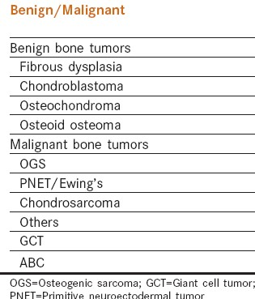
Μυοσκελετικοί ΄Ογκοι Οστών

Slide 3
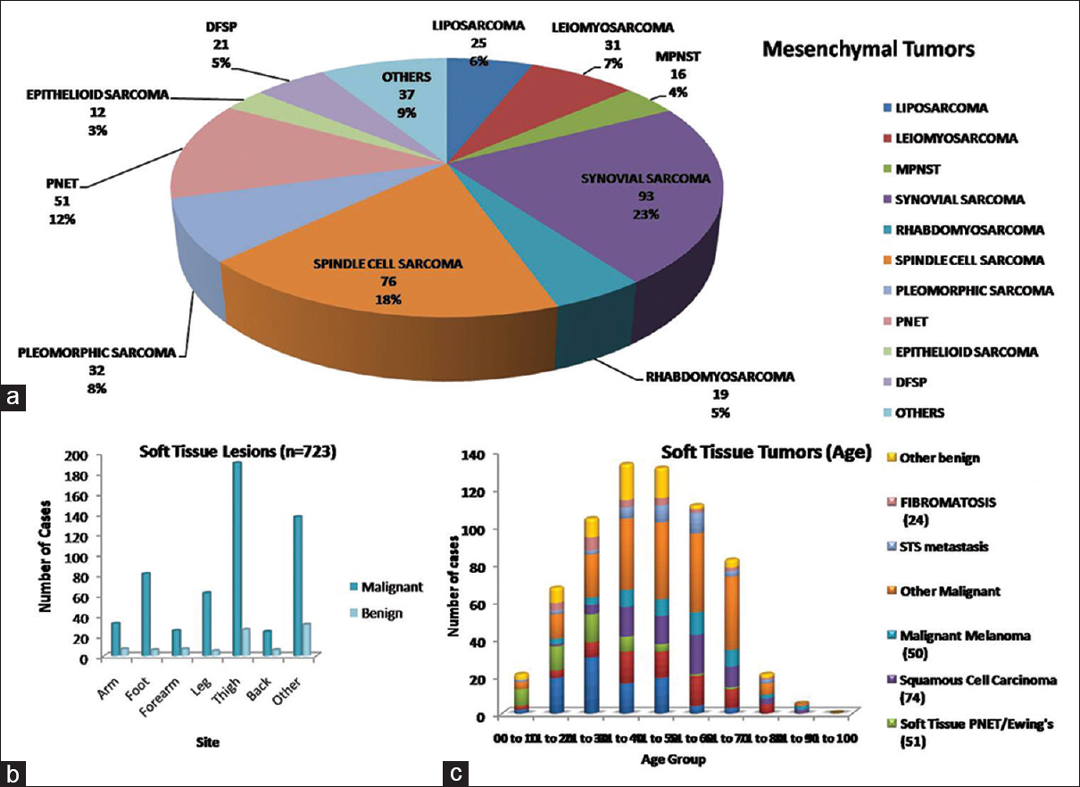
Μυοσκελετικοί ΄Ογκοι Μαλακών μορίων

Slide 4
Η θεραπεία την σαρκωμάτων μαλακών μορίων είναι η Χειρουργική, η ακτινοθεραπεία
και η χημειοθεραπεία. Το είδος της θεραπείας θα εξαρτηθεί από το στάδιο της νόσου
και το ιστορικό του ασθενούς.
Extent of resection.Age,comorbidities (diabetes, peripheral vascular disease, coronary artery disease, smoking history), nutritional status, steroid use, history of radiation treatment.
Η αφαίρεση του όγκου σε υγιή όρια είναι υποχρεωτική.
Μετά την αφαίρεση του όγκου ακόλουθεί η πλαστική επανορθωτική αποκατάσταση που
επιτυγχάνεται ανάλογα με το έλλειμμα των ιστών με άμεση συρραφή του τραύματος,
με δερματικό μόσχευμα μερικού πάχους, με δερμοπεριτοναϊκούς κρημνούς,
με τοπικούς μυϊκούς κρημνούς, περιοχικούς μυϊκούς κρημνούς και ελεύθερους κρημνούς.
Τα σαρκώματα αντιπροσωπεύουν την πλειοψηφία των περιστατικών που αντιμετωπίζονται
στην Α΄Ορθοπαιδική Χειρουργική του Πανεπιστημιακού Γενικού Νοσοκομείου “Αττικόν”.

Slide 5
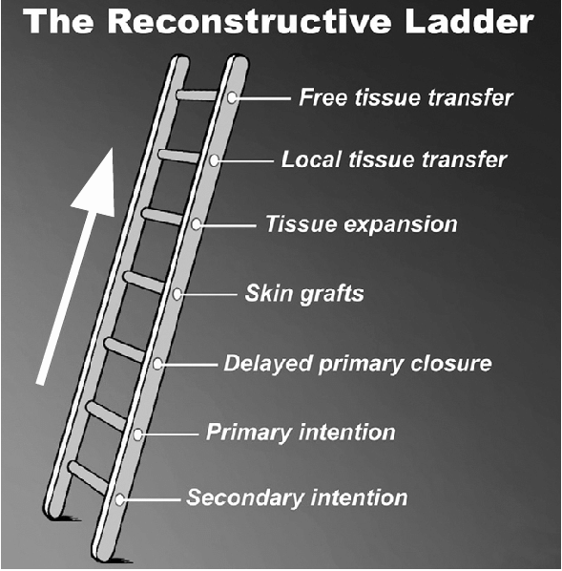

Slide 6
Επεμβάσεις Αποκατάστασης
Άμεση σύγκλειση τραύματος
Δερματικό μόσχευμα μερικού πάχους
Τοπικοί περιτονιοδερματικοί κρημνοί
Τοπικοί Μυϊκοί κρημνοί (local muscle flaps)
Γειτονικοί Μυϊκοί κρημνοί (regional muscle flaps)
Ελεύθεροι κρημνοί

Slide 7
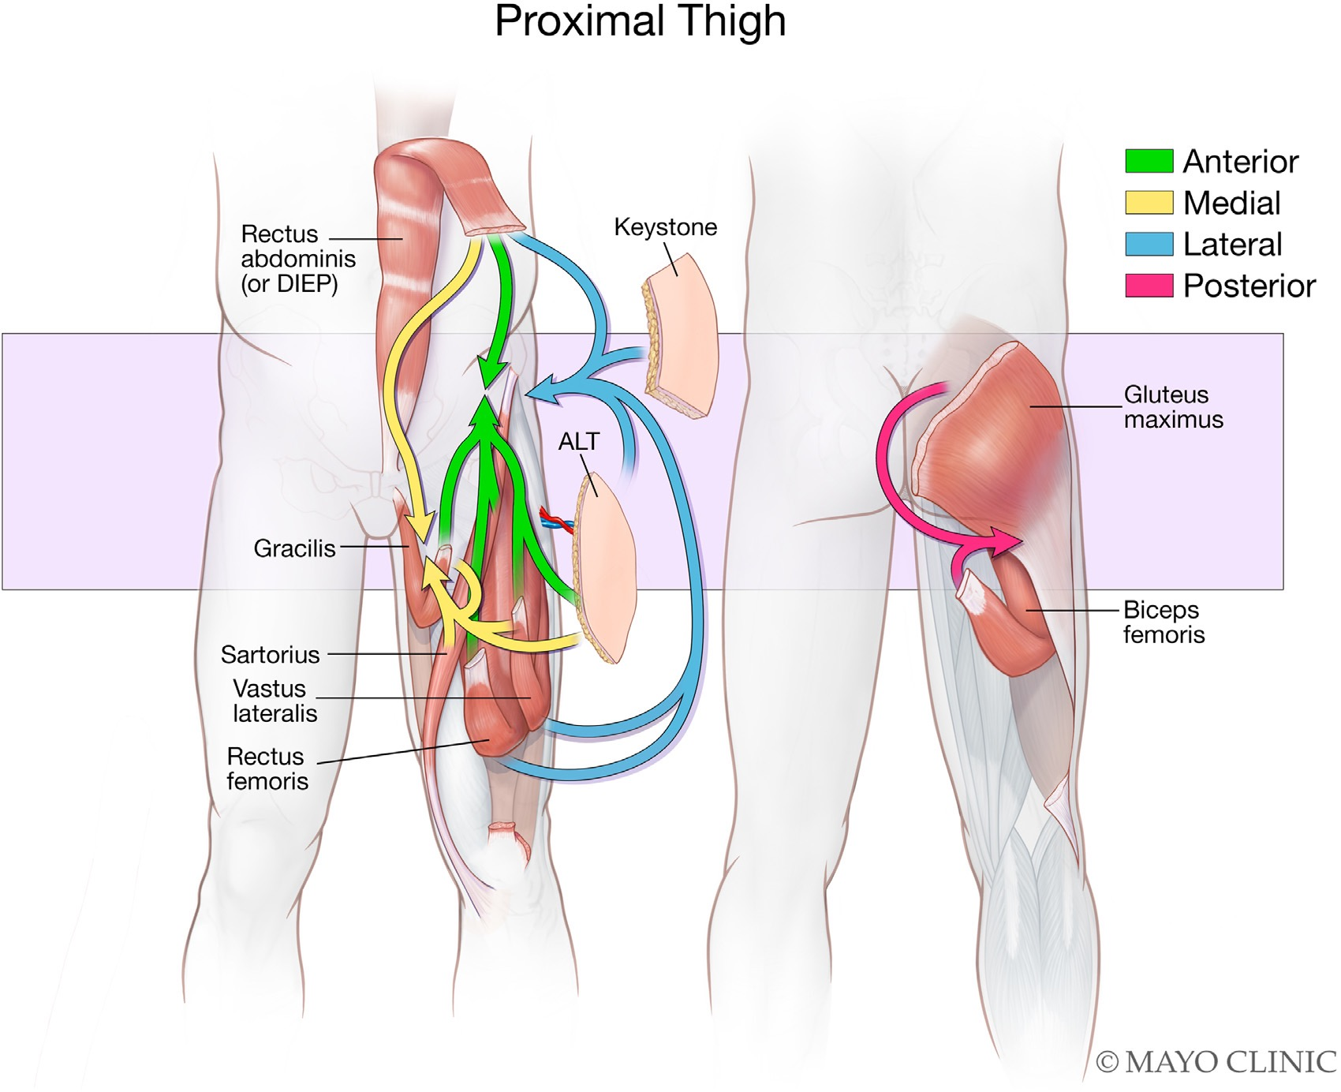
Thigh Reconstruction
Proximal thigh defects

Slide 8
Αποκατάσταση του ανώτερου Τριτημορίου του μηρού
Για το πρόσθιο τμήμα του μηρού:
Κρημνοί του ορθού κοιλιακού μυός:
VRAM,Diep flaps και κρημνοί του μηρού:
(rectus femoris,gracilis,sartorius and vastus lateralis.
Fasciocutaneous flaps (ALT)
Για το έσω τμήμα του μηρού:
pedicled rectus abdominis and thigh muscle flaps (gracilis,sartorius)
Για το οπίσθιο τμήμα του μηρού:
pedicled rectus abdominis, gluteus maximus flaps,thigh muscle flaps (biceps femoris) and fasciocutaneous flaps (ALT, keystone)

Slide 9
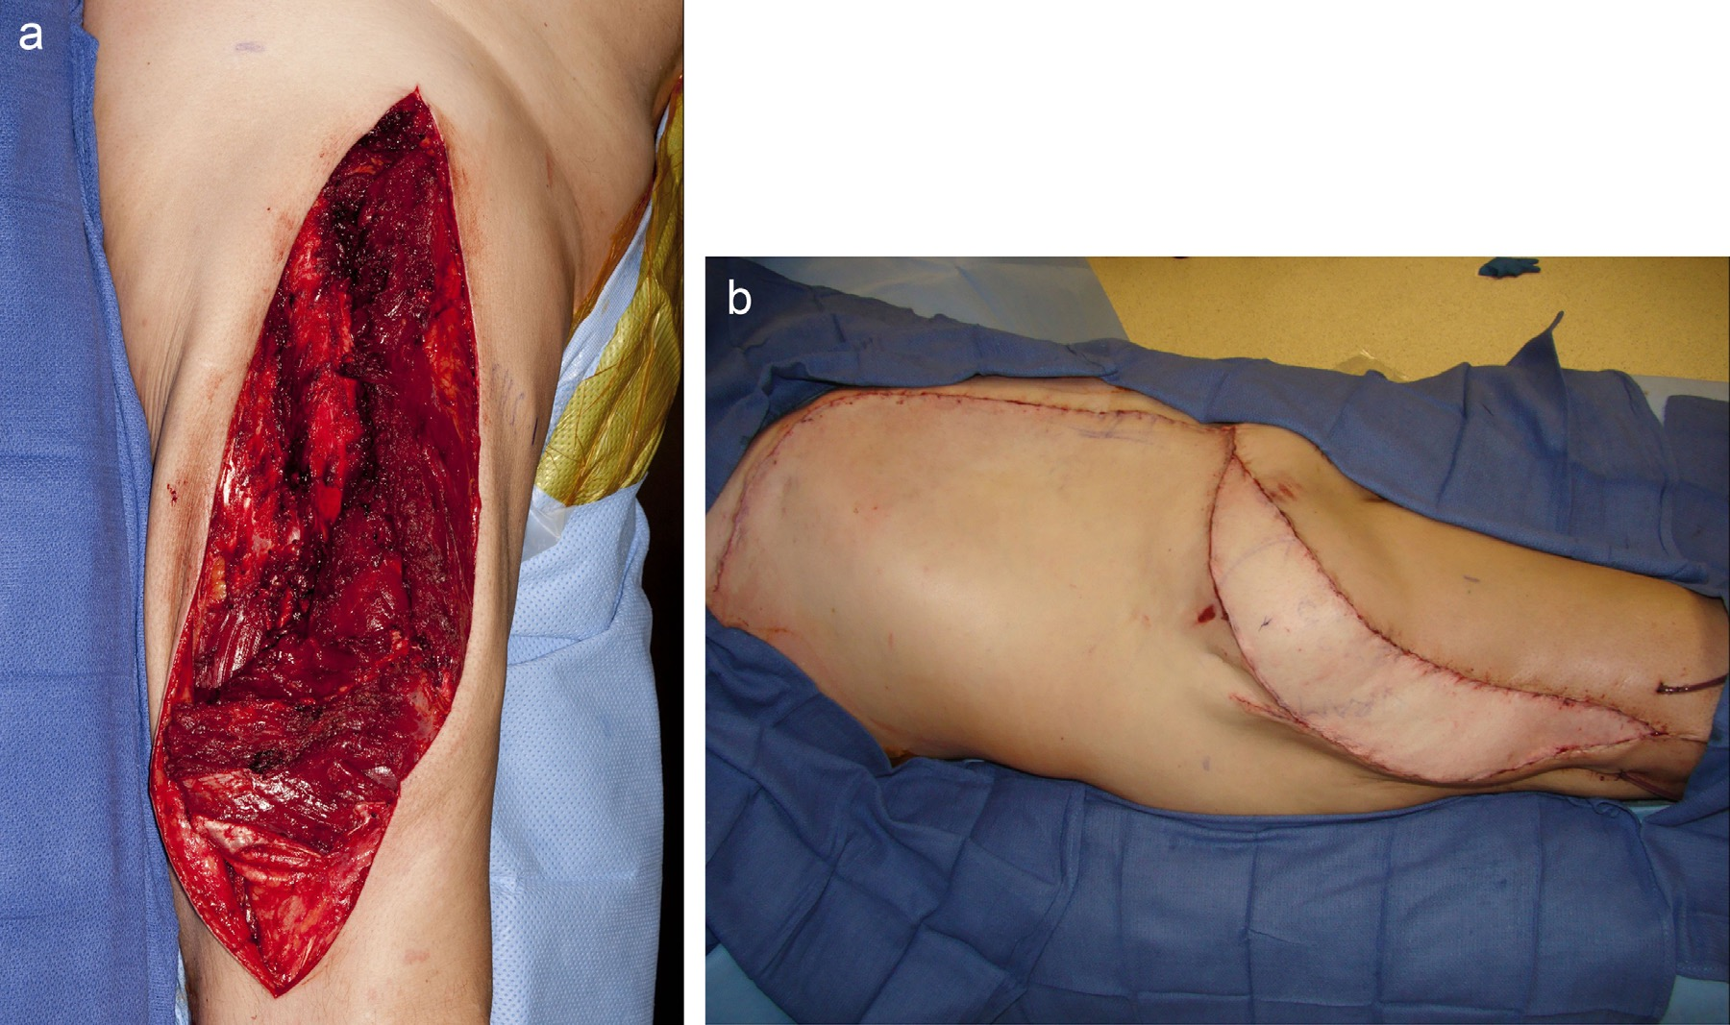
(a) A 64-year-old male with previous inadequate excision of an upper lateral thigh extra-skeletal osteosarcoma and subsequent chemotherapy and radiation now status post re-excision including the skin and subcutaneous tissue with a margin around the previous scar and the vastus lateralis and vastus intermedius muscles with a defect measuring 50 × 16 cm. The defect was reconstructed with an extended VRAM flap. (b) Inset of the flap.

Slide 10
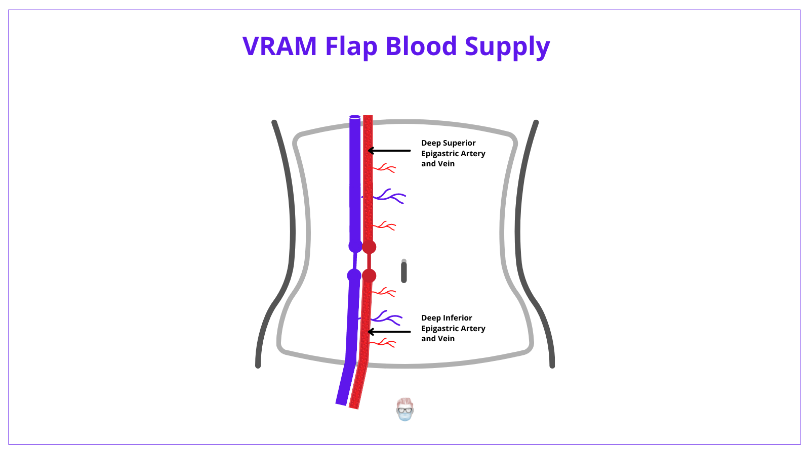

Slide 11
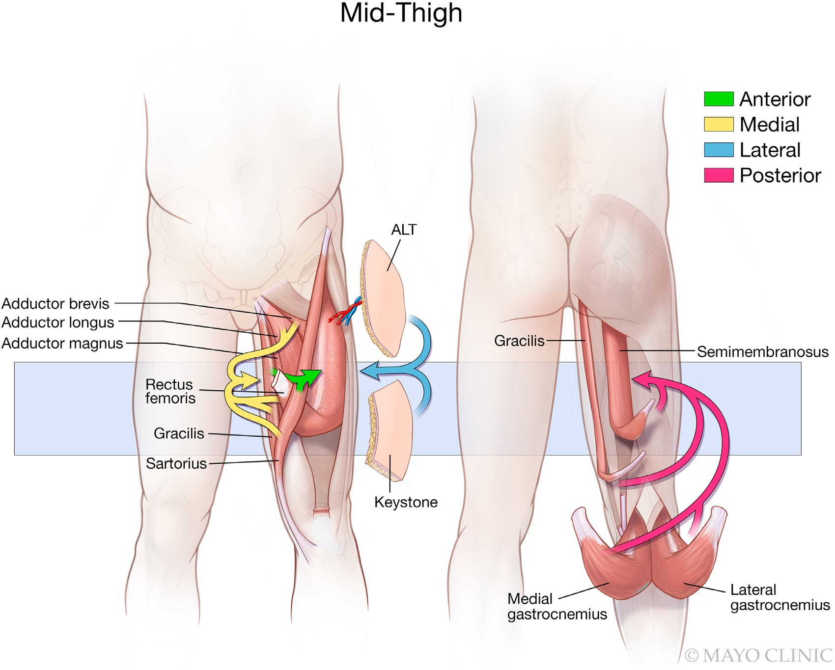
Thigh Reconstruction
Medial thigh defects
Μισχωτοί μυϊκοί
Κρημνοί του μηρού

Slide 12
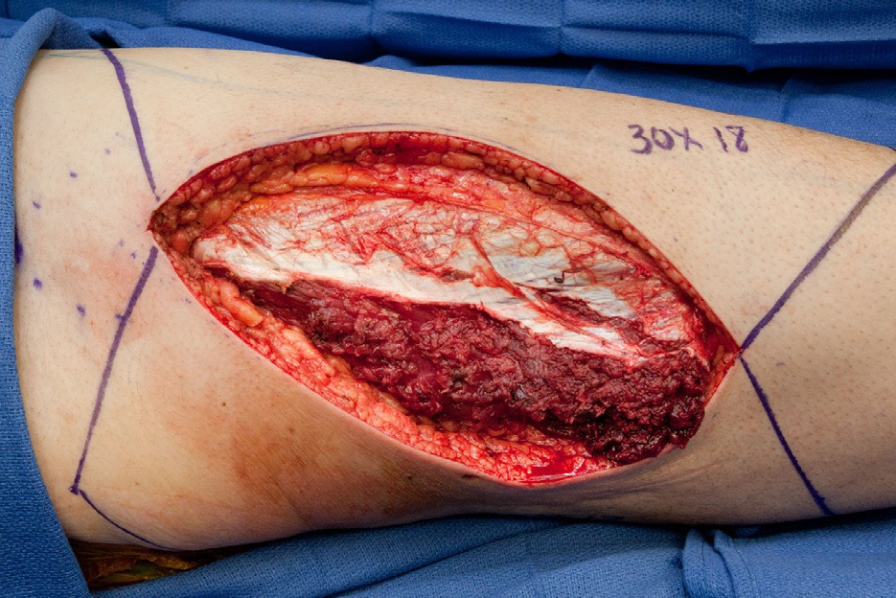
Reconstruction of a defect 30x18 cm after sarcoma excision with double keystone flaps
40X20 and 40X25 cm

Slide 13
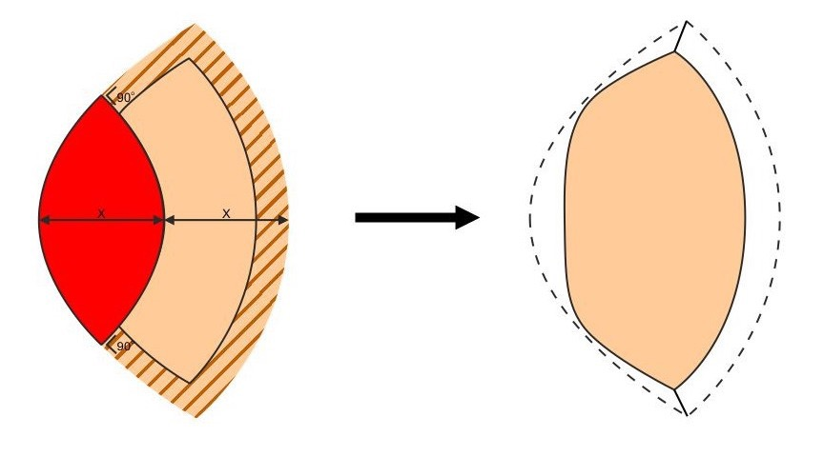
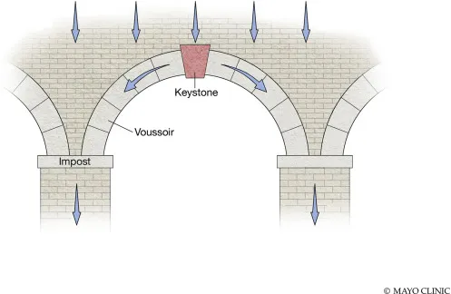
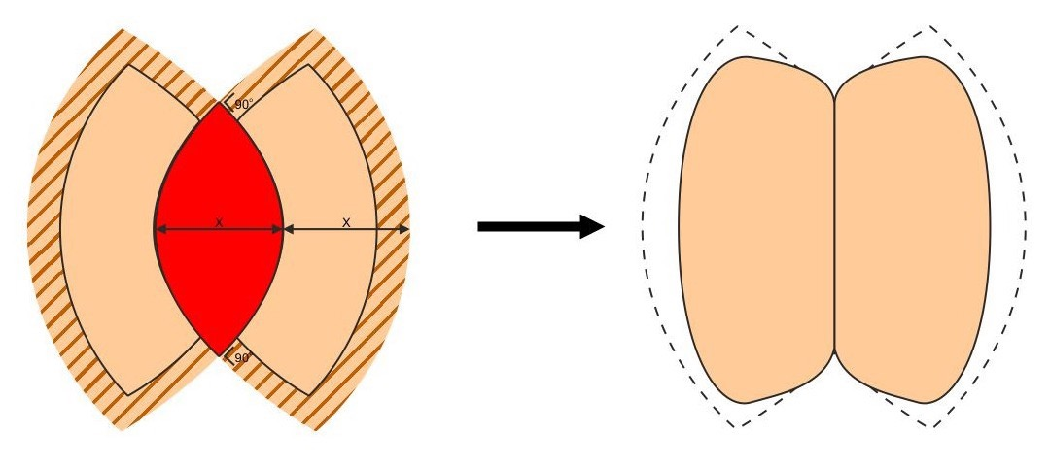

Slide 14
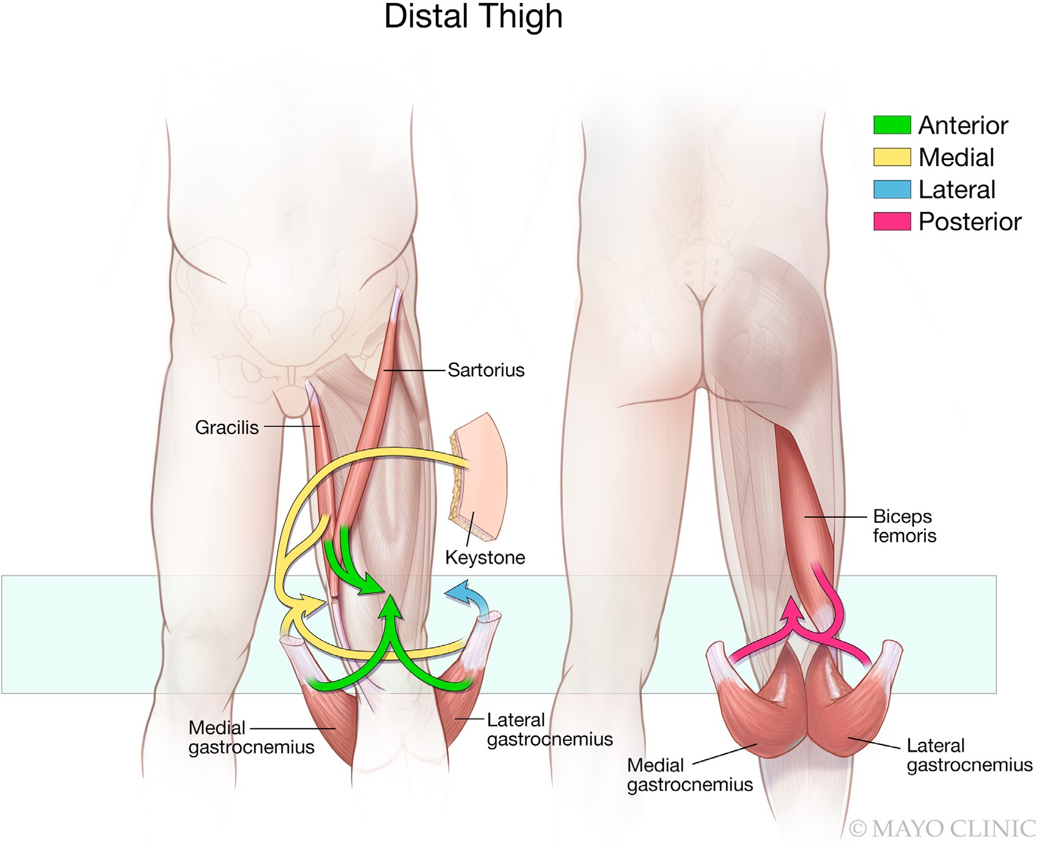
Thigh Reconstruction
distal thigh defects
Πρόσθιος μηρός: Pedicled gastrocnemius and thigh muscle
flaps(gracilis,sartorius),
Έσω μηρός:
pedicled gastrocnemius and thigh muscle
flaps(gracilis)
Οπίσθιος μηρός: pedicled gastrocnemius and biceps femoris

Slide 15
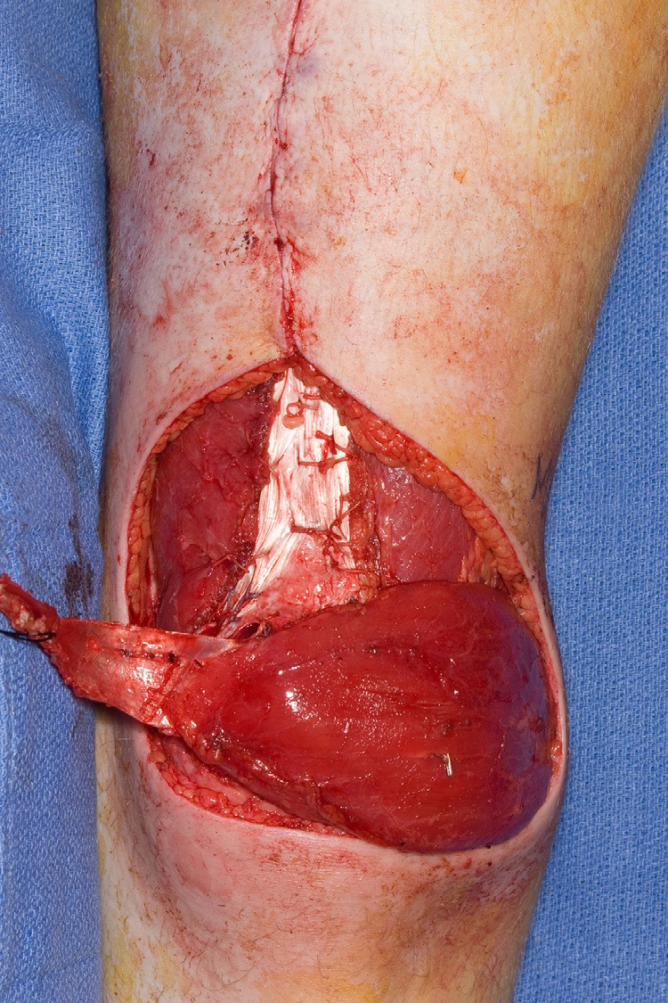
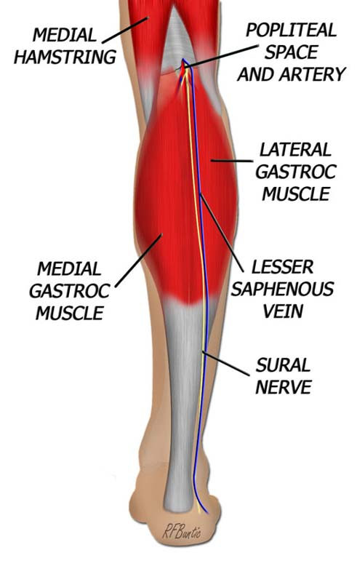
A 21-year-old male with excision of an epitheloid sarcoma of the lower anterior thigh requiring allograft extension mechanism reconstruction. The defect was reconstructed with a pedicled lateral gastrocnemius muscle flap, which was covered with a split-thickness skin graft.

Slide 16
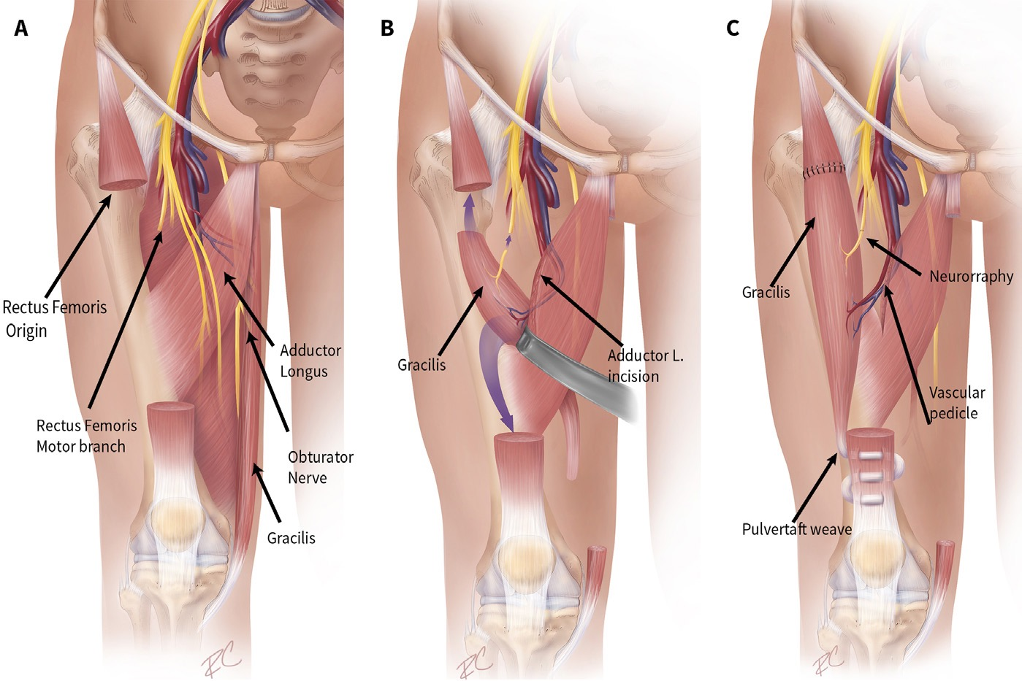
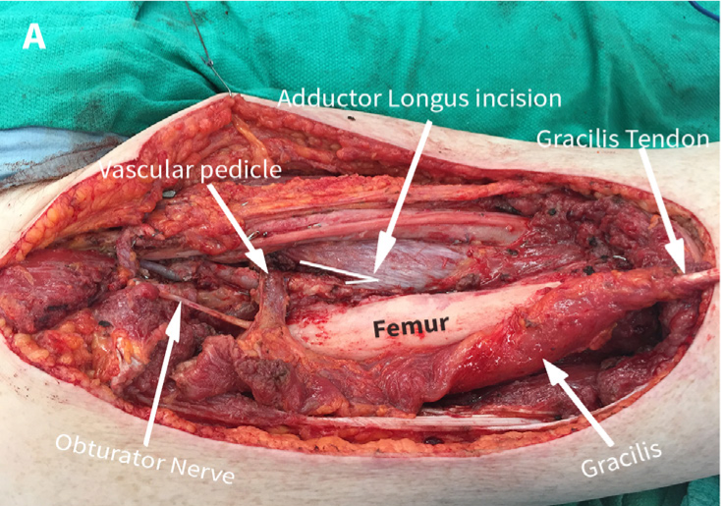
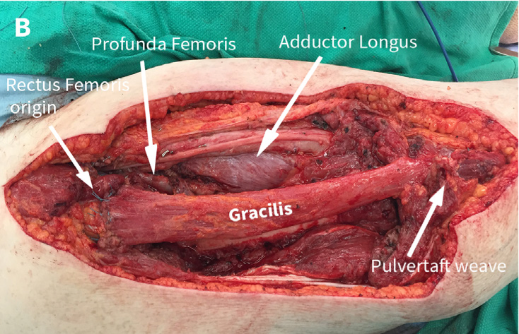
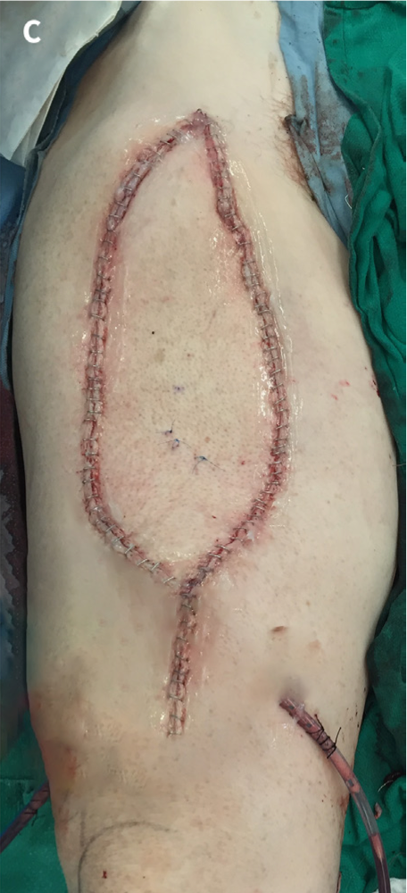
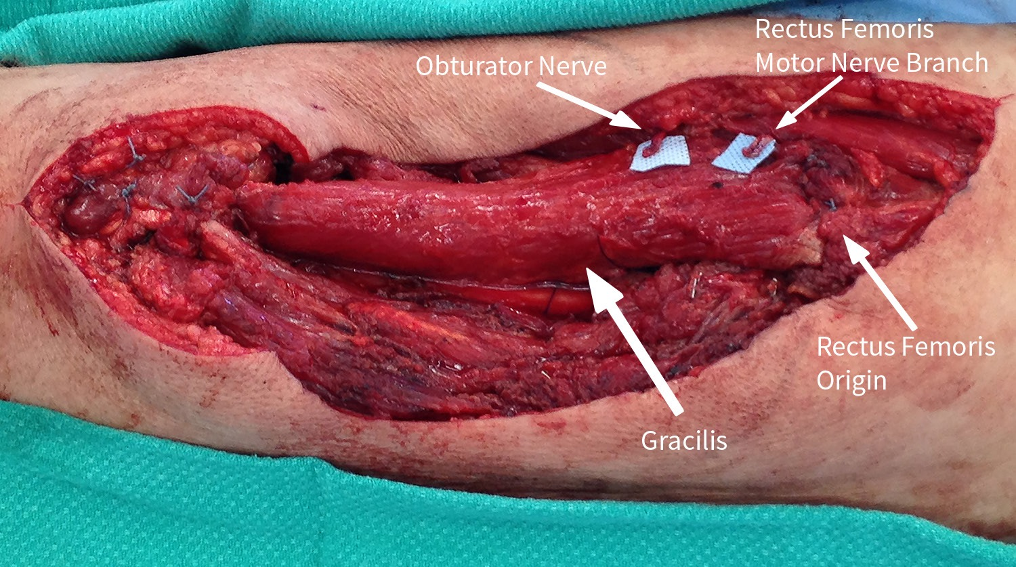
Neurorrhaphy of motor branch of obturator nerve to motor nerve of rectus femoris
A: Pedicled gracilis harvest post-resection. Note the adductor longus releasing incision to prevent pedicle kinking following flap transposition allowing for tension-free inset; B: Gracilis inset in position of rectus femoris; C: Skin defect was covered with free anterolateral thigh flap

Slide 17
Αποκατάσταση κάτω άκρου (άνω,μέσω,κάτω τριτημόριου) μετά απο χειρουργική αφαίρεση σαρκωμάτων.
Επανορθωτική σκάλα
Godina within 75 hours, failure rate: 0.75%, postoperative infection rate: 1.5%,
within 3 days-3 months, failure rate: 12%, postoperative infection rate: 17.5%,
3 months-12.6 years:failure rate: 9.5%, postoperative infection rate: 6%,
NPWT: reconstruction in subacute phase (1-6 weeks) with excellent results
If infection: Vac and debridements before definitive coverage procedure
Management of bone gaps: for bone defects <6 cm nonvascularized cancellous bone graft ,vascularized bone graft for defects >6 cm.Free fibula common and
Distraction osteogenesis for defects>2 cm
Amputation: complete disruption of posterior tibial nerve, serious associated life-threatening injuries, loss of sensation to plantar surface of foot.

Slide 18
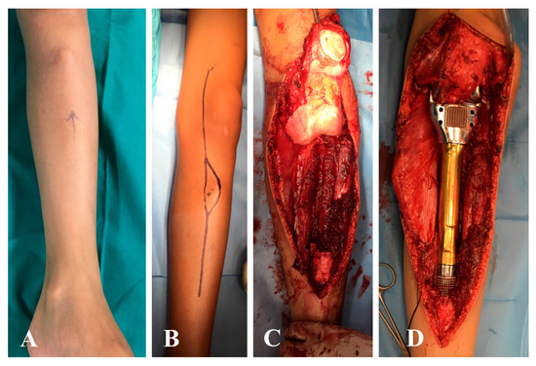
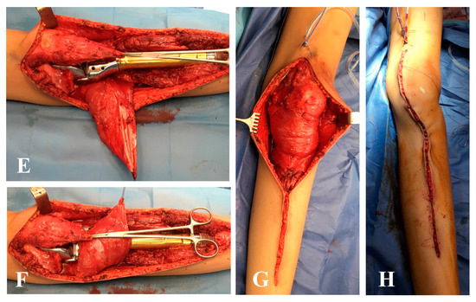
Upper third of leg reconstruction
Gastrocnemius is ideal for proximal leg defects,2nd the soleus
A 12-year-old male with osteosarcoma of the proximal tibia. (A) Swelling is visible in the soft tissue near the tibial tuberosity. (B) Surgical approach including the needle biopsy tract. (C) Surgical field after bone tumor resection and (D) after reconstruction with custom-made expandable prosthesis. (E) Distal detachment and rotation of the medial gastrocnemius muscle; (F,G) coverage of the prosthesis with the medial gastrocnemius and soleus muscle, and attachment of the extensor mechanism with sutures to the medial gastrocnemius. (H) Wound closure at the end of surgery.

Slide 19
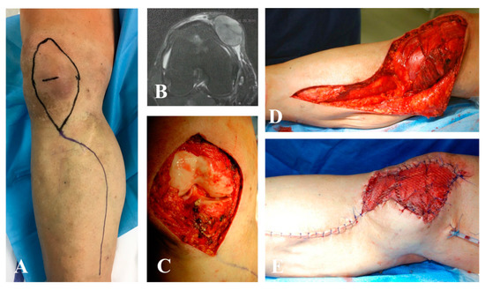
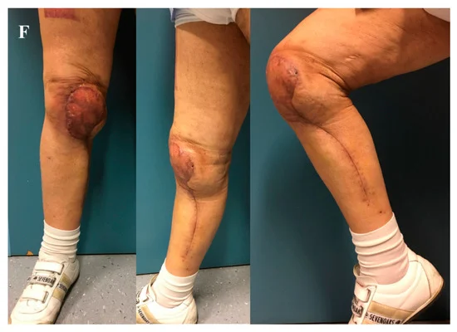
Upper third of leg reconstruction
Gastrocnemius is ideal for proximal leg defects
Wide resection for pleomorphic sarcoma of the right knee after radiotherapy and reconstruction with a pedicled medial gastrocnemius muscle flap and skin graft. (A,B) Preoperative planning is important to avoid basing the flap on perforator vessels located inside the irradiated field. In this case, a muscle flap from the posterior lodge was harvested. (C) Surgical field after wide excision of medial ligament and articular capsule; the defect resulted in the exposition of the knee joint, (D) requiring a stable and safe reconstruction with a muscle flap. (E) The area was covered by partial thickness skin grafts. (F) Clinical results at one-year follow-up.

Slide 20
Medial third of leg reconstruction
Soleus is ideal for proximal leg defects
The wound defect prior to the raising of the hemisoleus muscle flap. B: The medial incision, demonstrating that the hemisoleus muscle has been divided at its insertion, raised and will cover the defect, but it is not yet inset. C: The hemisoleus muscle has been inset, sutured in place and covered with an FTSG. Note the drain in situ within the now closed medial incision. Silk ties were employed to bolster and protect the graft. D: Completely healed now with an STSG at 1 week shy of 6 months.

Slide 21
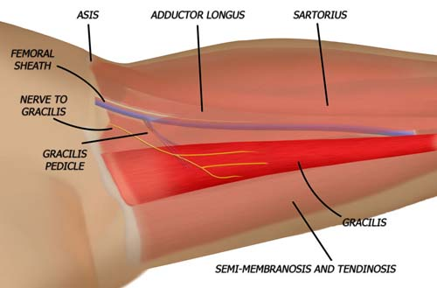
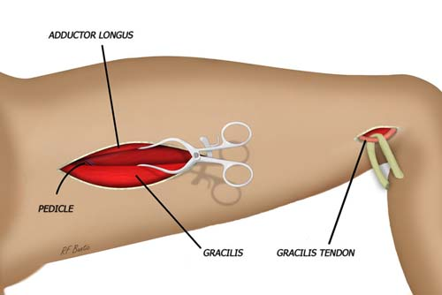
Lower third of leg reconstruction
Free flaps are ideal for lower third of lower limb

Slide 22
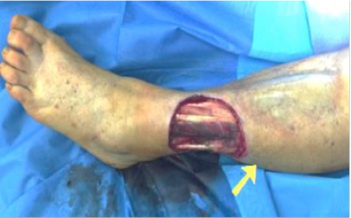
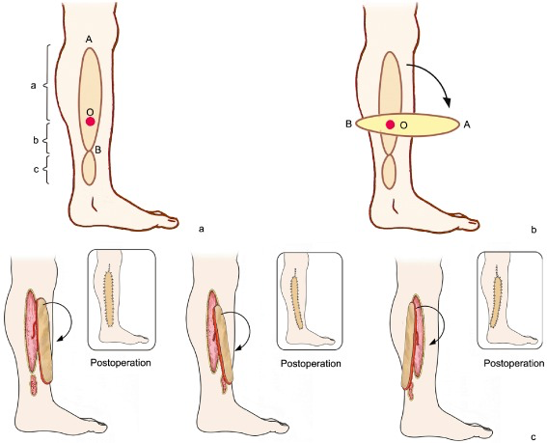
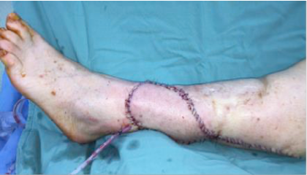
Schematic representation of perforator pedicled propeller flap. (a) Flap design. Preoperative use of color Doppler ultrasound to locate the perforator vessel and ascertain its diameter and blood flow velocity (perforator vessel 2 to 10 cm from the defect with diameter 0.6–1.0 mm, and maximal blood velocity usually selected). O is positioned preoperative of perforator vessel intended position, AB connect as the axis of the flap, a is the longitudinal length of the large paddle, b is the longitudinal length of the small paddle, c is wound defect longitudinal length. (b) The propeller flap is rotated clockwise and counterclockwise to determine the minimum angle required to cover the defect. (c) The donor and recipient area are closed.

Slide 23
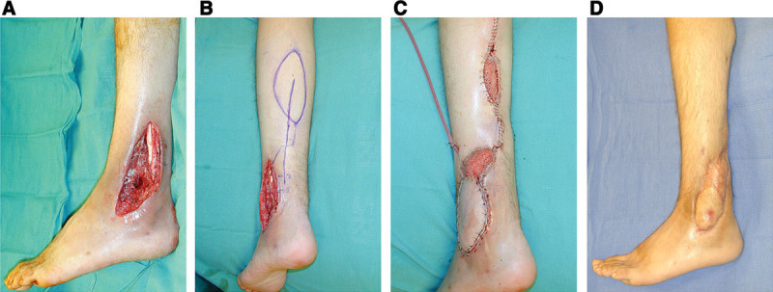
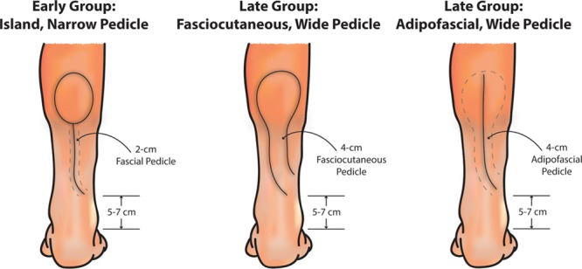
A successful island-type flap design, in the early group. A 20-year-old man with a lateral malleolar defect and fibular fracture. An island-type reverse superficial sural artery flap (RSSAF) was used for coverage of the wound. (A) The lateral malleolar defect after debridement, showing exposed tendon and fibula defect. (B) Outline of the flap. (C) Final wound closure, including skin graft coverage of the donor site and flap pedicle. (D) Healed wound at 4 months.

Slide 24
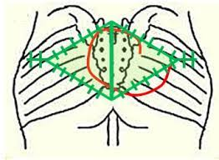
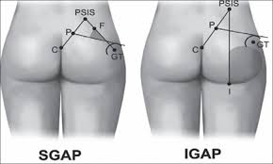
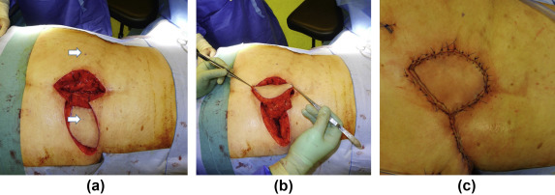

Slide 25
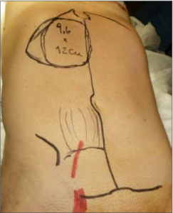
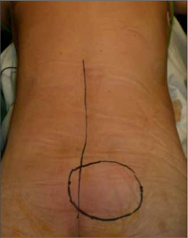
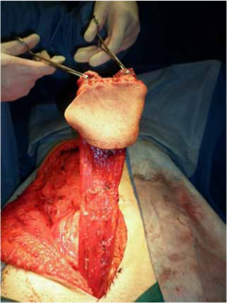
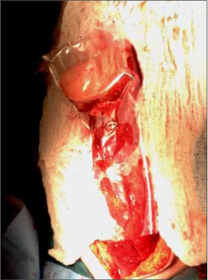
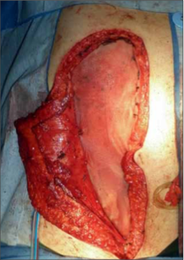
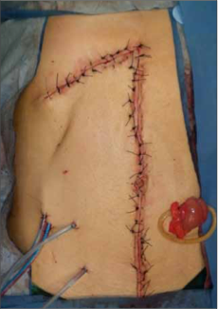
A. Preoperative planning and flap dissection. B. Planning of preoperative defect.
Flap introduced in sterile bag.
Reconstruction of abdominal wall with net.
Musculocutaneous flap based on lower pedicle.

Slide 26
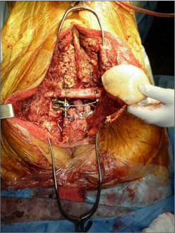
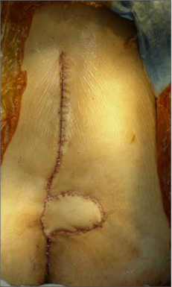
A. Recovery of flap at posterior level. B. Final closure of the cutaneous graft in the defect area.

Slide 27
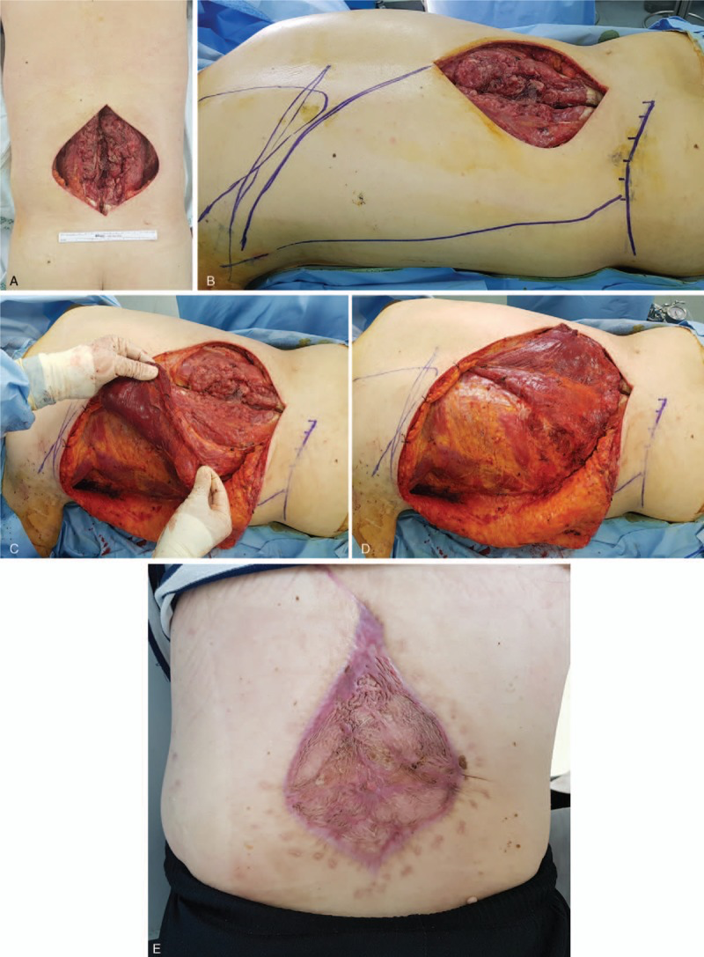
Preoperative (A), intraoperative (B–D), and postoperative (E) clinical photographs of a 41-year-old man (Case 2) who underwent reverse turnover pedicled LD muscle flap for reconstruction of the lower back defect, which was caused by wide resection of the dermatofibrosarcoma protuberans. The last follow-up photograph (D) was taken at postoperative 4 months. LD = latissimus dorsi.

Slide 28
Επανορθωτική σκάλα
Sarcoma tumors meeting
Η επιλογή του καλύτερου κρημνού για κάθε έλλειμμα εξαρτάται από την χειρουργική τεχνική, το ιατρικό ιστορικό του ασθενούς, την χειρουργική εκτομή του μυοσκελετικού όγκου, την ανατομική περιοχή του ελλείμματος, την αιμάτωση της δότριας περιοχής και του χειρουργικού χρόνου. Επίσης σημαντικό ρόλο παίζουν η προεγχειρητική και η μετεγχειρητική ακτινοβολία.
Δεν υπάρχει πλέον “flap of choice” για συγκεκριμένες χειρουργικές αποκαταστάσεις.
Ο προεγχειρητικός σχεδιασμός είναι πολύ σημαντικός, δεύτερες λύσεις και συνδυασμός μικροχειρουργικών τεχνικών όπου κρίνεται απαραίτητο.
Notes:
<αριθμός>

Slide 29
Bibliography
Sarah M. Elswick et al.
A reconstructive algorithm after thigh soft tissue sarcoma resection including predictors of free flap reconstruction,JPRAS, .
https://doi.org/10.1016/j.bjps.2019.04.016
Irena Sakura Rini et al.
A systematic review of the keystone design perforator island flap in the reconstruction of trunk defects, Archives of Plastic Surgery ,https://doi.org/10.5999/aps.2020.00094 • Arch Plast Surg 2020;47:535-541
Christopher M. Nguyen et al.
The technique of utilizing a single gracilis functional muscle transfer to restore quadriceps function following sarcoma surgery, Nguyen et al. Plast Aesthet Res 2019;6:31 DOI: 10.20517/2347-9264.2019.42
Franco L. De Cicco et al.
Rectus abdominis flap for the treatment of lumbosacral coverage defects
ReceivedonOctober30th,2017;acceptedafterevaluationonDecember5th,2017

Slide 30
THANK YOU

