Slide 1
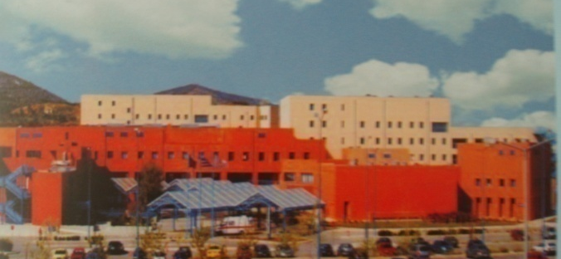
Επιφανειακοί οστικοί όγκοι (περιοστικοί- παροστικοί): Κλινικοεργαστηριακή διαγνωστική προσέγγιση, αρχές θεραπείας
ΠΜΣ “ΜΥΟΣΚΕΛΕΤΙΚΗ ΟΓΚΟΛΟΓΙΑ» 2024
Ολυμπία Παπακωνσταντίνου
Αναπληρώτρια Καθηγήτρια Ακτινολογιας ΕΚΠΑ
Β΄Εργαστηριο Ακτινολογιας Π.Γ.Ν «Αττικον»

Slide 3
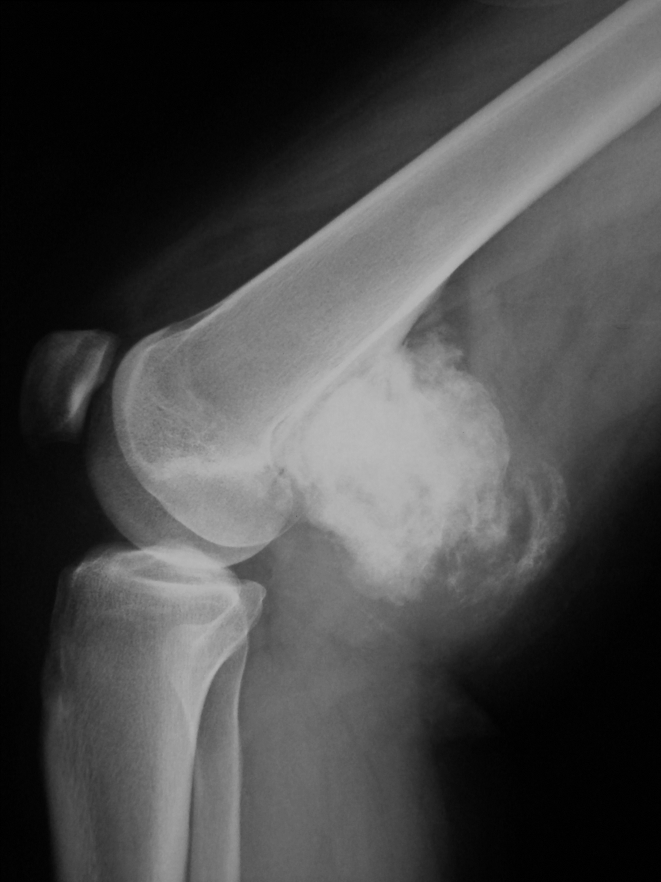
Case 1
Female, 16 yrs old
Lateral radiograph of the knee
- Large ossified opacity (arrows) attached to the posterior cortex of the distal femoral metaphysis. - Ossification is mainly central.
Parosteal osteosarcoma

Slide 4
CT
Sagittal CT reformatted images
- Superior detail the thin separation between the tumor and the intact femoral cortex (“cleft sign” – thin arrow)
- Ossified thick stuck .
- Lytic areas are seen within the ossified mass
- Thick hypodense rim representing cartilagenous tissue.

Slide 5
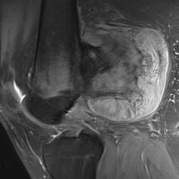
MRI
MRI:
A fat- suppressed T2w
-Densely ossified stuck centrally (arrowheads)
-Inhomogenous moderately T2 hyperintense mass in the middle (asterisk)
-Hyperintense carilagenous component in the periphery (white arrows) . There is no intramedullary extension of the tumor
*

Slide 6
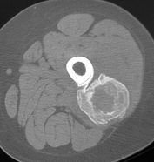
ΔΔ: Παροστικό οστεοσάρκωμα, οστεοποιός μυοσιτιδα, οστεοχόνδρωμα

Slide 7
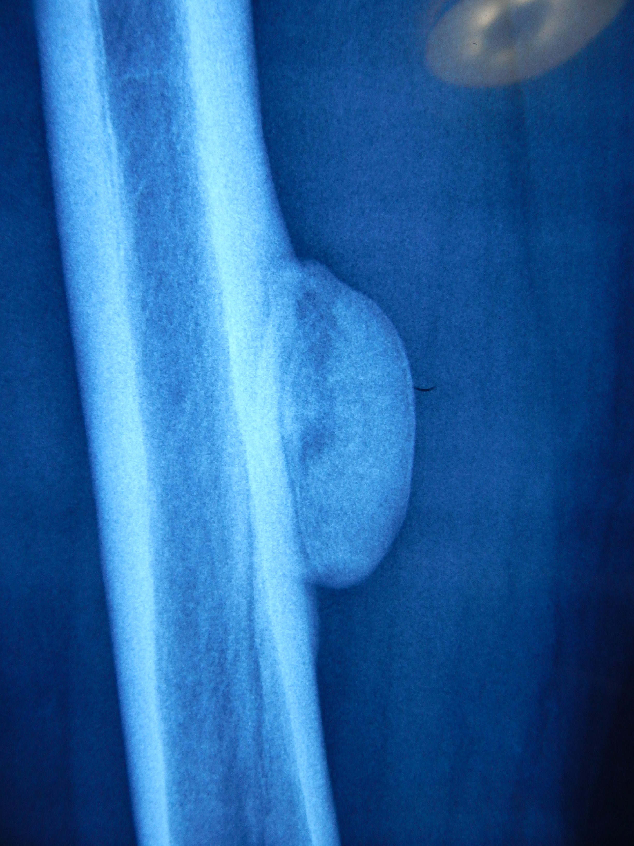
Case 2
Female, 35 yrs old
*
X-rays of the right femur
Smoothly marginated , ground glass density mass adjacent to the femoral cortex.
Cleft sign inferiorly (thin arrow)
Densely ossified stuck centrally (arrow) help to. Benign periosteal reaction (buttressing ) is seen in adjacent cortex (asterisk)
DD: atypical osteochondroma, rare exophytic fibrous dysplasia, cortical osteoma
Parosteal osteosarcoma
Notes:
7

Slide 8
CT
CT confirms the presence of the broad , of cortical density stuck(arrowhead) and the cleft sign (thin arrows ) that separates the ground glass mass (arrows) from the bone cortex
Notes:
8
Ct shows a sharply marginated mineralized mass (arrows) with a broad of cortical density stuck (arrowheads) in continuity with the femoral cortex. The cleft sign is seen (thin arrows ) .

Slide 9
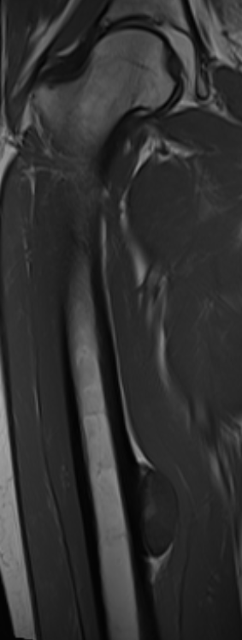
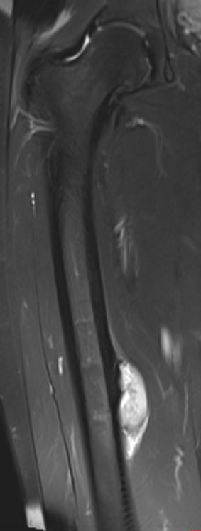
MRI
MRI
Coronal T1w
The diaphyseal mass is mildly hypointense to muscles (arrows) on a image (B) and
Coronal fat-suppressed T2w
inhomogenously hyperintense
The cortex remains intact
MR imaging excludes medullary extension.
PJP/ OS
Notes:
9

Slide 10
Μan, 22-yr-old with swelling at left calf.
AA lateral radiograph of the tibia shows a densely ossified exophytic mass with broad attachment and a proximal cleft sign (arrow).
OP
Parosteal osteosarcoma
Notes:
A lateral radiograph of the tibia (c) shows a typical
parosteal osteosarcoma in a 24-year-oldman with extensive ossification and a proximal cleft sign (arrow). (d) On coronal T2wI, themineralization
leads to hyperintensities within the inhomogeneous tumor appearance. Note the large base to the thickened cortex (arrow) and a hyperintense
central area that corresponds to mature bone marrow. (

Slide 11
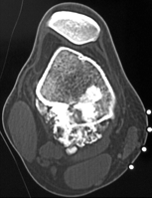
Μan, 22-yr-old
CT
CT shows dense mineralizations within the mass , extending into the medullary cavity (arrowhead)
OP
Notes:
A lateral radiograph of the tibia (c) shows a typical
parosteal osteosarcoma in a 24-year-oldman with extensive ossification and a proximal cleft sign (arrow). (d) On coronal T2wI, themineralization
leads to hyperintensities within the inhomogeneous tumor appearance. Note the large base to the thickened cortex (arrow) and a hyperintense
central area that corresponds to mature bone marrow. (

Slide 12
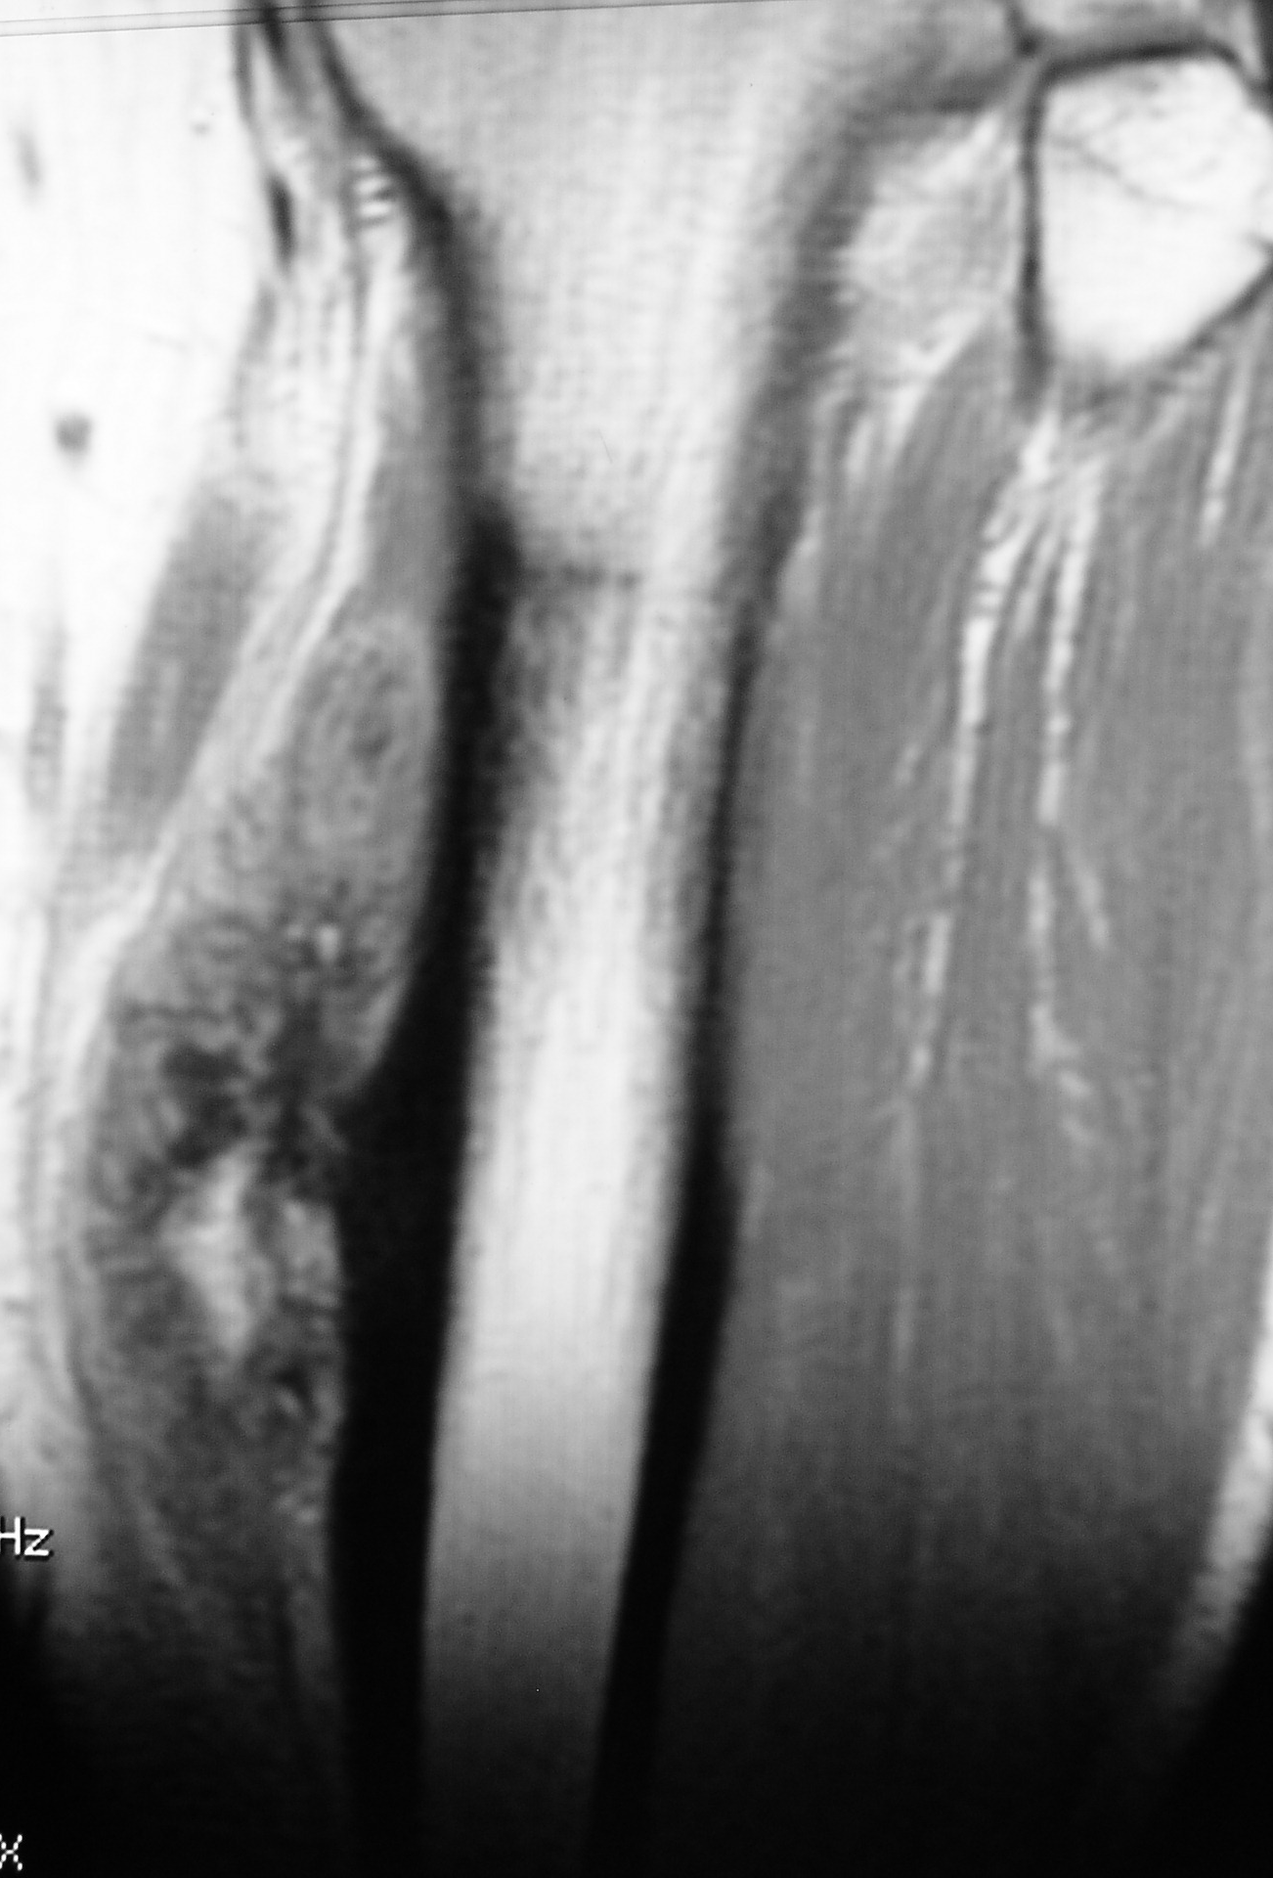
T1
OP
T2 FS
Notes:
A lateral radiograph of the tibia (c) shows a typical
parosteal osteosarcoma in a 24-year-oldman with extensive ossification and a proximal cleft sign (arrow). (d) On coronal T2wI, themineralization
leads to hyperintensities within the inhomogeneous tumor appearance. Note the large base to the thickened cortex (arrow) and a hyperintense
central area that corresponds to mature bone marrow. (

Slide 13
ΜRI, follow up

Slide 14
ΔΔ: εξωφυτικές σκληρυντικές αλλοιώσεις
Παροστικό οστεοσάρκωμα οστεοποιός μυοσίτιδα οστεοχονδρώματα

Slide 15
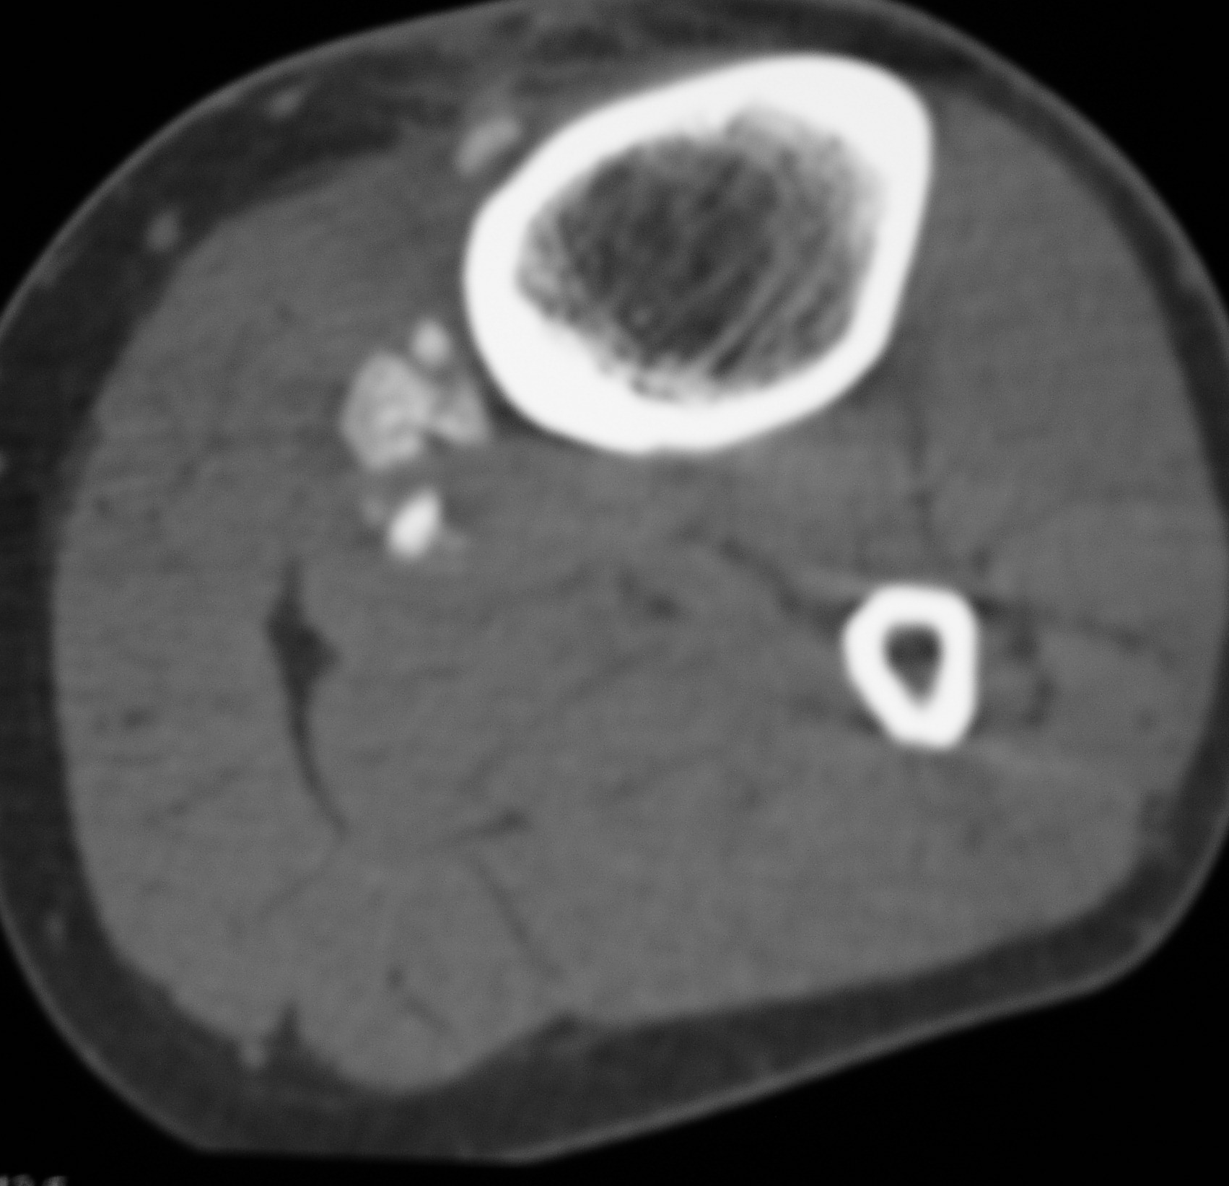
FIG 3. D, E
CT 3 mo follow-up
Follow-up MR imaging three months after surgical excision: inhomogenous soft tissue mass (arrows) at the surgical bed with hypointense non- enhancing areas (arrowhead) CT: as dense mineralizations (D axial image
ΥΠΟΤΡΟΠΗ ΠΑΡΟΣΤΙΚΟΥ ΟΣΤΕΟΣΑΡΚΩΜΑΤΟΣ
OP

Slide 16
Case 3
CT scan shows a cortical broad-based soft tissue mass (arrows) at the distal metaphysis of the left femur which surrounds about 50% of bone circumference.
The tumor contains amorphous calcifications and the adjacent cortex is thickened on this slice.
High-grade surface osteosarcoma

Slide 17
MRI, T2FS ax, cor
The bulky tumor (arrows) originating at the medial site of the left femur. The tumor is moderately hyperintense and presents significant intramedullary extension (arrows) .
At the distal margin of the tumor on the coronal image the bone cortex looks thinned
The neurovascular bundle remains intact in (thin arrow) . Note that the calcifications are not apparent on MR images.

Slide 18
Case 5
Female, 17 yrs old
Frontal radiograph of the humerus
Soft tissue mass (arrows) at the proximal metadiaphysis of the of the left humerus
causing ectosteal scalloping (arrowheads)
Barely seen punctuate and curvelinear calcifications at the periphery and within the mass (arrows) signifying cartilaginous matrix.
Periosteal chondrosarcoma
Notes:
18

Slide 19
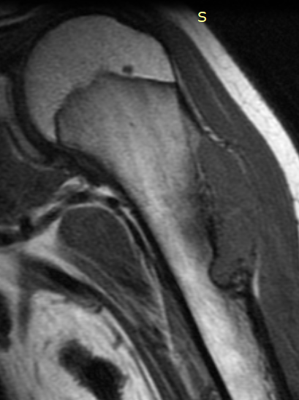
MRI
ΜRI
T1 wt coronal
The mass (arrows) is isointense to muscles
Coronal fat-suppressed MR image
hyperintense with a microlobular contour
Cortex seems intact.
Non-marginated area in the adjacent bone , hypointense on T1w and hyperintense on fat-suppressed T2w image corresponds to bone marrow edema as no malignant infiltration of the medulla was documented on surgery
*
*
Notes:
19

Slide 20
Case 6
A 42 –year old man with abdominal discomfort and deteriorating left hip pain during the last six months.
Frontal radiograph of the pelvis
A soft tissue mass (arrows) with typically cartilaginous rings and arcs calcifications , occupying the left pelvis.
A densely mineralized lesion is seen at the left acetabular roof (arrowheads) .
Secondary peripheral chondrosarcoma

Slide 21
CT image (bone window)
Exostostis with lytic areas within it (arrowheads) ) of the left innominate bone protruding anteriorly and medially.
A space-occupying soft tissue mass with calcified spots (arrows) seems to originate from the osseous protruberance and is displacing the adjacent left wall of the urinary bladder
OP
Notes:
$2 –year old man with … A frontal radiograph of the pelvis shows a bulky soft tissue mass with typically cartilaginous rings and arcs carcifications , occupying the left pelvis. A desely mineralized lesion is seen at the left acetalular roof. B. A CT image (bone window) shows a n exostostis with lytic areas within it (arrow) of the left innominate bone protruding anteriorly and medially. The space occupying soft tissue mass with calcified spots seems to originate from the protruberance and is displacing the adjacent left wall of the urinary bladder originating from the protruberance . The mass is typically hyperintense on a A fat-suppressed T2 w axial image.

Slide 22
MRI
T2 w axial image:
The mass is typically hyperintense
Calcifications are hypointense (arrowheads) Urinary bladder: asterisk .
*
Notes:
$2 –year old man with … A frontal radiograph of the pelvis shows a bulky soft tissue mass with typically cartilaginous rings and arcs carcifications , occupying the left pelvis. A desely mineralized lesion is seen at the left acetalular roof. B. A CT image (bone window) shows a n exostostis with lytic areas within it (arrow) of the left innominate bone protruding anteriorly and medially. The space occupying soft tissue mass with calcified spots seems to originate from the protruberance and is displacing the adjacent left wall of the urinary bladder originating from the protruberance . The mass is typically hyperintense on a A fat-suppressed T2 w axial image.

Slide 23
ΧΟΝΔΡΟΣΑΡΚΩΜΑ
Ευχαριστω για την προσοχή σας
sogofianol@gmail.com
Notes:
$2 –year old man with … A frontal radiograph of the pelvis shows a bulky soft tissue mass with typically cartilaginous rings and arcs carcifications , occupying the left pelvis. A desely mineralized lesion is seen at the left acetalular roof. B. A CT image (bone window) shows a n exostostis with lytic areas within it (arrow) of the left innominate bone protruding anteriorly and medially. The space occupying soft tissue mass with calcified spots seems to originate from the protruberance and is displacing the adjacent left wall of the urinary bladder originating from the protruberance . The mass is typically hyperintense on a A fat-suppressed T2 w axial image.

