Slide 1
Clinical Signs and findings
Sophia Lionaki

Slide 2
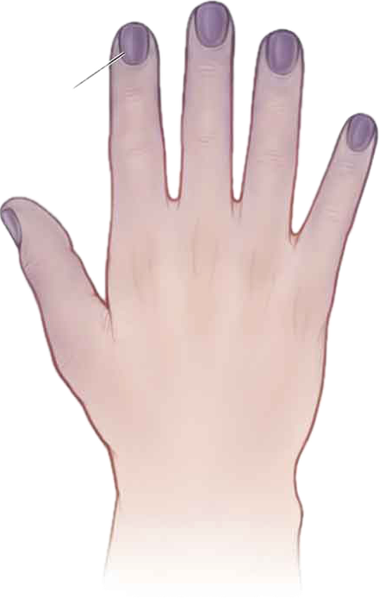
Cyanosis
Cyanosis is when your skin, lips and/or nails turn a bluish tone. It occurs when your blood lacks the oxygen it needs to reach the different tissues in your body. Cyanosis can be caused by many different conditions. Some may be serious medical conditions. Diagnosis and treatment depend on the cause. Oxygen therapy is usually a first treatment.
Cyanosis can mean your organs, muscles and tissues aren’t getting the amount of blood they need to function properly.

Slide 3
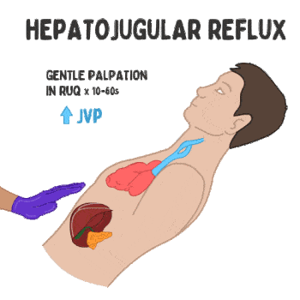
Hepatojugular reflux
The hepatojugular reflux, as presently defined, consists of a distention of the neck veins when pressure is applied over the liver.
With a competent heart, pressure on the liver does not elevate the venous blood level in the neck veins when the subjects are in the semirecumbent position
The hepatojugular reflux is a maneuver to help determine possible heart failure exacerbation or other conditions which could increase venous pressures. This is often performed if JVD is not obvious but clinical suspicion remains.
Apply gentle pressure over the RUQ or mid-abdomen for 10-60 seconds, and watch for increased JVD

Slide 4
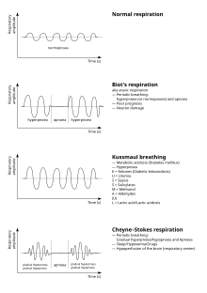
Kussmaul breathing
is a deep and labored breathing pattern often associated with severe metabolic acidosis, particularly diabetic ketoacidosis (DKA) but also kidney failure. It is a form of hyperventilation, which is any breathing pattern that reduces carbon dioxide in the blood due to increased rate or depth of respiration.

Slide 5
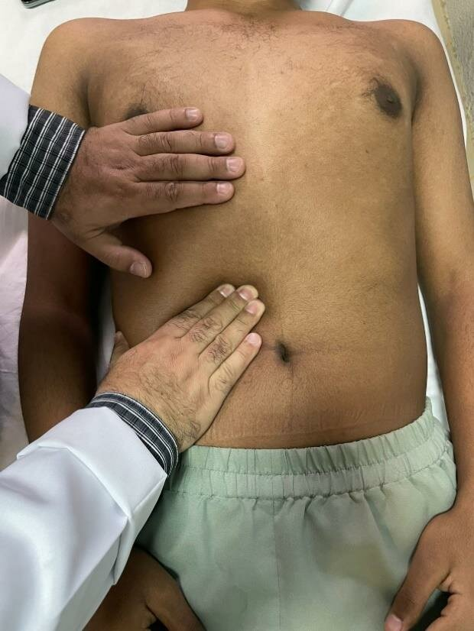
Murphy's sign
Murphy's sign is tested during an abdominal examination in supine position; I
t is performed by asking the patient to breathe out and then gently placing the hand below the costal margin on the right side at the mid-clavicular
line (the approximate location of the gallbladder). The patient is then instructed to breathe in.
Normally, during inspiration, the abdominal contents are pushed downward as the diaphragm moves down (and lungs expand). If the patient stops breathing in (as the gallbladder is tender and, in moving downward, comes in contact with the examiner's fingers) and winces with a "catch" in breath, the test is considered positive. In order for the test to be considered positive, the same maneuver must not elicit pain when performed on the left side.

Slide 6
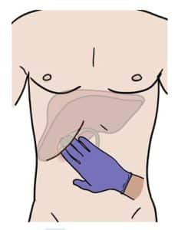
HOW TO TEST FOR MURPHY’S SIGN
To check for Murphy’s sign, place your fingers firmly in the patient’s right upper quadrant underneath the patient’s ribs, and ask the patient to take a deep breath. This is considered deep subcostal palpation, and on inspiration, the diaphragm pushes the gallbladder towards your palpating fingers, which should be painful if the gallbladder is inflamed.
A positive’s Murphy sign is indicated when during inspiration, the patient has an acute increase in pain that will often cause them to stop inspiring mid-way through their breath. In true acute cholecystitis – this is often positive as Murphy’s sign as high sensitivity (97%) for acute cholecystitis, however, it is much less specific (48%) – this means that it could indicate other pathology within the liver or surrounding area.

Slide 7
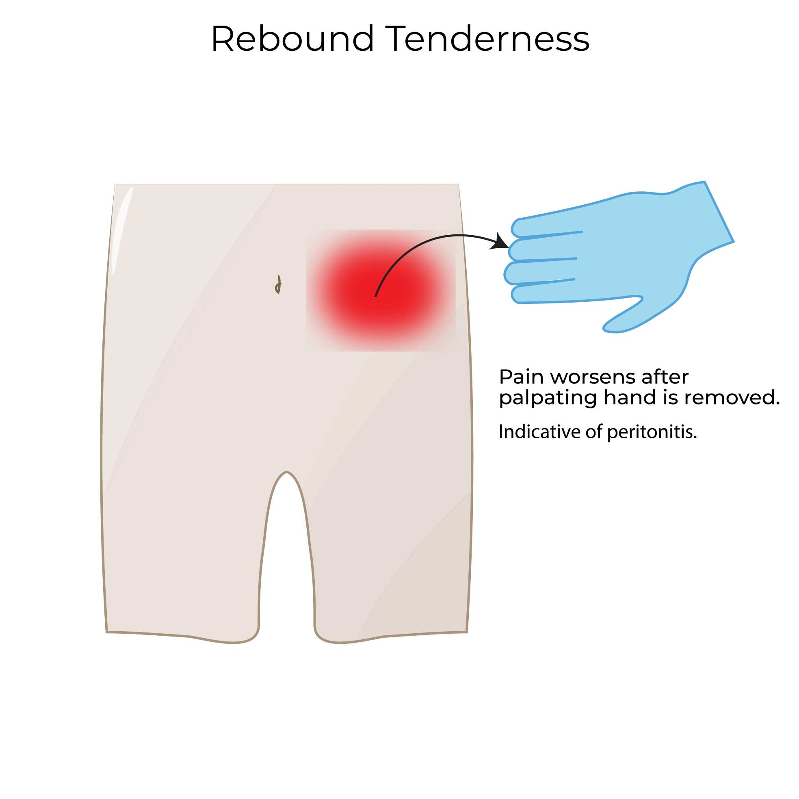
Rebound tenderness Blumberg sign
Rebound tenderness means that there is more pain when pressure on the tender area is released. It occurs when the tissue that lines the abdominal cavity (the peritoneum) is irritated, inflamed, or infected

Slide 8
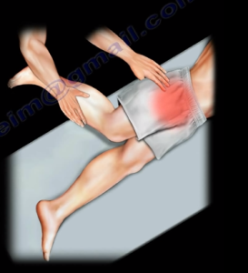
Psoas sign
The psoas (or iliopsoas sign) refers to right lower quadrant pain elicited with flexion of the hip against resistance. It may be seen in association with inflammation of a retrocecal appendix.

Slide 9
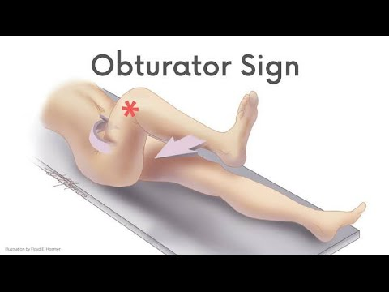
The obturator sign is right lower quadrant pain elicited with internal rotation of the hip.
Again, this is suggestive of inflammation of the appendix.

Slide 10
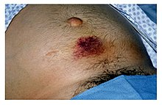
Cullen's sign
Cullen's sign is superficial edema and bruising in the subcutaneous fatty tissue around the umbilicus.
It is named for gynecologist Thomas Stephen Cullen (1869–1953), who first described the sign in ruptured ectopic pregnancy in 1916.
This sign takes 24–48 hours to appear and can predict acute pancreatitis, with mortality rising from 8–10% to 40%. It may be accompanied by Grey Turner's sign (bruising of the flank), which may then be indicative of pancreatic necrosis with retroperitoneal or intra-abdominal bleeding.

Slide 11
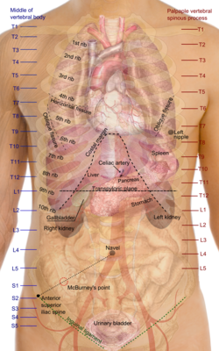
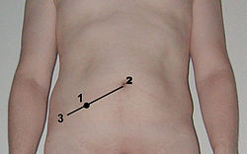
McBurney’s sign
Τυπικά σημεία της οξείας σκωληκοειδίτιδας είναι το σημείο (άλγος στη ψηλάφηση του δεξιού λαγονίου βόθρου), το σημείο της αναπηδώσας ευαισθησίας (άλγος κατά την απότομη άρση των χεριών από την κοιλιά λόγω ερεθισμού του τοιχωματικού περιτοναίου).

Slide 12
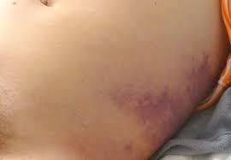
Σημείο Grey Turner

Slide 13
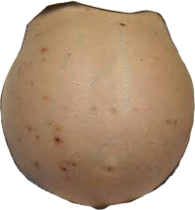
Βατραχοειδής κοιλία

Slide 14
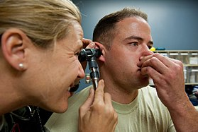
Valsalva maneuver
Valsalva maneuver is performed by a forceful attempt of exhalation against a closed airway, usually done by closing one's mouth and pinching one's nose shut while expelling air, as if blowing up a balloon.
Variations of the maneuver can be used either in medical examination as a test of cardiac function and autonomic nervous control of the heart, or to clear the ears and sinuses (that is, to equalize pressure between them) when ambient pressure changes, as in scuba diving, hyperbaric oxygen therapy, or air travel.

Slide 15
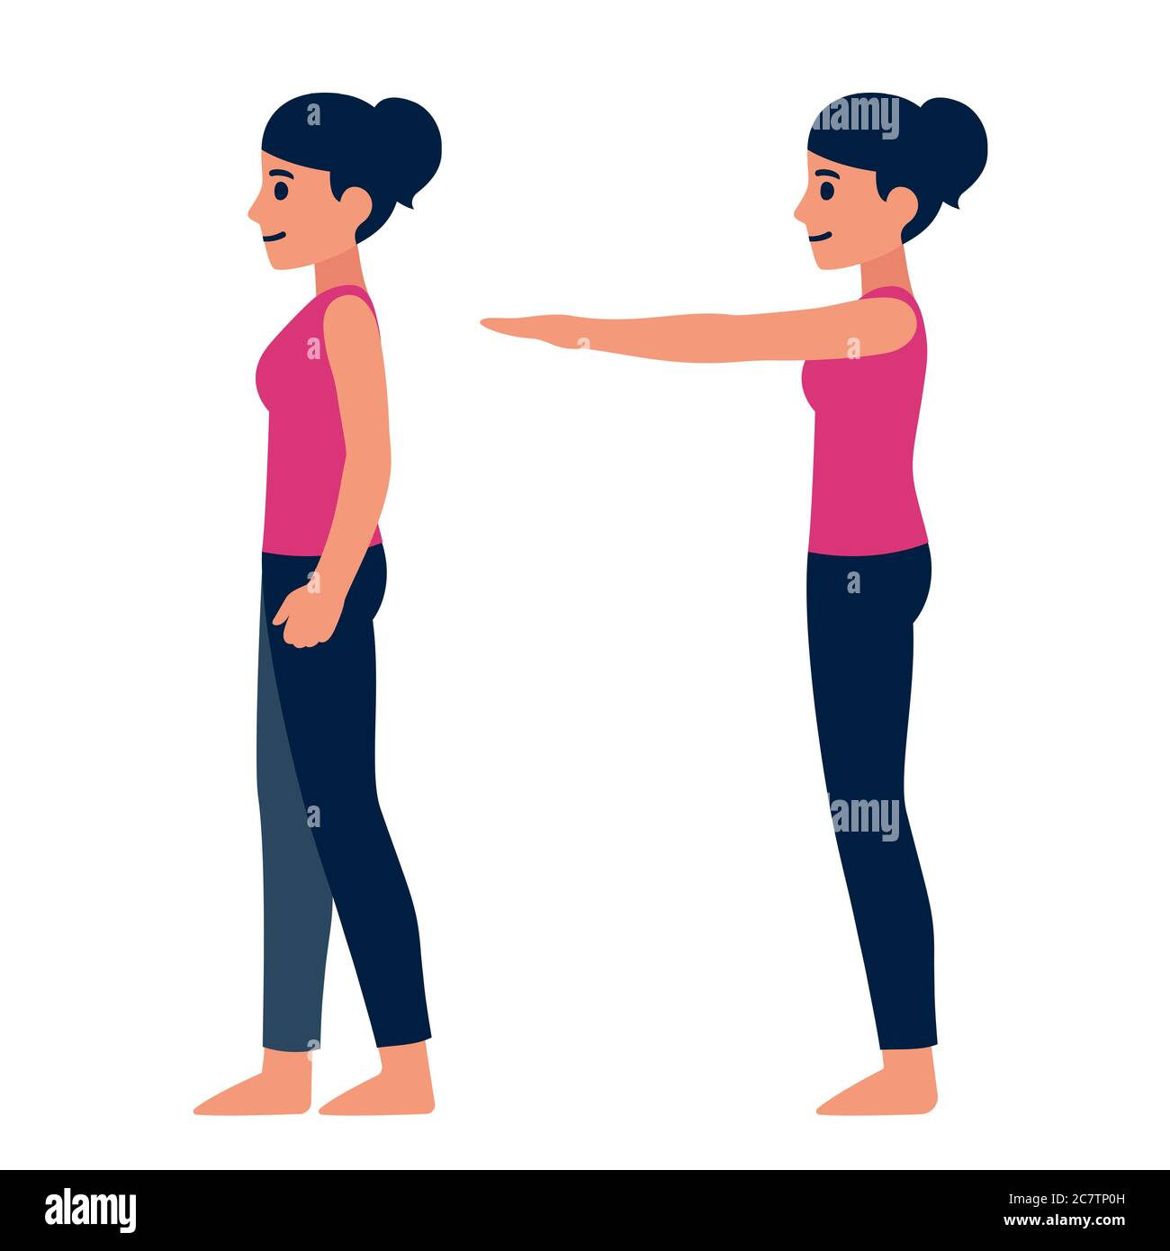
Romberg's test
Romberg's test, Romberg's sign, or the Romberg maneuver is a test used in an exam of neurological function for balance.
The exam is based on the premise that a person requires at least two of the three following senses to maintain balance while standing:
Proprioception (the ability to know one's body position in space)
Vestibular function (the ability to know one's head position in space)
Vision (which can be used to monitor and adjust for changes in body position).

Slide 16
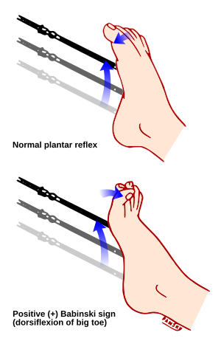
Babinski
The reflex occurs upon stroking of the sole of the foot with a blunt object such as a pen. If the reflex occurs in adults as illustrated at bottom it may be due to nerve damage or disease.

Slide 17
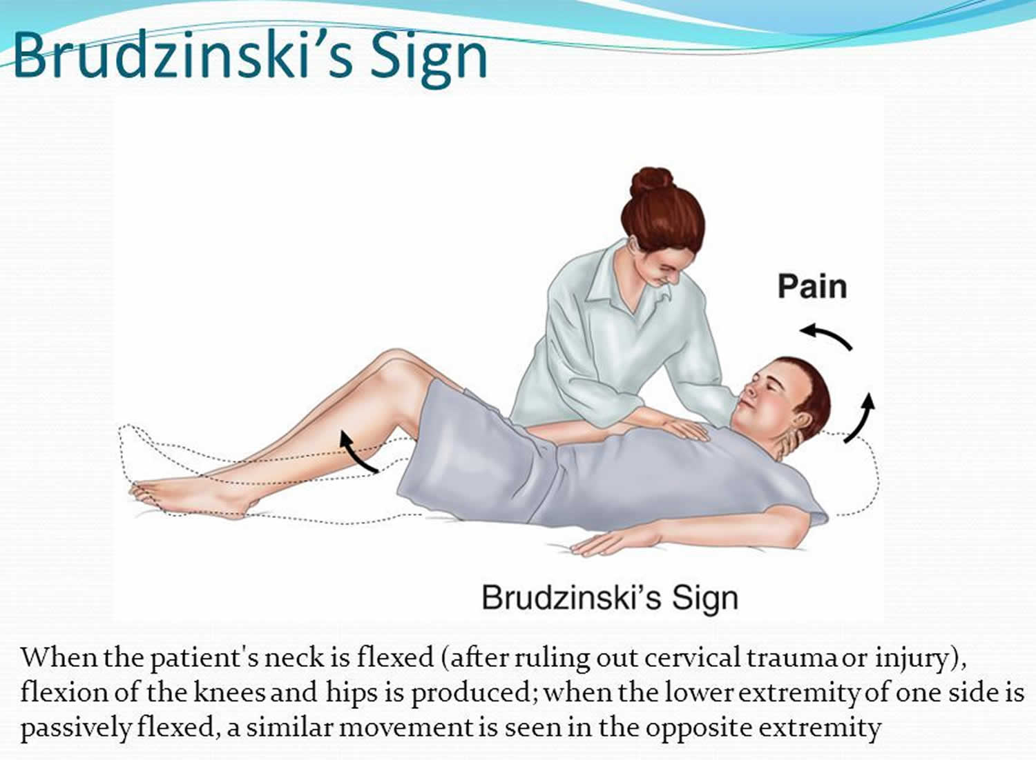
Brudzinski's sign
Brudzinski's sign is characterized by reflexive flexion of the knees and hips following passive neck flexion.
To elicit this sign, the examiner places one hand on the patient's chest and the other hand behind the patient's neck.

Slide 18
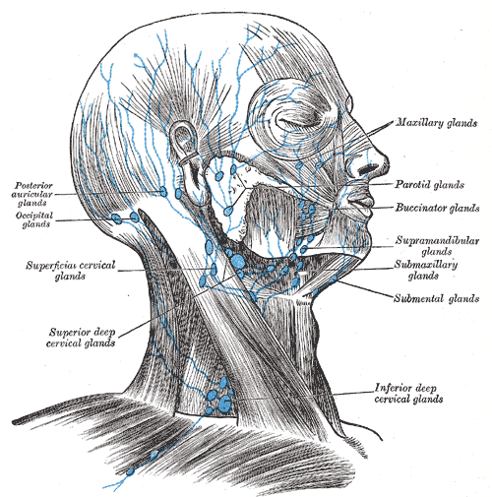
Virchow's nodes
Supraclavicular lymph nodes are lymph nodes found above the clavicle, that can be felt in the supraclavicular fossa. The supraclavicular lymph nodes on the left side are called Virchow's nodes.
It leads to an appreciable mass that can be recognized clinically, called Troisier sign.

Slide 19
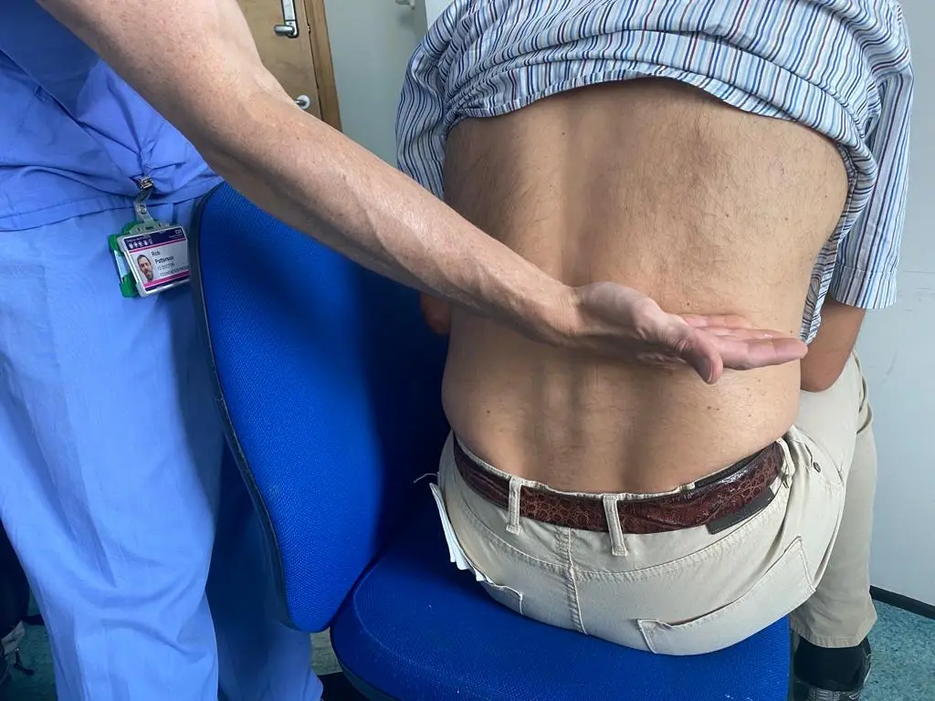
Giordano sign
A common sign in people with kidney infection or kidney stones is Giordano's sign, which refers to tenderness upon percussion to the costovertebral angle, formed by the angle between the 12th rib and the lumbar spine.

Slide 20
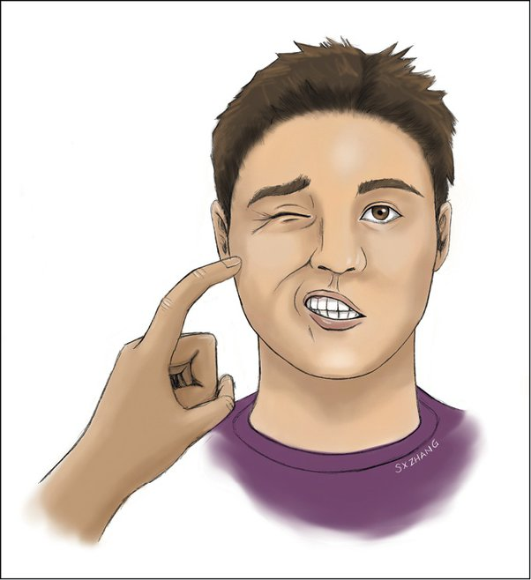
Chvostek sign
The increased irritability of the facial nerve, manifested by twitching of the ipsilateral facial muscles on percussion over the branches of the facial nerve, came to be known as Chvostek sign.
This clinical finding has become widely accepted in the medical community as a sign of hypocalcemia.

Slide 21
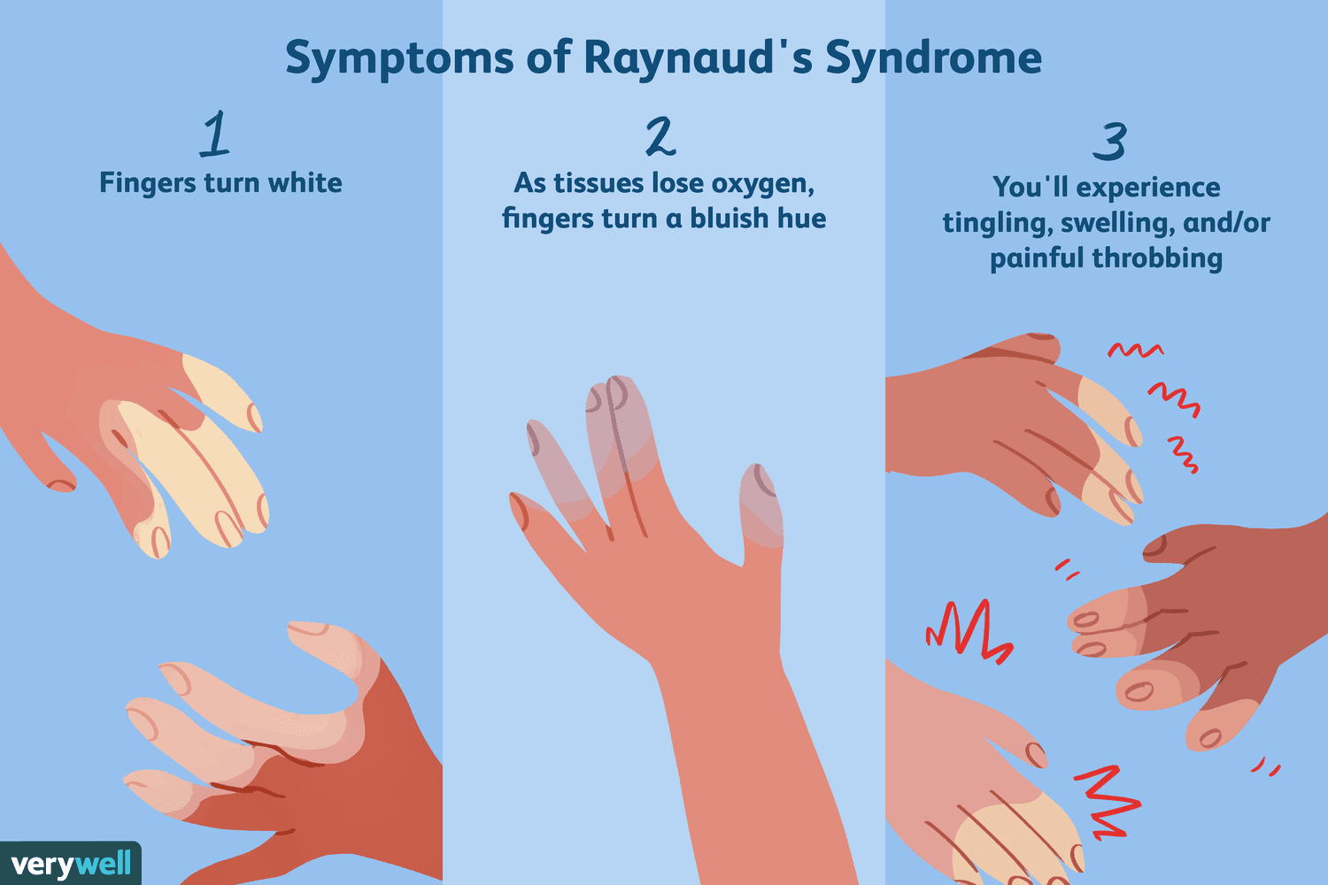
Raynaud’s
Symptoms of Raynaud's include fingers that turn pale or white then blue when exposed to cold, or during stress or emotional upset. They then turn red when the hands are warmed and blood flow returns. Managing Raynaud's means not being cold, dressing warmly, and stopping smoking.

Slide 22
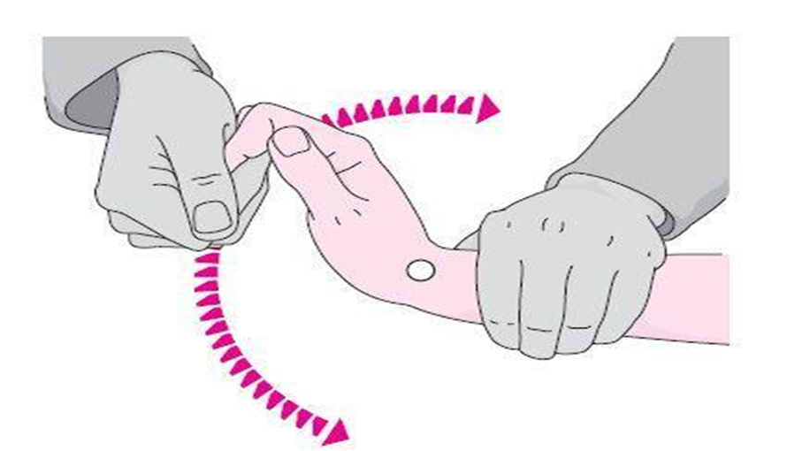
Σημείο οδοντωτού τροχού
Εμφανίζεται με δύο κλινικές μορφές: την δυσκαμψία τύπου « οδοντωτού τροχού » όταν τα άκρα του ασθενούς κατά την παθητική κίνηση μίας άρθρωσης δίδουν την εντύπωση γίνονται σημείο προς σημείο, όπως πχ κινείται ο δείκτης ενός ρολογιού ή την δυσκαμψία τύπου « μολυβδοσωλήνα» όταν η κίνηση γίνεται με διαδοχική δυσκολία όπως ...

Slide 23
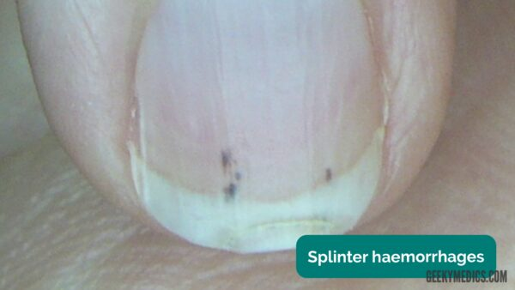
Splinter haemorrhages are caused by small emboli becoming lodged in nailbed capillaries causing secondary haemorrhage.
Causes include:
Local trauma
Infective endocarditis
Sepsis
Vasculitis
Psoriatic nail disease

Slide 24
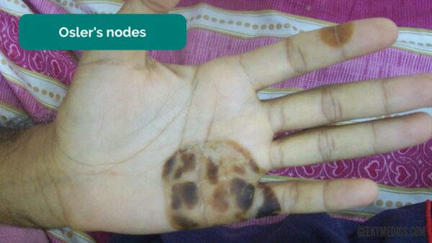
Osler’s nodes
Osler’s nodes are red-purple, slightly raised, tender lumps that often have a pale centre. These lesions are typically found on the fingers or toes and are associated with infective endocarditis.

Slide 25
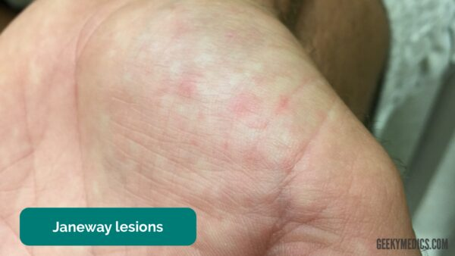
Janeway lesions
Janeway lesions are non-tender, haemorrhagic lesions that occur on the thenar and hypothenar eminences of the palms and soles. Janeway lesions are typically associated with infective endocarditis.

Slide 26
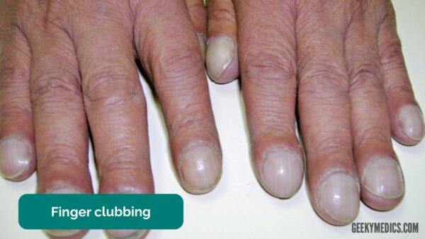
finger clubbing
Finger clubbing involves uniform soft tissue swelling of the terminal phalanx of a digit with subsequent loss of the normal angle between the nail and the nail bed.
Finger clubbing is associated with several underlying disease processes including:
Congenital cyanotic heart disease
Infective endocarditis
Atrial myxoma
Bronchiectasis
Lung cancer
Cystic fibrosis
Inflammatory bowel disease

Slide 27
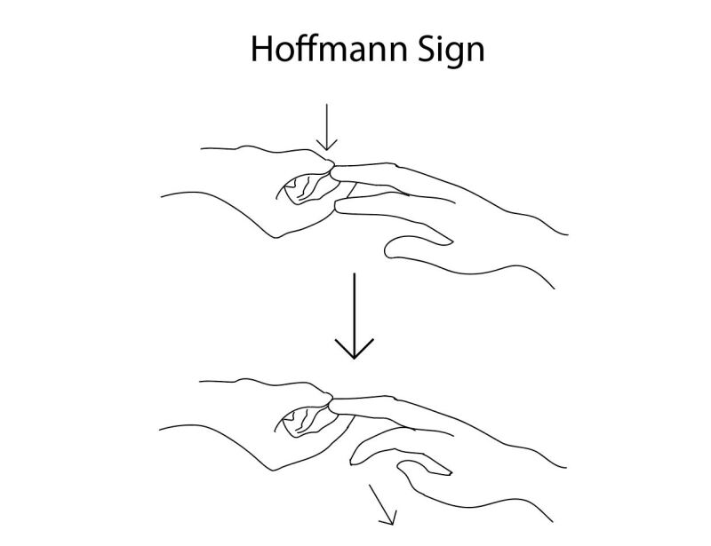
A positive Hoffmann sign indicates an upper motor neuron lesion and corticospinal pathway dysfunction likely due to cervical cord compression.
However, up to 3% of the population has been found to have a positive Hoffman without cord compression or upper motor neuron disease.

Slide 28
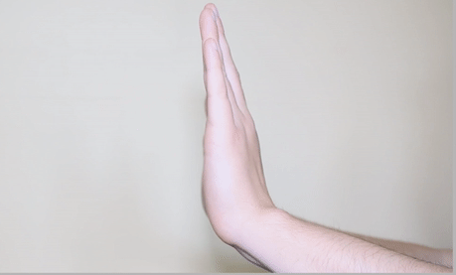
Asterixis
Asterixis (also known as ‘flapping tremor’) is a type of negative myoclonus characterised by irregular lapses of posture causing a flapping motion of the hands.
Causes of asterixis include:
CO₂ retention (e.g. COPD)
Uraemia
Hepatic encephalopathy

Slide 29
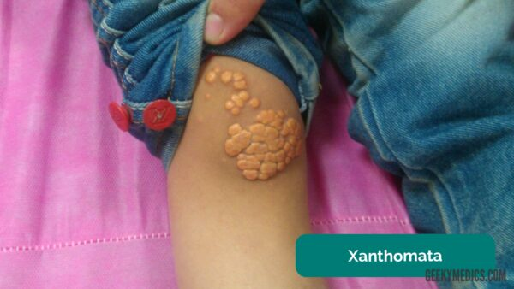
Xanthomata
Xanthomata are raised yellow cholesterol-rich deposits that are often noted on the palm, tendons of the wrist and elbow.
Xanthomata are associated with hyperlipidaemia (typically familial hypercholesterolaemia), an important risk factor for cardiovascular disease.

Slide 30
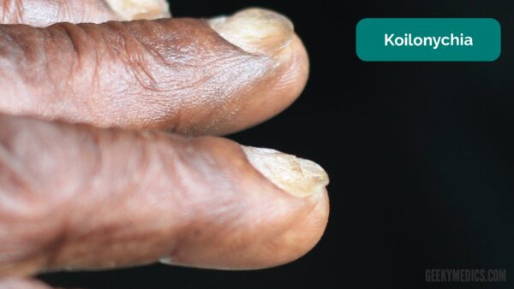
Koilonychia
Koilonychia refers to spoon-shaped nails.
Causes include:
Iron deficiency anaemia (e.g. Crohn’s disease)
Lichen planus
Rheumatic fever

Slide 31
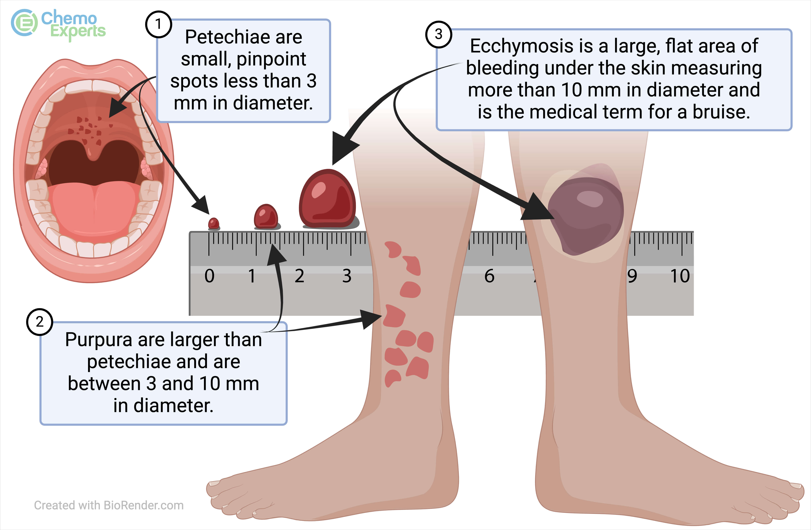
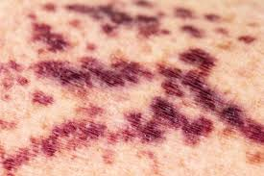
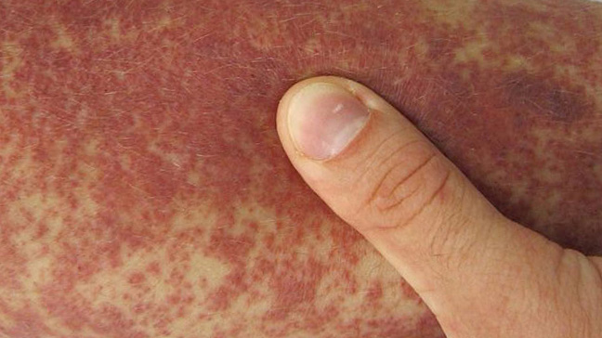

Slide 32
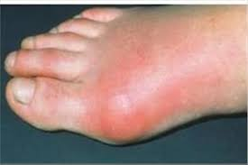
Ουρική αρθρίτιδα
Πρήξιμο της άρθρωσης
Ερυθρότητα
Θερμότητα
Έντονη ευαισθησία

