Slide 1
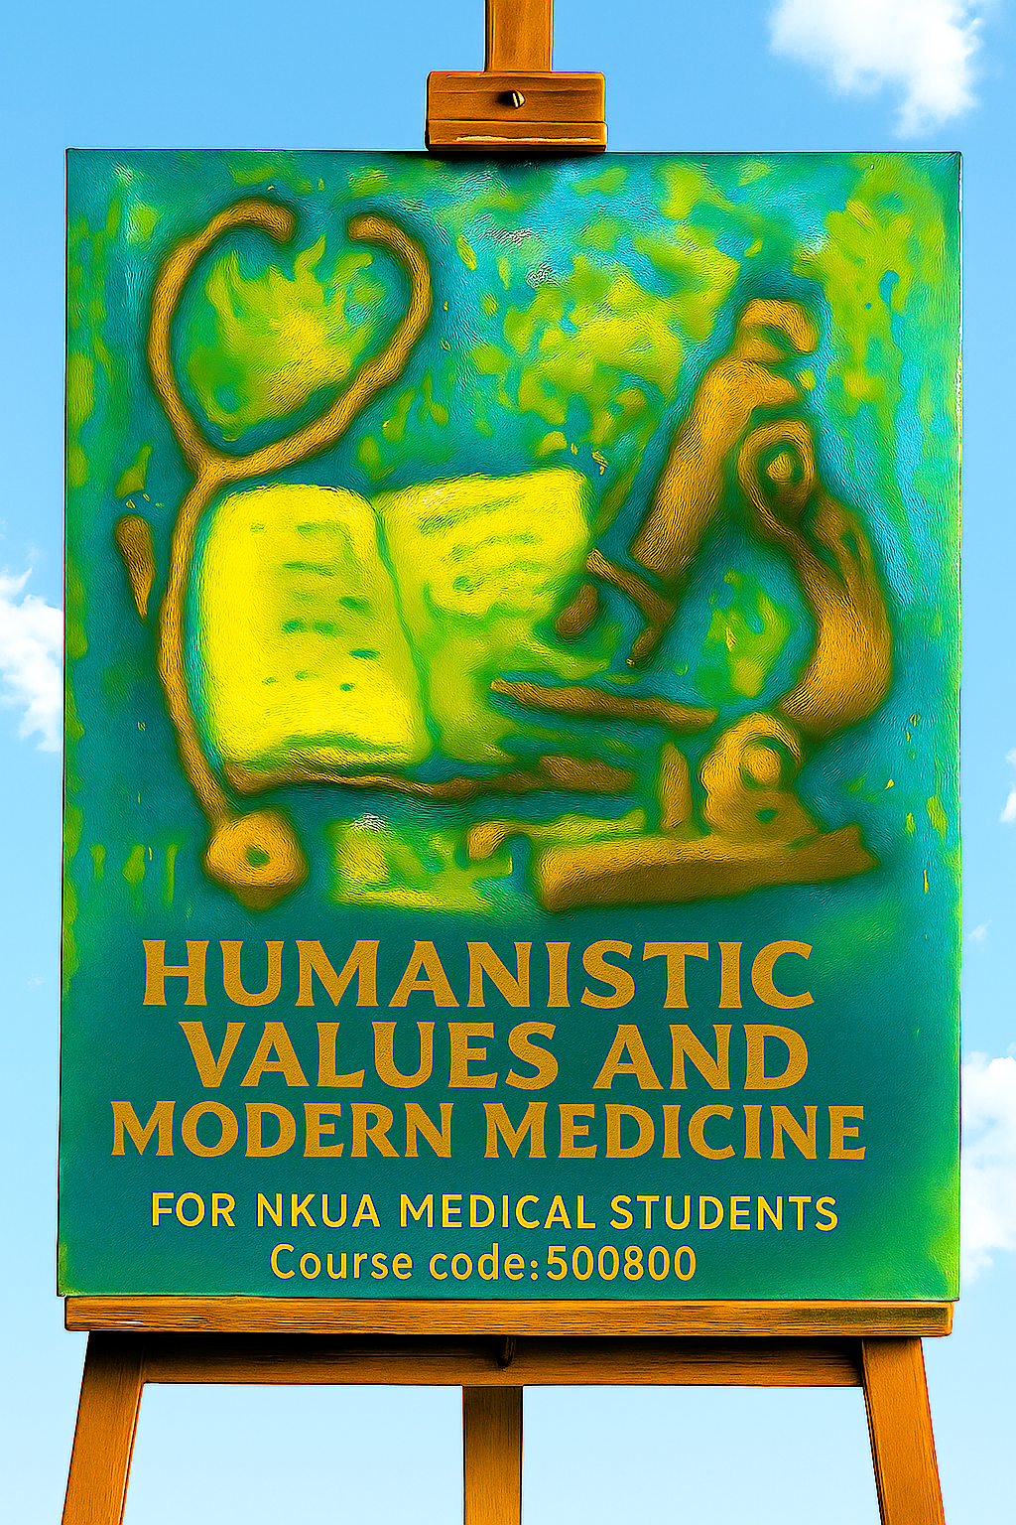

Embodied Learning: Cultivating Empathy Through Multi-Sensory Experience in Medical Education
Andreas C. Lazaris, Maria Giannari, Anatoli Em. Argyrou, Agnes Mariakaki
First Department of Pathology, School of Medicine, National and Kapodistrian University of Athens | MindSearch

Slide 2



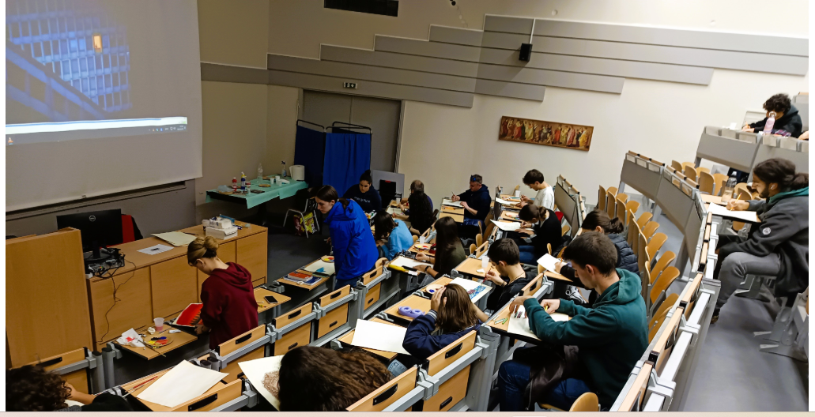








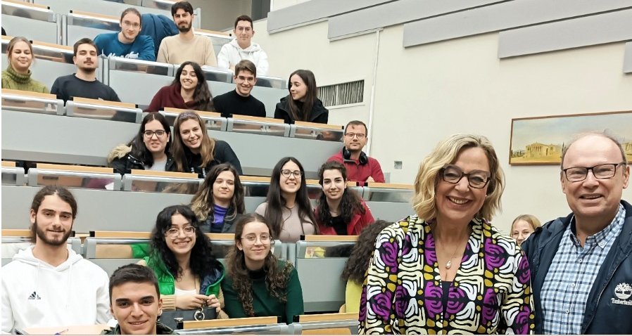






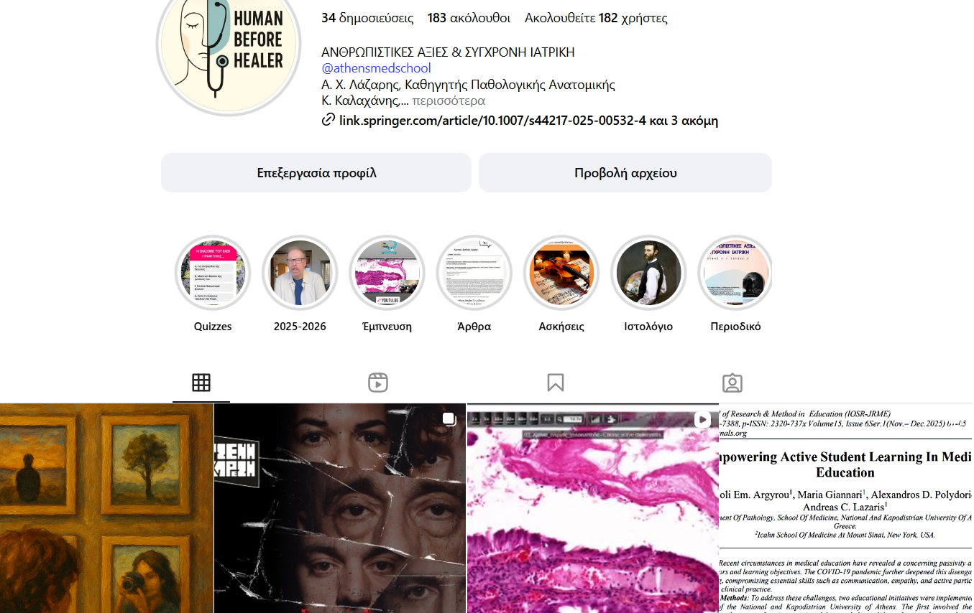
The Problem & Innovative Solution
PAINTING
WORKSHOP
The Problem
The Solution
Empathy Decline: Levels decrease during clinical training
EMPATHY
WORKSHOP
Multi-Sensory: Poetry, film, music, arts excursions
Hidden Curriculum: Emotional neutrality as professionalism
Experiential: Role-play, kinesthetic exercises
Traditional Methods: Lectures ineffective for empathy
Emotional Engagement: Bypasses cognitive defenses

Slide 3



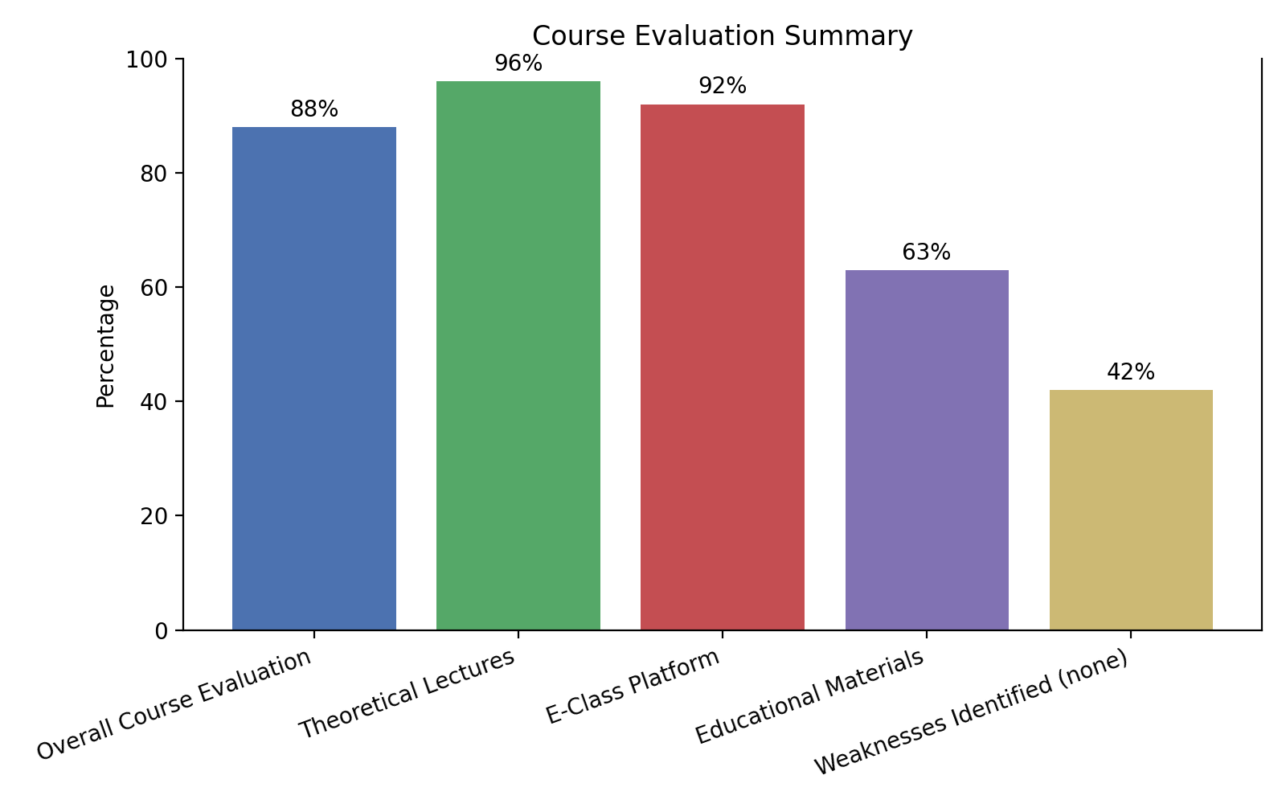







Outstanding Results & Future Impact
Student Satisfaction
Student Feedback
"A jewel in the curriculum"
"After an exhausting day, this course provides mental peace"
Future Impact
Address the "hidden curriculum"
Train future medical educators
Key Conclusions
Experiential learning fosters empathy
Multi-sensory approaches engage emotions

