Slide 1

Διδακτική Ενότητα: Κοινοί μοριακοί μηχανισμοί που συμμετέχουν στην ανάπτυξη καρδιομεταβολικών νοσημάτων
Βιοχημεία αθηροσκλήρωση - Βιοχημικοί δείκτες οξέων ισχαιμικών συνδρόμων - Μοριακές θεραπείες
Ευάγγελος Οικονόμου
Επίκουρος Καθηγητής Καρδιολογίας, Γ’ Πανεπιστημιακή Καρδιολογική Κλινική,
Γ.Ν.Ν.Θ.Α «Η Σωτηρία»

Slide 2
Atherosclerosis-The root of all cardiovascular evil
Χρόνια πάθηση των αρτηριών μεγάλου και μεσαίου μεγέθους.
Σκλήρυνση λόγω πάχυνσης του αρτηριακού τοιχώματος, με συνέπεια την απώλεια της ελαστικότητάς του και τη στένωση του αυλού.

Slide 3
Atherosclerosis-The root of all cardiovascular evil
Ένας στους τρεις θανάτους
Ένα καρδιακό επεισόδιο ανά 4 δευτερόλεπτα
Ένα αγγειακό εγκεφαλικό επεισόδιο ανά 5 δευτερόλεπτα

Slide 4
Αθηροσκληρωτική νόσος
Στεφανιαία νόσος
Καρωτιδική/Εγκεφαλοαγγειακή νόσος
Περιφερική αρτηριοπάθεια (άνω και κάτω άκρων)
Αορτική νόσος (ανευρύσματα/διαχωρισμός)
Στυτική δυσλειτουργία
Νεφραγγειακή νόσος
Μεσεντέριος ισχαιμία

Slide 5
Risk factors of atherosclerosis
Μη τροποποιήσιμοι
Ηλικία
Γενετική προδιάθεση
Τροποποιήσιμοι
Κάπνισμα
Παχυσαρκία
Κοινωνικοί παράγοντες
Ατμοσφαιρική ρύπανση
Εισόδημα
Φύλο
Φυλή
Αρτηριακή υπέρταση
Δυσλιπιδαιμία
Σακχαρώδης διαβήτης
Φλεγμονή
Τρόπος ζωής
Καθιστική ζωή
Δίαιτα
Υπερκατανάλωση Αλκοόλ
Ψυχιατρικές διαταραχές
Στρες

Slide 6
Atherosclerosis-A silent process
100
85%
80
71%
60%
60
Prevalence of coronary
atherosclerosis (%)
40
37%
20
17%
0
13–19
20–29
30–39
40–49
≥50
Age (years)
Data from 262 heart transplant donors.
Sites with intimal thickness ≥0.05 mm were defined as atherosclerotic.
Tuzcu EM, et al. Circulation. 2001;103:2705-2710.
Notes:
There is now a substantial body of research that suggests that the origins of atherosclerosis begin at an early age.
This slide shows data from 262 heart transplant donors.¹ Sites with an intimal thickness of ≥0.5 mm were defined as atherosclerotic. Results showed that the extent of atherosclerosis increases progressively with advancing age. Among the 13- to 19-year age group, atherosclerotic disease was present in 17% of subjects. By age 40, >70% of individuals had ≥1 atherosclerotic lesion.
These data suggest that coronary heart disease (CHD) is highly prevalent and that even relatively young individuals may have a substantial plaque burden that will require aggressive intervention.
Tuzcu EM, Kapadia SR, Tutar E, et al. High prevalence of coronary atherosclerosis in asymptomatic teenagers and young adults: evidence from intravascular ultrasound. Circulation. 2001;103:2705-2710.

Slide 7
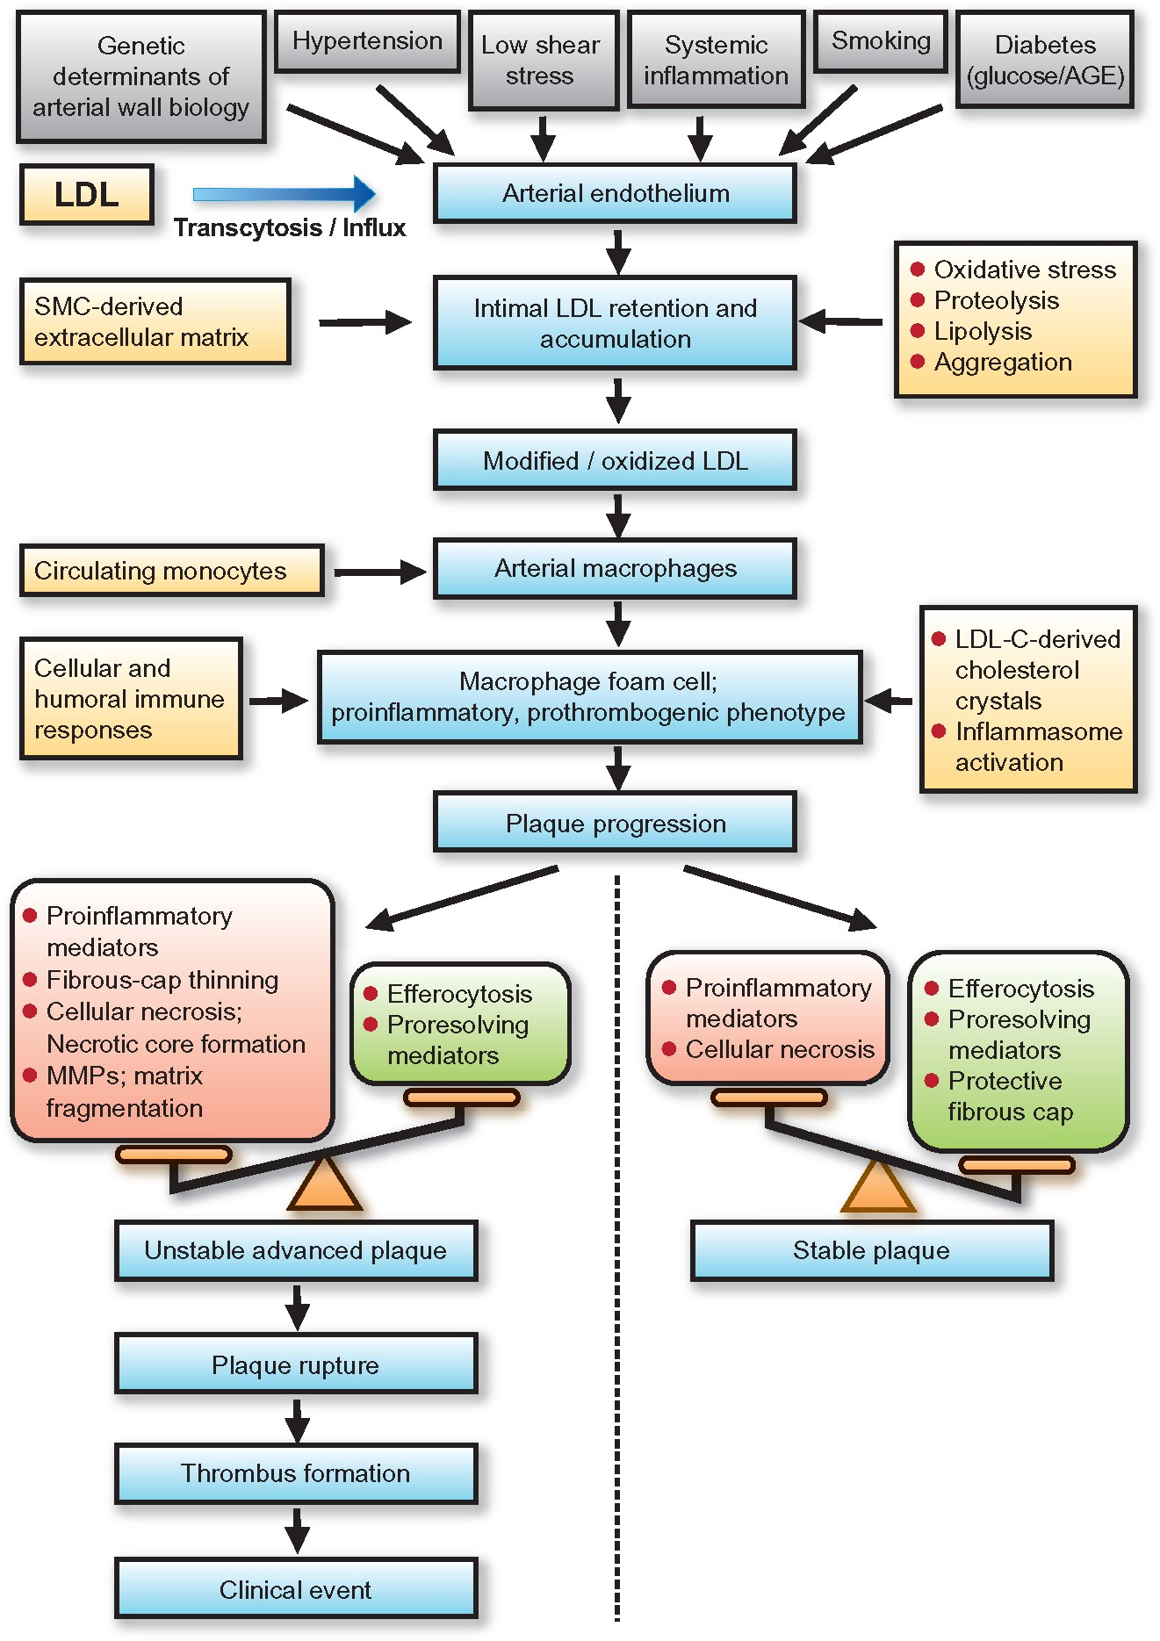
Endothelial dysfunction
Lipid infiltration
Inflammatory response
Plaque progression
Complications

Slide 8







Έναρξη αθηροσκλήρωσης
Ενδοθηλιακή δυσλειτουργία
LDL
Μονοκύτταρο
Τ λεμφοκύτταρα
Εισροή + Ωρίμανση μονοκυττάρων
Μόριο προσκόλλησης
Μακροφάγο
Αφρώδες κύτταρο
Λεία μυϊκά κύτταρα
Εισροή + Οξείδωση LDL
Έσω χιτώνας
Σχηματισμός Αφρώδους κυττάρου

Slide 9
Βασικοί μηχανισμοί αθηρωμάτωσης
Ενδοθηλιακή δυσλειτουργία
Διαταραχή λιποπρωτεϊνών
Αγγειακή φλεγμονή

Slide 10
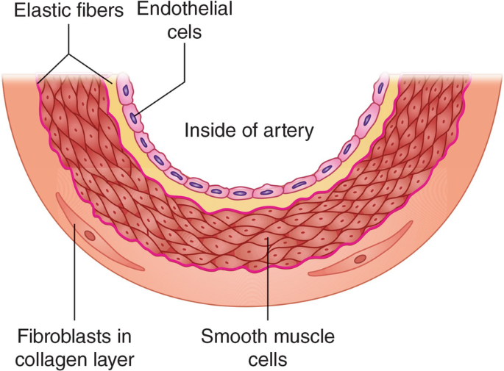
Ο ρόλος του ενδοθηλίου
Squamous cell monolayer
At the inner wall of blood vessel
Endothelial cells adjacent to a basal lamina ➔ formation of tunica intima

Slide 11
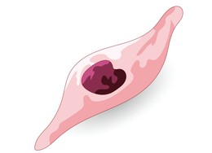
Ο ρόλος του ενδοθηλίου
Length: 30-50 μm
Width: 10-30 μm
Height: 0.1-1 μm
Along the vessel axis → mitigation of shear stress

Slide 12
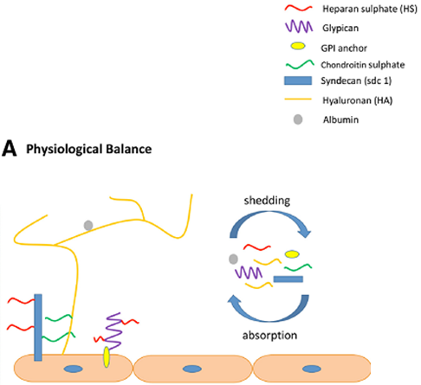
Ενδοθηλιακός γλυκοκάλυκας
0.5-5μm thick, negatively charged
Composition
proteoglycans (syndecans, versicans)
Glycolipids
Glycoproteins
GAG (HS, chondroitin sulfate, HA)
Functions
Adequate mechanotransduction
Normal leukocyte trafficking
Control of coagulation
Antioxidant effect
Ann Intensive Care. 2020 Jun 22;10(1):85.

Slide 13
Ιδιότητες ενδοθηλίου
Αγγειακός τόνος
Κυτταρική προσκόλληση
Πολλαπλασιασμός VSMC
Αιμόσταση
-
Θρόμβωση
Αγγειακή φλεγμονή
Αγγειακή αναδιαμόρφωση

Slide 14
How endothelium regulates vascular tone
Vasodilation
Prostacyclin (PGI2)
NO
Vasoconstriction
ATII
Prostaglandin (PGH2)
ET-1
Bradykinin
EDHF
Thromboxane A2 (TXA2)
Notes:
EDHF: υπερπολωτικός παράγοντας του ενδοθηλίου

Slide 15
How endothelium regulates coagulation
Fibrinolysis
PGI2
NO
Thrombosis
Fibronectin
PAI-1
vWF
t-PA
TF
Thrombomodulin

Slide 16
NO: The main endothelial regulator
Anti-inflammatory
Vasodilation
Reduced migration / WBC adhesion
Relaxation of SMCs
NO
Inhibition of smooth
muscle cell proliferation
Reduced platelet activation / aggregation
Antiproliferative
Antithrombotic

Slide 17
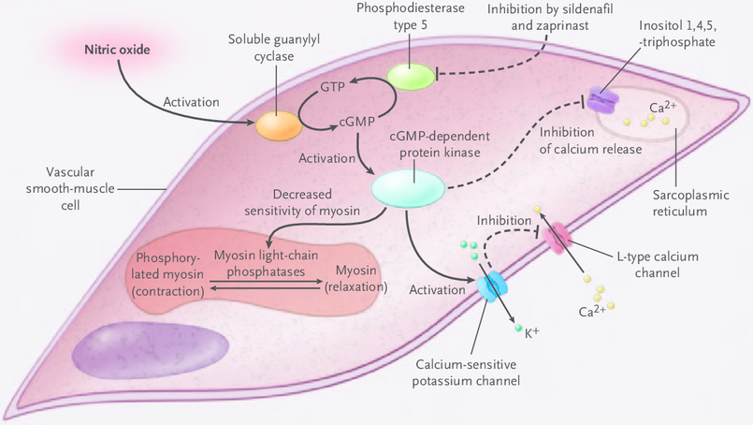
ΝΟ-Χάλαση VSMC
NEJM. 2005 Dec 22;353(25):2683-95.
Notes:
Nitric oxide activates soluble guanylyl cyclase, leading to the activation of cyclic guanosine 3´, 5´-monophosphate (cGMP)–dependent protein kinase (cGKI). In turn, cGKI decreases the sensitivity of myosin to calcium-induced contraction and lowers the intracellular calcium concentration by activating calcium-sensitive potassium channels and inhibiting the release of calcium from the sarcoplasmic reticulum.

Slide 18
Ενδοθηλιακή δυσλειτουργία
Μηχανισμοί
Μειωμένη παραγωγή NO
Αυξημένη καταστροφή NO
Διαταραχή της ισορροπίας αγγειοσυσπαστικών-αγγειοδιασταλτικών μορίων
Αγγειοσύσπαση
Κινητοποίηση λευκοκυττάρων
Φλεγμονή
Πήξη-Θρόμβωση

Slide 19
Αίτια ενδοθηλιακής δυσλειτουργίας
Γήρανση
Κάπνισμα
Παχυσαρκία
Αρτηριακή Υπέρταση
Σακχαρώδης διαβήτης
Δυσλιπιδαιμία
Φλεγμονή

Slide 20
Οξειδωτικό stress και ενδοθηλιακή δυσλειτουργία
Οξειδωτικό stress
έκθεση των ενδοθηλιακών κυττάρων στις οξειδωτικές ρίζες
BH₄ → BH₂
failure of salvage pathway
↓ eNOS
↑ ADMA
(endogenous eNOS inhibitor)
eNOS uncoupling
↓ NO
↑ Η₂Ο₂ ₊ ΟNOO⁻
↓ eNOS
    Tousoulis D et al. Nature Reviews Cardiology 2007
Notes:
The inability of a salvage pathway of BH4 production, by recycling of oxidized BH2 to BH4 through the action of dihydrofolate reductase (DHFR), has also been reported through depletion of DHFR enzyme.
The role of NADPH oxidase in the reduced BH4 bioavailability has been long established.

Slide 21
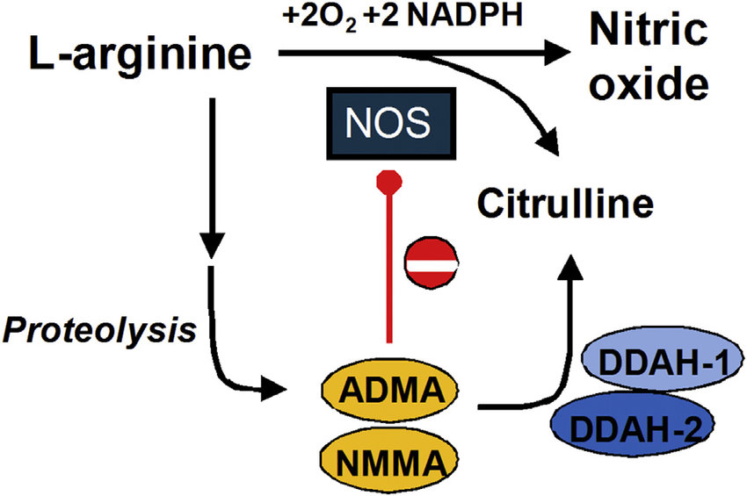
Ασύμμετρη διμεθυλαργινίνη
Notes:
Dimethylarginine dimethylaminohydrolase

Slide 22
    Siasos G et al.

Slide 23
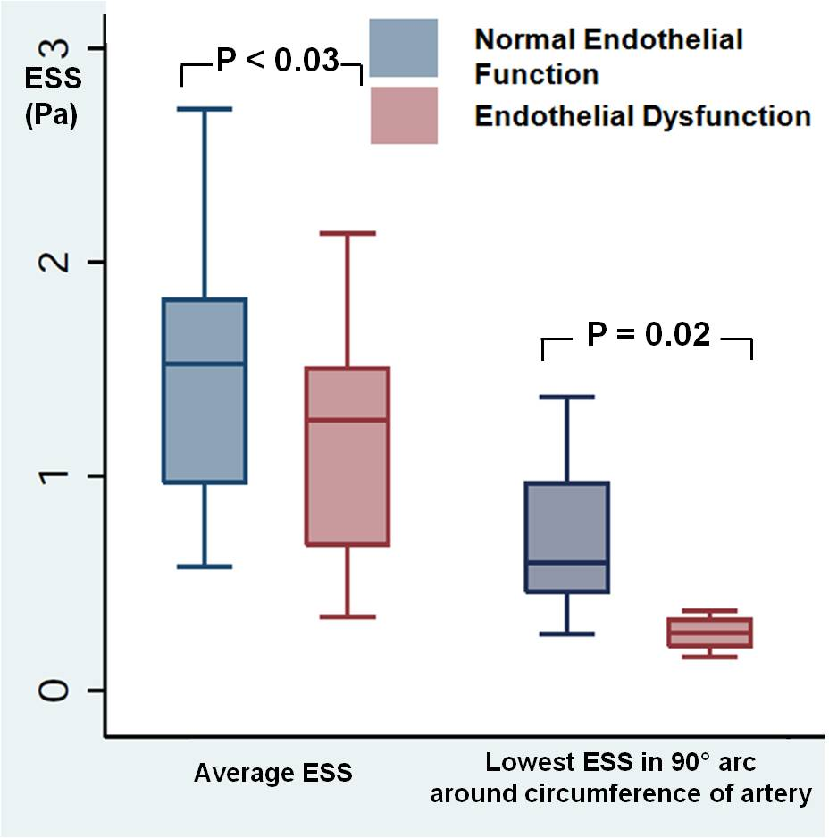


Low Endothelial Shear Stress Promotes Focal Coronary Endothelial Dysfunction in Patients with Early Coronary Atherosclerosis
Gerasimos Siasos, Jaskanwal D Sara,...Amir Lerman, Peter H Stone
AHA 2016

Slide 24
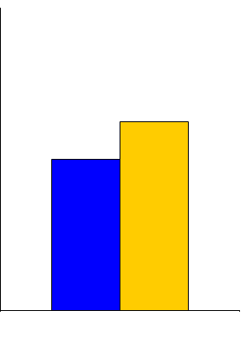
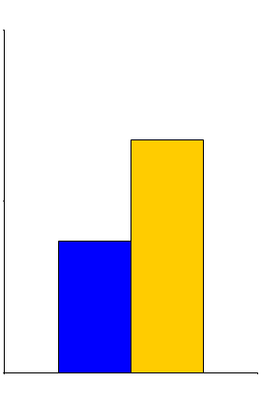
Clinical value of subclinical inflammation
JUPITER
Trial design: Apparently healthy patients with LDL cholesterol <130 mg/dl and hs-CRP ≥2 mg/dl were randomized to rosuvastatin 20 mg daily or placebo. Clinical outcomes were compared at a median of 1.9 years.
Trial design: Apparently healthy patients with LDL cholesterol <130 mg/dl and hs-CRP ≥2 mg/dl were randomized to rosuvastatin 20 mg daily or placebo. Clinical outcomes were compared at a median of 1.9 years.
(p < 0.00001)
(p = 0.02)
Results
Rosuvastatin associated with a significant ↓ in the primary outcome of MI, stroke, unstable angina, revascularization, or cardiovascular death (HR 0.56, 95% CI 0.46-0.69, p < 0.00001)
All-cause mortality ↓ with rosuvastatin (p = 0.02)
2
2
1.36
1.25
1.0
Events/100 Person-Yrs
1
0.77
1
Events/100 Person-Yrs
Rosuvastatin was associated with a significant reduction in major cardiovascular events, including death, in patients with LDL <130 mg/dl, but high hs-CRP (≥2.0 mg/dl)
0
0
Primary outcome
All-cause mortality
Rosuvastatin
(n = 8,901)
Placebo
(n = 8,901)
Ridker PM, et al. NEJM 2008;359:2195-207
Notes:
24
24
24
24

Slide 25
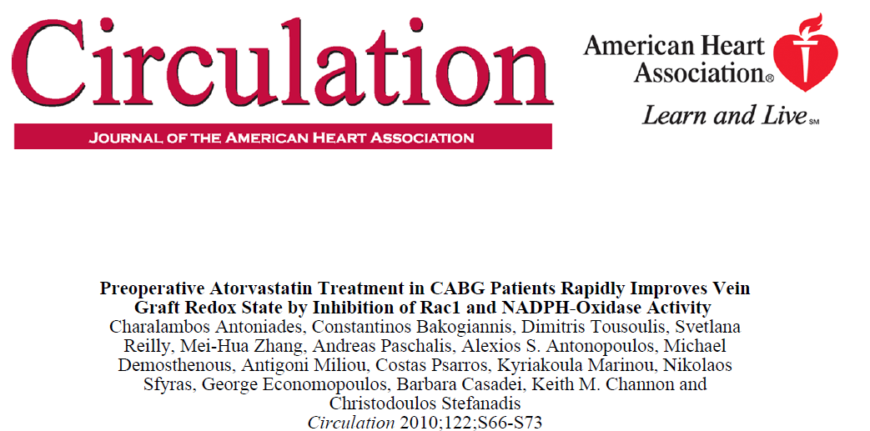

Slide 26



Residual Inflammatory Risk:
Addressing the Obverse Side of the Atherosclerosis Prevention Coin
Known Cardiovascular Disease LDL 150 mg/dL (3.8 mmol/L) hsCRP 4.5mg/L
High Intensity Statin
“Residual Cholesterol Risk”
LDL 110 mg/dL (2.8 mmol/L)
hsCRP 1.8 mg/L
“Residual Inflammatory Risk”
LDL 70 mg/dL (1.8 mmol/L)
hsCRP 3.8 mg/L
Additional LDL Reduction
Additional Inflammation Reduction
IMPROVE-IT : Ezetimibe 6% RRR FOURIER/SPIRE: PCSK9 Inhibition q2 weeks 15% RRR
No Prior Proof of Concept
Ridker PM. Eur Heart J 2016;37:1720-22

Slide 27
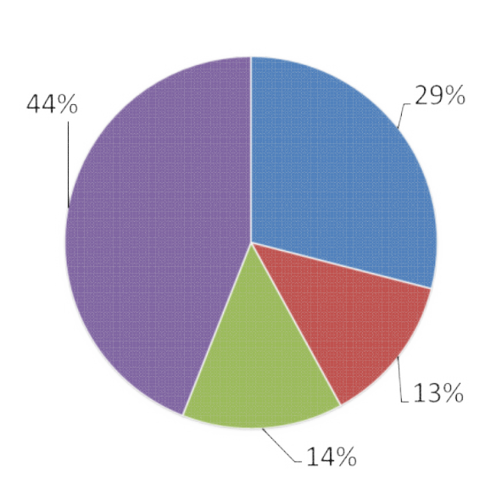
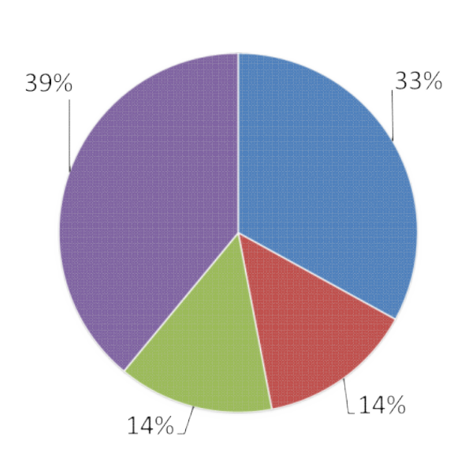
How Common is Residual Inflammatory Risk?
PROVE-IT
IMPROVE-IT
Residual Inflammatory Risk
Residual Cholesterol Risk
Both
Neither
hsCRP > 2 mg/L LDLC < 70 mg/dL
hsCRP < 2 mg/L LDLC > 70 mg/dL
hsCRP > 2 mg/L LDLC > 70 mg/dL
hsCRP < 2 mg/L LDLC < 70 mg/dL
Ridker PM. Circulation Res 2017;120:617-9.

Slide 28



Anti-Inflammatory Therapy with Canakinumab for Atherosclerotic Disease
Paul M Ridker, MD, MPH Eugene Braunwald Professor of Medicine Brigham and Women’s Hospital, Harvard Medical School, Boston MA, USA

Slide 29
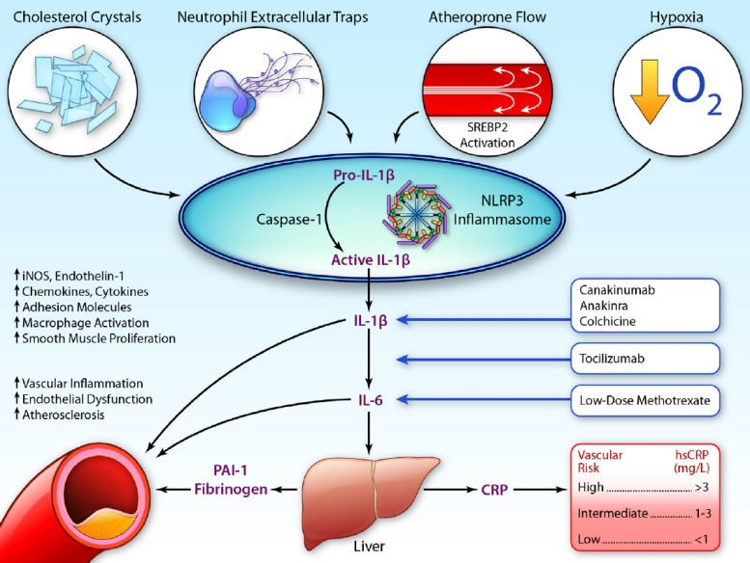
From CRP to IL-6 to IL-1: Moving Upstream to Identify novel Targets for Atheroprotection
Ridker PM. Circ Res 2016;118:145-156.

Slide 30
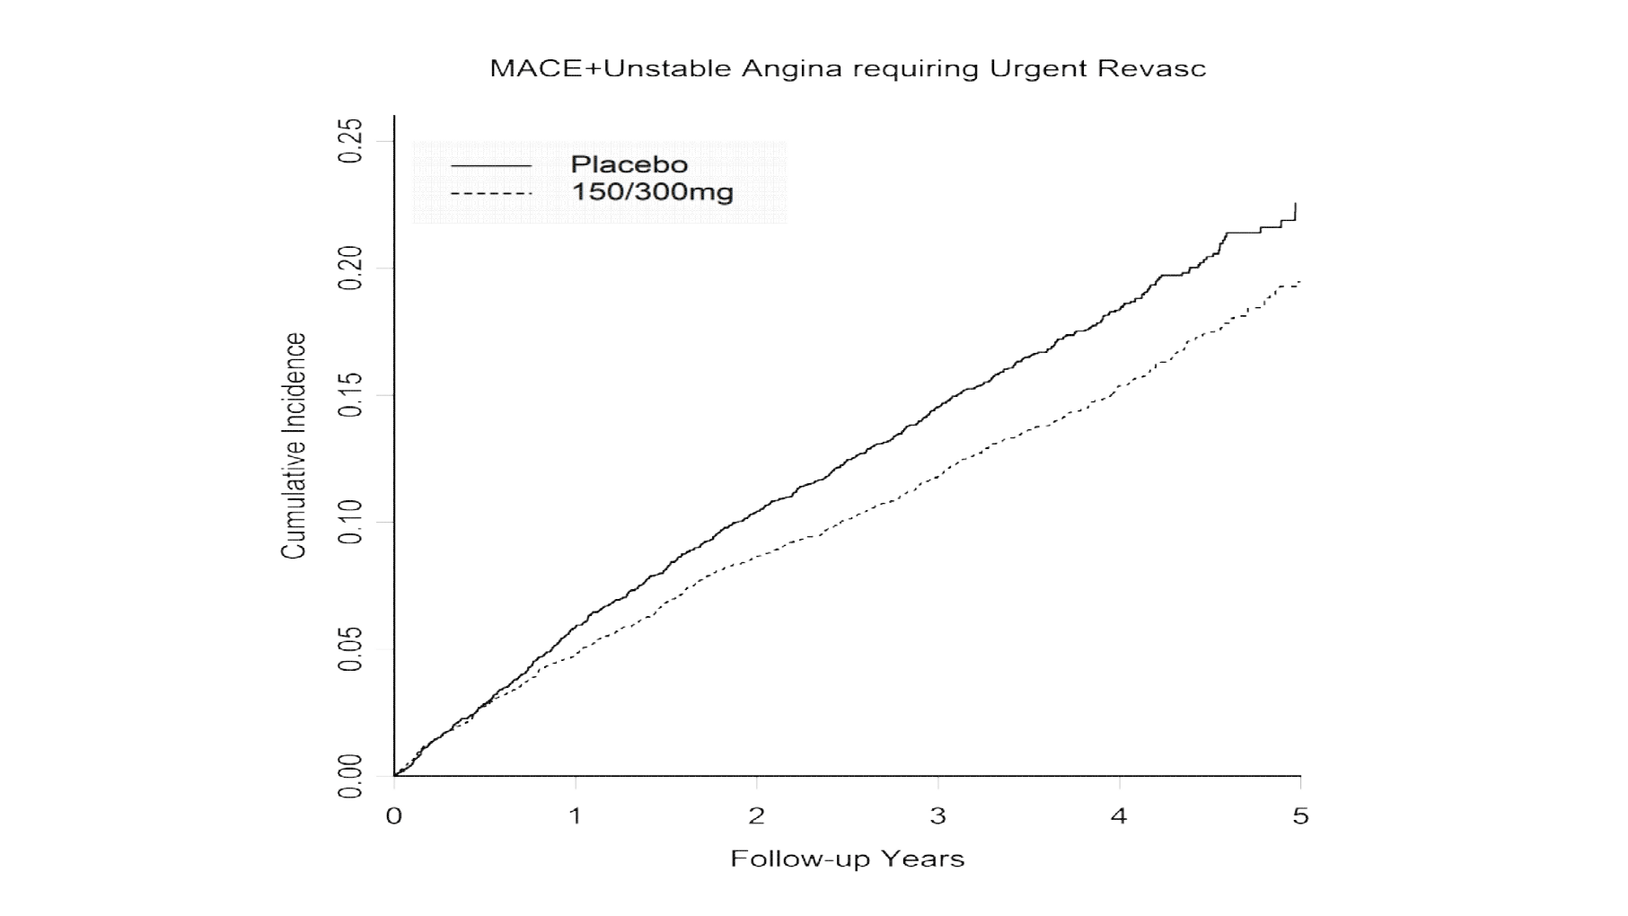
CANTOS: Key Secondary Cardiovascular Endpoint
(MACE+)
The 150mg group met multiplicity adjusted thresholds for formal statistical significance for both the primary and secondary cardiovascular endpoints
Placebo SC q 3 months
Canakinumab 150/300 SC q 3 months
HR 0.83
95%CI 0.74-0.92
P = 0.0006
Cumulative Incidence (%)
39% reduction in hsCRP No change in LDLC
17% reduction in MACE+

Slide 31
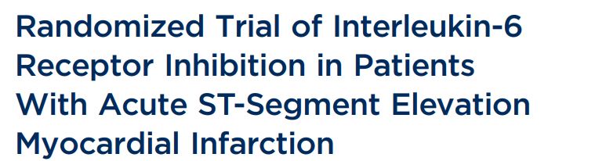
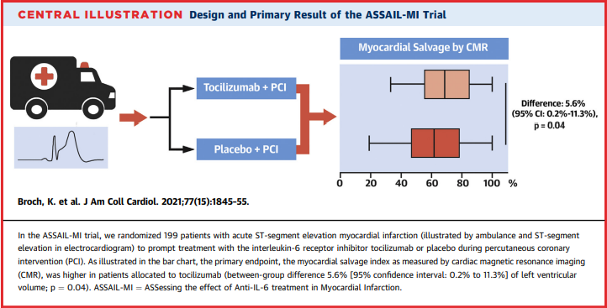
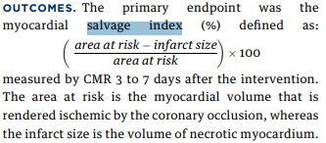

Slide 32
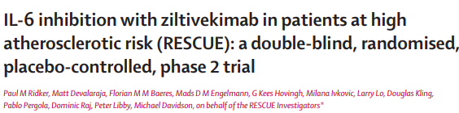
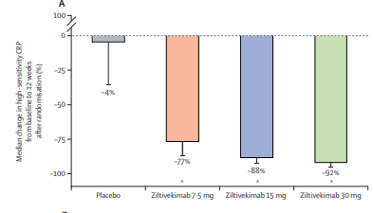
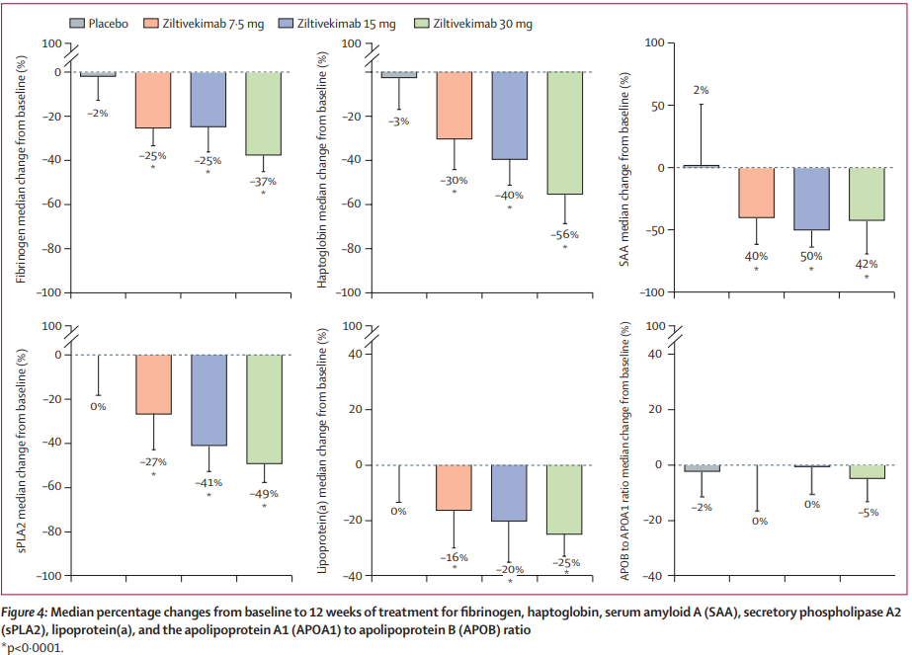

Slide 33


Slide 34
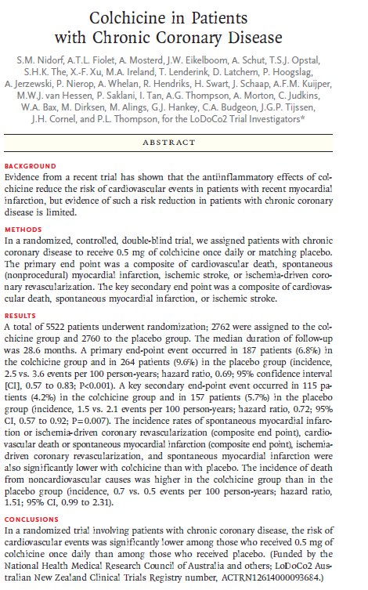

Slide 35
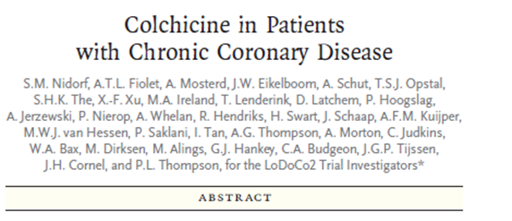
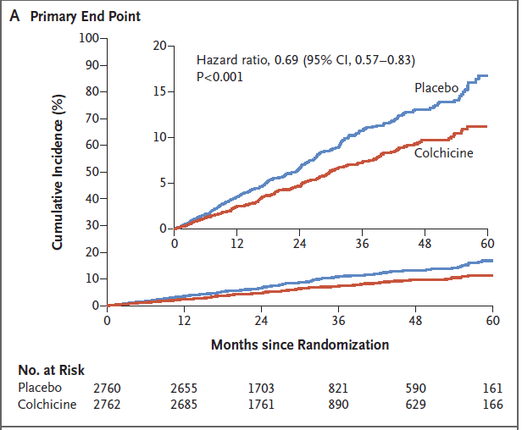
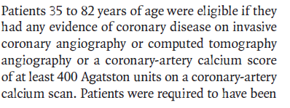


Slide 36
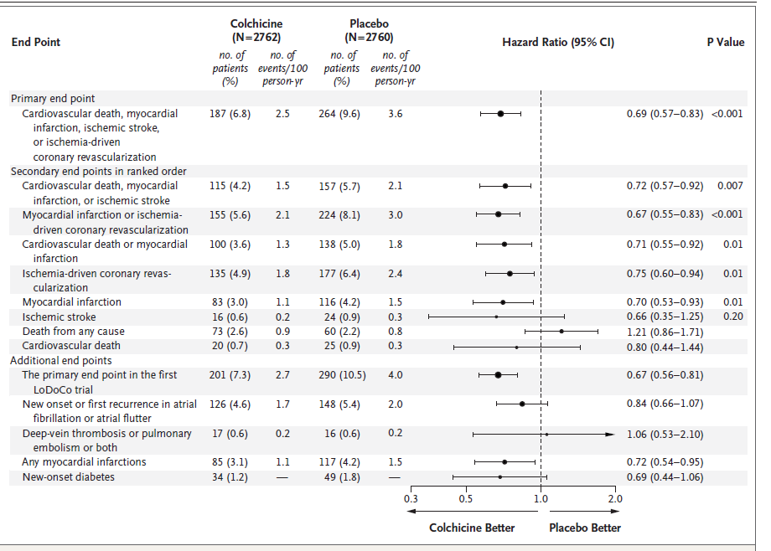

Slide 37

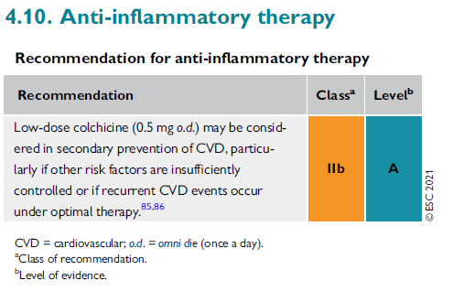

Slide 38
Δοκιμασίες ενδοθηλιακής λειτουργίας
Αγγειοδραστικές ουσίες
Endothelium-dependent vasodilation
Endothelium-independent vasodilation
Acetylcholine
Bradykinin
Substance P
L-NMMA
Shear stress
Adenosine
Sodium nitroprusside
NTG

Slide 39
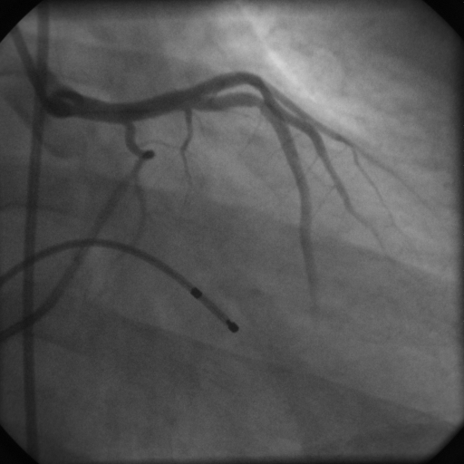
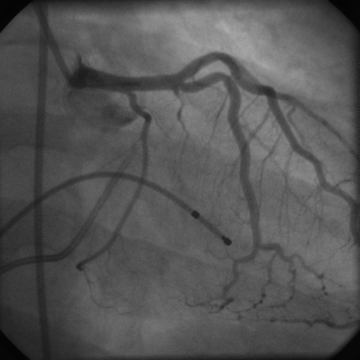
Φυσιολογική ενδοθηλιακή λειτουργία στεφανιαίων
Baseline
Acetylcholine

Slide 40
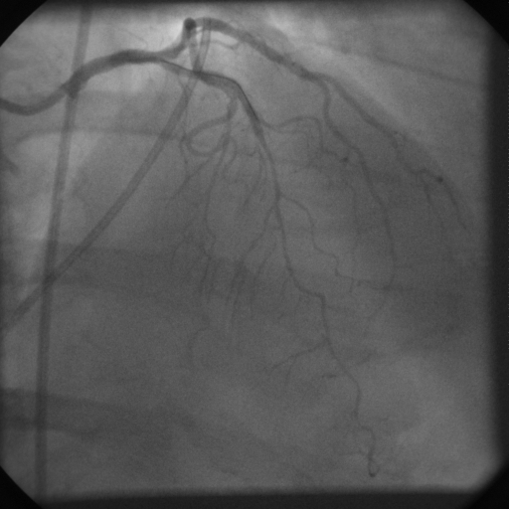
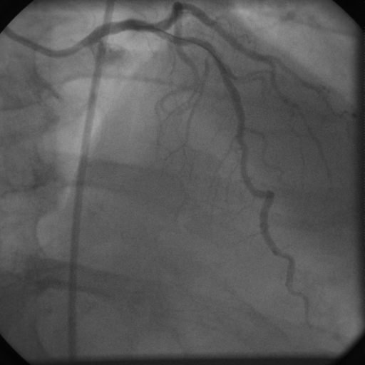
Ενδοθηλιακή δυσλειτουργία στεφανιαίων
Acetylcholine
Invasive method
Rarely performed in isolation (usually in CAG for another indication)
Various protocols (Ach dose, different vasoactive substances)
Nitroprusside

Slide 41
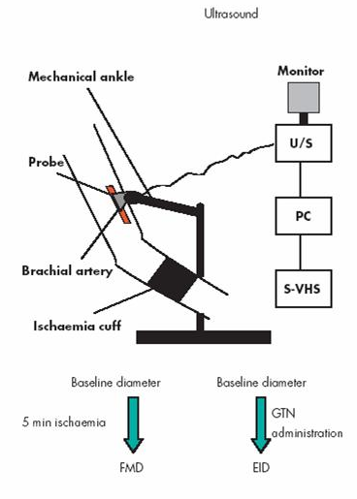
baFMD
Endothelium-dependent process
Relaxation of a conduit artery when exposed to increased flow (reactive hyperemia) and, thereby, increased shear stress.
impaired FMD ➔ endothelial dysfunction
No set reference ranges...
Not used in routine clinical practice – mainly for research purposes
Tousoulis D et al., Heart 2005: 91: 553-558.

Slide 42
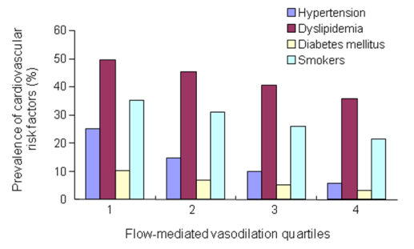
baFMD και καρδιομεταβολικοί παράγοντες κινδύνου
≤3.9 | 4.0–5.8 | 5.9–7.9 | ≥8.0
Heart. 2013 Dec;99(24):1837-42.

Slide 43
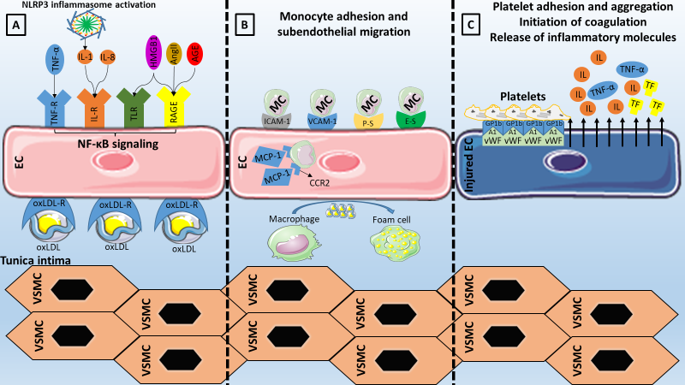
Βιοδείκτες ενδοθηλιακής δυσλειτουργίας
Theofilis P et al. Biomedicines. 2021 Jul 6;9(7):781.

Slide 44
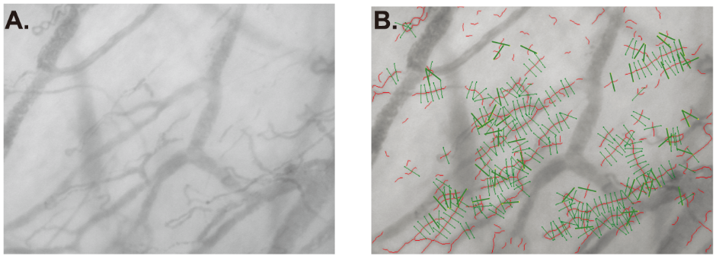
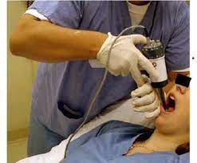
Perfused boundary region
sidestream darkfield camera

Slide 45
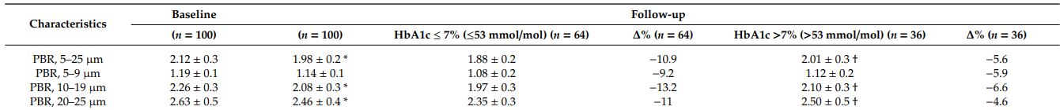
PBR και ΣΔ
100 poorly-controlled diabetic patients (age: 51 ± 12 years)
Intensified glycemic control for 12 months
J Clin Med. 2019 Jul 5;8(7):983.

Slide 46
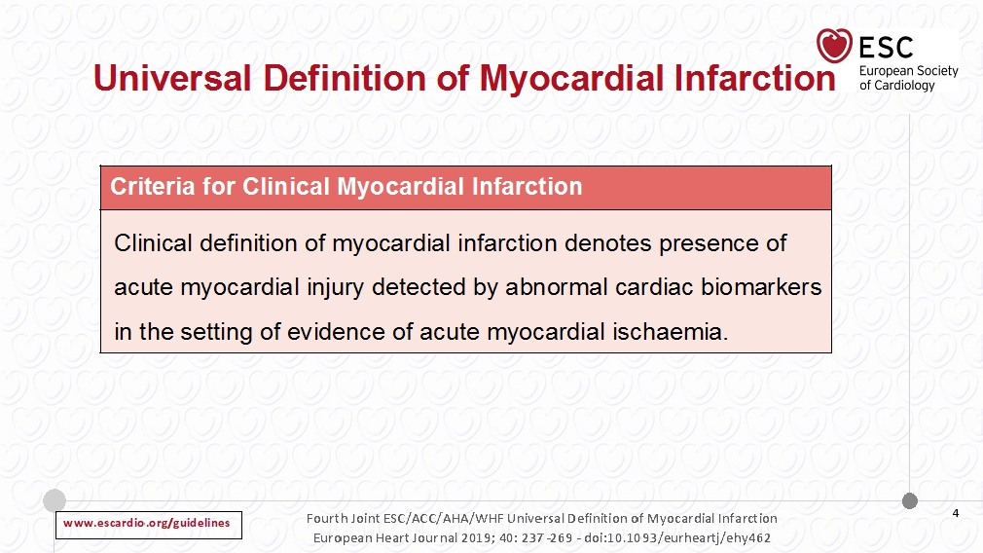

Slide 47
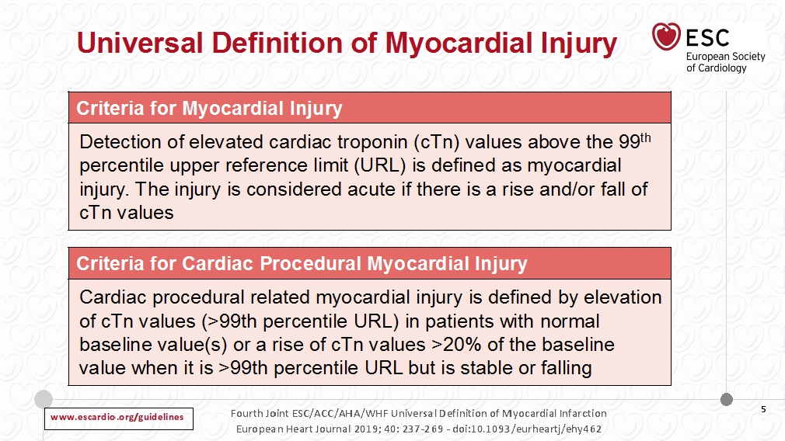

Slide 48
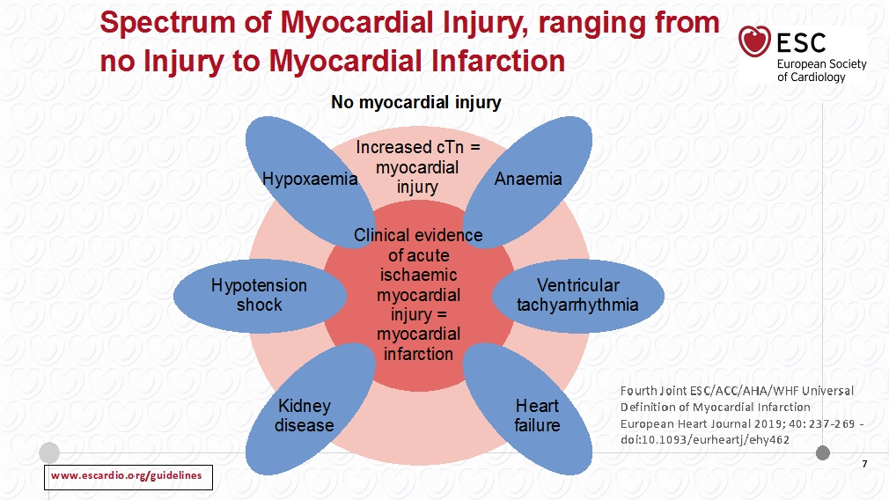

Slide 49
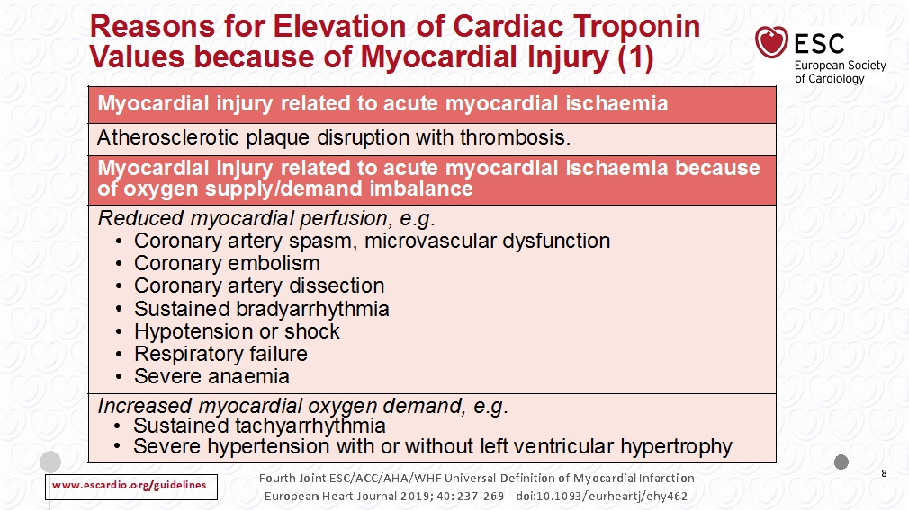

Slide 50
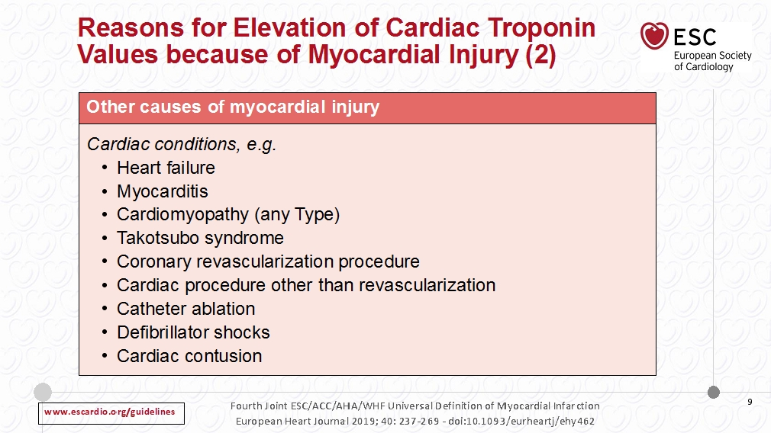

Slide 51
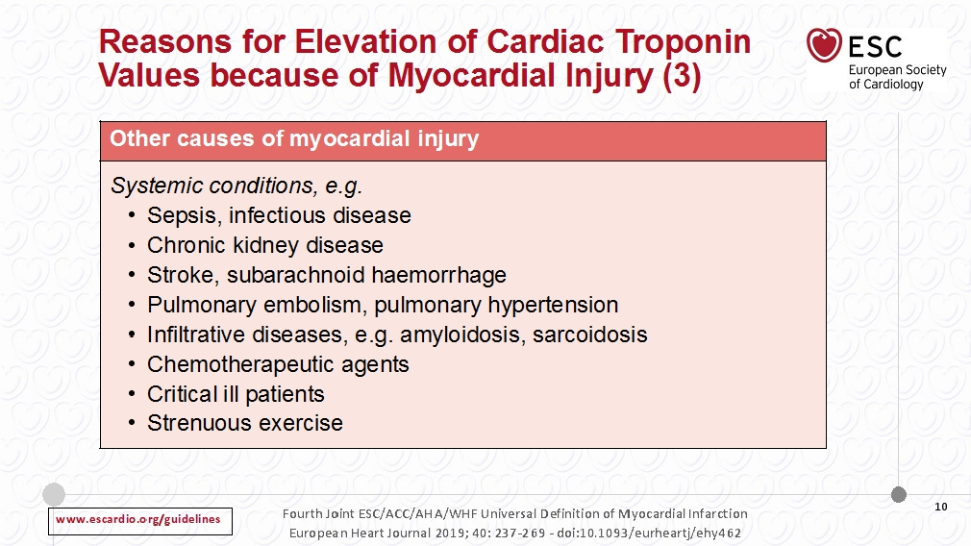

Slide 52
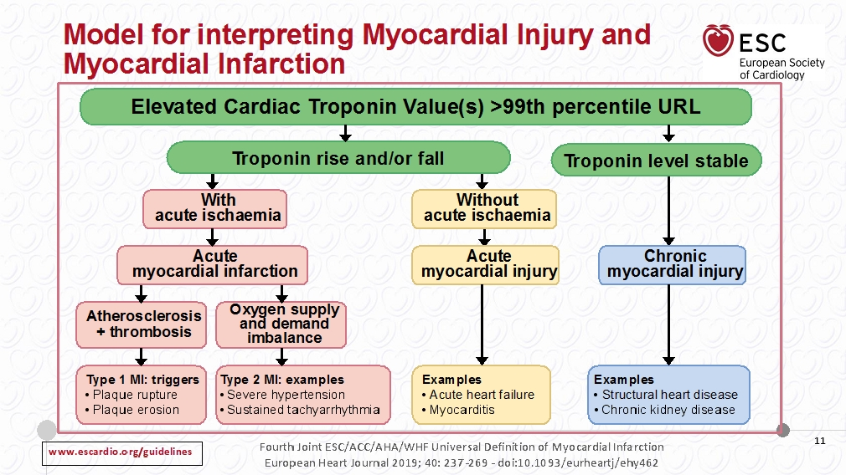

Slide 53
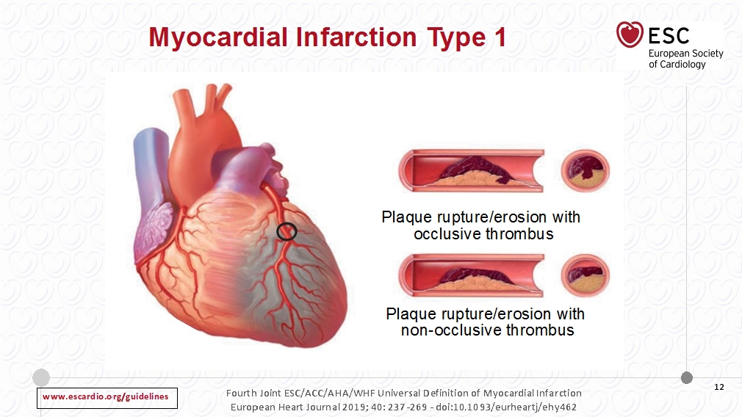

Slide 54
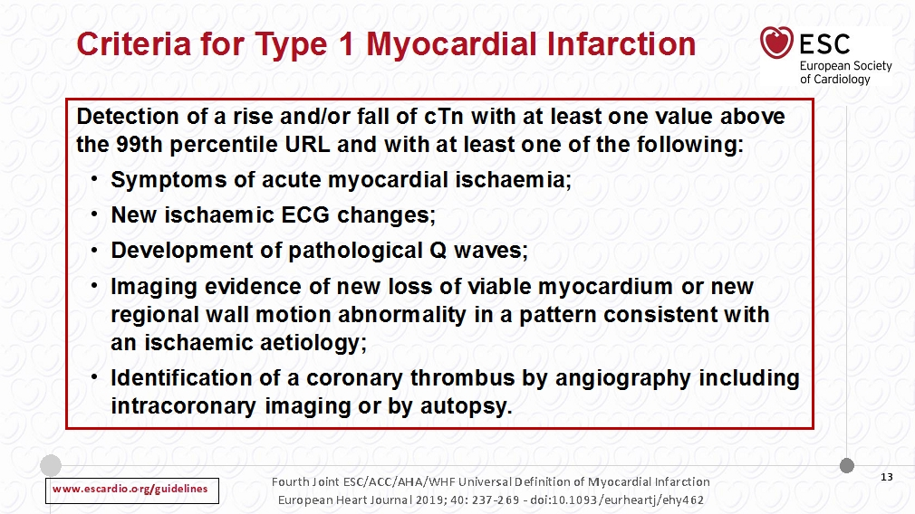

Slide 55
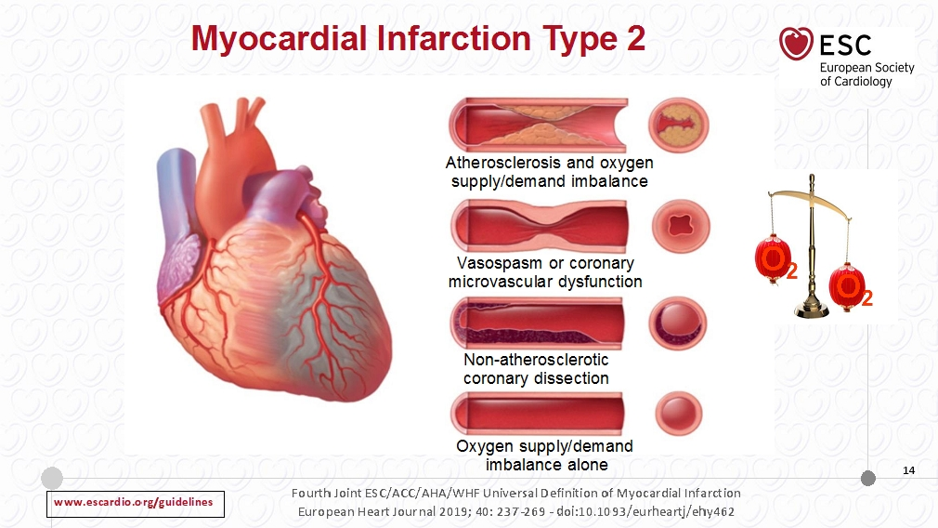

Slide 56
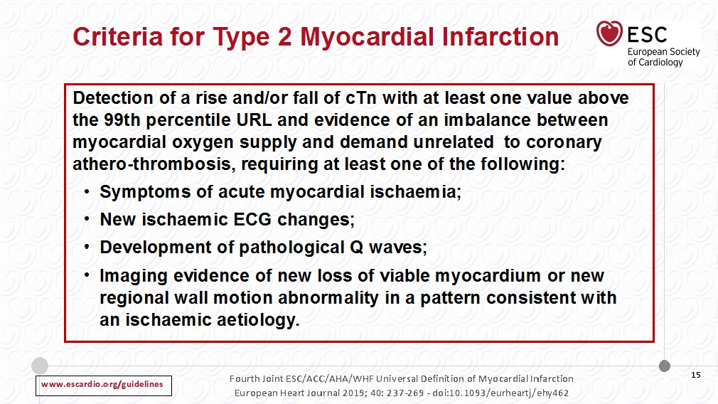

Slide 57
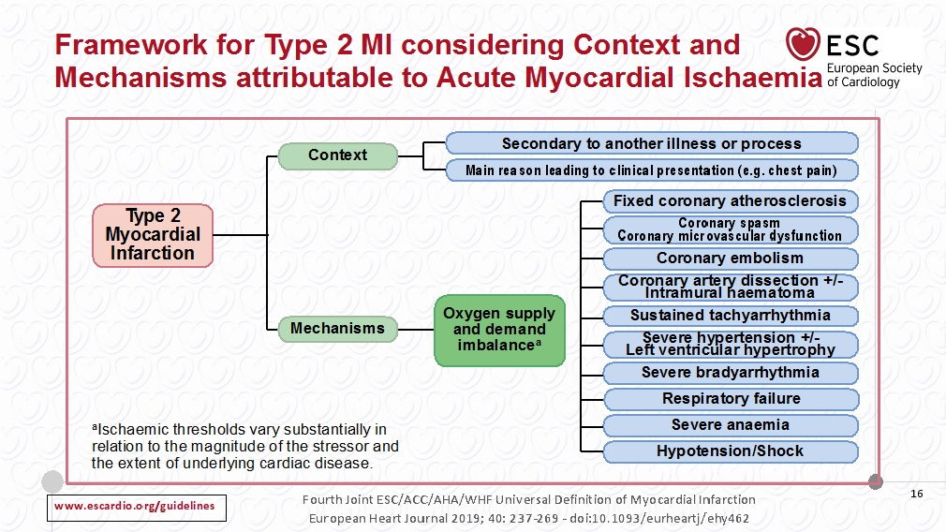

Slide 58
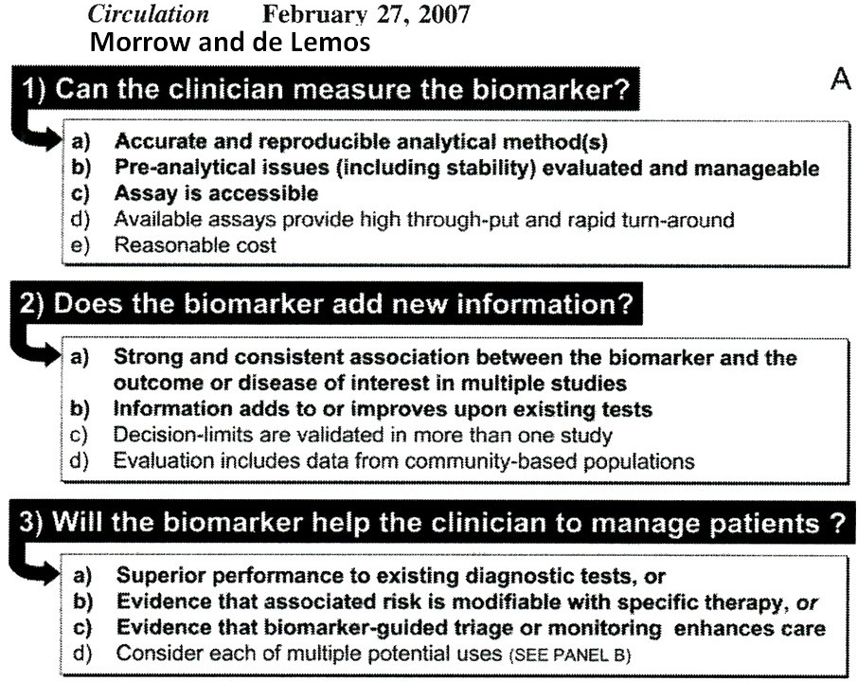

Slide 59

Biomarkers in
Cardiovascular Disease
Biomarkers in ACS

Slide 60

Biomarkers in
Cardiovascular Disease
Biomarkers in ACS
  Biomarkers of diagnosis

Slide 62
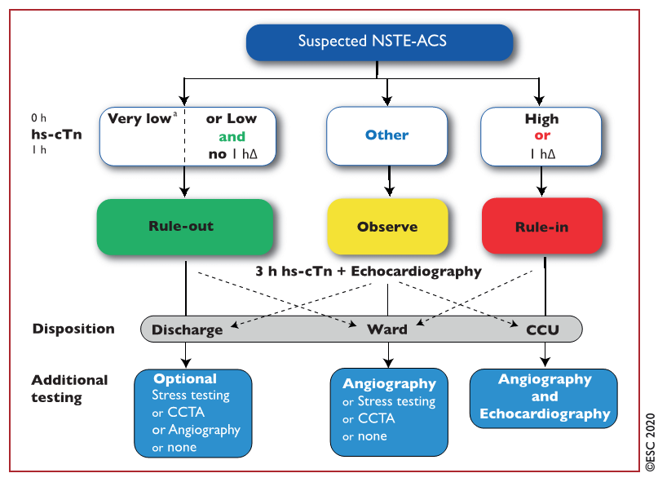

Slide 63


Slide 64




Slide 65


Slide 66




Slide 67


Notes:
The purpose of this study was to determine whether a new accelerated diagnostic protocol (ADP) for possible cardiac
chest pain could identify low-risk patients suitable for early discharge (with follow-up shortly after discharge).
Background Patients presenting with possible acute coronary syndrome (ACS), who have a low short-term risk of adverse
cardiac events may be suitable for early discharge and shorter hospital stays.
Methods This prospective observational study tested an ADP that included pre-test probability scoring by the Thrombolysis
In Myocardial Infarction (TIMI) score, electrocardiography, and 0 2 h values of laboratory troponin I as the sole
biomarker. Patients presenting with chest pain due to suspected ACS were included. The primary endpoint was
major adverse cardiac event (MACE) within 30 days.
Results Of 1,975 patients, 302 (15.3%) had a MACE. The ADP classified 392 patients (20%) as low risk. One (0.25%) of these patients had a MACE, giving the ADP a sensitivity of 99.7% (95% confidence interval [CI]: 98.1% to 99.9%), negative predictive
value of 99.7% (95% CI: 98.6% to 100.0%), specificity of 23.4% (95% CI: 21.4% to 25.4%), and positive predictive value of
19.0% (95% CI: 17.2% to 21.0%). Many ADP negative patients had further investigations (74.1%), and therapeutic (18.3%)
or procedural (2.0%) interventions during the initial hospital attendance and/or 30-day follow-up.
Conclusions Using the ADP, a large group of patients was successfully identified as at low short-term risk of a MACE and therefore
suitable for rapid discharge from the emergency department with early follow-up. This approach could decrease the
observation period required for some patients with chest pain. (An observational study of the diagnostic utility of an accelerated diagnostic protocol using contemporary central laboratory cardiac troponin in the assessment of patients presenting
to two Australasian hospitals with chest pain of possible cardiac origin; AC

Slide 68

**For patients presenting ED with typical symptoms, the use of hs-cTnT or hs-cTnI assays at the 99th percentile may help identify patients with low risk for AMI and promote early discharge from the ED
Notes:
Cardiovascular disease is the leading cause of mortality and morbidity. Serial troponin tests have been endorsed as essential diagnostic steps to rule out/-in acute myocardial infarction (AMI), and hs-cTn assays have shown promise in enhancing the accuracy and efficiency of AMI diagnosis in the emergency department (ED).
Methods: A systematic review and meta-analysis of diagnostic test accuracy studies were conducted to compare the diagnostic performance of various accelerated diagnostic algorithms of hs-cTn assays for patients with symptoms of AMI. Random-effects bivariate meta-analysis was conducted to estimate the summary sensitivity, specificity, likelihood ratios, and area under receiver operating characteristic curve.
Results: In the systematic review consisting of 56 studies and 67,945 patients, both hs-cTnT and hs-cTnI-based 0-, 1-, 2- and 0-1 h algorithms showed a pooled sensitivity >90%. The hs-cTnI-based algorithm showed a pooled specificity >80%. The hs-cTnT-based algorithms had a specificity of 68% for the 0-h algorithm and of around 80% for the 1-, 2-, and 0-1 h algorithms. The heterogeneities of all diagnostic algorithms were mild (I2 < 50%).
Conclusion: Both hs-cTnI- and hs-cTnT-based accelerated diagnostic algorithms have high sensitivities but moderate specificities for early diagnosis of AMI. Overall, hs-cTnI-based algorithms have slightly higher specificities in early diagnosis of AMI. For patients presenting ED with typical symptoms, the use of hs-cTnT or hs-cTnI assays at the 99th percentile may help identify patients with low risk for AMI and promote early discharge from the ED.

Slide 69

** 0/1-hour hs-cTnT protocol embedded in ED care enabled more rapid discharge of patients with suspected acute coronary syndrome
Notes:
High-sensitivity troponin assays promise earlier discrimination of myocardial infarction. Yet, the benefits and harms of this improved discriminatory performance when incorporated within rapid testing protocols, with respect to subsequent testing and clinical events, has not been evaluated in an in-practice patient-level randomized study. This multicenter study evaluated the noninferiority of a 0/1-hour high-sensitivity cardiac troponin T (hs-cTnT) protocol in comparison with a 0/3-hour masked hs-cTnT protocol in patients with suspected acute coronary syndrome presenting to the emergency department (ED).
Methods: Patients were randomly assigned to either a 0/1-hour hs-cTnT protocol (reported to the limit of detection [<5 ng/L]) or masked hs-cTnT reported to ≤29 ng/L evaluated at 0/3-hours (standard arm). The 30-day primary end point was all-cause death and myocardial infarction. Noninferiority was defined as an absolute margin of 0.5% determined by Poisson regression.
Results: In total, 3378 participants with an emergency presentation were randomly assigned between August 2015 and April 2019. Ninety participants were deemed ineligible or withdrew consent. The remaining participants received care guided either by the 0/1-hour hs-cTnT protocol (n=1646) or the 0/3-hour standard masked hs-cTnT protocol (n=1642) and were followed for 30 days. Median age was 59 (49-70) years, and 47% were female. Participants in the 0/1-hour arm were more likely to be discharged from the ED (0/1-hour arm: 45.1% versus standard arm: 32.3%, P<0.001) and median ED length of stay was shorter (0/1-hour arm: 4.6 [interquartile range, 3.4-6.4] hours versus standard arm: 5.6 (interquartile range, 4.0-7.1) hours, P<0.001). Those randomly assigned to the 0/1-hour protocol were less likely to undergo functional cardiac testing (0/1-hour arm: 7.5% versus standard arm: 11.0%, P<0.001). The 0/1-hour hs-cTnT protocol was not inferior to standard care (0/1-hour arm: 17/1646 [1.0%] versus 16/1642 [1.0%]; incidence rate ratio, 1.06 [ 0.53-2.11], noninferiority P value=0.006, superiority P value=0.867), although an increase in myocardial injury was observed. Among patients discharged from ED, the 0/1-hour protocol had a negative predictive value of 99.6% (95% CI, 99.0-99.9%) for 30-day death or myocardial infarction.
Conclusions: This in-practice evaluation of a 0/1-hour hs-cTnT protocol embedded in ED care enabled more rapid discharge of patients with suspected acute coronary syndrome. Improving short-term outcomes among patients with newly recognized troponin T elevation will require an evolution in management strategies for these patients.

Slide 70

** correlation between CMR-LGE quantification of infarct size and TnI release following STEMI
Notes:
Late gadolinium enhancement (LGE) with cardiac magnetic resonance (CMR) is commonly assumed to represent myocardial fibrosis; however, comparative human histological data are limited, and there is no consensus on the most accurate method for LGE quantitation. We evaluated the relationship between CMR assessment of regional fibrosis and infarct size assessment using serial biomarkers after ST elevation acute myocardial infarction (STEMI).
Methods: Ninety-three patients treated for STEMI (59±10 years, 86% male) underwent CMR 6 months after infarction. Infarct size was quantified by CMR-LGE using manual and range of semi-automated thresholds (range: 2-10 standard deviations [SD]) above reference myocardium and the full width-half maximum (FWHM) technique, and compared with the rise in serum biomarkers. The agreement between CMR and biomarker in the identification of large infarcts based on peak troponin (TnI) levels was also analysed.
Results: Quantification methods had a strong influence on the infarct size assessment with CMR-LGE. Significant correlations were observed between LGE and biomarkers across all of the signal intensity thresholds. Whilst there was a wide variation with respect to the estimation of total LGE size (from 6.8±7.7 to 32.1±11.3 grams), the variation in the correlation with peak troponin level was much smaller (r-values ranging from 0.670 to 0.876). There was good agreement between CMR-LGE and biomarker assessment of infarct size; the best agreement between CMR-LGE and large infarction using a threshold of 8SD for peak TnI>50ng/mL (Cohen's kappa (κ)=0.722), and a threshold of 4SD for peak TnI >95ng/mL (κ=0.761).
Conclusions: The correlation between CMR-LGE quantification of infarct size and biomarker release following STEMI at a range of semi-automated thresholds was consistently strong, with good agreement between measures across a range of thresholds.

Slide 71

** hsTnI at the time of presentation followed by early advanced coronary CTA assessment improves the risk stratification and diagnostic accuracy for ACS as compared to conventional troponin and traditional coronary CTA assessment
Notes:
This study compared diagnostic accuracy of conventional troponin/traditional coronary artery disease (CAD) assessment and highly sensitive troponin (hsTn) I/advanced CAD assessment for acute coronary syndrome (ACS) during the index hospitalization.
Background: hsTnI and advanced assessment of CAD using coronary computed tomography angiography (CTA) are promising candidates to improve the accuracy of emergency department evaluation of patients with suspected ACS.
Methods: We performed an observational cohort study in patients with suspected ACS enrolled in the ROMICAT II (Rule Out Myocardial Infarction/Ischemia using Computer Assisted Tomography) trial and randomized to coronary CTA who also had hsTnI measurement at the time of the emergency department presentation. We assessed coronary CTA for traditional (no CAD, nonobstructive CAD, ≥50% stenosis) and advanced features of CAD (≥50% stenosis, high-risk plaque features: positive remodeling, low <30-Hounsfield units plaque, napkin-ring sign, spotty calcium).
Results: Of 160 patients (mean age: 53 ± 8 years, 40% women) 10.6% were diagnosed with ACS. The ACS rate in patients with hsTnI below the limit of detection (n = 9, 5.6%), intermediate (n = 139, 86.9%), and above the 99th percentile (n = 12, 7.5%) was 0%, 8.6%, and 58.3%, respectively. Absence of ≥50% stenosis and high-risk plaque ruled out ACS in patients with intermediate hsTnI (n = 87, 54.4%; ACS rate 0%), whereas patients with both ≥50% stenosis and high-risk plaque were at high risk (n = 13, 8.1%; ACS rate 69.2%) and patients with either ≥50% stenosis or high-risk plaque were at intermediate risk for ACS (n = 39, 24.4%; ACS rate 7.7%). hsTnI/advanced coronary CTA assessment significantly improved the diagnostic accuracy for ACS as compared to conventional troponin/traditional coronary CTA (area under the curve 0.84, 95% confidence interval [CI]: 0.80 to .88 vs. 0.74, 95% CI: 0.70 to 0.78; p < 0.001).
Conclusions: hsTnI at the time of presentation followed by early advanced coronary CTA assessment improves the risk stratification and diagnostic accuracy for ACS as compared to conventional troponin and traditional coronary CTA assessment. (Multicenter Study to Rule Out Myocardial Infarction/Ischemia by Cardiac Computed Tomography [ROMICAT-II]; NCT01084239).

Slide 72


Slide 73

Reichlin et al, JACC 2009

Slide 74

**Adding copeptin to cTn improved the sensitivity and negative predictive value for the diagnosis of NSTEMI compared to cTn alone
**Adding copeptin to cTn might help to screen NSTEMI early upon admission to the ED
Notes:
This study aimed to determine the diagnostic accuracy of adding copeptin to cardiac troponin (cTn) on admission to the emergency department (ED) for non-ST elevation myocardial infarction (NSTEMI) compared to cTn alone.
Materials and methods: A literature search of MEDLINE, EMBASE, and the Cochrane Library was performed (search date: April 13, 2018). Primary studies were included if they accurately reported on patients with symptoms suggestive of acute myocardial infarction and measured both cTn alone and cTn with copeptin upon admission to the ED. The patients with evidence of ST elevation myocardial infarction were excluded. To assess the risk of bias for the included studies, the QUADAS-2 tool was used.
Results: The study participants included a total of 7,998 patients from 14 observational studies. The addition of copeptin to cTn significantly improved the sensitivity (0.81 [0.74 to 0.87] vs. 0.92 [0.89 to 0.95], respectively, p <0.001) and negative predictive value (0.96 [0.95 to 0.98] vs. 0.98 [0.96 to 0.99], respectively, p <0.001) at the expense of lower specificity (0.88 [0.80 to 0.97] vs. 0.57 [0.49 to 0.65], respectively, p <0.001) compared to cTn alone. Furthermore, adding copeptin to cTn showed significantly lower diagnostic accuracy for NSTEMI compared to cTn alone (0.91[0.90 to 0.92] vs. 0.85 [0.83 to 0.86], respectively, p < 0.001).
Conclusions: Adding copeptin to cTn improved the sensitivity and negative predictive value for the diagnosis of NSTEMI compared to cTn alone. Thus, adding copeptin to cTn might help to screen NSTEMI early upon admission to the ED.

Slide 75

**Adding copeptin to cTn improved the sensitivity and negative predictive value for the diagnosis of NSTEMI compared to cTn alone
**Adding copeptin to cTn might help to screen NSTEMI early upon admission to the ED

Slide 76

** After clinical work-up and single combined testing of troponin and copeptin to rule-out AMI, early discharge of low- to intermediate risk patients with suspected ACS seems to be safe and has the potential to shorten length of stay in the ED
Notes:
This randomized controlled trial (RCT) evaluated whether a process with single combined testing of copeptin and troponin at admission in patients with low-to-intermediate risk and suspected acute coronary syndrome (ACS) does not lead to a higher proportion of major adverse cardiac events (MACE) than the current standard process (non-inferiority design).
Methods and results: A total of 902 patients were randomly assigned to either standard care or the copeptin group where patients with negative troponin and copeptin values at admission were eligible for discharge after final clinical assessment. The proportion of MACE (death, survived sudden cardiac death, acute myocardial infarction (AMI), re-hospitalization for ACS, acute unplanned percutaneous coronary intervention, coronary artery bypass grafting, or documented life threatening arrhythmias) was assessed after 30 days. Intention to treat analysis showed a MACE proportion of 5.17% [95% confidence intervals (CI) 3.30-7.65%; 23/445] in the standard group and 5.19% (95% CI 3.32-7.69%; 23/443) in the copeptin group. In the per protocol analysis, the MACE proportion was 5.34% (95% CI 3.38-7.97%) in the standard group, and 3.01% (95% CI 1.51-5.33%) in the copeptin group. These results were also corroborated by sensitivity analyses. In the copeptin group, discharged copeptin negative patients had an event rate of 0.6% (2/362).
Conclusion: After clinical work-up and single combined testing of troponin and copeptin to rule-out AMI, early discharge of low- to intermediate risk patients with suspected ACS seems to be safe and has the potential to shorten length of stay in the ED. However, our results need to be confirmed in larger clinical trials or registries, before a clinical directive can be propagated.

Slide 77


Slide 78


Notes:
We aimed to investigate the usefulness of monocyte to HDL cholesterol ratio (MHR) in predicting coronary artery disease severity and future major adverse cardiovascular events (MACE) in patients with acute coronary syndrome (ACS).
Methods: 2661 patient with ACS were enrolled and followed up during median 31.6 months.
Results: MHR were significantly positively correlated with neutrophil to lymphocyte ratio (r=0.438), CRP (r=0.394), Gensini (r=0.407), and SYNTAX score (r=0.333). During in-hospital and long-term follow-up, MACE, stent thrombosis, non-fatal MI, and mortality occurred more frequently in the third tertile group. Kaplan-Meier analysis revealed the higher occurrence of MACE in the third tertile group compared with other tertiles. Adjusting for other factors, a MHR value in the third tertile group was determined as an independent predictor of in-hospital and long-term MACE.
Conclusions: MHR as a novel inflammation-based marker seemed to be an independent predictor of severity of coronary artery disease and future cardiovascular events in patients with ACS. MHR may utilise the identification of patients who are at higher risk for MACE and individualisation of targeted therapy.

Slide 79


Slide 80


Slide 81



Slide 82

Cytokines in Acute coronary syndromes
Tousoulis D, et al, J Am Coll Cardiol 2004; IJCA 2007

Slide 83


The association of IL-17A with ischemic symptoms and vulnerable plaque characteristics suggests that the proinflammatory cytokine IL-17A may contribute to atherosclerosis and plaque instability.

Slide 84

**In ACS patients, IL-18 concentrations increased after the acute event and remained increased for 6 months
**Baseline IL-18 levels were significantly associated with CV mortality, independent of clinical characteristics and indicators of renal/cardiac dysfunction
Notes:
We aimed to assess associations between circulating IL-18 concentrations and cardiovascular outcomes in patients with acute coronary syndromes (ACS).
Hypothesis and methods: Plasma IL-18 concentrations were measured at admission, discharge, 1 month, and 6 months in patients with ACS in the PLATelet inhibition and patient Outcomes (PLATO) trial. Associations with outcomes were evaluated with Cox regression models on the composite of CV death, spontaneous myocardial infarction (sMI), or stroke; and on CV death or sMI separately, including adjustment for clinical risk factors and biomarkers (cTnT-hs, NT-proBNP, cystatin C, CRP-hs, and GDF-15).
Results: Median IL-18 concentrations at baseline, discharge, 1 month, and 6 months were 237, 283, 305, and 320 ng/L (n = 16 636). Male sex, obesity, diabetes, and plasma levels of cystatin C, GDF-15, and CRP-hs were independently associated with higher IL-18 levels. Higher baseline IL-18 levels were associated with the composite endpoint and with CV death (hazard ratio [HR] 1.05, 95% confidence interval [95% CI] 1.02-1.07 and HR 1.10, 95% CI 1.06-1.14, respectively, per 25% increase of IL-18 levels). Associations remained significant after adjustment for clinical variables but became non-significant after adjustment for all biomarkers (HR 1.01, 95% CI 0.98-1.04 and HR 1.04, 95% CI 1.00-1.08, respectively). There were no associations with sMI.
Conclusions: In ACS patients, IL-18 concentrations increased after the acute event and remained increased for 6 months. Baseline IL-18 levels were significantly associated with CV mortality, independent of clinical characteristics and indicators of renal/cardiac dysfunction but this association was attenuated after adjustment for multiple biomarkers.

Slide 85

miRNAs in ACS

Slide 86





Tousoulis D, Siasos G, Oikonomou E, Mourouzis K, Zaromitidou M et al.

Slide 87



Slide 88


** miR-652 → a novel candidate biomarker for post-ACS prognosis beyond existing biomarkers of LVEF and NT-proBNP
** miR-323-3p → markedly elevated in patients for at least a year post-ACS - may be a stable biomarker for ACS
Notes:
The prognostic utility of circulating plasma microRNA in patients with acute coronary syndromes (ACS) has been proposed but not yet demonstrated. We set out to investigate circulating microRNA levels in patients incurring recent ACS and examined associations with neurohormones, cardiac structure and function, and survival over 5 years of follow-up.
Methods: An initial screen of 375 microRNAs was performed in 35 ACS patients and 16 healthy controls. Candidates identified from the initial screen (miR-323-3p, miR-652, miR-27b, miR-103 and miR-208a) were validated in a further cohort of 200 patients at baseline (~ 30 days post-ACS) and at 4 and 12 months post-ACS, and compared with 100 controls.
Results: In the validation cohort, significantly higher levels in patients were replicated for miR-323-3p, miR-652 and miR-27b (10-fold, 2.3-fold and 2.3-fold, respectively, adjusted p<0.05). Lower levels of miR-103 were not replicated and miR-208a was undetectable. From baseline to 4 months post-admission, miR-323-3p and miR-652 remained elevated in patients compared to controls (adjusted p<0.01), with no further change in levels between 4 and 12 months; whereas miR-27b fell to control levels by 4 months. Baseline levels of miR-652 in the lowest tertile were significantly associated with readmission for heart failure (log-rank p<0.001). In combination with NT-proBNP and LVEF, miR-652 significantly improved risk stratification (p<0.001).
Conclusions: Our study identifies miR-652 as a novel candidate biomarker for post-ACS prognosis beyond existing biomarkers of LVEF and NT-proBNP. Moreover circulating miR-323-3p was markedly elevated in patients for at least a year post-ACS and may be a stable biomarker for ACS.

Slide 89
Biomarkers in
Cardiovascular Disease
Biomarkers in ACS
  Biomarkers of treatment

Slide 90


** IL-1 drives C-reactive protein elevation at the time of NSTE-ACS
** 14 days post IL-1ra treatment → decreased inflammatory markers

Slide 91

Notes:
Acute coronary syndromes (ACSs) are driven by inflammation within coronary plaque. Interleukin-1 (IL-1) has an established role in atherogenesis and the vessel-response to injury. ACS patients have raised serum markers of inflammation.
We hypothesized that if IL-1 is a driving influence of inflammation in non-ST elevation ACS (NSTE-ACS), IL-1 inhibition
would reduce the inflammatory response at the time of ACS.
Methods
and results
A phase II, double-blinded, randomized, placebo-controlled, study recruited 182 patients with NSTE-ACS, presenting
,48 h from onset of chest pain. Treatment was 1:1 allocation to daily, subcutaneous IL-1receptor antagonist (IL-1ra)
or placebo for 14 days. Baseline characteristics were well matched. Treatment compliance was 85% at 7 days. The
primary endpoint (area-under-the-curve for C-reactive protein over the first 7 days) was: IL-1ra group, 21.98 mg day/L
(95%CI 16.31– 29.64); placebo group, 43.5 mg day/L (31.15 –60.75) (geometric mean ratio ¼ 0.51 mg/L; 95%CI
0.32 –0.79; P ¼ 0.0028). In the IL-1ra group, 14-day achieved high-sensitive C-reactive protein (P , 0.0001) and IL-6
levels (P ¼ 0.02) were lower than Day 1. Sixteen days after discontinuation of treatment (Day 30) high-sensitive
C-reactive protein levels had risen again in the IL-1ra group [IL-1ra; 3.50 mg/L (2.65– 4.62): placebo; 2.21 mg/L (1.67–
2.92), P ¼ 0.022]. MACE at Day 30 and 3 months was similar but at 1 year there was a significant excess of events in
the IL-1ra group.
Conclusion IL-1 drives C-reactive protein elevation at the time of NSTE-ACS. Following 14 days IL-1ra treatment inflammatory
markers were reduced. These results show the importance of IL-1 as a target in ACS, but also indicate the need for
additional studies with anti-IL-1 therapy in ACS to assess duration and safety

Slide 92


