Slide 1

Small bowel neuroendocrine tumor with Carcinoid Syndrome (CS) & Carcinoid Heart Disease (CHD) : ENETS 2022 Guidance Statement in Clinical Practice
Gregory Kaltsas MD FRCP (Lon)
EKPA LAIKO ENETS CENTER OF EXCELLENCE
EURACAN 4

Slide 2
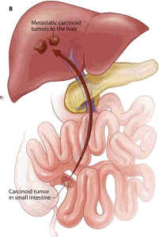
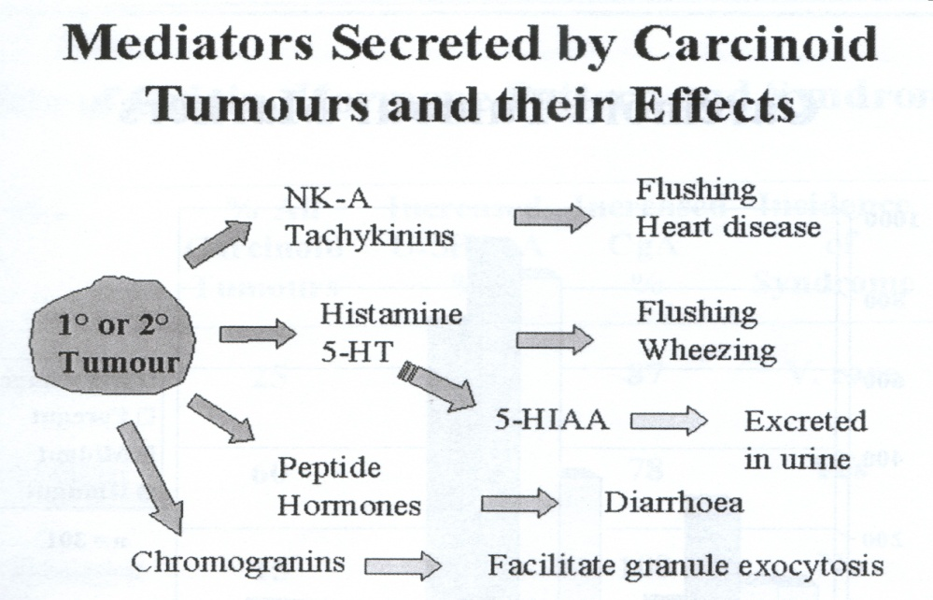
Carcinoid tumour (Neuroendocrine Neoplasm) mediators and somatostatin receptors
5-HT
 | SSTR1 | SSTR2 | SSTR3 | SSTR4 | SSTR5
Carcinoids | 76% | 99% | 43% | 68% | 77%
Gastrinomas | 79% | 93% | 36% | 61% | 93%
Insulinomas | 76% | 81% | 38% | 58% | 57%
NF-NET | 58% | 88% | 42% | 48% | 50%

Slide 3
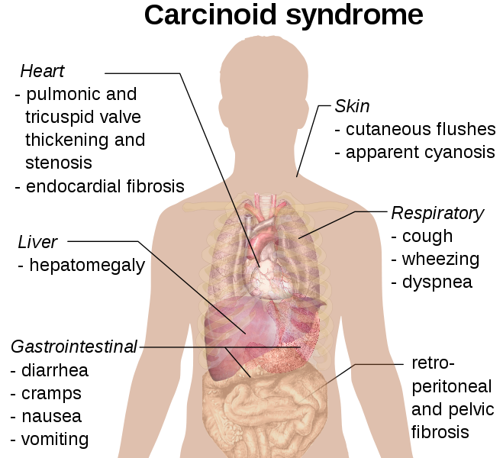
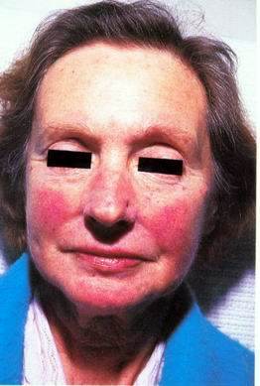
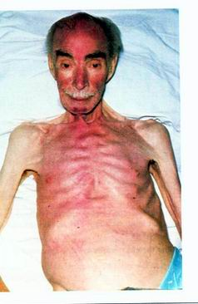

Slide 4

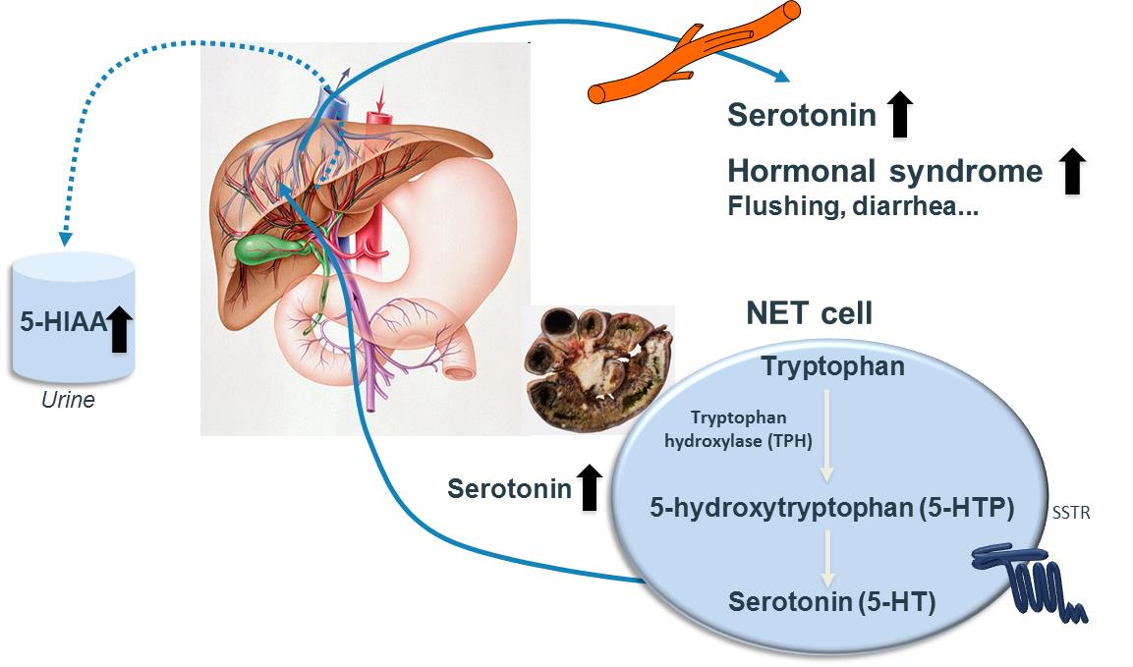
  Pathogenesis of CS
Excess serotonin (5-HT) secretion, as measured by its metabolite 5-hydroxyindoleacetic acid (5-HIAA), leads to persistent CS symptoms and progression toward life-threatening complications
  Serotonin promotes mucosal secretions and GI motility, in addition to its known role as a neurotransmitter and vasoconstrictor/vasodilator.¹
  In the presence of a NET tumour and liver metastases, serotonin release in the systemic circulation, causes increased mucosal secretions, GI peristalsis, and muscular spasm, resulting in diarrhea and other symptoms.^{2,3}
  Excess release of serotonin and other peptides may also induce fibrogenic responses which may be irreversible and could lead to severe CS complications.^{1,4,5}
5-HIAA, 5-hydroxyindoleacetic acid; 5-HT, serotonin; 5-HTP, hydroxytryptophan; TPH, tryptophan hydroxylase.
1. Berger M, Gray JA, Roth BL. Annu Rev Med 2009;60:355-66. 2. Kaltsas GA, et al. Endocr Rev 2004;25(3):458-511.3. Spiller R. Neurogastroenterol Motil 2007;19 Suppl 2:25-31. 4. Oberg KE. Ann Oncol 2010;21 Suppl 7:vii72-vii80. 5. Mota JM, et al. Ecancermedicalscience 2016;10:662.

Slide 5
Excessive release of serotonin and other vasoactive peptides lead to life-threatening complications
Carcinoid heart disease (CHD) develops in 16-29% of CS patients¹ and may lead to right heart failure and cardiac death
  CHD is prognostic factor for CS patients.²⁻⁴
Mesenteric (and/or retroperitoneal) fibrosis, reported in about 50% of patients with CS,^{5,6} can cause partial or complete intestinal obstruction.
Carcinoid crisis is manifested by the exacerbation of CS symptoms; it may be life-threatening.⁷
Other complications include niacin deficiency, cognitive impairment, psychiatric disorders, muscle wasting⁸
  CS-associated chronic diarrhea may lead to severe complications such as dehydration and electrolyte imbalance.⁸
1. Data on file. 2. Dobson R, et al. Br J Cancer 2014;111(9):1703-9. 3. Westberg G, et al. Br J Surg 2001;88(6):865-72. 4. Fox DJ, Khattar RS. Heart 2004;90(10):1224-8. 5. Druce M, et al. Nat Rev Endocrinol 2009;5(5):276-83. 6. Druce MR, et al. QJM 2010;103(3):177-85. 7. Oberg KE. Ann Oncol 2010;21 Suppl 7:vii72-vii80. 8. Mota JM, et al. Ecancermedicalscience 2016;10:662.

Slide 6
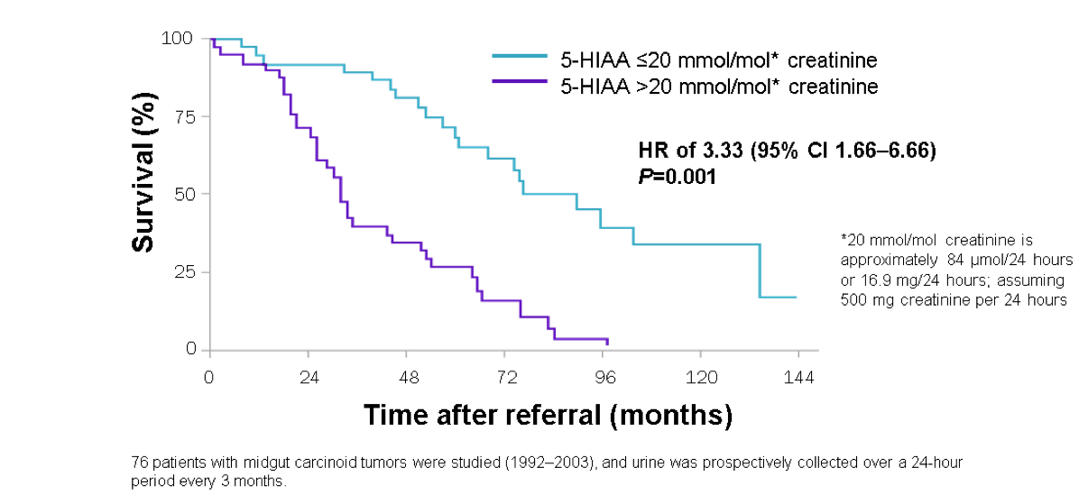
High urinary 5-HIAA level is an independent prognostic factor for patients with midgut NET
Median survival: 33 months for patients with u5-HIAA > 84 umol/24 hrs versus 90 months for patients with moderately high u5-HIAA level
  Prospective study; N=76; median follow-up 55 months
Adapted from Horst-Schrivers et.al. 2007
1. Van der Horst-Schrivers AN, et al. Eur J Cancer 2007;43(18):2651-7

Slide 7
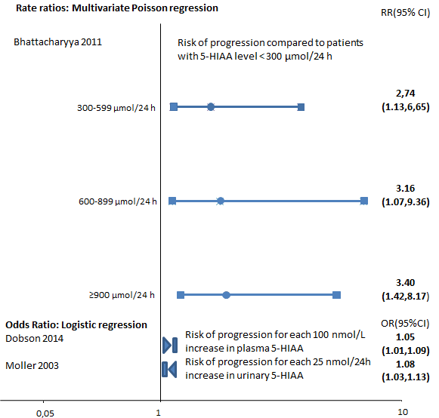
A number of studies have concluded on the association between CHD and high urinary 5-HIAA levels
    Observational studies of CS patients showing two-fold higher levels of 5-HIAA in the presence of CHD (n=32 consecutive outpatients).¹
    Patients with valvular dysfunction who have high 5-HIAA levels (median > 300 over 6 months) have a 2.74-fold increased risk of developing CHD.²
    Several studies consistently reported that 5-HIAA was an independent predictor of CHD progression (P<0.005).^{1,2,5,6}
    High levels of urinary 5-HIAA predicted increased cardiac score, indicative of CHD progression (OR of CHD progression per 25-mg/24-hour increase in 5-HIAA levels: 1.08; 95% CI 1.03-1.13; p = 0.009).²
    Increasing levels of 5-HIAA are associated with increased risk of CHD development: CHD incidence ratio 2.74-3.4 for 5-HIAA levels > 300 μmol/24h (> 32% of CS patients)³ vs 5-HIAA < 300 μmol/24h.^{2,4}
1. Zuetenhorst JM, et al. Cancer 2003;97(7):1609-15. 2. Optum. CHD and 5-HIAA: summary of key results from literature review. 2016. 3. Zandee WT, et al. Eur J Endocrinol 2016 Nov;175(5):361-6. 4. Bhattacharyya S, et al. Am J Cardiol 2011;107(8):1221-6. 5. Droogmans S, et al. Eur Heart J. 2007 Sep;28(17):2156-62. 6. Rajamannan NM, et al. J Heart Valve Dis. 2001 Nov;10(6):827-31. 7. Dobson R, et al. Br J Cancer 2014;111(9):1703-9. 8. Moller JE, et al. N Engl J Med 2003;348(11):1005-15.

Slide 8
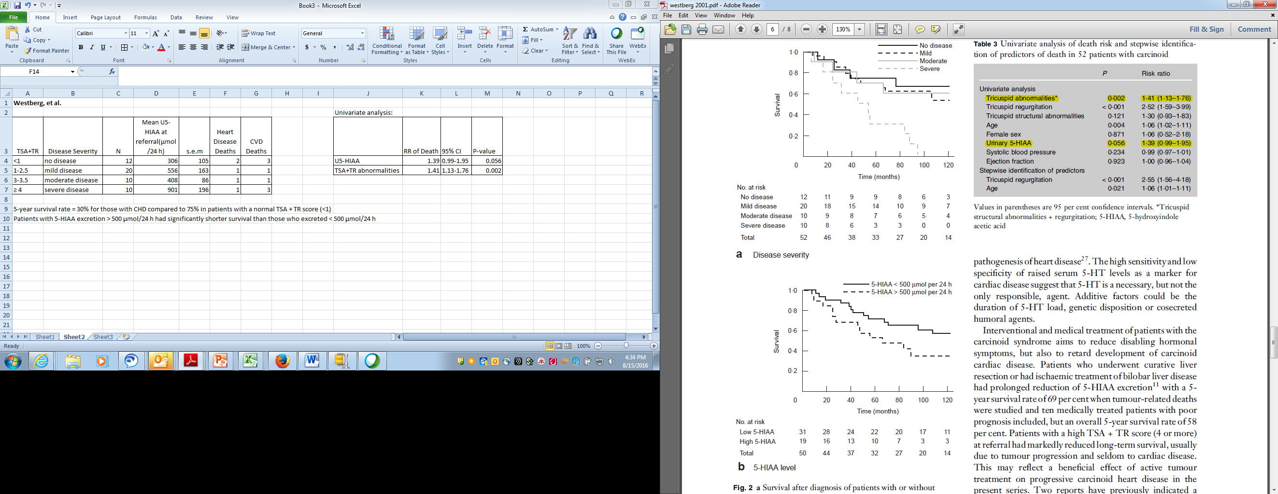
CHD is a negative prognostic factor for survival
  CHD is a strong prognostic factor for CS patients.¹⁻⁵
    Median survival is reduced by 50% in the presence of CHD (median 11 months);⁶ five-year survival is 37%.⁷
    Risk of death associated to CHD (defined based on presence of Tricuspid regurgitation) is an independant predictor of death in CS patients
      Risk increase between 2,55-fold (P<0,001)⁵ and up to 3,61-fold.¹
    In patients with midgut CS, CHD impact on survival was stronger as disease severity increased.⁵
Survival among patients with
midgut CS with and without CHD
Adapted from Westberg et.al. 2001.⁵
1. Dobson R, et al. Br J Cancer 2014;111(9):1703-9. 2. Bhattacharyya S, et al. Am J Cardiol 2011; 107(8):1221-6. 3. Denney WD, et al. J Am Coll Cardiol 1998;32(4):1017-22. 4. Moller JE, et al. N Engl J Med 2003;348(11):1005-15. 5. Westberg G, et al. Br J Surg 2001;88(6):865-72. 6. Connolly et al. 1995 JACC vol 25 n°2. 7. Norlen et al. 2012 World J Surg 36(6):1419-31.

Slide 9
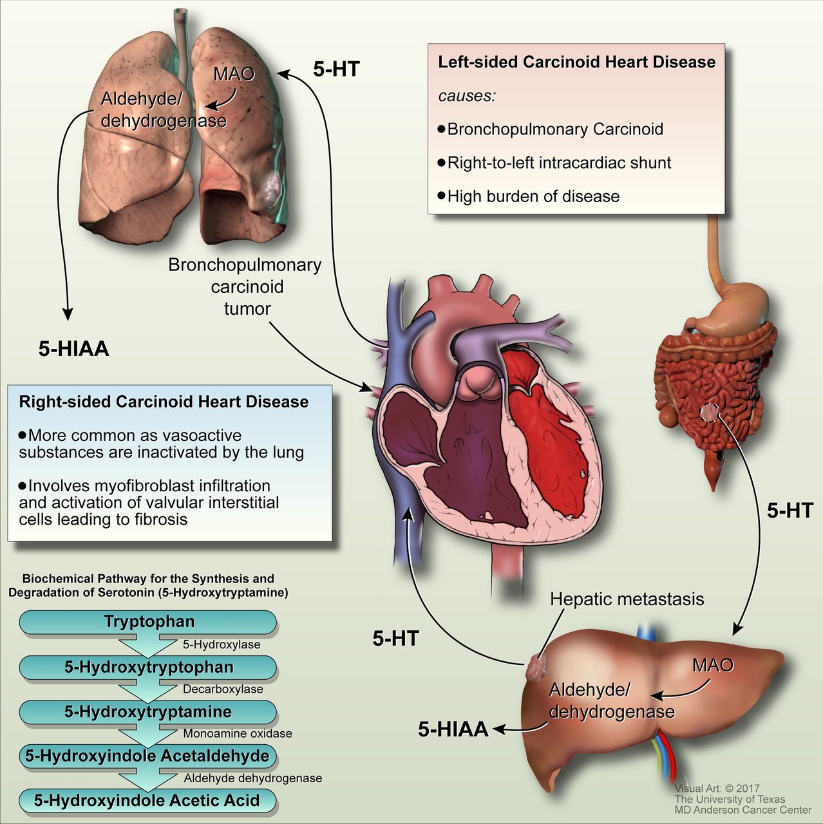
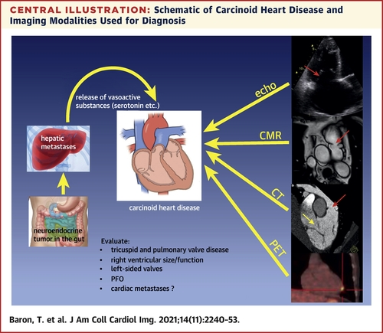
Carcinoid Heart Disease

Slide 10
Case: 53 year old female patient
Flushing episodes, for several years, considered to be premenopausal followed by watery diarrhea (> 5 times/day)
Shortness of breath & systolic murmur. ECHO: signs for carcinoid heart disease (CHD)
24-h urine collection for 5-HIAA levels (1,543 umol/24h, normal < 47)
MRI abdomen : hepatic metastases and mesenteric mass
Octreotide Scan : avid uptake in hepatic mets/mesenteric mass
Commenced on Lanreotide Autogel 120 mg/month, with partial improvement of symptoms

Slide 11
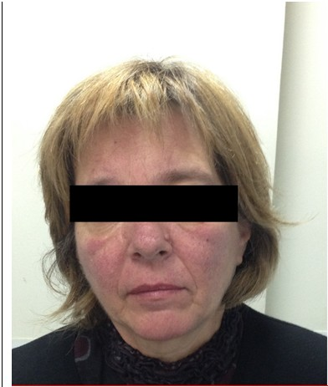
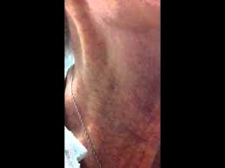
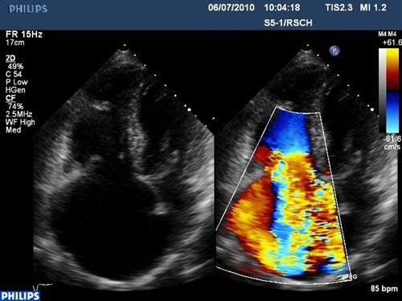
Sequelae of carcinoid syndrome : Carcinoid Heart Disease (CHD)
Almost 50% of patients with CS developed CHD
Following introduction of SSA this figure is 25%
High levels of pro-BNP

Slide 12
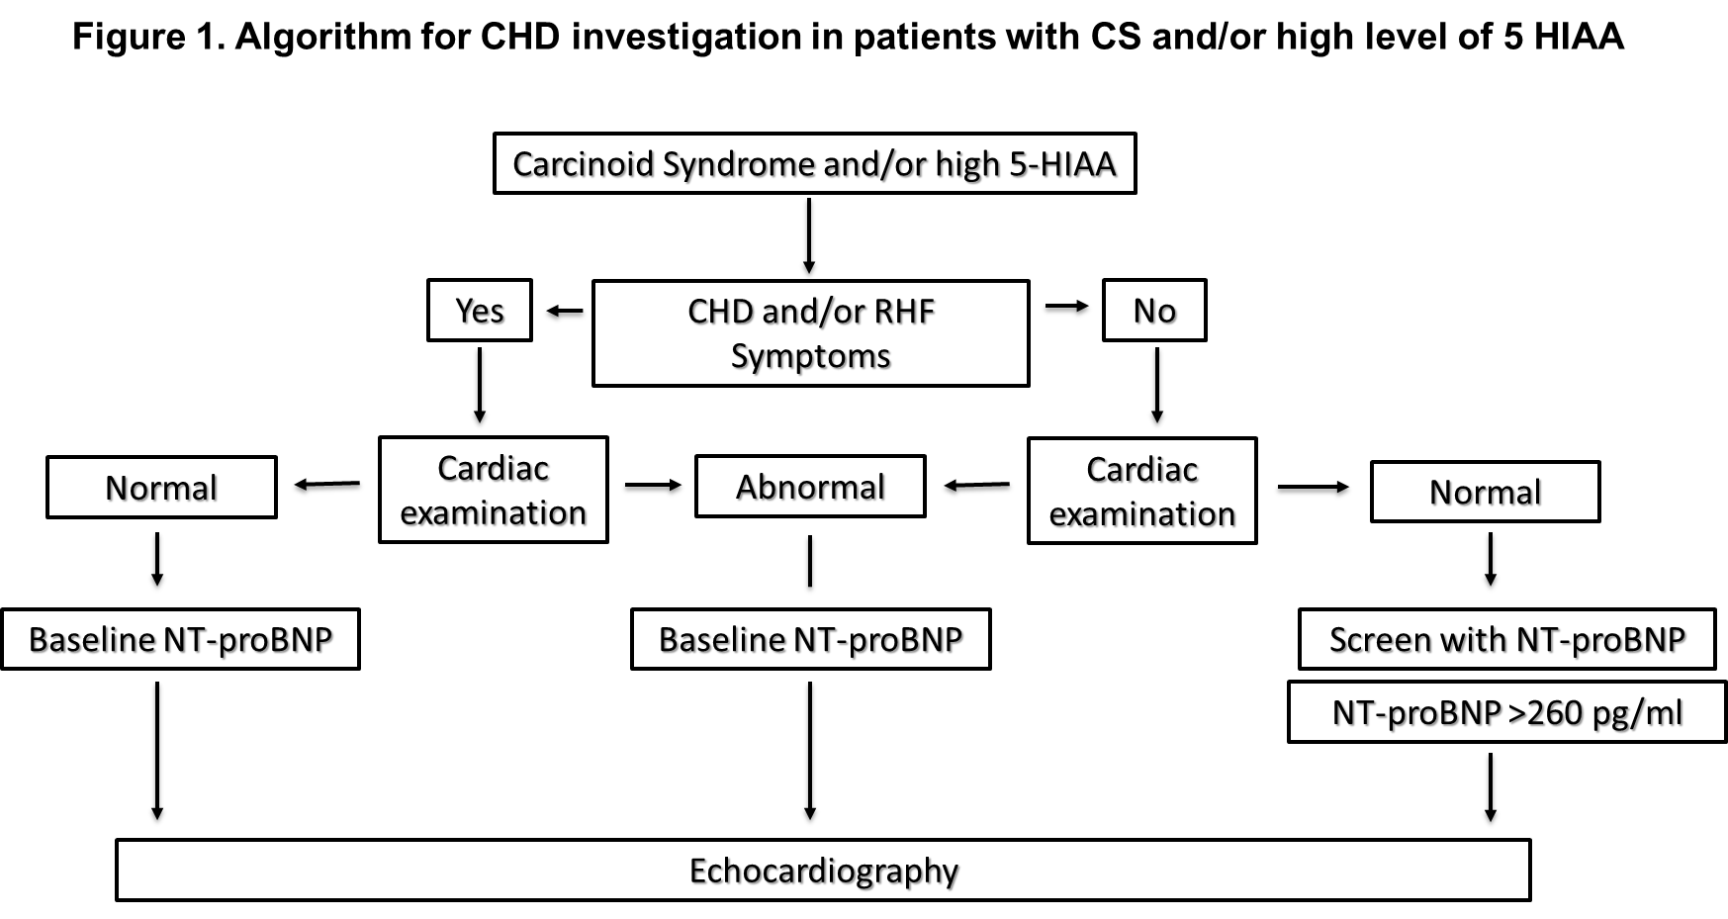
Grozinsky-Glasberg S, et al. J Neuroendocrinol. 2022 Jul;34(7):e13146. doi: 10.1111/jne.13146.
Notes:
- actively evaluate for CHD and/or RHF symptoms & signs

Slide 13
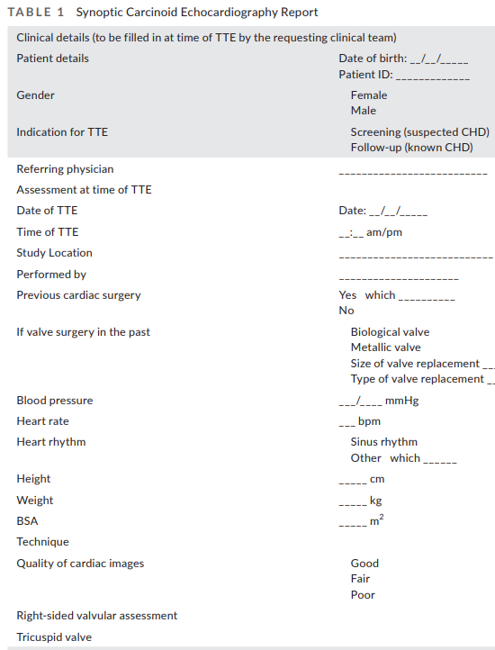
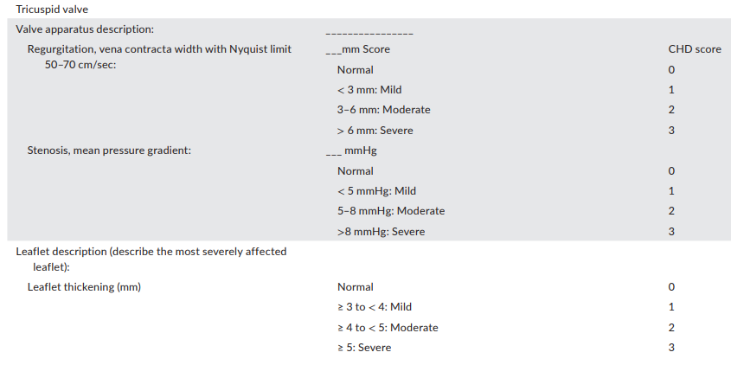
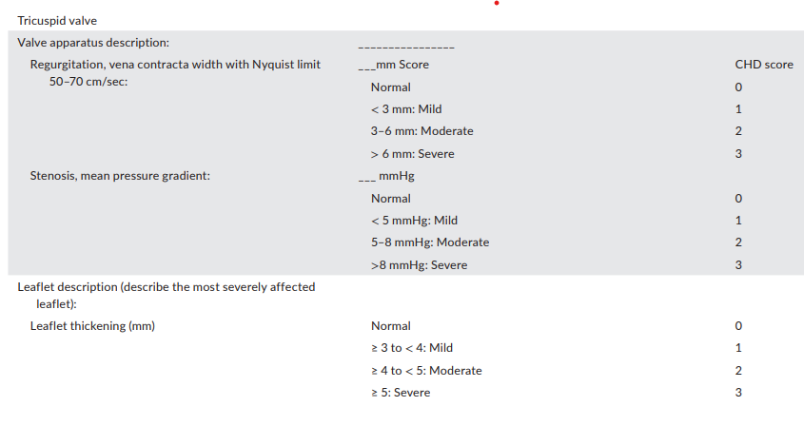
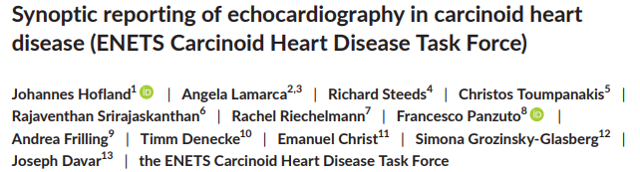
ENETS synoptic report on CHD

Slide 14
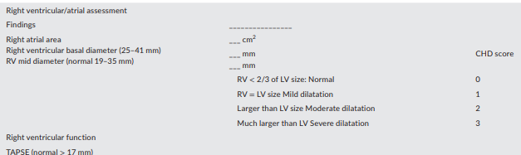
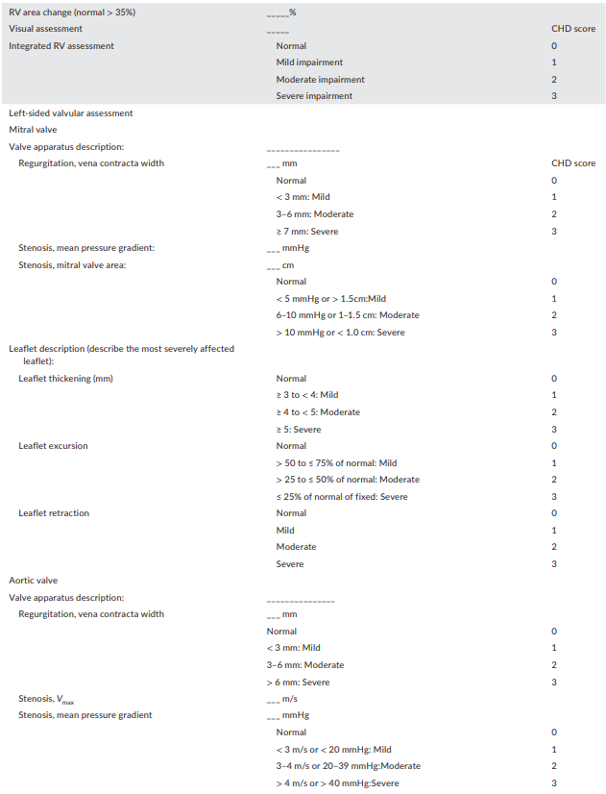
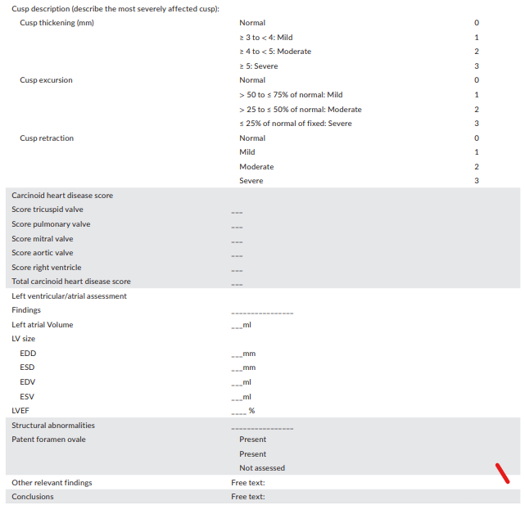
ENETS synoptic report on CHD

Slide 15
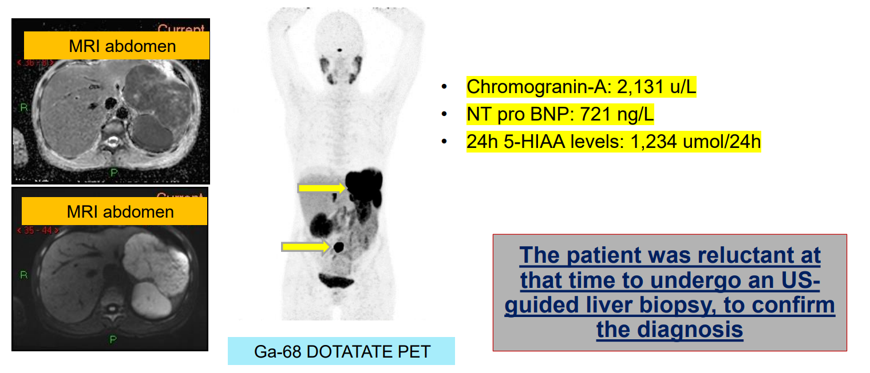
Female Patient with Carcinoid syndrome and CHD
Hepatic biopsy : Small Bowel NET, Grade 2 (Ki67 5%), serotonin (+)

Slide 16
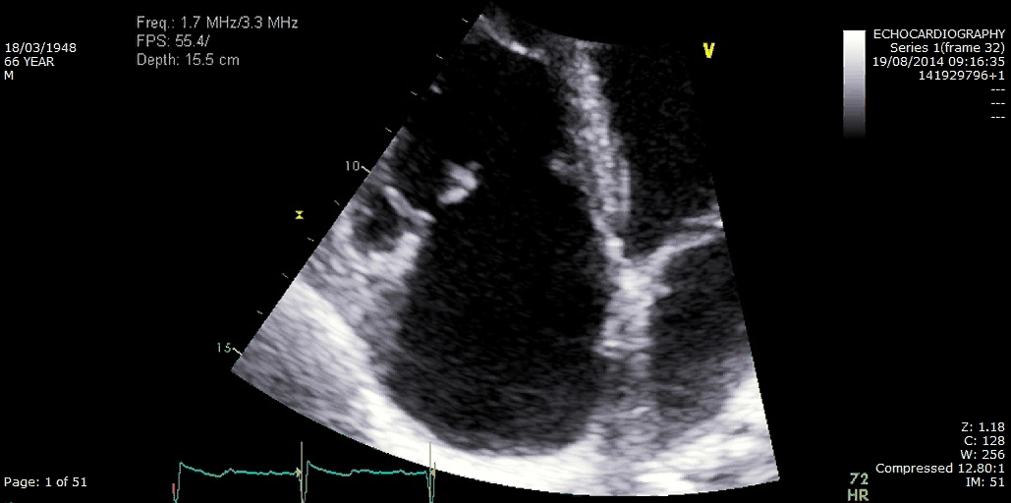
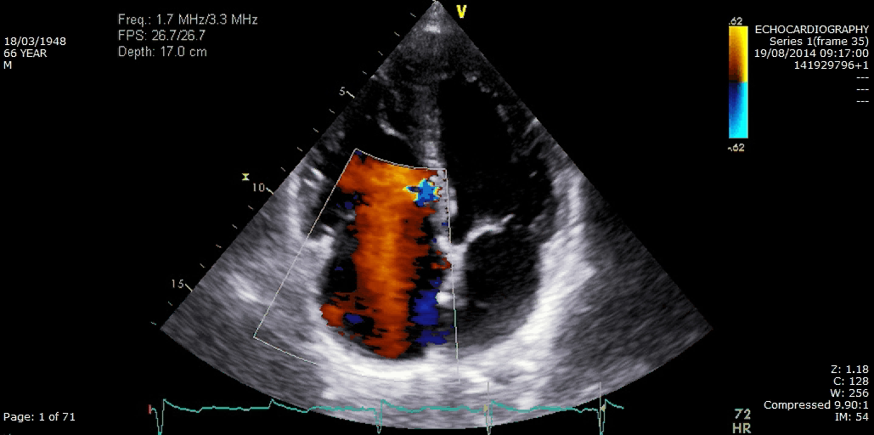
Carcinoid Heart Disease (CHD)
Diagnostic procedures,
  NT-proBNP = Grossly elevated
Echocardiography
  CHD: TV cusps fibrosis & retraction, severe/free TR
Provisional Diagnosis - WD SI NET, Stage 4, Grade 2, CS & CHD
RV
RV
RA
RA
WHAT NEXT?

Slide 17
Principles of Therapy to a CS & CHD Patient
1st Decrease Hormonal Levels, crucial:
    control the symptoms (±tumor growth)
    control the negative haemodynamic impact of serotonin
    prevent carcinoid crisis
    prevent CHD appearance/progression/recurrence
2nd Identify & Treat RHF
    relieve the symptoms of right heart failure (loop diuretics, fluid & salt restriction, compression stockings)
    cautious … in advanced RVF, these become deleterious due to the depletion of intravascular volume, further reducing of the cardiac output.
3rd Decide on Valve Replacement (NET MDT)
    evaluation of CHD severity, risk of bleeding, time of surgery & type of prosthesis, Discuss with the patient (risk, benefits, preference, etc.)
concomitantly
concomitantly

Slide 18
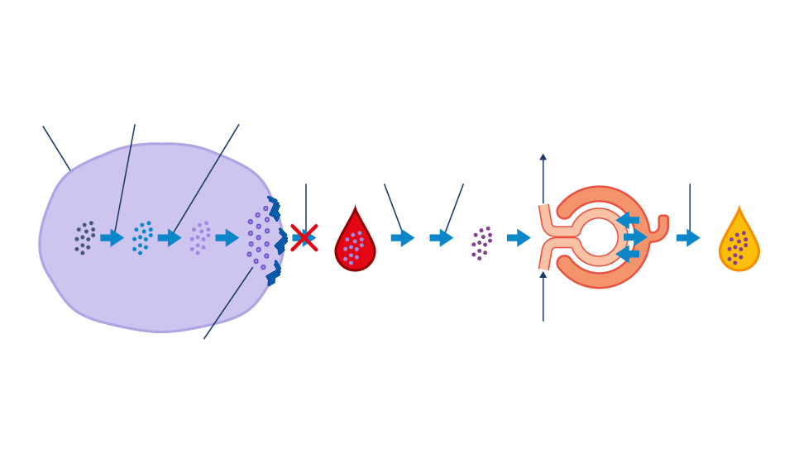
SSAs (HD) - the 1st line therapy in CS
NET cell
Tryptophan hydroxylase
Aromatic L-amino acid decarboxylase
Efferent arteriole
5-HT secretion
Monoamine oxidase
Aldehyde dehydrogenase
Excretion
Tryptophan
5-HTP
5-HT
↑5-HT in blood
5-HIAA
↑5-HIAA
in urine
5-HIAA filtered by kidney
5-HT stored in secretory granules
SSA
Afferent arteriole
Bind to SSTR, expressed by most NET cells.
Major anti-secretory effect (hormones/vasoactive substances).
  improve symptoms in up to 70%.
  decrease u5-HIAA levels in ~46%.
Dose escalation to above the standard dose improve CS symptom control.
O'toole D, et al. Cancer. 2000; 88: 770-776.
Strosberg JR, et al. Oncologist. 2014; 19(9): 930-6.
Riechelmann RP, et al. Ther Adv Med Oncol. 2017; 9(2): 127-137.
Hofland J, et al. Endocr Relat Cancer. 2019; 26(3): R145-R156.
Pavel M, et al. Eur J Cancer. 2021 Nov;157:403-414.
Alexandraki KI, et al. J Pers Med. 2023 Feb 9;13(2):304.
Notes:
Rationale - more than 90% of NETs express SSTR.

Slide 19
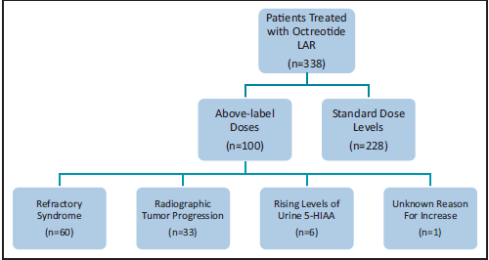
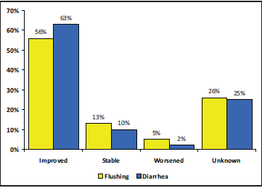
Refractory carcinoid syndrome (RCS) and severe Carcinoid heart disease. RCS is defined by recurring or persisting CS symptoms and increasing or persistently high u5‐HIAA levels despite the use of maximum label doses of SSA ENETS Guidance paper 2022
Patient was started on Lanreotide Autogel 120mg every 14 days and telotristat etitrate 250 mg X 3
Partial resolution of symptoms but diarrhea still remained
Minimal improvement in symptoms of CHD
Gastrointest Cancer Res 6:81-85, 2013

Slide 20
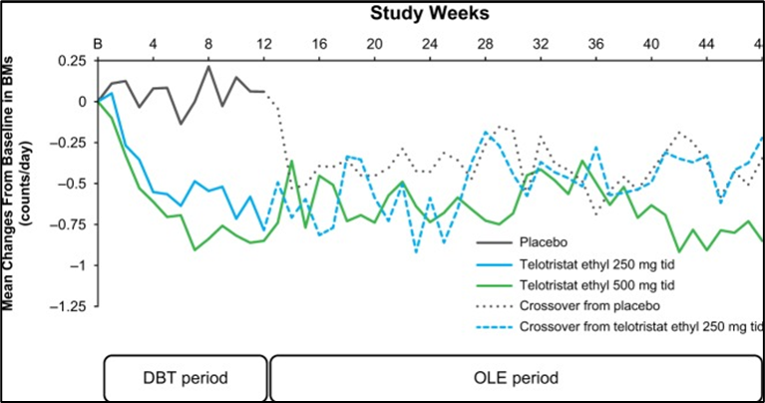
Telotristat Ethyl (XERMELO®) and CS
An oral inhibitor of TPH
TELESTAR & TELECAST: Sustained reduction in u5HIAA & BM Frequency
Approved (250mgX3/d) for CS diarrhea uncontrolled by SSA alone
Decrease in u5-HIAA of ≥30% at 12 weeks: 10% (placebo), 78% (250 mg), 87% (500 mg)
CHD prevention (u5-HIAA decrease, in patients w/o diarrhea)?
Serotonin Synthesis in Carcinoid Tumor Cells
Telotristat
Ethyl
Tryptophan
5-HTP
5-HT

TPH
5-HT secretion
5-HT in blood
5-HIAA
5-HIAA filtered by kidney
5-HIAA in urine
Monoamine oxidase
Aldehyde dehydrogenase
Kulke MH, et al. J Clin Oncol 2017; 35(1):14-23.
Pavel M, et al. Endocr Rel Cancer 2018; 25(3): 309–322.
Dillon JS, Chandrasekharan C. Future Oncol. 2018 May;14(12):1155-1164.
Notes:
20
An oral inhibitor of TPH (the rate-limiting enzyme in serotonin biosynthesis).

Slide 21
Tumor debulking & locoregional liver-directed therapies in CS
BE CAUTIOUS !
IN UNCONTROLLED CS & CHD
Loco-regional therapies are not recommended if severe CHD is present.
These procedures may induce a fast deterioration if used before heart surgery!
Needs preparation with sc or iv octreotide.
Hepatic intra-arterial therapies
  retrospective series, >1000 patients
  symptomatic improvement in 60-95% of patients for median 20-80m
Surgical debulking
  uncontrolled studies
  R2 surgical debulking of large tumor areas can induce symptom relief in 50-90% of cases with median duration of 19.3 - 45m
Laparoscopic radiofrequency ablation
  Small retrospective studies - symptomatic improvement in 70% of CS patients
Riechelmann RP, et al. Ther Adv Med Oncol 2017; Feb;9(2):127-137.
Grozinsky-Glasberg S, et al. Endocrine 2018; 47(3):683–98.
Notes:
21
Helsinki jun 2008
21

Slide 22
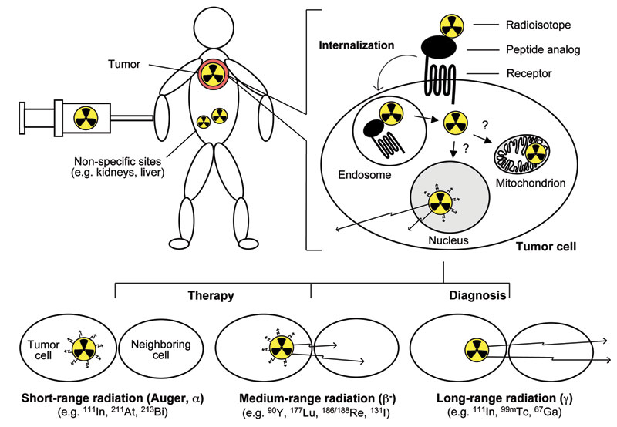
Radiopharmaceuticals for GEP-NETs

Slide 23
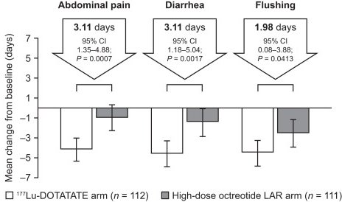
PRRT and CS
NETTER-1 (229 SINET):
  43% - uncontrolled CS
  PRRT was associated with statistically significant reductions in abdominal pain, diarrhea, flushing, with QoL improvement
Effective in RCS
BE CAUTIOUS !
PRRT IN UNCONTROLLED CS & CHD
May induce a fast deterioration if used before heart surgery!
Needs preparation with sc or iv octreotide.
HOWEVER
144 NET patients
  26 pts (22.6%) temporary increase >50% in u5HIAA!
Strosberg J, et al. J Nucl Med. 2021 Mar 26;62(12):1712–8.
Zandee WT, et al. J Clin Endocrinol Metab. 2021 Aug 18;106(9):e3665-e3672.
Hamiditabar M, et al. Clin Nucl Med. 2017; 42(6):436-443.
Notes:
23
Helsinki jun 2008
23
- NETTER-1 (177Lu-DOTATATE vs. HD-octreotide LAR) in 229 pts SINET PD: symptom diaries demonstrated that PRRT was associated with statistically significant reductions in abdominal pain, diarrhea, and flushing, with QOL improvement

Slide 24
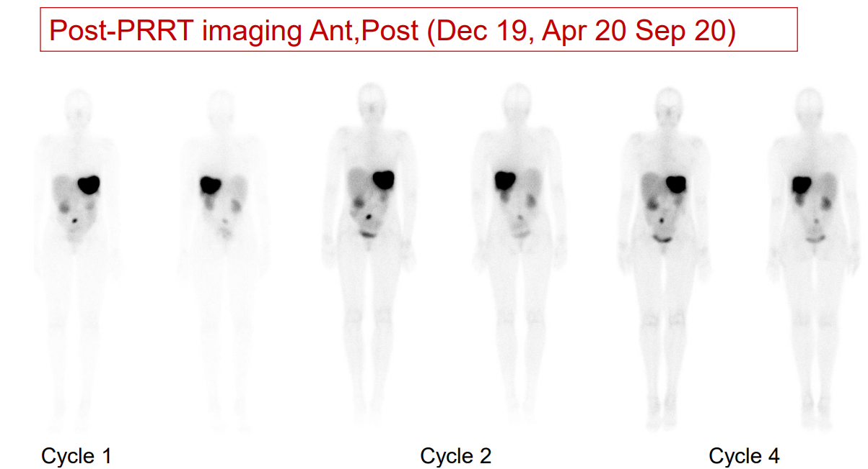
Refractory carcinoid syndrome (RCS) and severe Carcinoid heart disease. RCS is defined by recurring or persisting CS symptoms and increasing or persistently high u5‐HIAA levels despite the use of maximum label doses of SSA ENETS Guidance paper 2022

Slide 25
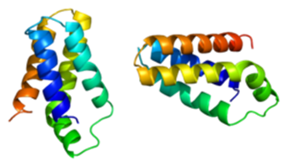
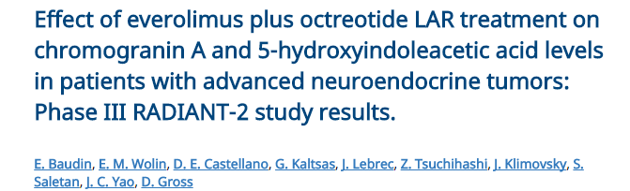
mTOR inhibitors (Everolimus) in CS
mTOR - a protein kinase, regulates cell proliferation & survival.
  over-activated in NETs
  its inhibition - arrests tumor growth.
Everolimus significantly prolonged PFS (RADIANT-2&4).
  Approved in G1 &G2 GI & Lung NETs
  Radiant-2: 61% reduction in u5-HIAA with E+O vs 46% P+O (p = 0.0001).
CgA
5-HIAA
Pavel ME, et al. Lancet, 2011; Dec 10;378(9808):2005-2012.
Baudin E, et al. Journal of Clinical Oncology, 2011; 29:15_suppl, 10527-10527
Notes:
25
Helsinki jun 2008
25

Slide 26
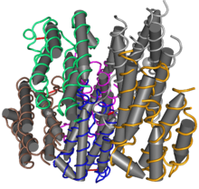
Interferon-alpha in CS
Pleiotropic effects
  Antiproliferative
    blocks cell cycle (GO-G1 phase), increases intra-tumoral fibrosis, inhibits angiogenesis, etc.
  Antisecretory
    reduction of mRNA expression for various hormones
Total of 27 studies (few randomised) ~ 679 patients
    biochemical & symptomatic responses - up to 70%
    tumour remission - ~10%
Poorly tolerated
Arnold R, et al. Clin Gastroenterol Hepatol. 2005; Aug;3(8):761-71.
Di Bartolomeo M, et al. Acta Oncol. 1993; ;32(2):235-8.
Oberg K. Semin Cancer Biol. 1992; Feb;3(1):35-41.
Notes:
26
Helsinki jun 2008
26

Slide 27
Decrease hormonal levels - based on the severity of CS
SSA, 1st Line
Severity of Refractory Carcinoid Syndrome
Nonaggressive: mild/moderate symptom burden, stable disease or indolent tumor progression
Increasing/persistently high u5-HIAA,
despite using maximum label doses of SSA
Aggressive: high symptom burden*, tumor progression, hepatic tumor burden > 50% and/or CHD
Dose-escalation of SSA
and/or telotristat ethyl**
SSA should never be discontinued.
Loco-regional therapies can be repeated if hepatic function is preserved.
Loco-regional therapies are not recommended if severe CHD is present.
If CHD is present, valve replacement should be performed prior to surgical debulking.
It is imperative that each decision on treatment should be dynamic, following an individualized specialized MDT evaluation, at each time-point in the therapeutic flow.
Dose-escalation of SSA & PRRT
and/or telotristat ethyl **
Loco-regional therapies; consider surgical evaluation for hepatic resection (curative intent or debulking)*** (low volume disease)
Loco-regional therapies; consider surgical evaluation for debulking***
PRRT
Everolimus
Interferon
Everolimus
Interferon
Grozinsky-Glasberg S, et al. J Neuroendocrinol. 2022 Jul;34(7):e13146. doi: 10.1111/jne.13146.
Notes:
Aggressive CS: more than 4 BM/day and/or more than 5 flushing episodes/day** When available, and when CS-related diarrhea is predominant *** Surgical debulking can be considered earlier, if possible, in highly selected cases, based on the type of liver metastasis (Type I or Type II) and weighing up severity of CHD and the impact of debulking on CHD.
RCS is defined by recurring or persisting CS symptoms and increasing or persistently high u5-HIAA levels despite the use of maximum label doses of SSA.
The best therapeutic sequence for RCS has not been yet determined by randomised trials, and it should be decided based on severity of RCS and tumour status
O Somatostatin Analogues (SSA), octreotide or lanreotide, are the mainstay of CS treatment
O It is not mandatory, but strongly recommended, to have a positive SRI to start therapy with SSA
O Second and further lines of management - Refractory CS (RCS) - is defined by recurring or persisting CS symptoms and increasing or persistently high u5-HIAA levels despite the use of maximum label doses of SSA. RCS may be divided into either non-aggressive or aggressive, based on symptoms burden (< or ≥ 4 BM/day, and/or < or ≥ 5 flushing episodes/day, respectively) together with disease stability (stable or progressive), hepatic burden (< or ≥ 50% liver involvement), and/or the presence of CHD.

Slide 28
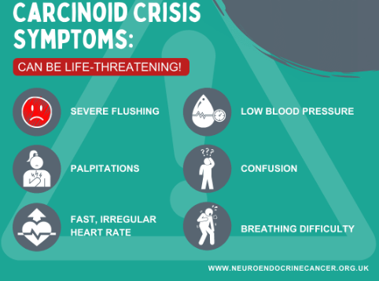
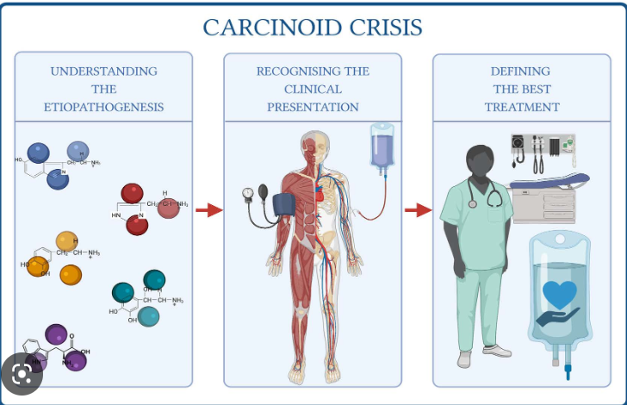
Carcinoid crisis: Lack of broadly defined definition : any hypotension or hemodynamic instability that cannot be attributed to acute blood loss or other obvious causes by the anesthesiologist or surgeon

Slide 29
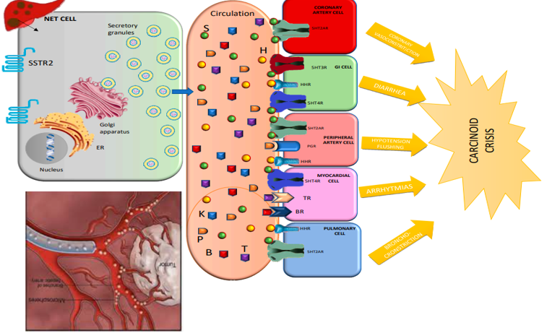
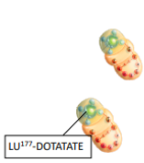
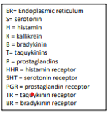
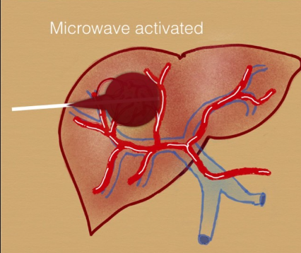
Precipitants of carcinoid crisis

Slide 30
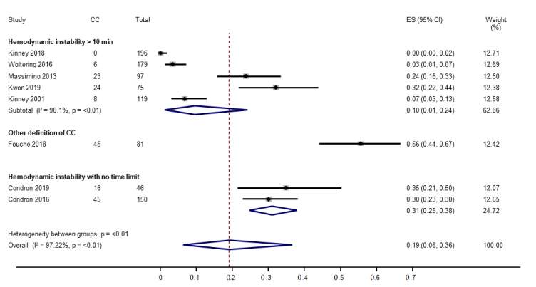
How common is carcinoid crisis
19%
Notes:
All studies were single-center; 6 were retrospective [20,21,23–25,27] and 2 were prospective studies [22,26]. Since all studies reported outcomes according to carcinoid crisis status, we classified all studies as case–control (n=8). The pooled incidence of carcinoid crisis (8 studies, 943 surgeries) was 19% (95% CI, 6–36%). The level of heterogeneity was high (I2 = 97.2%). T
in 7 studies, a systolic blood pressure (SBP) while in the eighth study the definition was based on a change in SBP representing a drop ≥40%. In 5 studies, a time-dependent effect was necessary to define carcinoid crisis, only if the findings lasted for 10 min or longer. all 8 studies, other physiologic changes were also included as alternatives for diagnosis of carcinoid crisis including tachycardia (HR > 120/min), hypertension (>180 mmHg), bronchospasm, flushing, urticaria, and acidosis [

Slide 31
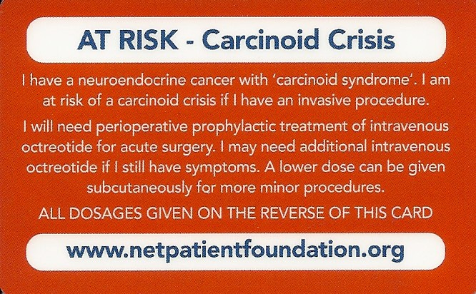
Special Consideration
Should we administer prophylactic octreotide prior/during invasive procedures - to reduce complications (crisis, death)?
Cons
Pros
Recent studies
  Questionable role
  Risk of post-op complications
Limitations (high bias)
  Most, retrospective
  Limited number patients
  Lack of control group
  Heterogeneous protocols
  Non-standardized definition of CC
  Non-systematic approach for prevention
Expert experience/opinion
Low cost
Excellent safety profile
Recommended by ENETS guidelines
Xu A, et al. Cancers (Basel). 2022 Jun 16;14(12):2966. doi: 10.3390/cancers14122966.
Wonn SM, et al. Surgery. 2022 Jan;171(1):88-93.
Condron ME, et al. Surgery. 2016 Jan;159(1):358-65.
Kaltsas G, et al. Neuroendocrinology. 2017; 105(3): 245-254.
Borna RM, et al. Anesthesiol Clin. 2017 Jun;35(2):327-339.
Maxwell JE, et al. Ann Surg Oncol 29, 3072–3084 (2022).
Grozinsky-Glasberg S, et al. J Neuroendocrinol. 2022 Jul;34(7):e13146. doi: 10.1111/jne.13146.
Notes:
31
Helsinki jun 2008
31
Recent studies indicated a Questionable role of prophylactic octreotide for preventing carcinoid crisis and a possible increased Risk of post-op complications.
CC definition should be guided by the presence of hemodynamic changes not otherwise explained by surgical or anesthetic treatments.
Short-acting Octreotide - prophylactic prior/during invasive procedures- to reduce complications (hypotension, crisis, death): subcutaneous, or sc octreotide 100μg to 500μg every 6 to 8 hours continuous infusion octreotide ≥50-200 μg/h started at least 12h before, until patient stable, slow tapering down before discontinuation
Antihistamines - prevent flushing & bronchospasm
Corticosteroids - reduce bradykinin
Minimize the use of specific drugs known to precipitate carcinoid crisis: opioids, the neuromuscular relaxant atracurium, dopamine, adrenaline/epinephrine)

Slide 32
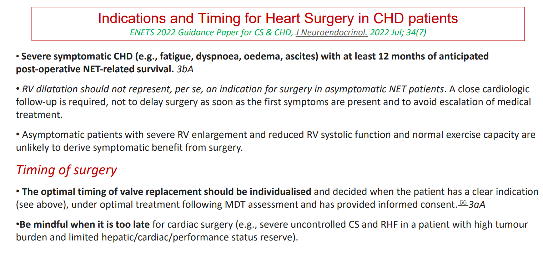

Slide 33
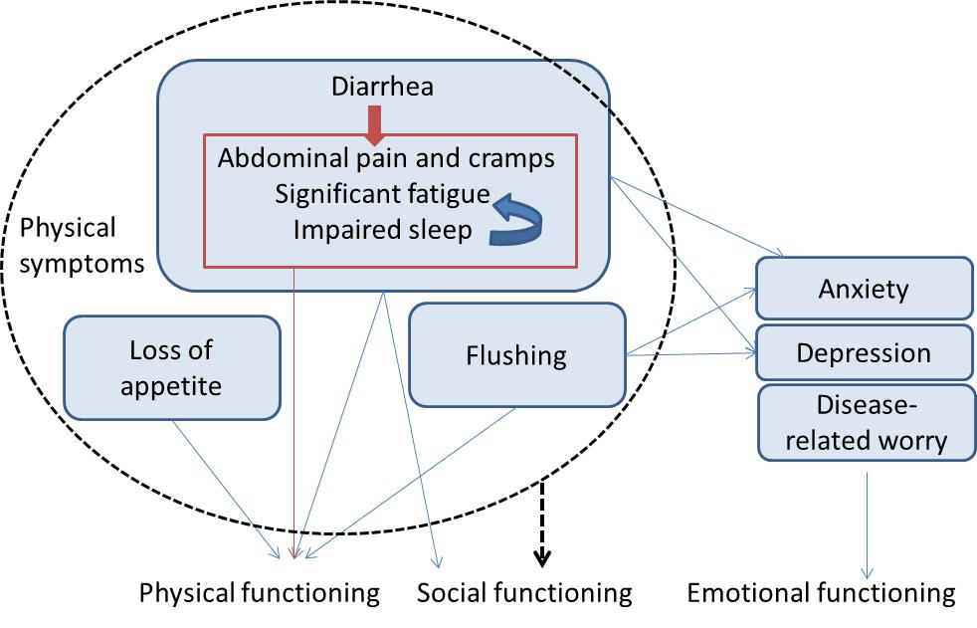
Several studies reported that CS symptoms have a negative impact on patients’ QoL
In a global survey of 1,928 NET patients, the majority of patients (92%) reported a lifestyle change as a result of their neuroendocrine cancer and:¹
  60% reported a negative effect on their emotional health
  49% reported that their cancer led them to stop or to cut back on physical activity
  43% reported that their cancer led them to stop or to cut back on social life
  In NET patients, lower physical, social, and emotional functioning were related to CS symptoms.²
  CS patients consistently reported the lowest levels of global HRQoL versus healthy populations and other NET patients.^{3,4}
1. Singh S, et al. J Glob Oncol 2016. 2. Mapi. Quality of life and carcinoid syndrome: literature review results. Version 2.0. 2016 Jul 25. 3. Beaumont JL, et al. Pancreas. 2012;41(3):461-466. 4. Fröjd C, et al. Health Qual Life Outcomes. 2007;5:18.
Based on MAPI 2016² and Beaumont 2012³

Slide 34
Conclusions
CHD occurs in approximately 25% of patients with CS
It is related to 5HIAA levels
Management relies on reduction of 5HIAA levels
Cautious medical management to avoid intravascular volume depletion & procedures of liver intervention
Timing of valve replacement (transplantation)

