Slide 1


Εισαγωγή στον Διαβήτη και στην Καρδιομεταβολική Ιατρική:
Διαγνωστικά Κριτήρια ΣΔ - Τύποι ΣΔ
Εμμανουήλ Κόρακας
Επιμελητής Β’ Παθολογίας, Β’ ΠΠΚ, ΠΓΝ ΑΤΤΙΚΟΝ
Senior Trust Doctor in Diabetes and Endocrinology, University College London Hospitals

Slide 2
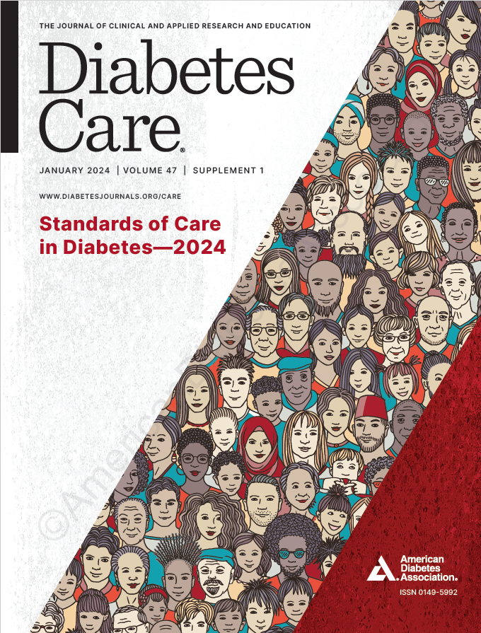
Standards of Care in Diabetes—2024
(Standards of Care)

Slide 3
Section 2.
Diagnosis and Classification of Diabetes

Slide 4
Diagnostic Tests for Diabetes
DIAGNOSIS AND CLASSIFICATION of Diabetes
2.1a Diagnose diabetes based on A1C or plasma glucose criteria, either the fasting plasma glucose (FPG) value, 2-h plasma glucose (2-h PG) value during a 75-g oral glucose tolerance test (OGTT), or random glucose value accompanied by classic hyperglycemic symptoms/crises criteria (Table 2.1). A
2.1b In the absence of unequivocal hyperglycemia (e.g., hyperglycemic crises), diagnosis requires confirmatory testing (Table 2.1). A

Slide 5
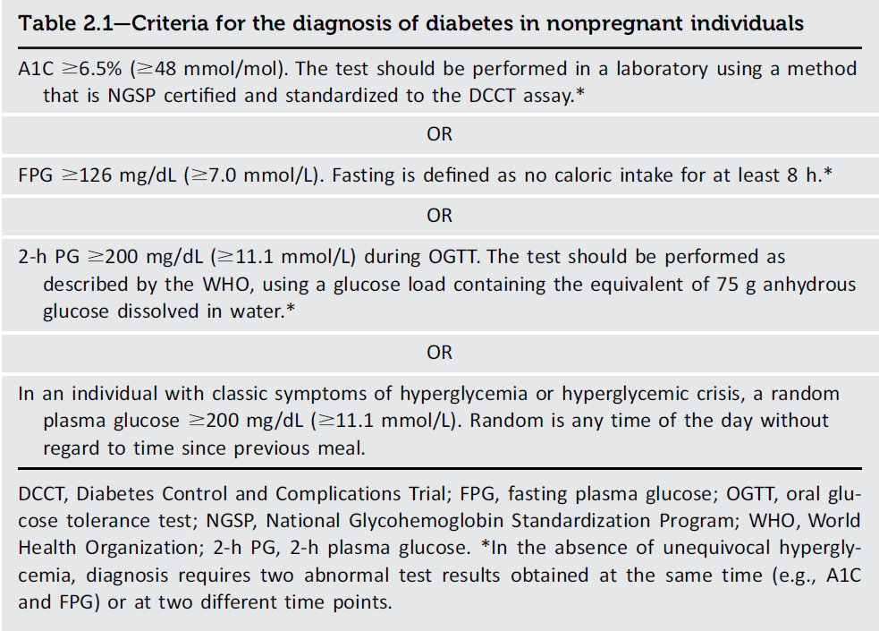
DIAGNOSIS AND CLASSIFICATION of Diabetes
Recent physical activity, illness, or acute stress can also affect glucose concentrations. Glucose concentrations will be falsely low if samples are not processed promptly or stored properly prior to analysis
Diagnosis and Classification of Diabetes:
Standards of Care in Diabetes - 2024. Diabetes Care 2024;47(Suppl. 1):S20-S42
5
Introduction and Methodology:
ElSayed NA, Aleppo G, Aroda VR, et al., American Diabetes Association. Introduction and methodology: Standards of Care in Diabetes—2023. Diabetes Care 2023;46(Suppl. 1):S1–S4
Notes:
An advantage of glucose testing is that these assays are inexpensive and widely available. Disadvantages include the high diurnal variation in glucose and fasting requirement. Individuals may have difficulty fasting for the full 8-h period or may misreport their fasting status. (1).

Slide 6
Use of A1C for Screening and Diagnosis of Diabetes
DIAGNOSIS AND CLASSIFICATION of Diabetes
2.2a The A1C test should be performed using a method that is certified by the National Glycohemoglobin Standardization Program (NGSP) as traceable to the Diabetes Control and Complications Trial (DCCT) reference assay. B
2.2b Point-of-care A1C testing for diabetes screening and diagnosis should be restricted to U.S. Food and Drug Administration- approved devices at Clinical Laboratory Improvement Amendments (CLIA)-certified laboratories that perform testing of moderate complexity or higher by trained personnel. B

Slide 7
Use of A1C for Screening and Diagnosis of Diabetes (continued)
DIAGNOSIS AND CLASSIFICATION of Diabetes
2.3 Marked discordance between A1C and repeat blood glucose values should raise the possibility of a problem or interference with either test. B
2.4 In conditions associated with an altered relationship between A1C and glycemia, such as some hemoglobin variants, pregnancy (second and third trimesters and the postpartum period), glucose-6- phosphate dehydrogenase deficiency, HIV, hemodialysis, recent blood loss or transfusion, or erythropoietin therapy, plasma glucose criteria should be used to diagnose diabetes. B
Notes:
A1C has several advantages compared with FPG and OGTT, including greater convenience (fasting not required), greater preanalytical stability, and fewer day-to-day perturbations during stress, changes in nutrition, or illness.

Slide 8
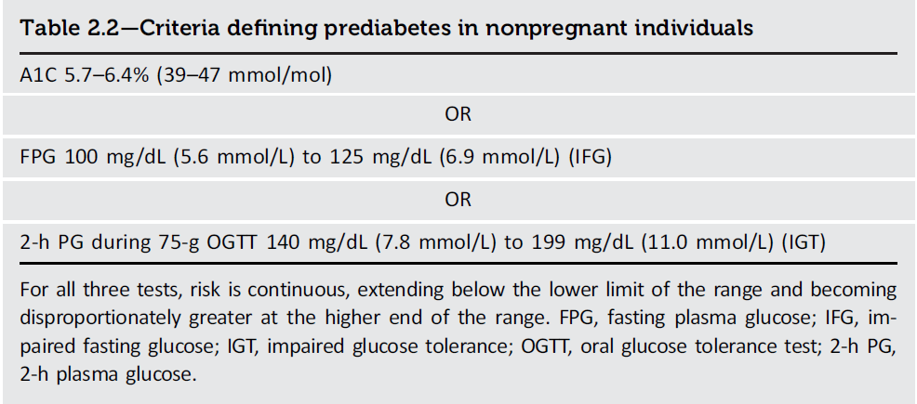
DIAGNOSIS AND CLASSIFICATION of Diabetes
Diagnosis and Classification of Diabetes:
Standards of Care in Diabetes - 2024. Diabetes Care 2024;47(Suppl. 1):S20-S42
8
Introduction and Methodology:
ElSayed NA, Aleppo G, Aroda VR, et al., American Diabetes Association. Introduction and methodology: Standards of Care in Diabetes—2023. Diabetes Care 2023;46(Suppl. 1):S1–S4

Slide 9
Classification
DIAGNOSIS AND CLASSIFICATION of Diabetes
2.5 Classify people with hyperglycemia into appropriate diagnostic categories to aid in personalized management. E
Classification is important for determining personalized therapy, but some individuals cannot be clearly classified as having type 1 or type 2 diabetes at the time of diagnosis.
The traditional paradigms of type 2 diabetes occurring only in adults and type 1 diabetes only in
children are not accurate, as both diseases occur in all age-groups.

Slide 10
Classification (continued)
DIAGNOSIS AND CLASSIFICATION of Diabetes
Diabetes can be classified into the following general categories:
Type 1 diabetes (due to autoimmune β-cell destruction, usually leading to absolute insulin deficiency, including latent autoimmune diabetes of adulthood)
Type 2 diabetes (due to a non-autoimmune progressive loss of adequate β-cell insulin secretion, frequently on the background of insulin resistance and metabolic syndrome)
Specific types of diabetes due to other causes, e.g., monogenic diabetes syndromes (such as neonatal diabetes and maturity-onset diabetes of the young), diseases of the exocrine pancreas (such as cystic fibrosis and pancreatitis), and drug- or chemical-induced diabetes (such as with glucocorticoid use, in the treatment of HIV, or after organ transplantation)
Gestational diabetes mellitus (diabetes diagnosed in the second or third trimester of pregnancy that was not clearly overt diabetes prior to gestation or other types of diabetes occurring throughout pregnancy, such as type 1 diabetes).

Slide 11
Type 1 Diabetes
DIAGNOSIS AND CLASSIFICATION of Diabetes
2.6 Screening for presymptomatic type 1 diabetes may be done by detection of autoantibodies to insulin, glutamic acid decarboxylase (GAD), islet antigen 2 (IA-2), or zinc transporter 8 (ZnT8). B
2.7 Having multiple confirmed islet autoantibodies is a risk factor for clinical diabetes. Testing for dysglycemia may be used to further forecast near-term risk. When multiple islet autoantibodies are identified, referral to a specialized center for further evaluation and/or consideration of a clinical trial or approved therapy to potentially delay development of clinical diabetes should be considered. B
2.8 Standardized islet autoantibody tests are recommended for classification of diabetes in adults who have phenotypic risk factors that overlap with those for type 1 diabetes (e.g., younger age at diagnosis, unintentional weight loss, ketoacidosis, or short time to insulin treatment). E
Notes:
It is clear from prospective studies that the persistent presence of two or more islet autoantibodies is a nearcertain predictor of clinical diabetes
The rate of progression is dependent on the age at first detection of autoantibody, number of autoantibodies, autoantibody specificity, and autoantibody titer. Glucose and A1C levels may rise well before the clinical onset of diabetes (e.g., changes in FPG and 2-h PG can occur about 6 months before diagnosis) (46), making diagnosis feasible well before the onset of DKA

Slide 12
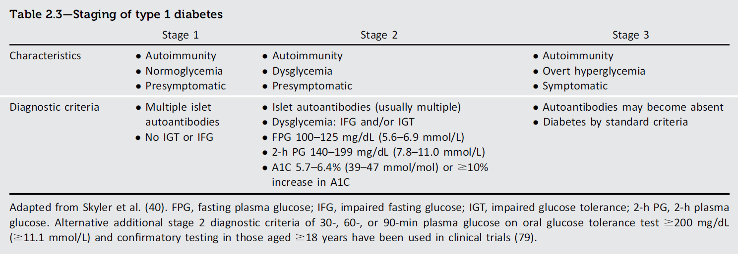
DIAGNOSIS AND CLASSIFICATION of Diabetes
Diagnosis and Classification of Diabetes:
Standards of Care in Diabetes - 2024. Diabetes Care 2024;47(Suppl. 1):S20-S42
12
Introduction and Methodology:
ElSayed NA, Aleppo G, Aroda VR, et al., American Diabetes Association. Introduction and methodology: Standards of Care in Diabetes—2023. Diabetes Care 2023;46(Suppl. 1):S1–S4
Notes:
At stage 1, the 5-year risk of developing symptomatic type 1 diabetes is 44% overall but varies considerably based on number, titer, and specificity of autoantibodies aswell as age of seroconversion and genetic risk (47). Stage 2 includes individuals with multiple islet autoantibodies and dysglycemia. At stage 2 of the disease, there is 60% risk by 2 years and 75% risk within 5 years of developing symptomatic type 1 diabetes (57,58).

Slide 13
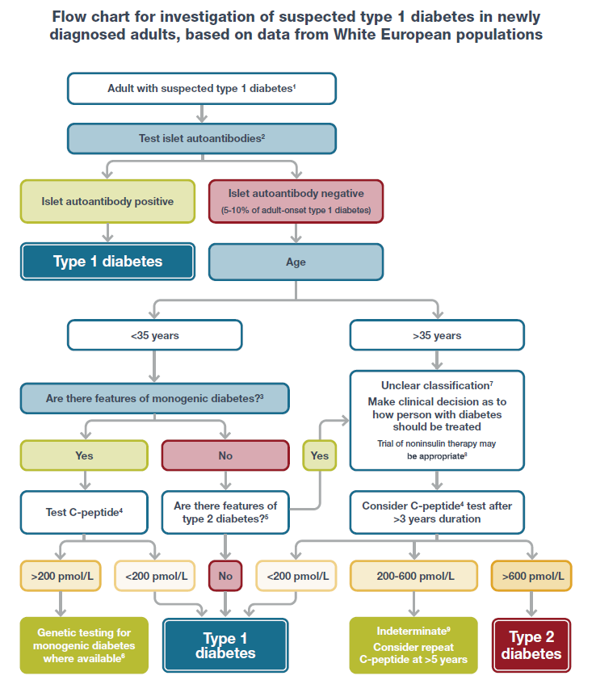
DIAGNOSIS AND CLASSIFICATION of Diabetes
A1C <58 mmol/mol (<7.5%) at diagnosis
One parent with diabetes
features of a specific monogenic cause (e.g., renal cysts, partial lipodystrophy, maternally inherited deafness, and severe insulin resistance in the absence of obesity)
monogenic diabetes prediction model probability >5%
Diagnosis and Classification of Diabetes:
Standards of Care in Diabetes - 2024. Diabetes Care 2024;47(Suppl. 1):S20-S42
13
Introduction and Methodology:
ElSayed NA, Aleppo G, Aroda VR, et al., American Diabetes Association. Introduction and methodology: Standards of Care in Diabetes—2023. Diabetes Care 2023;46(Suppl. 1):S1–S4
Notes:
4A C-peptide test is only indicated in people receiving insulin treatment. A random sample (with concurrent glucose) within 5 h of eating can replace a formal C-peptide stimulation test in the context of classification. If the result is $600 pmol/L ($1.8 ng/mL), the circumstances of testing do not matter. If the result is <600 pmol/L (<1.8 ng/mL) and the concurrent glucose is <4 mmol/L (<70 mg/dL) or the person may have been fasting, consider repeating the test. Results showing very low levels (e.g., <80 pmol/L [<0.24 ng/mL]) do not need to be repeated. Where a person is insulin treated, C-peptide must be measured prior to insulin discontinuation to exclude severe insulin deficiency. Do not test C-peptide within 2 weeks of a hyperglycemic emergency.
6 If genetic testing does not confirm monogenic diabetes, the classification is unclear and a clinical decision should be made about treatment.

Slide 14
Prediabetes and Type 2 Diabetes
DIAGNOSIS AND CLASSIFICATION of Diabetes
2.9 Screening for prediabetes and type 2 diabetes with an assessment of risk factors or validated risk calculator should be done in asymptomatic adults. B
2.10a Testing for prediabetes or type 2 diabetes in asymptomatic people should be considered in adults of any age with overweight or obesity who have one or more risk factors (Table 2.4). B
2.10b For all other people, screening should begin at age 35 years. B
Notes:
Type 2 diabetes frequently goes undiagnosed for many years, because hyperglycemia develops gradually and, at earlier stages, is often not severe enough for the individual to notice the classic diabetes symptoms caused by hyperglycemia, such as dehydration or unintentional weight loss. Nevertheless, even undiagnosed people with diabetes are at increased risk of developing macrovascular and microvascular complications.

Slide 15
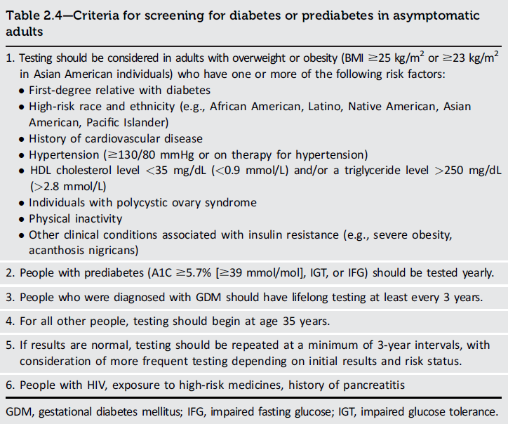
DIAGNOSIS AND CLASSIFICATION of Diabetes
Diagnosis and Classification of Diabetes:
Standards of Care in Diabetes - 2024. Diabetes Care 2024;47(Suppl. 1):S20-S42

Slide 16
Prediabetes and Type 2 Diabetes (continued)
DIAGNOSIS AND CLASSIFICATION of Diabetes
2.11 If tests are normal, repeat screening recommended at a minimum of 3-year intervals is reasonable, sooner with symptoms or change in risk (e.g., weight gain). C
2.12 To screen for prediabetes and type 2 diabetes, FPG, 2-h PG during 75-g OGTT, and A1C are each appropriate (Table 2.1 and Table 2.2). B
2.13 When using OGTT as a screen for prediabetes or diabetes, adequate carbohydrate intake (at least 150 g/day) should be assured for 3 days prior to testing. A

Slide 17
Prediabetes and Type 2 Diabetes (continued)
DIAGNOSIS AND CLASSIFICATION of Diabetes
2.14 Risk-based screening for prediabetes or type 2 diabetes should be considered after the onset of puberty or after 10 years of age, whichever occurs earlier, in children and adolescents with overweight (BMI ≥ 85th percentile) or obesity (BMI ≥ 95th percentile) and who have one or more risk factors for diabetes. (See Table 2.5 for evidence grading of risk factors.) B
2.15a Consider screening people for prediabetes or diabetes if on certain medications, such as glucocorticoids, statins, thiazide diuretics, some HIV medications, and second-generation antipsychotic medications, as these agents are known to increase the risk of these conditions. E

Slide 18
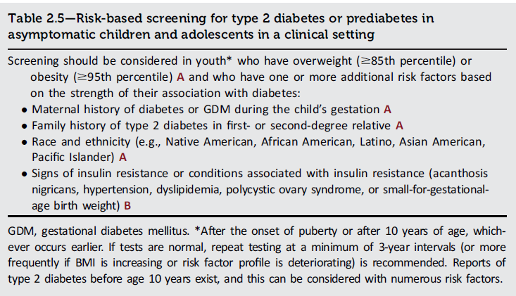
DIAGNOSIS AND CLASSIFICATION of Diabetes
Diagnosis and Classification of Diabetes:
Standards of Care in Diabetes - 2024. Diabetes Care 2024;47(Suppl. 1):S20-S42

Slide 19
Prediabetes and Type 2 Diabetes (continued)
DIAGNOSIS AND CLASSIFICATION of Diabetes
2.14 Risk-based screening for prediabetes or type 2 diabetes should be considered after the onset of puberty or after 10 years of age, whichever occurs earlier, in children and adolescents with overweight (BMI ≥ 85th percentile) or obesity (BMI ≥ 95th percentile) and who have one or more risk factors for diabetes. (See Table 2.5 for evidence grading of risk factors.) B
2.15a Consider screening people for prediabetes or diabetes if on certain medications, such as glucocorticoids, statins, thiazide diuretics, some HIV medications, and second-generation antipsychotic medications, as these agents are known to increase the risk of these conditions. E

Slide 20
Prediabetes and Type 2 Diabetes (continued)
DIAGNOSIS AND CLASSIFICATION of Diabetes
2.15b In people who are prescribed second-generation antipsychotic medications, screen for prediabetes and diabetes at baseline and repeat 12–16 weeks after medication initiation or sooner, if clinically indicated, and annually. B
2.16 People with HIV should be screened for diabetes and prediabetes with an FPG test before starting antiretroviral therapy, at the time of switching antiretroviral therapy, and 3–6 months after starting or switching antiretroviral therapy. If initial screening results are normal, FPG should be checked annually. E

Slide 21
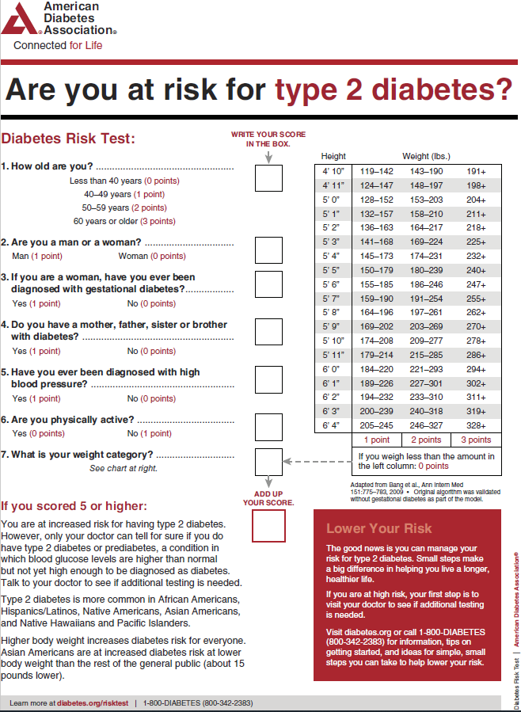
DIAGNOSIS AND CLASSIFICATION of Diabetes
diabetes.org/socrisktest
Diagnosis and Classification of Diabetes:
Standards of Care in Diabetes - 2024. Diabetes Care 2024;47(Suppl. 1):S20-S42

Slide 22
Pancreatic Diabetes or Diabetes in the Context of the Exocrine Pancreas
DIAGNOSIS AND CLASSIFICATION of Diabetes
2.17 Screen people for diabetes within 3–6 months following an episode of acute pancreatitis and annually thereafter. Screening for diabetes is recommended annually for people with chronic pancreatitis. E
Notes:
Pancreatitis, even a single bout, can lead to postpancreatitis diabetes mellitus. Both acute and chronic pancreatitis can lead to postpancreatitis diabetes mellitus, and the risk is highest with recurrent bouts.

Slide 23
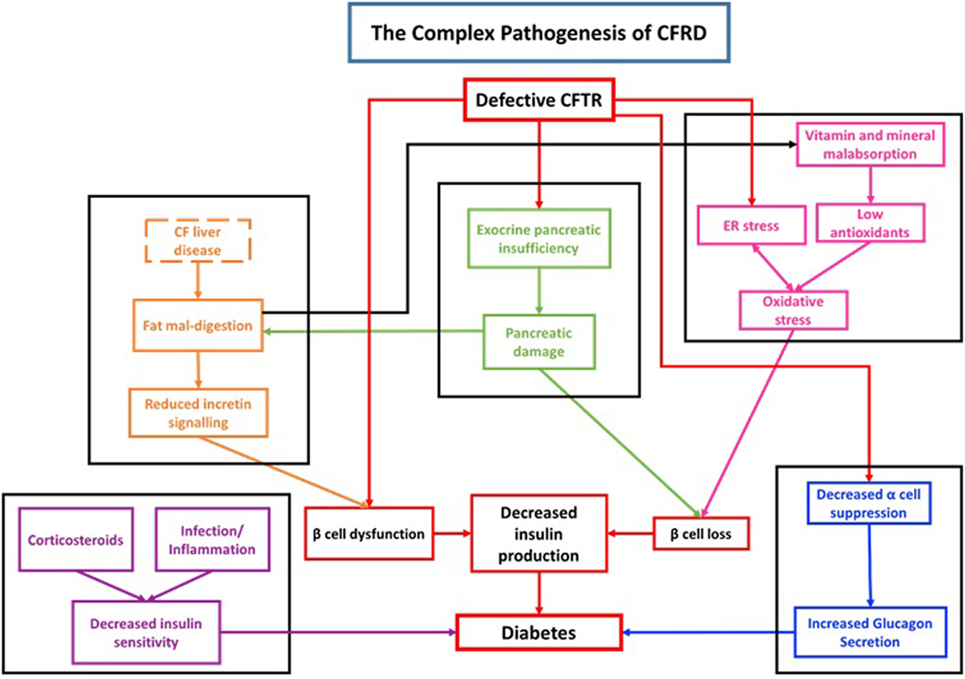
Kayani K, Mohammed R, Mohiaddin H. Cystic Fibrosis-Related Diabetes. Front Endocrinol (Lausanne). 2018;9:20.

Slide 24
Cystic Fibrosis-Related Diabetes
DIAGNOSIS AND CLASSIFICATION of Diabetes
2.18 Annual screening for cystic fibrosis-related diabetes (CFRD) with an OGTT should begin by age 10 years in all people with cystic fibrosis not previously diagnosed with CFRD. B
2.19 A1C is not recommended as a screening test for CFRD due to low sensitivity. However, a value of ≥ 6.5% (≥48 mmol/mol) is consistent with a diagnosis of CFRD. B
2.20 Beginning 5 years after the diagnosis of CFRD, annual monitoring for complications of diabetes is recommended. E

Slide 25
Posttransplantation Diabetes Mellitus
DIAGNOSIS AND CLASSIFICATION of Diabetes
2.21 After organ transplantation, screening for hyperglycemia should be done. A formal diagnosis of posttransplantation diabetes mellitus (PTDM) is best made once the individual is stable on an immunosuppressive plan and in the absence of an acute infection. B
2.22 The OGTT is the preferred test to make a diagnosis of PTDM. B
2.23 Immunosuppressive plans shown to provide the best outcomes for individuals and graft survival should be used, irrespective of PTDM risk. E

Slide 26
Monogenic Diabetes Syndromes
DIAGNOSIS AND CLASSIFICATION of Diabetes
2.24a Regardless of current age, all people diagnosed with diabetes in the first 6 months of life should have immediate genetic testing for neonatal diabetes. A
2.24b Children and young adults who do not have typical characteristics of type 1 or type 2 diabetes and who often have a family history of diabetes in successive generations (suggestive of an autosomal dominant pattern of inheritance) should have genetic testing for maturity-onset diabetes of the young (MODY). A
2.24c In both instances, consultation with a center specializing in diabetes genetics is recommended to understand the significance of genetic mutations and how best to approach further evaluation, treatment, and genetic counseling. E

Slide 27
Νεογνικός Διαβήτης
Ο νεογνικός ΣΔ εμφανίζεται σε ηλικία <6 μηνών, είναι μόνιμος (45% των περιπτώσεων), παροδικός (45%) ή συνδρομικός (10% των περιπτώσεων). Ο τελευταίος συνοδεύεται από παγκρεατική δυσγενεσία/απλασία.
Η διάγνωση και η παρακολούθηση γίνεται από εξειδικευμένα κέντρα.
Ο παροδικός νεογνικός ΣΔ διαρκεί λίγες εβδομάδες έως μήνες (μέση διάρκεια 12 εβδομάδες).
Μπορεί να υποχωρήσει αλλά να επανεμφανισθεί αργότερα (50-60%), συνήθως κατά την εφηβεία.
Ωστόσο, μπορεί να εμφανισθεί και από την ηλικία των 4 ετών.

Slide 28
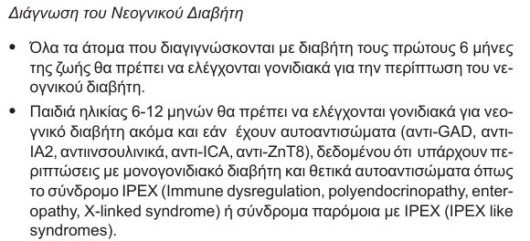

Slide 29
Monogenic Diabetes Syndromes
DIAGNOSIS AND CLASSIFICATION of Diabetes
2.24a Regardless of current age, all people diagnosed with diabetes in the first 6 months of life should have immediate genetic testing for neonatal diabetes. A
2.24b Children and young adults who do not have typical characteristics of type 1 or type 2 diabetes and who often have a family history of diabetes in successive generations (suggestive of an autosomal dominant pattern of inheritance) should have genetic testing for maturity-onset diabetes of the young (MODY). A
2.24c In both instances, consultation with a center specializing in diabetes genetics is recommended to understand the significance of genetic mutations and how best to approach further evaluation, treatment, and genetic counseling. E

Slide 30
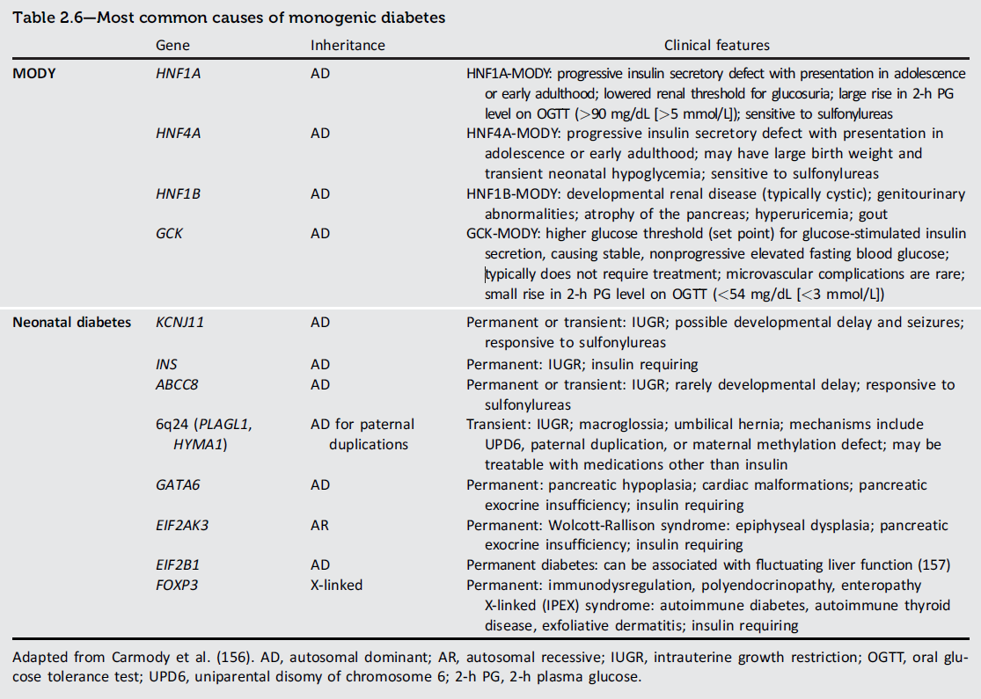
DIAGNOSIS AND CLASSIFICATION of Diabetes
MODY 3
MODY 1
MODY 5
MODY 2
Diagnosis and Classification of Diabetes:
Standards of Care in Diabetes - 2024. Diabetes Care 2024;47(Suppl. 1):S20-S42

Slide 31
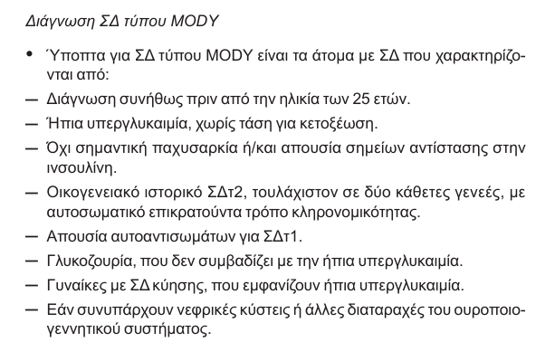

Slide 32
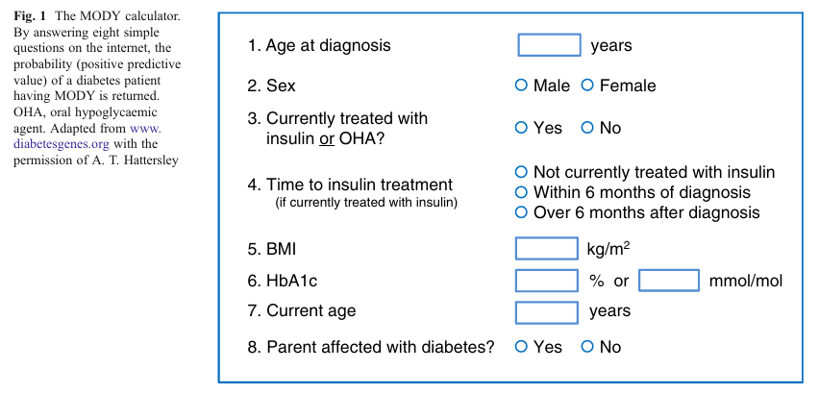
Njølstad, P R, and A Molven. “To test, or not to test: time for a MODY calculator?.” Diabetologia vol. 55,5 (2012): 1231-4.

Slide 33
DIAGNOSIS AND CLASSIFICATION of Diabetes
The diagnosis of monogenic diabetes should be considered in children and adults diagnosed with diabetes in early adulthood with the following findings:
Diabetes diagnosed within the first 6 months of life (with occasional cases presenting later, mostly INS and ABCC8 mutations)
Diabetes without typical features of type 1 or type 2 diabetes (negative diabetes-associated autoantibodies, no obesity, and lacking other metabolic features, especially with strong family history of diabetes)
Stable, mild fasting hyperglycemia (100–150 mg/dL [5.6–8.5 mmol/L]), stable A1C between 5.6% and 7.6% (between 38 and 60 mmol/mol), especially if no obesity

Slide 34
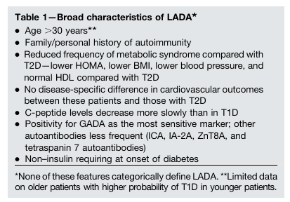
Latent autoimmune diabetes in Adults - LADA
Buzzetti, Raffaella et al. “Management of Latent Autoimmune Diabetes in Adults: A Consensus Statement From an International Expert Panel.” Diabetes vol. 69,10 (2020): 2037-2047.

Slide 35
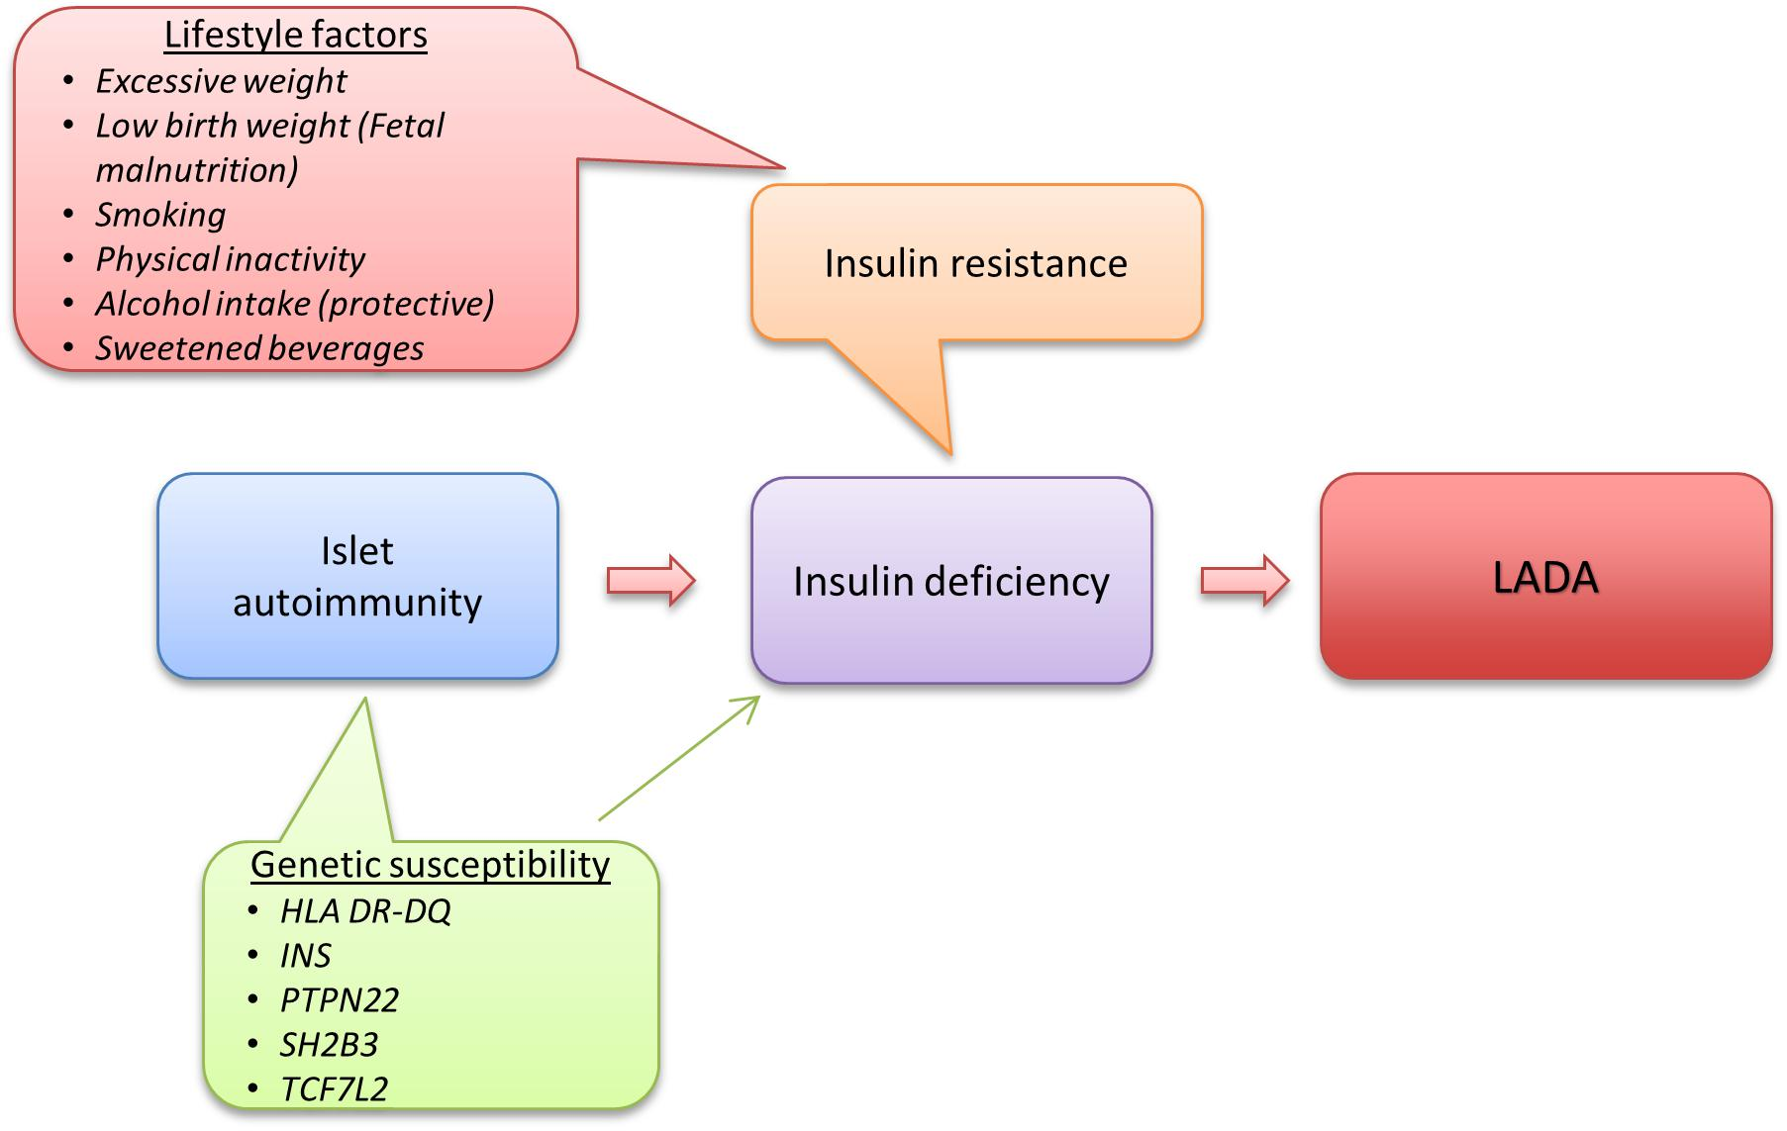
LADA pathophysiology
Carlsson, Sofia. “Etiology and Pathogenesis of Latent Autoimmune Diabetes in Adults (LADA) Compared to Type 2 Diabetes.” Frontiers in physiology vol. 10 320.
Notes:
Based on current knowledge, one can create a model over LADA development where the first step in disease development is genetically triggered autoimmunity that slowly destroys the beta-cells and reduces insulin release. At a second stage, exposure to unhealthy lifestyle factors leads to insulin resistance and increased demand on the beta-cells for a compensatory rise in insulin production. Eventually the beta-cells will fail to meet the increasing insulin need, resulting in hyperglycemia and LADA becomes manifest

Slide 36

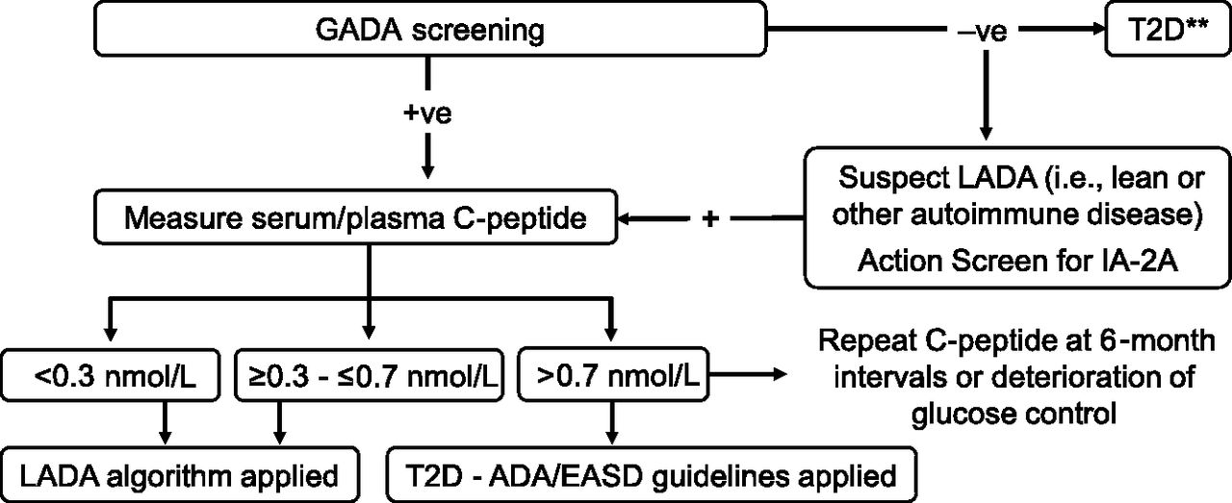
From: Management of Latent Autoimmune Diabetes in Adults: A Consensus Statement From an International Expert Panel
Diabetes. 2020;69(10):2037-2047. doi:10.2337/dbi20-0017
Figure Legend:
Algorithm for LADA diagnostic pathway based on autoantibody screening and C-peptide levels at diagnosis (to be used when financial restriction does not apply). **Consider also pancreatitis or monogenic diabetes.
Date of Download: 11/17/2024
Copyright © 2024 American Diabetes Association. All rights reserved.

Slide 37
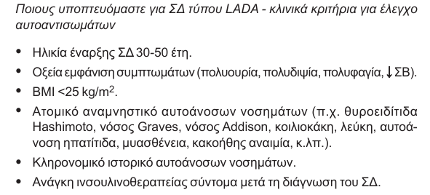

Slide 38
Gestational Diabetes Mellitus
DIAGNOSIS AND CLASSIFICATION of Diabetes
2.25 In individuals who are planning pregnancy, screen those with risk factors (Table 2.4) B and consider testing all individuals of childbearing potential for undiagnosed prediabetes or diabetes. E
2.26a Before 15 weeks of gestation, test individuals with risk factors (Table 2.4) B and consider testing all individuals E for undiagnosed diabetes at the first prenatal visit using standard diagnostic criteria if not screened preconception.
2.26b Before 15 weeks of gestation, screen for abnormal glucose metabolism to identify individuals who are at higher risk of adverse pregnancy and neonatal outcomes, are more likely to need insulin, and are at high risk of a later gestational diabetes mellitus (GDM) diagnosis. B Early treatment for individuals with abnormal glucose metabolism may provide some benefit. E

Slide 39
Gestational Diabetes Mellitus (continued)
DIAGNOSIS AND CLASSIFICATION of Diabetes
2.26c Screen for early abnormal glucose metabolism with dysglycemia using FPG of 110–125 mg/dL (6.1–6.9 mmol/L) or A1C 5.9–6.4% (41–47 mmol/mol). B
2.27 Screen for GDM at 24–28 weeks of gestation in pregnant individuals not previously found to have diabetes or high-risk abnormal glucose metabolism detected earlier in the current pregnancy. A
2.28 Screen individuals with GDM for prediabetes or diabetes at 4–12 weeks postpartum, using the 75-g OGTT and clinically appropriate nonpregnancy diagnostic criteria. A
2.29 Individuals with a history of GDM should have lifelong screening for the development of prediabetes or diabetes at least every 3 years. B

Slide 40
DIAGNOSIS AND CLASSIFICATION of Diabetes
GDM diagnosis (Table 2.7) can be accomplished with either of two strategies:
1. The “one-step” 75-g OGTT derived from the IADPSG criteria, or
2. The older “two-step” approach with a 50-g (nonfasting) screen followed by a 100-g OGTT for those who screen positive based on the work of Carpenter-Coustan’s interpretation of the older O’Sullivan and Mahan criteria.

Slide 41
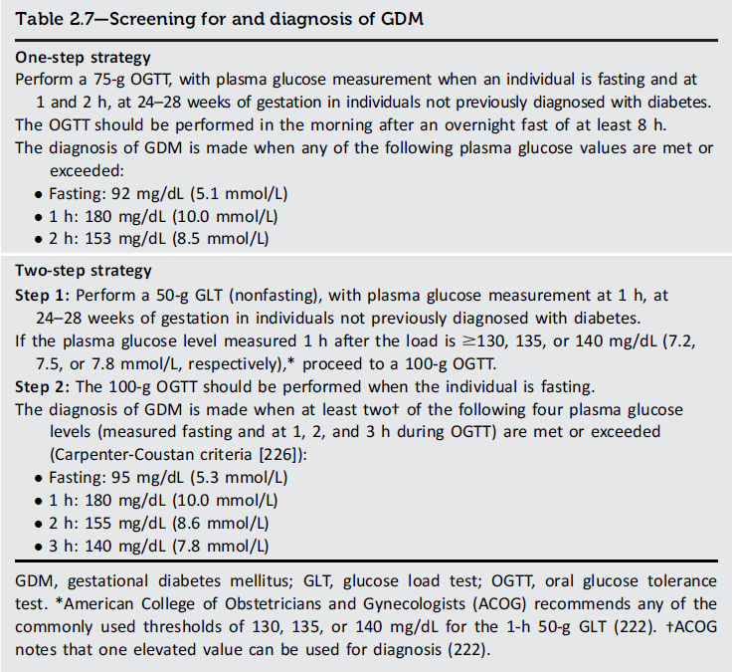
DIAGNOSIS AND CLASSIFICATION of Diabetes
Diagnosis and Classification of Diabetes:
Standards of Care in Diabetes - 2024. Diabetes Care 2024;47(Suppl. 1):S20-S42

Slide 42
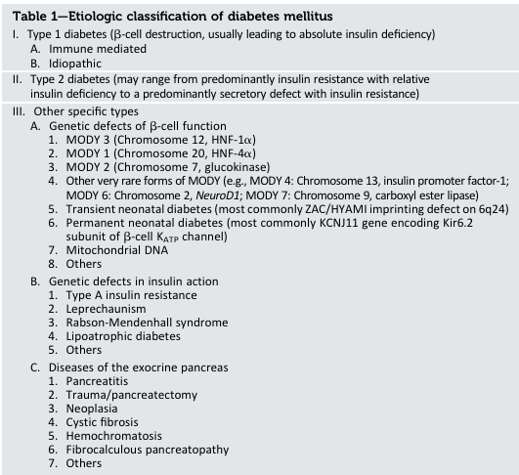
American Diabetes Association. Diagnosis and classification of diabetes mellitus. Diabetes Care 2014;37(Suppl. 1):S81–S90

Slide 43
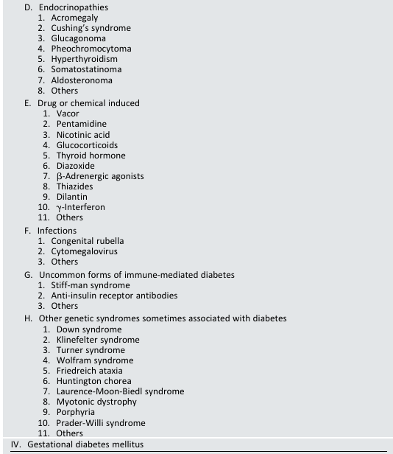

Slide 44
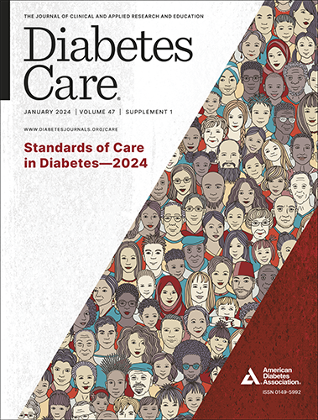
https://diabetesjournals.org/care/issue/47/Supplement_1
https://www.ede.gr/%ce%ba%ce%b1%cf%84%ce%b5%cf%85%ce%b8%cf%85%ce%bd%cf%84%ce%ae%cf%81%ce%b9%ce%b5%cf%82-%ce%bf%ce%b4%ce%b7%ce%b3%ce%af%ce%b5%cf%82-%ce%b5%ce%b4%ce%b5/

