Slide 1

ΜΕΤΑΠΤΥΧΙΑΚΟ ΚΑΡΔΙΟΜΕΤΑΒΟΛΙΚΗ ΙΑΤΡΙΚΗ
ΜΥΟΚΑΡΔΙΑΚΗ
ΙΣΧΑΙΜΙΑ ΒΙΩΣΙΜΟΤΗΤΑ
Γεώργιος Μακαβός MD, PhD
Καρδιολόγος, Επιμελητής Α’
Γ’ Παν.Καρδιολογικη Κλινική
ΓΝΝΘΑ «ΣΩΤΗΡΙΑ»

Slide 2
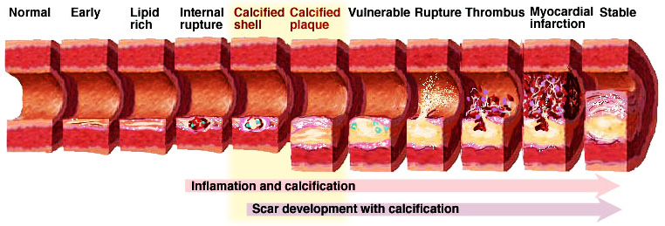
CORONARY ΑΡΤΕΡΥ DISEASE PROGRESSION
ATHEROMATIC PLAQUE

Slide 3
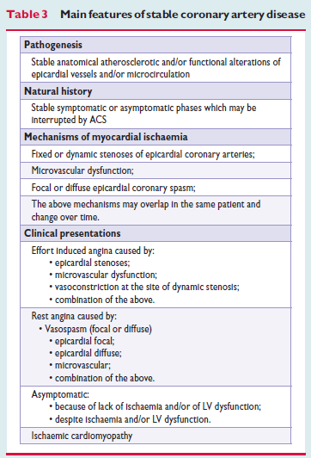
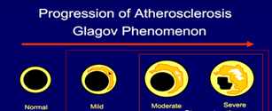
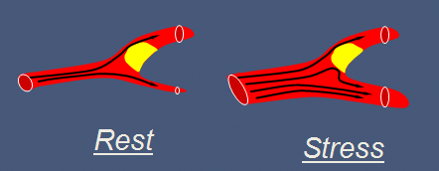
CORONARY ARTERY DISEASE AND ISCHEMIA
Characterized by episodes of reversible myocardial demand/supply mismatch, related to ischaemia or hypoxia, which are usually inducible by exercise, emotion or other stress and reproducible/ also occurring spontaneously.
Ιschaemia are commonly associated with transient chest discomfort (angina)

Slide 4
DIAGNOSIS AND ASSESSMENT OF ISCHEMIA
Clinical evaluation/symptoms (including conventional risk factors hypertension, dyslipidemia, DM smoking, family history, sedentary lifestyle, obesity)
ECG, blood tests
Resting ECHO
Stress testing
Coronary imaging confirms the diagnosis of CAD
Risk stratification

Slide 5
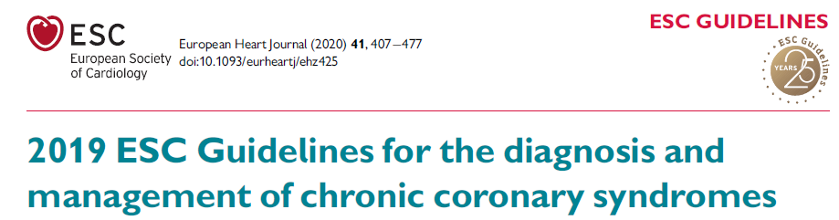
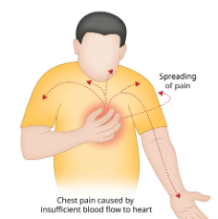
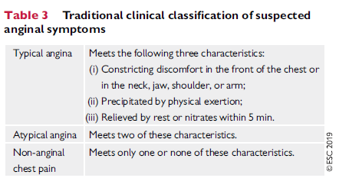
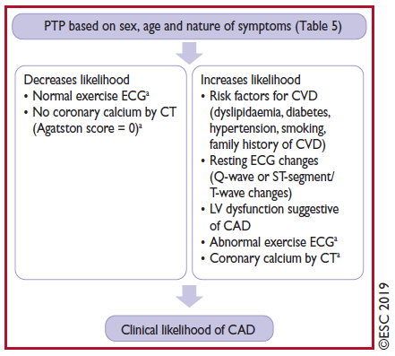
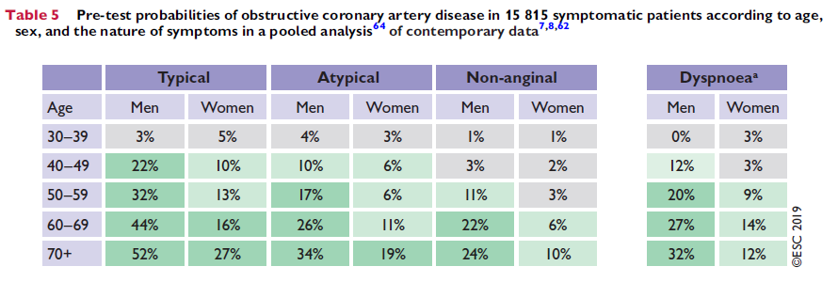
CLINICAL EVALUATION
LIKELIHOOD OF CAD
Κnuuti et al. European Heart Journal (2020) 41, 407477

Slide 6
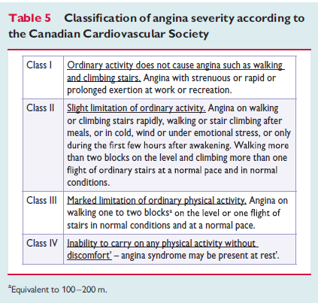
ANGINA SEVERITY CLASSIFICATION
European Heart Journal 2013;4:2949–3003

Slide 7
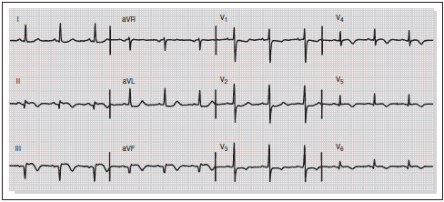
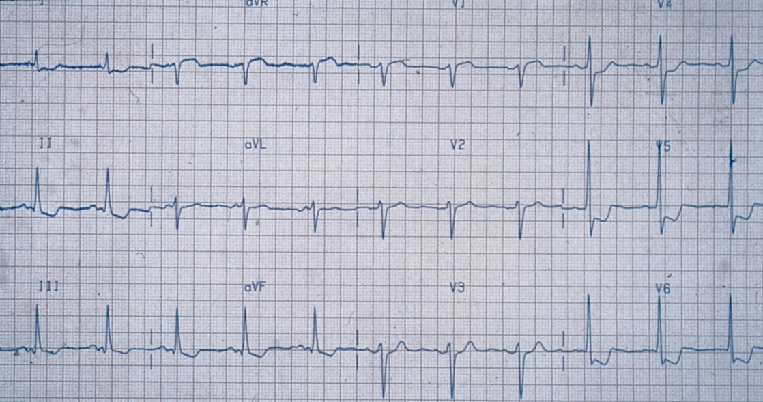
ECG
- An ECG during chest pain and immediately afterwards
- A normal resting ECG is not uncommon, even in patients with severe angina, and does not exclude the diagnosis of ischaemia.
- Resting ECG may show signs of CAD, such as previous MI, dynamic ST-segment changes
- ECG may also show other abnormalities LVH, LBBB or RBBB, preexcitation, arrhythmias, or conduction defects.

Slide 8
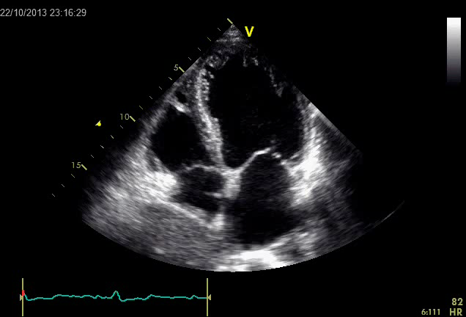
ECHO
LV dysfunction
RWMAs

Slide 9
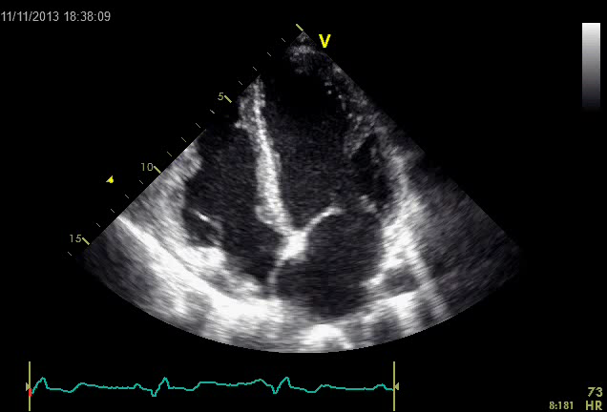
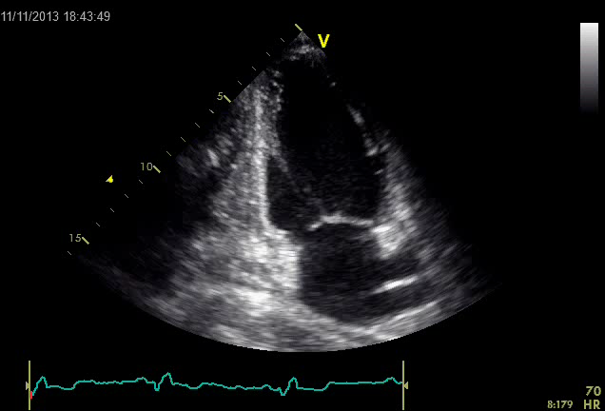

Slide 10
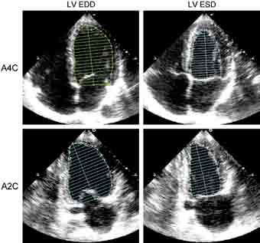
2D ECHO-Ποσοτική εκτίμηση
Βiplane method of discs (modified Simpson’s rule)
EFA4C = LVEDVA4C- LVESVA4C /LVEDVA4C X 100
EFA2C = LVEDVA2C- LVESV A2C
/LVEDVA2C X 100

Slide 11
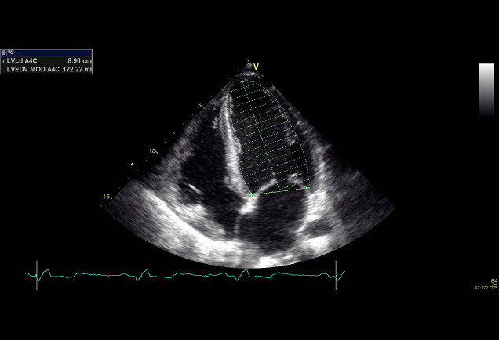
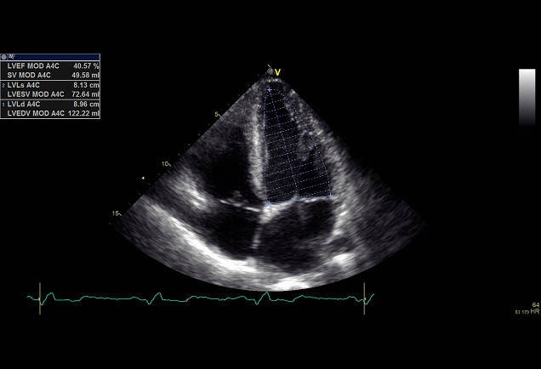
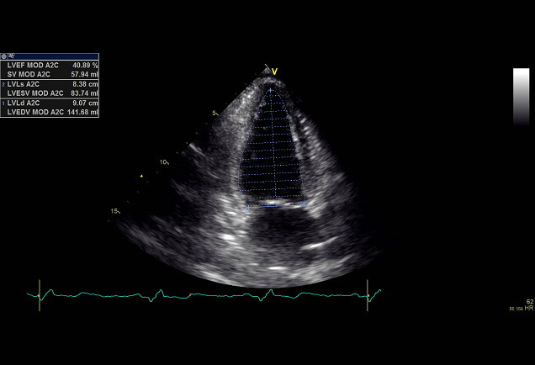
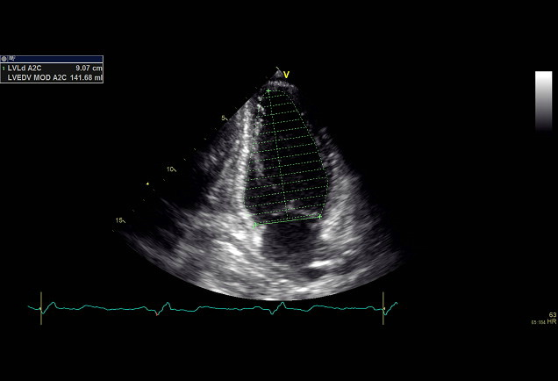

Slide 12
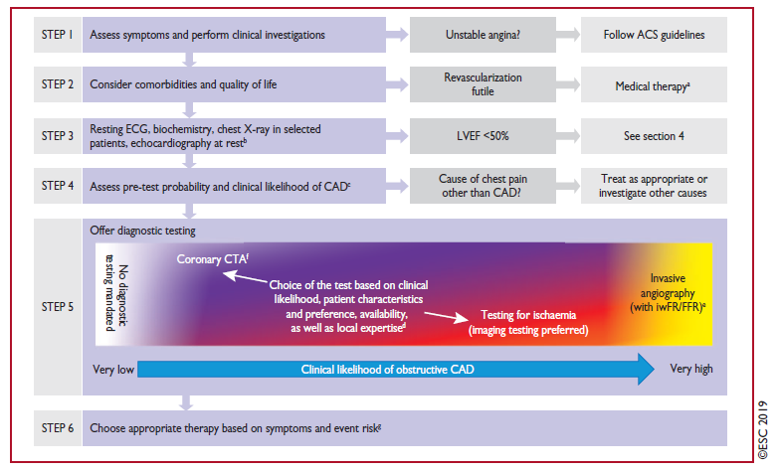
Κnuuti et al. European Heart Journal (2020) 41, 407477

Slide 13
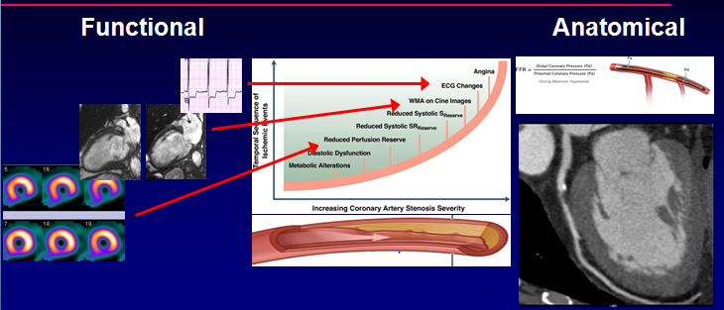
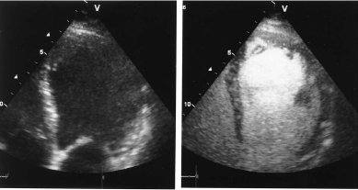
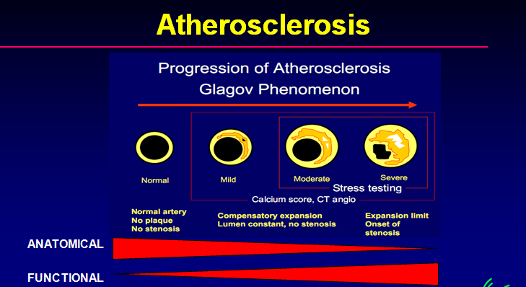

Slide 14
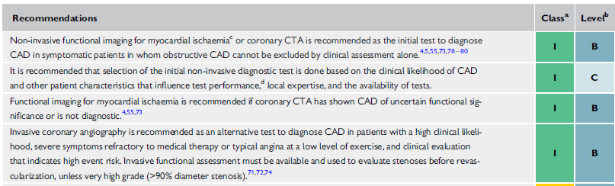
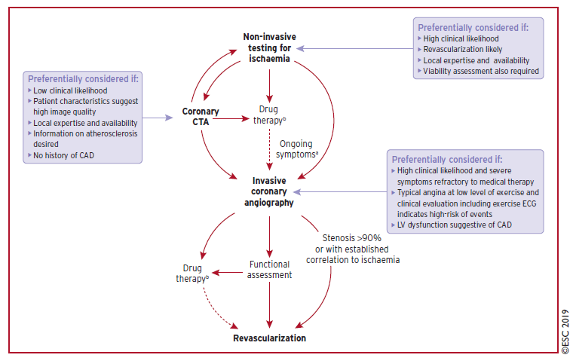
Κnuuti et al. European Heart Journal (2020) 41, 407477

Slide 15
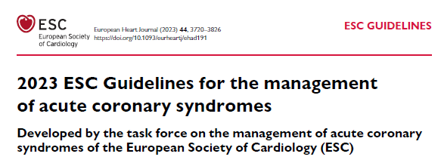
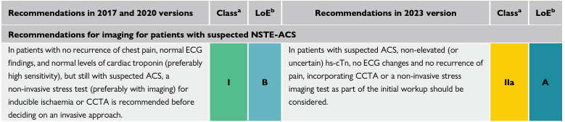
Byrne et al. European Heart Journal (2023) 44, 3720–3826

Slide 16
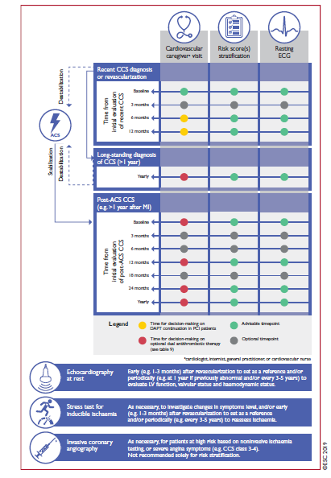
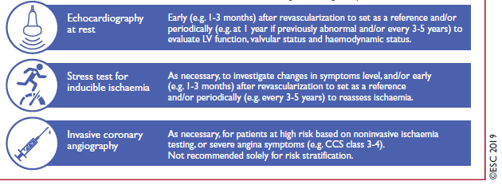

Slide 17
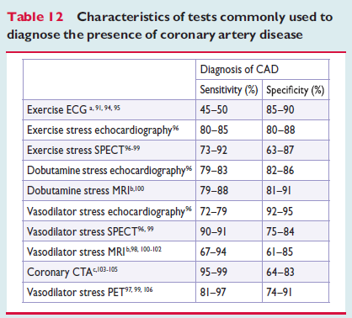
TESTS FOR ISCHEMIA AND CAD DIAGNOSIS
Sensitivities and specificities of approximately 85%
15% of all diagnostic results will be false.
Performing no test at all will provide fewer incorrect diagnoses in patients with a PTP below 15% (assuming all patients to be healthy)
or a PTP above 85% (assuming all patients to be diseased).
European Heart Journal 2013;4:2949–3003

Slide 18

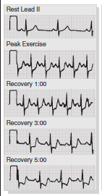
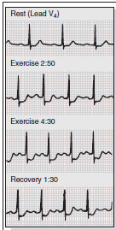
EXERCISE ECG
ST segment changes
Exercise ECG testing is not of diagnostic value in the presence of LBBB, paced rhythm and Wolff-Parkinson-White
Abnormal resting ECG in the presence of LVH, electrolyte imbalance, intraventricular conduction abnormalities, digitalis
Inability to exercise orthopaedic or other non-cardiac problems

Slide 19
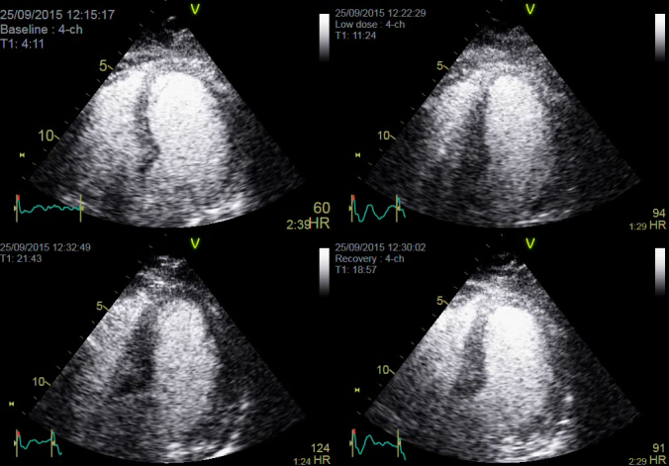
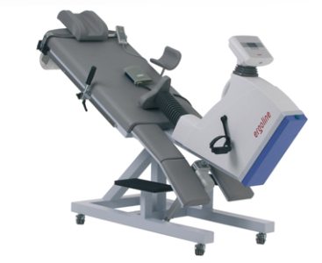
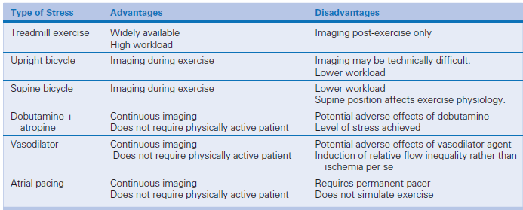
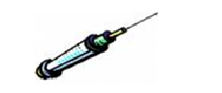
STRESS ECHO
Exercise: more physiological environment than pharmacological tests
Pharmacological agents: unable to exercise

Slide 20
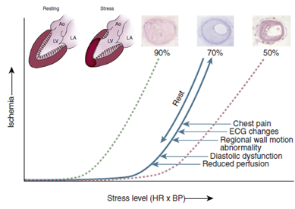
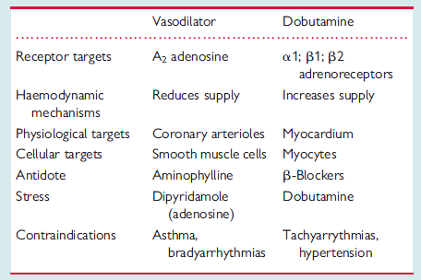
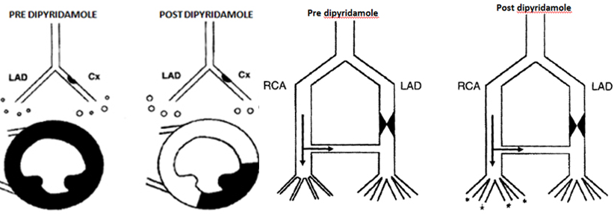
ISCHAEMIC STRESSORS
New RWMAs
Sicari et al European Heart Journal 2009;30278–289
Notes:
exercise, dobutamine, and vasodilators (at appropriately high doses) are equally potent ischaemic stressors for inducing wall abnormalities in the presence
of a critical epicardial coronary artery stenosis. Dobutamine and exercise mainly act through increased myocardial oxygen demand, and dipyridamole and adenosine through reduced subendocardial flow supply subsequent to inappropriate arteriolar vasodilation and steal phenomena. Figure 4: Vertical Steal. At rest, perfusion in the circumflex (Cx) is maintained due to vasodilation of the arteriolar bed (larger circles downstream from epicardial vessel), thus using some of the coronary flow reserve (CFR). After dipyridamole-induced vasodilation, flow through the LAD vessel increases significantly (as it can vasodilate normally since no CFR used at rest because there is no stenosis) However, the fall in perfusion pressure through the stenosed artery causes a critical drop in perfusion pressure to the capillary bed downstream, resulting in closing or ‘derecruitment’ of the capillaries. Figure 5: Horizontal Steal. The RCA is donating collateral supply to the diseased LAD. The LAD arterioles are vasodilated at rest (larger vessels drawn on left side of image). After dipyridamole-induced vasodilation, there is a drop in pressure along the supply artery and thus distal perfusion pressure to the collateral vessels falls. The RCA arteriolar bed thus steals blood from the LAD system.

Slide 21
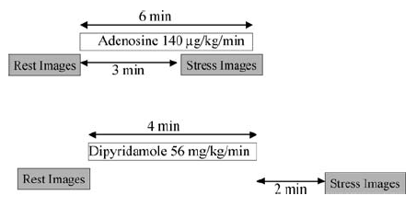
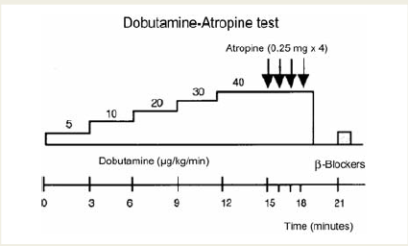
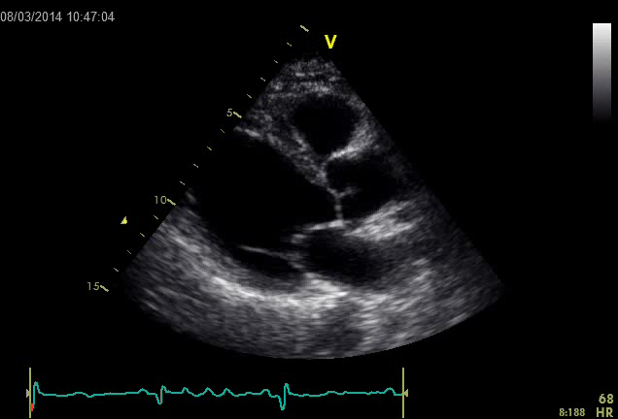
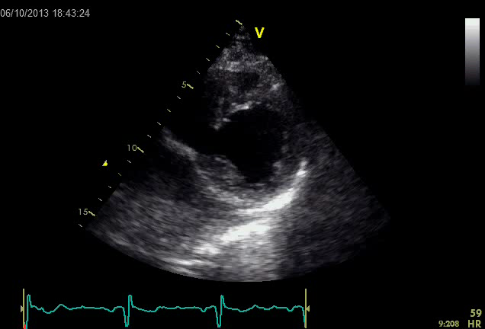
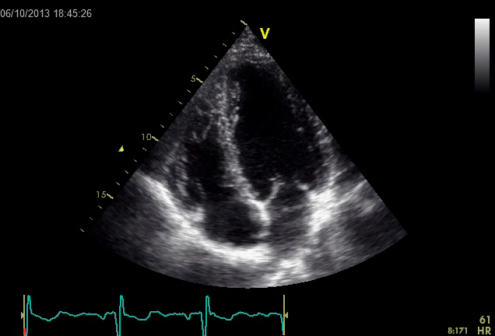
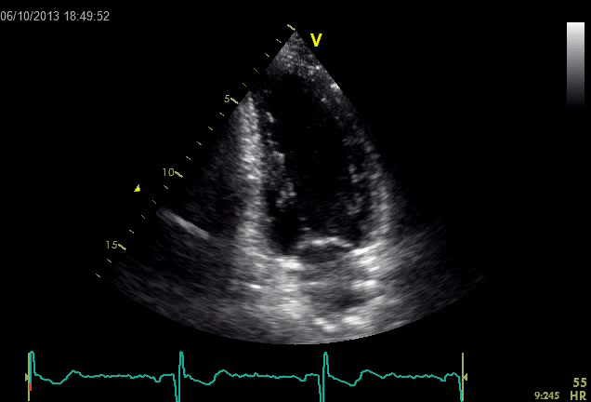
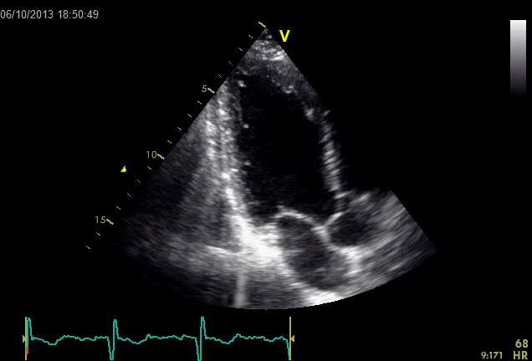
SE PROTOCOLS -VIEWS
0.84 mg/kg/min
PLAX
PSAX
4CH
2CH
3CH

Slide 22
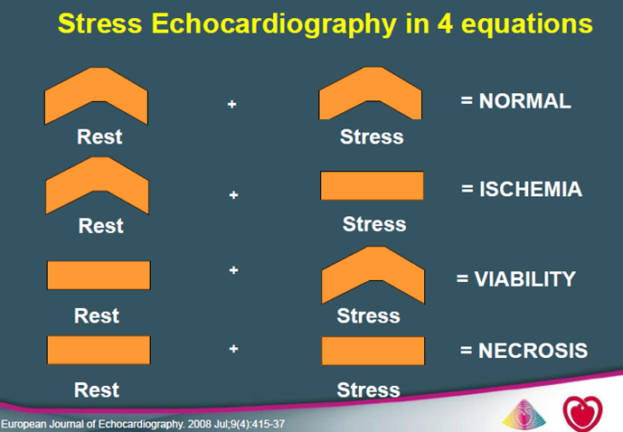
SE DIAGNOSTIC CRITERIA
Sicari et al European Heart Journal 2009;30278–289
Notes:
all stress echo responses follow four basic patterns: normal (rest 5 stress 5 normal function); ischaemia (rest 5 normal; stress 5 abnormal); necrotic
(rest 5 stress 5 abnormal); and viability (rest 5 abnormal; stress 5 normal or biphasic). Clear endocardial definition is crucial for optimal interpretation and it is recommended that harmonic imaging, when available, be routinely used for optimal endocardial border detection. Contrast-enhanced endocardial border detection could be used when suboptimal imaging is present.

Slide 23
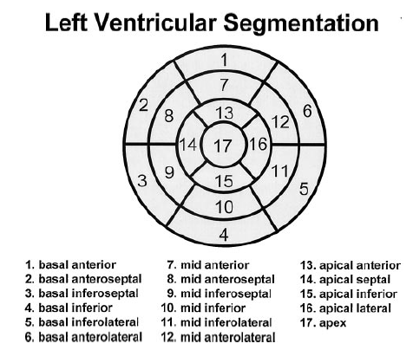
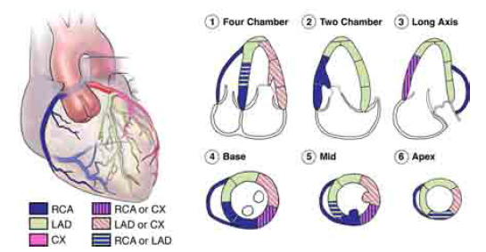
Wall Motion Score Index (WMSI)
LOCALISATION AND
SEMI-QUANTITIVE ASSESMENT OF ISCHEMIA
1 = normal motion
2 = hypokinesis
3 = akinesis
4 = dyskinesis
17-segment model
WMSI= sum of all scores/
total number of segments visualized
Cerqueira et al Circulation 2002;105:539-542
Notes:
Συστολική πάχυνση
Προς τα έσω κίνηση του ενδοκαρδίου

Slide 24


SE WITH CONTRAST (LV CONTRAST-MYOCARDIAL CONTRAST) FOR DIAGNOSIS OF ISCHEMIA
-If ≥ 2 segments not adequately visualized
-Simultaneous assesment of wall motion and perfusion
-Myocardial contrast incremental prognostic value over WMAs
-Perfusion defects precede WMAs and extend to a greater area
-Arterial vasodilators the ideal agents
-MC: Sensitivity 83% specificity 80% for CAD
Senior et al, 2009, Contrast Echocardiography: Evidence –based recommendations

Slide 25


CONTRAST ON THE DIAGNOSTIC ACCURACY OF DSE IN CAD - OPTIMIZE TRIAL
Segments visualized 67% → 96 % at stress
Interpretation of wall motion with high confidence with contrast agent 36% → 74%
Sensitivity significantly higher for LCX (62% vs. 49% p=0.0009) LCX or RCA (64% vs.52% p = 0.016)
Plana et al J Am Coll Cardiol Img 2008;1:145–52

Slide 26


DSE + LV Contrast
Significant LAD stenosis

Slide 27




DSE
4CH
Baseline
Low dose
Peak

Slide 28




DSE
2CH
Baseline
Low dose
Peak

Slide 29

COR.ANGIOGRAPHY
PTCA LAD

Slide 30




DSE + MC contrast
base
peak
Signficant LAD disease
PD

Slide 31

SAFETY OF STRESS ECHO
Sicari et al European Heart Journal 2009;30278–289

Slide 32
STRESS ECHO
FALSE NEGATIVE SE | FALSE POSITIVE SE
-Inadequate exercise (<85% of predicted maxHR) b-blockers, inadequate exercise capacity -Single vessel disease-disease of LCX -LV hypertrophy -LV concentric remodeling | -Hypertensive response -HCM -IDCM -DM -Myocarditis -Syndrome X -LBBB, RV pacing -Previous heart surgery
In diabetic patients, stress echo has shown a higher specificity than MPI
but suffers from higher rate of false positive results, possibly due to the coexistence of cardiomyopathy in many patients
Pellikka et al JASE 2007

Slide 33


WMA during stress testing may be caused by a variety of other conditions not related to CAD (Figure 7).
Edvardsen et al JASE 2022

Slide 34



CORONARY FLOW RESERVE
AND MICROCIRCULATION
Cortigiani et al. JACC 2007:1354–61
Assumed epicardial vessel lumen relatively constant during pharmacologic stress, the change in coronary flow velocity from baseline to maximal hyperemia is considered directly proportional to the change in absolute flow, allowing the calculation of a CFVR during vasodilator-stress
Vasodilation in the microvascular compartment is the main determinant of increased coronary blood flow during exertion.
De Bryune et al. JACC 2016:1170 – 2

Slide 35


TTE CORONARY FLOW RESERVE LAD
- mid-distal LAD
- high-frequency ultrasound probe
range from >3 to 8 MHz
-velocity range of ± 10–24 cm/s
-interventricular sulcus at the midway between a foreshortened two- and three-chamber apical view
-3–4mm sample volume positioned over the LAD color flow.
-flow profile biphasic with diastolic predominance
-feasibility of 90% for LAD
CFR < 2.0 flow limiting lesions
Sensitivity 86%,
Specificity 70%
positive 70%, and negative predictive values 85%
Vegsundvag et al. J Am Soc Echocardiogr 2011;24:758-67
The sensitivity 95%, specificity 69%, positive 90% and negative predictive value 82% of CFR >2 to detect a non significant lesion defined by normal FFR
Meimoun et al J Am Soc Echocardiogr 2011;24:374-81
Schroder, Prescot. Frontiers in Cardiovascular Medicine 2021
Notes:
However, few data reported
the intra-individual variability of TDE-CFR.8,9,47,48,61 In a
series of 10 volunteers who repeated TDE-CFR 3 weeks
apart, and in 11 patients who repeated the test 20 min
apart, we found that the between-measure interval of agreement
using the Bland-Altman method was from 210 to ώ12%
and 29 to ώ11%, respectively, indicating that individual
variability of TDE-CFR is low with adenosine

Slide 36



CFR +DSE contrast
CFR= 1,5

Slide 37






CORONARY FLOW RESERVE
MYOCARDIAL CONTRAST
Rest
β-microbubble velocity
A
Peak stress
A= plateau VI= Myocardial Blood Volume
β = rate of VI rise = Myocardial Flow Velocity
A * ß = Myocardial Blood Flow

Slide 38


Only large primary vessels can be reliably imaged, and difficulty in imaging all three major coronary arteries is a significant limitation, preventing the wide clinical use of this technique.
Edvardsen et al JASE 2022
Knuuti et al. European Heart Journal (2020) 41, 407477

Slide 39

MYOCARDIAL PERFUSION SCINTIGRAPHY
(SINGLE PHOTON EMISSION COMPUTED TOMOGRAPHY)
SPECT Technetium-99m (99mTc) Thalium-201 Exercise or pharmacological (dipyridamole, adenosine, dobutamine)
Regional tracer uptake relative regional myocardial blood flow. Myocardial hypoperfusion is characterized by reduced tracer uptake during stress, in comparison with the uptake at rest.
Increased uptake in the lung field identifies stress-induced ventricular dysfunction in patients with severe and extensive CAD
Transient ischaemic dilatation and reduced post-stress EF are important non-perfusion predictors of severe CAD
Microangiopathy can explain the low specificity of perfusion imaging compared to stress echocardiography in the detection of CAD in asymptomatic and symptomatic diabetic patients

Slide 40
MYOCARDIAL PERFUSION SCINTIGRAPHY (SINGLE PHOTON EMISSION COMPUTED TOMOGRAPHY)
Pharmacological stress testing with perfusion scintigraphy is indicated in patients who are unable to exercise adequately or may be used as an alternative to exercise stress.
Adenosine may precipitate bronchospasm in asthmatic individuals by activating A1, A2B and A3 receptors in addition to activation of the A2A adenosine receptor, which produces hyperaemia.
Dobutamine or regadenoson, a selectiveA2A receptor agonist, may be used as an alternative stressor
LBBB septal perfusion defects

Slide 41




PET
Superior to SPECT for detection of SCAD image quality, diagnostic accuracy.
Not widely available, expensive,
less commonly used for diagnosing
SCAD.
Di Carli et al, Circulation 2007

Slide 42


PET vs. SPECT FOR ISCHEMIA DETECTION
Bateman et al, J Nucl Cardiol 2006
Bengel et al, JACC 2009

Slide 43


PET
Bengel et al, JACC 2009
PET quantification of blood flow in mL/min/ g, which allows detecting microvascular disease., multivessel or left main stem coronary artery disease in situations where there is balanced flow reduction to all coronary arteries
Absolute myocardial blood flow quantification can be performed with all three cardiac PET myocardial perfusion tracers.

Slide 44

STRESS PERFUSION/FUNCTION CARDIAC MRI
Stress perfusion CMR
- more widely used
-Adenosine
-Dipyridamole
Stress Function CMR
-Dobutamine stress CMR to detect WMAs induced by ischaemia in patients with sub-optimal acoustic windows, especially those in whom pharmacologic perfusion imaging using adenosine is contra-indicated

Slide 45



STRESS PERFUSION MRI-CATH CORRELATION
Stress
Rest
Rest
Stress
Analysis is either visual, to identify low signal areas of reduced perfusion, or with computer assistance to determine the up-slope of myocardial signal increase during the first pass
Occlusion of the mid LAD (black arrow)
80% stenosis of the OM2 branch of the circumflex artery
Circulation 2004; 110:732-737

Slide 46
STRESS PERFUSION CMR –ADVANTAGES OVER NUCLEAR MEDICINE
No Ionizing Radiation
Decreased Study Duration: 30 minutes vs. Several Hours
Additional Studies: Function, Morphology, Valvular Assessment, Viability, Coronaries, etc.
Improved Resolution: Subendocardial Ischemia
Transmural Assessment: Triple Vessel Disease

Slide 47
IMAGING OF CORONARY ANATOMY
Coronary Disease Progression
Calcified Plaque Detected by CT
CTA

Slide 48

CALCIUM SCORING
Multidetector row CT detection of coronary calcification in non-contrast enhanced data sets.
A threshold of 130 Hounsfield units (HU) are defined as representing coronary calcium.
‘Agatston score’
With the exception of patients with renal—coronary calcium is exclusively a consequence of coronary atherosclerosis.
The amount of calcium correlates roughly to the total amount of atherosclerosis
Correlation with the degree of luminal narrowing is poor.
Even with severe calcification, luminal stenosis is not necessarily present and a ‘zero’ calcium score cannot be used to rule out coronary artery stenoses in symptomatic individuals especially when young and with acute symptoms.

Slide 49
Coronary calcification-Agatson score
linear scale with 4 calcium score categories:
  0 none
  1–99 mild
  100–400 moderate
  >400 severe
*Calcium score correlates directly with risk of events and likelihood of obstructive CAD*

Slide 50




CAC SCREENING IN PERSONS WITH METABOLIC SYNDROME AND DIABETES
Wong et al.,
Diabetes Care 2005;28:1445–1450.
Wong et al. J Am Coll Cardol
2003;41:1547–1553
Malik et al., Diabetes Care 2011; 34:2285–2290
Malik et al., Diabetes Care 2011; 34:2285–2290

Slide 51

CORONARY COMPUTED TOMOGRAPHY ANGIOGRAPHY
CT (at least 64-slice CT) with contrast can visualize the coronary artery lumen.
-adequate breath holding
-without severe obesity,
-sinus rhythm <65 b.p.m. preferably 60 b.p.m. or less)
Very high negative predictive value 97–99% especially for patients at low intermediate PTPs
Sensitivities 95–99% and specificities of 64–83%
Soft Plaque Visualization

Slide 52

CORONARY COMPUTED TOMOGRAPHY ANGIOGRAPHY
Severe coronary calcium negatively impacts specificity and accuracy of coronary CTA.
Overdiagnosis of stenoses in patients with Agatston scores >400
Coronary stents, due to artefacts caused by metal and the limited spatial resolution of CT
Assessment of CABG highly accurate while the evaluation of native coronary vessels in post-bypass patients prone to false positive findings.

Slide 53

RISK STRATIFICATION
Κnuuti et al. European Heart Journal (2020) 41, 407477

Slide 54


RISK STRATIFICATION

Slide 55

SE FOR CAD RISK STRATIFICATION
Edvardsen et al JASE 2022
(i) the number of segments with an abnormal response
(ii) the percentage of myocardium with an abnormal response (>20%)
(iii) the global myocardial ischemic severity (wall motion score index >1.4)
(iv) abnormal response in multiple coronary territories
(v) development of wall thickening abnormalities early during stress

Slide 56
Άνδρας 51 ετών με επεισόδιο θωρακικού άλγους στην ηρεμία
Ιστορικό από 1 έτους ΣΔ ΙΙ υπό αγωγή,HbA1C:7.3%, BMI 27kg/m², Καπνιστής
TCHOL: 185mg/dl LDL:127mg/dl HDL:28mg/dl TG:131mg/dl υπό αγωγή με ατορβαστατίνη 20 mg, BP=150/90mmHg
Hs-trop: (-) Χωρίς υποτροπή του ενοχλήματος, χωρίς ΗΚΓικές διαταραχές
baseline
20γ
Stop dobutamine
B-blocker iv
recovery

Slide 57
STRESS ECHO
baseline
20γ
Stop dobutamine
B-blocker iv
recovery

Slide 58



CORONARY ANGIOGRAPHY

Slide 59





ISCHEMIA-EXTEND
All-cause mortality was not different (7-year rate, 12.7% in invasive strategy, 13.4% in conservative strategy; adjusted hazard ratio, 1.00 [95% CI, 0.85–1.18]).
Lower 7-year rate cardiovascular mortality (6.4% vs 8.6%; adjusted hazard ratio, 0.78 [95% CI, 0.63–0.96]) with an initial invasive strategy
but a higher 7-year rate of noncardiovascular mortality (5.6% vs 4.4%; adjusted hazard ratio, 1.44 [95% CI, 1.08–1.91]) compared with the conservative strategy.
Moderate or severe ischemia, EF≥35%, no recent ACS
median follow-up of 5.7 years
Hochman et al. Circulation. 2023;147:8–19.

Slide 60





no significant difference in the rates of death (5.1% and 5.2%, HR 0.98; 95% CI, 0.55 to 1.75) or myocar dial infarction (8.1% and 12.0%; HR, 0.66; 95% CI, 0.43 to 1.00)
FAME 2
In patients with stable CAD, an initial FFR guided PCI strategy was associated with a significantly lower rate of the primary composite end point of death, myocardial infarction, or urgent revascularization at 5 years than medical therapy alone. At 5 years, 13.9% vs. 27.0%; hazard ratio, 0.46; 95% confidence interval [CI], 0.34 to 0.63; P<0.001). The difference was driven by urgent revascularizations, 6.3% of the patients in the PCI group as compared with 21.1% of those in the medical therapy group (HR, 0.27; 95% CI, 0.18 to 0.41
Xaplanteris et al. N ENGL J MED 2018:379;3

Slide 61

ASSESSMENT OF MYOCARDIAL VIABILITY IN PATIENTS WITH CAD AND LV DYSFUNCTION
Dysfunctional myocardium may be
-viable
(ischemic, stunned, hibernating)
-or non viable
(necrotic or scarred)
Assessment of myocardial viability may be done in order to select patients that are more likely to benefit from myocardial revascularization (CABG or PCI)
Bogaert et al.J Thorac Imaging 2014;29:134–146

Slide 62


BENEFITS OF REVASCULARIZATION IN CAD WITH LV DYSFUNCTION

Slide 63

MYOCARDIAL VIABILITY IMAGING TECHNIQUES
Cellular integrity
-Single-photon emission CT (SPECT),
-Late gadolinium enhancement cardiac magnetic resonance
(LGE-CMR)
-Myocardial contrast echo
Cellular metabolism
-Positron emission tomography (PET)
Contractile reserve
-Dobutamine stress echo.
-Dobutamine CMR

Slide 64

Imaging for myocardial viability
Anevakar JACC 2016

Slide 65

DOBUTAMINE STRESS ECHO
5-10-20μg/kg/min at least 50% viable myocytes in a given segment
-75-80% sensitivity
-80-85% specificity for predicting functional recovery following revascularization
in patients with chronic CAD (hibernation)
high-dose stage, biphasic
response
most specific for detection of myocardial viability and functional recovery.
-specificity 89%
-sensitivity 74%.
Sustained improvement
Biphasic response-”jeopardized myocardium”
Rahimtoola et al.JACC Cardiovasc Imaging 2008;1:536‑55
Afridi et al. Circulation 1995;91:663‑70.
.

Slide 66
Myocardial scar
wall thickness<6mm

Slide 67

Sustained improvement

Slide 68

SPECT
Myocyte membrane integrity thallium-201 and technetium-99m sestamibi/tetrofosmin
SPECT techniques compare the uptake of radiotracers in
the dysfunctional myocardium relative to the remote (normal)
myocardium.
A tracer activity >50% of the maximum tracer uptake is used as the threshold for viable tissue
-low spatial resolution (ie, 7 mm) limiting its ability to depict subendocardial infarcts
-radiation exposure of SPECT examinations ranges
between 8 and 20mSv

Slide 69
SPECT
sensitivity 86%–88%
specificity 55%–65%
Whereas the high sensitivities to predict segmental functional recovery after revascularization of thallium SPECT and
technetium-99m sestamibi SPECT are quite similar (87% vs 83%,
the specificity of technetium-99m sestamibi SPECT 65% is better than that of thallium-201 SPECT 54%
Up to 50% of dysfunctional segments without contractile reserve still have resting perfusion
≥50% of % uptake in myocardial perfusion imaging.
This discrepancy means that DSE indicates no viability but nuclear imaging does
Schinkel et al. Curr Probl Cardiol 2007;32:375‑410

Slide 70


PET
Cellular metabolism PET using
radiolabeled metabolic tracers (fatty acid or glucose analogs) in combination with a perfusion tracer.
13NH3 is used to quantify myocardial blood
flow, whereas 18F-FDG depicts myocardial metabolism
PET-viable pattern can consist of either hypoperfusion with relatively preserved FDG uptake (PET mismatch, hallmark of a hibernating myocardium)
PET match is indicative of necrosis/scar
transmural or nontransmural
-excellent sensitivity 92%,
-moderate specificity 63%,

Slide 71
PET
Main strengths of PET compared with SPECT are
superior spatial resolution
lower radiation burden,
absolute quantification of myocardial blood flow.
limited availability
short half-life of current available PET perfusion
lower spatial resolution compared
with CMR

Slide 72

CMR
Myocyte membrane integrity
Exactly delineates TM extent of the infarct (LGE) More than 50% LGE on CMR indicates a small probability of contractile recovery after revascularization
-Excellent spatial resolution
-Excellent sensitivity.
Can be combined with LDD‑MRI to add functional information to the anatomical scar imaging.
The LGE‑MRI and LDD‑MRI combine anatomical and functional imaging
and achieve optimal sensitivity (comparable to FDG‑PET) and optimal specificity (comparable to LD‑DSE).
Schinkel et al. Curr Probl Cardiol 2007;32:375‑410
Romero et al.JACC Cardiovasc Imaging. 2012;5:494–508

Slide 73


COMPARISON OF TECHNIQUES FOR VIABILITY DETECTION
FDG PET
DSE
Schinkel et al. Curr Probl Cardiol 2007;32:375‑410
Bax et al. J Nucl Cardiol 2015;22: 229-245

Slide 74


CABG and receive medical therapy or to receive medical therapy alone. Left ventricular ejection fraction was measured at baseline and after 4 months of follow-up in 318 patients. The primary end point was death from any cause. The median duration of follow-up was 10.4 years.
viability were defined as those with 5 or more segments with abnormal resting systolic function but manifesting contractile reserve during DSE.
STICH 10y
CABG plus medical therapy was associated with a lower incidence of death from any cause than medical therapy alone adjusted hazard ratio, 0.73; 95% CI, 0.60 to 0.90).
However, no significant interaction was observed between the presence or absence of myocardial viability and the beneficial effect of CABG plus medical therapy over medical therapy alone (P = 0.34 for interaction).
Panza et al. N Engl J Med 2019;381:739-48.

Slide 75


STICH 10y
An increase in LVEF was observed only among patients with myocardial viability, irrespective of treatment assignment.
No association between changes in left ventricular ejection fraction and subsequent death.
CONCLUSIONS
The findings of this study do not support the concept that myocardial viability is associated with a long-term benefit of CABG in patients with ischemic cardiomyopathy.
Viable myocardium was associated with improvement in LVEF, irrespective of treatment, but such improvement was not related to long-term survival.
Panza et al. N Engl J Med 2019;381:739-48.

Slide 76

F-18-FDG PET IMAGING-ASSISTED MANAGEMENT OF PATIENTS WITH SEVERE LV DYSFUNCTION AND SUSPECTED CAD. TRIAL (PARR-2)
Patients were stratified according to recent angiography or not, then randomized to management assisted by FDG PET (n =218) or standard care (n= 212).
The primary outcome was the composite of cardiac death, MI, or recurrent hospital stay for cardiac cause, within 1 year.
At 1 year, the cumulative proportion of patients who had experienced the composite event was 30% (PET arm) vs 36% (standard arm) (relative risk 0.82, 95% confidence interval [CI] 0.59 to 1.14; p=0.16).
The HR for the composite outcome, PET vs standard care, was 0.78 (95% CI 0.58 to 1.1; p 0.15
No significant reduction in cardiac events in patients with LV dysfunction and suspected CAD for FDG PET-assisted management vs standard care
Beanlands et al. J Am Coll Cardiol 2007;50:2002–12)

Slide 77




Patients with 2 to 3 prognostic factor had reduced mortality with CABG vs OMT [HR]:0.71;95% [CI]:0.56-0.89;p 0.004)
Net beneficial effect of CABG relative to OMT was observed at>2ys in patients with 2 to 3 factors (HR:0.53;95% CI:0.37-0.75;p<0.001)
Panza et al. STICH J Am Coll Cardiol 2014;64:553–61

Slide 78



PCI s OMT.demonstrable viability in at least four dysfunctional myocardial segments amenable to revascularization with PCI. median follow up of 41 months
REVIVED
These findings challenge the paradigm of myocardial hibernation, Our observations mirror those in the STICH trial, in which revascularization by CABG did not affect left ventricular function, a finding that was consistent across the whole trial cohort, including the subgroup who underwent discretionary viability testing. We have not yet determined the concordance between the coronary arteries revascularized by PCI and the viable myocardial segments; hence, we cannot determine whether viability tests predict changes in segmental contractile function after medical therapy or revascularization or whether such changes are linked to clinical outcomes.
Among patients with severe Ischemic LVD who received OMT revascularization by PCI did not result in a lower incidence of death from any cause or hospitalization for heart failure.
Perera et al. REVIVED-BCIS2N Engl J Med 2022;387:1351-60.

Slide 79


Notes:
Bonow RO, Maurer G, Lee KL, Holly TA, Binkley PF, Desvigne-Nickens P,
Drozdz J, Farsky PS, Feldman AM, Doenst T, Michler RE, Berman DS, Nicolau JC,
Pellikka PA, Wrobel K, Alotti N, Asch FM, Favaloro LE, She L, Velazquez EJ,
Jones RH, Panza JA, STICH Trial Investigators. Myocardial viability and survival in
ischemic left ventricular dysfunction. N Engl J Med 2011;364:16171625.
93. Panza JA, Ellis AM, Al-Khalidi HR, Holly TA, Berman DS, Oh JK, Pohost GM,
Sopko G, Chrzanowski L, Mark DB, Kukulski T, Favaloro LE, Maurer G, Farsky
PS, Tan RS, Asch FM, Velazquez EJ, Rouleau JL, Lee KL, Bonow RO. Myocardial
viability and long-term outcomes in ischemic cardiomyopathy. N Engl J Med
2019;381:739748.

Slide 80
ΕΥΧΑΡΙΣΤΩ

