Slide 1


O ρόλος της εντερικής μικροβιακής χλωρίδας στην αθηρογένεση
^{ΚΑΡΔΙΟΜΕΤΑΒΟΛΙΚΗ ΙΑΤΡΙΚΗ}
^{03.04.2025}
^{Θεμιστοκλής Κατσιμίχας}
^{Καρδιολόγος}
Μονάδα Καρδιογενετικής και Αθλητικής Καρδιολογίας
^{Α΄ Καρδιολογική Κλινική ΕΚΠΑ}
Cardiogenetics and Sports Cardiology, 1st Cardiology Dpt, National and Kapodistrian University of Athens

Slide 2
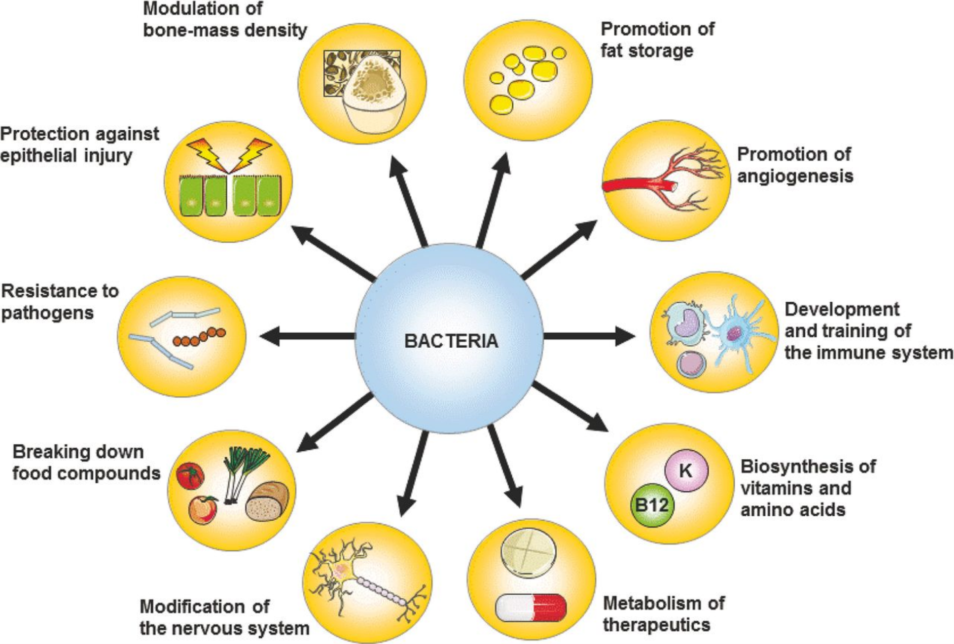
Functions of the intestinal microbiota
Modulation of bone-mass density
Promotion of fat storage
Protection against epithelial injury
Promotion of angiogenesis
Potection against epithelial injury
Resistance to pathogens
Development and training of the immune system
Breaking down of food compounds
Biosynthesis of vitamins and amino acids
Modification of the nervous system
Metabolism of therapeutics
FEMS Microbiol Rev. 2016;40:117-132.

Slide 3
Short-chain fatty acids modulate the immune system
Immune Netw. 2014;14:277-288.

Slide 4
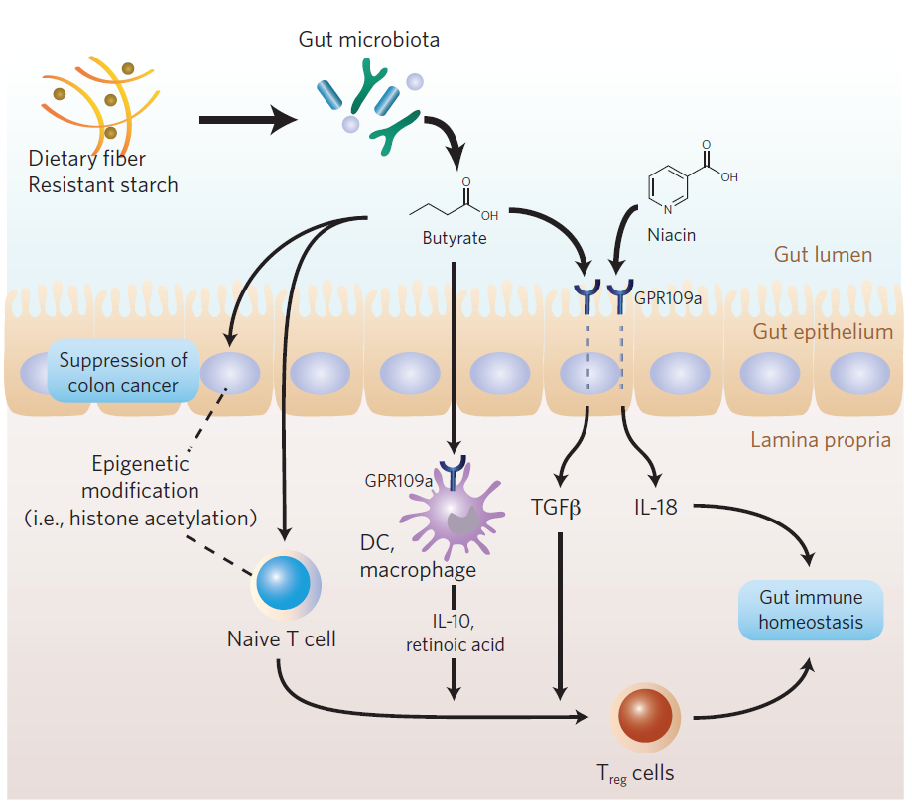
Immune system – related functions of butyric acid
Nat Chem Biol. 2014;10:416-424.
Notes:
Βουτυρικό οξύ. Παράγεται κυρίως από μικρόβια που ανήκουν στα Clostridia (class των Firmicutes, για παράδειγμαΤροφικός ρόλος – Κύρια πηγή ενέργειας εντερικών επιθηλιακών κυττάρων
Ανοσοποιητικός ρόλος – Ενισχύει την ακετυλίωση της ιστόνης Η3 και διευκολύνει την μετατροπή CD4+ Τ λεμφοκυττάρων σε Τreg κύτταρα. Οδηγεί επίσης σε έκκριση TGFβ και IL-18 και IL-10
Συνολικά, συμβάλλει στη διατήρηση της ομοιόστασης του εντερικού ανοσοποιητικού συστήματος.

Slide 5
Diverse composition, redundant functions
Major metabolic pathways
Circ J. 2018;82:1640-1650.
Notes:
Chromatic map of the 20 most abundant genera in patients and healthy controls, revealing the dominance of Bacteroides (blue) across all subjects. Their combined mean relative abundance reached 79.58% for patients and 84.45% for healthy controls; the other 99 genera in patients and 83 genera in healthy controls only made up 20.42% and 15.55% of the total, respectively. Vertical bars represent individual samples.

Slide 6
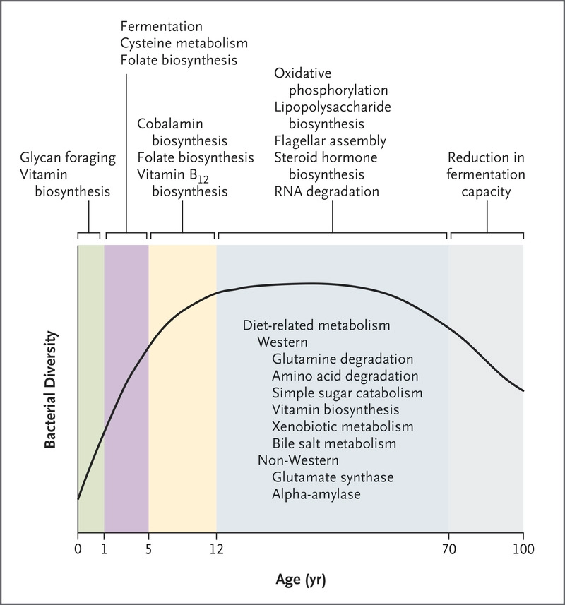
The intestinal microbiota remains relatively stable throughout life
N Engl J Med. 2016;375:2369-2379.

Slide 7
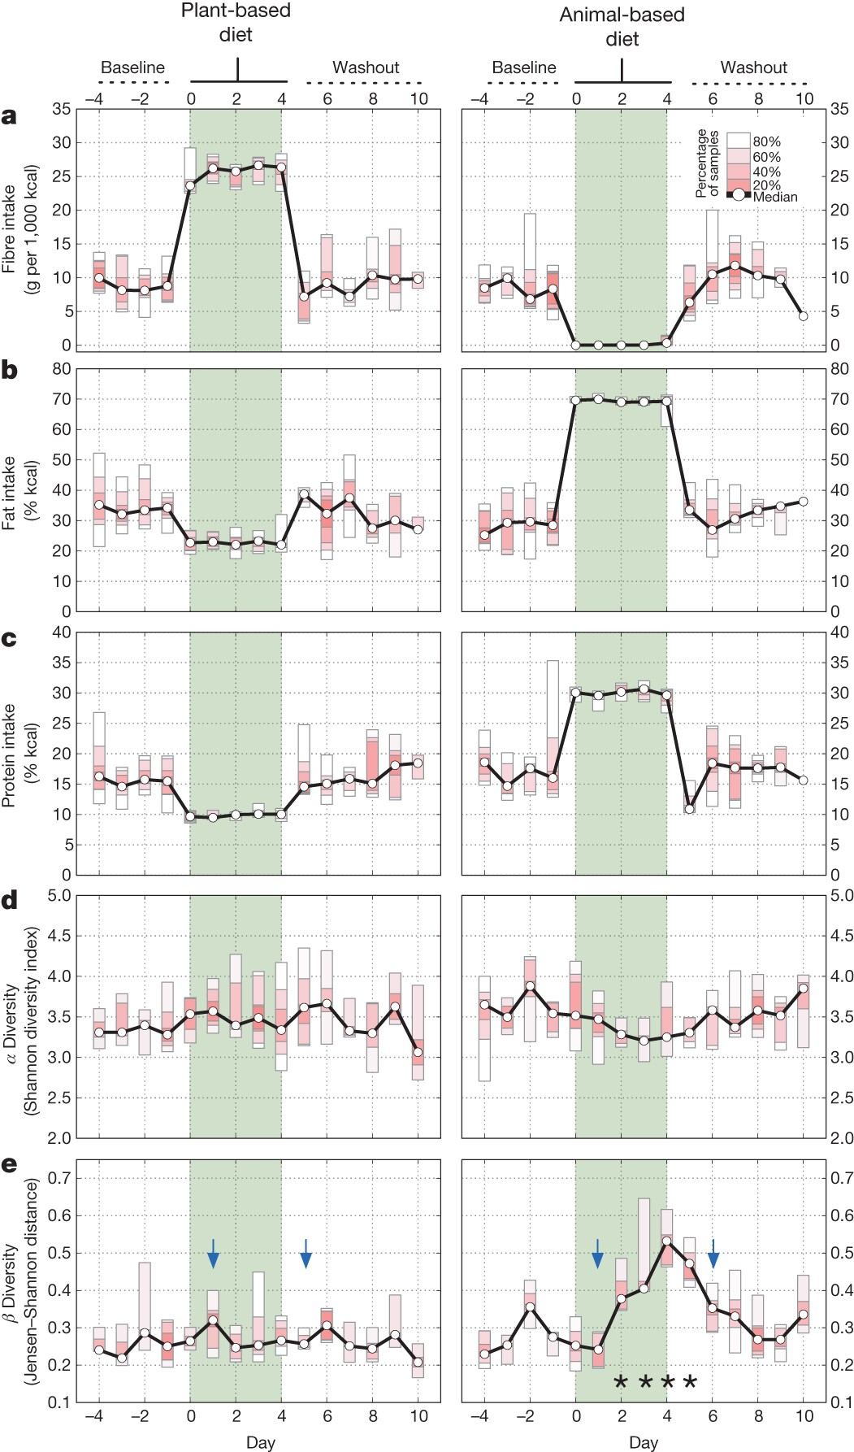
Human diet is the main driver of gut bacterial diversity
Short-term animal-based diet reduces beta diversity
Nature. 2014;505:559-563.

Slide 8
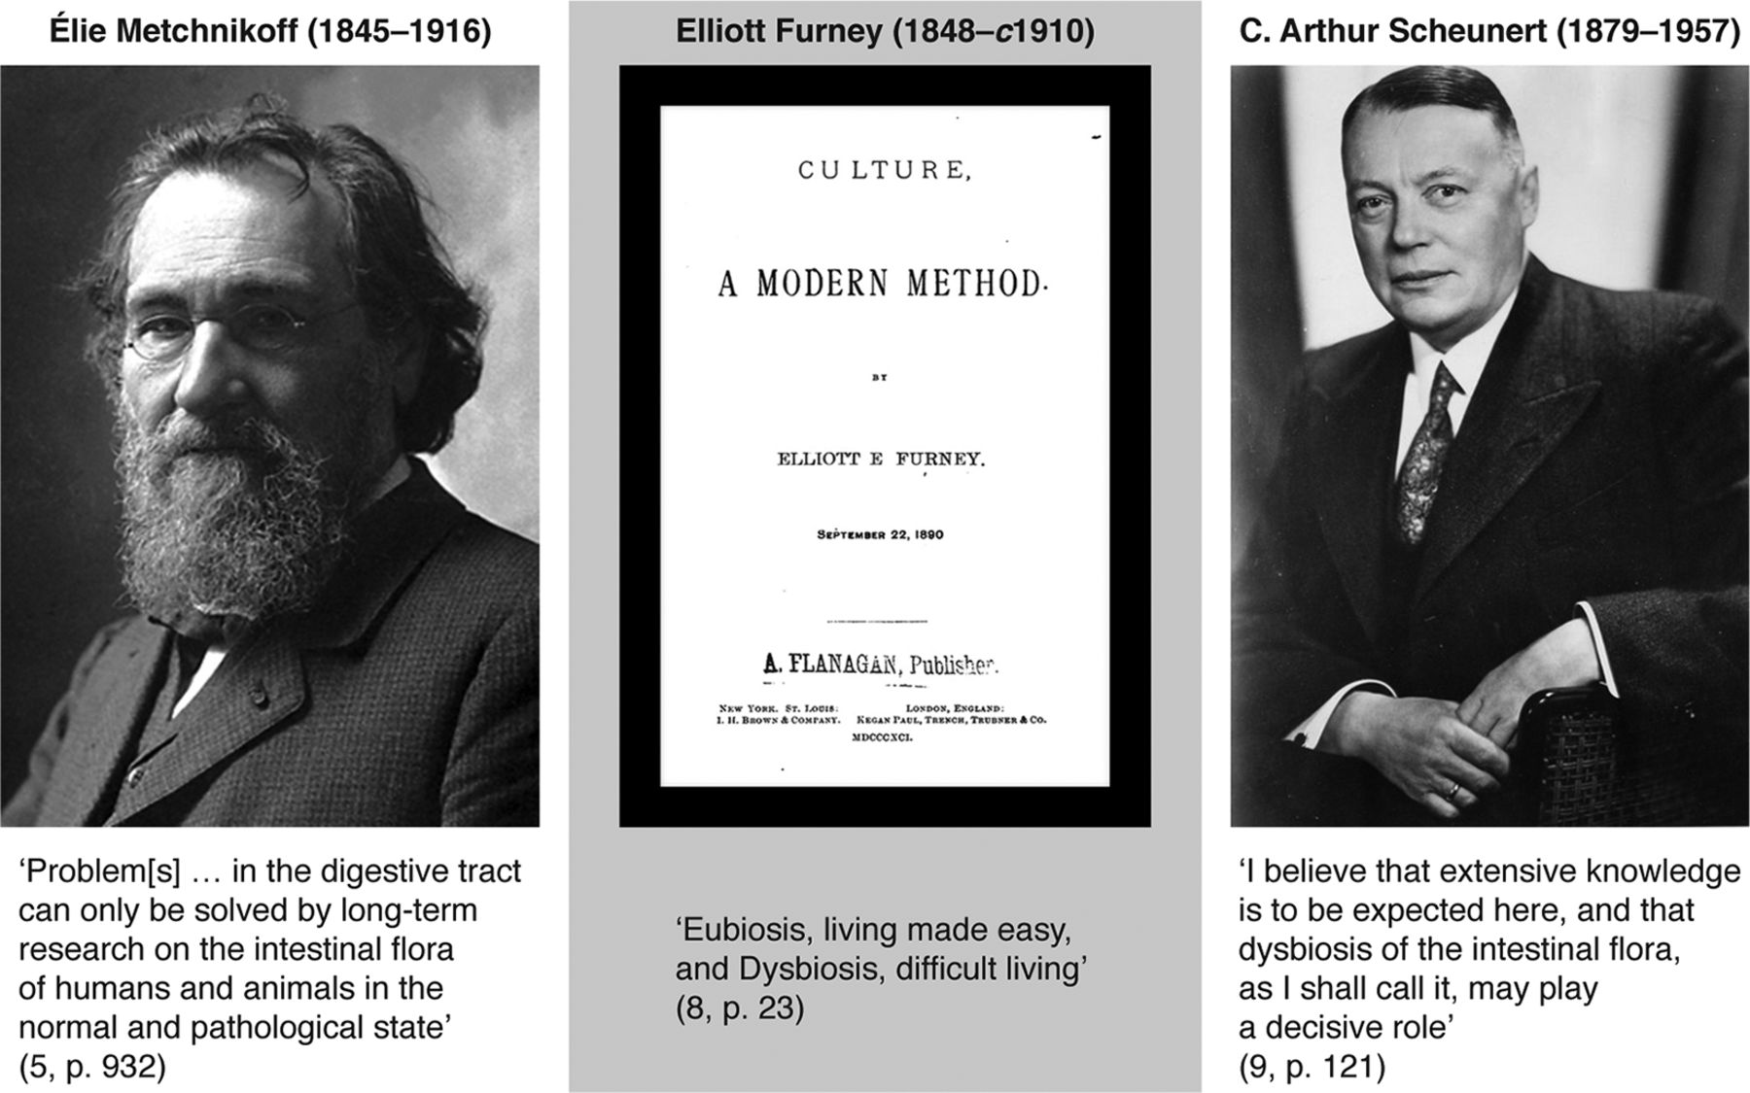

Gut Microbiota Dysbiosis
mBio. 2017;doi:10.1128/mBio.01492-17
Notes:
The contributions of Metchnikoff, Furney, and Scheunert to dysbiosis thinking. Metchnikoff photo from Les Prix Nobels 1908; Furney book cover from https://babel.hathitrust.org/cgi/pt?id=nnc1.1000947504;view=1up;seq=5; and Scheunert photo from http://www.ullmann-bernau.de/Ahnengemeinschaften (used with permission of the creator of the digital rendition, Steffen Ullmann [original photographer unknown]).

Slide 9
Microbiota-related pathways involved in CVD
Circ Res. 2017;120:1183-1196.

Slide 10
Links between the microbiota and atherosclerosis
Cardiovasc Res. 2019;115:1471-1486.

Slide 11
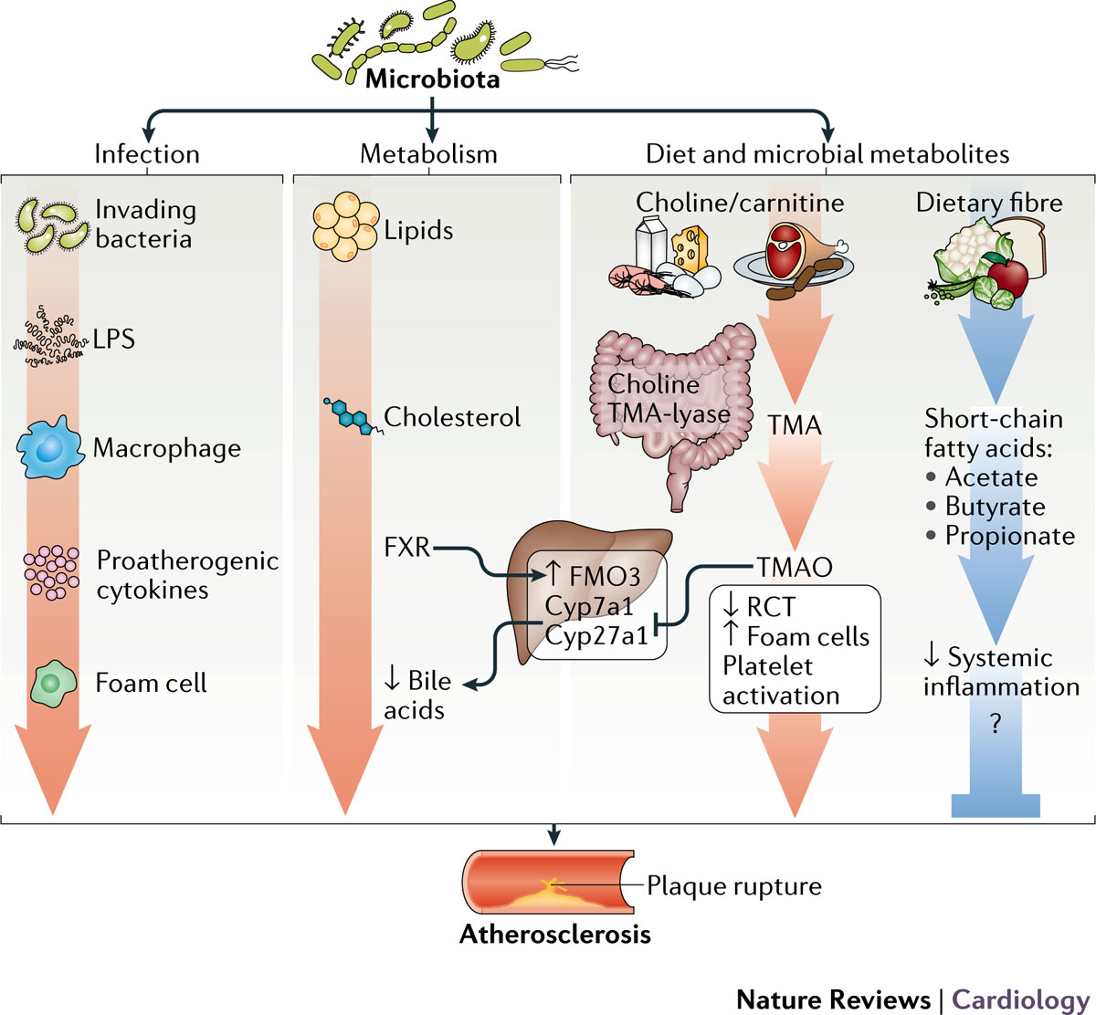
Links between the microbiota and atherosclerosis
Nat Rev Cardiol. 2017; 14:79-87.

Slide 12
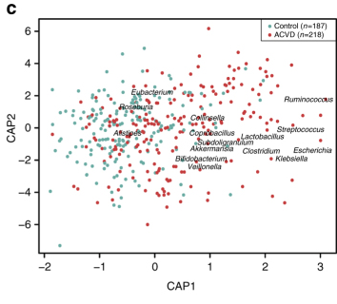
The intestinal microbiota discriminates between atherosclerotic patients and controls
CAP constrained analysis for beta diversity
Nat Commun. 2017;8:845.

Slide 13
TMAO and CVD
Nature 2011;472:57-63.
.

Slide 14
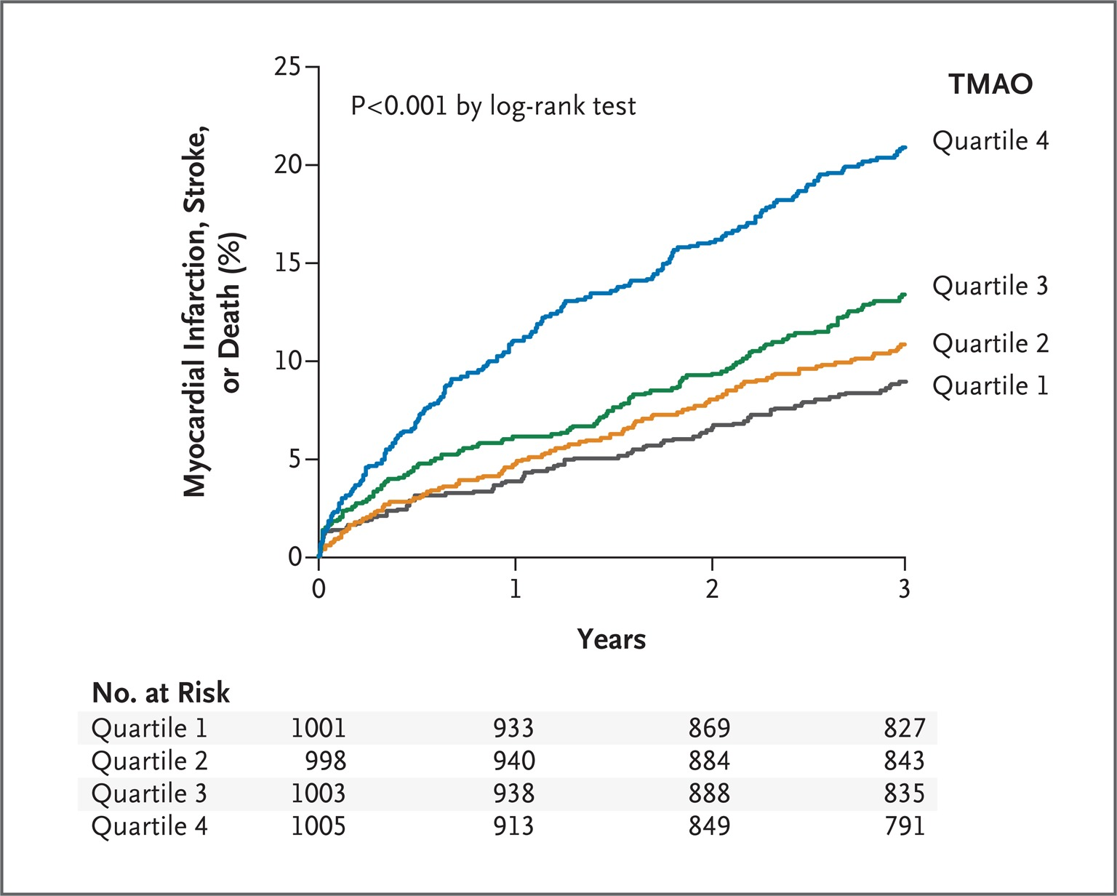
TMAO levels and risk of MACE in patients with CVD risk factors
N Engl J Med. 2013;368:1575-1584.

Slide 15
TMAO and total mortality risk
Pooled relative risks of high TMAO levels and all-cause mortality
J Am Heart Assoc. 2017;6:e004947.

Slide 16
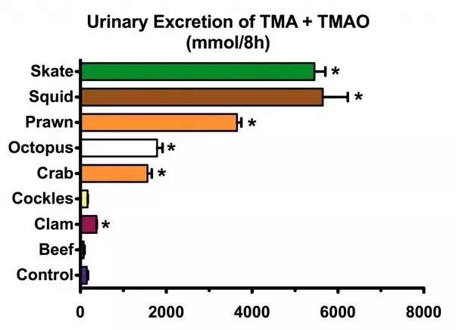
The TMAO paradox
The highest levels of free TMAO are contained in fish.
Food Chem Toxicol. 1999;37:515-520.

Slide 17
Interventions to reduce microbiota-related CVD risk
Circ Res. 2020;127:553-570.

Slide 18
FURTHER READING
Katsimichas T, et al. Gut Microbiota and Coronary Artery Disease: Current Therapeutic Perspectives. Metabolites. 2023; 13:256.
Tousoulis D, et al. Mechanisms, therapeutic implications, and methodological challenges of gut microbiota and cardiovascular diseases: a position paper by the ESC Working Group on Coronary Pathophysiology and Microcirculation. Cardiovasc Res. 2022; 118:3171-3182.
Katsimichas T, et al. The intestinal microbiota and cardiovascular disease. Cardiovasc Res. 2019; 115:1471-1486.
Gilbert JA, et al. Current understanding of the human microbiome. Nat Med. 2018; 24:392-400.
Jonsson AL, et al. Role of gut microbiota in atherosclerosis. Nat Rev Cardiol. 2017; 14:79-87.

Slide 19




