Slide 1


Η χρήση των φορητών συσκευών και εφαρμογών για την εκτίμηση καρδιομεταβολικής υπέρτασης ασθενών
Κωνσταντινίδης Δημήτρης
Καρδιολόγος
Υπεύθυνος Μονάδας Υπέρτασης
Ά Πανεπιστημιακή Καρδιολογική Κλινική
ΓΝΑ Ιπποκράτειο

Slide 2
Conflict of interest: MEDTRONIC, SERVIER, WINMEDICA, ASTRA ZENECA, ELPEN, SANOFI, MENARINI, IASPIS, UNI-PHARMA, NOVO NORDISK, VIANEX, KRKA, IASIS PHARMA, MERCK

Slide 3
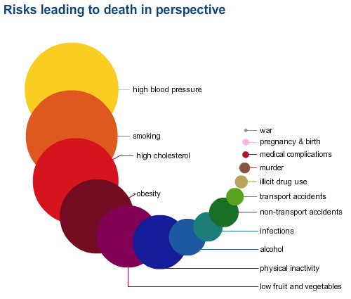
Risks leading to death

Slide 4
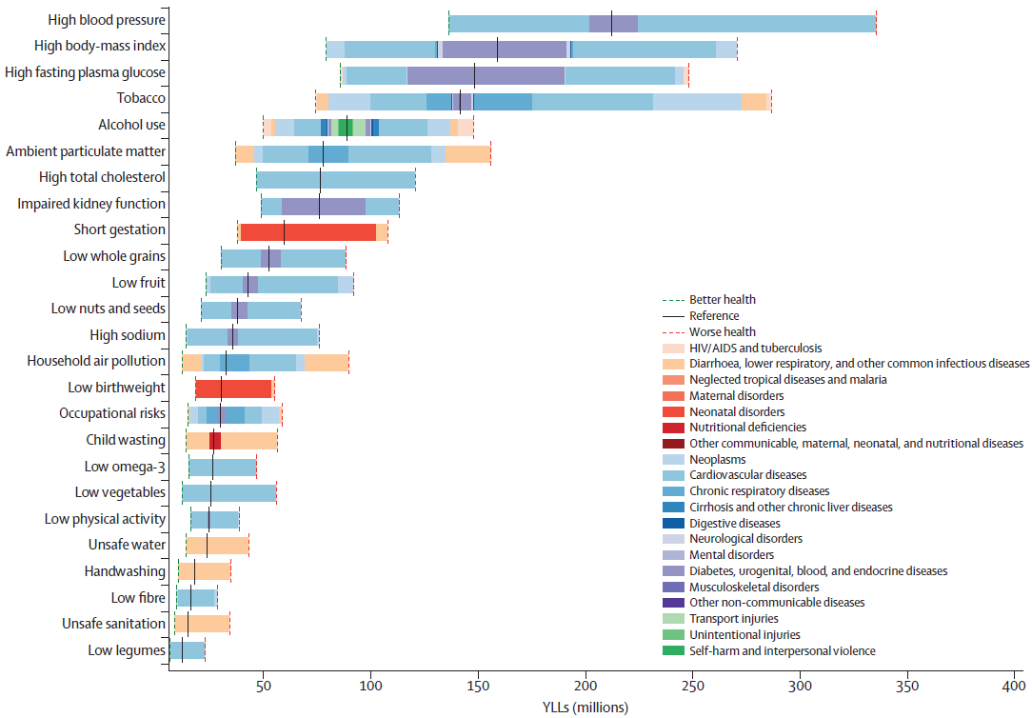
Leading 20 risk factors contributing to the global risk-attributable YLLs in 2040
Foreman KJ, et al. Lancet. 2018 Nov 10;392(10159):2052-2090

Slide 5
The unmet need in managing hypertension
1
3
HTN is estimated to have added $18.6B in avoidable costs* to the US health care system alone
in
ADULTS HAVE HTN
Treated and Controlled
Untreated
1B
people worldwide
Treated but Uncontrolled¹
1.6B
By 2025
Kearney PM, et al. Lancet. 2005 Jan 15-21;365(9455):217-23
Messerli FH et al. The Lancet. 2007;370:591–603
WHO Report 2002: Reducing risks, promoting healthy life
Notes:
20% των θανάτων παγκοσμίως οφείλονται στην ΑΥ

Slide 6

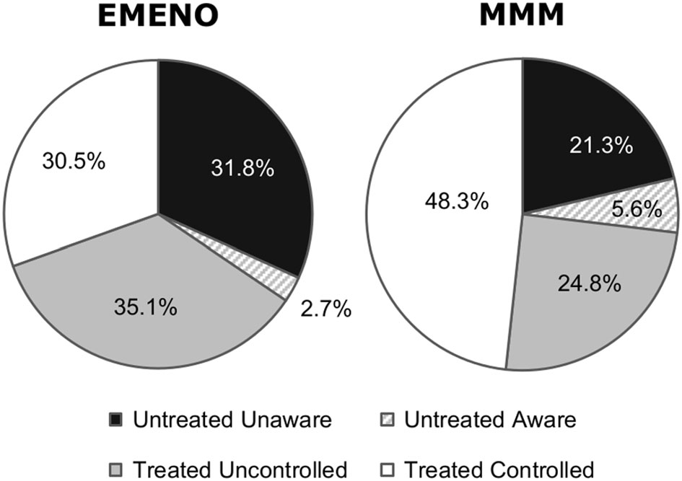
Awareness, treatment and control of hypertension in EMENO and MMM studies
Menti A, et al; J Hum Hypertens. 2021 Apr 9. Epub ahead of print
Stergiou GS, et al; Eur Heart J Suppl. 2021 May 20;23

Slide 7
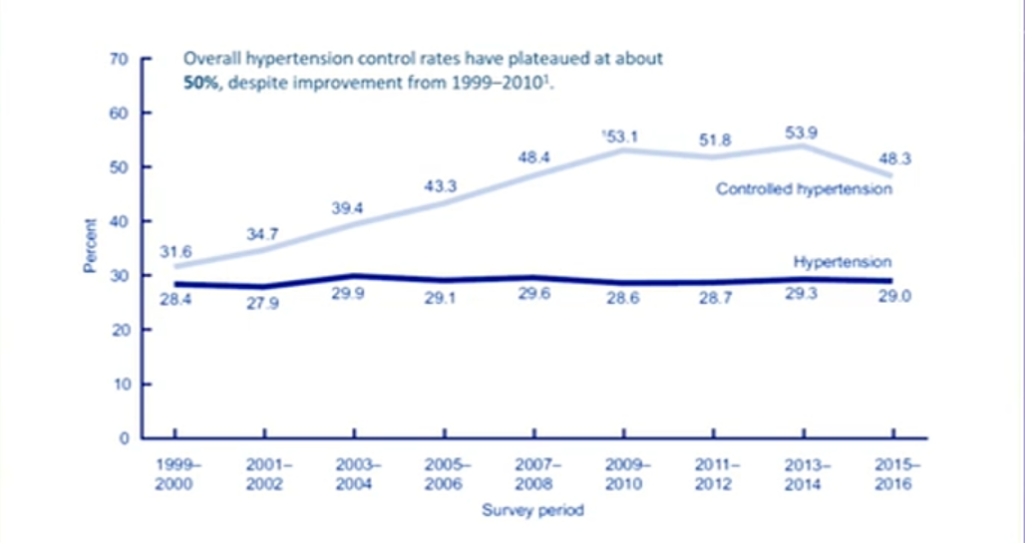
Current strategy is failing to improve HTN control
Fraya et al. NCHS Data Brief. 2017; 289: 1-8

Slide 8
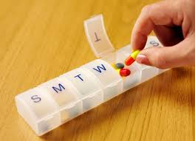
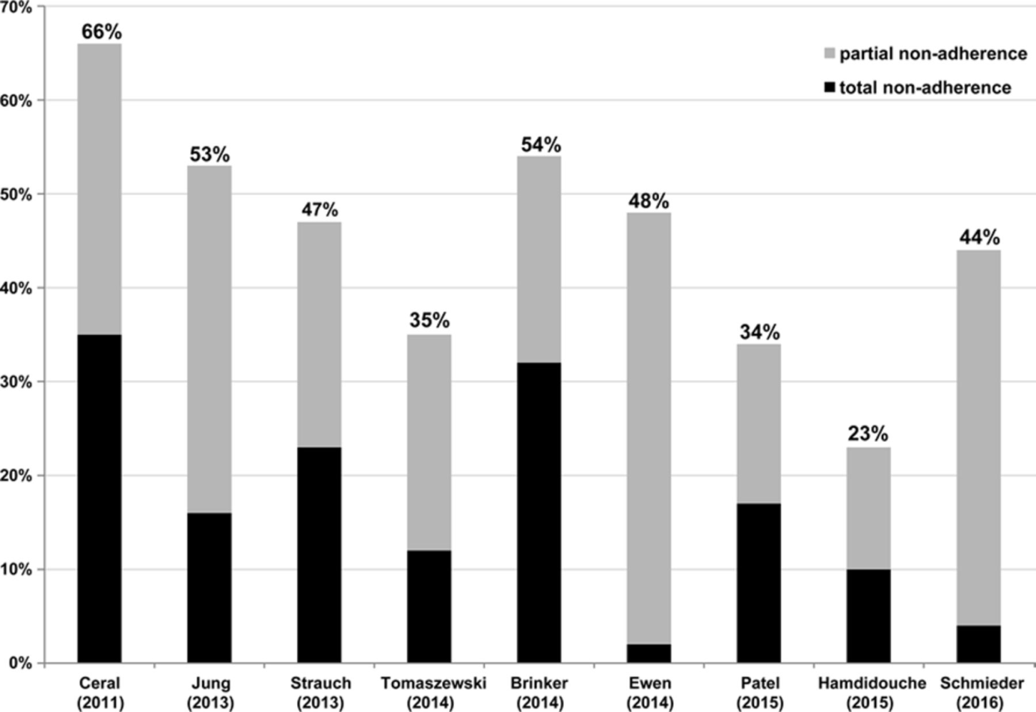
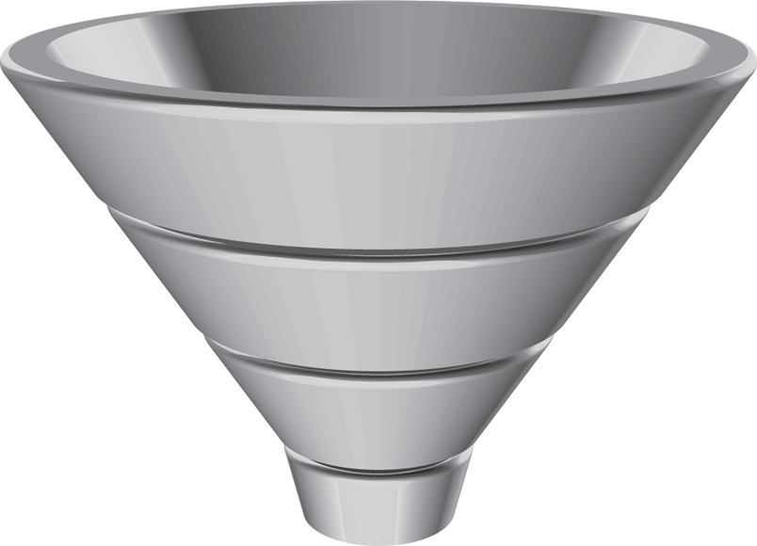
Adherence
For every 100 prescriptions written:
30%–50% never make it to the pharmacy
34%–52% are filled but never picked up
70%–75% are not taken as prescribed
15-20% are refiled
as prescribed
Berra E, et al. Hypertension. 2016 Aug;68(2):297-306
Notes:
at best 60% of treated hypertensive patients reaching recommended therapeutic goals.
In the absence of new drugs to control blood pressure, drug adherence has become a major issue in the management of hypertensive patients.
Numerous studies have demonstrated that the major problem is the lack of persistence followed by a poor day to day execution of the prescribed regimens.
the true incidence of poor adherence in resistant hypertension remains largely unknown with published figures ranging between 10 and
80%.
In clinical trials however, the rate of BP control that is achieved is often much higher reaching percentages of 80% or more. In these studies, the treatment protocol is rigorous, clinical visits are regular and frequent and both physicians and patients are motivated to reach the protocol's objectives.
According to the World Health Organization, adherence is "the extent to which a person’s behavior – taking medication, following a diet, and/or executing lifestyle changes – corresponds with agreed recommendations from a health care provider"

Slide 9
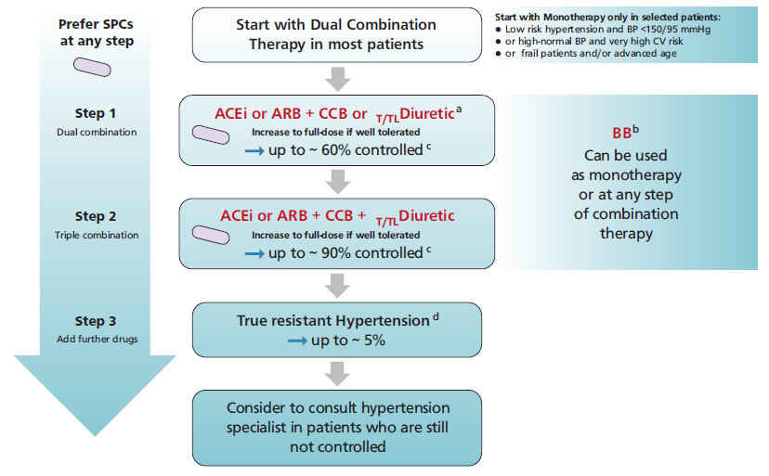
ESH 2023

Slide 10
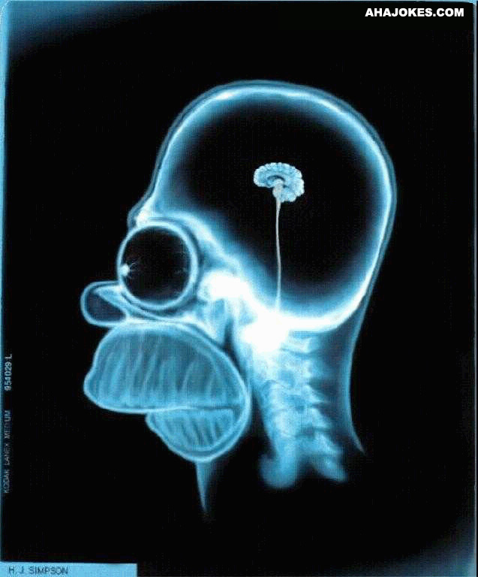
“The Good Doctor”
“Medicine is an art based on science”
Diagnosis
Treatment
Implementation
Notes:
Εξηγούμε τι έχει,
Εξασφαλίζουμε τη εφαρμογή της αγωγής,
Παρακολουθούμε

Slide 11

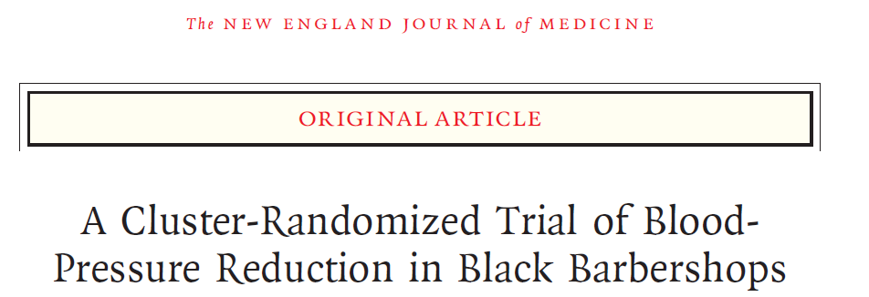
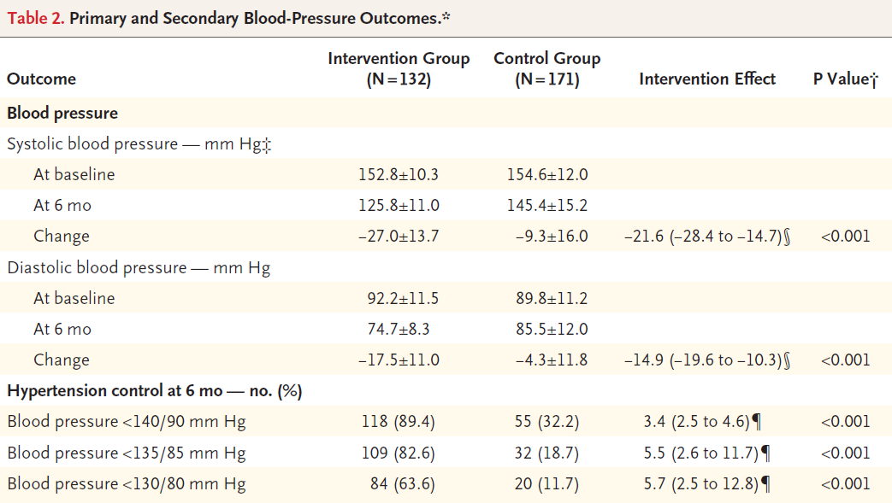
Victor RG, et al. N Engl J Med. 2018 Apr 5;378(14):1291-1301
Notes:
We enrolled a cohort of 319 black male patrons with systolic blood pressure of 140 mm Hg or more from 52 black-owned barbershops (nontraditional health care setting) in a cluster-randomized trial in which barbershops were assigned to a pharmacist-led intervention (in which barbers encouraged meetings in barbershops with specialty-trained pharmacists who prescribed drug therapy under a collaborative practice agreement with the participants’ doctors) or to an active control approach (in which barbers encouraged lifestyle modification and doctor appointments).
Pharmacists made drug therapy convenient by bringing it to the barbershop
A blood-pressure level of less than 130/80 mm Hg was achieved among 63.6% of the participants in the intervention group versus 11.7% of the participants in the control group (P<0.001)

Slide 12
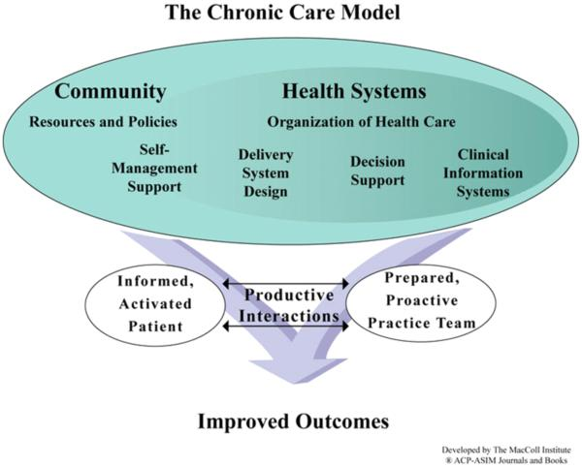
The Modern Model of chronic disease management
According to a modern model of HTN management, the patient and not his/her disease has a central role and is directly involved in his/her health care management in collaboration with the physician, family, and community, each other interacting in different ways to influence and support health decision.
Αn individualized or personalized approach is required, according to a modern medical model often referred to as “precision medicine”.
Carter BL, et al. J Clin Hypertens 2012 14:51–65
Melville S, Byrd JB. Curr Hypertens Rep 2019 21:13

Slide 13
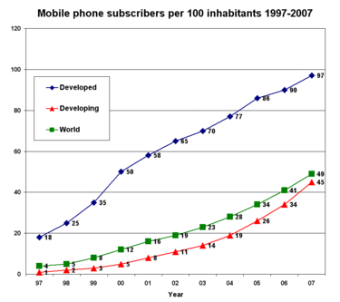
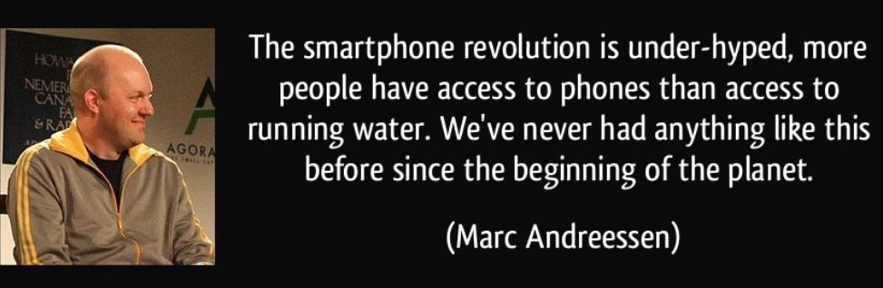
The revolution
E-health
Telemedicine
M-health
The explosive growth of the Internet economy and the reform of medical treatment systems have accelerated the growing mHealth market.
At present, the mHealth APP market is explosively growing due to the popularization of smartphones

Slide 14
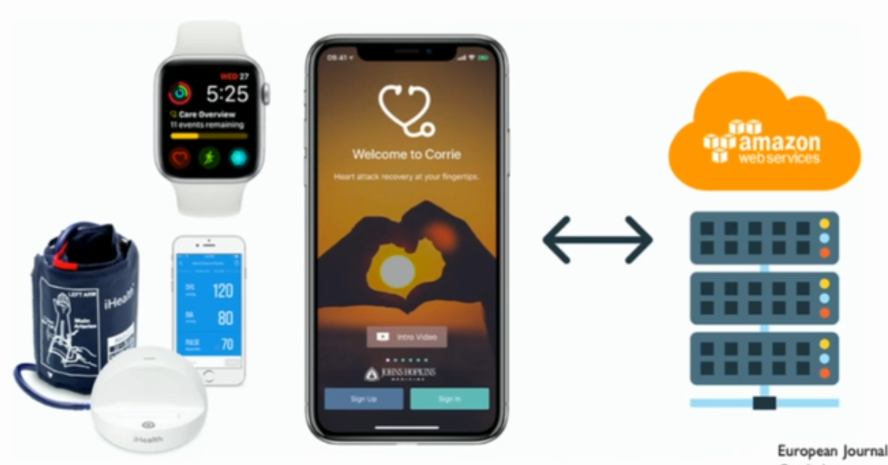
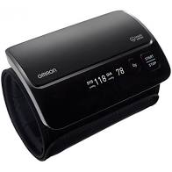
Transition from “all medicalized devices” to medical sensors adapted to usual used app and systems

Slide 15
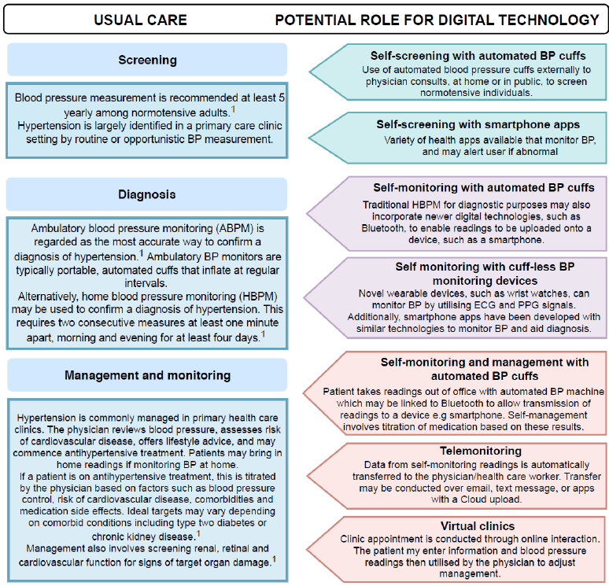
How digital technology may fit into future models of care
Kitt J, et al. J Cardiol and Cardiovasc Sciences. 2020;4(1):18-23

Slide 16
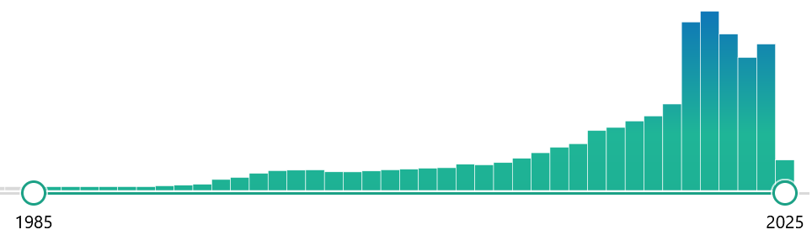
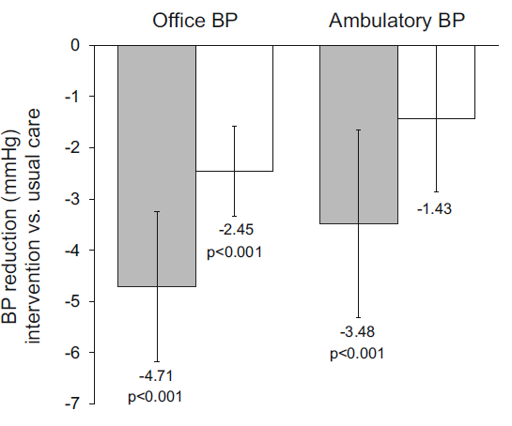
Telemedicine
Can reinforce and empower the physician-patient relationship, may even try to individualize it
Patients to easily and rapidly communicate to their doctors the occurrence of acute symptoms or sudden BP raises
Can reduce patients’ stress
May help empowering hypertensive patients, influencing their attitudes and behaviors, and improving their medical condition
Physicians can provide services to an increased number of patients
Omboni S, et al. High Blood Press Cardiovasc Prev. 2016 Sep;23(3):187-96

Slide 17
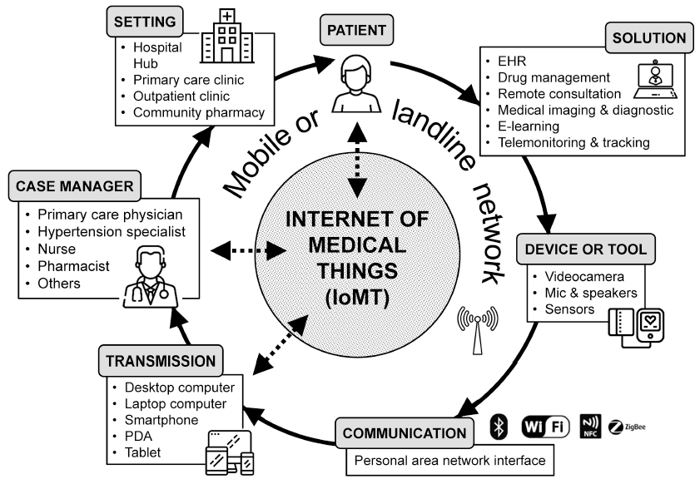
Telehealth Services
7 million patients are managed by telehealth solutions around the world
In US there are 200 telemedicine networks with 3,500 service sites and over half of all US hospitals have adopted some form of e- health
In Europe, 83% of countries have telemedicine services implemented, the main being teleconsultation (73%), followed by telediagnosis and telemonitoring (67%)
m-health apps can provide automatic patient-directed feedbacks or overcoming of preset thresholds and have the function of positive reinforcement of doctor’s prescription and recommendation
Omboni S. Front Cardiovasc Med. 2019 Jun 13;6:76

Slide 18
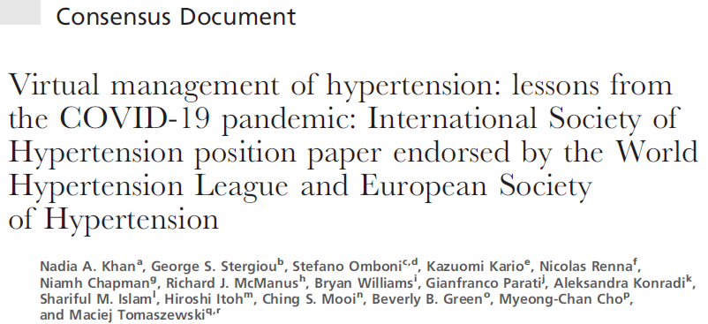
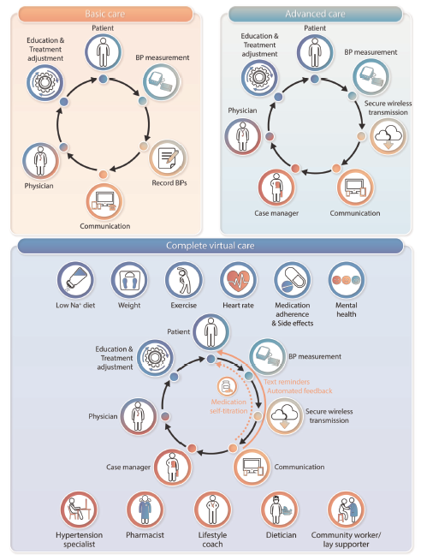

J Hypertens. 2022 Aug 1;40(8):1435-1448
Notes:
(audio-video conferencing through the internet, web-based exchange through mobile apps, electronic medical records (EMRs) portals or web platforms, text or electronic mail exchange or telephone consultations)
The benefits of self-monitoring appear to be driven by optimized prescription of antihypertensive medications to people with truly elevated BP, and improved medication adherence

Slide 19

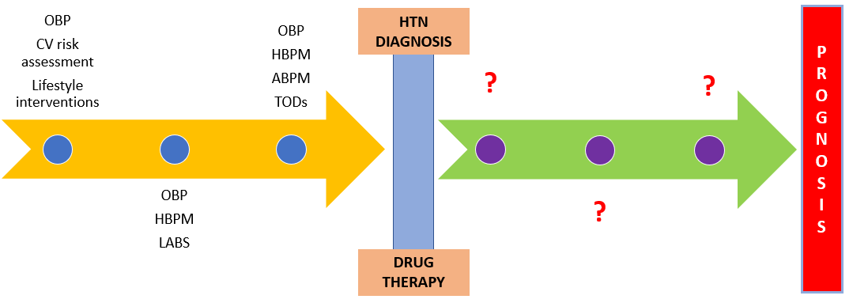
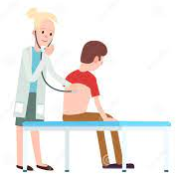
Diagnosis and management of HTN
D. Konstantinidis
Appropriate follow-up and monitoring enable assessment of:
adverse responses
response to therapy
adherence
target organ damage
progress toward treatment goals
ACC/AHA Hypertension Guidelines2017

Slide 20
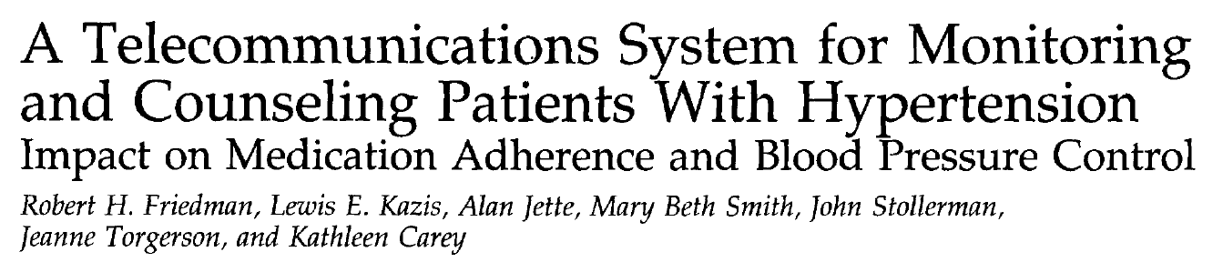
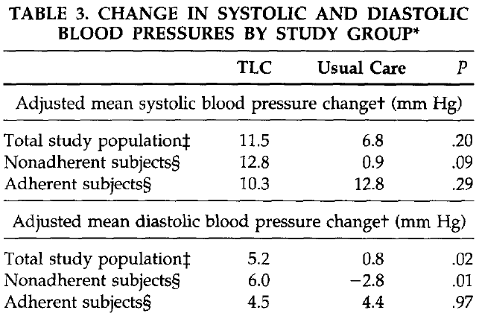
Am J Hypertens. 1996 Apr;9(4 Pt 1):285-92.
267 patients
≥ 60 yrs
Weekly, subjects in the telephone group reported self-measured BP, knowledge and adherence to antihypertensive medication regimens, and medication side-effects to a computer-controlled telephone system
Notes:
Από Βοστώνη

Slide 21
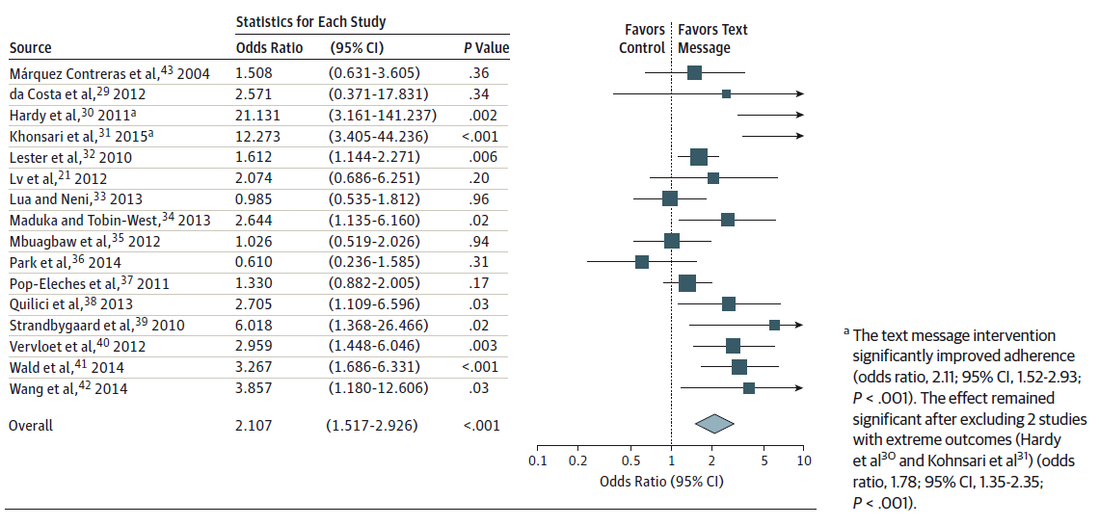
Systems for adherence (Mobile Telephone Text Messaging)
Thakkar J, et al. JAMA Intern Med. 2016 Mar;176(3):340-9

Slide 22

There's No Place Like Home to Diagnose Hypertension
The BP-CHECK study was a 3-group, office, home, and kiosk BP monitoring for diagnosing hypertension.
510 adults with elevated BP without diagnosed hypertension
Adherence to the monitoring regimen was:
home BP group (90.6%),
clinic group (87.2%),
kiosk group (67.9%)
From a patient-centered perspective, home BP monitoring is the most acceptable method for diagnosing hypertension
ΑΗΑ. Hypertension Scientific Sessions 2021: Presentation 50. Presented September 29, 2021
Notes:
Those assigned to clinic measurements were asked to return to the clinic for at least one additional BP check, as is routine in diagnosing hypertension in clinical practice.
Those in the home group were given and trained to use a bluetooth/web-enabled home BP monitor and were asked to take their BP twice a day (morning and evening, with two measurements each time) for 5 days.
Those in the kiosk group were trained to use a BP kiosk with a smart card and were asked to return to the kiosk (or a nearby pharmacy with the same kiosk) on three separate days and measure their BP three times at each visit.
All participants were asked to complete their group-assigned diagnostic regimens in 3 weeks and then to complete 24-hour ABPM.

Slide 23
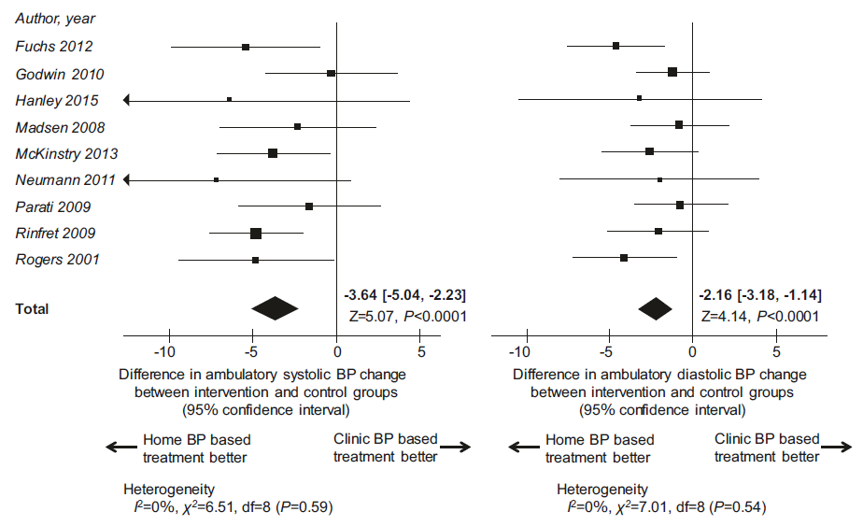
HBP vs OBP for BP control
HBPM:
evaluate the patients’ BP,
the antihypertensive effects,
the seasonable and day-to-day BP variation during treatment in the long term,
considered useful for improving patients’ adherence
For outcomes of cardiovascular events and related deaths, there are no appropriate studies
Satoh M, et al. Hypertens Res. 2019 Jun;42(6):807-816

Slide 24
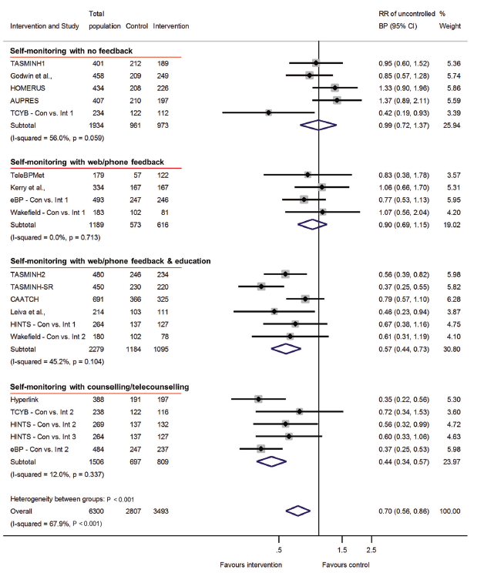
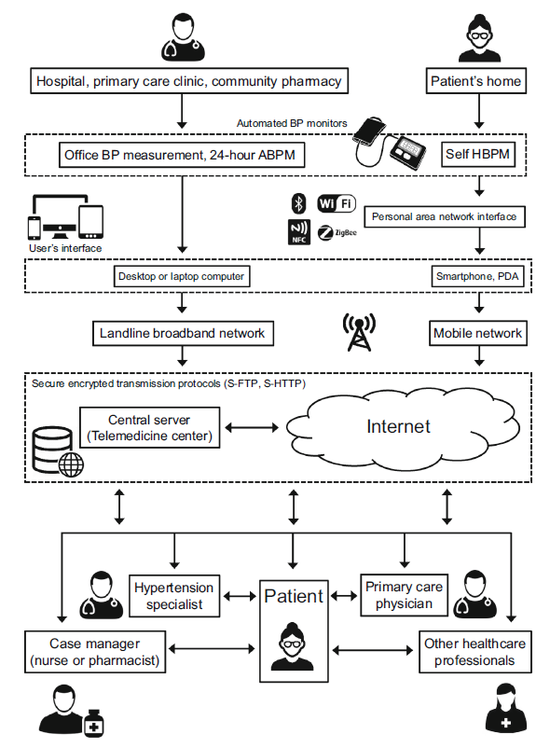
It’s a matter of intervention
Pellegrini D, et al. Hypertens Res. 2020 Jul;43(7):621-628

Slide 25
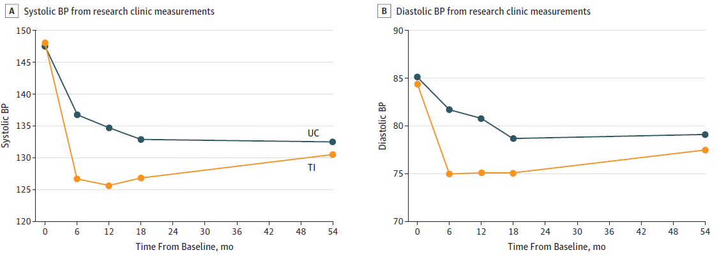
The long term effect
-2.5
-10.7
-6.6
-9.7
Margolis KL, et al. JAMA Netw Open. 2018 Sep 7;1(5):e181617
Notes:
The intervention was until 12months
The extended follow-up of this trial testing the effects of home BP telemonitoring with pharmacist management shows no significant difference in SBP or DBP at 54 months, primarily related to an increase in BP in the TI group.

Slide 26
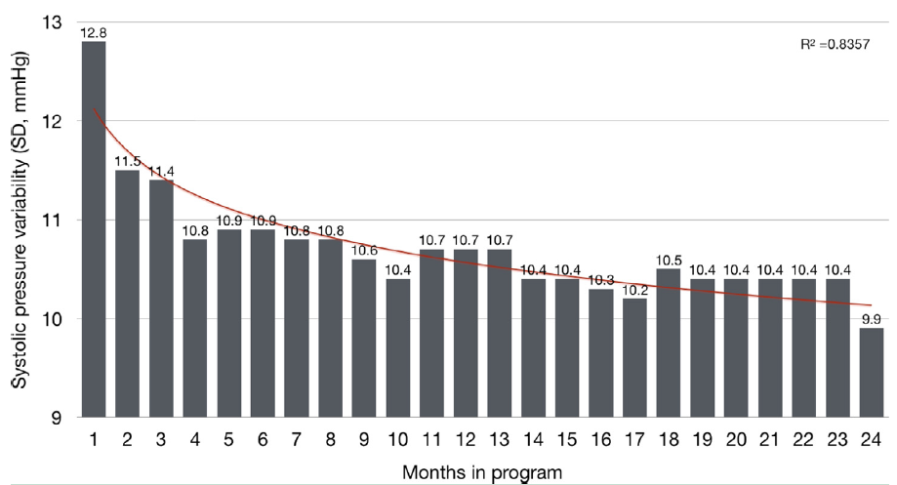
Telemedicine Improves BP Variability
803 hypertensive patients
Mean age 67 ± 12 yrs
Reduction of 8 mmHg for the SBP and 5 mmHg for the DBP
Milani RV, et al. Am J Med. 2020 Jul;133(7):e355-e359

Slide 27

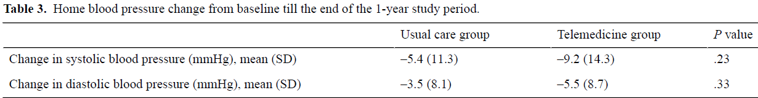
Is it safe?
Telemedicine group used a 3G network–attached HBP monitoring device, consulted hypertension specialists from an academic hospital through web-based video visits
Rate of SBP control (135 mmHg) was better in the telemedicine group (85.3% vs 70.0%; P=.01)
Significant adverse events were not observed
Telemedicine without actual office visits was determined to be relatively safe in managing hypertension for 1 year
Yatabe J, et al. JMIR Cardio. 2021 Aug 31;5(2):e27347
Notes:
In Japan, telemedicine without face-to-face communication has been permitted since early 2015. We developed an integrated web-based telemedicine platform to manage appointments, medical care, and payment without patients visiting a clinic.
The standard visit-to-visit interval was set at 6 weeks for the telemedicine group and was unspecified for the UC group, leaving it to the physician’s discretion.
However, the study was prematurely terminated at the end of March 2018 because the health insurance policy in Japan changed, requiring a face-to-face visit at least every 3 months

Slide 28
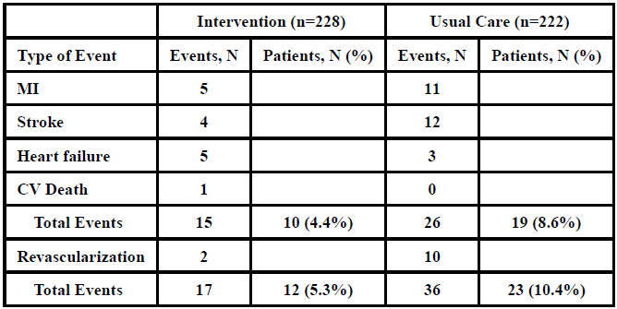
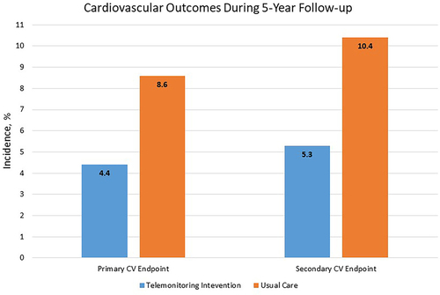
What about CV events?
Intervention costs were $1,511 per patient.
Over 5 years, estimated event costs were $758,000 in the TI group and $1,538,000 in the UC group for a return on investment of 126% and a net cost savings of about $1,900 per patient.
Margolis KL, et al. Hypertension. 2020 Oct;76(4):1097-1103

Slide 29

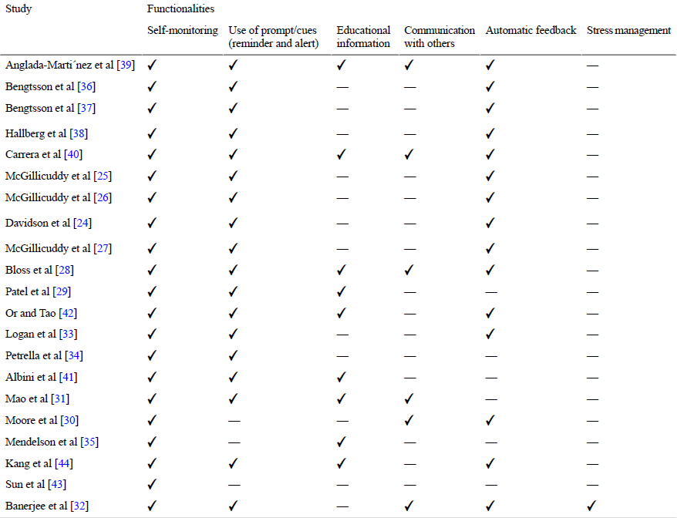
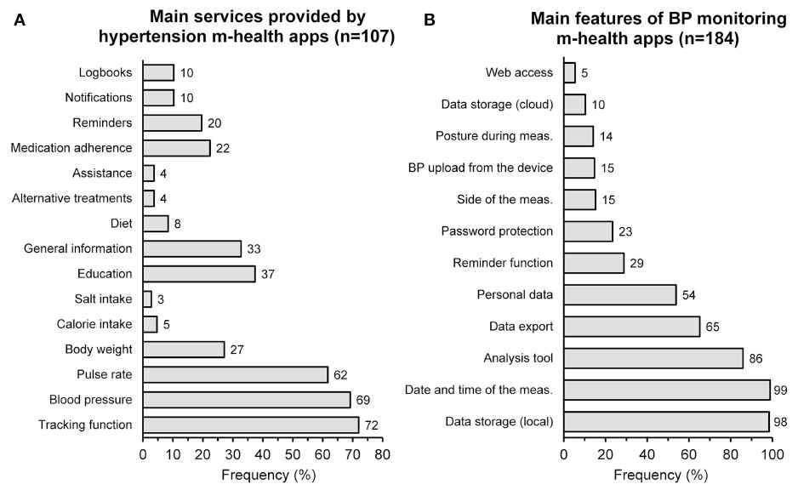
The Apps m-health in HTN
Omboni S. Front Cardiovasc Med. 2019 Jun 13;6:76
Alessa T, et al. JMIR Mhealth Uhealth. 2018 Jul 23;6(7):e10723

Slide 30
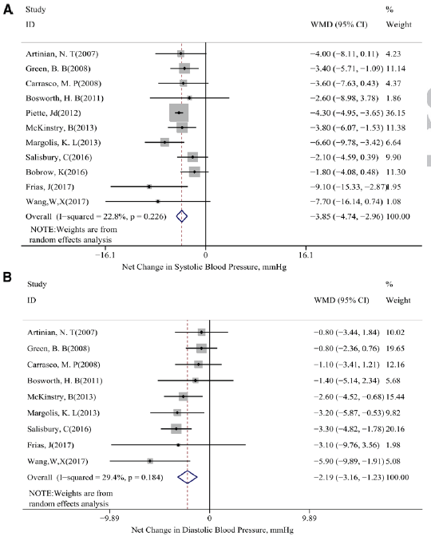
The mHealth intervention on BP
-3.85
-2.19
Lu X, Hypertension. 2019 Sep;74(3):697-704

Slide 31

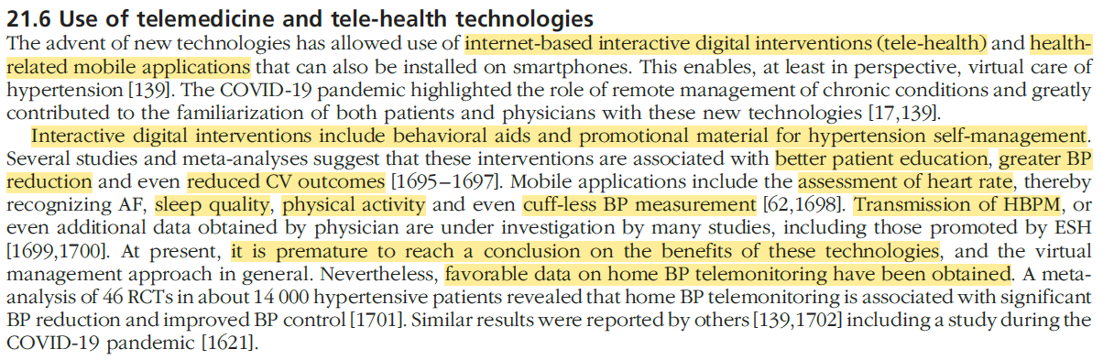
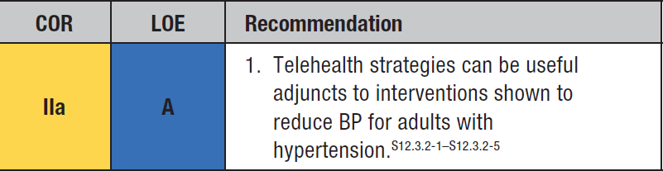


Slide 32
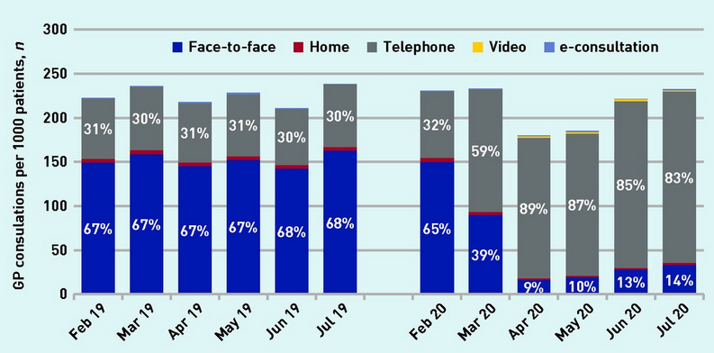
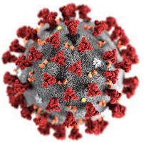
Hypertension management in the COVID era
Murphy M, et al. Br J Gen Pract. 2021 Feb 25;71(704):e166-e177

Slide 33
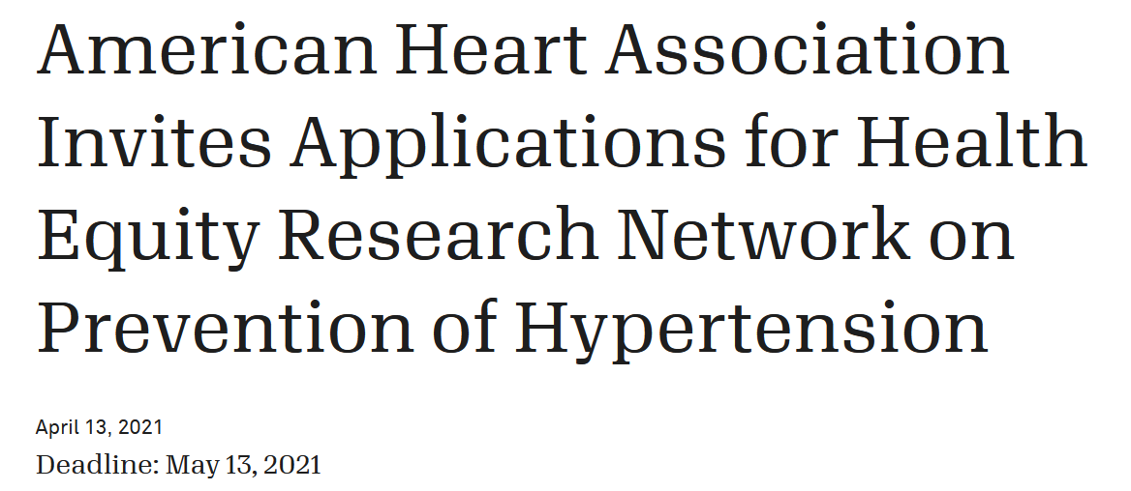
Not any war plan resist to enemy plans (Napoleon): COVID has changed our prespectives

Slide 34
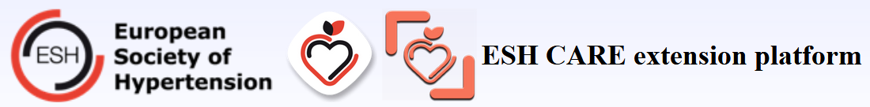
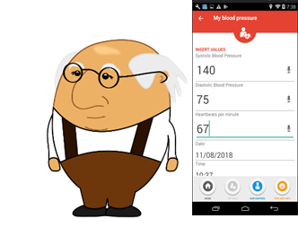
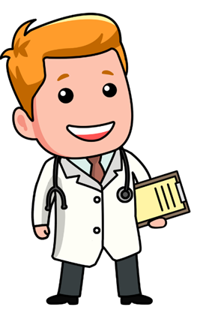
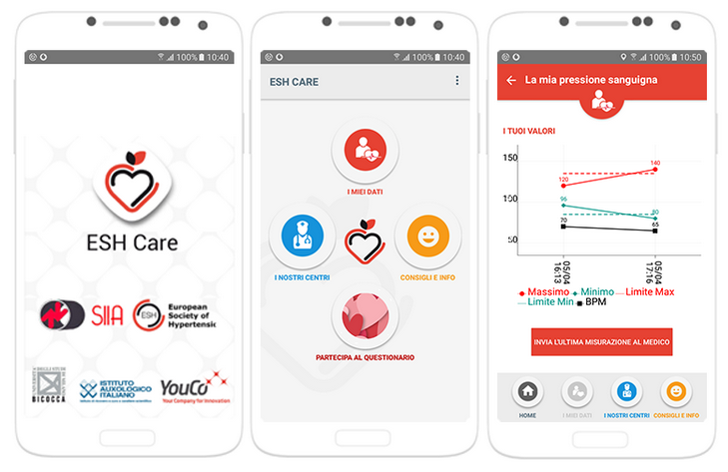
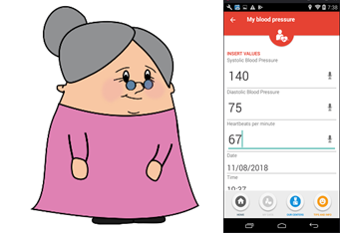


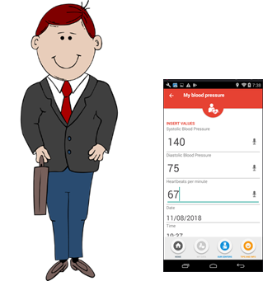

ESH CARE App and its extension platform
Overview of each doctor’s patients recent BP data
Statistics for each patient BP data (average BP, percentage above normal values, etc.)
Notifications/alerts for each doctor for extreme BP values
Notes:
eCRF
Simplifies the patients’ management
Email Notifications
To Patients
To Doctors

Slide 35
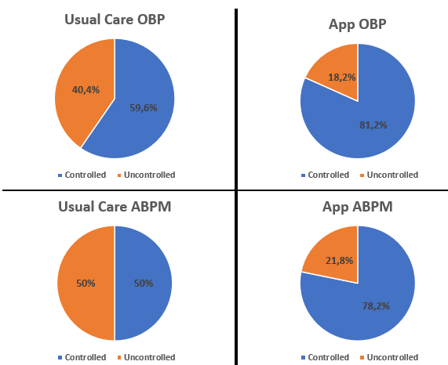

BP control with the ESH CARE App
Konstantinidis D, et al. Under publication

Slide 36


The patients’ perception
In 10 studies, including 1,120 patients, 87.1% of the participants regarded the BPT technique as useful to manage their condition.
Omboni S, et al. Curr Hypertens Rep. 2015 Apr;17(4):535
Notes:
physical component (PCS) and
mental component (MCS)

Slide 37

The physicians’ perception
Only 25% of doctors recommend the use of m-health
42% of doctors worry that m-health apps will make patients too independent
58% believe that telemedicine will play a significantly greater role in the future
Allows to reach distant patients and increase the number of served patients
There are no standardized methods for the quality evaluation of m-health apps
The lack of adequate infrastructures, lack of reimbursement
Omboni S. Front Cardiovasc Med. 2019 Jun 13;6:76
Notes:
Germany, Sweden, and the United Kingdom are relatively mature markets where governments are promoting the digitization of care and have standardized reimbursement pathways.
Spain, Italy for example, has many highly autonomous regional payers, so the pathways and evidence requirements vary.

Slide 38


AI applications and new technology for HTN management
Tsoi K, et al. J Clin Hypertens (Greenwich). 2021 Mar;23(3):568-574
Notes:
Temple University in Philadelphia was recently awarded $748,000 to build a ML system to “analyze electronic health data, identifying patients who are likely to have persistently uncontrolled blood pressure (BP) so doctors can be more proactive with their interventions”.
In the midst of a technological and information era, medical records are usually digitalized, and various sensors have been invented for the collection of vital signals. Therefore, artificial intelligence (AI) has been increasingly recognized as a data-derived computational approach in data analytics for clinical decision making

Slide 39

Prediction of BP Variability using Artificial Intelligence (AI)
Koshimizu, et al. Intern J Medical Inform 2020; 126: 104067

Slide 40

Anticipation medicine of CV disease
Kario K, et al. Prog Cardiovasc Dis. 2017 Nov-Dec;60(3):435-449

Slide 41

Support to GP and patients…
This study evaluates the effectiveness of the newly developed PIA (Pc supported case management of hypertensive patients to implement guideline-based hypertension therapy using a physician-defined and -supervised, patient-specific therapeutic algorithm) intervention with PIA-ICT and eLearning for general practices.
Leupold F, et al. EClinicalMedicine. 2022 Nov 3;55:101712

Slide 42


Blood pressure measurement
“The measurement of BP is likely the clinical procedure of greatest importance that is performed in the sloppiest manner”
Norman Kaplan 1998
Notes:
This cuff-based approach has not changed much since Scipione Riva-Rocci introduced it almost 125 years ago

Slide 43



When, Where, How?
“Τhe dynamic behavior of BP has been largely ignored, and focus put on snapshot
BP measurement”
Stergiou GS, et al. J Hypertens. 2021 Mar 11
Papaioannou TG, et al. Curr Pharm Des. 2015;21(6):697-9
Notes:
Based on the fact that: a) aortic BP is more relevant than brachial pressure in respect to cardiac function and b) BP values as a function of time are more relevant than a single measurement of BP under specific conditions, it is expected that pharmaceutical interventions, management of hypertension and prediction of BP-related risk could be further optimized. This might be achieved if therapeutic and diagnostic (theranostic) strategies would take into account the above spatiotemporal BP dynamics.

Slide 44


J Hum Hypertens. 2022 Mar 23:1–7

Slide 45

Uses and utilities that wearable BP monitors have the potential to support
Sola J, et al. Sci Rep. 2021 Oct 19;11(1):20644

Slide 46

Wearable devices for HTN management
Kario K. Hypertension. 2020 Sep;76(3):640-650

Slide 47




Wearable devices
Types
Wrist-cuff devices
Cuffless (wrist band)
Oscillometry (wrist cuff)
Applanation tonometry, photoplethysmography, pulse transit time, other
Methodology

Slide 48




J Clin Hypertens (Greenwich). 2019 Apr;21(4):463-469
J Clin Hypertens (Greenwich). 2019 Jun;21(6):853-858

Slide 49

Comparison of simultaneous monitoring with a wearable device and ABPM
Kario K. Hypertension. 2020 Sep;76(3):640-650
Notes:
After conducting continuous measurements both in office and out-of-office setting in 50 patients, there were comparable results between the two arms. The Heart Guide device showed only minor deviations in out-of-office measurements of 3.2 ± 17.0mm Hg (p < 0.001) in systolic BP (SBP) and −3.2 ± 11.3mm Hg in diastolic BP (DBP) (p < 0.001), attributed mainly to the lower position of the wrist. The percentage of differences that were within the ± 10mm Hg range was 58.7% in
the office and 47.2% in the out-of-office measurements.

Slide 50

Problems of the cuff-based BP measurement
Intermittent rather than continuous measurements
Unable to evaluate very-short-term BP variability
Only in static conditions
Effect of cuff inflation and vascular occlusion

Slide 51

Wearable BP devices
Non-invasive and cuffless measurements
BP record comfortably
Multiple or even continuous, rather than a small sample of measurements
Unaffected by body position and movements?
Detailed and unbiased information regarding circadian BP patterns and variability?
Complete picture of BP profile? BP profile?

Slide 52

Wearable cuffless BP devices: Can they improve HTN awareness and management?
Reliable measurements?
Schedule? Thresholds?
Type of intervention?

Slide 53
Wearable in clinical practice…
In order to recommend something for clinical use, it has to be able to provide reliable information on which to base patient decisions.
For something new to be useful in medicine, it need only do something a little bit better by certain criteria — maybe patients prefer it, maybe it improves outcome — but we need it to show some benefit on top of what we have.
We don't just add new things because they provide information. We have to prove that the information is reliable and can improve how we provide care.

Slide 54


The economic and scientific burden
Many cuffless devices are already available but this is being driven primarily by financial rather than scientific interest
Several factors influence the rising popularity of wearable devices, including comfort, the growing adoption of mobile platforms and preference towards home-based healthcare
Stergiou GS, et al. J Hypertens. 2022 Aug 1;40(8):1449-1460
Notes:
Από το 2005

Slide 55



Cuffless BP technologies
Stergiou GS, et al. J Hypertens. 2022 Aug 1;40(8):1449-1460

Slide 56



Photoplethysmography
Athaya T, et al. Sensors (Basel). 2021 Mar 7;21(5):1867

Slide 57

They predict changes of BP
Need to be calibrated
Calibration usually performed using a validated automated oscillometric upper arm cuff device
Often employ a mathematical model that combines demographics with a cuffless measurement from the individual as inputs to ‘predict’ BP
Vybornova A, et al. Blood Press Monit. 2021 Mar 4
Notes:
these are essentially BP ‘tracking’ rather than ‘measuring’ devices

Slide 58







Aktiia 24/7
Vybornova A, et al. Blood Press Monit. 2021 Mar 4
Notes:
On the advice of physicians, there is no display face so users aren't constantly checking and fretting about their blood pressure; you have to open an app on your smartphone to check your numbers.

Slide 59

Aktiia in different body positions
Increased venous congestion
Movement artefacts
Sola J, et al. Sci Rep. 2021 Oct 19;11(1):20644

Slide 60






Notes:
There are a lot of cuffless devices close to being approved, but none are recommended by the medical community for use in patients for clinical decision-making.
Approval is a validation that focuses on safety and less so on accuracy. So a cuffless device may be approved, but the other question is whether it is recommended.

Slide 61



Picone DS, et al. Hypertension. 2020 Jun;75(6):1593-1599

Slide 62

Validation
When you calibrate a cuffless device, you essentially tell the device your BP measurement, and it uses this as a reference. The cuffless device will pass the universal validation protocol because it repeatedly shows the calibrated BP…
A cuffless device must prove that it can track BP changes using an established protocol — this is the most important as well as the trickiest part of evaluating cuffless BP devices.
There are two types of tests we need to assess any kind of technology: lab tests and clinical field tests. You may have a device that is accurate under sterilized research conditions, but I also need a clinical field test to see whether it works for my needs.

Slide 63




Validation IEEE Standard for Wearable, Cuffless BP Measuring Devices
1
2
3
Wearable Cuffless BP Monitors Working Group: IEEE Standard for Wearable, Cuffless Blood Pressure Measuring Devices—Amendment 1, New York, IEEE, 2019
Notes:
Institute of Electrical and Electronics Engineers

Slide 64



Stergiou GS, et al. J Hypertens. 2021 Mar 11

Slide 65
Prognostic value?
It might take 20 years of research to know what a new measurement meant in terms of clinical outcomes
We had been working with the auscultatory method for many years, when oscillometry appeared. The developers realized that in order to be successful, they had to replicate the numbers that auscultation gives
Notes:
European Society of Hypertension (ESH) Working Group on Blood Pressure Monitoring. I'm 100% sure it's the strongest blood pressure monitoring group in the world — we involved people from Australia, Japan, Germany, the UK, and the United States. We're working on a statement about cuffless blood pressure monitoring that will probably be published in the summer.

Slide 66
Perspectives
A 24/7 BP device would be an excellent candidate to not only provide an alternative to HBPM/ABPM in terms of cost-efficiency and patient adherence but also to extend existing use-cases by providing insights into individual daily, monthly and yearly BP rhythms.
This would enable the first-ever large-scale phenotyping of populations in addition to driving personalized approaches for the diagnosis and the management of HTN.

Slide 67
Conclusion
We are at a momentum of change in healthcare due to
Improvement of informatics performance and algorithm effectiveness
Better acceptation from patients and professionals
Interest of regulatory authorities
Change from randomized to real life studies
Change of payment modalities (from pay for therapy / pay for effective service)
Need of distancing due to COVID
The question of reorganization of healthcare is crucial.
Digitalization should not be defined only by it’s medical dimension but with a 360º approach (patient/pathways/costs/datascience/effectiveness).
Digitalization is mandatory but has to be support by national authorities.

Slide 68



There is no limit…
A smartphone auscultatory BP kit
ANSI/AAMI/ISO 81060-2:2013 validated
Flexible, Wearable Oral Sodium Sensor
Chu G, et al. Blood Press Monit. 2017 Oct;22(5):290-294

Slide 69





Future
OBP
ABPM
Attended
Unattended
TBP
WBP
Big data refers to the enormous amount of structured as well as unstructured data, which helps organizations to improve their decision making processes.

Slide 70


Technology is not the panacea for the healthcare industry... but it is part of the solution!

