Slide 1
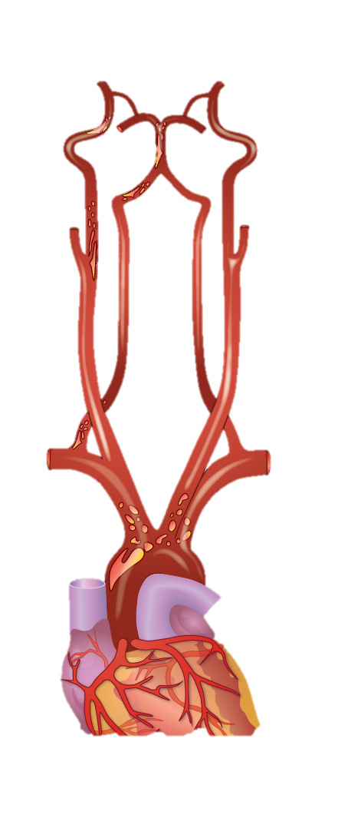


Αθηρωματικά ΑΕΕ από νόσο των μεγάλων αγγείων και αθηρωματικές πλάκες που προκαλούν μικρού βαθμού στένωση
Γεώργιος Ντάιος
Παθολογική Κλινική Πανεπιστημίου Θεσσαλίας
Ελληνικός Οργανισμός Εγκεφαλικών
Disclosures: Abbott; Amgen; AstraZeneca; Bayer; BMS/Pfizer; Boehringer-Ingelheim; Elpen; Ferrer; Javelin; Novartis; Sanofi

Slide 2
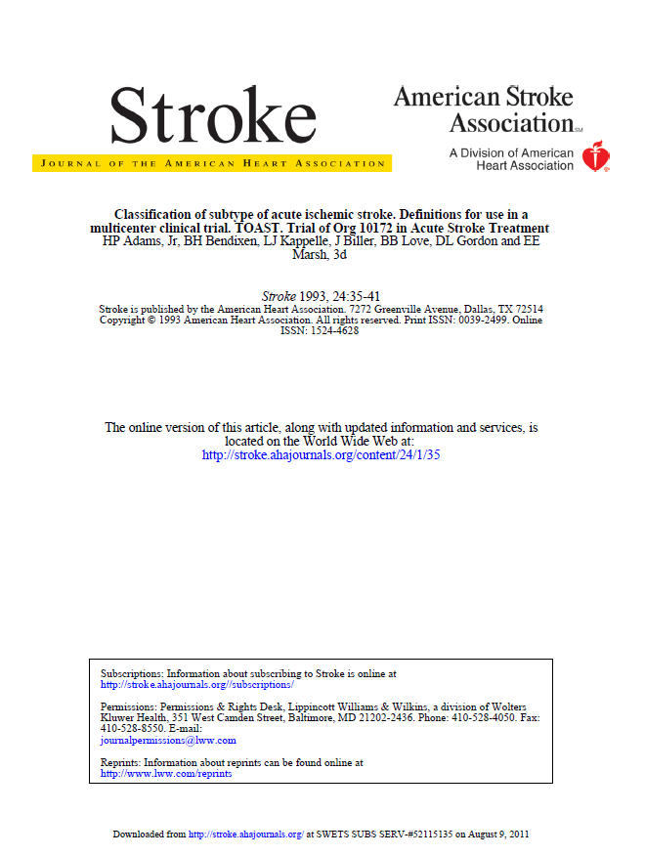
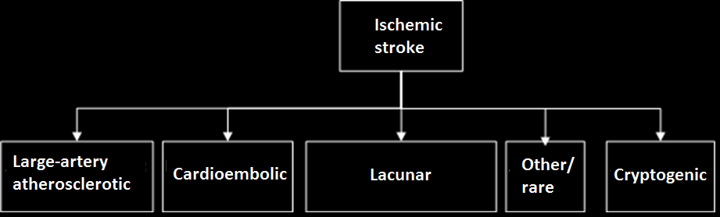
TOAST classification
>50% stenosis or occlusion
Adams et al. Stroke 1993
Notes:
ICM: insertable cardiac monitor

Slide 3
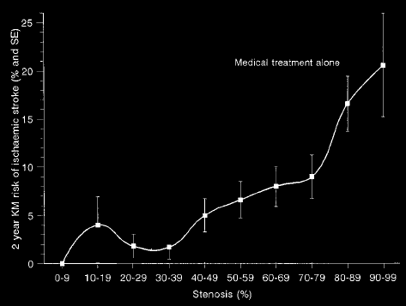
Association between stenosis degree and stroke risk
Stroke 2000; 31:615-621
Notes:
ICM: insertable cardiac monitor

Slide 4
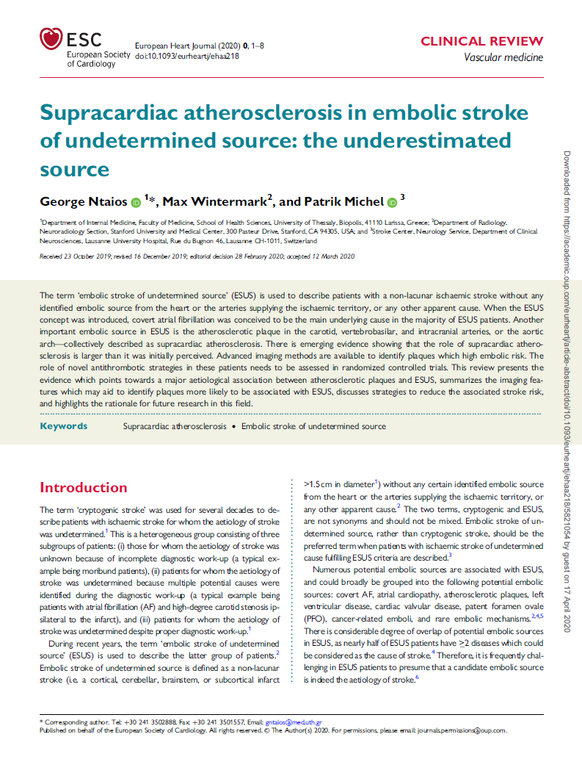
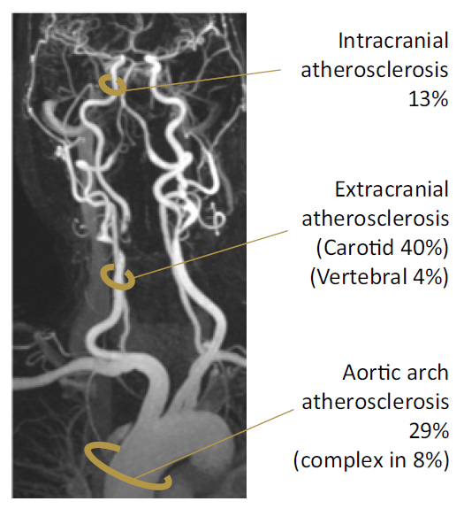
Incidence of non-stenotic atherosclerotic disease in ESUS
Ntaios, Wintermark, Michel. European Heart Journal 2021
Notes:
ICM: insertable cardiac monitor

Slide 5
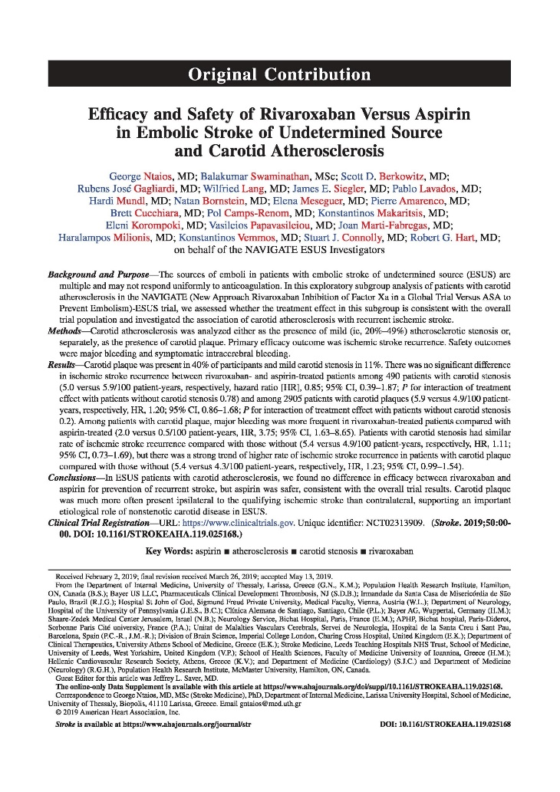
Ipsilateral vs contralateral prevalence of non-stenotic plaques
Stenosis (+)
n=490 (11%)
Bilateral stenosis
n=9 (2%)
Contralateral stenosis
n=86 (17%)
Ipsilateral stenosis
n=249 (51%)
Ntaios et al. Stroke 2019
Notes:
ICM: insertable cardiac monitor

Slide 6
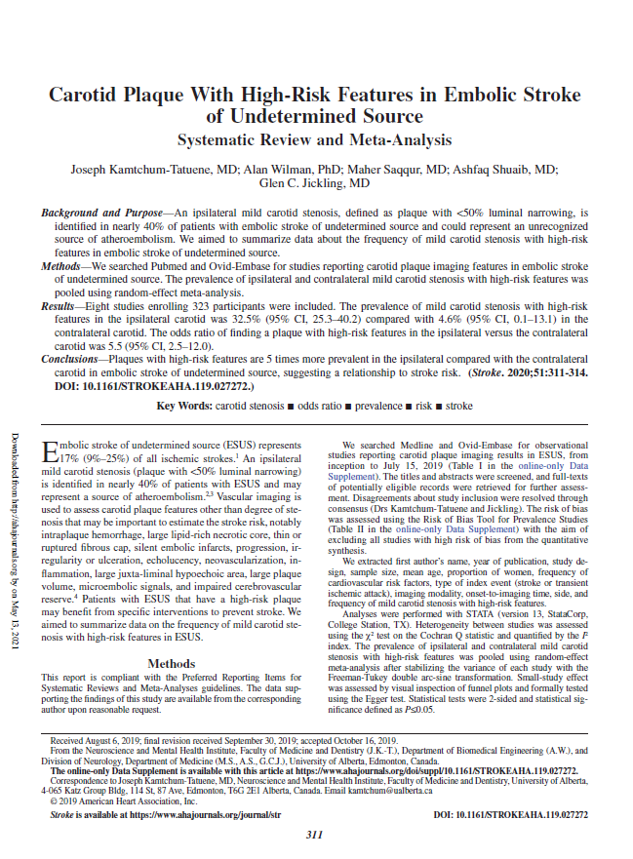
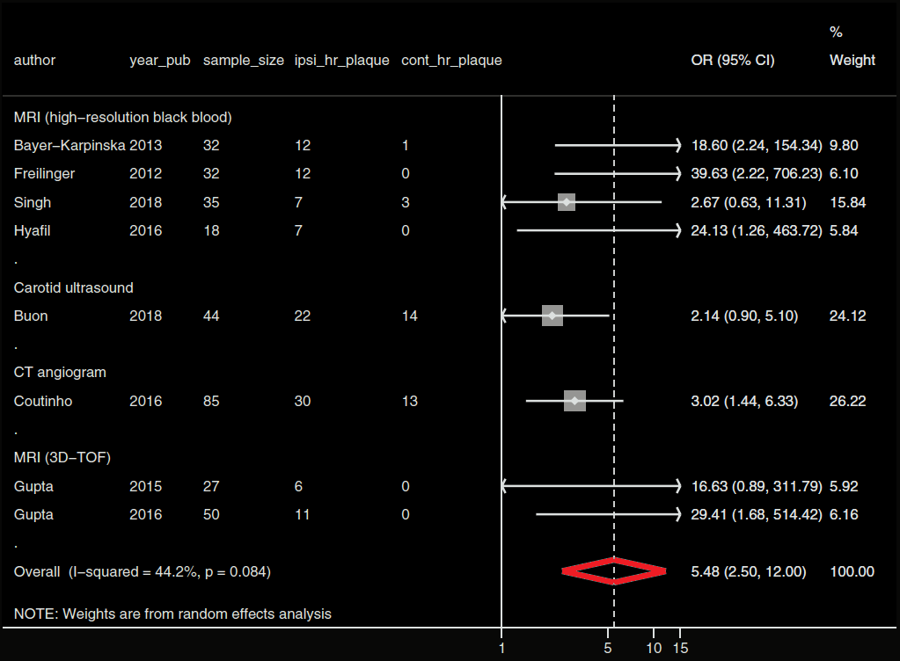
Ipsilateral vs contralateral prevalence of non-stenotic plaques
Kamtchum-Tatuene et al. Stroke 2020
Notes:
ICM: insertable cardiac monitor

Slide 7
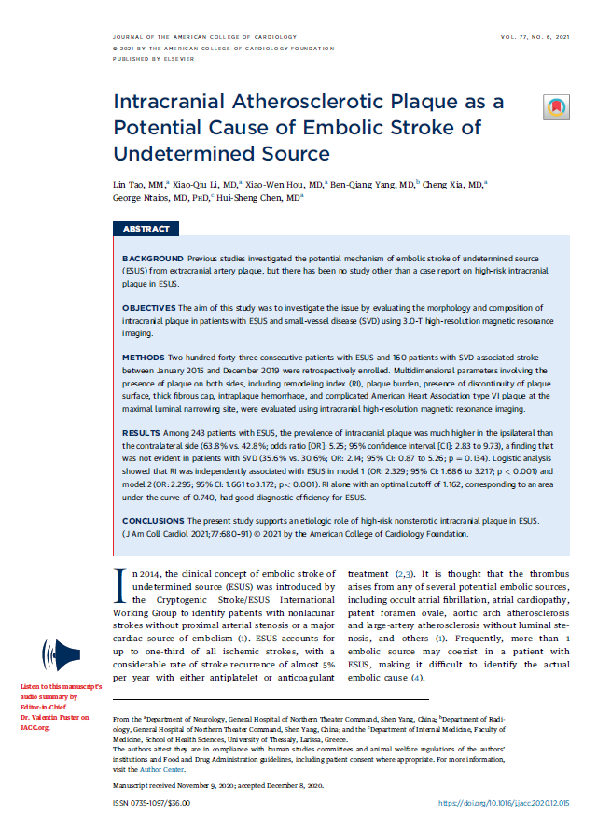
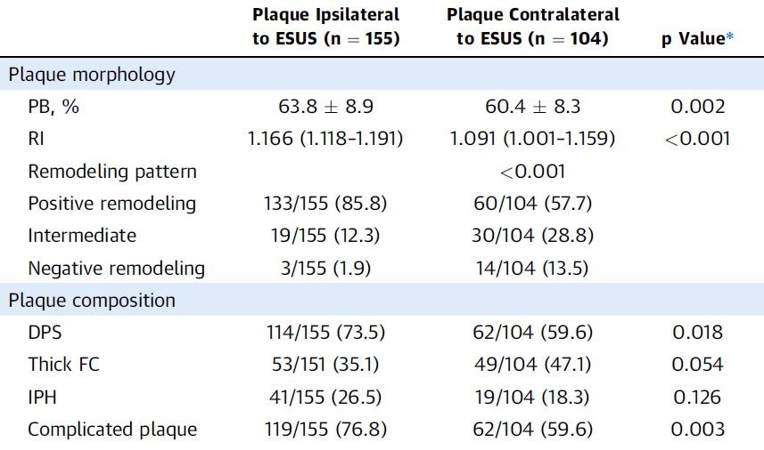
Intracranial non-stenotic plaques in ESUS
Tao L, Ntaios G, et al. JACC 2021
Notes:
ICM: insertable cardiac monitor

Slide 8
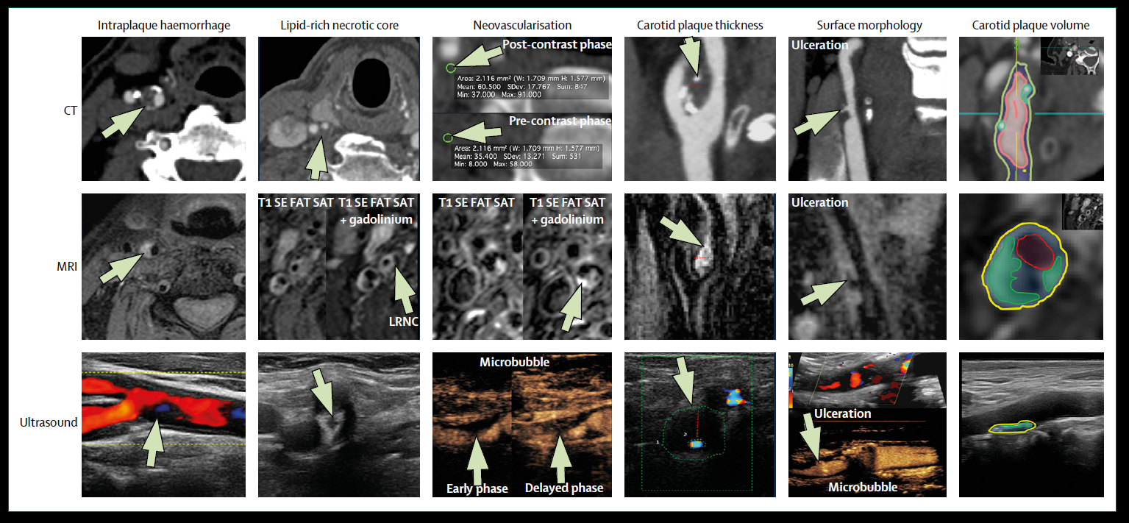
How to identify the risky plaque
Saba et al. Lancet Neurology 2019

Slide 9
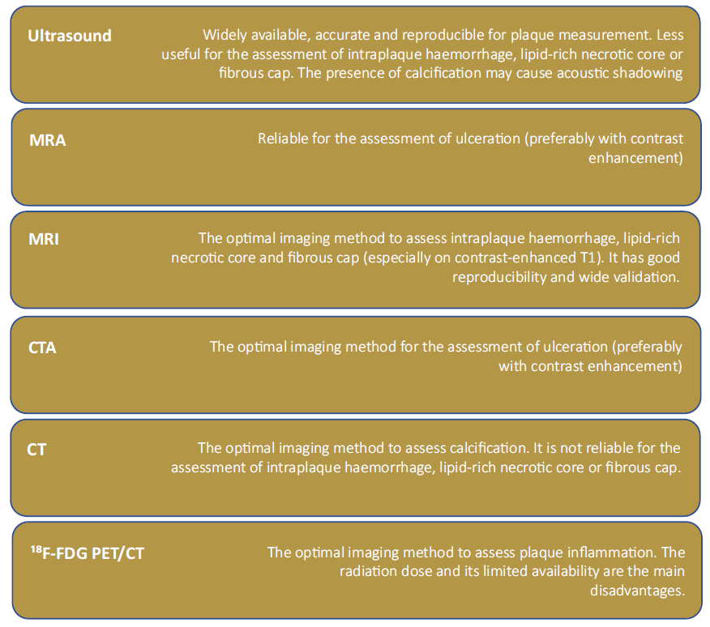
How to identify the risky plaque
Ntaios, Wintermark, Michel. European Heart Journal 2021
Notes:
ICM: insertable cardiac monitor

Slide 10
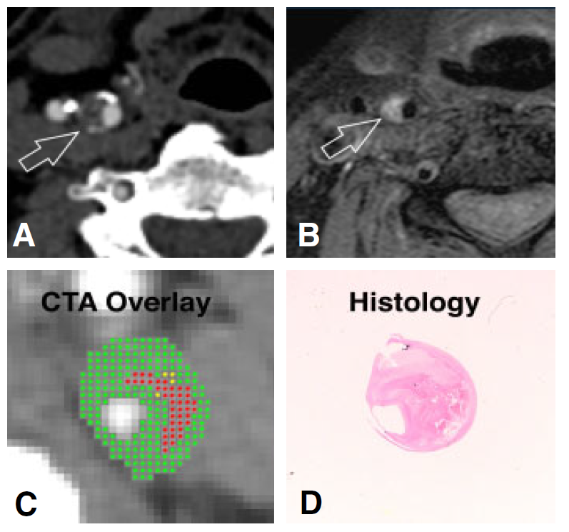
How to identify the risky plaque
Ntaios, Wintermark, Michel. European Heart Journal 2021
Notes:
The right image depicts computed tomography angiography (A) and MRI T1 fat sat (B) images showing a soft atherosclerotic plaque with speckles of calcifications in the right internal carotid artery, likely haemorrhagic (bright T1 signal on MRI). This plaque causes40% of stenosis according to the NASCET criteria. Because of its volume and its haemorrhagic component, this plaque is likely at higher risk of causing an ischaemic stroke despite the moderate degree of stenosis.
(C) In vivo computed tomography angiography image of the internal carotid artery using an automated classification computer algorithm-derived overlay, which shows a plaque with a large haemorrhage (red) that corresponds to a VIb lesion according to the American Heart Association classification. (D) The matching ex vivo section from the histologic examination. (C and D)

Slide 11
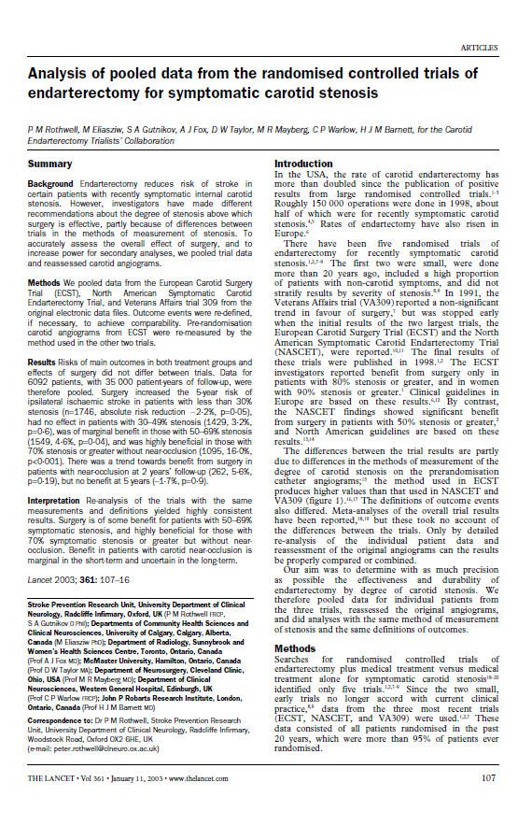
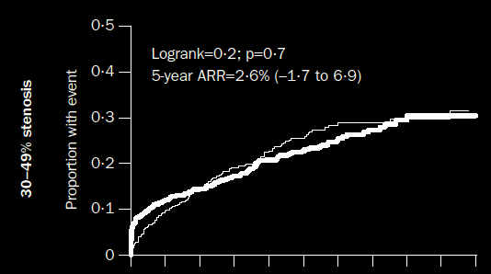
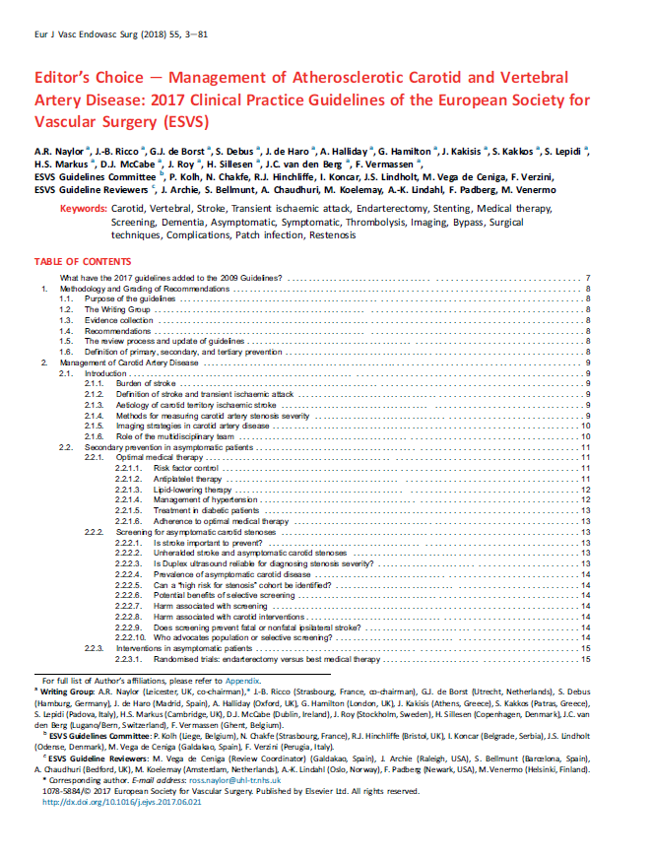
Arterial interventions
«In patients with <50% stenoses who report recurrent symptoms,
it may be reasonable to consider carotid endarterectomy or stenting»
Notes:
ICM: insertable cardiac monitor

Slide 12
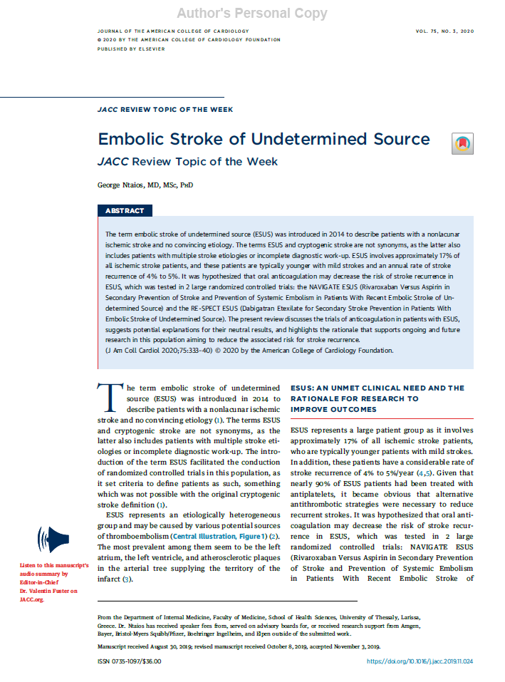
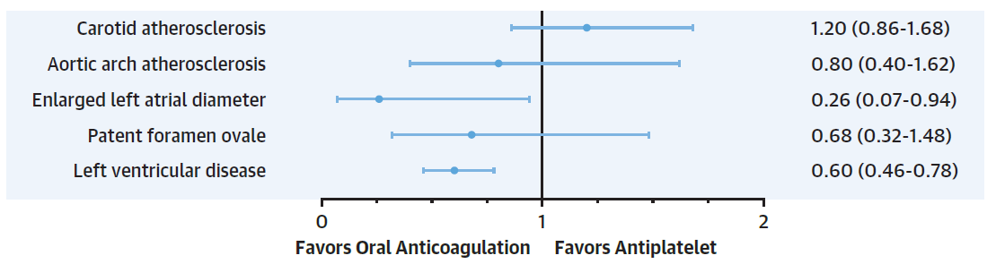
Anticoagulant or antiplatelet?
Ntaios. JACC 2020
Notes:
ICM: insertable cardiac monitor

Slide 13
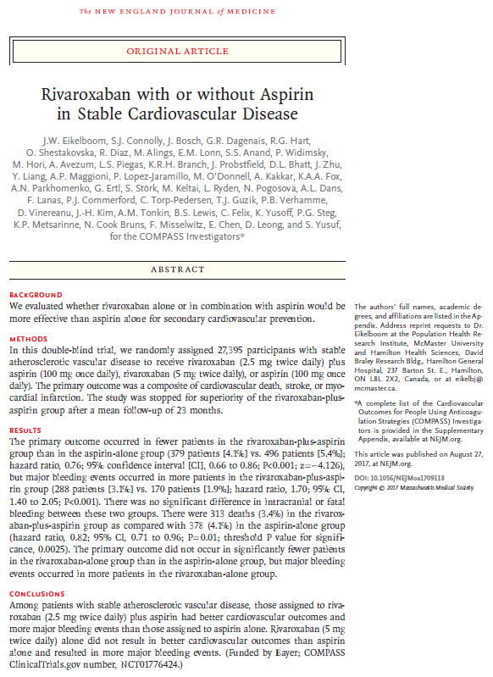
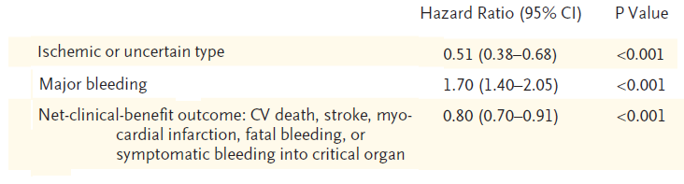
Antithrombotic treatment - COMPASS
Eikelboom et al. NEJM 2017
Notes:
ICM: insertable cardiac monitor

Slide 14
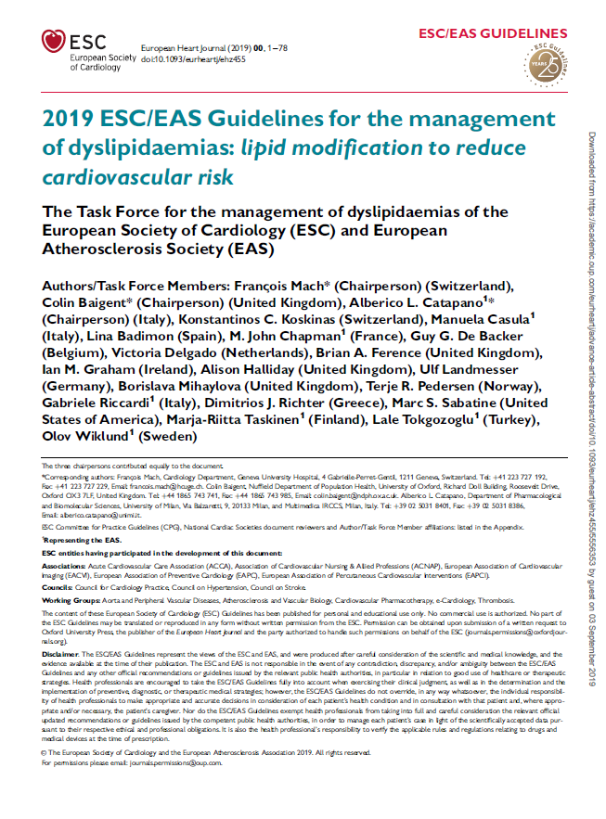
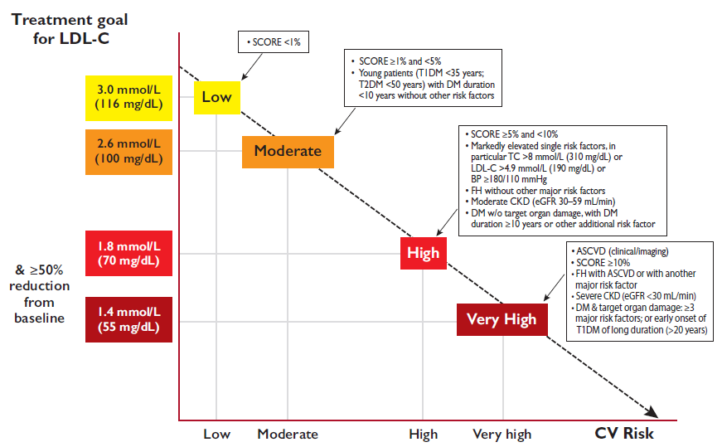
Medical treatment – LDL: the lower, the better
ESC/EAS Guidelines, Eur Heart Journal 2019
Notes:
ICM: insertable cardiac monitor

Slide 15
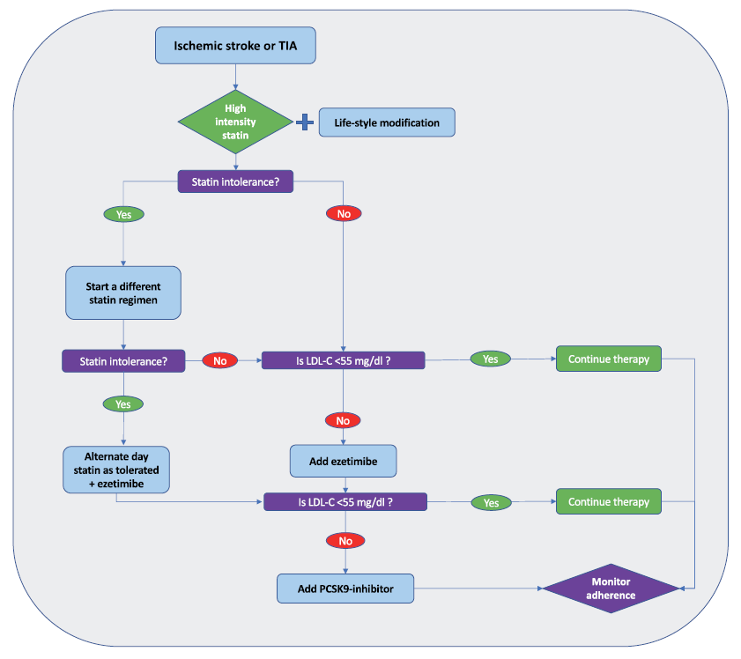
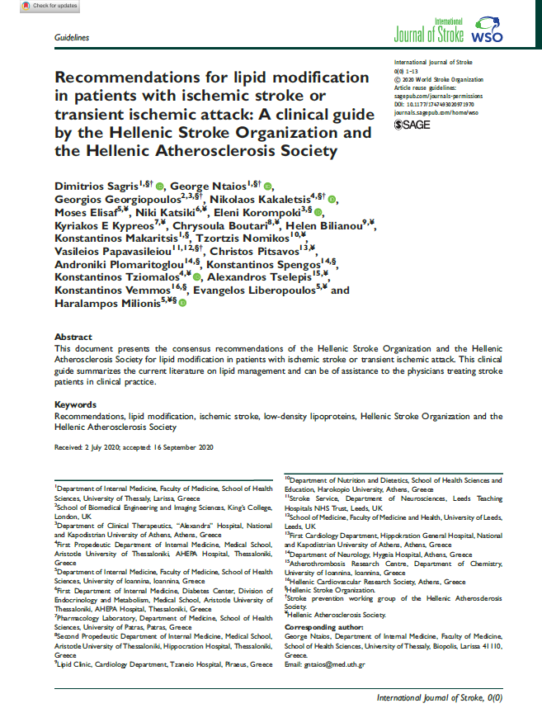
HSO/HAS Recommendations for lipid modification after stroke
Sagris, et al. International Journal of Stroke 2020
Notes:
So, our approach for LDL reduction in patients with stroke or transient ischemic attack is analogous to the strategy in coronary patients. That is, we start with a high-intensity statin. If the target of 55 is not achieved, we add ezetimibe. And if the target of 55 is still not achieved, we add evolocumab or alirocumab.

Slide 16
Take home messages
Non-stenotic atherosclerotic plaques & stroke risk
stronger association than initially considered
More frequent ipsilateral to stroke than contralateral
sophisticated imaging may identify high-risk plaques
Consider low-dose rivaroxaban & aspirin
LDL – the lower the better (<55mg/dl)

