Slide 1
Mitral valve anatomy
Στρατής Κατσιάνος
Ακαδημαικός υπότροφος ΓΠΚ

Slide 2
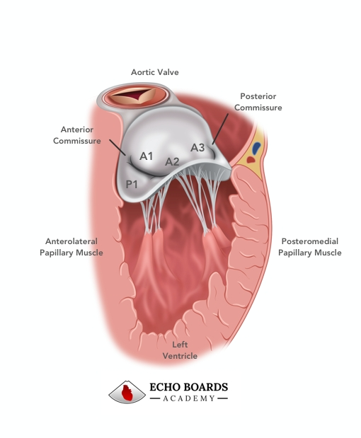
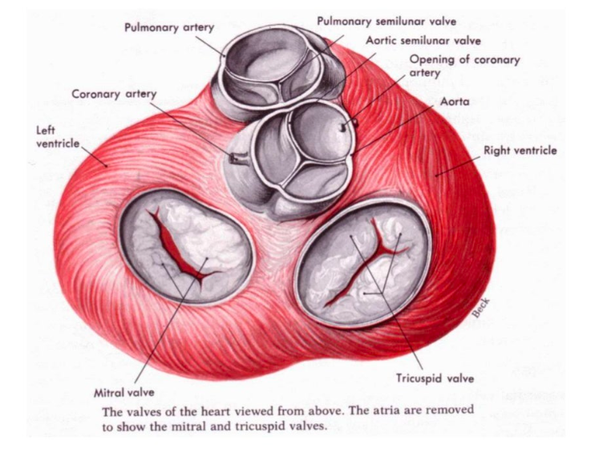
Mitral valve apparatus

Slide 3
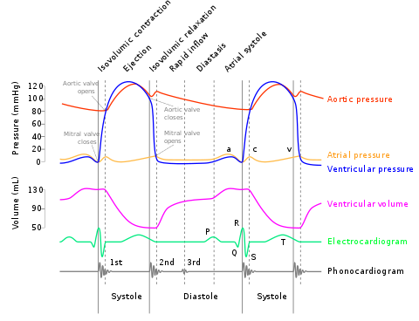
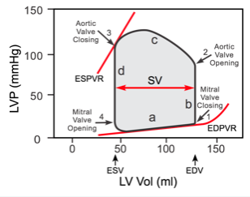
Cardiac cycle volume pressure loops

Slide 4
Components of mitral valve apparatus
Mitral valve annulus
Mitral leaflets with commissures
Chordae tendinae
Papillary muscles
Supporting LV wall

Slide 5
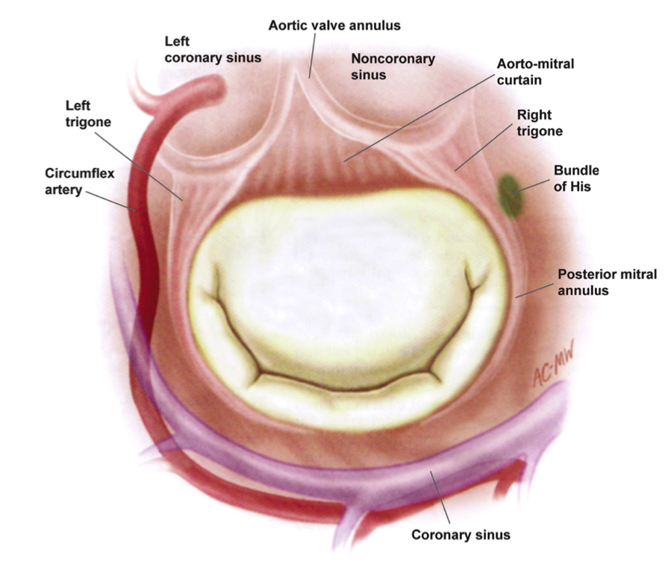
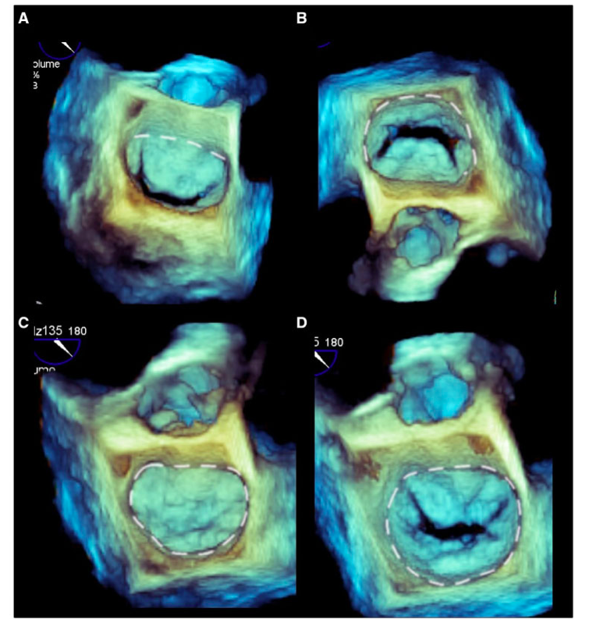
Mitral annulus
The hinge line attaching the mitral leaflets is commonly termed MA
Notes:
Anterior annulus, c-shaped posterior, d-shaped in systole, circular in diastole

Slide 6
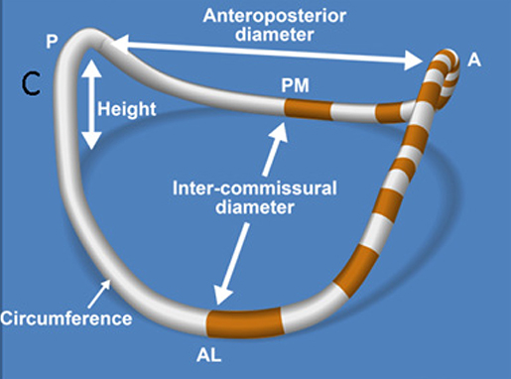
Saddle shaped mitral annulus
Normal mitral annulus changes over the cardiac cycle
Minimal variation throughout diastole
Early systole, AP contraction, folding across fixed intercommissural diameter
This contraction leads to accentuation of saddle-shape
Prevention of early systolic MR, even before LV pressure rises
Mitral annular area 10 cm²

Slide 7
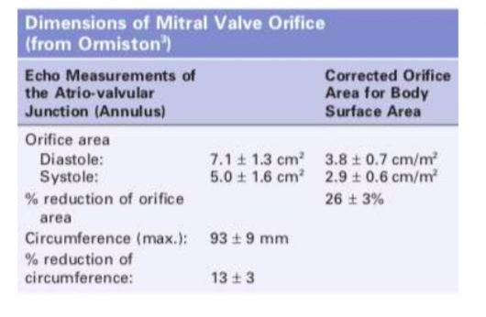

Slide 8
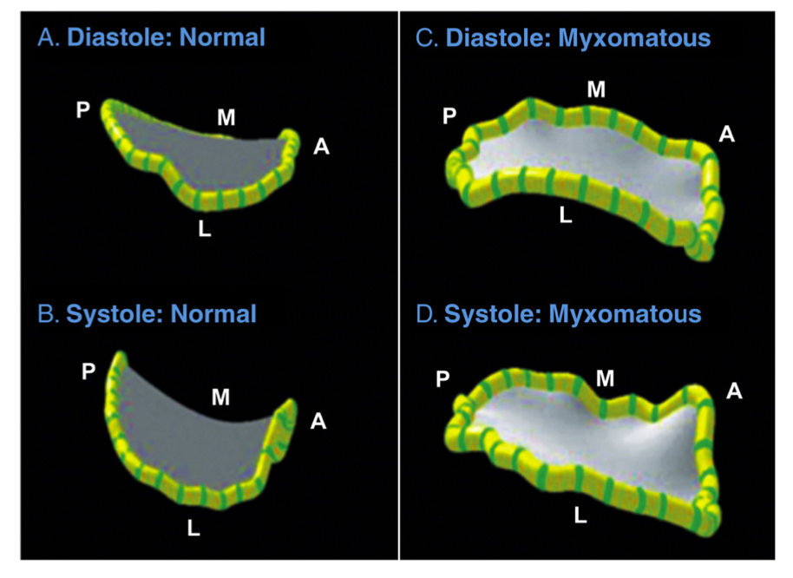
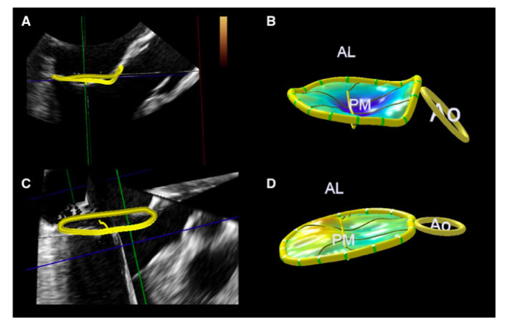
Mitral annulus abnormalities
PMR
FMR

Slide 9
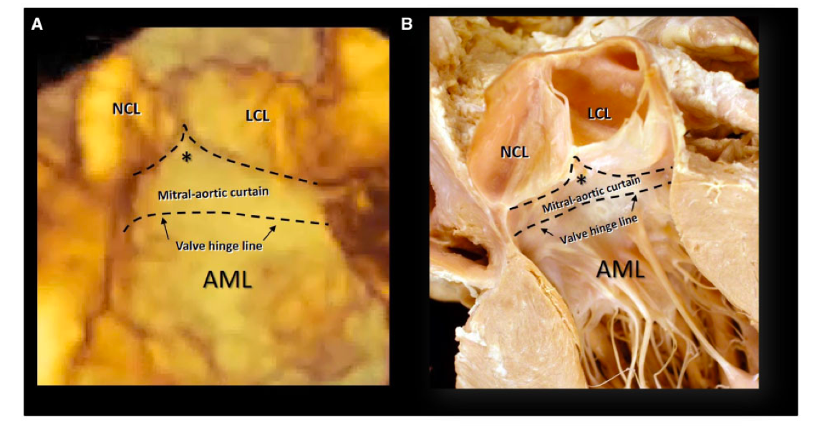
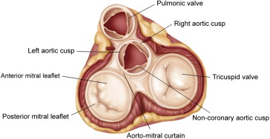
Aortic-mitral curtain
The right fibrous trigone -NCC
The left fibrous trigone – LCC
Dilatation most frequent in posterior annulus

Slide 10
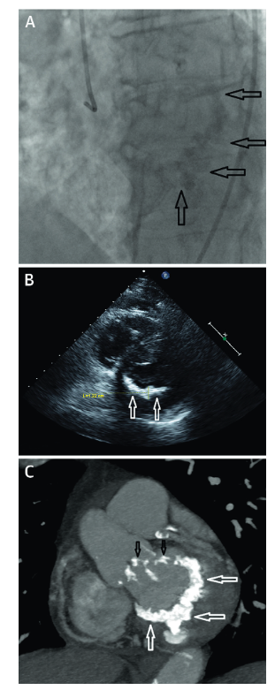
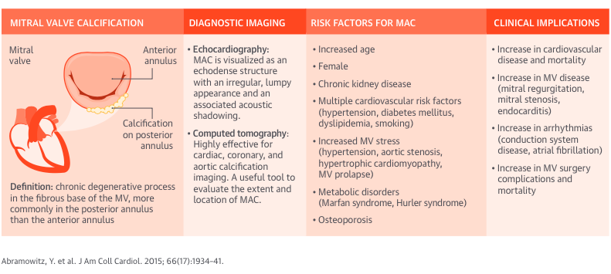
Mitral annulus calcification
Abramowitz et al. JACC 2015

Slide 11
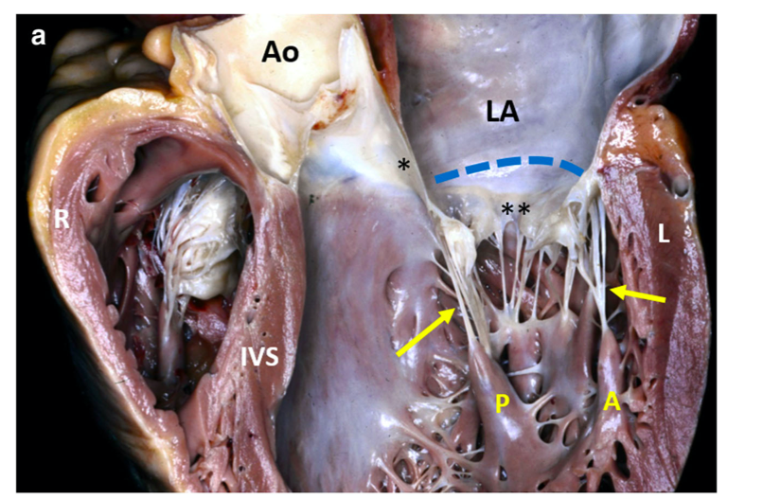
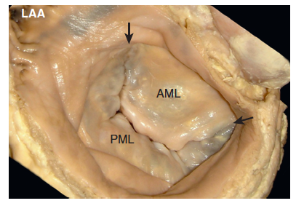
Mitral leaflets

Slide 12
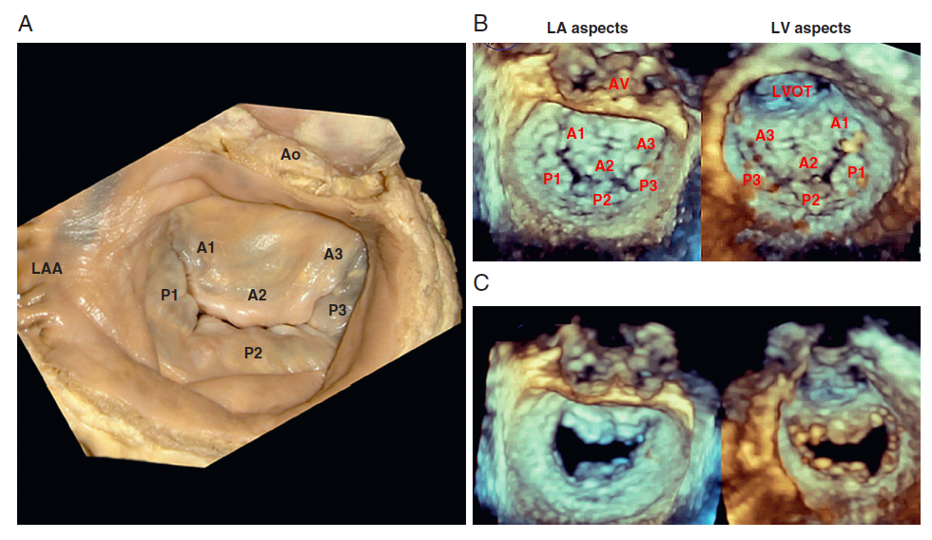
Surgical view- segmentation scallops

Slide 13
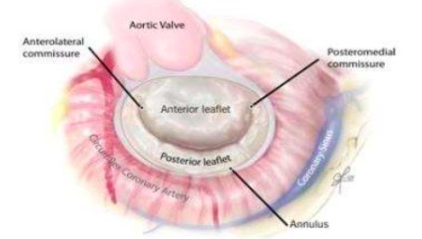
Mitral leaflets
AML
Narrower, 1/3 annular circumference
Longer than PML (18-24 mm)
Greater diastolic excursion into LV
Anchored to the aortic root
3 segments proposed by Carpentier (A1-lateral, A2-middle, A3-medial)
PML
2/3 annular circumference
Crescentic in shape,
Shorter than AML (12-14 mm)
3 segments proposed by Carpentier (P1-lateral, P2-middle, P3-medial)

Slide 14
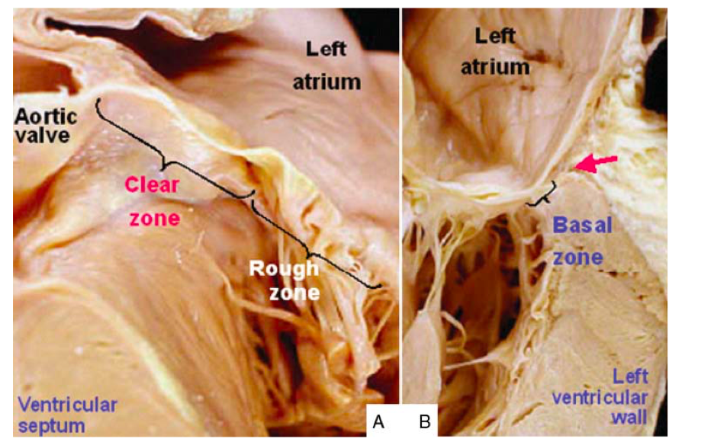
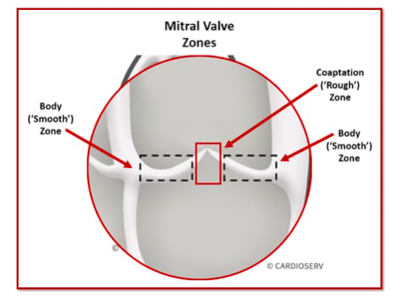
3 zones
Basal zone: area of connection to the AV junction
Thin central portion clear zone (smooth)
Thick rough zone at the free edge of the leaflet main area of chordae tendinae
Rough zone is irregular and thicker because of the numerous chordae attached to its ventricular side

Slide 15
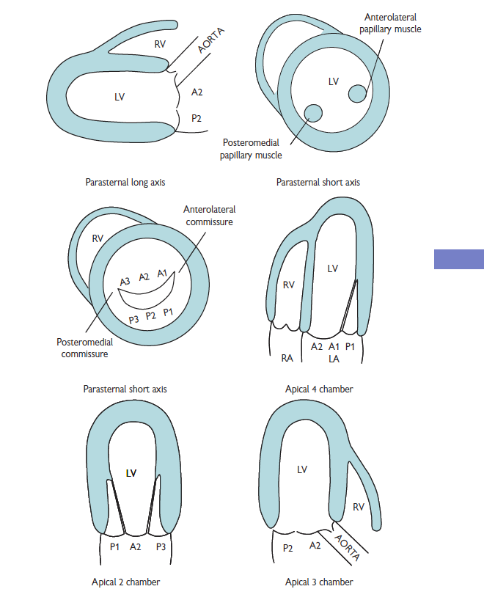
Scallops nomenclature transthoracic views

Slide 16
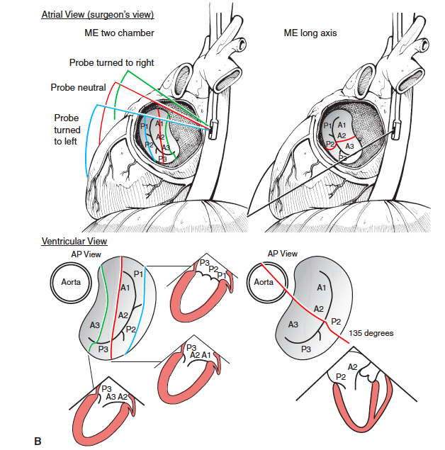
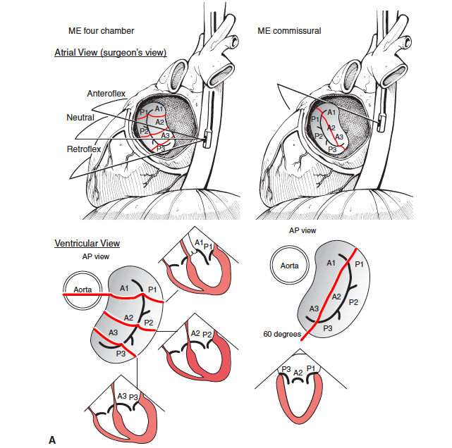

Slide 17
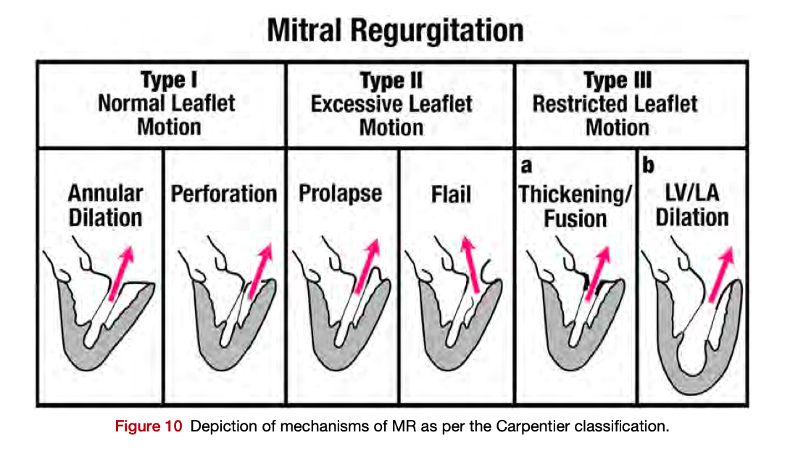
Carpentier classification

Slide 18
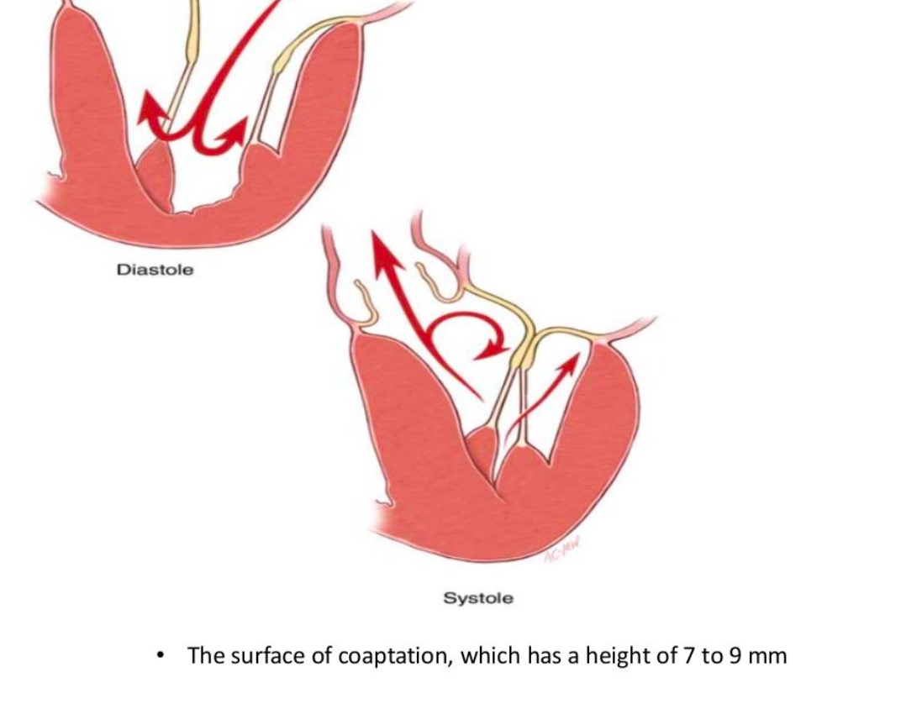
Commissures and coaptation line
Anterolateral and posteromedial
Zone of coaptation height of 7-9 mm
Height measured from atrial surface
Coaptation length and depth

Slide 19
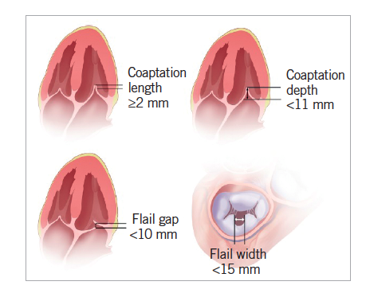
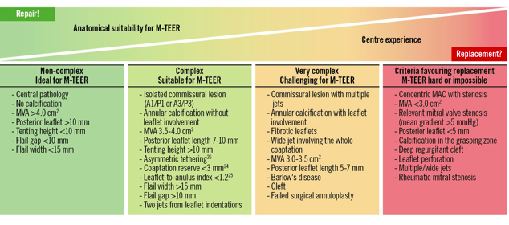
MitraClip Criteria
Praz F. et al. Eurointervention 2023

Slide 20
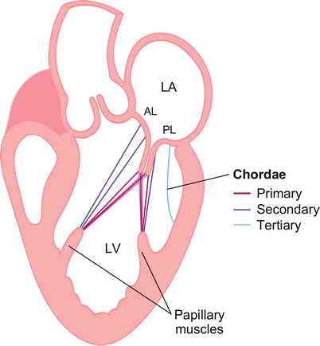
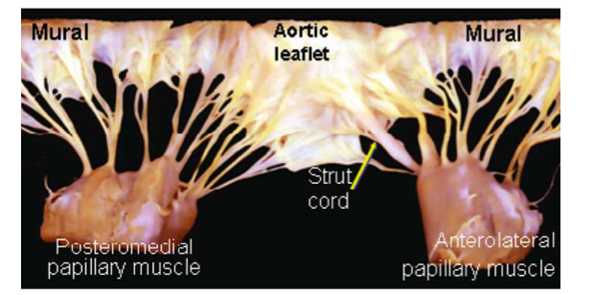
Chordae tendinae
Primary chords free edge of the rough zone of both leaflets
Secondary chords to the body of the leaflets
Tertiary chords attach directly to the ventricular wall, to PML
Papillary muscles provide chords to both leaflets

Slide 21
Commissural chordae
Chordae that insert into the interleaflet or commissural areas located at the junction of anterior and posterior leaflet
Two types
  Posteromedial
  Anterolateral
Shorter than the others and originate from the highest tip of papillary muscle

Slide 22
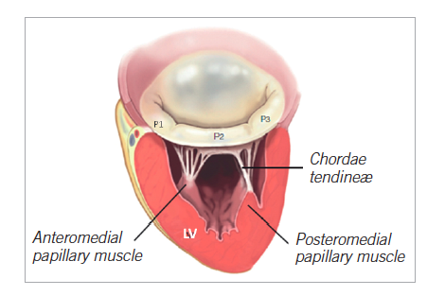
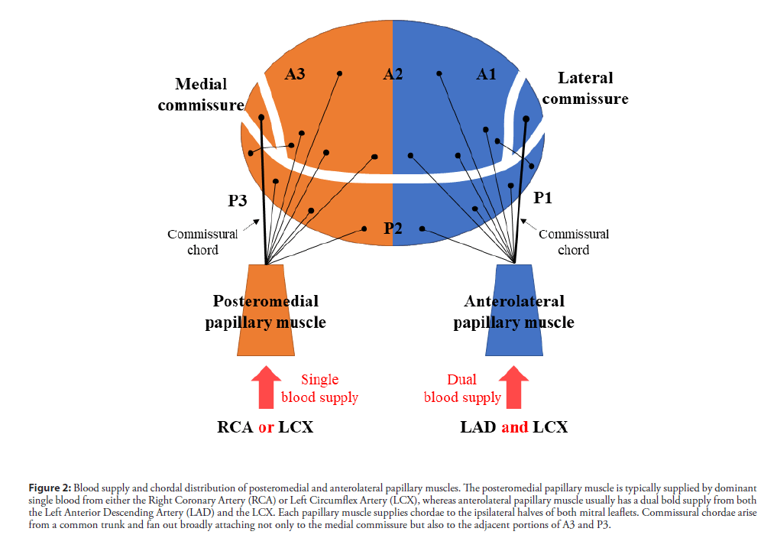
Papillary muscles

Slide 23
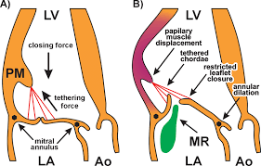
LV remodelling- displaced PM- FMR

Slide 24
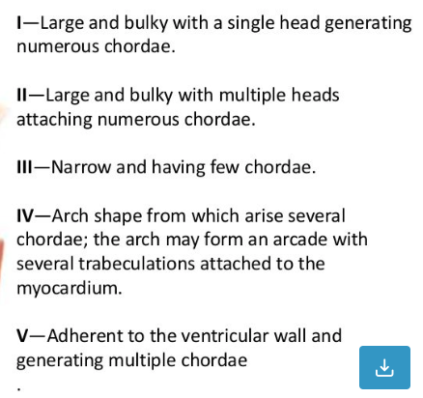
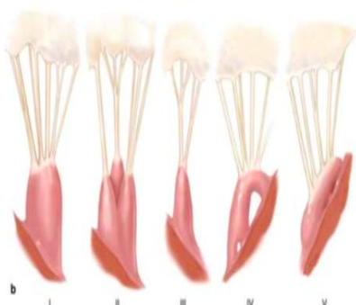
Papillary muscles

Slide 25
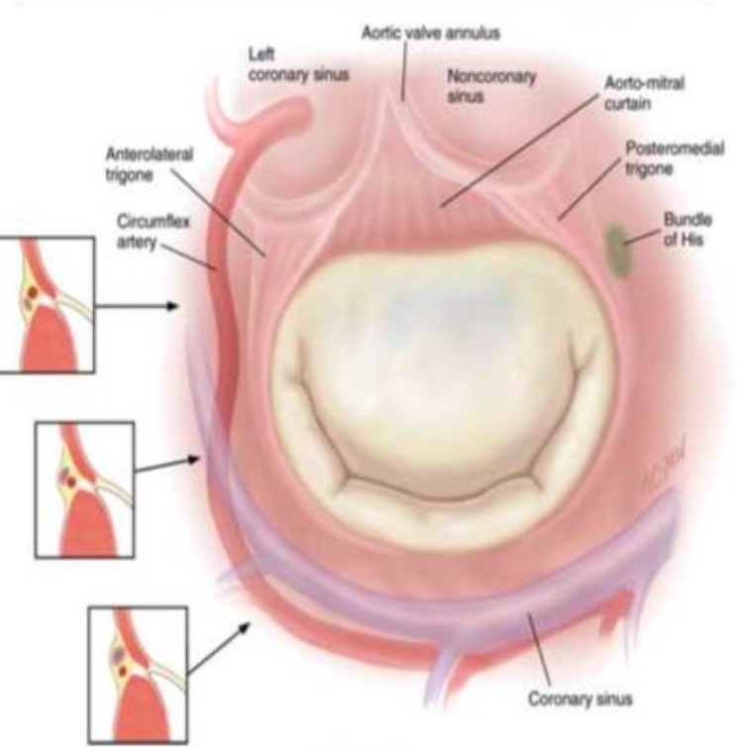
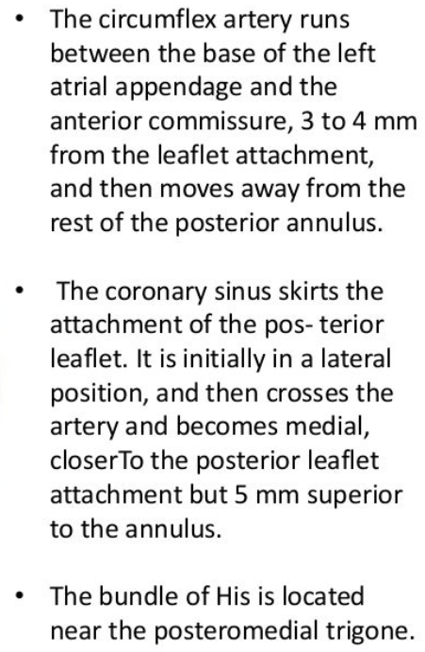

Slide 26
Left atrial wall
Left atrial myocardium extends over the proximal portion of the posterior leaflet
Left atrial enlargement can result in mitral regurgitation by affecting posterior leaflet
The anterior leaflet is not affected because of ist attachment to aortic root

