Slide 1
Αιμοδυναμική εκτίμηση και ενδοαγγειακή απεικόνιση στο αιμοδυναμικό εργαστήριο
Στρατής Κατσιάνος
Καρδιολογός, Επιστημονικός Συνεργάτης ΓΠΚ
Νοσοκομείο Σωτηρία

Slide 2
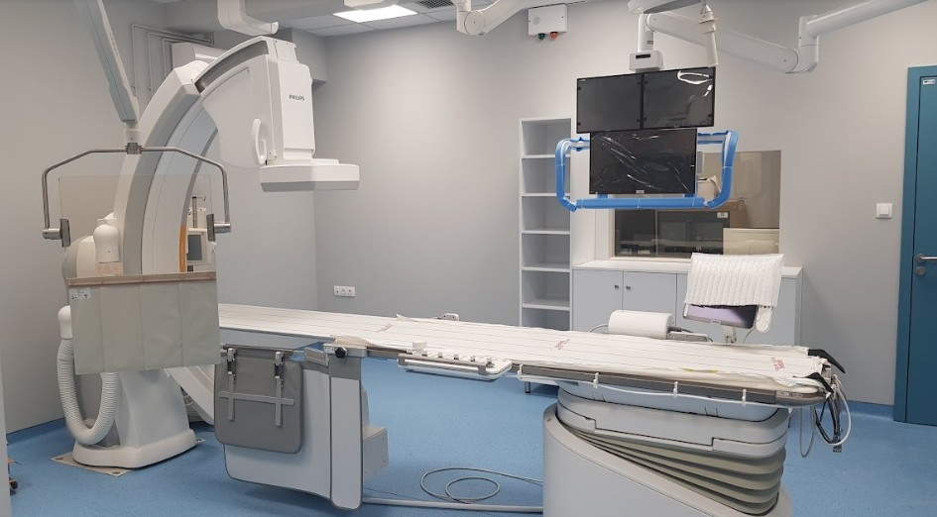
Step I

Slide 3
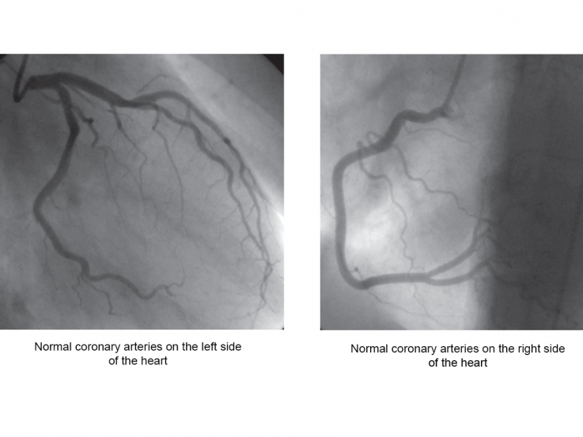

Slide 4
LIMITATIONS OF CORONARY ANGIOGRAPHY
– Interpretation is highly subjective
– CAG provides a 2–dimentional view of a 3-dimensional lumen.
– Severity of a stenotic lesion is reported in comparison to a normal reference segment . This is particularly fallacious in case of diffuse disease.
– CAG is a lumenography & does not provide information regarding vessel wall & extent of positive or negative remodeling.
– An eccentric stenosis has varying appearance of severity in different views. The length, size and severity of a lesion & its relationship with the vessel wall can affect the coronary flow.
– Several artifacts contribute to the disparity in interpretation like vessel foreshortening, overlapping vessels, calcification & contrast streaming.

Slide 5
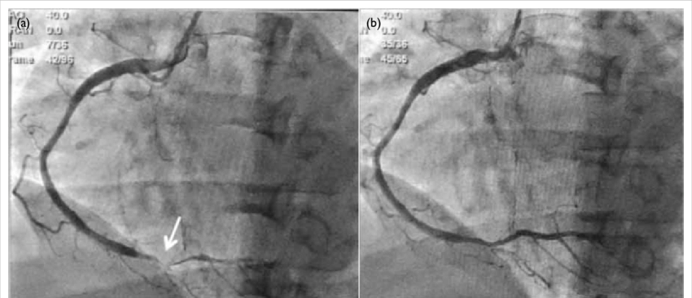

Slide 6
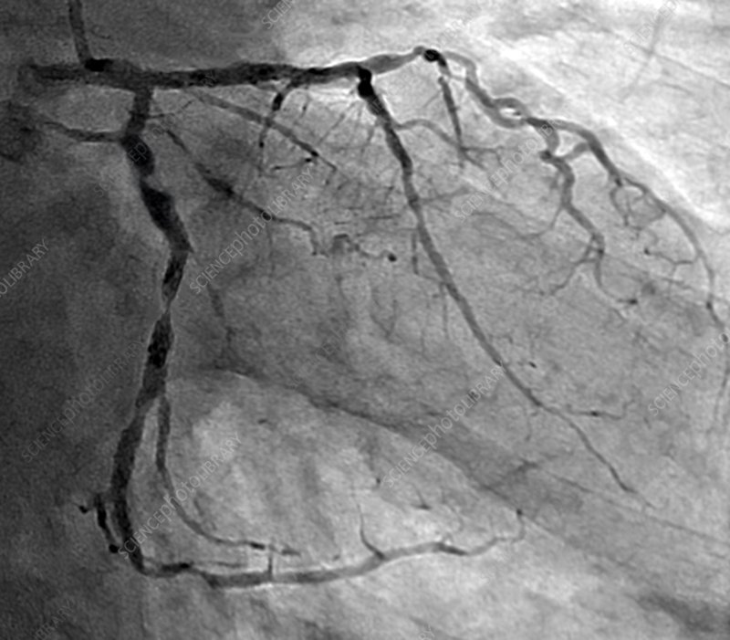

Slide 7
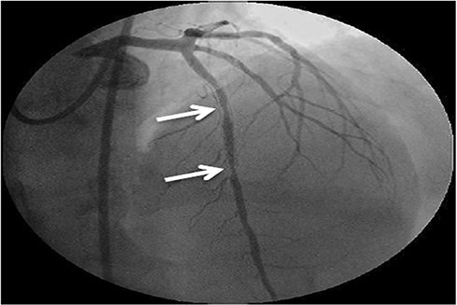

Slide 8
What happens when the lesion is not that clearly significant? Our tools….

Slide 9
The Coronary Pressure–Flow Relationships
Myocardial ischemia results from an imbalance between myocardial oxygen supply and demand.
Coronary blood flow provides the needed oxygen supply for any given myocardial oxygen demand and normally increases automatically from a resting level to a maximum level in response to increases in myocardial oxygen demand from exercise and neurohumoral or pharmacological hyperemic stimuli.
This increase from baseline to maximal flow has been termed coronary flow reserve (CFR).
Notes:
Η μυοκαρδιακή ισχαιμία προκύπτει από την ανισσοροπία προσφοράς και ζήτησης οξυγόνου, Η αμαιτική ροή στα στεφανιαία αυξάνει φυσιολογικά στην κόπωση και αυτή η αύξηση από το baseline sto max flow λέγεται

Slide 10
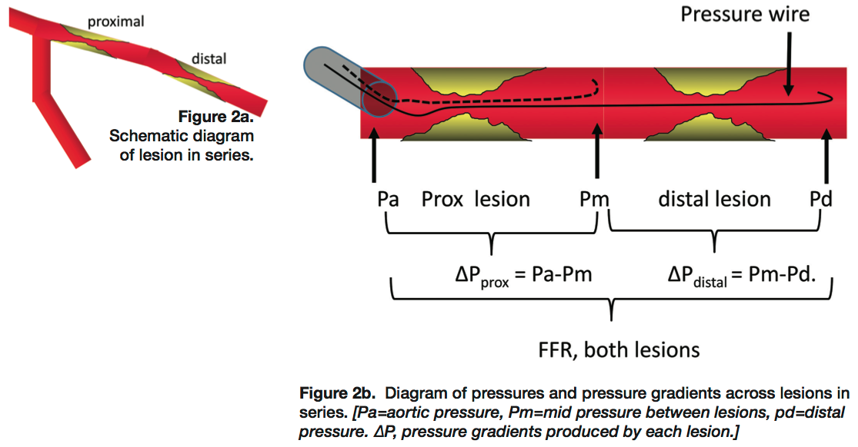
Fractional flow reserve (FFR) is a technique used in cardiac catheterization to measure pressure differences across a coronary artery stenosis. Fractional flow reserve (FFR) measurement involves determining the ratio between the maximum achievable blood flow in a diseased coronary artery and the theoretical maximum flow in a normal coronary artery to determine the likelihood that the stenosis impedes oxygen delivery to the heart muscle.
An FFR of 1.0 is widely accepted as normal. An FFR lower than 0.75-0.80 is generally considered to be associated with myocardial ischemia.
Indications for FFR measurement are as follows:
To determine the physiologic and hemodynamic significance of an angiographically intermediate coronary stenosis
To identify appropriate culprit lesion(s) in multivessel coronary artery disease (CAD)
To measure the functional importance of stenosis in the presence of distal collateral flow
To identify the precise location of a coronary lesion when the angiographic image is unclear
Notes:
Η εφεδρεία ροής είναι ο λόγος της ροής σε συνθήκες υπεραιμίας προς τη ροή σε συνθήκες ηρεμίας και ανάλογα με την τιμή του λόγου αυτού μια στένωση κρίνεται σημαντική ή όχι.

Slide 11
FFR is considered nowadays as a gold standard to assess whether any particular stenosis is responsible for inducible ischemia.
Decision making for coronary percutaneous intervention (PCI) guided by FFR is associated with favorable clinical outcomes compared with angiography-guided PCI.
FFR is easy to measure in the catheterization laboratory with an average of 7 minutes added to the case at a cost of 2.8 mSv of effective radiation dose and 35 ml of contrast medium

Slide 12
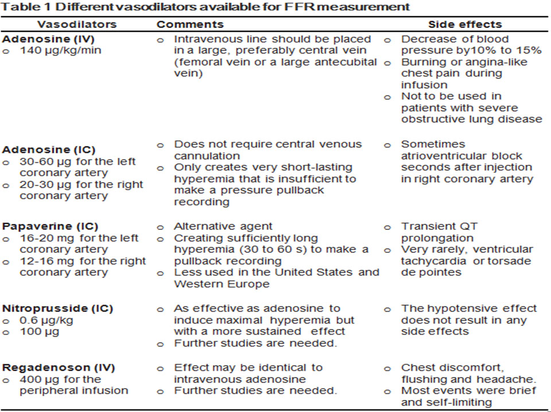
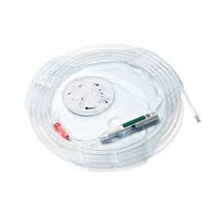

Slide 13
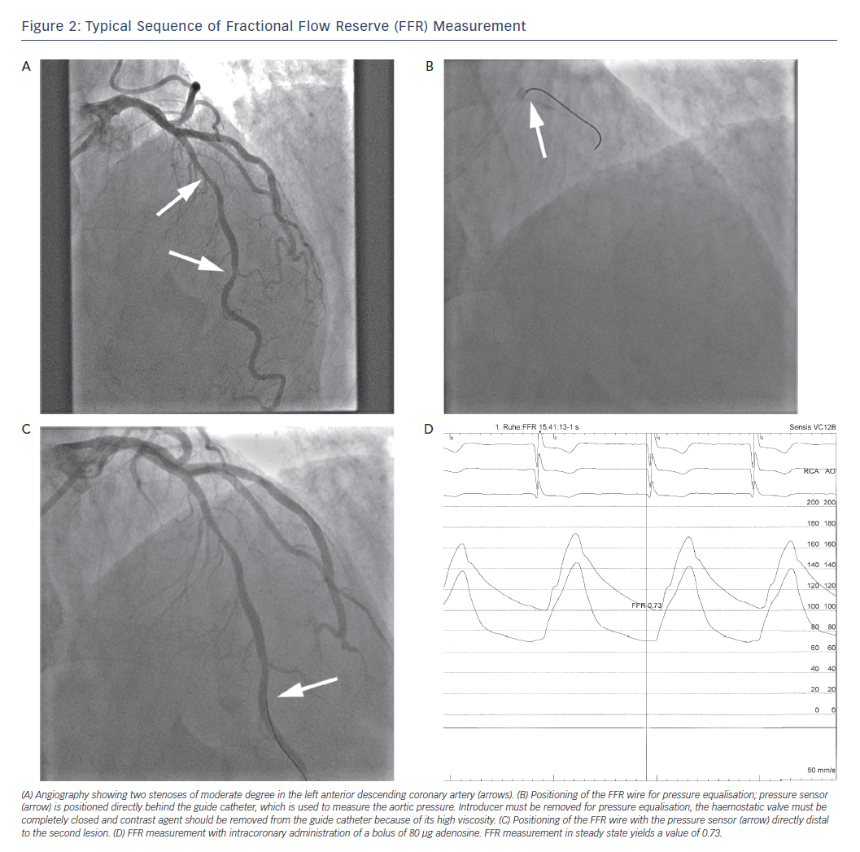

Slide 14
❗️An FFR value of 0.6 means that the maximum myocardial flow across the stenosis is only 60% of what it should be without the stenosis.
❗️ An FFR of 0.9 after percutaneous coronary intervention (PCI) means that the maximum flow to the myocardium is 90% that of a completely normal vessel.
❗️ An FFR 0.75 is associated with inducible ischemia (specificity, 100%), whereas a value 0.80 indicates absence of inducible ischemia in the majority of patients (sensitivity, 90%).
Notes:
Μια τιμή ΦΦΡ 0.6 σημαίνει ότι η μαχ καρδιακή ροή που περνάει από τη βλάβη είναι 60% ενώ ένα ΦΦΡ 0.9 μετα από PCI σημαίνει ροή στο μυοκάρδιο 90%. ΦΦΡ 0.75 σχετίζεται με αναστρέψιμη ισχεμία ενώ 0.8 δεν υπάρχει ένδειξη αναστρέψιμη ισχαιμία/

Slide 15
Stable angina FFR assessment
FFR is an evidence-based diagnostic test of the physiological significance of a coronary artery stenosis.
FFR is a pressure-derived index of the maximal achievable myocardial blood flow in the presence of an epicardial coronary stenosis as a ratio to maximum achievable flow if that artery were normal.
Available evidence suggests that peripheral and central venous routes of adenosine administration are associated with similar minimum FFR values.
In stable coronary artery disease (CAD), the evidence base supports revascularization of lesions with an FFR of ≤0.80, whereas CAD associated with an FFR of >0.80 can be managed medically.
There is prognostic importance of the FFR value (as opposed to an FFR binary cut-off value), and patients who have a low-normal FFR value, i.e. 0.81–0.85, have a higher likelihood of future adverse cardiac events compared with patients with a near normal FFR value, i.e. 0.96–1.0.

Slide 16
ACS and FFR assessment
In the early phase after ST segment elevated myocardial infarction (STEMI), severe microvascular impairment (no reflow, stunning, inflammation) may be present. A low FFR still indicates hemodynamic significance of the residual stenosis, but high FFR does not necessarily exclude this. Therefore, pressure-derived FFR should not be used for the culprit vessel during the acute phase (less than 5 days) of a STEMI.
After treatment of the culprit lesion, FFR analysis of other stenoses (when present) can be helpful and indicate the need for additional treatment, preventing repeated invasive procedures later on and thereby reducing costs.
In patients with prior MI (>5 days), the classical 0.75 to 0.80 threshold value could be used as usual to indicate residual ischemia of the infarct-relate or remote arteries.
In the setting of unstable angina or non-STEMI, FFR can be used if the culprit lesion is unclear or if lesions are present in multiple vessels. It has been shown that using coronary pressure measurement in unstable angina or non-STEMI, not only results in a favorable outcome, but is also cost-effective.

Slide 17
Is post interventional FFR valid?
FFR values >0.9 after stent implantation are correlated with better outcomes and a reduced need for repeat revascularization. Normalization of FFR after stent placement (thereby restoring normal conductance of the artery) is accompanied by a restenosis rate of <5% at 6-month follow-up, with a strong inverse correlation between poststent FFR and event rate.
So far, no data are available to clarify what should be done in case of a suboptimal postinterventional FFR. The following solutions may be reasonable:
❗️Intravascular ultrasound or optical coherence tomography to study stent deployment, then post dilation or not
❗️The hyperemic pressure pull-back recording to analyze the extent and significance of residual disease proximal or distal to the stent, then stent or not
❗️Aggressive secondary prevention

Slide 18
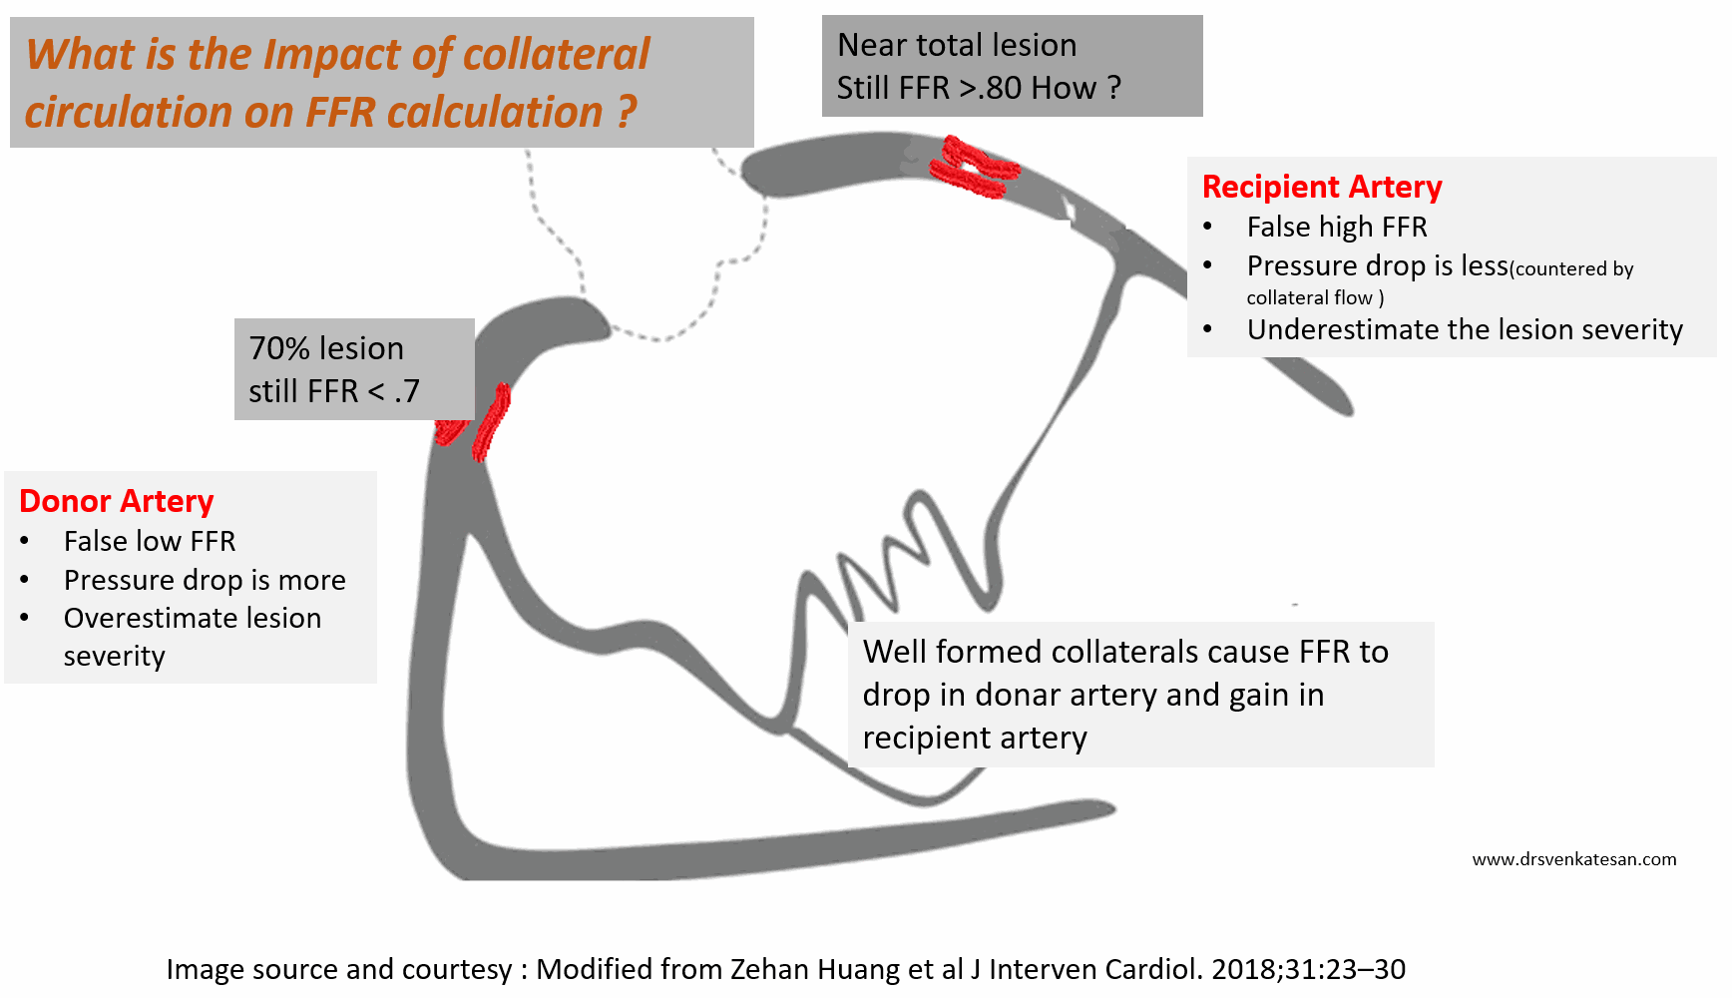
Be carefull…
FFR is artificially low in donar RCA (<.75) and makes an insignificant lesion as significant ( ie false positive) . Meanwhile, in the recipient artery LAD FFR is artificially high, and give a false negative result, underestimating the severity

Slide 19
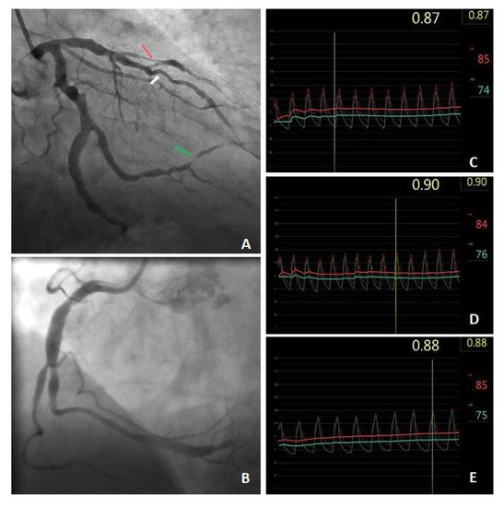
Slow flow within the ectatically dilated segments of the coronary arteries and the presence of significant atherosclerotic stenosis increase the risk of myocardial ischemia.
In this case, the FFR value is limited due to possible microcirculation disturbances and measurement errors caused by abnormal blood flow within the coronary artery ectasias.

Slide 20
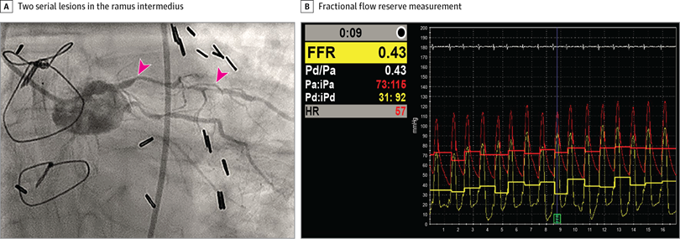
More than one lesions….
The most practical way to assess serial lesions involves two steps:
Step 1. After passing the pressure wire beyond the last lesion, measure the FFR (total) across all lesions with IV adenosine in standard fashion. For example, if the FFR is 0.84, then none of the lesions would need treatment and nothing further needs to be done.
Step 2. If the summed FFR in step 1 is < 0.80, then perform a pressure pull back during IV adenosine hyperemia.
Treatment of the most severely narrowed lesion is then determined by which of the lesions produces the biggest pressure gradient .
Do NOT measure separate lesion FFR values; it is the pressure gradient (ΔP) that will be used to decide which lesion to treat first.
After stenting the lesion with the largest ΔP, reassess the remaining lesion(s), repeating either step 1 or step 2, depending on how many lesions remain. If there are more than two lesions and FFR remains abnormal, then stent the lesion with the next largest ΔP.

Slide 21
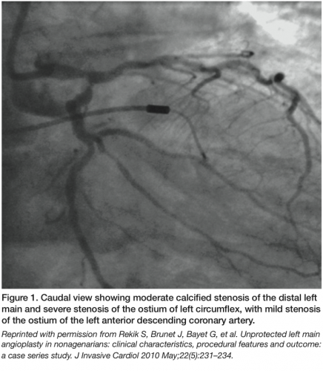
Left-Main Coronary Artery Disease • Left main coronary artery poses certain challenges which make the interpretation of CAG & severity of stenosis difficult.
– Greater inter-observer variability
– Under-estimation of functional significance since it supplies a large myocardial territory
– Diffuse atherosclerosis in a short LMCA results in absence of a reference segment to judge the significance of a lesion
– Spilling of contrast medium in to the aorta
– Overlapping the catheter with the LMCA
– Non – invasive testing may lead to false negative results since reduced tracer uptake in all vascular territories leading to balanced ischemia.
– FFR has been found to be safe in guiding LMCA revascularisation in several studies & is associated with improved outcomes.

Slide 22
Special case of serial lesions: The left main stenosis with LAD or LCx disease
An isolated left main narrowing with no LAD, LCx, or RCA stenoses reflects the physiologic significance of just the left main narrowing. However, when there is a significant lesion in either the LAD or the LCx, the apparent FFR of the left main would be higher than otherwise in the absence of a downstream lesion, because the myocardial flow bed is now smaller, flow is less, and FFR higher.
A new situation exists when there is left main narrowing plus LAD stenosis. The presence of the LAD lesion could produce a higher left main FFR (from 0.78 to 0.82, hypothetically) because the left main bed is now decreased due to the LAD stenosis. The same considerations would apply in the setting of a LCx narrowing. The left main FFR alone cannot be accurately measured when there are significant downstream serial lesions. If the LAD and LCx are hemodynamically insignificant, the left main FFR will be accurate.
For the left main stenoses with downstream additional disease, the left main FFR will be accurate if the summed FFR (left main + LAD) is > 0.60 and you can measure the left main FFR with the wire in the unobstructed CFX (and vice versa).
Notes:
Οταν υπάρχει βλάβη στο στέλεχοσ χωρίσ βλάβη σε ΛΑΔ και περισπωμενη οκ. Όταν υπάρχει βλάβη σε ΛΑΔ τοτε το ΦΦΡ στο στέλχοσ θα είναι ακριβές αν το άθροισμα του ΦΦΡ ΛΜ και ΛΑΔ είναι μεγαλύτερο από 0.6.

Slide 23
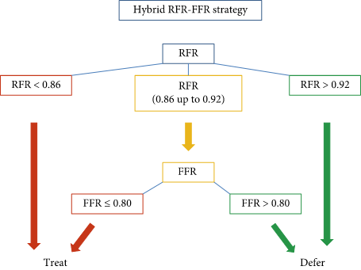
The resting full-cycle ratio (RFR) is a new NHPR that assesses the hemodynamic significance of coronary stenoses, identifying the lowest distal arterial pressure (Pd)/arterial pressure (Pa) ratio over the entire cardiac cycle.
In contrast to other NHPRs, its measurements would be independent of the morphology of the pressure waves, the electrical signal, and the phasic variations in microcirculatory resistance
Notes:
Το RFR αξιολογεί την αιμοδυναμική σημαντικότητα μιασ βλάβης βρίσκοντας τον λογο Pd/PA σε όλο τον καρδιακό κύκλο.

Slide 24
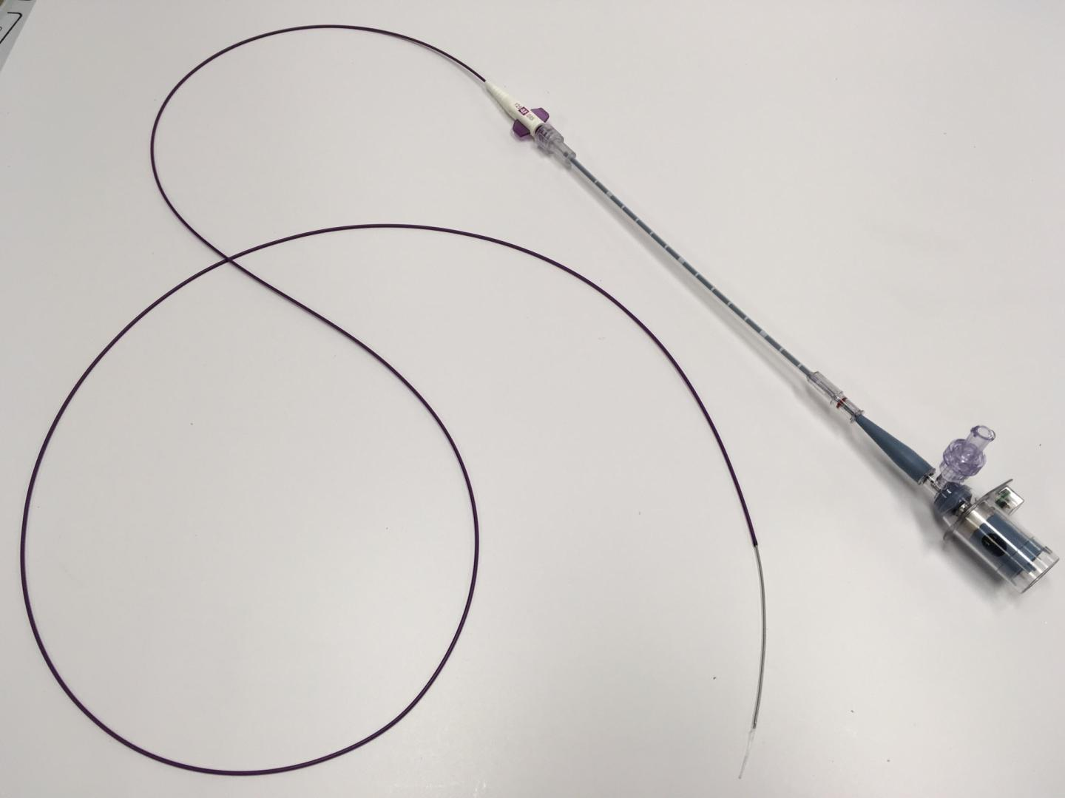
IVUS
Provides intravascular images of the coronary arteries
Has played a critical role
-coronary atherosclerosis pathophysiology
-diagnostic and therapeutic strategies for various vascular pathologies
-integral role in the evolution of interventional cardiology

Slide 25
Indications in CAD
Arterial wall thickness
Atheroma detection, assessment and characterization
Calcium content
Aneurysm assessment
In stent restenosis

Slide 26
IVUS in PCI
Plan interventional strategy and optimize stent deployment
Find Reference lumen dimensions and lesion length for appropriate stenting sizing
Identify superficial calcium which can lead to pre stent rotational atherectomy
Assess thrombus burden (Operators may alter anticoagulant therapies or consider mechanical thrombectomy)
Post stent IVUS assessment may detect complications of PCI and suboptimal stent deployment

Slide 27
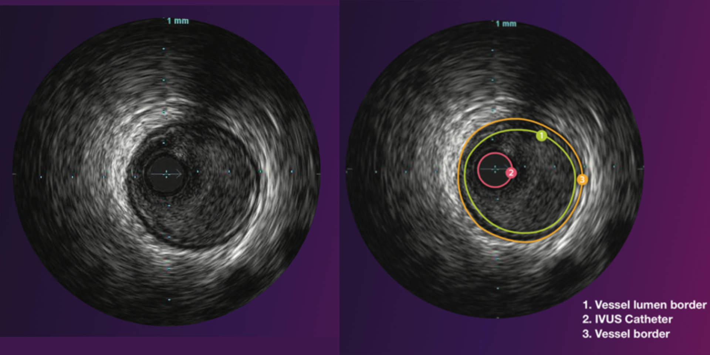
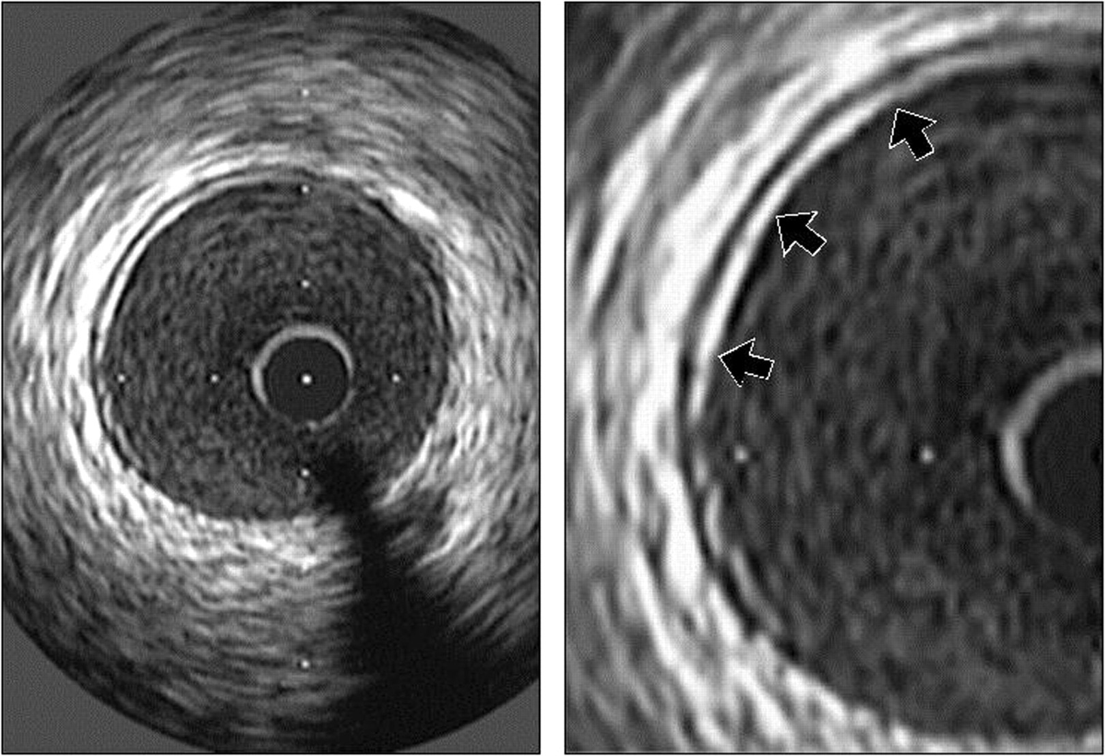
Normal Arterial Appearance
• A standard intravascular ultrasound image consists of three main components: catheter, lumen, and arterial wall.
An ultrasound reflection is generated at a tissue interface if an abrupt change in acoustic impedance occurs.

Slide 28
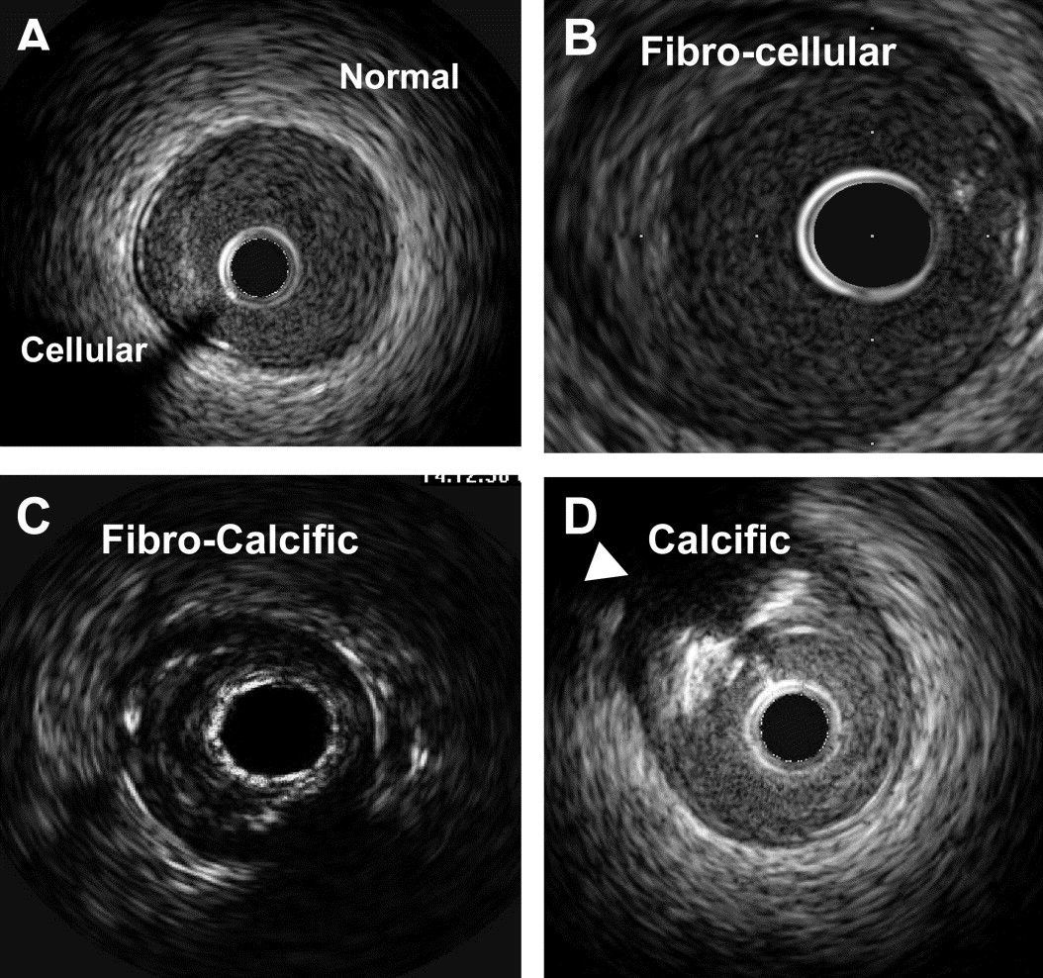

Slide 29
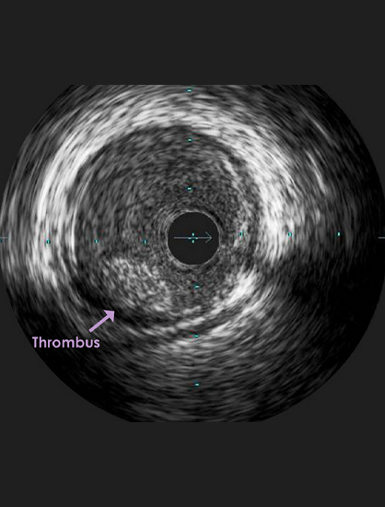

Slide 30
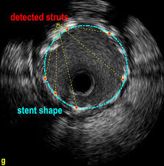
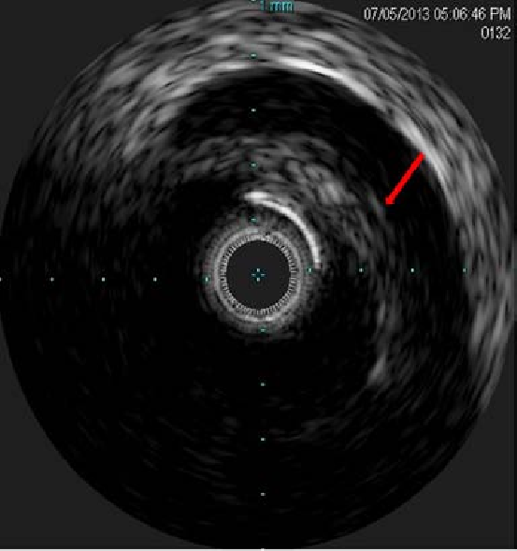

Slide 31
Evaluating Dissections And Other Complications After Intervention
Intravascular ultrasound is commonly used to detect and direct the treatment of dissections and other complications after intervention.
• IVUS allows for detailed classification of dissection and assessing the severity of the dissection.
• Important characteristics of a dissection are identified distinctly by intravascular ultrasonography such as- – Presence of a false lumen,
– Identification of mobile flap(s),
– Presence of calcium at the dissection border,
– Dissections in close proximity to stent edges

Slide 32
Unusual Lesion Morphology
• Intravascular ultrasonography can be used to characterize unusual lesion morphology, such as aneurysms, pseudo-aneurysms, and true versus false lumens.
Ambiguous lesions
• IVUS lends itself to the identification of technically difficult lesions, such as intermediate lesions of uncertain stenotic severity or ostial stenosis and disease at branching sites.
• IVUS can also be helpful for delineating lesions involving tortuous vessels and left main stem lesions.
• IVUS has a particularly important role in defining areas with intraluminal filling defects, angiographically hazy lesions, sites with plaque rupture, and lesions with local flow disturbances.
• IVUS can be used to determine vein graft morphology in situ as well.

Slide 33
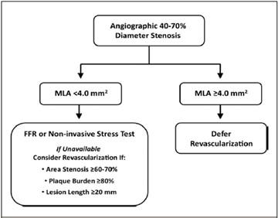
IVUS is valuable in defining moderate CL severity (30 to 70%) in left main (LM) or non-left main (NLM) coronaries using minimum luminal area (MLA) of ≤5.9 and ≤4 mm², respectively.

Slide 34
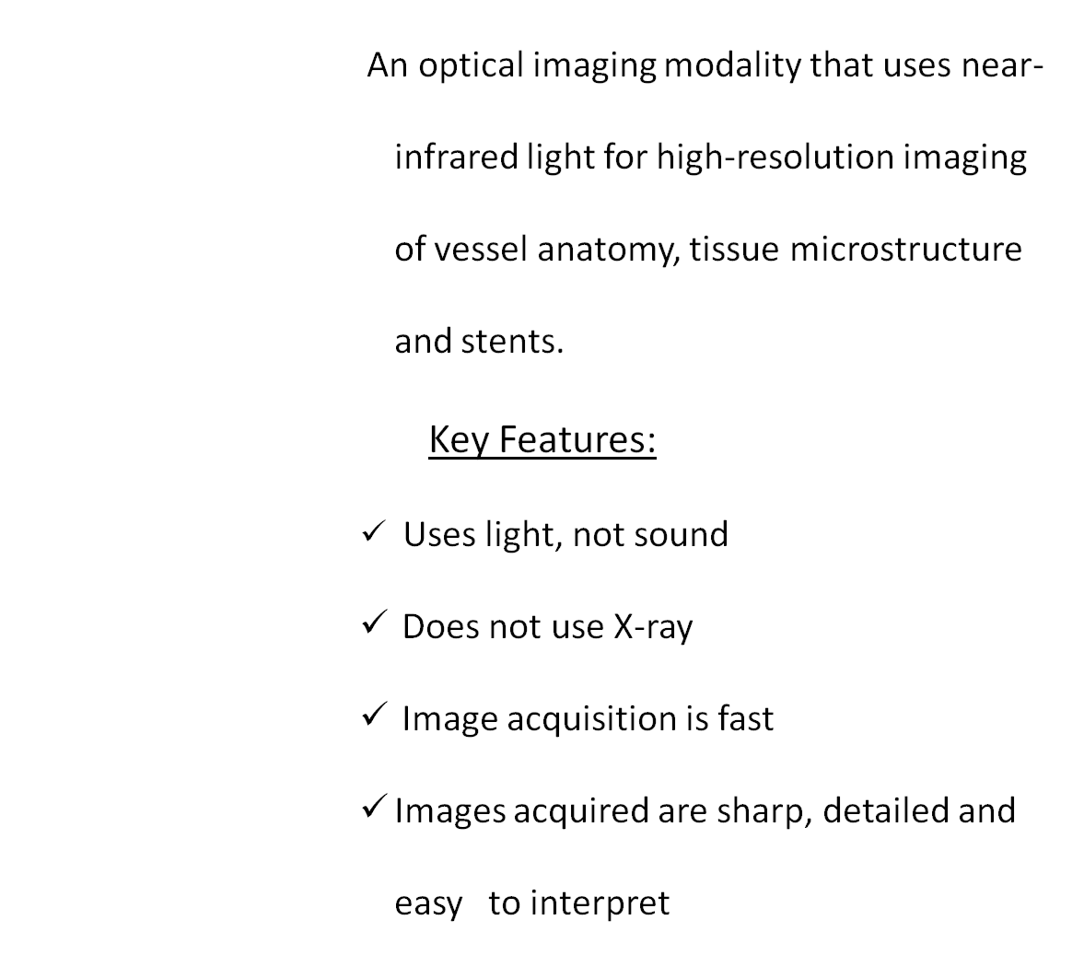
OCT in Interventional Cardiology

Slide 35
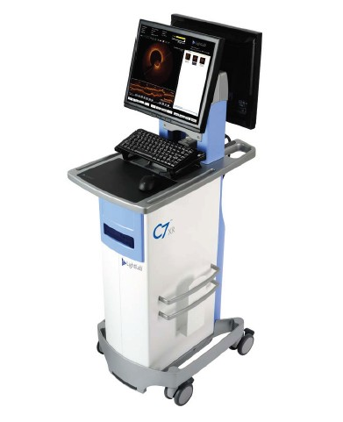
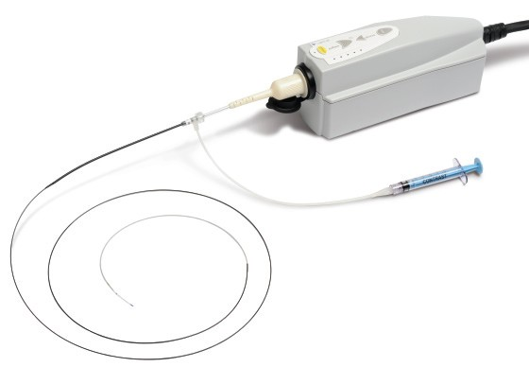
OCT Technology from St. Jude Medical
• Console
Rapid exchange (Rx) imaging catheter
Contrast flush; balloon occlusion not required
Fast image acquisition: 7.5cm pullback in 2.5 sec

Slide 36
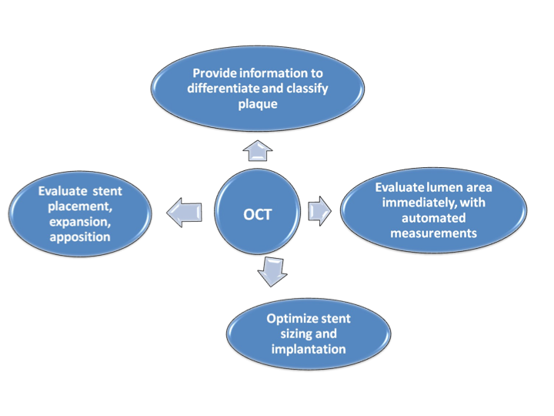

Slide 37
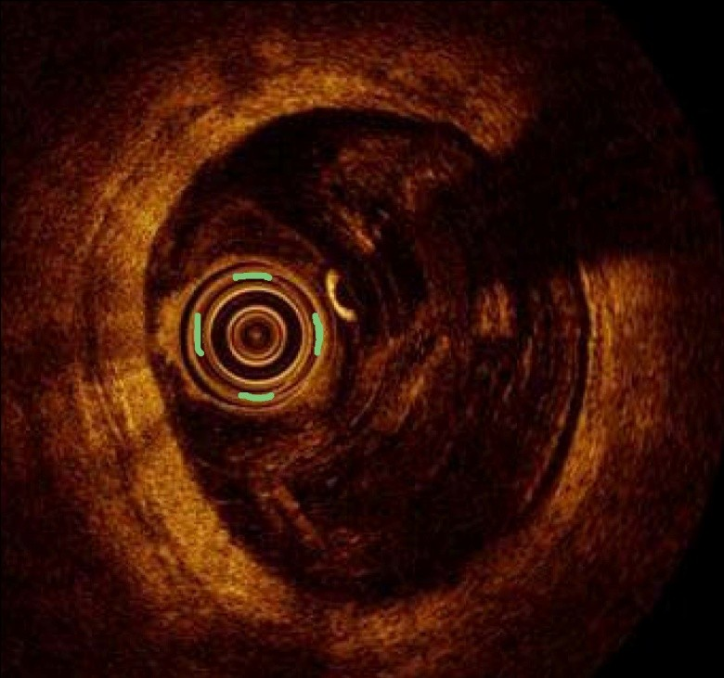
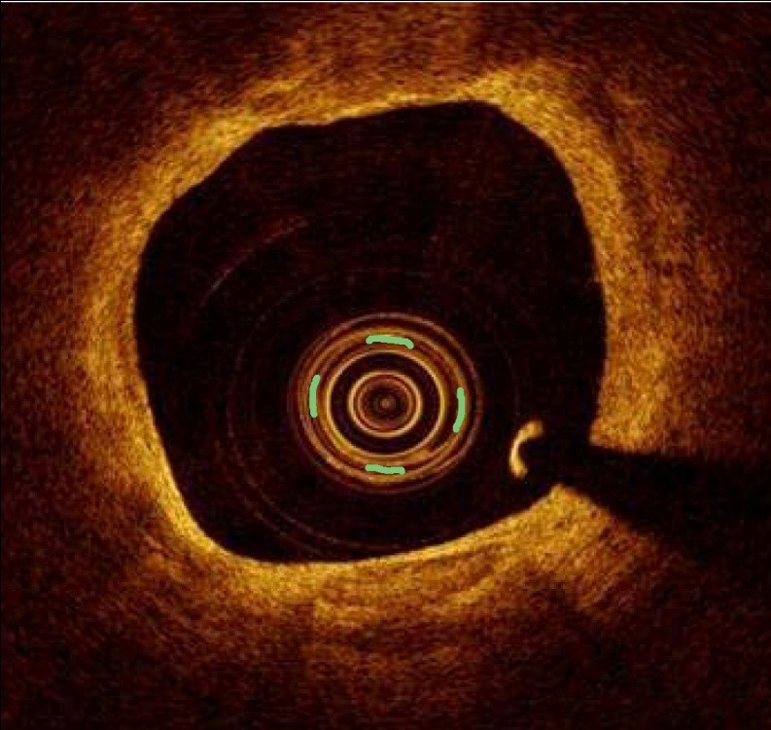
Findings of OCT
Detect the Thrombus , not detected with Angio – Image
Rapture Plaque
Differentiate between the Red and white Thrombus
Stent Thrombosis and Malappositon

Slide 38
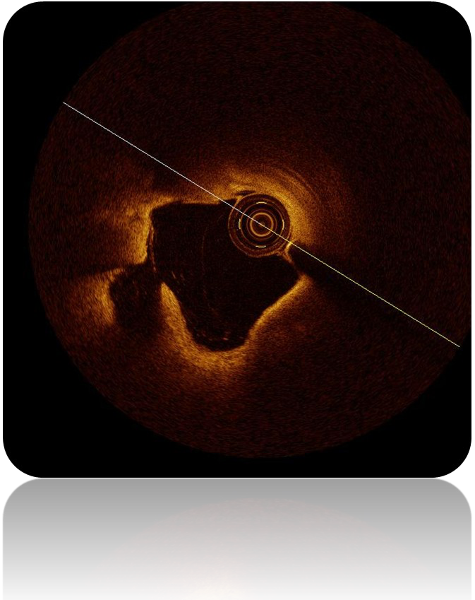
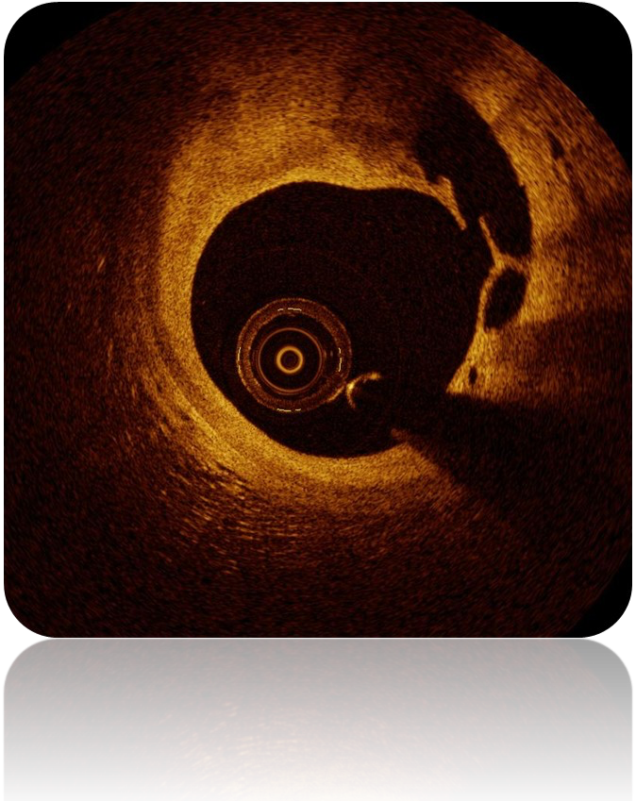

Plaque Rapture

Slide 39
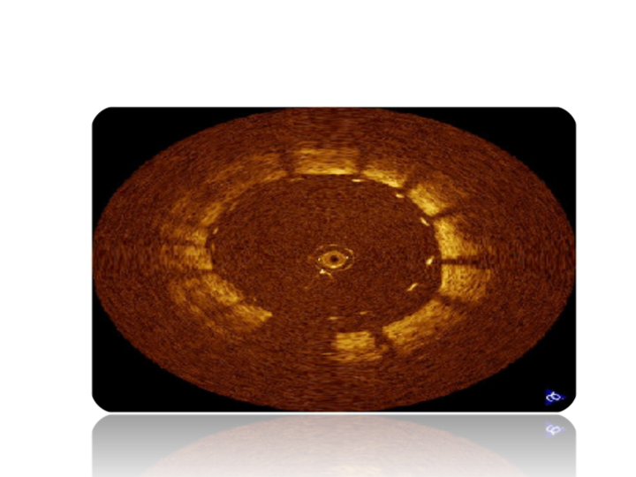
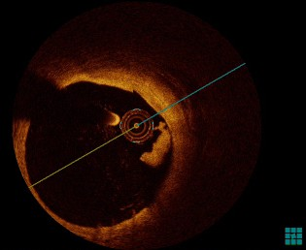
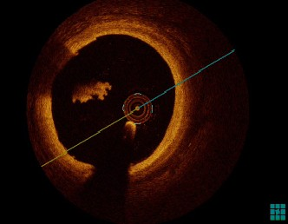

Thrombus Stent Malposition

Slide 40
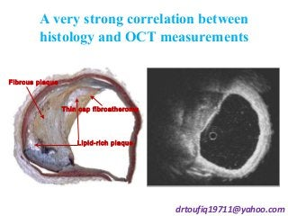
Progress in coronary image
Coronary angiography CAG
Intravascular ultrasound IVUS
Optical coherence tomography OCT
Ivus-guided stent implantation has showed to improve the outcomes with reduction of restenosis and thrombosis
The most prominent feature of OCT is its high resolution of 10μm. It enables real-time, full tomographic, in-vivo of vessel visualization mainly used in the following microstructure:
Fibrous cap and evaluate vulnerable plaque
Strut apposition and stent tissue coverage

Slide 41
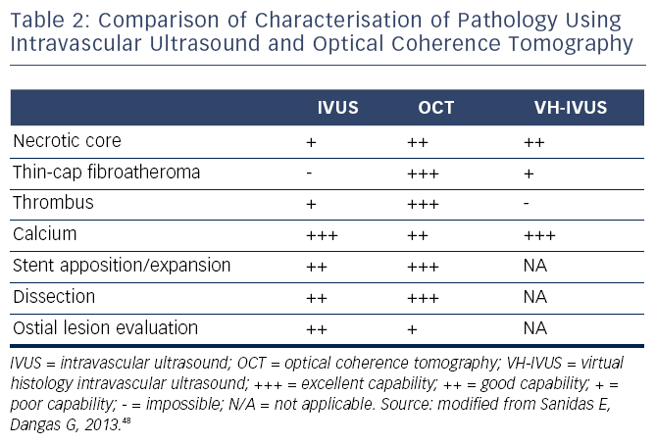

Slide 42

We have tools…
We need to learn to use them and be part of our daily practice.

