Slide 1
"Σταδιοποίηση κινδύνου και διαχείριση ασθενή μετά από έμφραγμα μυοκαρδίου"
ΚΑΡΔΙΟΜΕΤΑΒΟΛΙΚΗ ΙΑΤΡΙΚΗ
ΓΕΩΡΓΙΟΣ ΜΑΚΑΒΟΣ MD, PhD
KΑΡΔΙΟΛΟΓΟΣ, ΕΠΙΜΕΛΗΤΗΣ Α΄
Γ’ΠΑΝ.ΚΑΡΔΙΟΛΟΓΙΚΗ ΕΚΠΑ
«ΣΩΤΗΡΙΑ»

Slide 2
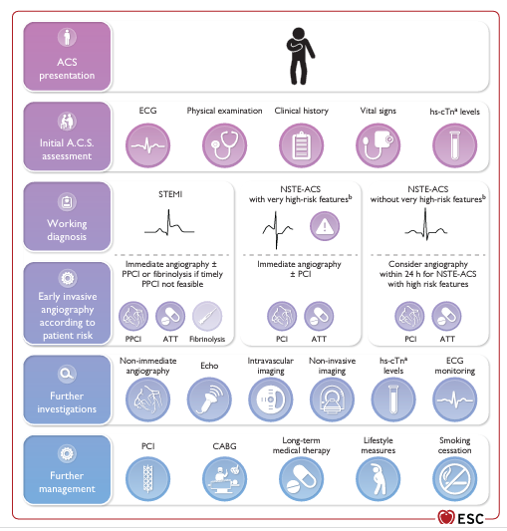
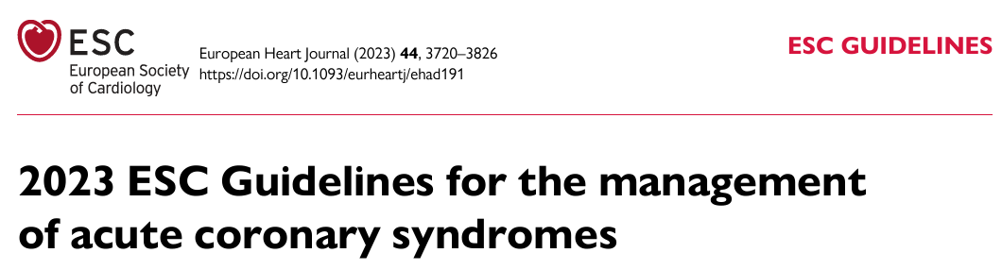
Byrne et al. European Heart Journal (2023) 44, 3720–3826

Slide 3
CLINICAL RISK ASSESSMENT POST MI
All patients post ACS (in particular, patients with STEMI) should have an early assessment of short-term risk.
extent of myocardial damage
achievement of successful reperfusion
presence of clinical markers of high risk of further events (i.e. older age, tachycardia, hypotension, Killip class >I, anterior MI, previous MI, elevated initial serum creatinine, history of HF, peripheral arterial disease or anaemia).
Assess the longer-term risk of all-cause mortality, or the combined risk of all-cause mortality or MI.

Slide 4
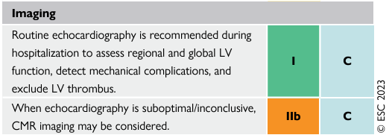
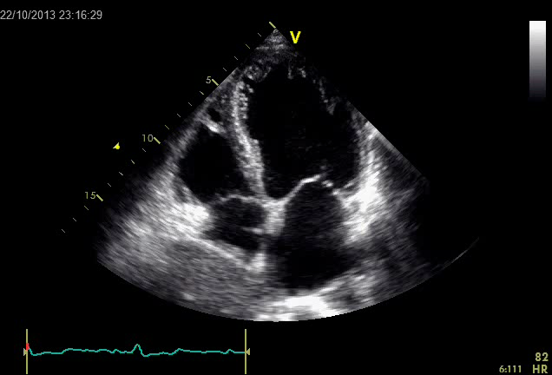
IMAGING RISK ASSESSMENT POST MI
‘low risk’ and suitable for early discharge: age <70 years, LVEF >45%, one- or two-vessel disease, successful PCI, without ongoing myocardial ischaemia, without arrhythmias, who are haemodynamically stable, who are not requiring vasoactive or mechanical support, and who are not scheduled for further revascularization.
Byrne et al. European Heart Journal (2023) 44, 3720–3826

Slide 5
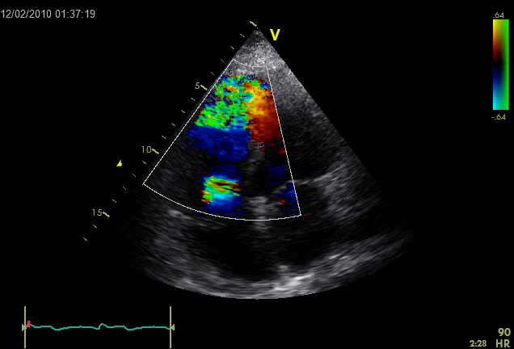
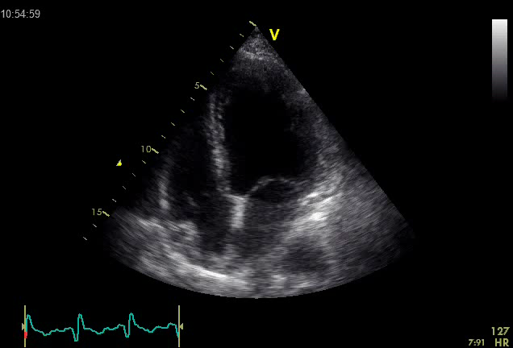
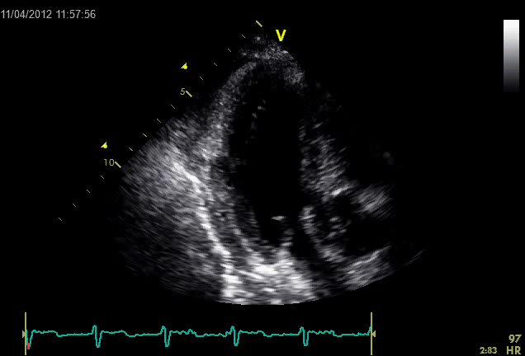
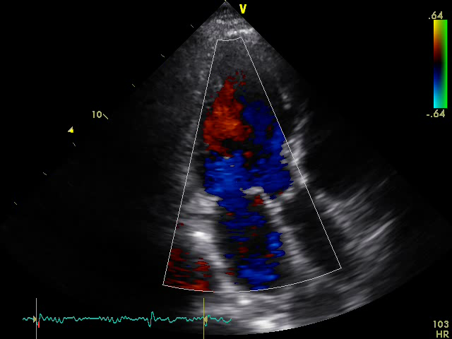
NON-INVASIVE IMAGING IN MANAGEMENT AND RISK STRATIFICATION
LVEF, RV and valve function, mechanical complications
SEVERE LV DYSFUNCTION
VSD
FREE WALL RUPTURE
MITRAL REGURGITATION

Slide 6
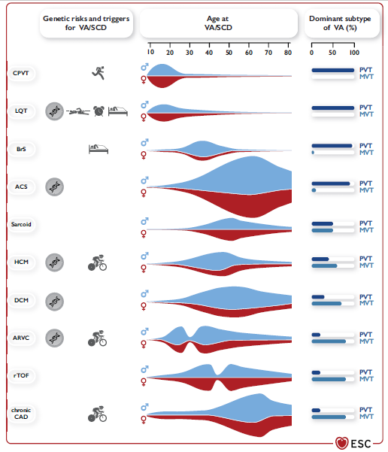
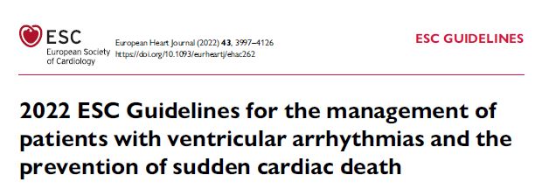
RISK OF SCD AFTER MI
Zepenfeld et al. European Heart Journal (2022) 43, 3997–4126

Slide 7
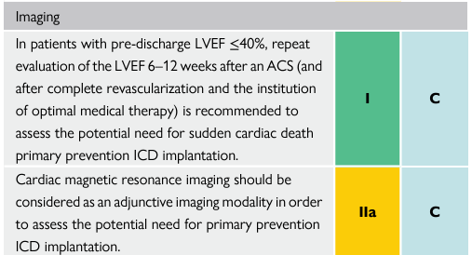
LVEF AS LONG-TERM PROGNOSTIC MARKER
In patients with a pre-discharge LVEF of ≤40%, re-evaluation of the LVEF 6–12 weeks after complete revascularization and optimal medical therapy is recommended to assess the potential need for primary prevention implantable cardioverter defibrillator (ICD)
ICD implantation within 40 days after MI is generally not indicated. although patients with a pre-existing impaired LVEF may be considered for ICD implantation for primary prevention even within the early post-infarction period.
Byrne et al. European Heart Journal (2023) 44, 3720–3826

Slide 8
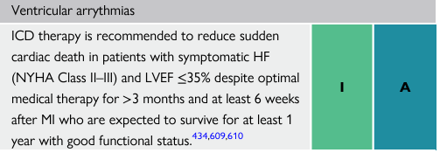
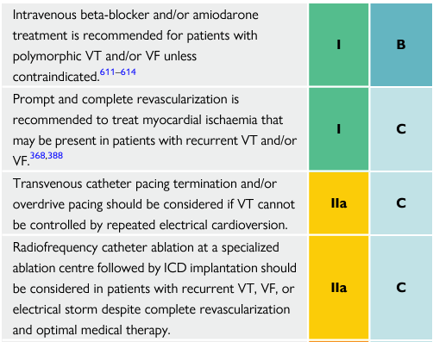
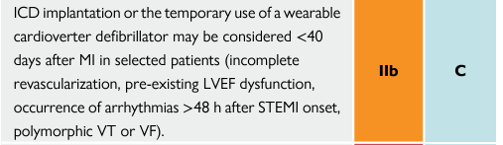
VENTRICULAR ARRHYTHMIAS
6–8% of patients with STEMI develop haemodynamically significant VT frequently polymorphic, and relatively fast VT, often degenerating into VF. Urgent reperfusion is most important as ischaemia is often the trigger for these arrhythmias.
VT/VF within the first 48 h of STEMI no increase in long-term arrhythmic risk.
During ongoing ischaemia or late after reperfusion (>48 h) is associated with an increase in long-term mortality.
Sustained VT/VF late after reperfusion (>48 h) requires an evaluation for ICD implantation for secondary prevention of sudden cardiac death.
Byrne et al. European Heart Journal (2023) 44, 3720–3826

Slide 9
REVASCULARIATION IN COMPLETED MI
In patients presenting days after an acute ACS event with a completed MI, the presence of recurrent angina or documented ischaemia and proven viability in a large myocardial territory may help to guide the strategy of planned revascularization of an occluded IRA.
(i) infarct size
(ii) myocardium at risk

Slide 10
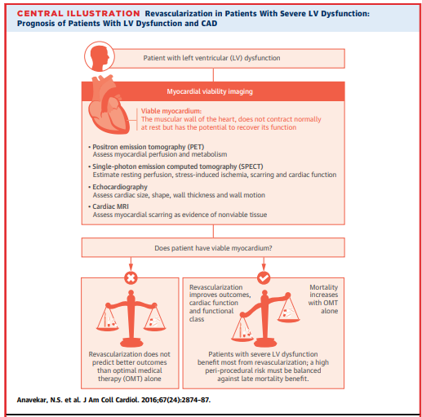
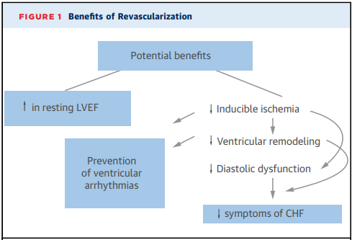
BENEFITS OF REVASCULARIZATION IN CAD WITH LV DYSFUNCTION
Patients with multivessel disease in which only the IRA lesion has been treated, or patients with late-presenting STEMI, may benefit from additional assessment for residual ischaemia or viability.

Slide 11
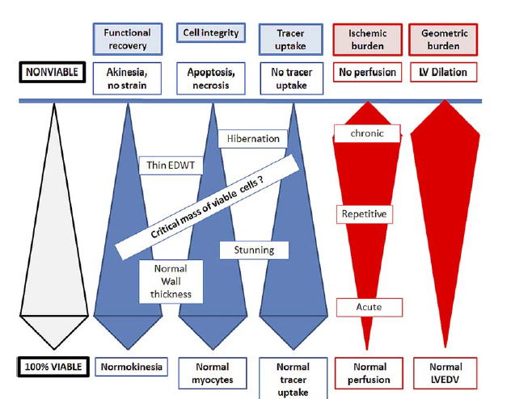
ASSESSMENT OF MYOCARDIAL VIABILITY IN PATIENTS WITH CAD AND LV DYSFUNCTION HIBERNATING MYOCARDIUM
Dysfunctional myocardium may be
-viable
(ischemic, stunned, hibernating)
-or non viable
(necrotic or scarred)
Assessment of myocardial viability may be done in order to select patients that are more likely to benefit from myocardial revascularization (CABG or PCI)
Bogaert et al.J Thorac Imaging 2014;29:134–146

Slide 12
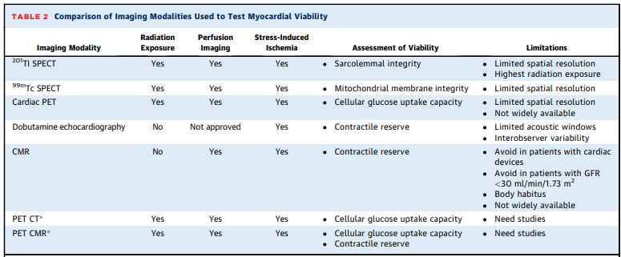
IMAGING FOR MYOCARDIAL ISCHEMIA/VIABILITY
Anevakar JACC 2016
Cellular integrity
-Single-photon emission CT (SPECT),
-Late gadolinium enhancement cardiac magnetic resonance
(LGE-CMR)
-Myocardial contrast echo
Cellular metabolism
-Positron emission tomography (PET)
Contractile reserve
-Dobutamine stress echo.
-Dobutamine CMR

Slide 13
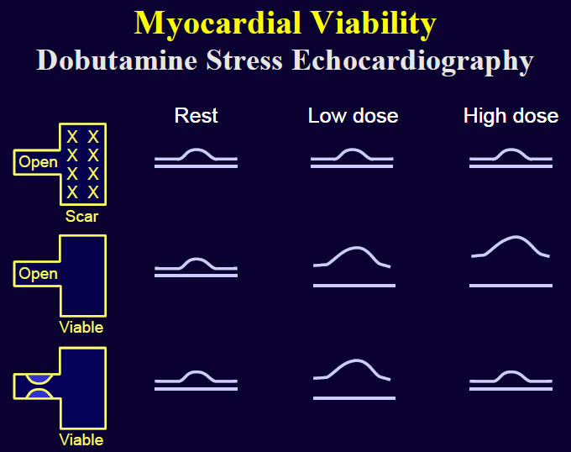
DOBUTAMINE STRESS ECHO
5-10-20μg/kg/min at least 50% viable myocytes in a given segment
-75-80% sensitivity
-80-85% specificity for predicting functional recovery following revascularization
in patients with chronic CAD (hibernation)
high-dose stage, biphasic
response
most specific for detection of myocardial viability and functional recovery.
-specificity 89%
-sensitivity 74%.
Sustained improvement
Biphasic response-”jeopardized myocardium”
Rahimtoola et al.JACC Cardiovasc Imaging 2008;1:536‑55
Afridi et al. Circulation 1995;91:663‑70.
.

Slide 14
DOBUTAMINE STRESS ECHO (2)
The degree of global LV functional recovery post revascularization is directly proportional to the number of myocardial viable segments on baseline LD‑DSE.
improvement in LVEF
5%-6% for baseline 2–5 viable segments
>10% for baseline ≥6 viable segments
Sustained improvement
Biphasic response-”jeopardized myocardium”
Meluzin et al.J Am Coll Cardiol 1998;32:912‑20.

Slide 15
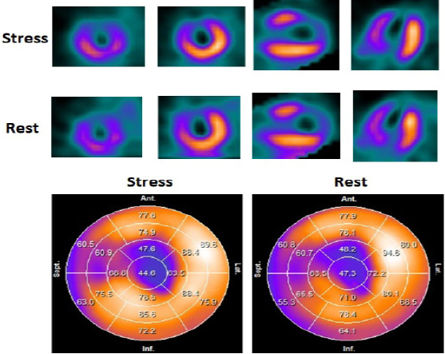
SPECT
Myocyte membrane integrity thallium-201 and technetium-99m sestamibi/tetrofosmin
SPECT techniques compare the uptake of radiotracers in the dysfunctional myocardium relative to the remote (normal) myocardium.
Reversible perfusion defects -ischemia
A tracer activity >50% of the maximum tracer uptake is used as the threshold for viable tissue
-low spatial resolution (ie, 7 mm) limiting its ability to depict subendocardial infarcts
-radiation exposure of SPECT examinations ranges
between 8 and 20mSv

Slide 16
SPECT (2)
sensitivity 86%–90%
specificity 55%–65% for functional recovery
Whereas the high sensitivities to predict segmental functional recovery after revascularization of thallium SPECT and
technetium-99m sestamibi SPECT are quite similar (87% vs 83%,
the specificity of technetium-99m sestamibi SPECT 65% is better than that of thallium-201 SPECT 54%
Up to 50% of dysfunctional segments without contractile reserve still have resting perfusion
≥50% of % uptake in myocardial perfusion imaging.
This discrepancy means that DSE indicates no viability but nuclear imaging does
Schinkel et al. Curr Probl Cardiol 2007;32:375‑410

Slide 17
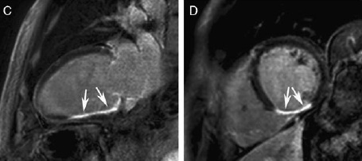
CMR
Myocyte membrane integrity
TM extent of the infarct (LGE)
More than 50% LGE on CMR indicates a small probability of contractile recovery after revascularization
-Excellent spatial resolution
-Excellent sensitivity.
Can be combined with LDD‑MRI to add functional information to the anatomical scar imaging.
The LGE‑MRI and LDD‑MRI combine anatomical and functional imaging
and achieve optimal sensitivity (lower than FDG‑PET) and optimal specificity (simlar to LD‑DSE).
Schinkel et al. Curr Probl Cardiol 2007;32:375‑410
Romero et al.JACC Cardiovasc Imaging. 2012;5:494–508

Slide 18
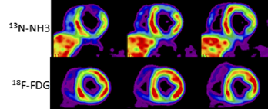
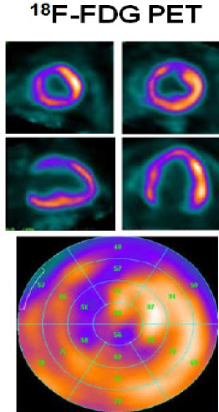
PET
Cellular metabolism PET using
radiolabeled metabolic tracers (fatty acid or glucose analogs) in combination with a perfusion tracer.
13NH3 is used to quantify myocardial blood
flow, whereas 18F-FDG depicts myocardial metabolism
PET-viable pattern can consist of either hypoperfusion with relatively preserved FDG uptake (PET mismatch, hallmark of a hibernating myocardium)
PET match is indicative of necrosis/scar
transmural or nontransmural
-excellent sensitivity 92%,
-moderate specificity 63%,

Slide 19
PET (2)
Main strengths of PET compared with SPECT are
superior spatial resolution
lower radiation burden,
absolute quantification of myocardial blood flow.
limited availability,
- cost
short half-life of current available PET perfusion
lower spatial resolution compared
with CMR

Slide 20
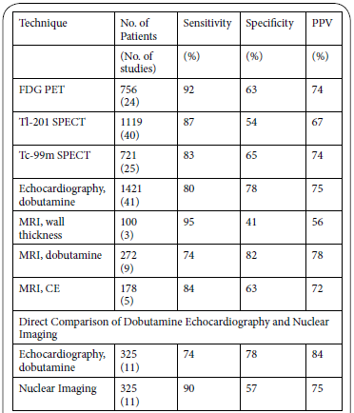
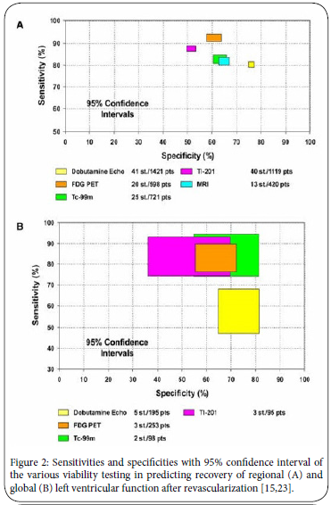
COMPARISON OF TECHNIQUES FOR VIABILITY DETECTION
FDG PET
DSE
Schinkel et al. Curr Probl Cardiol 2007;32:375‑410
Bax et al. J Nucl Cardiol 2015;22: 229-245

Slide 21
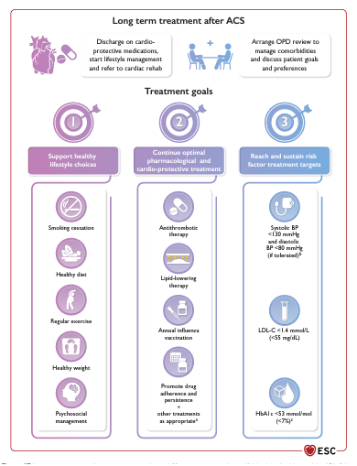
Byrne et al. European Heart Journal (2023) 44, 3720–3826
- Lifestyle changes
- Optimal medical teatment
- Treatment of risk factors

Slide 22
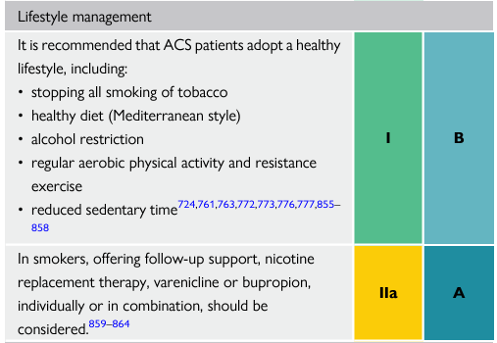
LIFESTYLE INTERVENTIONS
Cessation of smoking
Lifestyle recommendations
Physical activity/rehabilitation
Diet advice and weight control
Byrne et al. European Heart Journal (2023) 44, 3720–3826

Slide 23
SMOKING CESSATION
Smoking has a strong pro-thrombotic effect, and smoking cessation is potentially the most (cost) effective of all secondary prevention measures.
Reduced risk of re-infarction (30–40%) and death (35–45%) after MI
A significant number of CAD patients continue or restart smoking, illustrating the addictive nature of the smoking habit.
There is a strong evidence base for brief interventions, with a combination of behavioural support and pharmacotherapies including nicotine replacement therapy, bupropion, and varenicline
All forms of NRT are effective, and the anti-depressant bupropion aids in long-term smoking cessation with similar efficacy to NRT.
Varenicline is the most effective medical treatment to support smoking cessation and is safe to use in ACS patients.
Byrne et al. European Heart Journal (2023) 44, 3720–3826
Ibanez European Heart Journal (2018) 39, 119–177

Slide 24
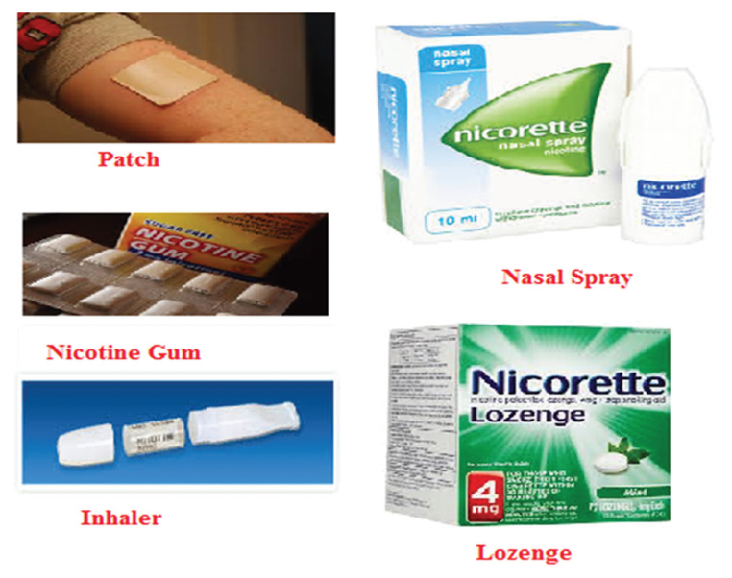
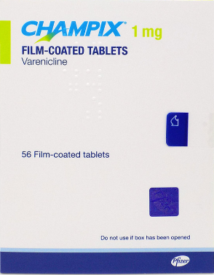
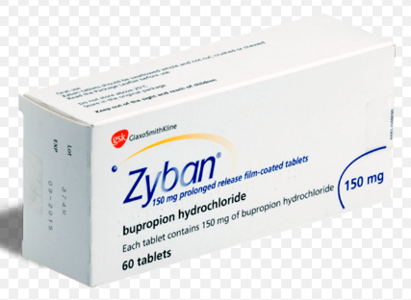
Pharmacological Approach to Smoking Cessation
For smokers willing to quit at the time of the visit, it is recommended to provide immediately integrated support (pharmacological and behavioral)
Pharmacotherapy acts synergistically with behavioral counseling to increase quit rates and should be encouraged
Nicotine replacement therapy
Varenicline
Buproprione

Slide 25
PHYSICAL ACTIVITY EXERCISE-BASED CARDIAC REHABILITATION
All AMI patients should participate in an exercise-based cardiac rehabilitation programme, taking into account their age, pre-infarction level of activity, and physical limitations.
A cardiac rehabilitation programme preferably includes exercise training, risk factor modification, education, stress management, and psychological support.
22% reduction in cardiac mortality rate in patients with CAD.
Ibanez European Heart Journal (2018) 39, 119–177

Slide 26
RESUMPTION OF ACTIVITIES
Return to work after AMI represents an important indicator of recovery.
Decisions should be individualized, based on LV function, completeness of revascularization and rhythm control, and the job characteristics.
Light-to-moderate physical activity after discharge should be encouraged.
Sexual activity can be resumed early if adjusted to physical ability.
Guidance on air travel. Factors related to the clinical circumstances as well as length of travel, whether accompanied, and the degree of anxiety also play a role. For uncomplicated completely revascularized MI with LVEF >40% the risk is low and travelling is regarded as safe after hospital discharge (from day 3 onwards).
Ibanez European Heart Journal (2018) 39, 119–177

Slide 27
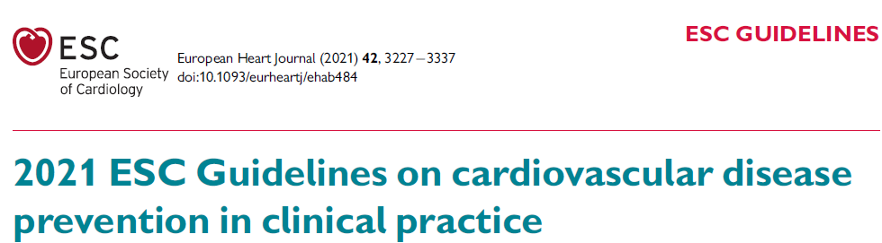
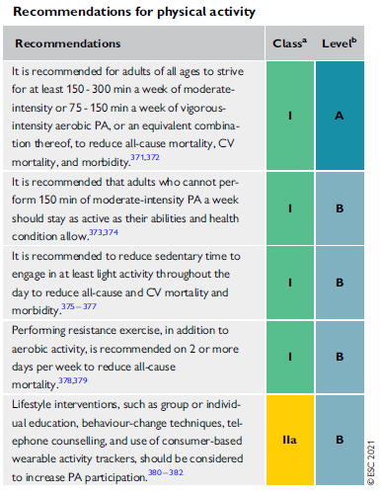
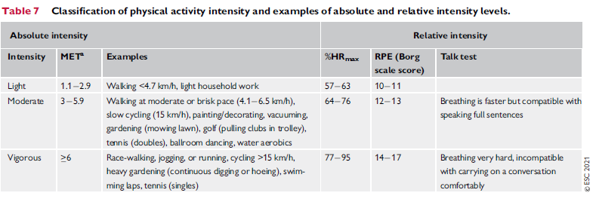
PHYSICAL ACTIVITY
Visseren et al. European Heart Journal (2021) 42, 32273337

Slide 28
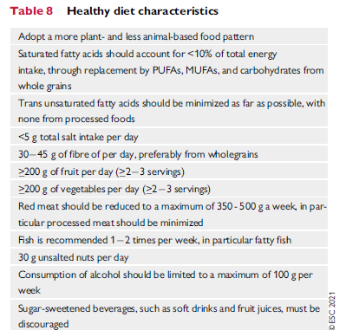
Overweight and obesity [body mass index (BMI) 25 kg/m2 ] is associated with higher all-cause mortality compared with a healthy weight (BMI between 20 kg/m2 and 25kg/m2
Visseren et al. European Heart Journal (2021) 42, 32273337

Slide 29
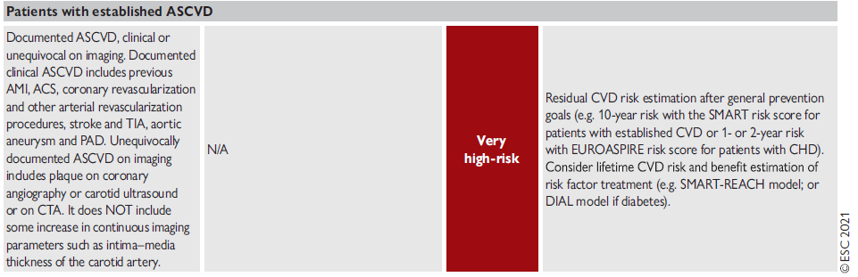
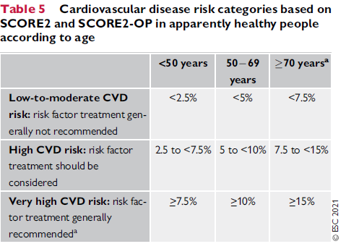
Visseren et al. European Heart Journal (2021) 42, 32273337

Slide 30
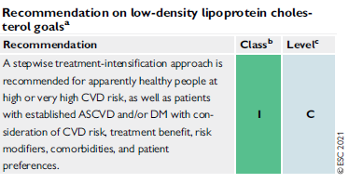
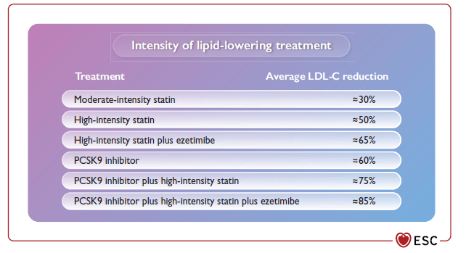
LDL GOALS
Lipids should be re-evaluated 4–6 weeks after the ACS to determine whether the target levels have been reached
Visseren et al. European Heart Journal (2021) 42, 32273337

Slide 31
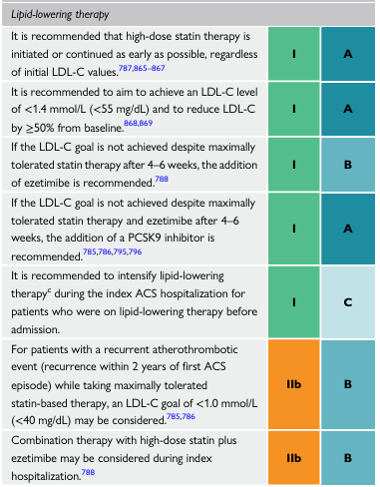
Byrne et al. European Heart Journal (2023) 44, 3720–3826

Slide 32
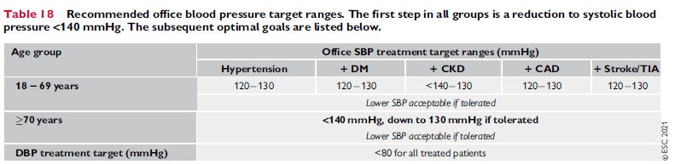
BP TARGETS
Visseren et al. European Heart Journal (2021) 42, 32273337

Slide 33
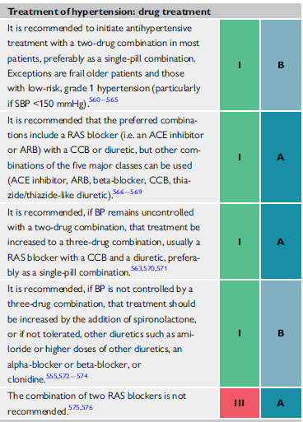
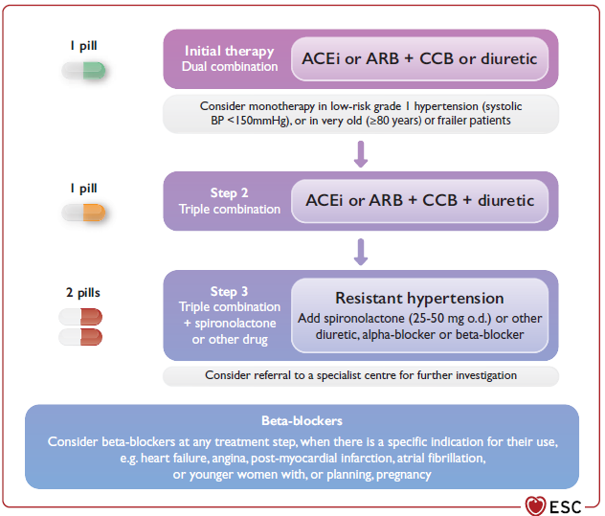
HTN TREATMENT
Visseren et al. European Heart Journal (2021) 42, 32273337

Slide 34
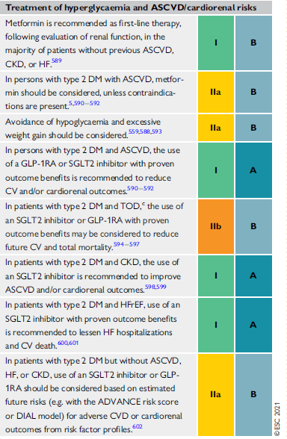
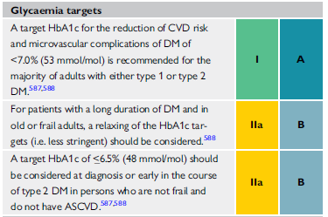
GLYCAEMIA TERGETS
Visseren et al. European Heart Journal (2021) 42, 32273337

Slide 35
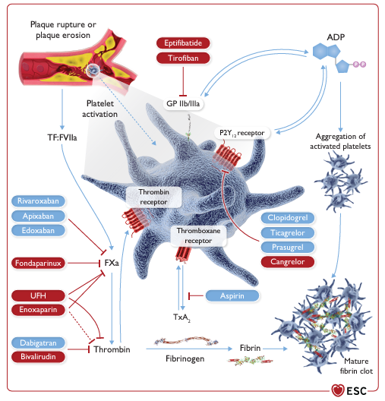
ANTITHROMBOTIC TREATMENT
Tailor antithrombotic duration and intensity, in order to maximize ischaemic protection and minimize bleeding risk in the individual patient.
Byrne et al. European Heart Journal (2023) 44, 3720–3826

Slide 36
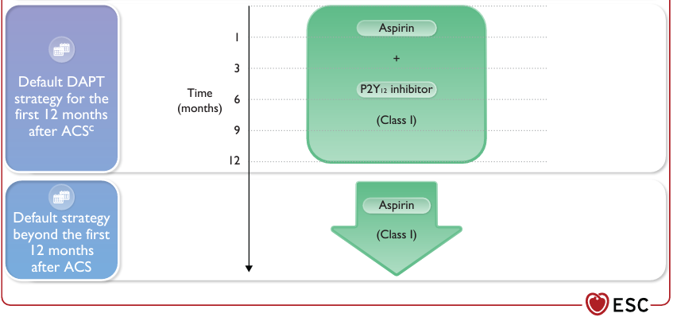
Byrne et al. European Heart Journal (2023) 44, 3720–3826

Slide 37
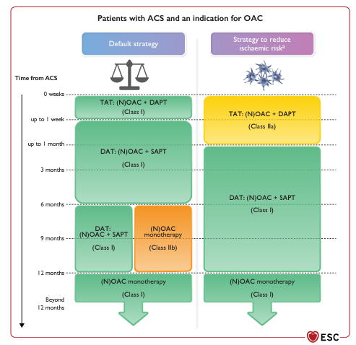
Byrne et al. European Heart Journal (2023) 44, 3720–3826

Slide 38
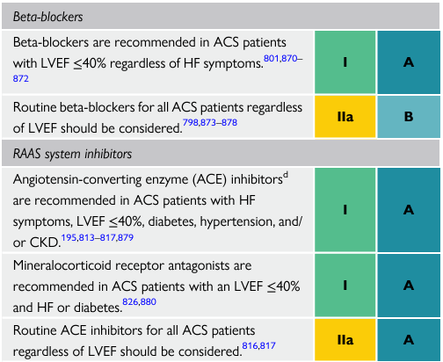


sacubitril plus valsartan are recommended for patients with established HFrEF regardless of the aetiology. These agents may be considered for patients with HF with mildly reduced ejection fraction
In patients with HF regardless of their LVEF, dapagliflozin and empagliflozin have been shown to significantly reduce the risk of worsening HF or CV death, both in the presence or absence of type 2 DM.
Byrne et al. European Heart Journal (2023) 44, 3720–3826

Slide 39
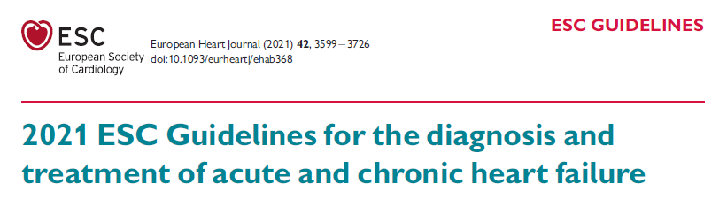
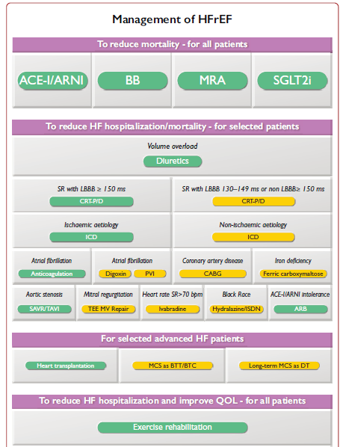
McDonagh European Heart Journal (2021) 42, 35993726

Slide 40



McDonagh European Heart Journal (2021) 42, 35993726

Slide 41



POST CARDIAC RESSYNCHRONIZATION
Baseline
Post CRT
Reduction of LVESV>15%

Slide 42
ADHERENCE TO TREATMENT
Low treatment adherence is an important barrier to achieving optimal treatment targets and is associated with worse outcomes.
Delayed outpatient follow-up after AMI results in worse short- and long-term medication adherence patients.
Adherence to cardiovascular medications was estimated to be about 57% after a median of 2 years.
It is generally recognized that adherence is determined by the interplay of socioeconomic, medication-related, condition-related, health system-related, and patient-related factors.
A strategy to reduce poor adherence is the use of a fixed-dose combination or polypill, including key medications to reduce cardiovascular risk, as a once-daily dose pill.

Slide 43
ΕΥΧΑΡΙΣΤΩ

