Slide 1


Εκτίμηση και Διαχείριση
Αμφιβληστροειδοπάθειας
Γκουλιόπουλος Νικόλαος
MD, PhD, PostDoc, FEBO
Medical Retina and Uveitis Clinical Fellow
Moorfields Eye Hospital, London, UK

Slide 2
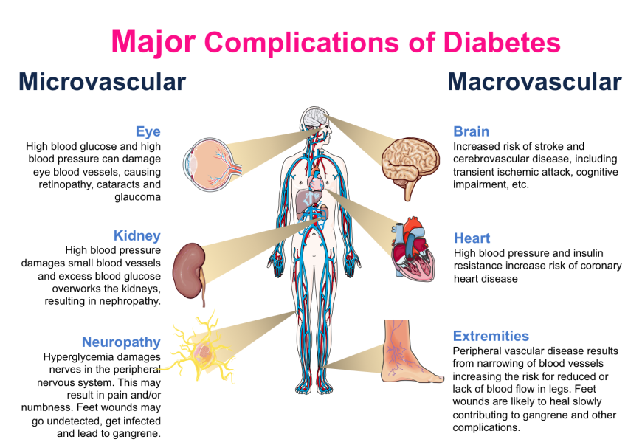
Diabetic Retinopathy
Iris trans-illumination defects
Unstable refraction
Recurrent styes
Xanthelasmata
Earlier and accelerated Cataract
Neovascular Glaucoma
Ocular motor nerve palsies
Reduced corneal sensitivity
Pupillary light-near dissociation
Rhino-orbital mucormycosis

Slide 3
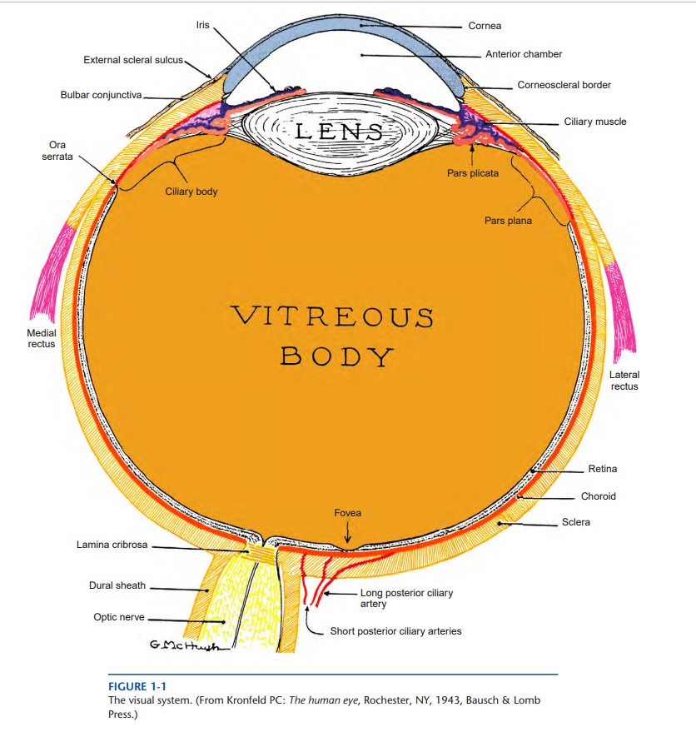
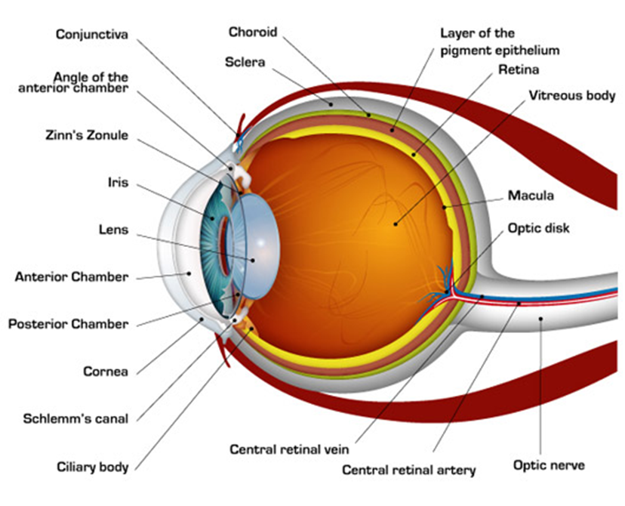

Anatomy
Remington LA (2012). Clinical Anatomy and Physiology of the Visual System (3rd Edition). Elsevier, St. Louis, Missouri

Slide 4
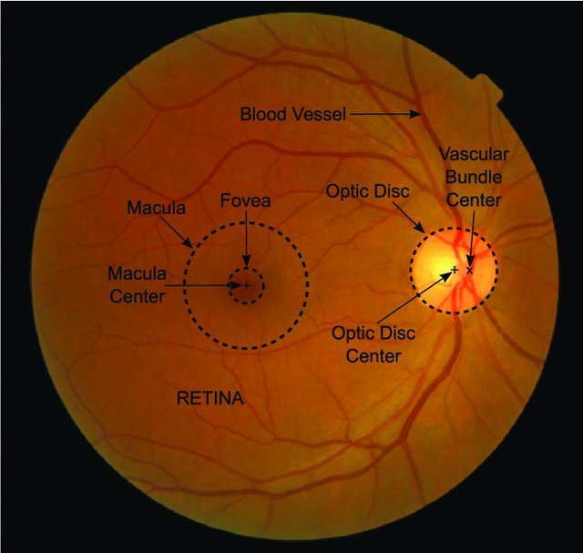
Anatomy
Retinal Artery
Posterior Pole
Retinal Vein
Molina-Casado JM, et al. Comput Methods Programs Biomed 2017;149:55-68

Slide 5
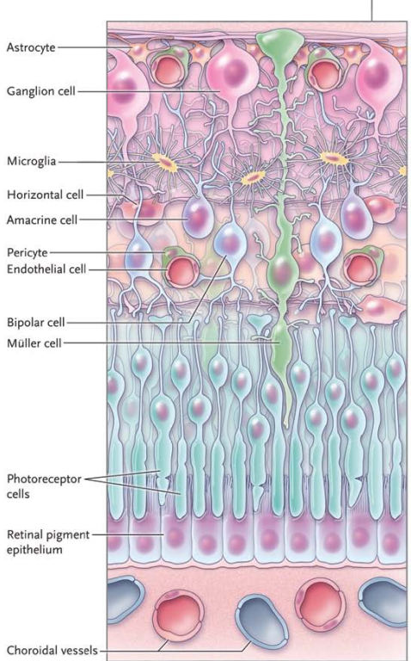
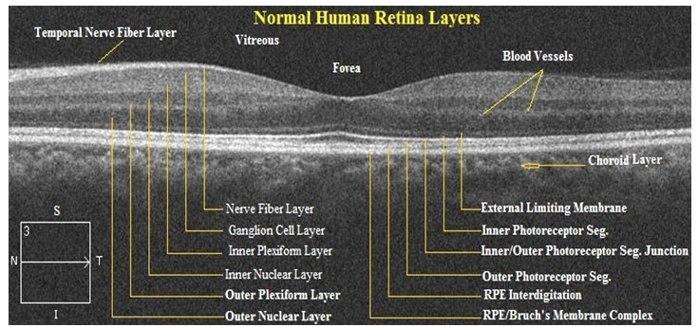

Anatomy
Mohandass G, et al. Biomed Pharmacol J 2017;10(3)
Antonetti DA, et al. N Engl J Med 2012; 366:1227-39

Slide 6
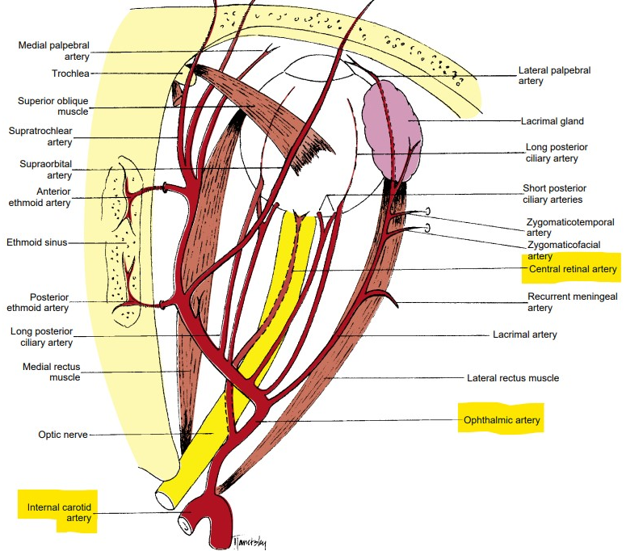
Anatomy – Retinal Circulation
    Arterial System
    Central Retinal Artery
      single endothelium layer on a collagenous zone
      internal elastic lamina separates intima from media
      media consists mainly of smooth muscle
      adventitia is composed of loose connective tissue
    Retinal Arterioles
      walls contain smooth muscle
      internal elastic lamina is discontinuous (vs arteries)
1cm behind the globe
Remington LA (2012). Clinical Anatomy and Physiology of the Visual System (3rd Edition). Elsevier
Bowling B (2016). Kanski’s Clinical Ophthalmology . A systematic approach (8th Edition). Elsevier

Slide 7
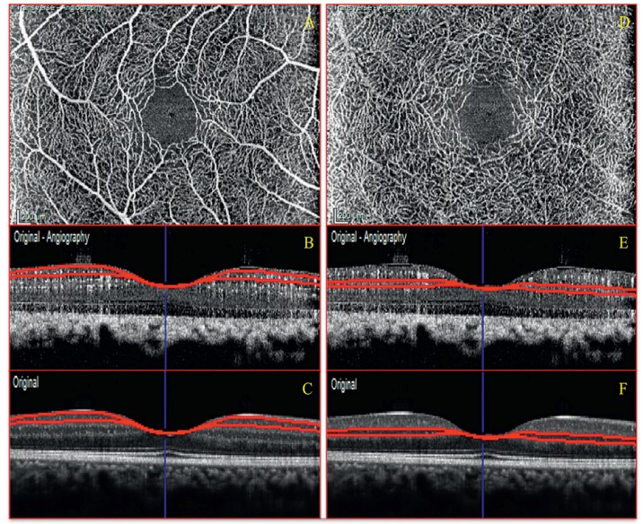
Anatomy – Retinal Circulation
inner/superficial capillary plexus at GCL
outer/deep capillary plexus at INL
    Capillaries
      supply inner 2/3 of retina
      Capillary-free zones:
        around arterioles
        fovea (Foveal Avascular Zone - FAZ)
      no smooth muscle and elastic tissue
      walls consist of
        a layer of endothelial cells on the basement membrane
        a basement membrane
        pericytes
Coscas G et al. Atlas OCT-Angio in diabetic maculopathy. L’europeenne d’editions
Bowling B (2016). Kanski’s Clinical Ophthalmology . A systematic approach (8th Edition). Elsevier

Slide 8
Anatomy – Retinal Circulation
    Venous
      drain blood from the capillaries
      venules larger than capillaries, with similar structure
      larger venules contain smooth muscle and form veins
      veins: small amount of smooth muscle and elastic tissue in their walls
      relatively distensible
      diameter gradually enlarges as they pass posteriorly towards the central retinal vein
Bowling B (2016). Kanski’s Clinical Ophthalmology . A systematic approach (8th Edition). Elsevier

Slide 9
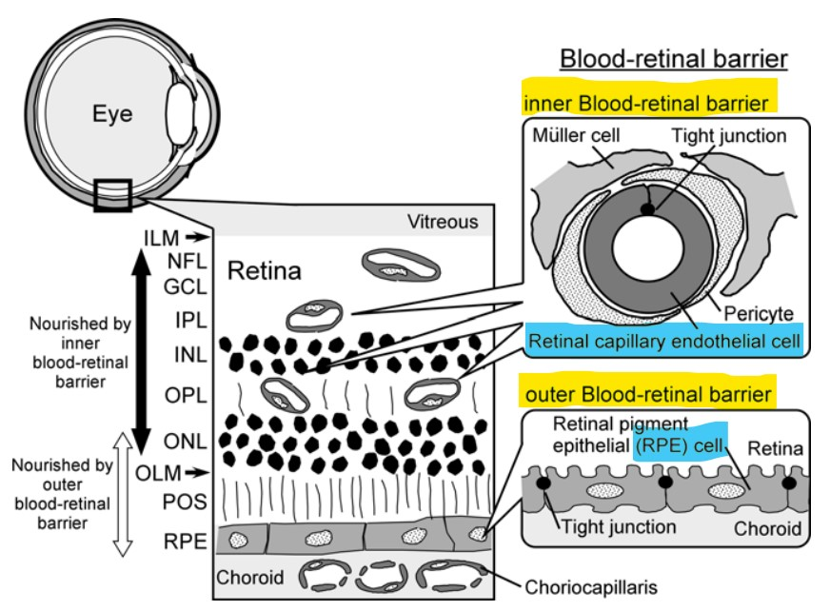
Anatomy – Blood Retinal Barrier
normally 1:1 with endothelial cells
contractile properties
microvascular circulation
autoregulation
Hosoya K, et al (2008). Inner Blood—Retinal Barrier: Transport Biology and Methodology. In: Ehrhardt, C., Kim, KJ. (eds) Drug Absorption Studies. Biotechnology: Pharmaceutical Aspects, vol VII. Springer, Boston, MA

Slide 10
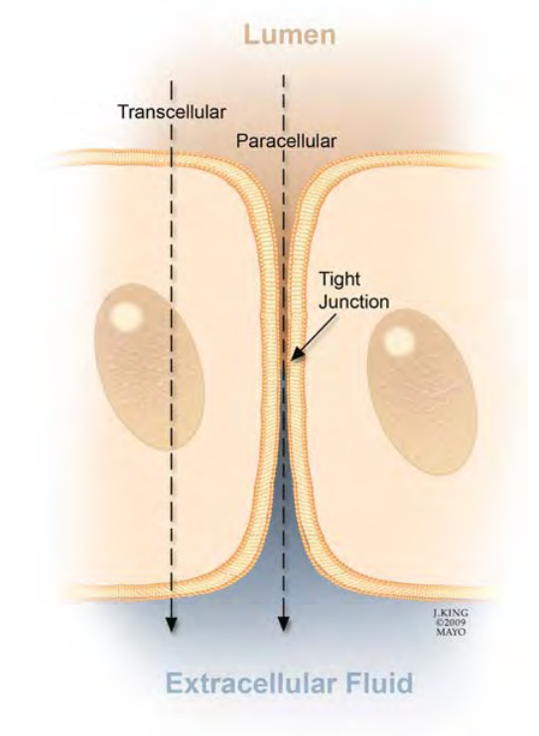
Anatomy – Blood Retinal Barrier
Ιnner Βlood-Retinal-Βarrier
tight junctions between adjacent retinal capillary endothelial cells
Browning D (2010). Diabetic Retinopathy. Evidence-Based Management. Springer

Slide 11
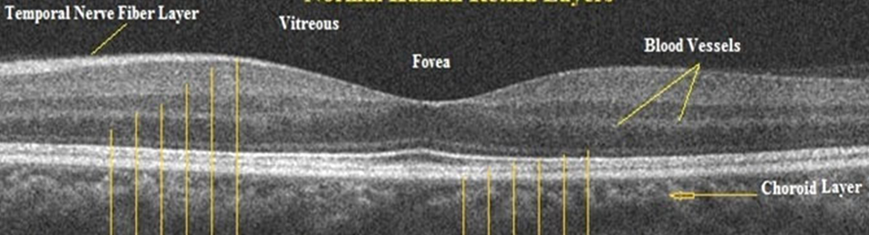
Terminology
    Non-proliferative diabetic retinopathy (NPDR) (or Background - BDR)
      only intraretinal vascular changes; no extra-retinal fibrovascular tissue
    Proliferative diabetic retinopathy (PDR)
      retinal neovascularization due to DM-induced ischemia
    Diabetic macular edema (DME)
      abnormal vascular permeability
      in patients with NPDR or PDR
      center- involved or non– center- involved DME
    Vision threatening diabetic retinopathy (VTDR)
      DME and/or PDR
Basic and Clinical Science Cource 2019-2020 (2020). Retina and Vitreous (12). American Academy of Ophthalmology

Slide 12
Epidemiology
    1st cause of irreversible blindness among working-age people in the western world
    5th cause of blindness and moderate/severe vision impairment worldwide
    present in 77,3% T1DM patients and 32,4% T2DM patients
    global prevalence (2020)
      DR (103.12 million)
      VTDR (28.54 million)
      DME (18.83 million)
    Greece:
      38.7% DR, 5% PDR, 6.3% DME
      T1DM: 52.4% DR - 9.5% DME
      T2DM: 37.6% DR - 6.1% DME
    highest in Africa (35.90%) and North American and the Caribbean (33.30%)
    lowest in South and Central America (13.37%)
Flaxman SR, et al. Lancet Glob Health 2017; 5:e1221-34
Gouliopoulos NS et al. Eur Rev Med Pharmacol Sci 2018; 22:7113-28
Lee R, et al. Eye Vis (Lond) 2015; 2:17
Teo ZL, et al. Ophthalmology 2021; 128:1580-91
Syriga M, et al. Int Ophthalmol 2022; 42:1679-87

Slide 13
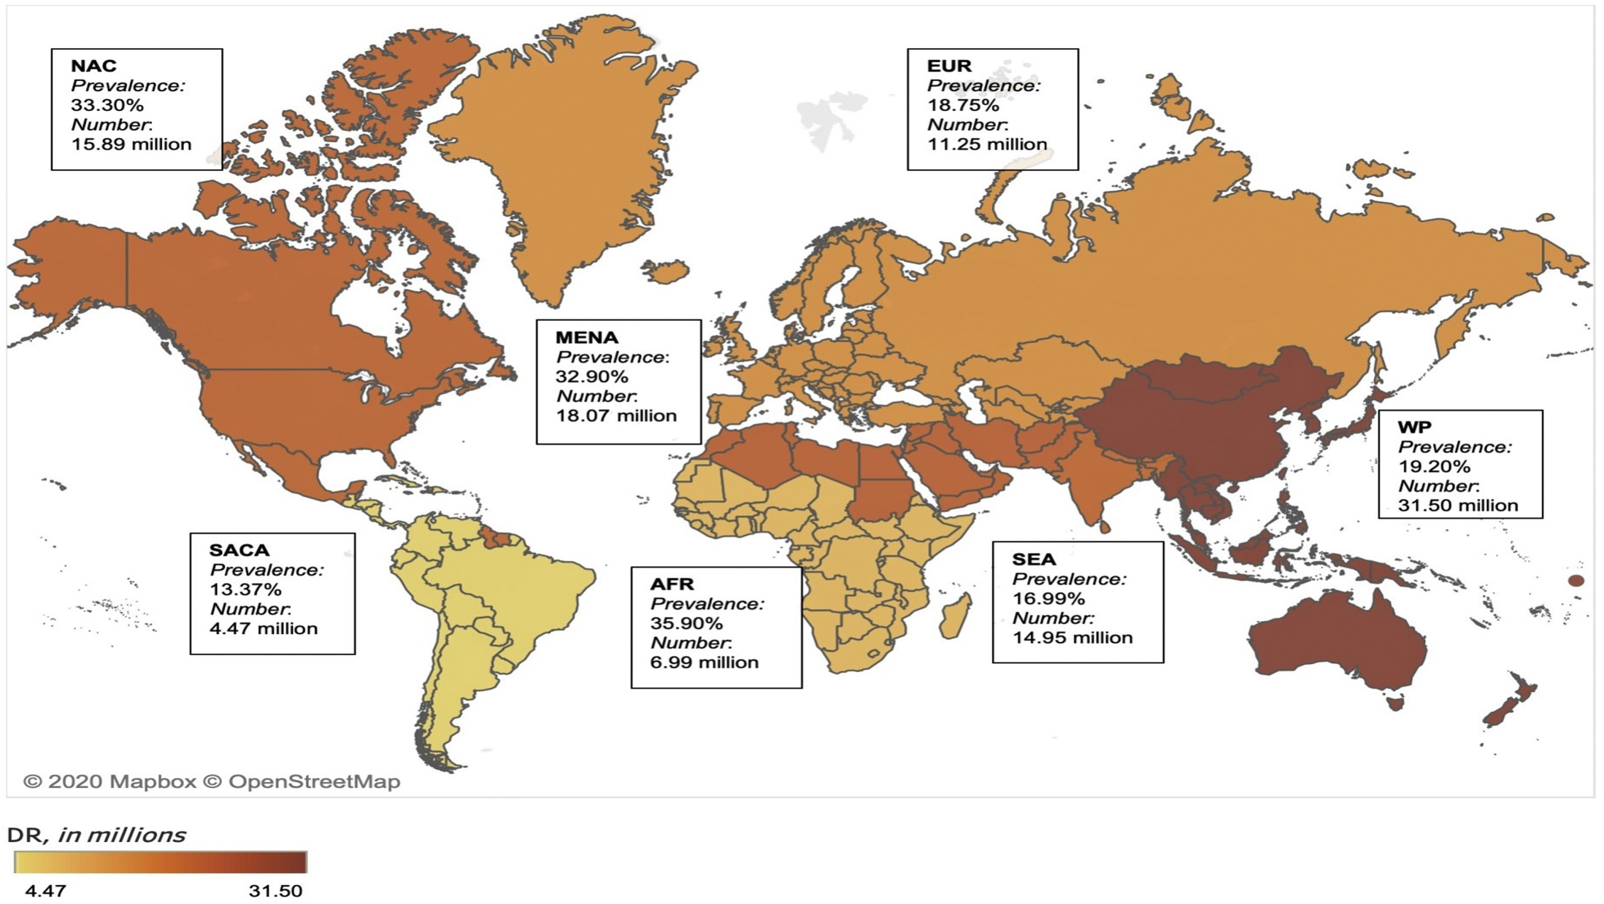
Teo ZL, et al. Ophthalmology 2021; 128:1580-91

Slide 14
Risk Factors
    the most prominent RFs
      DM duration and age of onset
      HbA1c levels
      hypertension
      hyperlipidemia
together explain only 44.6% of DR cases
Xie J, et al. J Diabetes Metab 2014; 5: 2

Slide 15
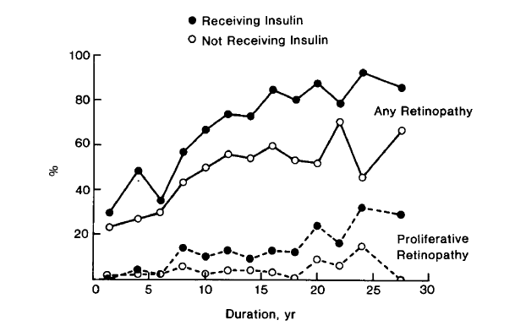
Risk Factors
    Duration (& Age of Onset)
      the most important RF (stronger predictor for PDR)
      DM diagnosis <30y →DR 50% at 10y and 90% at 30y
      rarely ≤5y of DM onset or before puberty
      T2DM ~5%: DR at presentation
      WESDR Study:
        DR: at 20y ~ 99% of T1DM and 60% of T2DM
        PDR: at 20y in 50% of T1DM
        at 25y in 25% of T2DM
Wisconsin Epidemiologic Study of Diabetic Retinopathy
Bowling B (2016). Kanski’s Clinical Ophthalmology . A systematic approach (8th Edition). Elsevier
Klein R, et al. Ophthalmology 2009 ; 116:497-503

Slide 16

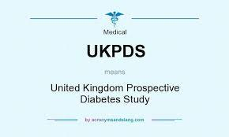

Risk Factors
    Poor glycemic control
      early and tight blood Glu control → prevent/delay DR development/progression
        ↓ DR risk by 33-41% for every 1% ↓ in HbA1c values
      greater benefit of good glycemic control in T1DM (DCCT)
      ↑ HbA1c levels: ↑ risk of PDR
      sudden ↓↓ HbA1c levels: maybe ↑ risk for early DR progression/worsening!!!
        reversed effect by 1.5 year
      UKPDS: recommended HbA1c levels <7.0% in T2DM
      ACCORD: HbA1c levels <6.0% for slowed DR progression in T2DM
Mohamed Q, et al. JAMA 2007;298:902-16
UK Prospective Diabetes Study Group. BMJ 1998;317:703–13
Chew EY, et al; ACCORD Eye Study Group. N Engl J Med 2010; 363:233–44
Nathan DM, et al; Diabetes Control and Complications Trial Research Group. N Engl J Med 1993; 329:977–86

Slide 17

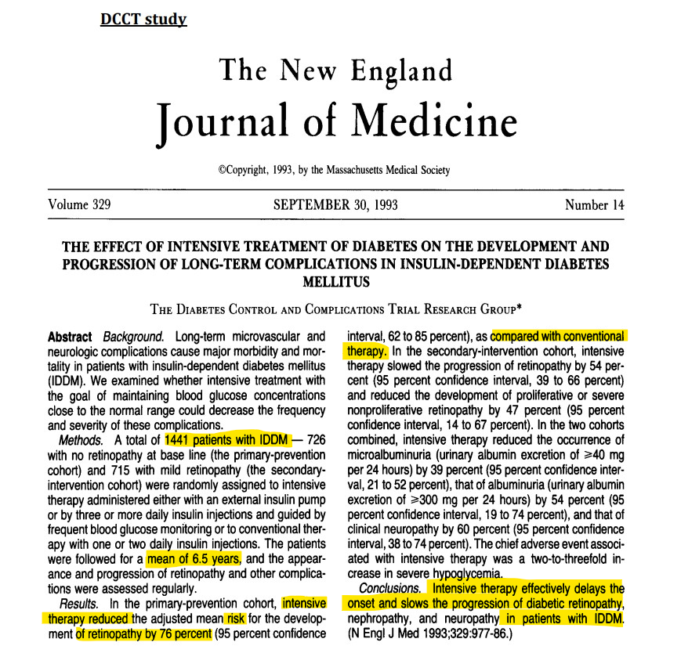

Slide 18

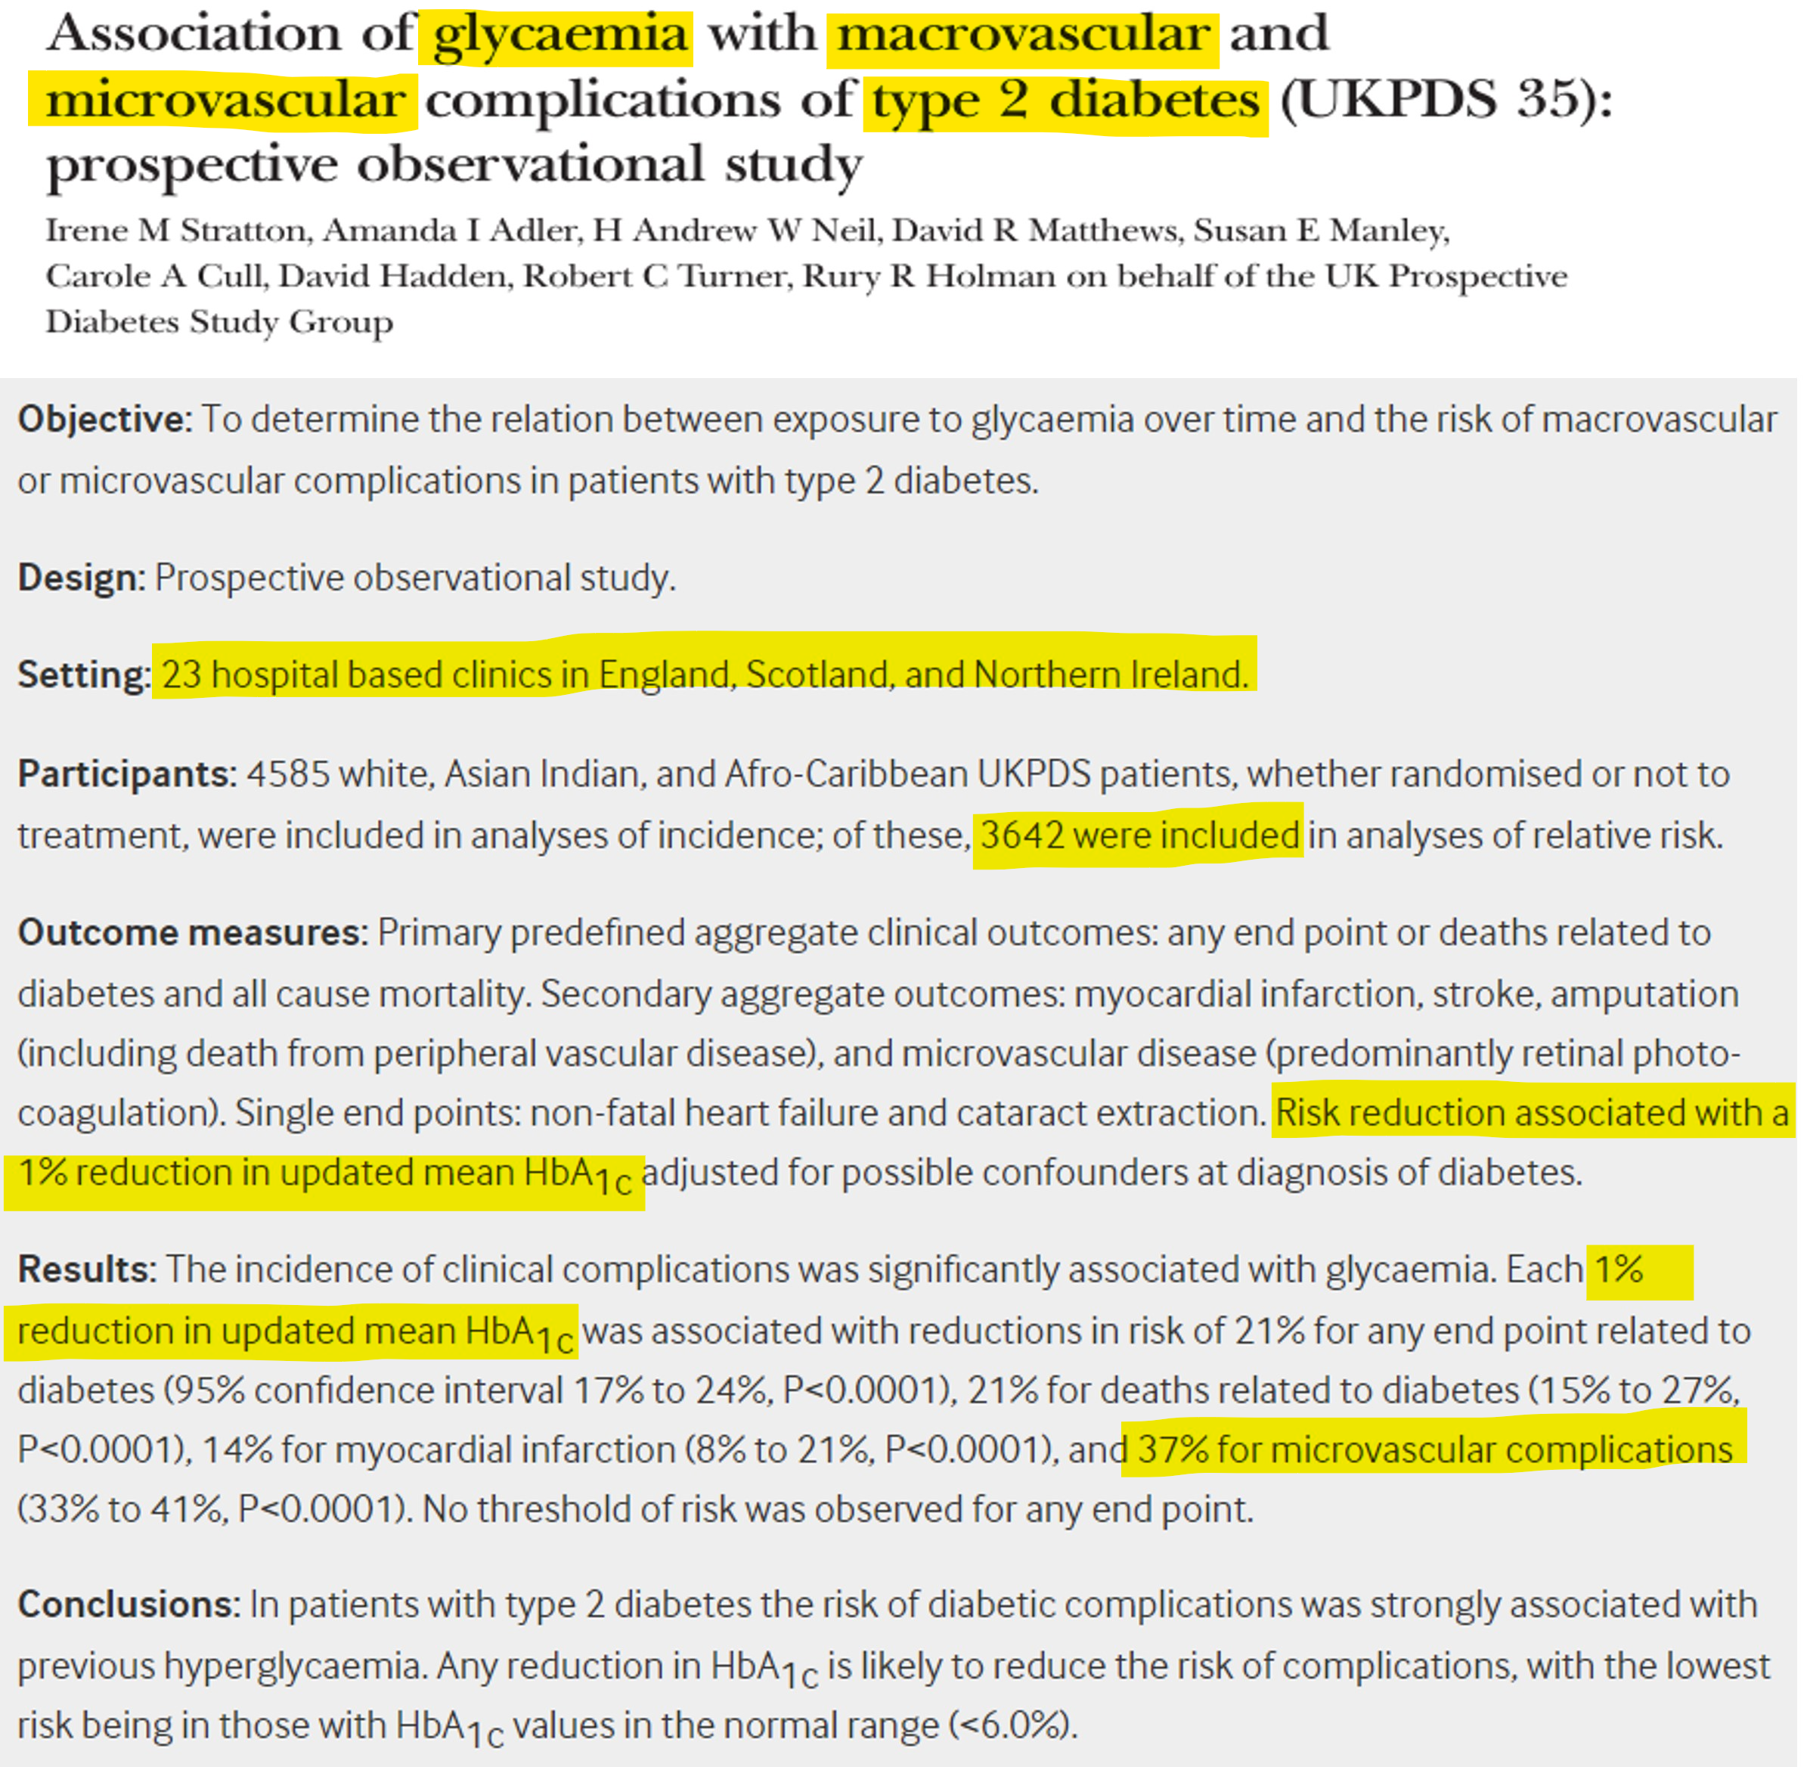

Slide 19

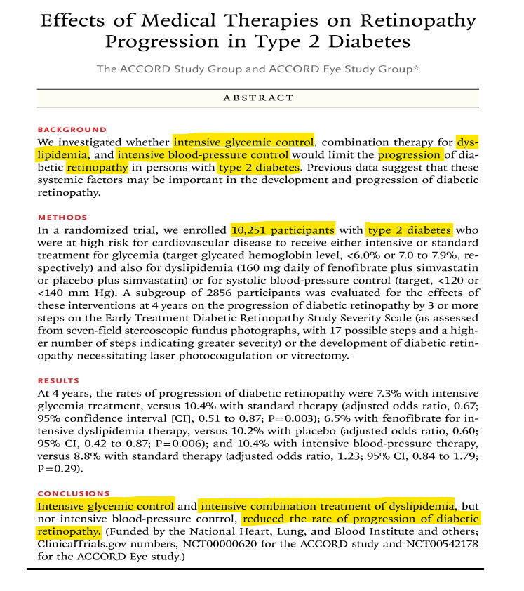

Slide 20
Risk Factors
    Hypertension
      tight control is suggested (<140/80 mmHg)
        particularly beneficial in T2DM with DME
      UKPDS:
        for every 10mmHg↑ in T2DM, the risk of early DR and DME ↑ by 10% and 15%
        no differences regarding the efficacy of ACE inhibitors vs b-blockers
UK Prospective Diabetes Study Group. BMJ 1998;317:703–13
Gouliopoulos NS et al. Eur Rev Med Pharmacol Sci 2018; 22:7113-28
Bowling B (2016). Kanski’s Clinical Ophthalmology . A systematic approach (8th Edition). Elsevier

Slide 21
Risk Factors
    Hyperlipidemia
      DCCT: DR severity in T1DM
        positive correlation with increased triglycerides
        negative correlation with HDL levels
      Hoorn Study:
        positive association of elevated LDL levels with hard exudates
      Fenofibrate 200 mg: in T2DM
        daily use reduces DR progression
        associated with ↓ risk of PDR and VTDR but not DME alone!!!
Meer E, et al. JAMA Ophthalmol 2022; 140:529–32
Gouliopoulos NS et al. Eur Rev Med Pharmacol Sci 2018; 22:7113-28
Bowling B (2016). Kanski’s Clinical Ophthalmology . A systematic approach (8th Edition). Elsevier
Nathan DM, et al; Diabetes Control and Complications Trial Research Group. N Engl J Med 1993; 329:977–86

Slide 22
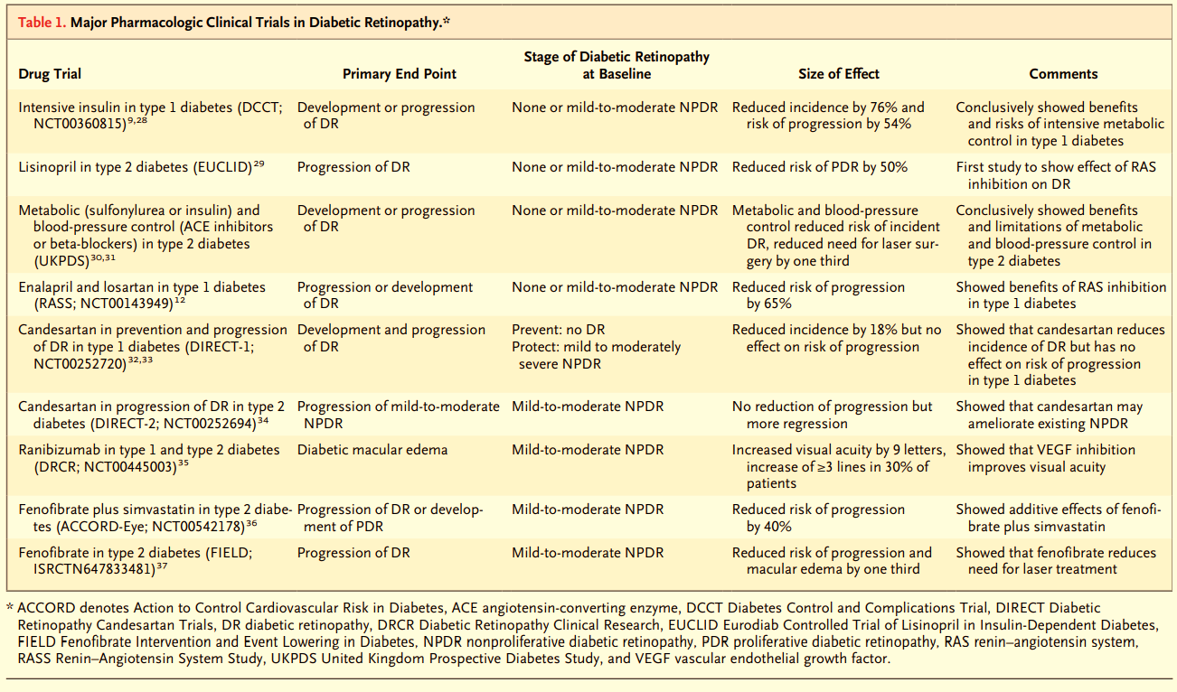
Risk Factors
Antonetti DA, et al. N Engl J Med 2012; 366:1227-39

Slide 23
Risk Factors
    Pregnancy: risk of progression
      pre-pregnancy DR severity
      poor pre-pregnancy DM control
      too rapid control during the early pregnancy stages
      pre-eclampsia
      DR severity in the first trimester
      spontaneous DME resolution after pregnancy - no need for treatment in late development
    Nephropathy
      ↑ severity associated with DR worsening
      renal disease treatment (e.g. transplantation) may be associated with DR improvement and better response to photocoagulation
Antonetti DA, et al. N Engl J Med 2012; 366:1227-39
Bowling B (2016). Kanski’s Clinical Ophthalmology . A systematic approach (8th Edition). Elsevier

Slide 24
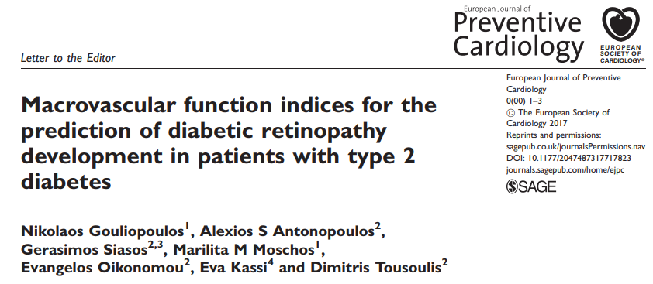
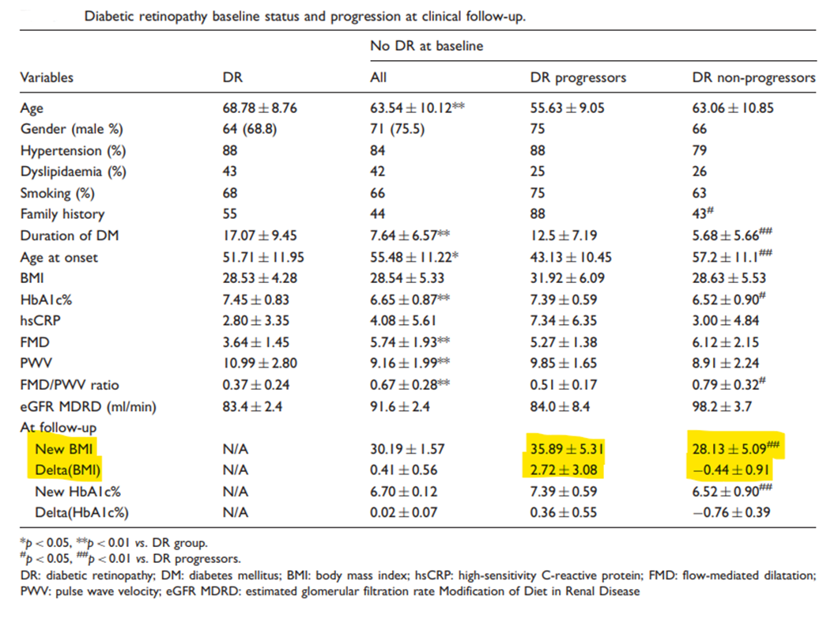
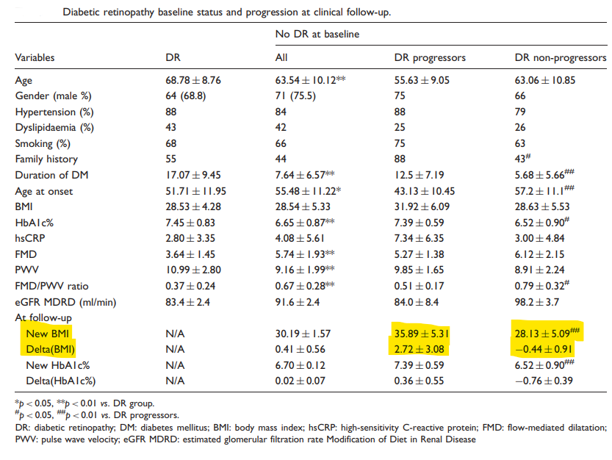
Risk Factors
    insulin treatment
    cataract surgery
    obesity
    ipsilateral carotid disease
    anaemia
    sleep apnea
    nonalcoholic fatty liver disease
    serum levels of prolactin – adiponectin - homocysteine
Antonetti DA, et al. N Engl J Med 2012; 366:1227-39
Bowling B (2016). Kanski’s Clinical Ophthalmology . A systematic approach (8th Edition). Elsevier

Slide 25
Risk Factors -Heritability
    DR ~ 27% - PDR ~ 52%
    stronger genetic association between in T2DM vs T1DM
    genetic variations in genes:
      aldose reductase (AKR1B1)
      vascular endothelial growth factor (VEGF)
      endothelial nitric oxide synthase (eNOS)
      angiotensin converting enzyme (ACE)
      receptor for AGEs (AGER)
      aldehyde dehydrogenase 2 (ALDH2)
      adiponectin (ADIPOQ)
      complement factor B (CFB)
      glutathione S-transferase theta 1 (GSTT1)
      intercellular adhesion molecule 1 (ICAM-1)
      interferon gamma (IFN-γ)
      interleukin 10 (IL-10)
      monocyte chemoattractant protein 1 (MCP-1)
      plasminogen activator inhibitor-1 (PAI-1)
      transforming growth factor beta 1 (TGF-β1)
      tumor necrosis factor alpha (TNFα)
Looker HC, et al. Diabetes 2007; 56:1160–6
Hietala K, et al. Diabetes 2008; 57: 2176–80
Antonetti DA, et al. N Engl J Med 2012; 366:1227-39
Gouliopoulos N, et al. Eur J Ophthalmol 2022 Sep 13: (Epub ahead of print)
Gouliopoulos N, et al. Ophthalmic Genet 2022; 43:326-31
Gouliopoulos N, et al. Eur J Ophthalmol 2022; 32:2582-8

Slide 26
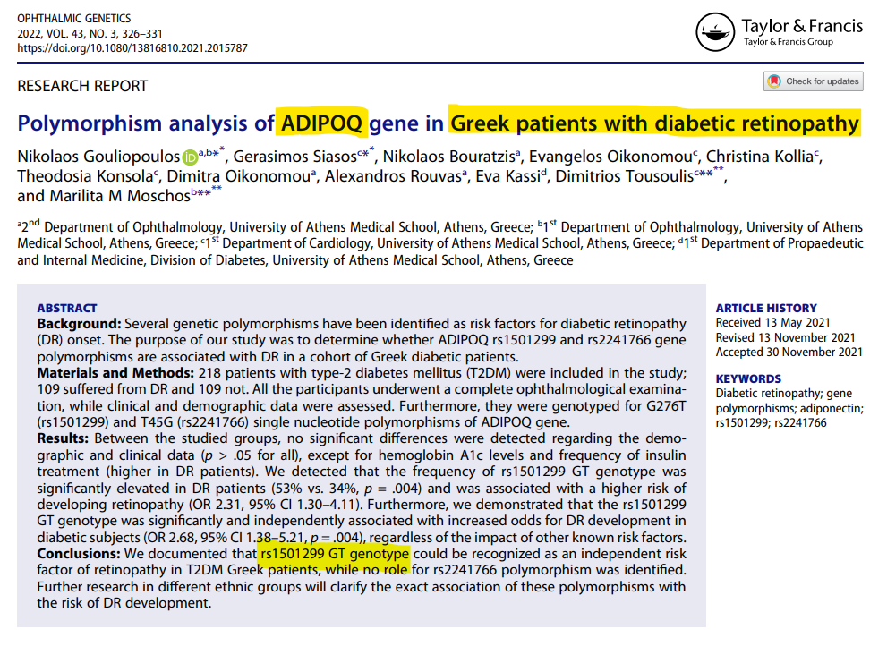
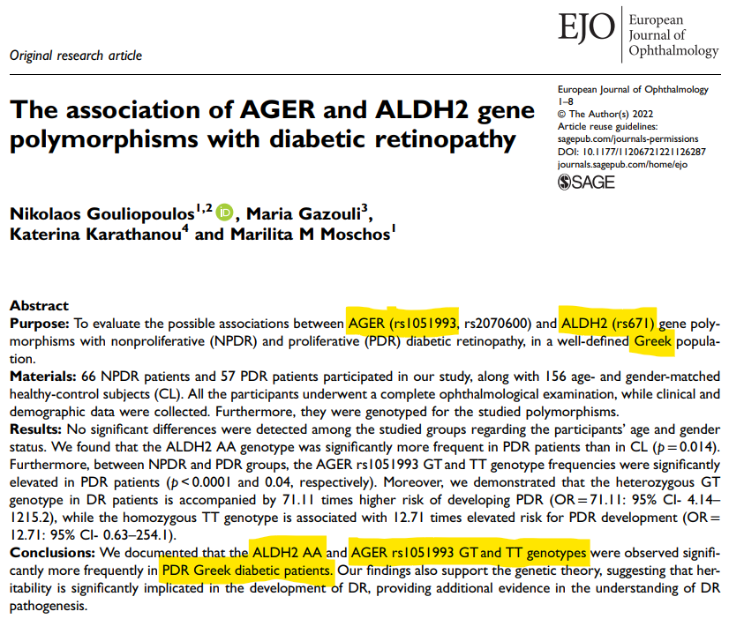
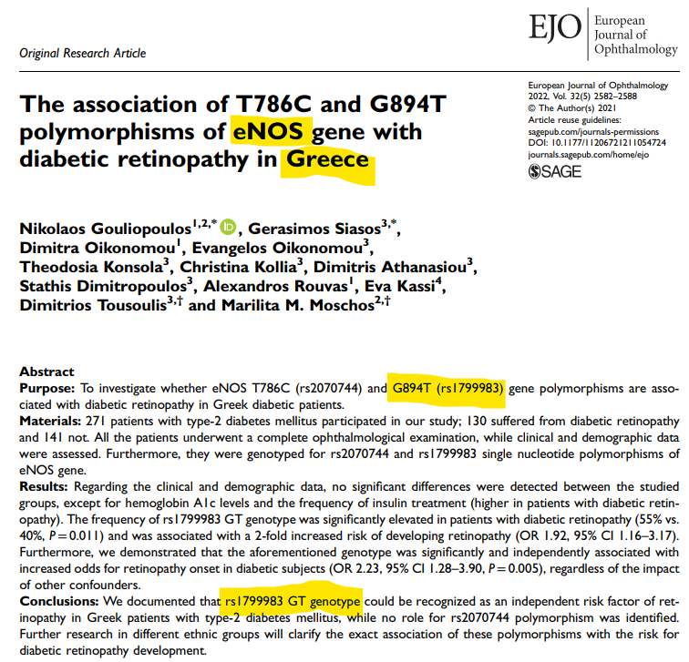

Slide 27
Classification
    rough classification
      non-proliferative (NPDR) or background (BDR)
      proliferative (PDR)
    classification systems
      ETDRS (gold standard)
      EURODIAB
      International Clinical Disease Severity Scale for DR
neovascularization marks the transition to the proliferative stage
Wu L, et al. World J Diabetes 2013; 4:290-4

Slide 28
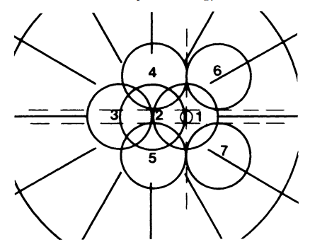
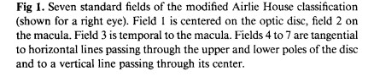
Classification - ETDRS
    modified Airlie House classification
      stereoscopic color fundus photography in 7 standard fields (30°)
    13 stages
      from no evidence of DR to the most advanced PDR stages
Early Treatment Diabetic Retinopathy Study Research Group. Ophthalmology 1991; 98(5 Suppl):786-806

Slide 29
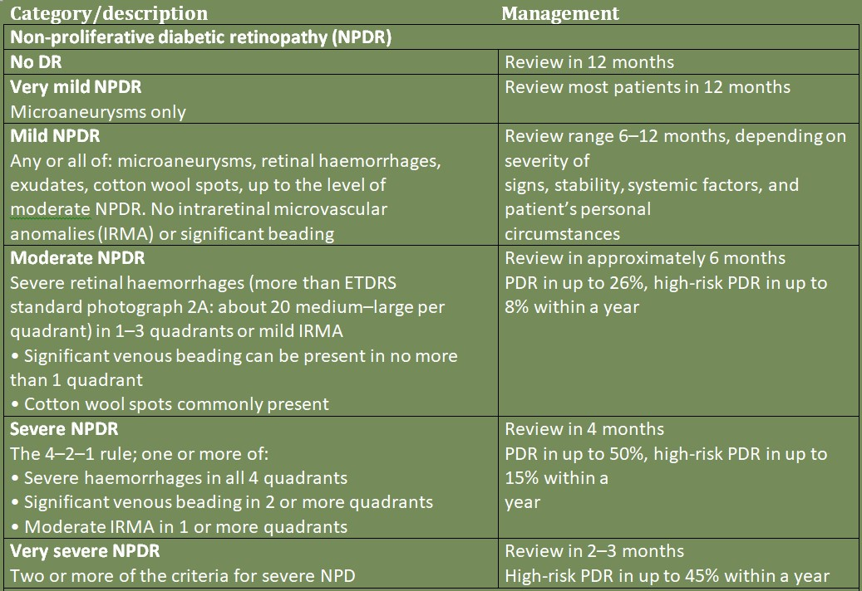
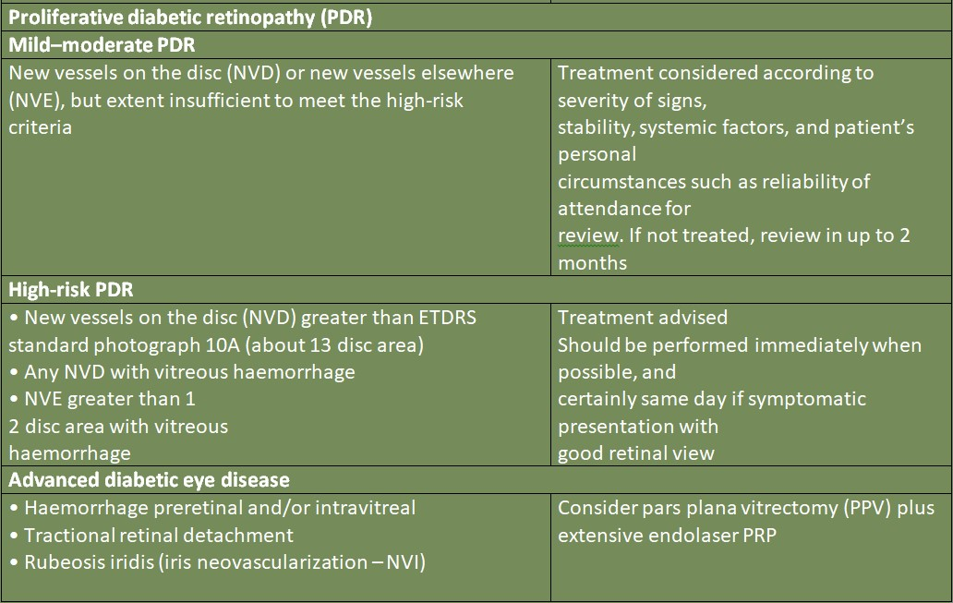
Bowling B (2016). Kanski’s Clinical Ophthalmology . A systematic approach (8th Edition). Elsevier

Slide 30
DR Grading
    Generally
      for first 2 years – 1 per year
        afterwards every 1 or 2 years
          depending on previous screening results
          no retinopathy at last two screenings:
            next screening in 2 years
          retinopathy detected
            screenings every 1 year
NICE Guidelines 2024

Slide 31

Pathophysiology
    microvascular disorder by retinal damage due to long-term DM effects
      damage to precapillary arterioles, capillaries and venules
    small blood vessels particularly vulnerable to damage from ↑↑ Glu
    direct hyperglycaemic effects on retinal cells possibly implicated
    DR initial damage to
      pericytes
      endothelial cells
      vascular basal lamina (thickening)
disruption of inner BRB
Antonetti DA, et al. N Engl J Med 2012; 366:1227-39
Bowling B (2016). Kanski’s Clinical Ophthalmology. A systematic approach (8th Edition). Elsevier

Slide 32
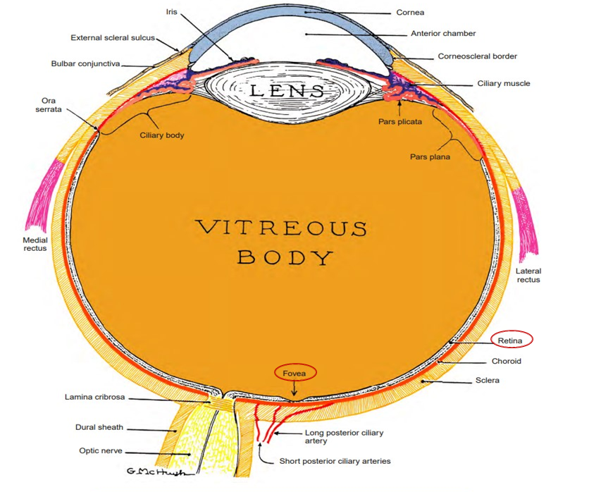
Pathophysiology
    NPDR
      increased vascular permeability/capillary leakage
      capillary occlusion → non perfusion → retinal ischemia
    PDR
      neovascularization due to retinal ischemia
        ≥ ¼ of the retina non-perfused before neovascularization
      new abnormal vessels may
        bleed into the vitreous
        cause a tractional retinal detachment
Wong TY, et al. Ophthalmology 2018; 125:1608-22
Solomon SD, et al. Diabetes Care 2017; 40:412-8.
Bowling B (2016). Kanski’s Clinical Ophthalmology. A systematic approach (8th Edition). Elsevier

Slide 33
Pathophysiology NPDR
    Hyperglycemia
      advanced glycation end products (AGEs) formation
        endothelial damage
          microaneurysms
            retinal hemorrhages
            leakage & exudates
    activated leukocyte adhering
        capillary occlusion
          retinal ischemia
          infarction of the nerve fiber layer
            cotton-wool spots
Wong TY, et al. Ophthalmology 2018; 125:1608-22
Fu X, et al. PLoS Comput Biol 2016; 12:e1004932

Slide 34
Pathophysiology DME
    chronic inflammation
    endothelial damage
    inner BRB breakdown
    increased vascular permeability
      fluid leaking into the retina (DME)
      hard exudates
    1st cause of vision loss in T2DM
Wong TY, et al. Ophthalmology 2018; 125:1608-22
Fu X, et al. PLoS Comput Biol 2016; 12:e1004932

Slide 35
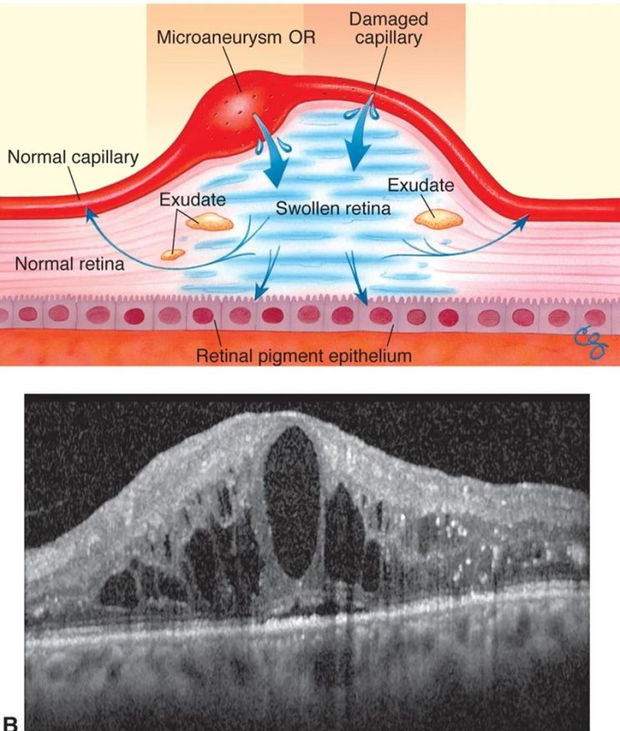
Pathophysiology DME

Slide 36
Pathophysiology PDR
    chronic retinal ischemia
      release of pro-angiogenic factors (mainly VEGF)
        neovascularization to bypass damaged retinal blood vessels
          adjacent to non-perfused retinal areas (NVE)
          optic disk (NVD)
          iris (NVI)
        new vessels
          immature, fragile, permeable, bleed very easily
          responsible for vitreous hemorrhage, tractional retinal detachment, neovascular glaucoma
Wang W, et al. Int J Mol Sci 2018; 19(6)
Falcão M, et al. The Open Circulation & Vascular Journal 2012; 3:30-42

Slide 37
Pathological Processes
    Hyperglycemia and the regulation of metabolic pathways
    Inflammation
    Oxidative stress
    Vascular abnormalities and angiogenesis pathways

Slide 38
Hyperglycemia & metabolic pathways
    chronic and excessive hyperglycemia → alternative Glu metabolism pathways
    polyol pathway - AGEs formation - PKC activation - hexosamine pathway flux
      activation of cytokines and growth factors (VEGF)
        endothelial dysfunction / inner BRB breakdown
        increased vascular permeability
        microvascular occlusion
          retinal ischemia
            IRMAs
            neovascularization
Whitehead M, et al. Expert Opin Biol Ther 2018; 18:1257-70

Slide 39
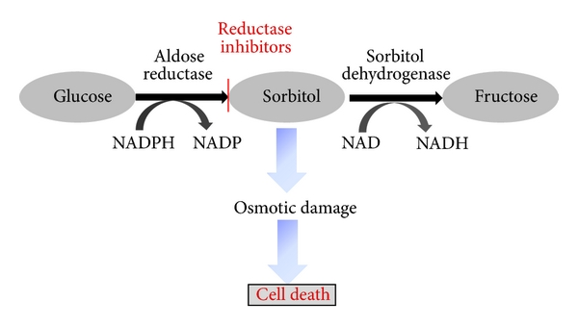
Hyperglycemia & metabolic pathways
    The Polyol Pathway
    excess Glu is metabolized via the polyol pathway to
      sorbitol
        intracellular accumulation
        osmotic damage → cellular death
      fructose
      deoxyglucosone
      ↓ NADPH availability
        ↑ sensitivity of affected cells to oxidative stress
deposition of AGEs
Gabbay KH. Annu Rev Med 1975; 26:521-36
Gabbay KH. N Engl J Med 1973; 288:831-6
Barnett PA, et al. Diabetes 1986; 35:426-32
Tarr JM, et al. ISRN Ophthalmol. 2013; 2013:343560

Slide 40
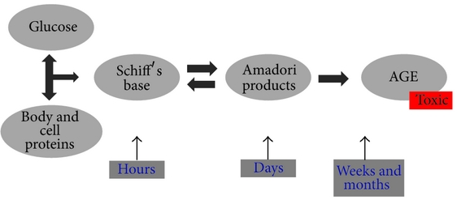
Hyperglycemia & metabolic pathways
    AGEs formation
    ↑↑ Glu → ↑↑ AGEs formation and accumulation in DM patients
      alter the structure and function of the proteins
      thickening of capillary basement membranes
      pericyte loss
        inner BRB breakdown
Peppa M, et al. Clinical Diabetes 2003; 21:186
Tarr JM, et al. ISRN Ophthalmol. 2013; 2013:343560

Slide 41
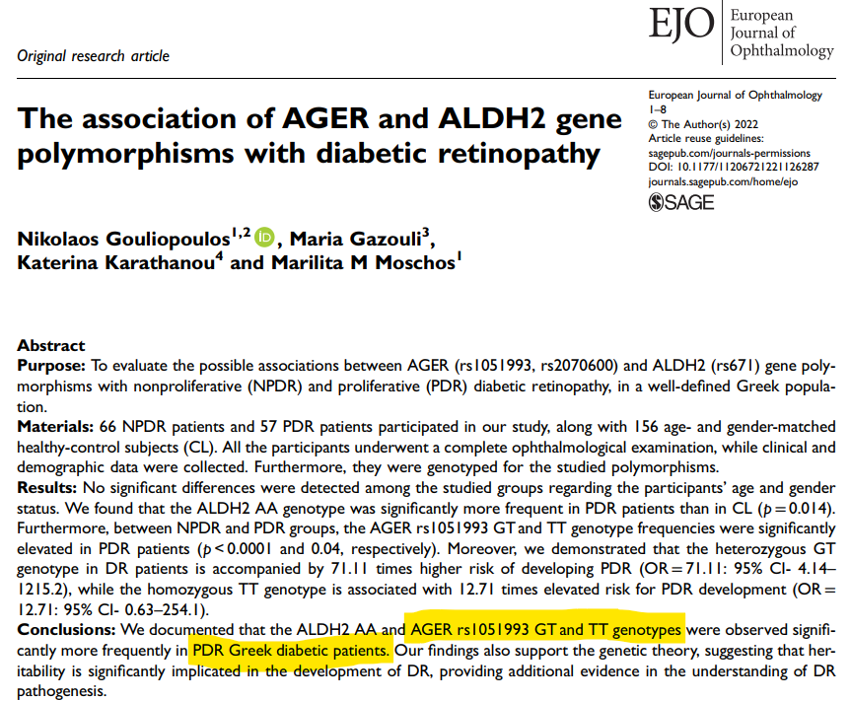
Hyperglycemia & metabolic pathways
      AGEs receptors (AGERs) activation
      pro-oxidant cascades
      pro-inflammatory cascades
        ↑oxidative stress
        ↑ leukocyte adhesion
      AGER inhibition in mice prevents DR development
      AGER gene polymorphisms alter the AGE/AGER binding
        beneficial or detrimental effect on diabetic vascular complications development
Hammes HP, et al. Proc Natl Acad Sci U S A 1991; 88:11555-8
Gouliopoulos N, et al. Eur J Ophthalmol 2022 Sep 13: (Epub ahead of print)

Slide 42
Hyperglycemia & metabolic pathways
    PKC Activation
    ↑↑ Glu → ↑ glycolysis → ↑ diacylglycerol (DAG) synthesis
      PKC pathway activation
        mitogen-activated protein kinase (MAPK) factors activation
          ↑ stress-related proteins
          ↑ mediators of vascular function (e.g. VEGF and such as c-Jun kinases)
        ↑↑ NADPH oxidase
        ↑↑ NFκB in vascular cells
oxidative stress and inflammation
Xia P, et al. Diabetes 1994; 43:1122-9
Koya D, et al. Diabetes 1998; 47:859-66
Rosse C, et al. Nat Rev Mol Cell Biol 2010; 11:103-12
Wang QJ, et al. Trends Pharmacol Sci 2006; 27:317-23

Slide 43
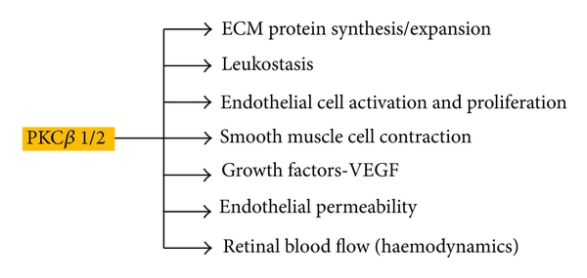
Hyperglycemia & metabolic pathways
    PKC Activation
    PKC: a 10 enzymes family
      β1/2 isoform associated with DR development
Tarr JM, et al. ISRN Ophthalmol. 2013; 2013:343560

Slide 44
Hyperglycemia & metabolic pathways
    Hexosamine Pathway Flux
    activated when ↑↑ intracellular Glu cannot be drained by glycolysis
        most of it is converted to glucose-6-phosphate (G6P) →
          converted to fructose-6-phosphate (F6P)
            in vascular cells
              ↑ TGFβ
              ↑ PAI-1
multiple factors involved in DR development are affected
Wells L, et al. Science 2001; 291(5512):2376-8
Hart GW, et al. Annu Rev Biochem 1997; 66:315-35

Slide 45
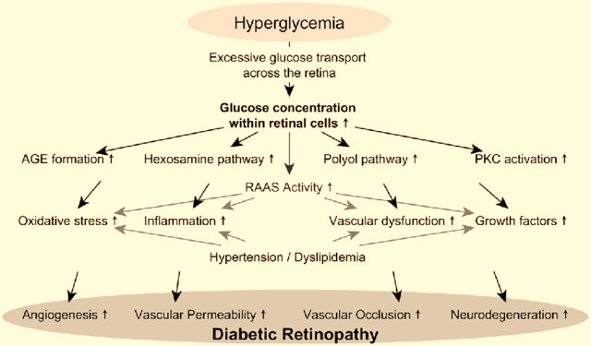
May M, et al. Ther Adv Endocrinol Metab 2019; 10:2042018819891886

Slide 46
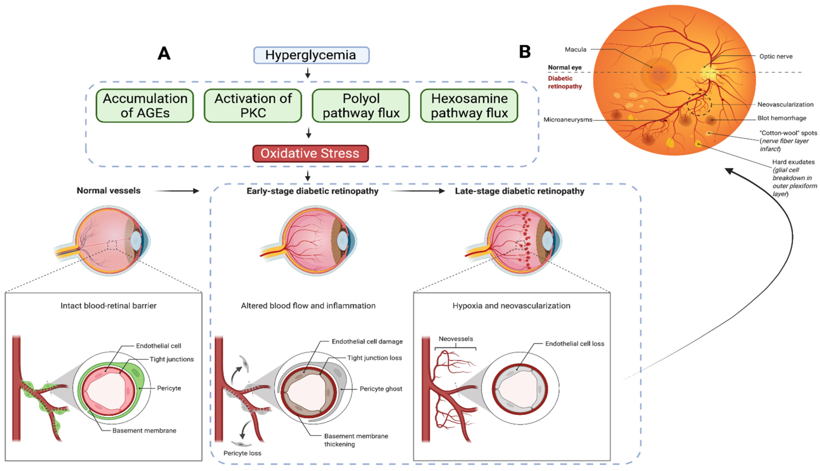
Chauhan MZ, et al. Cells 2022; 11:1950

Slide 47
Pathological Processes
    Hyperglycemia and the regulation of metabolic pathways
    Inflammation
    Oxidative stress
    Vascular abnormalities and angiogenesis pathways

Slide 48
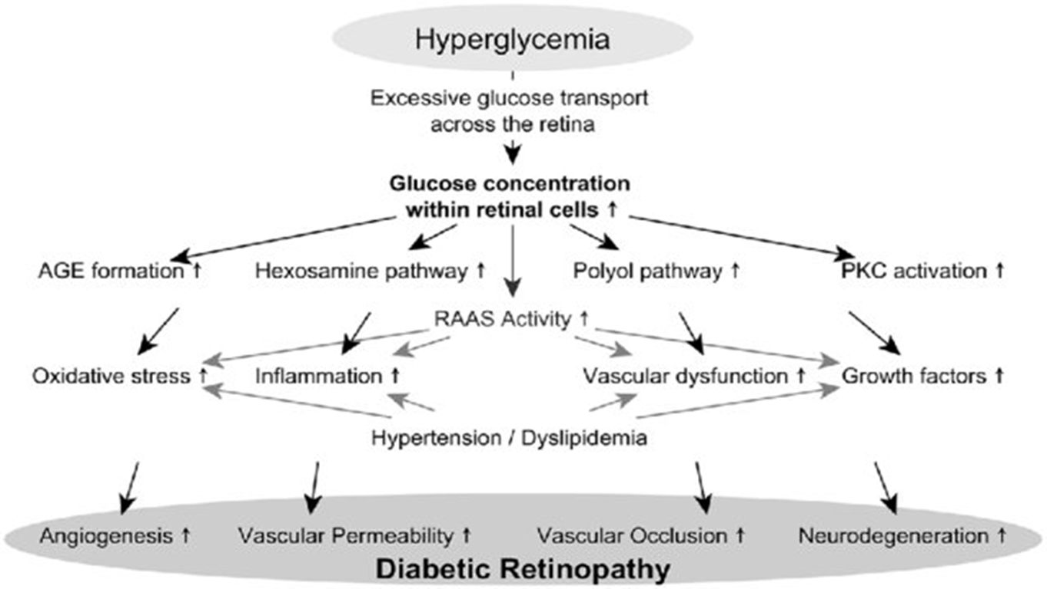
Inflammation
    key factor in DR pathogenesis
      simultaneous course of multiple metabolic pathways
        oxidative stress
        AGEs
        ↑ VEGF expression
inflammatory response

Slide 49
Inflammation
    chronic low-grade inflammation
      capillary occlusion
      hypoxia
        ↑ VEGF expression
    leukostasis
      retinal microvasculature occlusion
      endothelium damage
      inner BRB breakdown
Joussen AM, et al. Faseb j 2003; 17:76-8
Schroder S, et al. Am J Pathol 1991; 139:81-100

Slide 50
Inflammation
    hyperglycemic stress → microglia activation → retinal glial cell dysfunction
      ↑ secretion of
    anti-inflammatory drugs (e.g. intravitreal triamcinolone acetonide and topical application of NSAIDs like nepafenac)
      ↓ VEGF expression
      ↓ vascular permeability
      inhibition of retinal cell death
      diminished leukostasis
      improved visual acuity
        TNF-α
        IL-6
        MCP-1
        VEGF
endothelial impairment
leukocyte adherence to retinal endothelium
Kern TS, et al. Diabetes 2007; 56:373-9
Gillies MC, et al. Ophthalmology 2006 113:1533-8
Kuppermann BD, et al. Arch Ophthalmol 2007; 125:309-17

Slide 51
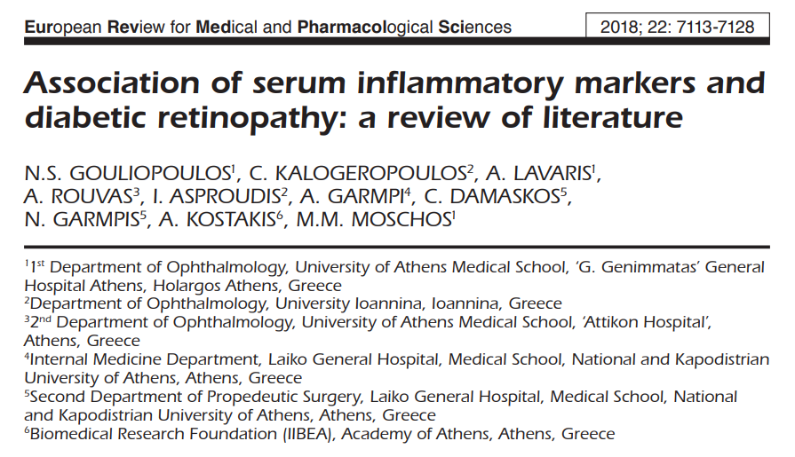
CRP ≥3 mg/L
  possible independent RF for DR development – more prominent if BMI >30kg/m²
TNF-α
  positive correlation with DR severity (EURODIAB Prospective Complications Study)
  strong and independent RF for both PDR and DME
  ↑ TNF-α serum levels by 10 pg/mL → 2-fold ↑ risk of PDR and/or DME
  baseline TNF-α levels ≥3.4 pg/mL → 3-fold ↑ risk of PDR and/or DME
IL-6
  presence of DR and disease severity in both DM types
ICAM-1
  baseline levels ≥165pg/mL → 3-fold ↑ risk of DME
E-selectin
  baseline levels ≥40 pg/mL → 2-fold ↑ risk of PDR
PAI-1
  independent and strong RF for DR incidence in T2DM, especially for severe PDR stages
  DR development risk ↑ by 12% for each 10ng/dL ↑in baseline PAI-1 levels

Slide 52
Pathological Processes
    Hyperglycemia and the regulation of metabolic pathways
    Inflammation
    Oxidative stress
    Vascular abnormalities and angiogenesis pathways

Slide 53
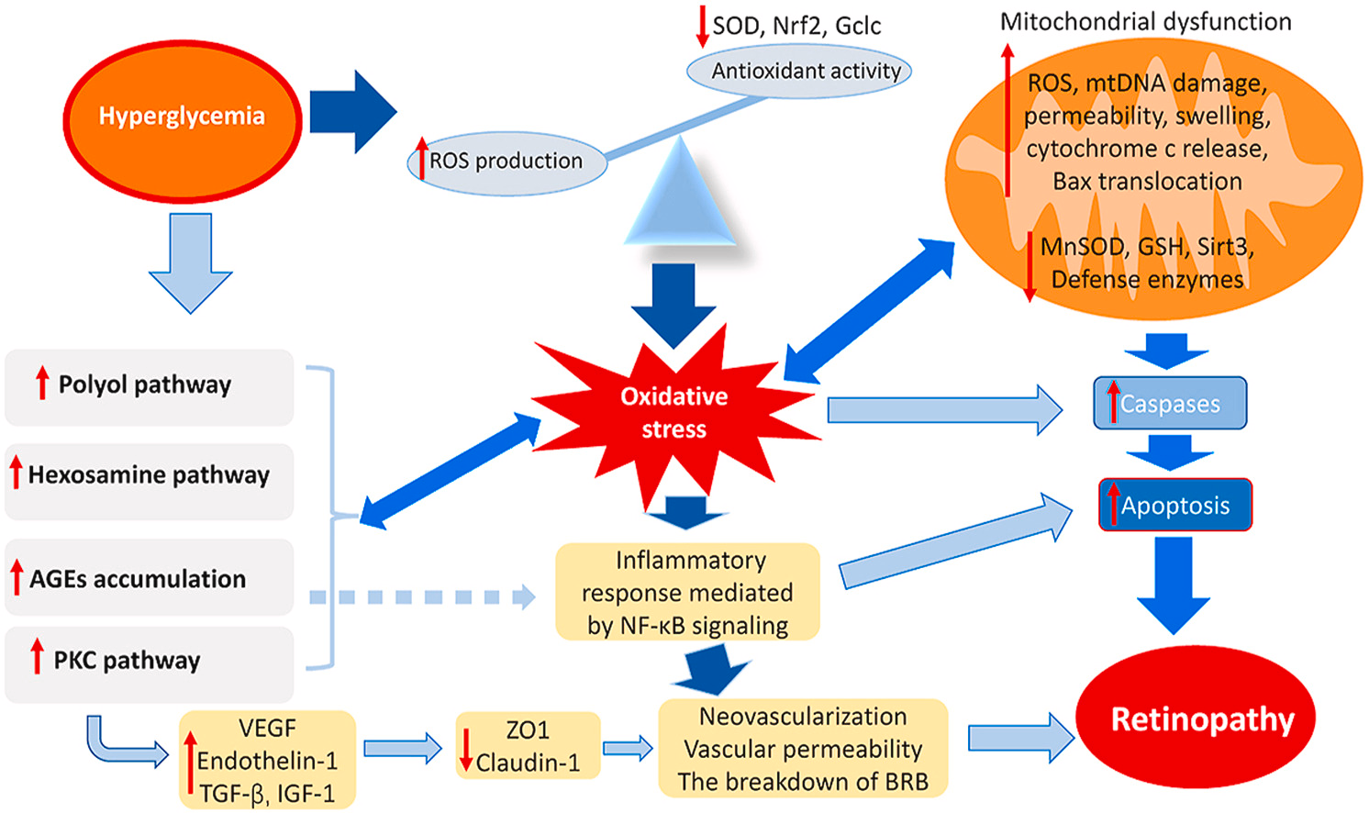
Oxidative stress
Kang Q, et al. Redox Biol 2020;37:101799

Slide 54
Pathological Processes
    Hyperglycemia and the regulation of metabolic pathways
    Inflammation
    Oxidative stress
    Vascular abnormalities and angiogenesis pathways

Slide 55
Vascular abnormalities and angiogenesis pathways
    hyperglycemia
      pericyte loss
      endothelial cells apoptosis
      basement membrane thickening
        inner BRB impairment
          leakage and exudates
      pericytes - responsible capillaries structure
        microaneurysm formation
      pronounced pericytes and endothelial cells loss
        capillary occlusion and ischemia
          ↑↑ VEGF via hypoxia-inducible factor 1 (HIF-1) activation
            neovascularization
Feldman-Billard S, et al. Diabetes Metab 2018; 44:4-14
Schmidt-Erfurth U, et al. Prog Retin Eye Res 2018; 67:1-29
Bressler NM, et al. N Engl J Med 2011; 365:1520-6

Slide 56
Association with systemic vascular dysfunction
    diabetic microvascular disease (DMD) (including DR)
      large vessel atherosclerosis via
        hypoxia
        alterations in vasa vasorum
        diminishing NO bioavailability in the vasculature
        activating pro-inflammatory mechanisms
      association with ↑ morbidity in the setting of acute coronary syndromes or strokes
    debatable whether DMD precedes large vessel atherosclerosis or they progress in parallel
Brownrigg JRW, et al. Lancet Diabetes Endocrinol 2016; 4:588–97
Antonopoulos AS, et al. Diabetes Care 2015; 38:e180–1
Antonopoulos AS, et al. Cardiovasc Res 2017; 113:1074–86

Slide 57
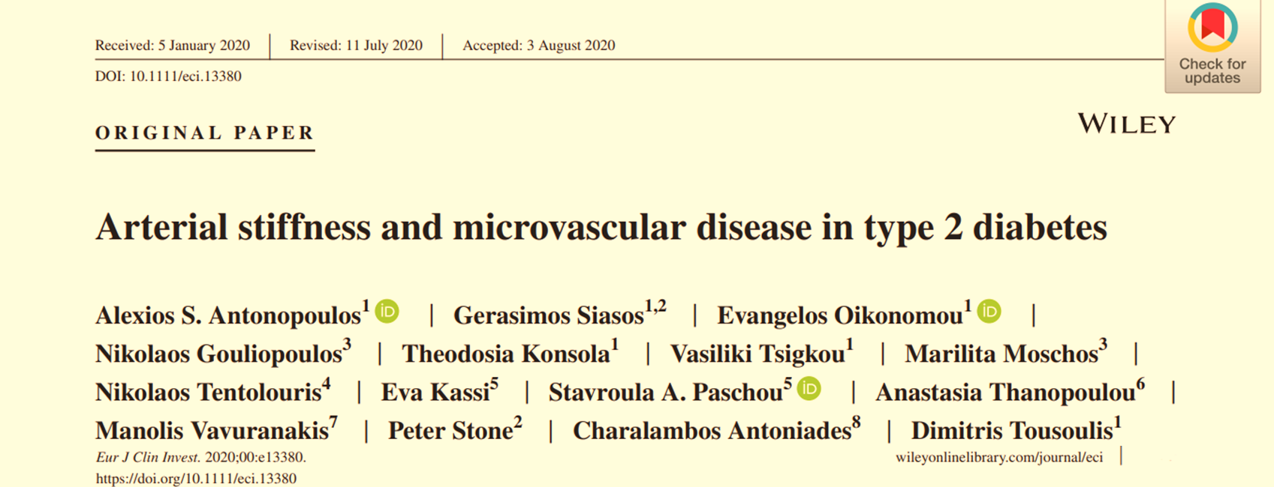
    presence of DMD (DR): independently predict
      hospitalization for heart failure
      future mortality cardiovascular disease risk
      non-fatal myocardial infarction
    absence of DR at baseline screening
      association with no mortality events in T2DM during the follow-up period (~30 months)

Slide 58
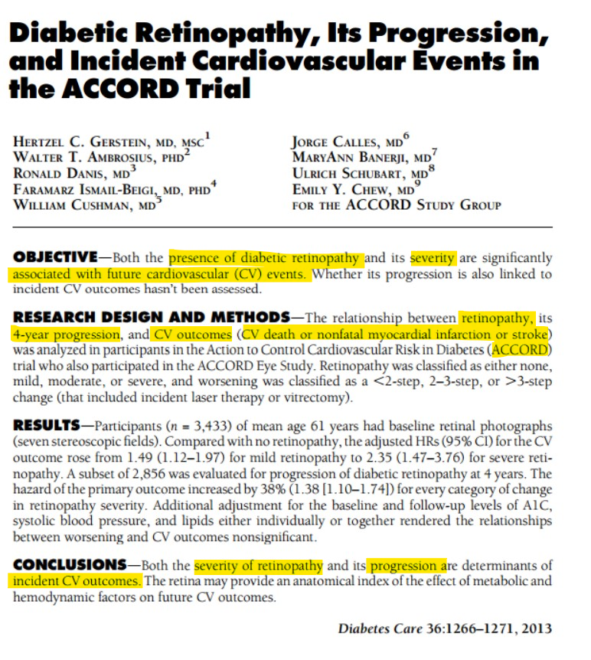

Slide 59
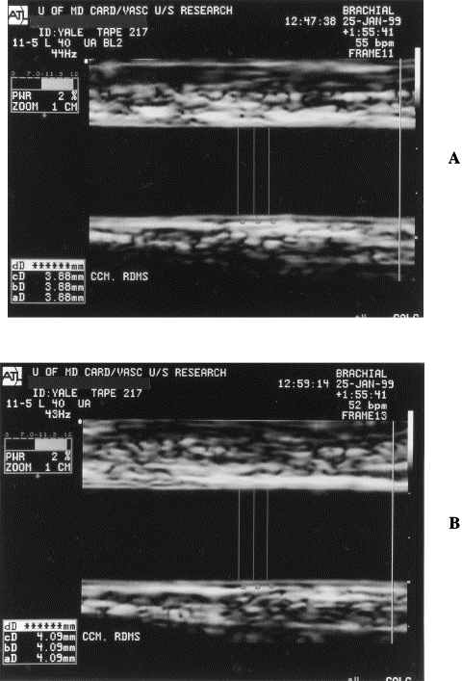
Flow-mediated dilatation
Resting diameter (RD)
Hyperemic diameter (HD)
HD -RD
RD
FMD =
Corretti M, et al. J Am Coll Cardiol 2002;39:257-65

Slide 60


Arterial Stiffness
Measurement of arterial stiffness by applanation tonometry with pulse-wave velocity has been the gold-standard method and is well-validated in large populations as a strong predictor of adverse cardiovascular outcomes.
A
Delay time from the R-top (ECG) to the 10% arterial diameter increase with pulse
Non-simultaneous recording
Distance
PWV =
Transit time
B
Cavalcante JL, et al. J Am Coll Cardiol 2011; 57:1511-22

Slide 61
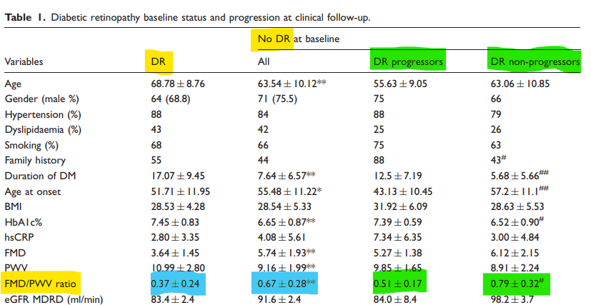
Association with systemic vascular dysfunction
      composite marker FMD/PWV
        index of systemic vascular function
Gouliopoulos N, et al. Eur J Prev Cardiol 2017; 24:1405-7

Slide 62
Association with systemic vascular dysfunction
      The Framingham Study: T2DM
        association between DR and macroangiopathy
          several common RFs between macro- and micro-angiopathy
      DR and endothelial dysfunction in T2DM
        strongly, positively and independently associated
        impaired FMD values
          independent predictor for DR progression
      arterial stiffness
        ↑ PWV in DR vs non-DR
          positive correlation among PWV, DM duration and the accumulation of AGEs in the aorta
          DR progression associated with
            DM duration
            AGEs accumulation
AGEs accumulation due to long-term glycemic exposure: the common mechanism of arterial stiffness and DR
Hiller R, et al. Am J Epidemiol 1988; 128:402-9
Siasos G, et al. Diabetes Care 2015 ; 38:e9-e10
UK Prospective Diabetes Study Group. BMJ 1998;317:703–13

Slide 63
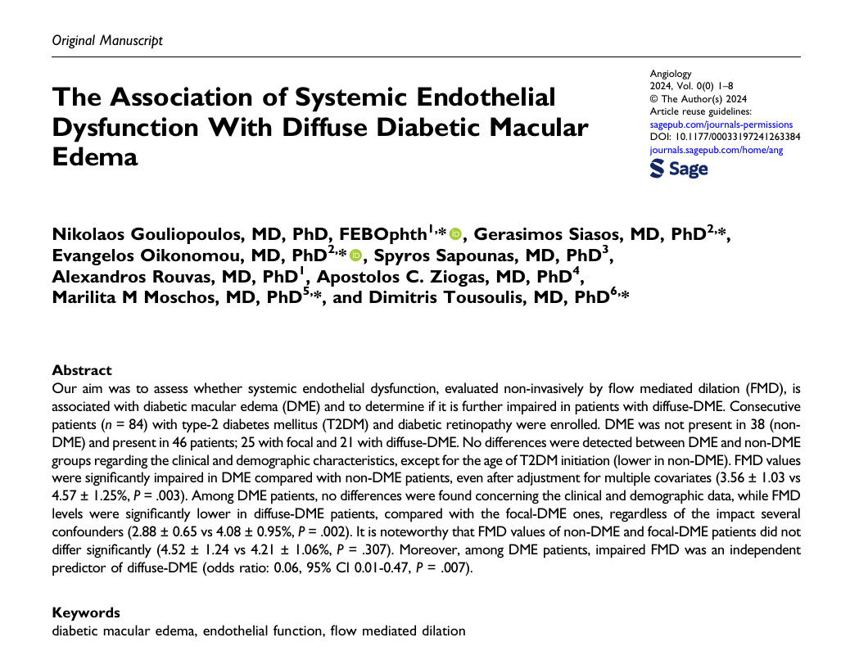
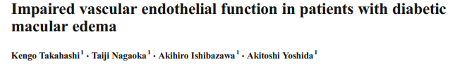

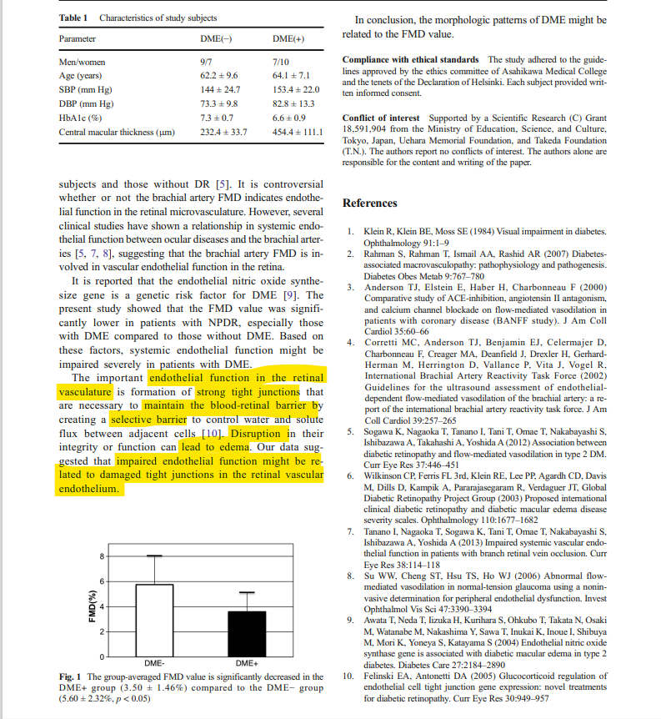

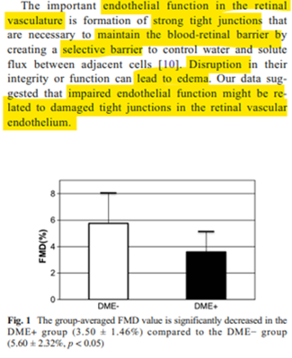








Association of DME with systemic vascular dysfunction

Slide 64
Findings NPDR
Microaneurysms
Retinal haemorrhages
  flame shaped
  dot blot
  dark round
Exudates
DME
  focal
  diffuse
Ischaemic retinopathy/maculopathy
Cotton wool spots
Venous changes
  beading
  dilatation and tortuosity
  looping
  ‘sausage’ like segmentation
IRMAs
Arterial Changes
  peripheral narrowing
  ‘silver wiring’
  obliteration
Bowling B (2016). Kanski’s Clinical Ophthalmology . A systematic approach (8th Edition). Elsevier

Slide 65
Findings PDR
retinal neovascularization
  ≥ ¼ of the retina non-perfused before PDR development
  preretinal neovascularization anywhere in the retina
    mainly at the posterior pole
  fibrous tissue development along with the new vessels
neovascularization of the optic disc (NVD)
neovascularization of the iris (NVI)
vitreous/preretinal haemorrhages
tractional retinal detachment
Bowling B (2016). Kanski’s Clinical Ophthalmology . A systematic approach (8th Edition). Elsevier

Slide 66
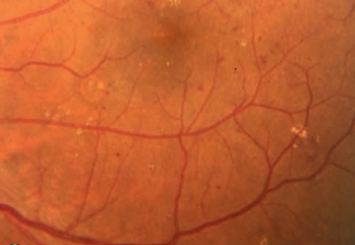
flame shaped haemorrhages
exudates
dot-blot haemorrhages
Bowling B (2016). Kanski’s Clinical Ophthalmology . A systematic approach (8th Edition). Elsevier

Slide 67
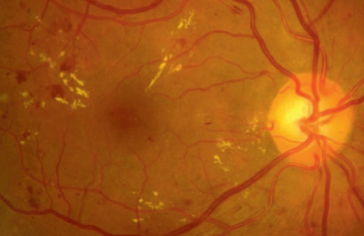
flame shaped haemorrhages
microaneurysms
exudates
Bowling B (2016). Kanski’s Clinical Ophthalmology . A systematic approach (8th Edition). Elsevier

Slide 68
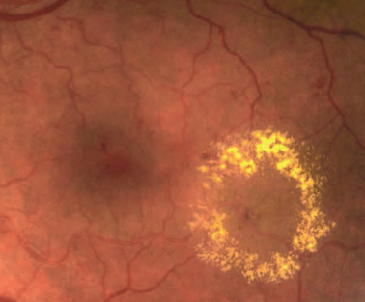
ring of exudates
diabetic macular edema
Bowling B (2016). Kanski’s Clinical Ophthalmology . A systematic approach (8th Edition). Elsevier

Slide 69

‘sausage’ like segmentation
venous looping
venous beading
Bowling B (2016). Kanski’s Clinical Ophthalmology . A systematic approach (8th Edition). Elsevier

Slide 70


IRMAs
arteriolar–venular shunts
bypass the capillaries
adjacent to areas of marked capillary hypoperfusion
do not cross major blood vessels
sign of retinal ischemia
↑ risk to PDR progression
better identified with fluorescein angiography (DD from neovascuarization)
Bowling B (2016). Kanski’s Clinical Ophthalmology . A systematic approach (8th Edition). Elsevier
Basic and Clinical Science Cource 2019-2020 (2020). Retina and Vitreous (12). American Academy of Ophthalmology

Slide 71


neovascularization of optic disc (NVD)
(up to 1 optic disc diameter from the optic disc margin)
Bowling B (2016). Kanski’s Clinical Ophthalmology . A systematic approach (8th Edition). Elsevier
Basic and Clinical Science Cource 2019-2020 (2020). Retina and Vitreous (12). American Academy of Ophthalmology

Slide 72


fibrovascular tissue
pre-retinal haemorrhage
neovascularization elsewhere in the retina (NVE)
Bowling B (2016). Kanski’s Clinical Ophthalmology . A systematic approach (8th Edition). Elsevier
Basic and Clinical Science Cource 2019-2020 (2020). Retina and Vitreous (12). American Academy of Ophthalmology

Slide 73

iris neovascularization (NVI)
Bowling B (2016). Kanski’s Clinical Ophthalmology . A systematic approach (8th Edition). Elsevier

Slide 74



Examination Techniques
    ophthalmoscopy after pupils dilation
      direct ophthalmoscopy
      indirect ophthalmoscopy
      slit-lamp biomicroscopy
    fundus photography
    fluorescein angiography (FA)
    optical coherence tomography (OCT)
    OCT angiography (OCT-A)
Wong TY, et al. Ophthalmology 2018;125:1608-22

Slide 75

less experienced examiners
refractive errors in patient’s and examiner’s eye are corrected
erect and magnified (~ x15) retina
in a slightly darkened room
dilated patient’s pupils
available green filter

Slide 76






Slide 77




Slide 78


Slide 79
Fundus Photography
    color
    red-free (a green filter ~540–570nm blocks red wavelengths of light)
      superficial lesions
      DR assessment and progression: vascular abnormalities, hemorrhages, IRMAs, NVD, NVE
    dilation frequently not required
      useful in eyes with bad dilation (e.g. pseudoexfoliation syndrome, a-blockers) & during pregnancy and lactation (!!!)
        drops used for dilation are classified as “category C” in pregnancy
        unknown whether they are excreted in human milk
    disease progression monitored over time
Ng E, et al (2014). Ophthalmological Imaging and Applications. CRC Press

Slide 80



Slide 81
Fluorescein Angiography
    fluorescence
      molecules emit a ↑ wavelength light after stimulation by a ↓ wavelength light
      fluorescein: excitation peak ~490nm (blue spectrum), stimulated molecules: emit yellow–green light (~530nm)
      fluorescein (sodium fluorescein)
        orange water-soluble dye
        after intravenous injection →mainly intravascular (>70% bound to serum proteins)
        urine excretion over 24–36 hours
    fluorescein angiography (FA)
      photographic surveillance of the passage of fluorescein through the retinal and choroidal circulations after intravenous injection
Bowling B (2016). Kanski’s Clinical Ophthalmology . A systematic approach (8th Edition). Elsevier

Slide 82


in DM possibly extended time
Bowling B (2016). Kanski’s Clinical Ophthalmology . A systematic approach (8th Edition). Elsevier

Slide 83


Bowling B (2016). Kanski’s Clinical Ophthalmology . A systematic approach (8th Edition). Elsevier

Slide 84

    intact inner BRB
      neither bound nor free fluorescein can pass
      disrupted inner BRB
        leakage of both bound and free fluorescein into the extravascular space
    classifying disease severity
    guiding laser therapy
    evaluating response to therapy
    required for anti-VEGF treatment approval
Bowling B (2016). Kanski’s Clinical Ophthalmology . A systematic approach (8th Edition). Elsevier

Slide 85



capillary non-perfusion
ischemia
preretinal haemorrhage
microaneurysms
diffuse DME
neocascularization
Dithmar S, Holz FG (2007). Fluorescence Angiography in Ophthalmology. Springer

Slide 86
Optical Coherence Tomography
Optical Coherence Tomography (OCT)
  non-invasive diagnostic technique
  in vivo cross sectional view of the retina (at least 10-15 microns)
OCT in DR
  presence and location
    intraretinal and/or
    subretinal fluid
    retinal thickness evaluation
    useful tool in monitoring whether the macular edema is responding to therapy
Huang D, et al. Science 1991; 254:1178-1181

Slide 87
Mohandass G, et al. Biomed Pharmacol J 2017;10(3)

Slide 88




Slide 89
OCT-Angiography
    OCT angiography (OCT-A)
      novel non-invasive technique for imaging the microvasculature of the retina and the choroid
      laser light reflectance of the surface of moving red blood cells accurately depict vessels through different segmented areas of the eye
      in DR:
        identification of new vessels
        quantification of foveal avascular zone
        quantification of non-perfused areas
Koustenis A, et al. Br J Ophthalmol 2017; 101: 16-20
Samara WA, et al. Ophthalmology 2017; 124:235-44
Spaide RF. Et al. Am J Ophthalmol 2015; 160:1200-10
Fingler J, et al. Investig Ophthalmol Vis Sci 2008; 49:5055-9

Slide 90



FAZ enlargement
hypo-intense lesions due to DME
Coscas G et al. Atlas OCT-Angio in diabetic maculopathy. L’europeenne d’editions

Slide 91


Initial Screening and Referral
    American Academy of Ophthalmology guidelines
      1st retinal examination for DM patients
        T1DM: 3-5y after diagnosis
        T2DM: at the time of diagnosis
        Pregnancy (T1DM or T2DM)
          soon after conception
          early in the 1st trimester of pregnancy
    eye examination not required if non-DM patients newly develop gestational diabetes during pregnancy
Flaxel CJ, et al. Ophthalmology 2020; 127:P66-P145

Slide 92
Treatment
    General
    patient‘s education
    optimized diabetic control
    optimized control of other RFs (e.g. hypertension, hyperlipidaemia, renal disease, anemia, smoking discontinuation)
    Fenofibrate 200mg/day (should be considered)
    Statins (NICE guidelines: prevention of progression of non-PDE and DME)
Kang Q, et al. Redox Biol 2020;37:101799

Slide 93
Treatment
    General – Follow Up
    stage of diabetic retinopathy
    HbA1c level
    renal function
    blood pressure
Kang Q, et al. Redox Biol 2020;37:101799

Slide 94


Treatment
    DME
    intravitreal injections of anti-VEGF agents
    laser photocoagulation
      grid or focal
    micropulse subthreshold laser
    intravitreal dexamethasone implant
    intravitreal triamcinolone
    pars plana vitrectomy
    PDR
    panretinal photocoagulation
    intravitreal injection of ranibizumab (anti-VEGF agent)
    pars plana vitrectomy

Slide 95


Notes:
Κ τέλος το 2^{ο} περιστατικό μας. Ο 32χρονος αυτός διαβητικός ασθενής προσήλθε στις 4/10 με την παρακάτω εικόνα βυθού στον ΑΟ. Είναι ξεκάθαρο ότι πρόκειται για μια πολύ προχωρημένη παραγωγική διαβητική αμφιβληστροειδοπάθεια. Αντίστοιχη ήταν και η εικόνα στον δεξιό οφθαλμό. Εκείνη την ημέρα πάρθηκαν οι λήψεις με την oct αγγειογραφία και ο ασθενής υποβλήθηκε κ σε φλουροαγγειογραφία.

Slide 96


Notes:
βλέπουμε στην 24ρα λήψη με το angio oct πόσο καλά απεικονίζονται οι νεοαγγειακοί θύσανοι και οι ισχαιμικές περιοχές στον δεξιό οφθαλμό

Slide 97


Notes:
αυτές τις εικόνες τις προσέθεσα μόνο κ μόνο για να φανεί πόσο ωραία καταγράφεται η επέκταση των νεοαγγειώσεων προς το υαλοειδές

Slide 98

Notes:
αυτές τις εικόνες τις προσέθεσα μόνο κ μόνο για να φανεί πόσο ωραία καταγράφεται η επέκταση των νεοαγγειώσεων προς το υαλοειδές

Slide 99


Notes:
αντίστοιχα εδώ βλέπετε και την φλουροαγγειογραφία που χρειαζόταν για τον σχεδιασμό της παναμφιβληστροειδικής φωτοπηξίας

Slide 100

Notes:
6 ημέρες αργότερα, στις 10/10 προσήλθε για να υποβληθεί σε PRP με το navilas και στους 2 οφθαλμούς. Όπως βλέπετε ομως χαρακτηριστικά είχε προκληθεί μία εκτεταμένη προαμφιβληστροειδική αιμορραγία κάτω και ρινικά του οπτικού δίσκου στον αριστερό οφθαλμό

Slide 101

Notes:
και στα 4 τεταρτημόρια όπως βλέπετε.

Slide 102

Thank you for your attention !

Slide 103


Slide 104


