Slide 1
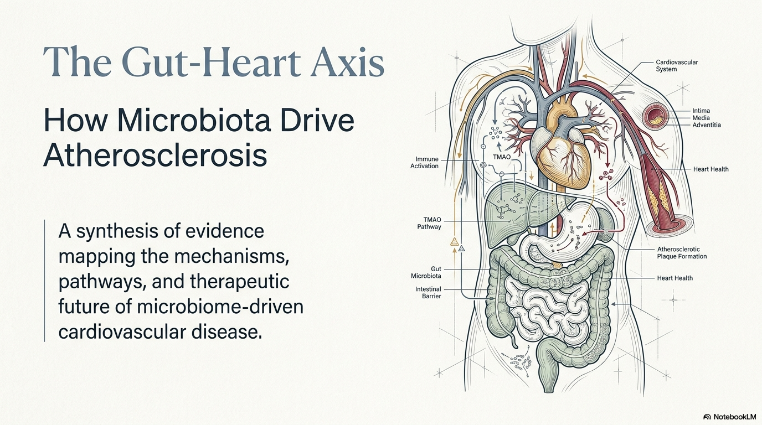

Slide 2
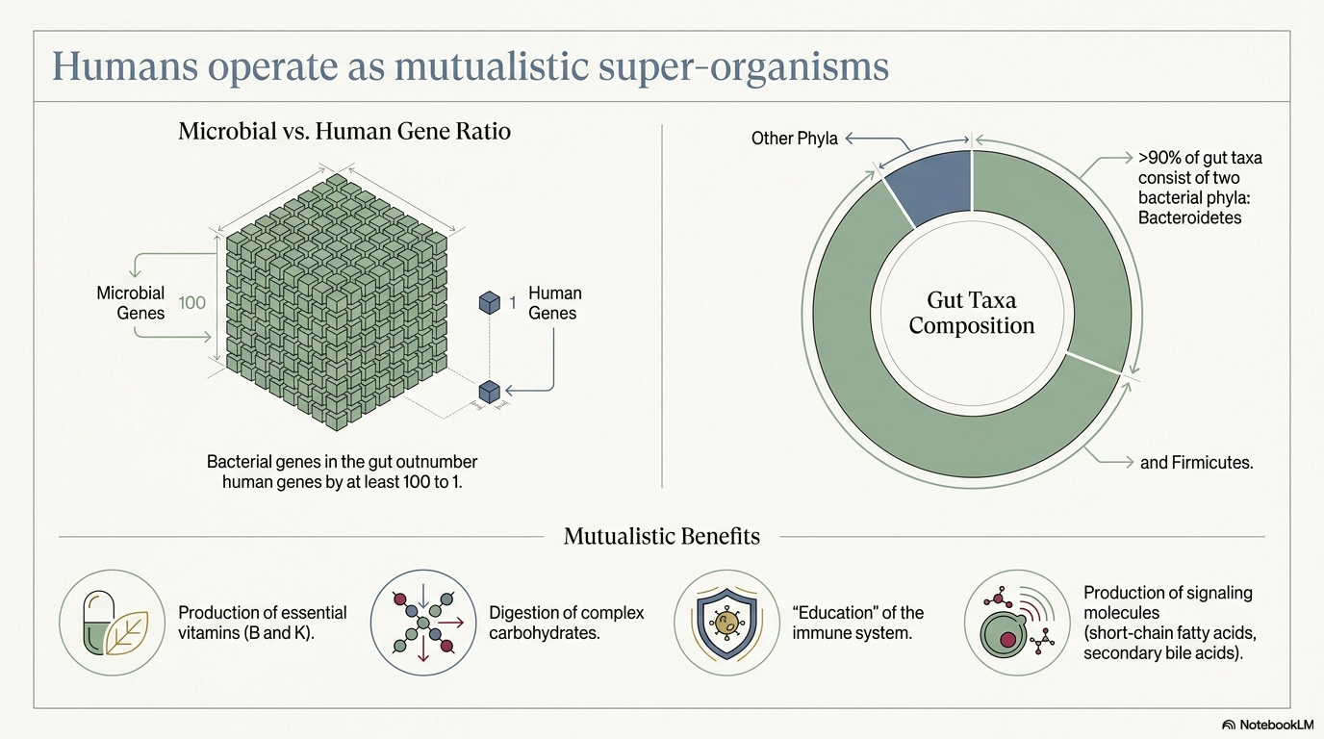

Slide 3
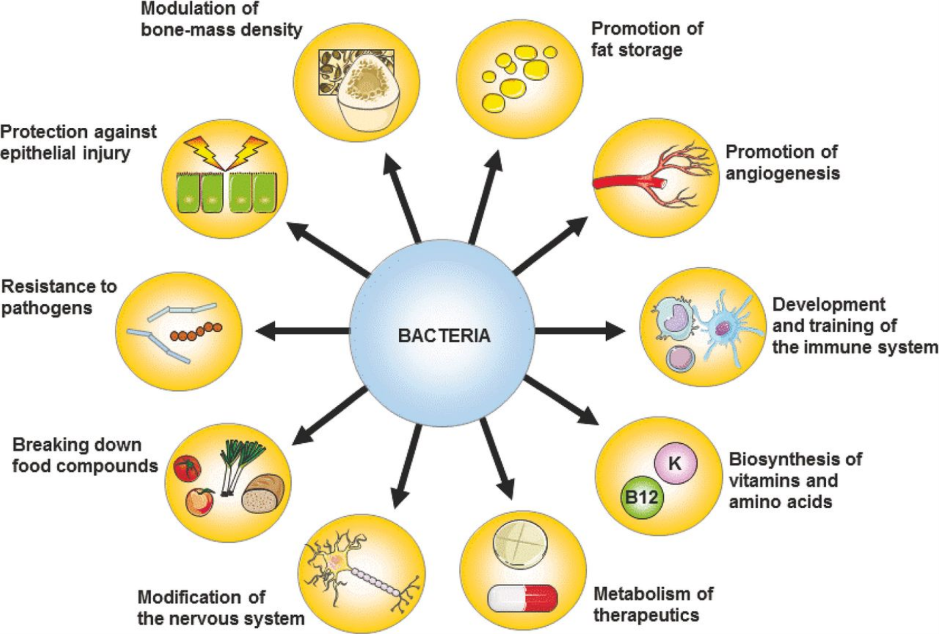
Functions of the intestinal microbiota
Modulation of bone-mass density
Promotion of fat storage
Protection against epithelial injury
Promotion of angiogenesis
Potection against epithelial injury
Resistance to pathogens
Development and training of the immune system
Breaking down of food compounds
Biosynthesis of vitamins and amino acids
Modification of the nervous system
Metabolism of therapeutics
FEMS Microbiol Rev. 2016;40:117-132.

Slide 4
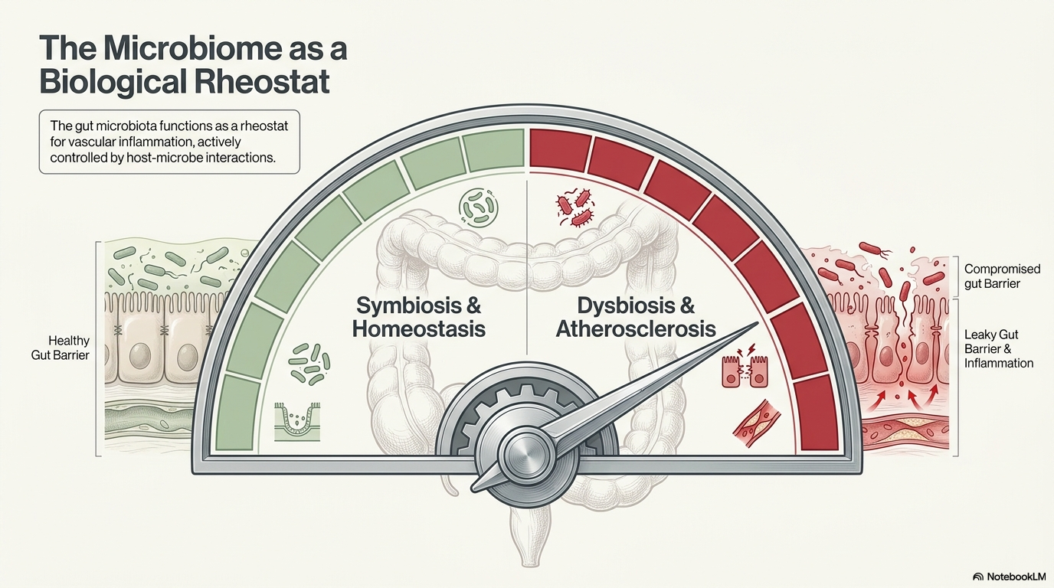

Slide 5
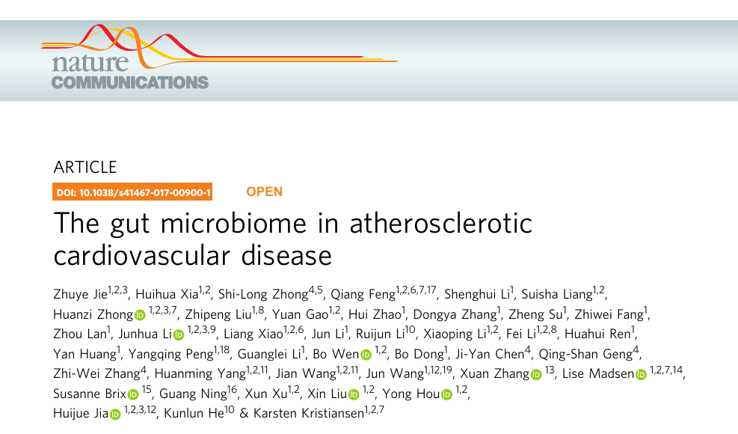

Slide 6
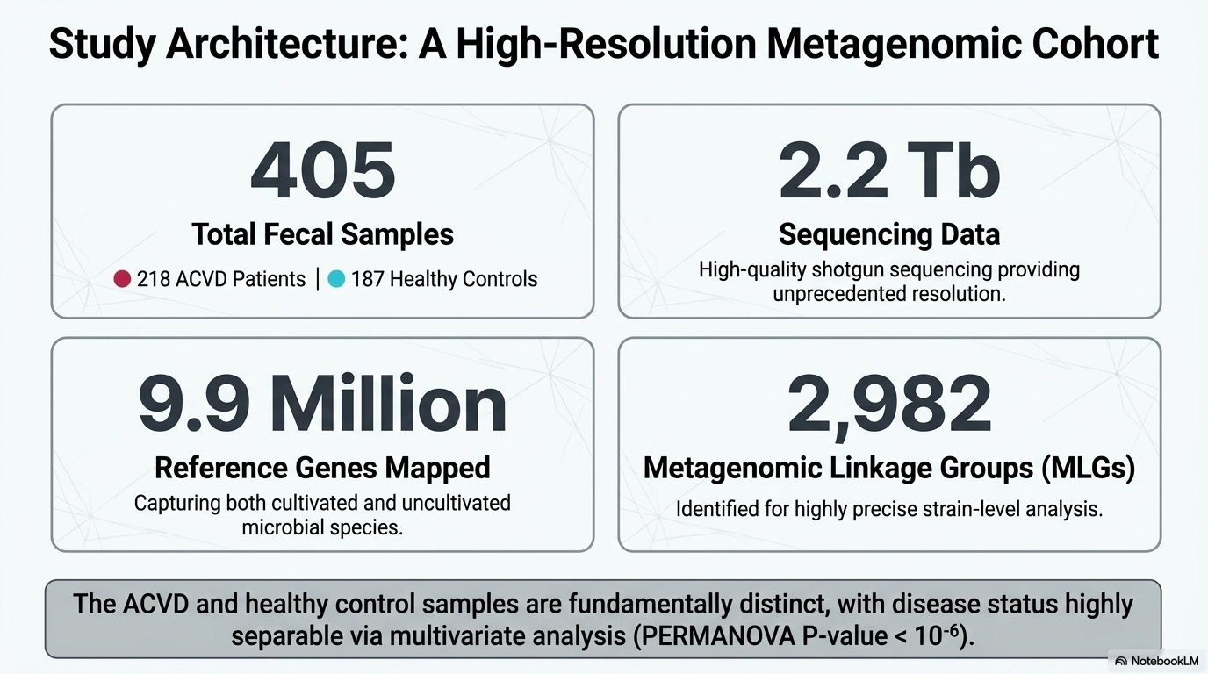

Slide 7
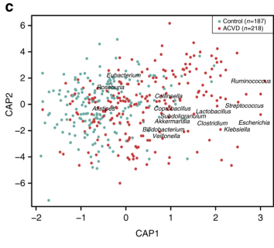
The intestinal microbiota discriminates between atherosclerotic patients and controls
CAP constrained analysis for beta diversity
Nat Commun. 2017;8:845.

Slide 8
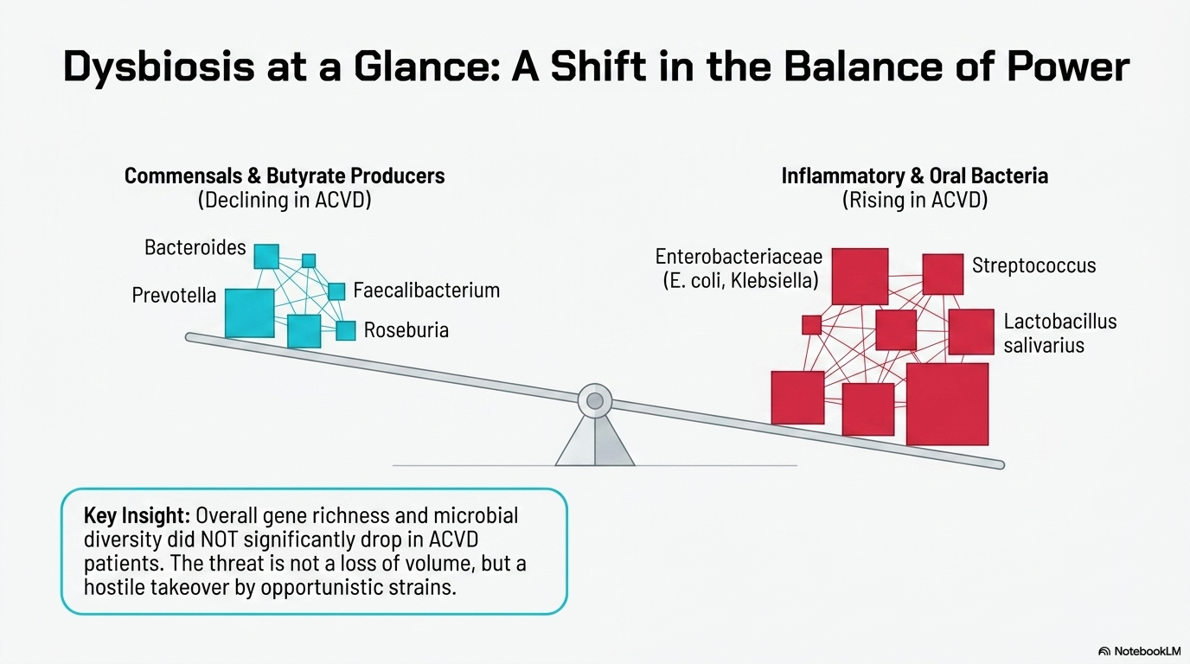

Slide 9
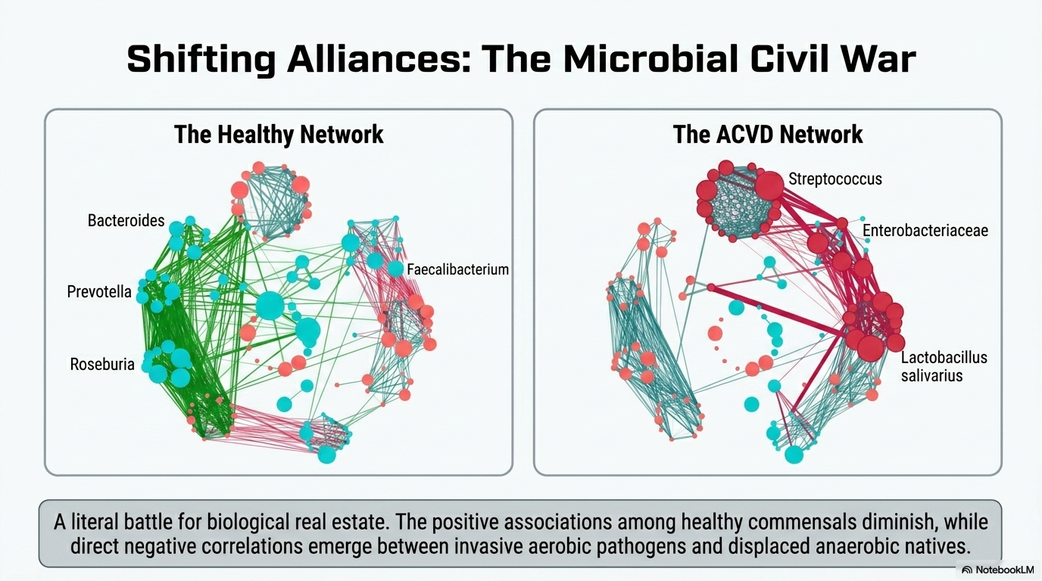

Slide 10
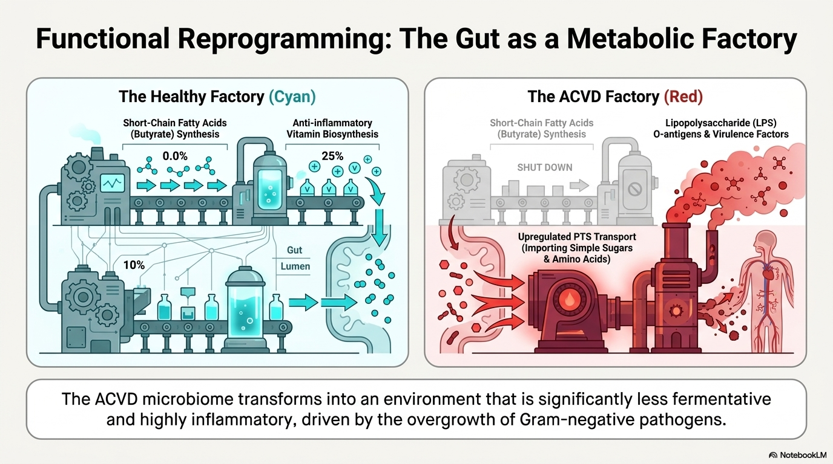

Slide 11
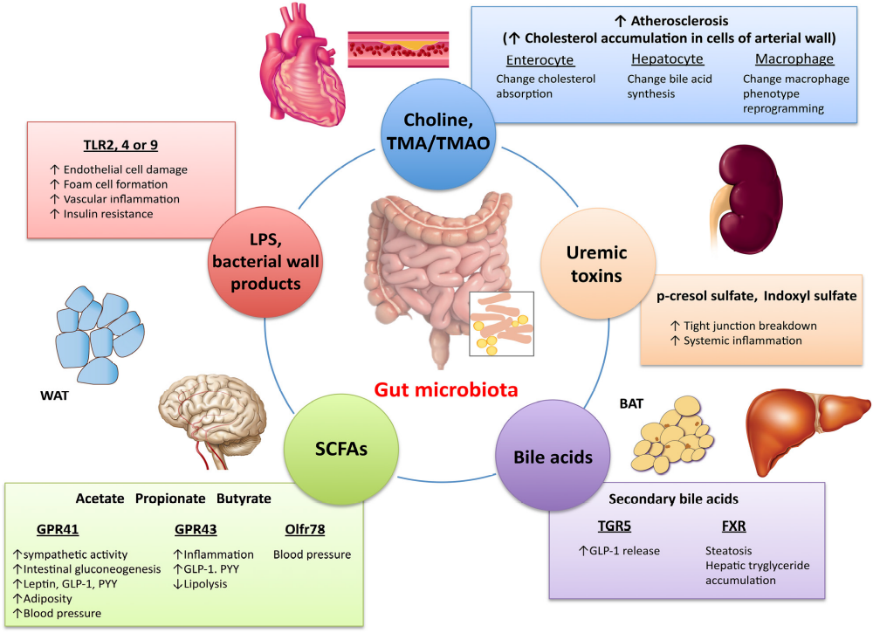
Microbiota-related pathways involved in CVD
Circ Res. 2017;120:1183-1196.

Slide 12
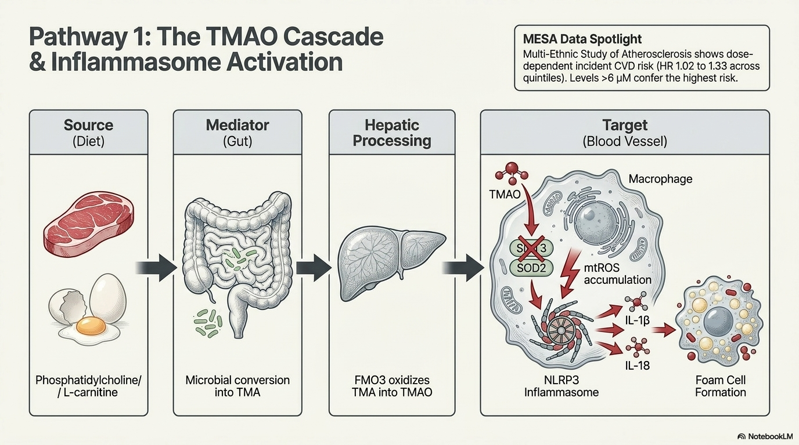

Slide 13
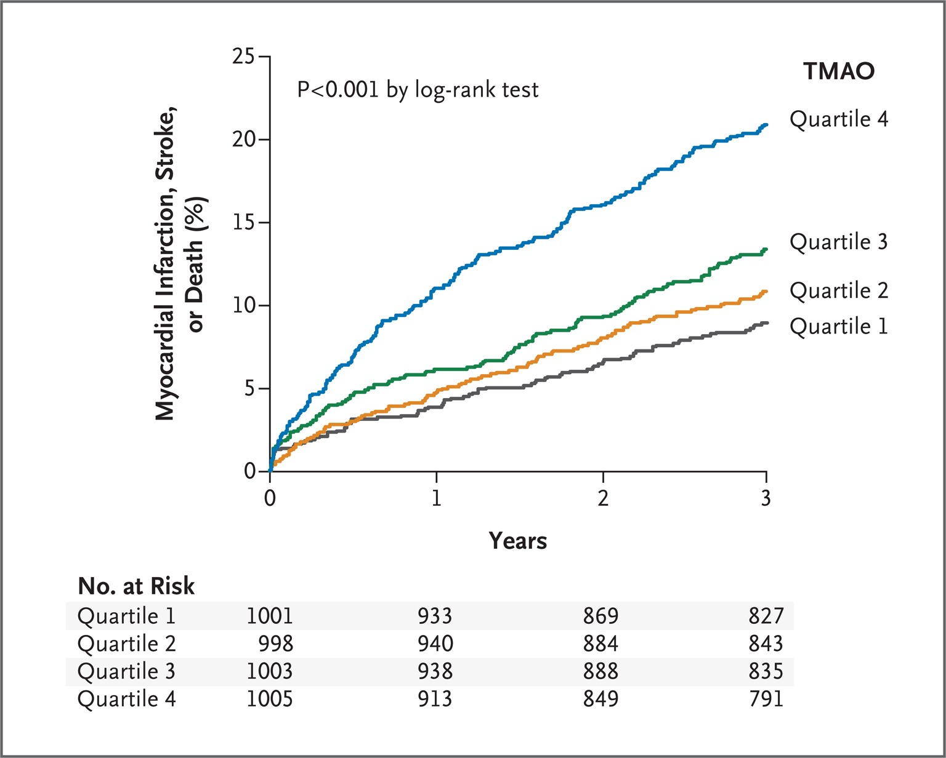
TMAO levels and risk of MACE in patients with CVD risk factors
N Engl J Med. 2013;368:1575-1584.

Slide 14
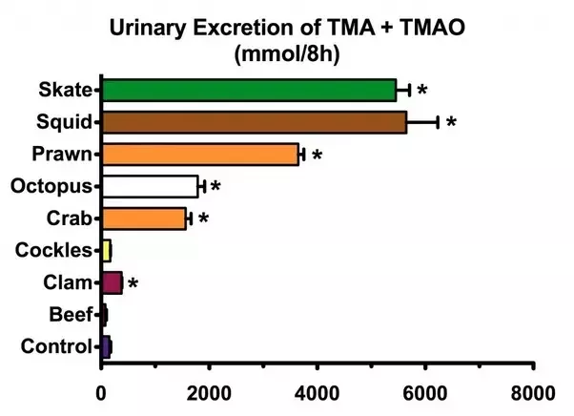
The TMAO paradox
The highest levels of free TMAO are contained in fish.
Food Chem Toxicol. 1999;37:515-520.

Slide 15
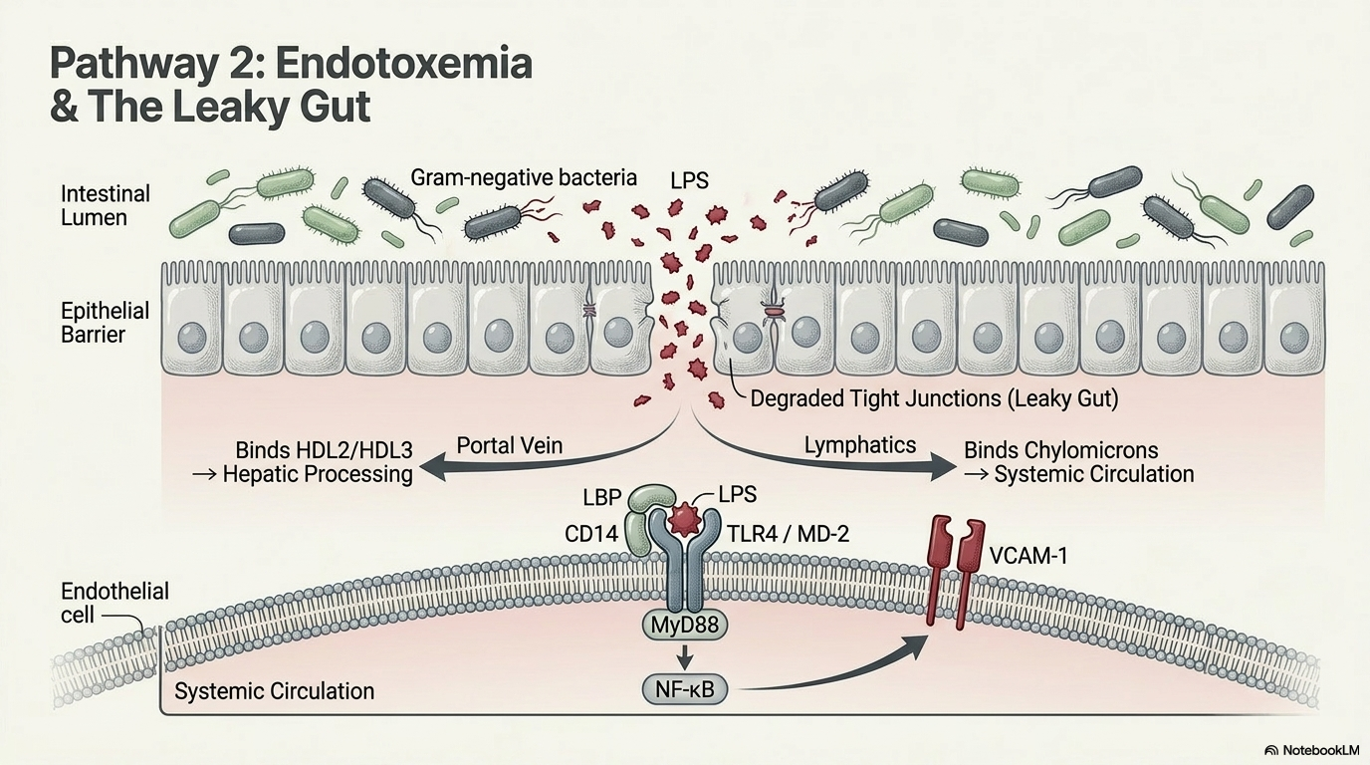

Slide 16
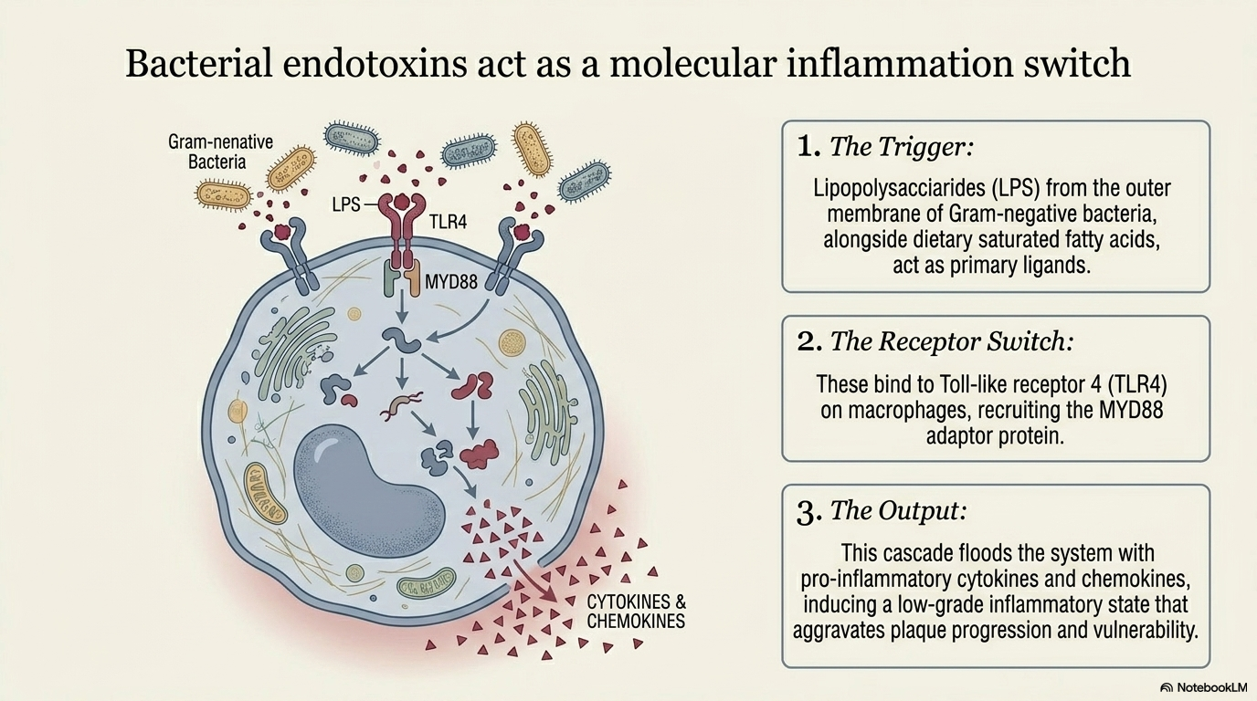

Slide 17
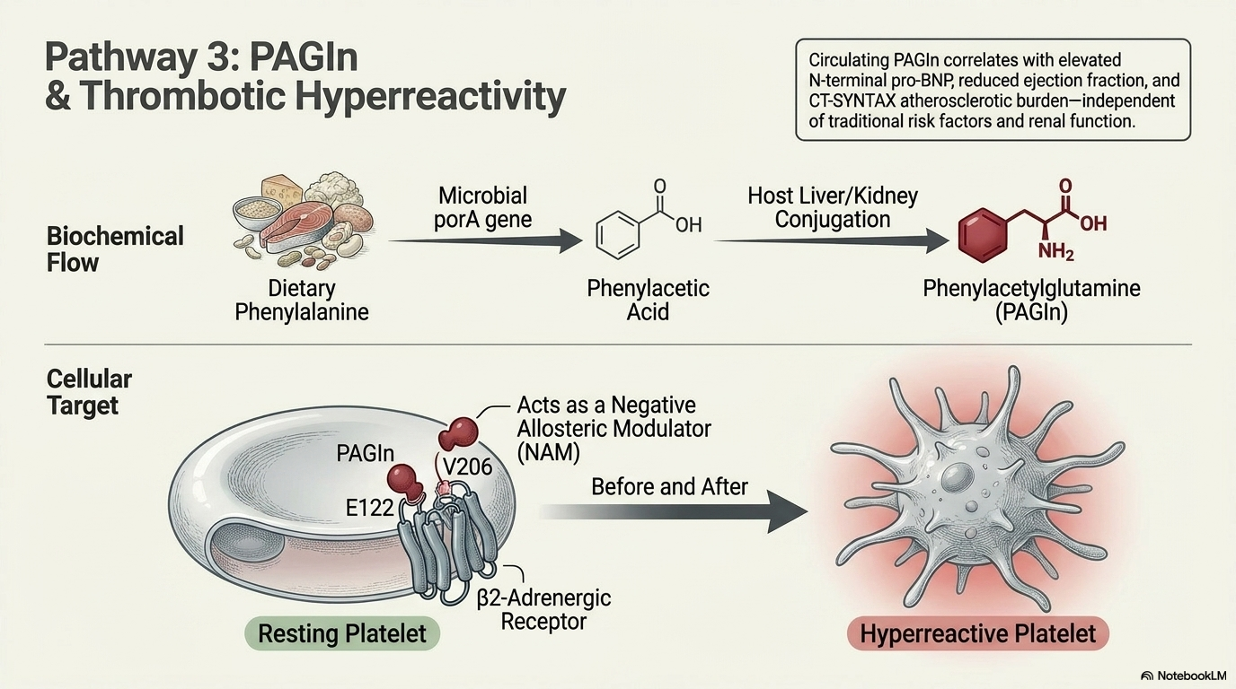

Slide 18
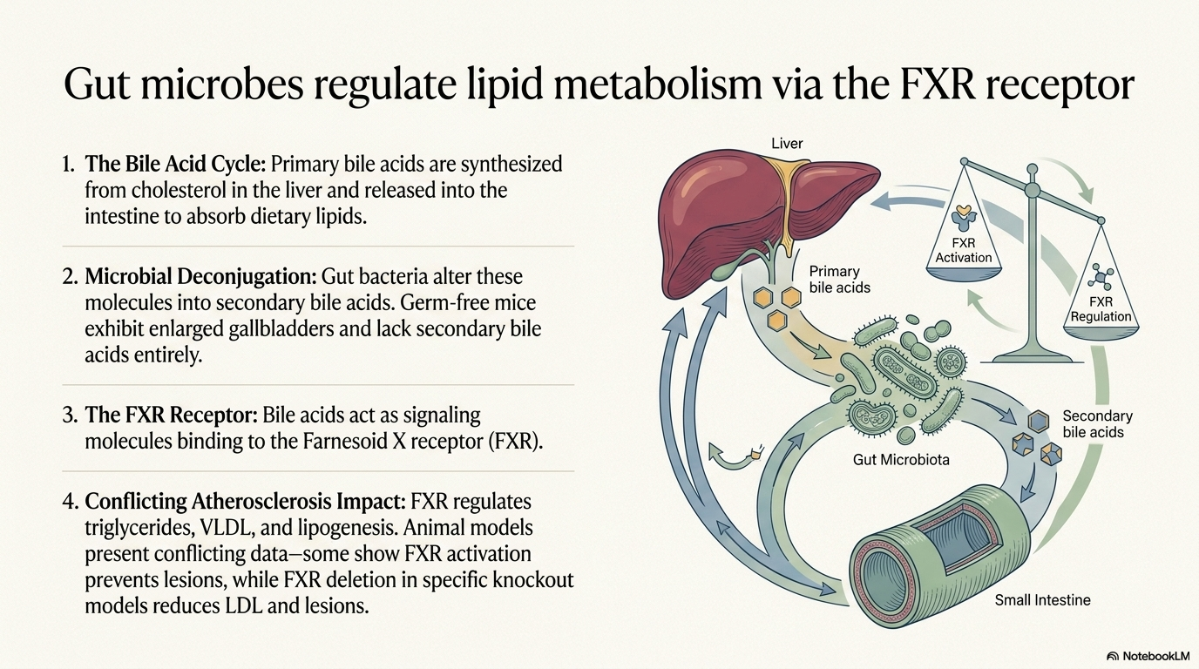

Slide 19
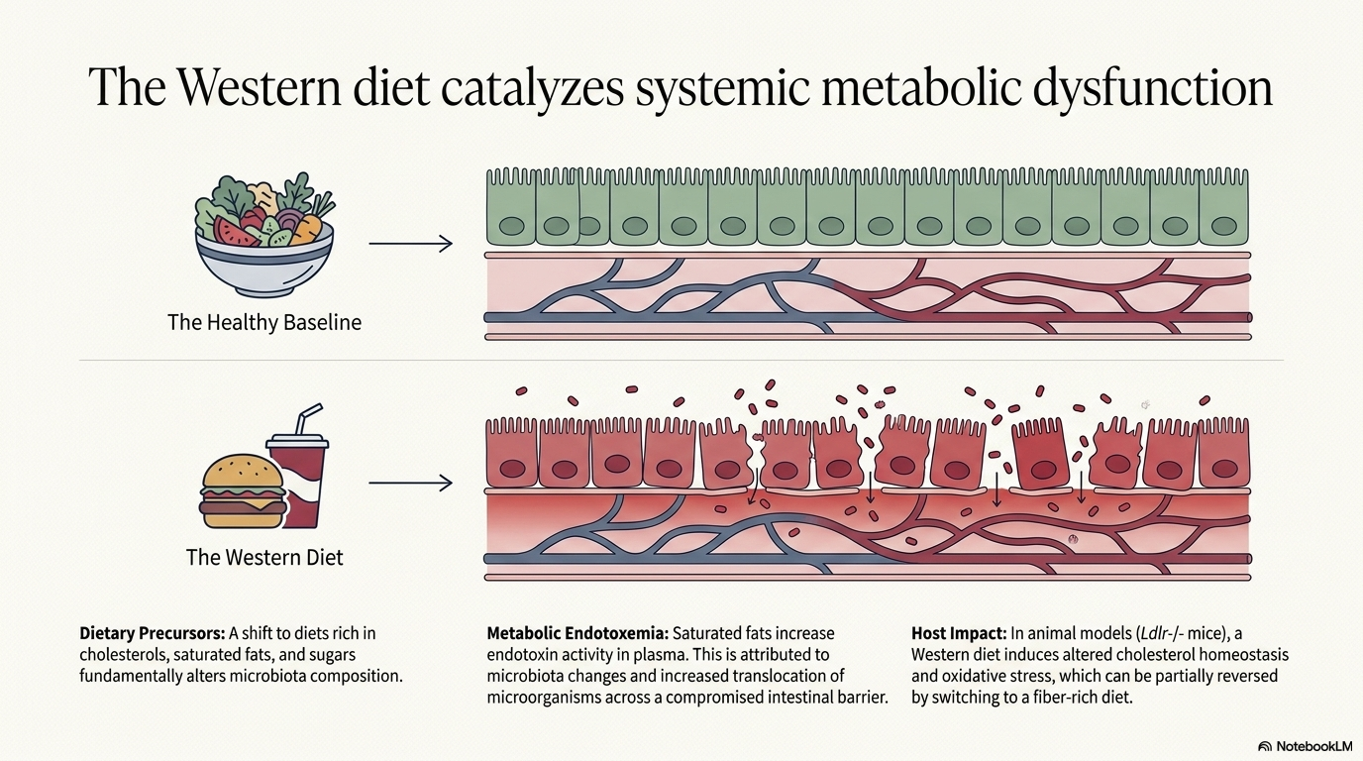

Slide 20
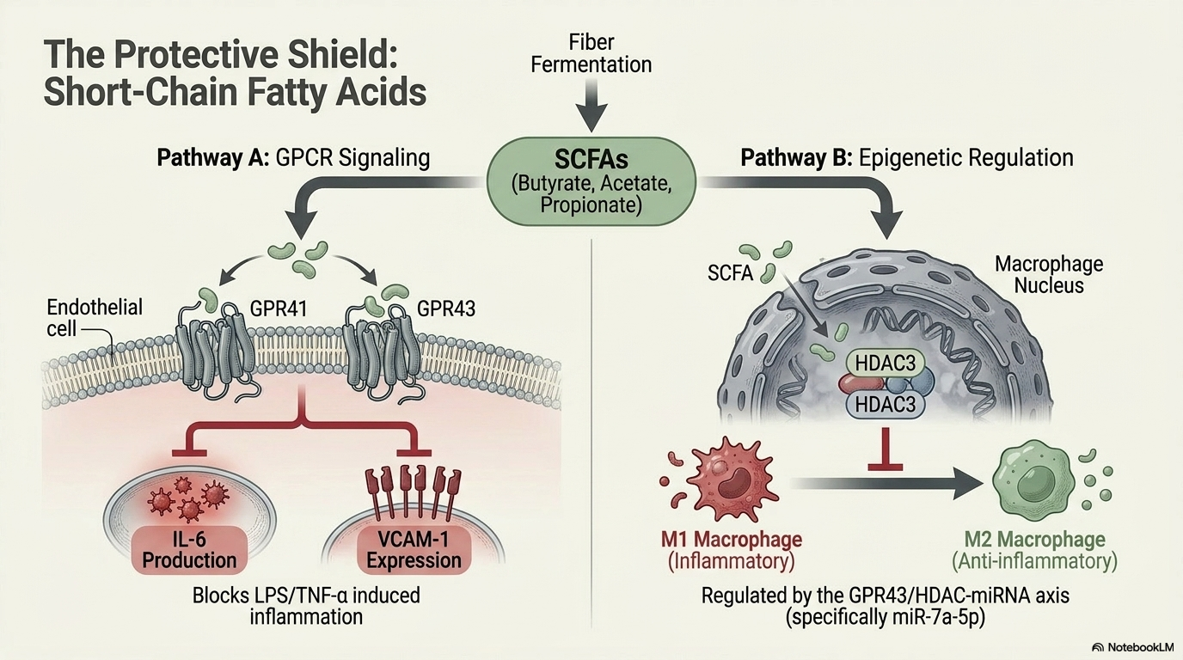

Slide 21
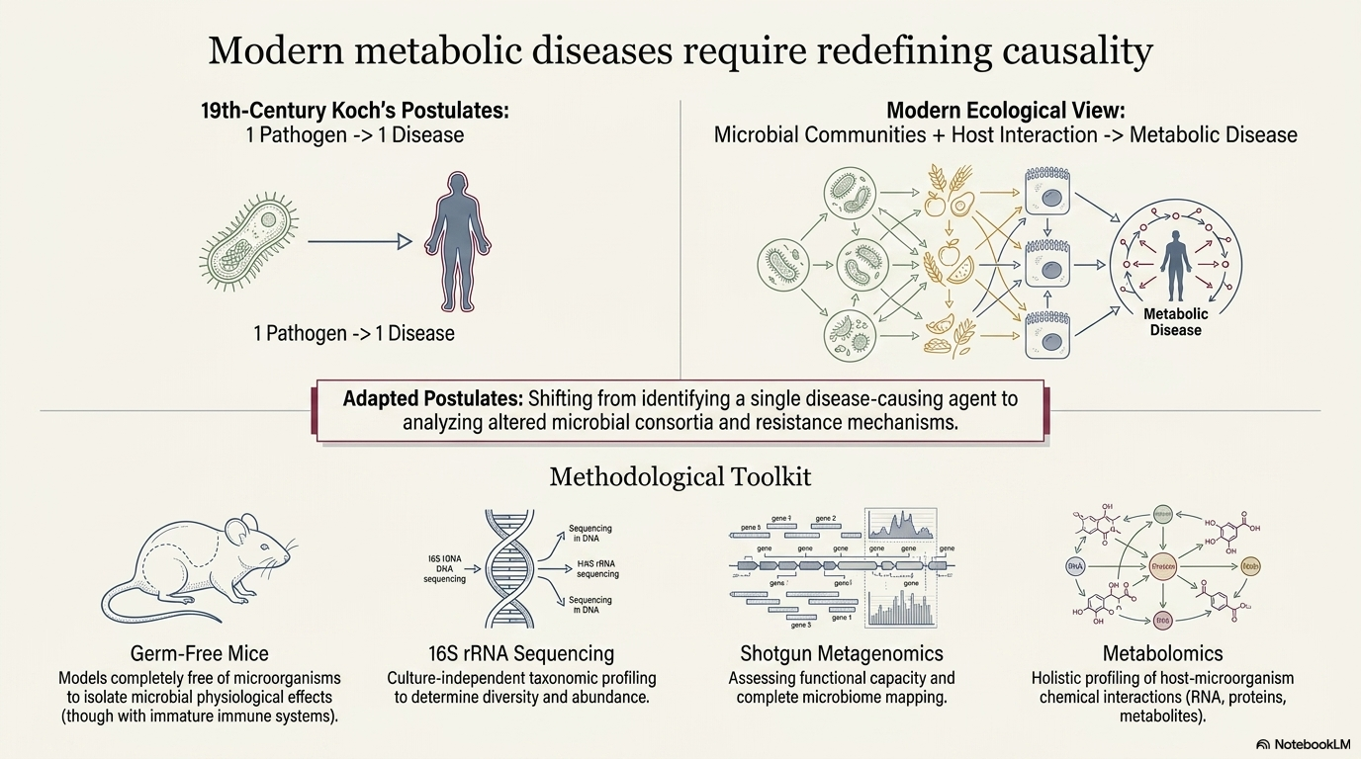

Slide 22
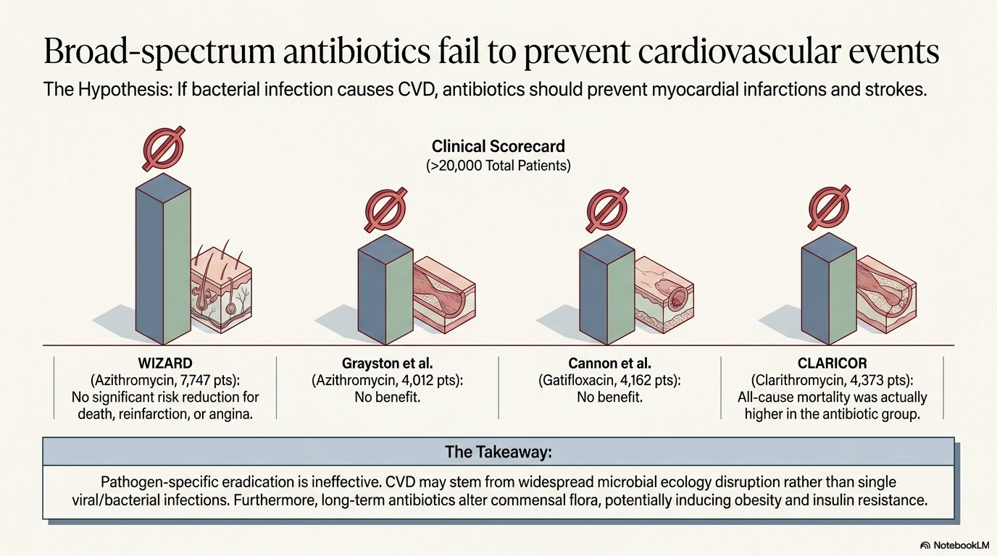

Slide 23
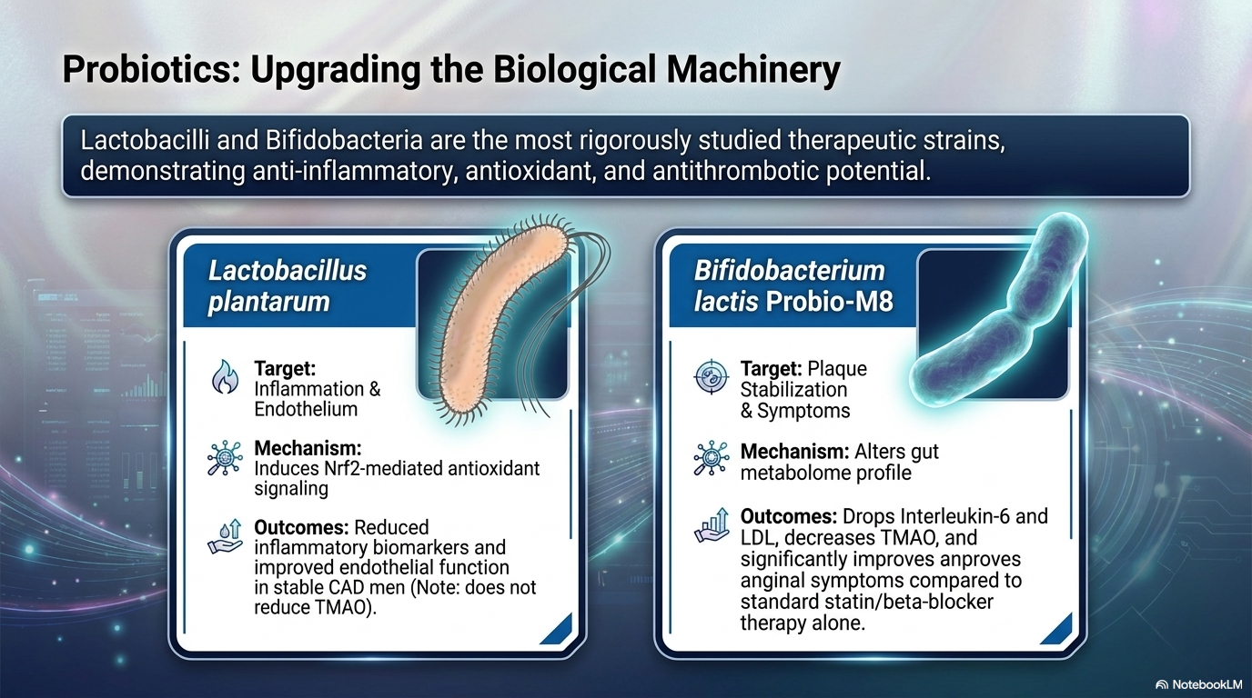

Slide 24
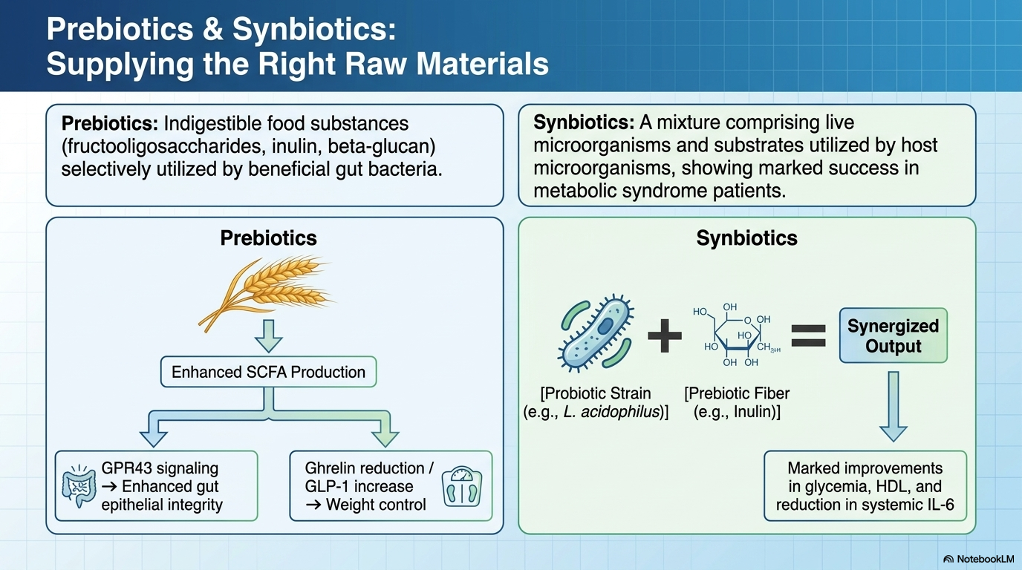

Slide 25
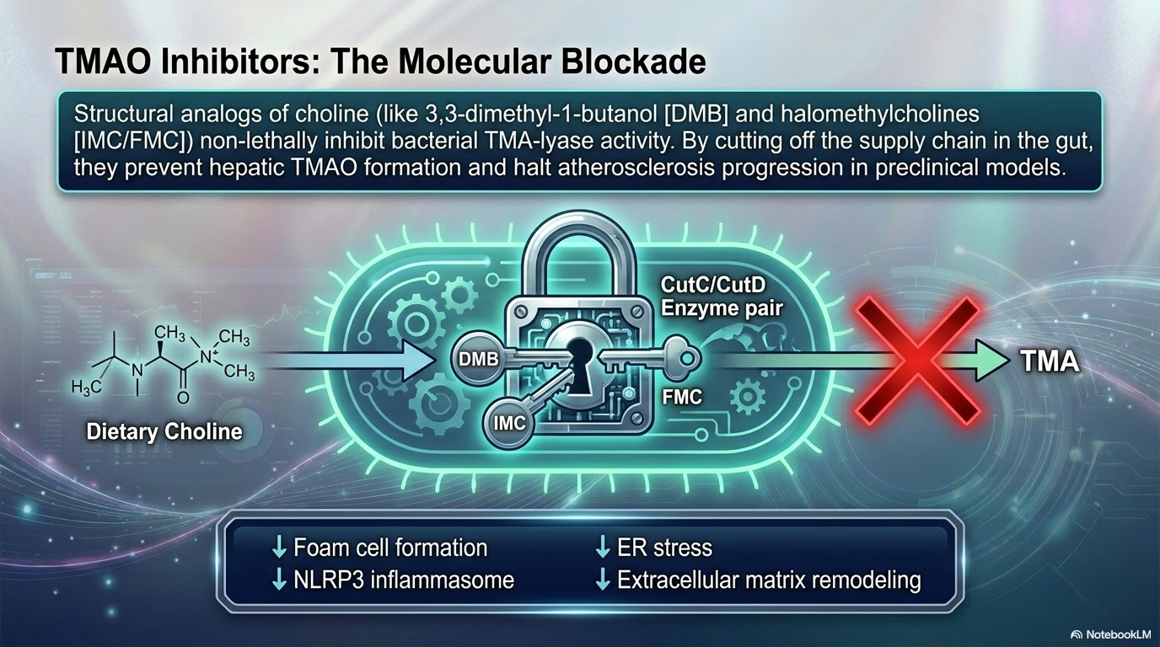

Slide 26
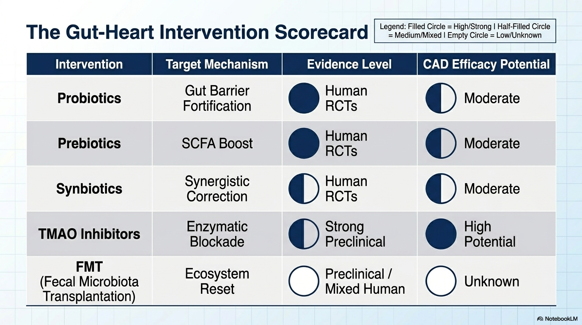

Slide 27
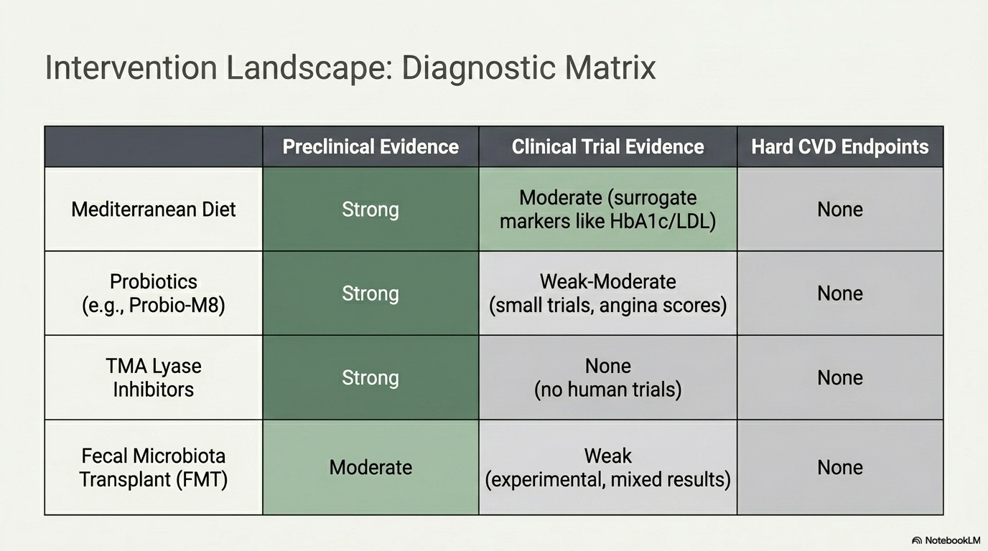

Slide 28
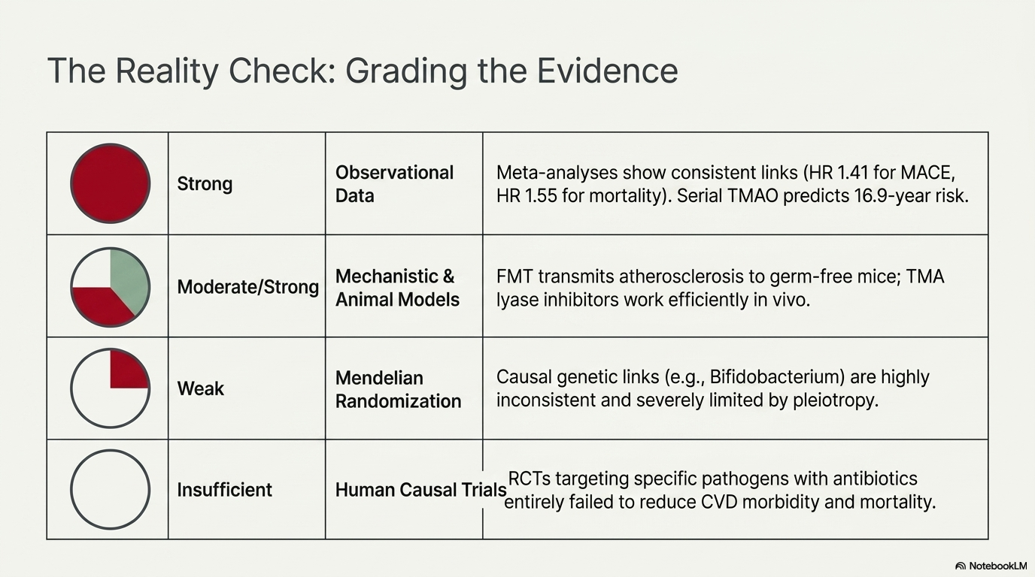

Slide 29
FURTHER READING
Katsimichas T, et al. Gut Microbiota and Coronary Artery Disease: Current Therapeutic Perspectives. Metabolites. 2023; 13:256.
Tousoulis D, et al. Mechanisms, therapeutic implications, and methodological challenges of gut microbiota and cardiovascular diseases: a position paper by the ESC Working Group on Coronary Pathophysiology and Microcirculation. Cardiovasc Res. 2022; 118:3171-3182.
Katsimichas T, et al. The intestinal microbiota and cardiovascular disease. Cardiovasc Res. 2019; 115:1471-1486.
Gilbert JA, et al. Current understanding of the human microbiome. Nat Med. 2018; 24:392-400.
Jonsson AL, et al. Role of gut microbiota in atherosclerosis. Nat Rev Cardiol. 2017; 14:79-87.

