Slide 1

ΥΠΕΡΗΧΟΓΡΑΦΙΚΗ ΕΚΤΙΜΗΣΗ ΚΑΡΔΙΑΣ
Eirini Beneki, MD, MSc, PhD(c)
CT/CMR Imaging Fellow
Lausanne University Hospital/CHUV
Lausanne, Switzerland
Hippokration General Hospital, Athens

Slide 2
Disclosures
I have nothing to declare

Slide 3
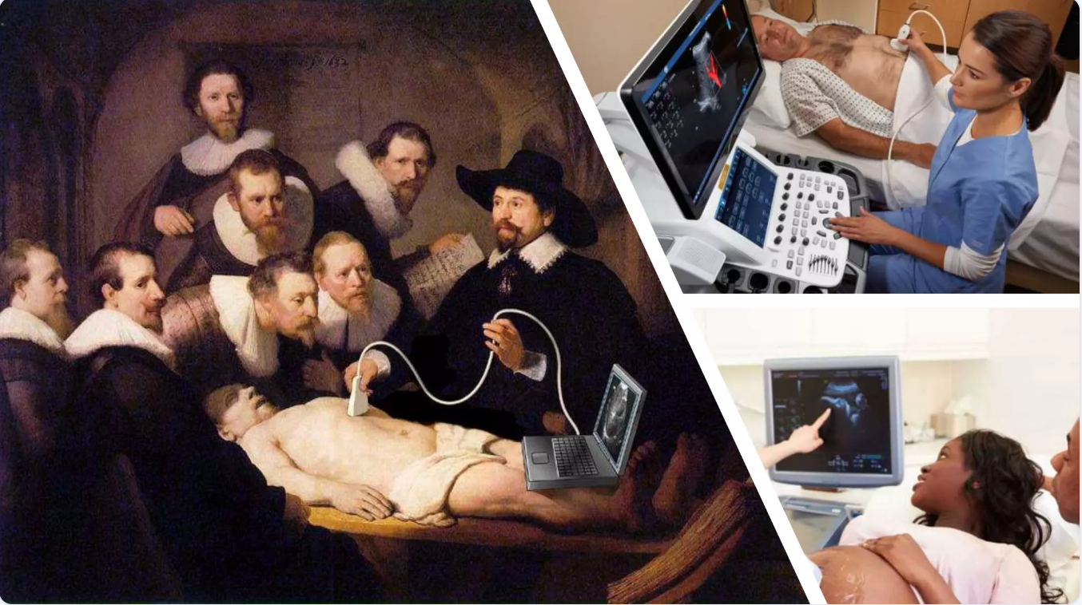
Transthoracic echocardiography (TTE) is not only a diagnostic tool. . .
but an extension of the traditional physical examination. . .
Notes:
Nowadays ultrasound is not only a diagnostic tool, it has become an extension of the traditional physical examination, enabling more accurate diagnoses and improved clinical management of our patients."

Slide 4
TTE is the stethoscope of the future?
Cardiac Point-of-Care Ultrasound
Stethoscope of the future
Real time diagnostic technique
More sensitive and specific than physical exam, ECG or CXR
Rapid visualization of cardiac structures and potential pathology

Slide 5

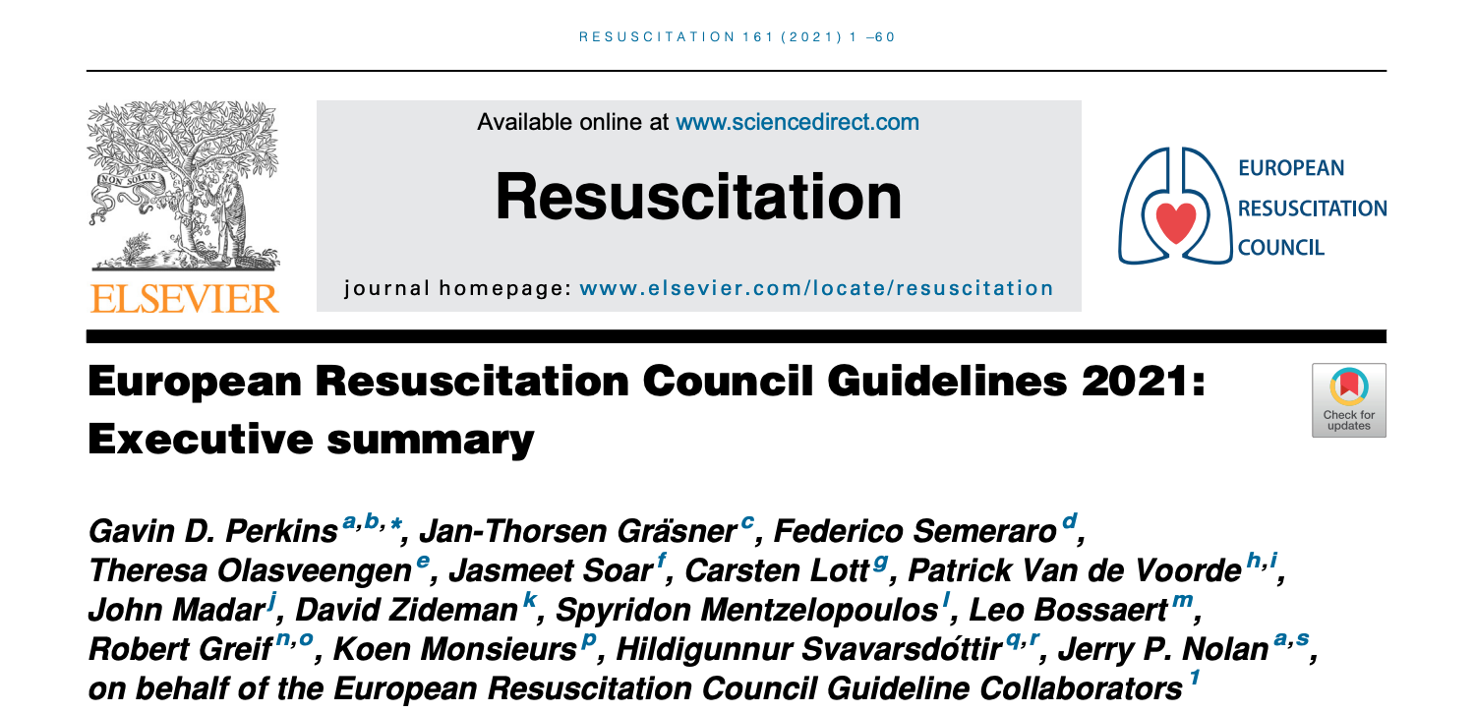
Point of Care Ultrasound (PoCUS) integration into the ACLS algorithm
First-line diagnostic tool in acute settings
PoCUS should not interfere with CPR efforts ! ! !
PoCUS lasts < 10 seconds

Slide 6
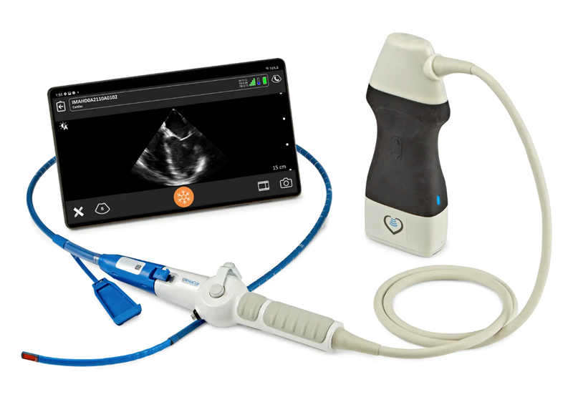
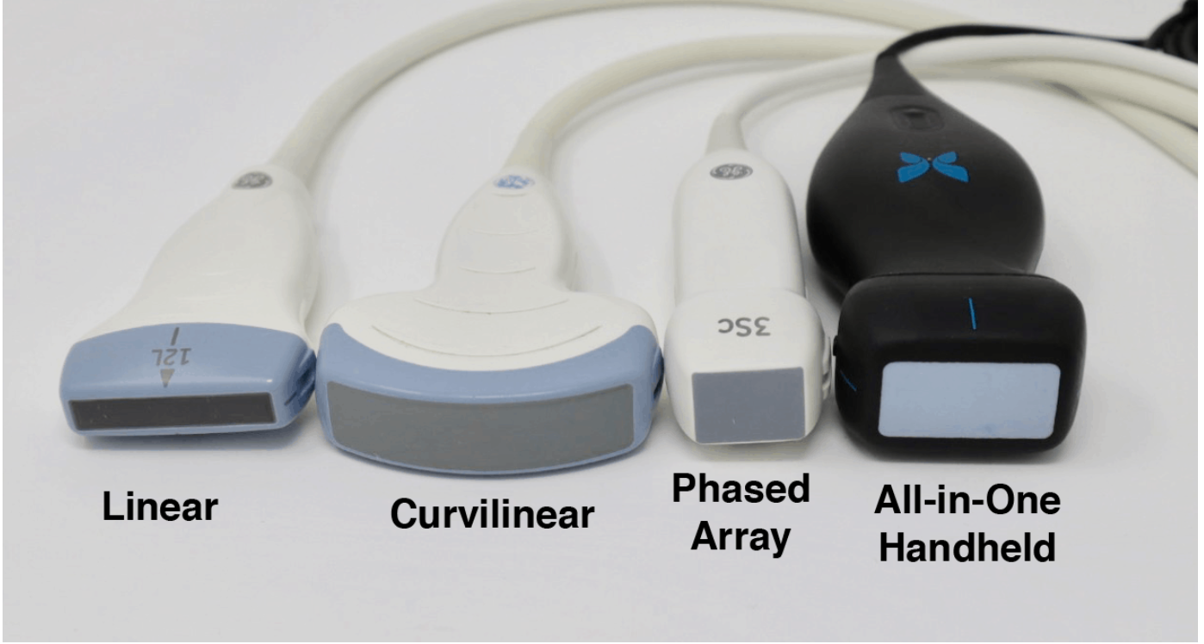
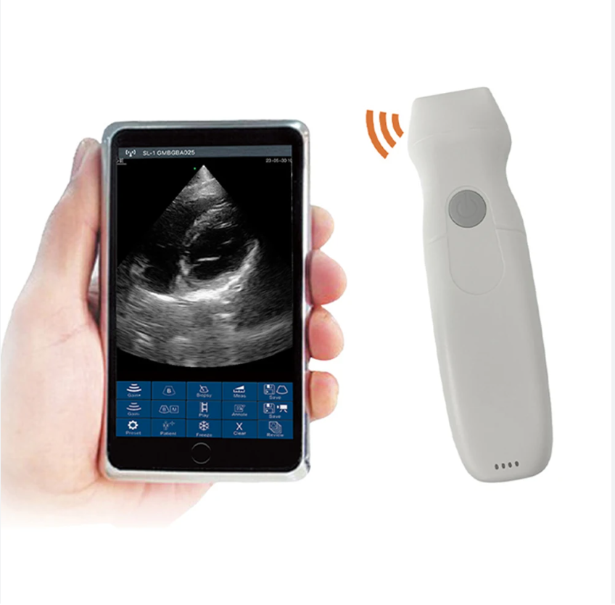
Appropriate Equipment - Probe of Choice
Portable, hand-held ultrasound machines
Phased array (or sector array) transducer
Frequency range: 1 - 5MHz
Piezoelectric crystals layered in the center of the probe making it easier to get in-between small spaces (ribs)
Kirkpatrick JN, et al. Recommendations for Echocardiography Laboratories Participating in Cardiac Point of Care Cardiac Ultrasound (POCUS) and Critical Care Echocardiography Training: Report from the American Society of Echocardiography. 2020

Slide 7
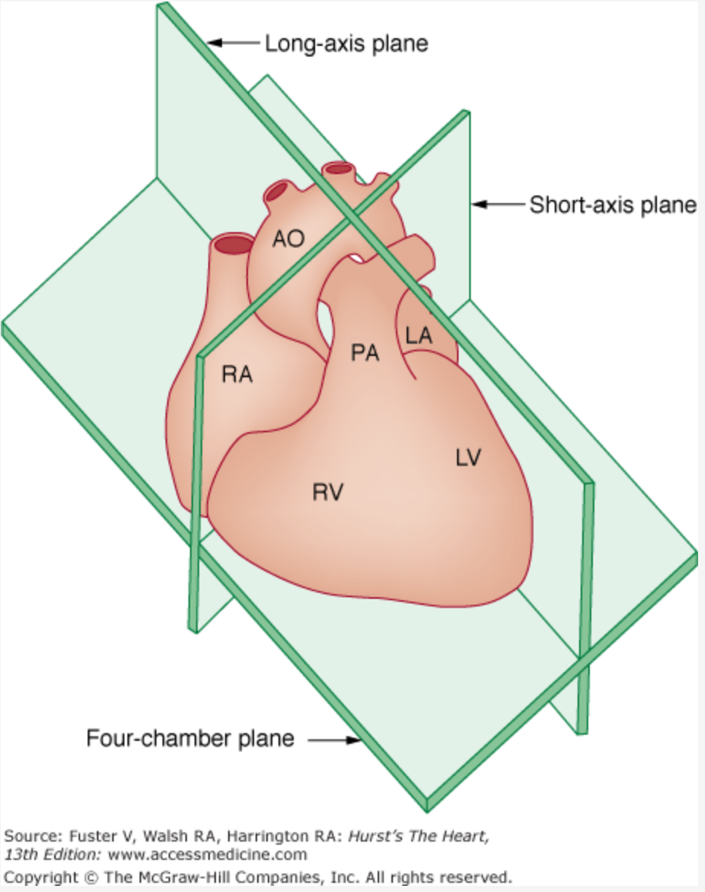
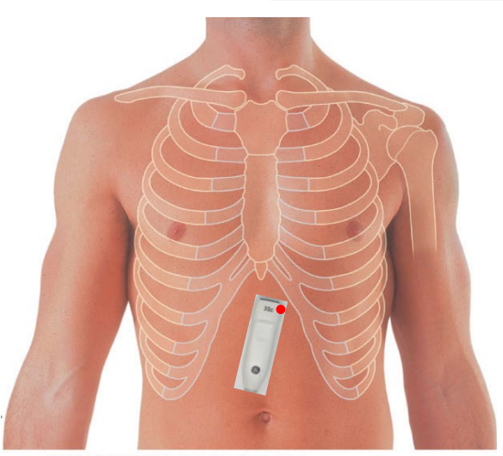
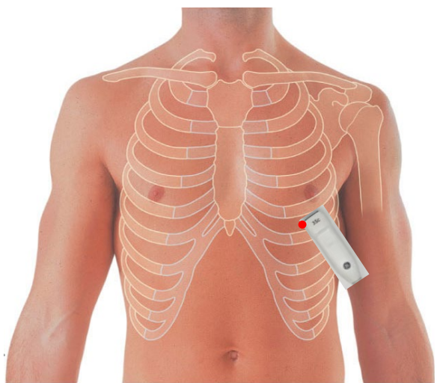
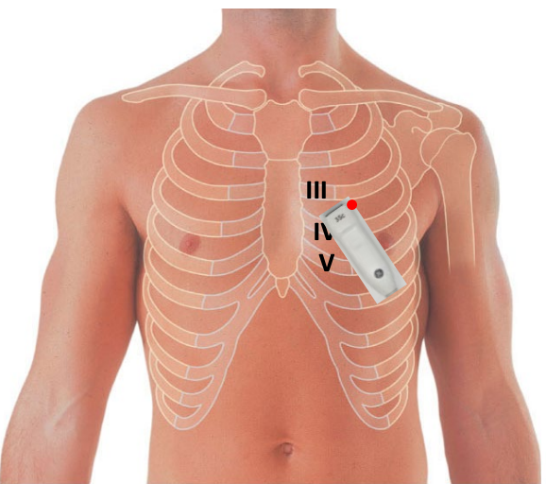
Basic imaging planes
3 key transducer positions
Subcostal
Apical
Parasternal
Skinner H, et al. Focus cardiac ultrasound core curriculum and core syllabus of the European Association of Cardiovascular Imaging. Eur Heart J Cardiovasc Imaging. 2018 May 1;19(5):475-481.

Slide 8
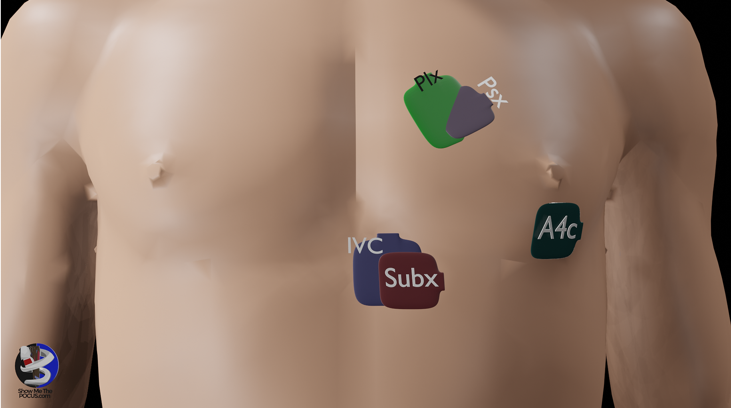
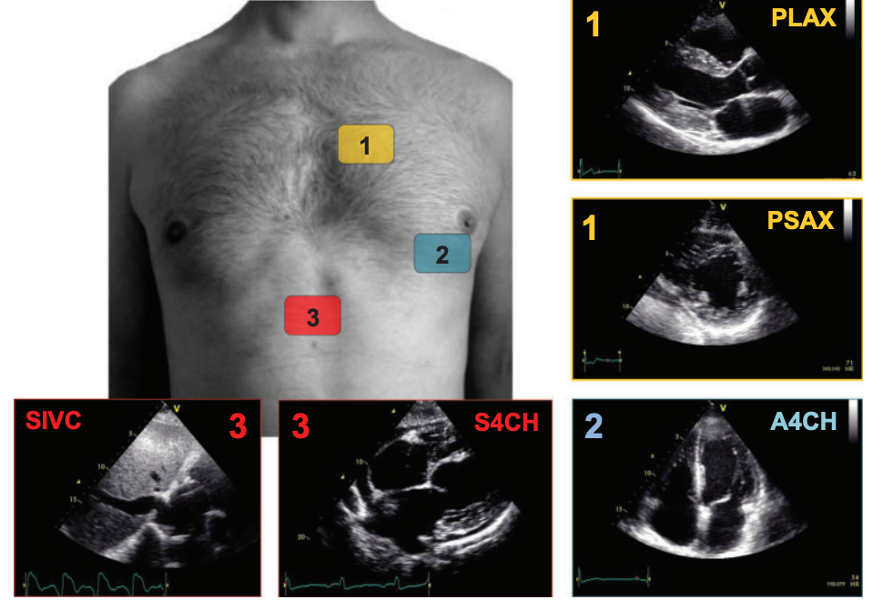
Focused Cardiac Ultrasound (FoCUS) views
5 FoCUSed views
Subcostal 4 Chamber view (S4CH)
Subcostal Inferior Vena Cava (IVC) view (SIVC)
Parasternal Long Axis view (PLAX)
Apical 4 Chamber view (A4CH)
Parasternal Short Axis view (PSAX)
Skinner H, et al. Focus cardiac ultrasound core curriculum and core syllabus of the European Association of Cardiovascular Imaging. Eur Heart J Cardiovasc Imaging. 2018 May 1;19(5):475-481.

Slide 9
Subcostal 4 Chamber view

Slide 10
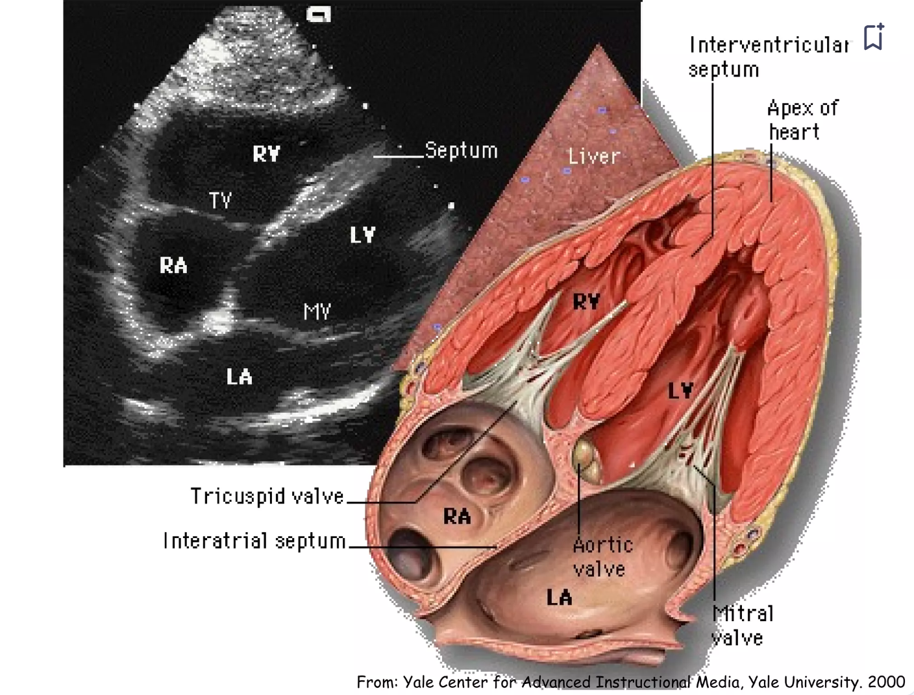
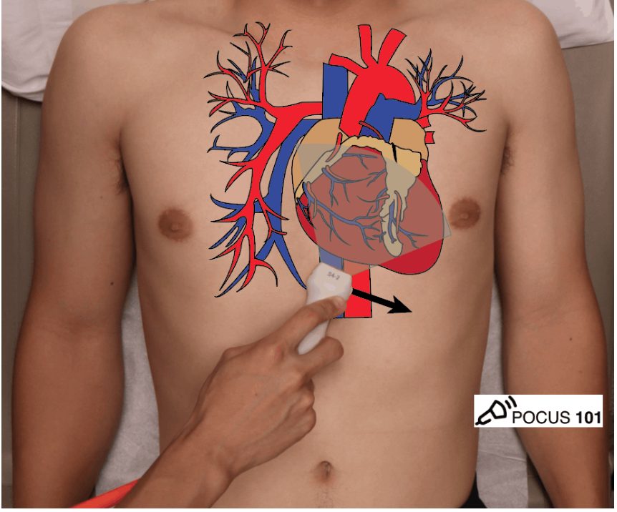
Subcostal 4 Chamber view
Probe placement: 2-3 cm below the
xiphoid process
Probe marker directed toward to patient’s LEFT shoulder
Most useful view overall
Patient position: supine
Adapted by showmethepocus.com

Slide 11
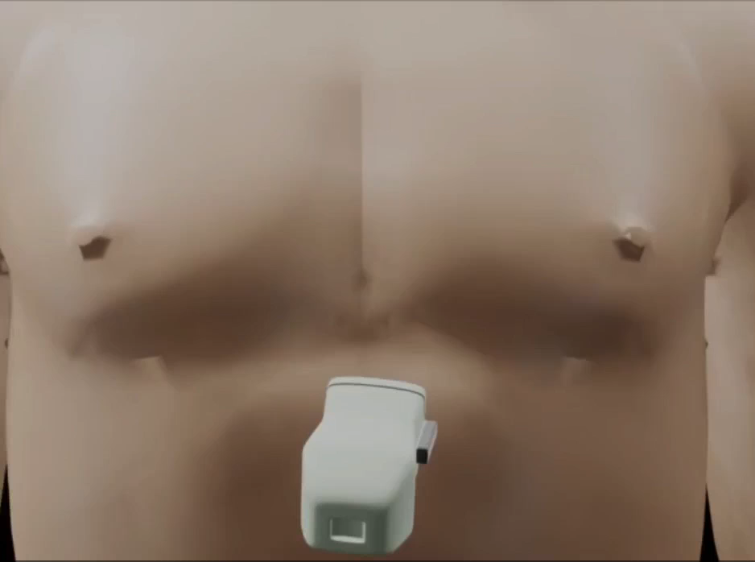
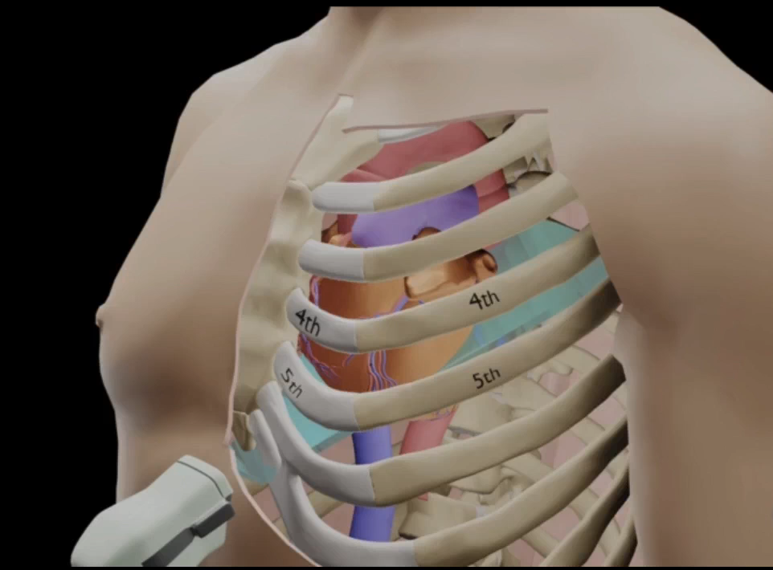
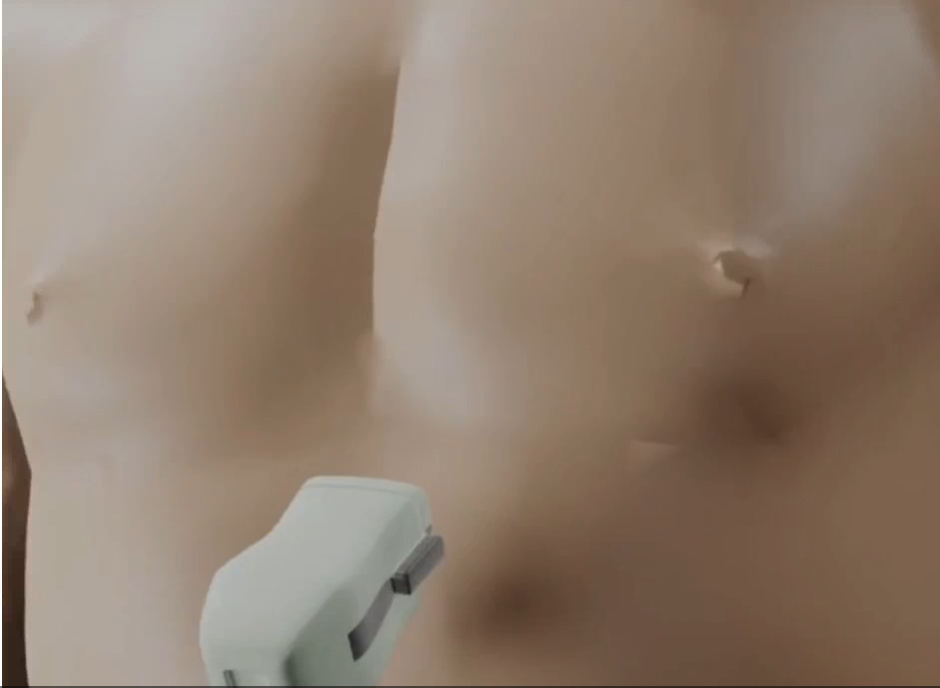
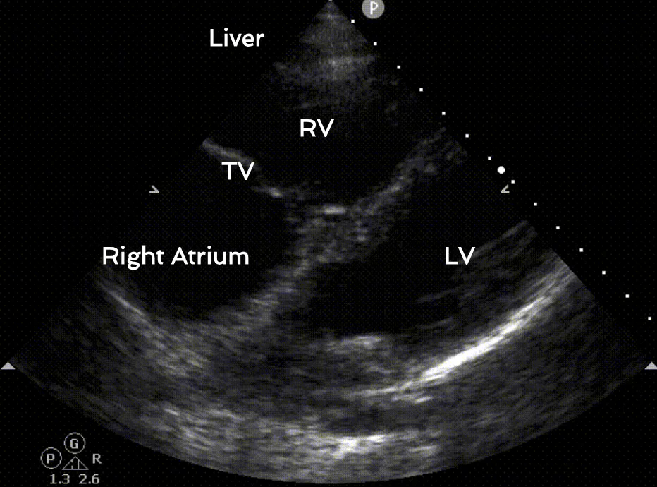
Adapted by showmethepocus.com

Slide 12
Subcostal Inferior Vena Cava view

Slide 13
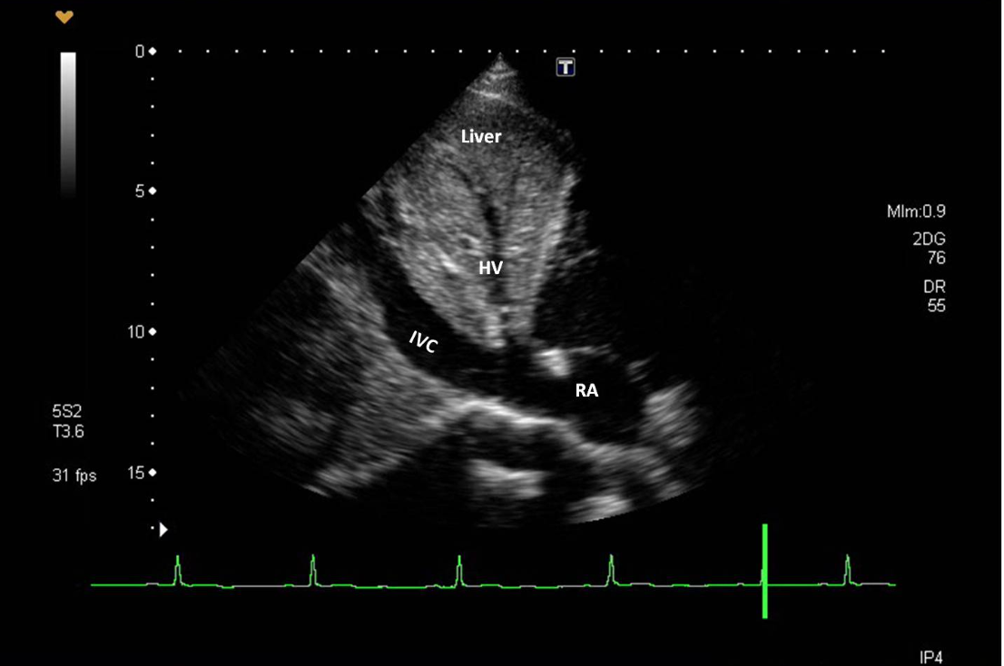
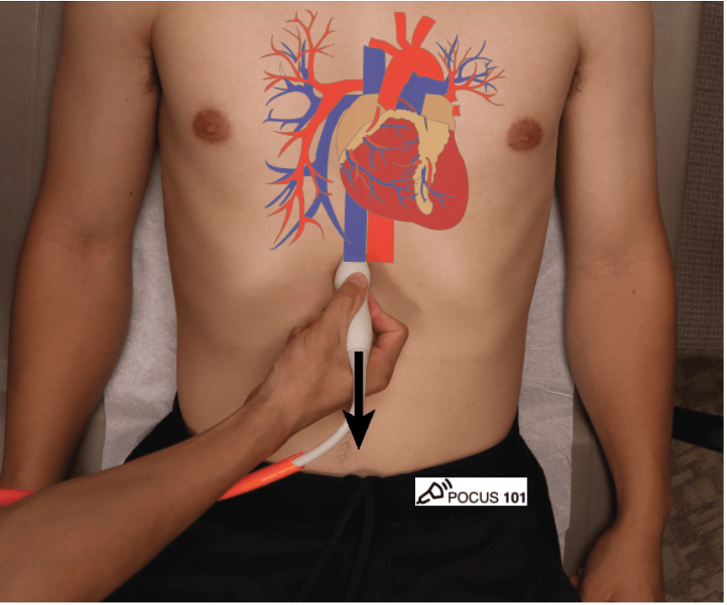
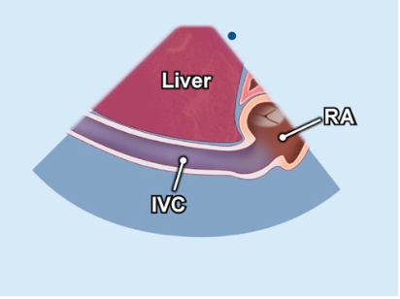
Subcostal Inferior Vena Cava view
Holding the probe in the SUBX 4 chamber view + rotating it 90 degrees anticlockwise
Probe marker now facing cranially
Identify IVC, assess size + collapsibility
with the sniff test
Adapted by showmethepocus.com

Slide 14
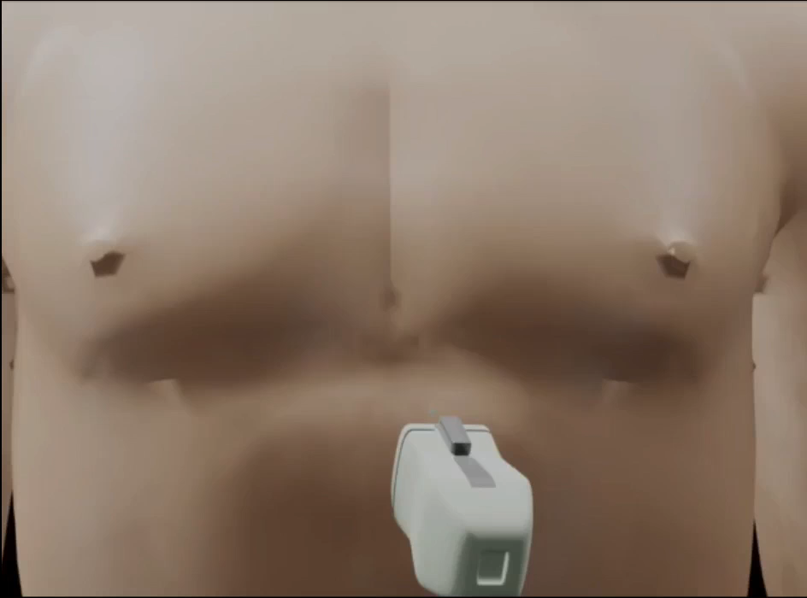
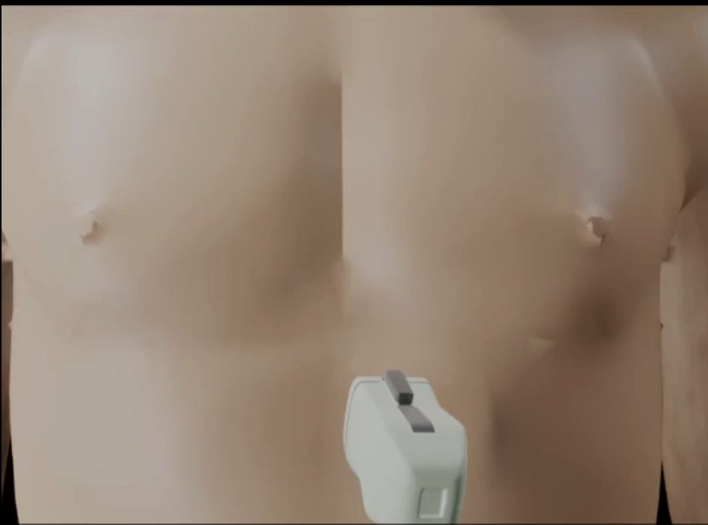
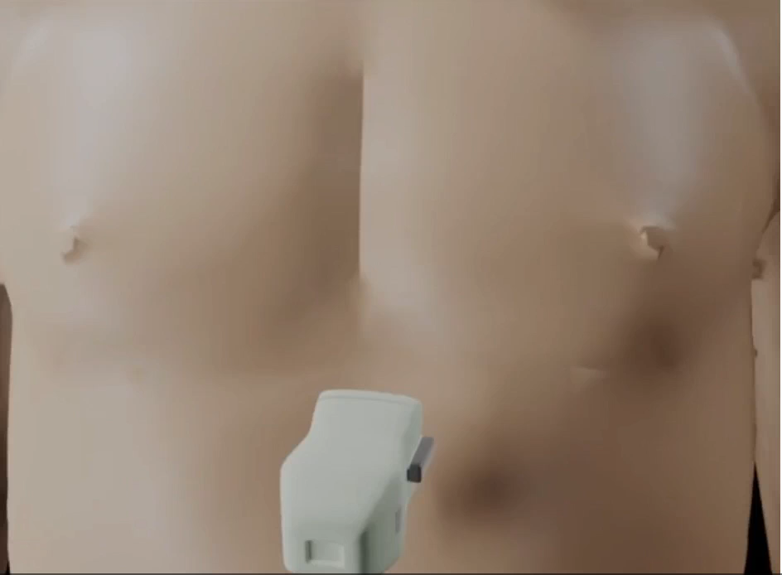
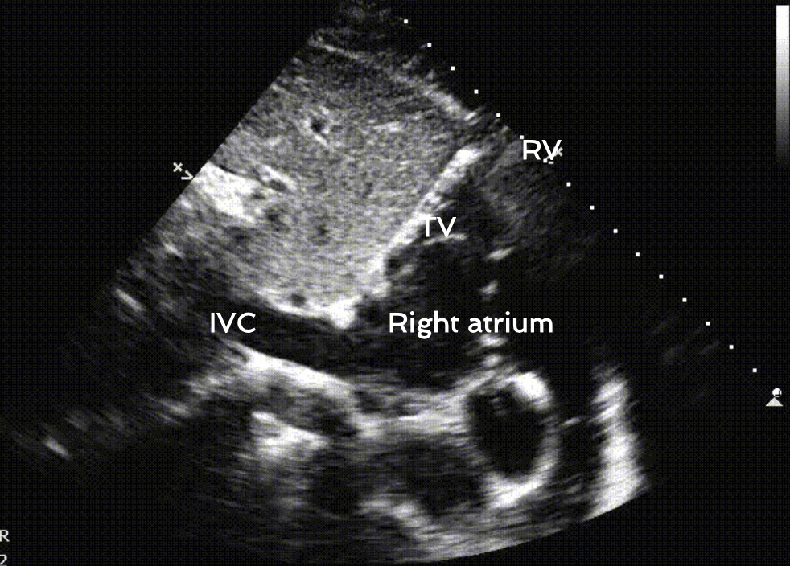
Adapted by showmethepocus.com

Slide 15
Parasternal long axis view

Slide 16
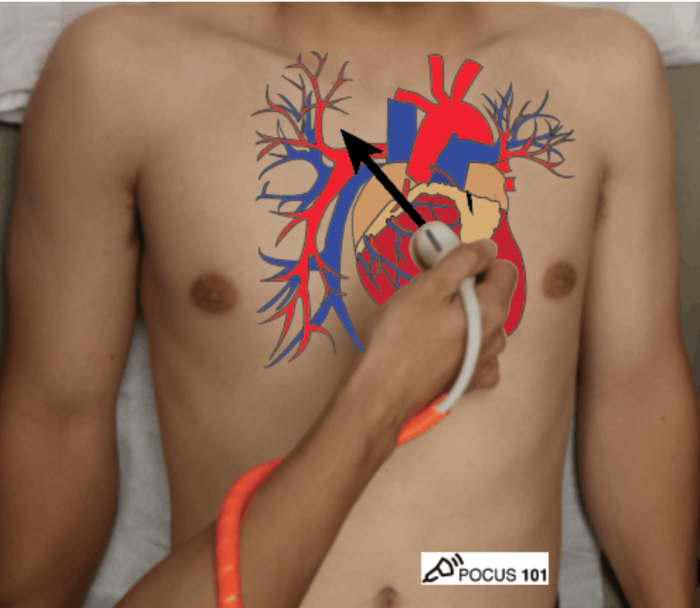
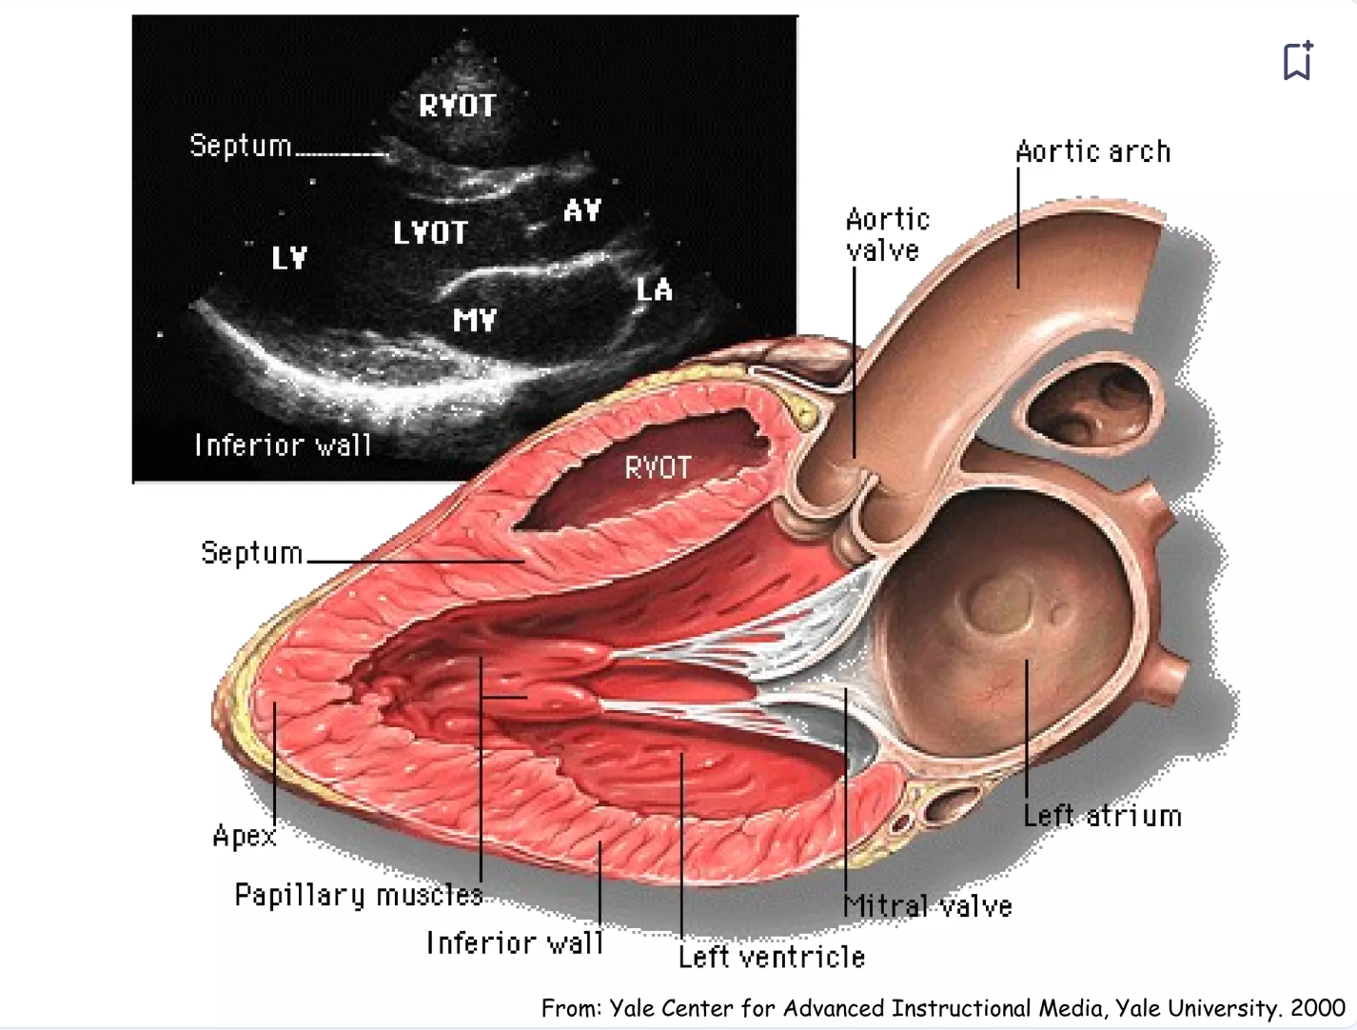
Parasternal long axis view
Probe placement: 3rd- 4th intercostal space to the left of sternum
Probe marker toward RIGHT shoulder
Patient position left lateral / supine
Adapted by showmethepocus.com

Slide 17
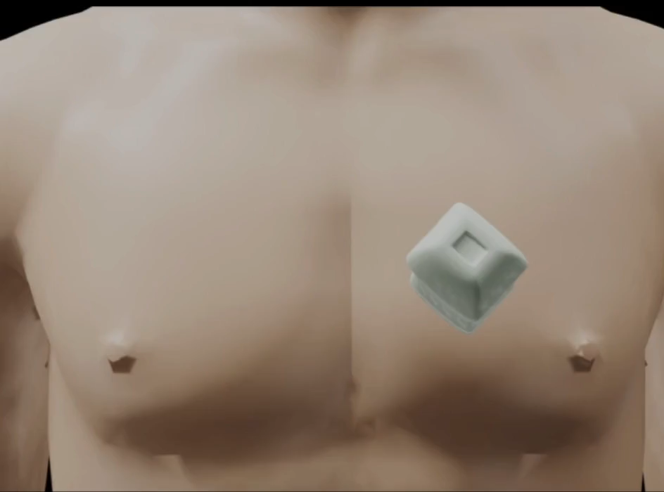
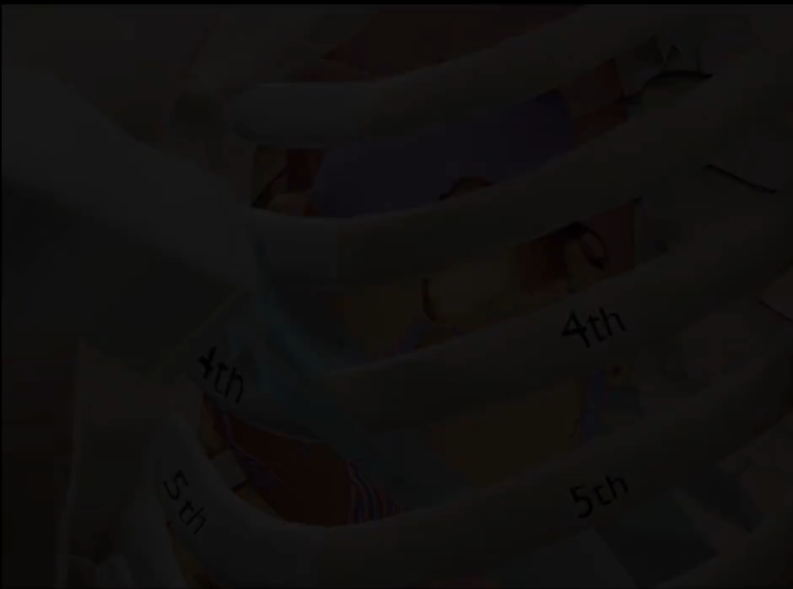
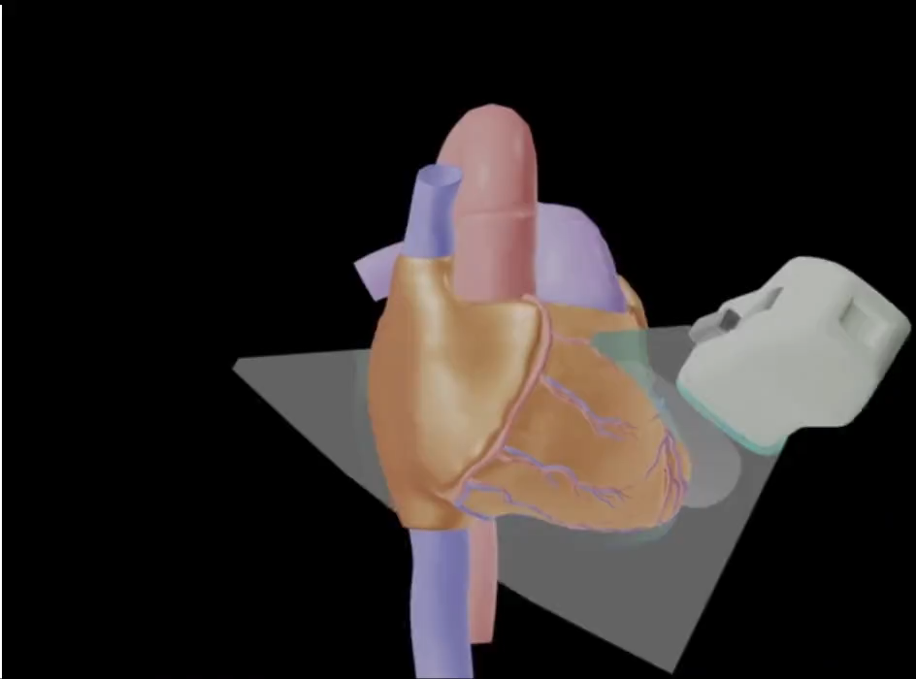
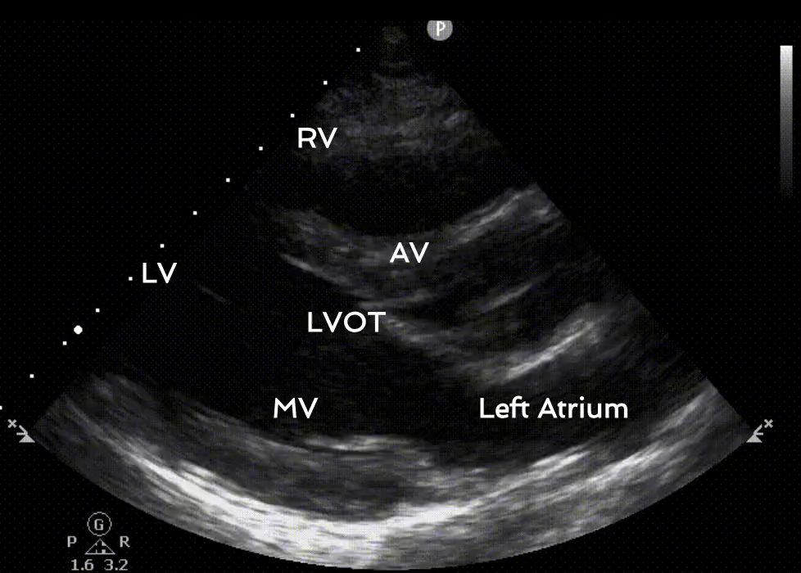
Adapted by showmethepocus.com

Slide 18
Parasternal short axis view

Slide 19
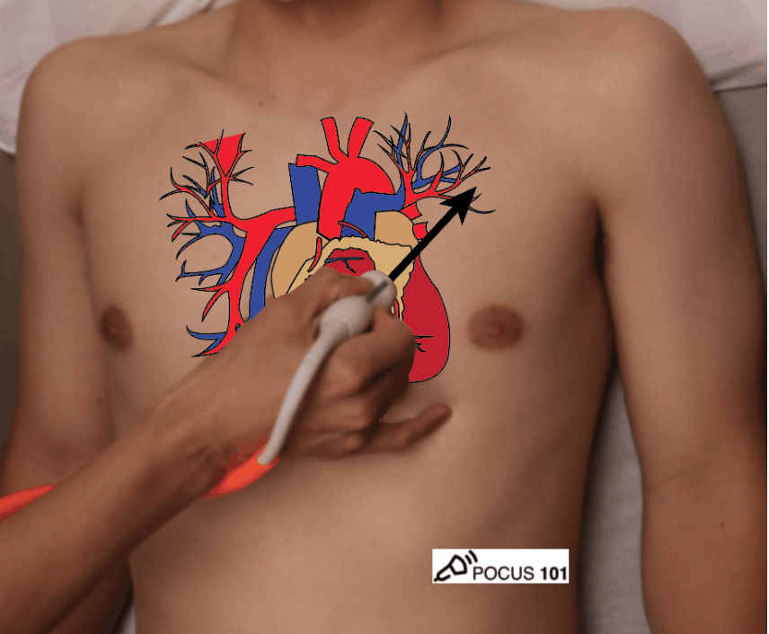
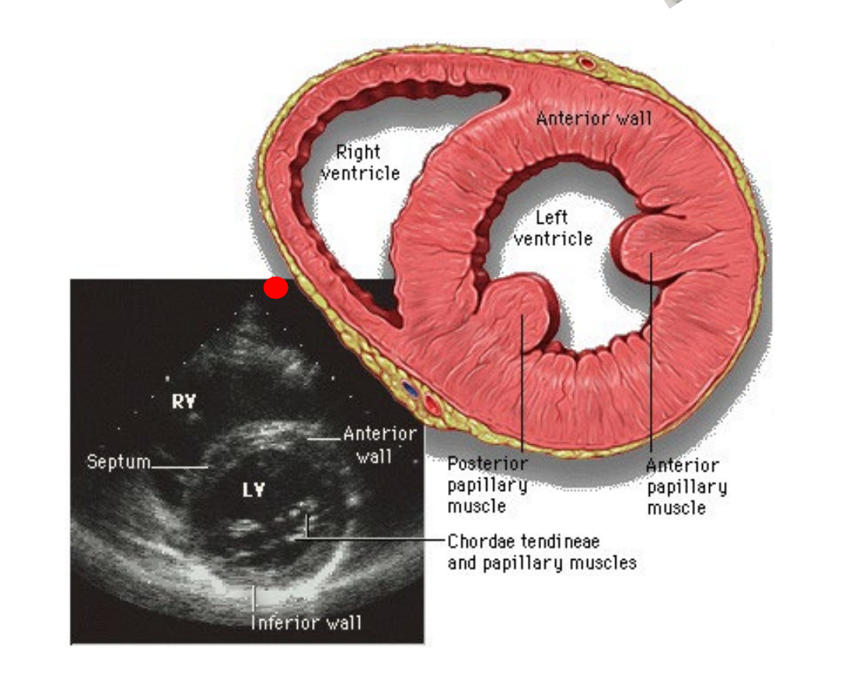
Parasternal short axis view
Holding the probe in the PLAX view + rotating it 90 degrees clockwise
Prober marker towards LEFT shoulder
Patient position left lateral / supine
Adapted by showmethepocus.com

Slide 20
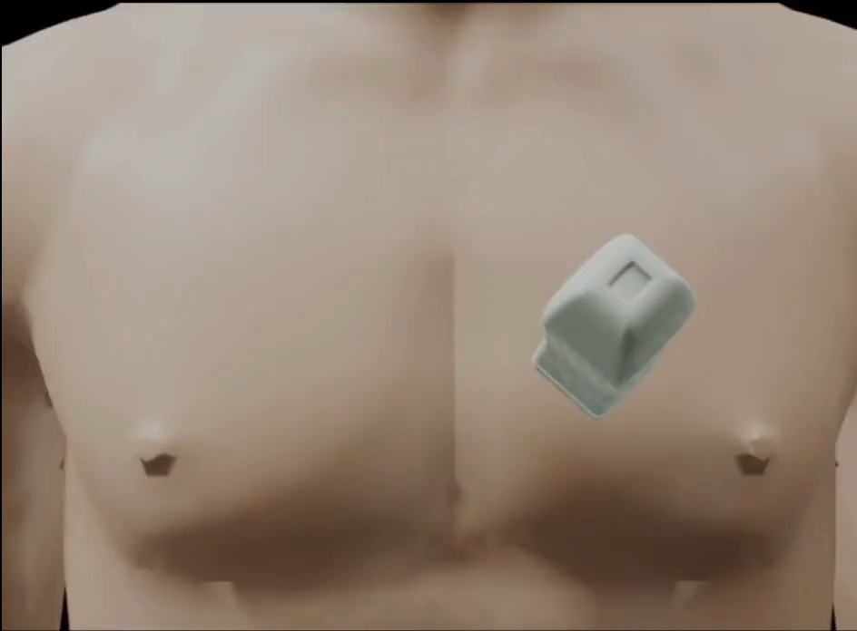
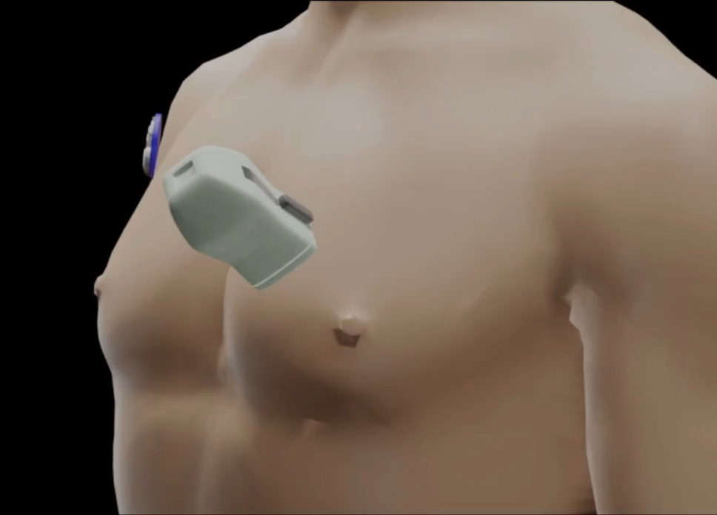
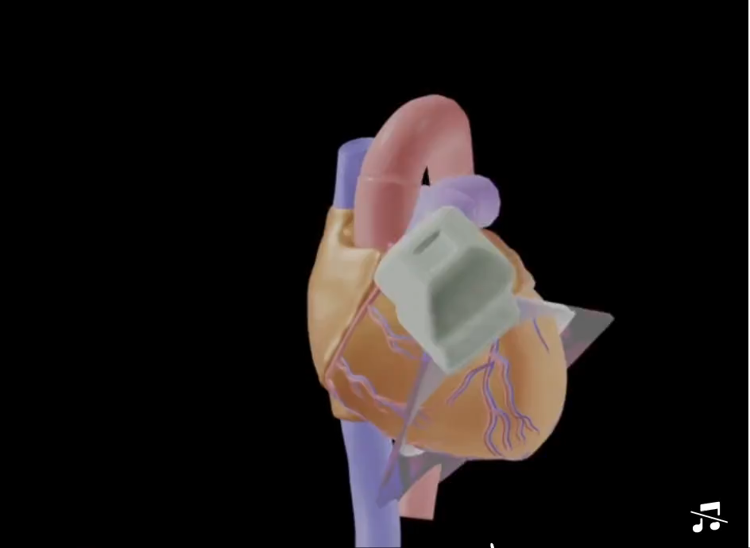
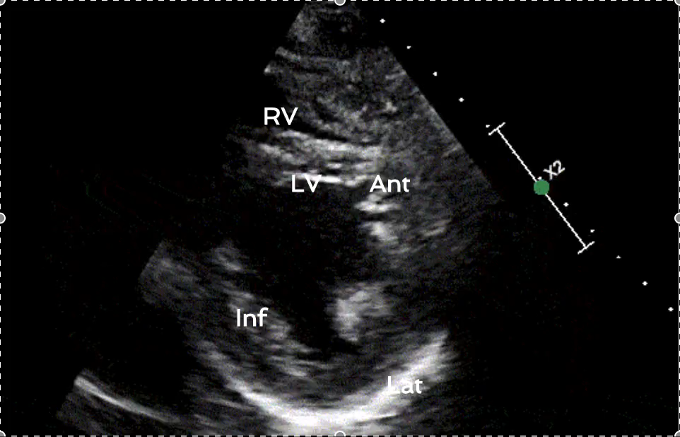
Adapted by showmethepocus.com

Slide 21
Apical 4 chamber view
Notes:
,

Slide 22
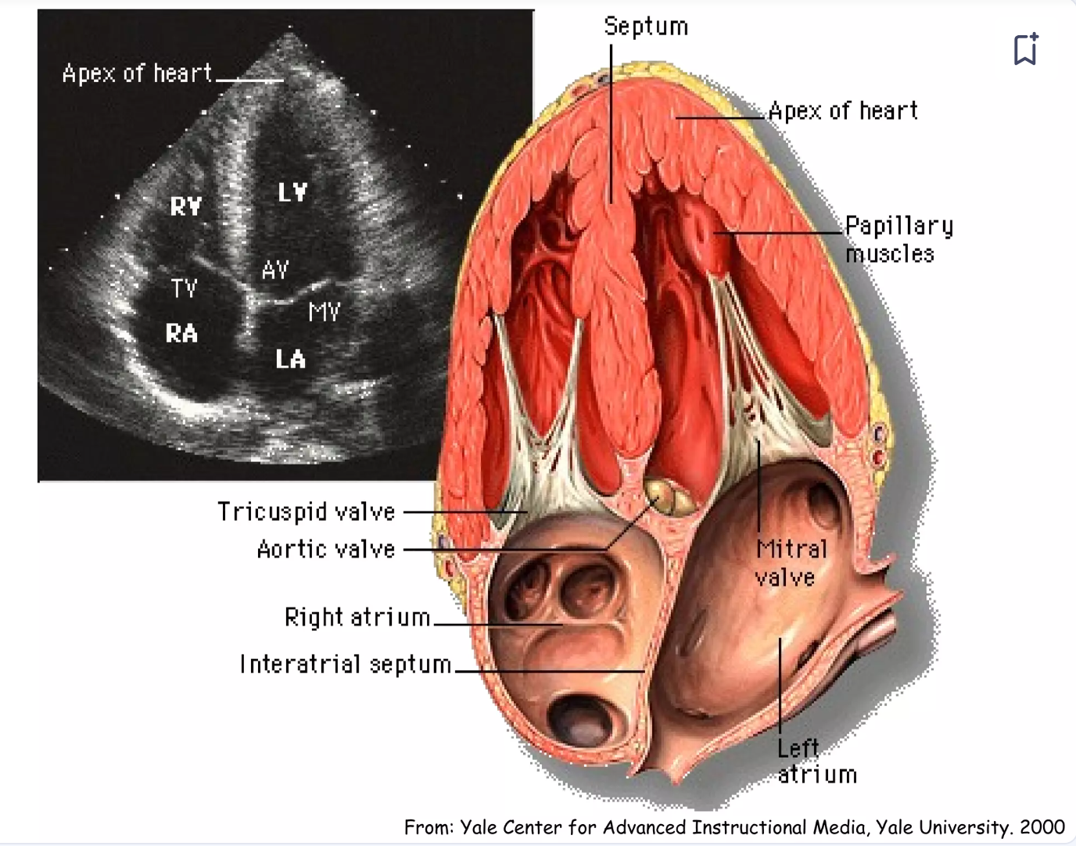
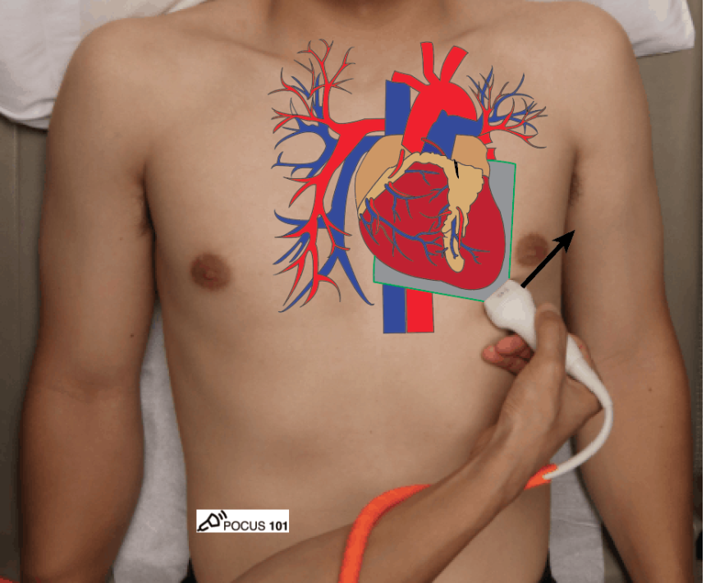
Apical 4 chamber view
Transducer at cardiac apex (4th-5th intercostal space)
Probe marker pointing toward left axilla
Patient position left lateral/ supine
Adapted by showmethepocus.com

Slide 23
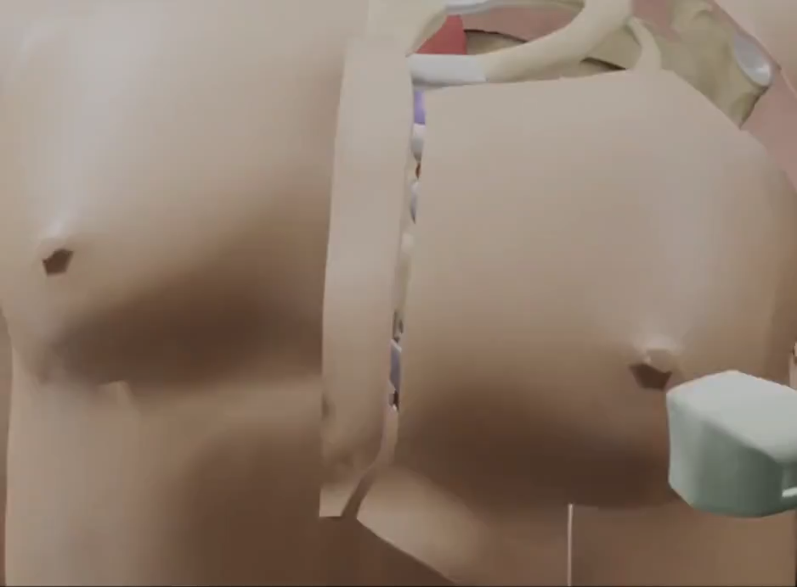
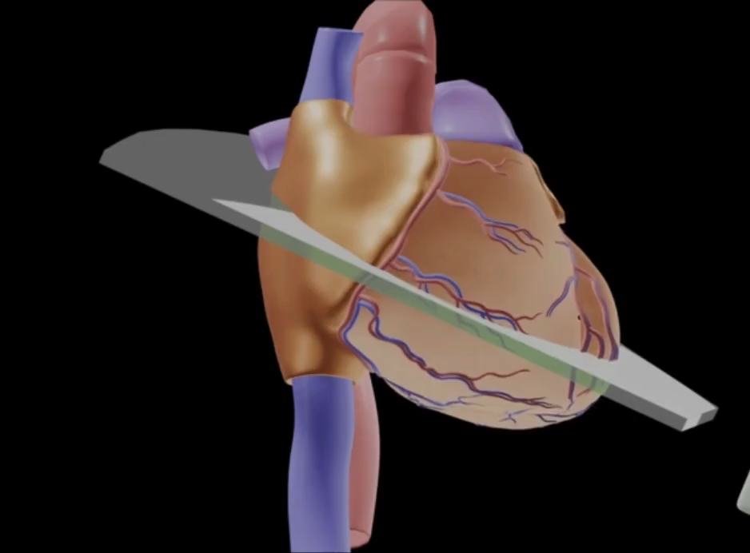
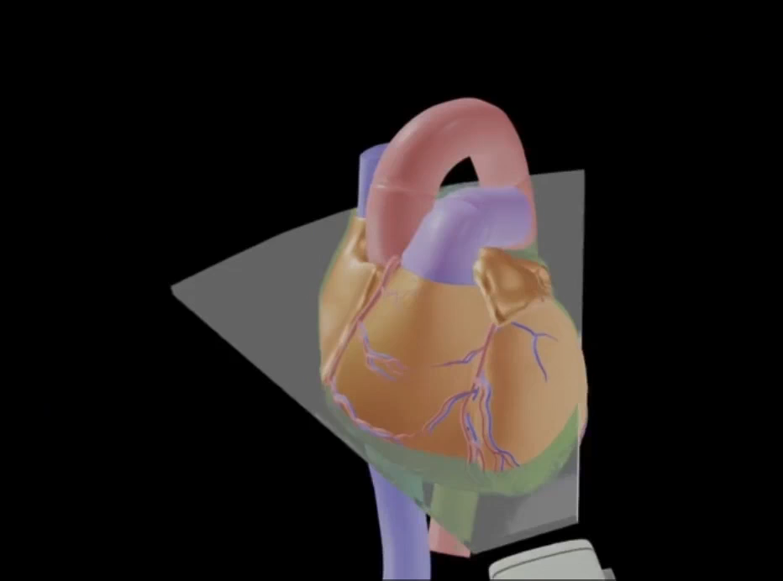
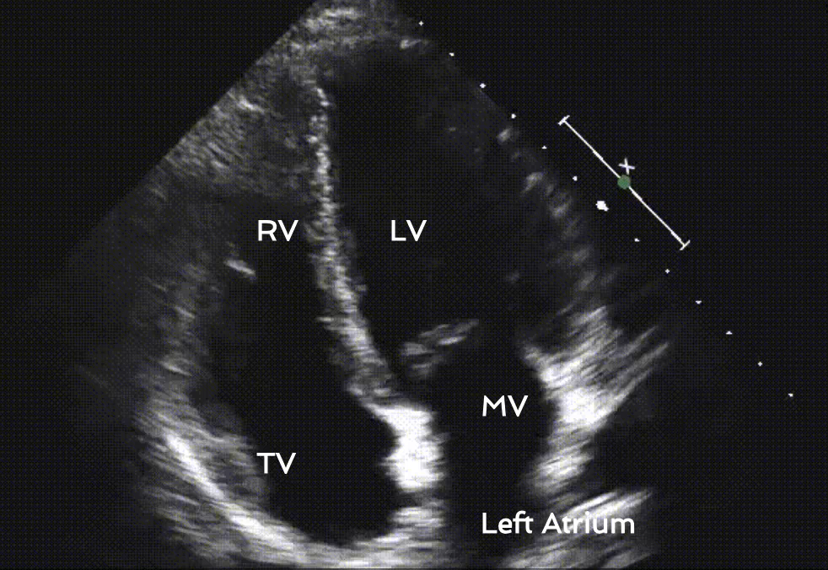
Adapted by showmethepocus.com

Slide 24
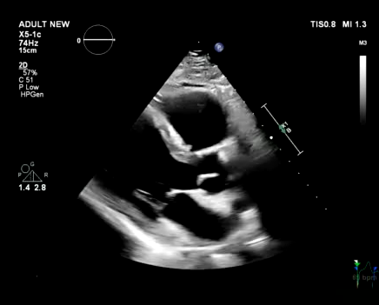
Normal appearance of heart
Chambers: anechoic spaces
Pericardium: uniform, bright, echogenic line
Myocardium: bulky, heterogenous, hyperechoic structure
Skinner H, et al. Focus cardiac ultrasound core curriculum and core syllabus of the European Association of Cardiovascular Imaging. Eur Heart J Cardiovasc Imaging. 2018 May 1;19(5):475-481.

Slide 25
Απαραίτητες πληροφορίες πριν ξεκινήσουμε το διαθωρακικό υπερηχογράφημα
Ύψος και Βάρος ασθενούς προκειμένου να προσαρμόσουμε τις μετρήσεις του στα σωματομετρικά του δεδομένα
Αρτηριακή πίεση κατά την εξέταση καθώς πολλά ευρήματα είναι άμεσα συνδεδεμένα με την αιμοδυναμική κατάσταση του ασθενούς
Καρδιακός ρυθμός και καρδιακή συχνότητα - για βελτιστοποίηση των μετρήσεων και της ερμηνείας τους
Κλινική Συσχέτιση – να δοθεί βάση στο αν υπάρχουν αίτια υπερδυναμικής κυκλοφορίας (εμπύρετο – εγκυμοσύνη – αναιμία – υπερθυρεοειδισμός)

Slide 26
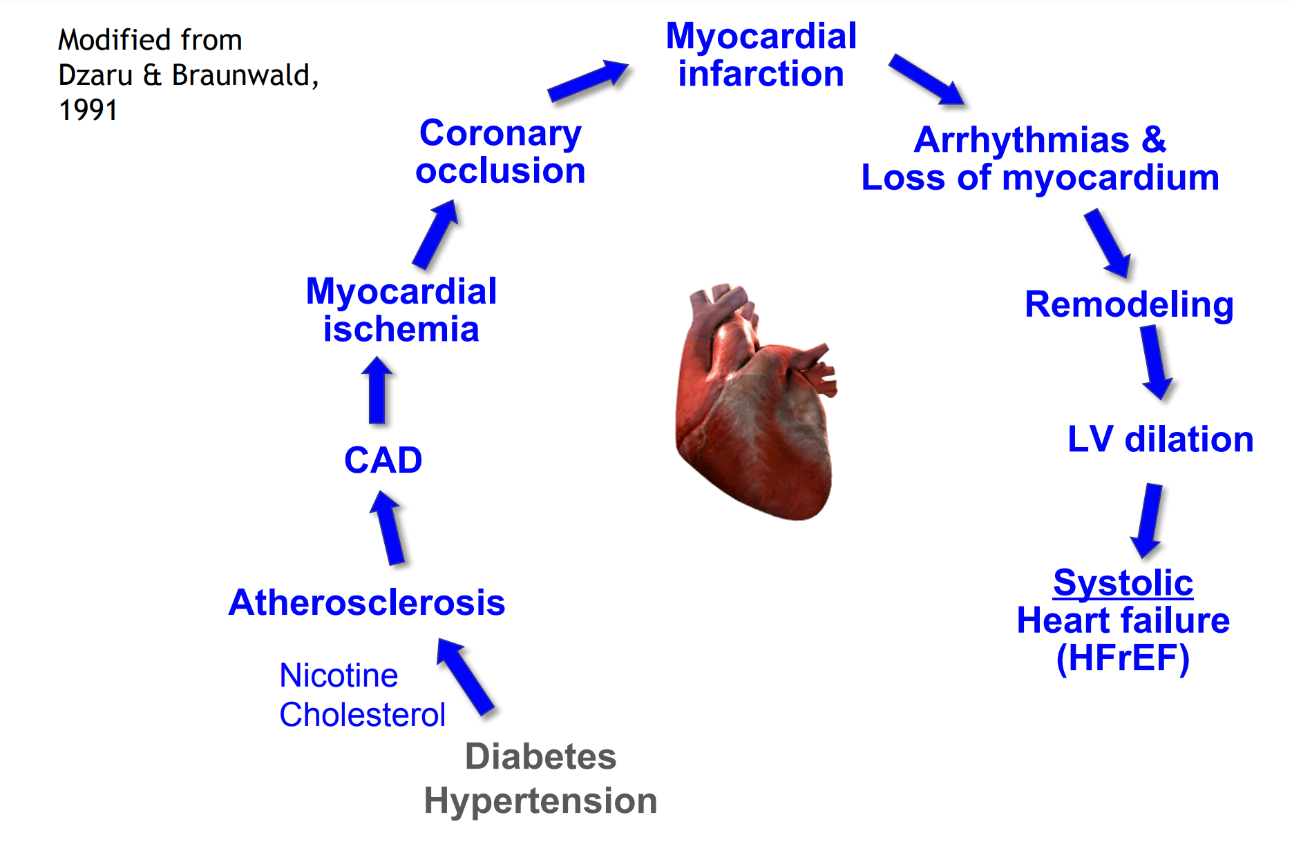

Slide 27
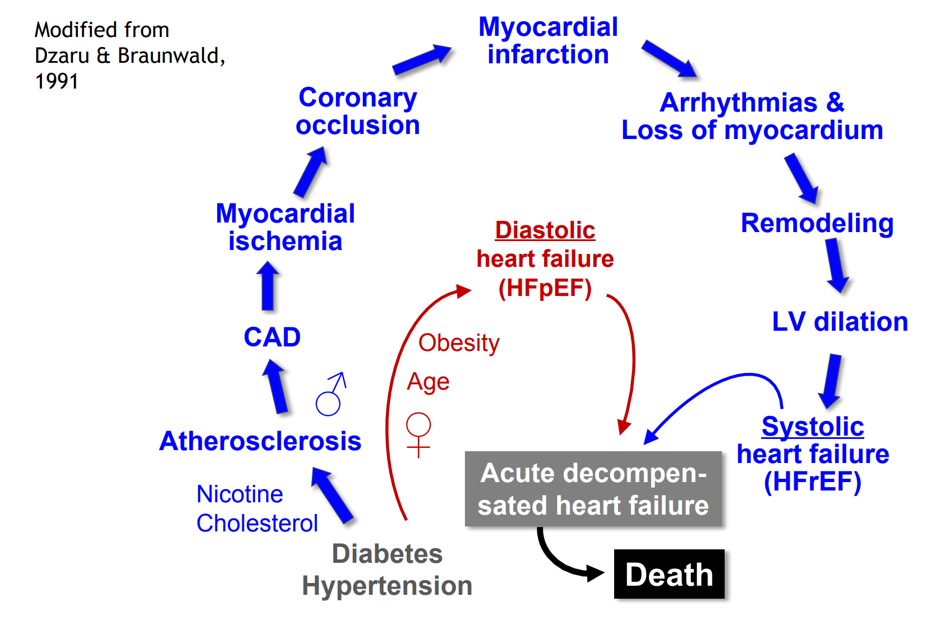

Slide 28
The role of TTE in preventive cardiology

Slide 29
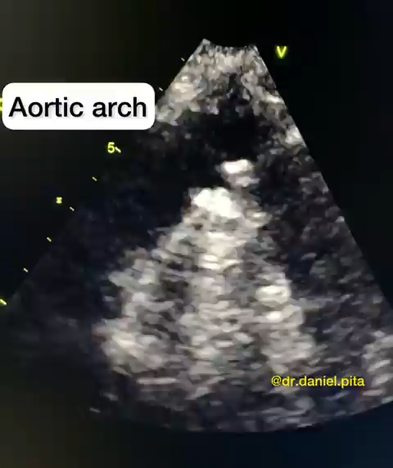
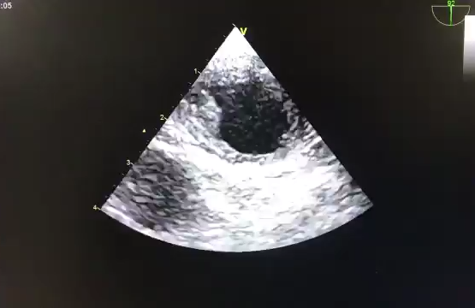
Atherosclerosis and aorta
Transthoracic echocardiogram
Transesophageal echocardiogram

Slide 30
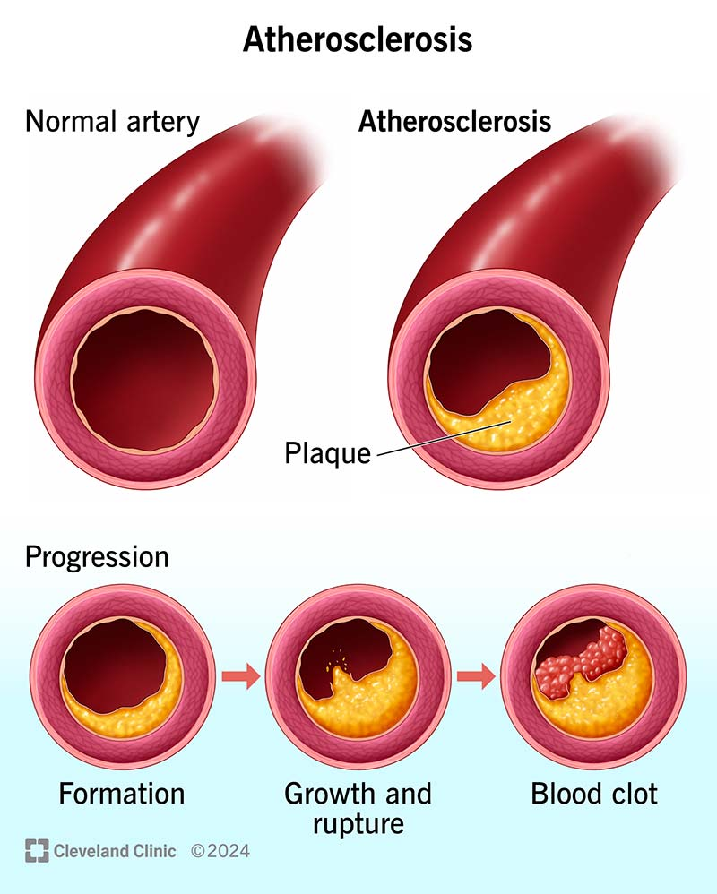


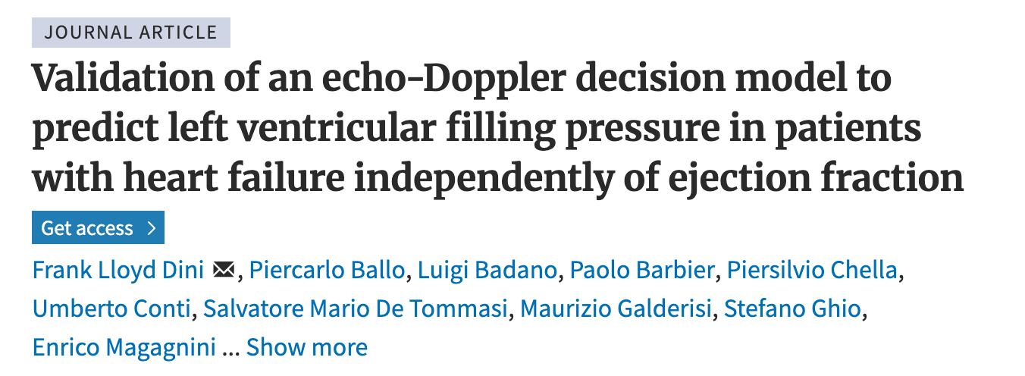
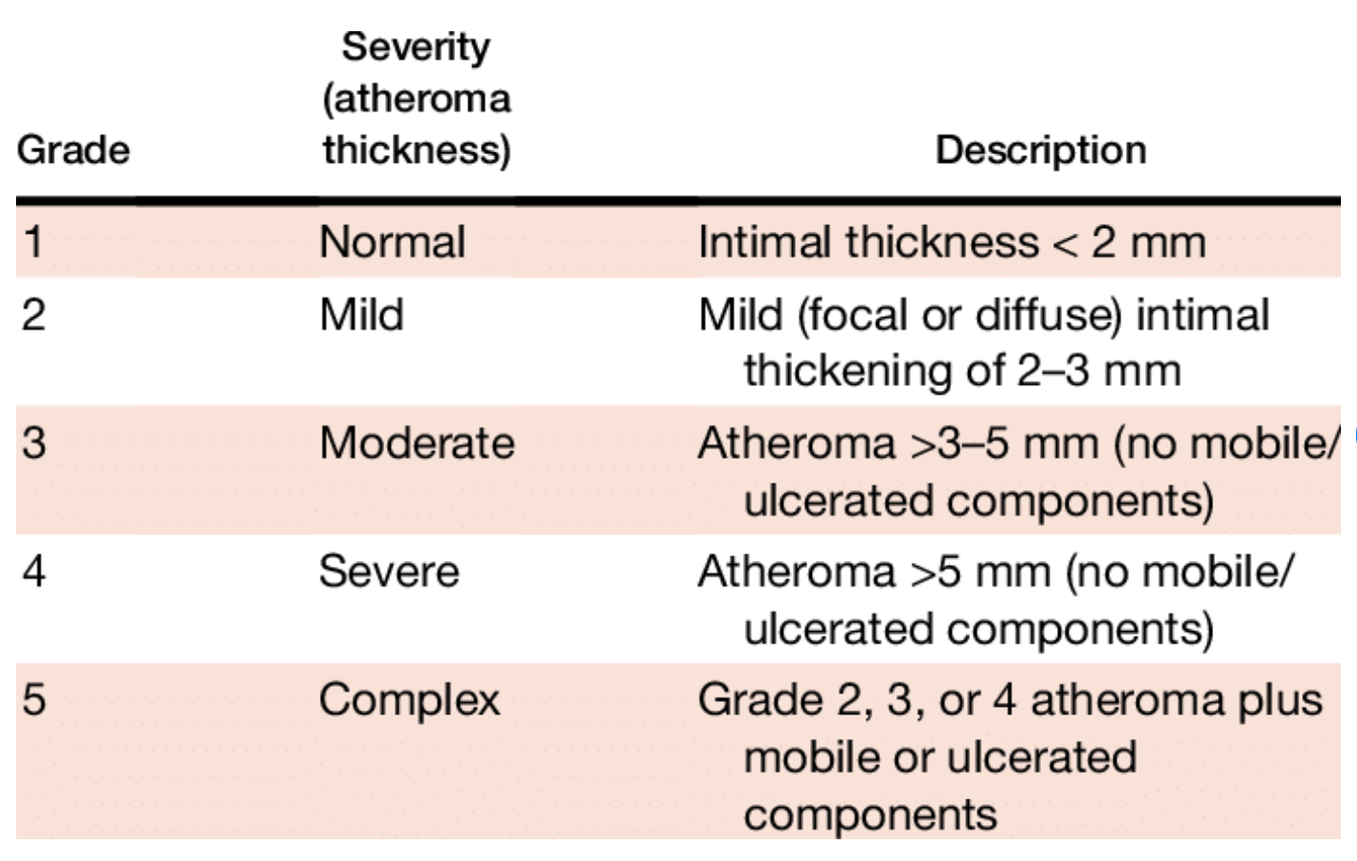
Grading system for severity of aortic atherosclerosis

Slide 31


Parasternal long axis view
Atheromatous plaque
Echogenic, linear structure
Sometimes mobile

Slide 32




High-risk atheromatous plaques for embolic events
Suprasternal view

Slide 33




Transesophageal echocardiography
Mild atheromatous plaque
Moderate atherosclerotic plaque
Thrombus attached to atherosclerotic plaque
Large atherosclerotic plaque

Slide 34
Atherosclerosis and heart
Subclinical atherosclerosis
Clinical atherosclerosis
Coronary heart disease
Valvular dysfunction

Slide 35

Subclinical atherosclerosis
Search for the presence of calcification
Aortic cusps
Mitral annulus
Aorta

Slide 36



Subclinical atherosclerosis
Search for the presence of epicardial fat

Slide 37

Pericardial effusion ?
OR
Epicardial fat ?

Slide 38


Subclinical atherosclerosis
Progressive aortic valve calcification leads to aortic valve stenosis
Calcified aortic cusps

Slide 39


Subclinical atherosclerosis
Aortic valve stenosis
Color Doppler
Spectral Doppler (CW)

Slide 40


Subclinical atherosclerosis
Mitral annular valve calcification
Mitral annular calcification (MAC)
Mitral regurgitation

Slide 41


Subclinical atherosclerosis
Mitral annular calcification
Circumferential calcification (3/3)

Slide 42

Subclinical atherosclerosis
Grades of mitral annular calcification
Higher early mortality and increased risk of MACE

Slide 43


Subclinical atherosclerosis
Mitral annular calcification
Mitral stenosis

Slide 44
Atherosclerosis and heart
Clinical atherosclerosis
Coronary heart disease

Slide 45

Clinical atherosclerosis
Coronary heart disease
Wall motion abnormalities

Slide 46



Clinical atherosclerosis
Coronary heart disease
2. Left ventricular thrombus

Slide 47


Clinical atherosclerosis
Coronary heart disease
2. Left ventricular thrombus
Higher embolic risk if mobile

Slide 48

Clinical atherosclerosis
Acute Myocardial Infarction Complications
Papillary muscle rupture

Slide 49




Clinical atherosclerosis
Acute Myocardial Infarction
Complications
Ventricular Septal Rupture after inferior STEMI
Beneki E, et al. A large ventricular septal rupture detected by cardiac point-of-care ultrasound. Coron Artery Dis. 2024 Jan 1;35(1):76-77.
Notes:
Ventricular septal rupture following an inferior STEMI is another life-threatening complication of acute myocardial infarction. It can be recognized, as shown in the video loops,by a turbulent flow through the ruptured septum, visualized using color Doppler.

Slide 50


Hypertension and aorta
Dilation of aorta
Acute aortic syndromes
Aortic dissection (AD) (80%)
Intramural hematoma (IMH) (15%)
Penetrating atherosclerotic ulcer (PAU) (5%)
Aortic aneurysm rupture

Slide 51


Hypertension and aorta
Dilation of aorta
Aortic regurgitation

Slide 52

Hypertension and aorta
Measurements of aorta
Leading edge-to-leading edge technique
Aortic root – Sinuses of Valsalva – Sinotubular junction –Ascending aorta

Slide 53


Hypertension and aorta
Aortic dissection
Intimal flap of aortic dissection
Aortic regurgitation
Pericardial effusion/tamponade
Bright, linear echogenic structure
in the aortic lumen
Independent motion from the aorta
Evangelista A., Echo Res Pract. 2019 Jun 1;6(2):R53-R63

Slide 54



Hypertension and aorta
Aortic intramural hematoma
Echo lucent areas in the aortic wall
No flow communication between lumen and hematoma
Song JK. J Cardiol. 2014 Sep;64(3):153-61.

Slide 55

Hypertension and aorta
Penetrating atherosclerotic ulcer
“Craterlike” out-pouching in the aortic wall
Multiple irregularities in the intimal layer
IMH
Aortic wall deformation
Extensive aortic atheroma
Jagged edges
Goldstein SA, et al. Am Soc Echocardiogr. 2015 Feb;28(2):119-82.

Slide 56
Hypertension and heart
Morphostructural changes of left ventricle
Functional changes of left ventricle

Slide 57


Hypertensive cardiomyopathy
Sigmoid septum
LVH
Left atrium dilation

Slide 58


Slide 59


Morphostructural changes of left ventricle
Relative wall thickness
PWT: posterior wall thickness
LVID: LV end-diastolic diameter

Slide 60


Slide 61

Concentric LVH
Concentric remodeling

Slide 62


Slide 63


Can we just measure LA diameter?

Slide 64


Slide 65

LV systolic dysfunction
LV diastolic dysfunction

Slide 66

LV Systolic Function
Ejection Fraction (EF) is a percentage of blood ejected from the LV with each contraction
Normal EF: 55-69%
Common views to assess LVEF: parasternal long axis view, parasternal short axis view, apical 4 chamber view

Slide 67

LV Systolic Function
Normal LV systolic function
Are the LV walls coming close to each other during systole?
Is anterior mitral valve leaflet coming close to the intraventricular septum during diastole?

Slide 68


Functional changes of heart
LV systolic dysfunction
Ischemic heart disease
Hypertensive cardiomyopathy →
Dilated cardiomyopathy (end-stage hypertrophy)

Slide 69

Functional changes of heart
LV diastolic dysfunction

Slide 70


Slide 71


