Slide 1
«Σακχαρώδης Διαβήτης και
Παχυσαρκία»
«Αντιυπερτασική θεραπεία στον προδιαβήτη και διαβήτη»
Κ. Δημητριάδης
Επίκουρος Καθηγητής Καρδιολογίας
Α’ Καρδιολογική Κλινική ΕΚΠΑ
Ιπποκράτειο ΓΝΑ
Notes:
Για την διαχρονικά σταθερή στηριξή του

Slide 2


Declaration of Interest
I have received travel expenses or Research Grant or honoraria fees from the following:
Medtronic, St. Jude Medical, Bayer, Boston, Novartis, Boehringer In, Pfizer, ELPEN, Sanofi, Unipharma, Bennett, Recordati, Angelini

Slide 3

Hypertension and pre-DM
Size of the problem and pathophysiology
NOD and drugs
BP targets
Drug therapy of choice

Slide 4



Insulin resistance: an inflammatory atherothrombotic syndrome
Hyperglycemia
Hyperinsulinemia
Triglyceride
INSULIN RESISTANCE
Insulin resistance
Cholesterol
PAI-1 tPA
Hypertension
Factor VII Factor XII
C-reactive protein Monocytes Cytokines
Adhesion molecules
Fibrinogen
PAI-1=plasminogen activator inhibitor-1; tPA=tissue plasminogen activator.
Adapted from Rydén L, et al. Eur Heart J 2013;34:3035–3087.

Slide 5
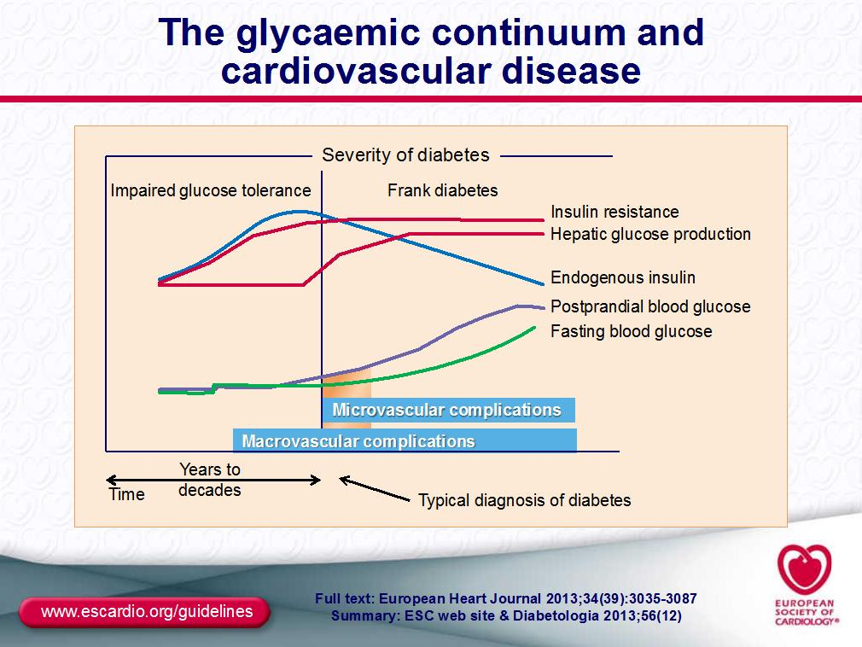

Slide 6

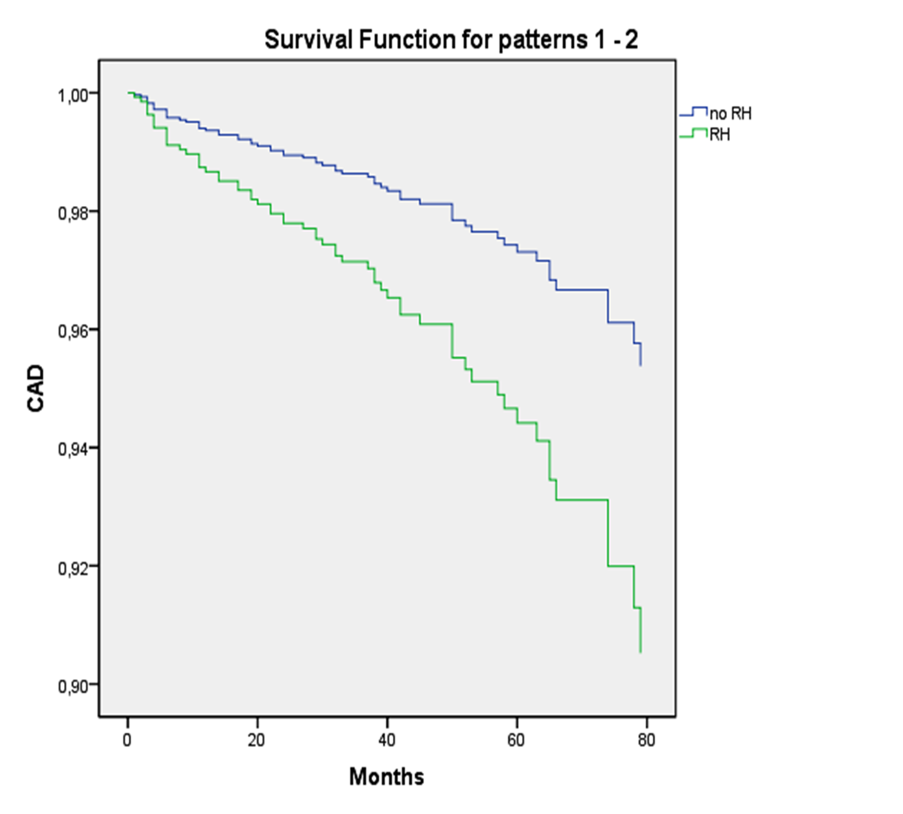
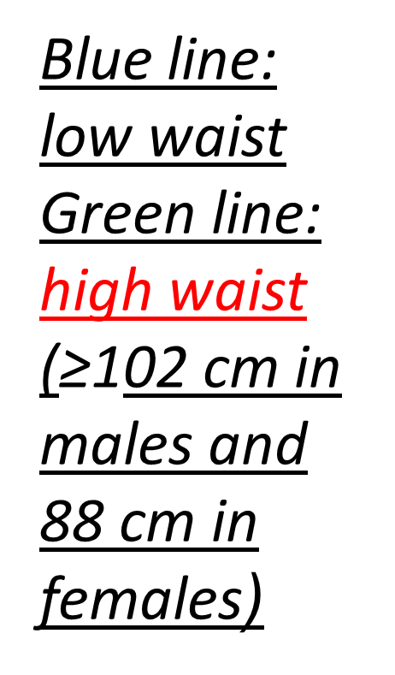
Waist circumference compared with other obesity parameters as determinants of coronary artery disease in essential hypertension: a 6-year follow-up study.
Dimitriadis K, Tsioufis C, et al. Hypertens Res 2016

Slide 7
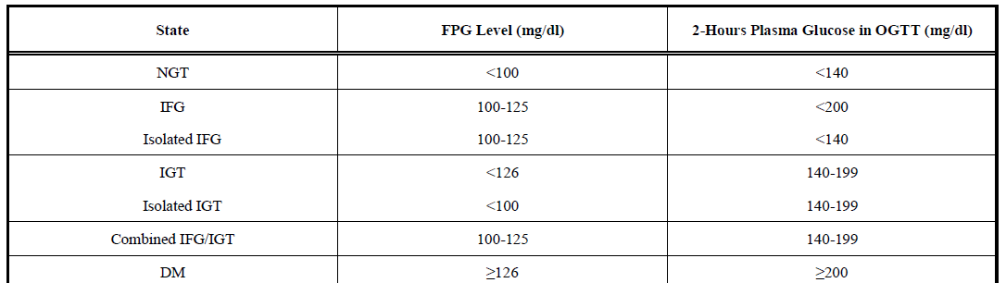
Classification of glucose tolerance states

Slide 8
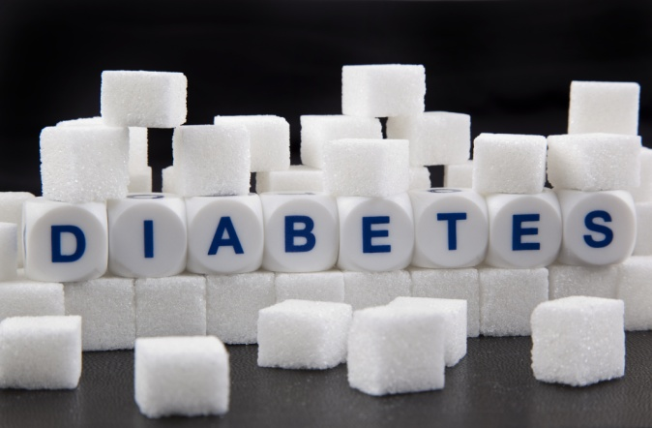
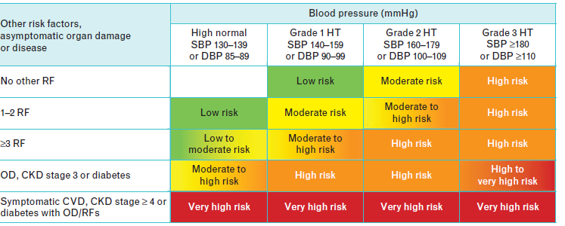
Some key facts
30 million 1985 becoming 382 million in 2014
and 592 million in 2035! (1/10 persons)
1.7 times higher CVD risk (MI, stroke)
Hypertension in 30% DM I and 60% DM II

Slide 9
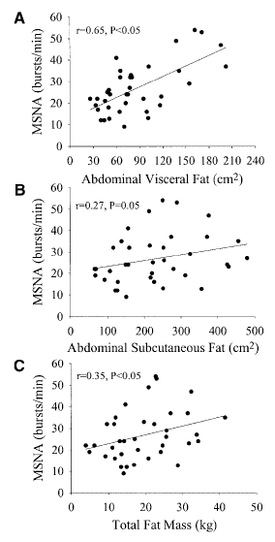
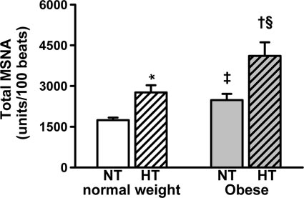
MSNA and obesity
Lambert et al. Hypertension. 2007;50:862-868

Slide 10
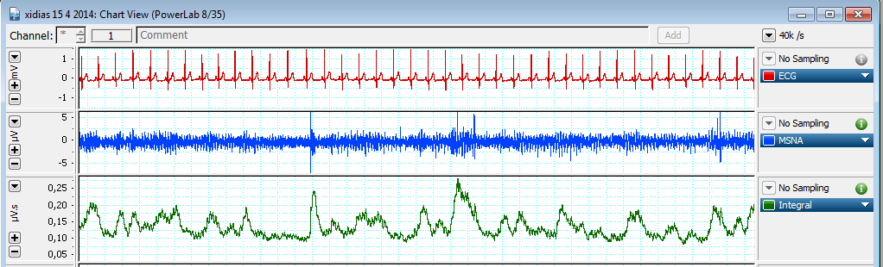
MSNA and metabolic syndrome in resistant hypertension
MSNA (bursts/100 heartbeats)
p<0.001
MS
Dimitriadis K, Tsioufis C, et al. ESH meeting 2016

Slide 11
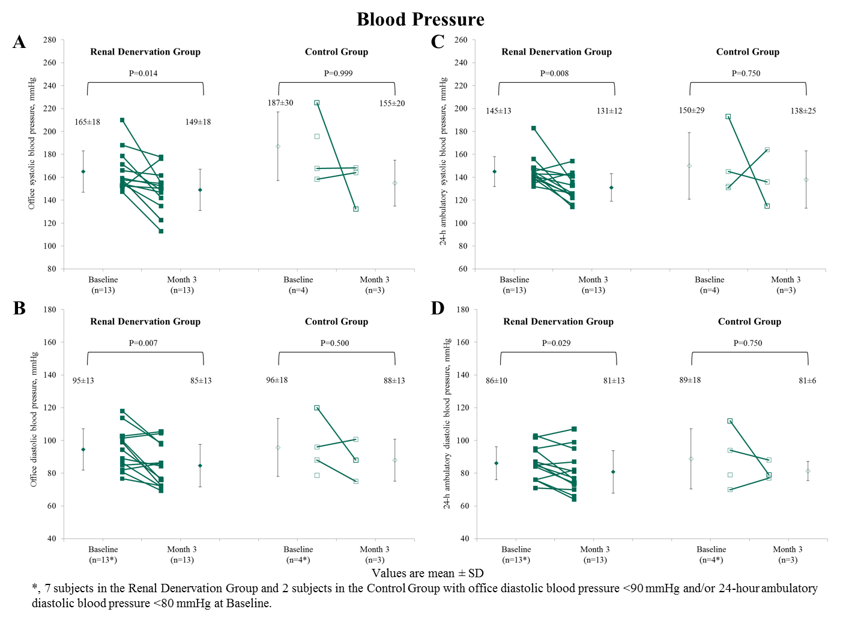
BP changes in MS pts after RDN
Tsioufis C, Dimitriadis K, et al . J Hypertens 2017

Slide 12
Changes in resting MSNA in groups
Tsioufis C, Dimitriadis K, et al . J Hypertens 2017

Slide 13
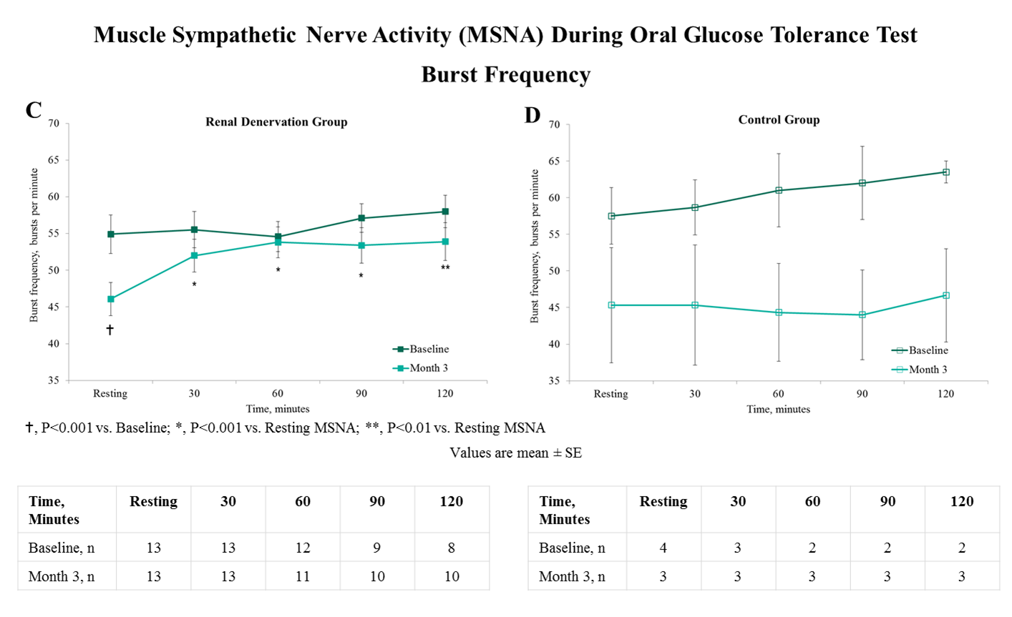
Changes in MSNA during OGTT
Tsioufis C, Dimitriadis K, et al . J Hypertens 2017

Slide 14
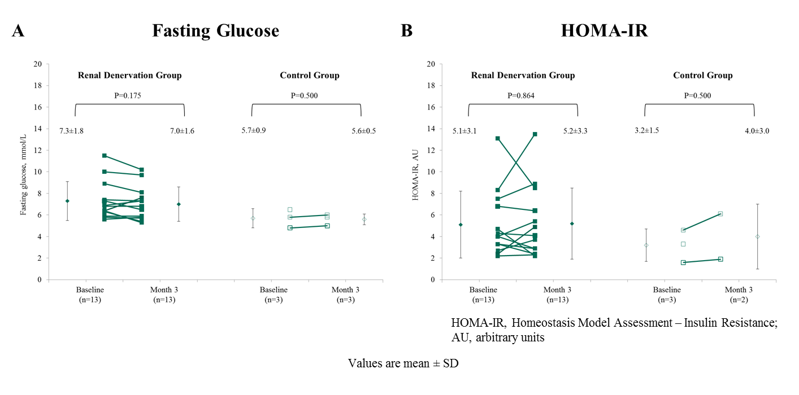
Changes in glucose metabolism
Tsioufis C, Dimitriadis K, et al . J Hypertens 2017

Slide 15

New-onset diabetes mellitus

Slide 16
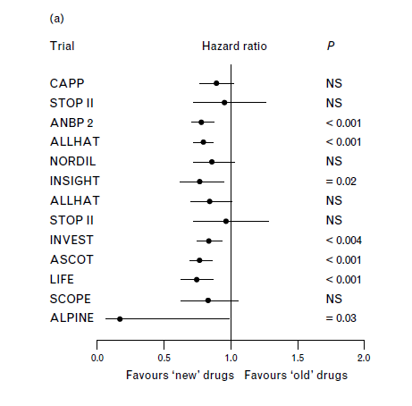
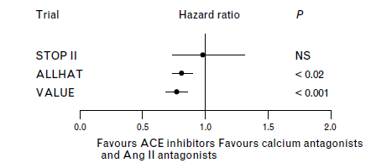
NOD in “new” and “older” drugs
20% less NOD with valsartan in VALUE vs amlodipine
Mancia G, et al. J Hypertens 2006

Slide 17
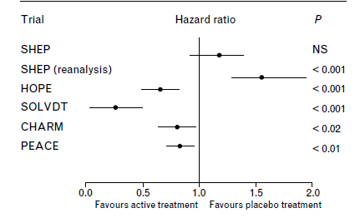
NOD: more insights from trials
SHEP: chlorothalidone+ atenolol more NOD
SCOPE: more NOD in placebo arm (more BB+diuretics not only HCTZ) vs candesartan group
22-74% lower NOD compared to placebo (but on top of multiple therapies)
CHARM: 22% less NOD but confounded by diuretic use+BB
Mancia G, et al. J Hypertens 2006

Slide 18
Prognostic impact of NOD
ALLHAT-more NOD with chlorothalidone vs amlodipine and lisinopril but better for HF, stroke and combined CV outcome
Verdecchia et al reports x3 in NOD due to diuretics but only 53 cases (16 years follow-up)
SHEP: NOD in placebo increased mortality but not in active group
Still research to do

Slide 19
NOD and cardiovascular events in essential hypertensives:
A 6-year follow-up study
The independent predictors for NOD were age , waist circumference , family history of diabetes and systolic BP at follow-up
The presence of NOD was independently associated with greater incidence of stroke (HR 2.404, p=0.046), whereas development of NOD had no relationship with the incidence of coronary artery disease
Tsiachris D, Tsioufis C, Thomopoulos C, et al. Int J Cardiol. 2010

Slide 20
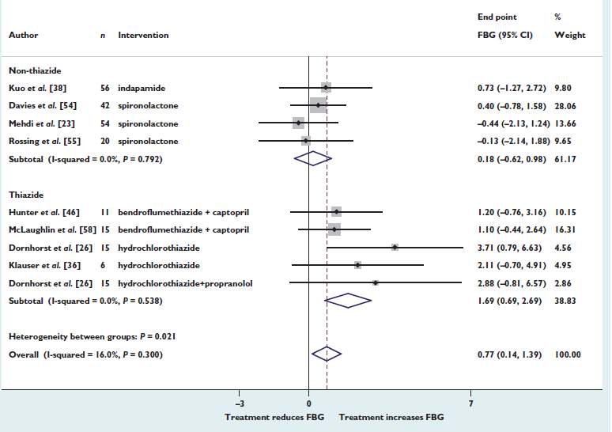
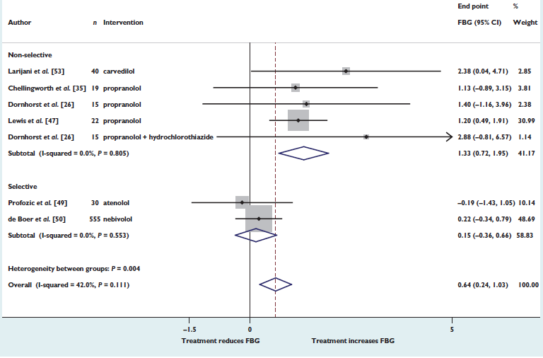
BB and diuretics in DM: Glycemic control
Hirst JA, et al. Br J Clin Pharmacol 2015

Slide 21
Possible pathophysiology for antidiabetogenic effects of RAS blockers
Increase in skin muscle blood flow
Potassium retention
Protection of pancreatic islets from glucotoxicity
Removal of Ang-II related oxidative stress
Agonistic action of peroxisome proliferator-activated receptor γ
Recruitment/differentation of adipocytes
Increased GLUT 4 glucose transportation

Slide 22
Possible pathophysiology for antidiabetogenic effects of RAS blockers
Reduce the vasoconstrictor action of Ang II and thus increase the perfusion of both pancreatic islet and skeletal muscle and improve glucose uptake and insulin delivery to the periphery
Increase adiponectin and leptin concentrations and to promote the differentiation of new fat cells
Favorable effect on phosphatidyl inositol 3-kinase (PI3-kinase) activity
Increase free circulating insulin-growth factor
I (IGF-I) levels and thus reduce insulin resistance

Slide 23
Possible pathophysiology for diabetogenic effects of diuretics
Hypokalemia impairs insulin secretion and sensitivity
Increased hepatic glucose production and to impaired peripheral glucose uptake
adipose tissue dysfunction with increased liver fat accumulation
and visceral fat redistribution, as well as in chronic low grade inflammation
increasing body mass
enhance the release of aldosterone that stimulates the release of inflammatory cytokines from fat cells and impairs insulin sensitivity
Decreased blood flow to skeletal muscle due to the reduction in blood volume and cardiac output

Slide 24
Possible pathophysiology for antidiabetogenic effects of CCBs
Influence glucose-stimulated insulin release due to their effects on voltage-dependent Ca2+ channels, which are associated with the exocytosis of a prohormone form of insulin from the secretory granules of the pancreatic cell
fasting blood glucose is generally not affected by verapamil, diltiazem or dihydropyridine taken in therapeutic doses, although some reports indicate that high-dose nifedipine or diltiazem may deteriorate glucose homeostasis
Neutral in terms of metabolic effects
Impairment of insulin release seems to be compensated
by modest increase in skeletal muscle glucose uptake

Slide 25
ΚΑΡΔΙΟΕΚΛΕΚΤΙΚΟΤΗΤΑ
ANTAGONIST (incubation time: 30 min) | RATIO β1/β2
nebivolol | 288
bisoprolol | 26
metoprolol | 25
atenolol | 15
celiprolol | 4,8
practolol | 3,5
bucindolol | 3,5
propranolol | 3,2
pindolol | 1,9
bunolol | 0,2

Slide 26
Ταξινόμηση β-αναστολέων
B-blockers
Μη καρδιοεκλεκτικοί
καρδιοεκλεκτικοί
& με α-ανασταλ-
τική δράση
Χωρίς ΕΣΔ
Nadolol
Propranolol
Timolol
Sotalol
Με ΕΣΔ
Pindolol
Carteolol
Penbutalol
Alprenolol
Oxprenolol
Χωρίς ΕΣΔ
Atenolol
Esmolol
Metoprolol
Bisoprolol
Betaxolol
Nebivolol
Με ΕΣΔ
Acebutol
Practolol
celiprolol
Labetalol
Carvedilol

Slide 27
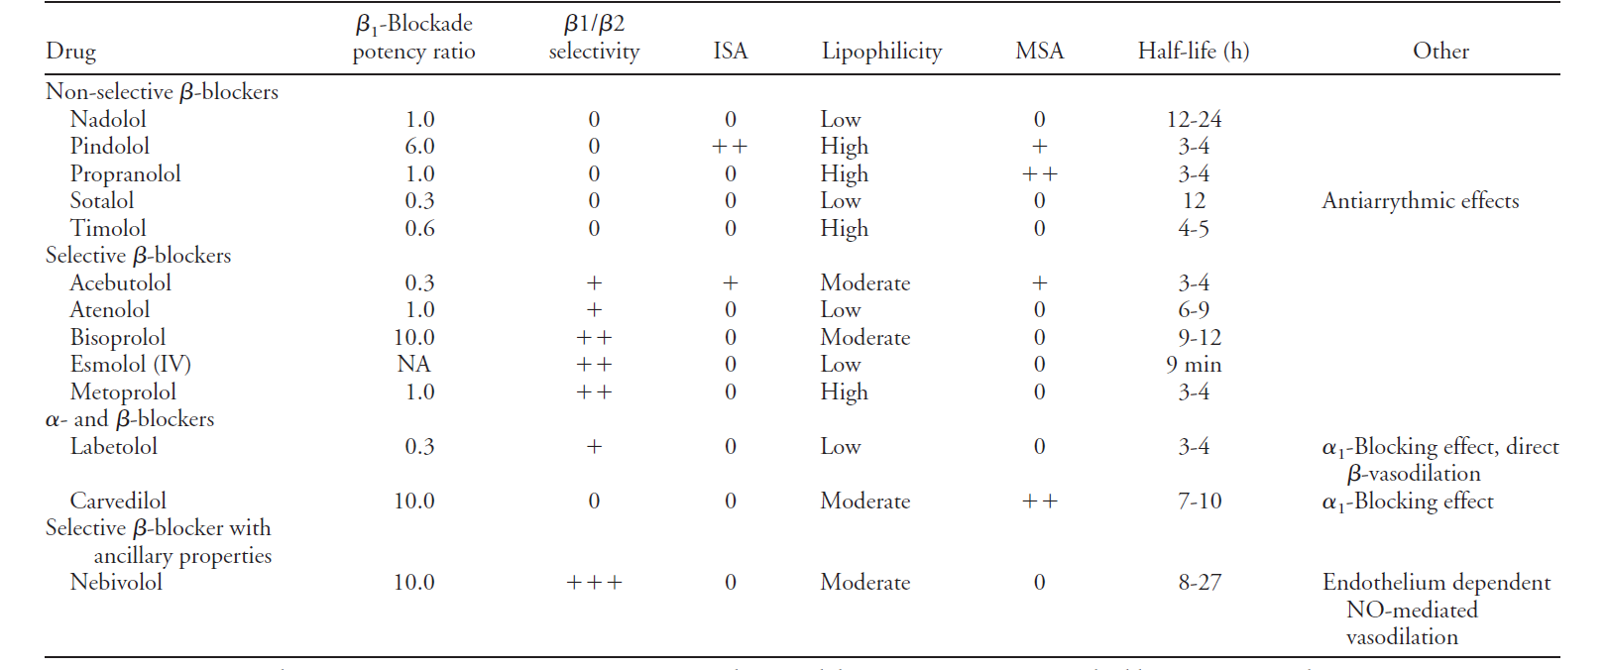

Slide 28
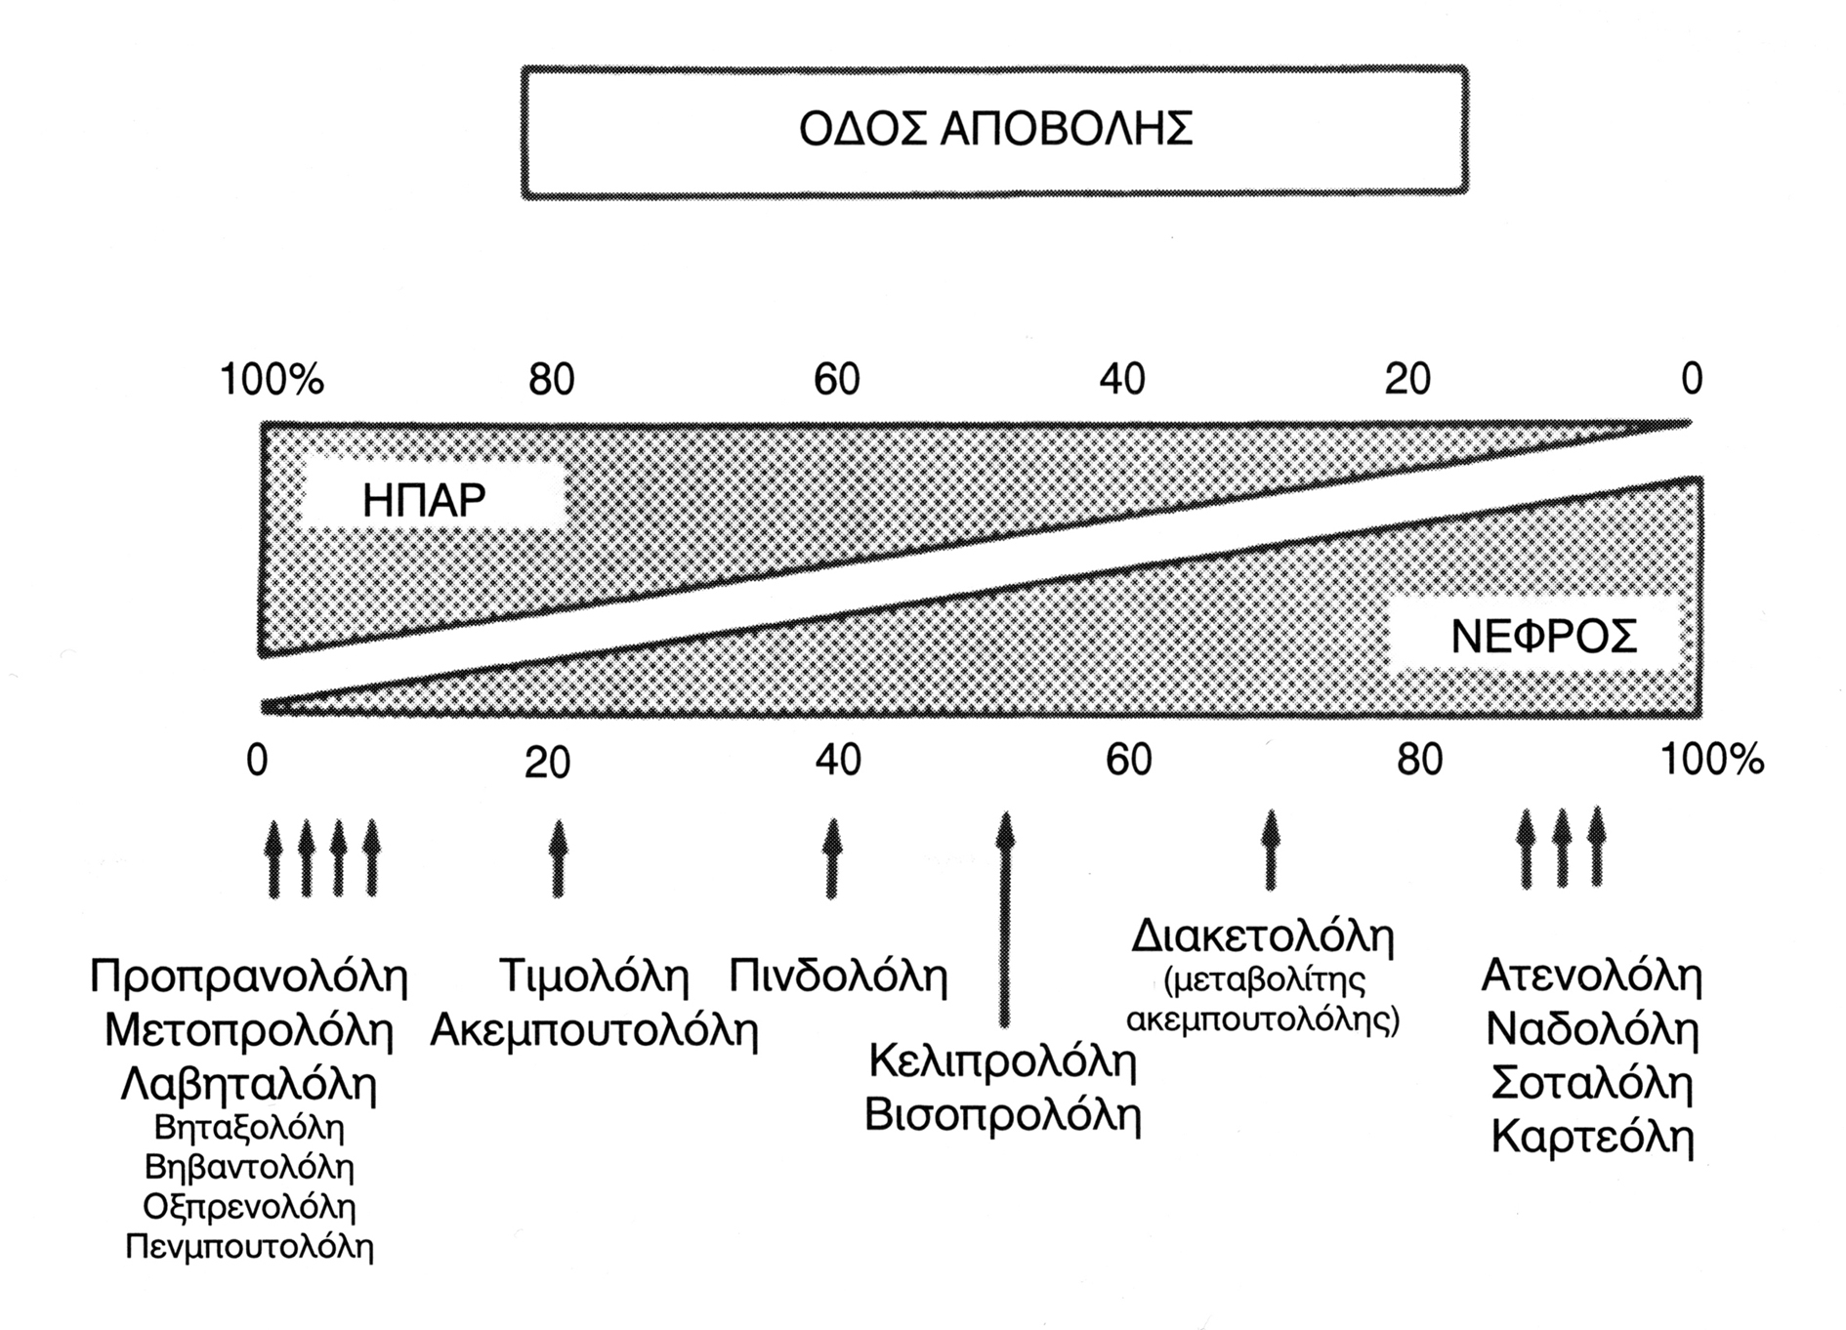
Νεμπιβολόλη

Slide 29

...λίγες περισσότερες «λεπτομέρειες»...

Slide 30
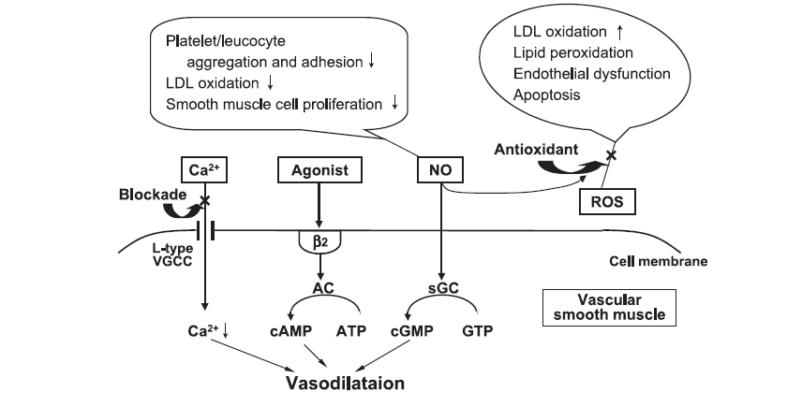

Αγγειοδιασταλτικοί Β-αποκλειστές
BBs are not a homogeneous class
Vasodilator BBs (celiprolol / nebivolol / carvedilol) do not share some of the negative properties described for other compounds

Slide 31
Vasodilator BBs - Favourable Effects
Less bradycardia
Aortic stiffness ↓
Central BP ↓
Less NOD than classical BBs (GEMINI)
NOD similar to placebo (SENIORS)
Less adverse effects on HbA1_{c} / lipid profile
Greater antiproteinuric effect
Improvement of coronary flow reserve in HT
Reduction of death / hospitalization in CHF
ESH Task Force Document, J Hypertens 2009

Slide 32
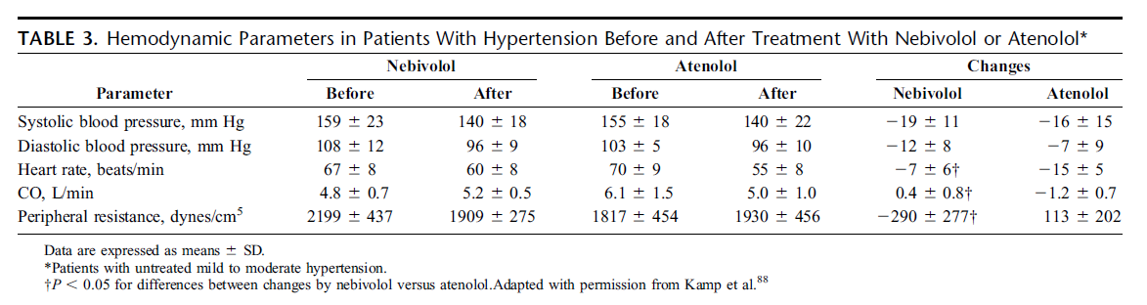
Διαφορές νεμπιβολόλης-ατενολόλης
Kamp O, et al. Am J Cardiol. 2003; 92:344–348.

Slide 33
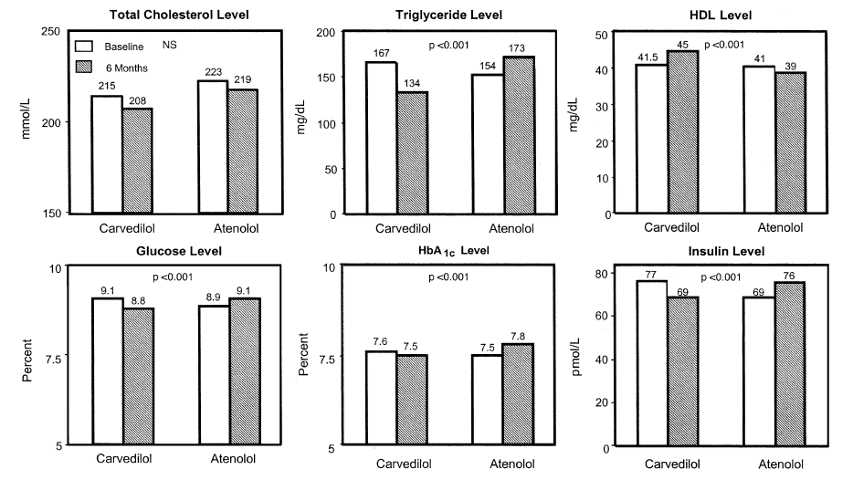
Διαφορές καρβεδιλόλης-ατενολόλης στο λιπιδαιμικό και γλυκαιμικό προφίλ
Giugliano D, et al. Ann Intern Med 1997;126:955–959.

Slide 34
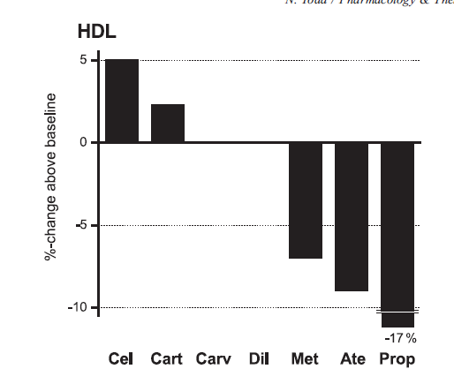
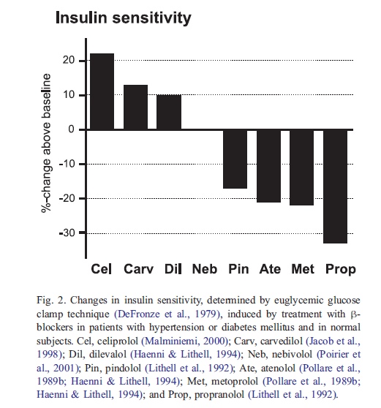
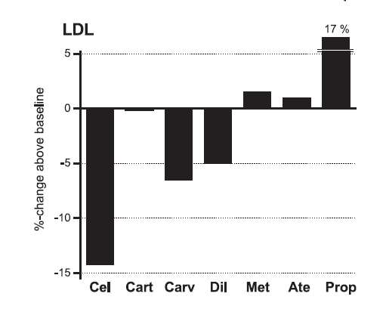
Διαφορές μεταξύ β-αποκλειστών στο μεταβολικό προφίλ

Slide 36
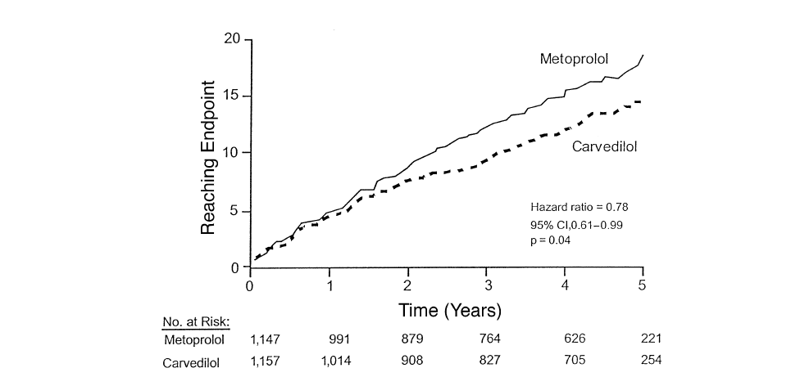
Νεοεμφανισθείς ΣΔ σε ασθενείς με ΚΑ υπό β-αποκλεισμό COMET STUDY
Poole-Wilson PA, et al. Lancet 2003;362:7–13.

Slide 37
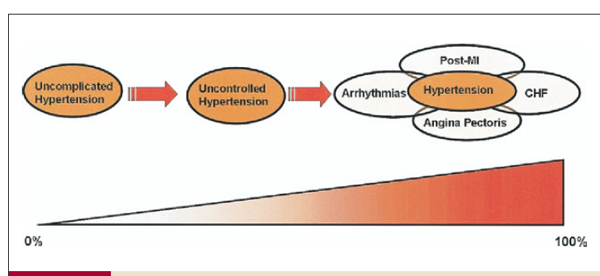
Νεότεροι β-αποκλειστές?

Slide 38

BP targets

Slide 39
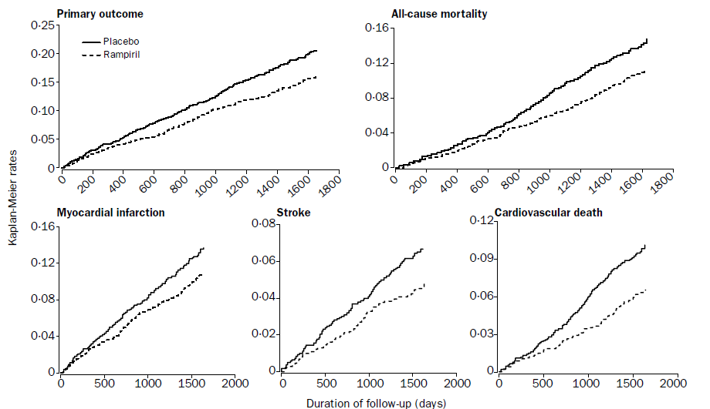
<140 mmHg target: HOPE
⬇ 24%
⬇ 25%
⬇ 37%
Lancet 2000

Slide 40
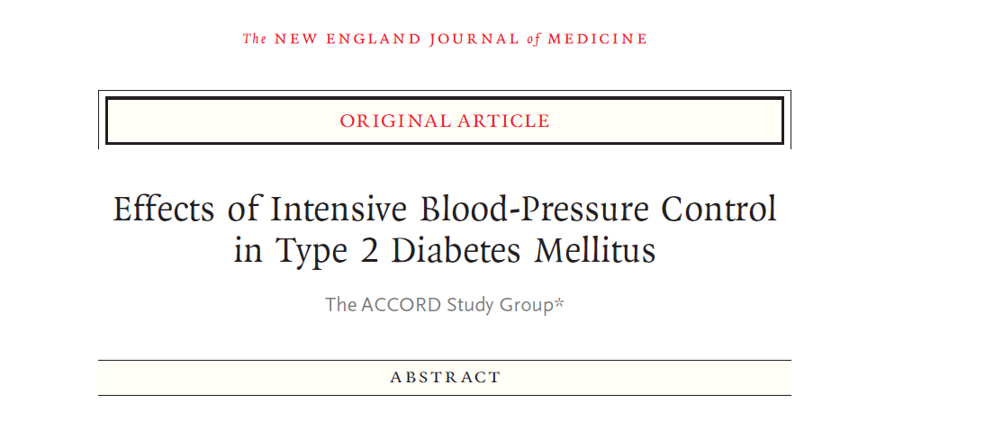

Slide 41
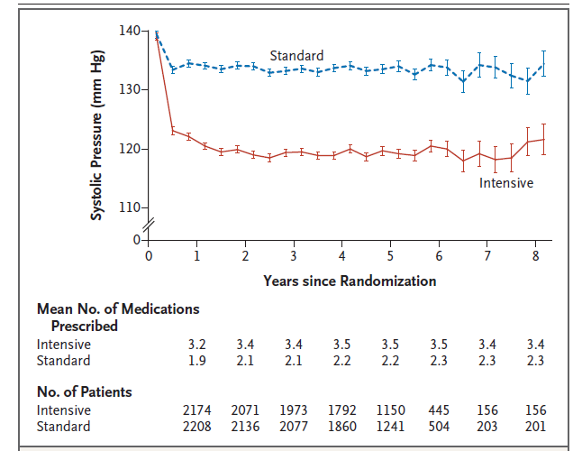
<140 mmHg
Achieved 133 mmHg
4733 pts High CV risk pts, DM+2 risk factors
130-180 mmHg with 3 or fewer drugs
4.7 years
<120 mmHg
Achieved 119 mmHg
NEJM 2010

Slide 42
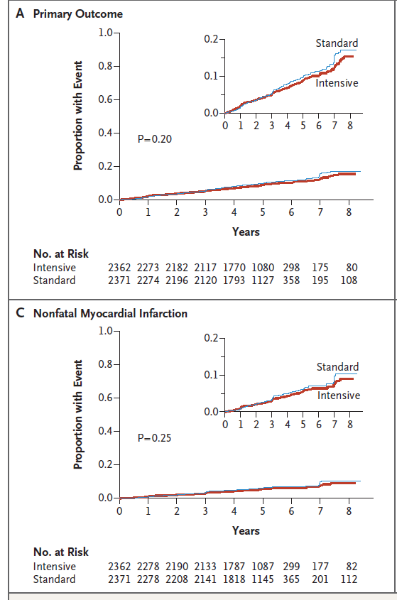
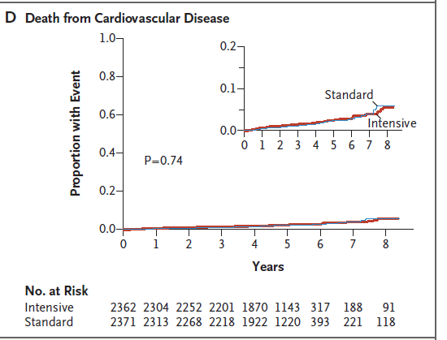
No effect of intensive therapy based on SBP targets on end-points in the ACCORD BP (including ESRD, HF)
NEJM 2010

Slide 43
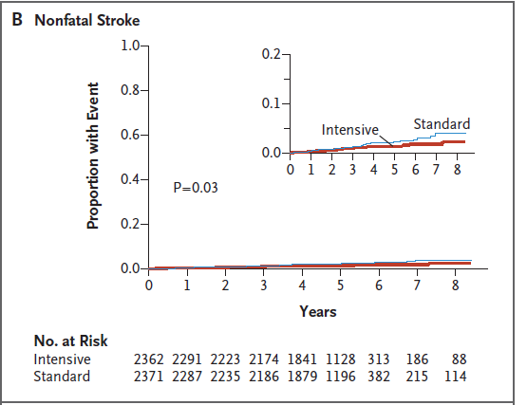
Risk reduction by 1.1%:
91 pts for 4.7 years for preventing 1 additional stroke
With the cost of 2% higher risk of adverse events (non-serious) (1/50 pts)
NEJM 2010

Slide 44
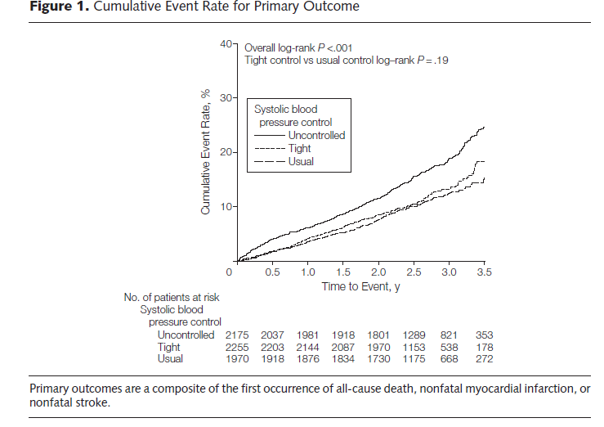
No differences except increased all-cause mortality in those with <130 mmHg
INVEST
DM+CAD
Cooper De-Hoff RM, et al. JAMA 2010

Slide 45
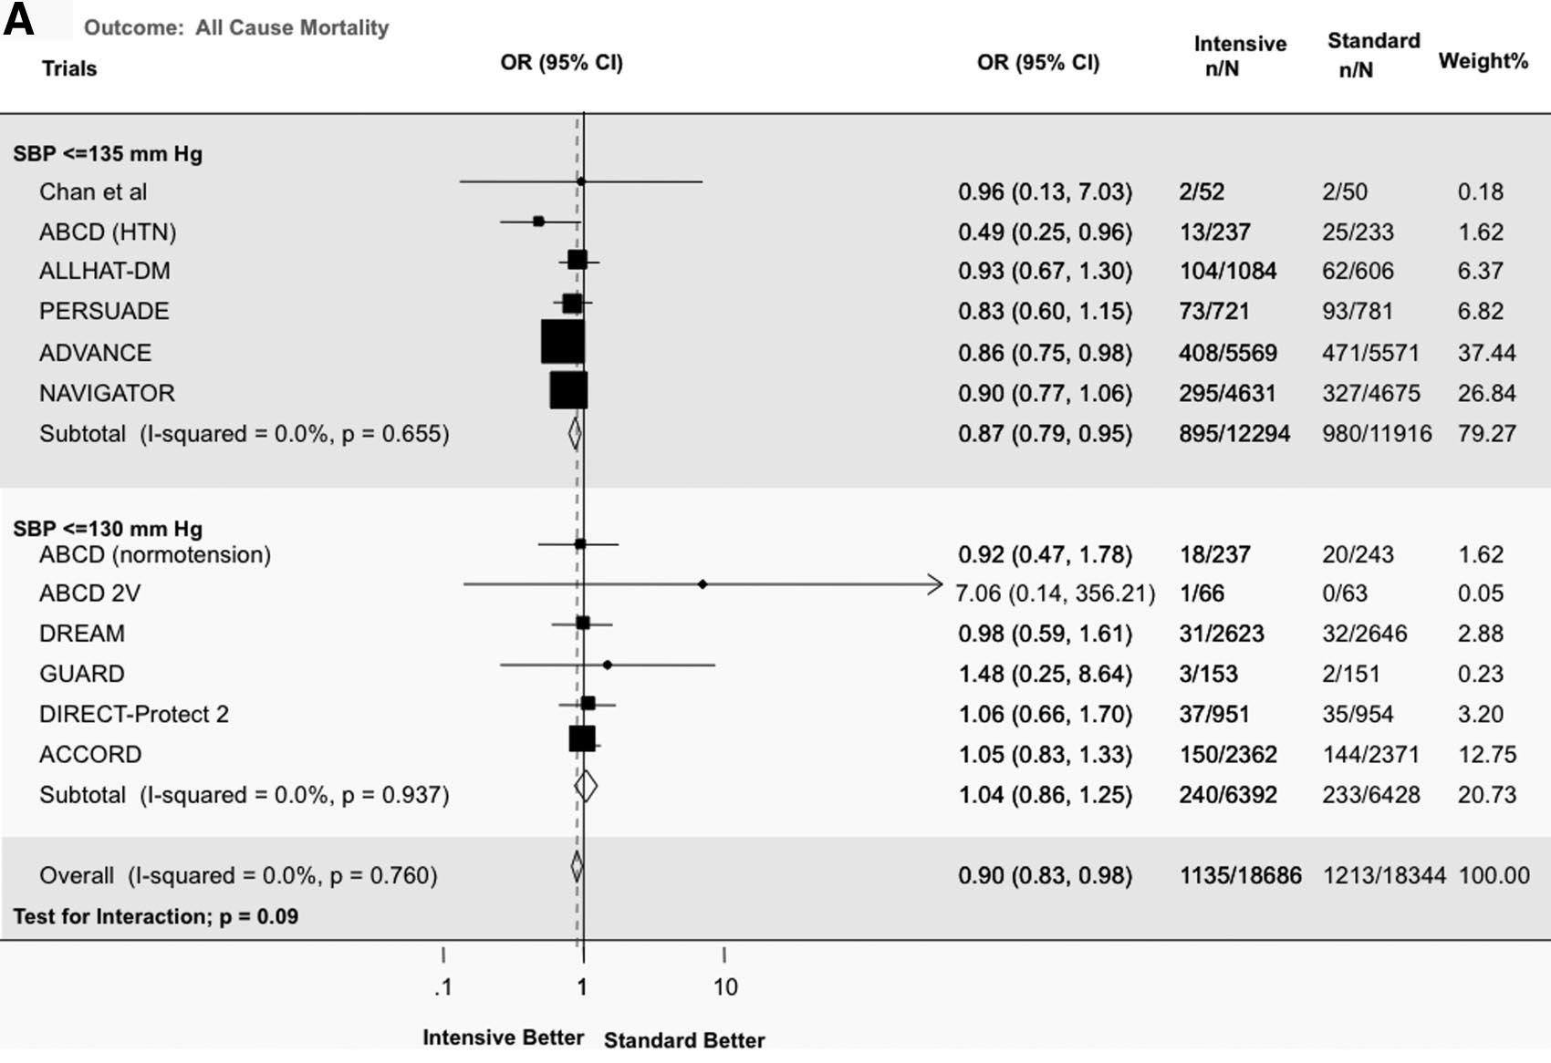
All-cause mortality in DM/IFG/IGT
Result driven by this group
Bangalore S, et al. Circulation 2011

Slide 46
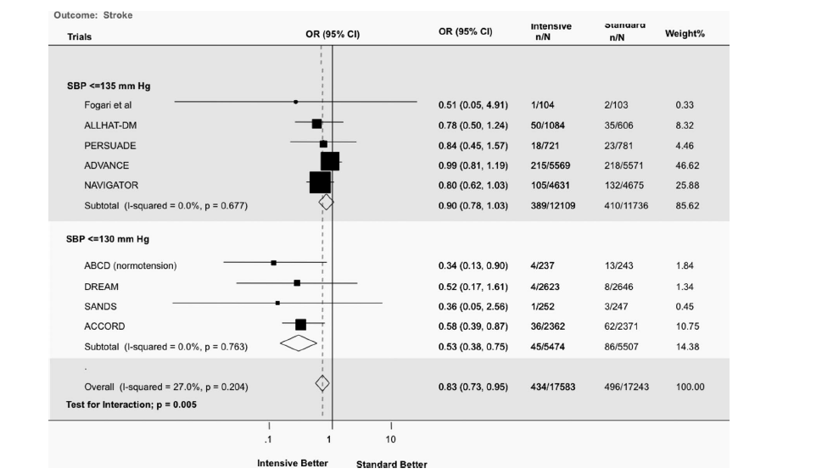
Stroke in DM/IFG/IGT
Bangalore S, et al. Circulation 2011

Slide 47
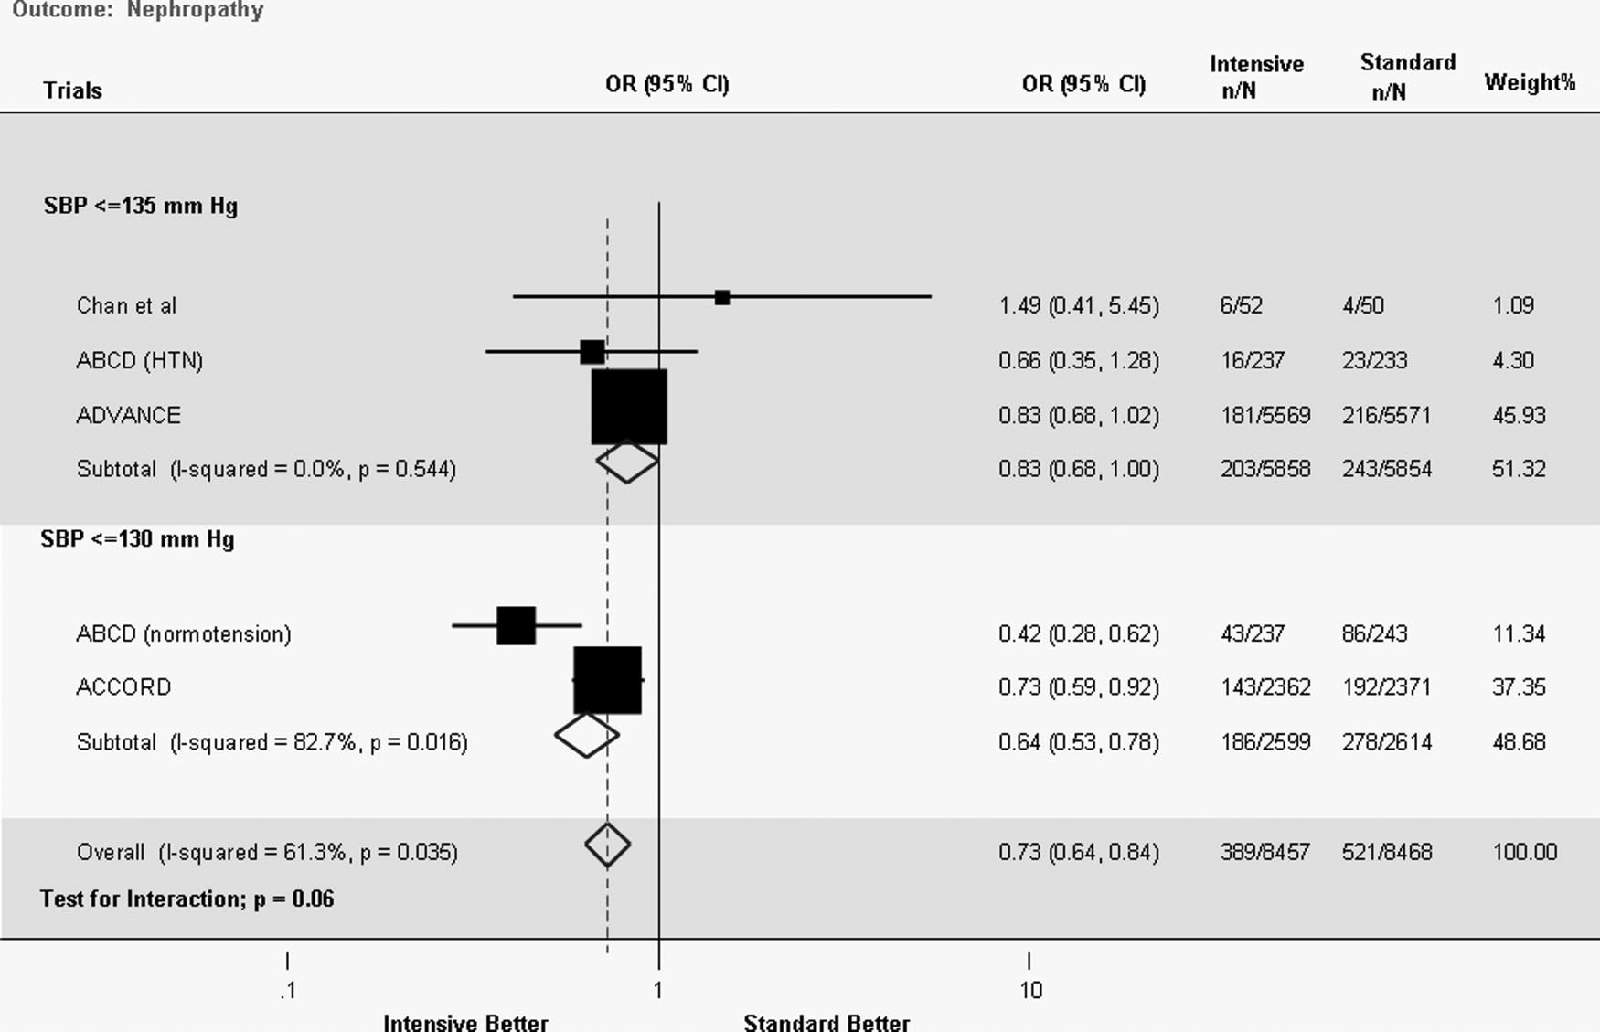
Nephropathy in DM/IFG
+17% reduction in OR for MA
Bangalore S, et al. Circulation 2011

Slide 48
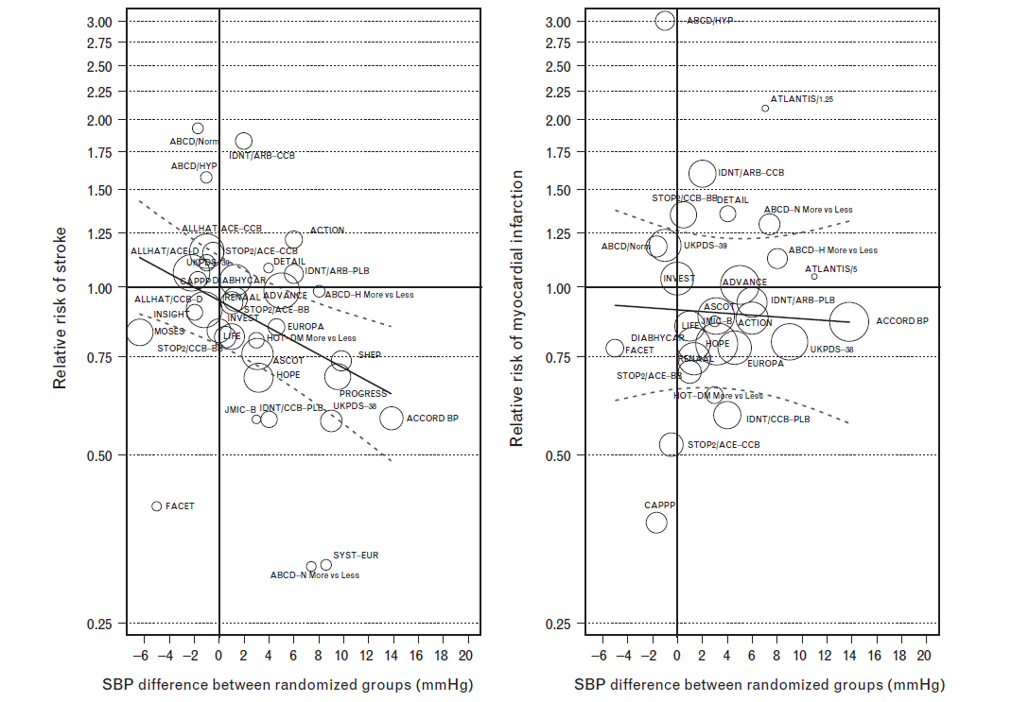
Stroke
MI
Reboldi G, et al. J Hypertens 2011

Slide 49
Diastolic BP targets

Slide 50
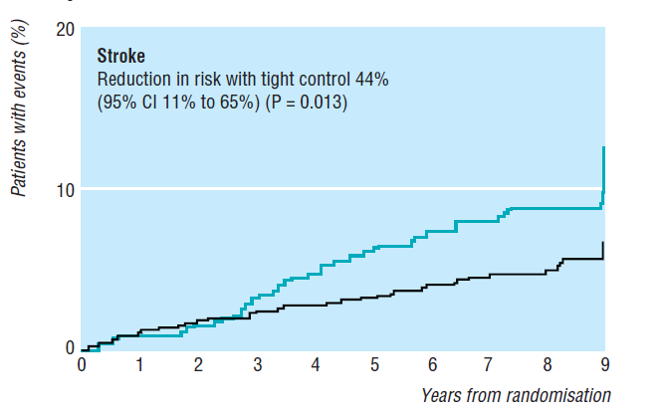
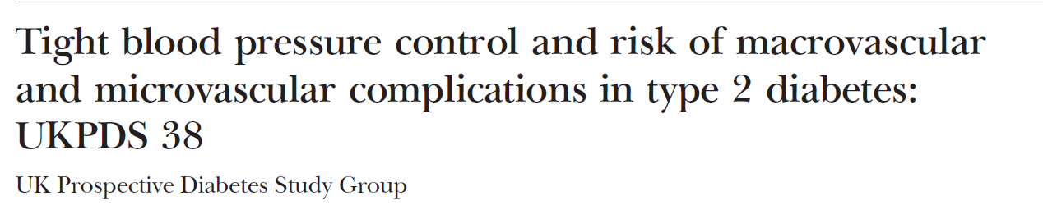
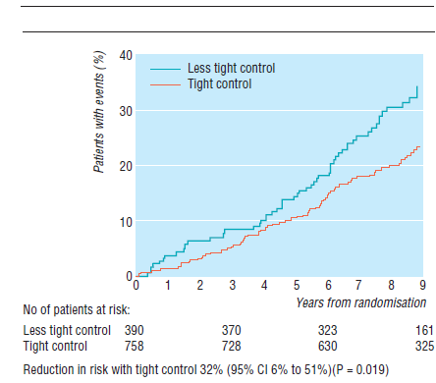
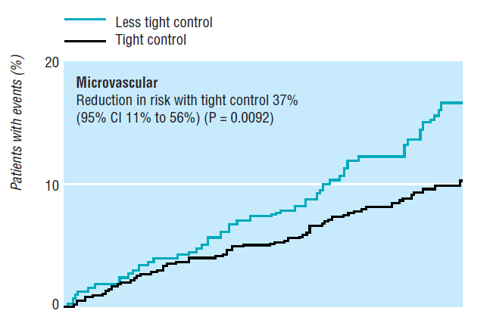
1148 all hypertensives with DM2
BP Aims:150/85 mmHg <180/105 mmHg
Achieved: 144/82 vs 154/87 mmHg
Presence of proteinuria related with improved outcome
DM death
BMJ 1998

Slide 51
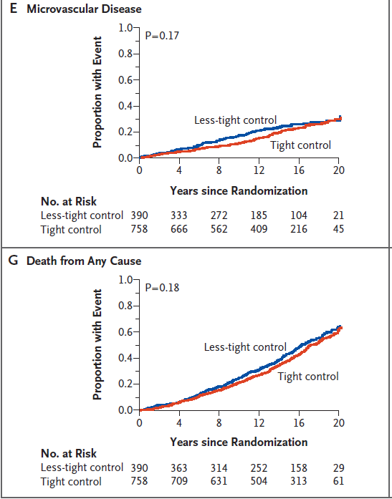
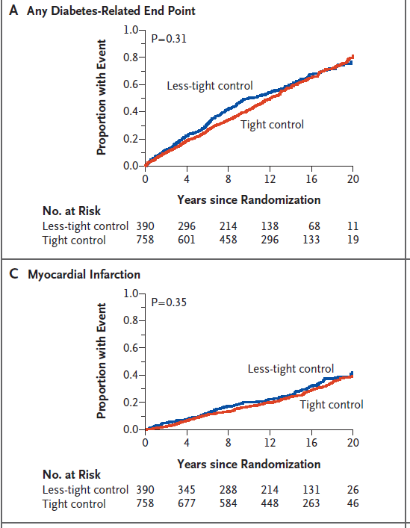
UKPDS 38
Long follow-up
Holmann R et al. NEJM 2008

Slide 52
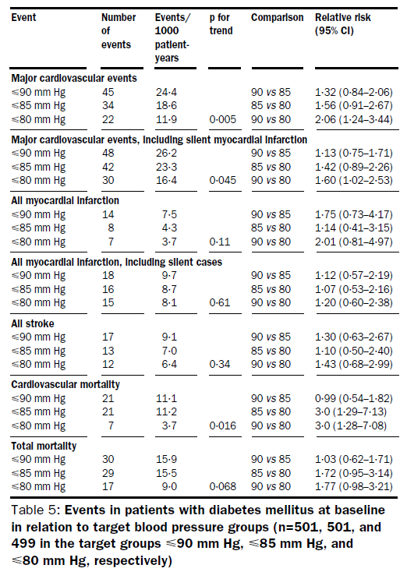
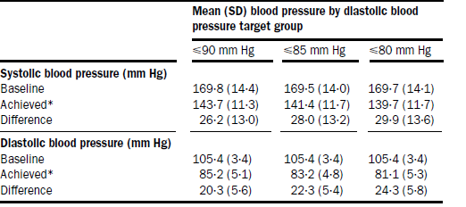
1501 DM pts
≤80 mmHg compared to ≤90 mmHg
1. halved the risk of major CVD events
2. 30% stroke reduction
3. CVD mortality benefit
Hansson L, et al. Lancet 1998

Slide 53
Diabetic CKD

Slide 54
Trials of DM CKD
Study | No | Hypertension(%) | Stage | Proteinuria (mg/24h) | Achieved BP
ORIENT | 577 | 93 | 3-4 | 250 | 133 vs 137
Lewis | 409 | 76 | 2-3 | <500 | 131 vs 133
IDNT | 1715 | 100 | 3-4 | 290 | 141 vs 144
RENAAL | 1513 | 93 | 3-4 | >300 | 144 vs 146
IRMA-2 | 590 | 100 | 2-3 | 60 | 142 vs 144
DIABHYCAR | 4912 | 56 | 2 | MA range | 143 vs 145
ACCORD | 4750 | 100 | 1-2 | <300 | 119 vs 131

Slide 55
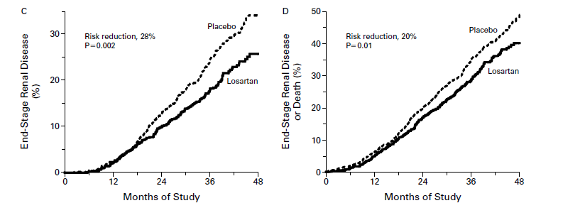
RENAAL
DM 2 and CKD
2.6 years follow-up (Losartan vs placebo)
BP decline at year:
152/82 to 140/74 mmHg (losartan)
153/82 to 142/74 mmHg (placebo)
No effect on death/CVD morbidity and mortality
The renal benefit exceeded that attributable to BP changes
NEJM 2001

Slide 56
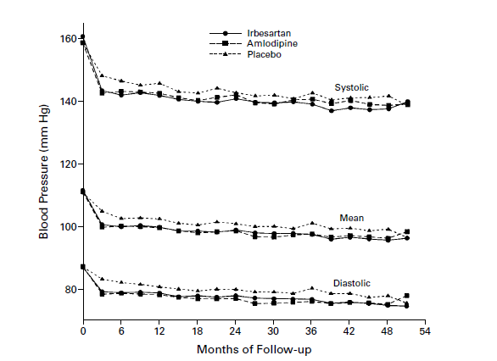
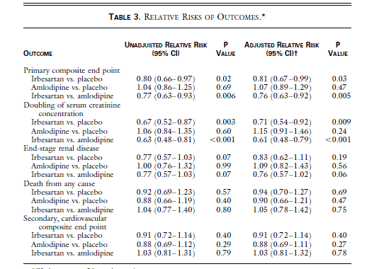
IDNT trial
1715 hypertensives with DM 2 and CKD
2.6 years follow-up
Better renal outcomes
in the irbesartan group
not explained by MAP
NEJM 2001

Slide 57
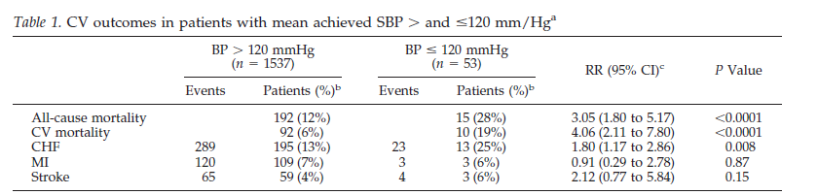

IDNT:
greater all-cause and CV mortality in ≤120 mmHg pts
Differences in baseline data
Berl T, et al. J Am Soc Nephrol 2005

Slide 58
The ALLHAT trial results
The ALLHAT study (Antihypertensive and Lipid- Lowering Treatment to Prevent Heart Attack Trial) investigated whether the incidence of CVD events in hypertensive patients differs between diverse antihypertensive treatments with thiazide diuretic (chlorthalidone), CCB (amlodipine) or ACEI (lisinopril)
Similar effectiveness of all 3 treatments regimens in preventing CVD events, but incidence of new-onset DM was higher in the chlorthalidone group in comparison with the amlodipine and
lisinopril groups
In a subgroup analysis of the ALLHAT data, the efficacy of the 3 treatments arms was investigated according to the glycemic status of the patients (DM, IFG or normoglycemia)
No difference in the incidence of CVD events was found in any of the 3 glycemic states when
chlorthalidone treatment was compared with lisinopril treatment.
However, within the IFG stratum, the primary outcome was significantly more common (p=0.02) in those assigned to amlodipine compared with chlorthalidone [RR 1.73 (95% CI, 1.10-2.72)] (no difference was established among diabetic or normoglycemic individuals).

Slide 59
The ALLHAT trial results
The incidence of new-onset DM at 4 years in patients with metabolic syndrome did not differ significantly between subjects treated with chlorthalidone or amlodipine, but individuals treated with lisinopril had significantly lower new-onset DM incidence in comparison with those in the chlorthalidone group (12.6% vs. 17.1%, p<0.05).
For those without metabolic syndrome the rate of new-onset DM was lower in patients in the lisinopril and amlodipine arm in comparison with subjects in the chlorthalidone group (7.7% for chlorthalidone, 4.2% for amlodipine, and 4.7% for lisinopril (p<0.05 for both comparisons).
No significant difference in the CVD events was noted among the 3 treatment regimens in subjects with or without metabolic syndrome.

Slide 60
Choice of antihypertensive treatment in subjects with pre-diabetes. Is there a dream after the navigator.
Eleftheriadou I, Tsioufis C, Tsiachris D, Tentolouris N, Stefanadis C.
Curr Vasc Pharmacol. 2011 9(6):715-22.
Antihypertensive treatment in diabetic patients. Review of current data
Georgia Argyrakopoulouª, Costas Tsioufis^{b}, Eleni Sdrakaª, Dimitris Tsiachris^{b}, Konstantinos Makrilakisª, Christodoulos Stefanadis^{b}
Maturitas 2013
Σε άτομα με προδιάθεση για ΣΔ (πχ μεταβολικό σύνδρομο) να αποφεύγονται ως αρχική επιλογή τα διουρητικά και οι β-αναστολείς

Slide 61


33395 DM pts from 27 trials
No differences
BMJ 2005

Slide 62

40 trials=100 354 participants
Emdin CA, et al. JAMA 2015

Slide 63


Meta-analysis CKD/DM
Palmer SC, et al. Lancet 2015; 385: 2047

Slide 64

Combination therapy in DM
ACCOMPLISH
ACE-I with amlodipine,
more effective in preventing fatal and nonfatal cardiovascular
outcomes particularly in high-risk
pts with cardiovascular, stroke, and
renal events
independent of hemodynamic
effects
Weber MA, et al. JACC 2010

Slide 65


ADVANCE trial: high-risk DM 2
RR 9% reduction of micro/macrovasc events
18% reduction of death
All death by 14%
LANCET 2007

Slide 66

Lisinopril+losartan no benefit in
renal decline, ESRD, death benefit, MI, stroke, HF
Only MA decrease
More AKI, hyperkalemia
Fried L, et al. NEJM 2013

Slide 67


Guidelines targets till 2018…
Systolic BP<140
Diastolic BP<90…85?...80?
Albuminuria

Slide 68



Slide 69

AHA Guidelines 2018

Slide 70
Compelling and possible contraindications
to the use of specific antihypertensive drugs
Drug | Contraindications
 | Compelling | Possible
Diuretics (thiazides/thiazide-type, e.g. chlorthalidone and indapamide) | Gout | Metabolic syndrome Glucose intolerance Pregnancy Hypercalcemia Hypokalemia
Beta-blockers | Asthma Any high-grade sino-atrial or atrioventricular block Bradycardia (heart rate < 60 beats per min) | Metabolic syndrome Glucose intolerance Athletes and physically active patients
Calcium antagonists (dihydropyridines) |  | Tachyarrhythmia Heart failure (HFrEF, class III or IV) Pre-existing severe leg oedema
Calcium antagonists (verapamil, diltiazem) | Any high-grade sino-atrial or AV block Severe LV dysfunction (LV EF < 40%) Bradycardia (heart rate < 60 beats per min) | Constipation
ACE inhibitors | Pregnancy Previous angioneurotic oedema Hyperkalemia (potassium > 5.5 mmol/L) Bilateral renal artery stenosis | Women of child-bearing potential without reliable contraception
ARBs | Pregnancy Hyperkalemia (potassium > 5.5 mmol/L) Bilateral renal artery stenosis | Women of child-bearing potential without reliable contraception

Slide 71
10-year CV risk categories (SCORE system)
Very high risk | People with any of the following: Documented CVD, either clinical or unequivocal on imaging. Clinical CVD includes acute myocardial infarction, acute coronary syndrome, coronary or other arterial revascularization, stroke, TIA, aortic aneurysm and PAD. Unequivocal documented CVD on imaging includes significant plaque (i.e. ≥ 50% stenosis) on angiography or ultrasound. It does not include increase in carotid intima-media thickness. Diabetes mellitus with target organ damage, e.g. proteinuria or a with a major risk factor such as grade 3 hypertension or hypercholesterolaemia Severe CKD (eGFR < 30 mL/min/1.73 m²) A calculated 10-year SCORE of ≥ 10%
High risk | People with any of the following: Marked elevation of a single risk factor, particularly cholesterol > 8 mmol/L (> 310 mg/dL) e.g. familial hypercholesterolaemia, grade 3 hypertension (BP ≥ 180/110 mmHg) Most other people with diabetes mellitus (except some young people with type 1 diabetes mellitus and without major risk factors, that may be moderate risk) Hypertensive LVH Moderate CKD (eGFR 30–59 mL/min/1.73 m²) A calculated 10-year SCORE of 5–10%
Moderate risk | People with: A calculated 10-year SCORE of 1% to < 5% Grade 2 hypertension Many middle-aged people belong to this category
Low risk | People with: A calculated 10-year SCORE of < 1%

Slide 72
Summary of office BP thresholds for treatment
Age group | Office SBP treatment threshold (mmHg) |  |  |  |  | Diastolic treatment threshold (mmHg)
 | Hypertension | + Diabetes | + CKD | + CAD | + Stroke/TIA
18−65 years | ≥ 140 | ≥ 140 | ≥ 140 | ≥ 140 | ≥ 140 | ≥ 90
65−79 years | ≥ 140 | ≥ 140 | ≥ 140 | ≥ 140 | ≥ 140 | ≥ 90
≥ 80 years | ≥ 160 | ≥ 160 | ≥ 160 | ≥ 160 | ≥ 160 | ≥ 90
Diastolic treatment threshold (mmHg) | ≥ 90 | ≥ 90 | ≥ 90 | ≥ 90 | ≥ 90

Slide 73
Initiation of BP-lowering treatment
(lifestyle changes and medication) at different initial office BP levels
High normal BP
BP 130-139 / 85-89
Grade 1 hypertension
BP 140-159 / 90-99
Grade 2 hypertension
BP 160-179 / 100-109
Grade 3 hypertension
BP ≥ 180/ 110
Lifestyle advice
Lifestyle advice
Lifestyle advice
Lifestyle advice
Consider drug treatment in very high risk patients with CVD, especially CAD
Immediate drug treatment in high or very high risk patients with CVD, renal disease or HMOD
Immediate drug treatment in all patients
Immediate drug treatment in all patients
Drug treatment in low-moderate risk patients without CVD, renal disease or HMOD
after 3-6 months of lifestyle intervention
if BP not controlled
Aim for BP control within 3 months
Aim for BP control within 3 months

Slide 74
Office BP treatment targets in hypertensive patients
Recommendations | Class | Level
It is recommended that the first objective of treatment should be to lower BP to < 140/90 mmHg in all patients, and provided that the treatment is well tolerated, treated BP values should be targeted to 130/80 mmHg or lower, in most patients. | I | A
In patients < 65 years receiving BP-lowering drugs, it is recommended that SBP should be lowered to a BP range of 120-129 mmHg in most patients. | I | A
In older patients (aged ≥ 65 years) receiving BP-lowering drugs:
It is recommended that SBP should be targeted to a BP range of 130-139 mmHg. | I | A
Close monitoring of adverse effects is recommended. | I | C
These BP targets are recommended for patients at any level of CV risk and in patients with and without established CVD. | I | A
A DBP target of < 80 mmHg should be considered for all hypertensive patients, independent of the level of risk and comorbidities. | IIa | B

Slide 75
Adoption of lifestyle changes in patients with hypertension
Recommendations | Class | Level
Salt restriction to < 5 g per day is recommended. | I | A
It is recommended to restrict alcohol consumption to: Less than 14 units per week for men. Less than 8 units per week for women. | I | A
It is recommended to avoid binge drinking. | III | C
Increased consumption of vegetables, fresh fruits, fish, nuts, unsaturated fatty acids (olive oil), low consumption of red meat, and consumption of low-fat dairy products are recommended. | I | A
Body-weight control is indicated to avoid obesity (BMI > 30 kg/m² or WC > 102 cm in men and > 88 cm in women) and aim at a healthy BMI (about 20–25 kg/m²) and WC values (< 94 cm in men and < 80 cm in women) to reduce BP and CV risk. | I | A
Regular aerobic exercise (e.g. at least 30 min of moderate dynamic exercise on 5–7 days per week) is recommended. | I | A
Smoking cessation and supportive care and referral to smoking cessation programs are recommended. | I | B

Slide 76

Core drug-treatment strategy for
uncomplicated hypertension
The core algorithm is also appropriate for most patients with HMOD, cerebrovascular disease, diabetes, or PAD

Slide 77
Treatment strategies in people with diabetes
Recommendations | Class | Level
Antihypertensive drug treatment is recommended for people with diabetes when office BP is ≥ 140/90 mmHg. | I | A
In people with diabetes receiving BP-lowering drugs it is recommended:
To target SBP to 130 mmHg and lower, if tolerated, but not lower than 120 mmHg. | I | A
In older people (aged ≥ 65 years), to target to an SBP range of 130 to < 140 mmHg. | I | A
To target the DBP to < 80 mmHg, but not lower than 70 mmHg. | I | C
It is recommended to initiate treatment with a combination of a RAS blocker with a CCB or thiazide/thiazide-like diuretic. | I | A
Simultaneous administration of two RAS blockers, e.g. and ACE inhibitor and ARB, is not indicated. | III | A

Slide 79
INOCA CURRENT TRENDS
INOCA (Ischaemia with Non-Obstructive Coronary Arteries): patients with angina + evidence of myocardial ischaemia WITHOUT obstructive coronary arteries
More frequently in women (50–70%) than men (30–50%).
Not a benign condition - Adverse events and impaired quality of life.
Often not diagnosed and, therefore, no tailored therapy
EAPCI Expert Consensus Document on INOCA. Eurointervention 2021

Slide 80


Slide 81


Slide 82

Escaned J, et al. Eur Heart J 2020
Notes:
Remodelling of the myocardial microvasculature and increased myocardial fibrosis associated with sustained chronic hypertension, as
documented in a swine model of chronic renovascular hypertension. Upper images show microvascular density, as documented with microcomputed tomography, in normotensive and hypertensive animals. Lower panels show myocardial histology (Masson’s trichrome staining, blue) illustrating increased myocardial fibrosis (with arrows) and arteriolar remodelling with perivascular fibrosis (yellow inset box) in the hypertensive heart.

Slide 83


Slide 84
MECHANISMS OF INOCA
EHJ(2020), EAPCI Expert Consensus Document on INOCA
Notes:
In INOCA, the mismatch between blood supply and myocardial oxygen demands may be caused by CMD and/or epicardial coronary artery spasm, typically in the setting of non-obstructive coronary atherosclerosis
-Two microcirculatory dysfunction endotypes account for most cases of MVA:structural microcirculatory remodelling and functional arteriolar dysregulation. In other words, microvascular dyfsunction may be structural, functional or both.16,48

Slide 85



CFR in hypertension
CFR linked to UAE but not to structural indices in the coronary bed of non-LVH patients
Tsioufis C, et al. Hellenic J Cardiol 2012
Tsiachris D, Tsioufis C, Dimitriadis K, et al. Am J Cardiol 2012
Notes:
In these lines, we have shown….

Slide 86


Close association of CFR with cardiac 123I metaiodobenzylguanidine scintigraphy indexes of SNS activity (late heart/mediastinum)

Slide 87


Slide 88
DIAGNOSTIC ALGORITHM
EAPCI Expert Consensus Document on INOCA. Eur Heart J 2020

Slide 89
Invasive Evaluation of INOCA
EAPCI Expert Consensus Document on INOCA. Eur Heart J 2020

Slide 90

CMD endotypes

Slide 91


INOCA
Pathophysiology Simplified

Slide 92


Zhou W et al . Eur Heart J 2020
Notes:
Myocardial flow reserve is associated with global longitudinal strain (A), E/e0 (B), and log NT-proBNP (C) independent of clinical risk factors and systolic function. *Adjusted for age, sex, body mass index, history of diabetes, history of coronary artery disease (myocardial infarction, percutaneous coronary intervention, or coronary artery bypass grafting), and left ventricular ejection fraction. GLS, global longitudinal strain; MFR,
myocardial flow reserve

Slide 93

Zhou W et al . Eur Heart J 2020
Notes:
In patients with hypertension and witout reduced LVEF or flow-limiting epicardial CAD, coronary microvascular dysfunction function is predictive of HF
hospitalization independent of overt adverse LV remodelling. This means that having information on microcirculatory changes at the level of the myocardium provides predictive data for HF in hypertension.

Slide 94

INOCA PROGNOSIS DATA
Patients with INOCA have an increase in MACEs including:
Myocardial infarction | Cardiovascular death
Stroke | Cardiac death
Diastolic dysfunction & HF | All-cause mortality
MEΛΕΤΗ | ΣΥΝΟΛΟ | MACEs | Results — Annual Events Rate* (%)
 |  |  | Normal Coronary Arteries | Non obstructive CAD | CAD
Sharaf et al 2013 | 917 Γυναίκες | Cardiovascular death MI | 6.7% (10yrs follow up) | 12.8% (10yrs follow up) | 25.9% (10yrs follow up)
Maddox et al 2014 | 36674 | All-cause death MI | 1.48 | 2.41 | 4,3
Nielsen et al 2016 | 16949 | Revascularization MI All-cause death | 0,4% | 1,5% | 6,8% (15% 3vessels/ LMA)
ANNUAL MACE RATE INOCA
MEΛΕΤΗ | ΣΥΝΟΛΟ | Cardiovascular deaths | Deaths without obstructive CAD
Kenkre et al 2017 | 936 γυναίκεςFollow up 9yr | 20% (184) Καρδιαγγειακοί θάνατοι | 31 % (57)
Herscovici R, et al. JAHA 2018
Notes:
Sex effects on coronary microvascular dysfunction measured by positron emission tomography and adverse outcomes in symptomatic patients without obstructive coronary artery disease. CFR indicates coronary flow reserve. Data obtained from Murthy et al.³²

Slide 95
1853 female patients
CMD was assessed by Doppler echo in LAD as coronary flow velocity reserve (CFVR).
follow-up of 4.5 years
96 events occurred
Positive predictive value of CFR
Schroder J, et al. Eur Heart J 2020
Notes:
Conclusion: Assessment of CFVR by echocardiography is feasible and predictive of adverse outcome in women with angina and no obstructive CAD. Results support a more aggressive preventive management of these patients and underline the need for trials targeting CMD.

Slide 96


CORonary MICrovascular Angina (CorMicA)
151 ασθενέις με στηθάγχη χωρίς στεφανιαία αποφρακτική νόσο
Τυχαιοποιημένη, διπλά τυφή μελέτη : ομάδα παρέμβασης (FFR, CFR,IMR, ACH) και
blinded control group
Interv. group + βέλτιστη φαρμακευτική αγωγή σχετίζονται με μειωμένη συμπτωματολογία (καλύτερη ποιότητα ζωής)
Χωρίς διαφορά στα MACEs σε follow-up 6 μηνών
H φαρμακευτική αγωγή οδηγεί σε λιγότερα επεισόδια στηθάγχης και βελτίωση της ποιότητας ζωής σε ασθενείς με τεκμηριωμένη MVD
Ford TJ et al, 1-year outcomes of angina management guided by invasive coronary function testing (CorMicA). JACC (2020)

Slide 97


Slide 98


Slide 99


Slide 100


Slide 101

Non-interventional methods

Slide 102

How to do echo CFR?

Slide 103

Interventional parameters

Slide 104


Slide 105


Angiography revealing no epicardial stenosis and normal LVEF

Slide 106


Slide 107


Slide 108
Coronary flow reserve abnormal
Increased microcirculatory resistance –
Diagnosis
INOCA in the setting of CVD risk factors

Slide 109

Addition of CCB
+ nitrates if neded
Control hypertension

Slide 110
EAPCI Expert Consensus Document on INOCA. Eur Heart J 2020
Notes:
-A current large randomized, controlled strategy trial (WARRIOR NCT03417388) is testing if all INOCA patients should be treated with ACEI and statins

Slide 111

Integrated approach to INOCA

Slide 112


Slide 113


Α’ ΚΑΡΔΙΟΛΟΓΙΚΗ ΚΛΙΝΙΚΗ
& ΟΜΩΝΥΜΟ ΕΡΓΑΣΤΗΡΙΟ ΠΑΝΕΠΙΣΤΗΜΙΟΥ ΑΘΗΝΩΝ
ΙΠΠΟΚΡΑΤΕΙΟ Γ.Ν.Α.
Διευθυντής: Κωνσταντίνος Τσίουφης, Καθηγητής Καρδιολογίας
Ερευνητικό Πρόγραμμα INOCA
Κυριάκος Δημητριάδης
Ειρήνη Δρή
Αθανάσιος Σακαλίδης
Παναγιώτης Ηλιάκης
Μάνος Μαντζουράνης
Ιωάννης Λεοντσίνης

Slide 114

An “Eureka” era in CVD therapy
Archimedes, by Domenico Fetti (1620, Art Museum Alte Meister in Dresden)

Slide 115

The CV effects of SGLT2s and GLP1

Slide 116

Mancia G, et al. J Hypertens 2016

Slide 117

Omsen G, et al. Diabetologia 2018

Slide 118


Slide 119


Slide 120


Slide 121

Dimitriadis K, …Tsioufis K. Eur Heart J Cardiovasc Pharmacother 2023

Slide 122

Dimitriadis K, …Tsioufis K. Eur Heart J Cardiovasc Pharmacother 2023

Slide 123

FIGURE 9
2023 ESH Guidelines for the management of arterial hypertension The Task Force for the management of arterial hypertension of the European Society of Hypertension Endorsed by the European Renal Association (ERA) and the International Society of Hypertension (ISH)
Mancia(Chairperson), Giuseppe; Kreutz(Co-Chair), Reinhold; Brunström, Mattias; Burnier, Michel; Grassi, Guido; Januszewicz, Andrzej; Muiesan, Maria Lorenza; Tsioufis, Konstantinos; Agabiti-Rosei, Enrico; Algharably, Engi Abd Elhady; Azizi, Michel; Benetos, Athanase; Borghi, Claudio; Hitij, Jana Brguljan; Cifkova, Renata; Coca, Antonio; Cornelissen, Veronique; Cruickshank, Kennedy; Cunha, Pedro G.; Danser, A.H. Jan; de Pinho, Rosa Maria; Delles, Christian; Dominiczak, Anna F.; Dorobantu, Maria; Doumas, Michalis; Fernández-Alfonso, María S.; Halimi, Jean-Michel; Járai, Zoltán; Jelaković, Bojan; Jordan, Jens; Kuznetsova, Tatiana; Laurent, Stephane; Lovic, Dragan; Lurbe, Empar; Mahfoud, Felix; Manolis, Athanasios; Miglinas, Marius; Narkiewicz, Krzystof; Niiranen, Teemu; Palatini, Paolo; Parati, Gianfranco; Pathak, Atul; Persu, Alexandre; Polonia, Jorge; Redon, Josep; Sarafidis, Pantelis; Schmieder, Roland; Spronck, Bart; Stabouli, Stella; Stergiou, George; Taddei, Stefano; Thomopoulos, Costas; Tomaszewski, Maciej; Van de Borne, Philippe; Wanner, Christoph; Weber, Thomas; Williams, Bryan; Zhang, Zhen-Yu; Kjeldsen, Sverre E.
Journal of Hypertension : June 21, 2023
doi: 10.1097/HJH.0000000000003480
Diagnosis by office BP and initial management of hypertension.

Slide 124

FIGURE 16
2023 ESH Guidelines for the management of arterial hypertension The Task Force for the management of arterial hypertension of the European Society of Hypertension Endorsed by the European Renal Association (ERA) and the International Society of Hypertension (ISH)
Mancia(Chairperson), Giuseppe; Kreutz(Co-Chair), Reinhold; Brunström, Mattias; Burnier, Michel; Grassi, Guido; Januszewicz, Andrzej; Muiesan, Maria Lorenza; Tsioufis, Konstantinos; Agabiti-Rosei, Enrico; Algharably, Engi Abd Elhady; Azizi, Michel; Benetos, Athanase; Borghi, Claudio; Hitij, Jana Brguljan; Cifkova, Renata; Coca, Antonio; Cornelissen, Veronique; Cruickshank, Kennedy; Cunha, Pedro G.; Danser, A.H. Jan; de Pinho, Rosa Maria; Delles, Christian; Dominiczak, Anna F.; Dorobantu, Maria; Doumas, Michalis; Fernández-Alfonso, María S.; Halimi, Jean-Michel; Járai, Zoltán; Jelaković, Bojan; Jordan, Jens; Kuznetsova, Tatiana; Laurent, Stephane; Lovic, Dragan; Lurbe, Empar; Mahfoud, Felix; Manolis, Athanasios; Miglinas, Marius; Narkiewicz, Krzystof; Niiranen, Teemu; Palatini, Paolo; Parati, Gianfranco; Pathak, Atul; Persu, Alexandre; Polonia, Jorge; Redon, Josep; Sarafidis, Pantelis; Schmieder, Roland; Spronck, Bart; Stabouli, Stella; Stergiou, George; Taddei, Stefano; Thomopoulos, Costas; Tomaszewski, Maciej; Van de Borne, Philippe; Wanner, Christoph; Weber, Thomas; Williams, Bryan; Zhang, Zhen-Yu; Kjeldsen, Sverre E.
Journal of Hypertension : June 21, 2023
doi: 10.1097/HJH.0000000000003480
BP-lowering drugs in hypertension and heart failure. (a) Non-DHP CCB are not recommended in HFrEF and should not be combined with BB. (b) Use of Diuretics: Use T/TLDiuretic if eGFR >45 ml/min/1.73 m2. Consider transition to Loop Diuretic if eGFR is between 30 to 45 ml/min/1.73 m2. Use loop Diuretic if eGFR <30 ml/min/1.73 m2 or in patients with fluid retention/oedema.

Slide 125

2023 ESH Guidelines for the management of arterial hypertension The Task Force for the management of arterial hypertension of the European Society of Hypertension Endorsed by the European Renal Association (ERA) and the International Society of Hypertension (ISH)
Mancia(Chairperson), Giuseppe; Kreutz(Co-Chair), Reinhold; Brunström, Mattias; Burnier, Michel; Grassi, Guido; Januszewicz, Andrzej; Muiesan, Maria Lorenza; Tsioufis, Konstantinos; Agabiti-Rosei, Enrico; Algharably, Engi Abd Elhady; Azizi, Michel; Benetos, Athanase; Borghi, Claudio; Hitij, Jana Brguljan; Cifkova, Renata; Coca, Antonio; Cornelissen, Veronique; Cruickshank, Kennedy; Cunha, Pedro G.; Danser, A.H. Jan; de Pinho, Rosa Maria; Delles, Christian; Dominiczak, Anna F.; Dorobantu, Maria; Doumas, Michalis; Fernández-Alfonso, María S.; Halimi, Jean-Michel; Járai, Zoltán; Jelaković, Bojan; Jordan, Jens; Kuznetsova, Tatiana; Laurent, Stephane; Lovic, Dragan; Lurbe, Empar; Mahfoud, Felix; Manolis, Athanasios; Miglinas, Marius; Narkiewicz, Krzystof; Niiranen, Teemu; Palatini, Paolo; Parati, Gianfranco; Pathak, Atul; Persu, Alexandre; Polonia, Jorge; Redon, Josep; Sarafidis, Pantelis; Schmieder, Roland; Spronck, Bart; Stabouli, Stella; Stergiou, George; Taddei, Stefano; Thomopoulos, Costas; Tomaszewski, Maciej; Van de Borne, Philippe; Wanner, Christoph; Weber, Thomas; Williams, Bryan; Zhang, Zhen-Yu; Kjeldsen, Sverre E.
Journal of Hypertension : June 21, 2023
doi: 10.1097/HJH.0000000000003480

Slide 126

FIGURE 20
2023 ESH Guidelines for the management of arterial hypertension The Task Force for the management of arterial hypertension of the European Society of Hypertension Endorsed by the European Renal Association (ERA) and the International Society of Hypertension (ISH)
Mancia(Chairperson), Giuseppe; Kreutz(Co-Chair), Reinhold; Brunström, Mattias; Burnier, Michel; Grassi, Guido; Januszewicz, Andrzej; Muiesan, Maria Lorenza; Tsioufis, Konstantinos; Agabiti-Rosei, Enrico; Algharably, Engi Abd Elhady; Azizi, Michel; Benetos, Athanase; Borghi, Claudio; Hitij, Jana Brguljan; Cifkova, Renata; Coca, Antonio; Cornelissen, Veronique; Cruickshank, Kennedy; Cunha, Pedro G.; Danser, A.H. Jan; de Pinho, Rosa Maria; Delles, Christian; Dominiczak, Anna F.; Dorobantu, Maria; Doumas, Michalis; Fernández-Alfonso, María S.; Halimi, Jean-Michel; Járai, Zoltán; Jelaković, Bojan; Jordan, Jens; Kuznetsova, Tatiana; Laurent, Stephane; Lovic, Dragan; Lurbe, Empar; Mahfoud, Felix; Manolis, Athanasios; Miglinas, Marius; Narkiewicz, Krzystof; Niiranen, Teemu; Palatini, Paolo; Parati, Gianfranco; Pathak, Atul; Persu, Alexandre; Polonia, Jorge; Redon, Josep; Sarafidis, Pantelis; Schmieder, Roland; Spronck, Bart; Stabouli, Stella; Stergiou, George; Taddei, Stefano; Thomopoulos, Costas; Tomaszewski, Maciej; Van de Borne, Philippe; Wanner, Christoph; Weber, Thomas; Williams, Bryan; Zhang, Zhen-Yu; Kjeldsen, Sverre E.
Journal of Hypertension : June 21, 2023
doi: 10.1097/HJH.0000000000003480
BP-lowering in patients with hypertension and chronic kidney disease. (a) Transition from T/TLDiuretic to Loop Diuretic should be individualized, in patients with eGFR < 45 ml/min/1.73 m2. (b) Cautious start with low-dose. (c) Check for dose adjustment according to renal impairment for drugs with relevant renal excretion rate. (d) When SBP is ≥140mmHg or DBP is ≥90 mmHg provided that: maximum recommended and tolerated doses of a three-drug combination comprising a RAS blocker (either an ACEi or an ARB), a CCB and a T/TLDiuretic were used. adequate BP control has been confirmed by ABPM or by HBPM if ABPM is not feasible, various causes of pseudo-resistant hypertension (especially poor medication adherence) and secondary hypertension have been excluded (Section 12). (e) Caution if eGFR <45 ml/min/1.73 m2 or serum potassium >4.5 mmol/l. (f) Should be used at any step as guideline directed medical therapy in respective indications or considered in several other conditions (Table 16). (g) SGLT2is and Finerenone should be used according to their approval for CKD treatment.

Slide 127

r patients

Slide 128

Take-home messages
Pre-diabetes and diabetes are increasing and constitute states of high cardiovascular risk
Antihypertensive therapy should be based on RAS blockade and CCBs
Prediabetes hypertensives often present with INOCA and intensified therapies should be applied
NOD is related to diuretic and b-blockers treatment but not directly related to CV and renal events
Further research needed
Main goal is to reduce BP and risk factor burden

Slide 129

Ευχαριστώ

Slide 132

Metoprolol
Καρδιοεκλεκτικός, λιποδιαλυτός, με ηπατική απέκκριση
Ιδιαίτερα μελετημένος στο οξύ έμφραγμα μυοκαρδίου και για την μετεμφραγματική προστασία που προσφέρει
Από την μελέτη MΕRIT ευεργετική δράση και στην καρδιακή ανεπάρκεια.

Slide 133

Αtenolol
Από τους πρώτους καρδιοεκλεκτικούς με ευρεία χρήση στη στηθάγχη και την υπέρταση.
Μακρά ημιπερίοδο ζωής, νεφρική απέκκριση, και ενδοφλέβια μορφή.
Βασικός «ένοχος» για τα αρνητικά αποτελέσματα μελετών...

Slide 134
The CAPPP study (Captopril Prevention Project) compared
the effect of RAS inhibition (using captopril) with
conventional therapy (using B-blockers and/or diuretics) on
CVD events in hypertensive patients. Similar effectiveness of both treatment regimens in preventing CVD events, but also a decreased incidence of DM by 12% in the captopril group in comparison with conventional therapy.
The HOPE trial (Heart Outcomes Prevention Evaluation) showed that ramipril not only reduced CVD, but also decreased the incidence of new-onset DM by 33% in patients with high risk for CVD.
Same percentage of patients in both ramipril-treatment and placebo-treatment regimens was treated with b-blockers and/or diuretics.
The INVEST trial (International VerapamilSR/Trandolapril) compared the effect of a non-dihydropyridine CCB (verapamil)-based therapy with atenolol-based therapy on
CVD events in hypertensive patients with coronary artery disease (CAD)
incidence of CVD was not different between the 2 treatment arms, but patients on verapamil-based therapy were less likely to develop DM in comparison with patients in the atenolol-based
Therapy with use of ACEs was equal in both treatment regimens

Slide 135
Celiprolol
Ιδιαίτερα καρδιοεκλεκτικός με αγγειοδιασταλτικές ιδιότητες και με ΕΣΔ
Χαμηλή λιποδιαλυτότητα, κυρίως νεφρική απέκκριση
Παρόμοια (μακρά) ημιπερίοδο ζωής με της ατενολόλης

Slide 136

Labetalol
Μη καρδιοεκλεκτικός με α-αγγειοδιασταλτικές ιδιότητες και με ΕΣΔ
Σε επείγουσες υπερτασικές καταστάσεις
Ελάττωση ΑΠ per os σε 2 ώρες, i.v. σε 5 λεπτά
Σε open-label μελέτες vs placebo: (100-400mg) μείωσε κατά 33/20 mmHg σε σταδίου ΙΙ-ΙΙΙ υπέρταση
Davidov M, et al. Am J Med 1991

Slide 137
Esmolol
Καρδιοεκλεκτικός χωρίς ΕΣΔ
Ιδιαίτερα ταχεία δράση (t1/2=15mins)
Υπερκοιλιακές ταχυκαρδίες
Περιεγχειρητική υπέρταση

Slide 138

Nebivolol
Υπερεκλεκτικός β1 αποκλεισμός
Δράση μέσω ΝΟ (αγγειοδιασταλτική -αντιθρομβωτική-αντιαθηρωματική -αντι οξειδωτική)
Χωρίς λιποδιαλυτότητα, νεφρική απέκκριση

Slide 139



Slide 140

Δράση στο νεφρικό σπείραμα
μέσω Ca-εξαρτώμενης ενεργοποίησης της eNOS
-ενεργοποίηση β2 αγγειακών υποδοχέων
Munzel , et al. JACC 2009

Slide 141

Ισχυρή αντιυπερτασική δράση νεμπιβολόλης
Weiss RJ, et al. J Clin Hypertens (Greenwich) 2007;9:667–676.

Slide 142

Carvedilol
Μη εκλεκτικός, με αντιοξειδωτικές ιδιότητες και μέσω α-αναστολής αγγειοδιασταλτικός.
Λιποδιαλυτός, με ηπατική απέκκριση
Εκτεταμένα μελετημένος στην καρδιακή ανεπάρκεια.
Έχει παρόμοιες ενδείξεις όπως και οι λοιποί β-αναστολείς

Slide 143
Effects of combined α- and β-blockade in hypertension
Decreased systemic and peripheral vascular resistance
Cardiac output maintained or increased
Neutral/positive effect on lipid profiles
Neutral/positive effect on insulin sensitivity
Renal perfusion and GFR maintained or increased

Slide 144


Slide 145


Slide 146


Slide 147



Slide 148

S
Bangalore S. JACC 2008

Slide 149

Bangalore S. JACC 2008

Slide 150

Bangalore S. JACC 2008

Slide 151
Beta-Blockers in Hypertension
Plusses
Adequate BP reduction
CV event reduction
  Placebo-controlled trials
  Comparison trials
Effective protection against CHD/CHF (primary prevention)
Superior CHD protection in CAD patients
Treatment of angina / CHF
Minuses
Dysmetabolic effects
Protection against subclinical OD
Side effects
Less central BP reduction?
Less prevention of stroke?
Less BP reduction / CVD protection in the elderly?
Notes:
151

Slide 155
Λιποδιαλυτότητα
Σημαίνει αποδεδειγμένη καρδιοπροστασία
Διέλευση του αιματοεγκεφαλικού φραγμού →αποκατάσταση της ισορροπίας συμπαθητικού-παρασυμπαθητικού συστήματος →μείωση αιφνιδίου θανάτου
Μετοπρολόλη, καρβεδιλόλη
ΑΕ: Εφιάλτες, αϋπνία, λήθαργος, κατάθλιψη
Tip: Επιλογή σε περιπτώσεις ημικρανίας λιπόφιλων σκεαυασμάτων
Poirer L, et al. CJ Cardiology 2012

Slide 156


HOPE-3

Slide 157



Slide 158


Slide 159


Slide 160


Slide 161


Slide 162

HOPE-3 trial design

Slide 163

Adherence and follow-up

Slide 164

End-points of HOPE-3

Slide 165

Baseline characteristics 12705 subjects

Slide 166

BP lowering vs placebo: SBP changes

Slide 167

BP lowering vs placebo

Slide 168

CV death, MI, stroke, cardiac arrest, revascularization, HF

Slide 169

Triads of SBP and outcomes

Slide 170

BP lowering: safety

Slide 171

BP and chol-lowering vs double placebo (n=6348)

Slide 172

Baseline characteristics

Slide 173

Baseline characteristics

Slide 174

Combination vs double placebo: change in SBP and LDL-C

Slide 175

Combination vs double placebo

Slide 176

CV death, MI, stroke, cardiac arrest, revascularization, HF

Slide 177

CAD Stroke

Slide 178

Overall outcomes

Slide 179
Eνδογενής συμπαθητική δράση
Μερική δράση αγωνιστή στο επίπεδο των β1 ή και των β2 με παράλληλο αποκλεισμό της δράσης ενδογενούς/εξωγενούς κατεχολαμίνης
Δράση/κλινική σημασία υπό ερώτηση
Tip: Ουδέτερη δράση σε λιπίδια/γλυκαιμικό προφίλ
Μικρότερη μείωση της ΚΣ στην ηρεμία, ίδια μείωση στην άσκηση
Πιο εκσεσημασμένη μείωση των περιφερικών αντιστάσεων σε μη εκλεκτικότητα
Ελλειψη δεδομένων επιπρόσθετης καρδιοπροστασίας μετά από έμφραγμα μυοκαρδίου
Πινδολόλη, σελιπρολόλη, πρακτολόλη
Poirer L, et al. CJ Cardiology 2012

Slide 180
...αγγειοδιασταλτικοί νεότεροι β-αποκλειστές....
Poirer L, et al. CJ Cardiology 2012

Slide 183

Drugs

Slide 184
Factors influencing CV risk in patients with hypertension - 1
Demographic characteristics and laboratory parameters
Sex (men > women)
Age
Smoking – current or past history
Total cholesterol and HDL-C
Uric acid
Diabetes
Overweight or obesity
Family history of premature CVD (men aged < 55 years and women aged < 65 years)
Family or parental history of early onset hypertension
Early onset menopause
Sedentary lifestyle
Psychosocial and socioeconomic factors
Heart rate (resting values > 80 beats per min)

Slide 185
Factors influencing CV risk in patients with hypertension - 2
Asymptomatic HMOD
Arterial stiffening: Pulse pressure (in older people) ≥ 60 mmHg Carotid–femoral PWV > 10 m/s
ECG LVH
Echocardiographic LVH
Microalbuminuria or elevated albumin–creatinine ratio
Moderate CKD with eGFR 30–59 mL/min/1.73 m² (BSA)
Ankle−brachial index < 0.9
Advanced retinopathy: haemorrhages or exudates, papilloedema
Established CV or renal disease
Advanced renal damage (eGFR < 30 ml/min)
Cerebrovascular disease: ischaemic stroke, cerebral haemorrhage, TIA
CAD: myocardial infarction, angina, myocardial revascularization
Presence of atheromatous plaque on imaging
Heart failure, including HFpEF
Peripheral artery disease
Atrial fibrillation
Severe CKD with eGFR < 30 mL/min/1.73 m²

Slide 186
Risk modifiers increasing CV risk
estimated by the SCORE system
Social deprivation – the origin of many causes of CVD
Obesity (measured by BMI) and central obesity (measured by waist circumference)
Physical inactivity
Psychosocial stress, including vital exhaustion
Family history of premature CVD (occurring at age < 55 years in men and < 60 years in women)
Autoimmune and other inflammatory disorders
Major psychiatric disorders
Treatment for infection with human immunodeficiency virus
Atrial fibrillation
Left ventricular hypertrophy
CKD
Obstructive sleep apnoea syndrome

Slide 187
Classification of hypertension stages according to BP levels,
presence of CV risk factors, HMOD, or comorbidities
Hypertension disease staging | Other risk factors, HMOD, or disease | BP (mmHg) grading
 |  | High-normal SBP 130−139 DBP 85−89 | Grade 1 SBP 140−159 DBP 90−99 | Grade 2 SBP 160−179 DBP 100−109 | Grade 3 SBP ≥ 180 DBP ≥ 110
Stage 1 (uncomplicated) | No other risk factors | Low risk | Low risk | Moderate risk | High risk
 | 1 or 2 risk factors | Low risk | Moderate risk | Moderate to high risk | High risk
 | ≥ 3 risk factors | Low to moderate risk | Moderate to high risk | High risk | High risk
Stage 2 (asymptomatic disease) | HMOD, CKD grade 3, or diabetes mellitus without organ damage | Moderate to high risk | High risk | High risk | High to very high risk
Stage 3 (established disease) | Established CVD, CKD grade ≥ 4, or diabetes mellitus with organ damage | Very high risk | Very high risk | Very high risk | Very high risk

Slide 188
Hypertension and CV risk assessment
Recommendation | Class | Level
CV risk assessment with the SCORE system is recommended for hypertensive patients who are not already at high or very high risk due to established CVD, renal disease or diabetes, a markedly elevated single risk factor (e.g. cholesterol), or hypertensive LVH. | I | B

Slide 189
Sensitivity to detect treatment-induced changes,
reproducibility and operator independence, time to changes,
and prognostic value of changes provided by markers of HMOD
Marker of HMOD | Sensitivity to changes | Reproducibility and operator independence | Time to changes | Prognostic value of the change
LVH by ECG | Low | High | Moderate (> 6 months) | Yes
LVH by echocardiogram | Moderate | Moderate | Moderate (> 6 months) | Yes
LVH by CMR | High | High | Moderate (> 6 months) | No data
eGFR | Moderate | High | Very slow (years) | Yes
Urinary albumin excretion | High | Moderate | Fast (weeks to months) | Moderate
Carotid IMT | Very low | Low | Slow (> 12 months) | No
PWV | High | Low | Fast (weeks to months) | Limited data
Ankle−brachial index | Low | Moderate | Slow (> 12 months) | Moderate

Slide 190
Major drug combinations used in trials of antihypertensive treatment
in a stepped approach or as a randomized combination.
Combinations vs. placebo or monotherapy
Trial | Comparator | Type of patients | SBP diff (mmHg) | Outcomes (change in relative risk)
ACE inhibitor and diuretic combination
PROGRESS | Placebo | Previous stroke or TIA | –9 | –28% strokes (P < 0.001)
ADVANCE | Placebo | Diabetes | –5.6 | –9% micro/macrovasc. events (P = 0.04)
HYVET | Placebo | Hypertensive; ≥ 80 years | –15 | –34% CV events (P < 0.001)
ARB and diuretic combination
SCOPE | Diuretic + placebo | Hypertensive; ≥ 70 years | –3.2 | –28% non-fatal strokes (P = 0.04)
Calcium channel blocker and diuretic combination
FEVER | Diuretic + placebo | Hypertensive | –4 | –27% CV events (P < 0.001)
ACE inhibitor and CCB combination
Syst-Eur | Placebo | Older with ISH | –10 | –31% CV events (P < 0.001)
Syst-China | Placebo | Older with ISH | –9 | –37% CV events (P < 0.004)
Beta-blocker and diuretic combination
Coope and Warrender | Placebo | Older hypertensive | –18 | –42% strokes (P < 0.03)
SHEP | Placebo | Older with ISH | –13 | –36% strokes (P < 0.001)
STOP-Hypertension | Placebo | Older hypertensive | –23 | –40% CV events (P = 0.003)
STOP-Hypertension 2 | ACEI or conv. antiHT | Hypertensive | 0 | NS difference in CV events
Combination of two RAS blockers/ACE inhibitor + ARB or RAS blocker + renin inhibitor)
ONTARGET | ACE inhibitor or ARB | High-risk patients |  | More renal events
ALTITUDE | ACE inhibitor or ARB | High-risk diabetic patients |  | More renal events

Slide 191
Major drug combinations used in trials of antihypertensive treatment
in a stepped approach or as a randomized combination.
Combinations vs. other combinations - 1
Trial | Comparator | Type of patients | SBP diff (mmHg) | Outcomes (change in relative risk)
ACE inhibitor and diuretic combination
CAPPP | BB + diuretic | Hypertensive | +3 | +5% CV events (NS)
ACCOMPLISH | ACE inhibitor + CCB | Hypertensive with risk factors | +1 | +21% CV events (P < 0.001)
ARB and diuretic combination
LIFE | BB + diuretic | Hypertensive with LVH | –1 | –26% stroke (P < 0.001)
Calcium channel blocker and diuretic combination
ELSA | BB + diuretic | Hypertensive | 0 | NS difference in CV events
CONVINCE | BB + diuretic | Hypertensive with risk factors | 0 | NS difference in CV events
VALUE | ARB + diuretic | High-risk hypertensive | –2.2 | –3% CV events (P = NS)
COPE | CCB + BB | Hypertensive | +0.7 | NS difference in CV events or stroke
ACE inhibitor and CCB combination
NORDIL | BB + diuretic | Hypertensive | +3 | NS difference in CV events
INVEST | BB + diuretic | Hypertensive with CAD | 0 | NS difference in CV events
ASCOT | BB + diuretic | Hypertensive with risk factors | –3 | –16% CV events (P < 0.001)
ACCOMPLISH | ACE inhibitor + diuretic | Hypertensive with risk factors | –1 | –21% CV events (P < 0.001)

Slide 192
Major drug combinations used in trials of antihypertensive treatment
in a stepped approach or as a randomized combination.
Combinations vs. other combinations - 2
Trial | Comparator | Type of patients | SBP diff (mmHg) | Outcomes (change in relative risk)
Beta-blocker and diuretic combination
CAPPP | ACE inhibitor + diuretic | Hypertensive | –3 | –5% CV events (P = NS)
LIFE | ARB + diuretic | Hypertensive with LVH | +1 | +26% stroke (P < 0.001)
ALLHAT | ACE inhibitor + BB | Hypertensive with risk factors | –2 | NS difference in CV events
ALLHAT | CCB + BB | Hypertensive with risk factors | –1 | NS difference in CV events
CONVINCE | CCB + diuretic | Hypertensive with risk factors | 0 | NS difference in CV events
NORDIL | ACE inhibitor + CCB | Hypertensive | –3 | NS difference in CV events
INVEST | ACE inhibitor + CCB | Hypertensive with CAD | 0 | NS difference in CV events
ASCOT | ACE inhibitor + CCB | Hypertensive with risk factors | +3 | +16% CV events (P < 0.001)
Beta-blocker and CCB combination
COPE | ARB+CCB | Hypertensive | +0.8 | NS difference in CV events or stroke
ARB and CCB combination
COPE | CCB + diuretic | Hypertensive | –0.7 | NS difference in CV events or stroke
COPE | CCB + BB | Hypertensive | –0.8 | NS difference in CV events or stroke
COLM | ARB + diuretic | Older hypertensive | 0 | NS difference in CV events

Slide 193

Drug-treatment strategy for
hypertension and CAD

Slide 194

Drug-treatment strategy for
hypertension and CKD

Slide 195





Drug-treatment strategies
Hypertension and CAD
Hypertension and CKD
Core drug-treatment strategy for uncomplicated hypertension
Hypertension and HRrEF
Hypertension and AF

Slide 196
Office BP treatment target range
Age group | Office SBP treatment target ranges (mmHg) |  |  |  |  | Diastolic treatment target range (mmHg)
 | Hypertension | + Diabetes | + CKD | + CAD | + Stroke/TIA
18−65 years | Target to 130 or lower if tolerated Not < 120 | Target to 130 or lower if tolerated Not < 120 | Target to < 140 to 130 if tolerated | Target to 130 or lower if tolerated Not < 120 | Target to 130 or lower if tolerated Not < 120 | < 80 to 70
65−79 years | Target to < 140 to 130 if tolerated | Target to < 140 to 130 if tolerated | Target to < 140 to 130 if tolerated | Target to < 140 to 130 if tolerated | Target to < 140 to 130 if tolerated | < 80 to 70
≥ 80 years | Target to < 140 to 130 if tolerated | Target to < 140 to 130 if tolerated | Target to < 140 to 130 if tolerated | Target to < 140 to 130 if tolerated | Target to < 140 to 130 if tolerated | < 80 to 70
Diastolic treatment target range(mmHg) | < 80 to 70 | < 80 to 70 | < 80 to 70 | < 80 to 70 | < 80 to 70

Slide 197


Worsening of glycemic control
UKPDS: atenolol increased body weight-metabolic parameters, HbA1c-apparent after 20 years
SHEP: chlorothalidone-lower CV morbidity, total mortality
ALLHAT: Diuretic better than lisinopril on secondary outcomes even with glucose increase

Slide 198
Antihypertensive Treatments and Incidence of New Onset Diabetes
Study | % Higher Incidence in Patients Using Diuretics, b-Blockers
CAPPP | diuretics, b-blockers | 13% |  | vs. captopril
CHARM | placebo ± SOC | 16% |  | vs. candesartan ± SOC
INVEST | atenolol ± HCTZ or trandolapril | 17% |  | vs. atenolol ± HCTZ or trandolapril
INSIGHT | co-amiloride ± b-blocker | 30% |  | vs. nifedipine GITS
LIFE | atenolol | 33% |  | vs. losartan
ALLHAT | chlorthalidone | 18% 43% |  | vs. amlodipine vs. lisinopril
HOPE | placebo ± SOC | 50% |  | vs. ramipril ± SOC
ALPINE | HCTZ ± atenolol | 720% |  | vs. candesartan ± felodipine
Lancet 1999;353:611-16. Lancet 2003;362:759-66. JAMA 2003;290:2805-2816. Lancet 2000;356:366-72.
Lancet 2002;359:995-1003. JAMA 2002;288:2981-97. N Engl J Med 2000;342:145-53. J Hypertension 2003;21:1563-1574.
Notes:
CAPPP: Hansson L et al. Lancet. 1999;353:611-16.
CHARM: Pfeffer MA et al. Lancet. 2003;362:759-66.
INVEST Pepine CJ et al. JAMA. 2003;290:2805-2816.
INSIGHT: Brown MJ et al. Lancet. 2000;356:366-72.
LIFE: Dahlöf B et al. Lancet. 2002;359:995-1003.
ALLHAT. JAMA. 2002;288:2981-97.
HOPE: Heart Outcome Prevention Evaluation Study Investigators. N Engl J Med. 2000;342:145-53.
ALPINE Lindholm LH et al. J Hypertension. 2003;21:1563-1574

Slide 199


Slide 200

HYPERTENSION THERAPY IN PRE-DIABETES
Οι θεραπευτικές αποφάσεις είναι δικές σας...
DECIDE

Slide 201


1111 non-DM hypertensive pts
Tight vs usual BP control
2 years end-point of LVH
<130 vs <140 mmHg
Verdecchia P , et al. Lancet 2009

Slide 202

1111 non-DM hypertensive pts
Tight vs usual BP control
2 years end-point of CV event
<130 vs <140 mmHg
Verdecchia P , et al. Lancet 2009

Slide 203

Among SPRINT participants without baseline LVH (n=7,559), intensive (vs. standard) BP lowering was associated with a 46% lower risk of developing LVH (HR=0.54, 95%CI: 0.43 to 0.68).
Similarly, among SPRINT participants with baseline LVH (n=605, 7.4%), those assigned to the intensive (vs. standard) BP lowering were 66% more likely to regress/ improve their LVH (HR=1.66, 95%CI: 1.31 to 2.11). Adjustment for LVH as a time-varying covariate did not substantially attenuate the effect of intensive BP therapy on CVD
Circulation 2017

Slide 204

Soliman E, et al. Circulation 2017

Slide 205


ACCORD LVH and BP control
Soliman E, et al. Hypertension 2015

Slide 206


J Hypertens 2002

Slide 207

Meta-analysis of LV regression
Fagard R , et al. Hypertension 2009

Slide 208
ΘΕΣΕΙΣ ΔΡΑΣΗΣ
β₁: υποδόριο ιστό , καρδιακά μυοκύτταρα → θετική ινότροπο και χρονότροπο δράση των κατεχολαμινών
παραγωγή ρενίνης στα κύτταρα της παρασπειραματικής συσκευής
β₂ : βρόγχοι, πάγκρεας, περιφερικά αγγεία (διαστολή)
Σκελετικοί μύς: γλυκόλυση και πρόσληψη καλίου
Ήπαρ: γλυκόλυση και γλυκονεογένεση
Πάγκρεας: έκκριση ινσουλίνης και γλυκαγόνης
Θυρεοειδής: Μετατροπή Τ4 σε Τ3
β₃: λιπόλυση και θερμογένεση στο λιπώδες ιστό

Slide 209
β- Αναστολείς
Μηχανισμοί μείωσης της ΑΠ
↓ CO 15-20%
Αναστολή απελευθέρωσης ρενίνης
↓ Φλεβικής επιστροφής και όγκου πλάσματος
↓ TPR
Επίδραση στο κεντρικό νευρικό σύστημα
Αλλαγή επιπέδων ρύθμισης των τασεουποδοχέων
Δράση στους προσυναπτικούς β υποδοχείς : ↓ απελευθέρωσης νορεπινεφρίνης
Προφύλαξη της απάντησης πίεσης σε κατεχολαμίνες με άσκηση και stress
Βελτίωση αγγειακής ενδοτικότητας
De Caterina A, et al. Am J Cardiol 2010

Slide 210
ΚΑΡΔΙΟΕΚΛΕΚΤΙΚΟΤΗΤΑ
Σε υψηλές δόσεις κανείς δεν είναι μόνο καρδιοεκλεκτικός
Συνύπαρξη των β1 & β2 υποδοχέων σε όλους τους ιστούς.
Όταν απαιτούνται υψηλά επίπεδα ενδογενών κατεχολαμινών (ασθματική κρίση) → ακόμα και ελάχιστος β2 αποκλεισμός → πρόβλημα./φαινόμενο Raynaud
Ανεπιθύμητες δράσεις από β2 αναστολή αλλά και β1 (↓ CO, αιματική ροή άκρων-αύξηση περιφερικών αντιστάσεων)
Bakris G. J Cardiovasc Pharmacol 2009

Slide 211



Metabolic syndrome and LV regression in LIFE study
De Simone, et al. Hypertension 2009

Slide 212


STRONG Heart study: 4 year lack of LVH regression
De Simone, et al. J Am Heart Assoc 2013

Slide 213

First generation meta-analysis
Open
Uncontrolled
Single drug
Design and comparisons
Small number of studies

Slide 214


Slide 215

Reduction of wall thickness by all drugs
Diuretic additional effect on internal diameter
Fagard R, et al. Hypertension 2009

Slide 216

The degree of differences in LV mass change in therapies
20/31 studies were with atenolol
1 with nebivolol
Fagard R, et al. Hypertension 2009

Slide 217



