Slide 1
ANEURYSMS
(Endovascular Treatment of Aortic Aneurysms)
Thanos Katsargyris, MD, PhD
Ass. Professor of Vascular Surgery
2nd Department of Vascular Surgery, Athens Universitυ Medical School, LAIKO Hospital &
Department of Vascular and Endovascular Surgery
Paracelsus Medical University
Klinikum Nuremberg, Germany

Slide 2
Introduction
Vascular Surgery little brother of cardiology
Revolutionary changes in treatment of aneurysms
Practical presentation

Slide 3
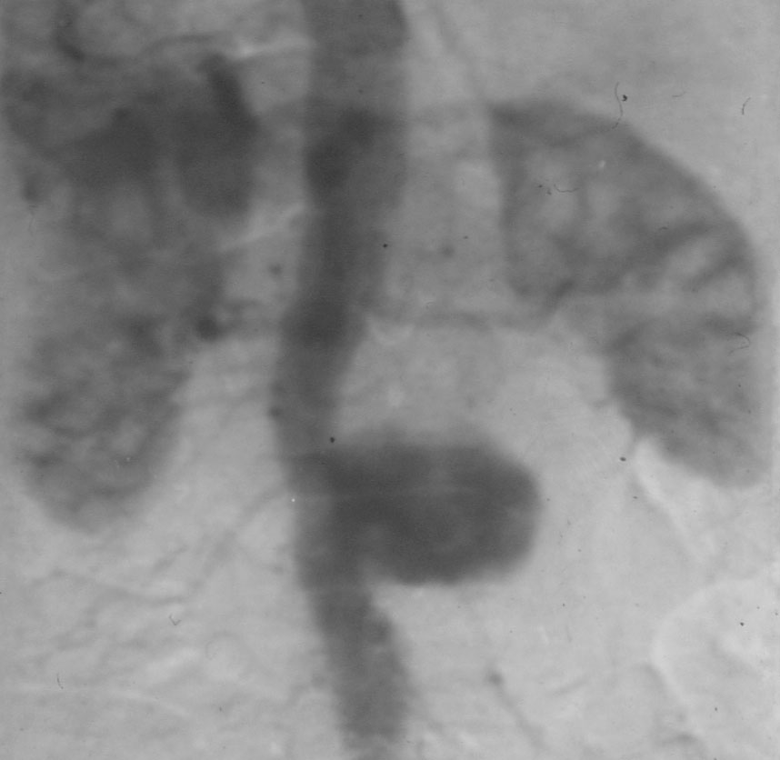
Definition: abnormal dilatation…

Slide 4
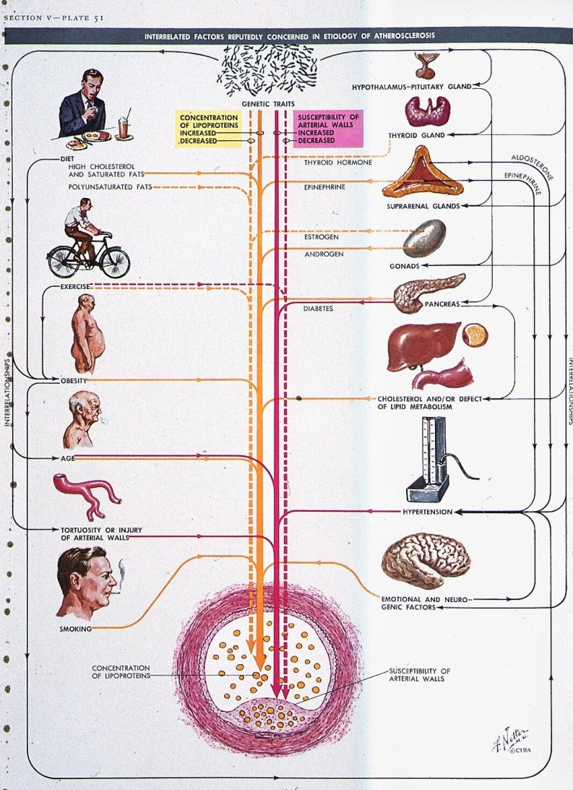
Pathophysiology
Genetic factors
◆
Dilatation of the Aorta
◆
Aneurysm (AAA)
◆
Arteriosclerotic AAA

Slide 5
Aneurysms: increase of incidence
We all get older
More aneurysms detected
Germany:
  20000 AAA’s per year
  (1/4 acute)

Slide 6
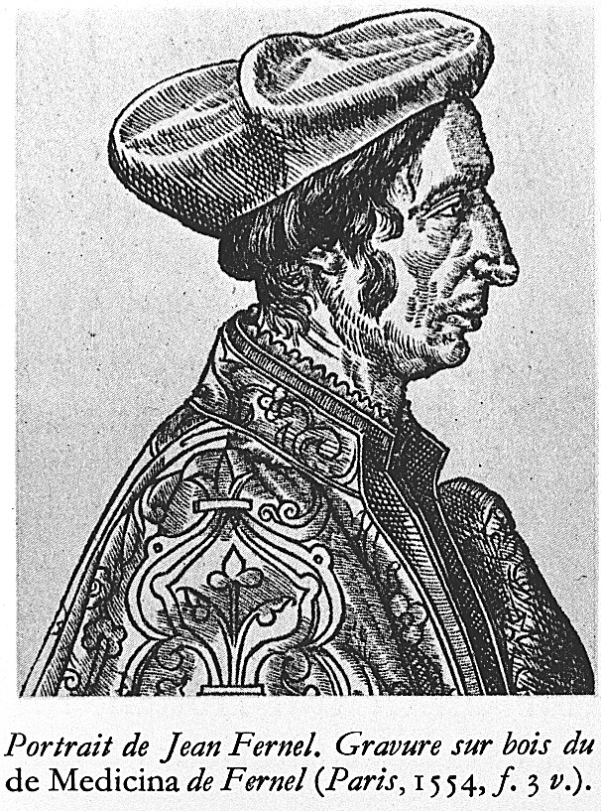
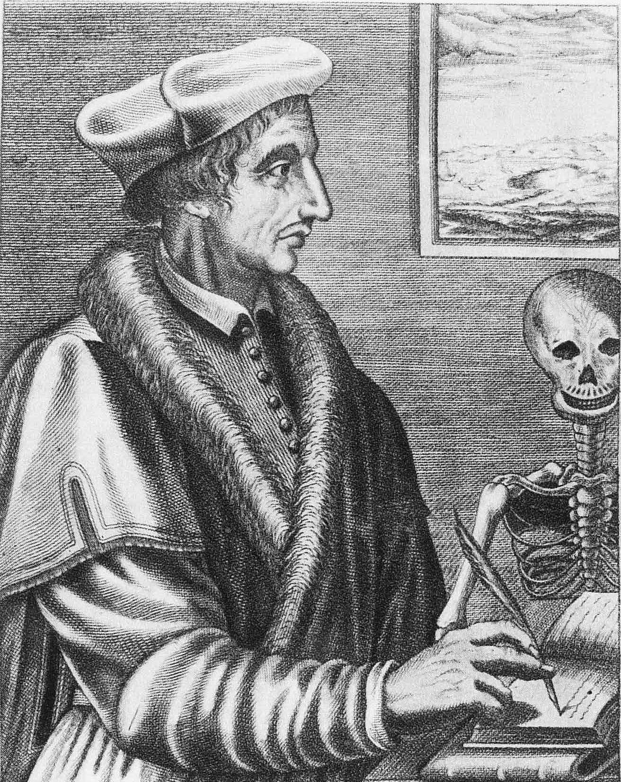
“An aneurysm sometimes occurs in the INTERNAL ARTERIES,
especially in the Chest.” Jean Fernel (1554)

Slide 7
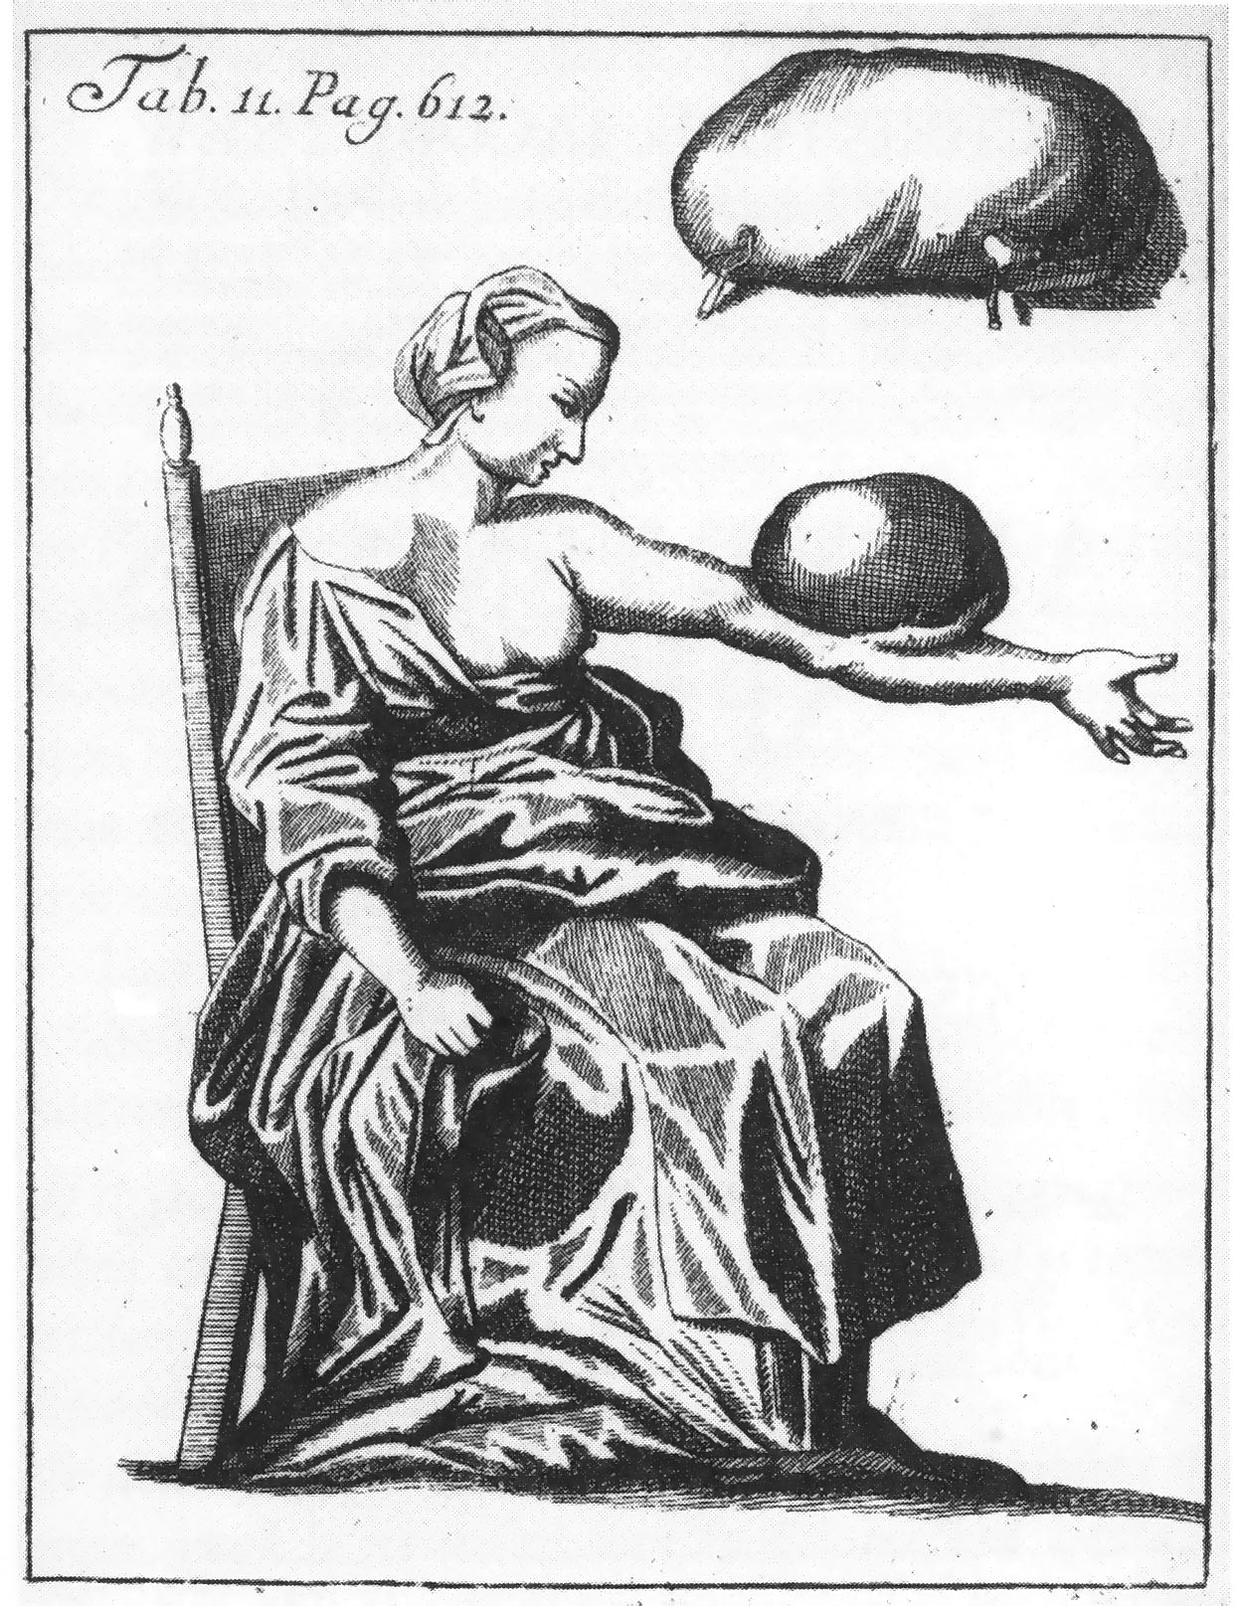
First illustration of
External Aneurysm
Purmann 1699

Slide 8
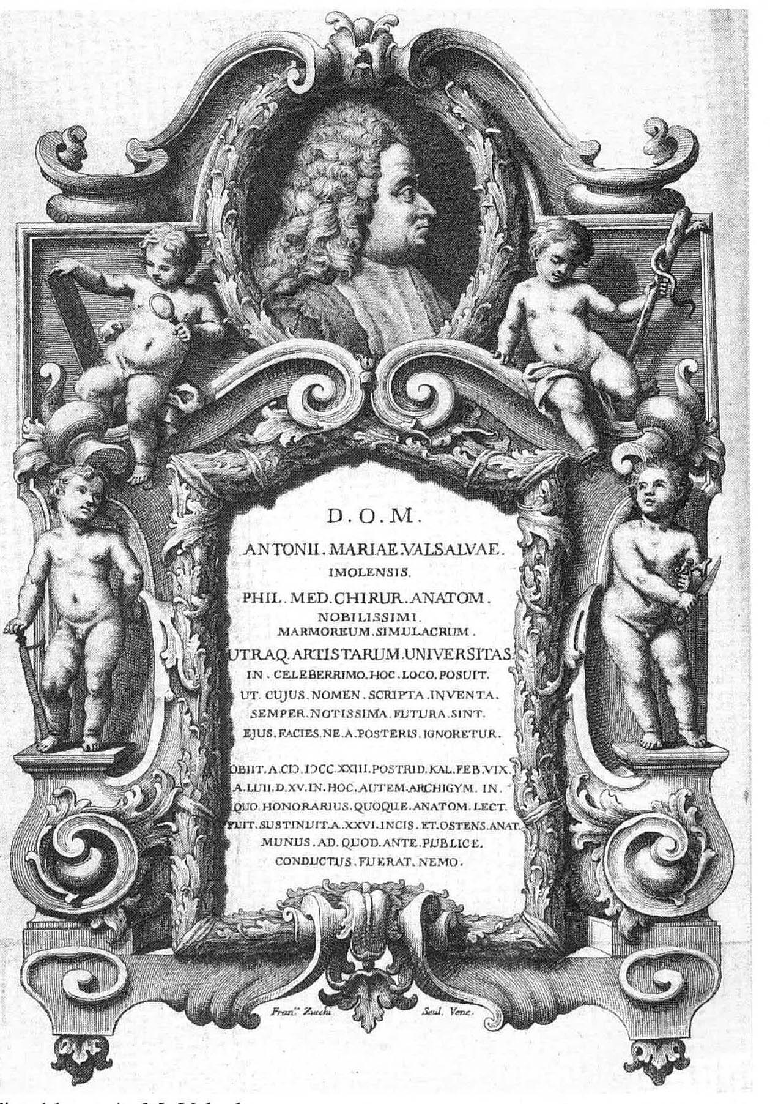
Conservative treatment
Valsalva (1666-1723)
-Ruhe in der Dunkelheit
-Fasten
-Aderlass
A happy few survived this regimen with a thrombosed aneurysm

Slide 9
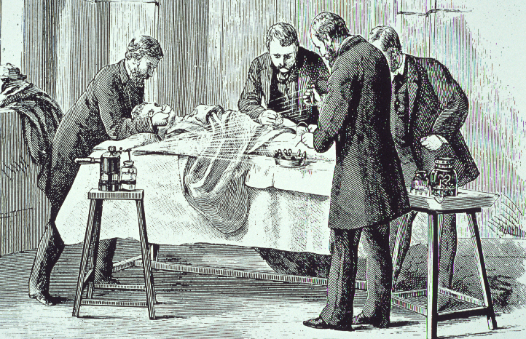
1850 - 1870
Era of Introduction of Antisepsis and Anesthesia.

Slide 10
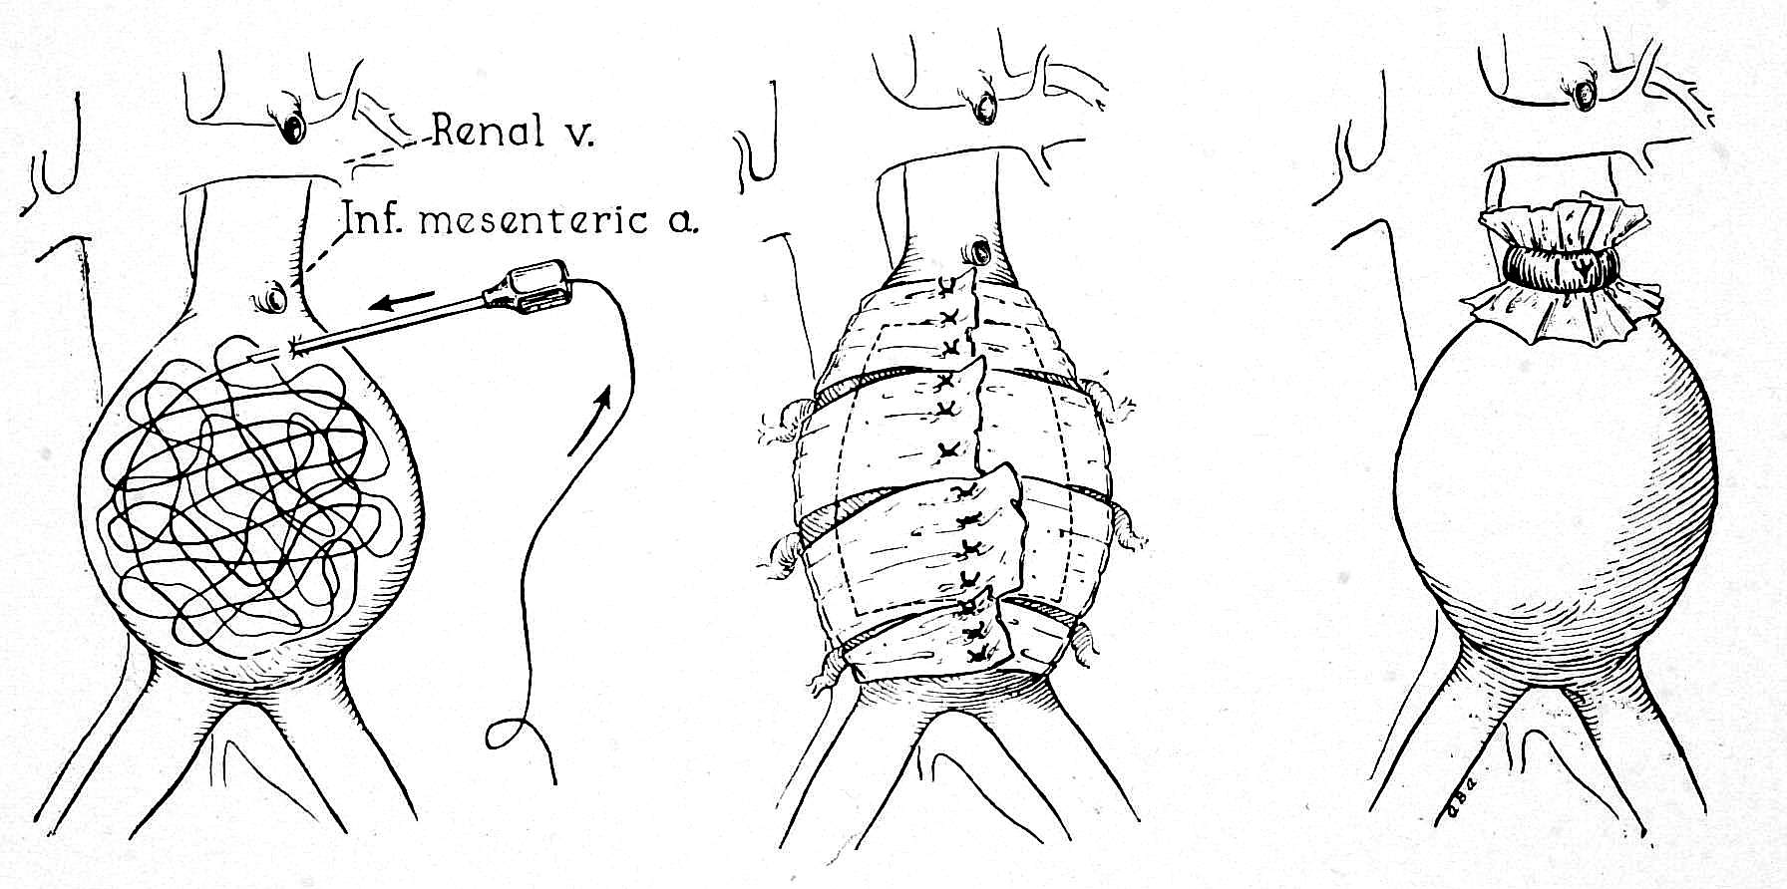
Wiring Wrapping Ligation
Surgical techniques 1900-1950

Slide 11
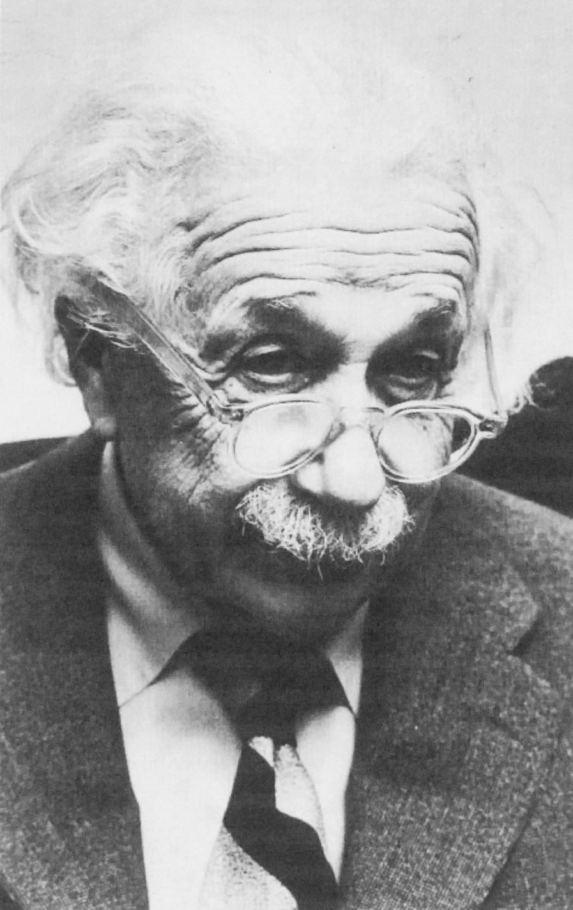
Albert EINSTEIN
(1879 - 1955 )
AAA
wrapping 1948
rupture 1955
(refused aortic surgery)

Slide 12
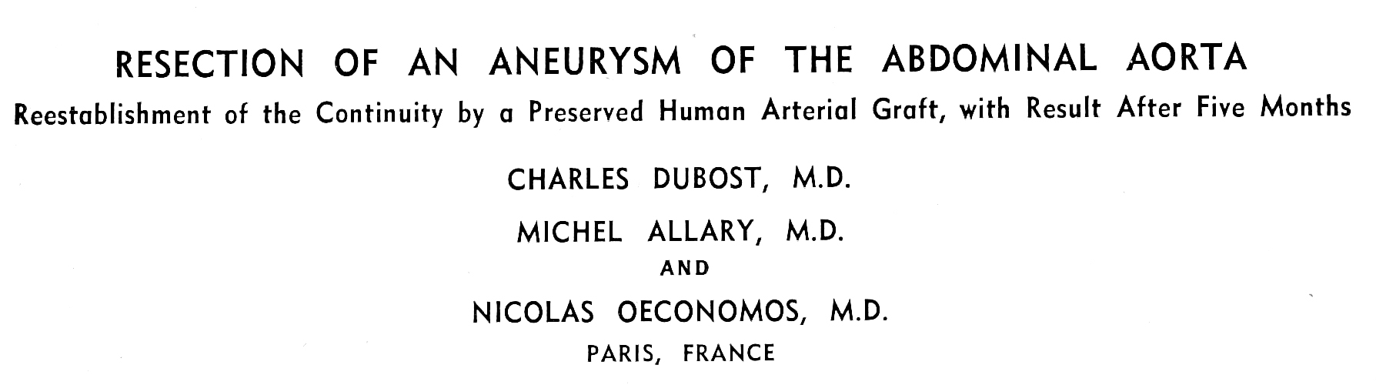
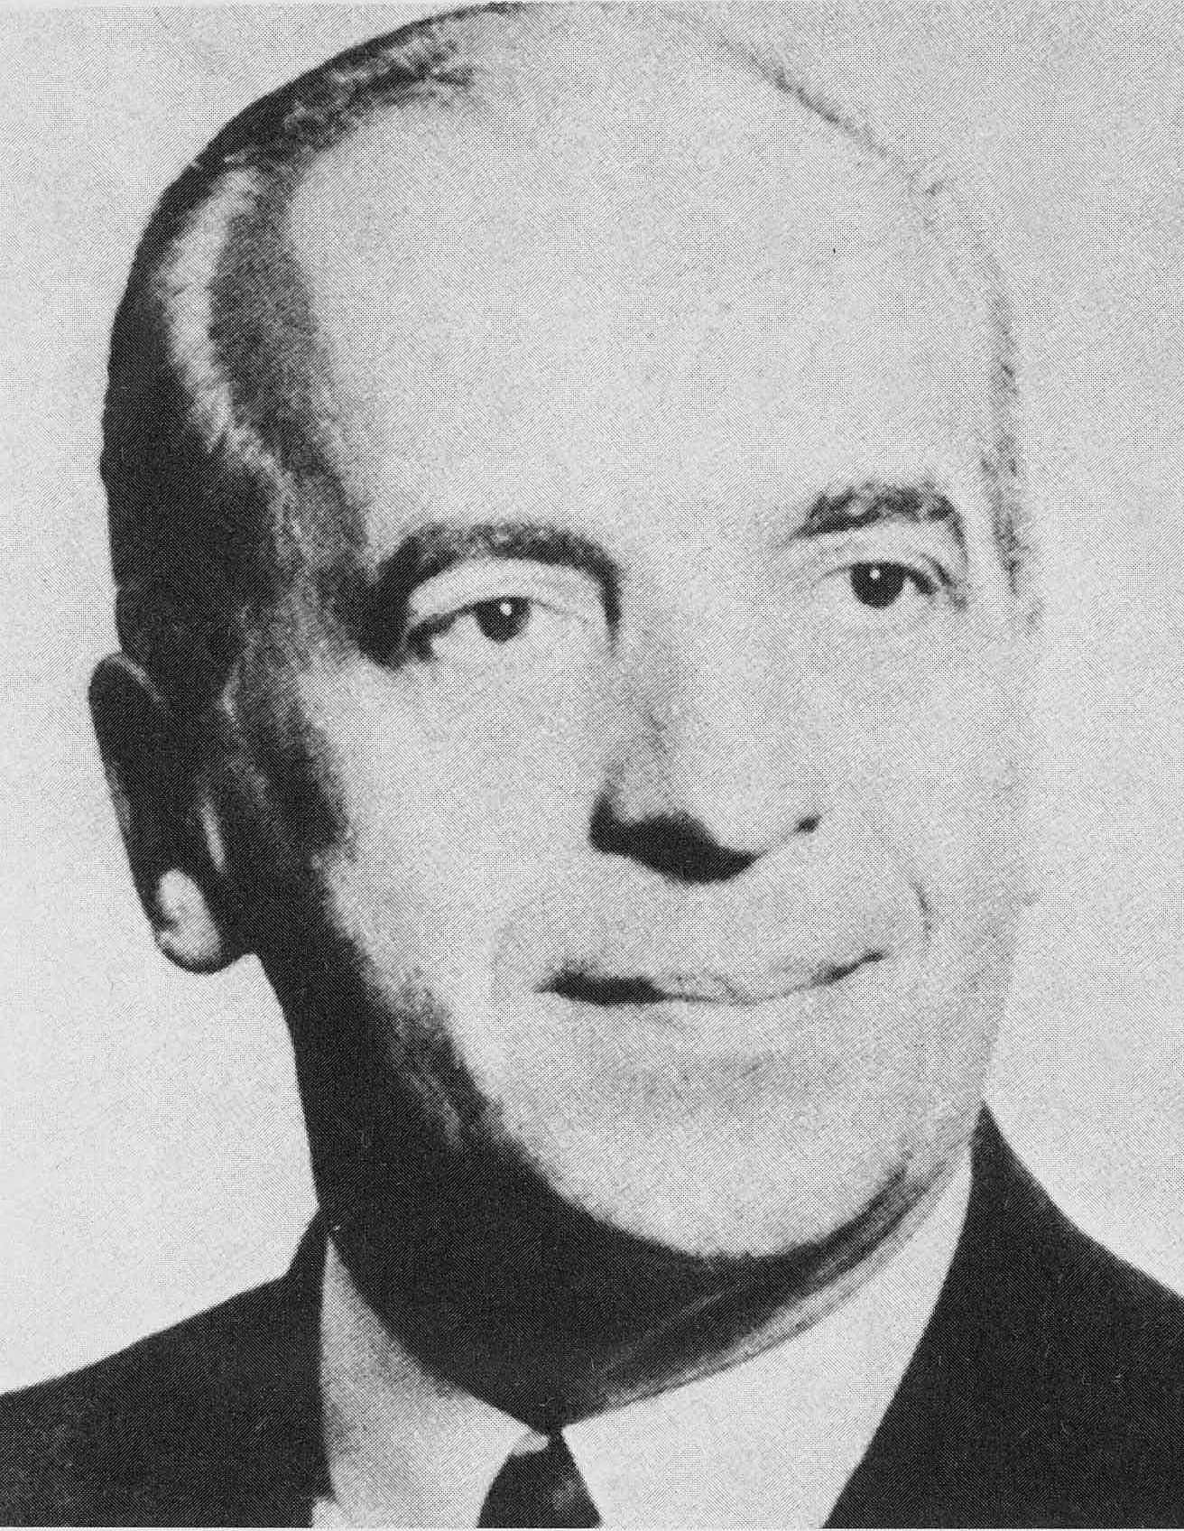
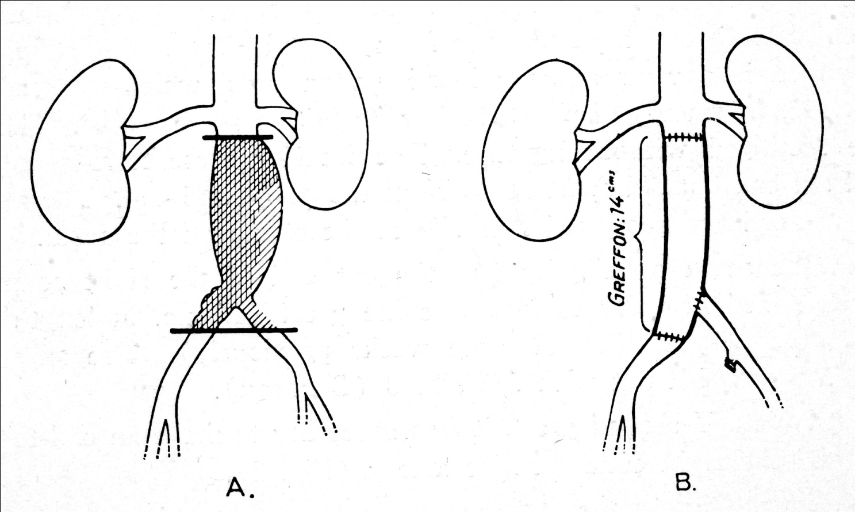
Mem. acad. chir., 1951.
Arch. Surg., 1952.

Slide 13
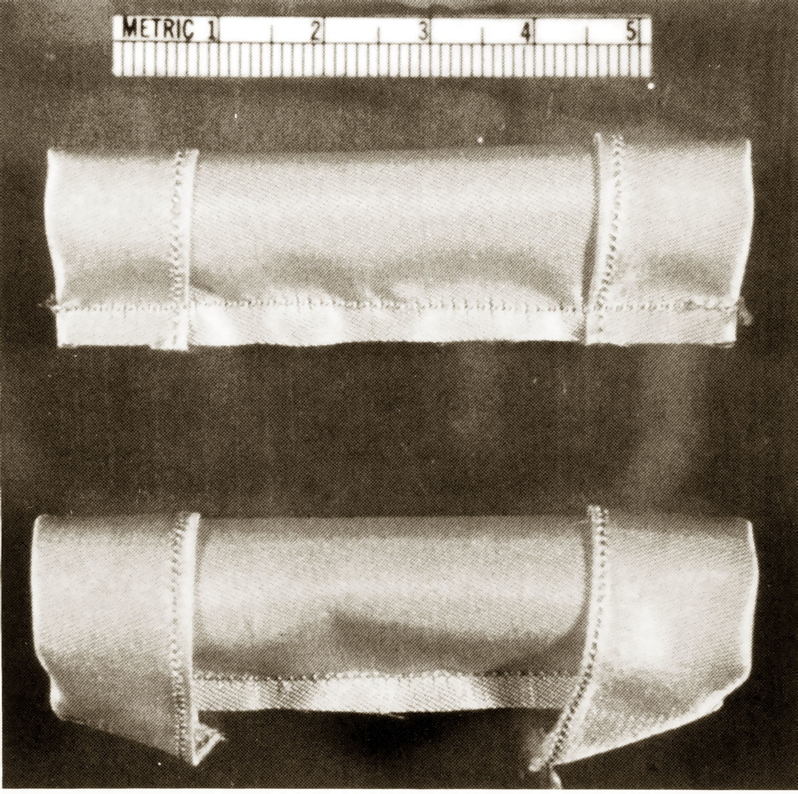
The first
Synthetic
Nylon-graft
Voorhees
New york
1951
Smith R.B. J. Vasc. Surg., 1993

Slide 14
Localisation
AAA
Thoracoabdominal aneurysm
Femoral
Popliteal
Cerebral
Internal Iliac artery
Branches aorta

Slide 15
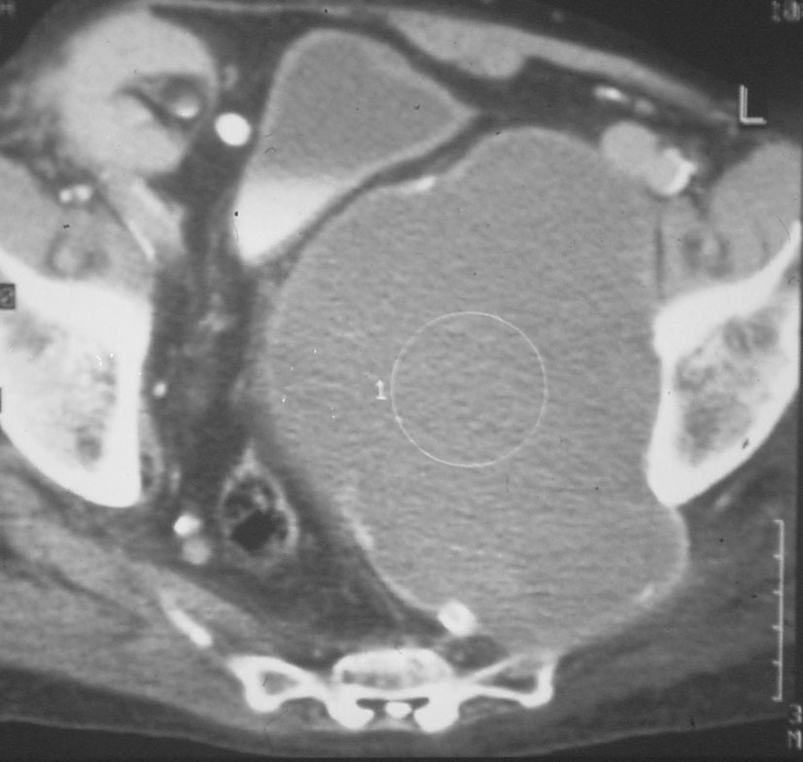
Symptomatology
None!!!!!
Expansion > Pain > Rupture
Local problem
  Knee
  Internal iliac artery: Hydronephrosis

Slide 16
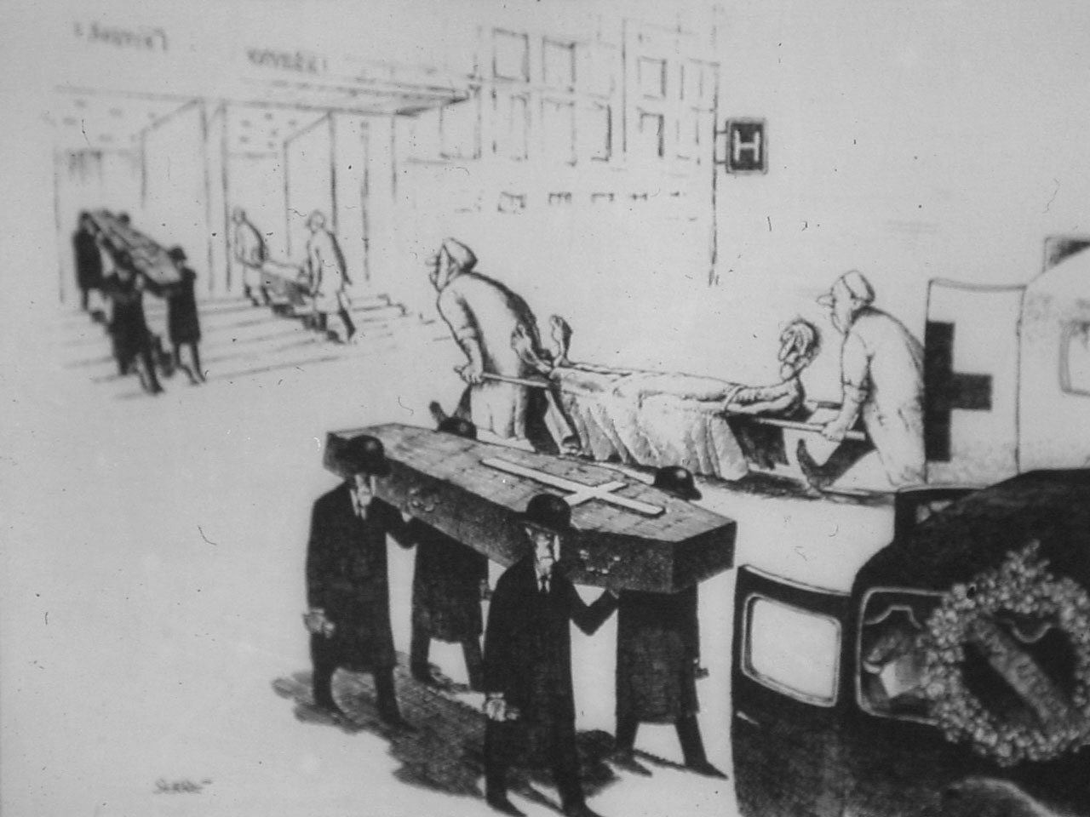
Dangers!!
Rupture
Thrombo-embolisation

Slide 17
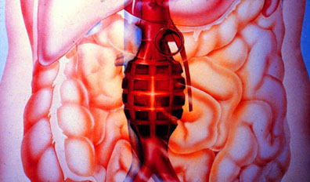
Mortality of RAAA 40-90%
Notes:
And with a mortality of 48% it is not surprising that we are looking for a different treatment modality

Slide 18
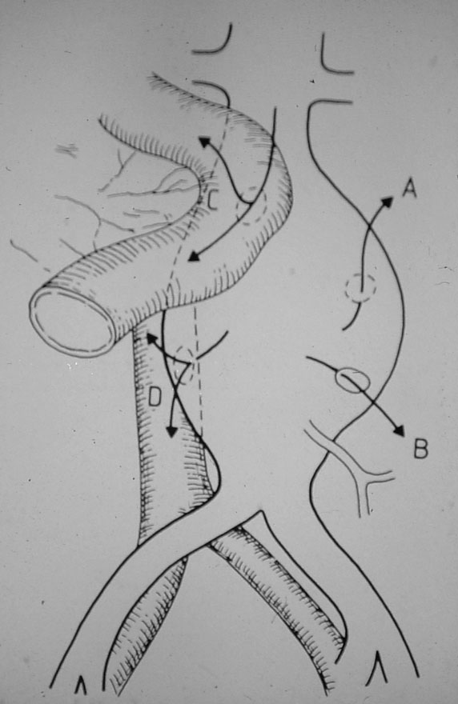
Rupture to…
A. Retroperitoneal
B. Transperitoneal
C. Aortoduodenal fistula
D. Aortocaval fistula

Slide 19
Symptoms acute/ruptured AAA
Acute onset of back pain
Abdominal pain
Shock
(Hemoptoe)
(Right sided heart failure)
Suspicion:
  Palpabele pulsating mass in abdomen
  Elderly man

Slide 20
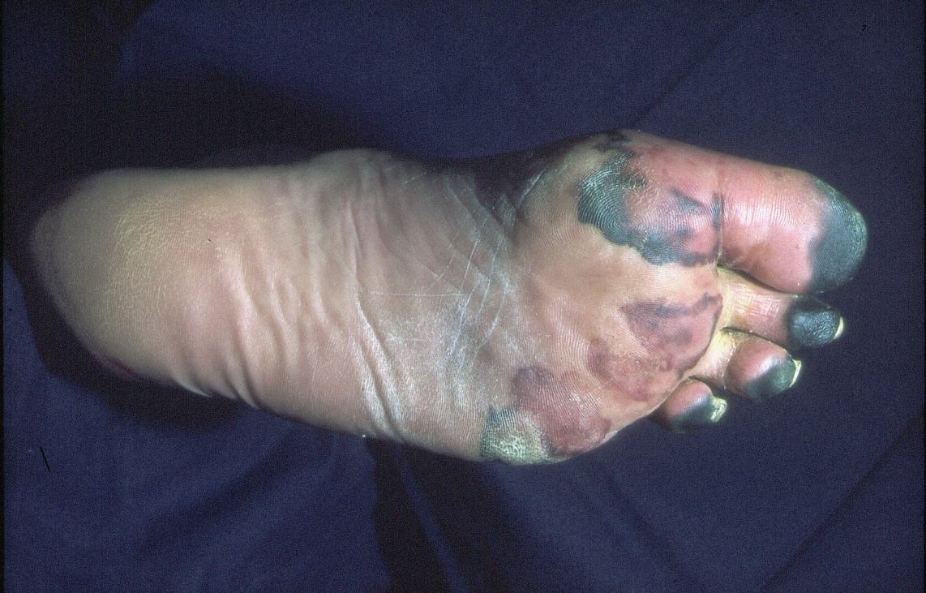
Dangers!!
Rupture
Thrombo-embolisation

Slide 21
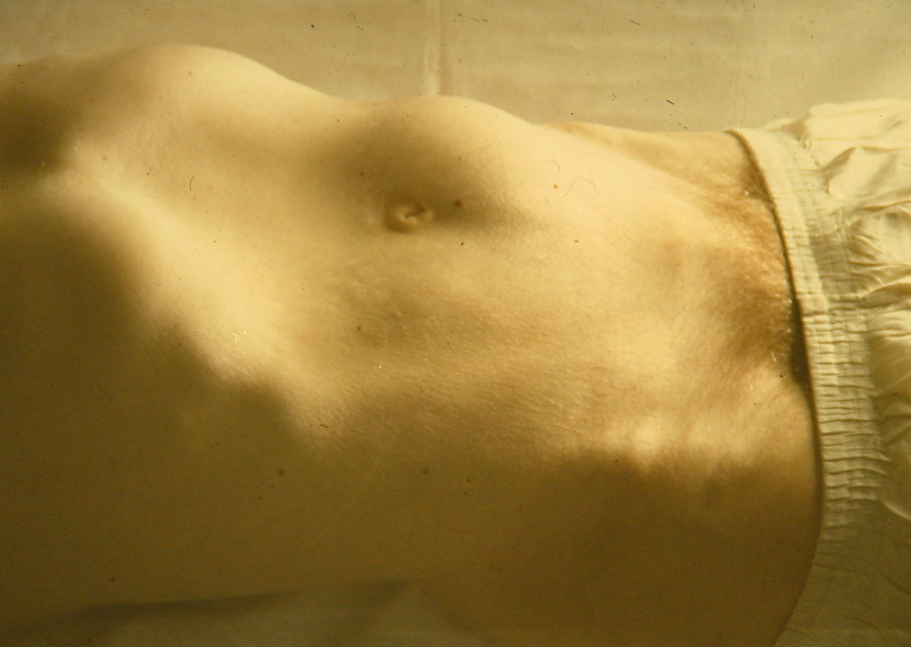
Diagnosis
Clinical examination
Co-incidental:
  Urology
  Internal Medicine

Slide 22
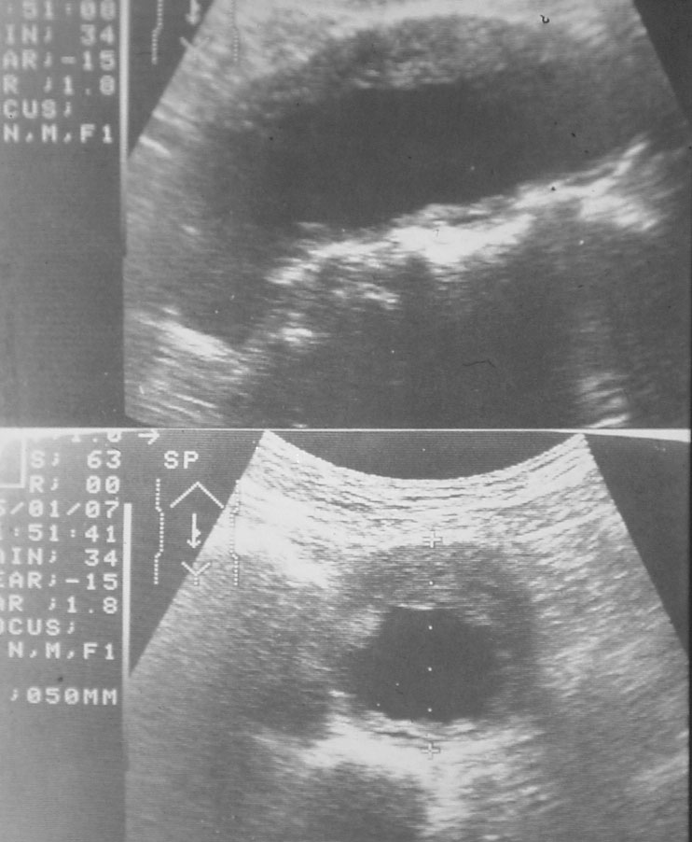
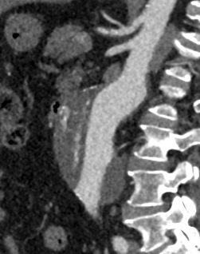
Utrasound/CTscan

Slide 23
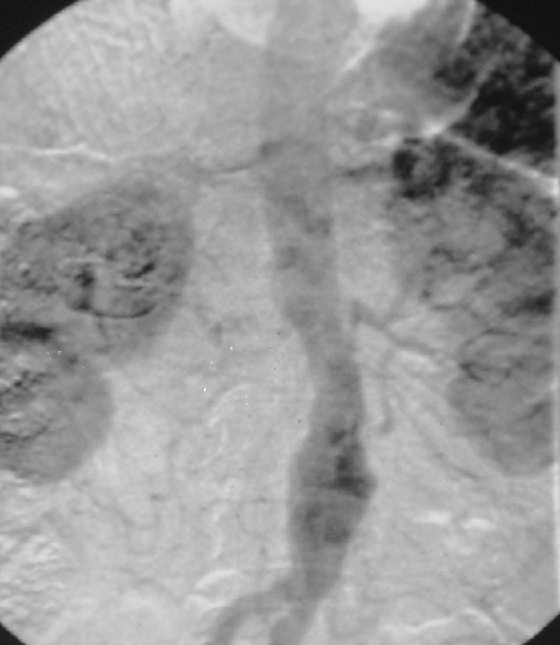
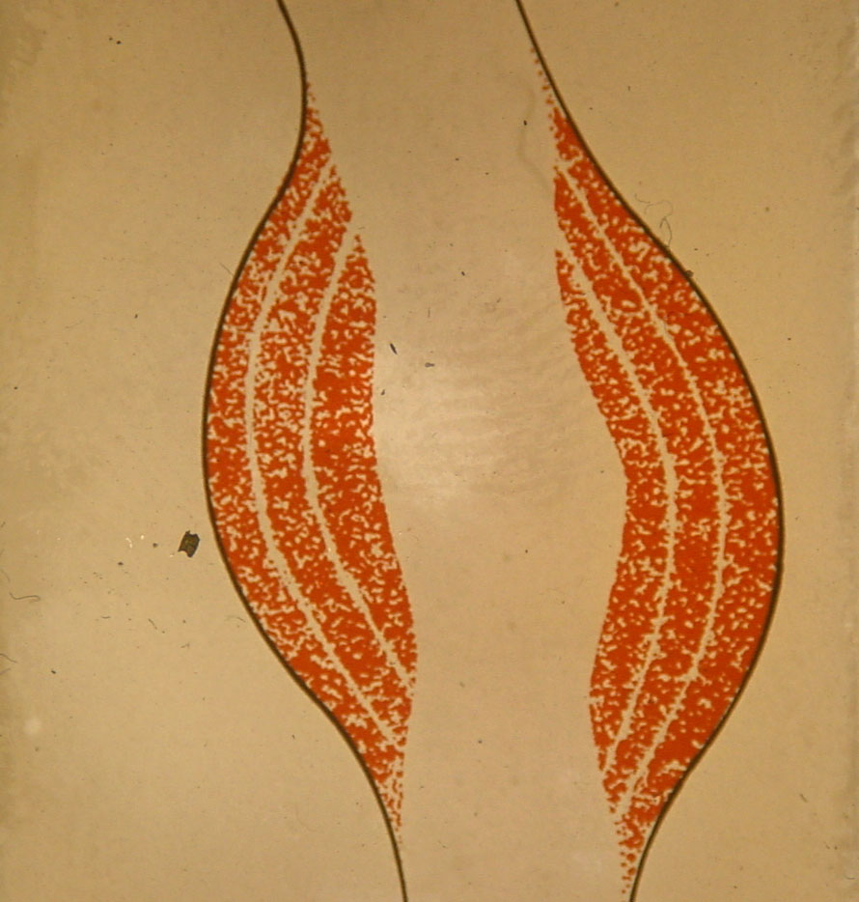
Angiography: NO!

Slide 24
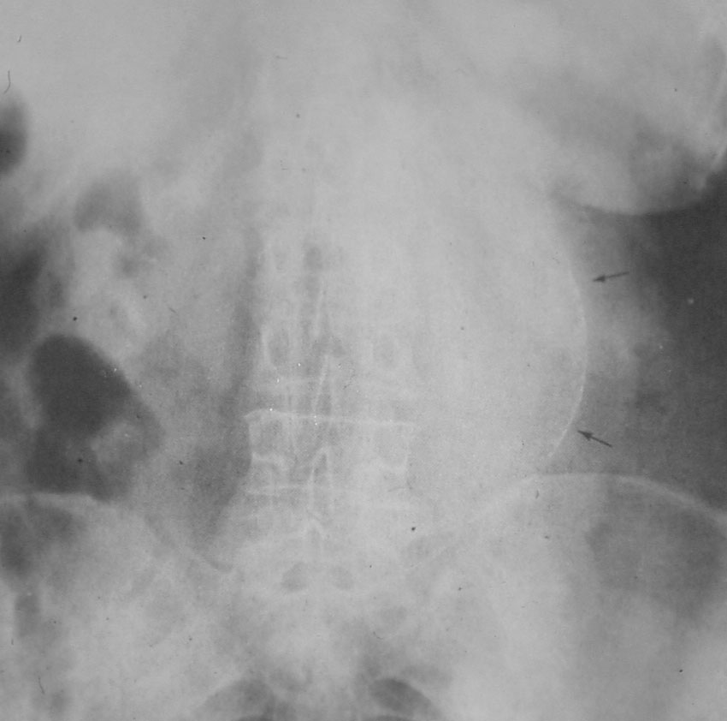
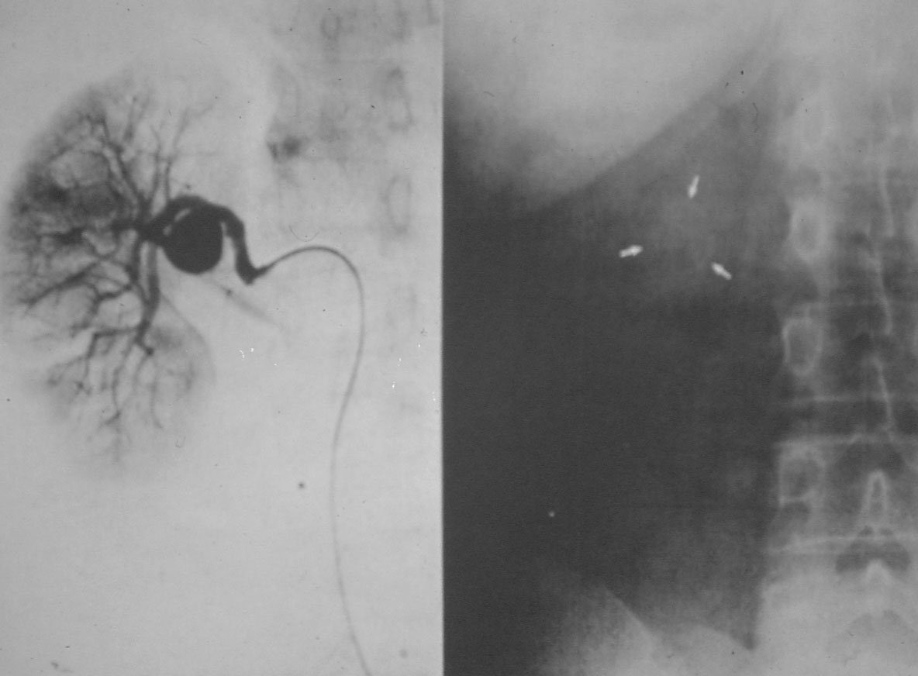
X-Ray

Slide 25
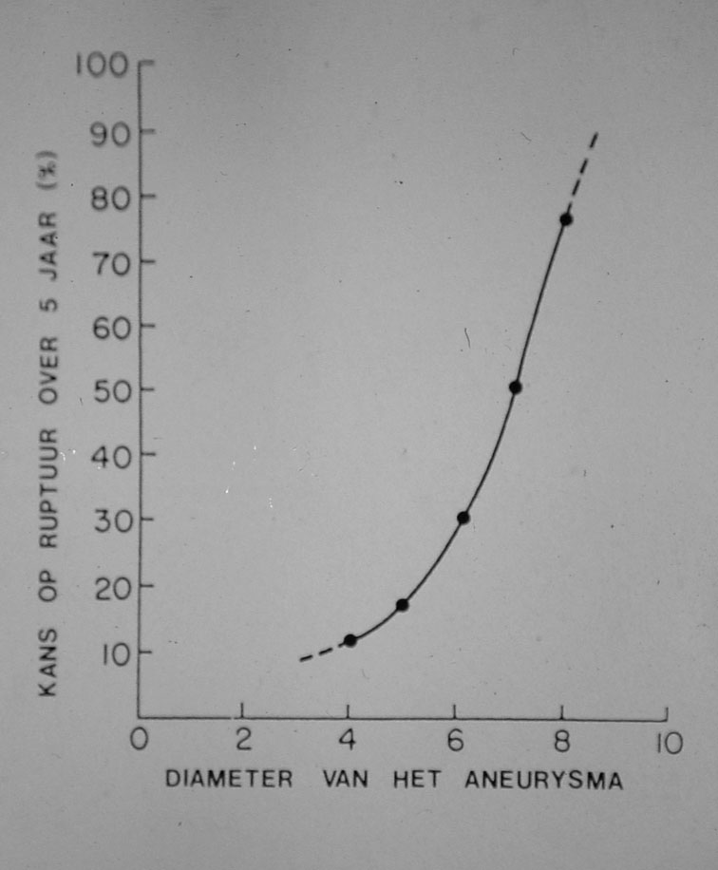
Treatment
Preventive
Exclusion of the aneurysm
Balance: risk of the procedure vs. risk of rupture

Slide 26
Treatment
General rule of thumb:
  Man: > 5,5 cm
  Female: > 5 cm
Based (amongst other literature) on English “Small Aneurysm Trial”

Slide 27
Open Treatment
Big procedure
Mortality: 5-7 %
Morbidity
  Cardiac
  Pulmonal
  Renal
  Sexual

Slide 28
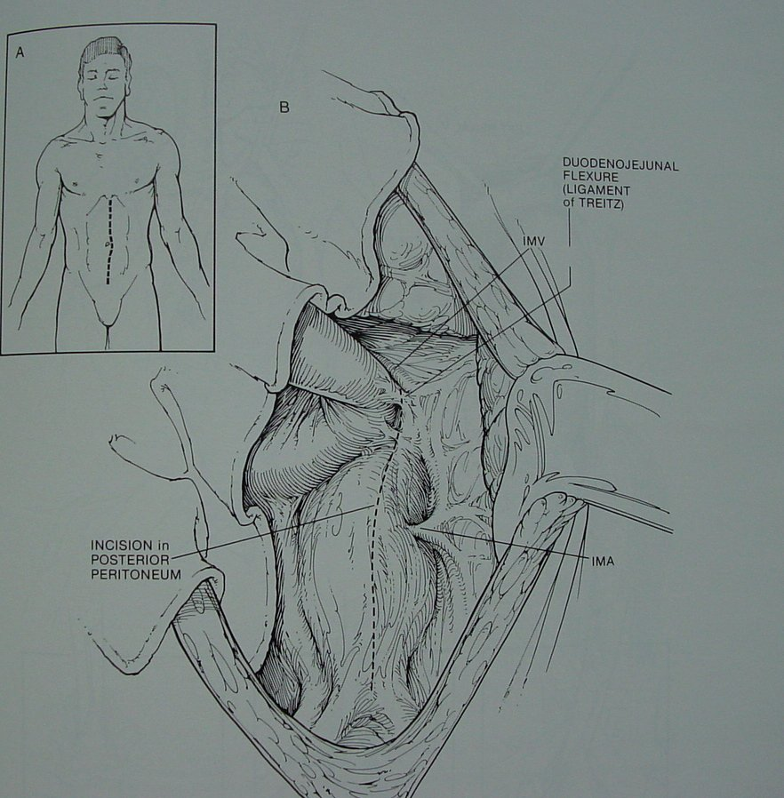
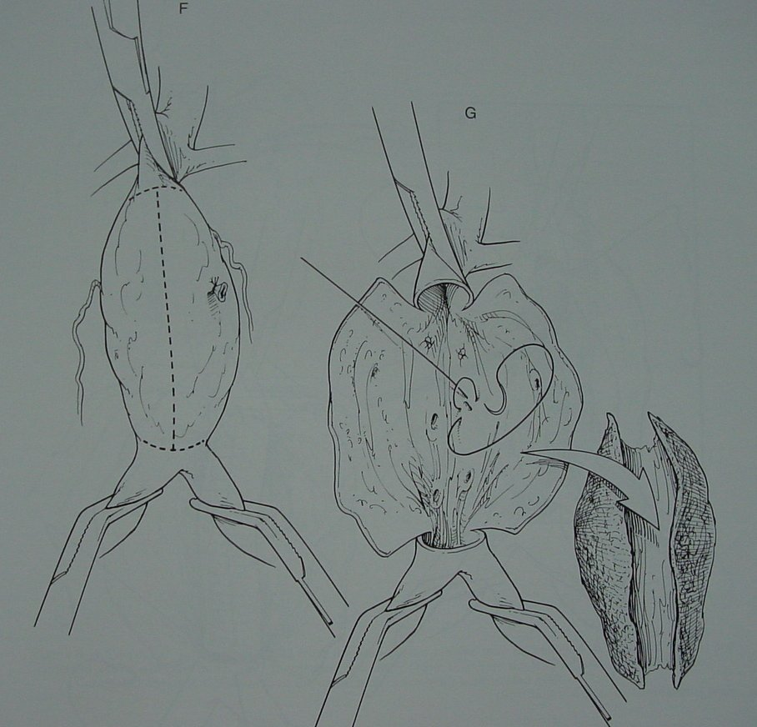
Open Surgery

Slide 29
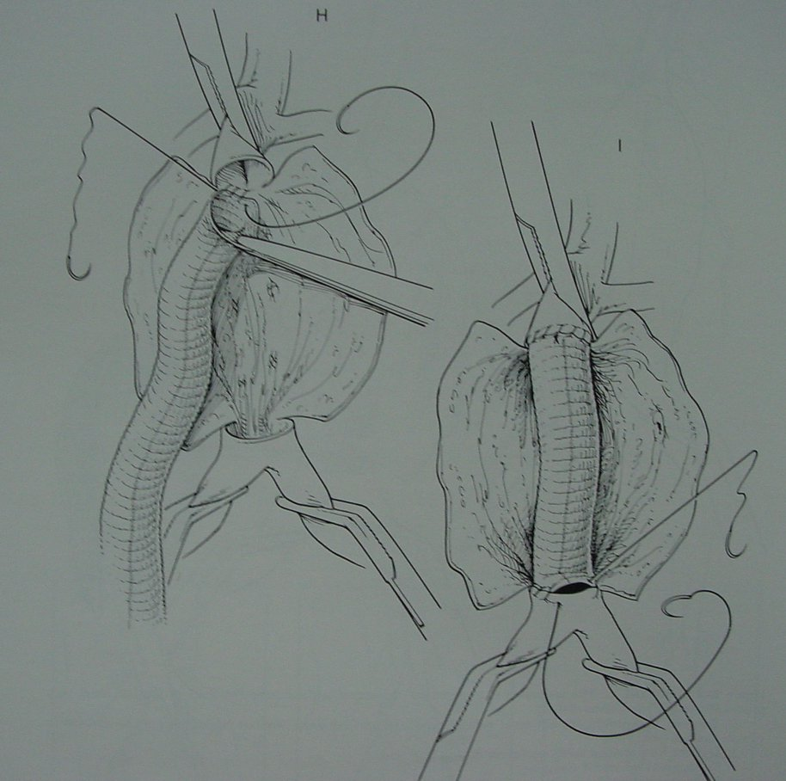
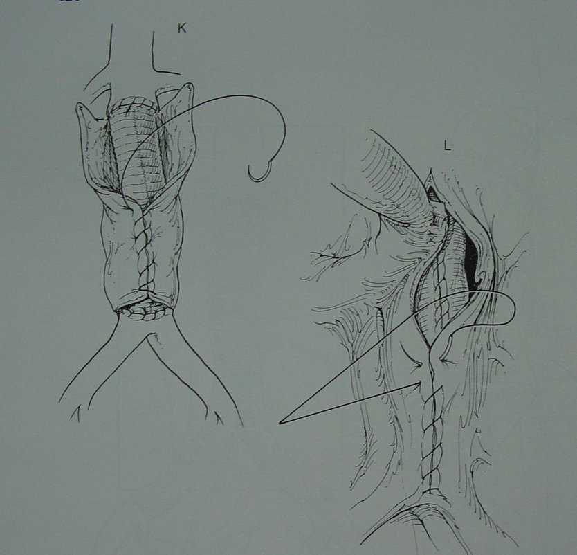
Open Surgery

Slide 30
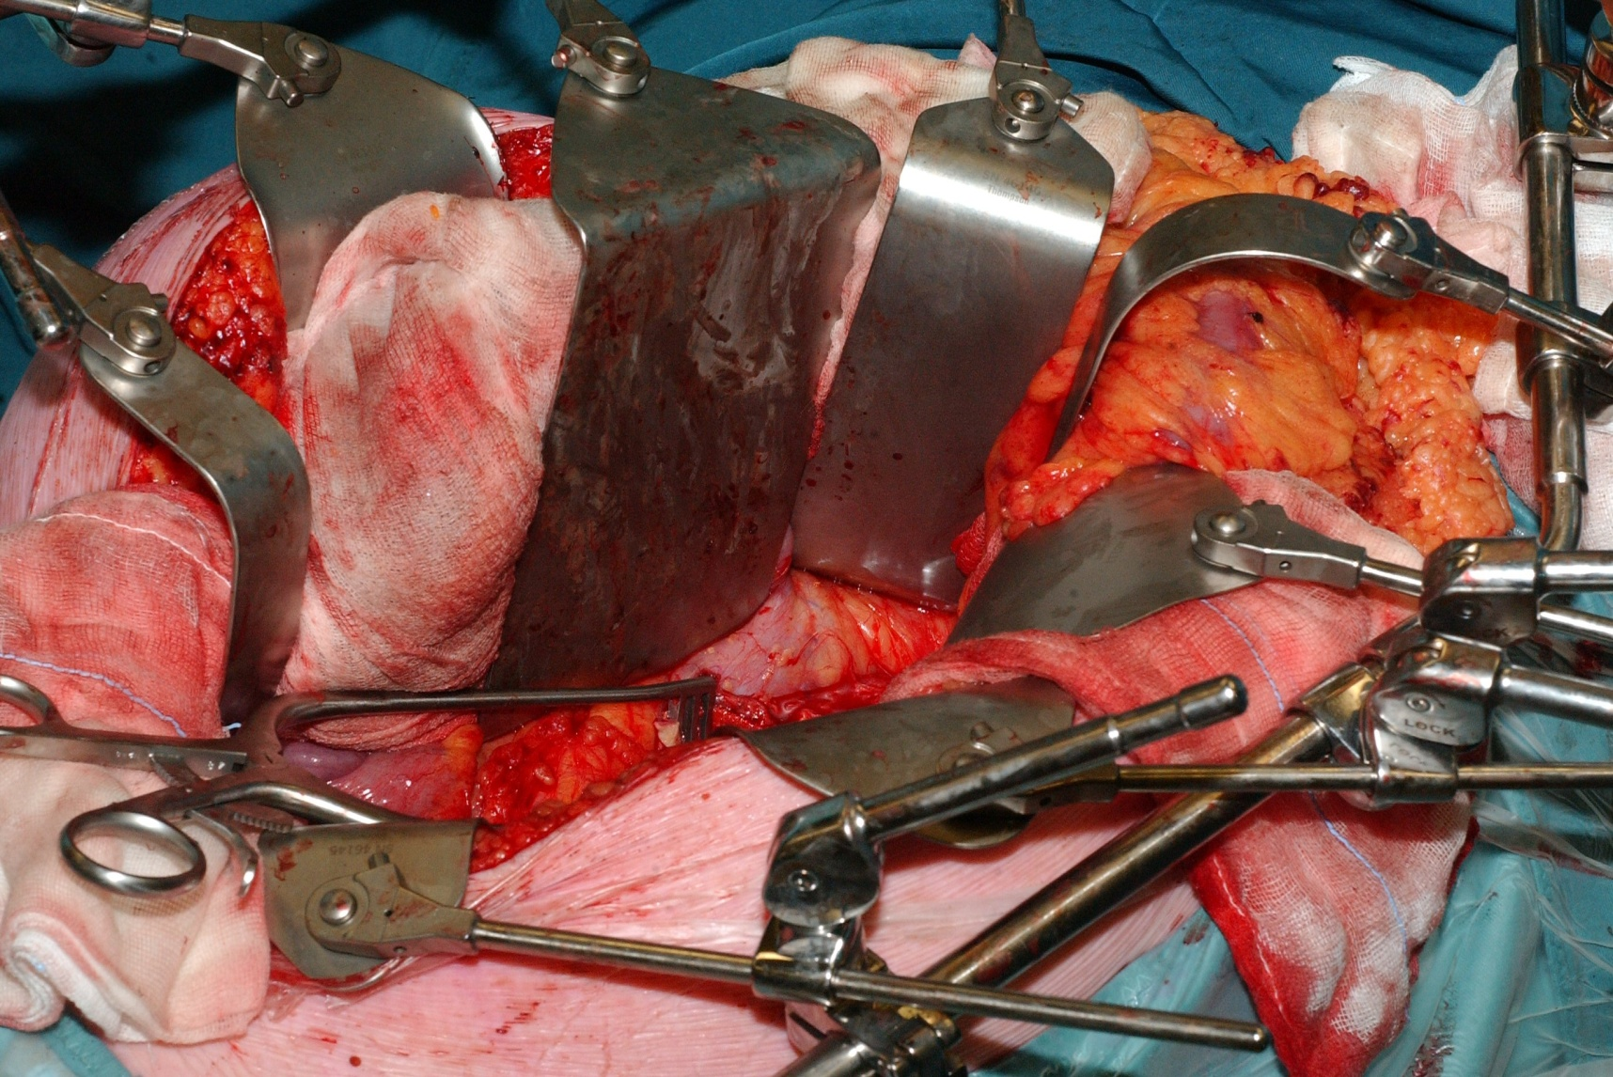
Open Surgery

Slide 31
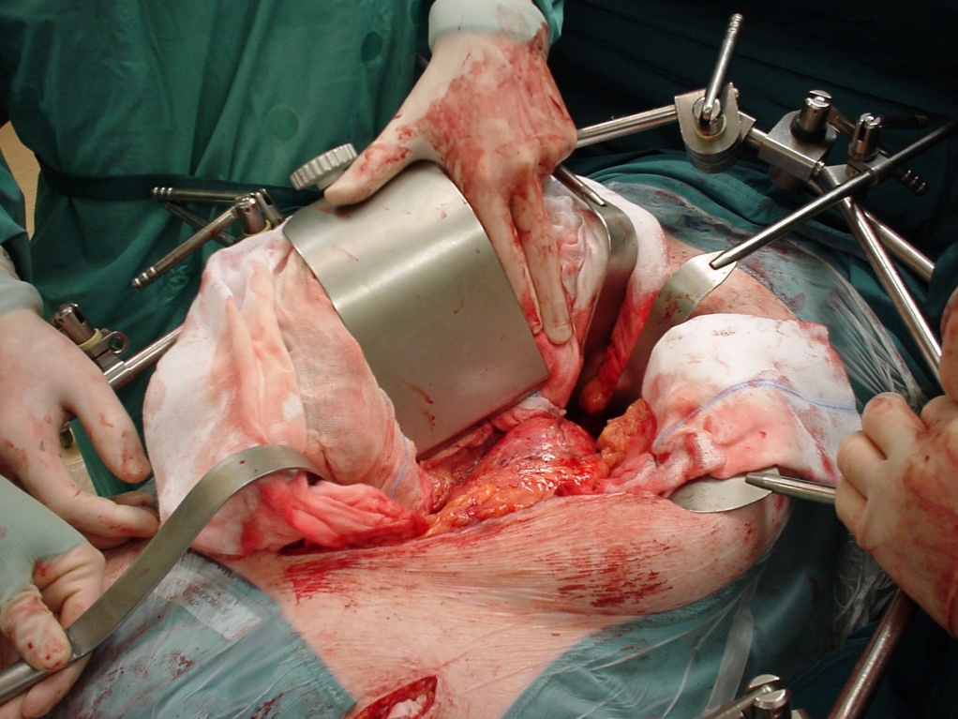
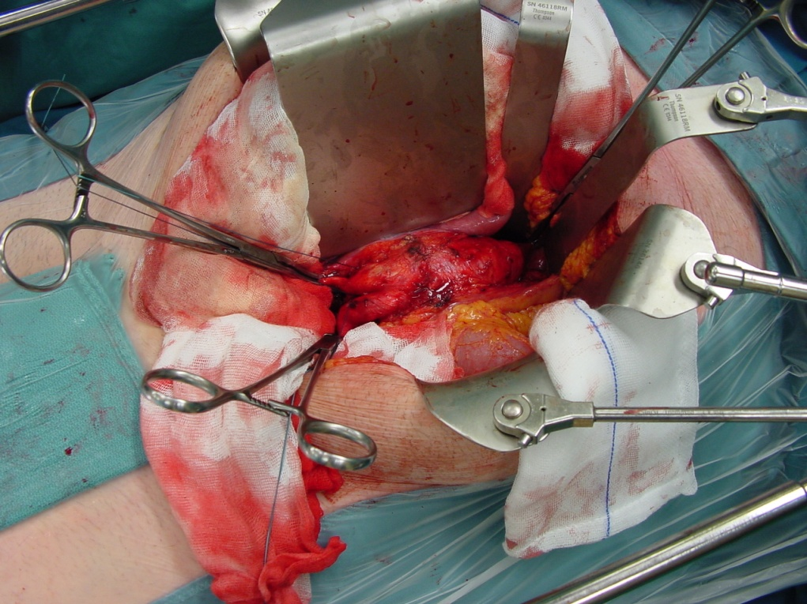
Open Surgery

Slide 32
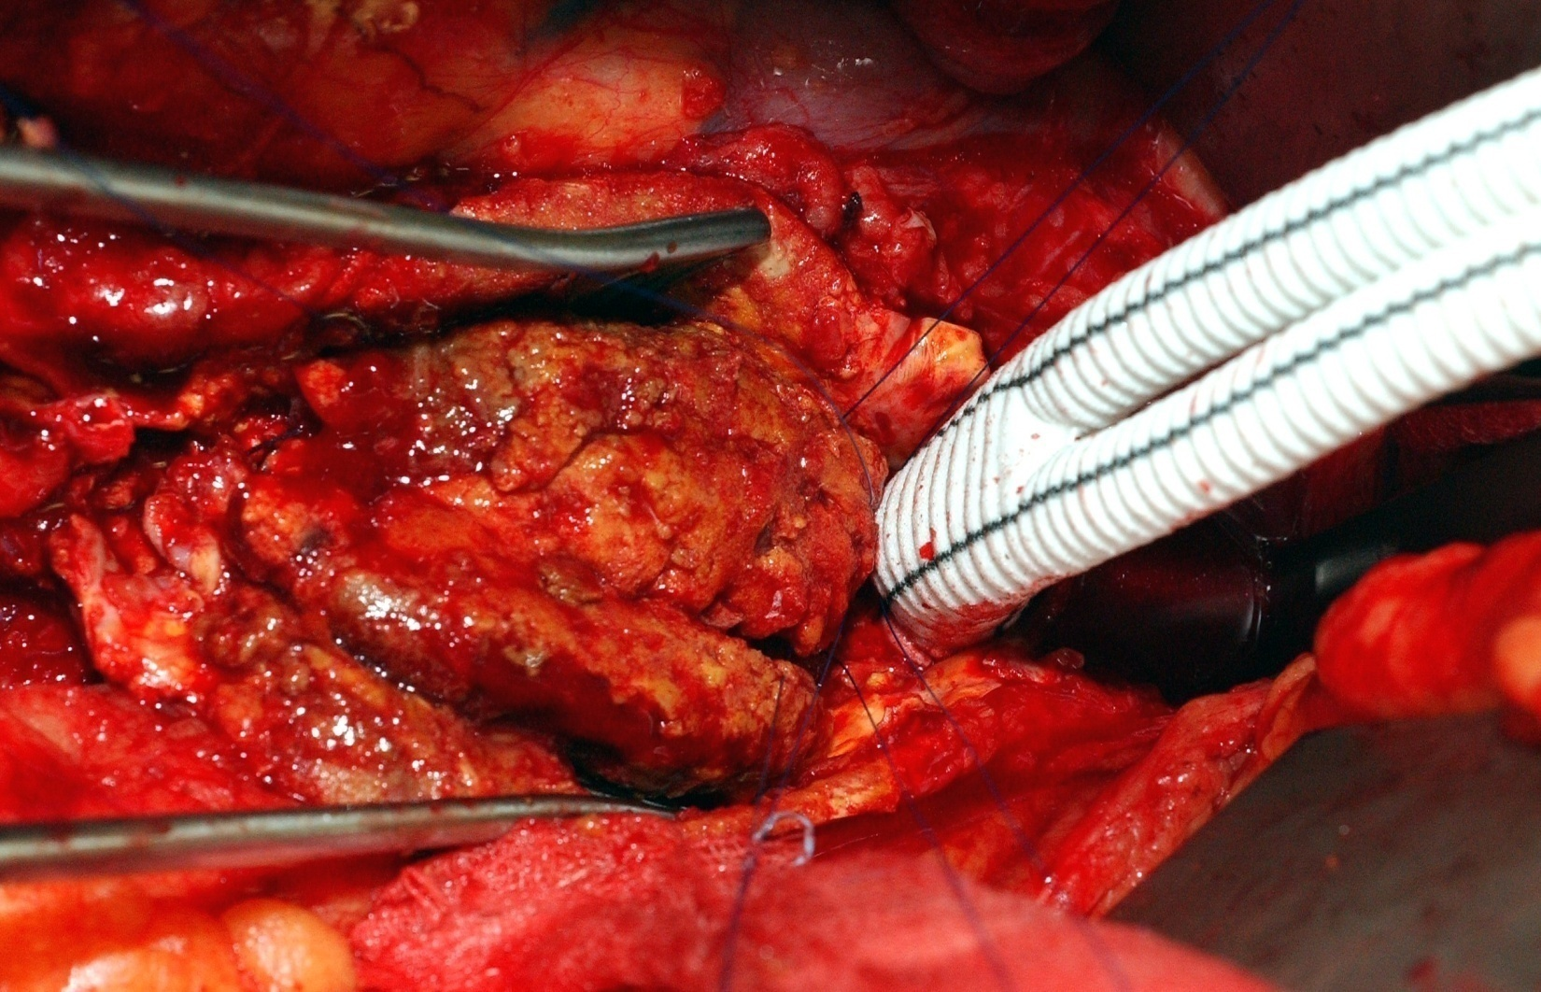
Open Surgery

Slide 33
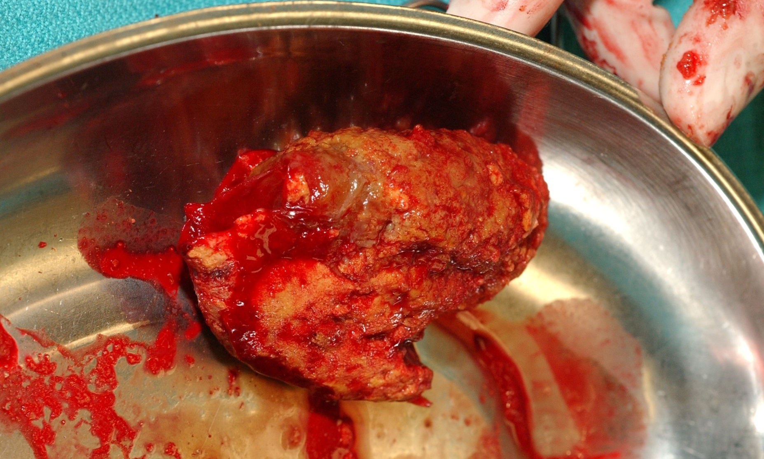
Open Surgery

Slide 34
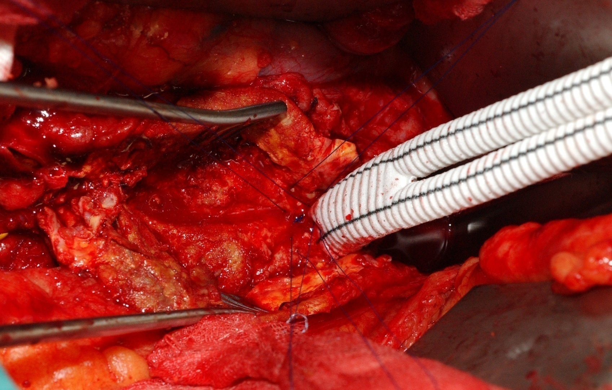
Open Surgery

Slide 35
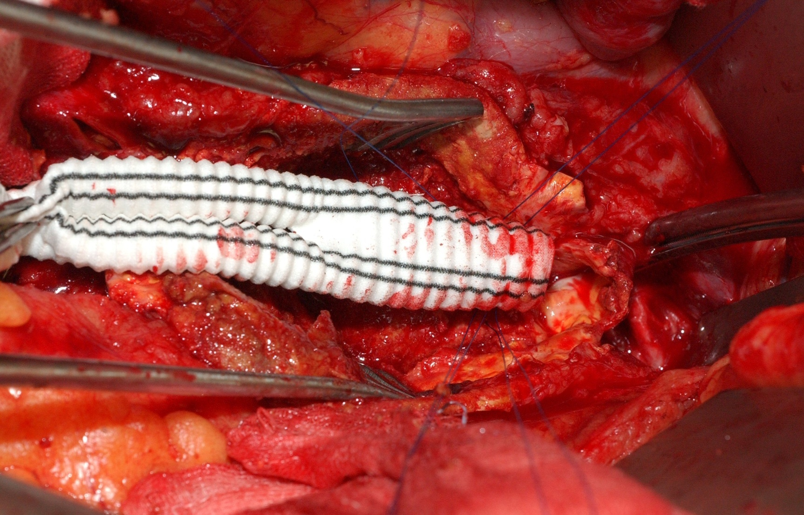
Open Surgery

Slide 36
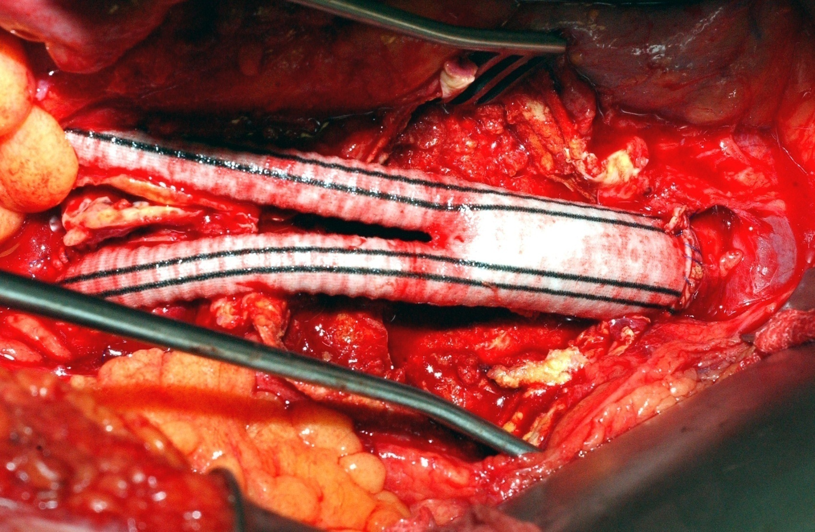
Open Surgery

Slide 37
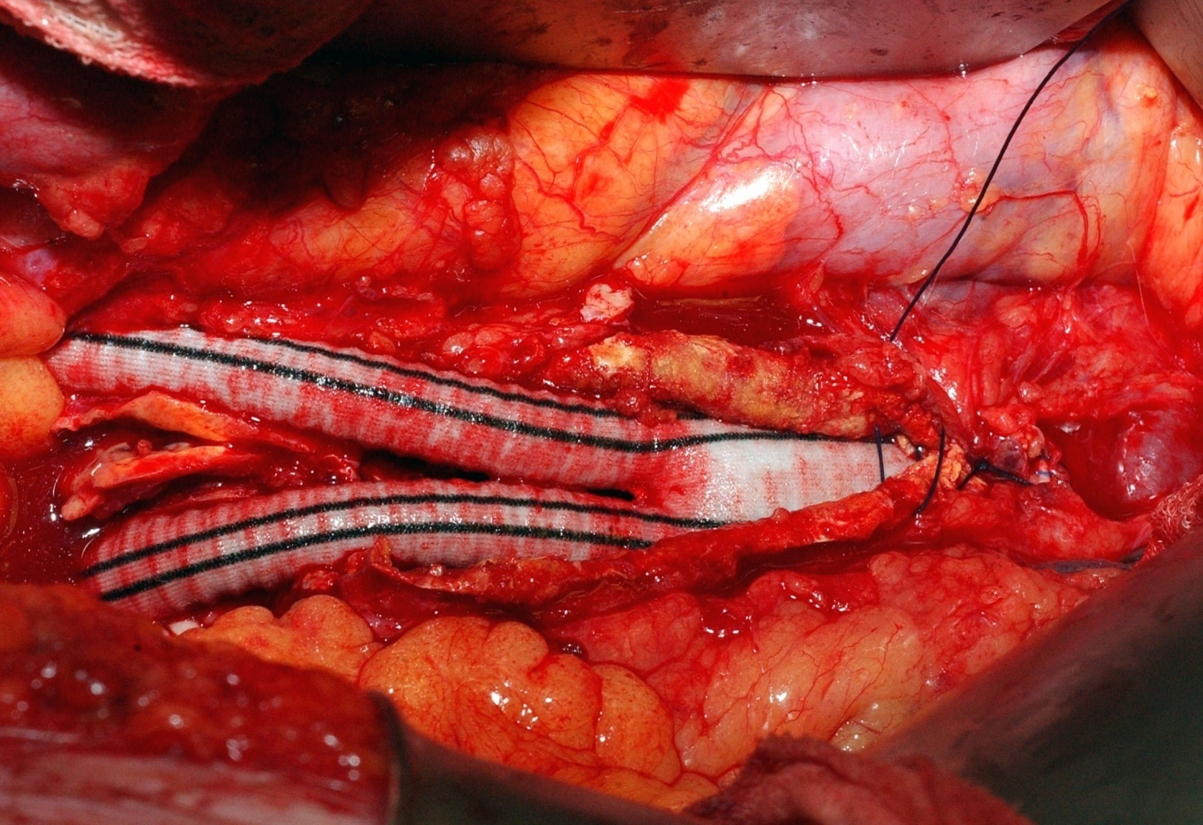
Open Surgery

Slide 38
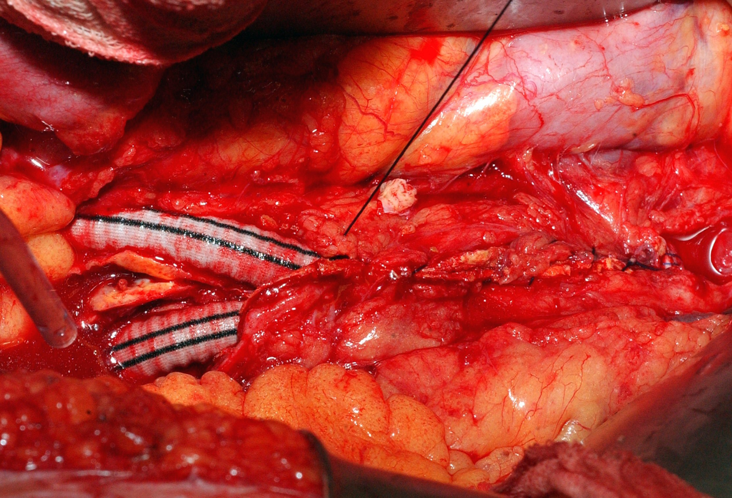
Open Surgery

Slide 39
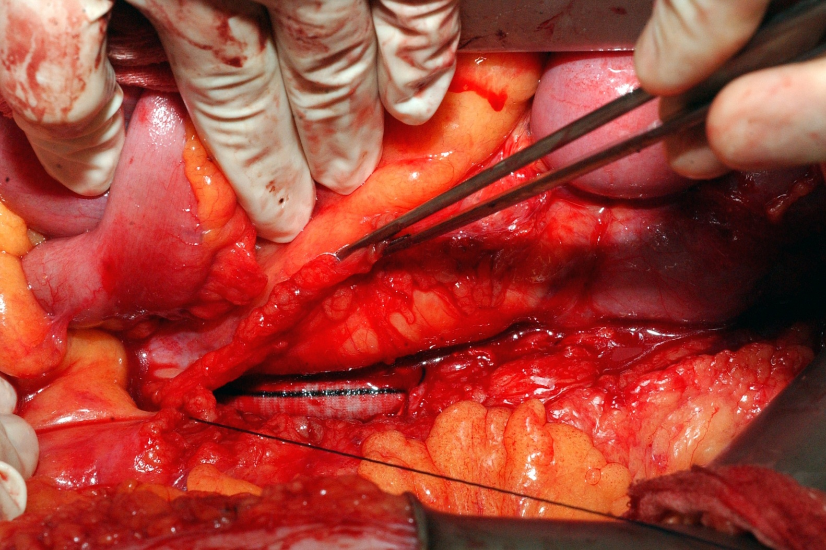
Open Surgery

Slide 40
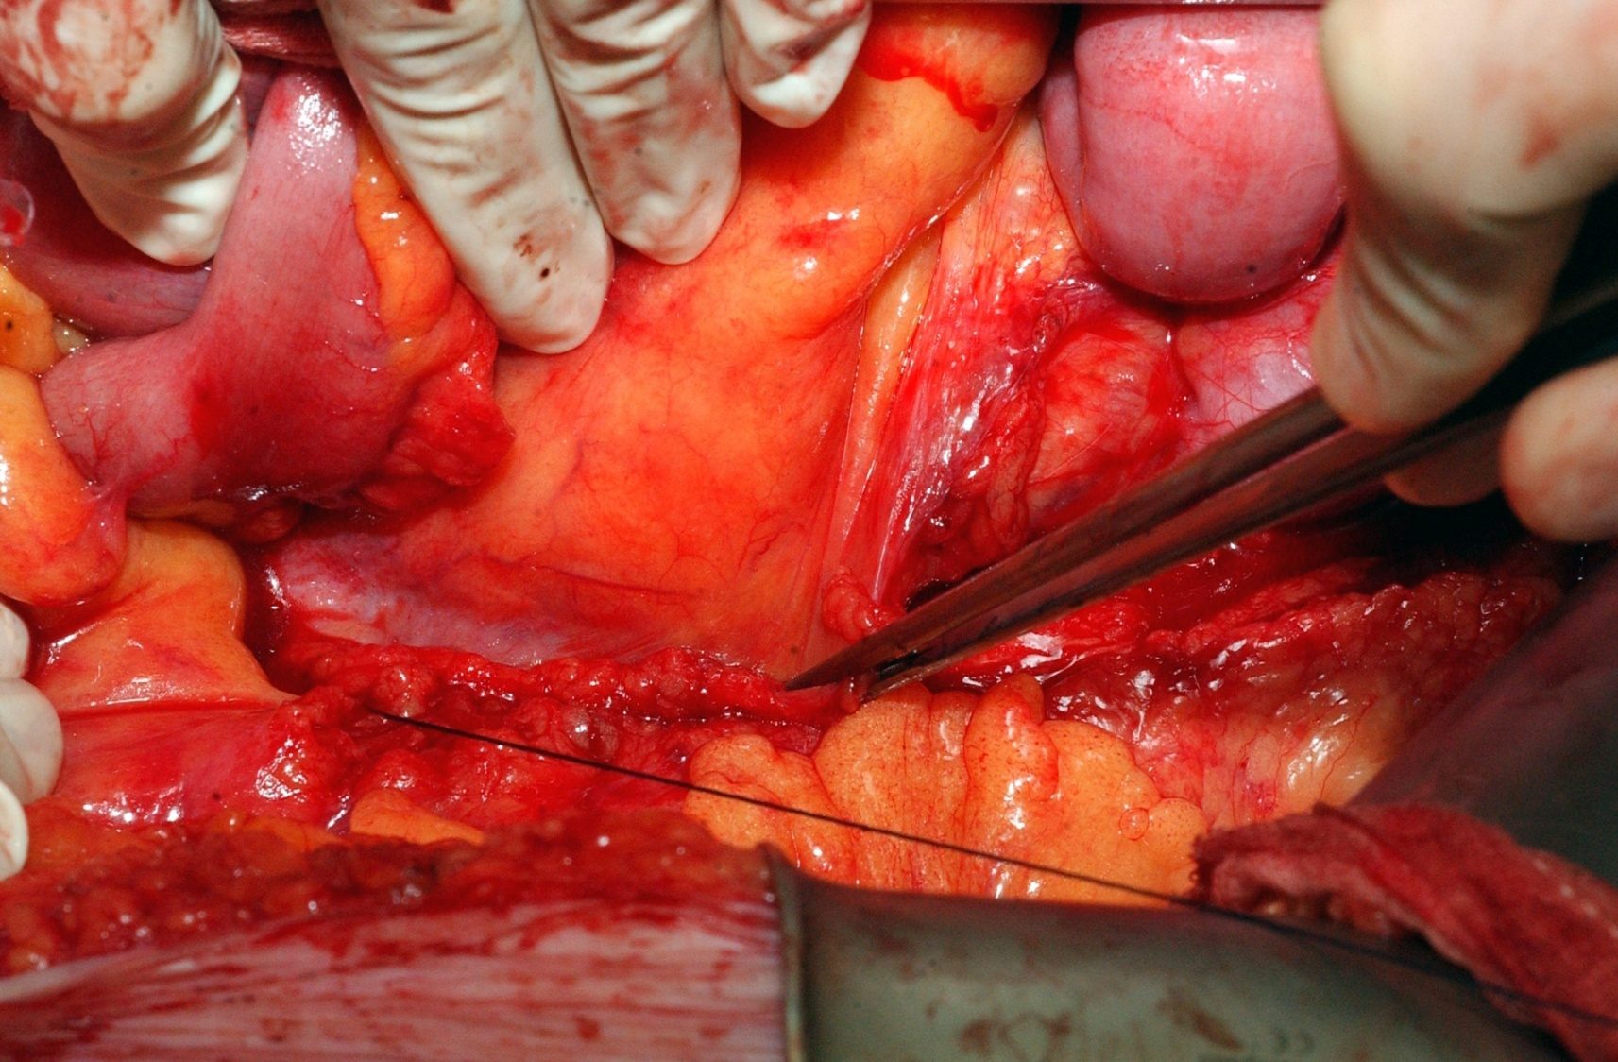
Open Surgery

Slide 41
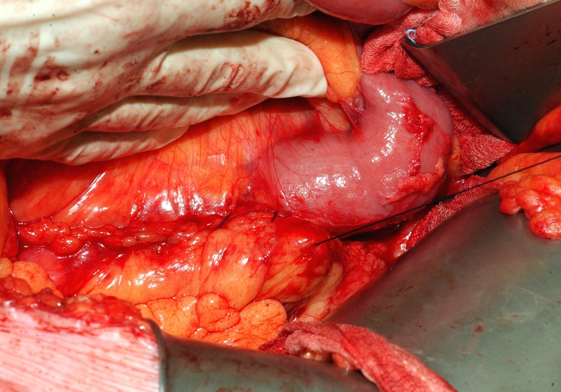
Open Surgery

Slide 42
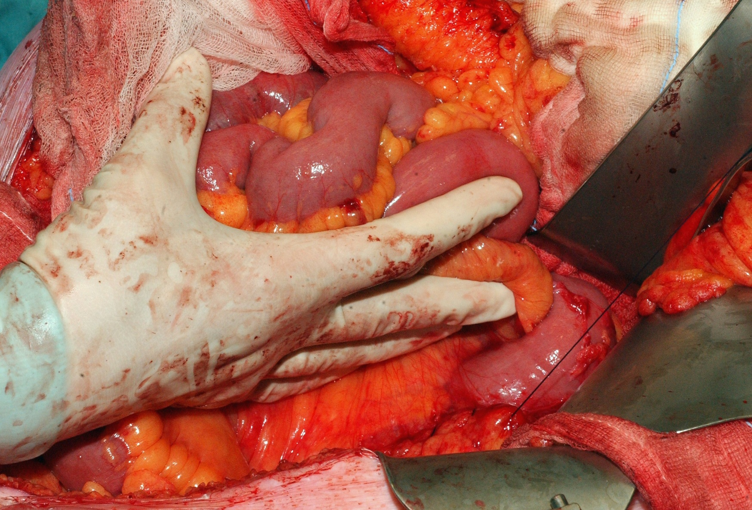
Open Surgery

Slide 43
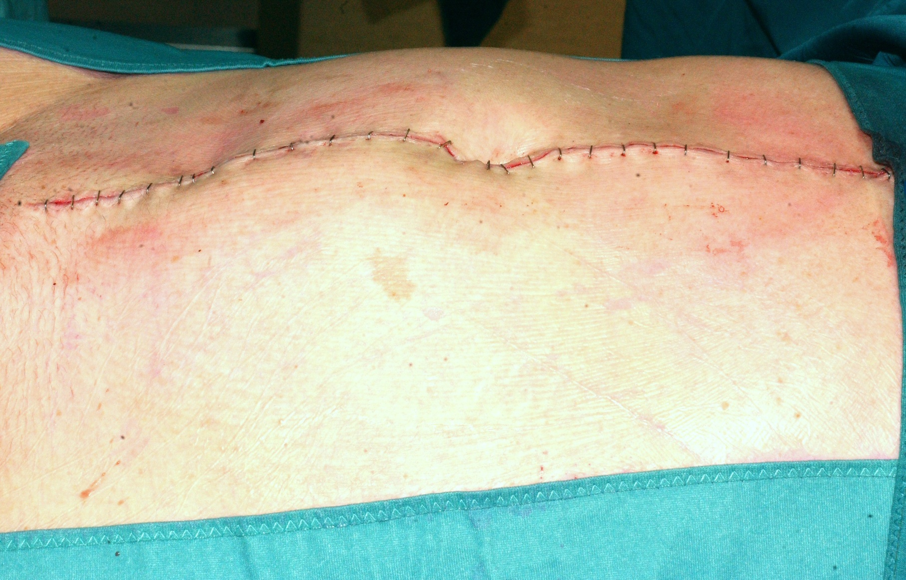
Open Surgery

Slide 44
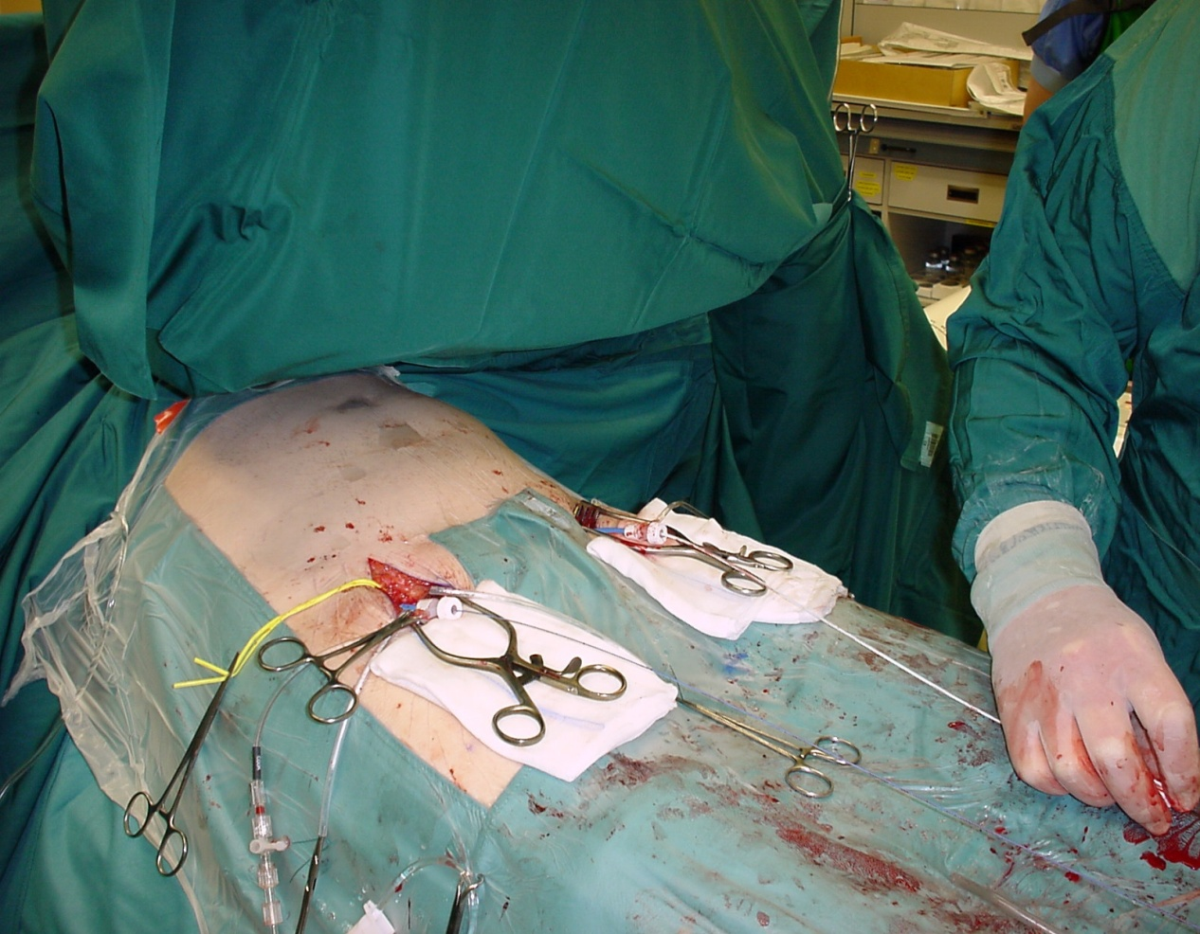
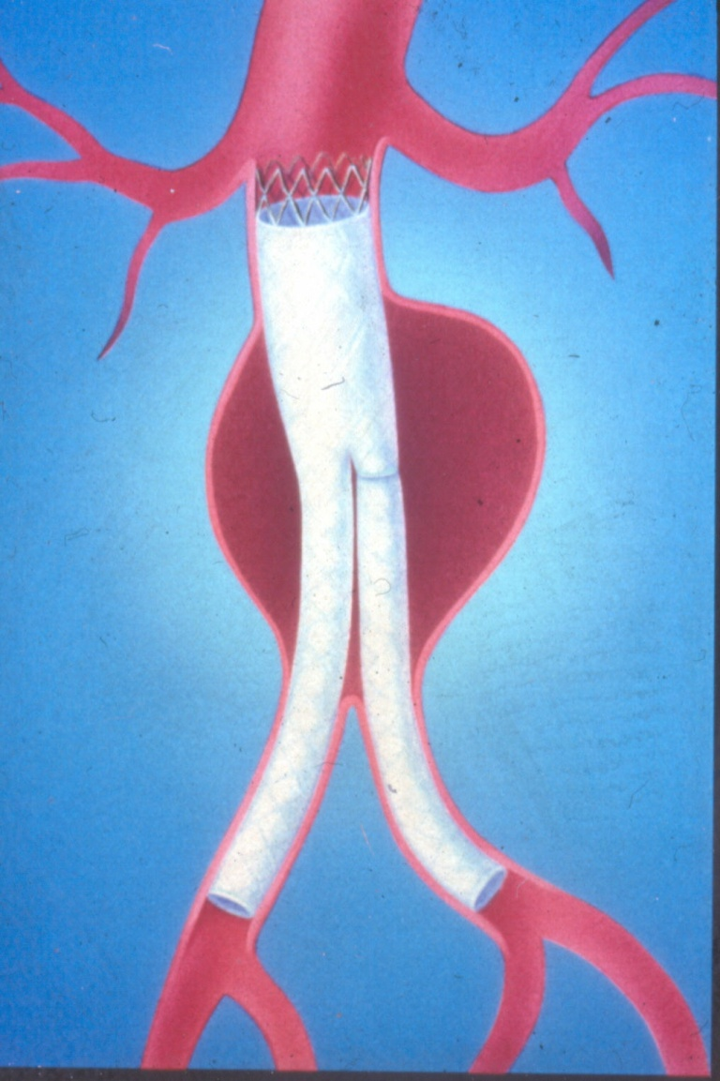
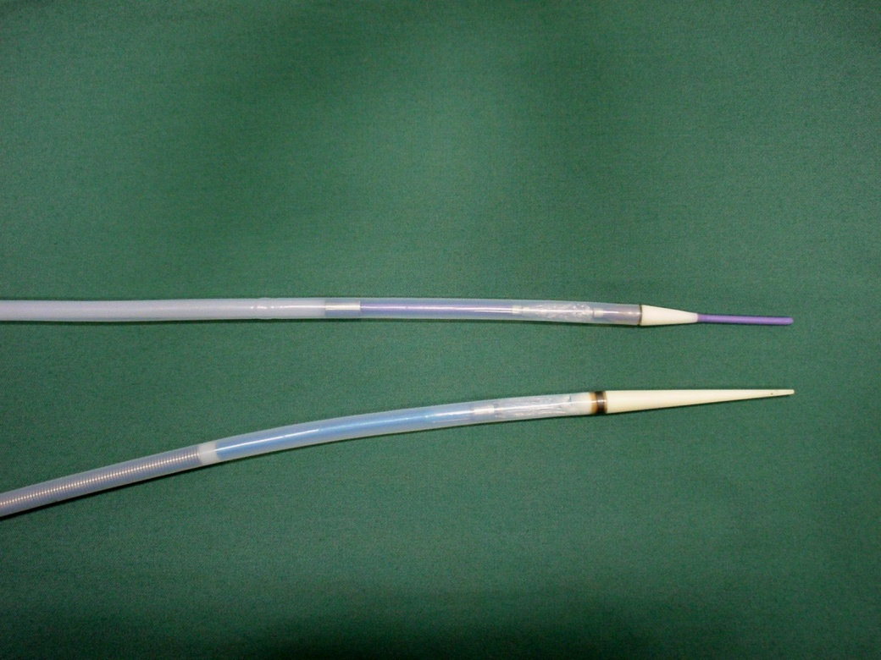
Endovascular Treatment

Slide 45
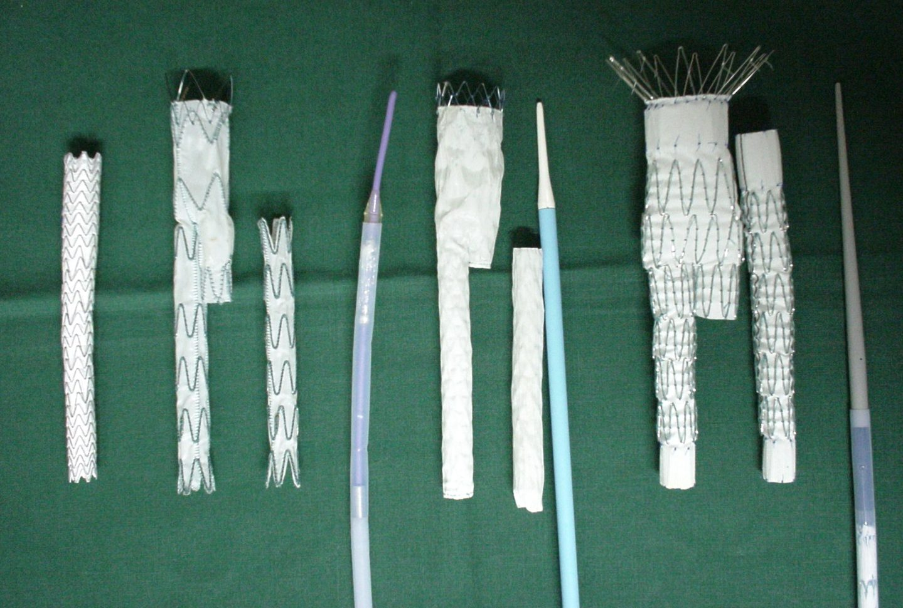
Endovascular Treatment

Slide 46
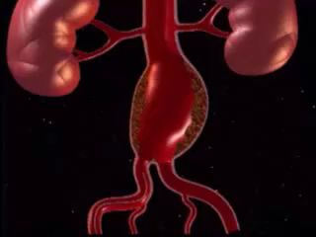

Slide 47

Indication
Same as open surgery:
  Based on diameter
Landing zone
  proximal
  distal
Access

Slide 48

Advantages
Smaller procedure
No blood transfusion
No I.C.U
Quicker recovery
Lower mortality
Lower morbidity

Slide 49
Complications?
Occlusions
Endoleaks
Migrations
Material failure

Slide 50



Occlusion

Slide 51


Endoleaks

Slide 52



Migration

Slide 53
Material failure
Metal
  Stent fractures
  Desintegration
Prosthesis
  Tearing

Slide 54

Stent fracture

Slide 55

Tear in graft material

Slide 56
Endovascular treatment
Much smaller procedure
Mortality: < 1 %?
Option for about 50%
Strict follow-up needed
Longer term results?

Slide 57
EVAR: Risk Benefit Analysis
Reduced magnitude
Reduced morbidity / mortality
Patient preference
Reduced hospital stay
_
+
Reduced technical success
Reduced durability
Increased procedure cost

Slide 58
EVAR versus Open Repair
Indication for treatment
Information to the patient
Logistics
  Measuring & Ordering
  Bail-out (plan B/reserve material)
  Surgery-Radiology-Industry

Slide 59

Most problems …..
……. Bad planning!

Slide 60
Fenestrated and branched stent-grafting

Slide 61


Fenestrated Grafts (FEVAR)
Created Neck

Slide 62


Slide 63


Slide 64


Slide 65

Branched Grafts (BEVAR)
  Start sealing in the thoracic aorta
  Connect visceral vessels with branches

Slide 66



Slide 67

Thoraco-abdominal Aneurysms (TAAA)

Slide 68



Slide 69


Slide 70


Slide 71
Treatment options
AAA patients
Conservative...
Open
Endovascular treatment
Fenestrated/Branched
~ age
~ co-morbidity
~ diameter
~ anatomy
~ choice patient

Slide 72
Bullit Points Aneurysm
Abnormal enlargement of a blood vessel
AAA most prevalent (Men above 65…)
Diagnosis: Clinical Examination, US, CT
Risk: Rupture
  Shock & acute back pain in elderly men
Preventive operation
  Balance Risk and Benefit
  Indication: > 5cm

