Slide 1
Εκτίμηση και Διαχείριση
Αμφιβληστροειδοπάθειας
Γκουλιόπουλος Νικόλαος
MD, PhD, PostDoc, FEBOphth
Οφθαλμίατρος, B’ Πανεπιστημιακή Οφθαλμολογική Κλινική, ΠΓΝ «Αττικόν»

Slide 2
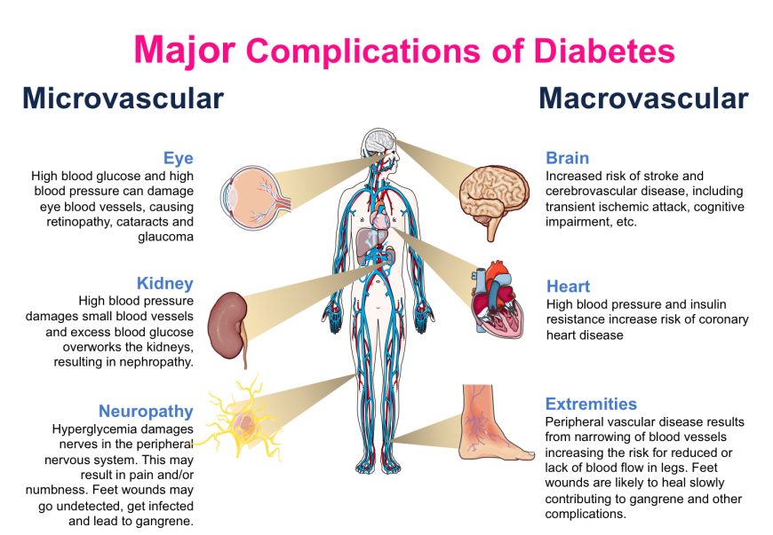
Diabetic Retinopathy
Iris trans-illumination defects
Unstable refraction
Recurrent styes
Xanthelasmata
Earlier and accelerated Cataract
Neovascular Glaucoma
Ocular motor nerve palsies
Reduced corneal sensitivity
Pupillary light-near dissociation
Rhino-orbital mucormycosis

Slide 3
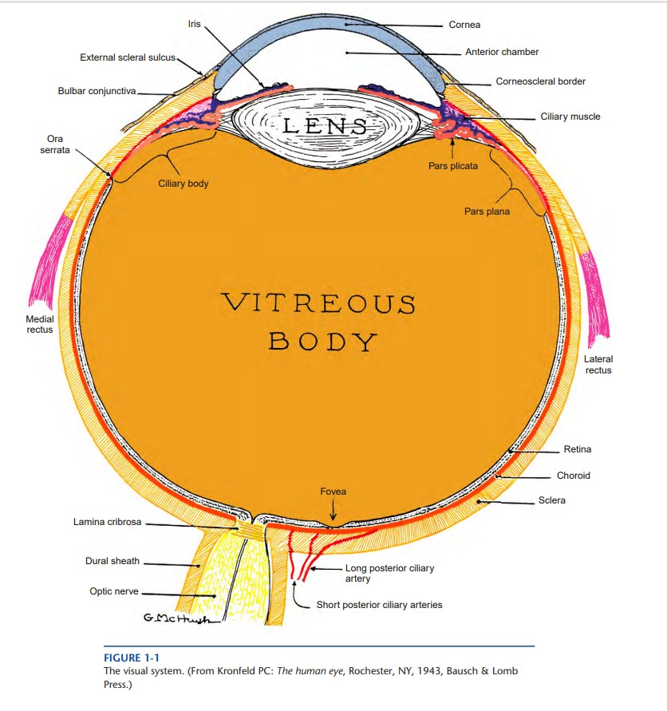
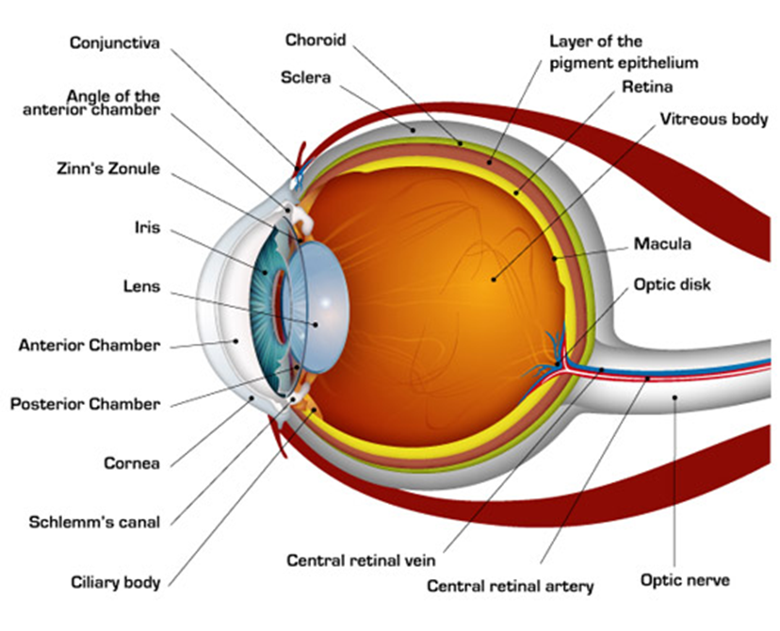
Anatomy
Remington LA (2012). Clinical Anatomy and Physiology of the Visual System (3rd Edition). Elsevier, St. Louis, Missouri

Slide 4
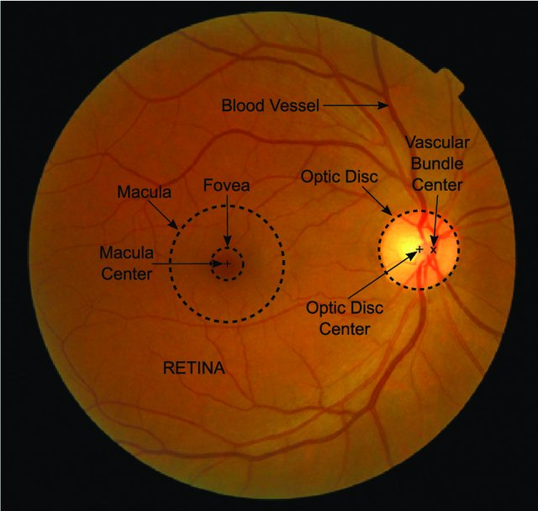
Anatomy
Retinal Artery
Posterior Pole
Retinal Vein
Molina-Casado JM, et al. Comput Methods Programs Biomed 2017;149:55-68

Slide 5
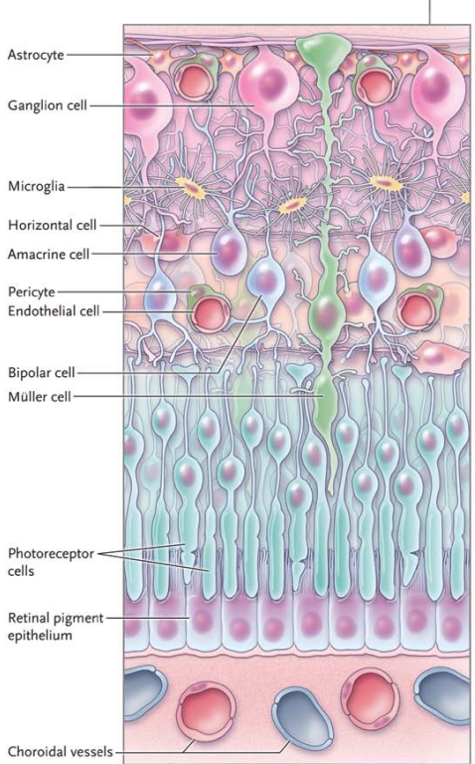
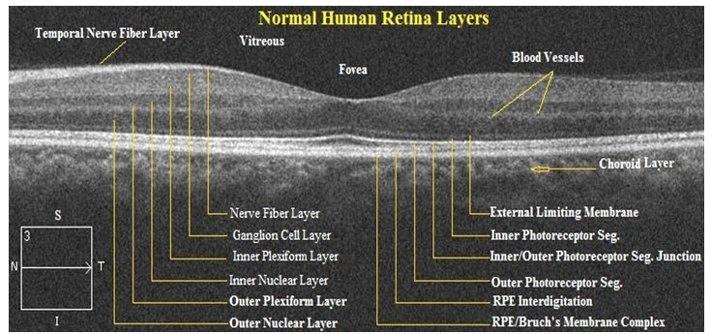
Anatomy
Mohandass G, et al. Biomed Pharmacol J 2017;10(3)
Antonetti DA, et al. N Engl J Med 2012; 366:1227-39

Slide 6
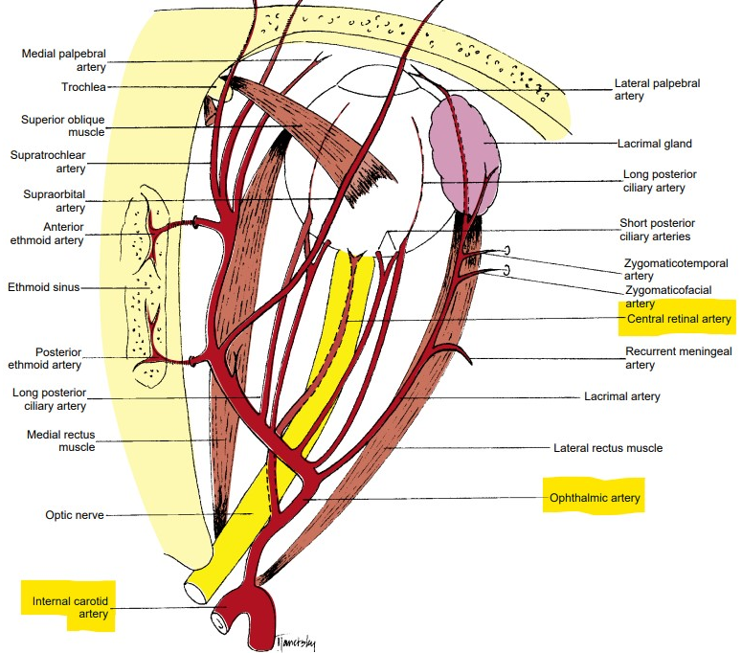
Anatomy – Retinal Circulation
Arterial System
Central Retinal Artery
single endothelium layer on a collagenous zone
internal elastic lamina separates intima from media
media consists mainly of smooth muscle
adventitia is composed of loose connective tissue
Retinal Arterioles
walls contain smooth muscle
internal elastic lamina is discontinuous (vs arteries)
1cm behind the globe
Remington LA (2012). Clinical Anatomy and Physiology of the Visual System (3rd Edition). Elsevier
Bowling B (2016). Kanski’s Clinical Ophthalmology . A systematic approach (8th Edition). Elsevier

Slide 7
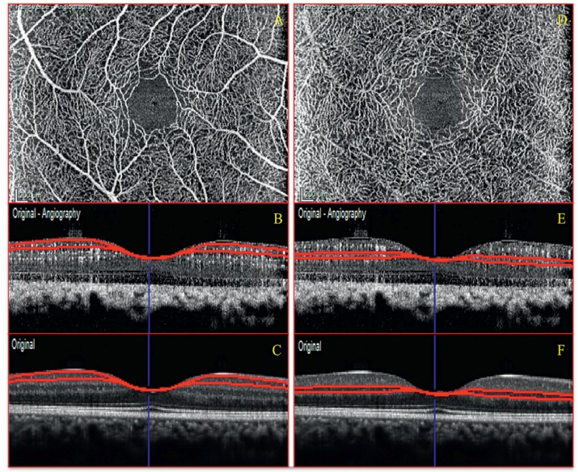
Anatomy – Retinal Circulation
inner/superficial capillary plexus at GCL
outer/deep capillary plexus at INL
Capillaries
supply inner 2/3 of retina
Capillary-free zones:
around arterioles
fovea (FAZ)
no smooth muscle and elastic tissue
walls consist of
a layer of endothelial cells on the basement membrane
a basement membrane
pericytes
Coscas G et al. Atlas OCT-Angio in diabetic maculopathy. L’europeenne d’editions
Bowling B (2016). Kanski’s Clinical Ophthalmology . A systematic approach (8th Edition). Elsevier

Slide 8
Anatomy – Retinal Circulation
Venous
drain blood from the capillaries
venules larger than capillaries, with similar structure
larger venules contain smooth muscle and form veins
veins: small amount of smooth muscle and elastic tissue in their walls
relatively distensible
diameter gradually enlarges as they pass posteriorly towards the central retinal vein
Bowling B (2016). Kanski’s Clinical Ophthalmology . A systematic approach (8th Edition). Elsevier

Slide 9
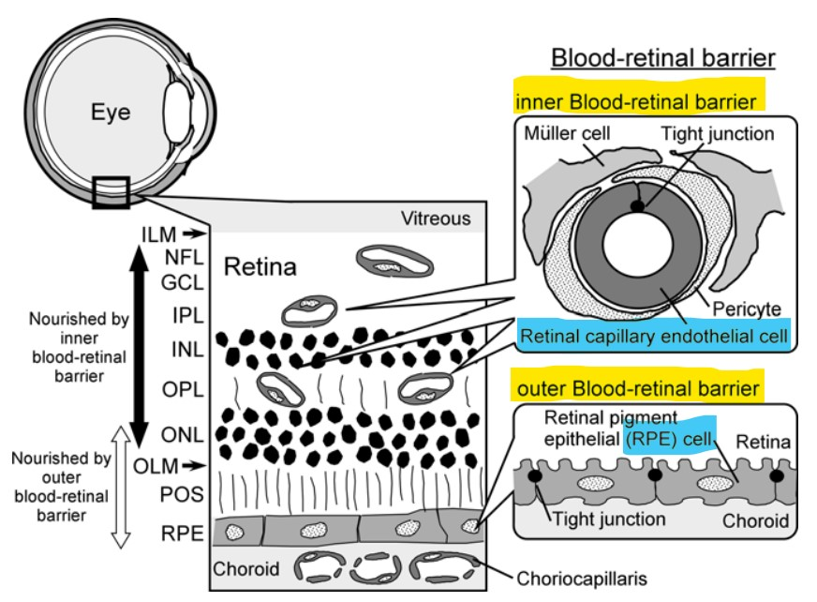
Anatomy – Blood Retinal Barrier
normally 1:1 with endothelial cells
contractile properties
microvascular circulation
autoregulation
Hosoya K, et al (2008). Inner Blood—Retinal Barrier: Transport Biology and Methodology. In: Ehrhardt, C., Kim, KJ. (eds) Drug Absorption Studies. Biotechnology: Pharmaceutical Aspects, vol VII. Springer, Boston, MA

Slide 10
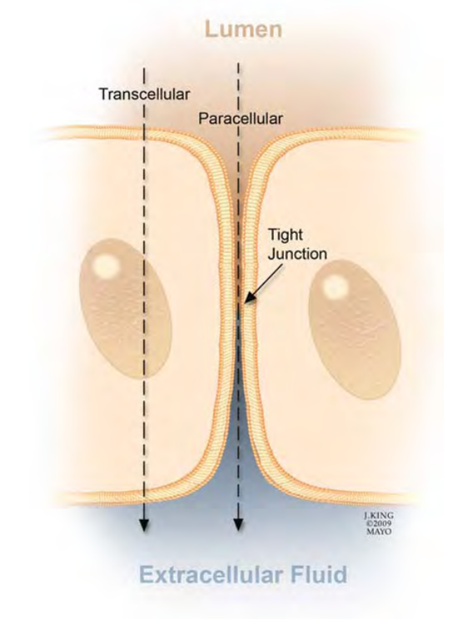
Anatomy – Blood Retinal Barrier
Ιnner Βlood-Retinal-Βarrier
tight junctions between adjacent retinal capillary endothelial cells
Browning D (2010). Diabetic Retinopathy. Evidence-Based Management. Springer

Slide 11
Terminology
Non-proliferative diabetic retinopathy (NPDR) (or Background - BDR)
only intraretinal vascular changes; no extra-retinal fibrovascular tissue
Proliferative diabetic retinopathy (PDR)
retinal neovascularization due to DM-induced ischemia
Diabetic macular edema (DME)
abnormal vascular permeability
in patients with NPDR or PDR
center- involved or non– center- involved DME
Vision threatening diabetic retinopathy (VTDR)
DME and/or PDR
Basic and Clinical Science Cource 2019-2020 (2020). Retina and Vitreous (12). American Academy of Ophthalmology

Slide 12
Epidemiology
1st cause of irreversible blindness among working-age people in the western world
5th cause of blindness and moderate/severe vision impairment worldwide
present in 77,3% T1DM patients and 32,4% T2DM patients
global prevalence (2020)
DR (103.12 million)
VTDR (28.54 million)
DME (18.83 million)
Greece:
38.7% DR, 5% PDR, 6.3% DME
T1DM: 52.4% DR - 9.5% DME
T2DM: 37.6% DR - 6.1% DME
highest in Africa (35.90%) and North American and the Caribbean (33.30%)
lowest in South and Central America (13.37%)
Flaxman SR, et al. Lancet Glob Health 2017; 5:e1221-34
Gouliopoulos NS et al. Eur Rev Med Pharmacol Sci 2018; 22:7113-28
Lee R, et al. Eye Vis (Lond) 2015; 2:17
Teo ZL, et al. Ophthalmology 2021; 128:1580-91
Syriga M, et al. Int Ophthalmol 2022; 42:1679-87

Slide 13
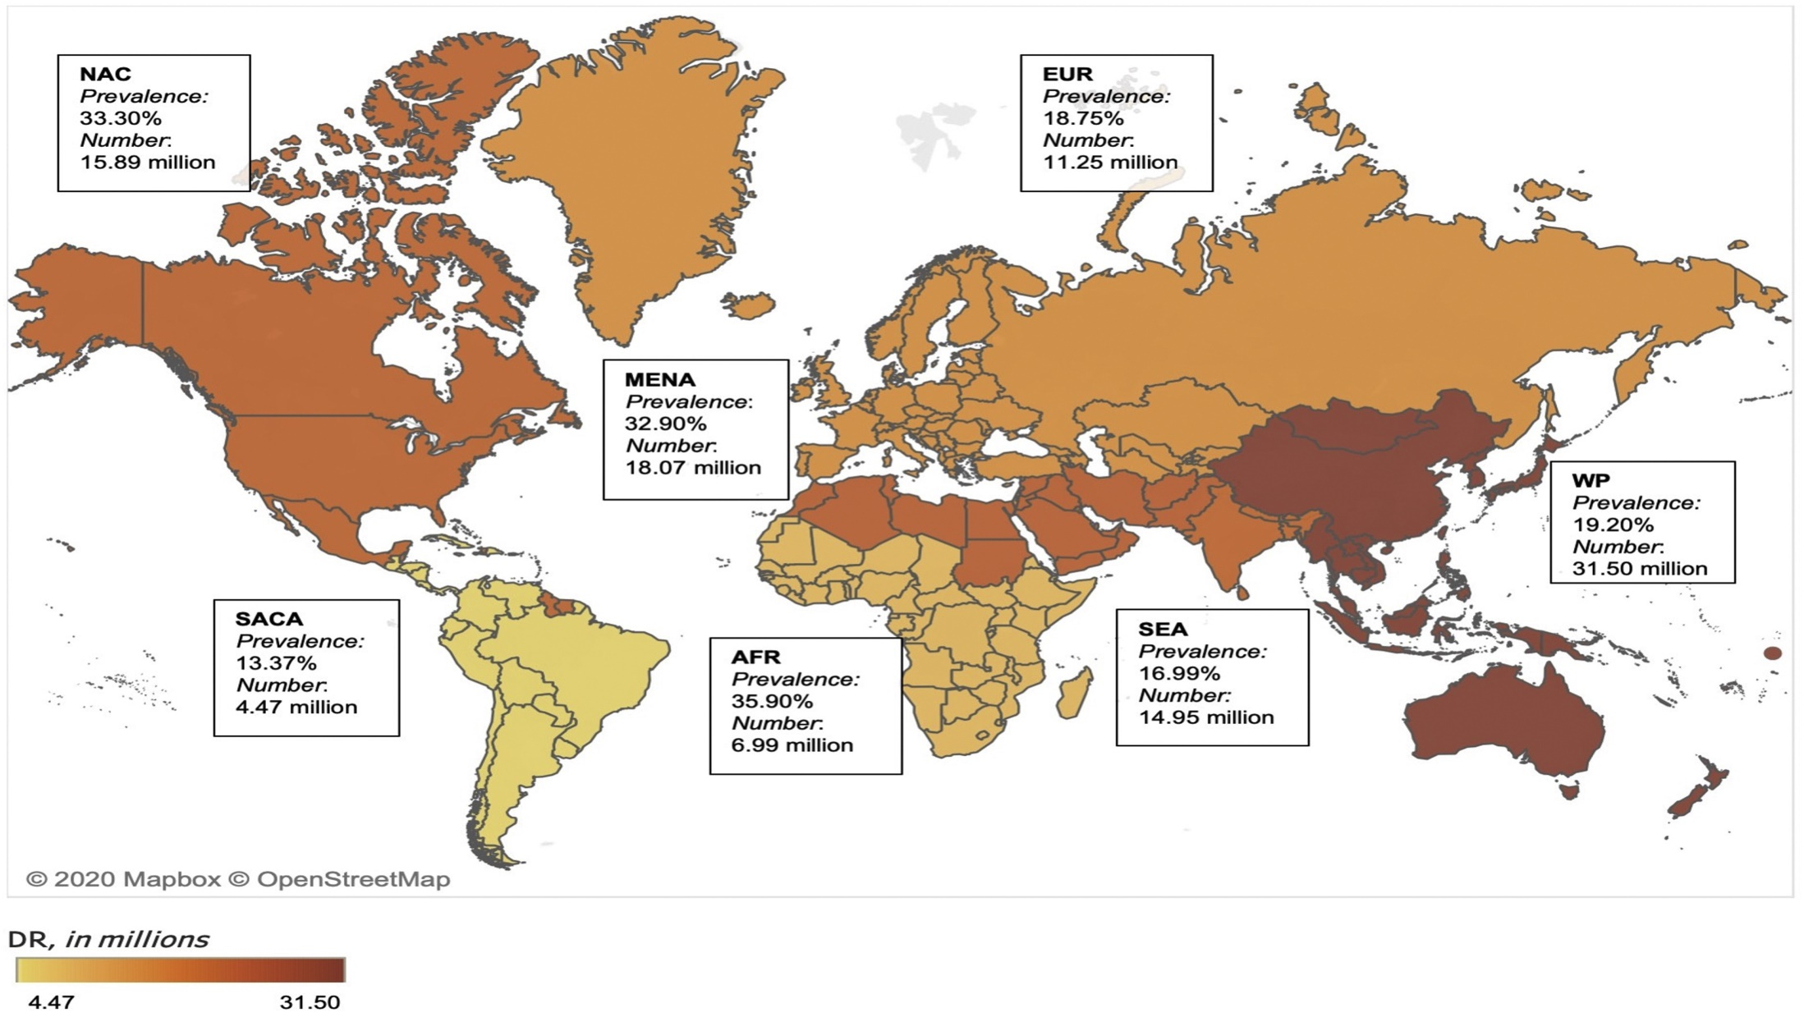
Teo ZL, et al. Ophthalmology 2021; 128:1580-91

Slide 14
Risk Factors
the most prominent RFs
DM duration and age of onset
HbA1c levels
hypertension
hyperlipidemia
together explain only 44.6% of DR cases
Xie J, et al. J Diabetes Metab 2014; 5: 2

Slide 15
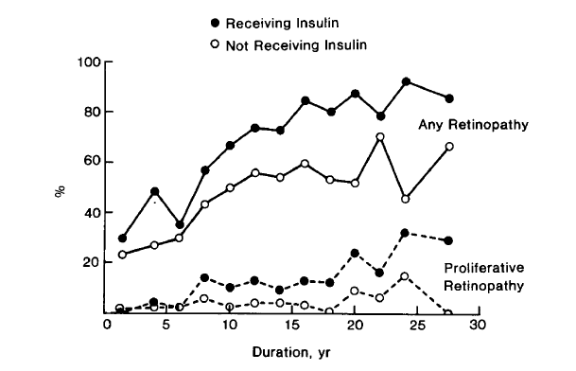
Risk Factors
Duration (& Age of Onset)
the most important RF (stronger predictor for PDR)
DM diagnosis <30y →DR 50% at 10y and 90% at 30y
rarely ≤5y of DM onset or before puberty
T2DM ~5%: DR at presentation
WESDR Study:
DR: at 20y ~ 99% of T1DM and 60% of T2DM
PDR: at 20y in 50% of T1DM
at 25y in 25% of T2DM
Wisconsin Epidemiologic Study of Diabetic Retinopathy
Bowling B (2016). Kanski’s Clinical Ophthalmology . A systematic approach (8th Edition). Elsevier
Klein R, et al. Ophthalmology 2009 ; 116:497-503

Slide 16
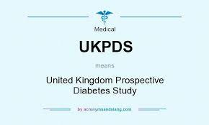
Risk Factors
Poor glycemic control
early and tight blood Glu control → prevent/delay DR development/progression
↓ DR risk by 33-41% for every 1% ↓ in HbA1c values
greater benefit of good glycemic control in T1DM (DCCT)
↑ HbA1c levels: ↑ risk of PDR
sudden ↓↓ HbA1c levels: maybe ↑ risk for early DR progression/worsening!!!
reversed effect by 1.5 year
UKPDS: recommended HbA1c levels <7.0% in T2DM
ACCORD: HbA1c levels <6.0% for slowed DR progression in T2DM
Mohamed Q, et al. JAMA 2007;298:902-16
UK Prospective Diabetes Study Group. BMJ 1998;317:703–13
Chew EY, et al; ACCORD Eye Study Group. N Engl J Med 2010; 363:233–44
Nathan DM, et al; Diabetes Control and Complications Trial Research Group. N Engl J Med 1993; 329:977–86

Slide 17
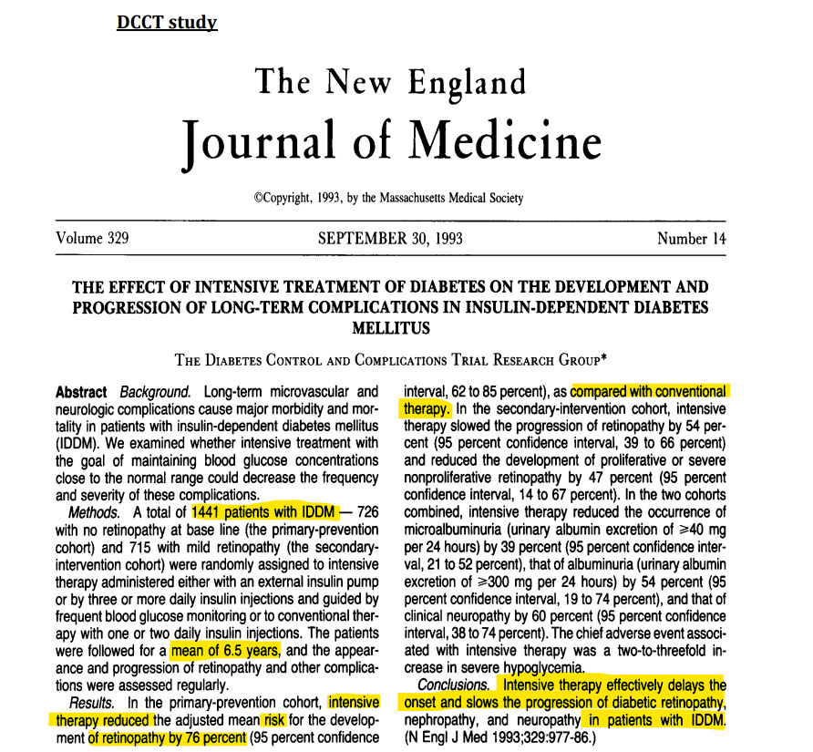

Slide 18
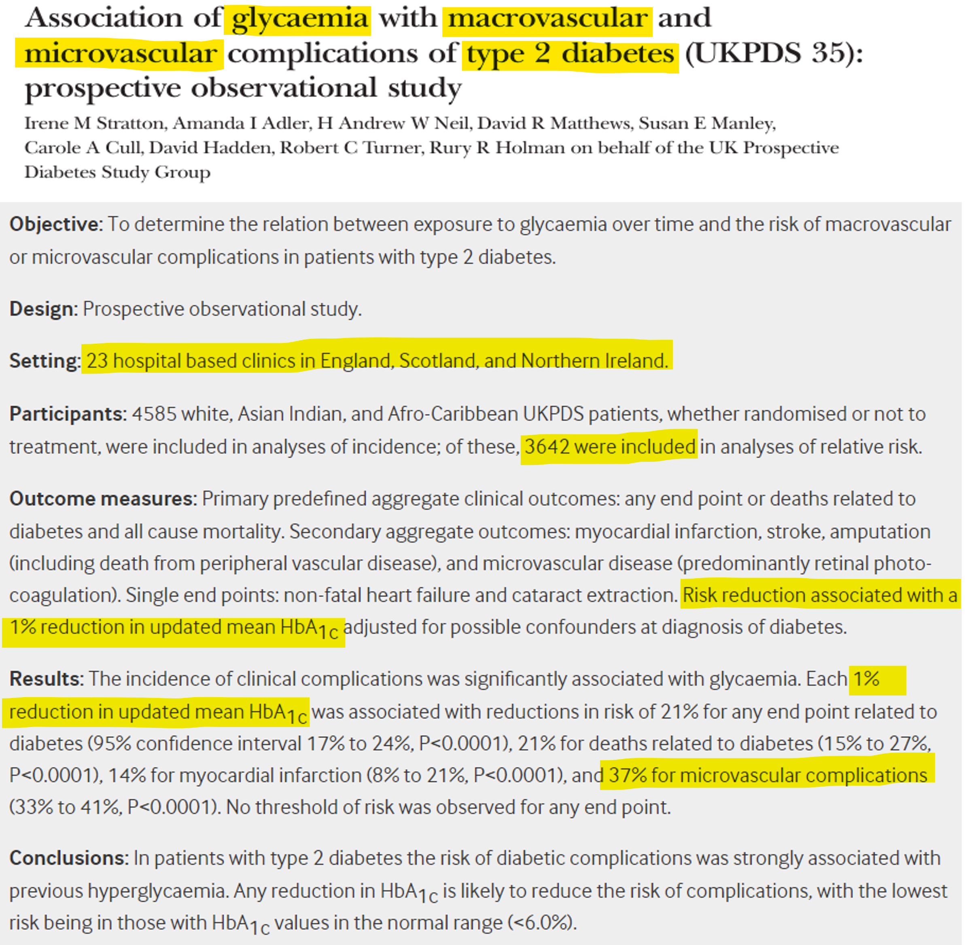

Slide 19
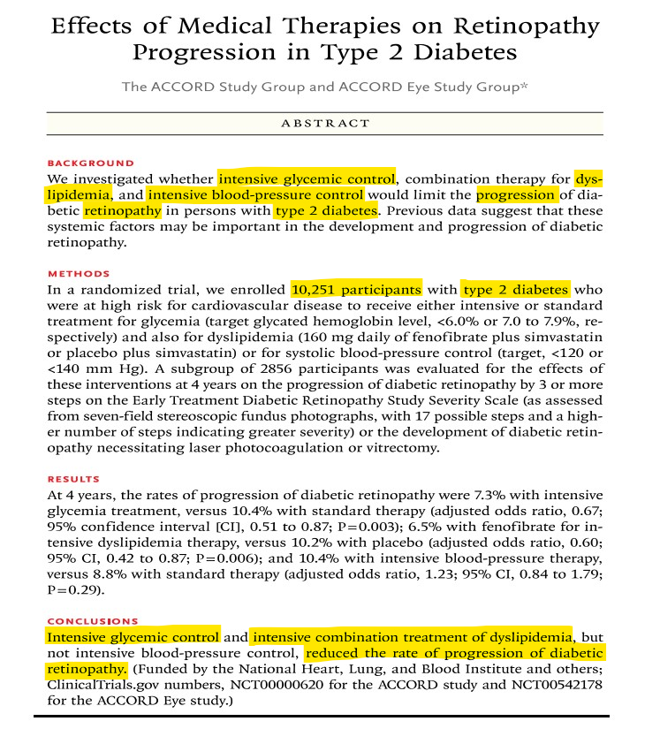

Slide 20
Risk Factors
Hypertension
tight control is suggested (<140/80 mmHg)
particularly beneficial in T2DM with DME
UKPDS:
for every 10mmHg↑ in T2DM, the risk of early DR and DME ↑ by 10% and 15%
no differences regarding the efficacy of ACE inhibitors vs b-blockers
UK Prospective Diabetes Study Group. BMJ 1998;317:703–13
Gouliopoulos NS et al. Eur Rev Med Pharmacol Sci 2018; 22:7113-28
Bowling B (2016). Kanski’s Clinical Ophthalmology . A systematic approach (8th Edition). Elsevier

Slide 21
Risk Factors
Hyperlipidemia
DCCT: DR severity in T1DM
positive correlation with increased triglycerides
negative correlation with HDL levels
Hoorn Study:
positive association of elevated LDL levels with hard exudates
Fenofibrate 200 mg: in T2DM
daily use reduces DR progression
associated with ↓ risk of PDR and VTDR but not DME alone!!!
Meer E, et al. JAMA Ophthalmol 2022; 140:529–32
Gouliopoulos NS et al. Eur Rev Med Pharmacol Sci 2018; 22:7113-28
Bowling B (2016). Kanski’s Clinical Ophthalmology . A systematic approach (8th Edition). Elsevier
Nathan DM, et al; Diabetes Control and Complications Trial Research Group. N Engl J Med 1993; 329:977–86

Slide 22
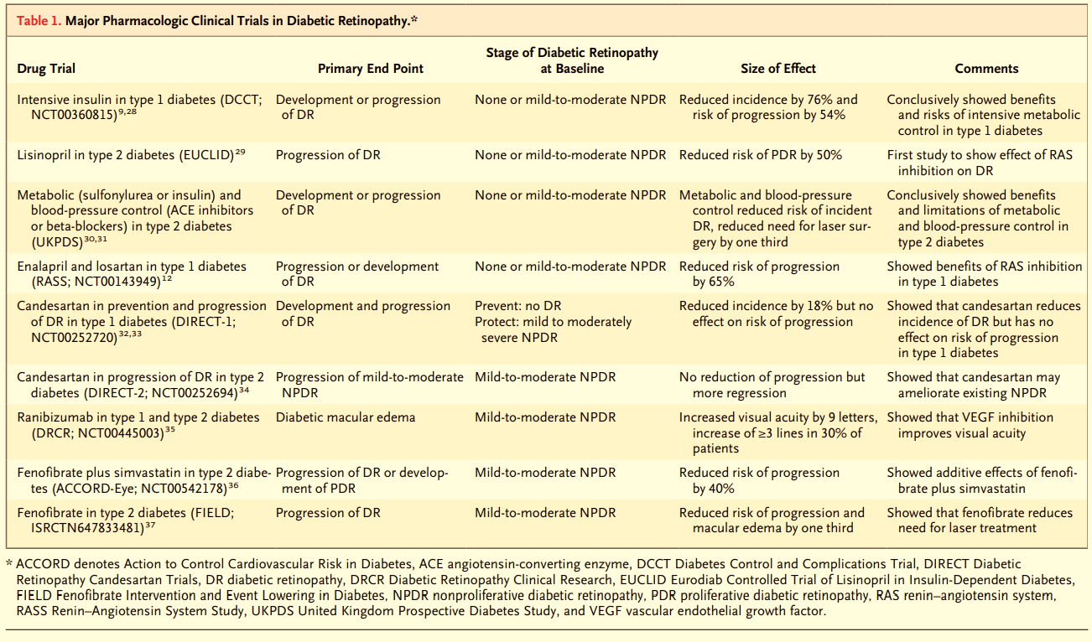
Risk Factors
Antonetti DA, et al. N Engl J Med 2012; 366:1227-39

Slide 23
Risk Factors
Pregnancy: risk of progression
pre-pregnancy DR severity
poor pre-pregnancy DM control
too rapid control during the early pregnancy stages
pre-eclampsia
DR severity in the first trimester
spontaneous DME resolution after pregnancy - no need for treatment in late development
Nephropathy
↑ severity associated with DR worsening
renal disease treatment (e.g. transplantation) may be associated with DR improvement and better response to photocoagulation
Antonetti DA, et al. N Engl J Med 2012; 366:1227-39
Bowling B (2016). Kanski’s Clinical Ophthalmology . A systematic approach (8th Edition). Elsevier

Slide 24
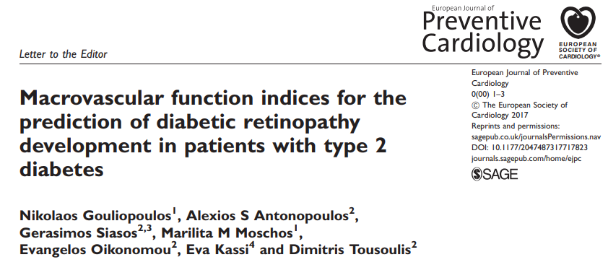
Risk Factors
insulin treatment
cataract surgery
obesity
ipsilateral carotid disease
anaemia
sleep apnea
nonalcoholic fatty liver disease
serum levels of prolactin – adiponectin - homocysteine
Antonetti DA, et al. N Engl J Med 2012; 366:1227-39
Bowling B (2016). Kanski’s Clinical Ophthalmology . A systematic approach (8th Edition). Elsevier

Slide 25
Risk Factors -Heritability
DR ~ 27% - PDR ~ 52%
stronger genetic association between in T2DM vs T1DM
genetic variations in genes:
aldose reductase (AKR1B1)
vascular endothelial growth factor (VEGF)
endothelial nitric oxide synthase (eNOS)
angiotensin converting enzyme (ACE)
receptor for AGEs (AGER)
aldehyde dehydrogenase 2 (ALDH2)
adiponectin (ADIPOQ)
complement factor B (CFB)
glutathione S-transferase theta 1 (GSTT1)
intercellular adhesion molecule 1 (ICAM-1)
interferon gamma (IFN-γ)
interleukin 10 (IL-10)
monocyte chemoattractant protein 1 (MCP-1)
plasminogen activator inhibitor-1 (PAI-1)
transforming growth factor beta 1 (TGF-β1)
tumor necrosis factor alpha (TNFα)
Looker HC, et al. Diabetes 2007; 56:1160–6
Hietala K, et al. Diabetes 2008; 57: 2176–80
Antonetti DA, et al. N Engl J Med 2012; 366:1227-39
Gouliopoulos N, et al. Eur J Ophthalmol 2022 Sep 13: (Epub ahead of print)
Gouliopoulos N, et al. Ophthalmic Genet 2022; 43:326-31
Gouliopoulos N, et al. Eur J Ophthalmol 2022; 32:2582-8

Slide 26
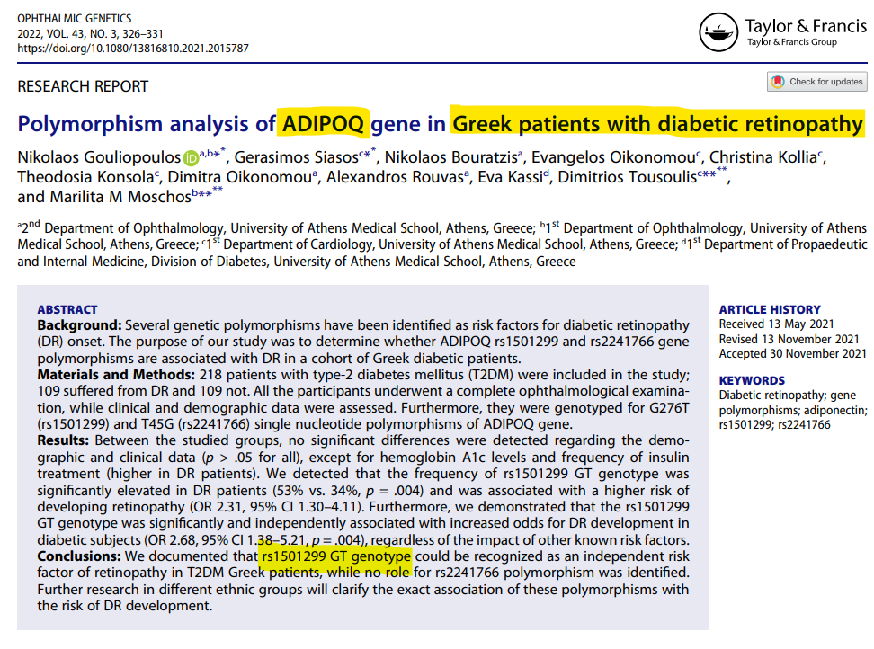
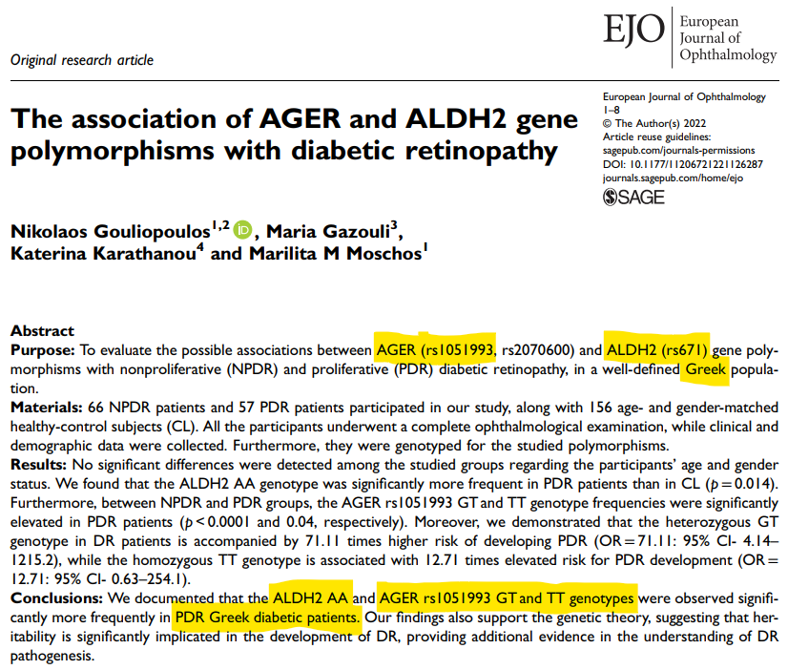
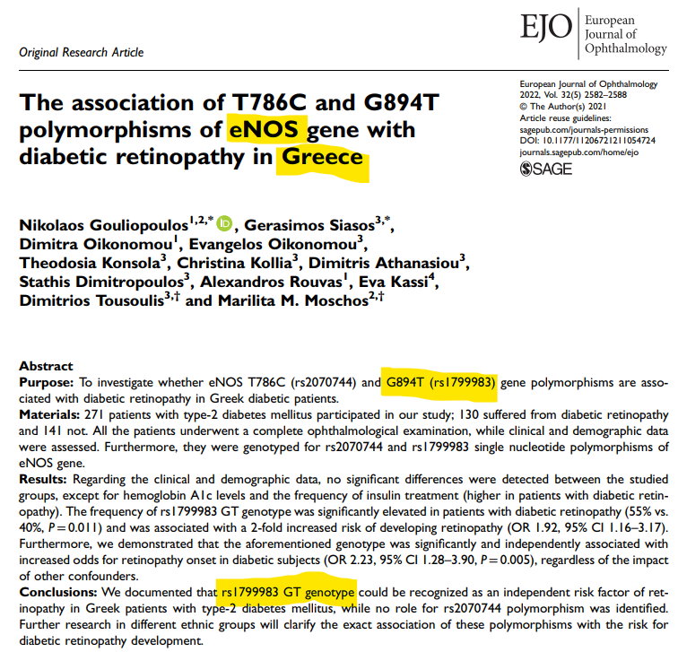

Slide 27
Classification
rough classification
non-proliferative (NPDR) or background (BDR)
proliferative (PDR)
classification systems
ETDRS (gold standard)
EURODIAB
International Clinical Disease Severity Scale for DR
neovascularization marks the transition to the proliferative stage
Wu L, et al. World J Diabetes 2013; 4:290-4

Slide 28
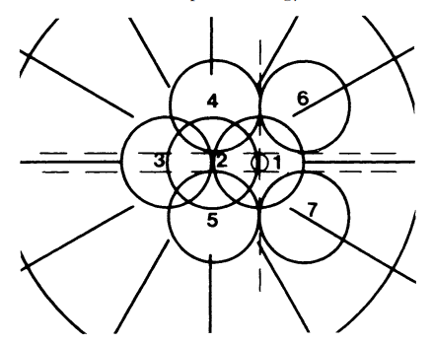
Classification - ETDRS
modified Airlie House classification
stereoscopic color fundus photography in 7 standard fields (30°)
13 stages
from no evidence of DR to the most advanced PDR stages
Early Treatment Diabetic Retinopathy Study Research Group. Ophthalmology 1991; 98(5 Suppl):786-806

Slide 29
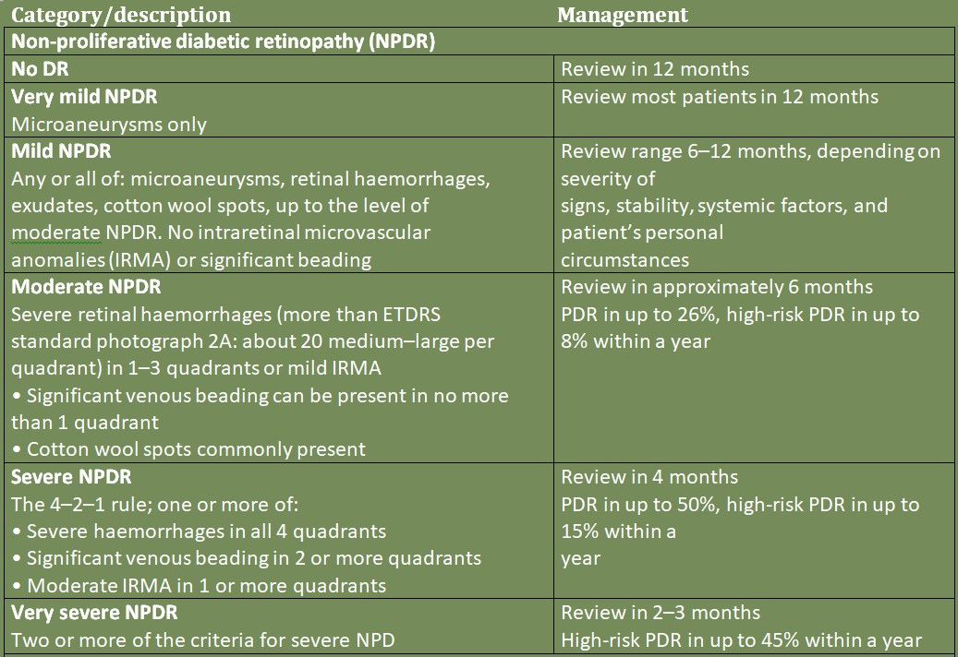
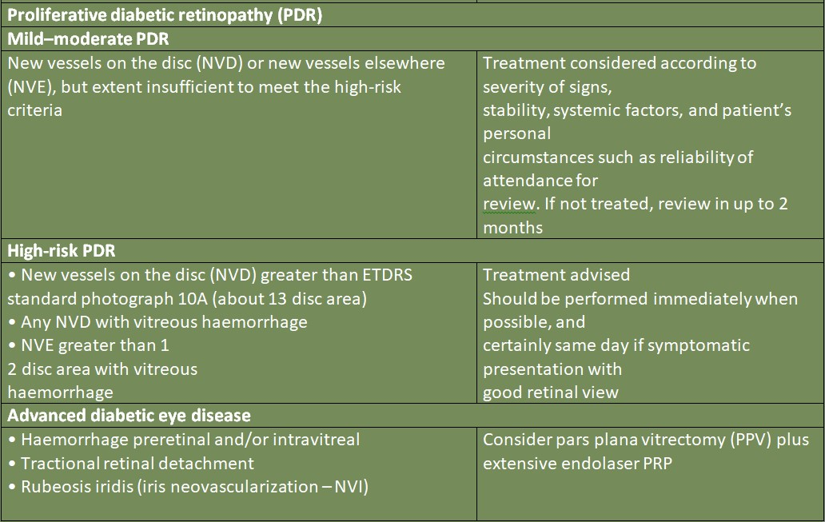
Bowling B (2016). Kanski’s Clinical Ophthalmology . A systematic approach (8th Edition). Elsevier

Slide 30
Pathophysiology
microvascular disorder by retinal damage due to long-term DM effects
damage to precapillary arterioles, capillaries and venules
small blood vessels particularly vulnerable to damage from ↑↑ Glu
direct hyperglycaemic effects on retinal cells possibly implicated
DR initial damage to
pericytes
endothelial cells
vascular basal lamina (thickening)
disruption of inner BRB
Antonetti DA, et al. N Engl J Med 2012; 366:1227-39
Bowling B (2016). Kanski’s Clinical Ophthalmology. A systematic approach (8th Edition). Elsevier

Slide 31
Pathophysiology
NPDR
increased vascular permeability/capillary leakage
capillary occlusion → non perfusion → retinal ischemia
PDR
neovascularization due to retinal ischemia
≥ ¼ of the retina non-perfused before neovascularization
new abnormal vessels may
bleed into the vitreous
cause a tractional retinal detachment
Wong TY, et al. Ophthalmology 2018; 125:1608-22
Solomon SD, et al. Diabetes Care 2017; 40:412-8.
Bowling B (2016). Kanski’s Clinical Ophthalmology. A systematic approach (8th Edition). Elsevier

Slide 32
Pathophysiology NPDR
Hyperglycemia
advanced glycation end products (AGEs) formation
endothelial damage
microaneurysms
retinal hemorrhages
leakage & exudates
activated leukocyte adhering
capillary occlusion
retinal ischemia
infarction of the nerve fiber layer
cotton-wool spots
Wong TY, et al. Ophthalmology 2018; 125:1608-22
Fu X, et al. PLoS Comput Biol 2016; 12:e1004932

Slide 33
Pathophysiology DME
chronic inflammation
endothelial damage
inner BRB breakdown
increased vascular permeability
fluid leaking into the retina (DME)
hard exudates
1st cause of vision loss in T2DM
Wong TY, et al. Ophthalmology 2018; 125:1608-22
Fu X, et al. PLoS Comput Biol 2016; 12:e1004932

Slide 34
Pathophysiology PDR
chronic retinal ischemia
release of pro-angiogenic factors (mainly VEGF)
neovascularization to bypass damaged retinal blood vessels
adjacent to non-perfused retinal areas (NVE)
optic disk (NVD)
iris (NVI)
new vessels
immature, fragile, permeable, bleed very easily
responsible for vitreous hemorrhage, tractional retinal detachment, neovascular glaucoma
Wang W, et al. Int J Mol Sci 2018; 19(6)
Falcão M, et al. The Open Circulation & Vascular Journal 2012; 3:30-42

Slide 35
Pathological Processes
Hyperglycemia and the regulation of metabolic pathways
Inflammation
Oxidative stress
Vascular abnormalities and angiogenesis pathways

Slide 36
Hyperglycemia & metabolic pathways
chronic and excessive hyperglycemia → alternative Glu metabolism pathways
polyol pathway - AGEs formation - PKC activation - hexosamine pathway flux
activation of cytokines and growth factors (VEGF)
endothelial dysfunction / inner BRB breakdown
increased vascular permeability
microvascular occlusion
retinal ischemia
IRMAs
neovascularization
Whitehead M, et al. Expert Opin Biol Ther 2018; 18:1257-70

Slide 37
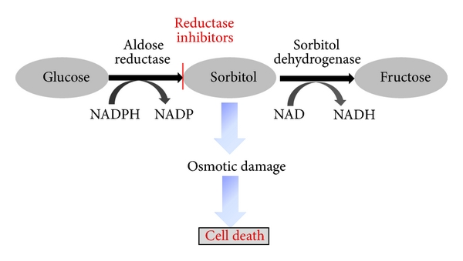
Hyperglycemia & metabolic pathways
The Polyol Pathway
excess Glu is metabolized via the polyol pathway to
sorbitol
intracellular accumulation
osmotic damage → cellular death
fructose
deoxyglucosone
↓ NADPH availability
↑ sensitivity of affected cells to oxidative stress
deposition of AGEs
Gabbay KH. Annu Rev Med 1975; 26:521-36
Gabbay KH. N Engl J Med 1973; 288:831-6
Barnett PA, et al. Diabetes 1986; 35:426-32
Tarr JM, et al. ISRN Ophthalmol. 2013; 2013:343560

Slide 38
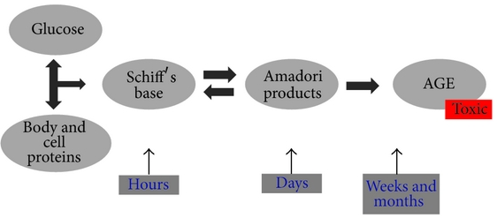
Hyperglycemia & metabolic pathways
AGEs formation
↑↑ Glu → ↑↑ AGEs formation and accumulation in DM patients
alter the structure and function of the proteins
thickening of capillary basement membranes
pericyte loss
inner BRB breakdown
Peppa M, et al. Clinical Diabetes 2003; 21:186
Tarr JM, et al. ISRN Ophthalmol. 2013; 2013:343560

Slide 39
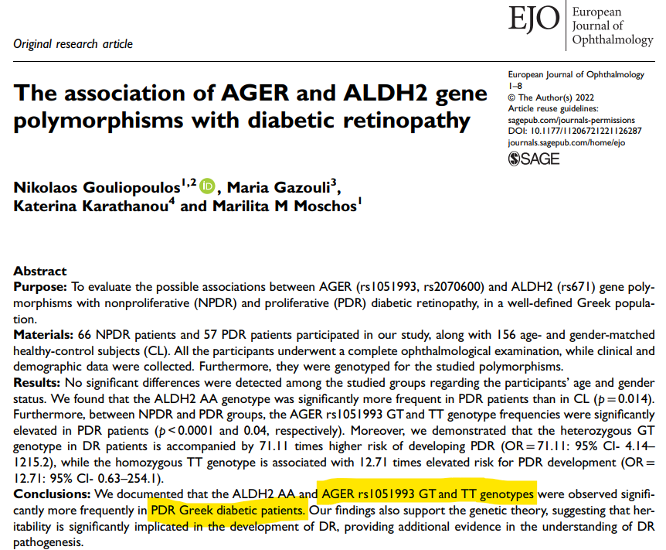
Hyperglycemia & metabolic pathways
AGEs receptors (AGERs) activation
pro-oxidant cascades
pro-inflammatory cascades
↑oxidative stress
↑ leukocyte adhesion
AGER inhibition in mice prevents DR development
AGER gene polymorphisms alter the AGE/AGER binding
beneficial or detrimental effect on diabetic vascular complications development
Hammes HP, et al. Proc Natl Acad Sci U S A 1991; 88:11555-8
Gouliopoulos N, et al. Eur J Ophthalmol 2022 Sep 13: (Epub ahead of print)

Slide 40
Hyperglycemia & metabolic pathways
PKC Activation
↑↑ Glu → ↑ glycolysis → ↑ diacylglycerol (DAG) synthesis
PKC pathway activation
mitogen-activated protein kinase (MAPK) factors activation
↑ stress-related proteins
↑ mediators of vascular function (e.g. VEGF and such as c-Jun kinases)
↑↑ NADPH oxidase
↑↑ NFκB in vascular cells
oxidative stress and inflammation
Xia P, et al. Diabetes 1994; 43:1122-9
Koya D, et al. Diabetes 1998; 47:859-66
Rosse C, et al. Nat Rev Mol Cell Biol 2010; 11:103-12
Wang QJ, et al. Trends Pharmacol Sci 2006; 27:317-23

Slide 41
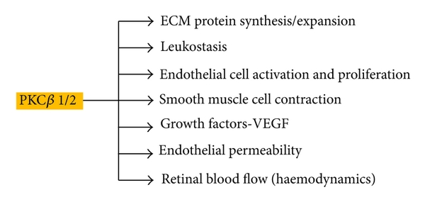
Hyperglycemia & metabolic pathways
PKC Activation
PKC: a 10 enzymes family
β1/2 isoform associated with DR development
Tarr JM, et al. ISRN Ophthalmol. 2013; 2013:343560

Slide 42
Hyperglycemia & metabolic pathways
Hexosamine Pathway Flux
activated when ↑↑ intracellular Glu cannot be drained by glycolysis
most of it is converted to glucose-6-phosphate (G6P) →
converted to fructose-6-phosphate (F6P)
in vascular cells
↑ TGFβ
↑ PAI-1
multiple factors involved in DR development are affected
Wells L, et al. Science 2001; 291(5512):2376-8
Hart GW, et al. Annu Rev Biochem 1997; 66:315-35

Slide 43
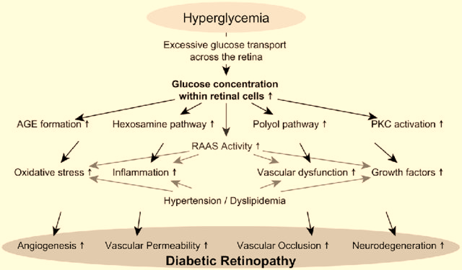
May M, et al. Ther Adv Endocrinol Metab 2019; 10:2042018819891886

Slide 44
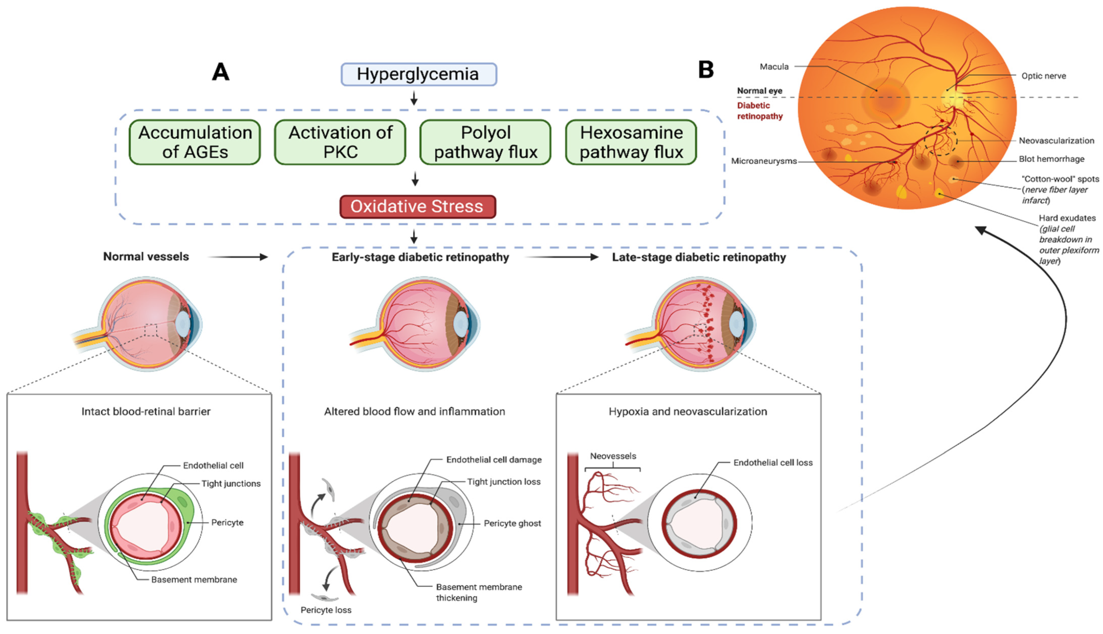
Chauhan MZ, et al. Cells 2022; 11:1950

Slide 45
Pathological Processes
Hyperglycemia and the regulation of metabolic pathways
Inflammation
Oxidative stress
Vascular abnormalities and angiogenesis pathways

Slide 46
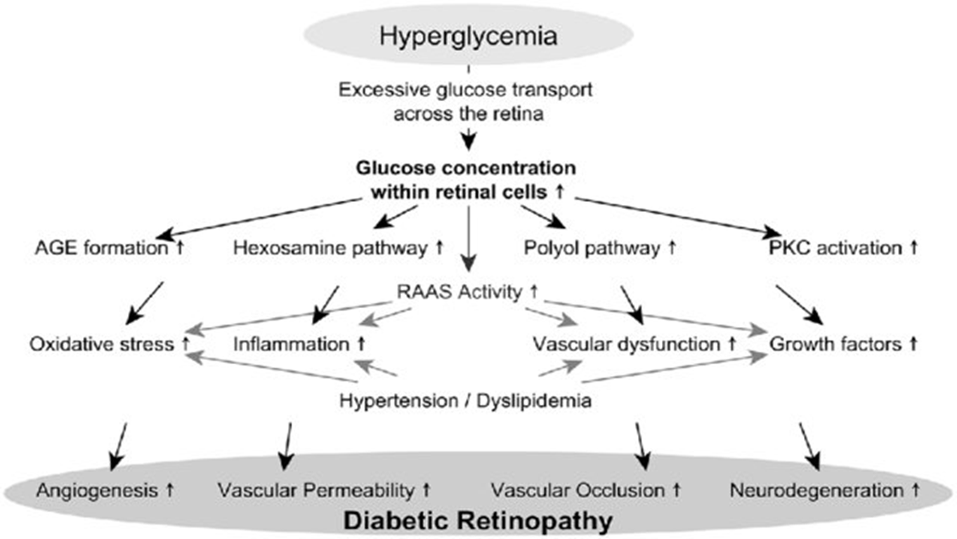
Inflammation
key factor in DR pathogenesis
simultaneous course of multiple metabolic pathways
oxidative stress
AGEs
↑ VEGF expression
inflammatory response

Slide 47
Inflammation
chronic low-grade inflammation
capillary occlusion
hypoxia
↑ VEGF expression
leukostasis
retinal microvasculature occlusion
endothelium damage
inner BRB breakdown
Joussen AM, et al. Faseb j 2003; 17:76-8
Schroder S, et al. Am J Pathol 1991; 139:81-100

Slide 48
Inflammation
hyperglycemic stress → microglia activation → retinal glial cell dysfunction
↑ secretion of
anti-inflammatory drugs (e.g. intravitreal triamcinolone acetonide and topical application of NSAIDs like nepafenac)
↓ VEGF expression
↓ vascular permeability
inhibition of retinal cell death
diminished leukostasis
improved visual acuity
TNF-α
IL-6
MCP-1
VEGF
endothelial impairment
leukocyte adherence to retinal endothelium
Kern TS, et al. Diabetes 2007; 56:373-9
Gillies MC, et al. Ophthalmology 2006 113:1533-8
Kuppermann BD, et al. Arch Ophthalmol 2007; 125:309-17

Slide 49
CRP ≥3 mg/L
possible independent RF for DR development – more prominent if BMI >30kg/m²
TNF-α
positive correlation with DR severity (EURODIAB Prospective Complications Study)
strong and independent RF for both PDR and DME
↑ TNF-α serum levels by 10 pg/mL → 2-fold ↑ risk of PDR and/or DME
baseline TNF-α levels ≥3.4 pg/mL → 3-fold ↑ risk of PDR and/or DME
IL-6
presence of DR and disease severity in both DM types
ICAM-1
baseline levels ≥165pg/mL → 3-fold ↑ risk of DME
E-selectin
baseline levels ≥40 pg/mL → 2-fold ↑ risk of PDR
PAI-1
independent and strong RF for DR incidence in T2DM, especially for severe PDR stages
DR development risk ↑ by 12% for each 10ng/dL ↑in baseline PAI-1 levels

Slide 50
Pathological Processes
Hyperglycemia and the regulation of metabolic pathways
Inflammation
Oxidative stress
Vascular abnormalities and angiogenesis pathways

Slide 51
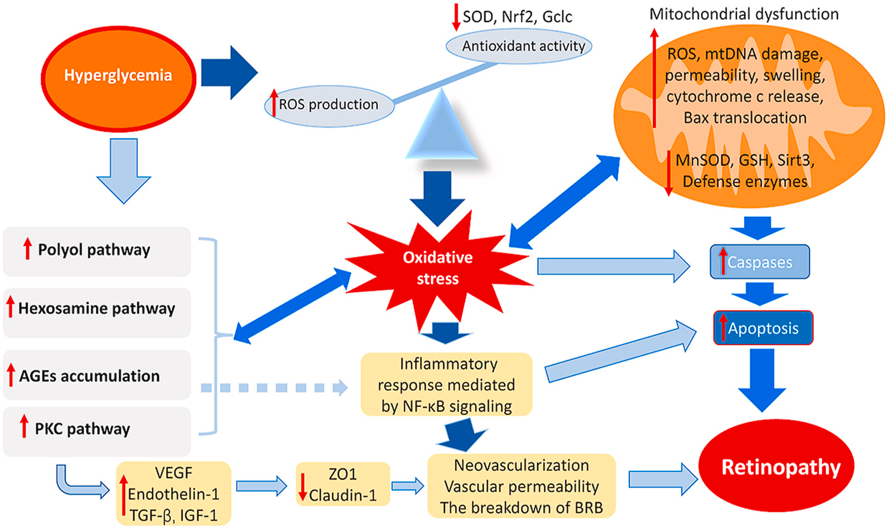
Oxidative stress
Kang Q, et al. Redox Biol 2020;37:101799

Slide 52
Pathological Processes
Hyperglycemia and the regulation of metabolic pathways
Inflammation
Oxidative stress
Vascular abnormalities and angiogenesis pathways

Slide 53
Vascular abnormalities and angiogenesis pathways
hyperglycemia
pericyte loss
endothelial cells apoptosis
basement membrane thickening
inner BRB impairment
leakage and exudates
pericytes - responsible capillaries structure
microaneurysm formation
pronounced pericytes and endothelial cells loss
capillary occlusion and ischemia
↑↑ VEGF via hypoxia-inducible factor 1 (HIF-1) activation
neovascularization
Feldman-Billard S, et al. Diabetes Metab 2018; 44:4-14
Schmidt-Erfurth U, et al. Prog Retin Eye Res 2018; 67:1-29
Bressler NM, et al. N Engl J Med 2011; 365:1520-6

Slide 54
Association with systemic vascular dysfunction
diabetic microvascular disease (DMD) (including DR)
large vessel atherosclerosis via
hypoxia
alterations in vasa vasorum
diminishing NO bioavailability in the vasculature
activating pro-inflammatory mechanisms
association with ↑ morbidity in the setting of acute coronary syndromes or strokes
debatable whether DMD precedes large vessel atherosclerosis or they progress in parallel
Brownrigg JRW, et al. Lancet Diabetes Endocrinol 2016; 4:588–97
Antonopoulos AS, et al. Diabetes Care 2015; 38:e180–1
Antonopoulos AS, et al. Cardiovasc Res 2017; 113:1074–86

Slide 55
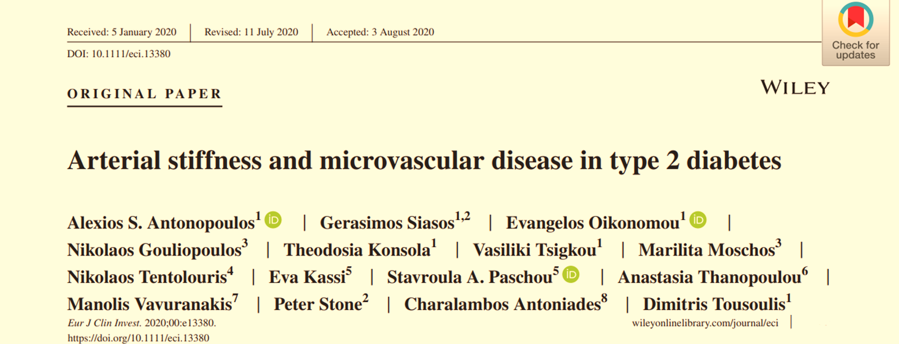
presence of DMD (DR): independently predict
hospitalization for heart failure
future mortality cardiovascular disease risk
non-fatal myocardial infarction
absence of DR at baseline screening
association with no mortality events in T2DM during the follow-up period (~30 months)

Slide 56
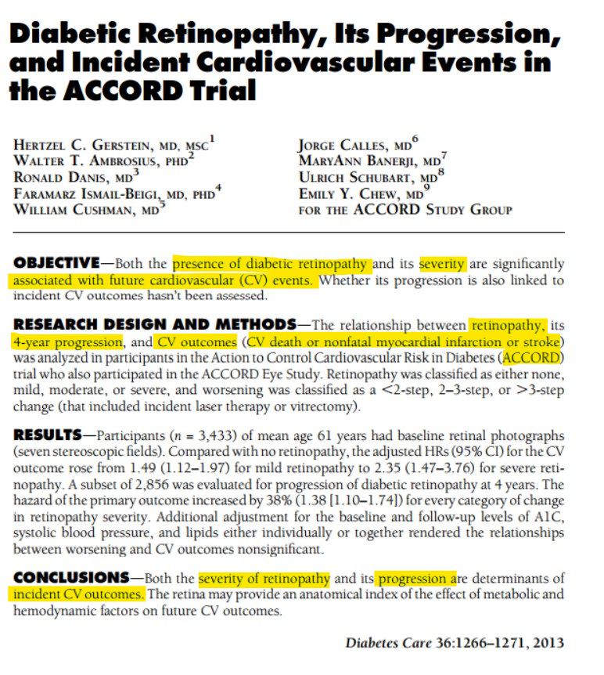

Slide 57
Flow-mediated dilatation
Resting diameter (RD)
Hyperemic diameter (HD)
HD -RD
RD
FMD =
Corretti M, et al. J Am Coll Cardiol 2002;39:257-65

Slide 58
Arterial Stiffness
Measurement of arterial stiffness by applanation tonometry with pulse-wave velocity has been the gold-standard method and is well-validated in large populations as a strong predictor of adverse cardiovascular outcomes.
A
Delay time from the R-top (ECG) to the 10% arterial diameter increase with pulse
Non-simultaneous recording
Distance
PWV =
Transit time
B
Cavalcante JL, et al. J Am Coll Cardiol 2011; 57:1511-22

Slide 59
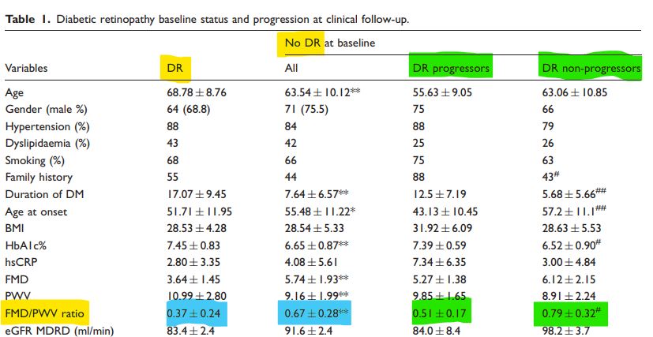
Association with systemic vascular dysfunction
composite marker FMD/PWV
index of systemic vascular function
Gouliopoulos N, et al. Eur J Prev Cardiol 2017; 24:1405-7

Slide 60
Association with systemic vascular dysfunction
The Framingham Study: T2DM
association between DR and macroangiopathy
several common RFs between macro- and micro-angiopathy
DR and endothelial dysfunction in T2DM
strongly, positively and independently associated
impaired FMD values
independent predictor for DR progression
arterial stiffness
↑ PWV in DR vs non-DR
positive correlation among PWV, DM duration and the accumulation of AGEs in the aorta
DR progression associated with
DM duration
AGEs accumulation
AGEs accumulation due to long-term glycemic exposure: the common mechanism of arterial stiffness and DR
Hiller R, et al. Am J Epidemiol 1988; 128:402-9
Siasos G, et al. Diabetes Care 2015 ; 38:e9-e10
UK Prospective Diabetes Study Group. BMJ 1998;317:703–13

Slide 61
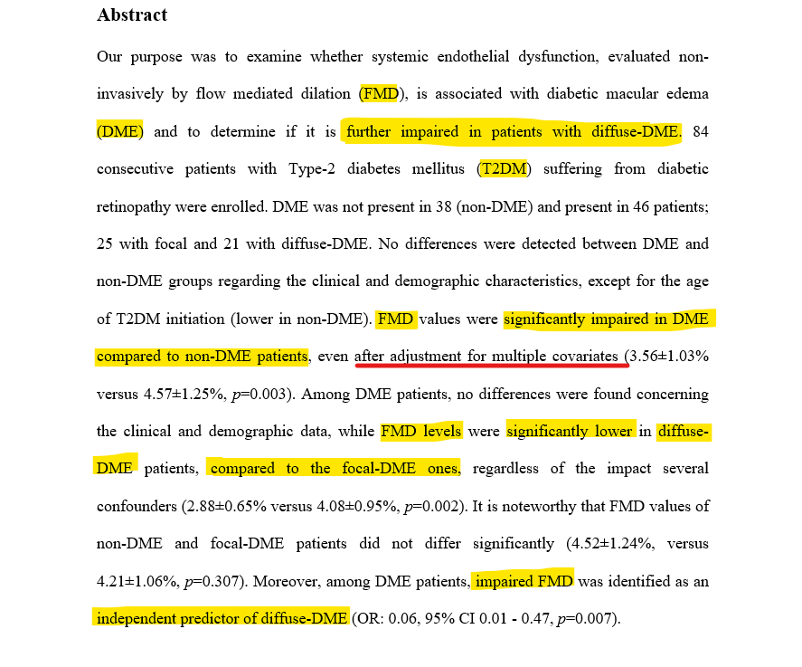
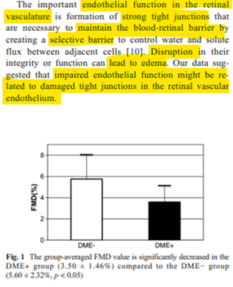
Association of DME with systemic vascular dysfunction

Slide 62
Findings NPDR
Microaneurysms
Retinal haemorrhages
flame shaped
dot blot
dark round
Exudates
DME
focal
diffuse
Ischaemic retinopathy/maculopathy
Cotton wool spots
Venous changes
beading
dilatation and tortuosity
looping
‘sausage’ like segmentation
IRMAs
Arterial Changes
peripheral narrowing
‘silver wiring’
obliteration
Bowling B (2016). Kanski’s Clinical Ophthalmology . A systematic approach (8th Edition). Elsevier

Slide 63
Findings PDR
retinal neovascularization
≥ ¼ of the retina non-perfused before PDR development
preretinal neovascularization anywhere in the retina
mainly at the posterior pole
fibrous tissue development along with the new vessels
neovascularization of the optic disc (NVD)
neovascularization of the iris (NVI)
vitreous/preretinal haemorrhages
tractional retinal detachment
Bowling B (2016). Kanski’s Clinical Ophthalmology . A systematic approach (8th Edition). Elsevier

Slide 64
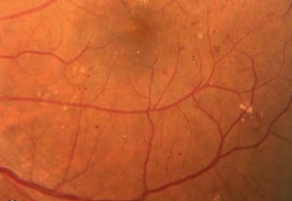
flame shaped haemorrhages
exudates
dot-blot haemorrhages
Bowling B (2016). Kanski’s Clinical Ophthalmology . A systematic approach (8th Edition). Elsevier

Slide 65
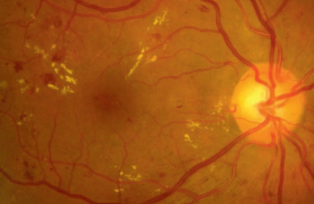
flame shaped haemorrhages
microaneurysms
exudates
Bowling B (2016). Kanski’s Clinical Ophthalmology . A systematic approach (8th Edition). Elsevier

Slide 66
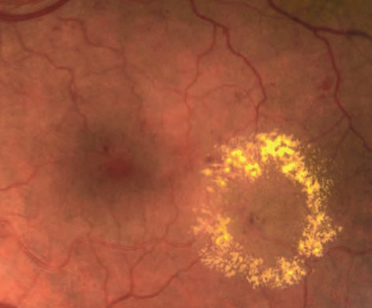
ring of exudates
diabetic macular edema
Bowling B (2016). Kanski’s Clinical Ophthalmology . A systematic approach (8th Edition). Elsevier

Slide 67
‘sausage’ like segmentation
venous looping
venous beading
Bowling B (2016). Kanski’s Clinical Ophthalmology . A systematic approach (8th Edition). Elsevier

Slide 68
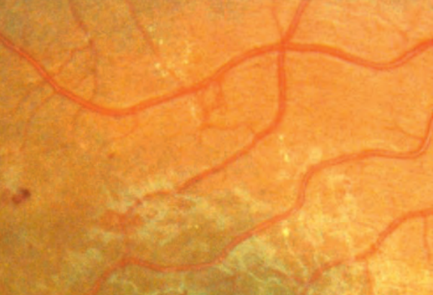
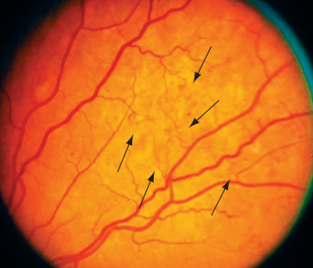
IRMAs
arteriolar–venular shunts
bypass the capillaries
adjacent to areas of marked capillary hypoperfusion
do not cross major blood vessels
sign of retinal ischemia
↑ risk to PDR progression
better identified with fluorescein angiography (DD from neovascuarization)
Bowling B (2016). Kanski’s Clinical Ophthalmology . A systematic approach (8th Edition). Elsevier
Basic and Clinical Science Cource 2019-2020 (2020). Retina and Vitreous (12). American Academy of Ophthalmology

Slide 69
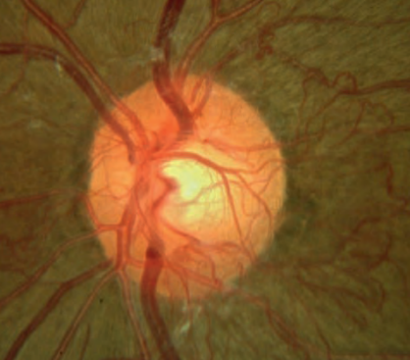
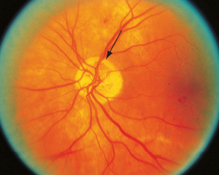
neovascularization of optic disc (NVD)
(up to 1 optic disc diameter from the optic disc margin)
Bowling B (2016). Kanski’s Clinical Ophthalmology . A systematic approach (8th Edition). Elsevier
Basic and Clinical Science Cource 2019-2020 (2020). Retina and Vitreous (12). American Academy of Ophthalmology

Slide 70
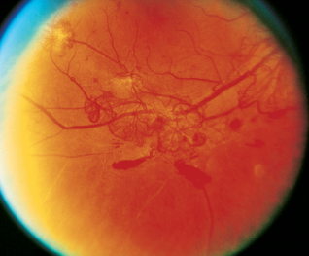
fibrovascular tissue
pre-retinal haemorrhage
neovascularization elsewhere in the retina (NVE)
Bowling B (2016). Kanski’s Clinical Ophthalmology . A systematic approach (8th Edition). Elsevier
Basic and Clinical Science Cource 2019-2020 (2020). Retina and Vitreous (12). American Academy of Ophthalmology

Slide 71
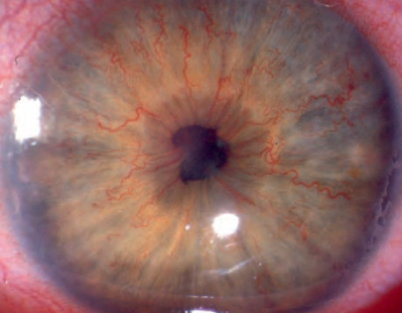
iris neovascularization (NVI)
Bowling B (2016). Kanski’s Clinical Ophthalmology . A systematic approach (8th Edition). Elsevier

Slide 72
Examination Techniques
ophthalmoscopy after pupils dilation
direct ophthalmoscopy
indirect ophthalmoscopy
slit-lamp biomicroscopy
fundus photography
fluorescein angiography (FA)
optical coherence tomography (OCT)
OCT angiography (OCT-A)
Wong TY, et al. Ophthalmology 2018;125:1608-22

Slide 73
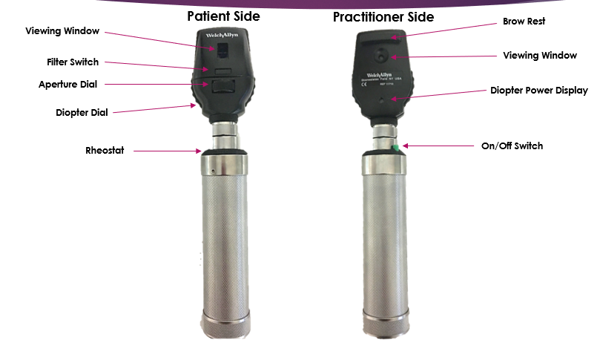
less experienced examiners
refractive errors in patient’s and examiner’s eye are corrected
erect and magnified (~ x15) retina
in a slightly darkened room
dilated patient’s pupils
available green filter

Slide 74
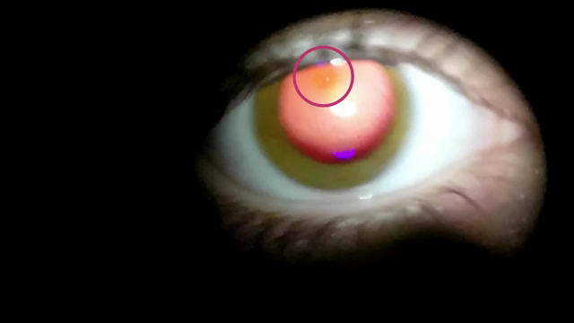
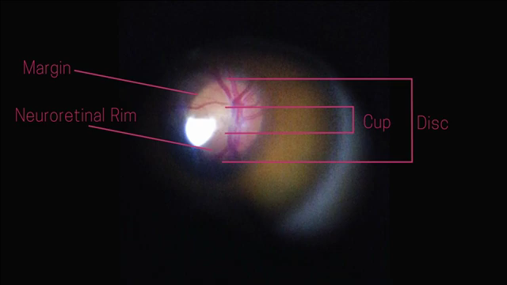

Slide 75
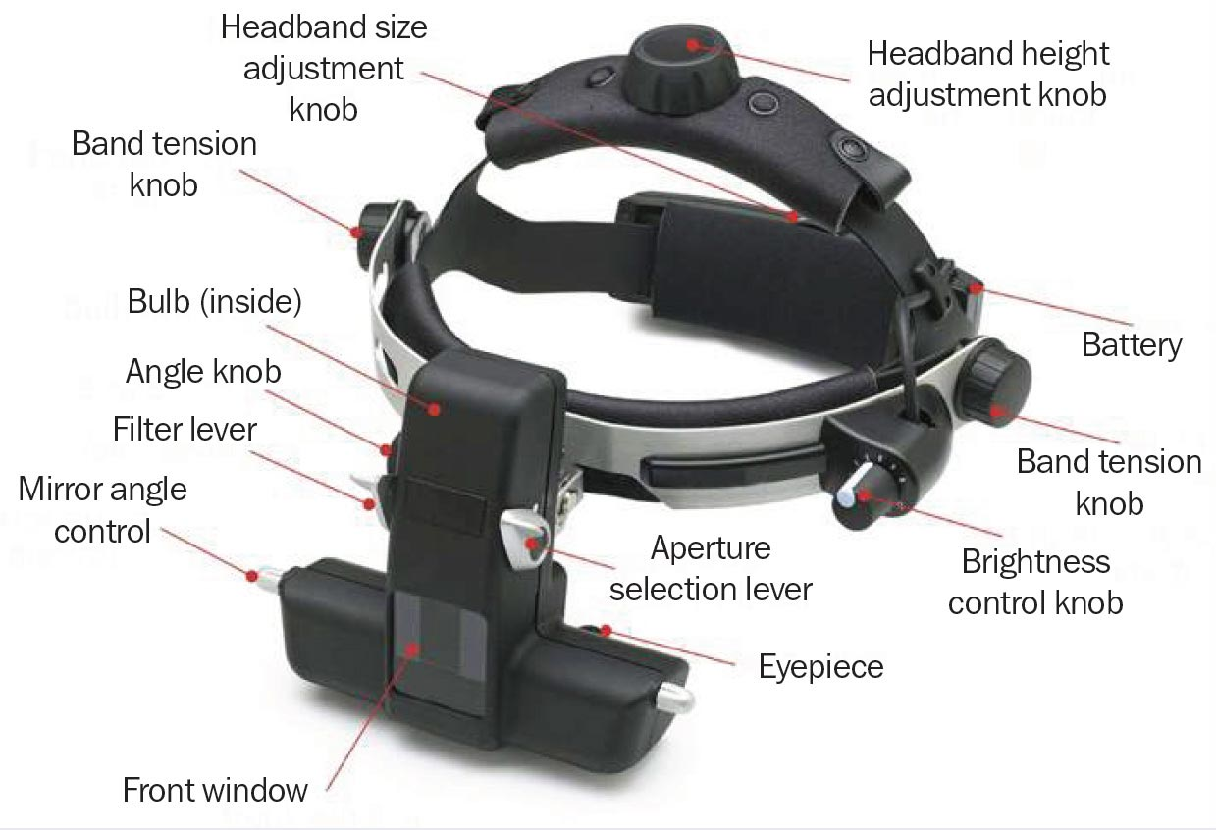

Slide 77
Fundus Photography
color
red-free (a green filter ~540–570nm blocks red wavelengths of light)
superficial lesions
DR assessment and progression: vascular abnormalities, hemorrhages, IRMAs, NVD, NVE
dilation frequently not required
useful in eyes with bad dilation (e.g. pseudoexfoliation syndrome, a-blockers) & during pregnancy and lactation (!!!)
drops used for dilation are classified as “category C” in pregnancy
unknown whether they are excreted in human milk
disease progression monitored over time
Ng E, et al (2014). Ophthalmological Imaging and Applications. CRC Press

Slide 79
Fluorescein Angiography
fluorescence
molecules emit a ↑ wavelength light after stimulation by a ↓ wavelength light
fluorescein: excitation peak ~490nm (blue spectrum), stimulated molecules: emit yellow–green light (~530nm)
fluorescein (sodium fluorescein)
orange water-soluble dye
after intravenous injection →mainly intravascular (>70% bound to serum proteins)
urine excretion over 24–36 hours
fluorescein angiography (FA)
photographic surveillance of the passage of fluorescein through the retinal and choroidal circulations after intravenous injection
Bowling B (2016). Kanski’s Clinical Ophthalmology . A systematic approach (8th Edition). Elsevier

Slide 80
in DM possibly extended time
Bowling B (2016). Kanski’s Clinical Ophthalmology . A systematic approach (8th Edition). Elsevier

Slide 81
Bowling B (2016). Kanski’s Clinical Ophthalmology . A systematic approach (8th Edition). Elsevier

Slide 82
intact inner BRB
neither bound nor free fluorescein can pass
disrupted inner BRB
leakage of both bound and free fluorescein into the extravascular space
classifying disease severity
guiding laser therapy
evaluating response to therapy
required for anti-VEGF treatment approval
Bowling B (2016). Kanski’s Clinical Ophthalmology . A systematic approach (8th Edition). Elsevier

Slide 83
capillary non-perfusion
ischemia
preretinal haemorrhage
microaneurysms
diffuse DME
neocascularization
Dithmar S, Holz FG (2007). Fluorescence Angiography in Ophthalmology. Springer

Slide 84
Optical Coherence Tomography
Optical Coherence Tomography (OCT)
non-invasive diagnostic technique
in vivo cross sectional view of the retina (at least 10-15 microns)
OCT in DR
presence and location
intraretinal and/or
subretinal fluid
retinal thickness evaluation
useful tool in monitoring whether the macular edema is responding to therapy
Huang D, et al. Science 1991; 254:1178-1181

Slide 85
Mohandass G, et al. Biomed Pharmacol J 2017;10(3)

Slide 87
OCT-Angiography
OCT angiography (OCT-A)
novel non-invasive technique for imaging the microvasculature of the retina and the choroid
laser light reflectance of the surface of moving red blood cells accurately depict vessels through different segmented areas of the eye
in DR:
identification of new vessels
quantification of foveal avascular zone
quantification of non-perfused areas
Koustenis A, et al. Br J Ophthalmol 2017; 101: 16-20
Samara WA, et al. Ophthalmology 2017; 124:235-44
Spaide RF. Et al. Am J Ophthalmol 2015; 160:1200-10
Fingler J, et al. Investig Ophthalmol Vis Sci 2008; 49:5055-9

Slide 88
FAZ enlargement
hypo-intense lesions due to DME
Coscas G et al. Atlas OCT-Angio in diabetic maculopathy. L’europeenne d’editions

Slide 89
Initial Screening and Referral
American Academy of Ophthalmology guidelines
1st retinal examination for DM patients
T1DM: 3-5y after diagnosis
T2DM: at the time of diagnosis
Pregnancy (T1DM or T2DM)
soon after conception
early in the 1st trimester of pregnancy
eye examination not required if non-DM patients newly develop gestational diabetes during pregnancy
Flaxel CJ, et al. Ophthalmology 2020; 127:P66-P145

Slide 90
Treatment
General
patient‘s education
optimized diabetic control
optimized control of other RFs (e.g. hypertension, hyperlipidaemia, renal disease, anemia, smoking discontinuation)
Fenofibrate 200mg/day (should be considered)
Kang Q, et al. Redox Biol 2020;37:101799

Slide 91
Treatment
DME
intravitreal injections of anti-VEGF agents
laser photocoagulation
grid or focal
micropulse subthreshold laser
intravitreal dexamethasone implant
intravitreal triamcinolone
pars plana vitrectomy
PDR
panretinal photocoagulation
intravitreal injection of ranibizumab (anti-VEGF agent)
pars plana vitrectomy

