Slide 1


O ρόλος του εντερικού μικροβιώματος στην αθηρογένεση
^{ΚΑΡΔΙΟΜΕΤΑΒΟΛΙΚΗ ΙΑΤΡΙΚΗ}
^{18.04.2024}
^{Θεμιστοκλής Κατσιμίχας}
^{Καρδιολόγος}
Μονάδα Καρδιογενετικής και Αθλητικής Καρδιολογίας
^{Α΄ Καρδιολογική Κλινική ΕΚΠΑ}
Cardiogenetics and Sports Cardiology, 1st Cardiology Dpt, National and Kapodistrian University of Athens

Slide 2
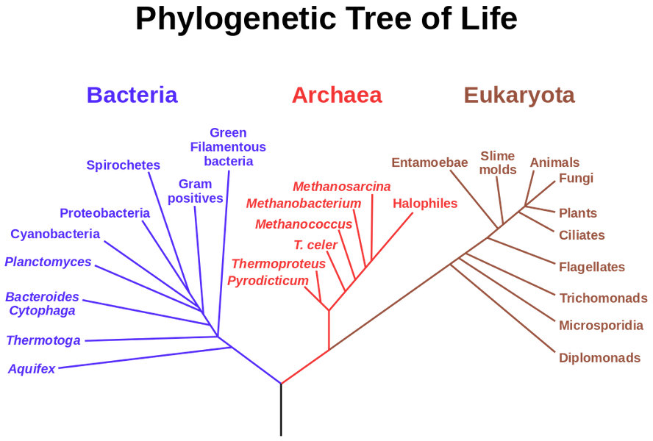
Notes:
O Woese ήταν ο μικροβιολόγος που ανακάλυψε την Επικράτεια των Archaea

Slide 3
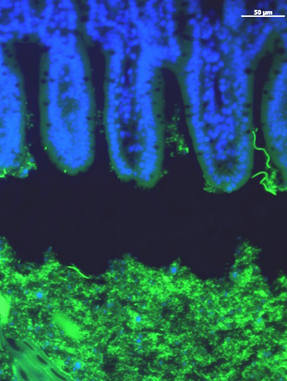
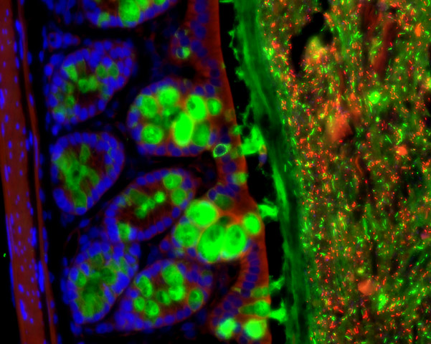
The Gut Microbiota
4 major phyla (συνομοταξίες)
300-1000 species (30-40 species constitute 99%)
>99% anaerobes
60% of dry fecal mass
1:1 with human cells
Epithelium
Epithelium
Mucus
Microbes
Microbes
Science. 2011; 334:255-258.
Cell. 2016; 167:1495-1510.e12.

Slide 4
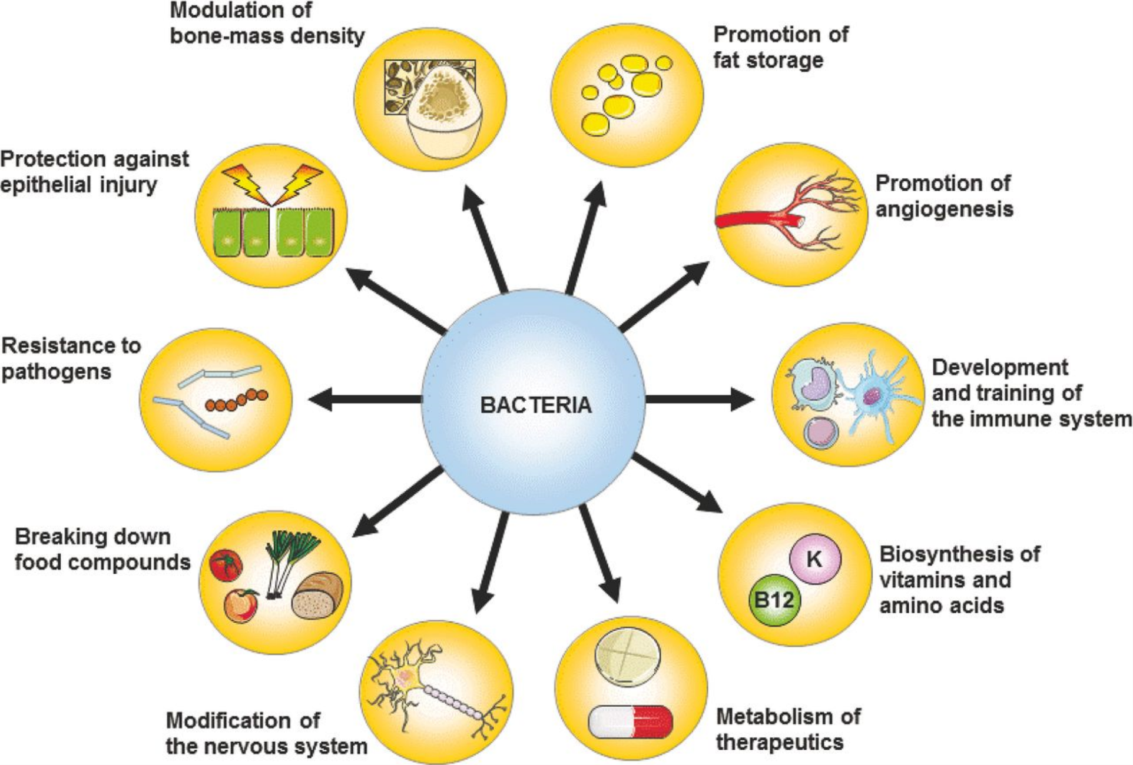
Functions of the intestinal microbiota
Modulation of bone-mass density
Promotion of fat storage
Protection against epithelial injury
Promotion of angiogenesis
Resistance to pathogens
Development and training of the immune system
Breaking down of food compounds
Biosynthesis of vitamins and amino acids
Modification of the nervous system
Metabolism of therapeutics
FEMS Microbiol Rev. 2016; 40:117-132.

Slide 5
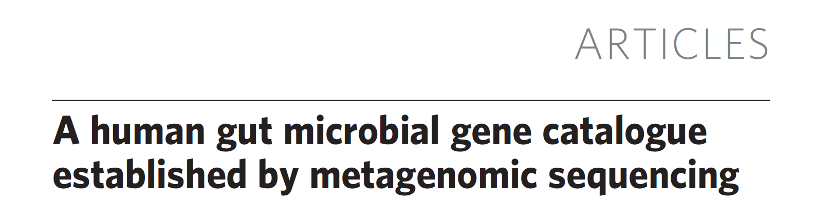
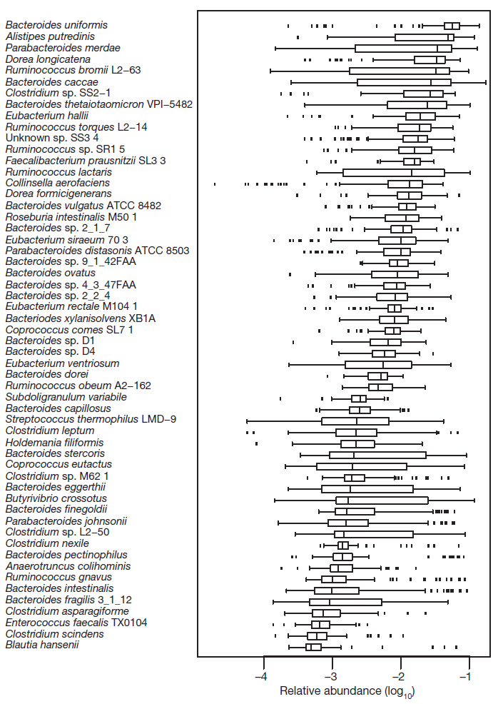
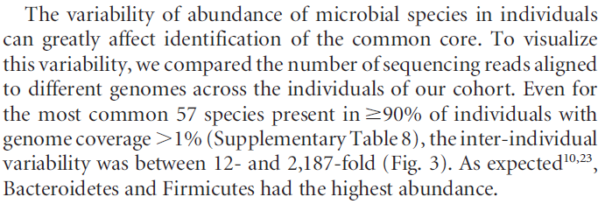
124 European individuals
Nature. 2010; 464:59-65.

Slide 6
The microbiota is compositionally diverse, but functionally redundant
Relative abundance of genes for major metabolic pathways in all subjects
Circ J. 2018; 82:1640-1650.
Notes:
Chromatic map of the 20 most abundant genera in patients and healthy controls, revealing the dominance of Bacteroides (blue) across all subjects. Their combined mean relative abundance reached 79.58% for patients and 84.45% for healthy controls; the other 99 genera in patients and 83 genera in healthy controls only made up 20.42% and 15.55% of the total, respectively. Vertical bars represent individual samples.

Slide 7
The intestinal microbiota remains relatively stable throughout life
N Engl J Med. 2016; 375:2369-2379.

Slide 8
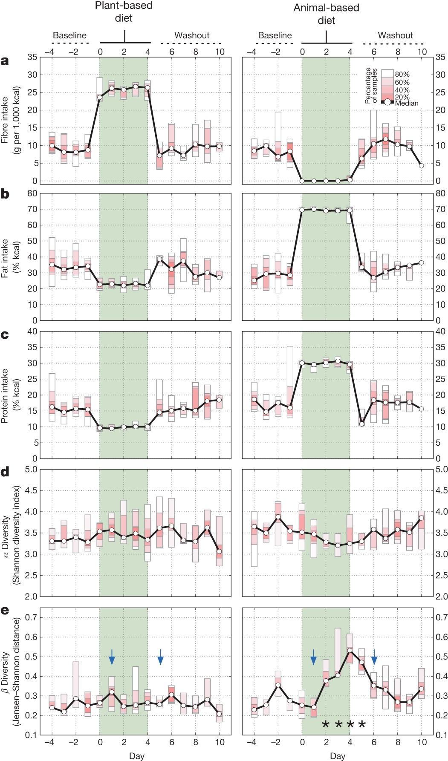
Human diet is the main driver of gut bacterial diversity
Short-term animal-based diet reduces beta diversity
Nature. 2014; 505:559-563.

Slide 9
Microbiota-related pathways involved in CVD
Circ Res. 2017; 120:1183-1196.

Slide 10
Heart-Gut axis in atherosclerosis
Eur Heart J. 2014; 35:426-430.

Slide 11
Links between the microbiota and atherosclerosis
Cardiovasc Res. 2019; 115:1471-1486.

Slide 12
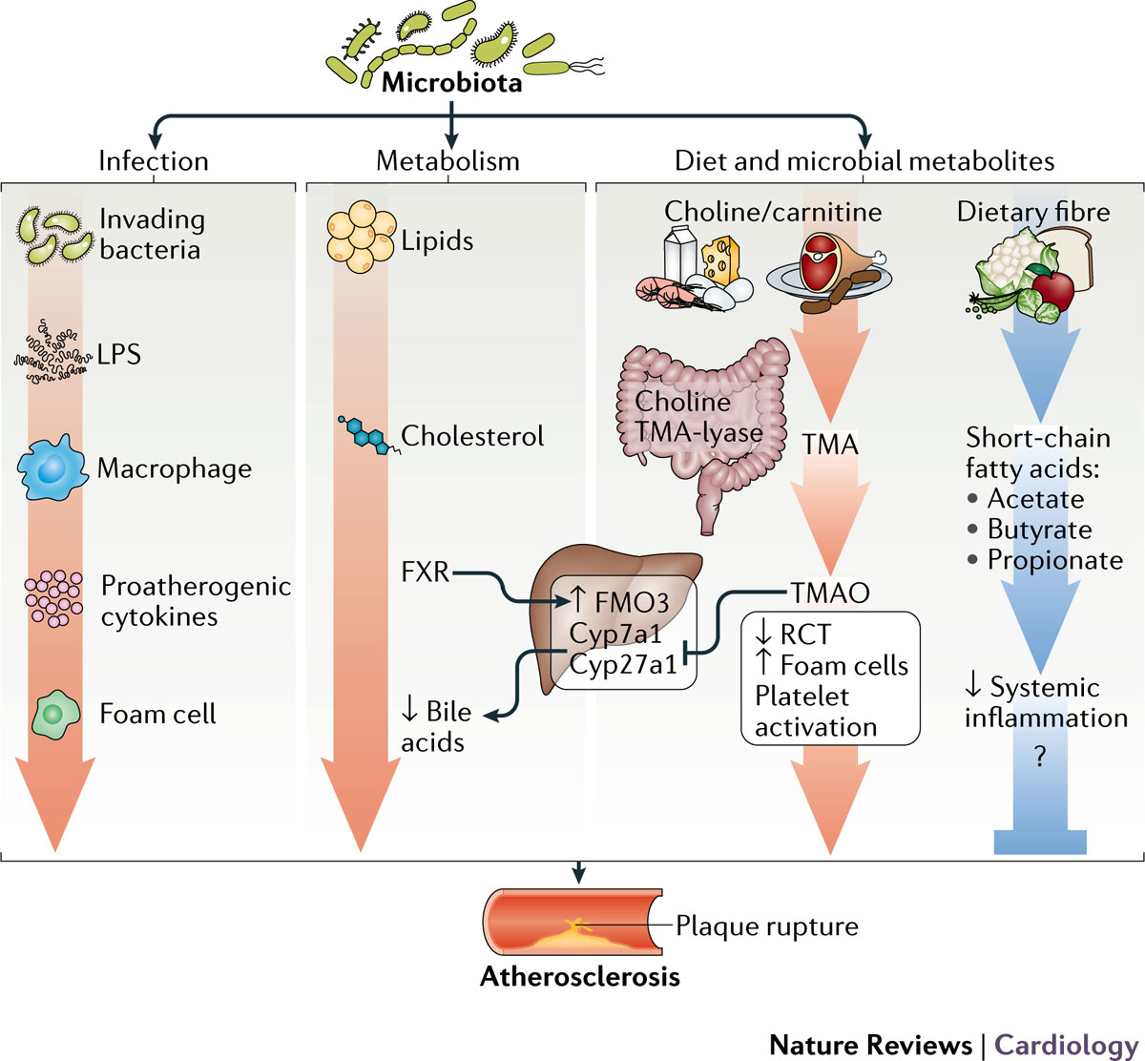
Links between the microbiota and atherosclerosis
Nat Rev Cardiol. 2017; 14:79-87.

Slide 13
Atherosclerotic plaques contain bacteria, which may have translocated from the gut or the oral cavity
Atherosclerotic plaque
PC 2 (11%)
Gut
Oral
PC 1 (28%)
Principal Coordinates Analysis
Proc Natl Acad Sci USA. 2011; 108 Suppl 1:4592-4598.

Slide 14
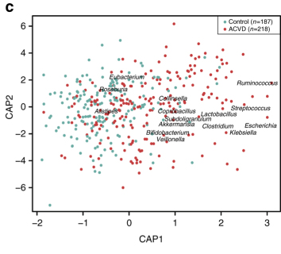
The intestinal microbiota discriminates between atherosclerotic patients and controls
CAP constrained analysis for beta diversity
Nat Commun. 2017; 8:845.

Slide 15
TMAO and CVD
Nature. 2011; 472:57-63.
.

Slide 16
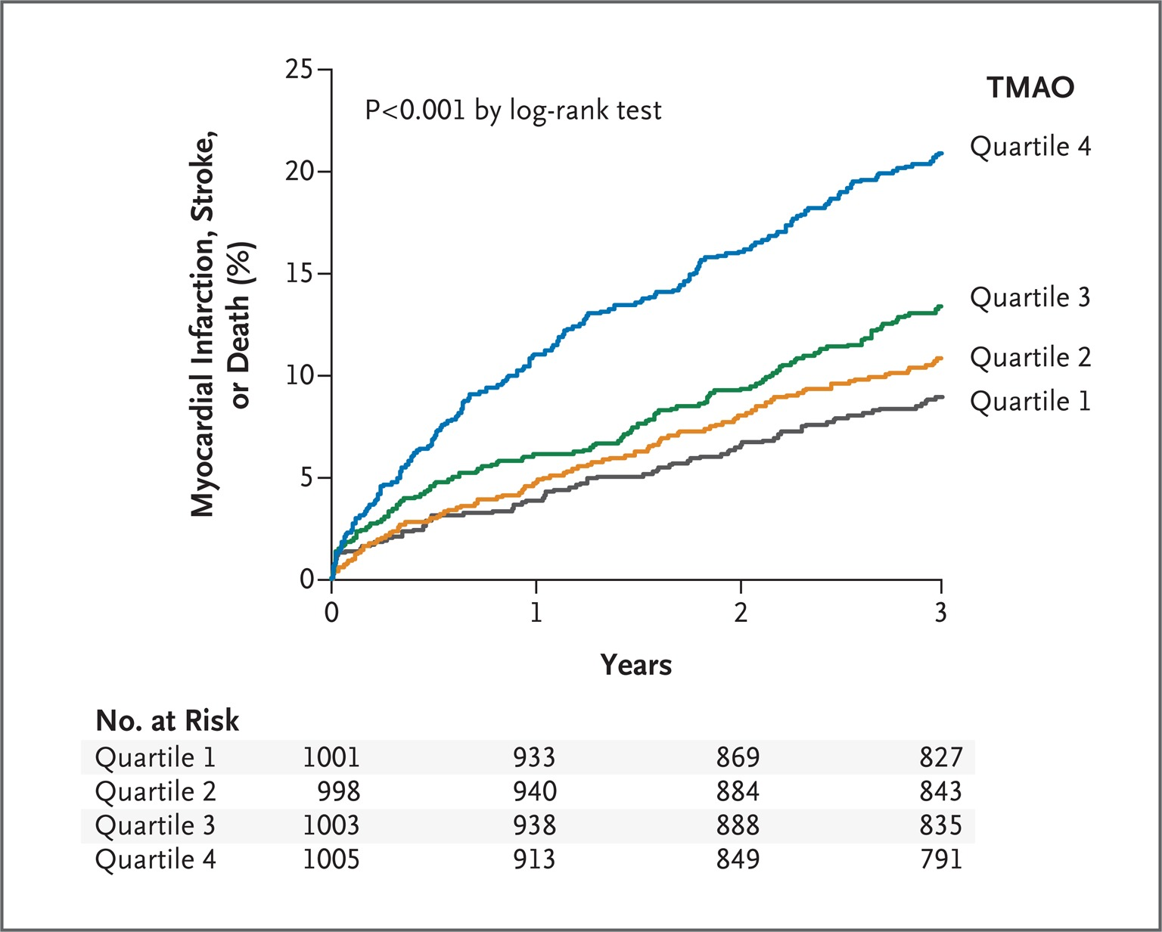
TMAO levels and risk of MACE in patients with multiple CVD risk factors
N Engl J Med. 2013; 368:1575-1584.

Slide 17
The TMAO paradox
The highest levels of free TMAO are contained in fish, not meat/eggs.
Consumption of fish is beneficial for cardiovascular health.
Food Chem Toxicol. 1999; 37:515-520.

Slide 18
Interventions to reduce microbiota-related CVD risk
Circ Res. 2020; 127:553-570.

Slide 19
FURTHER READING
Katsimichas T, et al. Gut Microbiota and Coronary Artery Disease: Current Therapeutic Perspectives. Metabolites. 2023; 13:256.
Tousoulis D, et al. Mechanisms, therapeutic implications, and methodological challenges of gut microbiota and cardiovascular diseases: a position paper by the ESC Working Group on Coronary Pathophysiology and Microcirculation. Cardiovasc Res. 2022; 118:3171-3182.
Katsimichas T, et al. The intestinal microbiota and cardiovascular disease. Cardiovasc Res. 2019; 115:1471-1486.
Gilbert JA, et al. Current understanding of the human microbiome. Nat Med. 2018; 24:392-400.
Jonsson AL, et al. Role of gut microbiota in atherosclerosis. Nat Rev Cardiol. 2017; 14:79-87.

