Slide 1

Επιδράσεις Υπογλυκαιμικών Φαρμάκων στην ΚΑ
Πρόγραμμα Μεταπτυχιακών Σπουδών
«Καρδιομεταβολική Ιατρική»
Ευάγγελος Οικονόμου
Επ. Καθηγητής Καρδιολογίας
Γ’ Πανεπιστημιακή Καρδιολογική Κλινική, Γ.Ν.Ν.Θ.Α «Η Σωτηρία»

Slide 2
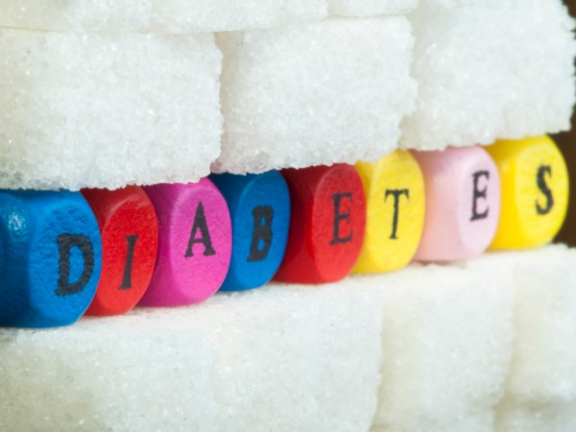
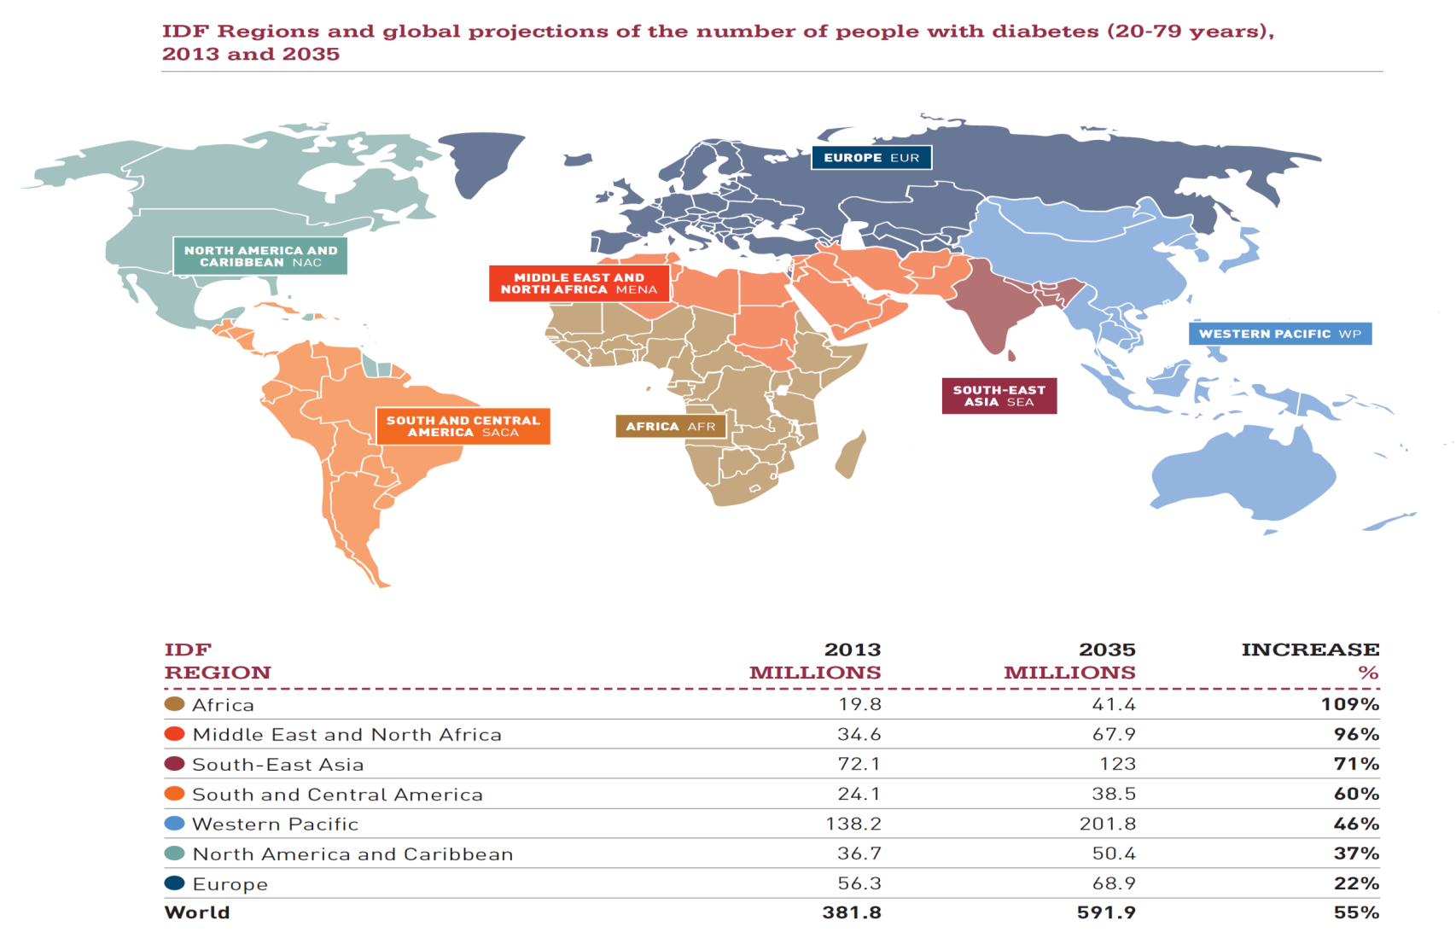
Notes:
διεθνή ομοσπονδία του sakxarodi διαβήτη

Slide 3
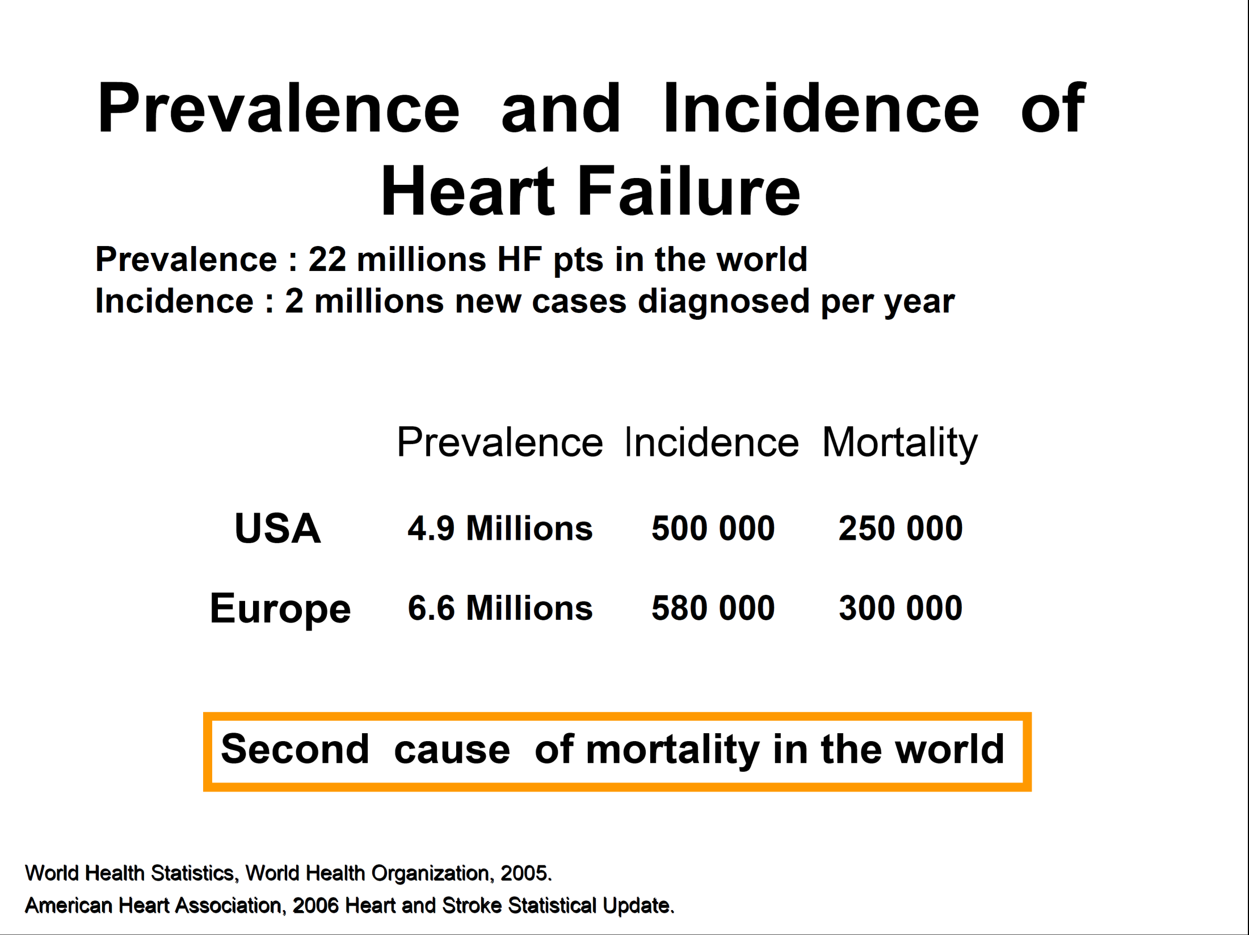
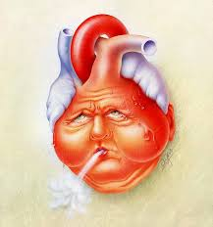

Slide 4
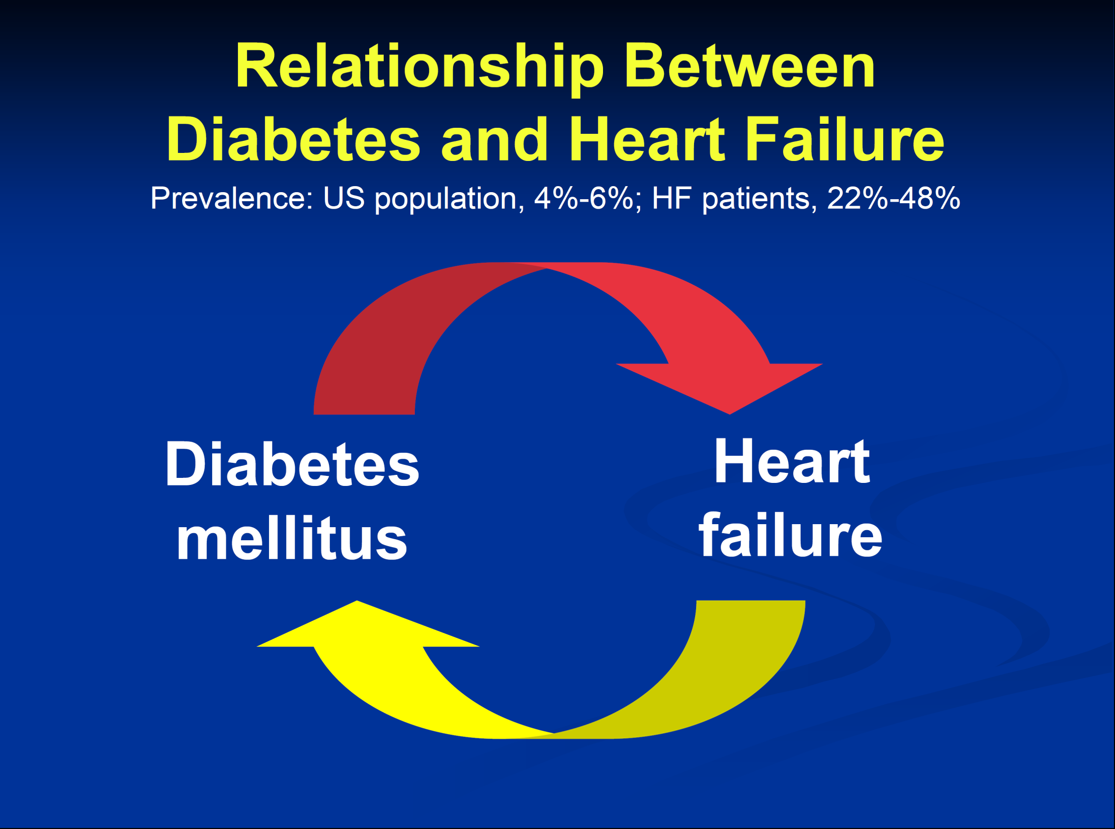

Slide 5

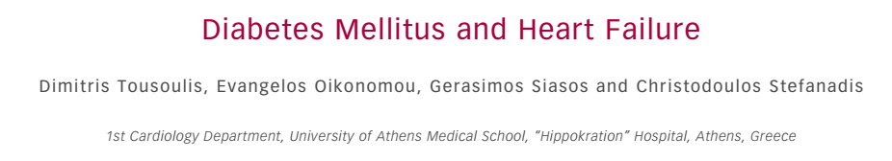
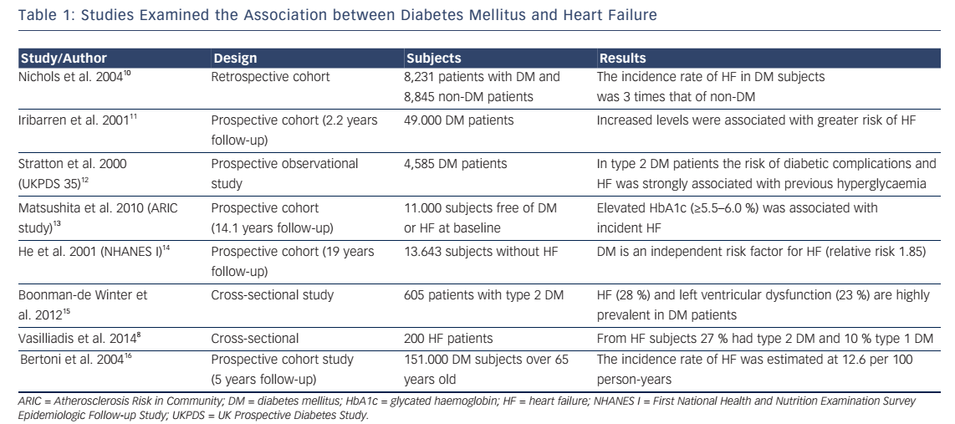

Slide 6
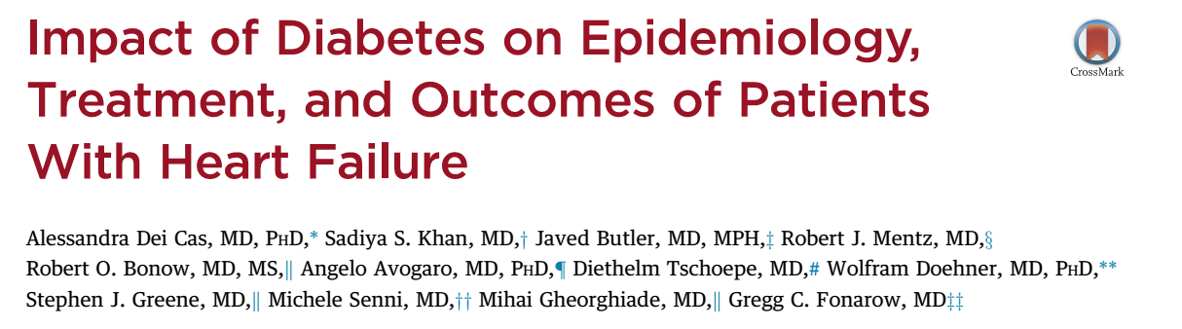
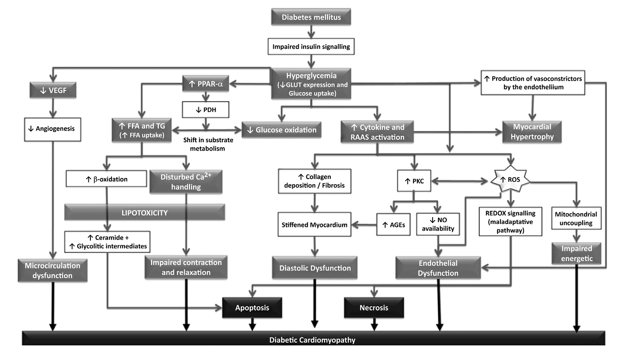

Slide 7
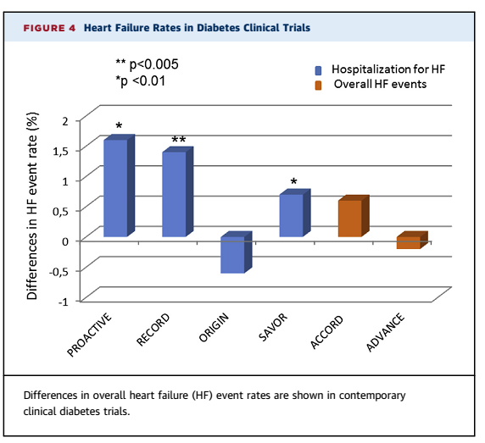
Pioglitazone
Rosiglitazone
Insulin
Saxagliptin
Intensive

Slide 8
Παθοφυσιολογικοί μηχανισμοί

Slide 9
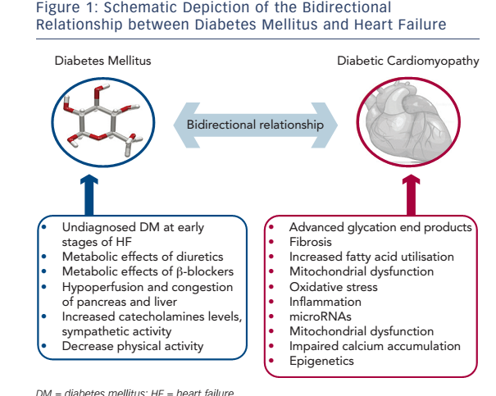
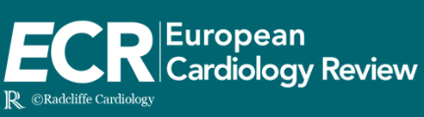

Slide 11
Γιατί οι ασθενείς με ΚΑ αναπτύσσουν ΣΔ;
Καθιστική ζωή
Απώλεια μυϊκής μάζας
Κυτοκίνες που επιδρούν στο πάγκρεας, ήπαρ και στους μύες
Ενεργοποίηση νευροενδροκρινικού συστήματος (SNS, RASS)
Σπάνια αίτια: αιμοχρωμάτωση, διαταραχή θυρεοειδούς

Slide 12
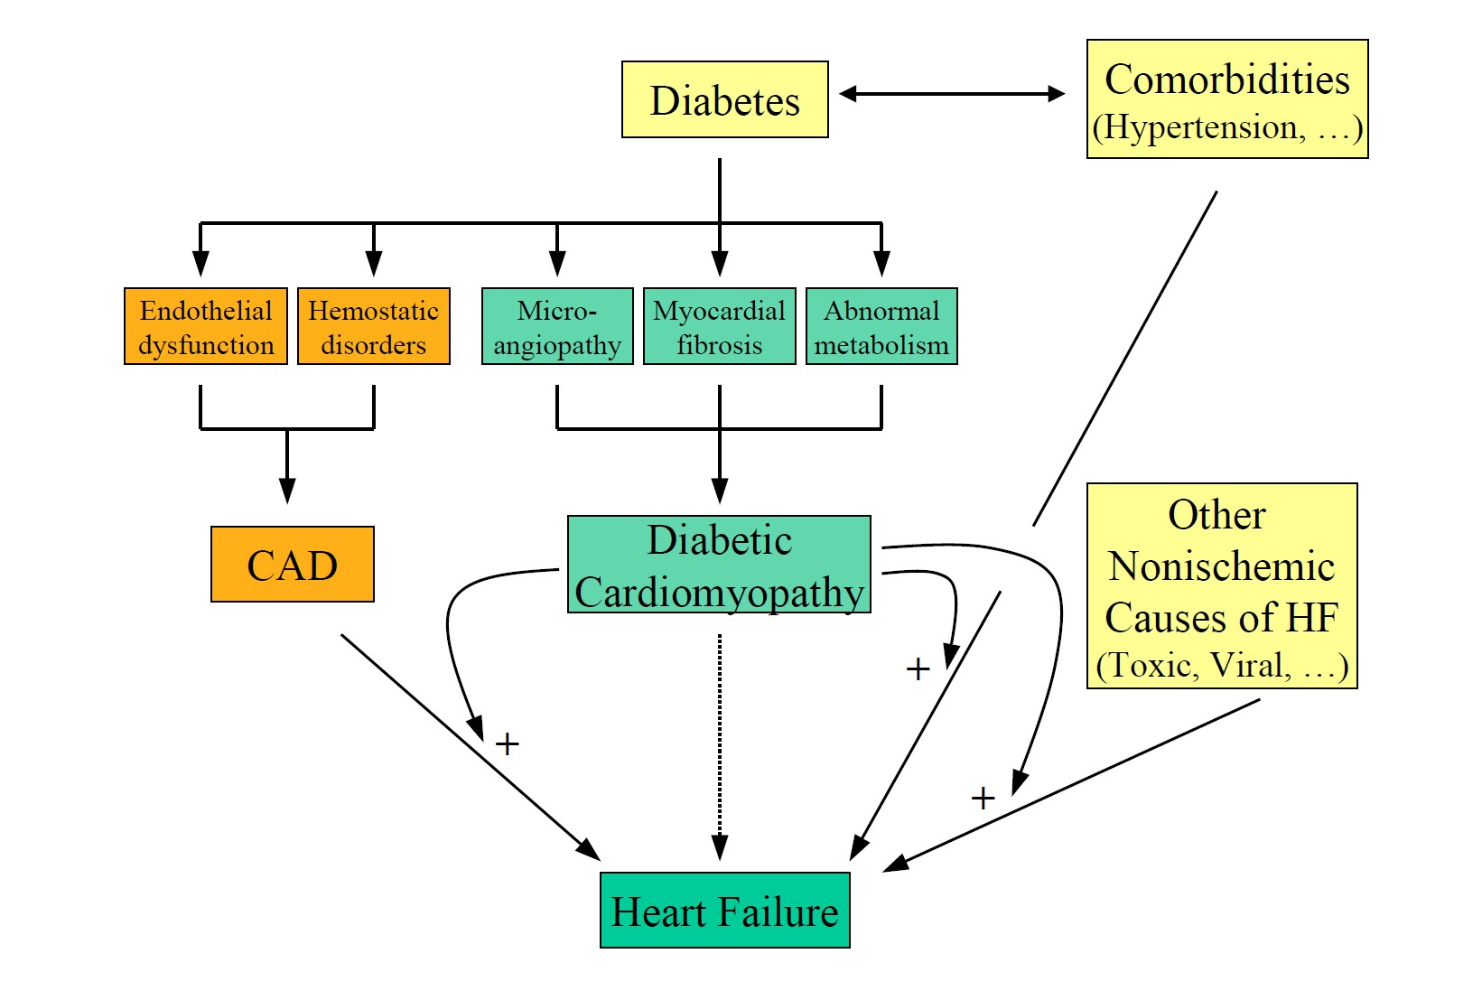
Γιατί οι Διαβητικοί ασθενείς αναπτύσσουν ΚΑ;
Υπέρταση
Δυσλιπιδαιμία
Νεφρική βλάβη-Νεφρική ανεπάρκεια
Λοιμώξεις
Bauters C, et al. Cardiovasc Diabet. 2003; 2: 1
Notes:
Ειδικά σε διαβητικούς ασθενείς με οξεία απορύθμιση ΚΑ οι λοιμώξεις του αναπνευστικού και ουροποιητικού συστήματος είναι συχνό αίτιο απορρύθμισης

Slide 14
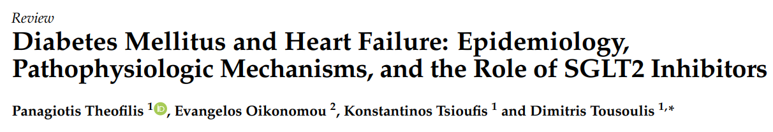
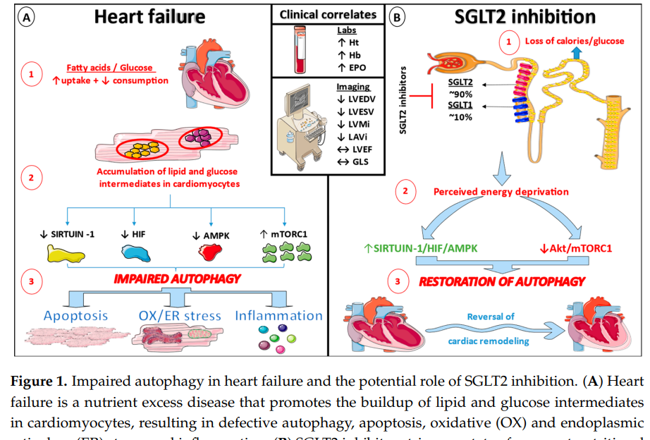

Slide 15
Φαινότυπος ΚΑ

Slide 16
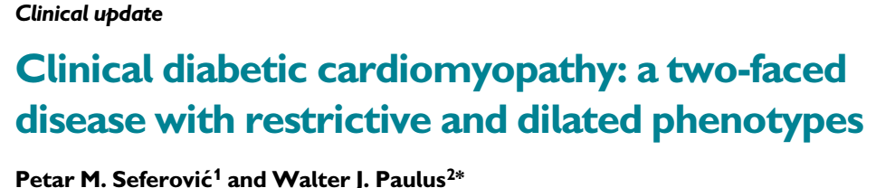
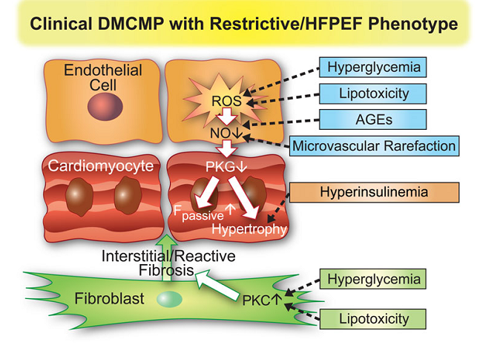
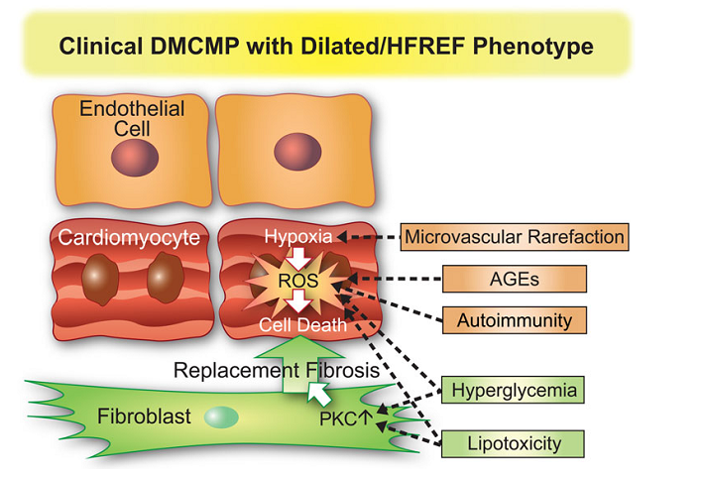
European Heart Journal (2015) 36, 1718–1727

Slide 17
Θεραπεία ΚΑ σε ασθενείς με ΣΔ

Slide 18
Use Same Treatments as in People without Diabetes…
Recommendations for the treatment of heart failure in patients with diabetes
Notes:
It is recognized that diabetes can cause heart failure independently of ischemic heart disease by causing a diabetic cardiomyopathy.
incidence of heart failure is 2- to 4-fold higher in people with diabetes compared to those without diabetes
occurrence of asymptomatic abnormalities of ventricular systolic and diastolic function, independently from ischemic heart disease or systemic hypertension.
18

Slide 19
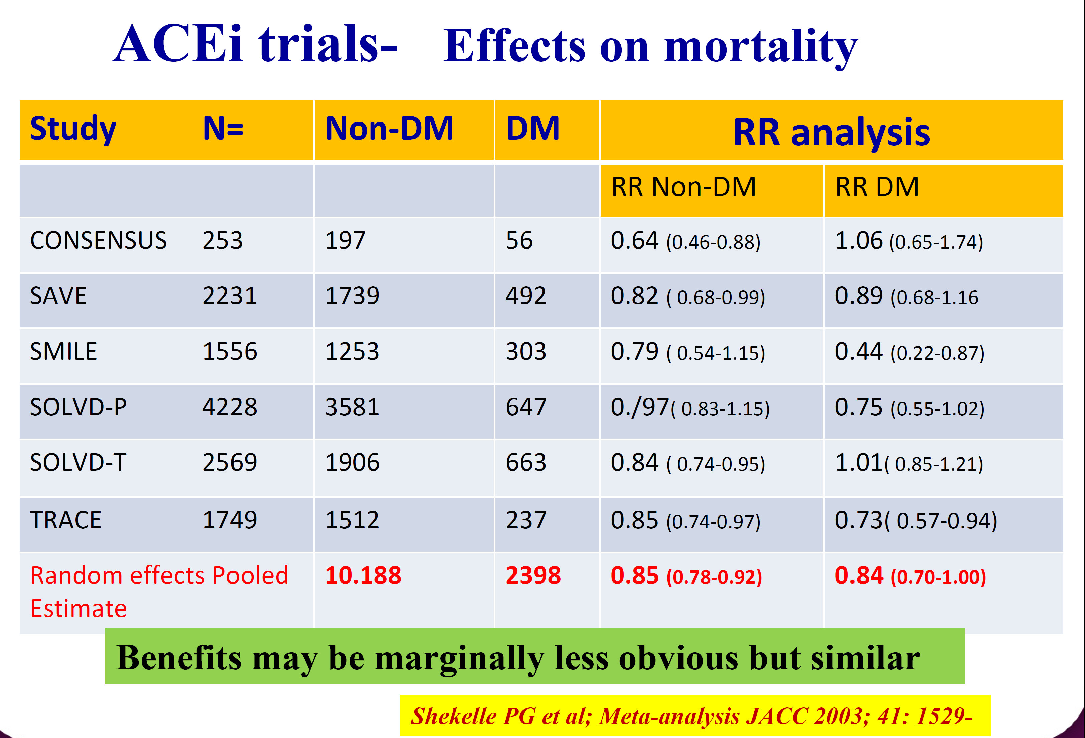

Slide 20
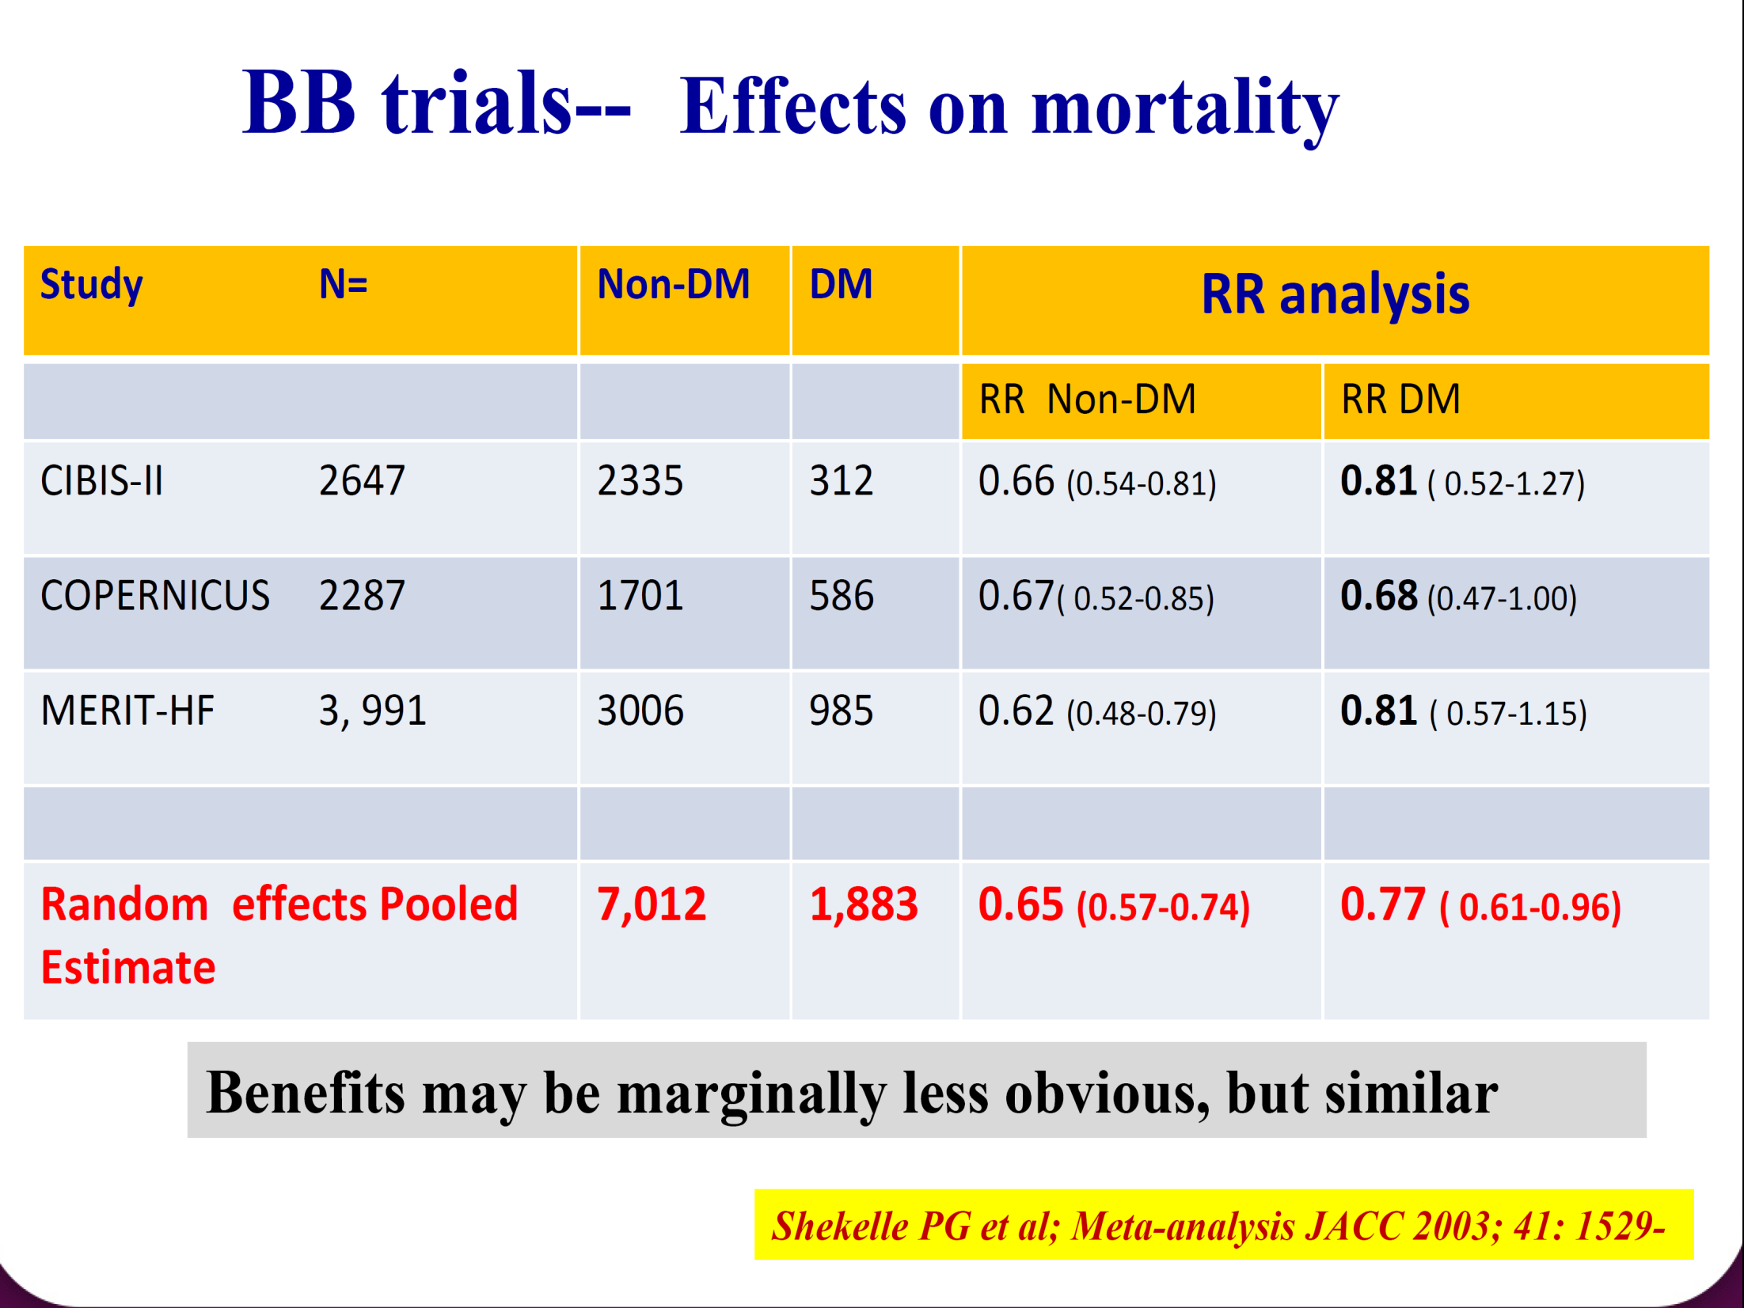

Slide 21
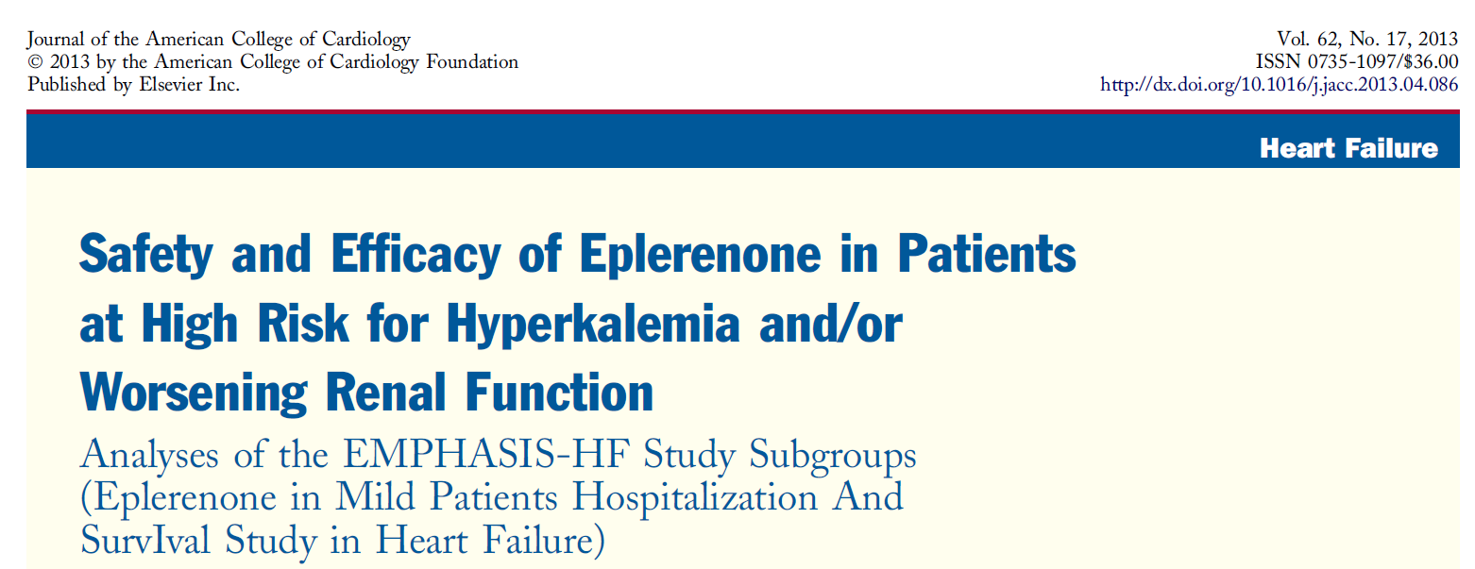
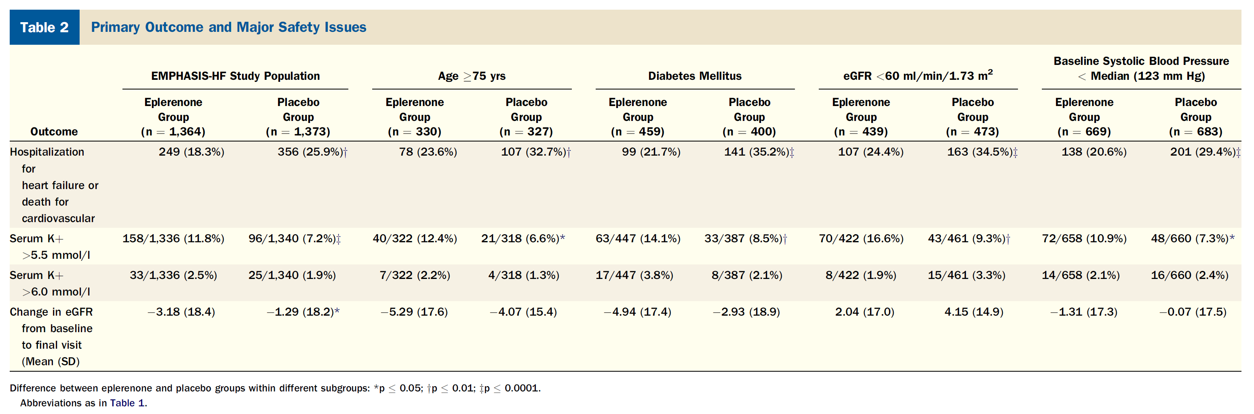
Eschalier et al, JACC, 2013; 62: 1585-93

Slide 22
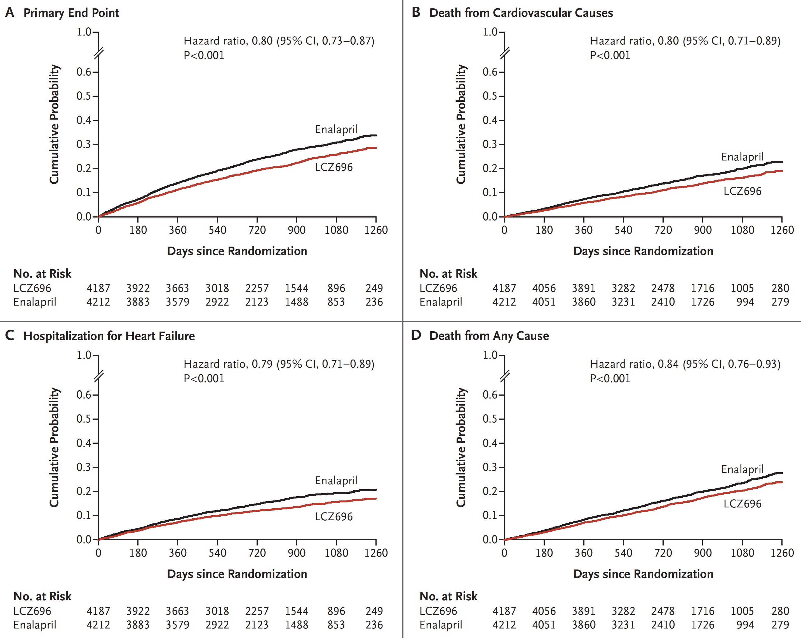
Sacubitril/valsartan (LCZ696) reduced CV outcomes in HFrEF (34% had Diabetes)
McMurray JJV et al. N Engl J Med 2014;371:993-1004.

Slide 23
PARADIGM trial– LCZ696

Slide 24
!!!!!!
Comorbidities, such as renal dysfunction and propensity for hyperkalemia, are more prevalent in people with diabetes and may influence heart failure drug doses and monitoring of therapy but not therapeutic targets

Slide 25
Recommendations for the treatment of patients with diabetes to reduce heart failure risk

Slide 26

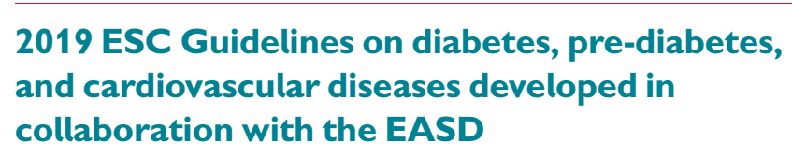
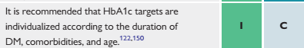

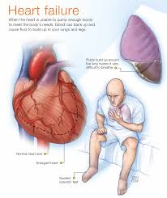
Στόχοι υπογλυκαιμικής θεραπείας
HbA1c <8%
Notes:
It is recognized that diabetes can cause heart failure independently of ischemic heart disease by causing a diabetic cardiomyopathy.
incidence of heart failure is 2- to 4-fold higher in people with diabetes compared to those without diabetes
occurrence of asymptomatic abnormalities of ventricular systolic and diastolic function, independently from ischemic heart disease or systemic hypertension.
26

Slide 27
Metformin Use in Heart Failure Patients
Veterans Affairs
6,185 with CHF & DM
Oral antihyperglycemic:
  With metformin (n=1,561)
  Without metformin
Statistically adjusted for
co-variables
1.00
0.95
Metformin
Survival estimates
0.90
0.85
No metformin
0.80
p = 0.01
Death: 0.76 (0.63-0.92) p < 0.01
CHF hospitalization: 0.93 (0.74-1.18) p = 0.56
Total hospitalization: 0.94 (0.83-1.07) p = 0.35
0.75
0
100
200
300
400
500
600
700
Time (days)
Aguilar D, et al. Circ Heart Fail 2011;4:53-8.
Notes:
Speaker’s Notes:
The association between metformin use and clinical outcomes was examined in a cohort of 6,185 ambulatory patients with diabetes and established heart failure; 1,561 (25.2%) patients were treated with metformin. At two years of follow-up, there were 246 (15.8%) deaths among patients receiving metformin and 1,177 (25.5%) deaths among patients not receiving metformin (p < 0.001). In the propensity score-matched analysis (n = 2,874), there were 232 (16.1%) deaths among patients receiving metformin compared with 285 (19.8%) deaths among patients not receiving metformin (hazard ratio 0.76; 95% CI 0.63–0.92; p < 0.01).
Reference:
Aguilar D, Chan W, Bozkurt B, Ramasubbu K, Deswal A. Metformin use and mortality in ambulatory patients with diabetes and heart failure. Circ Heart Fail 2011;4:53-8.
27

Slide 28
Metformin Use in Heart Failure Patients
Tayside, Scotland
(population 400,000)
n=422 with CHF and diabetes
Antihyperglycemic therapy:
Metformin alone n=68
SU alone n=217
Combination n=137
1.0
0.8
0.6
Cumulative mortality
Sulfonylurea
monotherapy
0.4
Metformin
monotherapy +
combination
0.2
0
0
1000
2000
3000
4000
5000
Time (days)
Evans JM, et al. Am J Cardiol 2010;106:1006-10.
Notes:
Speaker’s Notes:
While chronic heart failure has generally been considered a contraindication for metformin, there is mounting evidence that it may actually be beneficial. The Health Informatics Centre-dispensed prescribing database for the population of Tayside, Scotland (population ∼400,000) was linked to the Diabetes Audit and Research in Tayside Scotland (DARTS) information system. Patients with diabetes and incident chronic heart failure from 1994 to 2003 receiving oral hypoglycemic agents but not insulin were identified. Of 422 study subjects 68 were taking metformin monotherapy, 217 were taking sulfonylurea monotherapy, and 137 were taking combination medication. Fewer deaths occurred in the subjects taking metformin, alone or in combination with sulfonylureas, compared with those taking sulfonylurea monotherapy.
Reference:
Evans JM, Doney AS, AlZadjali MA, et al. Effect of Metformin on mortality in patients with heart failure and type 2 diabetes mellitus. Am J Cardiol 2010;106:1006-10.
28

Slide 29
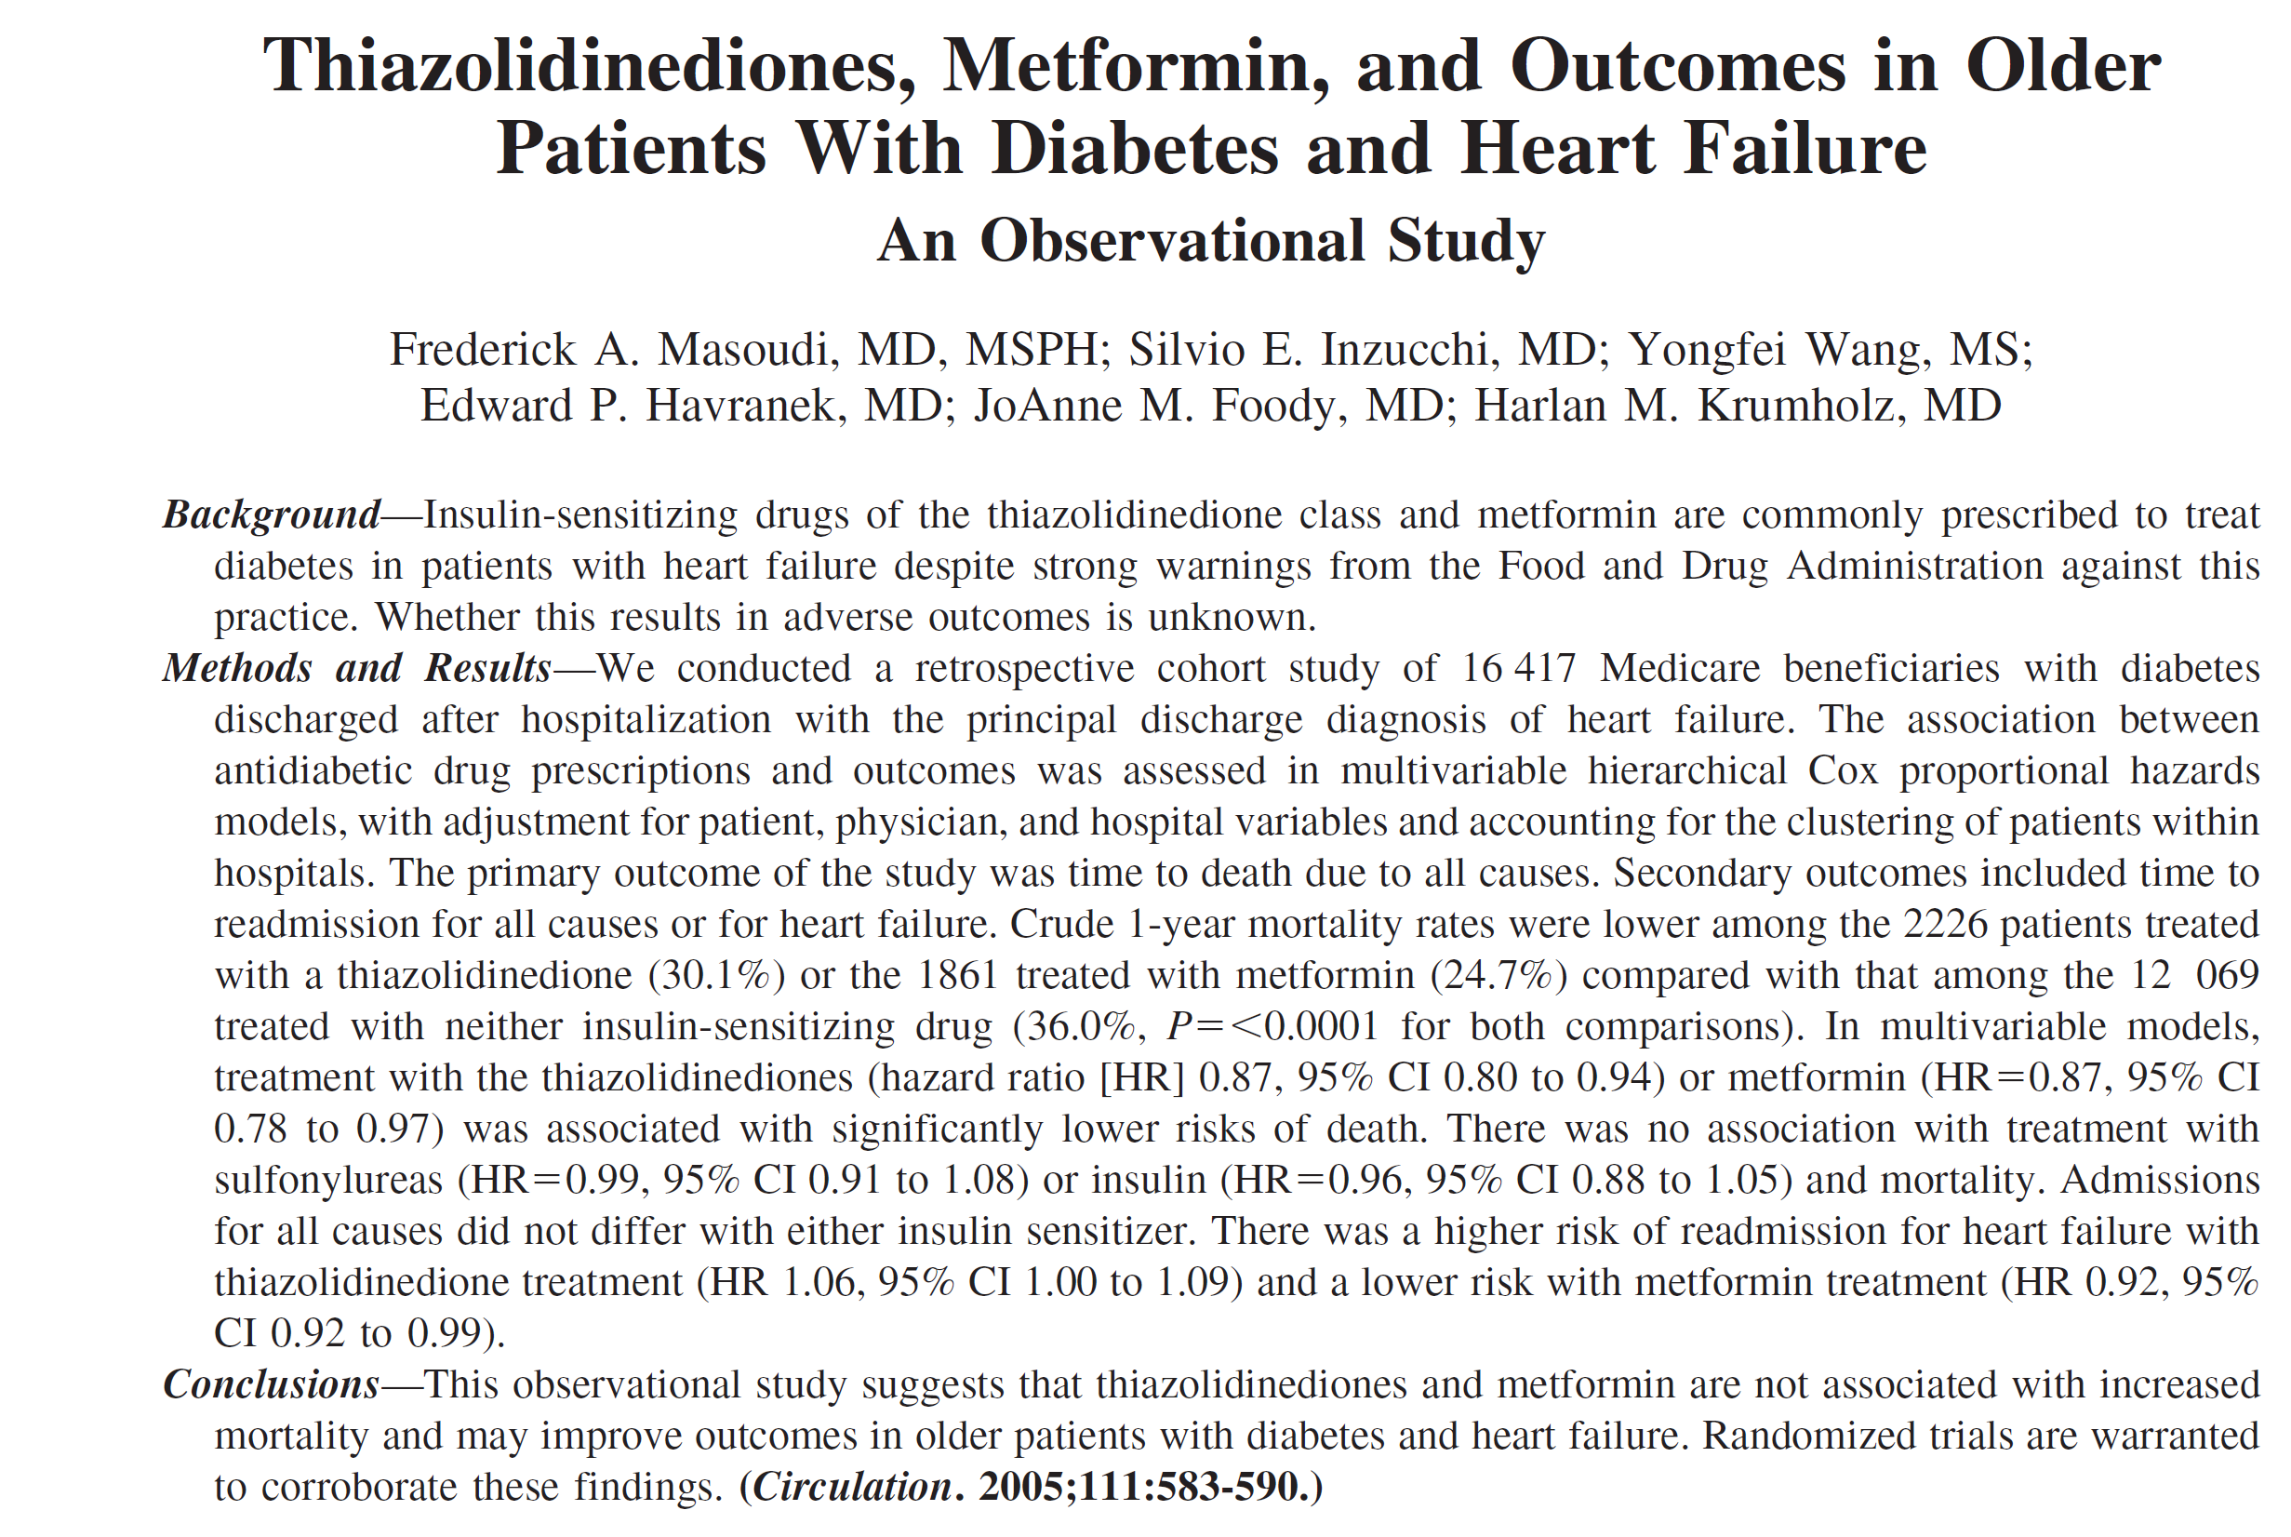
Μετφορμίνη και γαλακτική οξέωση
Ο κίνδυνος αυτός δεν επιβεβαιώθηκε

Slide 30
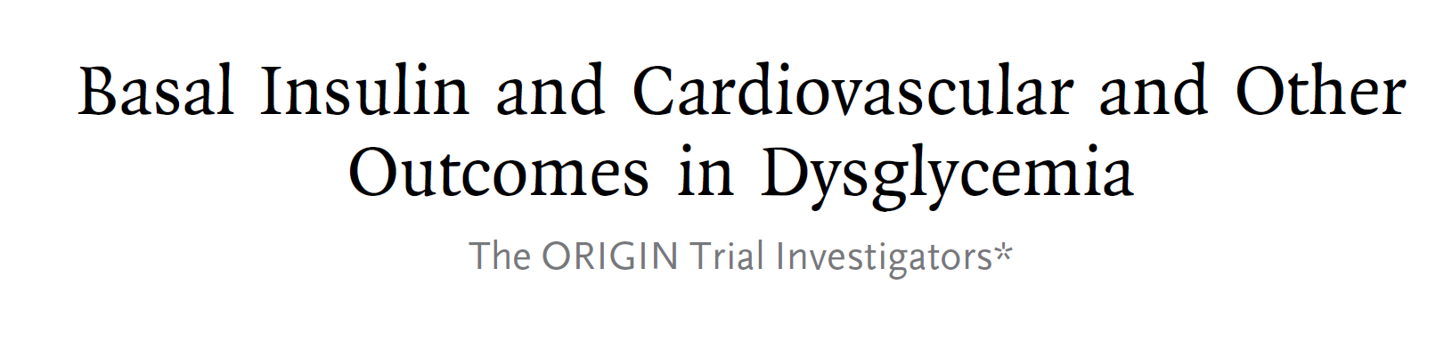
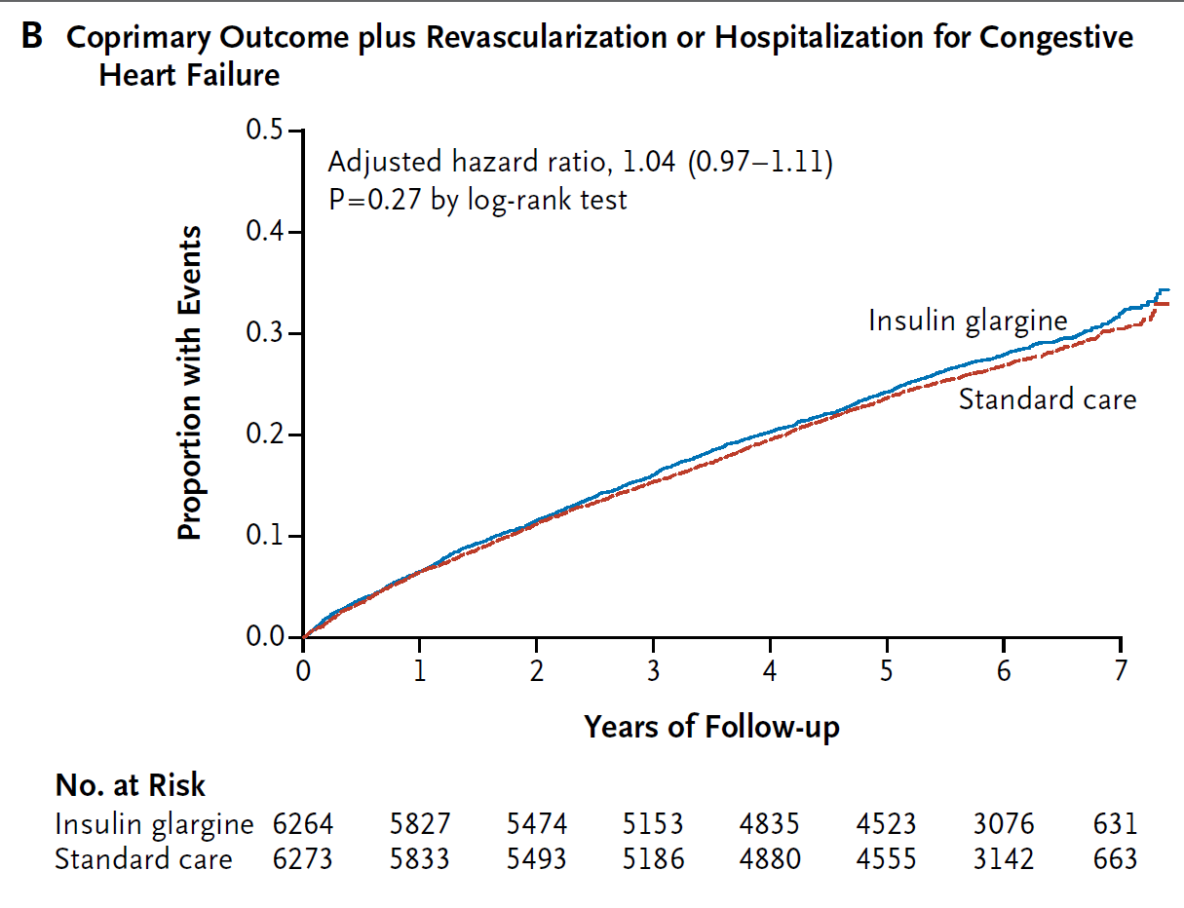
N Engl J Med 2012; 367:319-328

Slide 31
Νεότερα Αντιδιαβητικά

Slide 32
Hospitalization for Heart Failure:
DPP-4 inhibitors
 | Study Drug n/N (%) | Placebo n/N (%) | Hazard Ratio | 95% CI | P Value
EXAMINE¹ (alogliptin vs. placebo) | 106/2701 (3.9%) | 89/2679 (3.3%) | 1.19 | 0.90, 1.58 | 0.220
SAVOR-TIMI 53² (saxagliptin vs. placebo) | 289/8280 (3.5%) | 228/8212 (2.8%) | 1.27 | 1.07, 1.51 | 0.007
TECOS³ (sitagliptin vs. placebo) | 228/7332 (3.1%) | 229/7339 (3.1%) | 1.00 | 0.83, 1.20 | 0.983
Notes:
References:
White WB, Cannon CP, Heller SR et al. Alogliptin after acute coronary syndrome in patients with type 2 diabetes. N Engl J Med. 2013;369:1327-35.
Scirica BM, Bhatt DL, Braunwald E et al. Saxagliptin and cardiovascular outcomes in patients with type 2 diabetes mellitus. N Engl J Med. 2013;369:1317-26.
Green JB et al. Effect of Sitagliptin on Cardiovascular Outcomes in Type 2 Diabetes. N Engl J Med. 2015. doi: 10.1056/NEJMoa1501352.

Slide 33



Completed GLP-1 Receptor Agonist Cardiovascular Outcome Trials
Key inclusion criteria
A_{1C} , %
Median follow-up duration (y)
Drug exposure time (y)
Primary End point
(1)
5.5-11.0
Lixisenatide
1.9
MACE-4
(non-inferiority)
ACS within 180 days
≥30y
R
2.1
N=6068
Placebo
2.0
≥50y with CVD/renal dysfunction/HF, or
≥60y with CV RFs
≥7.0
Liraglutide
3.5
MACE-3
(non-inferiority)
(2)
≥7.0
3.8
R
N=9340
Placebo
3.5
(3)
≥7.0
Semaglutide
1.8
MACE-3
(non-inferiority)
SUSTAIN-6
≥50y with CVD, or ≥60y with subclinical CVD
≥7.0
2.1
R
1.9
N=3297
Placebo
Established CVD as well as primary prevention (70/30 split), ≥18y
6.5-10.0
Exenatide
2.4
MACE-3
(non-inferiority for safety/
superiority for efficacy)
R
3.2
Placebo
2.3
N=14752
0
1
2
3
4
¹ Pfeffer MA et al. N Engl J Med 2015; 373: 2247–2257
² Marso SP et al. N Engl J Med 2016; 375: 311–322
³ Marso SP et al. N Engl J Med 2016; 375: 1834–1844
  Median Follow-up Duration (years)

Slide 34
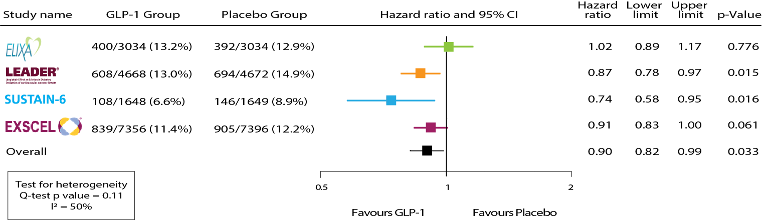
Meta-analysis: MACE-3 endpoint
Bethel et al. TLDE 2017; in press

Slide 35
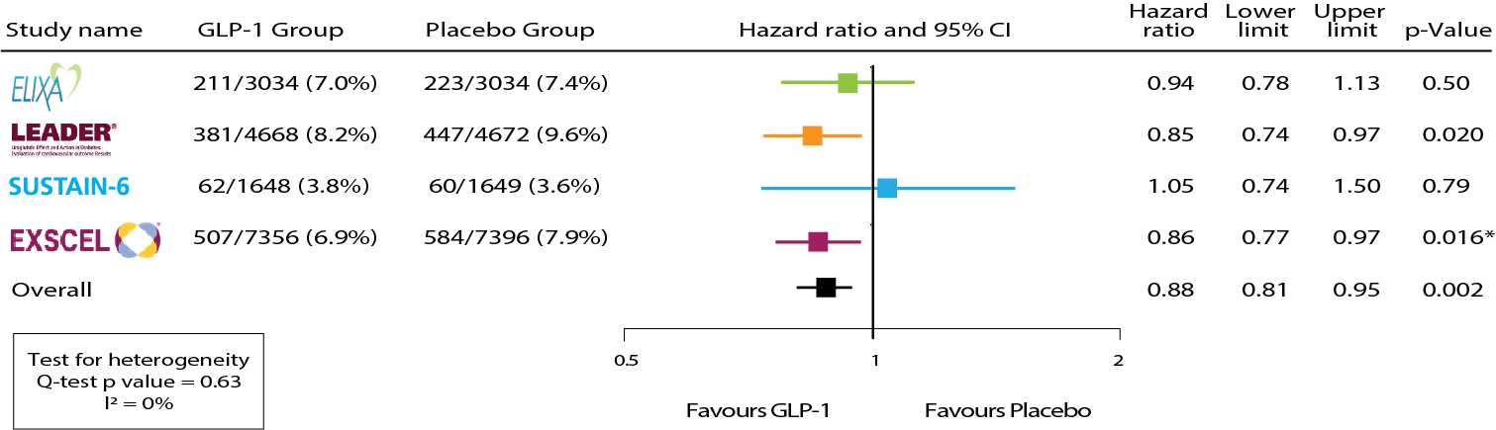
Meta-analysis: All-cause mortality
Bethel et al. TLDE 2017; in press

Slide 36
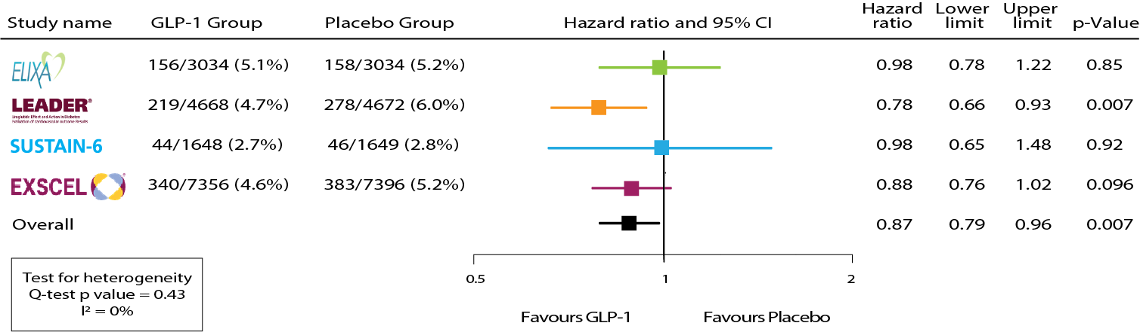
Meta-analysis: CV mortality
Bethel et al. TLDE 2017; in press

Slide 37
Meta-analysis: Other CV outcomes
Neutral impact of GLP-1 RA treatment
Endpoint | HR (95% CI) | p-value
Fatal and nonfatal myocardial infarction | 0.94 (0.86, 1.03) | 0.18
Fatal and nonfatal stroke | 0.87 (0.75, 1.00) | 0.052
Heart failure hospitalization | 0.93 (0.83, 1.04) | 0.20
Unstable angina hospitalization | 1.09 (0.90, 1.32) | 0.39

Slide 38
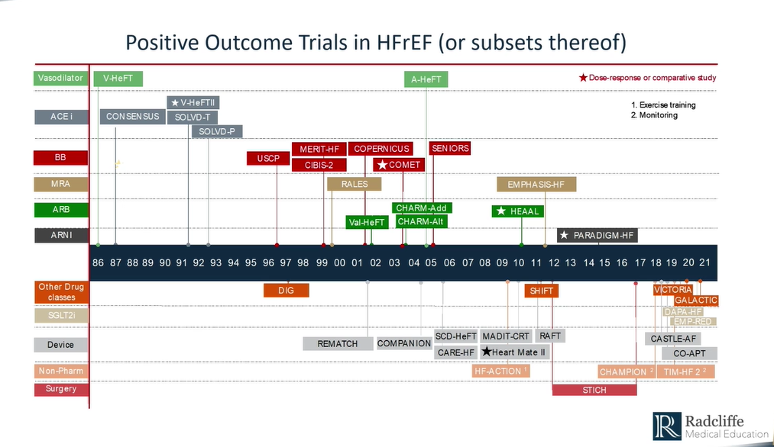

Slide 39
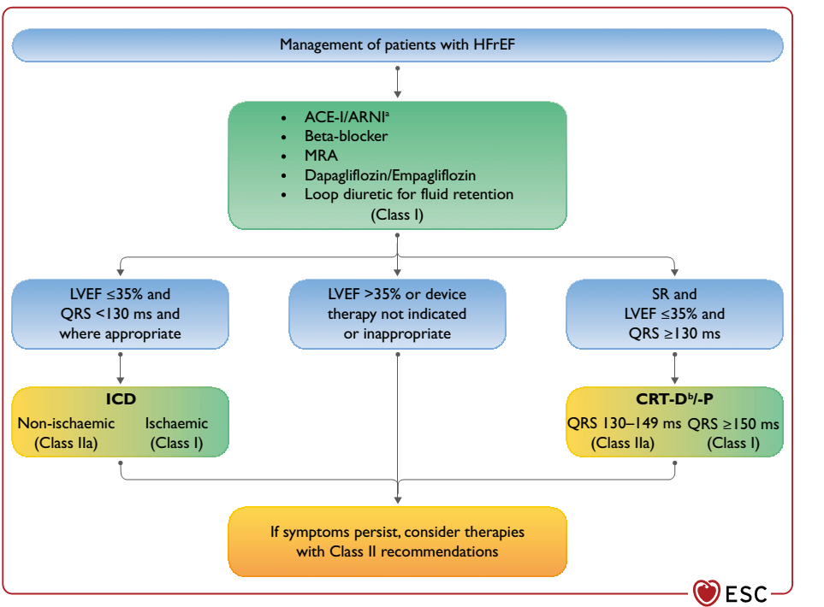

Slide 40

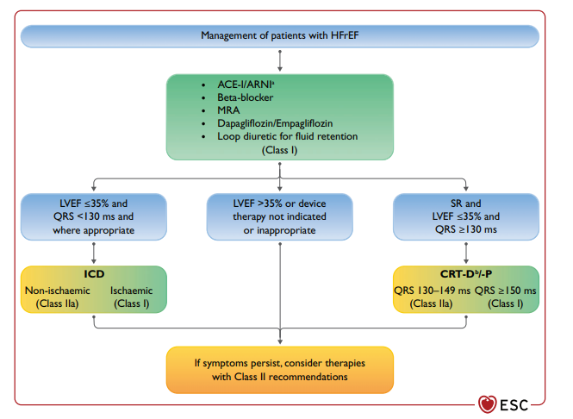

Slide 41
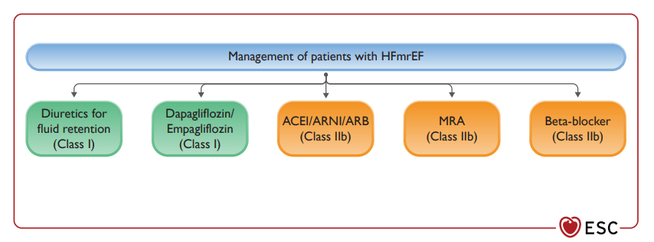

Slide 42
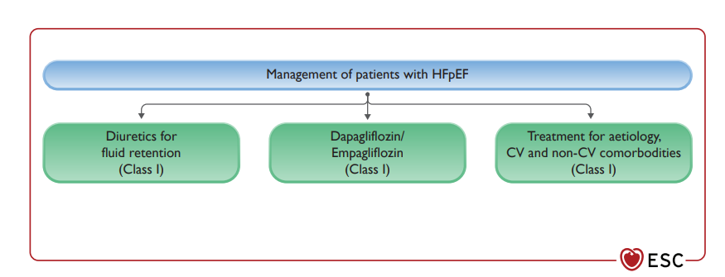

Slide 43
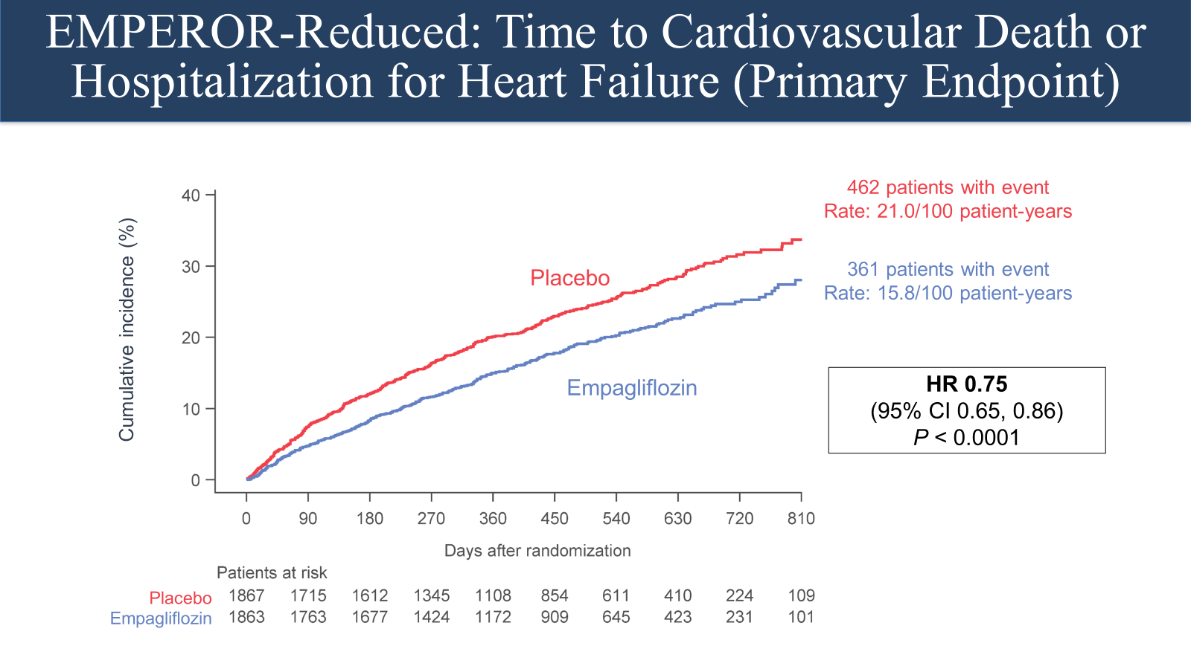
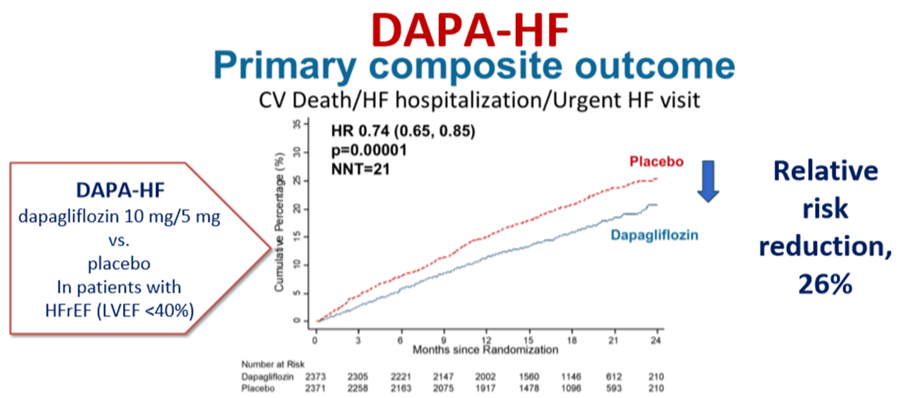
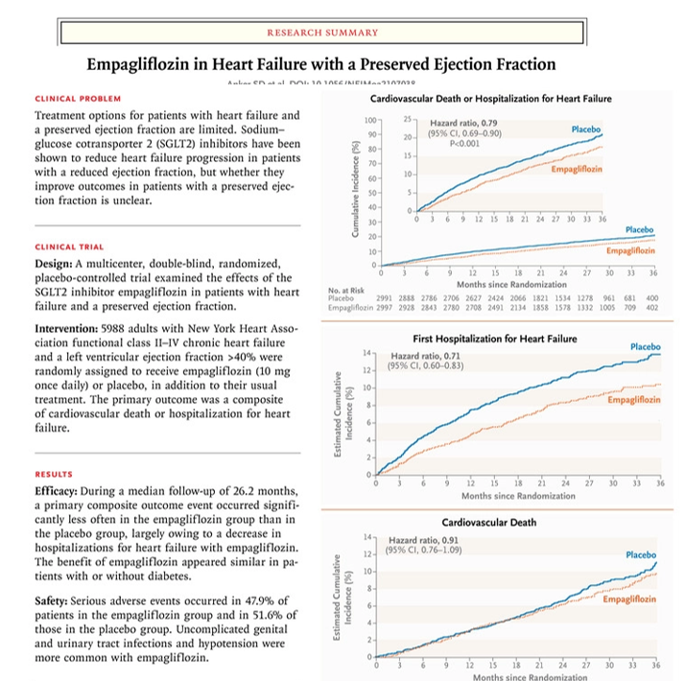
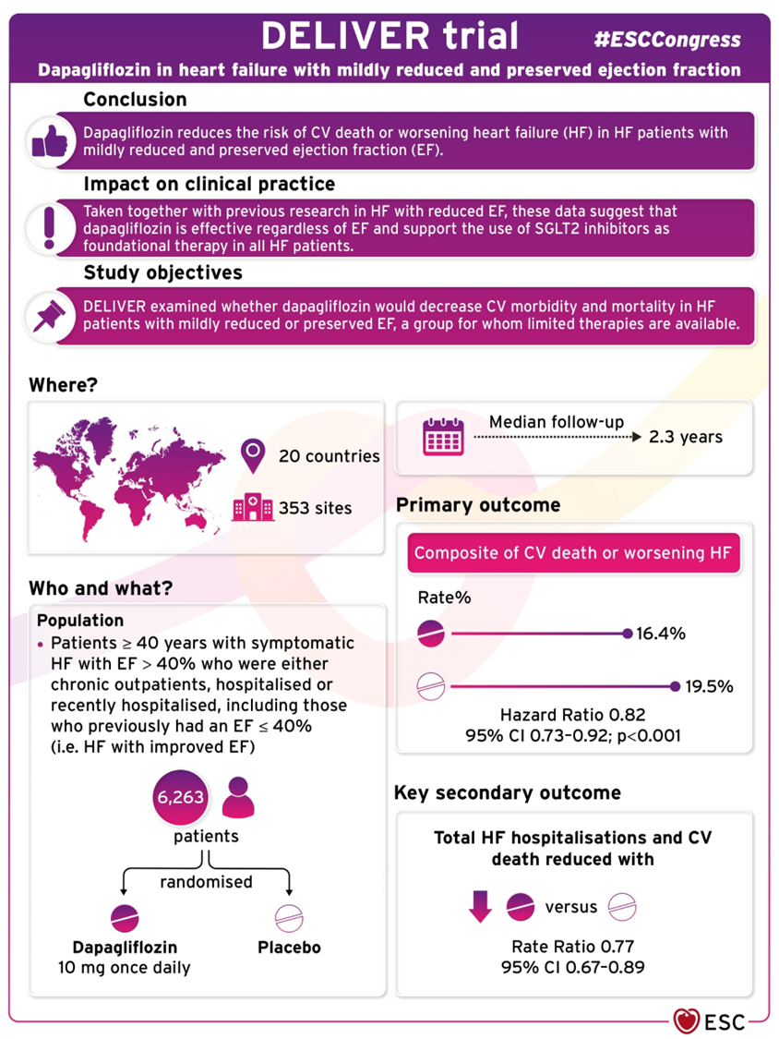

Slide 44
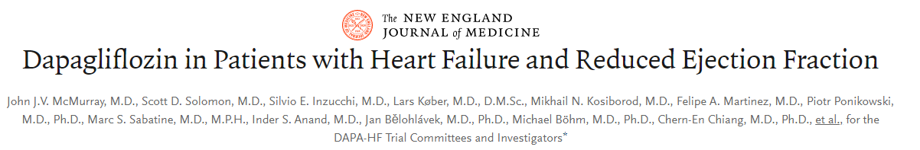



Slide 45
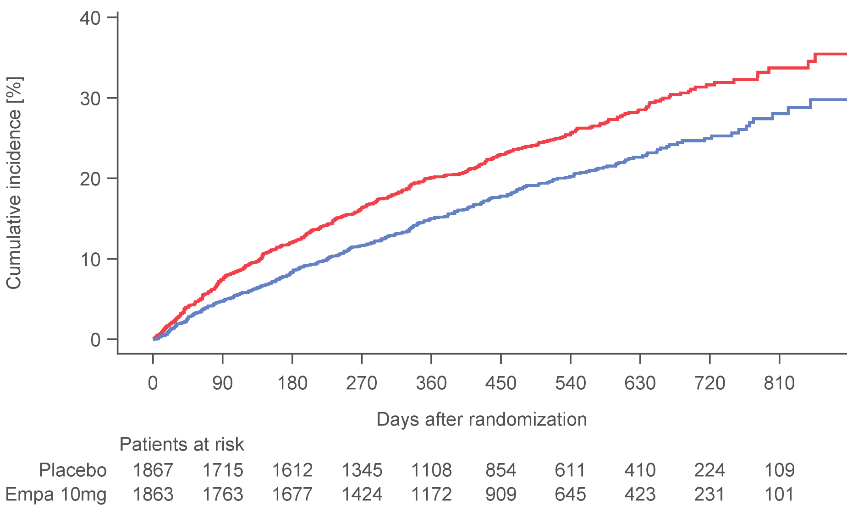
EMPEROR-Reduced: Time to Cardiovascular Death or Hospitalization for Heart Failure (Primary Endpoint)
462 patients with event
Rate: 21.0/100 patient-years
Placebo
361 patients with event
Rate: 15.8/100 patient-years
Cumulative incidence (%)
Empagliflozin
HR 0.75
(95% CI 0.65, 0.86)
P < 0.0001
Placebo
Empagliflozin

Slide 46
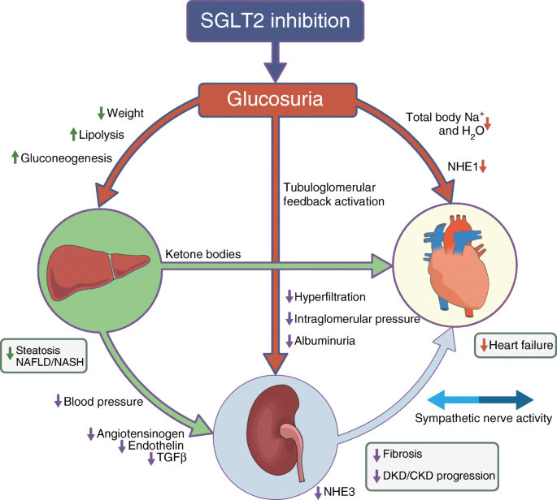
SGLT2 inhibitors- Physiological effects

Slide 47
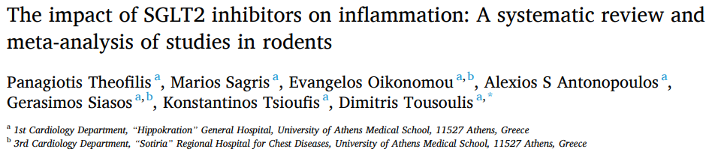
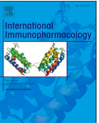
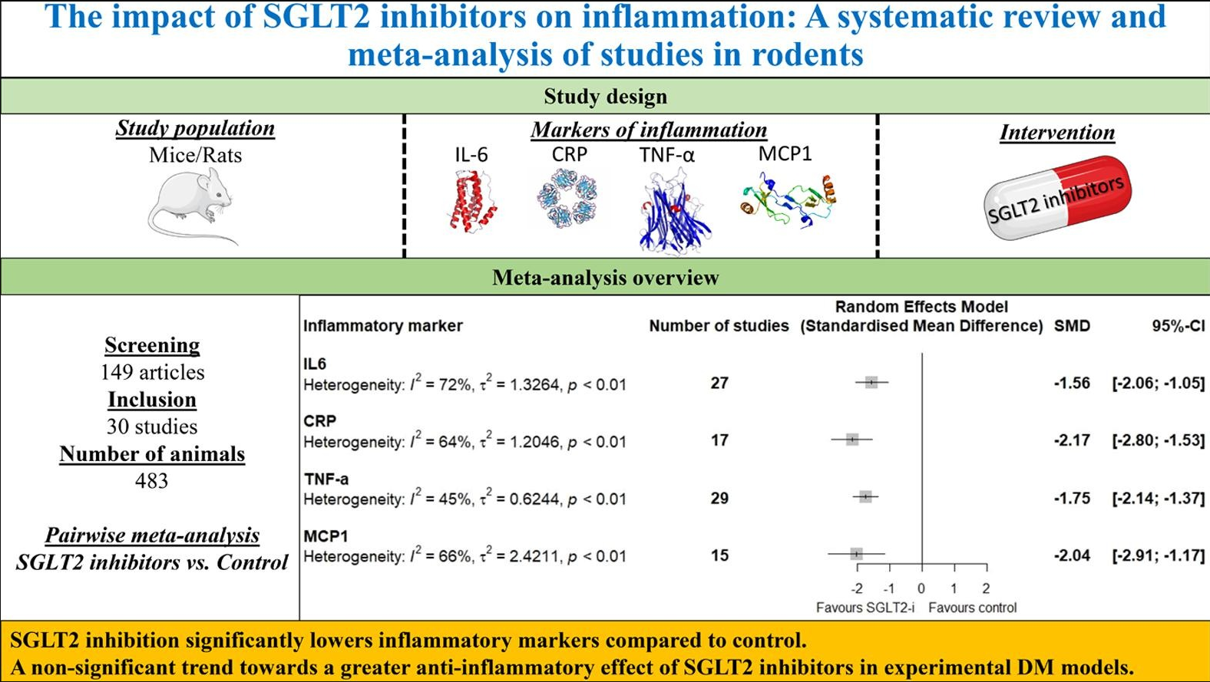

Slide 48
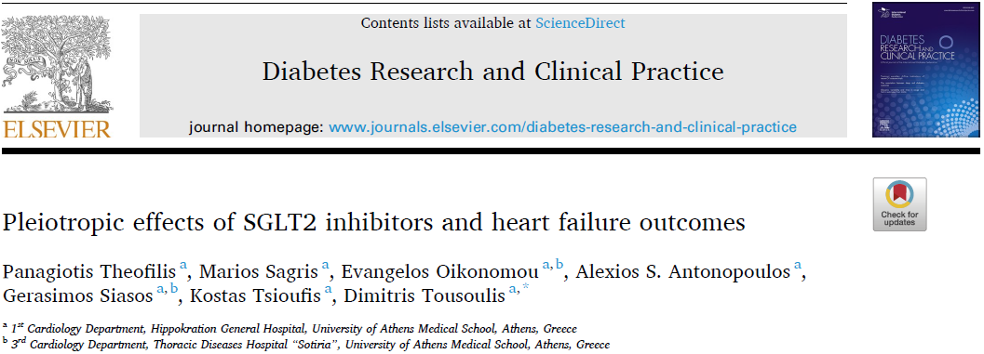
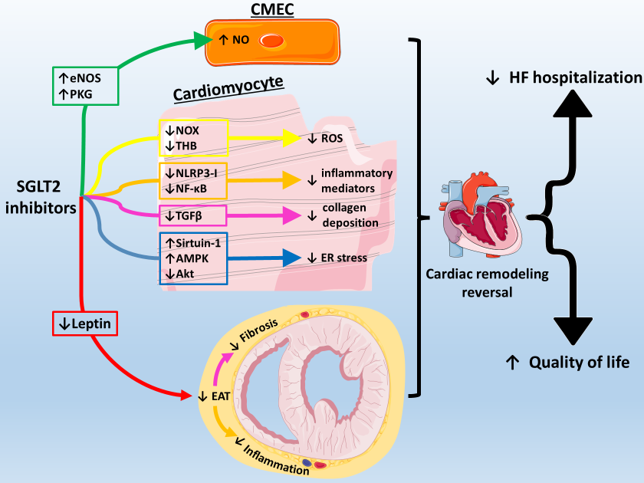

Slide 49

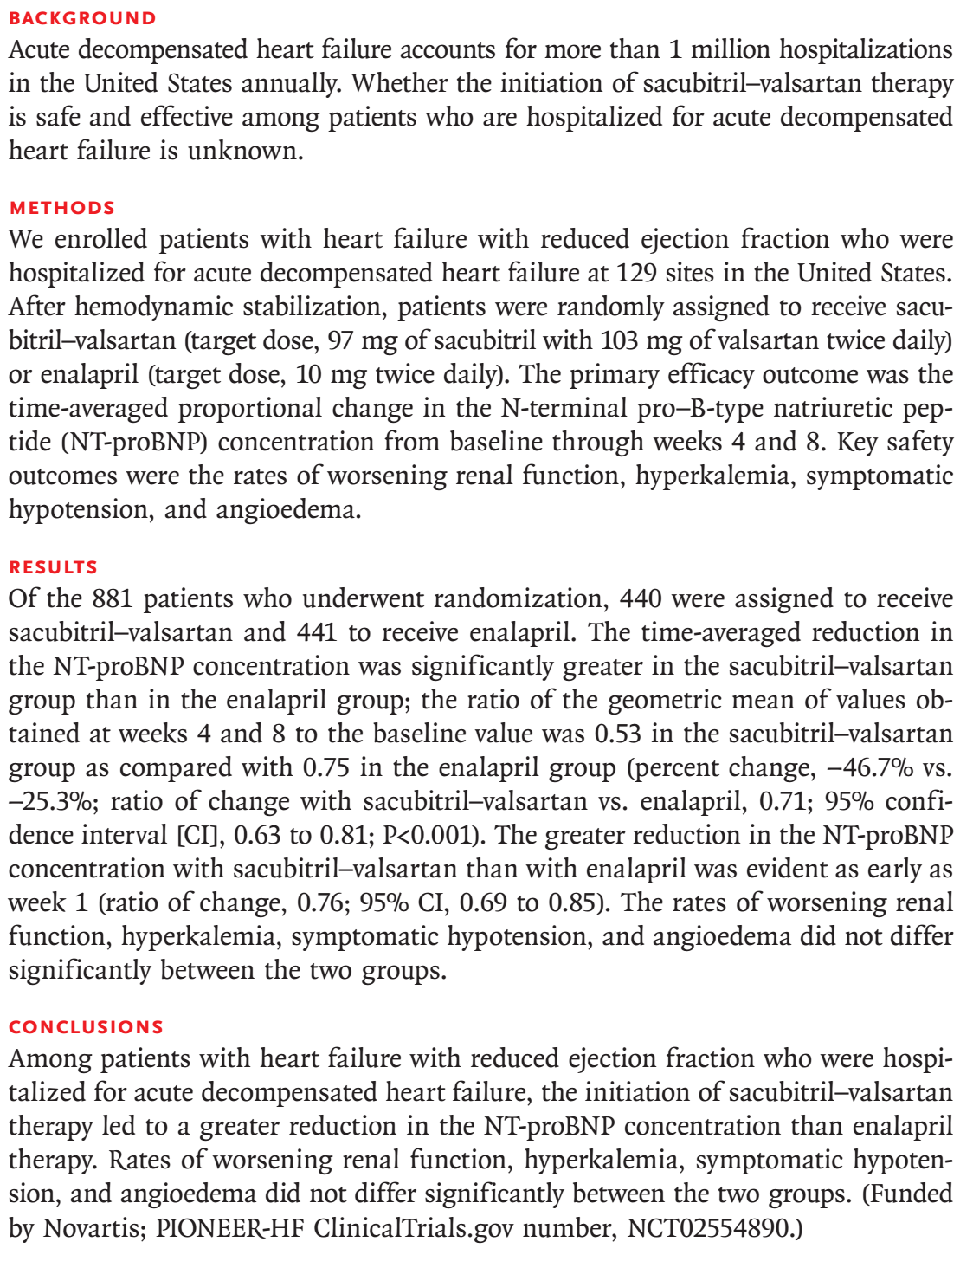

Acute Decompensate Heart Failure
8 Weeks

Slide 50




Slide 51



Acute Heart Failure trials
EMPULSE AHF trial
530 patients with a primary diagnosis of acute de novo or decompensated chronic heart failure regardless of left ventricular ejection fraction were randomly assigned to receive empagliflozin 10 mg once daily or placebo.

Slide 52



Acute Heart Failure trials
Empagliflozin in acute myocardial infarction: the EMMY trial
In this academic, multicentre, double-blind trial, patients (n = 476) with acute myocardial infarction accompanied by a large creatine kinase elevation (>800 IU/L) were randomly assigned to empagliflozin 10 mg or matching placebo once daily within 72 h of percutaneous coronary intervention. The primary outcome was the N-terminal pro-hormone of brain natriuretic peptide (NT-proBNP) change over 26 weeks.
European Heart Journal (2022) 00, 1–12

Slide 57


