Slide 1
Ο ρόλος των λιπιδίων στην παχυσαρκία και στις διαταραχές του ύπνου
Ευάγγελος Οικονόμου
Καρδιολόγος,
Γ’ Πανεπιστημιακή Καρδιολογική Κλινική, Γ.Ν.Ν.Θ.Α «Η Σωτηρία»

Slide 4
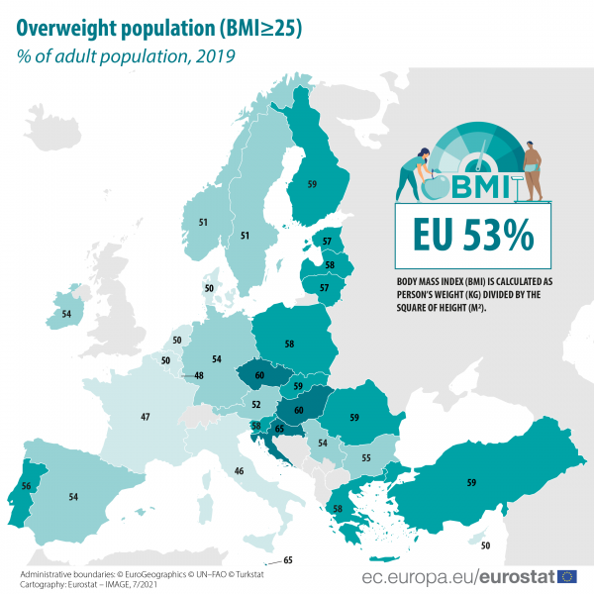

Slide 6
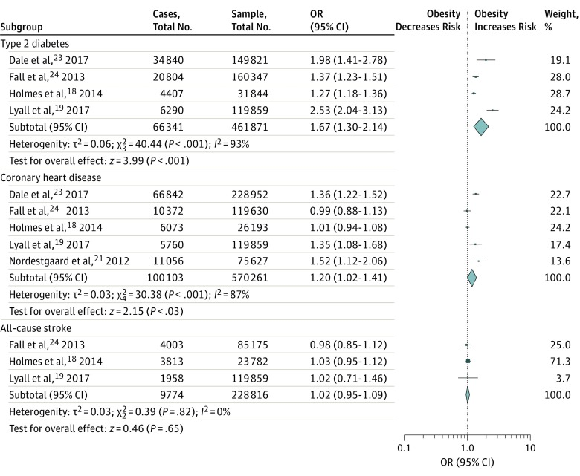
Association Between Obesity and Cardiovascular Outcomes
A Systematic Review and Meta-analysis of Mendelian Randomization Studies
each 1 SD increase in BMI increased the odds of coronary artery disease by 20% and T2DM by 67%

Slide 8
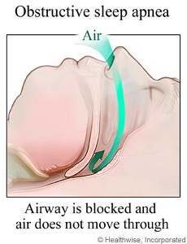

Slide 10
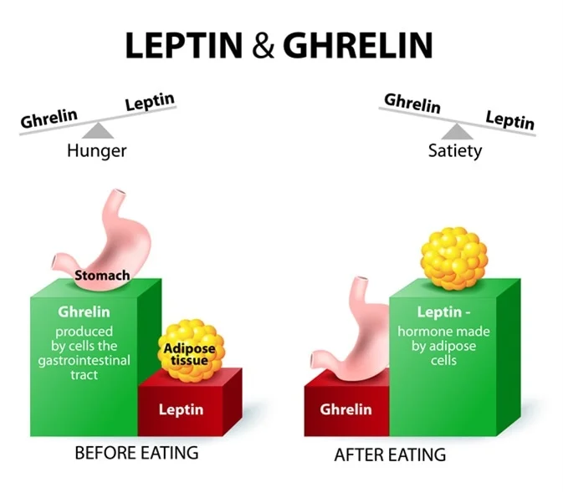

Slide 11
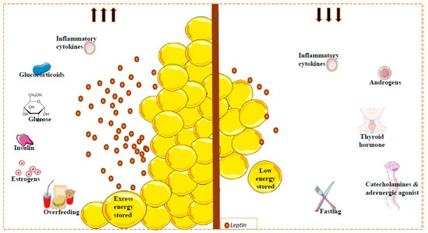
Int. J. Mol. Sci. 2020, 21(17), 6039; https://doi.org/10.3390/ijms21176039
Notes:
Figure 1. Factors implicated in circulating leptin levels. Leptin is secreted mainly by white adipose tissue. Leptin levels are correlated with the amount of fat (reflecting the amount of energy stored), and with changes in caloric intake. Other factors can regulate the circulating leptin levels. Glucose, insulin, estrogens and some inflammatory cytokines (acute effect) promote leptin secretion (left); catecholamines or adrenergic agonists, thyroid hormones, androgens and inflammatory cytokines inhibit the secretion of this hormone (right). Fat mass and leptin levels are significantly affected by gender and by menopausal status, where the leptin levels can decrease; leptin levels in females are higher than in males. This sexual dimorphism is due, at least in part, to the suppressive effect of androgens on leptin [78].

Slide 12
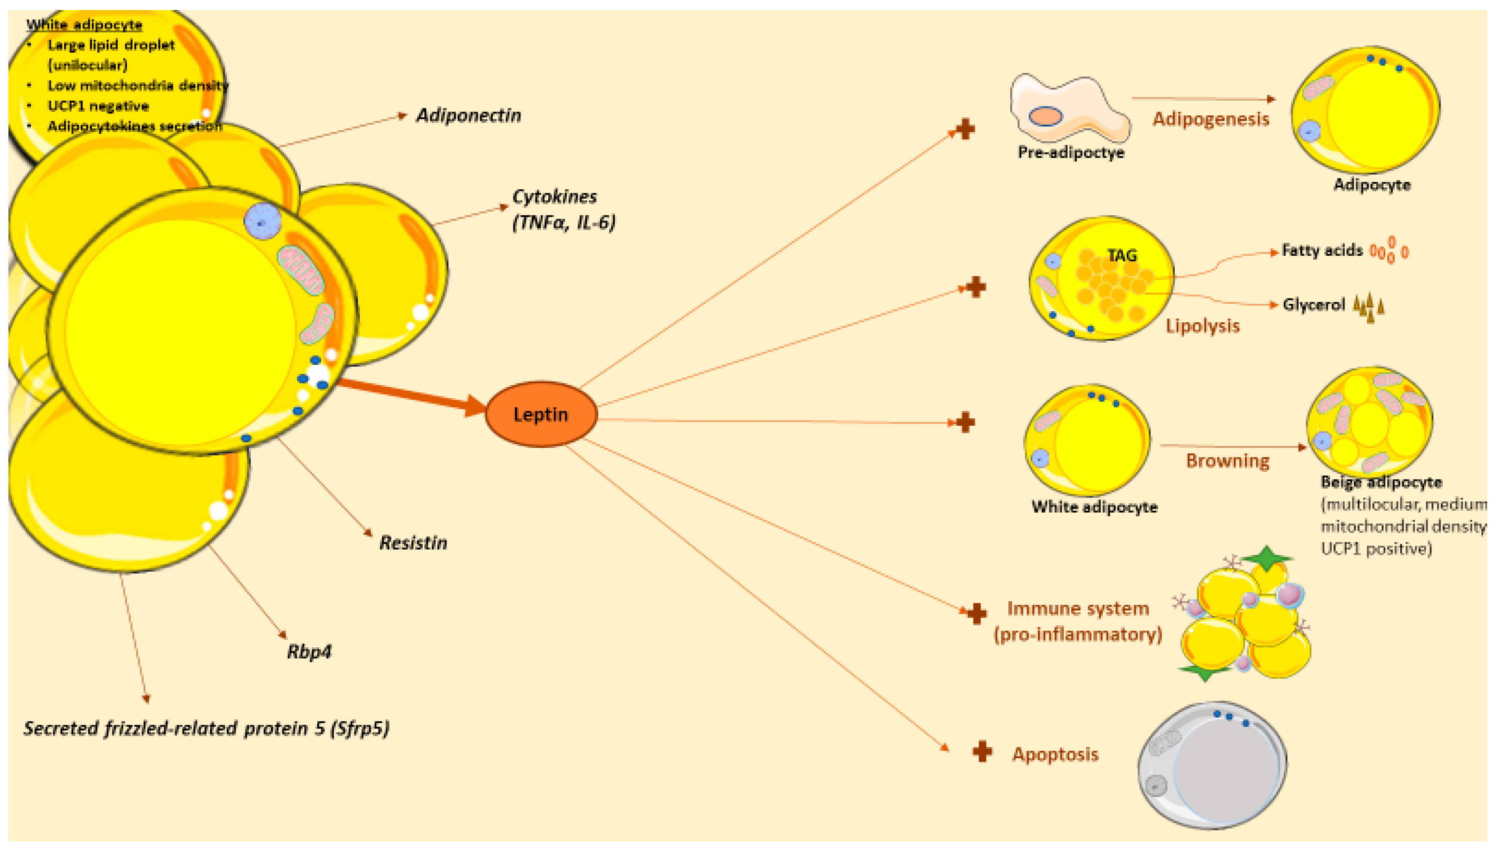
Int. J. Mol. Sci. 2020, 21(17), 6039; https://doi.org/10.3390/ijms21176039

Slide 13
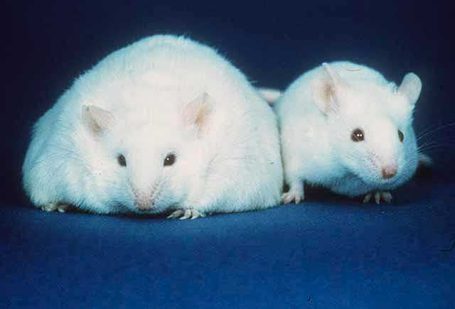
A comparison of a mouse unable to produce leptin, resulting in obesity, constant hunger, and lethargy (left), and an active normal weight mouse (right)

Slide 15
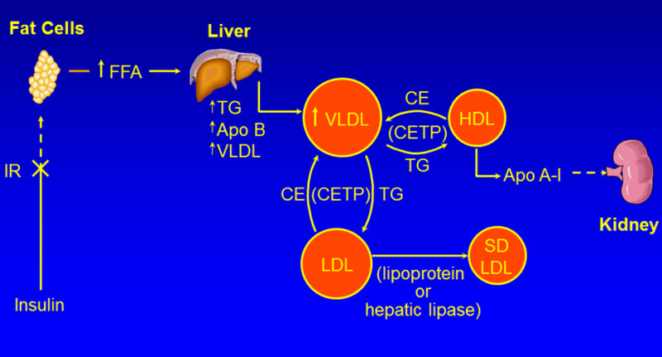

Slide 17
The circulating levels of adiponectin are decreased in subjects who are obese (38). Decreased adiponectin levels are associated with elevations in serum triglyceride levels and decreases in HDL-C levels (38).

Slide 18
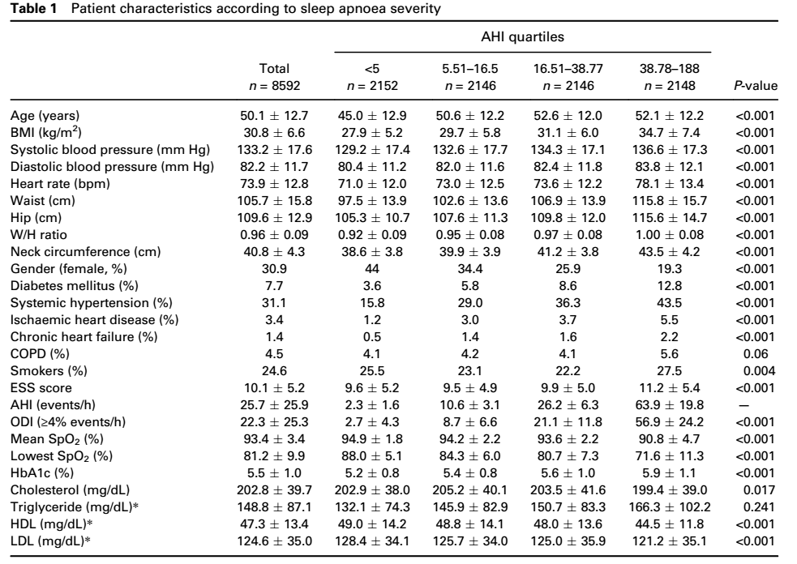

Slide 19
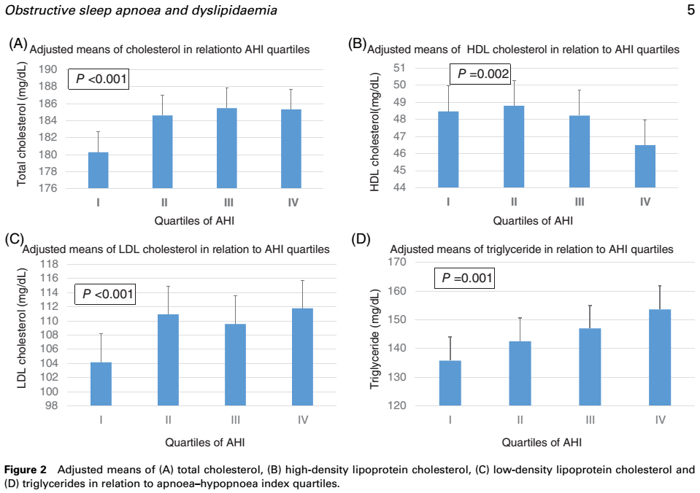

Slide 22
OSA treatment →
Lipids levels?

Slide 25
J Diabetes Res. 2019; 2019: 9583286.

Slide 26
J Diabetes Res. 2019; 2019: 9583286.

Slide 28
OSA → Lipids Levels
OSA treatment -> Lipids levels ??????
OSA Lpa levels???

