Slide 1
CMR in Ischaemic Heart Disease
Konstantinos Bratis
CMR Unit, Bioiatriki Healthcare Group
Cardio Rheumatology Outpatient Clinic, UGH Attikon

Slide 2
The role of CMR in IHD
Extent of systolic impairment
Differential diagnosis of jeopardized myocardium (ischaemia, stunning, hibernation, infarction)
Presence and extent of inducible ischaemia
Presence of myocardial necrosis
Coronary artery imaging

Slide 3
Ischaemia assessment - Stress CMR

Slide 4
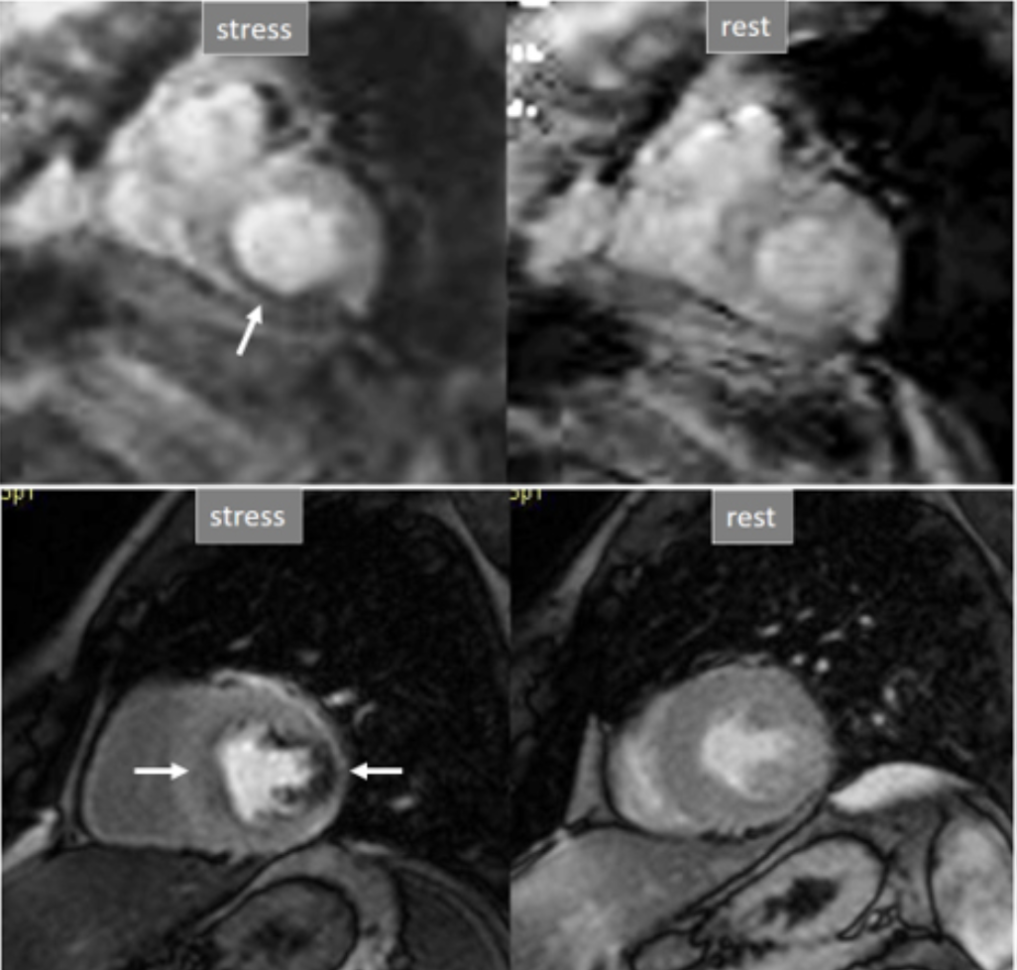
Stress perfusion CMR
Non-radiating
Good safety profile
of contrast agent & stressor
High-resolution
Integrated assessment

Slide 5
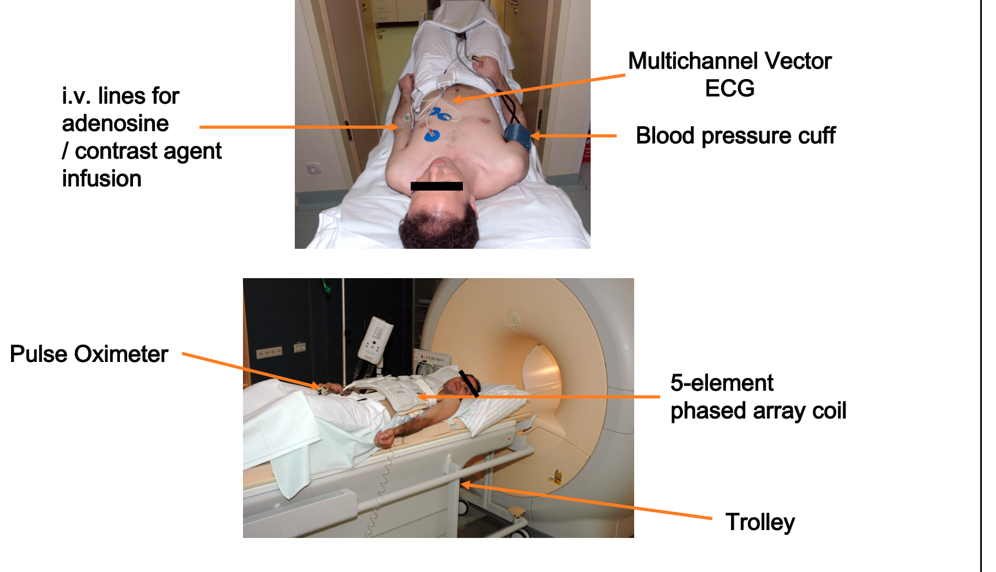
Practicalities

Slide 6
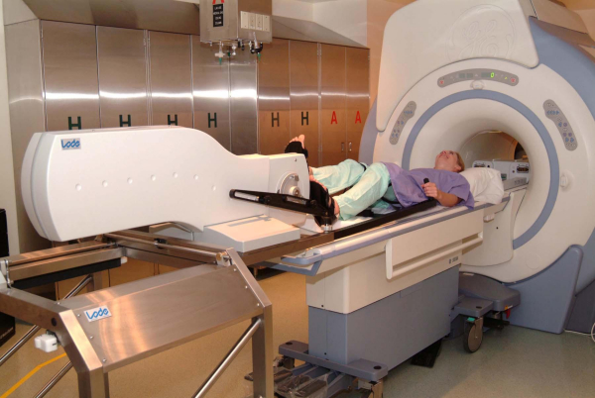
Stress protocol: Pharmacological vs exercise
Adenosine (A2A receptor agonists) | Dobutamine | Exercise
Most frequently used | Used mainly when adenosine contra-indicate or to assess contractile reserve | Used in some centres / research
Fast & steerable protocol | More time-consuming | Even more time-consuming Requires conditional equipment Depends on patient’s compliance
Safe (short half-life); mild side-effects Hypotension under GA! | Onset of action: IV: 1-10 minutes Maximum effect: 10-20 minutes Half-life: 2 minutes | More physiological
Potent vasodilator Weaker chronotropic agent | Potent chronotropic agent (less time for imaging) | Depends on patient’s compliance to achieve target heart rate
Contraindications: 2nd 3rd degree AV block sinus node disease Bronchoconstrictive/spastic lung disease Hypersensitivity to adenosine Hypotension | Contraindications: Recent (1 wk) MI / unstable angina Significant aortic stenosis Significant obstructive cardiomyopathy Tachyarrhythmias & history of VT Uncontrolled hypertension Thoracic aortic aneurysm | Limitations/contraindications: Frail patients Paediatric patients
FDA off-label use in paediatrics | Additional decision support regarding timing for intervention (Fallot) ^{1,2} | -

Slide 7
Contraindications/Termination
Contraindication for Adenosine & Magnetic field
  Asthma or severe obstructive pulmonary disease
  AV-block >IIa
  Claustrophobia
  Non compatible biometallic implants (pacemaker/AICD)
Contraindications for Exercise
  Stenotic valvular disease
  Autonomic dysfunction
  Myocardial infarction <3 Days
  Unstable angina pectoris
Termination criteria
  Persistent or symptomatic AV-block
  Significant drop in systolic pressure (>20 mmHg)
  Persistent or symptomatic hypotension
  Severe respiratory difficulty

Slide 8
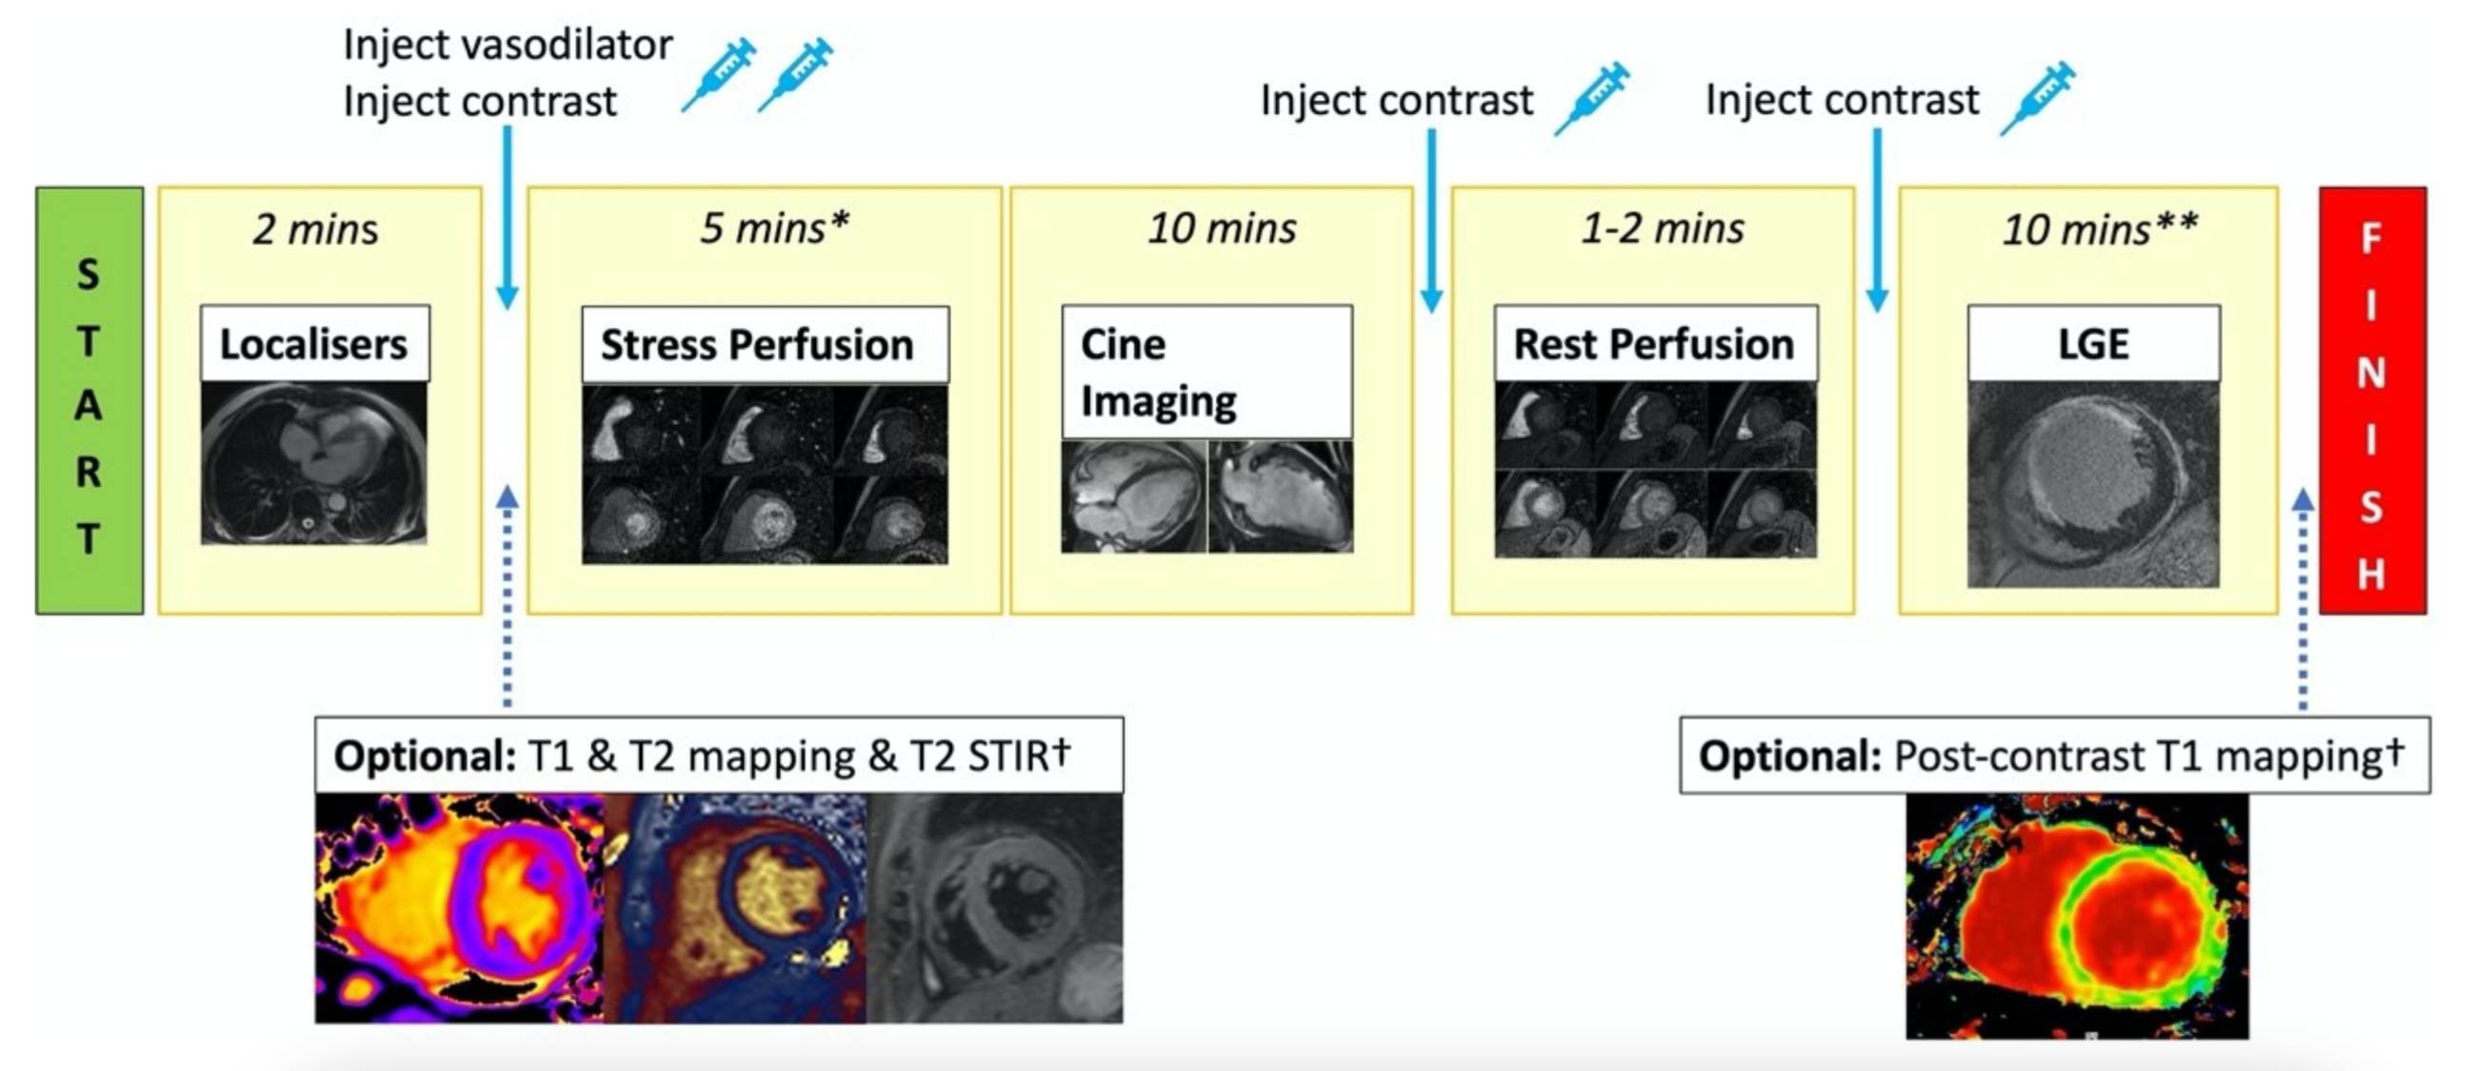

Slide 9
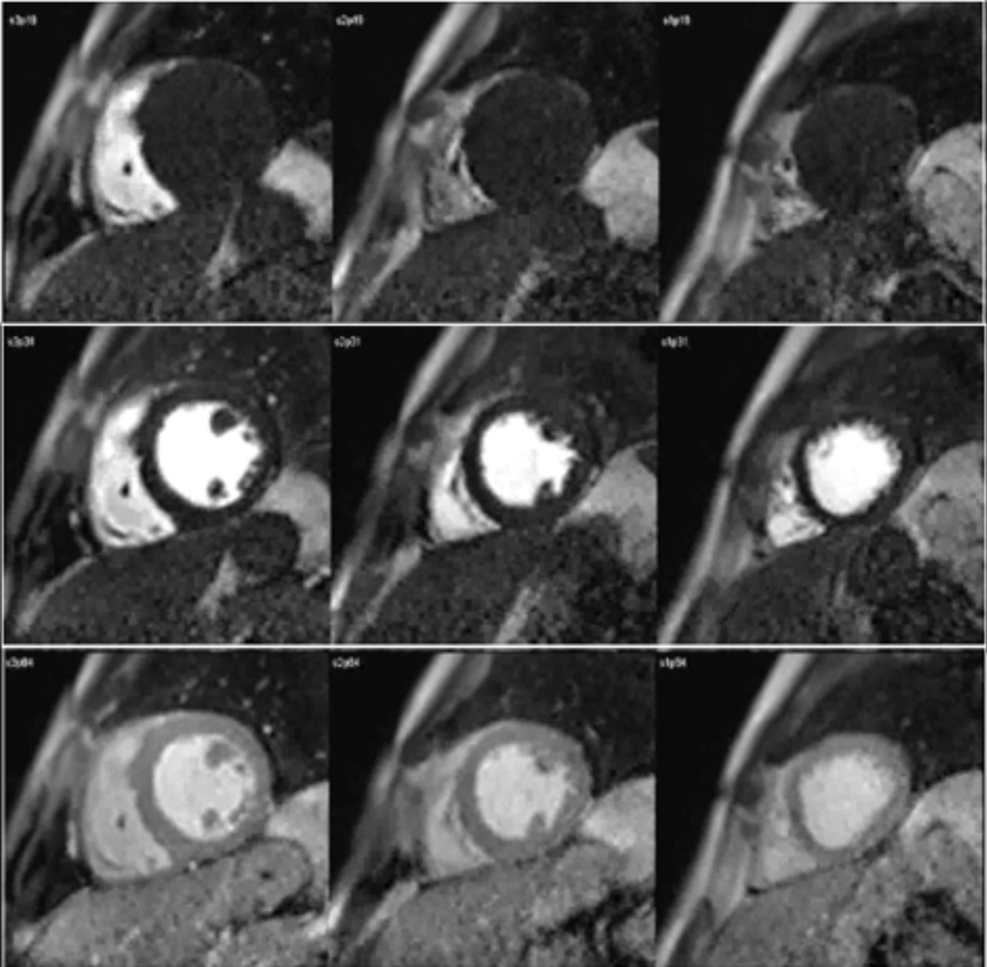
Normal exam

Slide 10
Analysis of MR Perfusion Studies cover 16 out of 17 myocardial segments
Visual Analysis
  For routine clinical use, we do a qualitative analysis by visual comparison of the contrast enhancement in different myocardial regions (see next slide)
Quantitative
  Absolute Tissue Perfusion (Unit: ml/g/min) (requires mathematical modeling)
  Semi quantification (stress induced change of upslope)

Slide 11
Visual assessment
Clinically established method

Slide 12
SCMR criteria for perfusion post-processing
i) Occurs first when contrast arrives in LV myocardium
ii) Persists beyond peak myocardial enhancement and for several RR intervals (usually >4)
iii) Is more than one pixel wide
iv) Is most prominent in the subendocardial portion of the myocardium
vi) Over time, defect regresses towards the subendocardium
vii) Is present at stress but not at rest
viii) Conforms to the distribution territory of one or more coronary arteries
Schulz-Menger et al. Journal of Cardiovascular Magnetic Resonance 2013

Slide 13
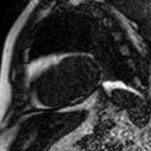
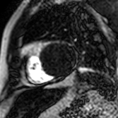
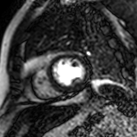
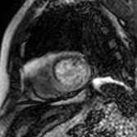
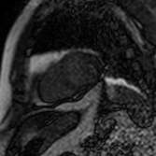
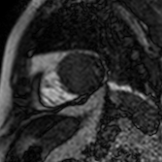
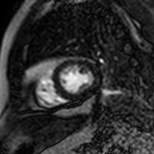
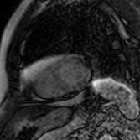
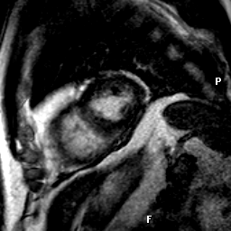
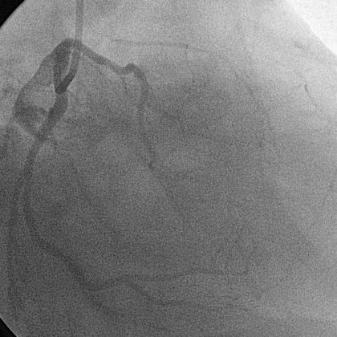
Baseline
RV contrast uptake
LV contrast uptake
Myocardial contrast uptake
Stress Perfusion
Rest Perfusion
Viability and CA

Slide 14
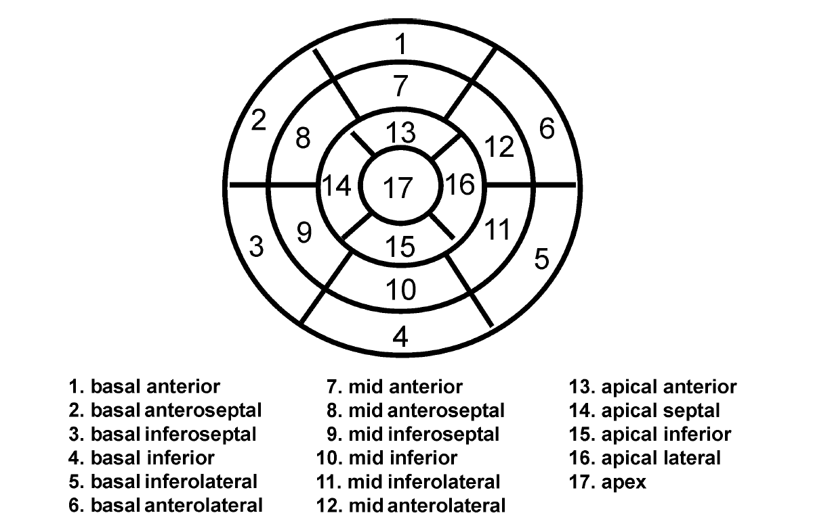
Report
Data is reported for 16 (segment 1 – 16). The apical segment (17) is not visualized with 3 short axis views.
Perfusion defects are reported with their transmurality (transmural defect vs. subendocardial defect).
Perfusion images are compared to cine and late enhancement images

Slide 15
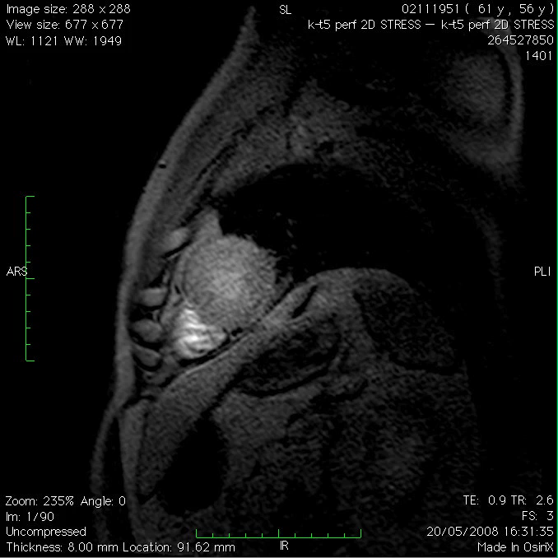
1- vessel disease

Slide 16
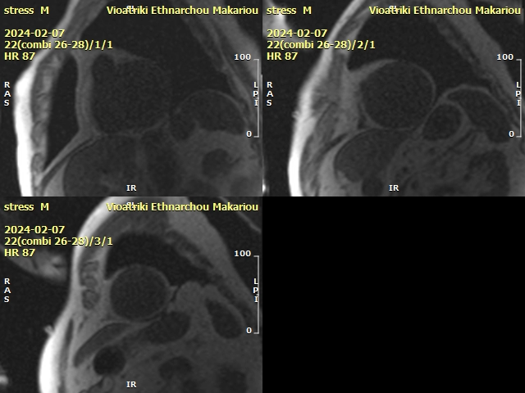
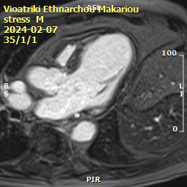
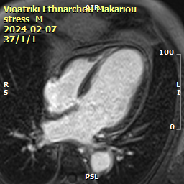
3- vessel disease

Slide 17
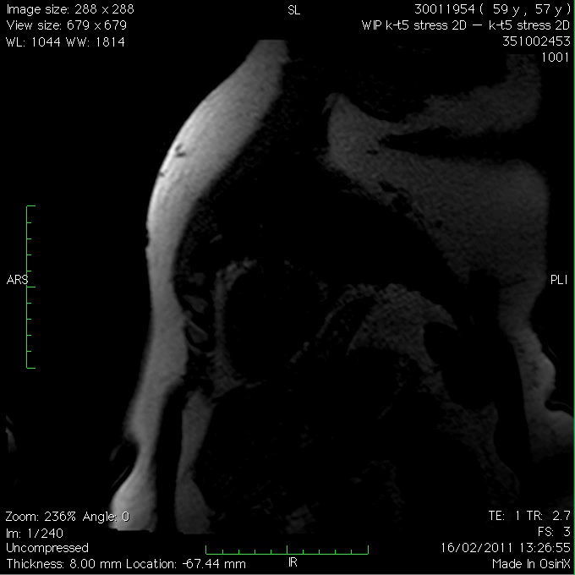
Microvascular dysfunction

Slide 18
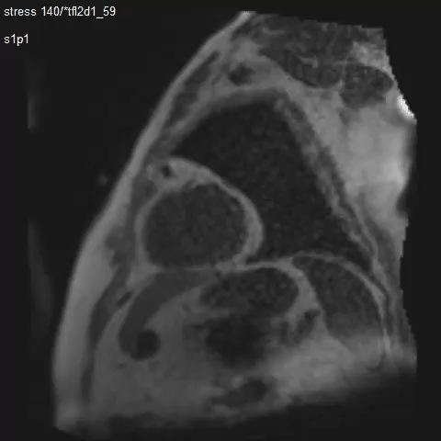
Microvascular dysfunction + CAD

Slide 19
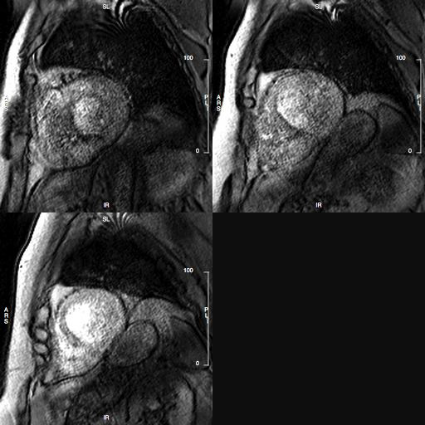
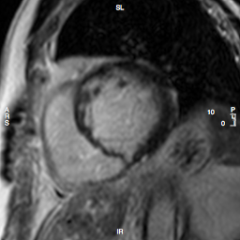
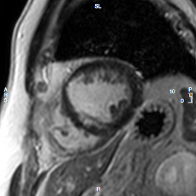
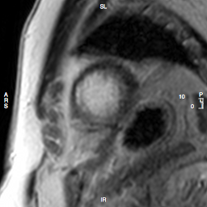
Peri-infarct ischaemia
Stress
Scar

Slide 20
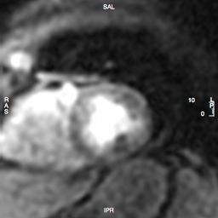
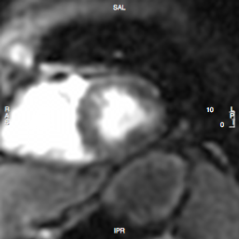
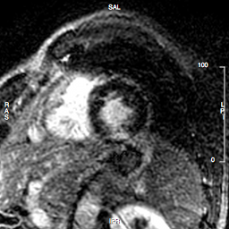
Fixed defect
Stress
Rest
LGE

Slide 21
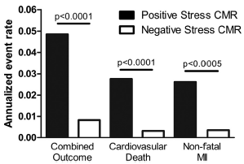
Perfusion CMR - Prognostic value
Meta analysis of 19 studies (14 PCMR, 4 DCMR, 1 P-DCMR)
11636 pts with known or suspected CAD (29% positive exam)
Follow up of 32 months
➔AER: 4,5% vs 0,8%
Lipinski et al, JACC Vol. 62, No. 9, 2013

Slide 22
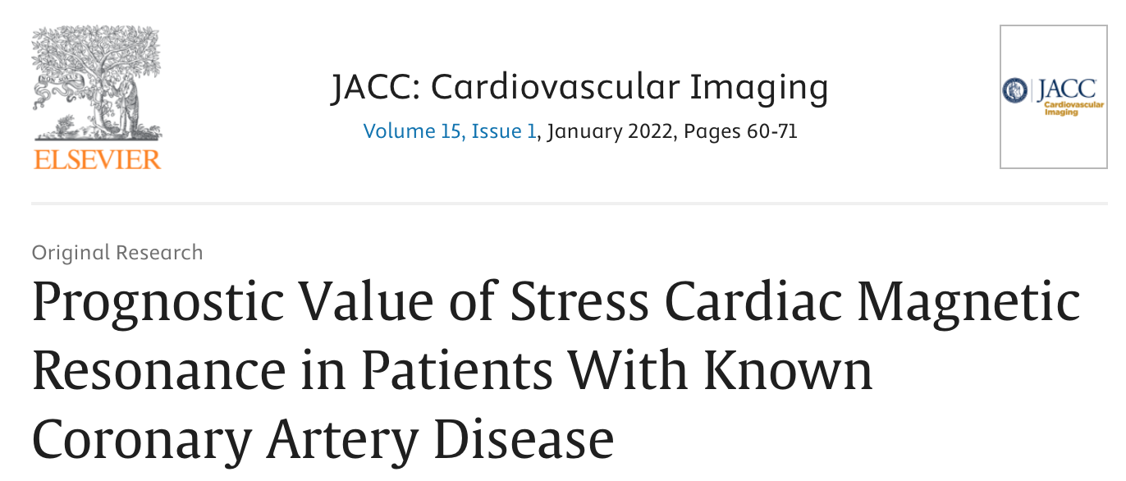
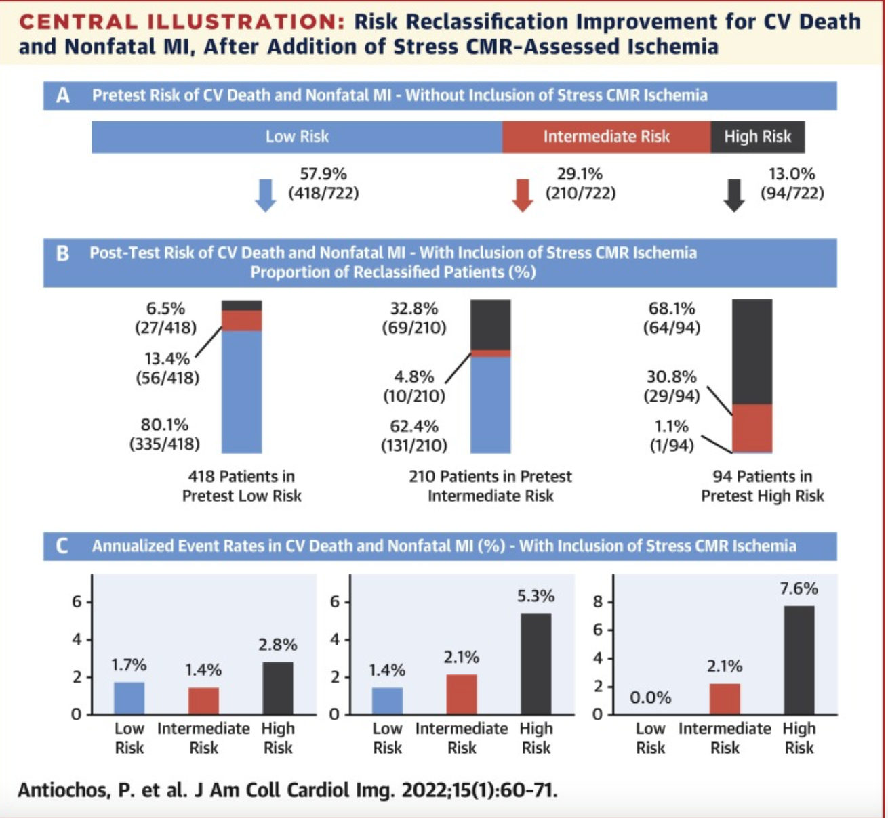
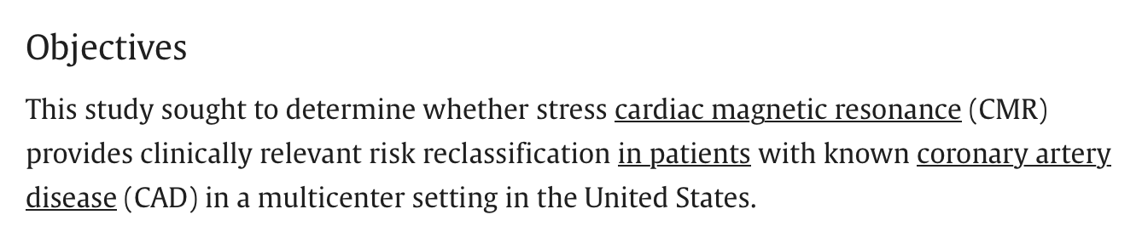
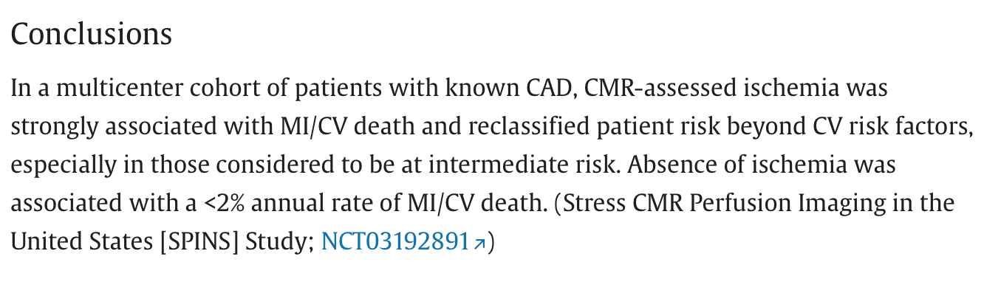
Risk stratification - Prognosis

Slide 23
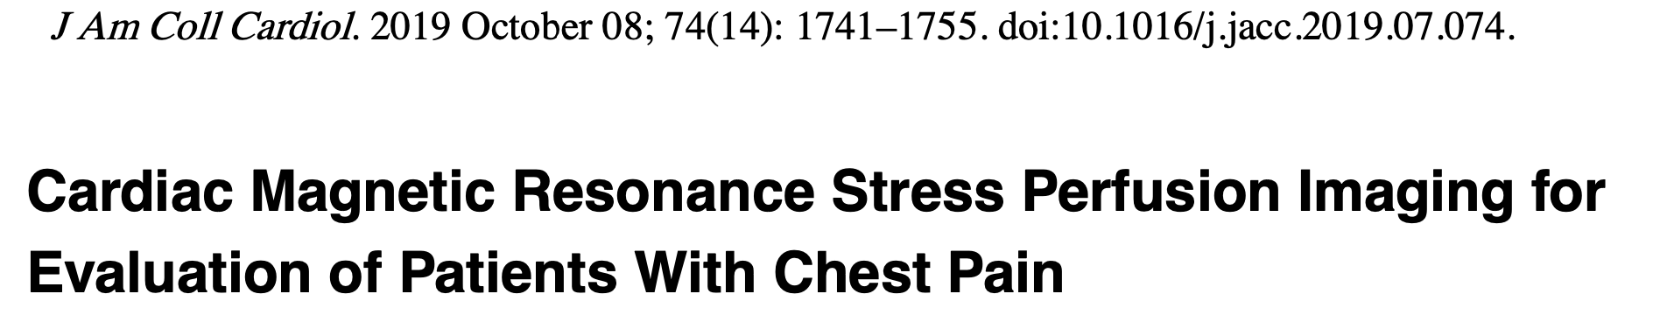
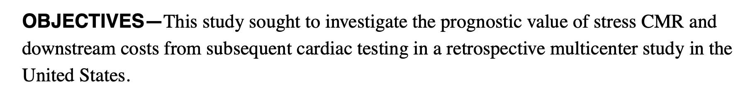
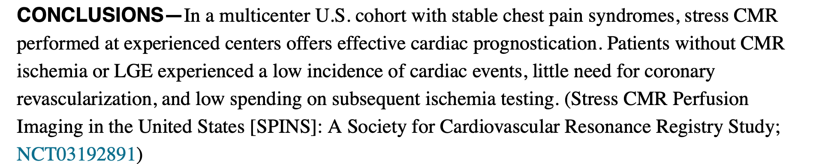
Risk stratification - Prognosis
Ischaemia + / LGE +
Ischaemia + / LGE –
Ischaemia - / LGE -

Slide 24

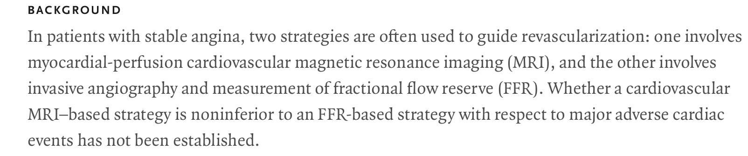
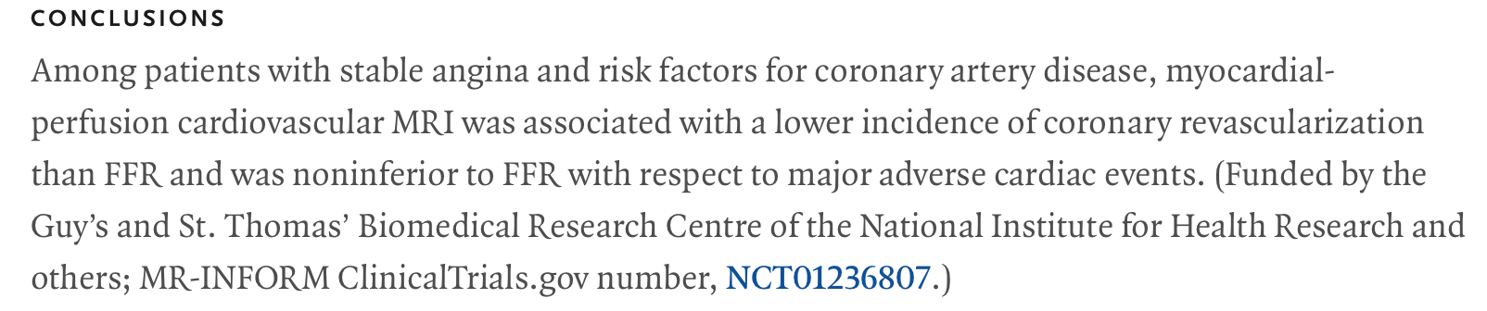
MR INFORM

Slide 25

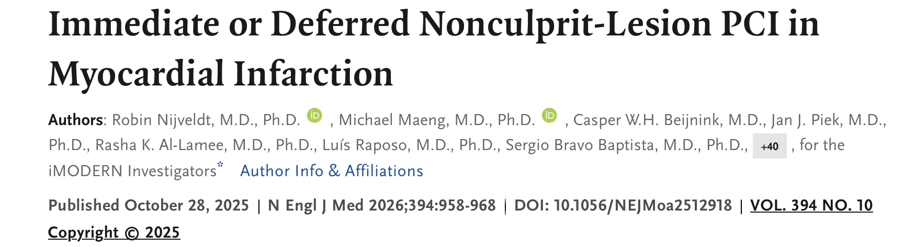
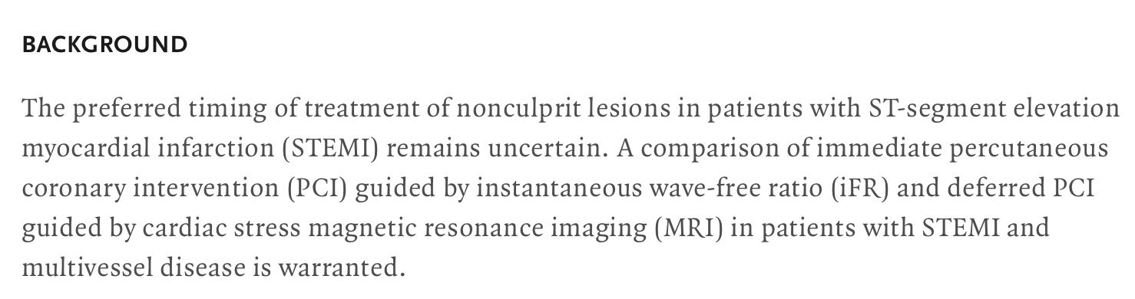
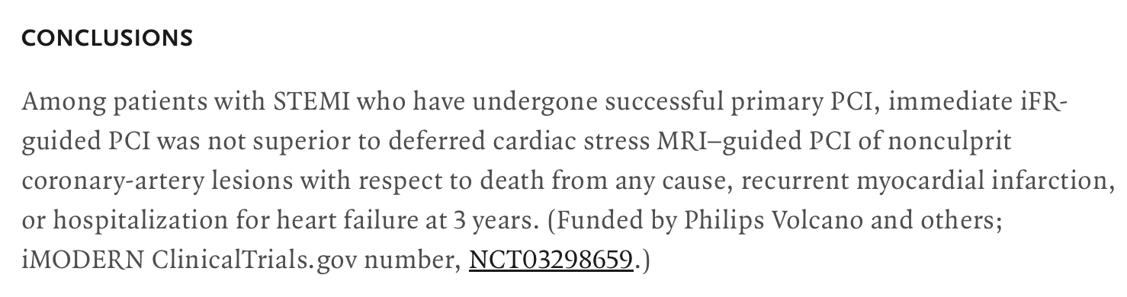
iMODERN

Slide 26

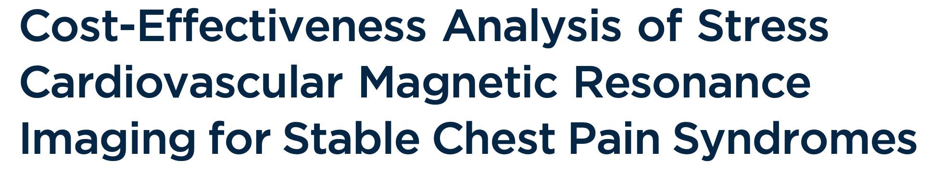
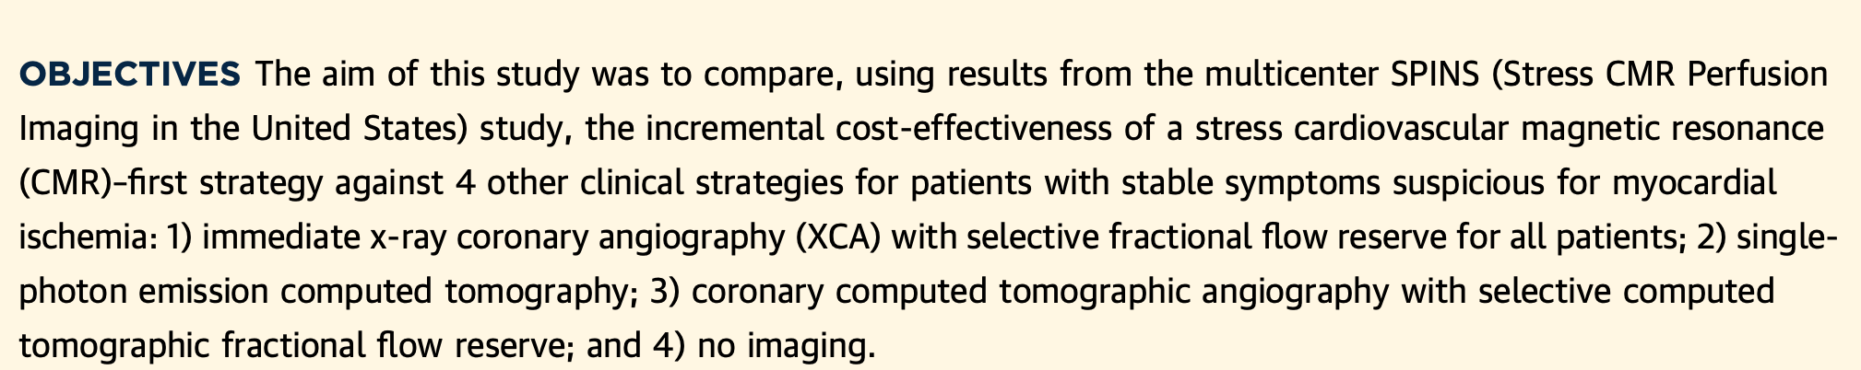
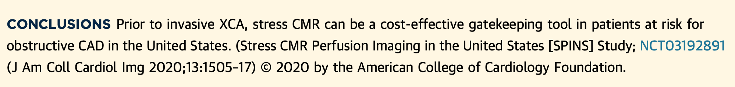

Slide 27
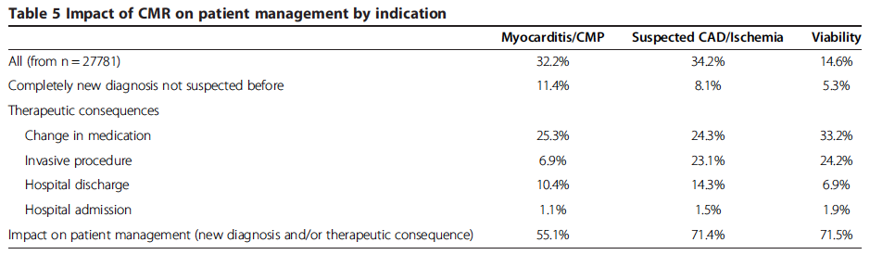
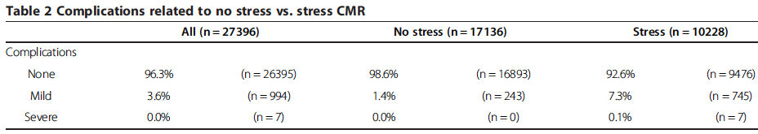
Euro CMR Registry

Slide 28
Semi quantification
Studying signal properties

Slide 29
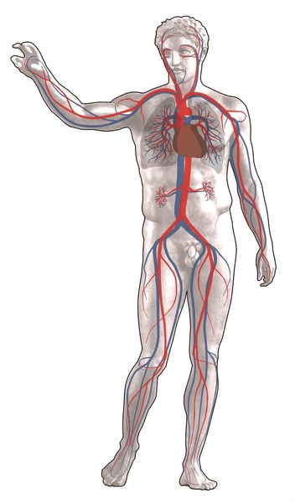

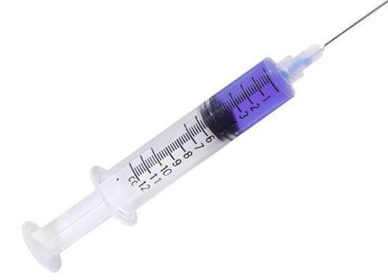
Semi quantification
MR Signal
Time
MR Contrast agent
(Gadolinium based)
Courtesy of S. Kozerke, Zurich, CH

Slide 30
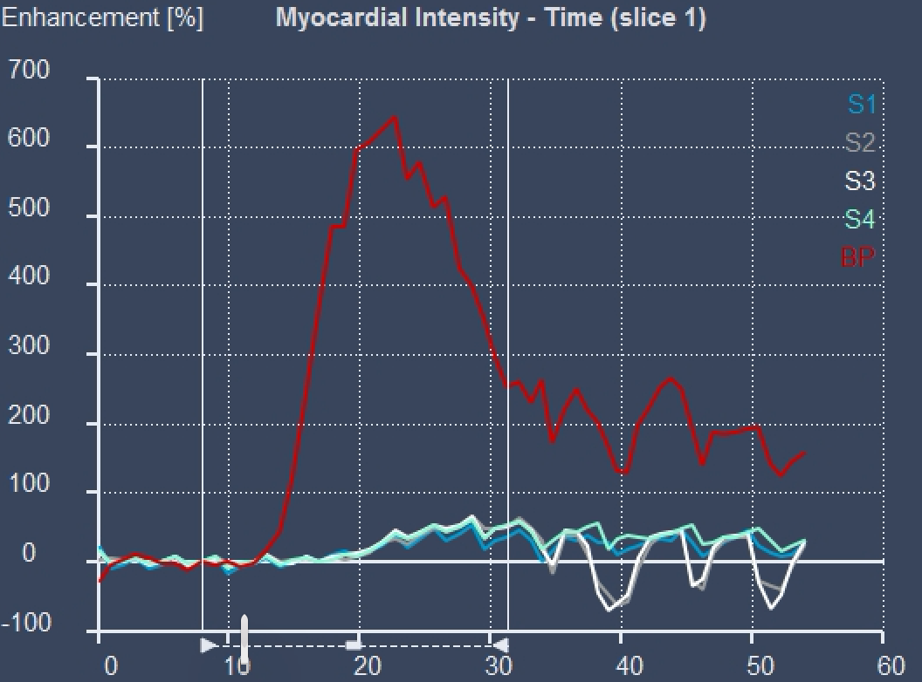



FDL/ Atypical symptoms
Stress
Rest

Slide 31
Semi quantification
Allows to distinguish between normal and abnormal perfusion properties (balanced, MvD)
But
Time consuming
Not efficient for comparison between different pathologies or for follow up

Slide 32
Absolute Quantification
Translating signal properties into physiology
Grading of inducible perfusion defects

Slide 33
Absolute quantitative perfusion analysis
Based on the indicator–dilution theory, the measured LV signal intensity Caif (tracer concentration), and the measured myocardium tissue signal intensity, Ctiss, under the assumption that the initial concentration in tissue region is zero, are related according to the following convolution:
Where h(t) is the myocardial impulse response.
SI
AIF
Myocardial Signal
time
Fermi deconvolution
Rest and stress perfusion estimates
Myocardial perfusion reserve (stress/rest perfusion)

Slide 34
Absolute quantitative perfusion CMR
High resolution / Pixel wise analysis
Accurate regional and sub segmental analysis
Study of the intramyocardial gradient
Improved detection of 3-vessel disease / balanced ischaemia / MvD

Slide 35



Normal
R STRESS MBF
< 1.94 mL/min/g = IHD
G STRESS MBF
Normal 2.25 mL/min/g > MvD> 3VD 1.82 mL/min/g
MvD
3VD
Kotecha T, JACC: Cardiovascular Imaging. 2020; 13: 2546–2557.

Slide 36
3VD
VISUAL ASSESSMENT - 50% ACCURACY
Kotecha T, JACC: Cardiovascular Imaging. 2020; 13: 2546–2557.
MVD
VISUAL ASSESSMENT- 58% ACCURACY
Rahman H et al, JACC Cardiovascular Imaging. 2021; 14: 978–986.

Slide 37





Slide 38



Subclinical disease?
Epicardial & Microvascular involvement?
Significance of regional ischaemic burden differences (transmurality, intensity)?

Slide 39



Slide 40



Slide 41



Slide 42



Slide 43



Slide 44
Perfusion in children

Slide 45

3 yo with Kawasaki disease
Courtesy of King’s College London

Slide 46


3 yo with Kawasaki disease
Without Adenosine
With Adenosine Infusion
Pixelwise analysis

Slide 47
3453. Κλινική εμπειρία εφαρμογής μελέτης αιματώσεως μυοκαρδίου με μαγνητικό συντονισμό (stress perfusion CMR) σε ασθενείς με εμφυτευόμενες καρδιακές συσκευές (Cardiac Implantable Electronic Devices - CIEDs): ασφάλεια & αποτελεσματικότητα.
Κ Μπράτης (1), Μ Πεντάρης (2), Σ Μυκωνιάτη (2), Ζ Μόρου (2), Μ Παντερμαράκη (2), Η Ματσούκας (1), Ε Αρβανίτης (1), Κ Λέγκου (1), Ε Ρεπάσος (3), Μ Μπιτσαρά (2), Κ Μπιρμπίλης (2), Ν Μπιάγκης (2), Ν Μακρής (3), Ν Αγγελής (2), Σ Χατζίδου (3), Α Νταλιάνης (2)
Τμήμα Μαγνητικής Τομογραφίας Καρδιάς, Όμιλος Βιοϊατρική, Αθήνα
Μονάδα Στεφανιαίας Νόσου και Μυοκαρδιοπαθειών, ΓΝΑ Αλεξάνδρα, Αθήνα
Μονάδα Στεφανιαίας Νόσου και Μυοκαρδιοπαθειών, ΓΝΑ Αλεξάνδρα, Αθήνα

Slide 48





CIED interrogation
& programming
Stress CMR
pre assessment
MRI protocol optimisation
Close monitoring &
Post scan evaluation

Slide 49



48 yo male
ICM-CABG
DDDR ICD
LVEF 15 %

Slide 50
Viability assessment

Slide 51

Tissue types as identified by CMR

Slide 52
EXTENT / TRANSMURALITY
Within each segment
0%, 1-25%, 26%-50%, 51%-75%, 76%-100%
PREDICTING IMPROVEMENT IN CONTRACTILITY AFTER REVASCULARISATION
PROGNOSTIC VALUE
Kim RJ et al. NEJM 2001
Roes D et al. AJC 2007

Slide 53

Transmurality
Transmurality of infarction relates to the likelihood of functional recovery after revascularization
10±7% transmurality - improved contractility after revascularization
75% transmurality of LGE was found to have 100% negative predictive value for improved contractility

Slide 54
INTERPRETATION OF LATE GADOLINIUM ENHANCEMENT
Post-MI myocardial scar …within the (vessel) territory, there is … indicating
O-50%: significant viability
51-75%: small areas of viability with low likelihood of functional recovery
75-100%: no viability
Consider contractility and thickness!

Slide 55


Late Gadolinium Enhancement (LGE)

Slide 56

Thrombus

Slide 57

RV extension - Thrombus

Slide 58
Coronary artery imaging

Slide 59


Slide 60
Advantages of CMRA
Non-invasive
No radiation (follow up)
Use of contrast not systematically necessary

Slide 61


LCA

Slide 62


RCA

Slide 63




Multi vessel disease

Slide 64



Slide 65
The role of CMR in IHD
Extent of systolic impairment - METHOD OF CHOICE
Differential diagnosis of jeopardized myocardium (ischaemia, stunning, hibernation, infarction)
Presence and extent of inducible ischaemia - FIRST LINE EXAM/EQUALLY PROPOSED
                - SAFE, ROBUST, IMPACTFUL, PROGNOSTIC, QUANTITATIVE IF NEEDED
Presence of myocardial necrosis - METHOD OF CHOICE
Coronary artery imaging - UNDER DEVELOPMENT, NOT CLINICALLY APPLICABLE FOR LUMEN ASSESSMENT

