Slide 1
ΗΠΑΡ
Ανατομία, φυσιολογία, ίκτερος
Κων/νος Γ. Τούτουζας
Καθηγητής Χειρουργικής ΕΚΠΑ

Slide 2
Liver…in a glance
It is classed as a gland
2% of the body weight
13% of the bodie’s blood supply
It carries out over 500 essential tasks
It is the only organ that can regenerate

Slide 3
ΑΝΑΤΟΜΥ
The liver is the largest of the abdominal viscera, occupying a substantial portion of the upper abdominal cavity
It is composed largely of epithelial cells (hepatocytes), which are bathed in blood derived from the hepatic portal veins and hepatic arteries.
Hepatocytes are also associated with an extensive system of minute canals, which form the biliary system into which products are secreted.

Slide 4
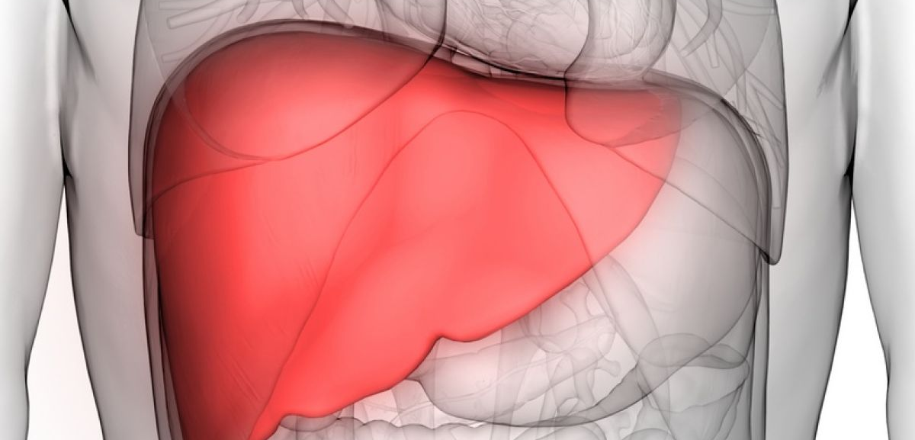

Slide 7
The liver is attached to the anterior abdominal wall, diaphragm and other viscera by several ligaments, which are formed from condensations of the peritoneum :
} Falciform ligament
} Coronary ligament
} Triangular ligaments
} Lesser omentum

Slide 8
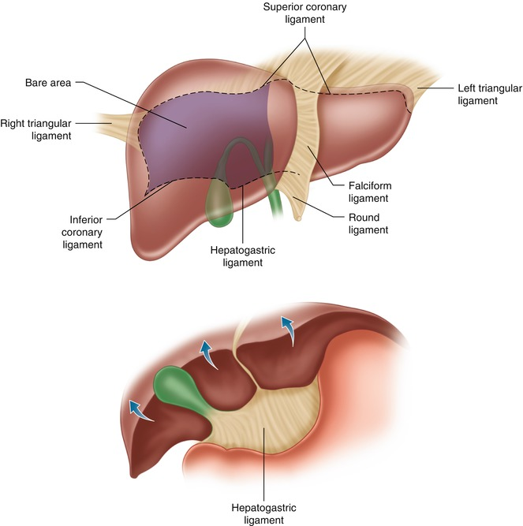
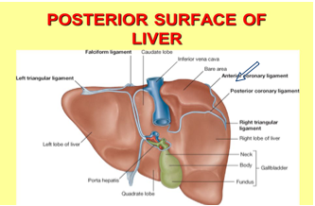

Slide 9
Porta hepatis
The Porta hepatis is the area of the inferior surface through which all the neurovascular and biliary structures, except the hepatic veins, enter and leave the liver.
It is situated between the quadrate lobe in front and the caudate process behind.
Right and left hepatic bile ducts emerge from it.
All these structures are enveloped in the perivascular fibrous capsule - hepatobiliary capsule of Glisson - a sheath of loose connective tissue which surrounds the vessels

Slide 10
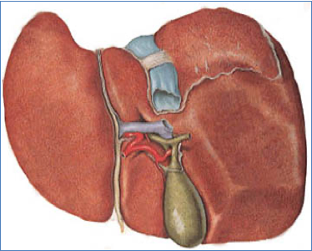
Porta hepatis
The Porta hepatis is the area of the inferior surface through which all the neurovascular and biliary structures, except the hepatic veins, enter and leave the liver.
It is situated between the quadrate lobe in front and the caudate process behind.
Right and left hepatic bile ducts emerge from it.
All these structures are enveloped in the perivascular fibrous capsule - hepatobiliary capsule of Glisson - a sheath of loose connective tissue which surrounds the vessels

Slide 11
Blood supply – portal vein

Slide 12
Blood supply – hepatic artery

Slide 13
Lobation and segmentation
The liver has four lobes or eight segments, depending on whether it is defined by its gross anatomical appearance or by its internal architecture.

Slide 14
Gross anatomical lobes
Right lobe
The right lobe is the largest in volume and
contributes to all surfaces
Quadrate lobe
The quadrate lobe is only visible from the inferior
surface. it is functionally related to the left lobe.
Caudate lobe
this lobe is said to arise from the right lobe, but it is
functionally separate
Left lobe
The left lobe is the smaller of the two 'main' lobes

Slide 15
Couinaud segments
The liver is divided by the 'principal plane' into two halves of approximately equal size. The principal plane is defined by an imaginary parasagittal line from the gallbladder anteriorly to the inferior vena cava posteriorly.
The usual functional division of the liver into right and left lobes lies along this plane.
The liver is further subdivided into segments, each supplied by a
principal branch of the hepatic artery, portal vein and bile duct.

Slide 16
Couinaud segments
Segments I, II, III and IV make up the functional left lobe,
Segments V, VI, VII and VIII make up the functional right
lobe
Segment I corresponds to the gross anatomical caudate lobe and segment IV to the quadrate lobe

Slide 17
Couinaud segments

Slide 19
FUNCTION
Filters the blood: The liver filters and removes compounds from the body, including hormones, such as estrogen and aldosterone, and compounds from outside the body, including alcohol and other drugs.
Immunological function: The liver is part of the mononuclear phagocyte system. It contains high numbers of Kupffer cells that are involved in immune activity. These cells destroy any disease-causing agents that might enter the liver through the gut.

Slide 20
FUNCTION
Absorbing and metabolizing bilirubin: Bilirubin is formed by the breakdown of hemoglobin. The iron released from hemoglobin is stored in the liver or bone marrow and used to make the next generation of blood cells.
Metabolizing carbohydrates: Carbohydrates are stored in the liver, where they are broken down into glucose and siphoned into the bloodstream to maintain normal glucose levels. They are stored as glycogen and released whenever a quick burst of energy is needed.
Vitamin and mineral storage: The liver stores vitamins A, D, E, K, and B12. It keeps significant amounts of these vitamins stored. In some cases, several years’ worth of vitamins is held as a backup. The liver stores iron from hemoglobin in the form of ferritin, ready to make new red blood cells. The liver also stores and releases copper.

Slide 21
FUNCTION
Bile production: Bile helps the small intestine break down and absorb fats, cholesterol, and some vitamins. Bile consists of bile salts, cholesterol, bilirubin, electrolytes, and water.
Supporting blood clots: Vitamin K is necessary for the creation of certain coagulants that help clot the blood. Bile is essential for vitamin K absorption and is created in the liver. If the liver does not produce enough bile, clotting factors cannot be produced.
Fat metabolization: Bile breaks down fats and makes them easier to digest.
Proteins metabolization: Bile helps break down proteins for digestion.

Slide 22
FUNCTION
Production of albumin: Albumin is the most common protein in blood serum. It transports fatty acids and steroid hormones to help maintain the correct pressure and prevent the leaking of blood vessels.
Synthesis of angiotensinogen: This hormone raises blood pressure by narrowing the blood vessels when alerted by production of an enzyme called renin in the kidneys.

Slide 23
Liver regeneration
Because of the importance of the liver and its functions, evolution has ensured that it can regrow rapidly as long as it is kept healthy. This ability is seen in all vertebrates from fish to humans.
It can regenerate completely, as long as a minimum of 25 percent of the tissue remains. One of the most impressive aspects of this feat is that the liver can regrow to its previous size and ability without any loss of function during the growth process.
In mice, if two-thirds of the liver is removed, the remaining liver tissue can regrow to its original size within 5 to 7 days. In humans, the process takes slightly longer, but regeneration can still occur in 8 to 15 days – an incredible achievement, given the size and complexity of the organ.
Over the following few weeks, the new liver tissue becomes indistinguishable from the original tissue.

Slide 24
Liver regeneration
This regeneration is helped by a number of compounds, including growth factors and cytokines. Some of the most important compounds in the process appear to be:
hepatocyte growth factor
insulin
transforming growth factor-alpha
epidermal growth factor
interleukin-6
norepinephrine

Slide 25
Liver diseases
Hepatitis: Hepatitis is the name given to a general infection of the liver, and viruses, toxins, or an autoimmune response can cause it. It is characterized by an inflamed liver. In many cases, the liver can heal itself, but liver failure can occur in severe cases.
Cirrhosis: This sees scar tissue replace liver cells in a process known as fibrosis. This condition can be caused by a number of factors, including toxins, alcohol, and hepatitis. Eventually, fibrosis can lead to liver failure as the functionality of the liver cells is destroyed.
Alcoholic liver disease: Drinking too much alcohol over long periods of time can cause liver damage. It is the most common cause of cirrhosis in the world.
Primary sclerosing cholangitis (PSC): PSC is a serious inflammatory disease of the bile ducts that results in their destruction. There is currently no cure, and the cause is currently unknown, although the condition is thought to be autoimmune.
Fatty liver disease: This usually occurs alongside obesity or alcohol abuse. In fatty liver disease, vacuoles of fat build up in the liver cells. If it is not caused by alcohol abuse, the condition is called non-alcoholic fatty liver disease (NAFLD).
It is usually caused by genetics, medications, or a diet high in fructose sugar. It is the most common liver disorder in developed countries and has been associated with insulin resistance. Non-alcoholic steatohepatitis (NASH) is a condition that can develop if NAFLD gets worse. NASH is a known cause of liver cirrhosis.
Liver cancer: The most common types of liver cancer are hepatocellular carcinoma and cholangiocarcinoma. The leading causes are alcohol and hepatitis. It is the sixth most common form of cancer and the second most frequent cause of cancer death.

Slide 26
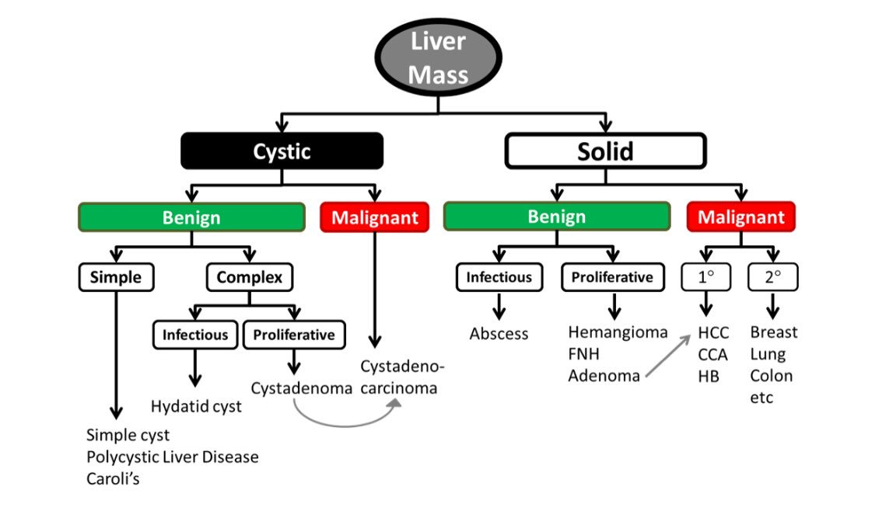

Slide 28
ΙΚΤΕΡΟΣ
Η κίτρινη χροιά στο δέρμα, τους βλεννογόνους και τους επιπεφυκότες, η οποία οφείλεται σε αύξηση της χολερυθρίνης στο αίμα (φυσιολογική τιμή 0,3 – 1,2mg/dl)
O ίκτερος γίνεται αντιληπτός με την επισκόπηση όταν το ποσό της χολερυθρίνης του αίματος υπερβαίνει τα 4-5mg%.
Οταν η τιμή της χολερυθρίνης κυμαίνεται από 2-4 mg/dl, παρατηρείται κίτρινη χρώση μόνο του σκληρού χιτώνα των ματιών, που ονομάζεται υπίκτερος

Slide 29
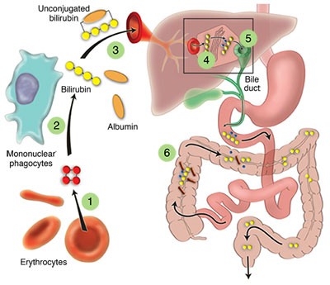
Bilirubin metabolism
Heme, the substrate of bilirubin, is derived from red blood cells that have died.
Heme is degraded to biliverdin by heme oxygenase in the mononuclear phagocytes.
Biliverdin is subsequently reduced to bilirubin by biliverdin reductase.
Circulating bilirubin (insoluble) is bound to albumin and subsequently taken up by the hepatocytes.
To make it soluble, bilirubin undergoes conjugation, a reaction catalyzed by bilirubin UDPglucuronyl transferase (UDPG).
Conjugated bilirubin (soluble) is excreted into bile and reaches the bowel.
Bilirubin glucuronides are deconjugated by colonic bacteria and eliminated in the feces.

Slide 30
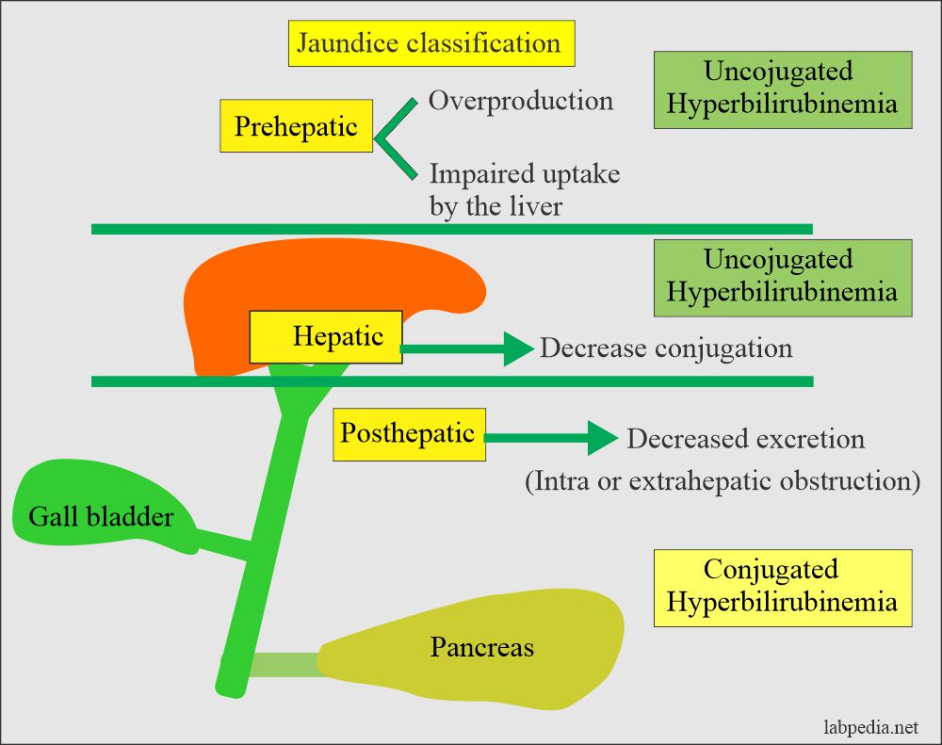

Slide 31
Είδη ικτέρου
Κάθε διαταραχή στο μεταβολισμό της χολερυθρίνης μπορεί να προκαλέσει ίκτερο
Παραγωγή - μεταφορά εντός των ηπατοκυττάρων - έκκριση στα χοληφόρα τριχοειδή – αποβολή στο έντερο
Αιμολυτικός
Ηπατοκυτταρικός
Αποφρακτικός

Slide 32
Αιμολυτικός ίκτερος
Αυξημένη καταστροφή αιμοσφαιρίνης
Αιμολυτικά σύνδρομα (μεσογειακή αναιμία, μικροδρεπανοκυτταρική αναιμία, σφαιροκυττάρωση, αυτοάνοσα αιμολυτικά σύνδρομα)
Αναιμία & ίκτερος
Έμμεση υπερχολερυθριναιμία
Χολολιθίαση, ηπατίτιδα Β ή C

Slide 33
Ηπατοκυτταρικός ίκτερος
Ανεπάρκεια σύζευξης της χολερυθρίνης (Gilbert, Rotor)
Ηπατοκυτταρική βλάβη (ηπατίτιδα, κίρρωση, φάρμακα)
Εμμεση υπερχολερυθριναιμία ή μικτή (ενδοηπατική χολόσταση)
Τρανσαμινασαιμία, υποαλβουμιναιμία, διαταραχές πήξης

Slide 34
Αποφρακτικός ίκτερος
Διαταράσσεται η αποβολή άμεσης χολερυθρίνης από τα χοληφόρα προς το έντερο
Οφείλεται σε απόφραξη των εξωηπατικών χοληφόρων – χειρουργικός ίκτερος
Αμεση υπερχολερυθριναιμία
Υπέρχρωση ούρων (σαν κονιάκ), αποχρωματισμός κοπράνων (στοκώδη)
Αποφρακτικά ένζυμα (γGT, ALP)

Slide 35
Αποφρακτικός ίκτερος
Το αίτιο της απόφραξης μπορεί να είναι ενδοαυλικό (χοληδοχολιθίαση, χολαγγειοκαρκίνωμα, παράσιτα) ή εξωαυλικό (νεόπλασμα)
Ενδοηπατική χολόσταση – βλάβη στο μικρά χολαγγεία και ειδικότερα στα χοληφόρα τριχοειδή. Κυρίως φάρμακα (παρακεταμόλη, μεθυλντόπα, ισονιαζίδη, χλωροπροπαμίδη, ερυθρομυκίνη, αζαθειοπρίμη)

Slide 36
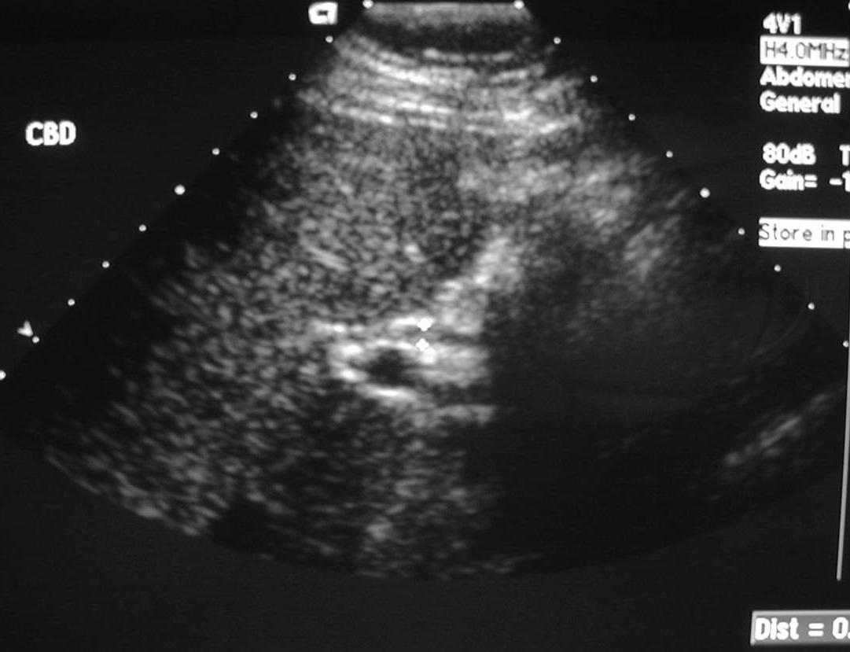
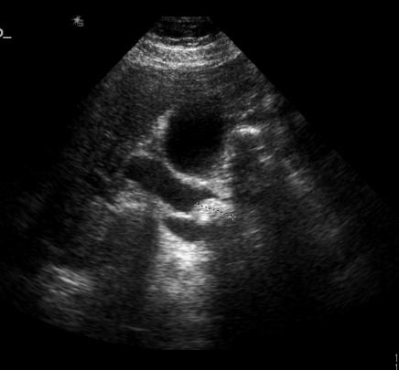
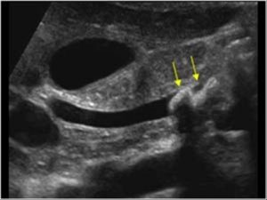
Αποφρακτικός ίκτερος διάταση χοληφόρων

Slide 37



