Slide 1

ΣΗΨΗΗ
Μανουράς Ιωάννης
Χειρουργός Εντατικολόγος

Slide 2
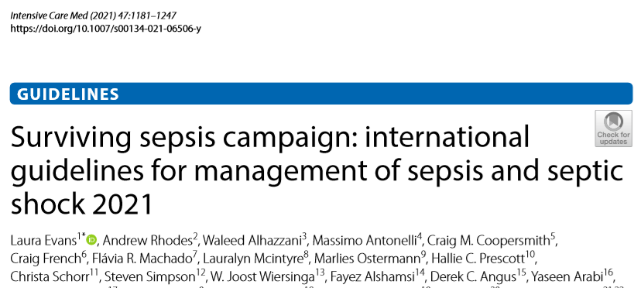

Slide 3


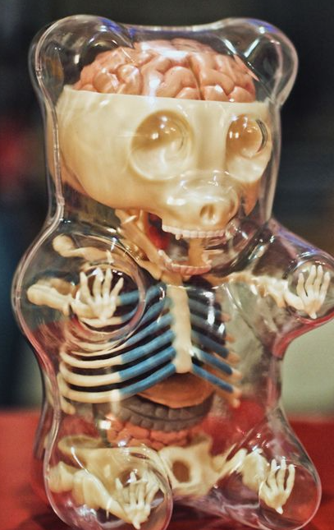
Τι είναι σήψη;
Λοίμωξη
Δυσανάλογη απόκριση ξενιστή
Δυλειτουργία Οργάνων

Slide 4
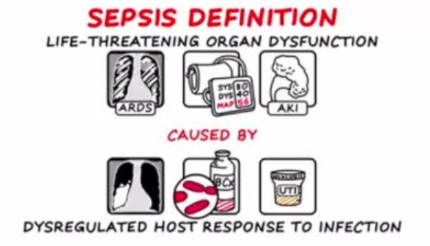
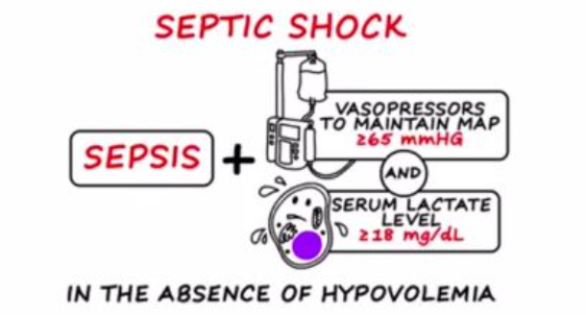
ΟΡΙΣΜΟΙ
Σήψη: Η απειλητική για τη ζωή δυσλειτουργία οργάνων που προκαλείται από τη δυσανάλογη απόκριση του ξενιστή στη λοίμωξη
Σηπτική καταπληξία: υποσύνολο της Σήψης που οι υποκείμενες διαταραχές της κυκλοφορίας και του κυτταρικού μεταβολισμού είναι τόσο εξεσημασμένες, ώστε να αυξάνουν τη θνητότητα σε σημαντικό βαθμό
Singer M, Deutschman CS, Seymour CW, et al. The Third International Consensus Definitions for Sepsis and Septic Shock (Sepsis-3). JAMA. 2016;315(8):801-810. doi:10.1001/jama.2016.0287

Slide 5
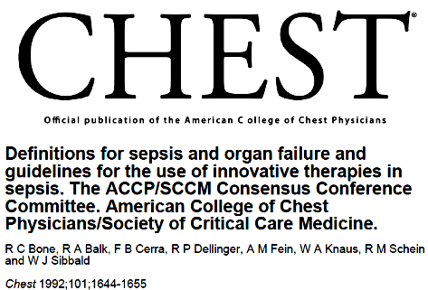
1. Body temperature higher than 38°C or lower than 36 °C
2. Heart rate higher than 90/min
3. Hyperventilation evidenced by respiratory rate higher than 20/min or
PaCO2lower than 32 mmHg
4. White blood cell count higher than 12,000 cells/μl or lower than 4,000/μl
or >10% immature bands

Slide 6
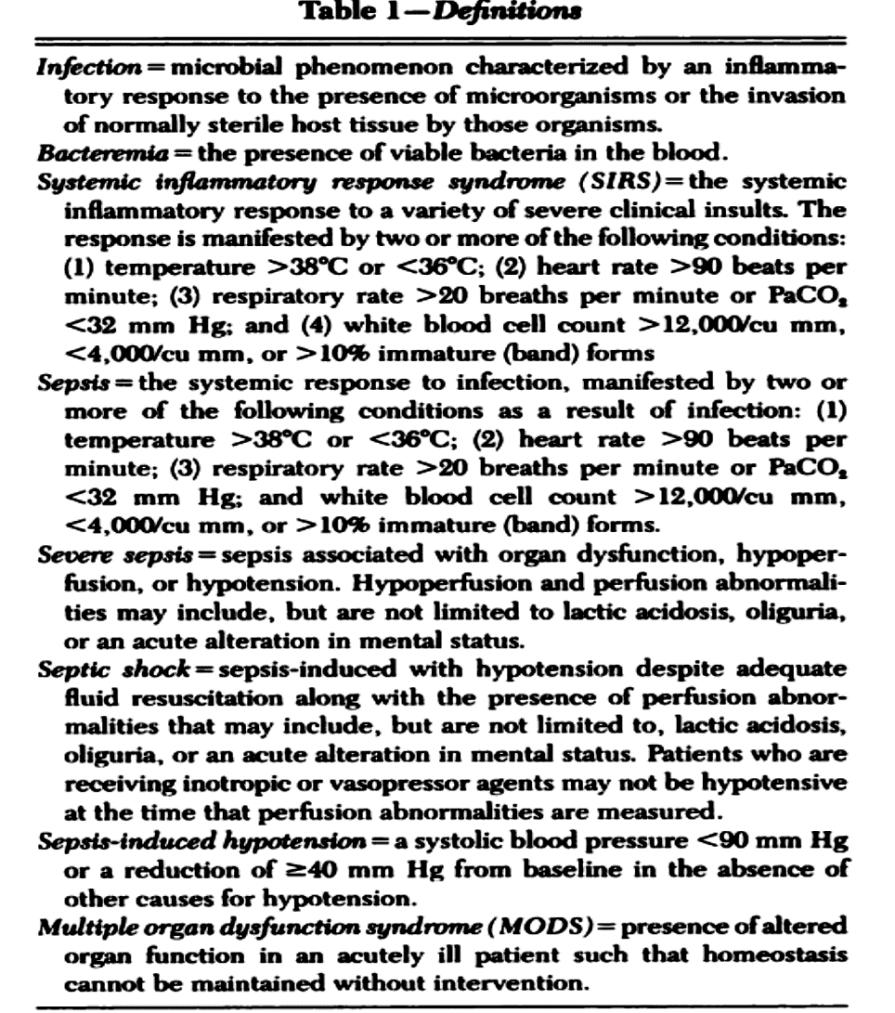

Slide 7
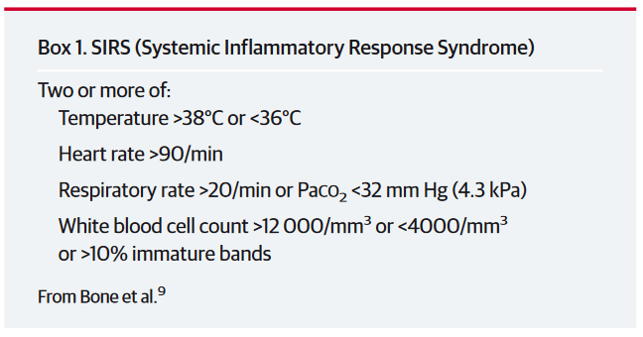

Slide 8
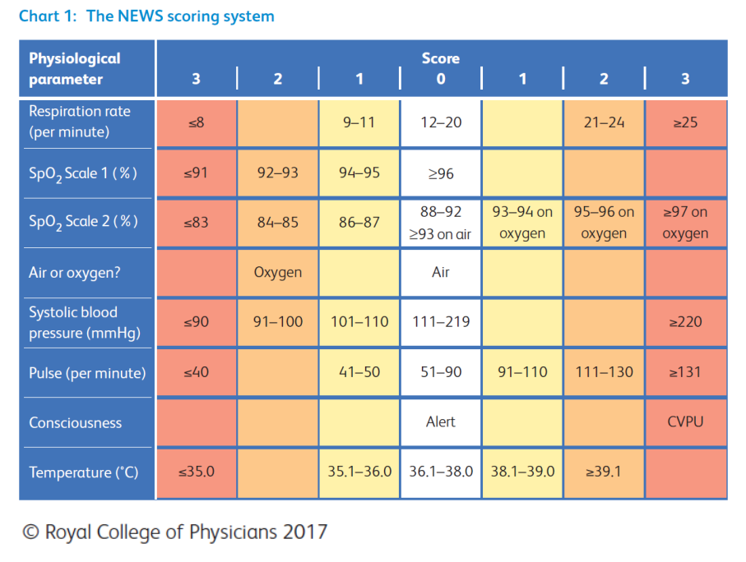
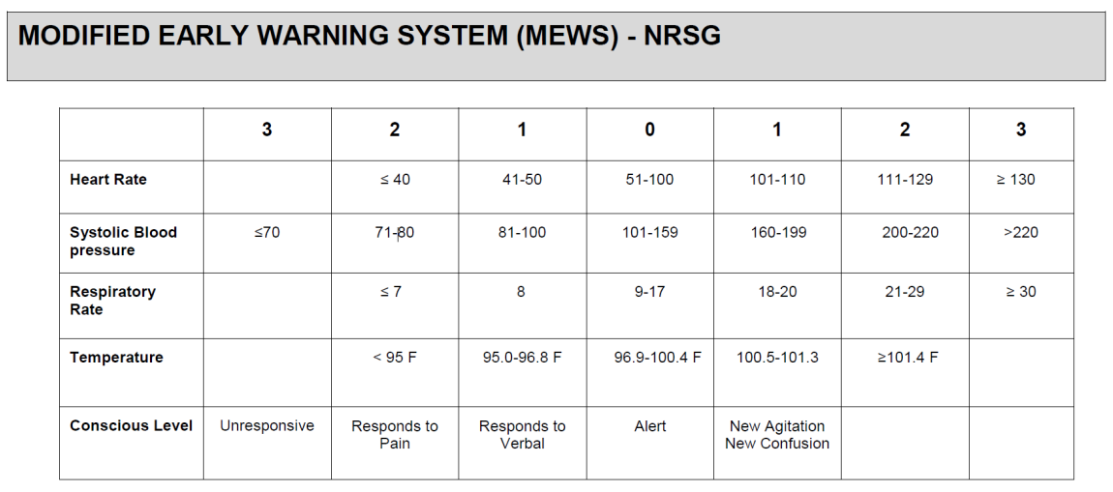

Slide 9
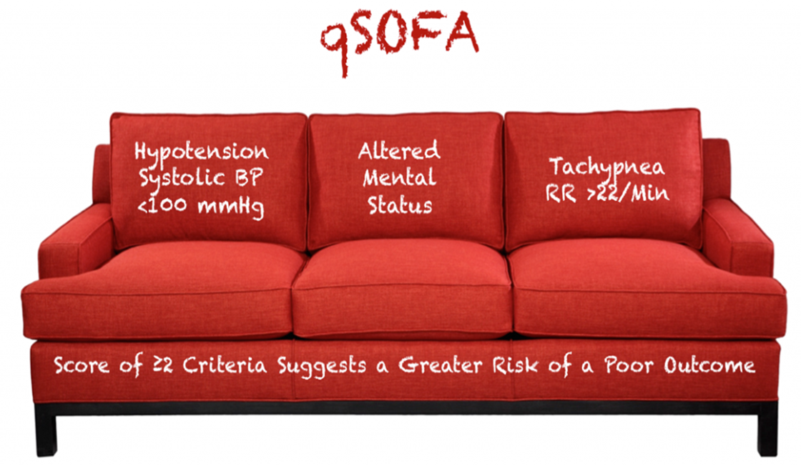

Slide 10
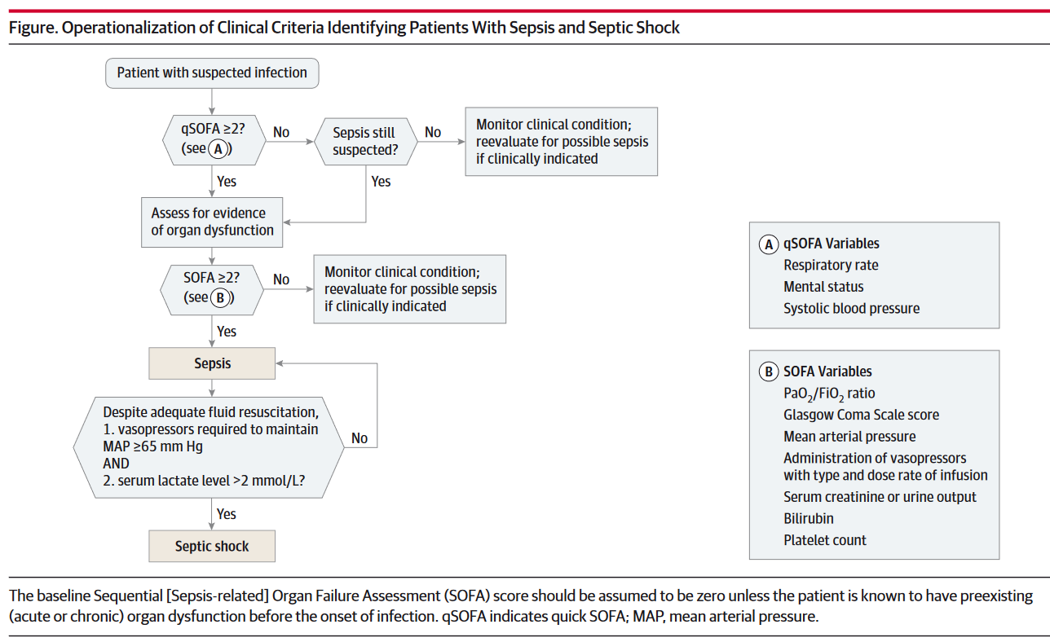

Slide 11

Sepsis is defined as life-threatening organ dysfunction caused by a dysregulated host response to infection
The SIRS criteria do not necessarily indicate a dysregulated, life-threatening response and are present in many hospitalized patients, including those who never develop infection
Singer M, Deutschman CS, Seymour CW, et al: The third international consensus definitions for sepsis and septic shock (Sepsis-3) JAMA 2016; 315:801–810

Slide 12

Patients with septic shock can be identified with a clinical construct of sepsis with persisting hypotension requiring vasopressors to maintain MAP ≥65mmHg and having a serum lactate level >2 mmol/L despite adequate volume
resuscitation.
Septic shock is a subset of sepsis in which underlying circulatory and cellular/metabolic abnormalities are profound enough to substantially increase mortality
With these criteria, hospital mortality is in excess of 40%

Slide 13
Randomized controlled trials have demonstrated a significant reduction in mortality with lactate guided resuscitation
If initial lactate is elevated (> 2mmol/L), it should be remeasured within 2−4 h to guide resuscitation to normalize lactate in patients with elevated lactate levels as a marker of tissue hypoperfusion
The Surviving Sepsis Campaign Bundle: 2018 Update
Levy Mitchell M.; Evans Laura E.; Critical Care Medicine 46(6):p 997-1000, June 2018

Slide 14

The presence of an elevated or normal lactate level significantly increases or decreases, respectively, the likelihood of a final diagnosis of sepsis in patients with suspected sepsis
However, lactate alone is neither sensitive nor specific enough to rule-in or rule out the diagnosis on its own

Slide 15


The Institute for Health Metrics and Evaluation (IHME) study on the global burden of sepsis estimated 48.9 million incident sepsis cases and 11 million sepsis-related deaths (representing 19.7% of all global deaths) worldwide in 2017
Rudd KE, Johnson SC, Agesa KM et al (2020) Global, regional, and national sepsis incidence and mortality, 1990-2017: analysis for the Global Burden of Disease Study Lancet 395:200–211

Slide 16
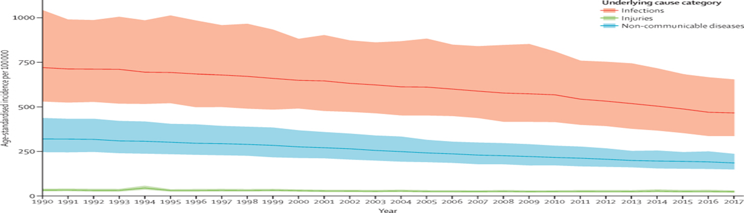
Between 1990 and 2017 age-standardized sepsis incidence fell by 37% and
mortality decreased by 52.8%
Rudd KE et al (2020) Global, regional, and national sepsis incidence and mortality,
1990-2017: analysis for the Global Burden of Disease Study Lancet 395:200–211

Slide 17
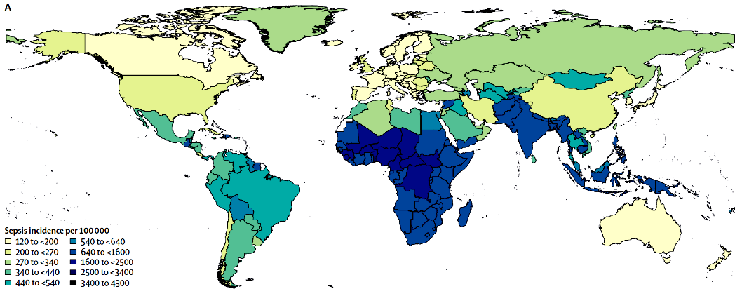
85% of sepsis cases and sepsis-related deaths occurring in low- and middle-income countries
Need for greater prevention and treatment of sepsis, particularly in areas of the world with the lowest SDI (Socio-demographic Index)

Slide 18
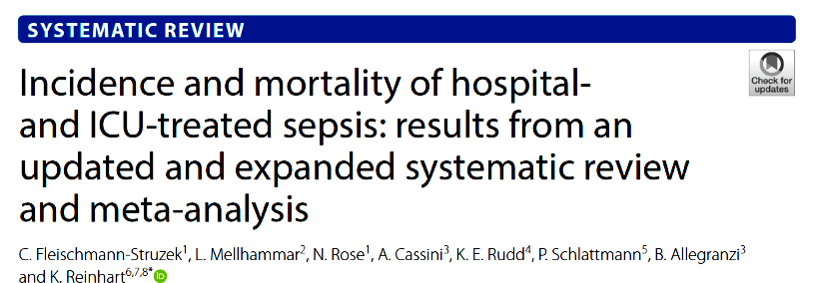
Compared to results from the IHME study, we found an approximately 50% lower incidence of hospital-treated sepsis
One out of four sepsis patients did not survive their hospital stay
The incidence of sepsis remains unknown for the vast majority of LMICs (low- or middle-income countries), highlighting the urgent need for improved epidemiological sepsis surveillance
Intensive Care Med (2020) 46:1552–1562

Slide 19
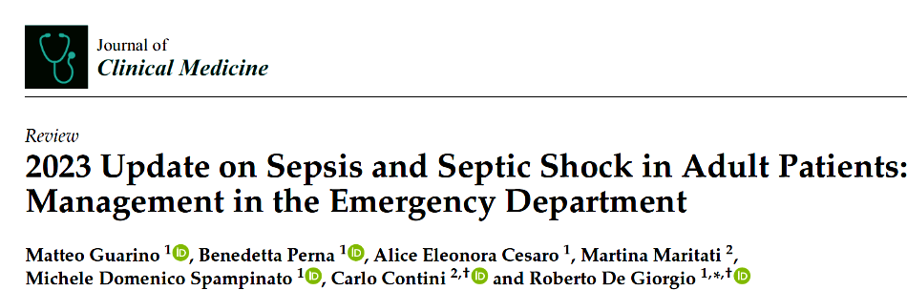
This alarming increase in incidence can be attributed to different factors:
(i) the advanced average age among patients, especially in western countries;
(ii) the increased number of invasive procedures;
(iii) the wide usage of immunosuppressive drugs and chemotherapy;
(iv) antibiotic resistance

Slide 20


Αρχική Αναζωογόνηση

Slide 21
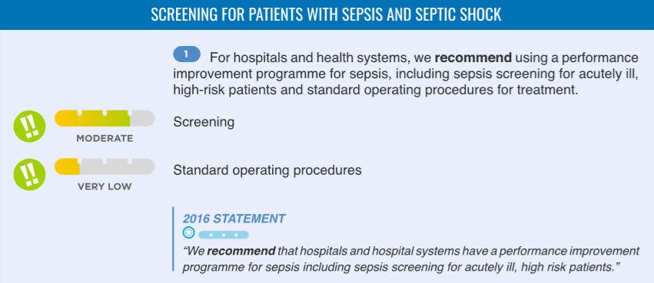
SCREENING & ΠΡΩΙΜΗ ΘΕΡΑΠΕΙΑ
wide variation in sensitivity and specificity of sepsis screening tools, they are an important component of identifying sepsis early for timely intervention.
Standard operating procedures are a set of practices that specify a preferred response to specific clinical circumstances
Sepsis SOPs, initially specified as Early Goal Directed Therapy have evolved to “usual care” which includes a standard approach with components of the sepsis bundle, early identification, lactate, cultures, antibiotics, and fluids

Slide 22

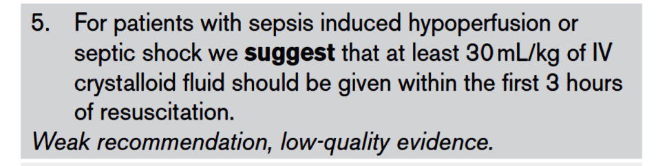
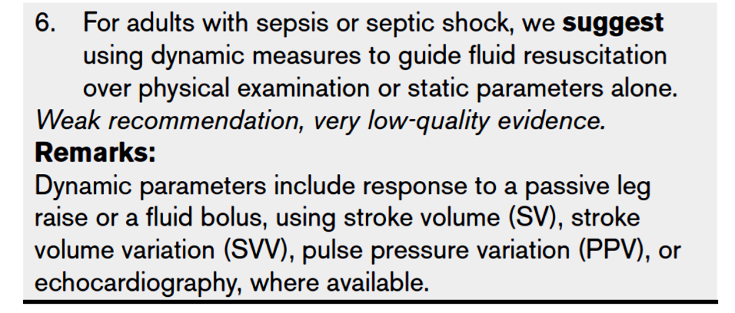


Slide 23
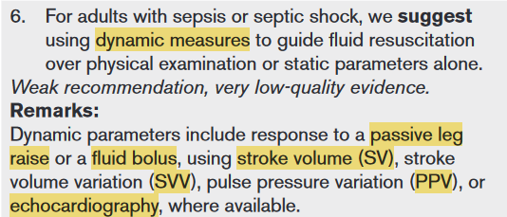
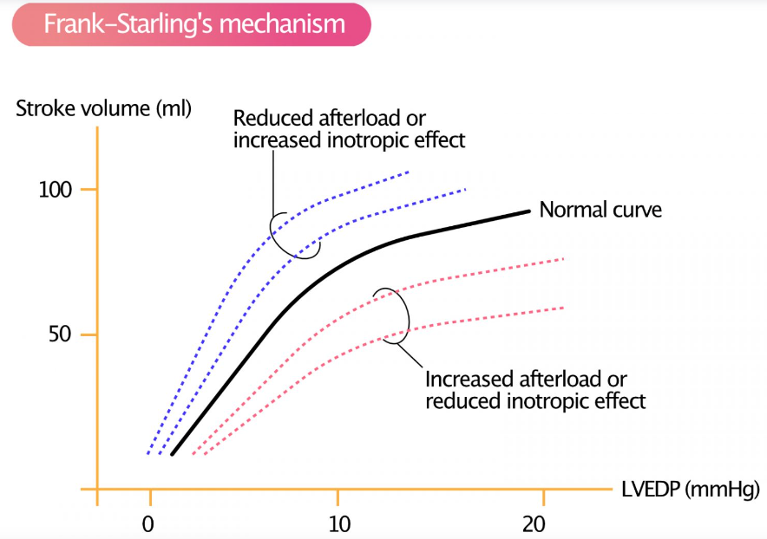

Static Parameters:
left ventricular end-diastolic area (LVEDA)
Inferior vena cava diameter (IVCd) – ECHO
Global end diastolic volume (GEDV) -transpulmonary thermodilution (TTD)
Central venous pressure (CVP) measured with a central venous line.
While such static parameters were previously widely used, evidence has repeatedly shown that CVP and other static parameters fail to predict fluid responsiveness, even in its extreme values. Therefore, fluid administration guided by static parameters is strongly discouraged.
Οδηγός αναζωογόνησης υγρών -> Δυναμικές μετρήσεις αντί μόνο φυσική εξέταση και στατικές μετρήσεις

Slide 24

Critically ill emergency department patients with a ≥ 6 hr delay in intensive care unit transfer had increased hospital length of stay and higher intensive care unit and hospital mortality.
Chalfin DB, Trzeciak S, Likourezos A, et al; DELAY-ED study group: Impact of delayed transfer of critically ill patients from the emergency department to the intensive care unit. Crit Care Med 2007; 35:1477–1483

Slide 26


Όχι Βιοδείκτες για έναρξη αντιμικροβιακών

Slide 27

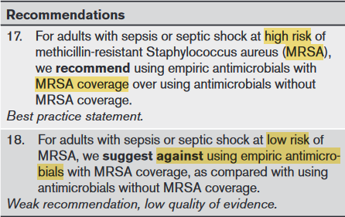
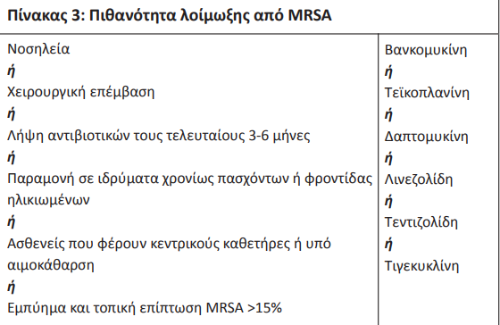
Antimicrobial Choice - MRSA

Slide 28
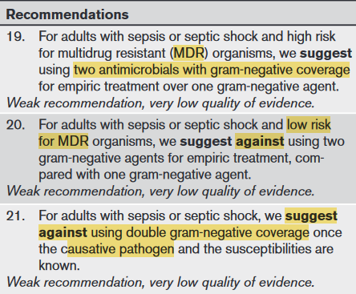
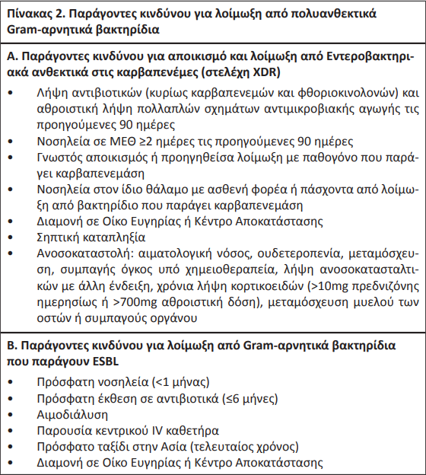
Antimicrobial Choice – Gram (-) MDR

Slide 29
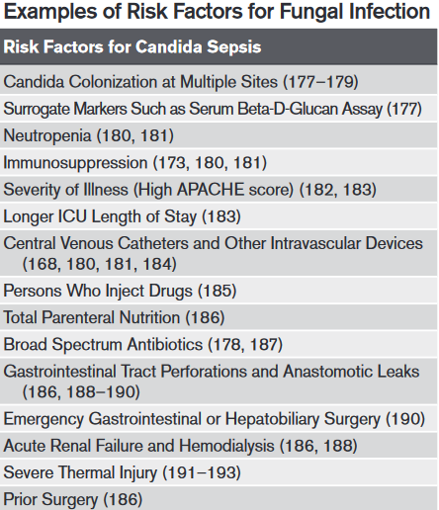
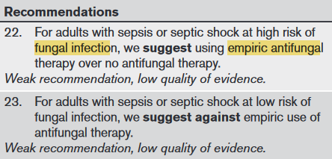
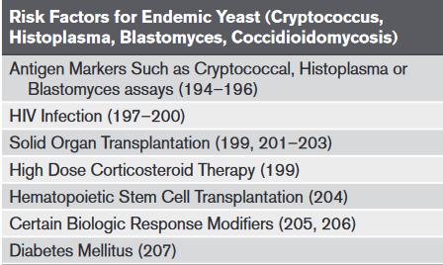
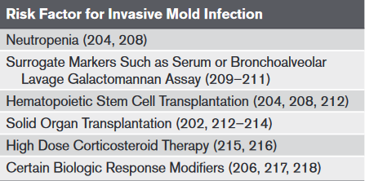
Antimicrobial Choice –Mύκητες

Slide 30

Antimicrobial Choice – Ιοί

Slide 31
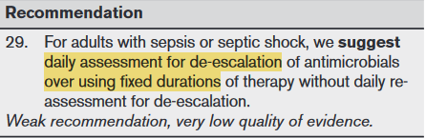

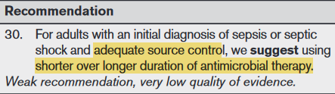

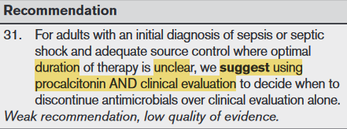
Αποκλιμάκωση & Διάρκεια Αντιμικροβιακών

Slide 32
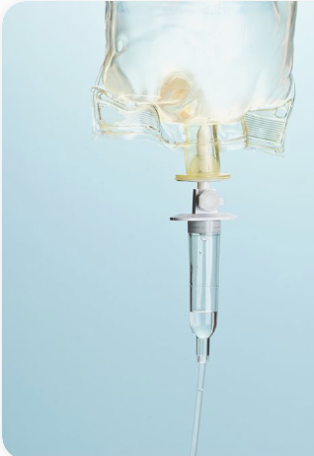
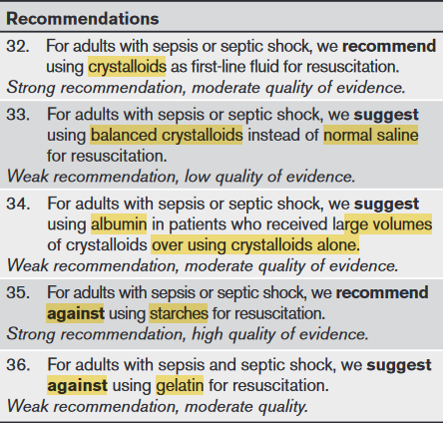
Διαχείριση υγρών

Slide 33
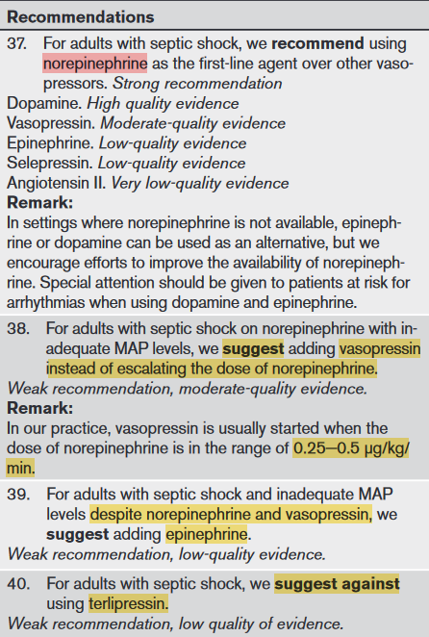
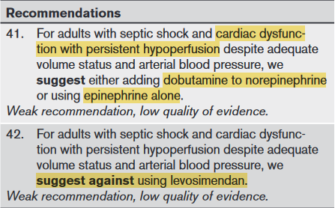
Αγγειοδραστικοί Παράγοντες
Ινότροπα

Slide 34


Slide 35
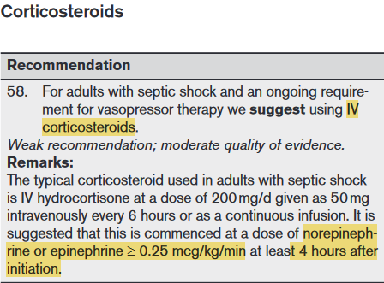
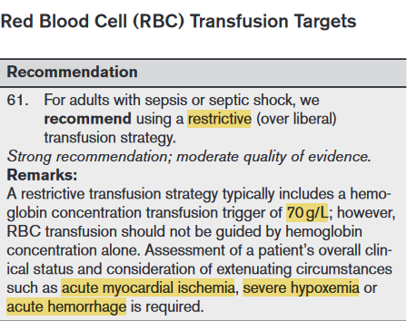
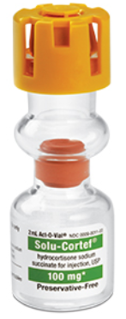
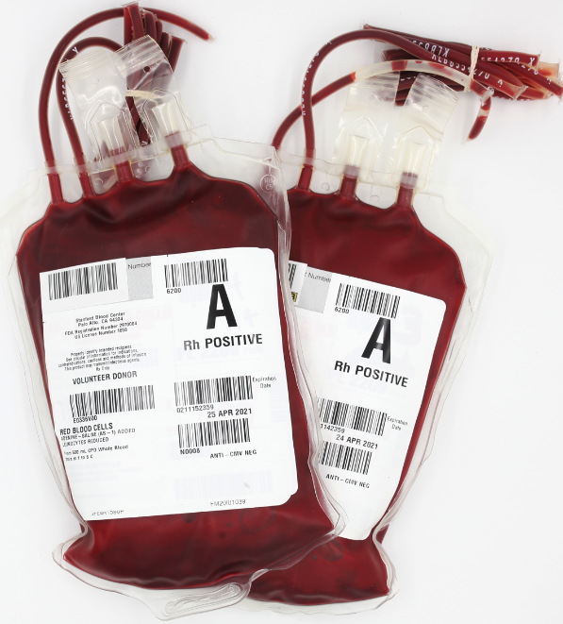
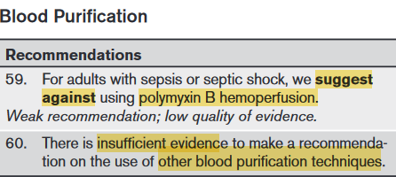
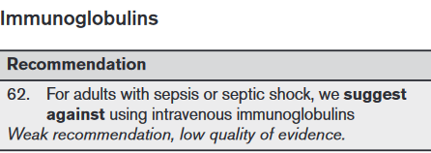

Slide 37


