Slide 1
Παθησεις μαστου
ΑΙΚΑΤΕΡΙΝΗ ΣΤΥΛΙΑΝΑΚΗ
ΠΛΑΣΤΙΚΟΣ ΧΕΙΡΟΥΡΓΟΣ

Slide 2
ΜΑΣΤΟΣ- εμβρυολογία
Η πρώτη καταβολή του μαστού εμφανίζεται σε έμβρυα πέμπτης ή έκτης εβδομάδας
Αναγνωρίζονται τότε δυο συμμετρικές παχύνσεις του εξωδέρματος, οι μαστικές γραμμές ή ακρολοφίες, που εκτείνονται από τη μασχαλιαία κοιλότητα έως τη βουβωνική χώρα.
Αργότερα, τα κατώτερα 2/3 της δεξιάς και αριστεράς μαστικής γραμμής ατροφούν και εξαφανίζονται, ενώ από τα άνω 1/3 διαπλάσσονται οι σύστοιχοι αρχέγονοι μαστοί.
Συγκεκριμένα, εξωδερμικά κύτταρα της θωρακικής πάχυνσης σχηματίζουν 15-20 συμπαγείς βλάστες που καταδύονται στο υποκείμενο χόριο του δέρματος. Στα τέλη του 3ου μήνα της ενδομήτριας ζωής, οι συμπαγείς αυτές επιθηλιακές καταδύσεις πολλαπλασιάζονται και διακλαδίζονται ποικιλοτρόπως, σχηματίζοντας τις καταβολές των γαλακτοφόρων πόρων. Αυτοί, στους δυο τελευταίους μήνες της κύησης, αποκτούν αυλό και εκβάλλουν σε μια εμβάθυνση της επιδερμίδας στην περιοχή της θηλής.
Κατά τη γέννηση του εμβρύου, η θηλή και η θηλαία άλως έχουν πλέον διαμορφωθεί πλήρως και υπάρχει ένα αρχέγονο λοβιακό και εκφορητικό σύστημα με 15-20 στόμια που εκβάλλουν στην εξωτερική επιφάνεια της θηλής. Η όλη αρχιτεκτονική του συστήματος προσδίνει στη θηλή μια κεντρική θέση, με τους γαλακτοφόρους πόρους να κατευθύνονται ακτινοειδώς προς αυτή. Στο πρώιμο αυτό στάδιο της ανάπτυξης, η διάπλαση του μαστού είναι κοινή στα δύο φύλα και επηρεάζεται από διάφορες ορμόνες. Μερικές φορές η έντονη επίδραση της μητρικής προλακτίνης οδηγεί σε παροδική εκκριτική δραστηριότητα του αδένα που αφορά, το ίδιο συχνά, κορίτσια και αγόρια.
Στη συνέχεια και σε όλη τη διάρκεια της ζωής, ο μαστός παραμένει υποανάπτυκτος στο άρρεν, ενώ στο θήλυ εμφανίζει νέο κύμα ανάπτυξης κατά τη διάρκεια της εφηβείας. Η πλήρης πάντως μορφολογική και λειτουργική ωριμότητα του γυναικείου μαστού ολοκληρώνεται κατά τη διάρκεια της γαλουχίας.

Slide 3
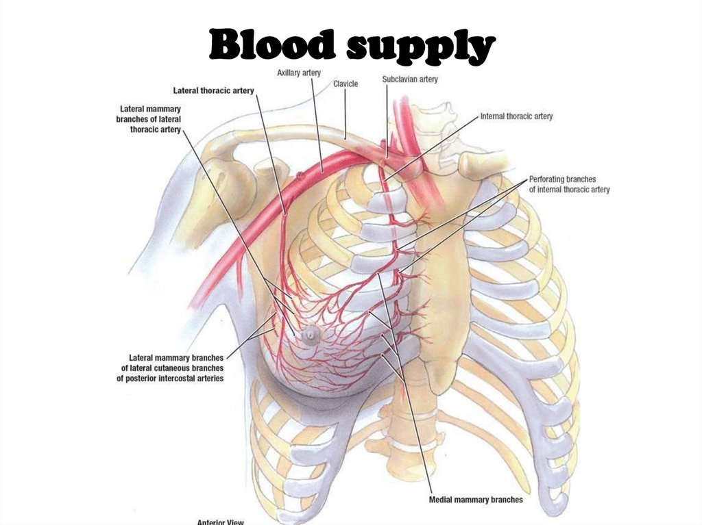
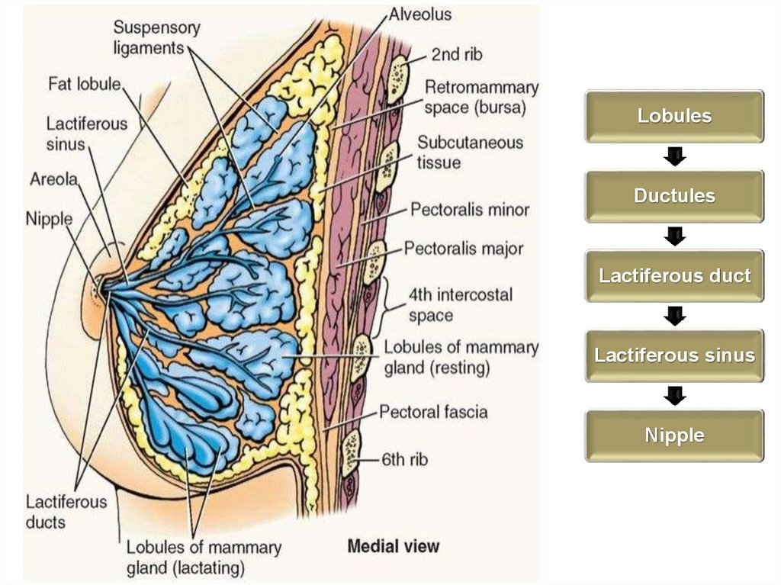
ΑΝΑΤΟΜΙΑ ΜΑΣΤΟΥ

Slide 4
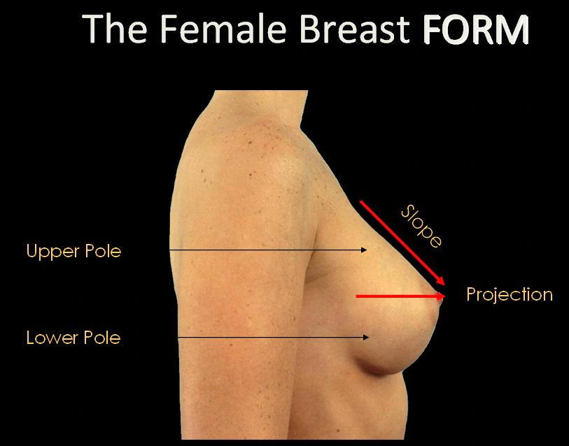
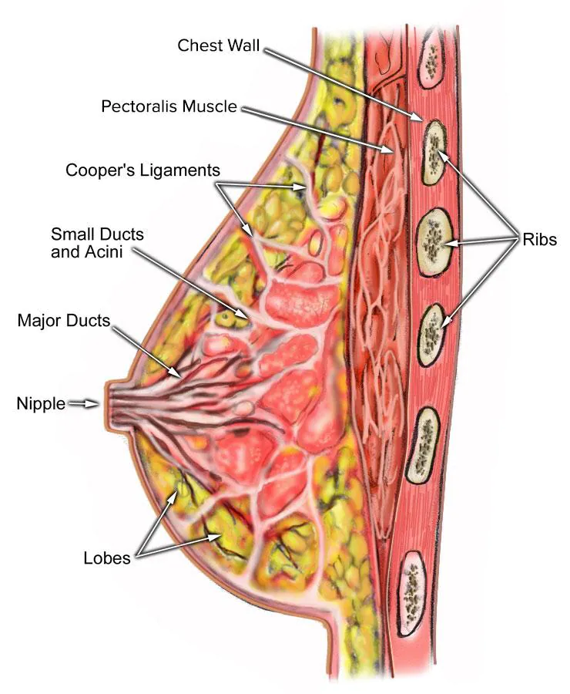
The

Slide 5
Αιματωση μαστου

Slide 6
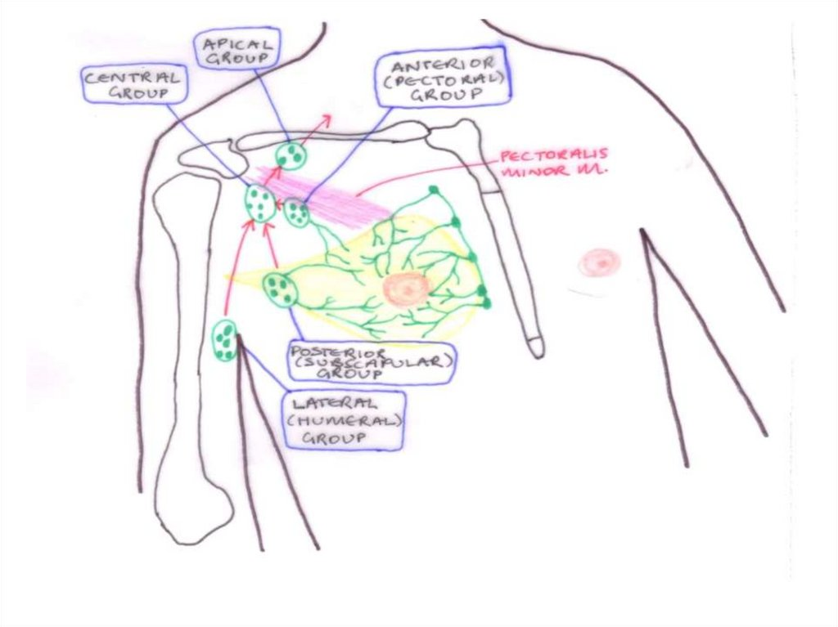

Slide 7
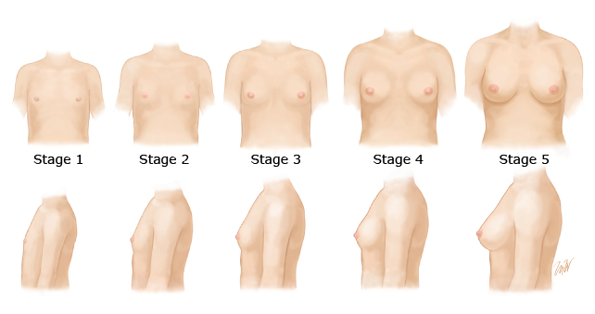
Tanner Classification
Stage 1: Prepubertal.
Stage 2: Breast bud stage with elevation of breast and papilla; enlargement of areola.
Stage 3: Further enlargement of breast and areola; no separation of their contour.
Stage 4: Areola and papilla form a secondary mound above level of breast.
Stage 5: Mature stage with projection of papilla only, related to recession of areola.

Slide 9
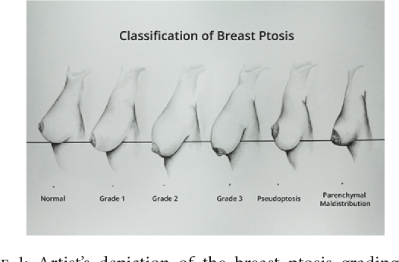
Πτώση μαστών
Επέρχεται με την ηλικία
Επηρεάζεται από το θηλασμό και την κύηση

Slide 11
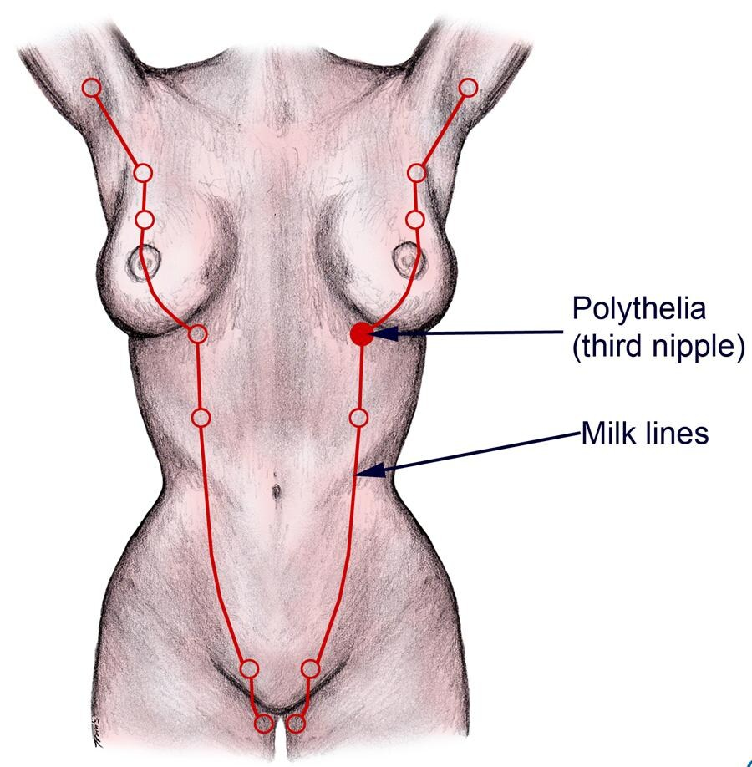
Αμαστία , Πολυμαστία , Πολυθηλία
Εμφανίζεται κατά μήκος των γαλακτοφόρων γραμμών
Πλήρη ανάπτυξη των μαστών ή μόνο της θηλής

Slide 12
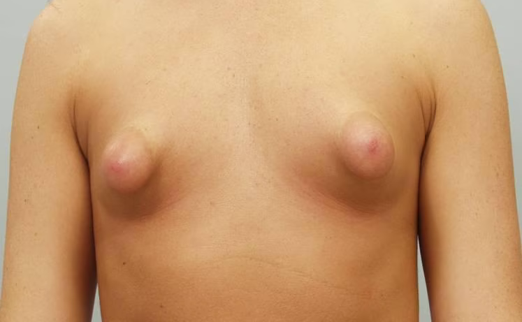
Σωληνώδεις μαστοί

Slide 14
Σύνδρομο Poland
absence (aplasia) of chest wall muscles on one side of the body (unilateral) and abnormally short, webbed fingers (symbrachydactyly) of the hand on the same side (ipsilateral).
In those with the condition, there is typically unilateral absence of the pectoralis minor and the sternal or breastbone portion of the pectoralis major. The pectoralis minor is a thin, triangular muscle of the upper chest wall; the pectoralis major is a large, fanlike muscle that covers most of the upper, front part of the chest.
Affected individuals may have variable associated features, such as underdevelopment or absence of one nipple (including the darkened area around the nipple [areola]) and/or patchy absence of hair under the arm (axilla). In females, there may be underdevelopment or absence (aplasia) of one breast and underlying (subcutaneous) tissues. In some cases, associated skeletal abnormalities may also be present, such as underdevelopment or absence of upper ribs; elevation of the shoulder blade (Sprengel deformity); and/or shortening of the arm, with underdevelopment of the forearm bones (i.e., ulna and radius).

Slide 15
Μαστίτιδα
Οξεία Μαστίτιδα
during the first 3 months postpartum as a result of breast feeding
Also known as puerperal or lactation mastitis
is a cellulitis of the interlobular connective tissue within the mammary gland, which can result in abscess formation and septicemia.
It is diagnosed based on clinical symptoms and signs indicating inflammation
Risk factors fall into two general categories: improper nursing technique, leading to milk stasis and cracks or fissures of the nipple, which may facilitate entrance of microorganisms through the skin; and stress and sleep deprivation, which both lower the mother’s immune status and inhibit milk flow, thus causing engorgement
Κοκκιωματώδης Μαστίτιδα Granulomatous reactions resulting from an infectious etiology, foreign material, or systemic autoimmune diseases such as sarcoidosis and Wegener’s granulomatosis can involve the breast.
Αντίδραση ξένου σώματος

Slide 16
Πορεκτασία- Mammary Duct Ectasia
Mammary duct ectasia, also called periductal mastitis is a distinctive clinical entity that can mimic invasive carcinoma clinically. It is a disease of primarily middle-aged to elderly parous women, who usually present with nipple discharge, a palpable subareolar mass, noncyclical mastalgia, or nipple inversion or retraction. The pathogenesis and the etiology of the disease are still being debated. Smoking has been implicated as an etiologic factor in mammary duct ectasia
This association appears to be more important in young women who smoke. Mammary duct ecta- sia is usually an asymptomatic lesion and is detected mammographically because of microcalcifications.
The most important histologic feature of this disorder is the dilatation of major ducts in the subareolar region. These ducts contain eosinophilic, granular secretions and foamy histiocytes both within the duct epithelium and the lumen. The inspissated luminal secretions may undergo calcifications that may be the presenting sign in many patients].
Mammary duct ectasia generally does not require surgery and should be managed conservatively

Slide 17
Νέκρωση λίπους
Fat necrosis of the breast is a benign nonsuppurative inflam- matory process of adipose tissue. It can occur secondary to accidental or surgical trauma, or it may be associated with carcinoma or any lesion that provokes suppurative or necrotic degeneration, such as mammary duct ectasia and, to a lesser extent, fibrocystic disease with large cyst forma- tion

Slide 18
Ινοκυστικές αλλοιώσεις
Fibrocystic changes (FCCs) constitute the most frequent benign disorder of the breast. Such changes generally affect premenopausal women between 20 and 50 years of age . Although many other names have been used to describe this entity over the years, (including fibrocystic disease, cystic mastopathy, chronic cystic disease, mazoplasia, Reclus’s disease), the term “fibrocystic changes” is now preferred, because this process is observed clinically in up to 50% and histologically in 90% of women
FCCs may be multifocal and bilateral. The most common presenting symptoms are breast pain and tender nodularities in breasts. Although the exact pathogenesis of the entity is not clear, hormonal imbalance, particularly estrogen predominance over progesterone, seems to play an important role in its development .
FCCs comprise both cysts (macro and micro) and solid lesions, including adeno- sis, epithelial hyperplasia with or without atypia, apocrine metaplasia, radial scar, and papilloma. Over the years, it has been one of the major issues to determine whether these lesions are a risk factor for the subsequent development of breast cancer.
As the use of mammography and the identification of benign breast diseases become more common, it is crucial to identify women who are at an increased risk for breast cancer. Therefore, it is practical to evaluate FCCs under a classification system first proposed by Dupont and Page, as nonproliferative lesions, proliferative lesions without atypia, and proliferative lesions with atypia (atypical hyperplasia). In various studies, it has been shown that the great majority of breast biopsies (up to 70%) show non- proliferative lesions.

Slide 19
Ινοκυστικές αλλοιώσεις
Nonproliferative lesions include cysts, papillary apocrine change, epithelial-related calcifications, mild epi- thelial hyperplasia, as well as ductal ectasia, nonsclerosing adenosis, and periductal fibrosis. Proliferative lesions with- out atypia include moderate or florid ductal hyperplasia of the usual type, sclerosing adenosis, radial scar, and intra- ductal papilloma or papillomatosis. Proliferative lesions
with atypia include atypical ductal and lobular hyperplasia. In each of these lesions, the subsequent risk for breast cancer is associated with the histologic appearance of the lesion compared with the general population, women with nonproliferative lesions on breast biopsy have no elevation in breast cancer risk, whereas women with pro- liferative disease without atypia and women with atypical ductal or lobular hyperplasia have a greater breast cancer risk, with relative risks ranging from 1.3–1.9 and 3.9–13.0, respectively, according to various studies].
Apart from the histologic features, the age at biopsy and the degree of family history of breast cancer are reported to be the major determinants of breast cancer risk after the diagnosis of benign breast disease]. According to Hartmann et al., the risk for breast cancer in young women with a diagnosis of atypical epithelial proliferation is twice the risk observed among women over 55 years with a diagnosis of atypical epithelial proliferation. It was also reported, in the same study, that family history of breast cancer is an independent risk factor and that strong family history may increase breast cancer risk even in patients with nonproliferative lesions. Absolute risk, however, for both atypical and nonatypical epithelial proliferations is quite low. More than 80% of patients with a diagnosis of atypical hyperplasia do not develop invasive cancer during their lifetimes.

Slide 20
Κύστεις
Cysts are fluid-filled, round or ovoid structures that are found in as many as one third of women between 35 and 50 years old. Although most are subclinical “microcysts,” in about 20%–25% of cases, palpable (gross) cystic change, which generally presents as a simple cyst, is encountered [10, 53]. Cysts cannot reliably be distinguished from solid masses by clinical breast examination or mammography; in these cases, ultrasonography and fine needle aspiration (FNA) cytology, which are highly accurate, are used.
Cysts are derived from the terminal duct lobular unit. In most cysts, the epithelial lining is either flattened or totally absent. In only a small number of cysts, an apocrine epithelial lining is observed. Because gross cysts are not associated with an increased risk of carcinoma development, the current consensus on the management of gross cysts is routine follow-up of the patient, without further therapy [53].
Complex (or complicated or atypical) cyst is a sonographic diagnosis that is characterized by internal echoes or thin septations, thickened and/or irregular wall, and absent posterior enhancement [54]. They are reported in approximately 5%–5.5% of all breast ultrasound examinations. The malignancy rate of complex cysts, which is 0.3% as described by Venta et al., is lower than that for lesions classified as “probably benign.”
However, if the lesion also includes an intracystic mass (intracystic nodule), it should be regarded as “suspicious for neoplasm” and managed as solid lesions. Either a core needle biopsy or surgical biopsy is indicated for these lesions

