Slide 1
Critically ill surgical patient
ICU Monitoring
NATIONAL AND KAPODISTRIAN UNIVERSITY OF ATHENS
FACULTY OF MEDICINE
Elective Course
Acute Care Surgery and Management of Trauma Patients
June 2022
MANOURAS IOANNIS
SURGEON - INTENSIVIST
First Propaedeutic Department of Surgery
“Hippocration” General Hospital

Slide 2

Critical Care
Patients needing ITU care
Emergency
Multiple trauma (including burns)
Leaking AAA
Severe acute pancreatitis
Post-operative complications:
- Surgical
- Cardiac
- Respiratory
- Renal
Severe sepsis
Elective
Major vascular (e.g. AAA)
Esophagectomy
Cardiac operations
Major procedures
- Whipple’s
- Patients ≥ ASA 2

Slide 3
Critical Care
Indications for ICU transfer
Potential incipient or actual organ failure in a remediable condition
Advanced monitoring of organ function
Treatment of organ failure:
Heart – use of inotropes
Lungs – ventilation
Kidneys – renal replacement therapy
A need for 1:1 nursing

Slide 4
Critical Care
Tools for critical care
Respiratory
Pulse oximetry
- O₂ saturation of arterial blood
Capnography
- CO₂ tension in expired gas
Cardiovascular
Arterial lines
CVP
Pulmonary artery flotation catheter (PAFC) / Swan-Ganz catheter
Cardiac output measurement (Vigileo)
ECG

Slide 5
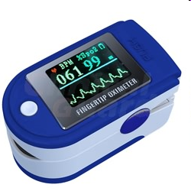
Critical Care
Pulse oximetry
95% - 100% = normal
93% = Warning! PaO₂ around 60
< 90% = patient is in severe trouble

Slide 6
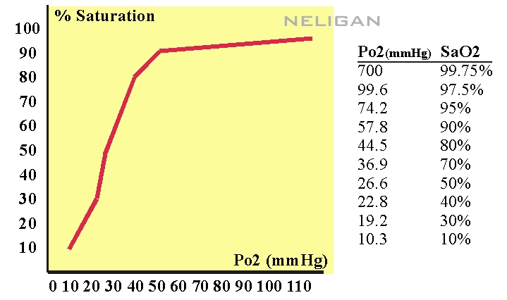
Oxygen dissociation curve

Slide 7
Critical Care
Pulse oximetry
Gives estimate of percentage saturation of oxygen binding sites
Related to PaO₂ by oxygen dissociation curve

Slide 8
Critical Care
Arterial line
Indications
Continuous BP measurement
Access for serial arterial blood gas analysis
Complications
Bleeding
Thrombosis
Infection
Pseudo-aneurysm
Accidental drug injection
Site the line in the radial artery of the non-dominant hand. Allen’s test should be performed.

Slide 9
Critical Care
Arterial Line
Allen’s test
The fist is tightly clenched, both wrist pulses are tightly obstructed and the fist then released. Pressure is released from the ulnar artery first. Allen’s test is positive when the medial part of the hand remains blanched.

Slide 10
Critical Care
Central venous catheterisation
Indications
Invasive monitoring for estimation of fluid status and right heart function
Long term infusions: TPN, chemotherapy
Haemodialysis
Lack of peripheral venous access
Access for pulmonary artery catheterisation

Slide 11
Critical Care
Central venous catheterisation
Complications
Inadvertent - arterial puncture
- thoracic duct puncture
- lung puncture
Air embolus
Catheter-related sepsis
Clot formation
Malposition and rupture of vein

Slide 12
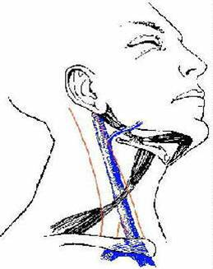
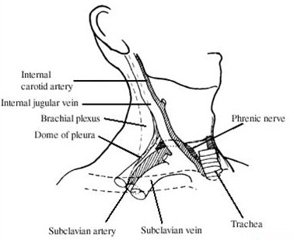
Central Venous Line
Techniques
Internal Jugular Vein

Slide 13
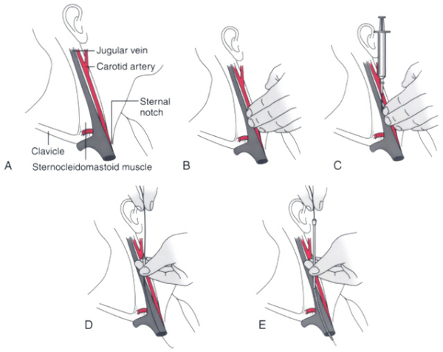

Slide 14
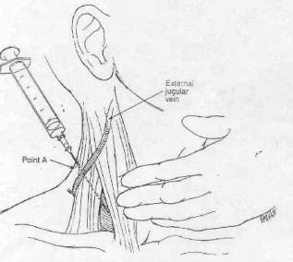

Slide 15
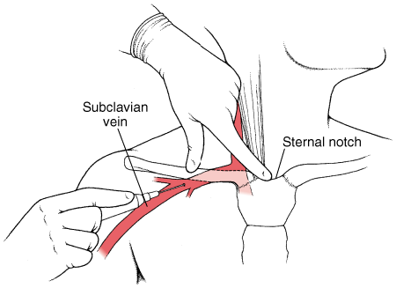
Central Venous Line
Techniques
Subclavian Vein

Slide 16
Critical Care
Pulmonary artery wedge pressure (PWAP)
It is an accurate representation of the left atrial pressure which closely parallels the left ventricular end-diastolic pressure thus helping to guide fluid therapy.

Slide 17
Critical Care
Pulmonary artery wedge pressure (PWAP)
Introduced in 1970s by two cardiologists, Drs Swan and Ganz
Used to measure:
Pressure within the pulmonary artery
Pulmonary artery wedge pressure
Cardiac output by thermodilution or dye dilution method
Sampling of mixed venous blood

Slide 18
Critical Care
Pulmonary artery wedge pressure (PWAP)
Complications
Valvular damage
Ventricular rupture
Pulmonary artery rupture
Aneurysm or infarction
Those of central venous catheterisation

Slide 19
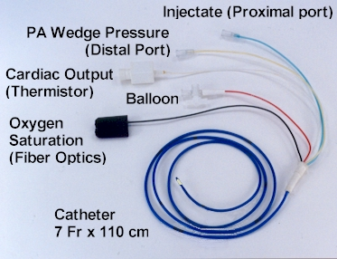
Pulmonary artery flotation catheter (PAFC) / Swan-Ganz catheter

Slide 20
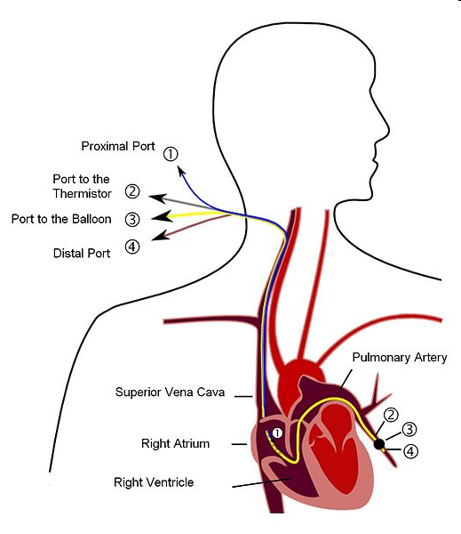

Slide 21
Cardiac Outpout (Flotrac / Vigileo system)

Slide 22
Flotrac / Vigileo system
Data from arterial line and central venous line
to calculate various hemodynamic parameters
SV -stroke volume
SVI -stroke volume index
SVV -stroke volume variation
CO -cardiac output
CVP -central venous pressure
CI -cardiac index
PR -pulse rate
MAP -mean arterial pressure
SVR -systemic vascular resistance
GEDV -global end diastolic volume
PVPIpulmonary vascular permeability index
EVLW -extravascular lung water
GEF -global ejection fraction

Slide 23
Critical Care
Standard values
Central venous pressure (CVP): 0-6 mm Hg
Right ventricular pressure: 25 / 0-6mm Hg
Pulmonary artery pressure (PAP): 25 / 6-12 mm Hg
Wedge pressure (PAWP): 6-12 mm Hg
Cardiac index (CI): >2.8-3.6 L / min / m²
Systemic vascular resistance(SVR): 770-1500 dynes / sec / cm⁵
Oxygen delivery: 600ml / min / m²
Oxygen consumption: 150 mls / min / m²

Slide 24
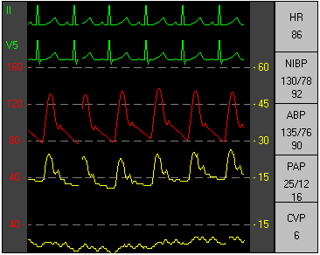
ECG monitor

Slide 25
Ventilator

Slide 26
Ventilator modes
Method to inflate the lungs
Volume Control Ventilation (VCV): the inflation (tidal) volume is preselected, and the lungs are inflated at a constant flow rate until the desired volume is delivered. The inspiratory flow rate is adjusted so that the time for lung inflation is no more than one-third of the respiratory cycle (i.e., I:E ratio of 1:2).
Pressure Control Ventilation (PCV): the inflation pressure is preselected, and high flow rates are used at the onset of lung inflation to achieve the desired inflation pressure quickly. The flow rate decelerates during lung inflation, and the inspiratory time is adjusted to allow the flow rate to fall to zero at the end of inspiration.

Slide 27
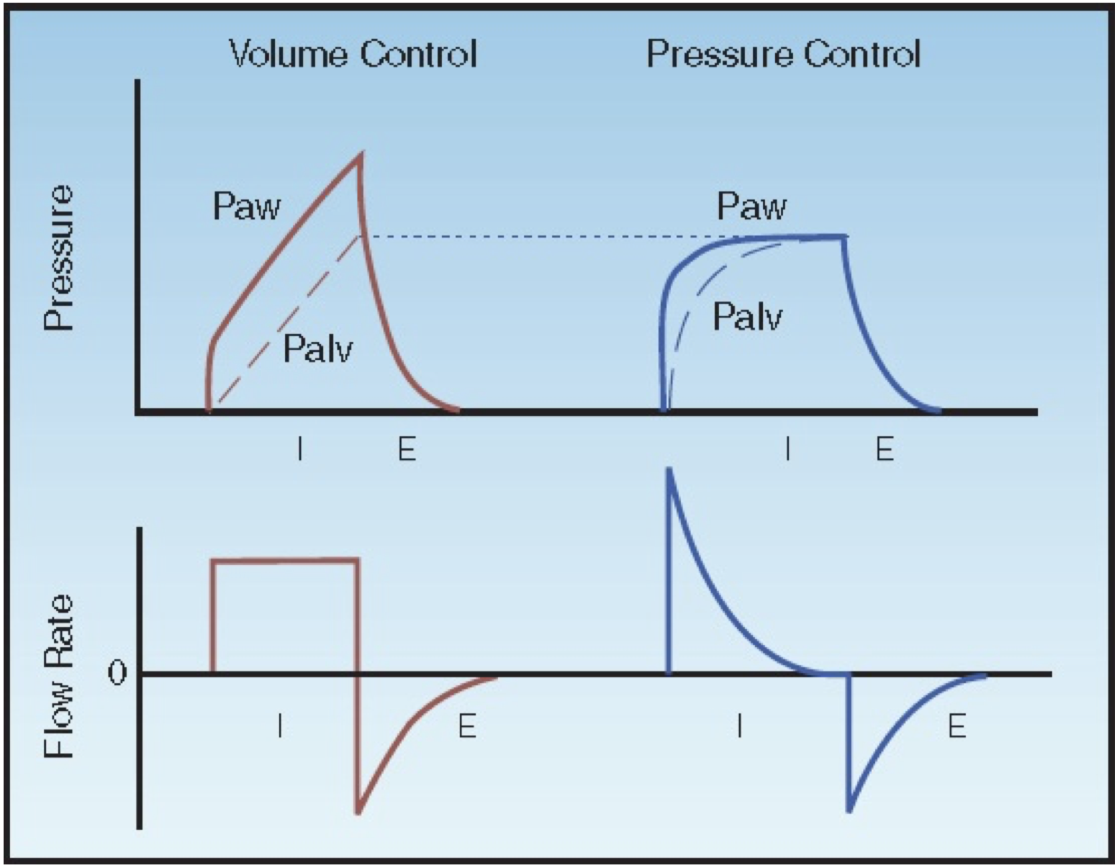

Slide 28
Ventilator modes
Which method is preferred?
VCV → constant level of alveolar ventilation, despite changes in the mechanical properties of the lungs. PCV → alveolar ventilation will decrease if there is an increase in airways resistance (secretions) or decrease in lung compliance (atelectasis).
PCV → patient comfort (promotes synchronous breathing with the ventilator and reduces the work of breathing).
PCV → lower peak airway pressures..

Slide 29
Ventilator modes
Assist Control Ventilation (A/C)
Mode of choice in most circumstances.
Allows the ventilator to essentially take over the work of breathing
It is preferred when a patient has acute cardiac or respiratory failure.
It provides full respiratory support.
If the patient wants to breathe over the set rate, he can; when he triggers the ventilator, he gets the full breath.
↑ : Takes over the work of breathing; clinician can choose to set a tidal volume (volume control) or an inspiratory pressure (pressure control). with minimal effort.
↓ : A tachypneic patient will get the full tidal volume on every breath, so without adequate sedation this could lead to significant respiratory alkalosis or air trapping. This can be a problem in patients with COPD or asthma.

Slide 30
Ventilator modes
Synchronised Intermittent Mandatory Ventilation (SIMV)
Provides full ventilator support and is a very popular mode.
The clinician can choose a tidal volume or an inspiratory pressure.
Major difference between SIMV – A/C is what happens when the patient initiates a breath— in A/C, he gets the full tidal volume; in SIMV, he gets whatever he can pull (usually with the help of pressure support).
↑ : Can take over the work of breathing but allows the patient more spontaneous breathing than in A/C. Can be useful for weaning support gradually.
↓ : If the machine rate is not set high enough, an unstable patient can get fatigued due to excessive work of breathing. If the pressure support is not set high enough, spontaneous breaths may be fast and shallow, which also leads to fatigue.

Slide 31
Ventilator modes
Pressure Support Ventilation (PSV)
It allows the patient to breathe on his own and “boosts” each breath with a pressure that the clinician selects.
In conjunction with CPAP to improve alveolar recruitment.
Patients who are either intubated for reasons other than cardiac or respiratory failure (altered mental status, jeopardized airway) or for weaning.
↑ : Allows the patient to set his own rate and pattern of breathing, which is more comfortable; spontaneous breathing has salutary effects on hemodynamics and VQ matching.
↓ : There’s no backup rate, so if the patient goes apneic nothing will happen until the alarms sound. Unstable patients will fatigue rapidly if the work of breathing is imposed on them, even with high levels of pressure support.

Slide 32
Ventilator Settings
Position
Mode
Tidal Volume (Vt)
Fraction of inspired Oxygen (FiO₂)
Peak Inspiratory Pressure limit (PIP)
Plateau Pressure (Pplat)
Peak Inspiratory Flow (Pinsp)
Respiratory Rate (RR)
Inspiration : Expiration (I:E) ratio
Expiratory time
Positive End-Expiratory Pressure (PEEP)

Slide 33
Positive End-Expiratory Pressure (PEEP)
Distal airspaces → collapse at the end of expiration in dependent lung regions (especially in patients with COPD or ARDS) → alveoli that remain collapsed will impair gas exchange.
PEEP (usually 5 cm H₂O) is routinely applied to the airways during mechanical ventilation.
It is created by a pressure-relief valve in the expiratory limb of the ventilator circuit, which allows exhalation to proceed until a preselected pressure is reached, and PEEP is then maintained until the next inspiration.
PEEP increases both the end-inspiratory alveolar pressure and the mean airway pressure.

Slide 34
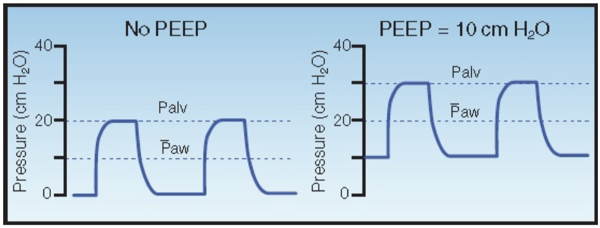
Positive End-Expiratory Pressure (PEEP)

Slide 35
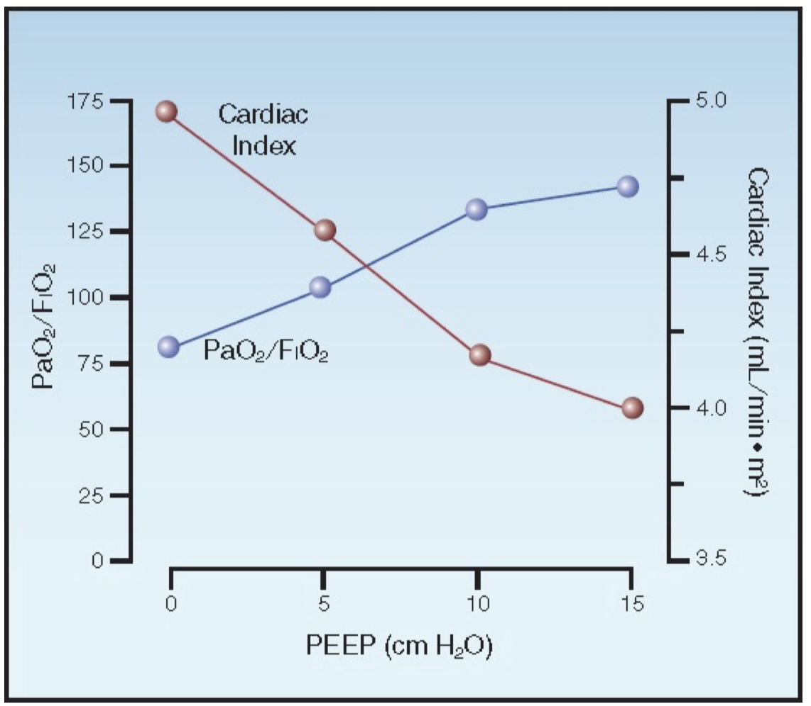
Positive End-Expiratory Pressure (PEEP)
Decrease in cardiac output by several mechanisms, including impaired venous return, increased right ventricular afterload, and external constraint of the ventricles. These effects are exaggerated by hypovolemia.
Decrease in cardiac output can cancel the benefits of PEEP in improving arterial oxygenation

Slide 36
Critical Care
A 60 year old man had a right hemicolectomy.
On the 1st postoperative day he has developed a temperature of 39⁰ C, is very short of breath and looks slightly cyanosed; his oxygen saturation is 92%.
What will you suspect and how will you manage the condition?

Slide 37
Critical Care
Postoperative pulmonary collapse
Although atelectasis and collapse are often used synonymously, atelectasis strictly speaking refers to lung parenchyma that has never been expanded.
Cuschieri A, Steele RJC & Moosa AR: Patients with postoperative complications in Essential Surgical Practice, 2000, 418

Slide 38
Critical Care
Postoperative pulmonary collapse
This arises from reduced ventilation of the lung bases resulting in accumulation of bronchial secretions. This may be basal, segmental, lobar or complete lung collapse. The degree of hypoxia depends upon the extent of collapse.
Infection with consolidation supervenes with the organisms being Haemophilus influenza, streptococcus pneumoniae, coliform, MRSA and pseudomonas.

Slide 39
Postoperative pulmonary collapse
Clinical features
Tachypnoea
Pyrexia
Productive cough
Cyanosis
Dullness on percussion
Bronchial breathing

Slide 40
l Care
A 65 year old lady had a hip replacement 10 days ago.
She is ready to be discharged. She went to the toilet just prior to leaving the ward for home. She collapsed in the toilet.
What is your diagnosis and management?

Slide 41
Critical Care
Pulmonary embolus
Clinical diagnosis
Dyspnoea
Tachypnoea
Pleuritic chest pain
Small haemoptysis
Calf tenderness and swelling

Slide 42
Critical Care
Pulmonary embolus
Management
Resuscitation
Investigations
Treatment

Slide 43
Critical Care
Pulmonary embolus
Management
The stable patient
The unstable patient

Slide 44
Critical Care
Pulmonary embolus
Investigations
The stable patient
ECG & CXR; blood gases
VQ scan
CT angiography
Duplex Doppler u/s of leg veins
Pulmonary angiogram

Slide 45
Critical Care
Pulmonary embolus
Investigations
The unstable patient
Echocardiogram
Pulmonary angiogram
Spiral CT – very sensitive

Slide 46
Critical Care
A 60 year old patient of ASA 1 anaesthetic risk underwent a total gastrectomy for cancer stomach.
While in the ITU, 12 hours postoperatively, his BP has fallen to 80 mm hg systolic, with no urine outpout over the last 3 hours and is hypoxic with O₂ saturation of 92%.
What will you suspect and how will you manage?

Slide 47
Critical Care
Post-operative hypotension from bleeding
Q. Where would the bleeding come from?
Slipped left gastric artery ligature
Q. Where does the left gastric artery arise from?
The coeliac axis

Slide 48
Critical Care
Post-operative hypotension
Investigations
Monitor BP
Continuous ECG, pulse oximetry
Monitor urine output
Monitor core and peripheral temperature
Blood samples: FBC, Cross match
Coagulation screen

Slide 49
Critical Care
A 60 year old woman has been admitted as an emergency with a 4-day history of severe right upper quadrant pain, vomiting, jaundice and intense pruritus and is very toxic – high temperature with rigors and hyper-dynamic circulation.
What will you suspect and outline the management.

Slide 50
Critical Care
Septic shock from acute calculous biliary obstruction +/- Acute pancreatitis
Resuscitation
Confirmation of diagnosis
Definitive treatment

Slide 51
Critical Care
A 70-year old patient (ASA score 3) underwent an emergency closure of a perforated duodenal ulcer.
The operation were uneventful. On POD 1, he complained of feeling very unwell with a systolic BP of 80 mmHg and no unusual signs in his abdomen; there was impaired conscious level and peripheral vasoconstriction.
What will go through your mind and outline your management?

Slide 52
Critical Care
Cardiogenic shock from myocardial infarction
Patient already has a drip
ECG - ST elevation in precordial leads
- Development of new Q waves – wide & / or deep
- T wave inversion
Pulse oximeter
Blood samples: CK-MB (creatine kinase, membrane bound )
ALT (alanine aminotransferase)
AST (aspartate aminotransferase)
LDH (lactic dehydrogenase)
Troponin T assay
Transfer to CCU

Slide 53
Critical Care
A 50-year old man underwent a laparoscopic closure of a perforated duodenal ulcer.
His post-operative period during the first 4 to 5 days was uneventful. However, thereafter he did not progress satisfactorily, had a swinging pyrexia, hiccoughs, was tachypnoeic, toxic and complained of pain in the right upper quadrant and right shoulder tip.
What would you suspect and outline the management?

Slide 54
Critical Care
Intra-abdominal sepsis
Sub-phrenic abscess
Resuscitation
Confirmation of diagnosis
Definitive treatment

Slide 55
Critical Care
Sub-phrenic abscess
Resuscitation
Oxygen
Analgesia
IV fluids
Antibiotics after blood cultures

Slide 56
Patient Monitoring:
Non Instrumental: clinical observation (“look, listen, feel”)
Visual and auditory surveillance is central to patient monitoring, and involves many dimensions
Observing the patient’s color, respiratory pattern, accessory muscle use, and looking for movements, grimaces or unsafe patient positioning

Slide 57
Observing the patient’s clinical data on intraoperative monitors
Observing bleeding and coagulation at the surgical site (e.g. are the surgeons using many sponges or are they doing a lot of suctioning?)
Monitoring the functioning of all lines to ensure that IV catheters have not infiltrated
Conducting an anesthesia machine and workspace checkout

Slide 58
Pulse: rate, volume, rhythm ------ etc
Capillary refilling
Sweating

Slide 59
Instrumental patient monitoring
Electrocardiogram (Provides information about rate, rhythm, ischemia – ST segments)
Blood pressure (manual, automatic, arterial catheter)
Pulse oximeter (usually on fingertip or ear lobe)
Capnograph (especially in patients with an LMA or ETT)
Oxygen analyzer (part of anesthesia machine)
Anesthetic agent concentration analyzer

Slide 60
Instrumental patient monitoring
7. Temperature (usually esophageal or axillary)
8. Precordial or esophageal stethoscope (heart sounds, breath sounds)
9. Gas flows/ spirometry (part of anesthesia machine)
10. Airway pressure monitor (part of anesthesia machine)
11. Airway disconnect alarm (part of anesthesia machine)
12. Peripheral nerve stimulator (where appropriate)
13. Urometer (measure urine output where appropriate)

Slide 61
Maximos Frountzas MD MPA PhD
froumax@hotmail.com
6978 880045
THANK
YOU!

