Slide 1
Α' ΠΡΟΠΑΙΔΕΥΤΙΚΗ ΧΕΙΡΟΥΡΓΙΚΗ ΚΛΙΝΙΚΗ ΕΚΠΑ
Μεταμοσχεύσεις Οργάνων
ΜΑΤΘΑΙΟΥ ΣΠΥΡΟΣ
ΕΠΙΜΕΛΗΤΗΣ Α΄ ΧΕΙΡΟΥΡΓΙΚΗΣ

Slide 2
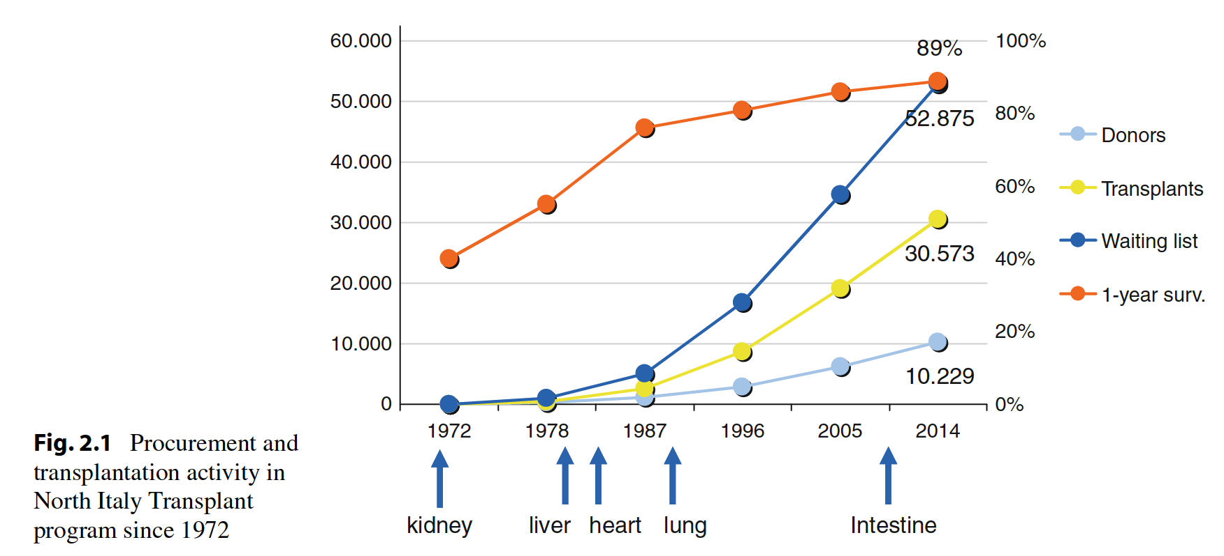

Slide 3
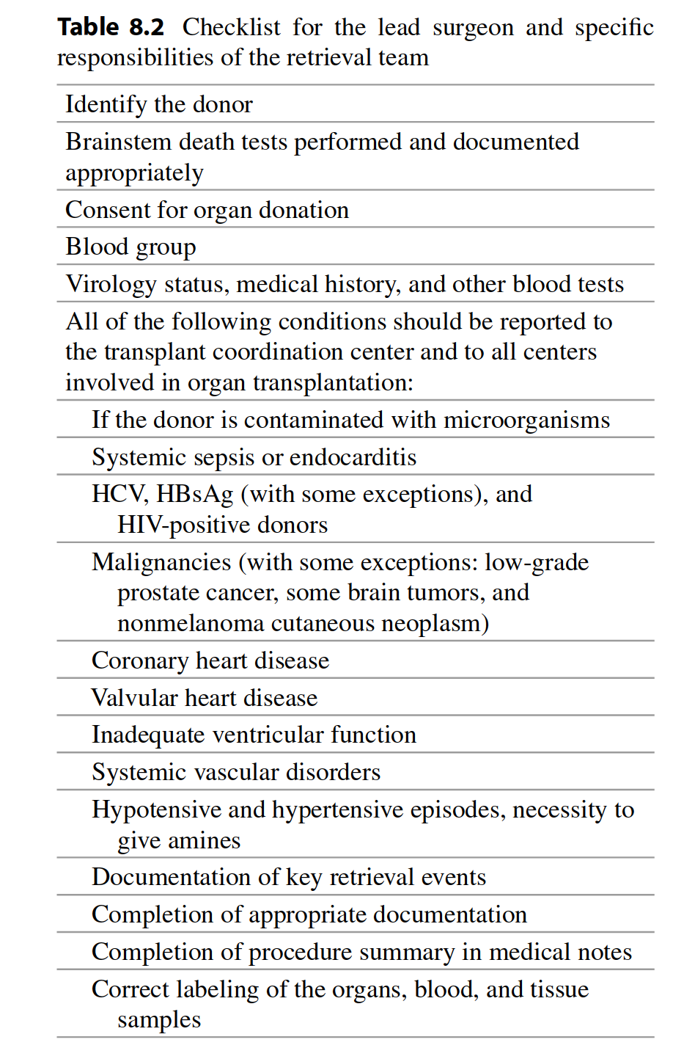

Slide 4
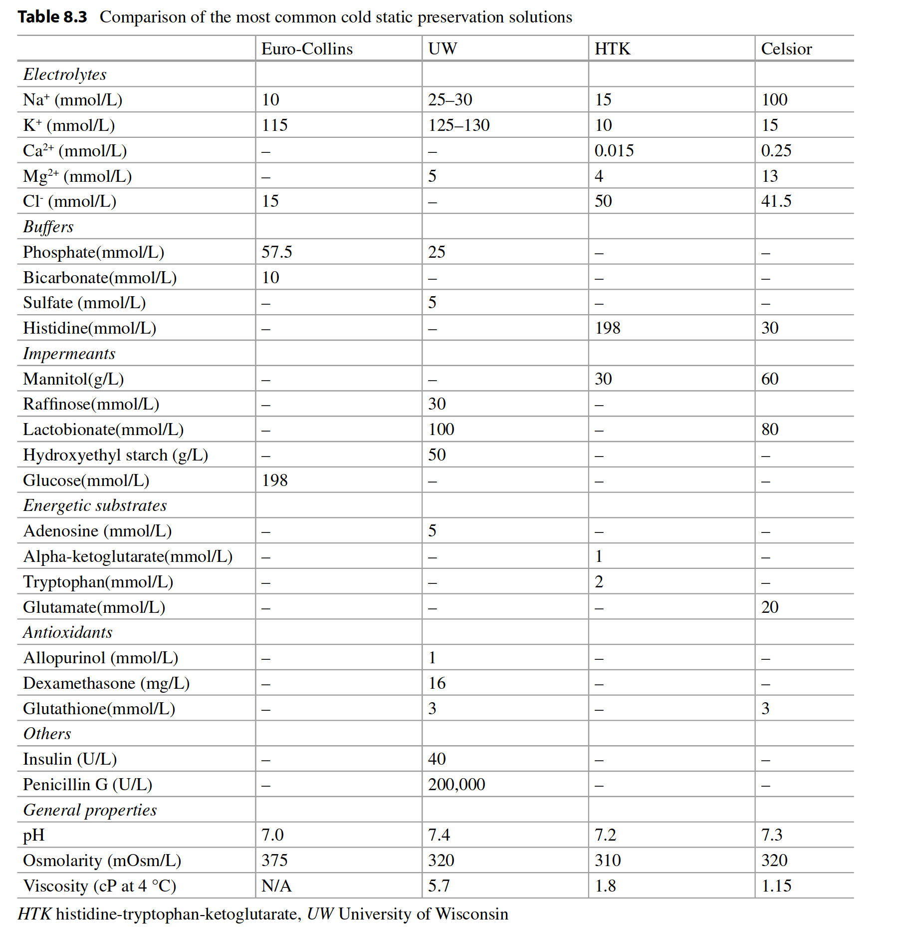

Slide 5
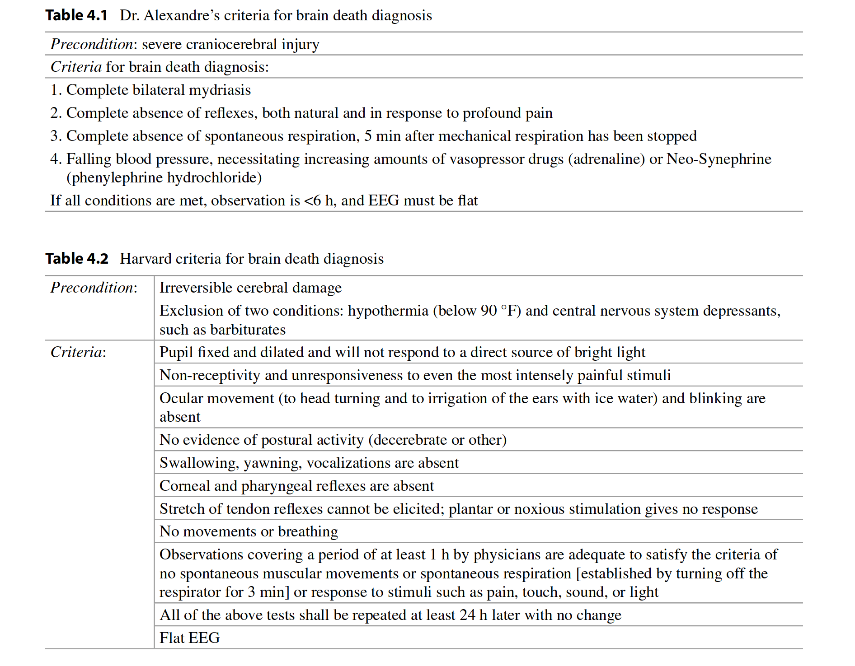

Slide 6
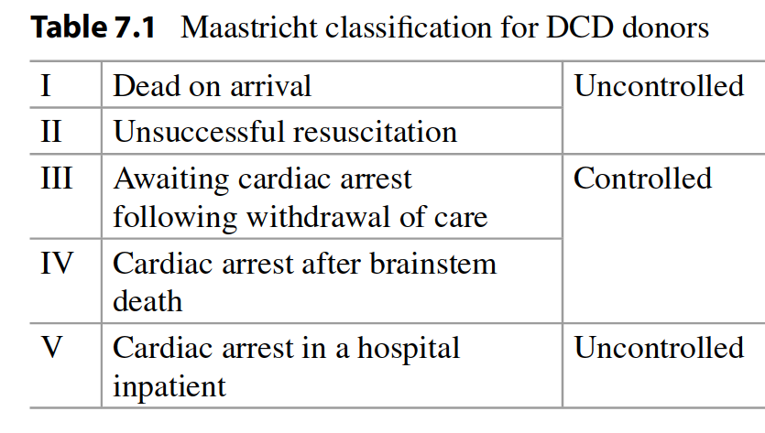
Non-Heart-Beating Donors

Slide 7
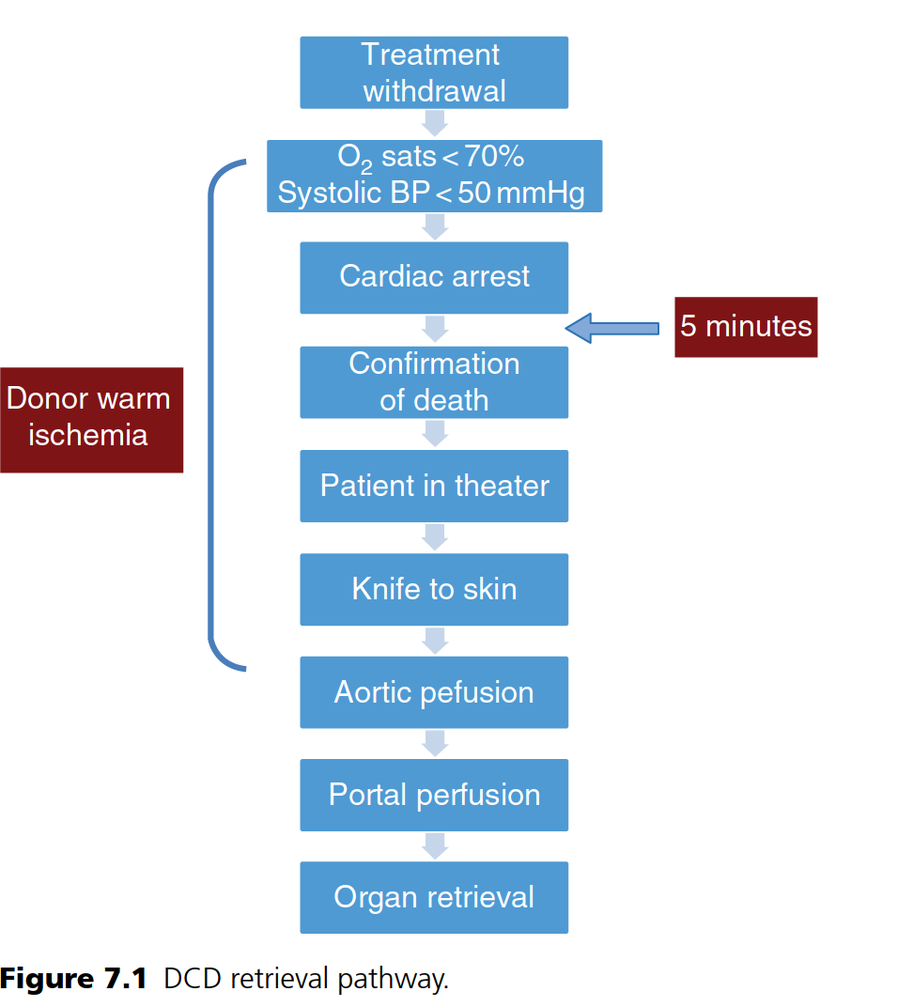

Slide 8
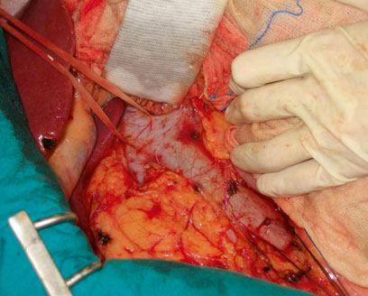
A retrieval procedure involves two phases: abdominal organ dissection before aortic cannulation (warm phase) and further dissection and organ removal post circulatory arrest and cold perfusion (cold phase)

Slide 9
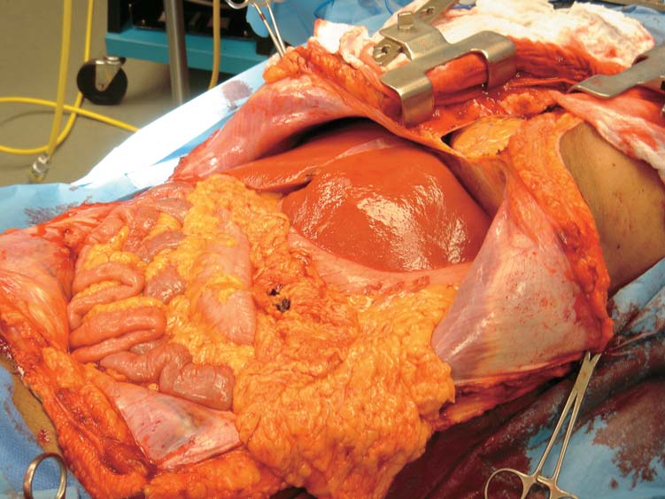
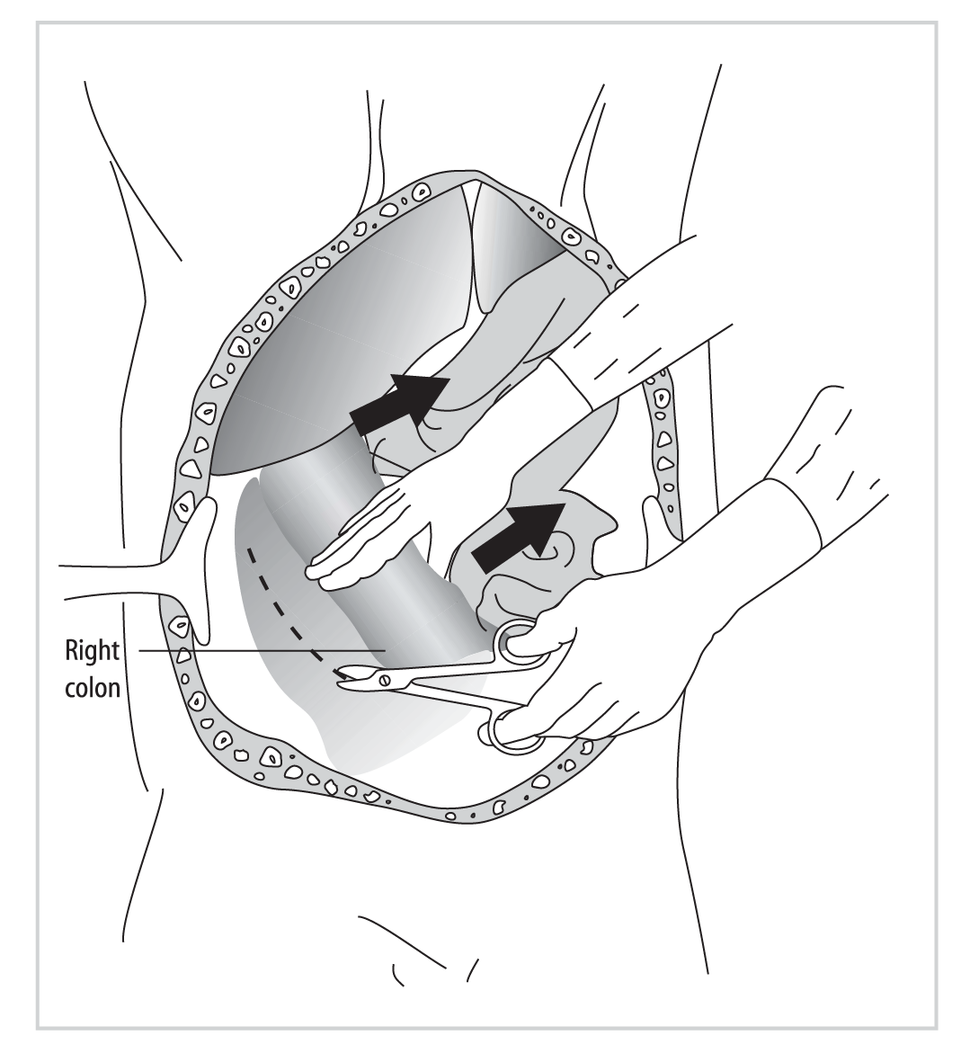
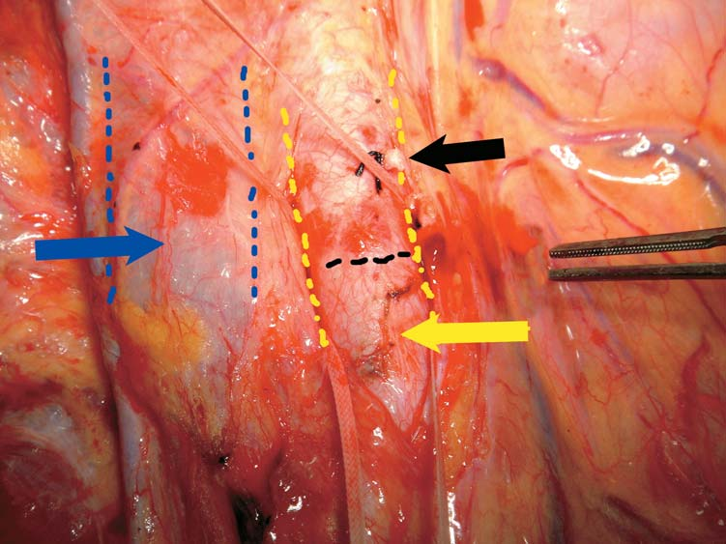
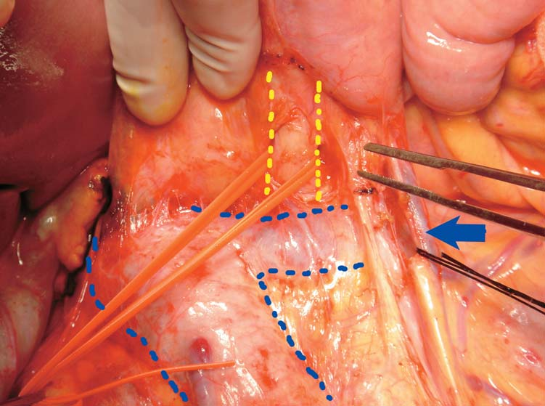
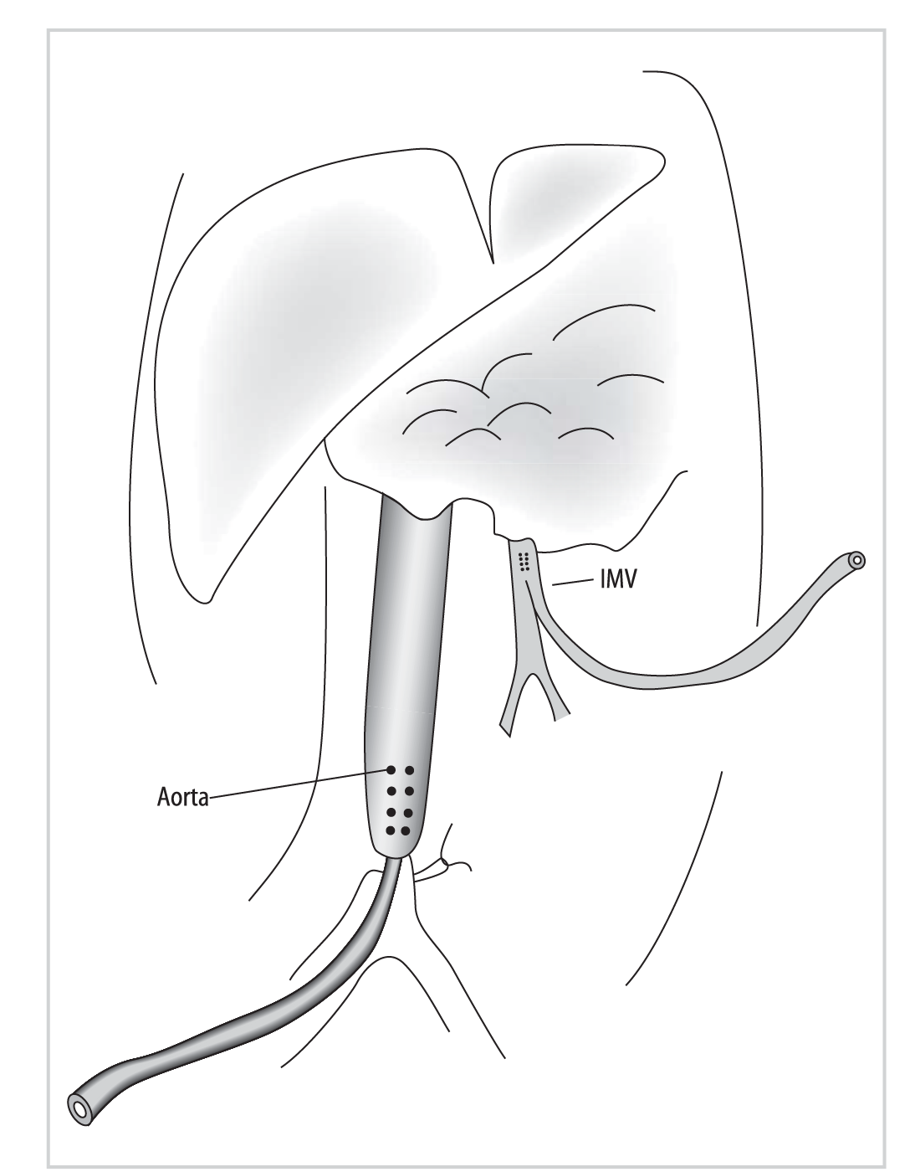
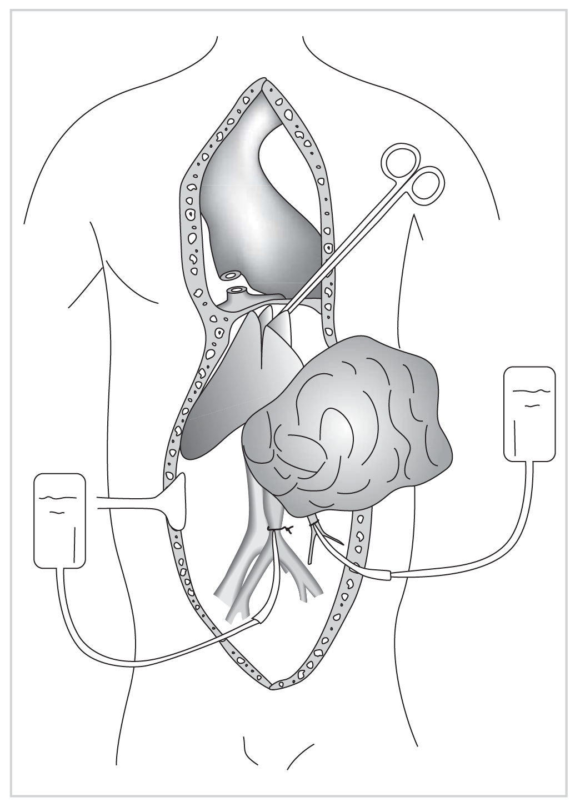

Slide 10
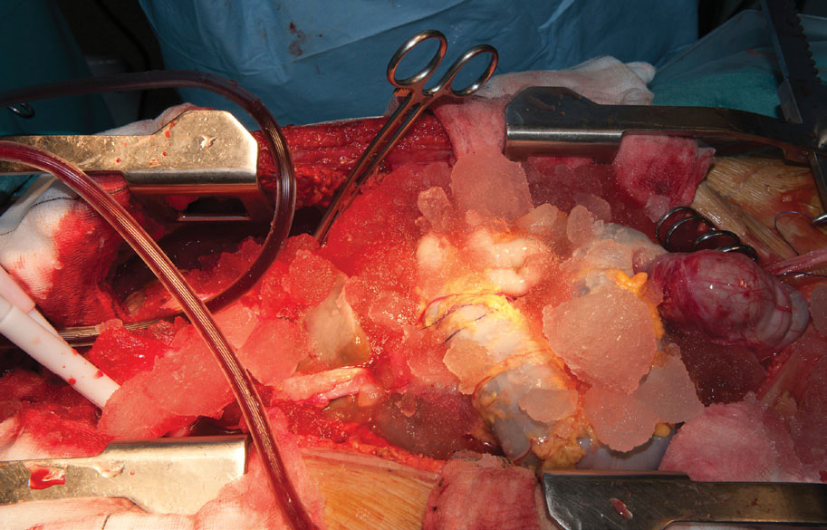

Slide 11
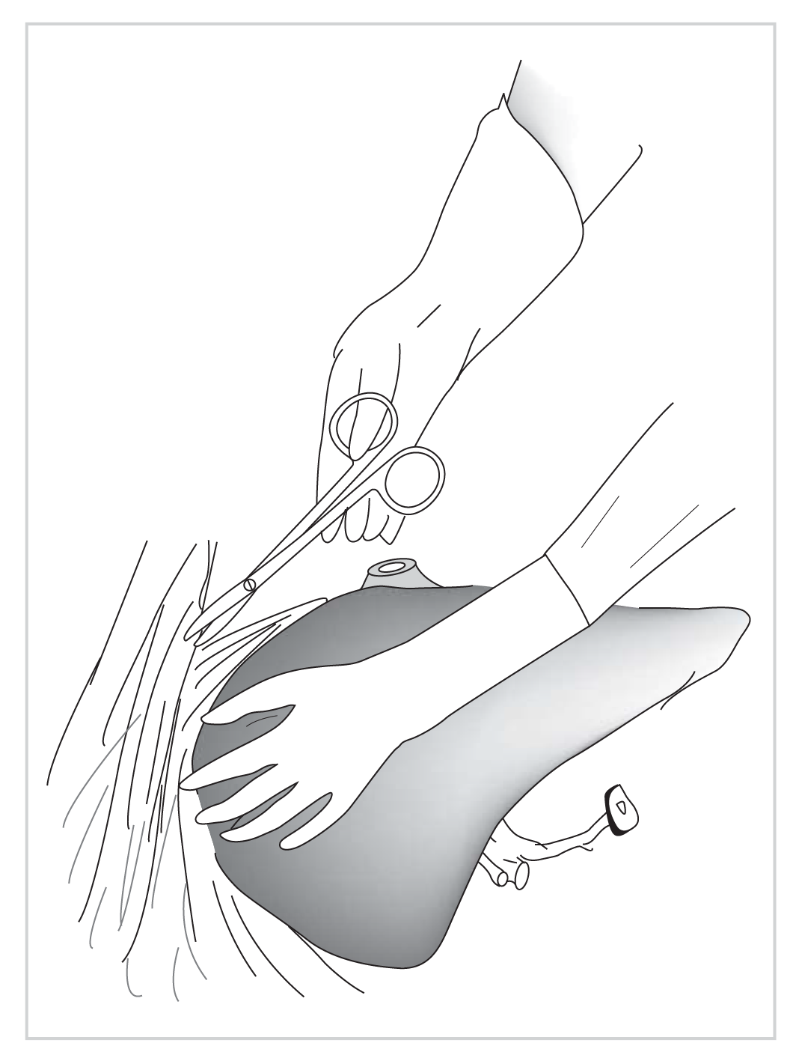
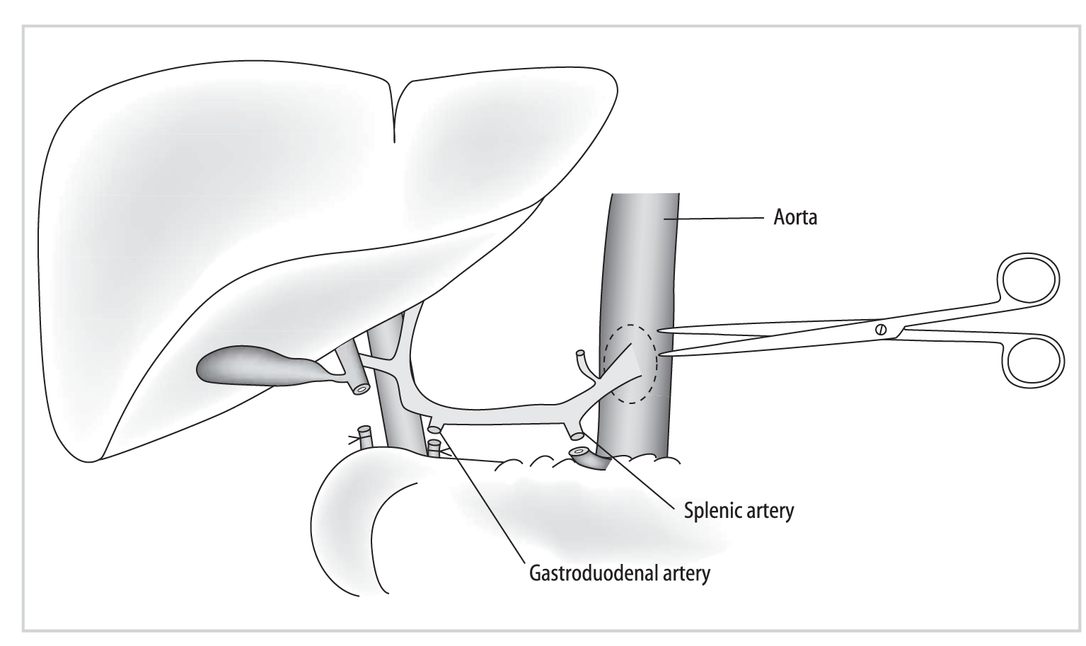
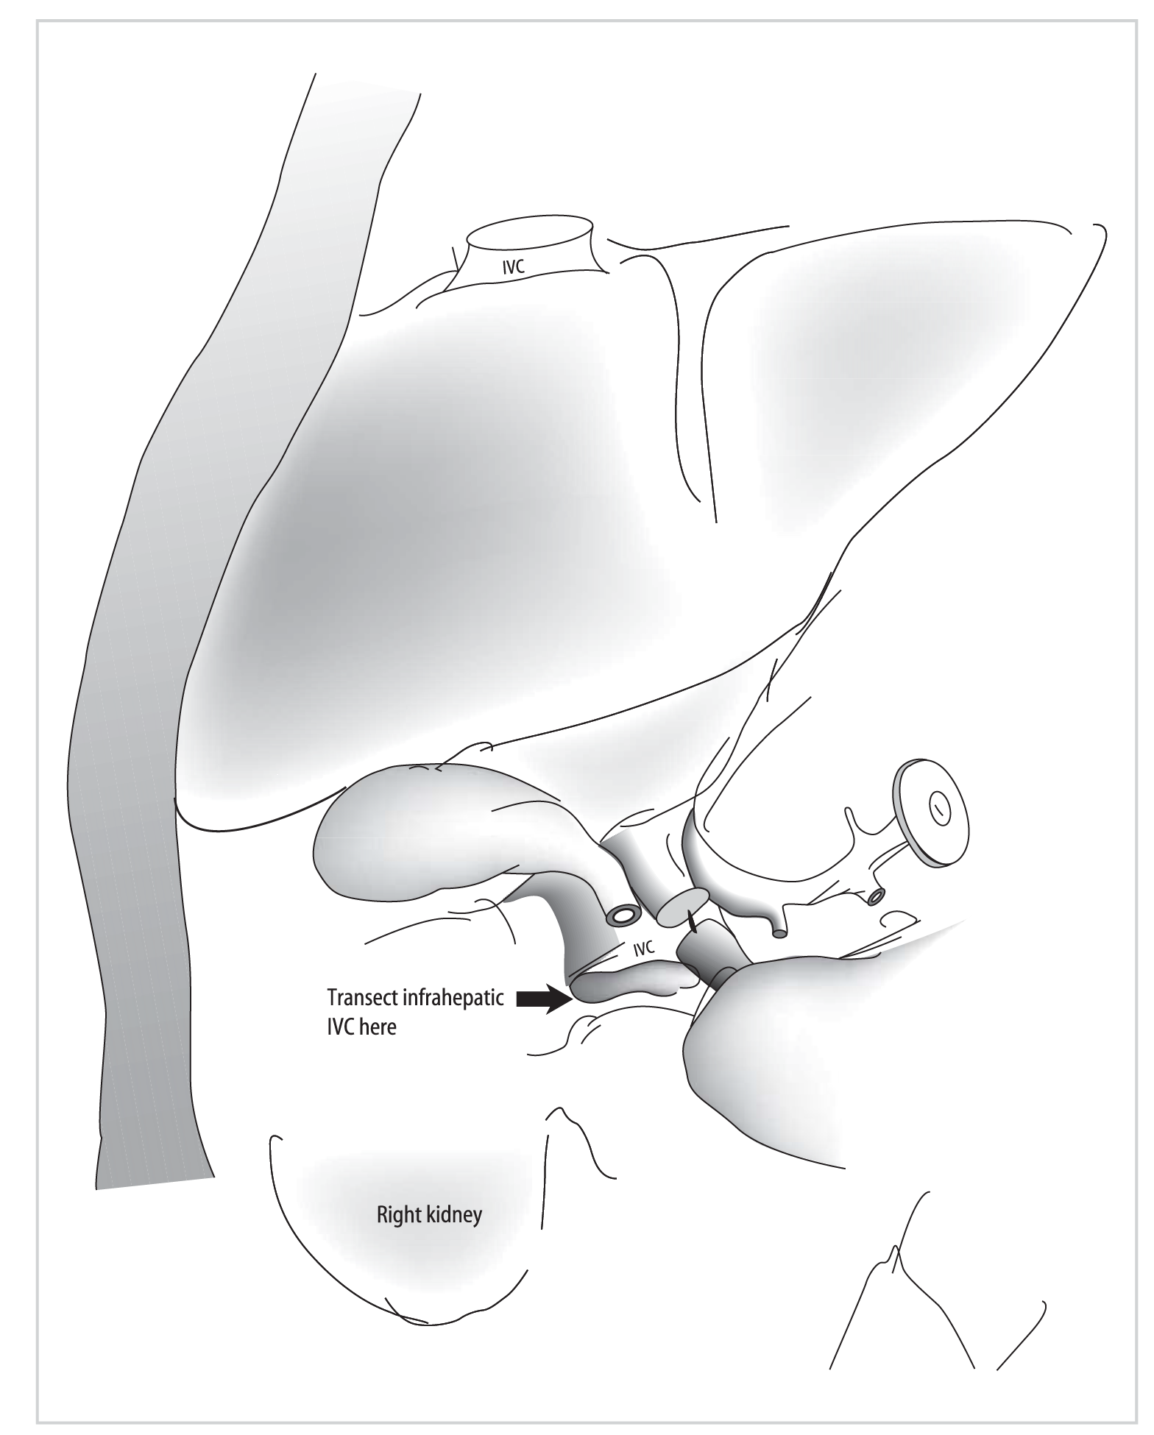

Slide 12
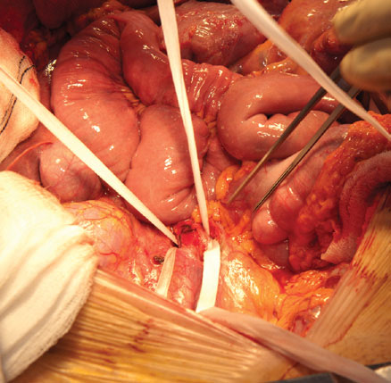
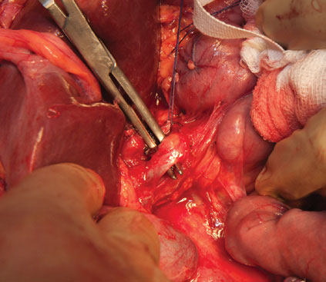
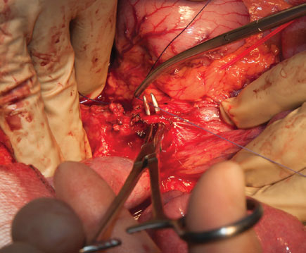
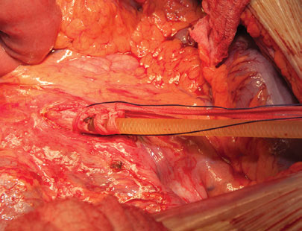

Slide 13
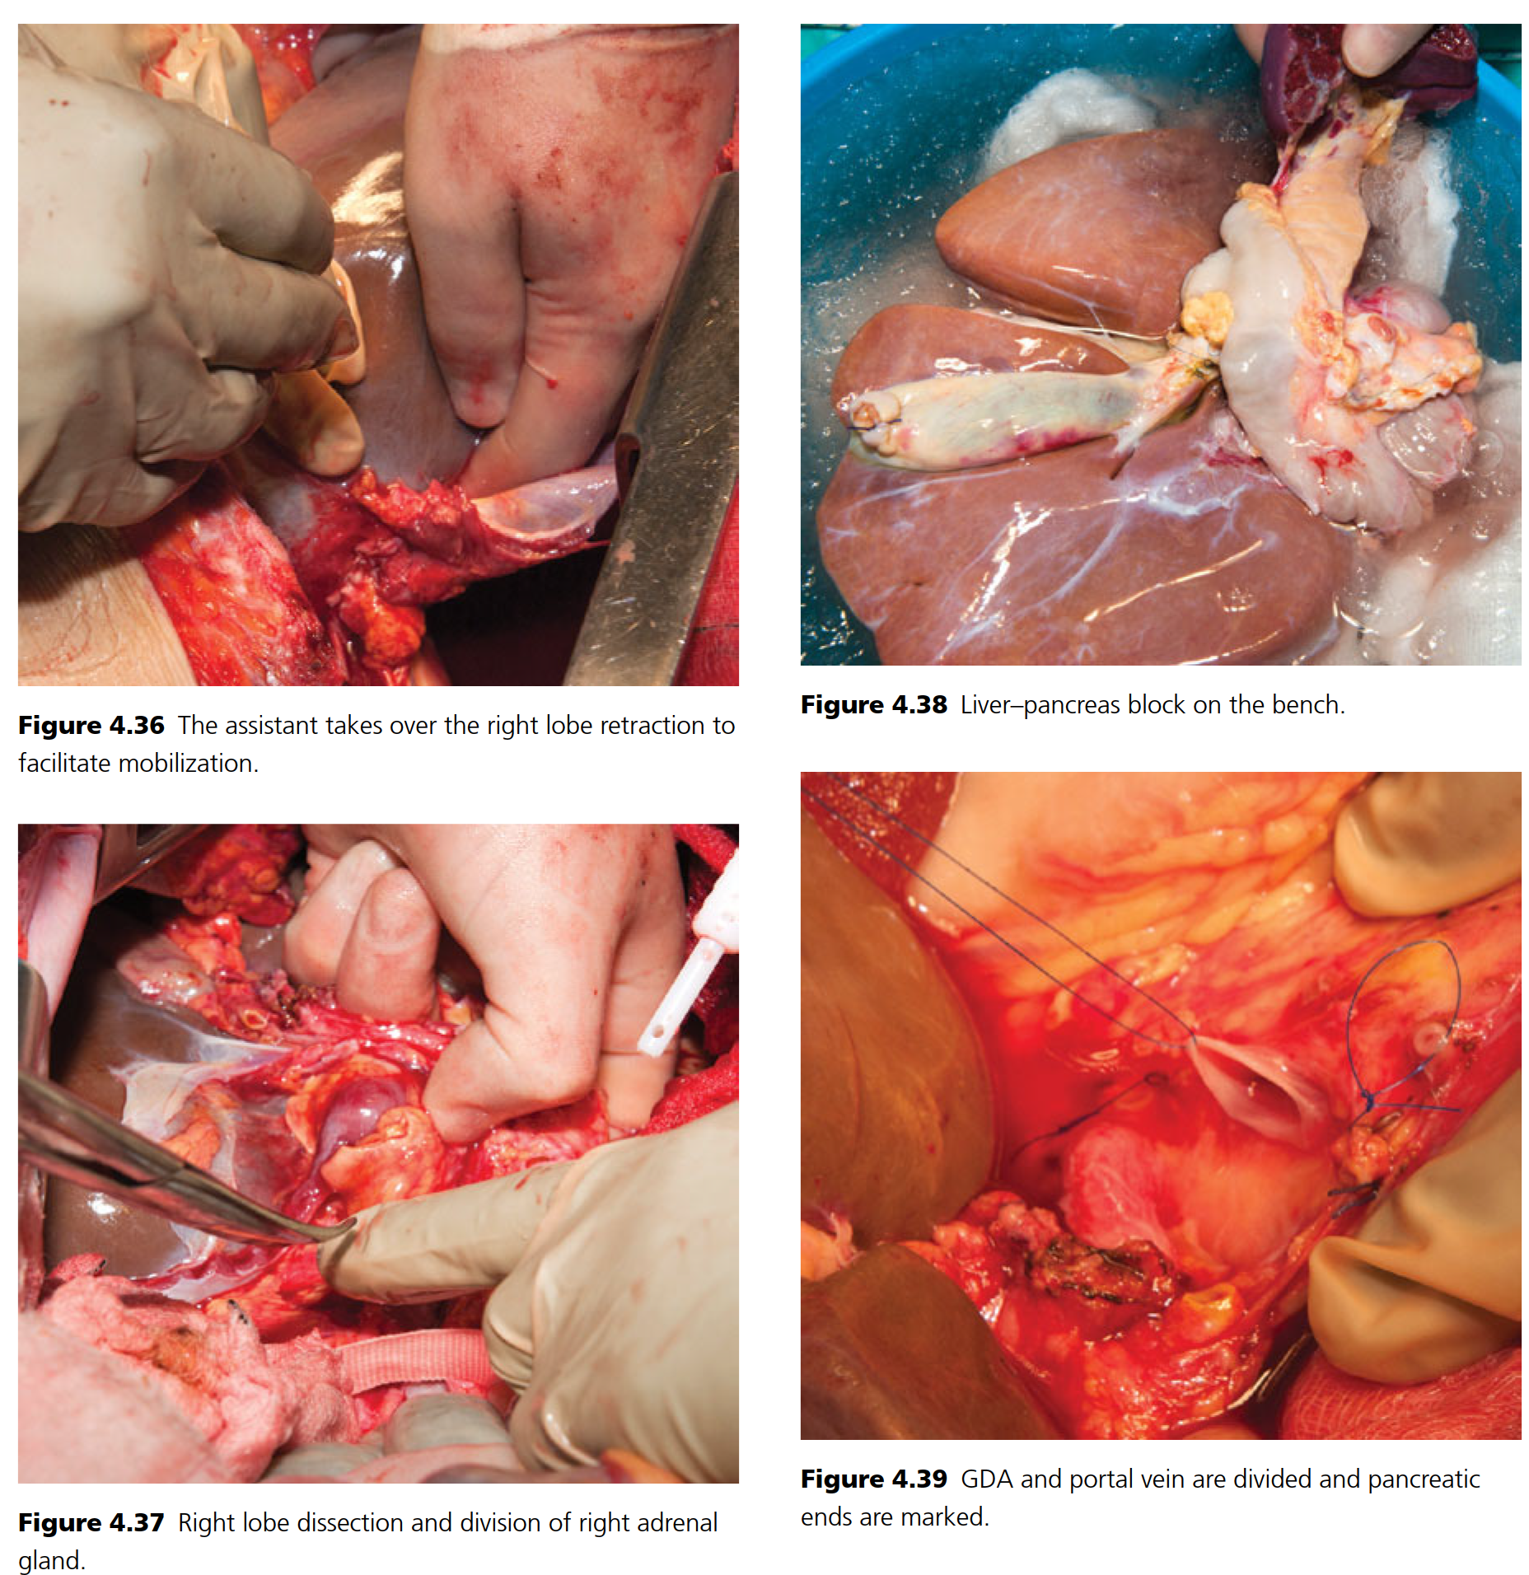

Slide 14
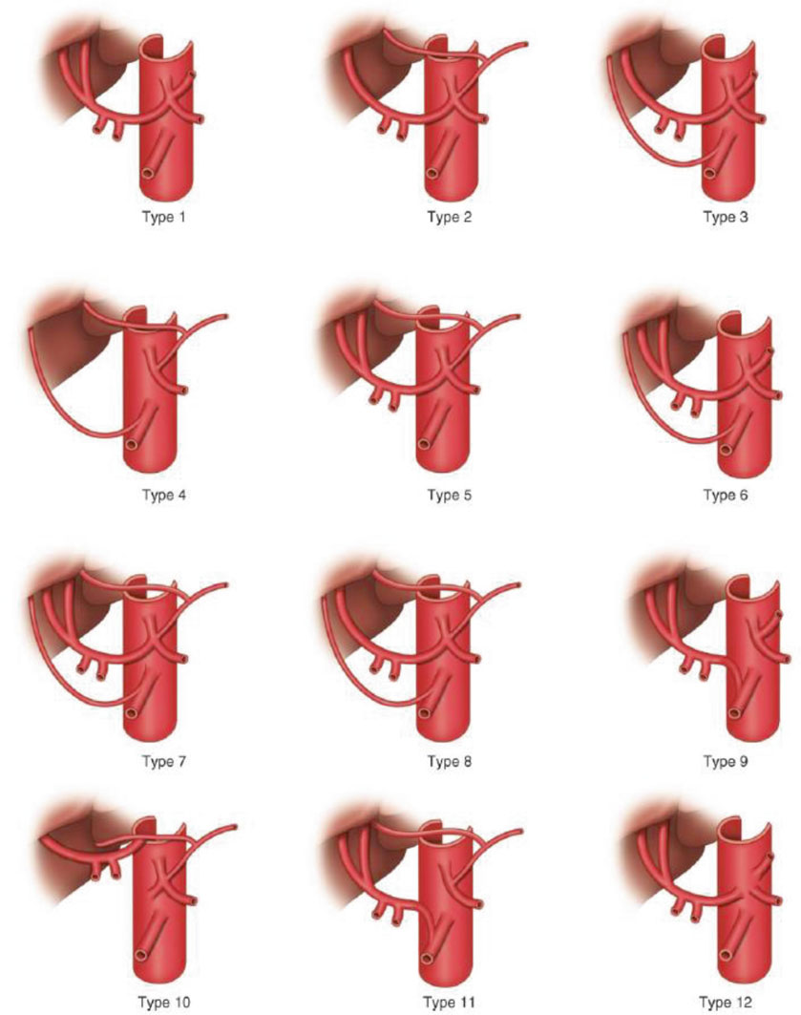
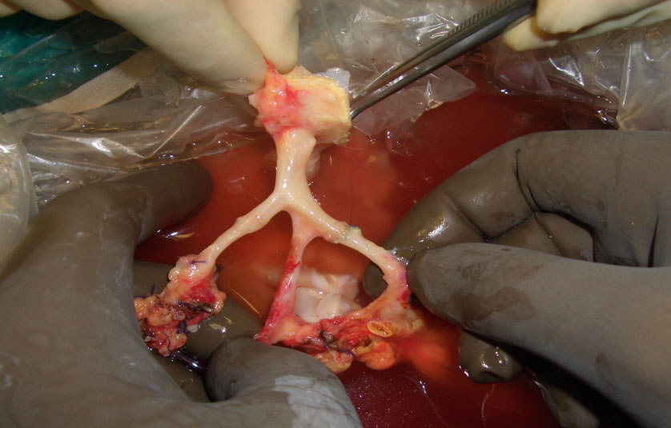

Slide 15
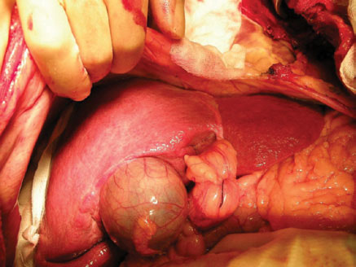
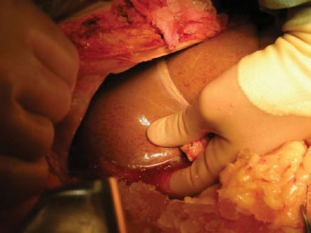
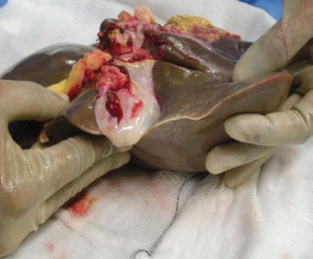
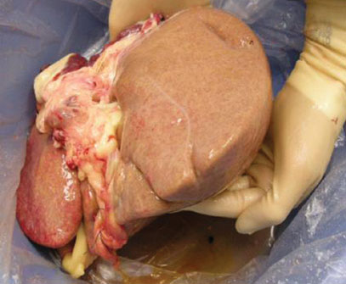

Slide 16
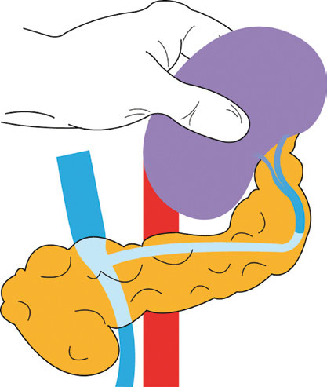
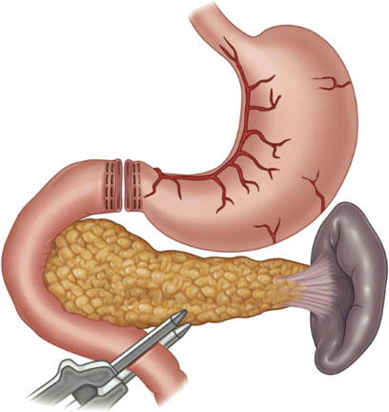
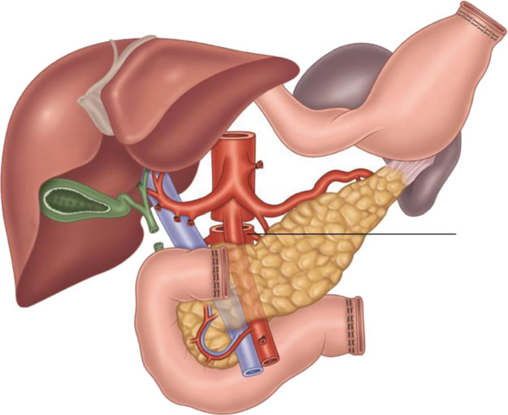

Slide 17
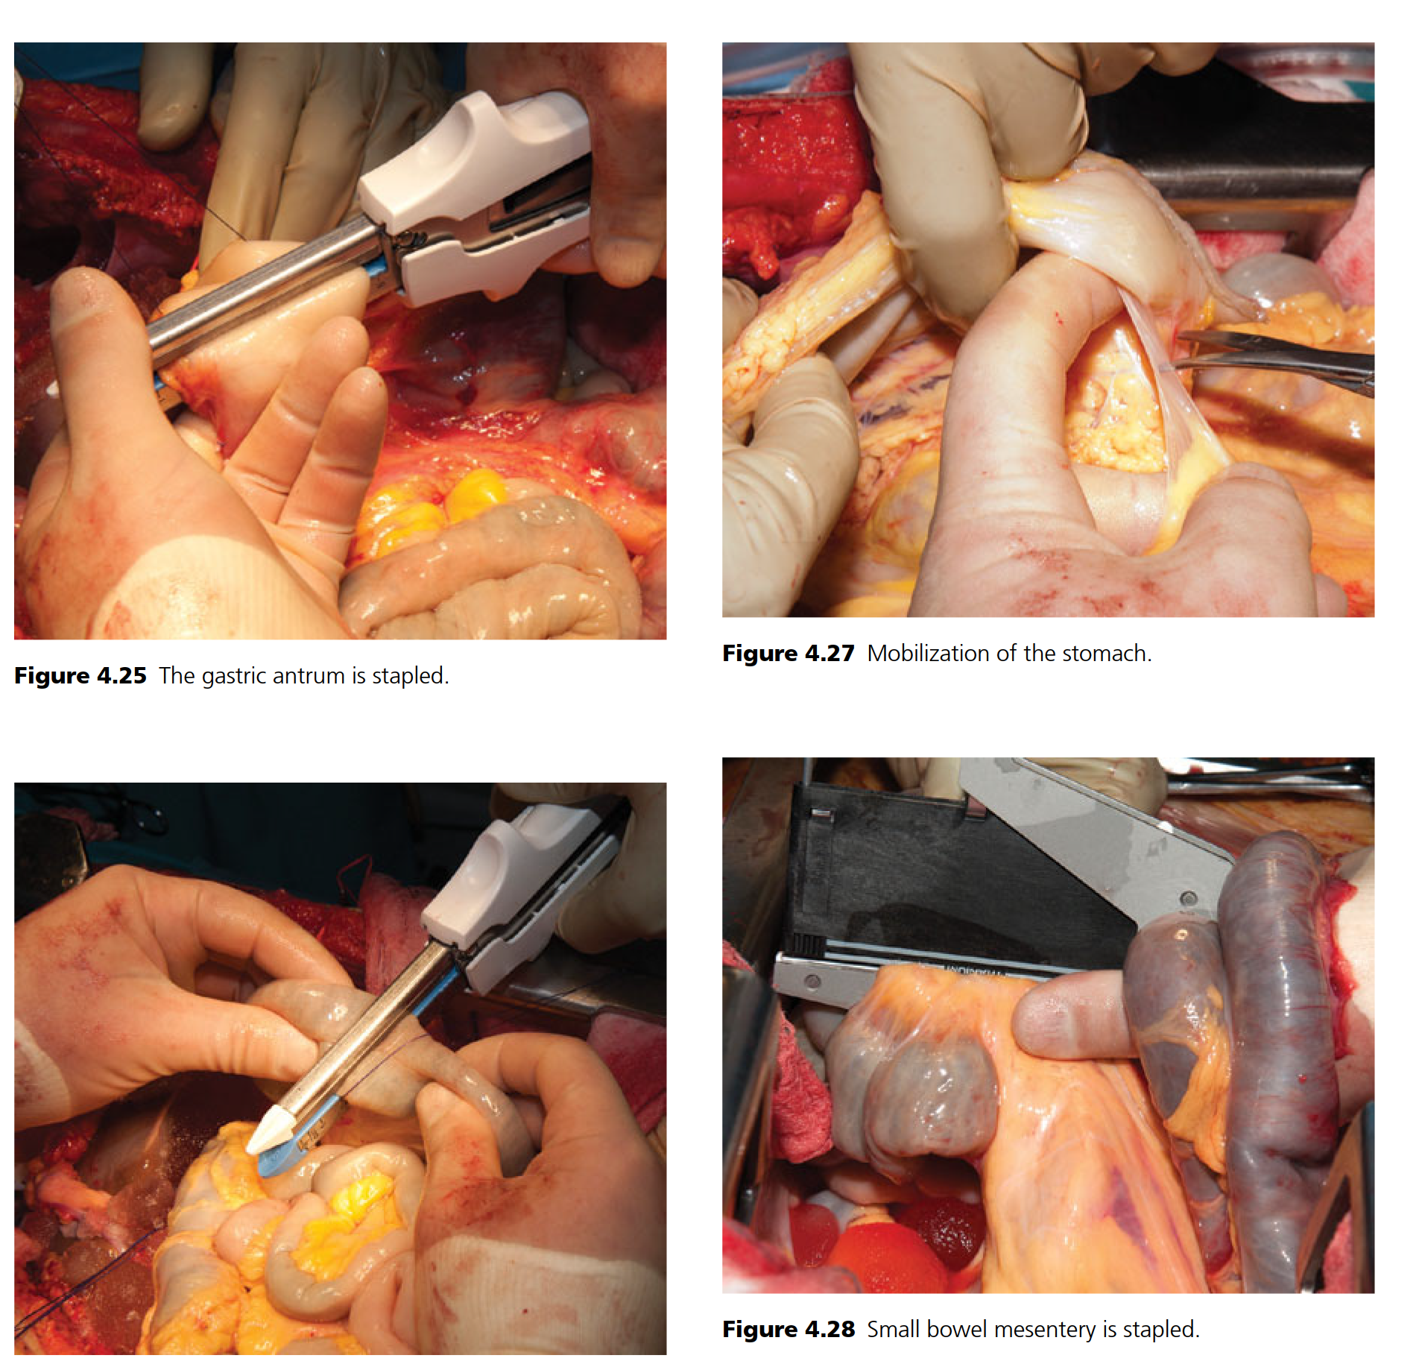

Slide 18
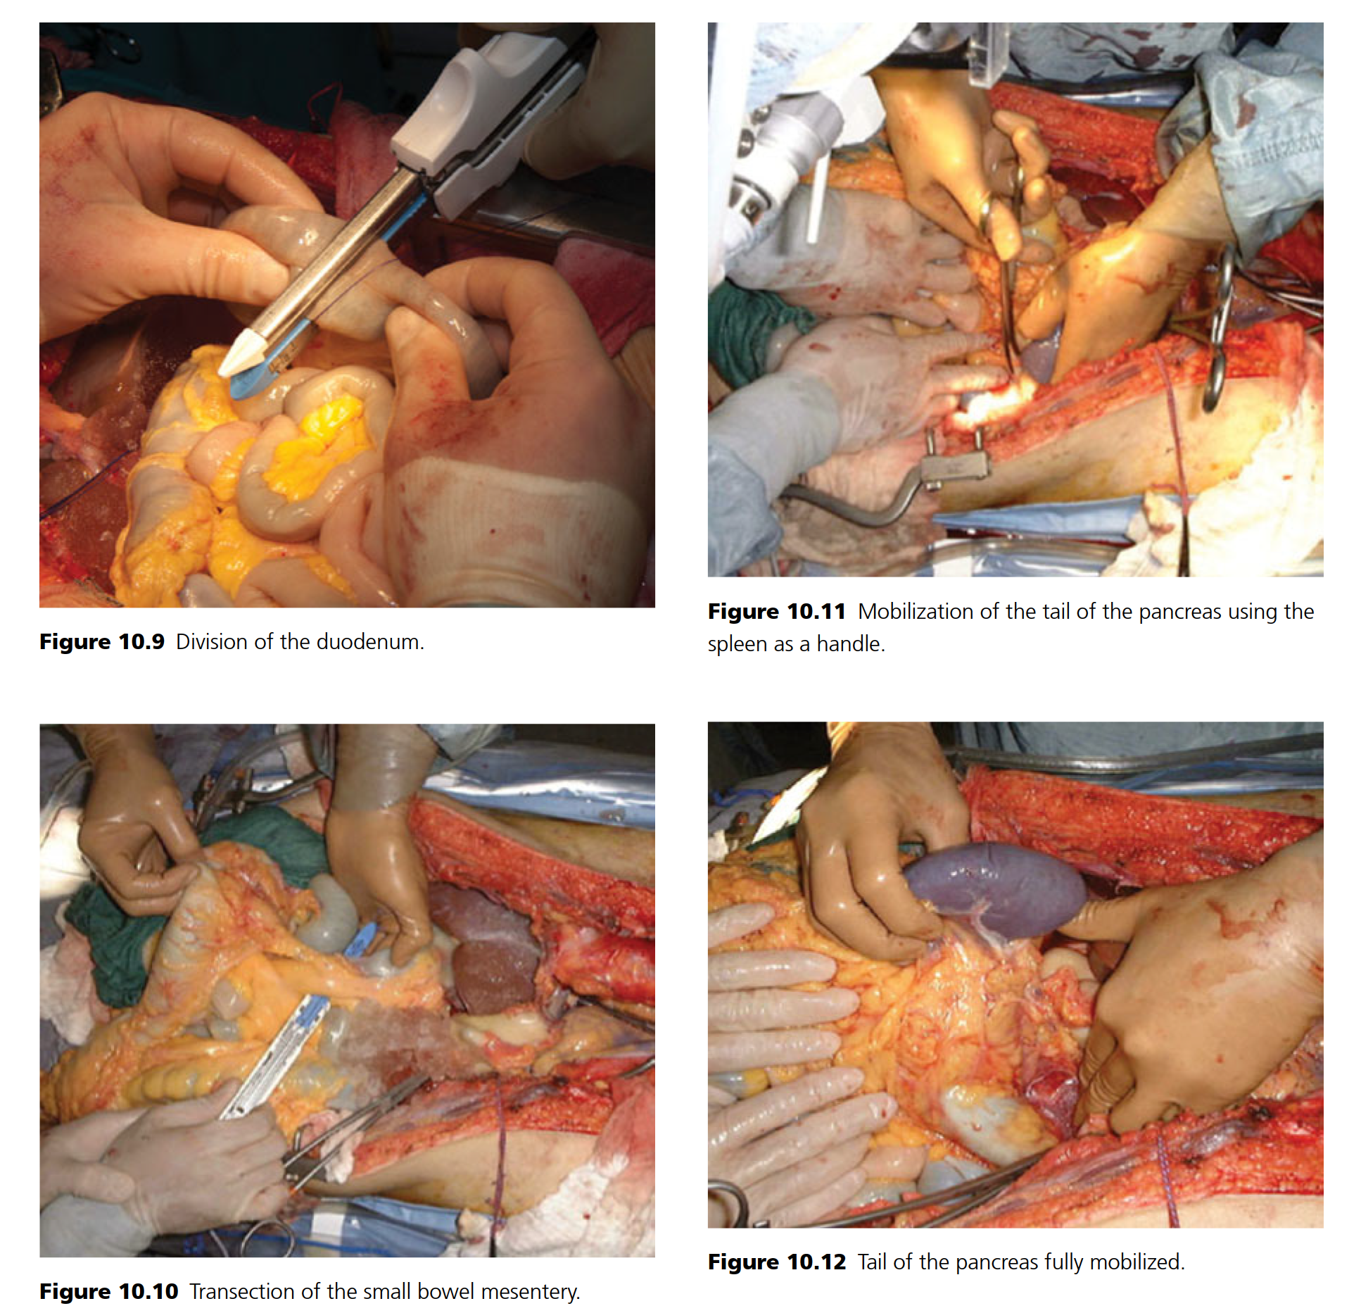
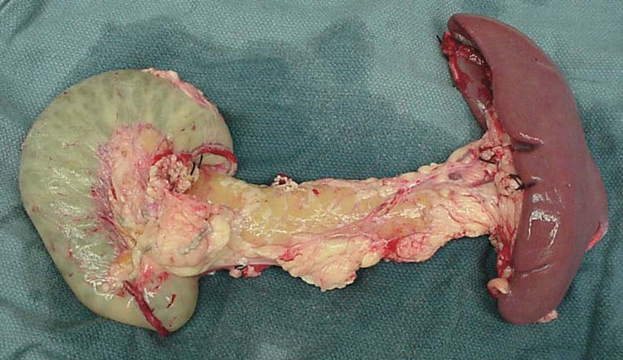
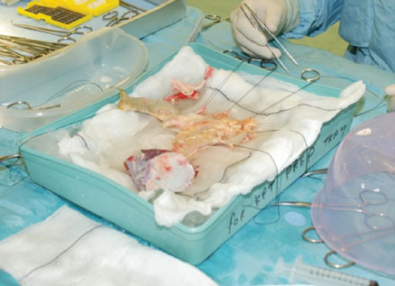

Slide 19
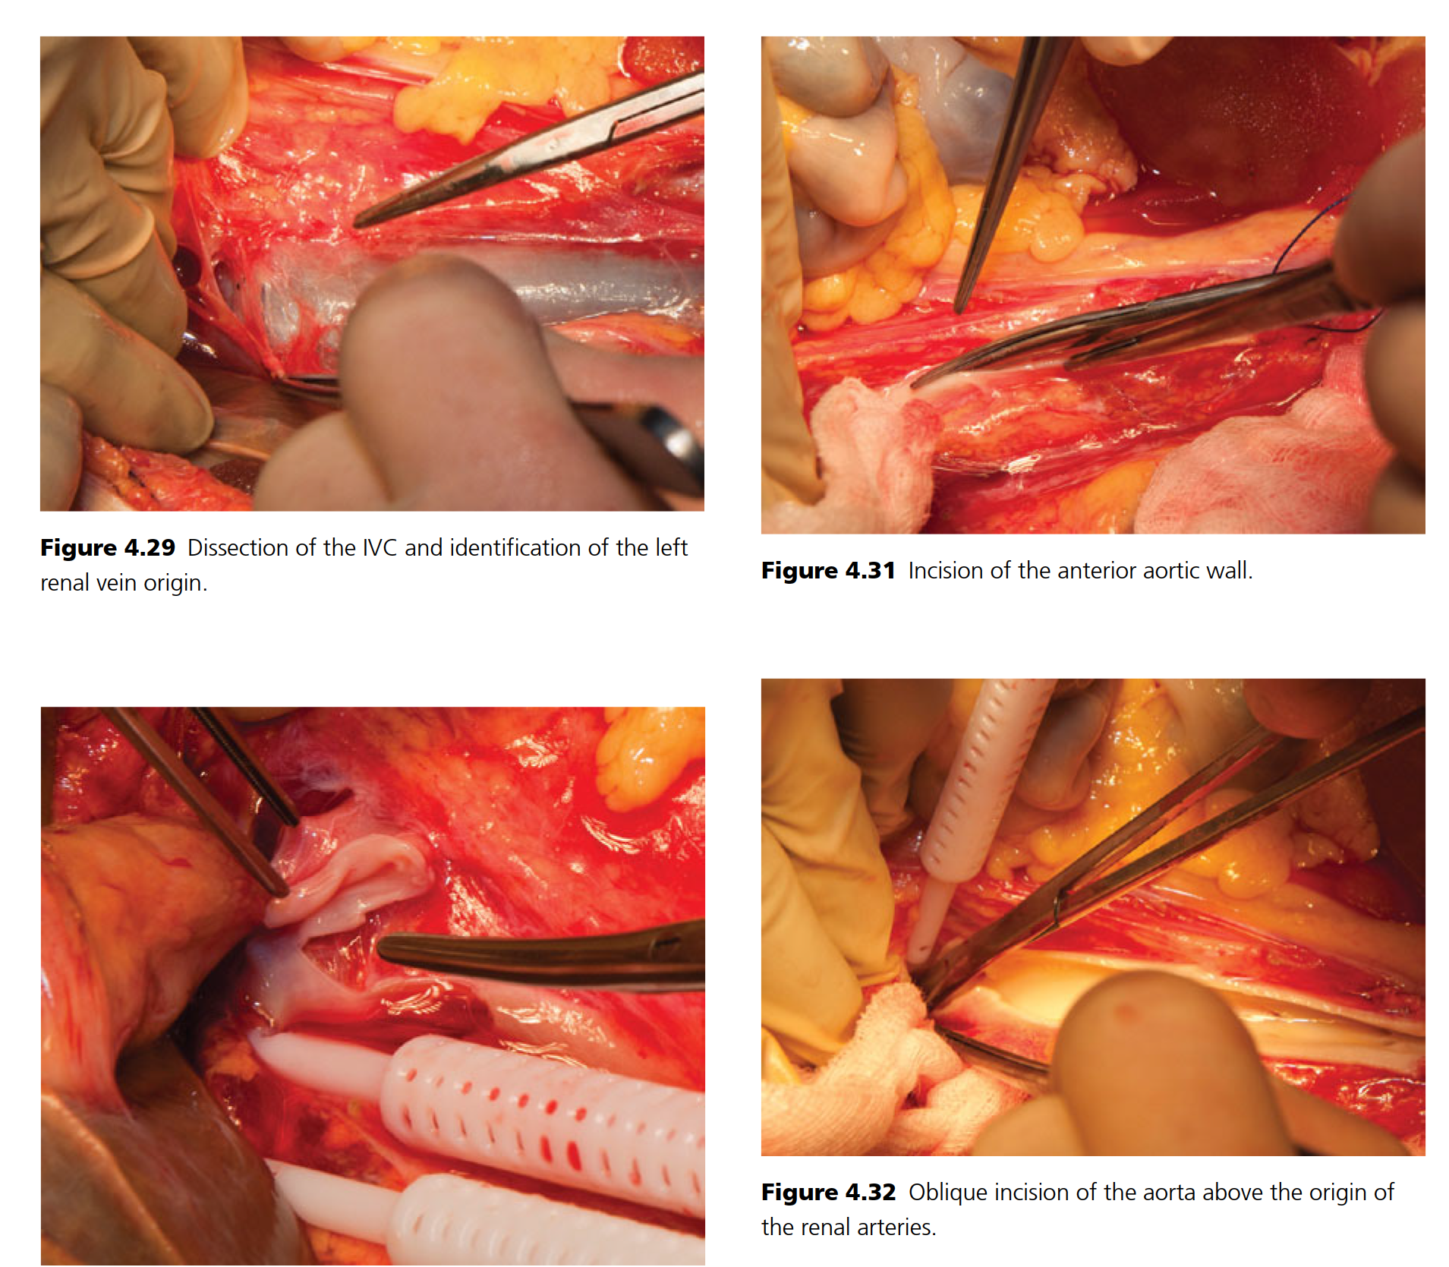

Slide 20
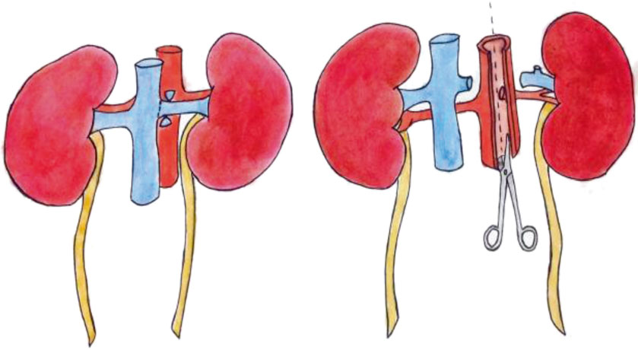

Slide 21
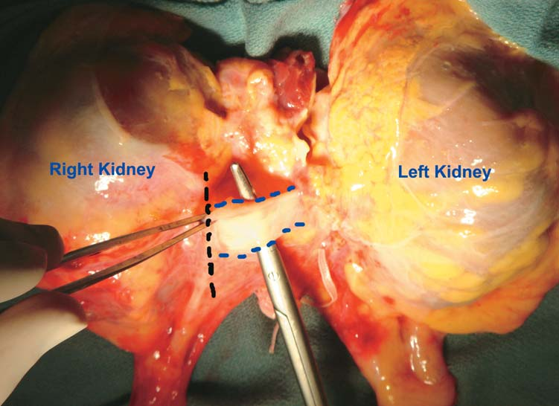
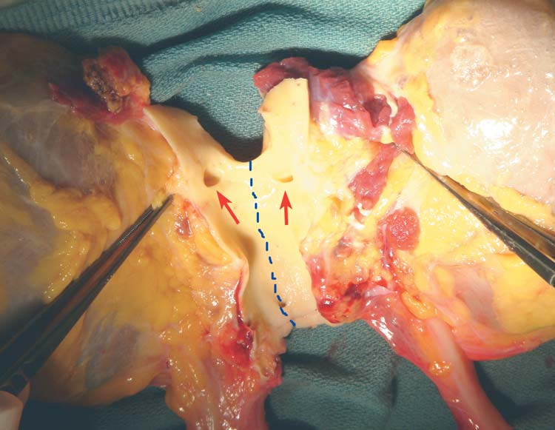
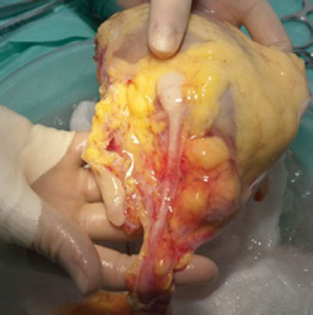

Slide 22
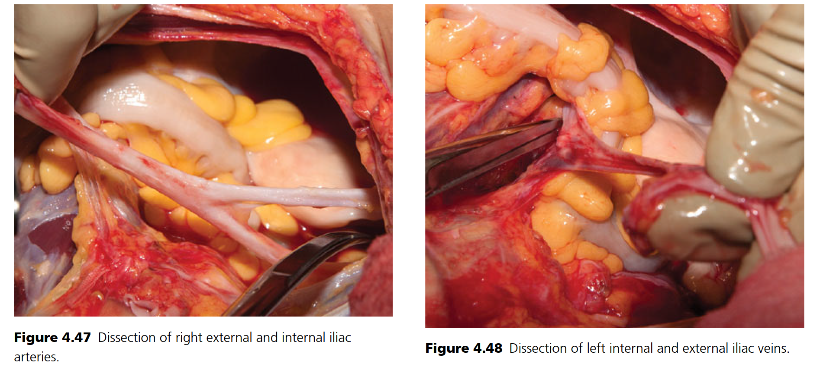

Slide 23
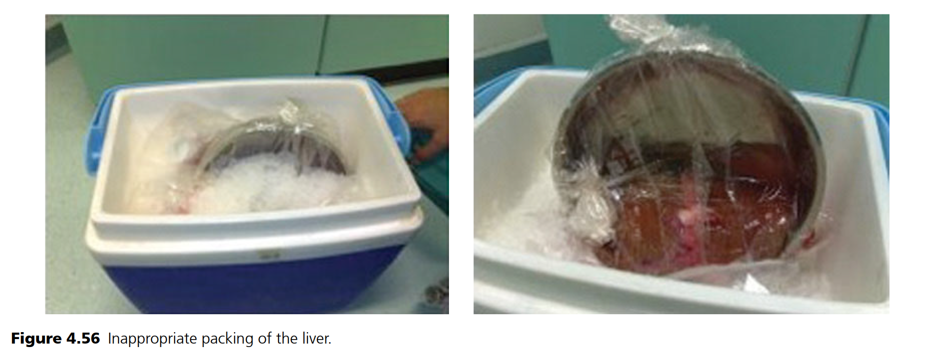

Slide 24
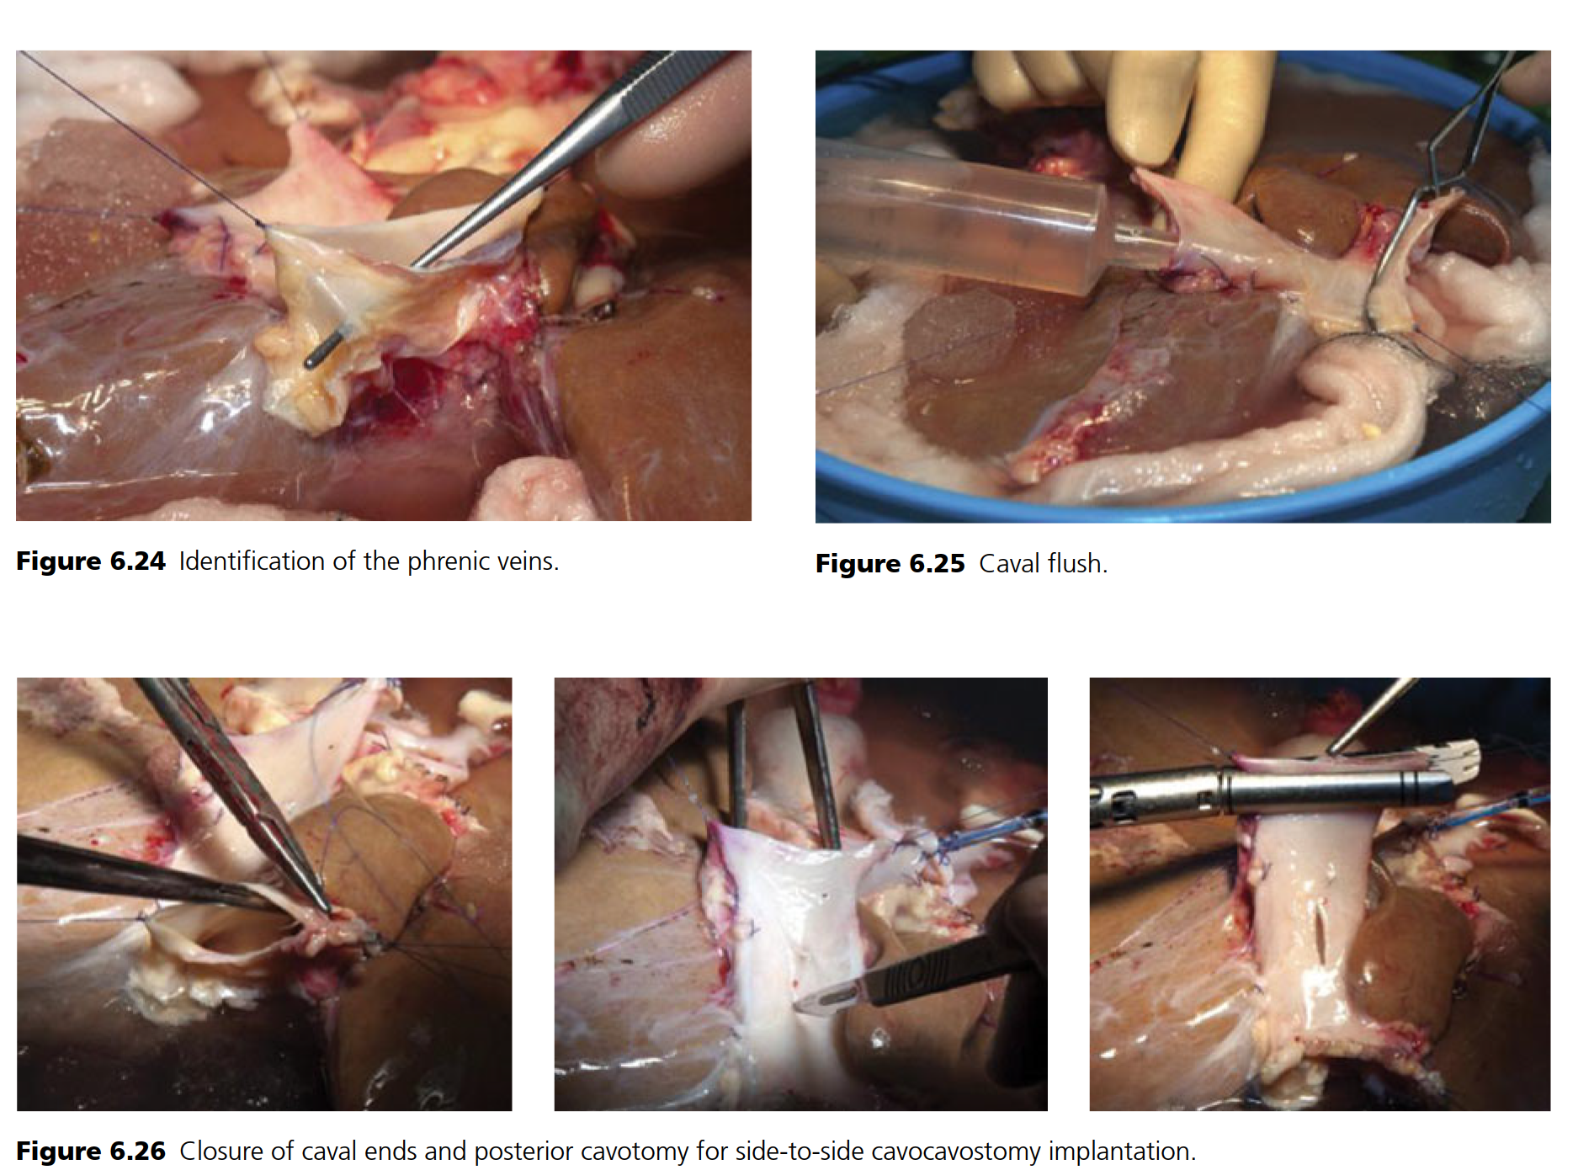

Slide 25
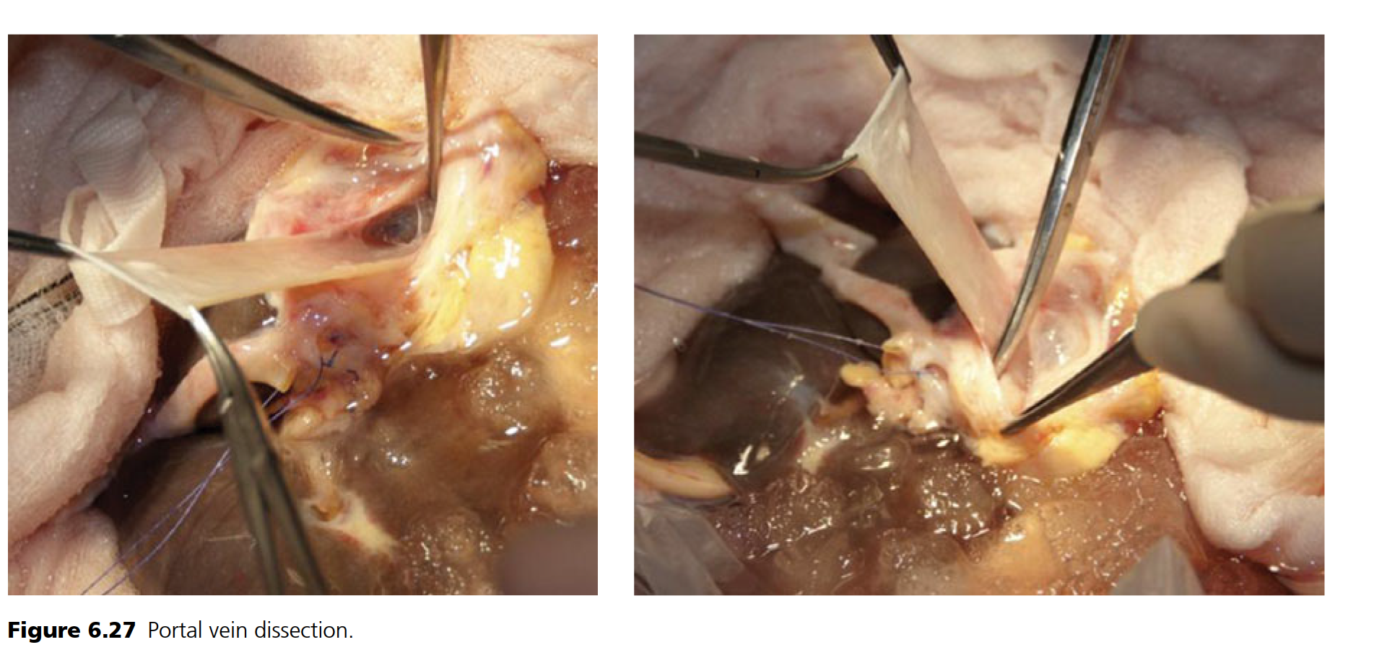
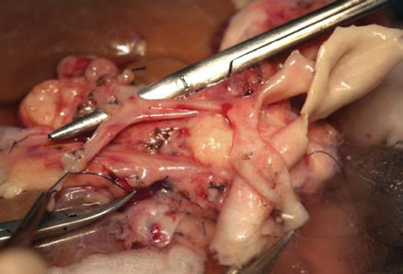
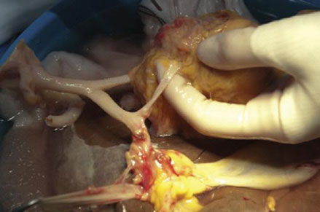

Slide 26
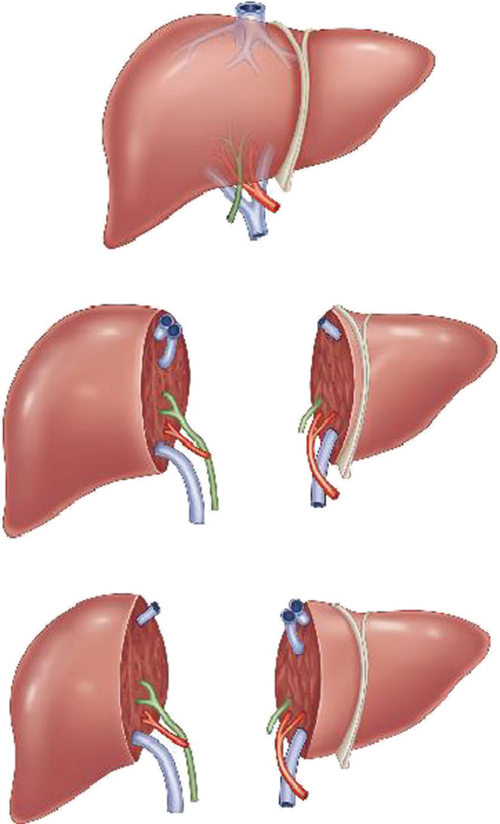
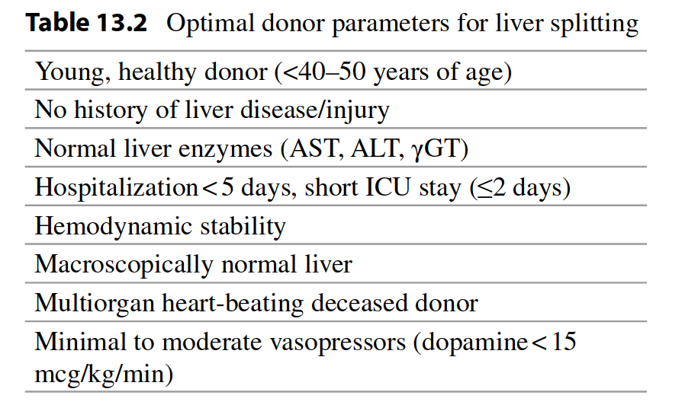

Slide 27
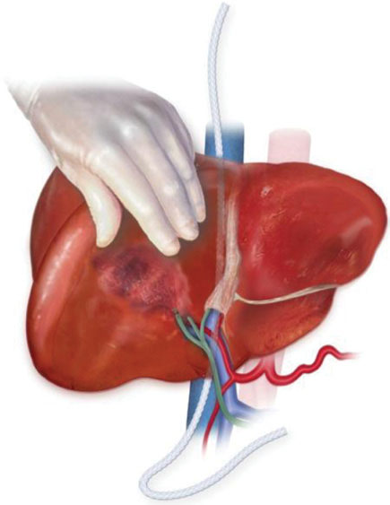
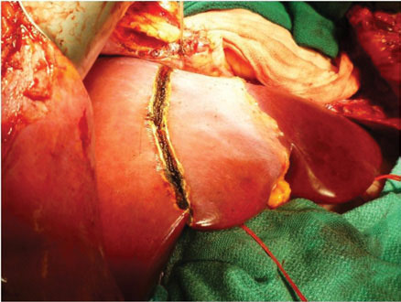




Slide 28



Slide 29



Slide 30



Slide 31






HEART TRANSPLANTATION
Coronary atherosclerosis, believed to be a manifestation of chronic graft rejection, occurs in 30%-40% of patients within 5 years after transplantation
Heart-lung transplantation currently results in a 70% 1-year survival rate.

Slide 32




LUNG TRANSPLANTATION
Lung transplantation is currently performed for a myriad of indications, including emphysema, cystic fibrosis, idiopathic pulmonary fibrosis, α1-antitrypsin deficiency, primary pulmonary hypertension, and congenital diseases.

Slide 33





Classic Liver Transplantation with Vena Cava Replacement

Slide 34


Piggyback Liver Transplantation

Slide 35


Auxiliary Liver Transplantation
This procedure is becoming established as the optimal treatment for young patients with severe acute liver failure. Auxiliary liver transplantation (ALT) restores liver function in such patients, allowing time for the native liver to regenerate

Slide 36




Pancreas Transplantation

Slide 37


Living Donor Pancreas Transplantation

Slide 38



Small Bowel Transplantation

Slide 39

Small Bowel Transplantation

Slide 40

Multivisceral Transplantation

Slide 41



Slide 42
KIDNEY TRANSPLANTATION
Diabetes is the most common cause of chronic renal failure in adults and accounts for 45% of all renal failure in the United States. The second most common cause is hypertensive nephropathy (27%), followed by chronic glomerulonephritis (11%). The causes of renal failure in children are somewhat different, with congenital causes, including both nonobstructive and obstructive uropathies
Major histocompatibility (MHC) antigens: (HLA)-A, HLA-B, HLA-C, HLA-D, HLA-DR, HLA-DQ, and HLA-DP (chromosome 6). Class I antigens (HLA-A, HLA-B, and HLA-C) are expressed by all nucleated cells. Class II antigens (HLA-DR, HLA-DP, and HLA-DQ) are expressed by antigen-presenting cells (APCs) such as B lymphocytes, dendritic cells, macrophages, and other phagocytic cells. They present the fragments of foreign proteins to T lymphocytes.
ABO-compatible
Lymphocytes are categorized as either B or T cells. B cells are responsible for antibody production against donor antigens
Living Donors: The mortality rate is estimated to be 0.03%
In 20% of kidney transplants from deceased donors, the kidney will fail to function immediately. This complication is termed delayed graft function and is due to acute tubular necrosis of the kidney. It can also occur following living donor transplantation (< 3%)

Slide 43

GRAFT REJECTION
Hyperacute rejection is due to preformed cytotoxic antibodies against donor antigens (24-48 hours)
Acute rejection is the most common type of rejection episode during the first 3 months
Chronic rejection

Slide 44

KIDNEY TRANSPLANTATION
1-year graft survival rate with a living donor kidney was nearly 98%; with a deceased donor kidney, the rate was approximately 95%
1-year graft failure rate dropped from approximately 20% in 1989 to less than 7% in 2009 to 4.8% in 2015; with a living donor kidney, the rate dropped from 8.5% in 1989 to less than 3% in 2015

Slide 45



Slide 46
LIVER TRANSPLANTATION
More than 5000 liver transplants are performed annually in the United States, and 1-year patient survival rates are more than 85%.
The most common indication for liver transplantation is currently cirrhosis due to chronic hepatitis C infection. Other diseases for which liver transplant is indicated include cirrhosis due to hepatitis B, alcoholic cirrhosis, primary biliary cirrhosis, sclerosing cholangitis, autoimmune hepatitis, and cirrhosis secondary to nonalcoholic fatty liver disease. Less common indications are Wilson disease, α1-antitrypsin deficiency, Budd-Chiari syndrome, and hemochromatosis. In children, the most common indication is biliary atresia. Other common diagnoses include α1-antitrypsin deficiency, tyrosinemia, and other inborn errors of metabolism
Recent data, however, suggest that recurrence of hepatitis C in the new liver graft is virtually universal following transplantation, and 25% of patients will have developed cirrhosis in the graft within 5 years. It is not surprising that longer-term data are now appearing showing that the 10-year survival for patients transplanted for hepatitis C is significantly worse than for other diagnoses
5%-10% of liver transplant recipients will require reoperation because of continued bleeding following the procedure due to coagulopathy
5% and 10% primary nonfunction, vascular complications
20% of liver trans-plant recipients will experience a bile duct complication
20%-50% Rejection

Slide 47
PANCREAS TRANSPLANTATION
Type 1 diabetes: severe retinopathy at an early age, leading to blindness and renal disease as well as severe neuropathy and peripheral vascular disease
The most common nonsurgical complication post transplant is rejection. The incidence of rejection is about 30% within the first year. The diagnosis is usually based on an increase in serum amylase and lipase levels and, in bladder-drained recipients, a decrease in urinary amylase levels. A sustained drop in urinary amylase levels greater than 25% from baseline should prompt a pancreas graft biopsy to rule out rejection. In enteric-drained recipients, one must rely on serum amylase and lipase levels only.
In 2010 to 2014 vs. 2005 to 2009, U.S. SPK transplant patient survival at 1 year posttransplant increased from 95.7% to 97.4%, pancreas graft function increased from 88.3% to 91.3%, and kidney function increased from 93.6% to 95.5%.
ISLET TRANSPLANTATION
In the most experienced centers, long-term rates of diabetes reversal are now about 50% at 5 years posttransplant

