Slide 1

Χ Α Π
GOLD
Global Initiative for Chronic
Obstructive Lung Disease
ΠΝΕΥΜΟΝΟΛΟΓΙΚΟ ΤΜΗΜΑ
ΓΝΑ ΛΑΪΚΟ

Slide 2

Saudi Arabia
Bangladesh
Slovenia
Germany
Brazil
Ireland
United States
Australia
Yugoslavia
Croatia
Canada
Austria
Taiwan ROC
Philippines
Mongolia
Portugal
Thailand
Yeman
Malta
Moldova
Norway
Greece
China
South Africa
Kazakhstan
United Kingdom
Syria
Hong Kong ROC
Italy
New Zealand
Israel
Nepal
Chile
Argentina
Mexico
Pakistan
Russia
United Arab Emirates
Peru
Japan
GOLD National Leaders
Poland
Korea
Netherlands
Venezuela
Egypt
France
Georgia
Switzerland
India
Kyrgyzstan
Iceland
Macedonia
Czech Republic
Albania
Denmark
Turkey
Slovakia
Belgium
Columbia
Ukraine
Singapore
Spain
Romania
Sweden
Uruguay
Vietnam
© 2015 Global Initiative for Chronic Obstructive Lung Disease

Slide 3

Global Strategy for Diagnosis, Management and Prevention of COPD, 2016:
Ορισμός
Διάγνωση
Θεραπεία
Αντιμετώπιση
Εξάρσεις
Συνοσηρότητες
ACOS

Slide 4
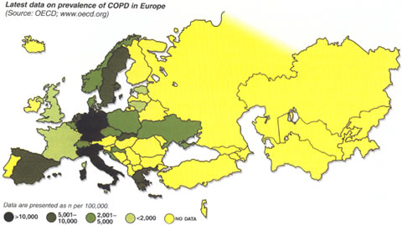

Slide 5
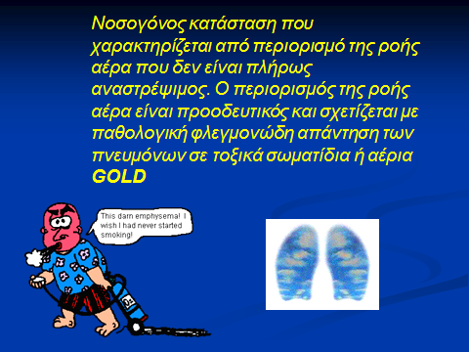
ΟΡΙΣΜΟΣ ΧΑΠ

Slide 6


Slide 7
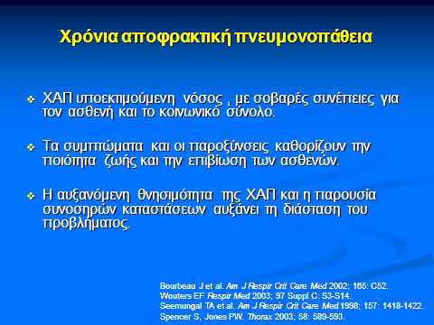

Slide 8
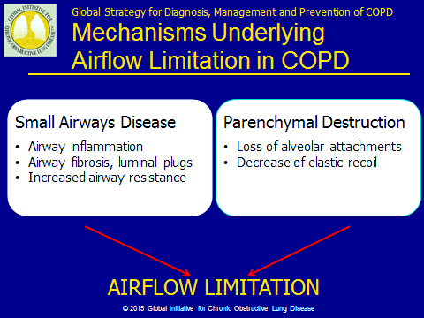

Slide 9
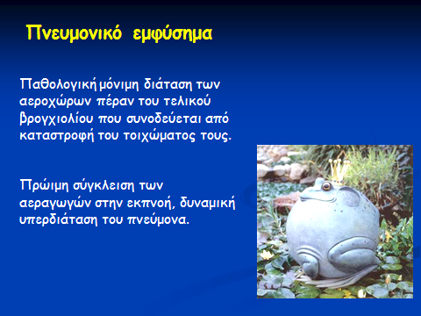


Slide 10
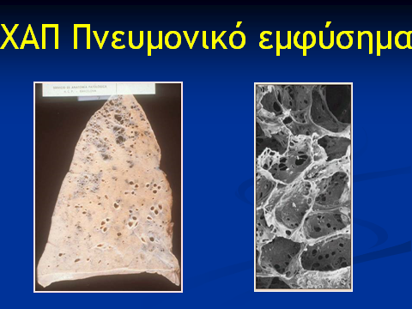
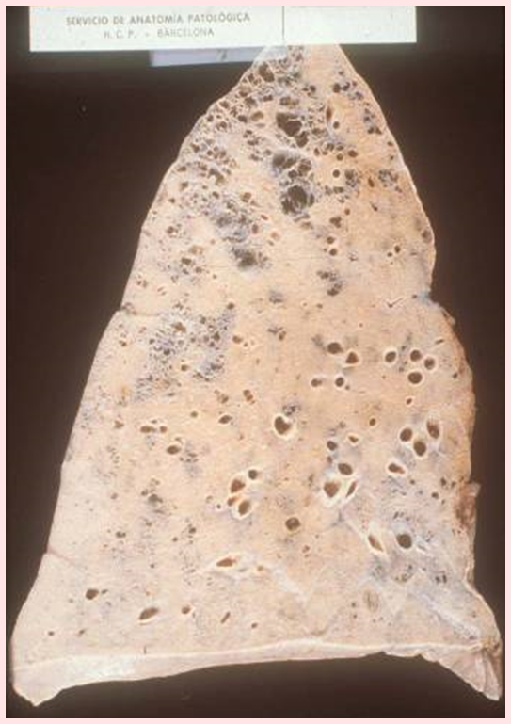
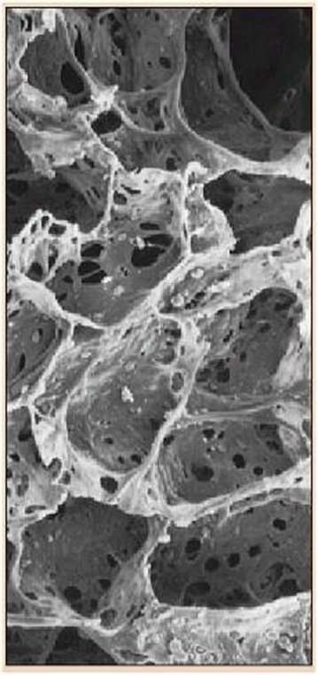

Slide 11
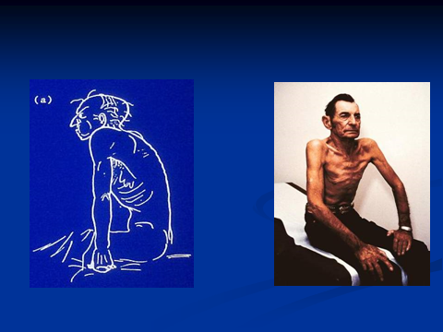
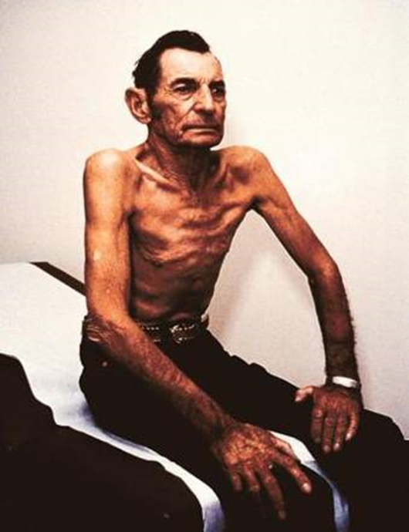

Slide 12
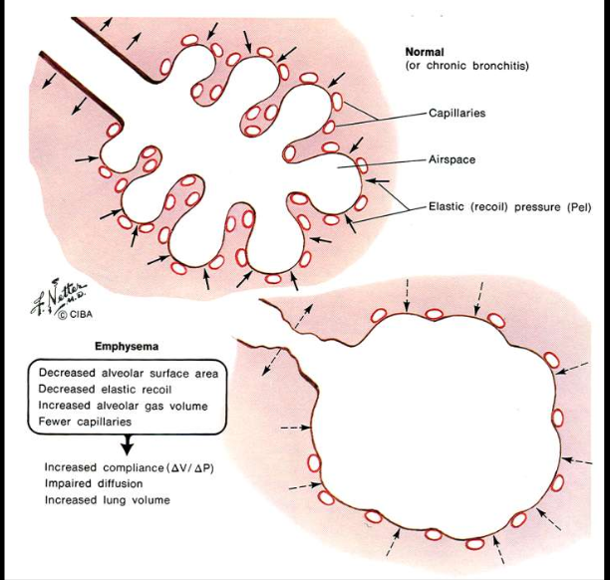

Slide 13
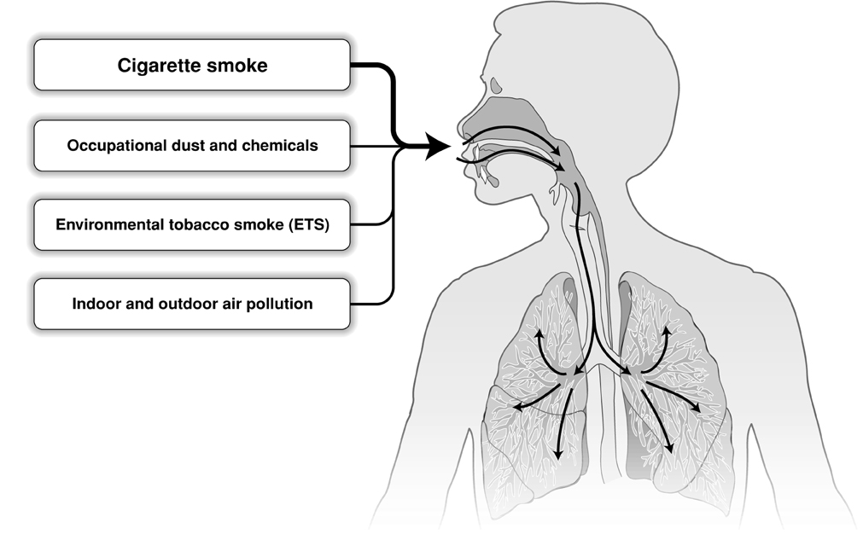
ΠΑΡΑΓΟΝΤΕΣ ΚΙΝΔΥΝΟΥ
Genes
Infections
Socio-economic status
Aging Populations

Slide 14
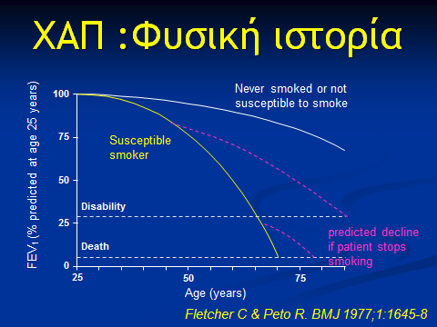

Slide 15
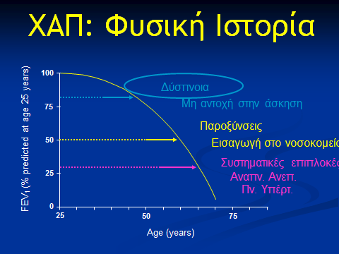

Slide 16
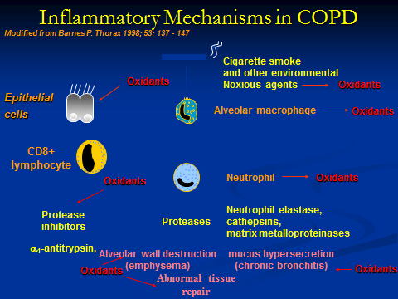

Slide 17


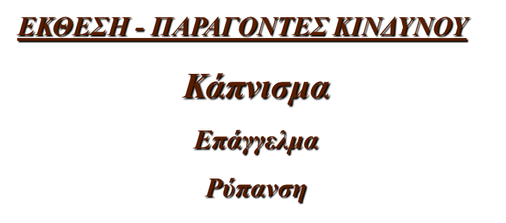







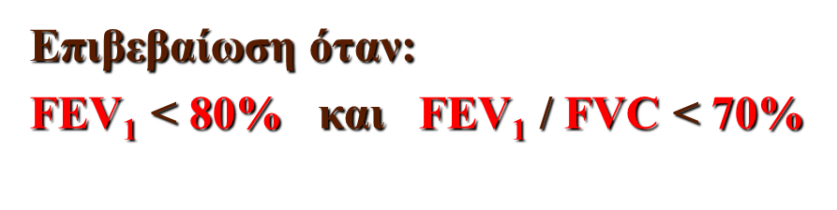

Slide 18
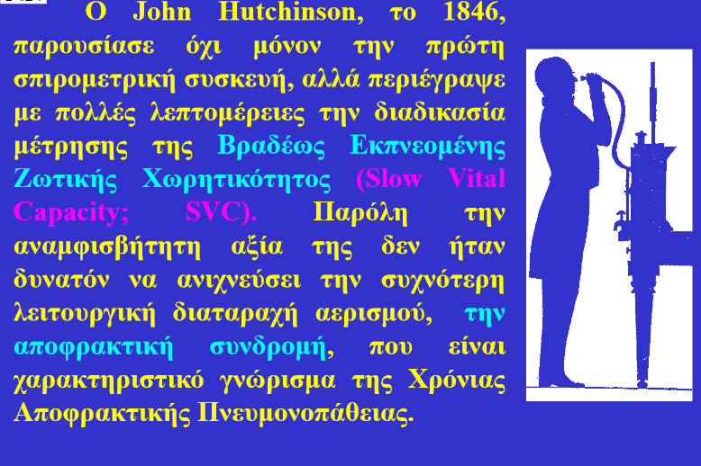

Slide 19
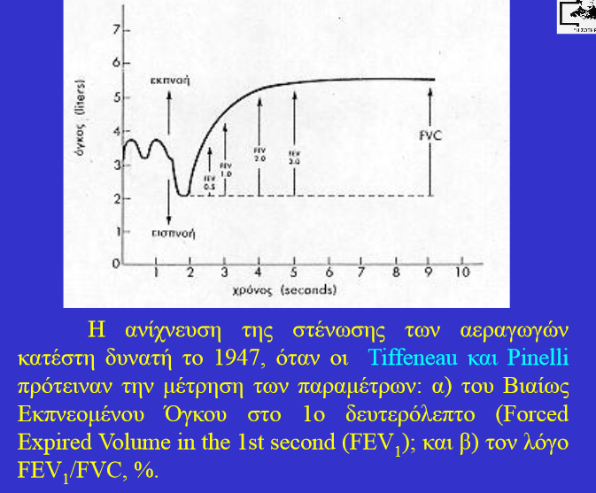

Slide 20
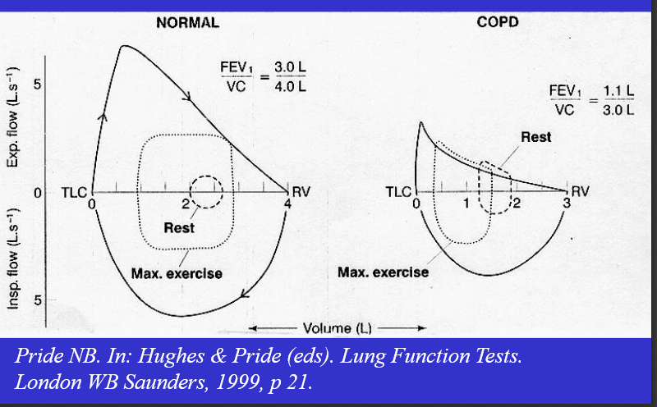

Slide 21
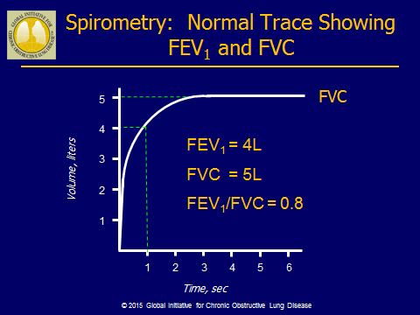

Slide 22
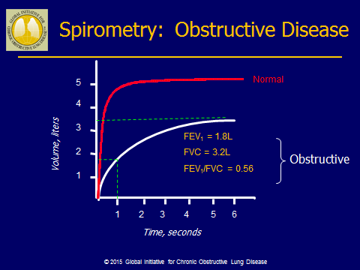

Slide 23
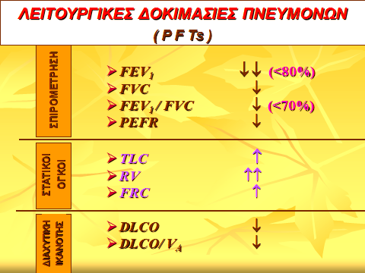

Slide 24
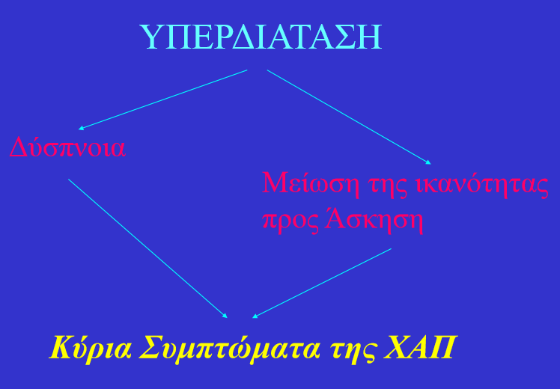

Slide 25
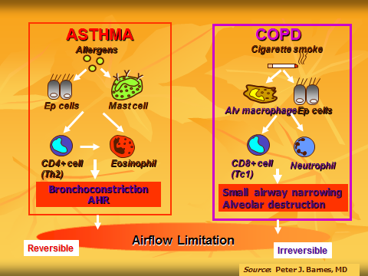

Slide 26
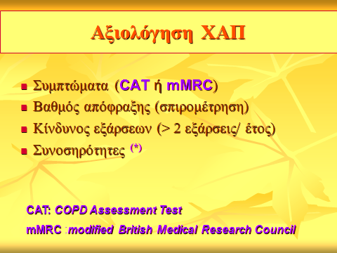

Slide 27
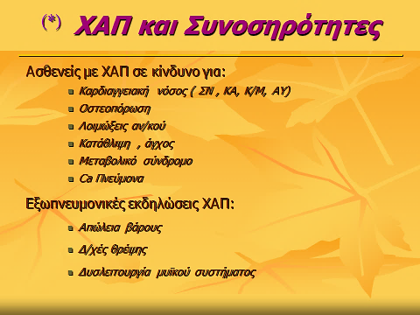

Slide 28
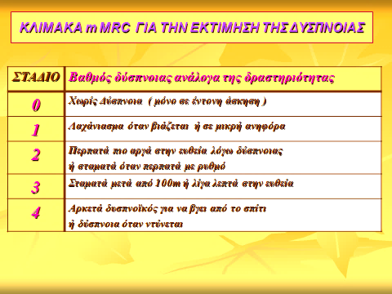

Slide 29
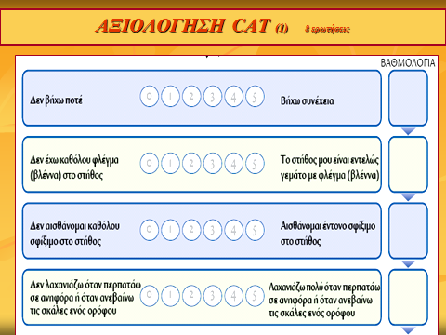

Slide 30
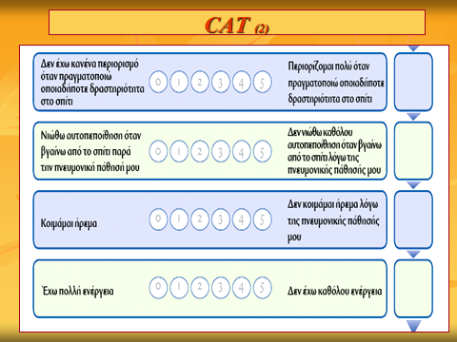

Slide 31
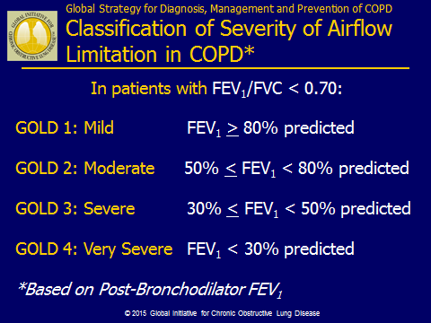

Slide 32
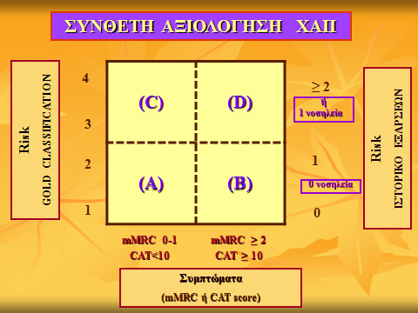

Slide 33
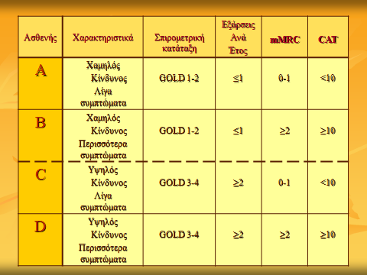

Slide 34
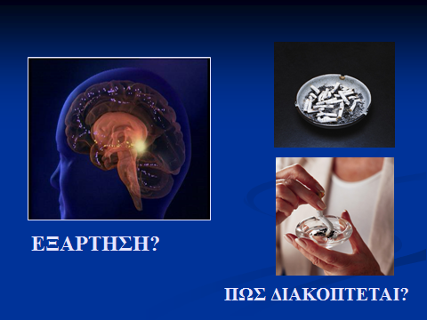

Slide 35
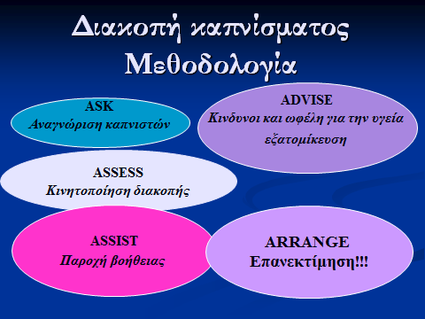

Slide 36
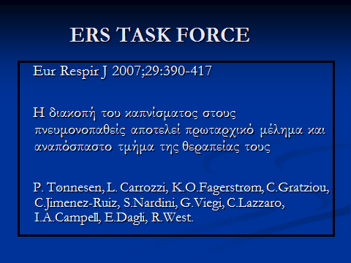

Slide 37


Slide 38
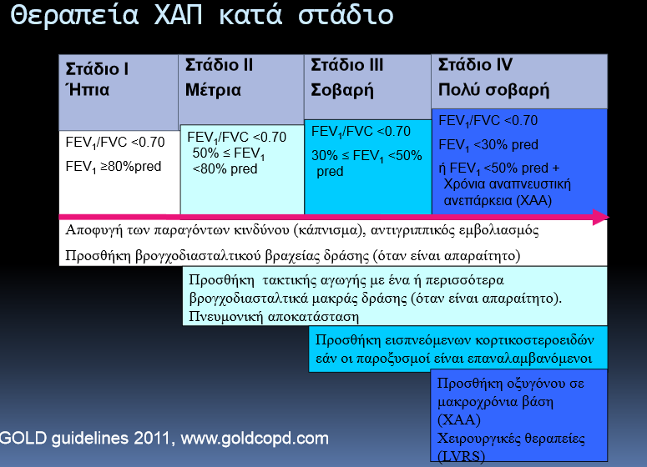
2015

Slide 39
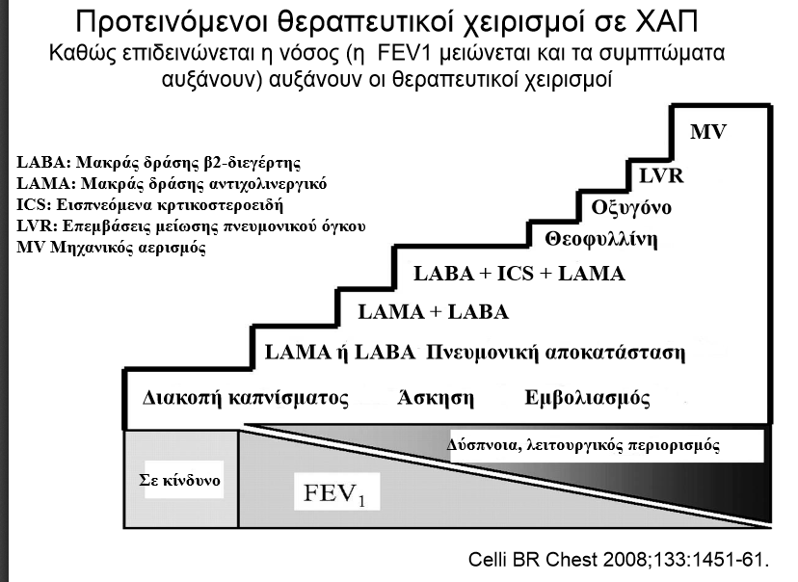

Slide 40
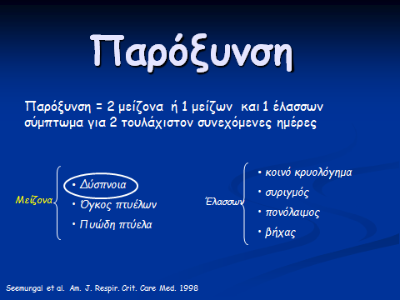

Slide 41
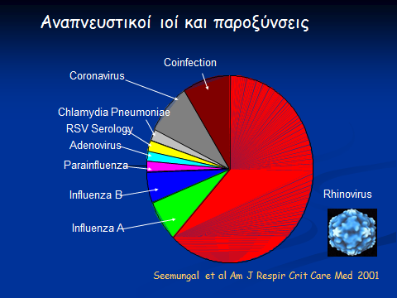

Slide 42
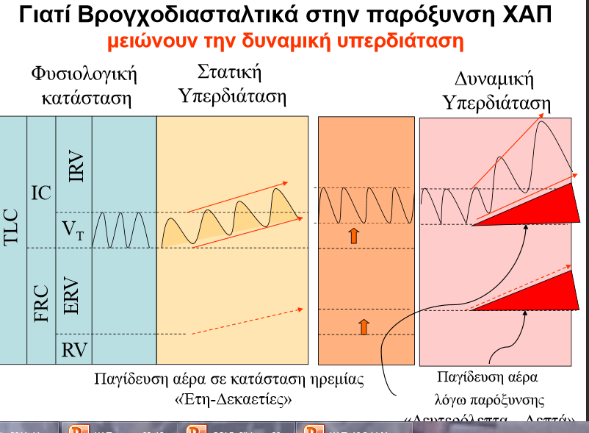

Slide 43
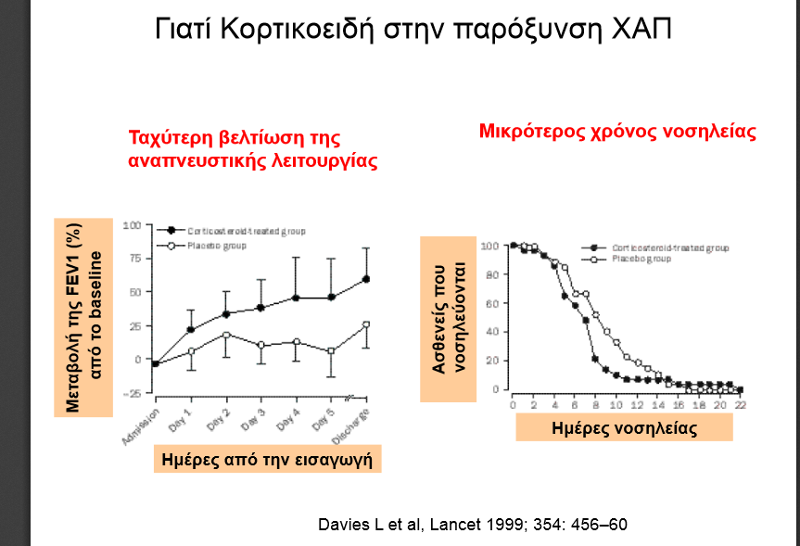

Slide 44
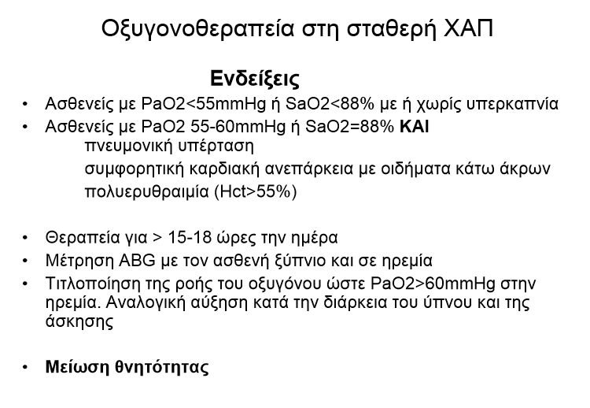

Slide 45
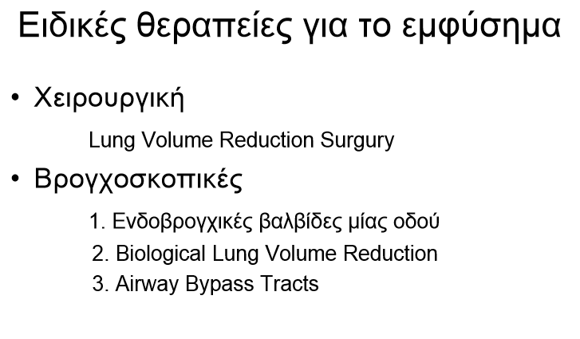

Slide 46
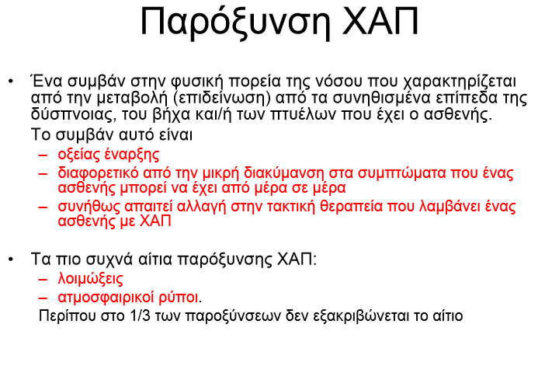

Slide 47
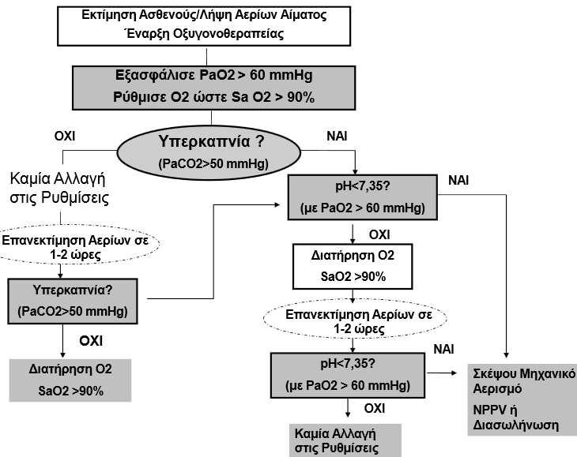

Slide 48
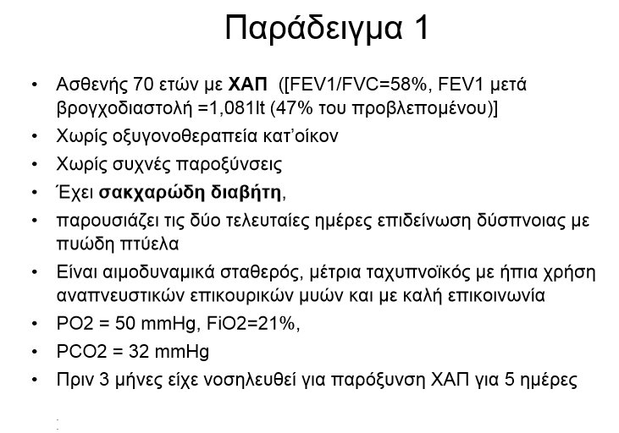

Slide 49
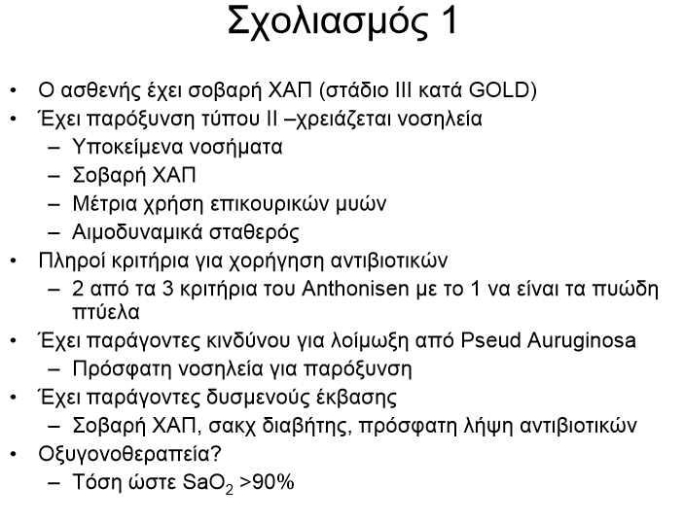

Slide 50
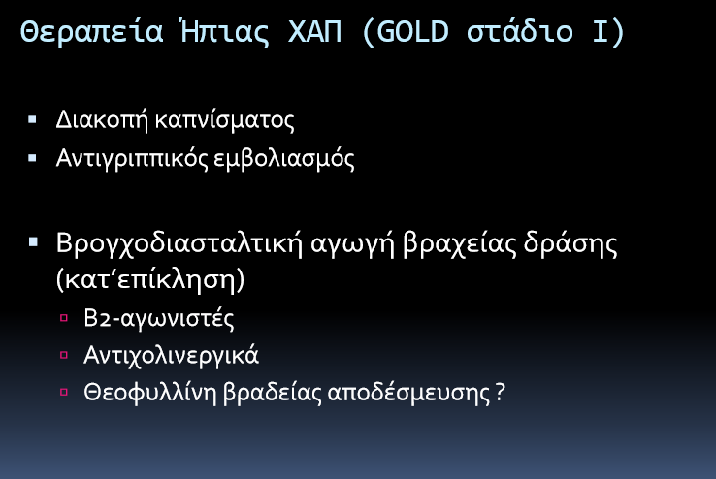

Slide 51
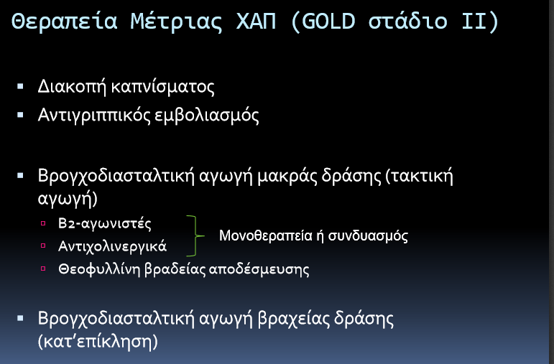

Slide 52


Slide 53


Slide 54


Slide 55


Slide 56


Slide 57


Slide 58


Slide 59


Slide 60


Slide 61

Διακοπη καπνισματος

Slide 62


Slide 63


Slide 64


Slide 65


Slide 66


Slide 67


Slide 68


Slide 69


Slide 70


Slide 71


Slide 72


Slide 73


Slide 74


Slide 75


Slide 76


Slide 77


Slide 78



Slide 79


