Slide 1
Καρκίνος μαστού
Δήμητρα Στεφάνου
Παθολόγος Ογκολόγος
Επιμελήτρια Β’
Α΄ ΠΚ, ΓΝΑ Λαικό

Slide 9
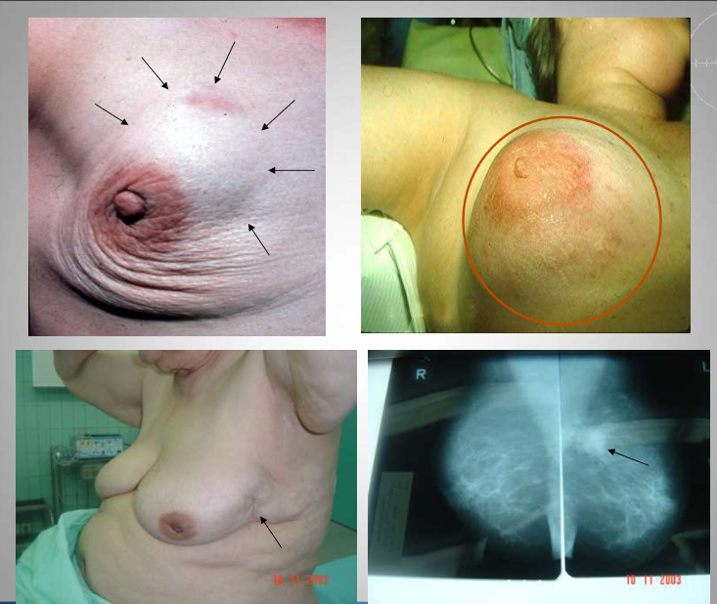

Slide 11
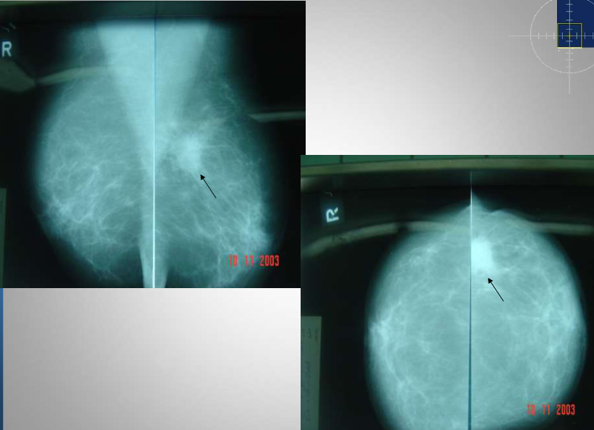

Slide 15
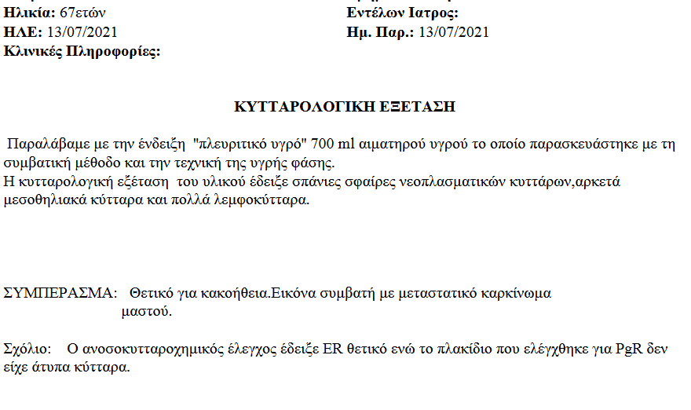

Slide 16
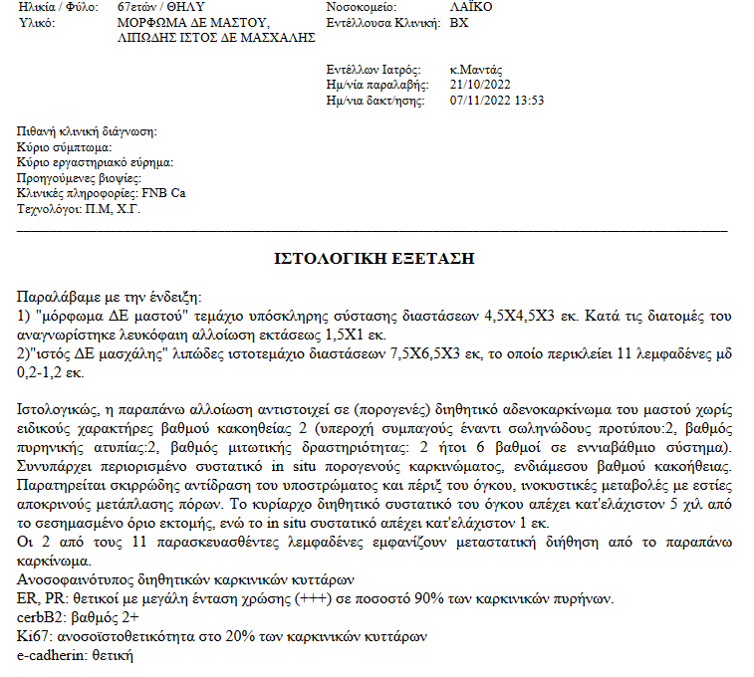

Slide 19
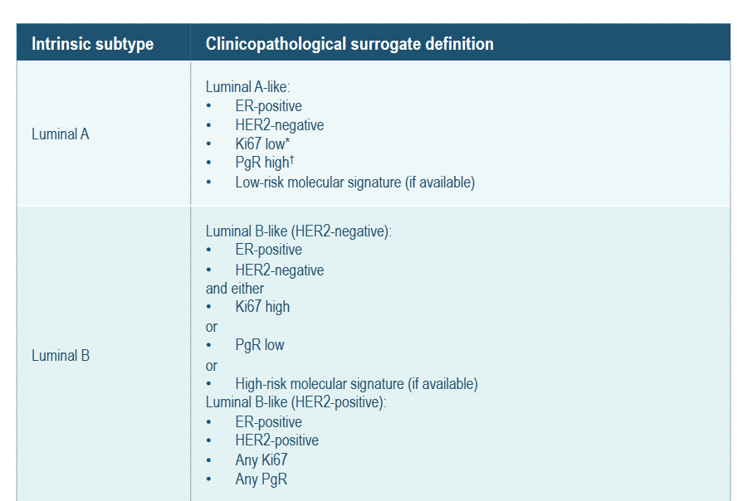
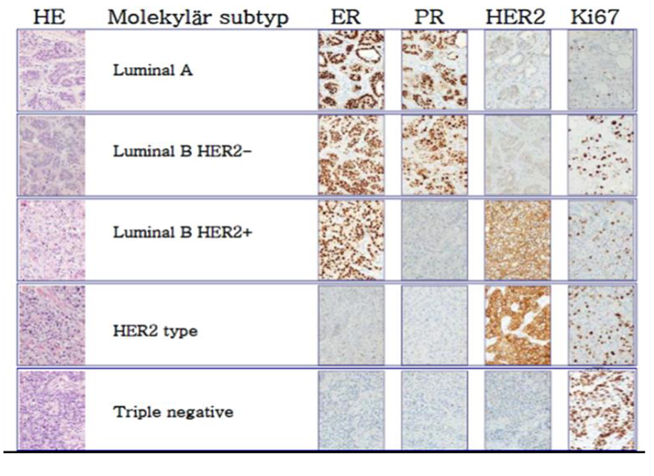

Slide 20
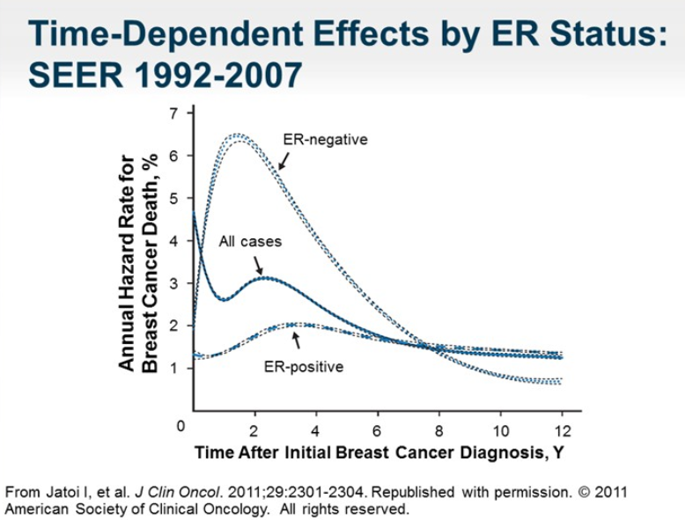

Slide 22
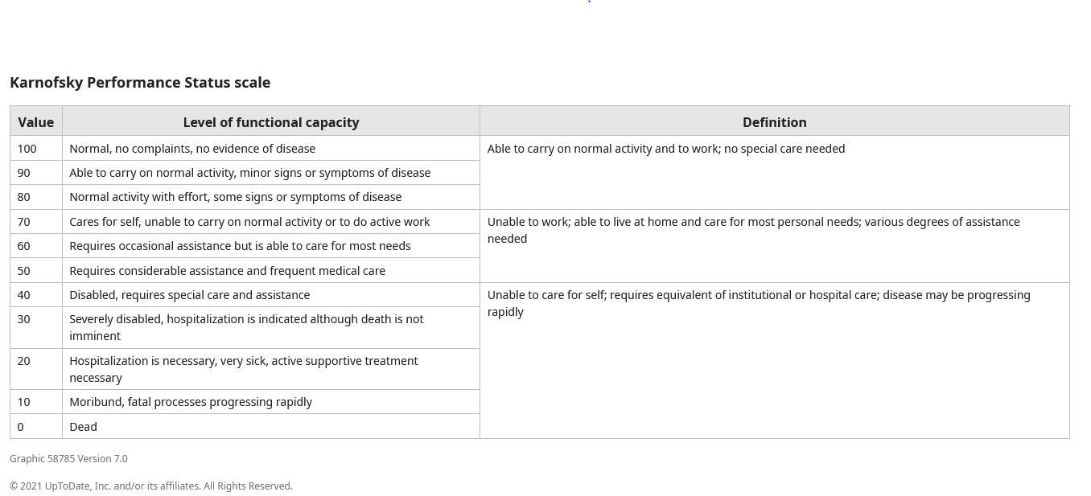
Γενική κατάσταση ασθενούς

Slide 24
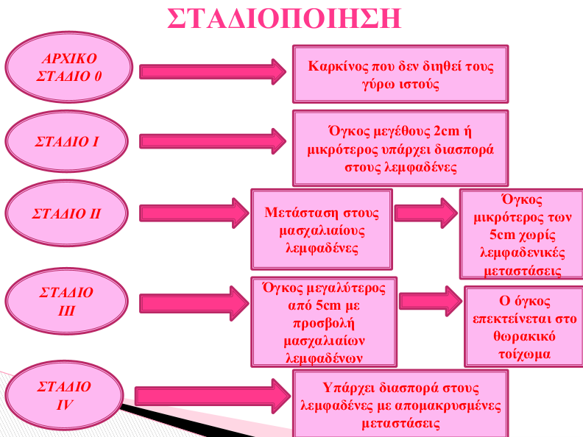

Slide 26
Χειρουργείο (ριζικό-παρηγορητικό)
Ακτινοθεραπεία (ριζική-συμπληρωματική-παρηγορητική)
Συστηματική θεραπεία →(επικουρική-νεοεπικουρική- διάσωσης-συντήρησης)
→ (χημειοθεραπεία-ανοσοθεραπεία-στοχευτικοί παράγοντες-συζευγμένα μόρια- ορμονοθεραπεία)

Slide 31
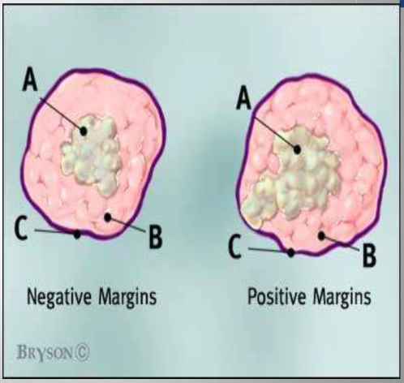

Slide 35
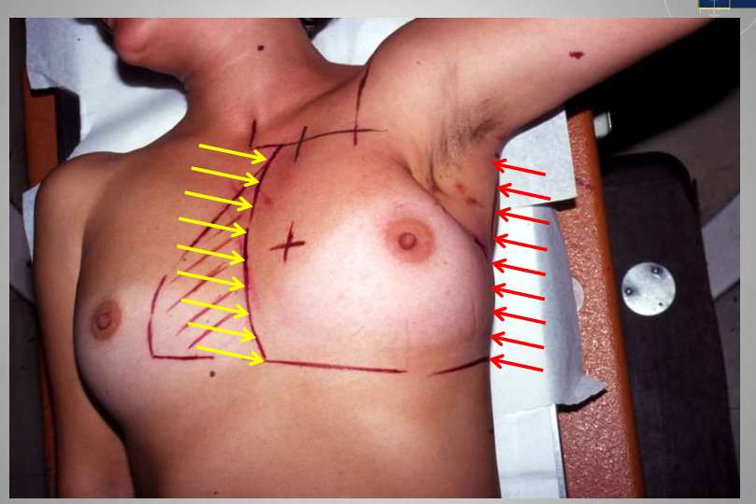

Slide 43
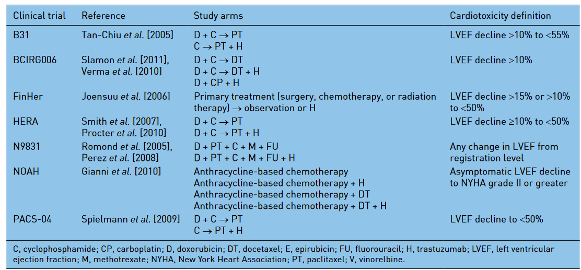
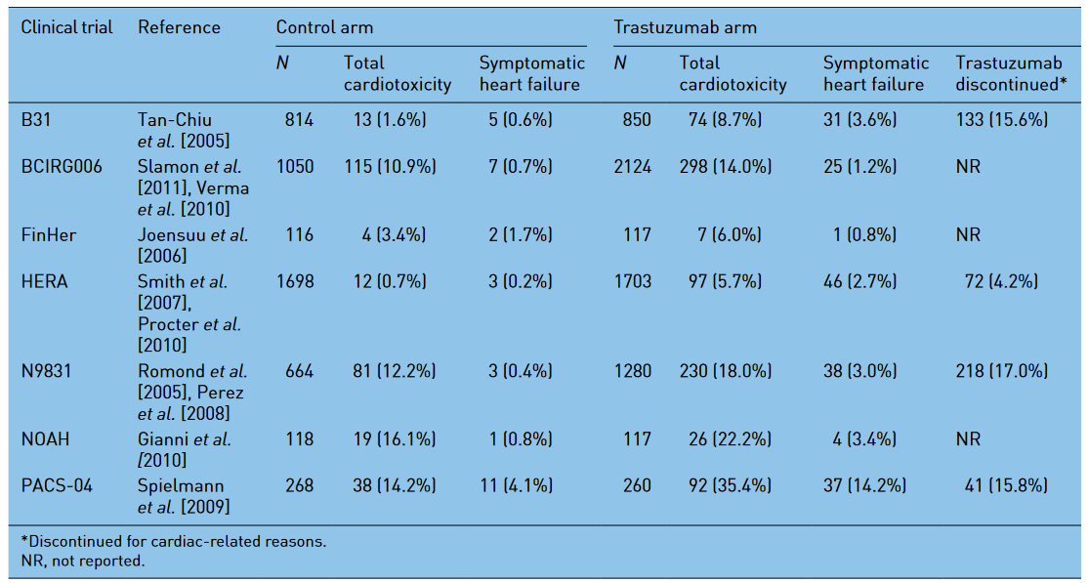

Slide 54
Παρακολούθηση

Slide 61
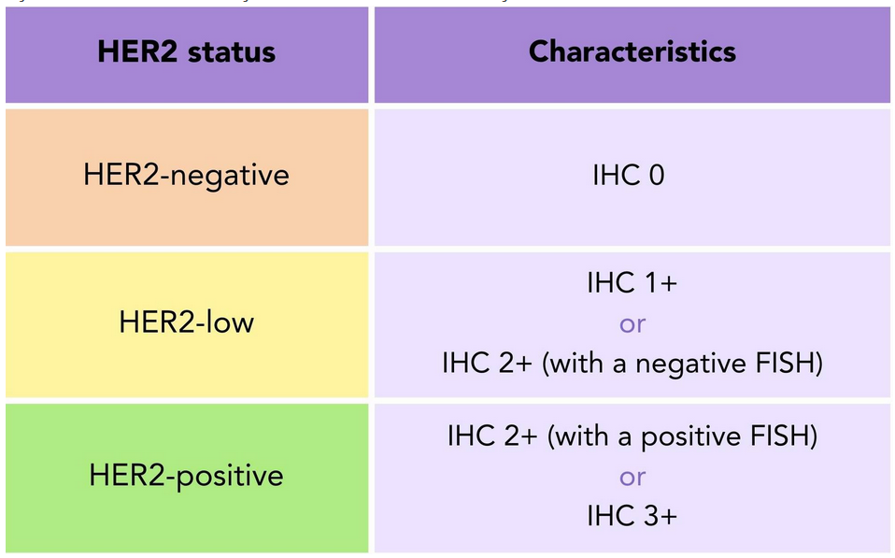
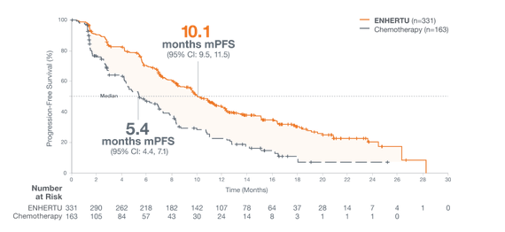
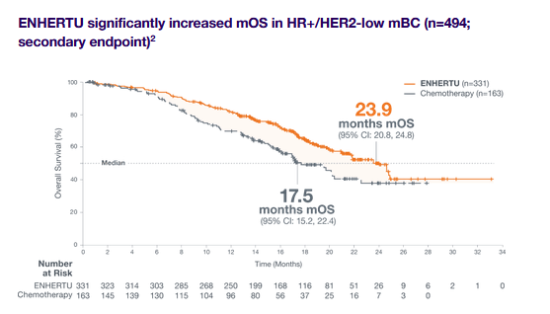
enhertu

Slide 62
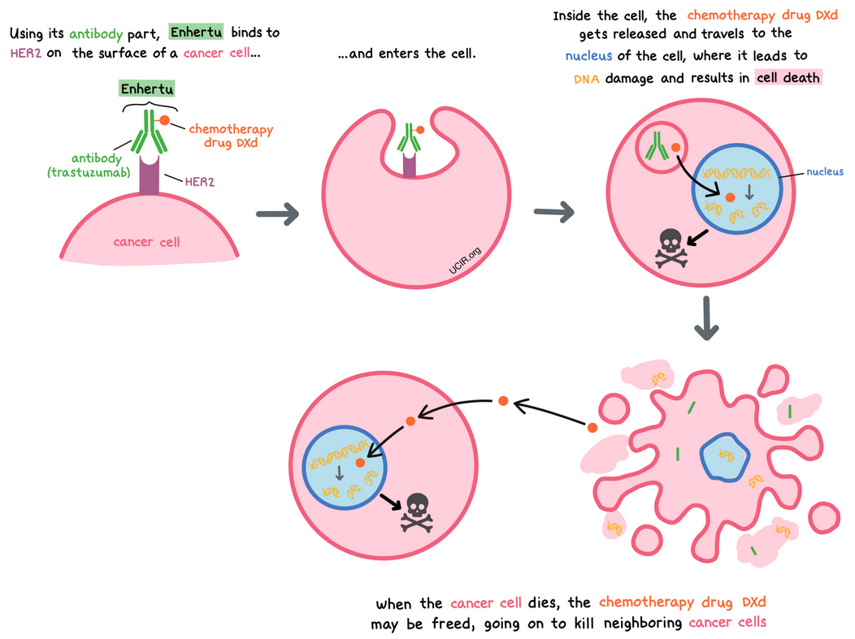

Slide 64
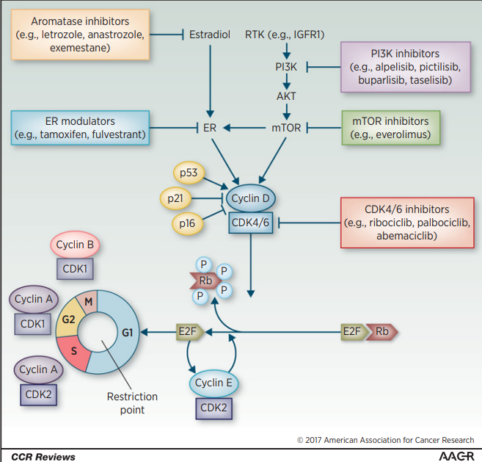
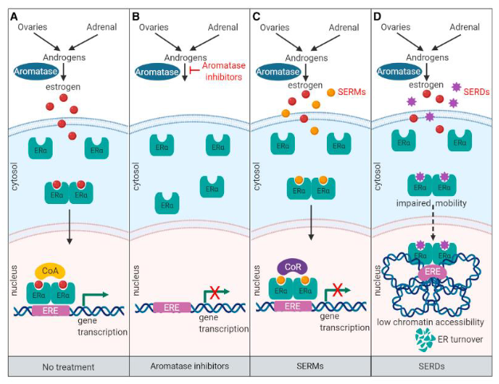
The role of cyclin D–CDK4/6–p16–Rb pathway in the cell cycle
Figure 1.
The role of cyclin–CDK complexes and the cyclin D–CDK4/6–p16–Rb pathway in the cell cycle. The cell cycle is regulated by cyclins and checkpoints, with different cyclins (and cyclin–CDK combinations) and checkpoints acting at phase transition of the cell cycle. At the G1–S cell-cycle checkpoint, mutiple mitogenic pathways, including ER and PI3K/AKT/mTOR, promote the synthesis of cyclin D, which associates with and activates CDK4/6. Activated CDK4/6 phosphorylates the Rb protein to disrupt its sequestering interaction with E2F, releasing its transcription effect and allowing the expression of genes necessary for cell-cycle progression, including cyclin E. Cyclin E associates with CDK2, which further phosphorylates Rb, resulting in progression of the cell cycle past the restriction point and
irreversible S-phase entry. Additional cyclin–CDK complexes act at further cell-cycle checkpoints; cyclin A–CDK2 enables the S–G2 transition, and cyclin A–CDK1 and cyclin B–CDK1 facilitate the onset and progression ofmitosis, respectively (82). Selective inhibitors of CDK4/6, such as ribociclib, act directly on the cyclin D–CDK4/6–p16–Rb pathway to block cell-cycle progression. The pathway may also be impacted by inhibitors of other pathways acting upstream of CDK4/6, providing a rationale for dual inhibition. ER, estrogen receptor; IGFR1, insulin-like growth factor 1 receptor; RTK, receptor tyrosine kinase.
Tripathy D, et al. Clin Cancer Res. 2017 Jul 1;23(13):3251-3262

Slide 65
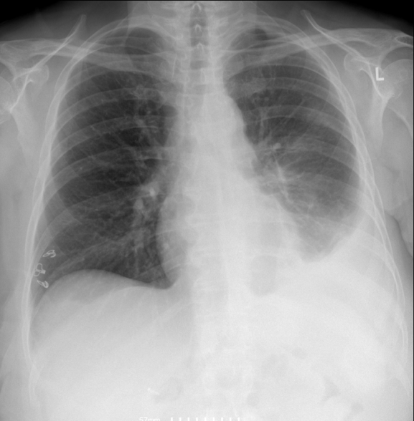
Περιστατικό 1
Γυναίκα 68 ετών προσέρχεται στα επείγοντα στο ΓΝΑ Λαικό λόγω ετερόπλευρης πλευριτικής συλλογής.
Ιστορικό καρκίνου μαστού το 2005:
Μαστεκτομή-ΧΜΘ-RT- ορμονοθεραπεία
με ταμοξιφαίνη για 10 έτη

Slide 66
Σταδιοποιήση με αξονικές: πλευριτική συλλογή ΔΕ

Slide 67
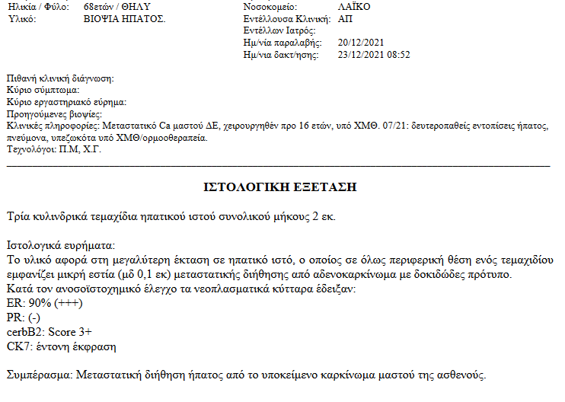

Slide 68
Περιστατικό
7/2004: ΜΣ 48 ετών με 2 κόρες
ΤΡΜ και λεμφαδενικός καθαρισμός→ Πορογενές διηθητικό ΝΟS ,grade III, T3N0M0, ER-, PR-, HER2-
Έλαβε ΧΜΘ/RT
10/2021: ελεύθερη νόσου

Slide 69
17 χρόνια μετά προσέρχεται στο ιατρείο η κόρη της ασθενούς και ρωτάει ποιο είναι το ενδεδειγμένο screening για αυτήν και την αδελφή της

Slide 70
Ε.Μ.
Δ.Χ.
Δ.Ρ.
Μ.Μπ
Σ.Χ.
Μ.Σ.
Δ.Σ.

Slide 71
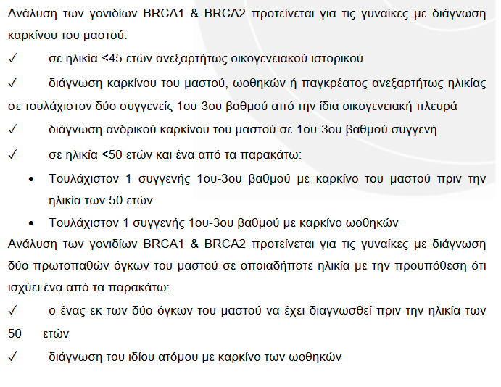
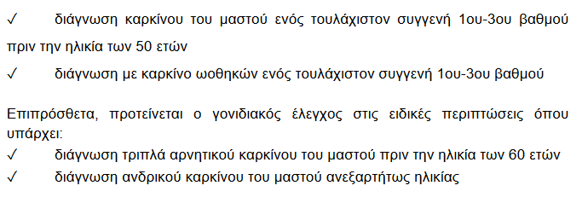

Slide 72
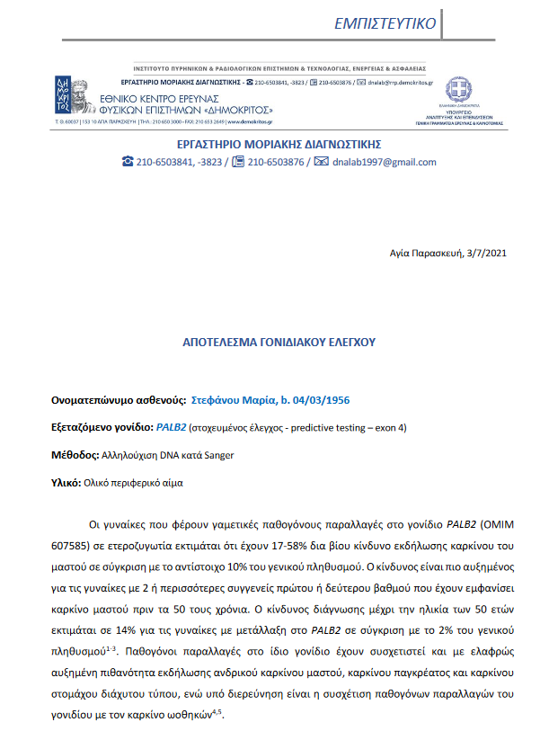
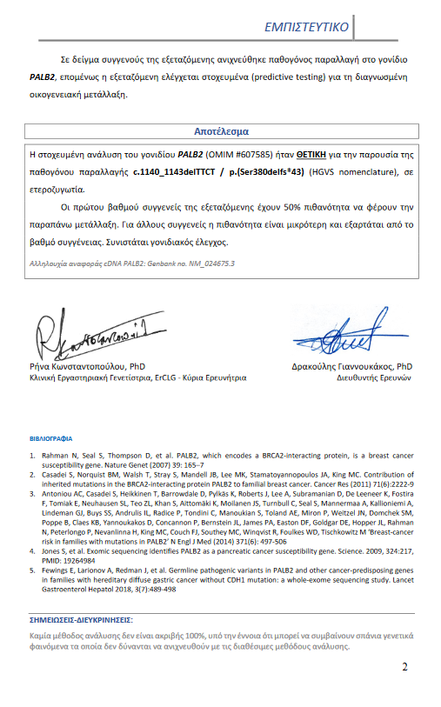
Μ.Μ.

Slide 75
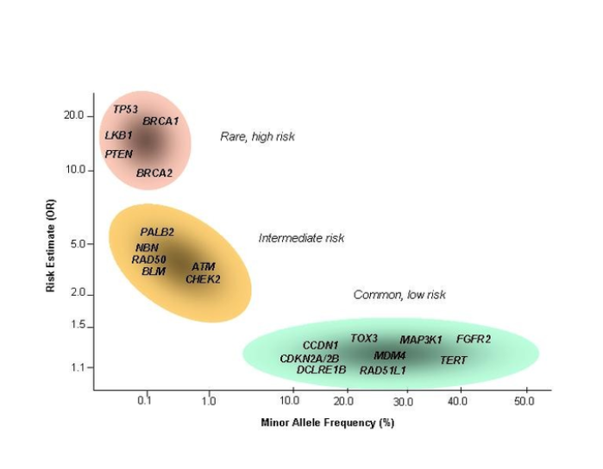

Slide 79
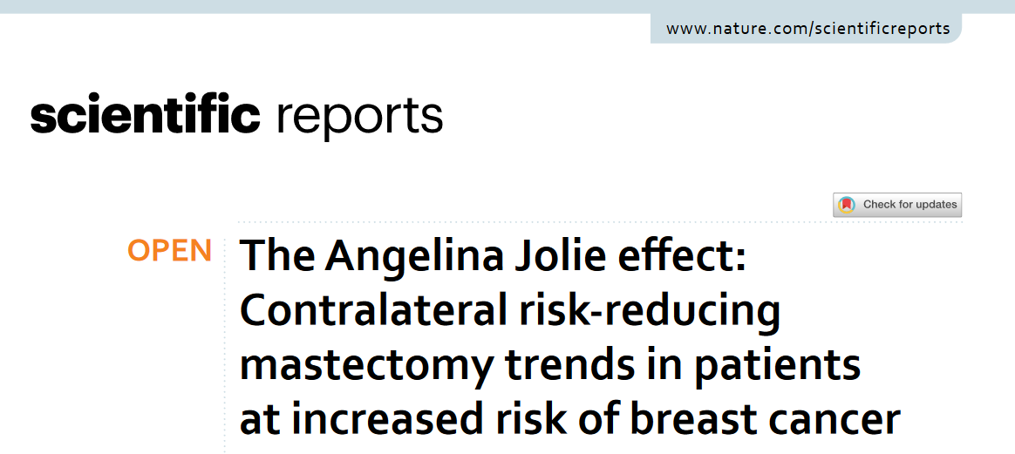
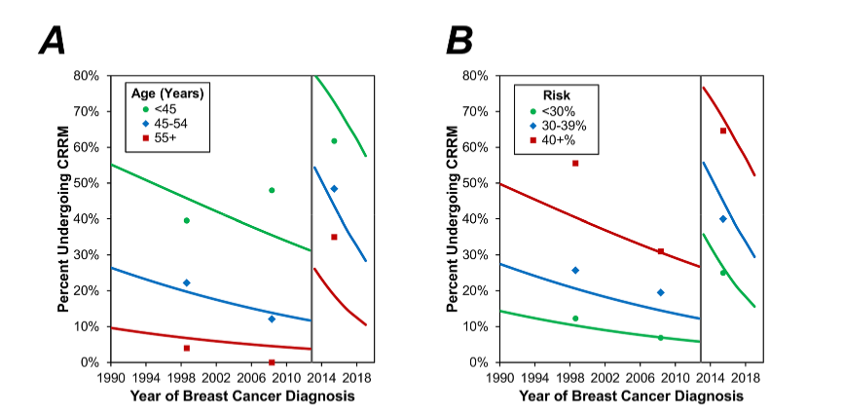
Notes:
Όχι με σωστά κριτήρια

Slide 80
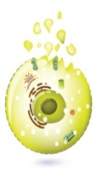
…Synthetic lethality: Why BRCA mutant cancers are selectively sensitive to PARP inhibitor
DNA damage – SSB
Normal cell
PARP inhibition in normal cell
BRCA mutation/HRD with PARP inhibition
Base Excision Repair (BER)
PARP
PARP
PARP
Inhibition of BER leads to DSBs
BRCA1/2
BRCA1/2
SSBs fixed by BER
DSBs fixed by HR, which requires functional BRCA genes
DSBs not fixed by HR
Repair
Repair
Cell death
Ellisen LW. Cancer Cell. 2011;19:165–167; McLornan DP et al. N Engl J Med. 2014;371:1725–1735.
Notes:
PARP Inhibition in the setting of BRCA mutation is a prime example of a synthetic lethal approach to targeting cancer cells
Failure to repair single-strand breaks efficiently by means of base excision repair (BER) can result in the generation of DSBs in replicating DNA
In the setting of tumour-specific loss-of-function mutations in BRCA1/2, these DSBs cannot be repaired accurately through HRR and their accumulation leads to apoptosis
Ordinarily, SSBs would be repaired by the BER pathway. Inhibition of PARP results in persistence of these SSBs, which are then converted to DNA DSBs during replication. In HRR-proficient cells these DSBs would be repaired by HRR. However, in the absence of functioning BRCA1and/or 2, impaired HRR results in persistence of these breaks and lethality
In sporadic TNBC cases, HRD has been reported via
methylation, somatic mutation, and other epigenetic
mechanisms. When homologous recombination fails,
other DNA repair processes take over driving a mutator
phenotype

Slide 81
Συμεράσματα
Νεοεπικουρική στις περισσότερες περιπτώσεις
Προσπάθεια για αποκλιμάκωση της υεραπείας στους χαμηλού κινδύνου και ενταντικοποίηση της θεραπείας στους υψηλού κινδύνου με την προσθήκη βιοδεικτών και στοχευτικών θεραπείων
Όλες οι θεραπείες έχουν τοξικότητα

Slide 82
Ευχαριστώ πολύ

Slide 85
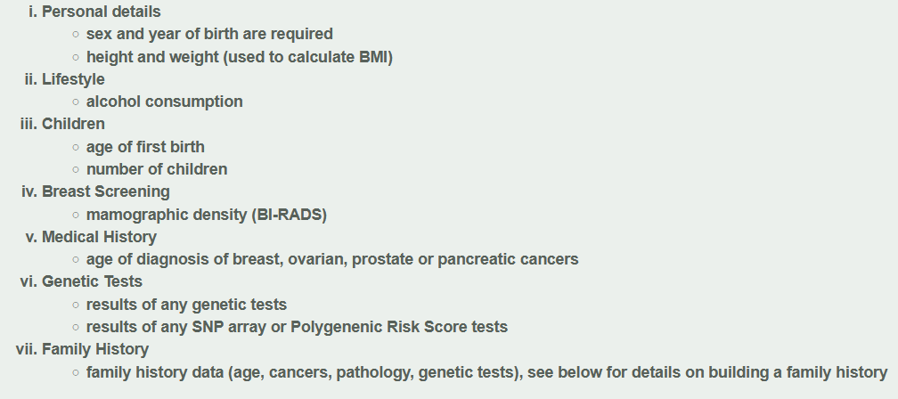

Slide 86
The role of cyclin D–CDK4/6–p16–Rb pathway in the cell cycle
Figure 1.
The role of cyclin–CDK complexes and the cyclin D–CDK4/6–p16–Rb pathway in the cell cycle. The cell cycle is regulated by cyclins and checkpoints, with different cyclins (and cyclin–CDK combinations) and checkpoints acting at phase transition of the cell cycle. At the G1–S cell-cycle checkpoint, mutiple mitogenic pathways, including ER and PI3K/AKT/mTOR, promote the synthesis of cyclin D, which associates with and activates CDK4/6. Activated CDK4/6 phosphorylates the Rb protein to disrupt its sequestering interaction with E2F, releasing its transcription effect and allowing the expression of genes necessary for cell-cycle progression, including cyclin E. Cyclin E associates with CDK2, which further phosphorylates Rb, resulting in progression of the cell cycle past the restriction point and
irreversible S-phase entry. Additional cyclin–CDK complexes act at further cell-cycle checkpoints; cyclin A–CDK2 enables the S–G2 transition, and cyclin A–CDK1 and cyclin B–CDK1 facilitate the onset and progression ofmitosis, respectively (82). Selective inhibitors of CDK4/6, such as ribociclib, act directly on the cyclin D–CDK4/6–p16–Rb pathway to block cell-cycle progression. The pathway may also be impacted by inhibitors of other pathways acting upstream of CDK4/6, providing a rationale for dual inhibition. ER, estrogen receptor; IGFR1, insulin-like growth factor 1 receptor; RTK, receptor tyrosine kinase.
Tripathy D, et al. Clin Cancer Res. 2017 Jul 1;23(13):3251-3262

