Slide 1

ΠΡΩΤΟΠΑΘΕΙΣ Ή ΙΔΙΟΠΑΘΕΙΣ ΝΟΣΟΙ
ΤΩΝ ΝΕΦΡΩΝ
Δημήτριος Β. Βλαχάκος
Καθηγητής Παθολογίας-Νεφρολογίας
Υπεύθυνος Νεφρολογικής Μονάδας
Β΄ Προπαιδευτική Παθολογική Κλινική
Πανεπιστημιακό Γενικό Νοσοκομείο «ΑΤΤΙΚΟΝ»

Slide 2
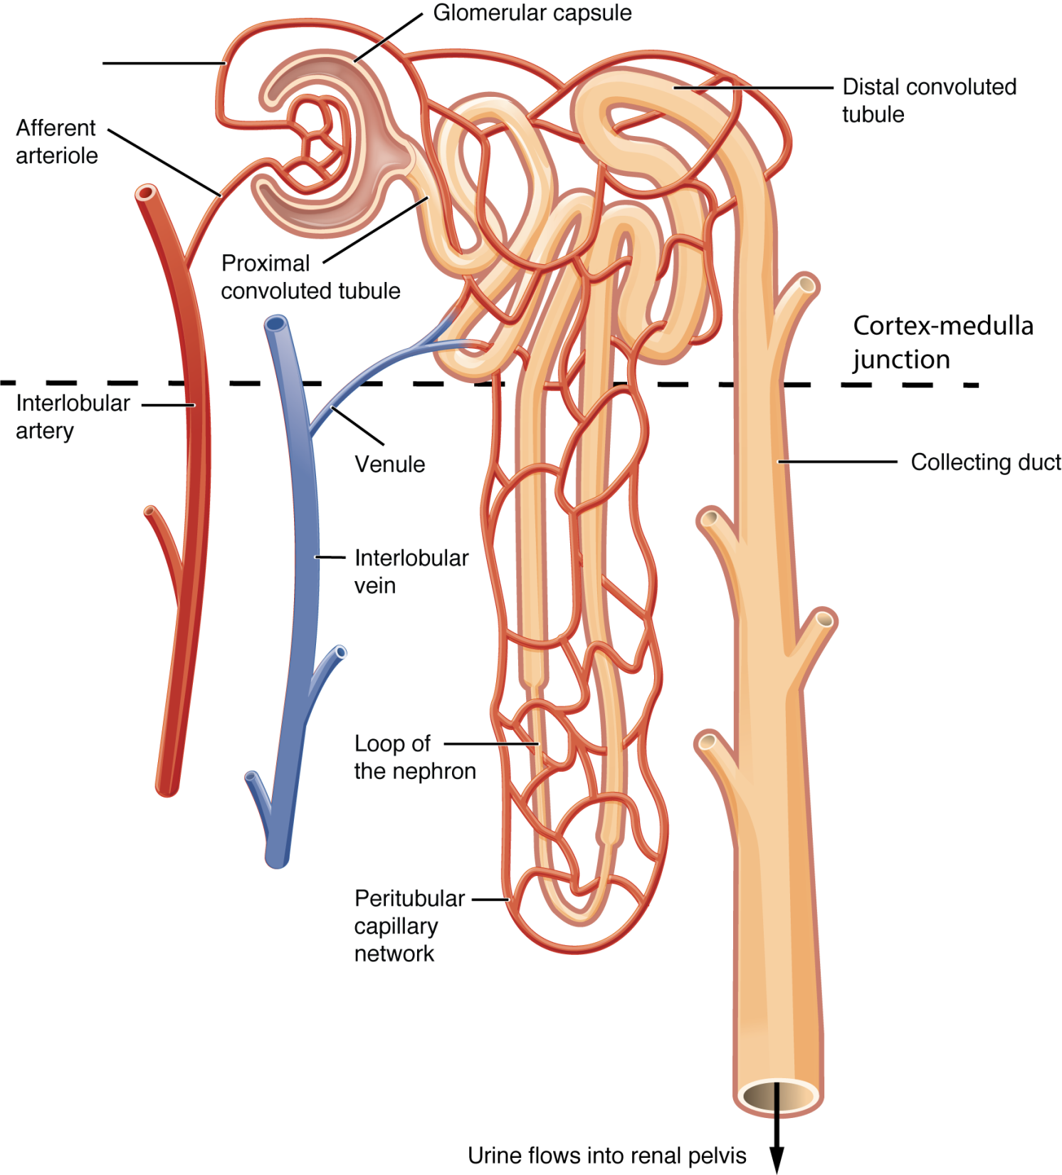

Slide 3
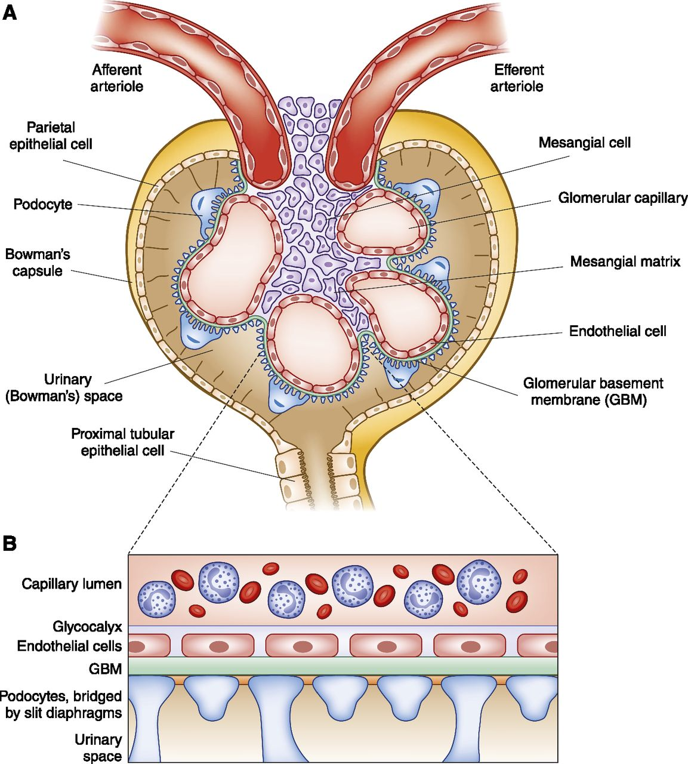

Slide 4
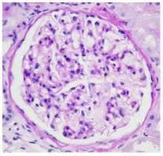
Φυσιολογικό σπείραμα

Slide 5
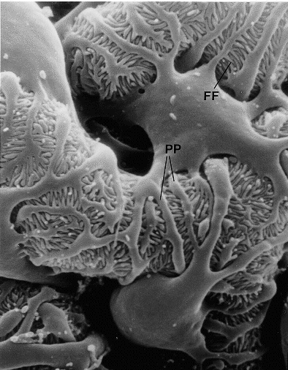
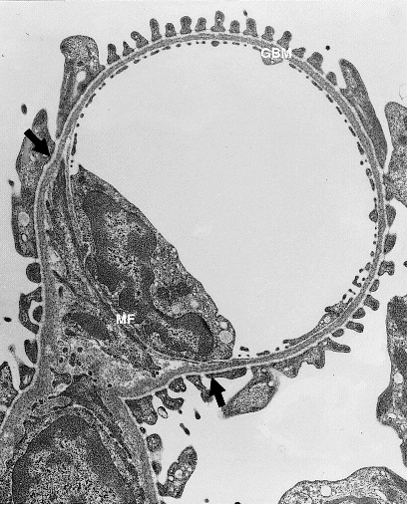

Slide 6
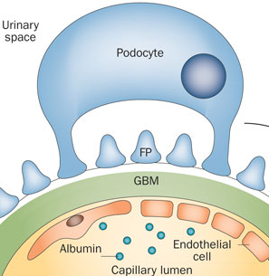

Slide 7
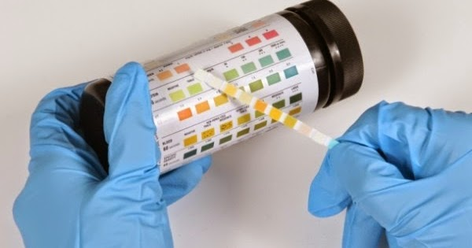
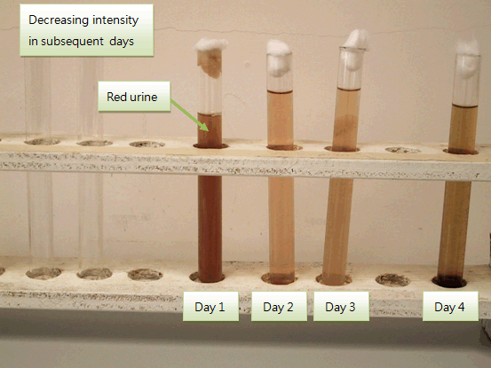

Slide 8


Slide 9
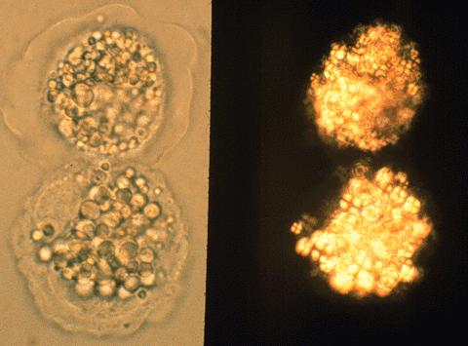
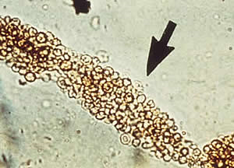
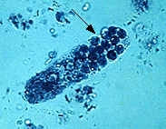
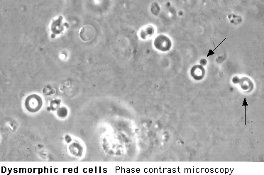
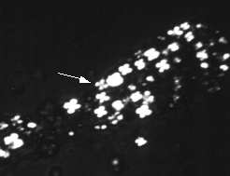
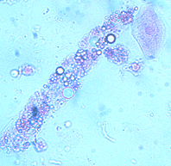

Slide 10
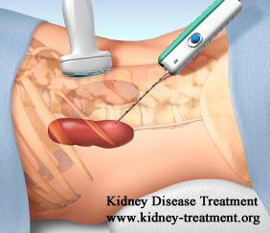

Slide 11
MNEMONIC “ANNURIC”)
A Asymptomatic hematuria/proteinuria
N Nephrotic syndrome
N Nephritic syndrome
U Urolithiasis
R Rapidly progressive glomerulonephritis
I Interstitial and tubular diseases
C Chronic renal disease

Slide 12
MNEMONIC “ANNURIC”)
A Asymptomatic hematuria/proteinuria
N Nephrotic syndrome
N Nephritic syndrome
U Urolithiasis
R Rapidly progressive glomerulonephritis
I Interstitial and tubular diseases
C Chronic renal disease

Slide 13
Asymptomatic Proteinuria
Transient Idiopathic: Ιn children, adolescents, and young adults, otherwise healthy, normal urinalysis. Repeat 2-3 times.
Intermittent Idiopathic: <30 years old and long term prognosis is favorable. Yearly monitoring is recommended.
Functional: Acute illness, fever, CHF, exercise, seizures, pregnancy.
Orthostatic In up to 3-5 % of adolescents and young men; uncommon in patients >30 years old. Do split 24 hour urine collection to diagnose.
Persistent Isolated: Proteinuria that persists at < 3.5 g/24h/1.73 m2 in the absence of other renal or systemic disease. Patients should be followed closely and referred to nephrologist for any change in urinary sediment, worsening proteinuria, or onset of renal insufficiency. Renal biopsy probably indicated.

Slide 14
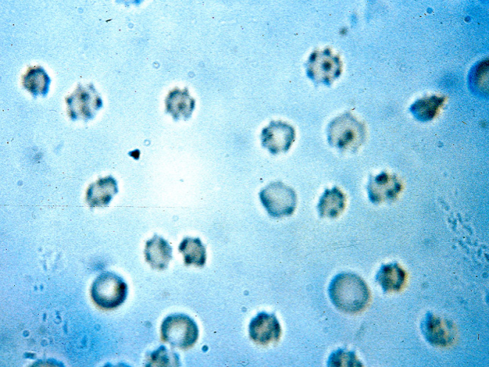
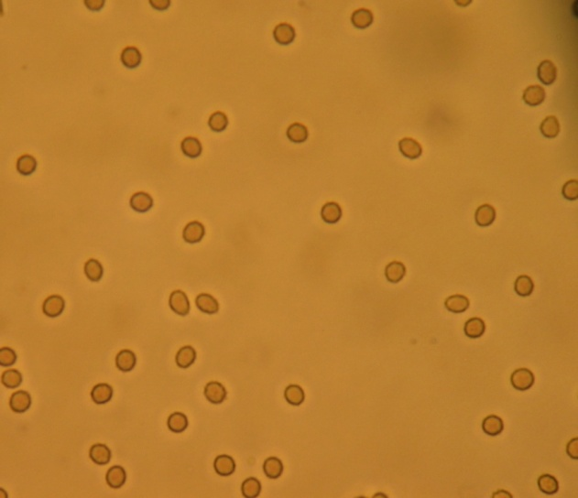
Isolated Microhematuria
Κληρονομικές παθήσεις πχ νόσος λεπτής μεμβράνης, σύνδρομο Alport
Επίκτητες παθήσεις πχ ΙgA, Μεσαγγειοϋπερπλαστική ΣΝ,

Slide 15
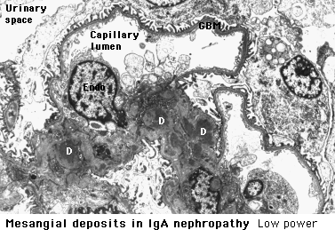
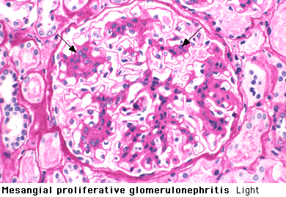
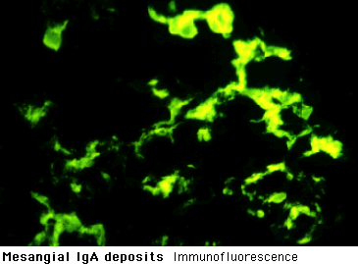
IgA Nephropathy - Berger's Disease

Slide 16
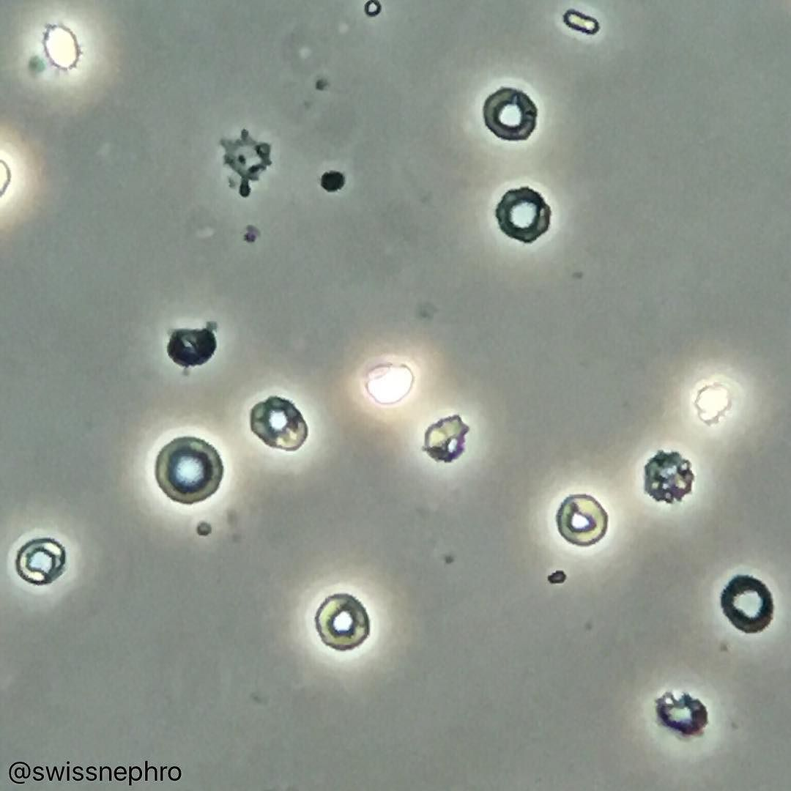
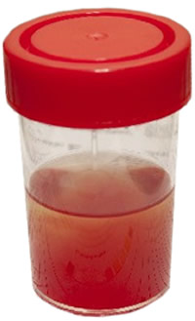

Slide 17
IgA NEPHROPATHY (BERGER)
Most common form of GN in young adults (15-30 years)
Pathology: -IgA deposits in mesangium
-varied severity
-IgA is anionic and polymeric IgA,
-poorly O-galactosylated IgA1,
-alterations in IgA1 sialylation.
Protean manifestations
40% asymptomatic microscopic hematuria
40% bouts of macro hematuria
10% nephrotic syndrome
10% renal failure

Slide 18
MNEMONIC “ANNURIC”)
A Asymptomatic hematuria/proteinuria
N Nephrotic syndrome
N Nephritic syndrome
U Urolithiasis
R Rapidly progressive glomerulonephritis
I Interstitial and tubular diseases
C Chronic renal disease

Slide 19
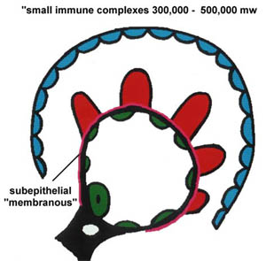
Νεφρωσικό Σύνδρομο
Πρωτεϊνουρία > 3g / 24ωρο
Υπολευκωματιναιμία (< 3 g/dl)
Υπερλιπιδαιμία
Λιπιδουρία
Οίδημα

Slide 20
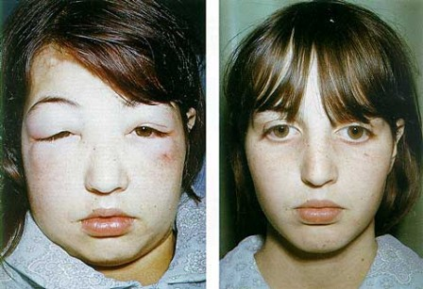
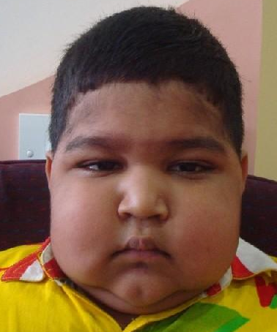
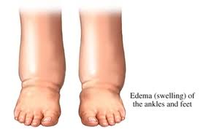

Slide 21
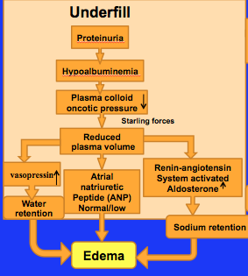

Slide 22
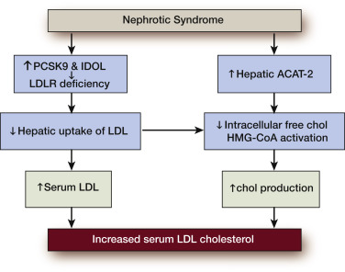

Slide 23
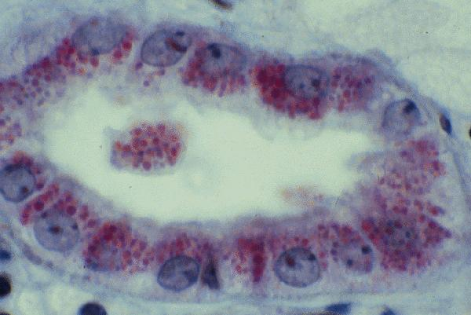
ΙΖΗΜΑ ΟΥΡΩΝ ΣΕ ΝΕΦΡΩΣΙΚΟ ΣΥΝΔΡΟΜΟ

Slide 24
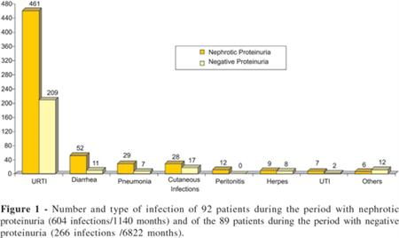

Slide 25
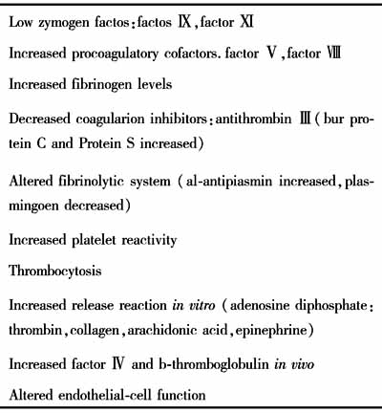
Hypercoagulation in NS

Slide 26
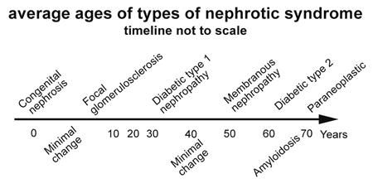

Slide 27
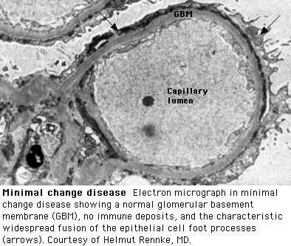
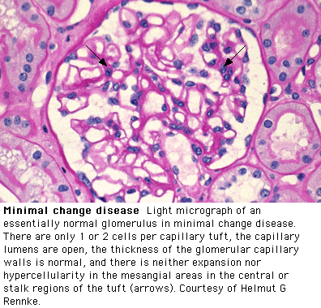
Nόσος Ελαχίστων Αλλοιώσεων

Slide 28
MINIMAL CHANGE GLOMERULOPATHY
CL: Most common cause of nephrotic syndrome in children
E/P: Remission can be induced by measles,
occurs more frequently in Hodgkin lymphoma, cured by glucocorticoids, cyclophosphamide or retuximab,
the permeability factor seems to be IL-13.
Path: normal by LM and IF
EM: fusion of foot processes

Slide 29
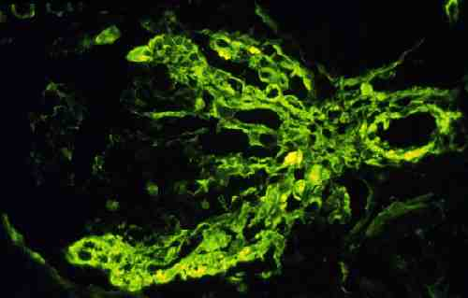
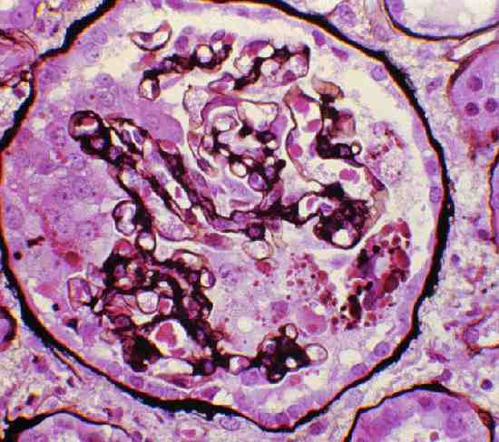
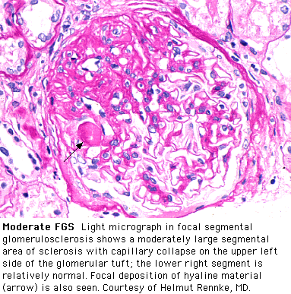
ΕΣΤΙΑΚΗ ΣΠΕΙΡΑΜΑΤΟΣΚΛΗΡΥΝΣΗ

Slide 30
FOCAL SEGMENTAL GLOMERULOSCLEROSIS
Def: 15% of all nephrotic syndromes; heterogenous group of diseases (primary vs secondary)
E/P: Increased circulating levels of soluble urokinase receptor (suPAR). In HIV, IV drug abuse, CHD, obesity, sickle-cell disease
Path: focal and segmental glomerular hyalinosis
“Collapsing” pattern (e.g. HIV)
Trapping of serum proteins (IF and EM)
Clin: Nephrotic syndrome→ESRD (5-20y); In HIV related FSGS → ESRD (1 year)
Therapy: Glycocorticosteroids +/- calcineurin inhibitors

Slide 31
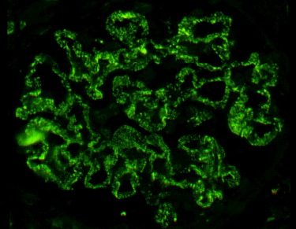
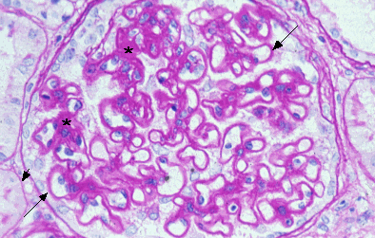
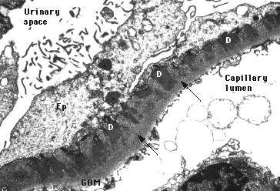
ΜΕΜΒΡΑΝΩΔΗΣ ΣΠΕΙΡΑΜΑΤΟΠΑΘΕΙΑ

Slide 32
MEMBRANOUS NEPHROPATHY
Def: Most common cause of nephrotic syndrome in adults (40%)
M-Type Phospholipase A₂ Receptor as Target Antigen in Idiopathic Membranous Nephropathy -> Immune complex→BM thickening
E/P: Primary
Secondary (SLE, HBV, drugs, cancer)
Path: Subepithelial deposits of immune complex
CL: Nephrotic syndrome
(25% recover, 50% persist, 25% progress)
Therapy: Glycocorticoids and cytotoxic therapy

Slide 33
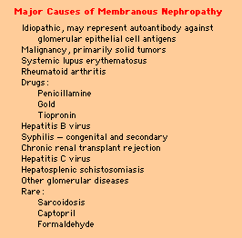
Αίτια Μεμβρανώδους Σπειραματοπάθειας

Slide 34
MNEMONIC “ANNURIC”)
A Asymptomatic hematuria/proteinuria
N Nephrotic syndrome
N Nephritic syndrome
U Urolithiasis
R Rapidly progressive glomerulonephritis
I Interstitial and tubular diseases
C Chronic renal disease

Slide 35
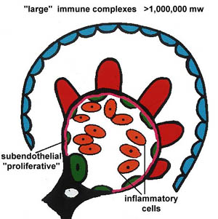
Νεφριτιδικό Σύνδρομο
Αιματουρία
Πρωτεϊνουρία
Ολιγοανουρία
Ουραιμία
Οίδημα
Υπέρταση
Καρδιακή Κάμψη - Πνευμονικό Οίδημα

Slide 36
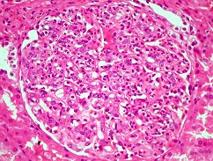
Υπερπλαστική Σπειραματονεφρίτιδα (μεταλοιμώδης ΣΝ)

Slide 37
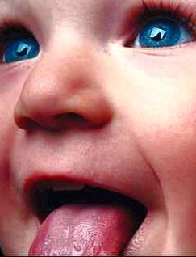
ACUTE POSTINFECTIOUS GN
Def: Acute nephritic syndrome 1-2 weeks after infection
E/P: immune response to A β-hemolytic streptococci
(other infections Staph, malaria, HBV less common)
Path: Acute glomerulonephritis
Clin: Childhood nephritic syndrome
90% recover
9% presistent hematuria/proteirunria
1% chronic renal disease

Slide 38
MNEMONIC “ANNURIC”)
A Asymptomatic hematuria/proteinuria
N Nephrotic syndrome
N Nephritic syndrome
U Urolithiasis
R Rapidly progressive glomerulonephritis
I Interstitial and tubular diseases
C Chronic renal disease

Slide 39
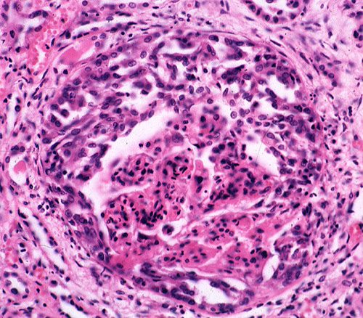
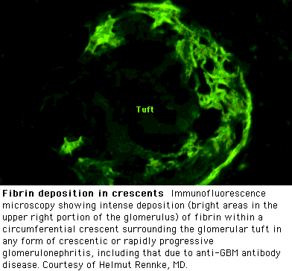
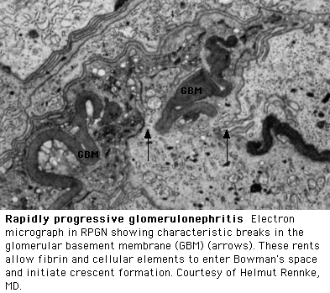
Ταχέως εξελεισσόμενη ΣΝ
Rapidly Progressive GN
(RPGN) is a clinical syndrome manifested by features of glomerular disease in the urine and by progressive loss of renal function over a comparatively short period of time (days, weeks or months).

Slide 40
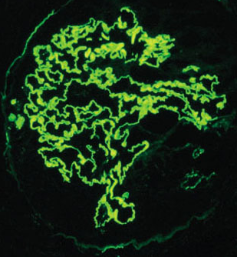
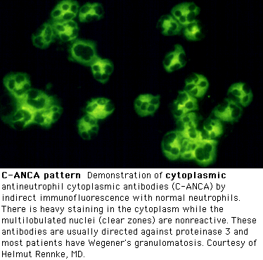
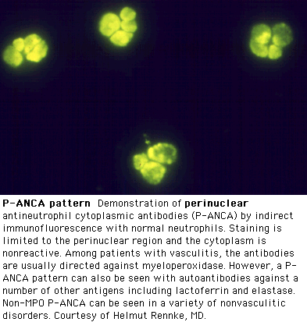
Ταχέως Εξελισσόμενη Σπειραματονεφρίτις
- Anti-GBM Disease (Type 1)
Immune Complex diseases (Type 2)
- Systemic Lupus Erythematosus
(WHO Class III and IV)
- Infectious Endocarditis
- HCV-associated
cryoglobulinemia
Pauci-immune complex diseases (Type 3)
- ANCA related (Microscopic
polyarteritis, Wegener’s Granulomatosis), -Henoch Schoenlein Purpura
-Thrombotic Thrombocytopenic Purpura /Hemolytic Uremic Syndrome

Slide 41
ANTI-GBM ANTIBODY GN
RPGN mediated by antibody
Antibody to collagen IV
Linear IF
Fibrinoid necrosis of GBM
Crescentic GN
Goodpasture syndrome

Slide 42




Pulmonary Involvement
Circulating anti-GBM antibodies must have access to the alveolar basement membrane to do damage.
Underlying pulmonary injury:
Smoking
Infection
Cocaine inhalation
Hydrocarbon exposure
Notes:
Patients with and without alveolar hemorrhage appear to have similar auto-antibodies against the alpha-3 chain
Variable presence of pulmonary → general lack of access of the circulating anti-GBM antibodies to the alveolar basement membrane

Slide 43




Treatment of Choice
Early diagnosis and treatment
Plasmapheresis + Prednisone + Cyclophosphamide
  Plasmapheresis removes circulating anti-GBM antibodies and other mediators of inflammation (such as complement),
  immunosuppressive agents minimize new antibody formation.

Slide 44
Prognosis
If treated:
  ~40 to 45 percent of patients will benefit by not progressing to end-stage renal disease or death
  Recovery is more likely when treatment begins before oliguria.
However, in those who require dialysis or who have 75 - 100 percent crescents on biopsy, recovery is rare regardless of treatment.

Slide 45

Clinical manifestations of SLE
Variable: from mild to life threatening
Onset: gradual (more common) or acute
Remitting-relapsing course
Kidney is the most common major organ involved (lupus nephritis)

Slide 46
Anti-neutrophil cytoplasmic autoantibodies
 | Proteinase 3 (PR3/c-Anca) | Myeloperoxidase (MPO/p-ANCA) | Negative
Wegener’s granulomatosis | 70% | 25% | 5%
Microscopic polyangiitis | 40% | 50% | 10%
Churg-Strauss syndrome | 10% | 60% | 30%
Pauci-immune glomerulonephritis | 20% | 70% | 10%

Slide 47
Wegener’s Granulomatosis
Pulmonary
Interstitial infiltrates
Hemoptysis
Cavitating lesions
Pleural effusion
Subglottic stenosis
Cough
Shortness of breath
Upper Airway
Sinusitis
Epistaxis
Rhinitis
Saddle nose deformity
Otologic
Ottitis
Tinnitus
Eustachian tube dysfunction

Slide 48




HENOCH-SCHÖNLEIN PURPURA

Slide 49
EPIDEMIOLOGY
90% of cases reported in children
  Peak in children aged 4-7
Male:Female (1.5:1)
50% follow a URI
Renal disease is more severe in adults

Slide 50
MANAGEMENT
Usually self-limiting (1-6 weeks)
Steroids:
  may decrease tissue edema, may aid in arthralgias and some abdominal pain
  Has not been shown to be beneficial in kidney disease or dermal manifestations
  Does not lessen chance of recurrence
  Does not shorten duration of disease

Slide 51
Post-Diarrheal Hemolytic Uremic Syndrome (D+HUS)
The syndrome includes:
  Acute kidney failure
  Hemolytic anemia
  Thrombocytopenia (low platelet count)
Most common cause of acute renal (kidney) failure in young children; also occurs in older children and adults

Slide 52
How did these otherwise harmless E. coli become such killers?
DNA from a Stx producing bacterium (Shigella dysenteriae type 1) transferred by bacteriophage to E. coli
This provided E. coli with genes to produce Shiga toxin (Stx), one of the most potent toxins known to man

Slide 53
Signs and Symptoms
diarrhea (usually bloody) with severe pain; can be mistaken for appendicitis
pallor
bruises
seizures and/or coma (occasionally)
little (oliguria) or no (anuria) urine
high blood pressure
pancreatic damage (diabetes)

Slide 54
Outcomes
Death in 3-5%, due to:
  brain damage (stroke and/or brain swelling)
  bowel necrosis and perforation
  heart damage
  lung injury
  multiorgan injury (seen in most fatal cases)

Slide 55
Thrombotic Thrombocytopenic Purpura
In 1924, Dr.Eli Moschcowitz described a 16- year old girl with abrupt onset of petechiae, pallor, followed by paralysis, coma, and death.
Autopsy showed ‘hyaline’ thrombi occluding terminal arterioles and capillaries.

Slide 56
Definition
Syndrome of Coomb’s negative microangiopathic hemolysis and thrombocytopenia in the absence of an alternative explanation for these manifestations.
Presence of Fever, Neurological and renal abnormalities : classic Pentad.

Slide 57
Clinical Presentation
Approximately 1000 new cases occur each year
Common in middle aged group,median age-40
Female:male (2:1).
Acute onset and fulminant course
Mortality rate >90% in pre-pheresis era.
Relapse rates, 10-40% ranging from months to years have been reported.

Slide 58

ULVWF Model
Notes:
Under normal conditions, ULVWF is released into circulation(a, b), attach to endothelium ©, at the site of injury(d).
ADAMTS13 cleaves the A2 domain.(A) rapidly under the influence of fluid shear stress, where platelets binding to VWF thru Gib Iia receptors, causes platelet aggregation. Hence the ULVWF is broken into smaller units.(E)
In the absence of ADAMTS13, larger multimere tend to bind platelets causing activation & formation of thrombi.

Slide 59
Diagnosis
Primary diagnostic criteria
  Thrombocytopenia ( often below <20,000)
  Microangiopathic hemolytic anemia
    Negative Coomb’s test.
    Fragmented red cells (schistocytes) on peripheral smear
    LDH elevation is the hallmark of RBC destruction and tissue injury related to ischemia.
Presence of above criteria is sufficient to establish presumptive diagnosis & begin PE
Notes:
there is No gold standard for the diagnosis of TTP. The diagnosis usually requires high index of suspicion and the exclusion of the other causes.

Slide 60
Treatment
Plasma exchange:
  Untreated TTP has 80-90% mortality.
  Removes ULvWF multimers, autoantibody and replaces metalloproteinase.
  Randomized controlled trial (Rock et al, 1991)
  FFP as the replacement fluid is most widely used and cost effective.
Notes:
Prompt initiation of plasmapheresis has reduced mortality to 15-20%.
In 1991 Canadian pheresis group reported the results where 72 pts were randomized to plasma exchange with FFP versus plasma infusion.
Exchange was more efficacious since 3-fold greater amount of plasma were infused, there by replacing the greater amount of the metalloproteinase.

Slide 61

ΒΙΟΨΙΑ ΣΕ ΑΣΘΕΝΗ ΜΕ ΔΙΑΜΕΣΟ ΝΕΦΡΙΤΙΔΑ

Slide 62
Αίτια Διαμέσου Νεφρίτιδας
Φάρμακα
Λοιμώξεις
Σαρκοείδωση
Sjogren’s syndrome
Ενδημική Νεφροπάθεια των Βαλκανίων
Chinese Herb Nephritis

Slide 63
Φάρμακα και Διάμεσος Νεφρίτις
β-λακτάμες π.χ. μεθικιλλίνη, πενικιλλίνη, κεφαλοσπορίνες
Ριφαμπικίνη
Φάρμακα με σουλφομάδα π.χ. Φουροσεμίδη, Σουλφαμεθοξαζόλη, Σουλφασαλαζίνη
Σιπροφλοξασίνη
Μη στερινοειδή αντιφλεγμονώδη π.χ. φενοπροφένη

Slide 64
Λοιμώξεις και Διάμεσος Νεφρίτις
Legionella
Leptospirosis
Streptococcal infections
Viruses

Slide 65
ΕΥΧΑΡΙΣΤΩ ΓΙΑ ΤΗΝ ΠΡΟΣΟΧΗ ΣΑΣ

