Slide 1
ΑΝΟΣΟΛΟΓΙΚΟΣ ΕΛΕΓΧΟΣ
Πελαγία Κατσιμπρή
Ρευματολόγος
Επιμελήτρια A’
Δ’ Παθολογική Κλινική
Πανεπιστημιακό Νοσοκομείο <<ΑΤΤΙΚΟΝ>>

Slide 2
ΑΣΘΕΝΗΣ ΜΕ ΥΠΟΨΙΑ ΑΥΤΟΑΝΟΣΟΥ ΡΕΥΜΑΤΙΚΟΥ ΝΟΣΗΜΑΤΟΣ:
RF +/- antiCCP
ANA
dsDNA
ENA – Ro(SSa), La(ssB), Sm, RNP, scl-70, Jo-1
Ab cardiolipines, Β2gp1, LA1
C3, C4
ANCA
Κρυοσφαιρίνες

Slide 3
ΡΕΥΜΑΤΟΕΙΔΕΙΣ ΠΑΡΑΓΟΝΤΑΣ (RF)
Αυτοαντισώματα όλων των ανοσοσφαιρινών (IgΜ, IgG, IgΑ) κατά του Fc κλάσματος της ανθρώπινης ανοσοσφαιρίνης IgG.
Συνήθως μετριέται ο IgM-RF στον ορό, το αρθρικό υγρό (διαγνωστικός) ή και άλλα σωματικά υγρά.
Συσχετίζεται με:
βαρύτερες μορφές της νόσου,
εξωαρθρικές εκδηλώσεις,
ταχεία και βαριά εξέλιξη της νόσου και των ακτινολογικών αλλοιώσεων.
Αρνητικός RF δεν αποκλείει τις βαριές οστικές καταστροφές.

Slide 4
ΡΕΥΜΑΤΟΕΙΔΕΙΣ ΠΑΡΑΓΟΝΤΑΣ (RF) -2
Θετικοποιείται ή αρνητικοποιείται κατά την πορεία της νόσου ανάλογα με εξάρσεις, υφέσεις ή έλεγχο με ειδική φαρμακευτική αγωγή.
Δεν αποτελεί δείκτη ενεργότητας της νόσου όπως η ΤΚΕ και η CRP.
Μικρή ευαισθησία και ειδικότητα στην έναρξη της ΡΑ.
Συνήθως (+) στο 25-70%, ενώ θετικοποιείται αργότερα σε ποσοστό 75-85%.

Slide 5
ΝΟΣΗΜΑΤΑ ΜΕ RF+ -1
Rheumatic disorders
Ρευματοειδή αρθρίτιδα — 26 - 90 %
Σύνδρομο Sjögren's — 75 - 95 %
Μικτή νόσος συνδετικού ιστού — 50 - 60 %
Μικτή κρυοσφαιριναιμία (τύπου II & III) — 40 - 100 %
Συστηματικός ερυθηματώδη λύκος — 15 - 35 %
Πολυμυοσίτιδα/δερματομυοσίτιδα — 5 - 10 %

Slide 6
ΝΟΣΗΜΑΤΑ ΜΕ RF+ -2
Nonrheumatic disorders
Indolent or chronic infection, as with SBE or hepatitis B or C virus infection.
Inflammatory such as sarcoidosis.
Fibrosing pulmonary disorders
Malignancy.
Primary biliary cirrhosis.

Slide 7
ΝΟΣΗΜΑΤΑ ΜΕ RF+ -3
Υγιείς πληθυσμός
4 % των νέων υγιές ατόμων.
3 - 25 % των ηλικιωμένων χωρίς ρευματικά νοσήματα (πιο συχνά σε ηλικιωμένους με χρόνια νοσήματα σε σύγκριση με υγιείς ηλικιωμένους).
RF + σε χαμηλό έως μέτριο τίτλο (1:40 to 1:160) σε άτομα χωρίς καμία ρευματική ή φλεγμονώδη νόσος.

Slide 8
Μη ρευματικά νοσήματα με RF +
Νόσημα | Συχνότητα του RF ( %)
Ηλικία (> 60) | 5 – 25
Λοίμωξη
Λοιμώδη Ενδοκαρδίτιδα* | 25 – 50
Ηπατίτιδα B ή C* | 20 – 75
Φυματίωση | 8
Σύφιλη* | Έως 13
Parasitic diseases | 20 – 90
Leprosy* | 5 -58
Ιογενή λοιμώξεις* | 15 – 65
Πνευμονικά νοσήματα
Σαρκοείδωση* | 3 – 33
Ιδιοπαθή διάμεση πνευμονοπάθεια | 10 – 50
Silicosis | 30 – 50
Asbestosis | 30
Διάφορα
1^{ο} Χολική Κύρωση* | 45 – 70
Νεοπλασίες* | 5 – 25
Μετά από πολλαπλούς εμβολιασμούς | 10 - 15
* Νοσήματα που μπορούν να μιμηθόυν τη ρευματοειδή αρθρίτιδα.
Notes:
Leukemias and colon carcinoma are most common malignancies.
The best documented examples of viral infection are rubella, mumps, influenza and HIV;

Slide 9
anti-cyclic citrullinated peptide antibodies (anti-CCP)
anti-CCP or APCA (anti citrullinated protein antibodies)
αντισώματα έναντι κιτρουλλινωμένων πρωτεϊνών.
Κατά τη διάρκεια της φλεγμονής υπολείμματα πρωτεϊνών μετατρέπονται σε κιτρουλλίνη (κιτρουλλινοποίηση). Στη συνέχεια αναγνωρίζονται ως αντιγόνα από το ανοσοποιητικό σύστημα προκαλώντας φλεγμονή.
Σημαντικοί βιοδείκτες στη διάγνωση της ΡΑ.
Συμπεριλαμβάνονται στα 2010 ACR/EULAR διαγνωστικά κριτήρια για ΡΑ.
Παραγωγή anti CCP πριν την έναρξη κλινικών συμπτωμάτων ΡΑ.
(Van Gaalen F: Arthritis Rheum 2004)
Anti-CCP found in 39% of donors at a median of 5.3 yr before onset of RA symptoms.(Nielen M. Arthritis Rheum 2004)
Anti-CCP found in 25% of donors 1.5 - 9 yr before onset of first RA symptoms. (Rantapää-Dahlqvist S et al. Arthritis Rheum 2003)

Slide 10
Anti-citrullinated protein/peptide antibodies are very specific markers for RA.
Anti-CCP levels decrease with remission induction and increase with disease exacerbation.
High levels of anti-CCP antibodies are prognostic
for an erosive disease course, in RA.
Anti-CCP antibodies prevail in RA patients carrying the HLA-DR4 shared epitope, most of which are RF-positive.
Several environmental factors influence the onset of anti-CCP positive RA (tobacco smoking, coffee consumption, alcohol consumption, exercise).

Slide 11
Usefulness of testing for ANA
The usefulness is in the following clinical settings:
To help establish a diagnosis in a patient with clinical features suggestive of an autoimmune or connective tissue disorder.
To exclude such disorders in patients with few or uncertain clinical findings.
To subclassify a patient with an established diagnosis of an autoimmune or connective tissue disease.
To monitor disease activity (eg, anti-double stranded DNA antibody levels in lupus nephritis).

Slide 12
ΝΟΣΗΜΑΤΑ ΜΕ ΑΝΑ +
Συστηματικά αυτοάνοασα νοσήματα(ΣΑΝ)
ANA + είναι απαραίτητα για τον χαρακτηρισμό ορισμένων ΣΑΝ όπως ΣΕΛ, αλλά συσχετίζονται επίσης με πολλά άλλα ΑΝ όπου η παρουσία τους δεν είναι απαραίτητη διαγνωστικά.
* SLE — 93 %
* Scleroderma — 85 %
* Mixed connective tissue disease — 93%
* Polymyositis/dermatomyositis — 61 %
* Rheumatoid arthritis — 41 %
* Rheumatoid vasculitis — 33 %
* Sjögren's syndrome — 48 %
* Drug-induced lupus —100 %
* Discoid lupus — 15 %
* Pauciarticular juvenile chronic arthritis — 71 %

Slide 13
ΝΟΣΗΜΑΤΑ ΜΕ ΑΝΑ +
Specific organ autoimmune disease
+ve ANA are occasionally seen in patients with AID limited to a specific organ such as the thyroid gland, liver, or lung. The following sensitivities have been reported in these disorders.
Hashimoto's thyroiditis — 46 %
Graves' disease — 50 %
AI hepatitis — 63 to 91 %
1^{Ο} biliary cirrhosis 10 to 40 %
1^{Ο} AI cholangitis — 100 %
Idiopathic pulmonary arterial hypertension — 40%

Slide 14
ΝΟΣΗΜΑΤΑ ΜΕ ΑΝΑ +
Others
Chronic infectious diseases, such as EBV, HCV infection, subacute bacterial endocarditis, tuberculosis, HIV, and some lymphoproliferative diseases.
Rarely associated with malignancy, with the exception of dermatomyositis in which both may be present.
Up to 50% of patients taking certain drugs. However, most of these patients do not develop drug-induced lupus.
False positive ANAs (ie, ANAs in the absence of autoimmune disease or known antigenic stimuli) are more commonly seen in women and in elderly patients. The majority of these are present in low titer.

Slide 15
Clinical features suggestive of an autoimmune or connective tissue disorder
Raynaud’s phenomenon
Arthralgias/Arthritis
Sicca symptoms
Alopecia
Photosensitivity/Malar rash
Sclerodactyly
Leucopenia/Thrombocytopenia/Anaemia

Slide 16
Enzyme linked immunosorbent assay (ELISA) vs immunofluorescence
Attempts to substitute the enzyme linked immunosorbent assay (ELISA) for the immunofluorescence ANA assay, the current gold standard .
The advantage of an ELISA over the immunofluorescence ANA assay is the ability to automate the procedure.
There are a number of commercial sources of ELISA-ANA testing.
Each kit relies upon a different method for preparing and coating the nuclear antigens. Generally poor correlation between positivity with the ELISA test and significant titers by immunofluorescence.
ELISA method can be automated and is less labour intensive, many labs are now screening ANA by ELISA and then immunofluorescence only the ELISA
+ve specimens.
The reliability of the ELISA assay that employ recombinant nuclear antigens may not be as reliable as other methods, at least when detecting antinuclear antibodies in children .

Slide 17
Types and usefulness of staining pattern of ANA
Antinuclear antibodies produce a wide range of different staining patterns.
Reflects the presence of antibodies to one or a combination of nuclear antigens.
The nuclear staining pattern was commonly used in the past to detect specific antibody and antigen specificity.
Pattern type has relatively low sensitivity and specificity for different autoimmune disorders.

Slide 18
Antinuclear antibodies (photomicrographs) In clockwise order, the peripheral, diffuse, nucleolar and speckled immunofluorescent patterns are presented.
HOW ARE IMMUNOFLUORESCENT
ANA LEVELS MEASURED?
Results are reported in titers and the patterns that the autoantibodies make, e.g., homogeneous, speckled, centromere, etc.
Titer reading is determined by adding saline to the liquid portion of a person’s blood.
For example, 1 part blood is mixed with 40 parts saline to create a 1:40 dilution. The dilution then is taken through a series of additional steps, creating tubes of 1:80, 1:160, 1:320, and 1:640 dilutions, respectively.

Slide 19
TYPES OF ANA
The different types of ANAs are defined by their target antigen:
dsDNA,
individual nuclear histones
other nuclear proteins
RNA-protein complexes.
Some of these antibodies are relatively specific for a particular disease or for specific clinical manifestations in patients with SLE.

Slide 21
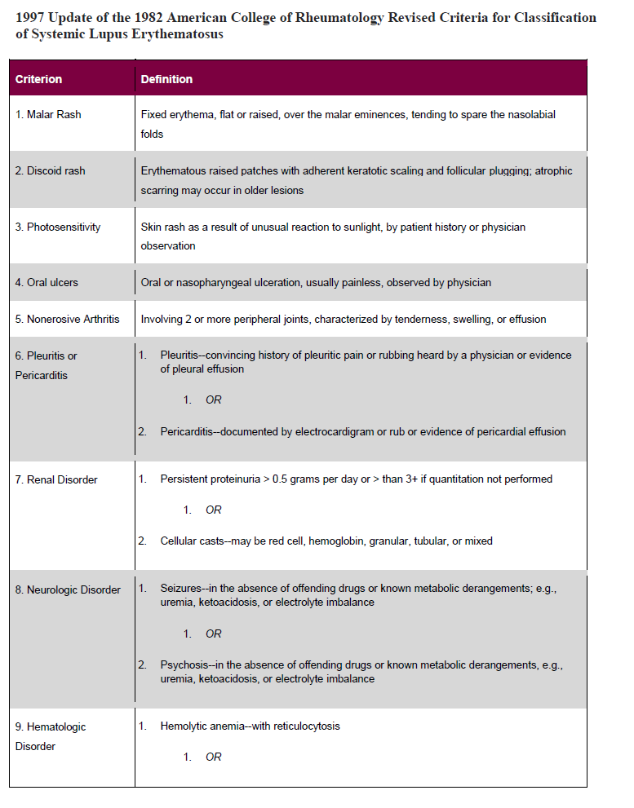

Slide 22
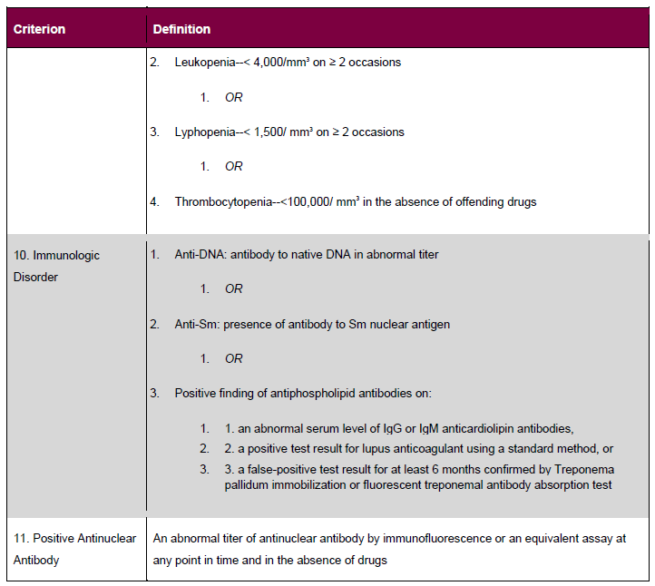

Slide 23
Clinical associations of autoantibodies in SLE
Antigen specificity | Clinical associations | Prevalence, percent*
dsDNA | Marker for active disease, titers fluctuates with disease activity, correlates best with renal disease 40-60 | 40-60
ssDNA | Nonspecific, no clinical utility | 70
Ro/SSA | Subacute cutaneous lupus (75 percent), photosensitivity, neonatal lupus, complement deficiencies | 40
RNP (U1-RNP) | SLE generally in conjunction with Sm; in MCTD, required for diagnosis | 30-40
La/SSB | With La, low prevalence of renal disease Neonatal lupus (75 percent) | 10-15
Sm | Marker for disease, not generally useful in management; Associated with CNS disease | About 20
Phospholipids | Hypercoagulable state in some patients. No clinical significance in others. Thrombocytopenia, later trimester abortions | 30
Histones | >95 percent in drug-related lupus. Also present in RA, SLE, reported in systemic sclerosis with pulmonary fibrosis
Ribosomal P | Initially associated with psychosis in SLE, more recently with depression | 10-40
KU | SLE, MCTD (European, American population) Scleroderma/myositis overlap (Japanese population) | ≤19 , ≤39
PCNA |  | 3

Slide 24
Undifferentiated rheumatic diseases
Undifferentiated rheumatic diseases generally comprise one or more of the following clinical scenarios:
* Early Raynaud phenomenon alone
* Early inflammatory polyarthritis that does not fulfill ACR criteria for the diagnosis of RA
* Nonspecific rash resembling the cutaneous findings found in defined rheumatic diseases
* Patients who, despite manifesting multiple nonspecific clinical or serologic abnormalities, do not meet ACR criteria for the diagnosis of a specific rheumatic disease

Slide 25
Undifferentiated rheumatic diseases and overlap syndromes
Name Synonyms
Mixed connective tissue disease
Lupus-scleroderma-polymyositis-rheumatoid arthritis
Undifferentiated systemic rheumatic disease (Early) undifferentiated connective . tissue, collagen vascular, or a.i.d.
Nonclassic systemic lupus erythematosus Lupus-like, lupus variant, or near, . borderline/latent/incipient/ . . incomplete/ possible/probable LE
Overlap syndromes
Rheumatoid arthritis-lupus Rhupus
Scleroderma-polymyositis/dermatomyositis
Scleroderma-lupus
Scleroderma-rheumatoid arthritis
Polymyositis overlaps
Juvenile idiopathic arthritis-lupus
Sjögren's syndrome overlaps
Other
Undifferentiated polyarthritis syndrome
Undifferentiated spondyloarthritis

Slide 26
Effect of glucocorticoids on B cells and antibody production
Circulating B lymphocytes are reduced by glucocorticoid administration, but less than T cells.
Synthesis of antibodies by B cells unchanged following short-term steroid administration. Glucocorticoids may acutely promote B cell Ig secretion by inhibiting CD8+ suppressor T cells.
Low-dose glucocorticoid therapy appears to have little, if any effect on antigen-stimulated antibody production.
If glucocorticoids are administered chronically over a period of years, however, there may be a decrease in total IgG and IgA, possibly as a consequence of inhibition of T cell help and/or increased catabolism of generated antibody.

Slide 27
ANCA
Αυτοαντισώματα έναντι συστατικων του κυτταρο-πλάσματος των ουδετεροφύλων κυττάρων.
Δύο μορφές διακρίνονται με τον ανοσοφθορισμό:
α) c-ANCA ή κυτταροπλασματικά που στρέφονται κατά των πρωτοπαθών κοκκίων που περιέχουν πρωτεϊνάση-3(PR-3).
β) p-ANCA ή περιπυρηνικά που στρέφονται κατά τη μυελοπεροξειδάση(MPO).

Slide 28
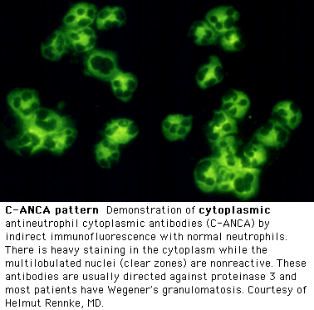
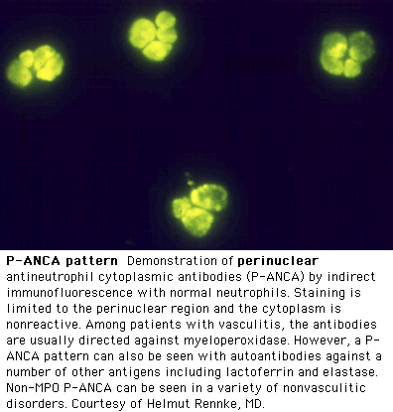
ΑNCA
Μέθοδοι ανίχνευσης:
Έμμεσος ανοσοφθορισμός Ανοσοενζυμική μέθοδος
Κοκκιωμάτωση Wegener
P-ANCA:
Μυελοϋπεροξειδάση (MPO)
Περιπυρηνικός φθορισμός
Mικροσκοπική Πολυαγγειίτις (45-80%)
C-ANCA: πρωτεϊνάση-3 (PR3)
Κυτταροπλασματικός φθορισμός, με κοκκιώδη χρώση → ενεργότητα-βαρύτητα

Slide 29
Antiphospholipid antibodies-aPL
APL, which are directed against plasma proteins bound to anionic phospholipids, may be detected as:
* Lupus anticoagulants
* Anticardiolipin antibodies
* Antibodies to ß2 glycoprotein-I

Slide 30
Anticardiolipin antibodies — ACL
ACL reacts with cardiolipin but may also react with phosphatidylserine, phosphatidylinositol, phosphatidylglycerol, ß2-GP-I, prothrombin, or annexin V.
The concordance between the presence of an LA and aCL is approx. 85 %.
LAs comprises a separate population of antibodies from aCL.
Testing should be performed for both LAs and aCL if APS is suspected on a clinical basis.
Elevated levels of IgG aCL - greater risk of thrombosis than other immunoglobulin isotypes .
IgM and IgA aCL isotypes may be associated with the APS

Slide 31
False positive serologic test for syphilis
The false positive test for syphilis (BFPTS) phenomenon occurs because the syphilis antigen used in the VDRL and RPR tests is cardiolipin mixed with cephaline and cholesterol.
Examples of BFPTS are positive rapid plasma reagin (RPR) or Venereal Disease Research Laboratory (VDRL) tests that are not confirmed by specific treponemal assays. These tests for the diagnosis of syphilis have been replaced by specific antitreponemal tests in most laboratories.
RPR and VDRL assays, not appropriate screening tests for aPL because of their low sensitivities and specificities.

Slide 32
Lupus anticoagulants — LAs
LAs - antibodies directed against plasma proteins such as ß2-GP-I, prothrombin, or annexin V that are bound to anionic phospholipids.
"the lupus anticoagulant" is a misnomer, for three reasons:
* The presence of an LA is generally associated with a clotting tendency, not an anticoagulant effect.
* More than one antibody is associated with LA activity. As examples, both aCL and antibodies to ß2-GP-I can have LA activity.
* Only about 50 percent of individuals with an LA meet the ACR criteria for the classification of SLE.

Slide 33
Anti-ß2-glycoprotein-I antibodies — ß2-GP-I
-a naturally occurring inhibitor of coagulation and platelet aggregation. The properties of this protein as a clotting inhibitor could explain why neutralizing antibodies promote thrombosis. Consistent with this hypothesis is the observation that aPL prolong the aPTT if added to normal plasma but not to plasma depleted of ß2-GP-I .
-binds to negatively-charged phospholipids such as phosphatidylserine and phosphatidylinositol and inhibits both contact activation of the clotting cascade and the conversion of prothrombin to thrombin.
Antibodies to ß2-GP-I are found in a large percentage of patients with 1o or 2o APS .Usually found in association with other aPL.
They are the sole aPL detectable in approx.11% of such patients.

Slide 34
Diseases associated with aPL
SLE.
* Approx. 31 % an LA
* 23 - 47 %have an aCL
* 20 % have ß2-GP-I
Conversely, approximately 50 % of patients with an LA have SLE
Other AI and rheumatic diseases (eg, scleroderma, psoriatic arthritis) but, in the absence of clinical events associated with the APS, their significance is not clear
Infections — usually IgM aCL, which may occasionally result in thrombotic events. Usually do not have anti-ß2-GP-I antibody activity
* Bacterial infections — Bacterial septicemia, leptospirosis, syphilis, Lyme disease (borreliosis), tuberculosis, leprosy, infective endocarditis, post-streptococcal rheumatic fever, and Klebsiella infections.
* Viral infections — Hepatitis A, B, and C, mumps, HIV, HTLV-I, cytomegalovirus, varicella-zoster, Epstein-Barr virus, adenovirus parvovirus, and rubella. Several earlier studies had reported an association between infection with hepatitis C virus and aPL.
* Parasitic infections— Malaria, Pneumocystis jirovecii, and visceral leishmaniasis.

Slide 35
Diseases associated with aPL
Medications — A number of medications associated with aPL. phenothiazines (chlorpromazine), phenytoin, hydralazine, procainamide, quinidine, quinine, dilantin, ethosuximide, alpha interferon, amoxicillin, chlorothiazide, oral contraceptives, and propranolol.
The aPL are usually transient, often of the IgM isotype, and rarely associated with thrombosis. The mechanism unknown.
Neoplasms — Solid tumors of the lung, colon, cervix, prostate, kidney, ovary, breast, and bone; with Hodgkin's and non-Hodgkin lymphomas; and with myelofibrosis, polycythemia vera, myeloid and lymphocytic leukemias.
Other associations — APL have been noted in association with immune thrombocytopenia, sickle cell anemia, pernicious anemia, diabetes mellitus, inflammatory bowel disease, dialysis, and Klinefelter syndrome

